Slide 1
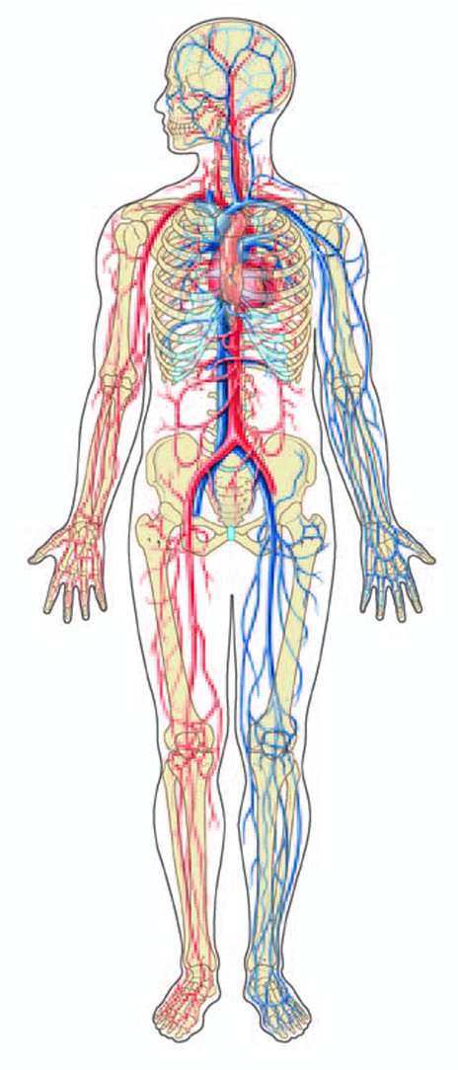
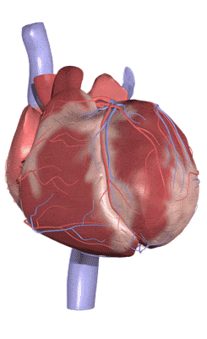
Cardio-Vascular system

Slide 2
Cardio-Vascular system
Also called as circulatory system
A closed system of the heart and blood vessels
  The heart pumps blood
  Blood vessels allow blood to circulate to all parts of the body
The function of the cardiovascular system is to deliver oxygen and nutrients and to remove carbon dioxide and other waste products

Slide 3
Heart
Cone-shaped organ about the size of a closed fist
In the mediastinum
Extends from the level of the second rib to about the level of the sixth rib
Slightly left of the midline
Heart is bordered:
  Laterally by the lungs
  Posteriorly by the vertebral column
  Anteriorly by the sternum
Rests on the diaphragm inferiorly

Slide 4
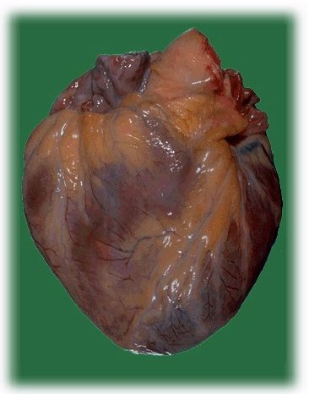
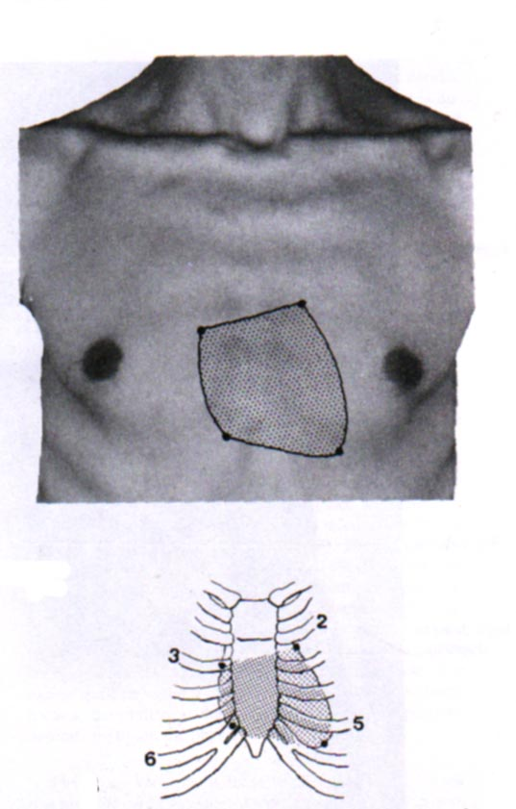
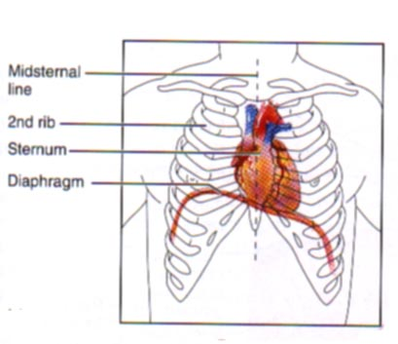

Slide 5
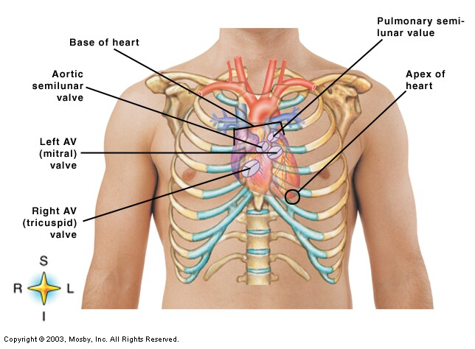
Heart

Slide 6
Chambers of the Heart
Atria – two superior chambers
  “Receiving chambers”
  Blood from veins enters atria
Ventricles – two inferior chambers
  “pumping chambers”
  Thick muscular walls to increase force of pumping action
    Left > right
  Separated by interventricular septum

Slide 7
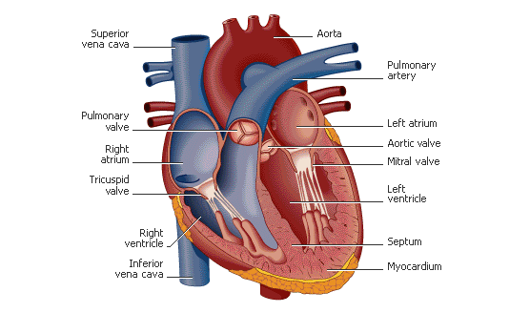

Slide 8
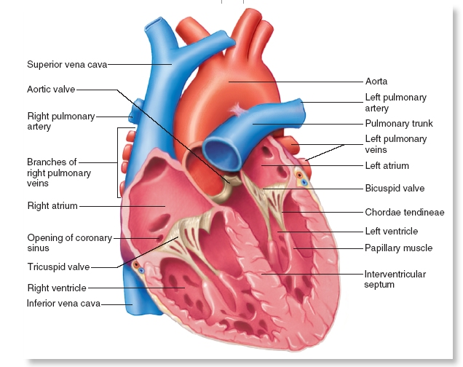

Slide 9
Valves of the Heart
Permit blood flow in one direction during circulation
Atrioventricular valves (AV valves)
  Also cuspid valves
  Between atria and ventricles
Semilunar (SL valves)
  Between R ventricle and pulmonary arteries and L ventricle and aorta

Slide 10
Atrioventricular Valves
Tricuspid valve
  Btwn R atrium and ventricle
  3 flaps of endocardium
  Connected to ventricular papillary muscle via chordae tendinae
Bicuspid valve
  Btwn L atrium and ventricle
  Also called mitral valve
  Two flaps of endocardium

Slide 11
Semilunar Valves
Pulmonary semilunar valve
  Btwn R ventricle and pulmonary trunk
Aorta semilunar valve
  Btwn L ventricle and aorta

Slide 12
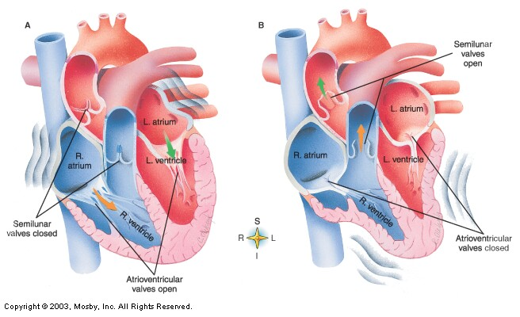
Chambers & Valves

Slide 13
The Heart
Humans have a four chambered heart surrounded by a fluid filled membrane known as the pericardium.
The right and left side of the heart are separated by a wall of muscle called the septum.

Slide 14
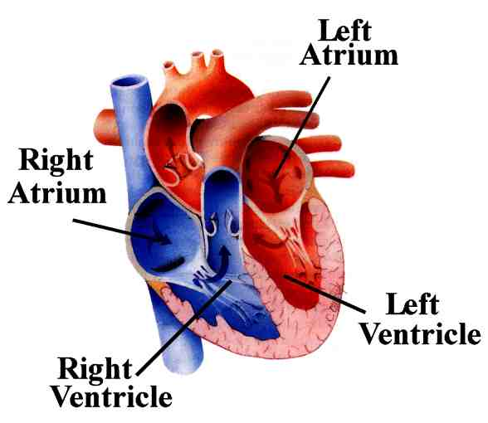
Atria
The heart contains two thin walled upper chambers known as atria.
The atria collect blood from the veins.

Slide 15
Ventricles
The heart contains two thick walled lower chambers called ventricles.
The ventricles receive blood from the atria and pump it out of the heart.

Slide 16
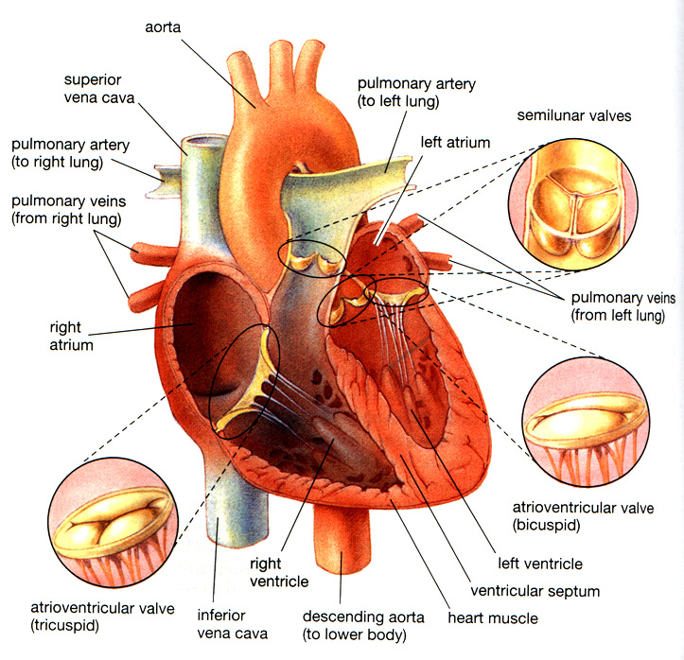
Heart Valves
The heart contains valves that control the flow of blood.
Valves are located between the atria and the ventricles known as atrioventricular valves.
Valves are also located between the ventricles and the arteries known as semi-lunar valves.

Slide 17
Covering layers of heart
Pericardium – a double-walled sac around the heart composed of:
  A superficial fibrous pericardium
  A deep two-layer serous pericardium
    The parietal layer lines the internal surface of the fibrous pericardium
    The visceral layer or epicardium lines the surface of the heart
  Pericardial space: between parietal and visceral layer
    Filled with 10-15mL of pericardial fluid
    Decreases friction

Slide 18
Covering layers of heart
The Function of the Pericardium:
  Protects and anchors the heart
  Prevents overfilling of the heart with blood
  Allows for the heart to work in a relatively friction-free environment

Slide 19
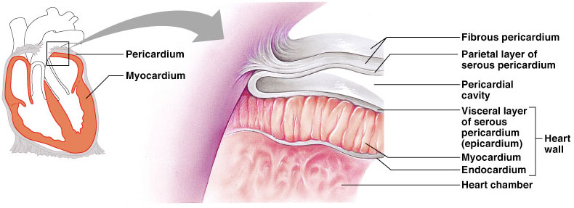
Pericardial Layers of the Heart
Figure 18.2

Slide 20
Heart Wall
3 layers –
      Epicardium
      Myocardium
      Endocardium
Epicardium – outer layer
  Epicardium = visceral layer of serous pericardium
Myocardium – thick, contractile layer composed of cardiac muscle cells
  Intercalated disks contain many gap junctions
  Allow cardiac muscle cells to function as a single unit
Endocardium – interior of cardiac wall
  Endothelial tissue
  Provides smooth lining for inner side of heart
  Covers valves of heart.

Slide 21
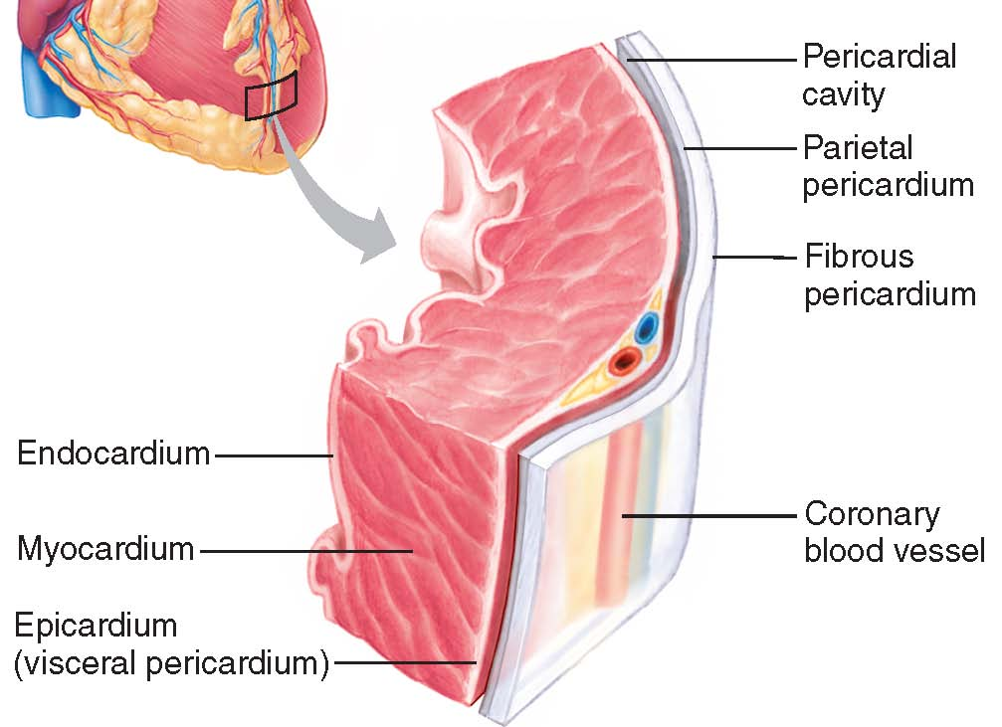

Slide 22
Path of Blood
Oxygen depleted blood enters the right side of the heart through the inferior/superior vena cava.
Blood enters the right atrium and the atrium contracts.
The atrioventricular (tricuspid) valve opens and blood enters the right ventricle.
The right ventricle contracts.
The (pulmonary) semilunar valve opens and blood enters the pulmonary artery.

Slide 23
Path of Blood
The pulmonary artery carries the oxygen depleted blood to the lungs where the carbon dioxide is dropped off and oxygen is picked up.
Oxygen rich blood now travels back to the left side of heart through the pulmonary vein.
Blood enters the left atrium and the left atrium contracts.

Slide 24
Path of Blood
The atrio-ventricular (bicuspid) valve opens and blood enters the left ventricle.
The left ventricle contracts.
The (aortic) semi-lunar valve opens and the oxygen rich blood enters the aorta.
The aorta carries the oxygenated blood to the entire body.

Slide 25
Pathway of Blood Through the Heart and Lungs
Right atrium → tricuspid valve → right ventricle
Right ventricle → pulmonary semilunar valve → pulmonary arteries → lungs
Lungs → pulmonary veins → left atrium
Left atrium → bicuspid valve → left ventricle
Left ventricle → aortic semilunar valve → aorta
Aorta → systemic circulation

Slide 26
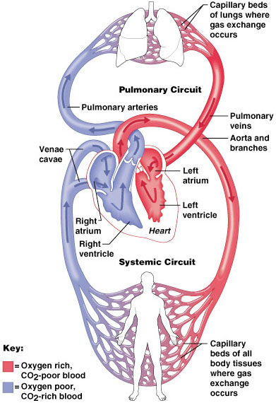
Pathway of Blood Through the Heart and Lungs
Figure 18.5

Slide 27
Blood Flow
Right
Atrium
Tricuspid
Valve
Right
Ventricle
Pulmonary
Valve
Body
Lungs
Aortic
Semilunar
Valve
Left
Ventricle
Bicuspid
Valve
Left
Atrium
Pulmonary
Semilunar
Valve

Slide 28
Blood Vessels: The Vascular System
Taking blood to the tissues and back to the heart
  Arteries
  Arterioles
  Capillaries
  Venules
  Veins
Copyright © 2003 Pearson Education, Inc. publishing as Benjamin Cummings
Slide 11.23

Slide 29
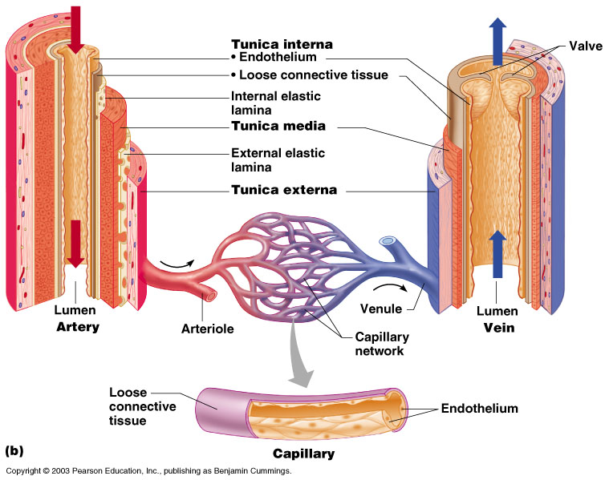
The Vascular System
Figure 11.8b
Copyright © 2003 Pearson Education, Inc. publishing as Benjamin Cummings
Slide 11.24

Slide 30
Structure of Blood Vessels
Tunica adventitia - outermost layer
  Fibrous connective tissue
  Holds vessels open; prevents tearing of vessels walls during body movements
  Larger in veins than arteries
Tunica media – middle layer
  Smooth muscle and elastic CT
  Helps vessels constrict and dilate
  Larger in arteries

Slide 31
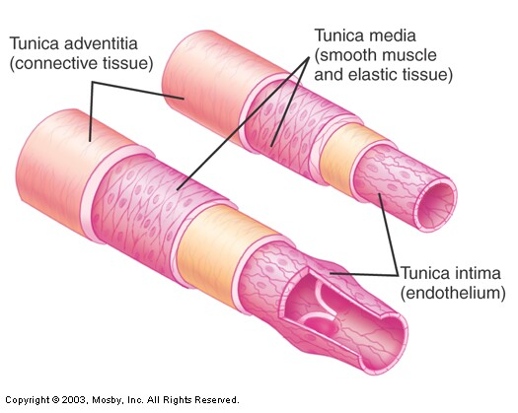
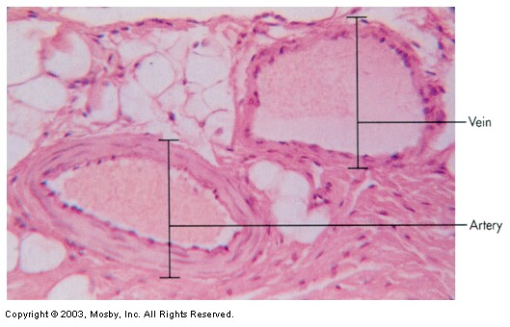
Structure of Blood Vessels
Tunica intima – innermost layer
  Composed of endothelium
  Semilunar valves present in veins
  One cell thick in capillaries

Slide 32
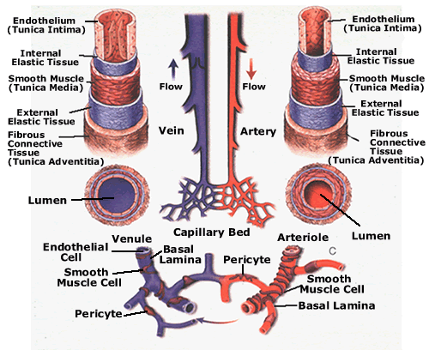
Types of Blood Vessels
There are three types of blood vessels in mammalian circulation: arteries, veins and capillaries.
Together they form a network of blood vessels throughout the organism that transport blood.

Slide 33
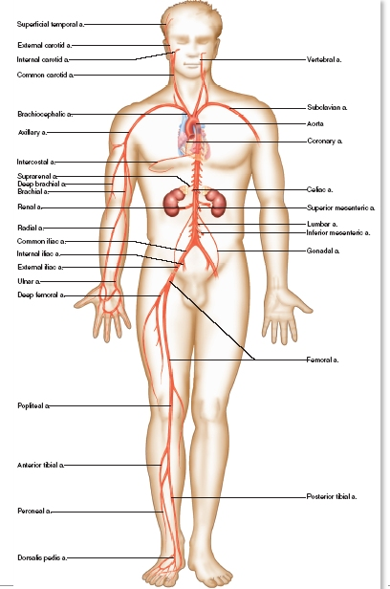
Arteries
Arteries are blood vessels that carry oxygen rich blood away from the heart. (except pulmonary artery)
The walls of arteries are very thick layers of connective tissue and muscle fibres and are therefore able to withstand the pressure of blood pumped from the heart.
The walls are also elastic to allow for increased blood flow.
  Paired – left and right artery of the same name

Slide 34
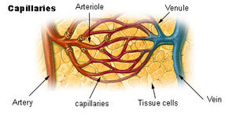
Arterioles
Arteries decrease in size to become arterioles which are composed of smooth muscle and elastic fibre.
Blood flows through arteries into smaller and smaller vessels known as arterioles.
The arterioles finally connect to the capillaries.

Slide 35
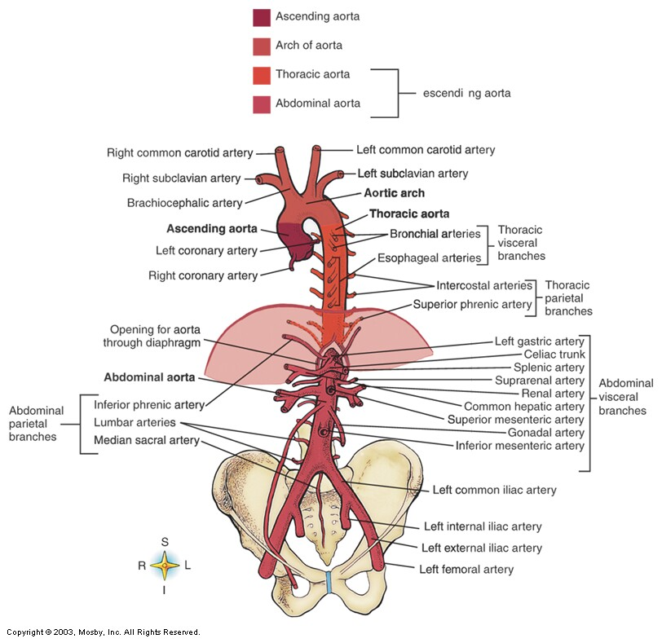
Aorta

Slide 36
Systemic Arteries
Arch of aorta
Subclavian (L and R)
Brachiocephalic
common carotid (L and R)
Axillary (L and R)
Brachial (L and R)
Radial
Ulnar
Thoracic aorta
Abdominal aorta
Common iliac
External iliac
Femoral
Popliteal
Posterior tibial
Anterior tibial
Dorsal pedis

Slide 37
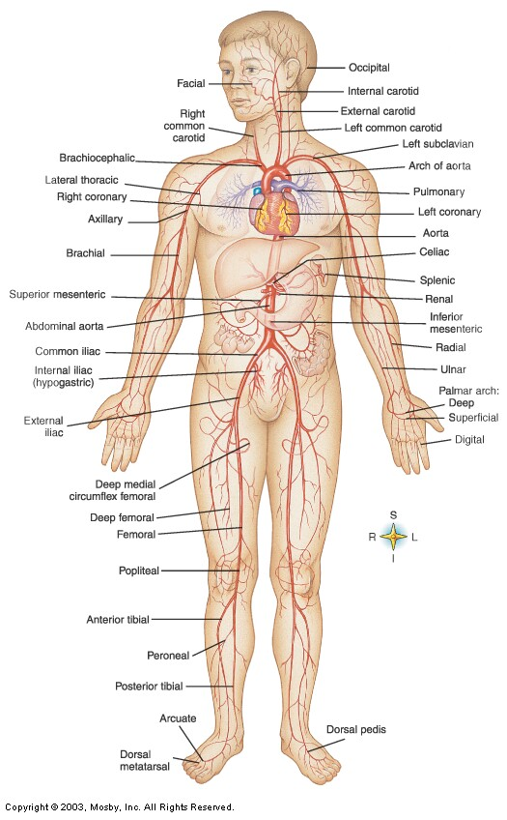

Slide 38
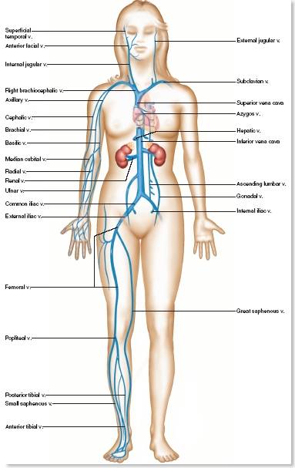
Veins
Veins are blood vessels that carry oxygen poor blood from the body back to the right side of the heart. (except pulmonary vein)
The walls of the veins are composed of smooth muscles. Pressure in the veins is low so they rely on skeletal muscles to aid in venous blood flow.
  Most large veins have the same names as the arteries

Slide 39
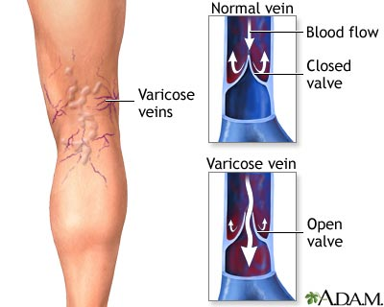
Veins
Veins contain valves that ensure blood flows in one direction only. In other words, they prevent the backward flow of blood.
Sometimes these valves are damaged and the pooling blood causes the veins to bulge and the result is varicose veins.

Slide 40
Systemic Veins
Superior vena cava
Inferior vena cava
External jugular
Internal jugular
Brachiocephalic (L and R)
Subclavian (L and R)
Cephalic
axillary
Basilic
Median basilic
Median cubital
Common iliac
External iliac
Femoral
Popliteal
Great saphenous
Small saphenous

Slide 41
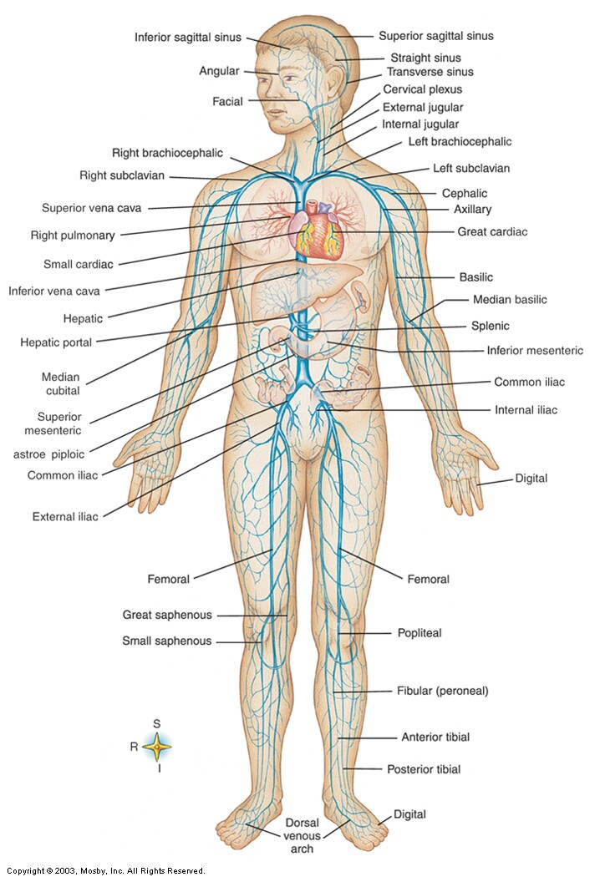

Slide 42
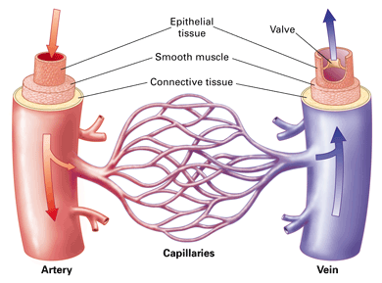
Capillaries
Capillaries are the smallest blood vessels with walls that are composed of a single layer of cells.
Exchange of materials between the blood and the body cells occurs in the capillaries. The single layer of cells is ideal for diffusion of nutrients and gases.

Slide 43
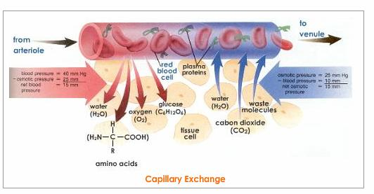

Slide 44
Differences Between Blood Vessel Types
Walls of arteries are the thickest
Lumens of veins are larger
Skeletal muscle “milks” blood in veins toward the heart
Walls of capillaries are only one cell layer thick to allow for exchanges between blood and tissue
Copyright © 2003 Pearson Education, Inc. publishing as Benjamin Cummings
Slide 11.26

Slide 45
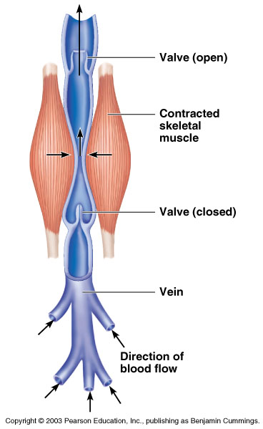
Movement of Blood Through Vessels
Most arterial blood is pumped by the heart
Veins use the milking action of muscles to help move blood
Figure 11.9
Copyright © 2003 Pearson Education, Inc. publishing as Benjamin Cummings
Slide 11.27

Slide 46
Blood circulation
4 types –
  Systemic circulation
  Pulmonary circulation
  Coronary circulation
  Portal circulation

Slide 47
Systemic Circulation
the system of blood vessels that carries oxygenated blood from LV of heart to the tissues of the body and deoxygenated blood back to the heart (RA).
  The pathway between the left and right sides of the heart.
  Left ventricle → aorta → arteries → arterioles → capillaries → venules → veins → vena cava → heart (right atrium)

Slide 48
Pulmonary circulation
Includes the system of blood vessels that carries deoxygenated blood from RV to the lungs and oxygenated blood back to the heart (LA).
  The blood pathway between the right side of the heart, to the lungs, and back to the left side of the heart.
  Right ventricle → pulmonary artery trunk → pulmonary arteries → lungs → pulmonary veins → heart (left atrium)
  Purification of the blood

Slide 49
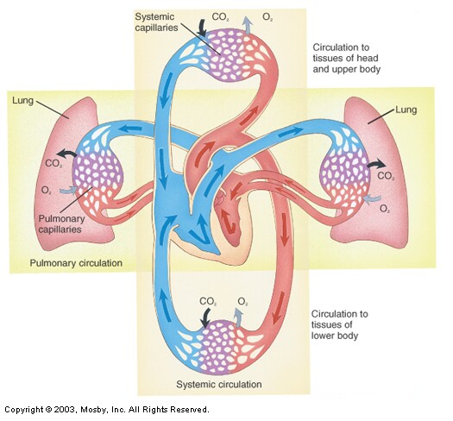

Slide 50
Coronary Circulation
Coronary circulation is the functional blood supply to the heart muscle itself
Blood in the heart chambers does not nourish the myocardium
The heart has its own nourishing circulatory system
  Coronary arteries
  Cardiac veins
  Blood empties into the right atrium via the coronary sinus

Slide 51
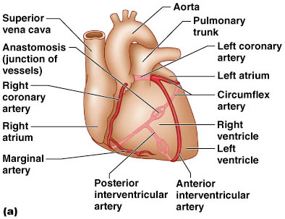
Coronary Circulation: Arterial Supply
Figure 18.7a

Slide 52
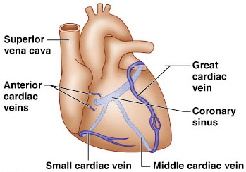
Coronary Circulation: Venous Supply
Figure 18.7b

Slide 53
Portal circulation
The portal system is the system of veins comprising the hepatic portal vein and its tributaries.
The portal venous system is responsible for directing blood from parts of the gastrointestinal tract & spleen to the liver. Substances absorbed in the small intestine travel first to the liver for processing before continuing to the heart.
It also includes venous drainage from the spleen and pancreas.
The hepatic portal vein is a blood vessel that conducts blood from the gastrointestinal tract and spleen to the liver. This blood is rich in nutrients that have been extracted from food, and the liver processes these nutrients; it also filters toxins that may have been ingested with the food. The blood leaves the liver to the heart in the hepatic veins.

Slide 54
The hepatic portal vein is usually formed by the combination of the superior mesenteric, inferior mesenteric, gastric, and splenic veins.

Slide 55
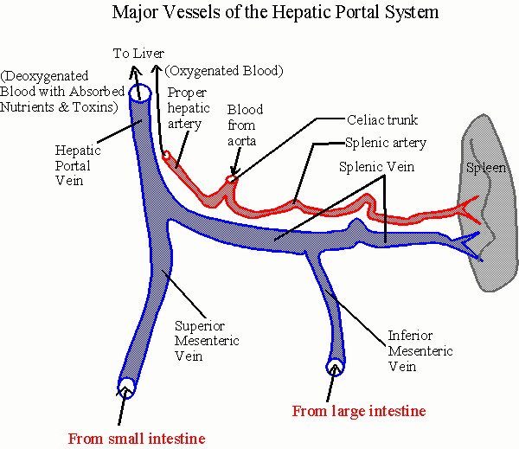

Slide 56
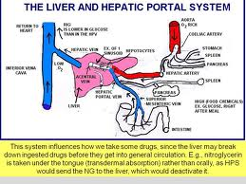

Slide 57
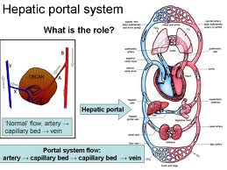

Slide 58
Conduction System of The Heart
Heart has Intrinsic conduction system
consisting of special junctional tissues. (Hence, Heart muscle cells contract, without nerve impulses, in a regular, continuous way).
These specialized tissues generate & conduct the electrical cardiac impulses all over the heart.
Copyright © 2003 Pearson Education, Inc. publishing as Benjamin Cummings
Slide 11.13a

Slide 59
Conduction System of The Heart
    Four structures composed of modified cardiac muscle
    Sinoatrial node (SA Node)
    Atrioventricular node (AV Node)
    Atrioventricular bundle (Bundle of His) with its right & left branches
    Purkinje fibers
Copyright © 2003 Pearson Education, Inc. publishing as Benjamin Cummings
Slide 11.13b

Slide 60
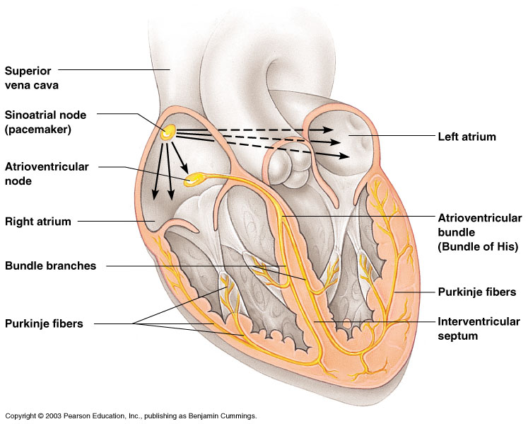
Figure 11.5
Copyright © 2003 Pearson Education, Inc. publishing as Benjamin Cummings
Slide 11.14b

Slide 61
Conduction System of the Heart
Sinoatrial Node (SA Node)
  Pacemaker of the heart – generates impulses
  100s of cells in the R atrium near the opening of the superior vena cava.
  Sends impulses to AV node
Atrioventricular Node (AV Node)
  Small mass of cardiac muscle tissue
  Left lower border of R atrium
  Receives impulses from SA node & sends to Bundle of His.
  When SA node fails to generate impulse, AV node generates impulses.

Slide 62
Conduction System of the Heart
Atrioventricular Bundle
  Also called as Bundle of His
  Bundle of specialized cardiac muscle fibers originating in the AV node
  Branches into R and L branches eventually becoming Purkinje fibers
  Extend into the walls of the ventricles and papillary muscles

Slide 63
Heart Physiology: Sequence of Excitation
Sinoatrial (SA) node generates impulses about 75 times/minute
Atrioventricular (AV) node delays the impulse approximately 0.1 second
Impulse passes from atria to ventricles via the atrioventricular bundle (bundle of His)
  AV bundle splits into two pathways in the interventricular septum (bundle branches)
  Bundle branches carry the impulse toward the apex of the heart
  Purkinje fibers carry the impulse to the heart apex and ventricular walls

Slide 64
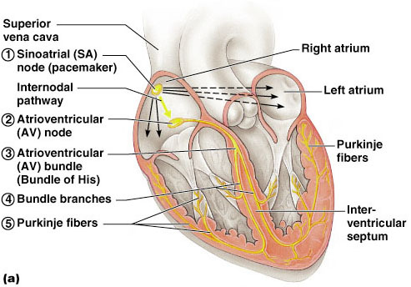
Figure 18.14a

Slide 65
The Heart: Cardiac Conduction System
Group of structures that send electrical impulses through the heart
Sinoatrial node (SA node)
  Wall of right atrium
  Generates impulse
  Natural pacemaker
  Sends impulse to AV node
Atrioventricular node (AV
node)
  Between atria just above ventricles
  Atria contract
  Sends impulse to the bundle of His
Bundle of His
  Between ventricles
  Two branches
  Sends impulse to Purkinje fibers
Purkinje fibers
  Lateral walls of ventricles
  Ventricles contract
Link to Diagram

Slide 66
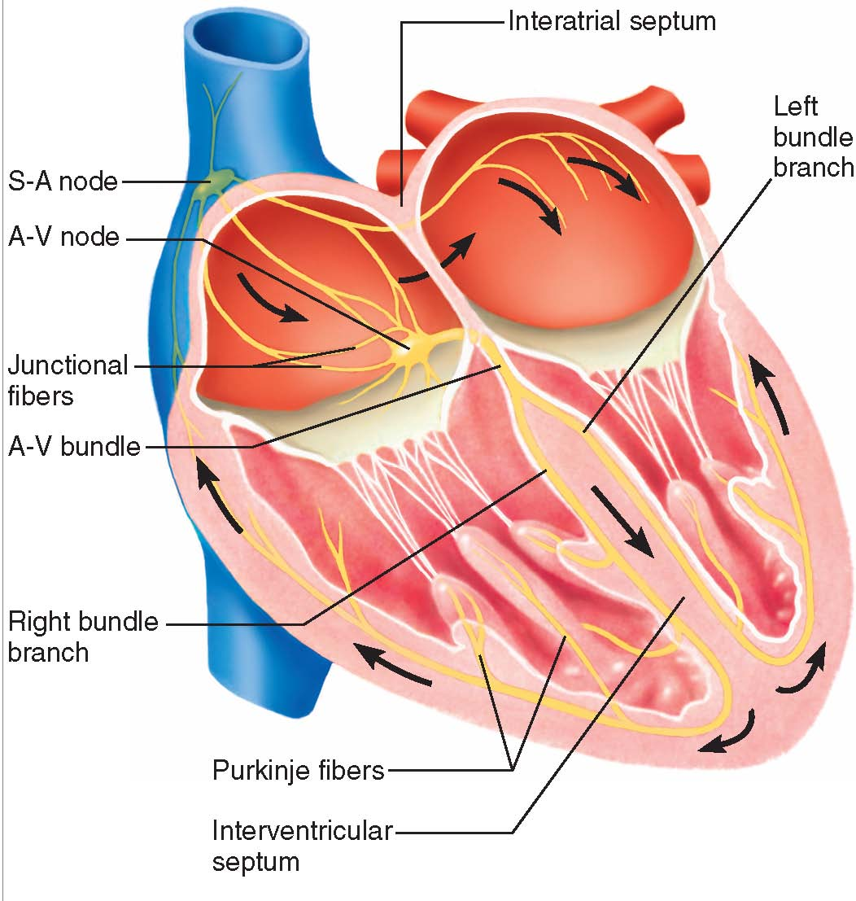

Slide 67
Heart Physiology
Cardiac cycle

Slide 68
Cardiac Cycle
It is the sequence of events which occurs during one complete heart beat.
In each cardiac cycle, heart contracts & relax alternately, leading to pressure difference & flow of blood from higher pressure to lower pressure.
Total time required for one cardiac cycle is 0.8 sec
    Systole = contraction of heart muscle
    Diastole = relaxation of heart muscle

Slide 69
Events of Cardiac cycle
Both atria & ventricles undergo systolic & diastolic phases, hence one cardiac cycle is divided into 4 phases –
  Atrial Systole – Contraction of atrium – 0.1 sec
  Atrial Diastole – Relaxation of atrium – 0.7 sec
  Ventricular Systole – Contraction of ventricles – 0.3 sec
  Ventricular Diastole – Relaxation of ventricles – 0.5 sec

Slide 70
Atrial events
These include atrial systole & atrial diastole.
Atrial systole occurs for 0.1 sec followed by atrial diastole for 0.7 sec.
During atrial systole, atria contract & pour their blood into respective ventricles.
Right atrium contracts
  Tricuspid valve opens
  Blood fills right ventricle
Left atrium contracts
  Bicuspid valve opens
  Blood fills left ventricle

Slide 71
Atrial events
During atrial diastole, atria relax & the blood from SV & IV fill the RA & the blood from PV fills the LA.
After this, they again contract to perform atrial systole.

Slide 72
Ventricular events
As the atrial systole ends, the ventricular systole begins & continues for 0.3 sec & is followed by ventricular diastole for 0.5 sec.
The ventricular events can be studied in different periods such as-
    Isometric ventricular contraction period (0.05)
    Rapid & slow ejection period(0.25)
    Prodiastolic period (0.04)
    Isometric ventricular relaxation period (0.08)
    Rapid & slow inflow period (0.28)
    Last rapid filling period (0.1)

Slide 73
Ventricular events
    Isometric ventricular contraction period – As ventricular systole starts, both the AV valves close synchronously. This produces first heart sound. At this time SL valves are also closed & hence the ventricular pressure is increasing without any decrease in its volume. This period is Isometric ventricular contraction period. This period remains for 0.05 sec.
This period starts with closure of AV valves & ends with opening of SL valves.

Slide 74
Ventricular events
    Rapid & slow ejection period – After 0.05 sec, the SL valves open & due to ventricular systole, blood is ejected out into respective arteries. This is rapid ejection period (0.15 sec). Later on, as the volume decreases, the intraventriclar pressure declines & blood is poured out with slow speed. This is called as slow ejection period (0.1 sec)
Prodiastolic period – After ventricular systole, blood tries to rush back into respective ventricles. But, this is suddenly stopped by the closure of SL valves. This produces 2nd heart sound, indicating the end of ventricular systole. The interval between start of ventricular diastole & closure of SL valves is known as Prodiastolic period (0.04 sec)

Slide 75
Ventricular events
Isometric ventricular relaxation period – After Prodiastolic period, the ventricles undergo relaxation (even atria). During this period (0.08) both SL & AV valves are closed & both atria & ventricles are in diastolic condition. Thus, intra-ventricular pressure is minimum & heart is relaxing.
Rapid & slow inflow period (0.28) – The Isometric ventricular relaxation period ends with opening of AV valves & since ventricles are relaxing, rapid flow of blood from atria to ventricles starts. This is known as rapid inflow period – 3rd heart sound is heard on echophone at this time. After this slow inflow of blood continues.

Slide 76
Last rapid filling period (0.1) – When ventricular diastole is about to end, the atrial systole has already started & it overlaps for 0.1 sec. During this period, because of active contraction of atria, filling of ventricles start rapidly. This is called as rapid filling period & 4th heart sound is heard at this time on echophone.

Slide 77
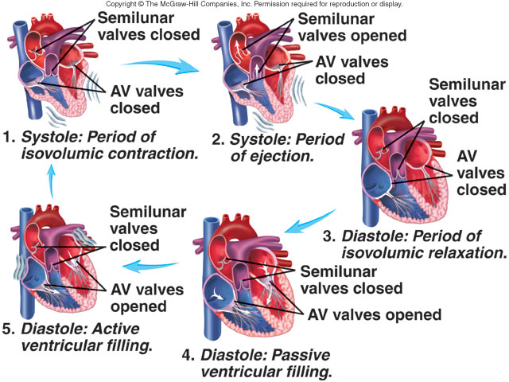

Slide 78
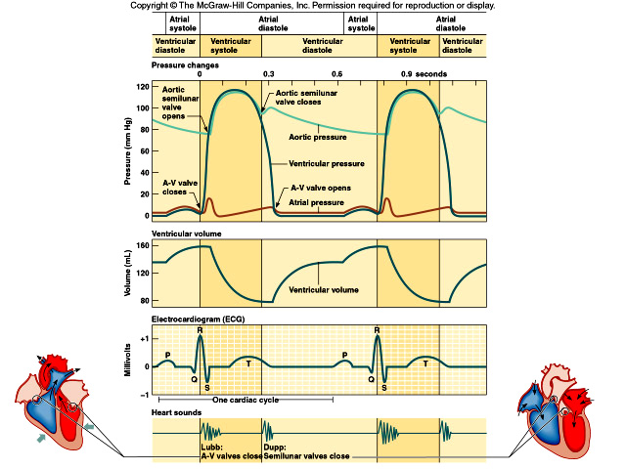

Slide 79
Heart Sounds
Heart sounds (lub-dup) are associated with closing of heart valves
  First sound occurs as AV valves close and signifies beginning of systole (contraction)
  Second sound occurs when SL valves close at the beginning of ventricular diastole (relaxation)

Slide 80
Heart Sounds
First heart sound or “lubb”
  Atrioventricular valves and surrounding fluid vibrations as valves close at beginning of ventricular systole
Second heart sound or “dupp”
  Results from closure of aortic and pulmonary semilunar valves at beginning of ventricular diastole, lasts longer
Third & fourth heart sound (occasional)
  Caused by turbulent blood flow into ventricles and detected near end of first one-third of diastole

Slide 81
The Heart: Heart Sounds
One cardiac cycle – two heart sounds (lubb and dubb) when valves in the heart snap shut
  Lubb – First sound
    When the ventricles contract, the tricuspid and bicuspid valves snap shut
  Dubb – Second sound
    When the atria contract and the pulmonary and aortic valves snap shut

Slide 82
Significance of heart sounds
The intensity & duration of heart sounds indicate functioning of myocardium.
First sound “Lubb” indicates proper functioning of AV valves & beginning of ventricular systole
Second sound “Dubb” indicates proper functioning of Semi lunar valves & end of ventricular systole & beginning of ventricular diastole.

Slide 83
ECG
Electrocardiogram
It is the graphical recording of electrical changes in the heart during cardiac cycle.
Instrument used – Electrocardiograph.
In clinical practice, ECG is recorded by placing electrodes on the arms & legs (Limb leads) & six positions on the chest (chest leads).
The electrocardiograph amplifies the heart’s electrical activity & produces different tracings on the graph paper

Slide 84
Electrocardiogram
A normal ECG consists of 3 different waves-
P wave corresponds to depolarization of SA node
QRS complex wave corresponds to ventricular depolarization
T wave corresponds to ventricular repolarization
Atrial repolarization record is masked by the larger QRS complex

Slide 85
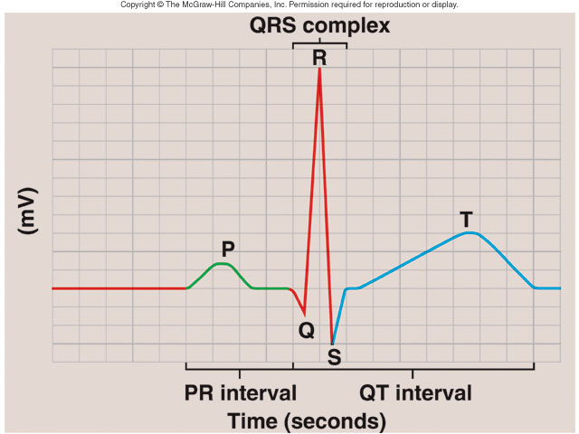
Electrocardiogram
Pattern
  P wave
    Atria depolarization
  QRS complex
    Ventricle depolarization
    Atria repolarization
  T wave:
    Ventricle repolarization

Slide 86
Electrocardiogram
P wave (0.2 mV, 0.08 sec) is a small upward wave, representing atrial depolarization (excitation followed by contraction), which spreads from SA node through out both atria.
QRS complex (1.8 mV, 0.06 sec), begins as large downward wave, continues as large upright triangular wave & ends as a downward wave.
The QRS complex represent the onset of ventricular depolarization, as the electrical impulses spreads through the ventricles.

Slide 87
Electrocardiogram
T wave (0.4 mV, 1.12 sec) is a dome shaped upward deflection, which indicates the ventricular repolarization (relaxation) & starts just before ventricles begin to relax.
The repolarization of atrium is not evident in ECG, bcoz, it is buried under QRS complex.

Slide 88
Significance of ECG
ECG is a diagnostic tool to assess cardiac functions. It gives information about the following–
  Heart rate, & rhythm & conduction of cardiac impulses.
  Position of heart in the chest cavity.
  Relative size of cardiac chambers & muscle.
  Type of conduction blockade
  Site, duration & extent of ischemic damage to the myocardium.
  Extra systoles or Arrthymias

Slide 89
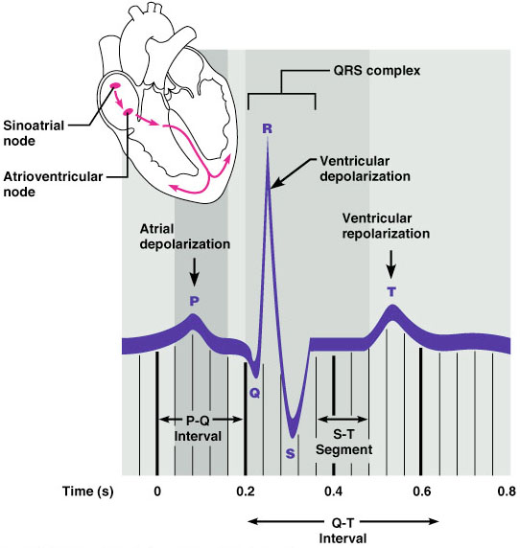
Electrocardiography
Figure 18.16

Slide 90
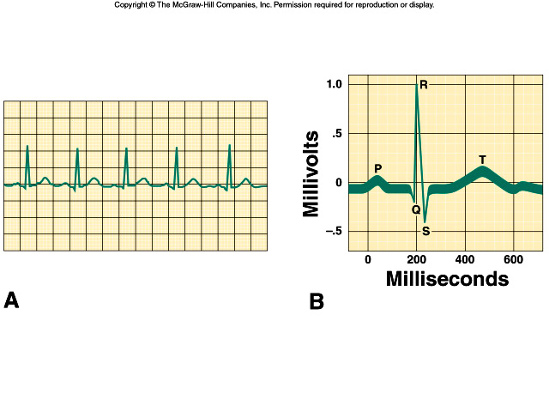
Electrocardiogram (ECG) can trace conduction
of electrical signals through the heart

Slide 91
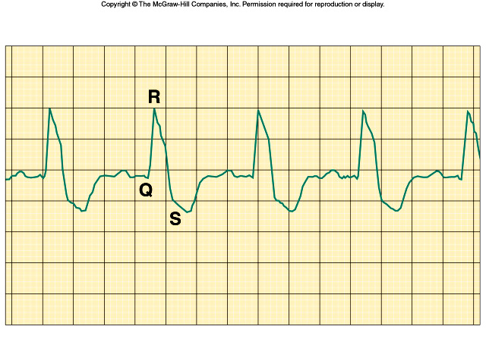
Aberrant ECG patterns indicate damage

Slide 92
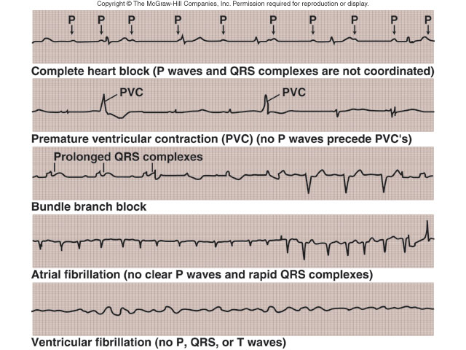
Alterations in Electrocardiogram

Slide 93
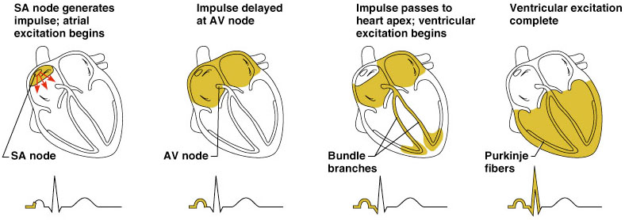
Heart Excitation Related to ECG
Figure 18.17

Slide 94
Cardiac Output
Cardiac output (CO)
  Amount of blood pumped out by heart (both RV & LV) in one minute
  CO = heart rate x stroke volume
Stroke volume
  Volume of blood pumped out by heart (both ventricles) in one cardiac cycle or heart beat.
  70 ml per beat
Copyright © 2003 Pearson Education, Inc. publishing as Benjamin Cummings
Slide 11.18

Slide 95
Cardiac output, cont.
CO = HR x SV
5040 ml/min = 72 beats/min x 70 ml/beat
Normal cardiac output = 5 litres/min
Hence, almost entire blood supply passes through heart once per minute.
CO varies with demands of the body.

Slide 96
The Heart: Regulation of Heart Rate
Stroke volume usually remains relatively constant
  Starling’s law of the heart – the more that the cardiac muscle is stretched, the stronger the contraction
Changing heart rate is the most common way to change cardiac output
Copyright © 2003 Pearson Education, Inc. publishing as Benjamin Cummings
Slide 11.20

Slide 97
Regulation of Heart Rate
Increased heart rate
  Sympathetic nervous system
    Crisis
    Low blood pressure
  Hormones
    Epinephrine
    Thyroxine
  Exercise
  Decreased blood volume
Copyright © 2003 Pearson Education, Inc. publishing as Benjamin Cummings
Slide 11.21

Slide 98
The Heart: Regulation of Heart Rate
Decreased heart rate
  Parasympathetic nervous system
  High blood pressure or blood volume
  Decreased venous return
  In Congestive Heart Failure the heart is worn out and pumps weakly. Digitalis works to provide a slow, steady, but stronger beat.
Copyright © 2003 Pearson Education, Inc. publishing as Benjamin Cummings
Slide 11.22

Slide 99
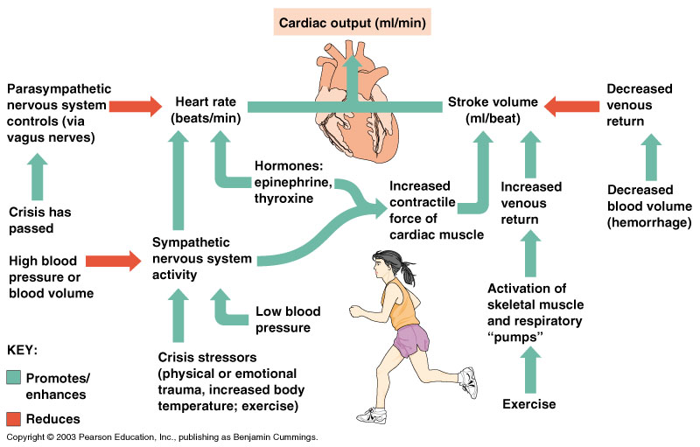
Cardiac Output Regulation
Figure 11.7
Copyright © 2003 Pearson Education, Inc. publishing as Benjamin Cummings
Slide 11.19

Slide 100
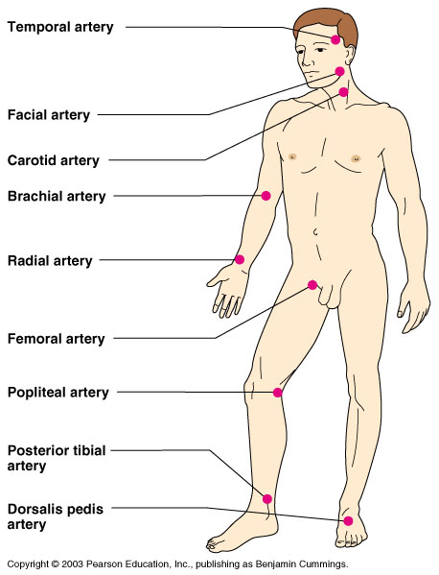
Pulse
Pulse – pressure wave of blood
Monitored at “pressure points” where pulse is easily palpated
Figure 11.16
Copyright © 2003 Pearson Education, Inc. publishing as Benjamin Cummings
Slide 11.35

Slide 101
Blood Pressure
Force/Lateral pressure exerted by the blood on the inner walls of blood vessels.
  Highest in arteries
  Lowest in veins
In clinical practice, usually BP is measured
in large arteries.
Systolic pressure (110 – 140 mm of Hg)
  Is the maximum pressure exerted by blood
  during ventricular systole
Diastolic pressure (70 – 90 mm of Hg)
  Is the minimum pressure exerted by blood
  during ventricular diastole
Reported as the systolic number over the diastolic number (120/80 mm of Hg)

Slide 102
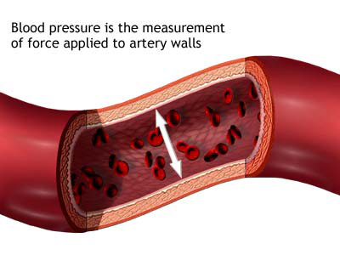
Blood Pressure
The force of blood on the arteries’ walls = blood pressure
Blood pressure decreases when the heart relaxes, but there must always be some pressure to keep the blood flowing
Doctors measure blood pressure with a sphygmomanometer by 3 methods
  Palpatory method
  Auscultatory method
  Oscillatory method

Slide 103
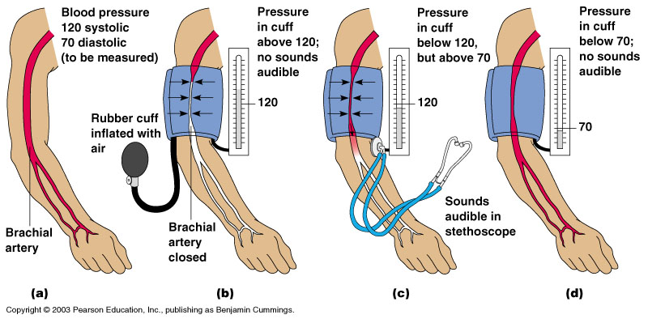
Measuring Arterial Blood Pressure
Figure 11.18
Copyright © 2003 Pearson Education, Inc. publishing as Benjamin Cummings
Slide 11.37

Slide 104
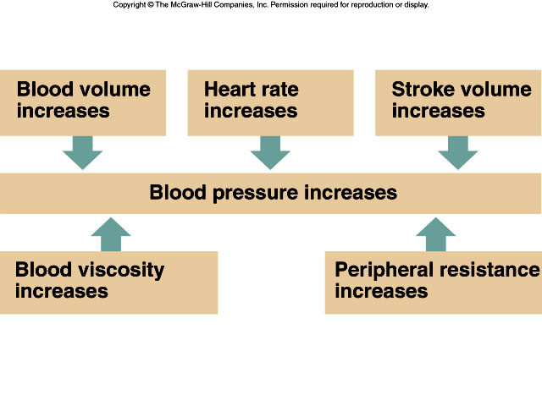
More cells constriction of blood
vessel walls

Slide 105
Regulation of Blood Pressure
BP is regulated by 3 different process –
  1. Autonomic nervous system regulation
      Baroreceptor reflex
      Chemoreceptor reflex
  2. Chemical regulation
  3. Hormonal regulation
      Renin-Angiotensinogen-Aldosterone system
      Adrenaline & Nor-adrenaline
      Anti-diuretic hormone
      Atrial Natriuretic peptide

Slide 106
Baroreceptor reflex
Baroreceptors are present in carotid sinus & aortic arch
Sensitive to changes in blood pressure & sends impulses to Cardiac centre of medulla oblongata.
The cardiac center in turn responds and sends impulses back to heart through sympathetic & parasympathetic nerves

Slide 107


Slide 108

Baroreceptor Reflex

Slide 109
Chemoreceptor reflex
Chemoreceptors are sensitive to change in concentration of chemicals such as Oxygen, Carbon dioxide & Hydrogen.
Located nearby to baroreceptors such as carotid bodies & aortic bodies present at carotid sinus & arch of aorta respectively.
They responds to the changes in concentration of these chemicals in blood & sends impulses to cardiac center & respiratory center.

Slide 110
During Hypoxia, Hypercapnia & acidosis, BP is decreased & the chemoreceptors sends impulses to cardiac center, which in turn causes sympathetic stimulation leading to vasoconstriction & increase in cardiac output & hence increase in BP.

Slide 111

Chemoreceptor Reflex-pH

Slide 112

Baroreceptor and Chemoreceptor
Reflexes

Slide 113
Chemical regulation
The inorganic salts present in the blood maintains the BP.
Sodium, Potassium & Calcium ions
Increase in sodium ions leads to increase in BP
Increase in potassium ions leads to decrease in BP.
Increase in calcium ions leads to increase in BP

Slide 114
Hormonal regulation
Hormones provide long term regulation of BP by –
    Altering cardiac output
    Changing peripheral vascular resistance
    Adjusting total blood volume
Adrenaline & Nor-Adrenaline – these are produced by adrenal medulla gland. They increase pumping action of heart (HR & FOC) & bring about the vasoconstriction of arteries in skin & abdominal organs leading to increase in BP.

Slide 115
Anti-diuretic hormone – is produced by hypothalamus & stored & released from posterior pituitary gland.
ADH causes vasoconstriction of blood vessels & also decrease the loss of water & salts through urine (so blood volume is increased) leading to increase in BP.

Slide 116
Atrial-Natriuretic peptide – is released by the cells of atrium of heart.
ANP lowers the BP by causing vasodilatation & promoting loss of water & salts through urine.

Slide 117
Renin-Angiotensinogen-Aldosterone system
It is the main regulating system of BP in long term.
Due to decrease in blood volume, sodium levels, the BP decreases.
Decrease in BP stimulates Juxta-Glomerular cells of kidney to secrete an enzyme called as Renin.
The increased levels of renin in blood leads to conversion of Angiotensinogen (a plasma protein produced by liver) into Angiotensin-I.
As blood flows through the lungs, an enzyme called as Angiotensin converting enzyme (ACE)in lung capillaries converts inactive Angiotensin-I into active Angiotensin-II.

Slide 118
This angiotensin-II has multiple targets.
1. Angiotensin –II acts on adrenal cortex gland to increase the secretion of Aldosterone.
The aldosterone increases the reabsorption of sodium & water in renal tubules leading to increase in blood volume & BP.
2. Angiotensin –II directly acts on smooth muscles in the walls of arteries to cause vasoconstriction & rise in BP.

Slide 119
3. Angiotensin-II can directly act on renal tubules to increase the reabsorption of sodium & water leading to increase in blood volume & BP.
4. Angiotensin-II can also stimulate sympathetic nervous system.
5. Angiotensin-II can also increase the secretion of ADH from posterior pituitary gland, leading to increase in reabsorption of sodium & water which leads to increase in blood volume & BP

Slide 120

Notes:
120

Slide 121


Slide 122


Slide 123


Slide 124

Notes:
124

Slide 125
Cardiovascular disorders
Hypertension,
Hypotension,
Arteriosclerosis,
Atherosclerosis,
Angina pectoris,
Myocardial infarction,
Congestive heart failure,
Cardiac arrhythmias

Slide 126
Hypertension
Is the persistent increase in BP.
Systolic BP=140 mm of Hg or more
Diastolic BP = 90 mm of Hg or more
Two types
    1. Primary or Essential Hypertension
    2. Secondary Hypertension
Primary Hypertension – it is persistently elevated BP, for which exact cause is not known. It may be due to stress, high fat diet, increased sodium level, increased blood volume or genetic reasons.

Slide 127
Secondary hypertension – is the secondary rise in BP due to presence of some other primary disorders such as renal diseases, pheochromocytoma, Cushing's syndrome, hyperthyroidism, aldosteronism etc.
Hypotension – generally called as acute fall in BP due to excessive blood loss or cardiovascular disorders. The systolic BP is less than 100 mm Hg & diastolic is less than 60 mm Hg.

Slide 128
Arteriosclerosis – is the thickening of the walls of arteries & loss of elasticity. Generally occurs in old age, due to which lumen of arteries become narrow leading to reduced flow of blood.
Atherosclerosis – is a type of arteriosclerosis, in which fatty substance especially cholesterol & triglycerides accumulate in the walls of medium & large sized damaged arteries.
The causes for damage to arteries include – smoking, carbon monoxide, high BP for long term, DM or genetic factors. After damage, series of deposition of platelets, cholesterol, triglycerides occurs forming atherosclerotic plaque, which narrows the artery & produces ischemic heart diseases.

Slide 129
Angina pectoris – is a clinical pain syndrome felt at chest region, which radiates to left arm, neck & jaws.
It occurs due to myocardial ischemia i.e. low blood supply to heart through coronary artery. This may be due to obstruction or narrowing of coronary artery.
The causative factors include – obesity, smoking, high cholesterol levels, atheromatus plaque, spasm of coronary smooth muscle etc.

Slide 130
Myocardial infarction – is more serious than ischemia, commonly called as Heart attack.
It is the death of part of myocardium due to reduced blood supply for long term.
It occurs due to myocardial ischemia
Congestive cardiac failure – is the failure/inability of heart to pump sufficient amount of blood into the arteries. This is due to less force of contraction of heart leading to less cardiac output.
It is of two types – Right ventricular failure & Left ventricular failure.

Slide 131
Cardiac arrhythmia –
is abnormal/irregular heart beats. There is absence of normal rhythm in heart beat.
It may be due to abnormal generation & conduction of cardiac impulses.
If the heart beat is more than 100 per min, it is termed as Tachycardia & if it is less than 60 per min, it is called as Bradycardia

Slide 132
Questions
Explain the conducting system of heart. Add a note on ECG. (10)
Write the significance of heart sounds (2)
Explain cardiac cycle (5)
Explain the various events of cardiac cycle. Add a note on Glaucoma (10)
Explain ECG. Mention the different waves of ECG (5)
Write a note on Renin- Angiotensin system (5)
Define cardiac arrhythmia & Congestive cardiac failure (2)
Explain coronary circulation (2)
With the help of neat labeled diagram, describe the internal anatomy of heart. Add a note on heart sounds (10)

Slide 133
Explain the role of renin –angiotensin system in BP regulation (5)
Draw a neat labeled diagram of internal anatomy of heart (5)
Define Blood pressure. Discuss the various factors that regulate BP (5)
Define hypertension (2)
Define cardiac cycle (2)
Define CCF & Myocardial infarction (2)
ECG (2)
Describe the structure & functions of conducting system of heart. (5)

Slide 134
Define hypertension & hypotension (2)
Define & label deflection waves of normal ECG (2)
Explain ECG with diagram. Enumerate different events of cardiac cycle (5)
How is BP maintained (5)
Write the significance of heart beat (2)
What is cardiac cycle. Explain the various events of cardiac cycle. Add a note on heart sounds. (10)
Explain ECG. Mention the significance of each wave. (5)
Define Angina pectoris & atherosclerosis (2)
Heart sounds (2)

