Slide 1
Haemopoietic System
Blood

Slide 2
Blood
Specialized fluid CT, continuously flowing in closed system of blood vessels.
It is a red, opaque, viscous (4 – 5) & slightly alkaline (pH = 7.36-7.41) fluid with specific gravity of 1.055 – 1.060.
Volume – 7 - 8 % of human BW
Average volume of blood:
  5–6 L for males; 4–5 L for females (Normovolemia)
  Hypovolemia - low blood volume
  Hypervolemia - high blood volume

Slide 3
Functions of Blood
Blood performs a number of functions dealing with:
  Substance distribution
  Regulation of blood levels of particular substances
  Body protection

Slide 4
Blood functions - Distribution
Blood transports:
  Oxygen from the lungs and nutrients from the digestive tract
  Metabolic wastes from cells to the lungs and kidneys for elimination
  Hormones from endocrine glands to target organs
  Vitamins, Enzymes, Pigments, Minerals etc.

Slide 5
Blood functions- Regulation
Blood maintains:
  Appropriate body temperature by absorbing and distributing heat to other parts of the body
  Acid – Base balance i.e. Normal pH in body tissues using buffer systems
  Fluid balance i.e. adequate fluid volume in the circulatory system.
  Ionic balance

Slide 6
Blood functions - Protection
Blood prevents blood loss by:
  Activating plasma proteins and platelets
  Initiating clot formation when a vessel is broken
Blood prevents infection by:
  Synthesizing and utilizing antibodies
  Activating complement proteins
  Activating WBCs to defend the body against foreign invaders

Slide 7
Composition of Blood
2 major components
  Liquid = plasma (55%)
  Formed elements (45%) – suspended & carried in plasma
    Erythrocytes, or red blood cells (RBCs)
    Leukocytes, or white blood cells (WBCs)
    Thrombocytes, or Platelets

Slide 8
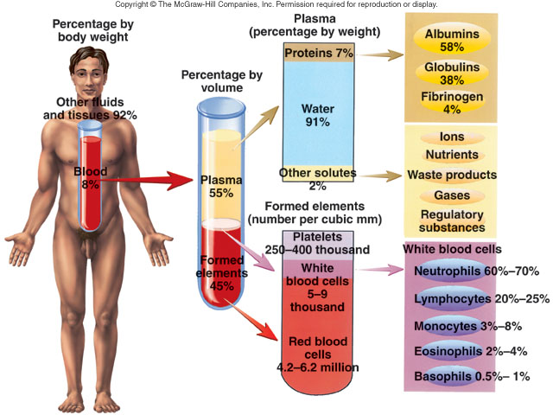

Slide 10
Plasma
Plasma is a straw coloured liquid consisting of:
  Water = 90-92%
  Proteins = (6-8%) Albumin, Globulins, Fibrinogen, Clotting factors
  Organic nutrients – glucose, carbohydrates, amino acids
  Electrolytes – sodium, potassium, calcium, chloride, bicarbonate
  Nonprotein nitrogenous substances – lactic acid, urea, creatinine
  Respiratory gases – oxygen and carbon dioxide

Slide 11
Plasma proteins
3 types – Albumin, Globulins & Fibrinogen
Albumin – most abundant (4 %) pp obtained from liver.
    Maintains plasma osmotic pressure at its normal level (25 mm Hg) – regulation of water movement between tissue & blood.
    Regulation of blood volume
    Gives viscosity to the blood

Slide 12
Plasma proteins
Globulins – obtained from liver & lymphoid tissue ( 2.7%).
3 subtypes – Alpha, Beta & Gamma globulins
  Alpha & Beta – Transportation of some hormones & mineral salts & lipids. (TH, I2, Iron, Copper)
  Gamma – Immune response
Fibrinogen – obtained from liver (0.25- 0.3 %)
    Helps in blood coagulation
    Gives viscosity to the blood.

Slide 13
Formed elements of blood
Formed elements comprise 45% of blood
    Erythrocytes,
    Leukocytes, and
    Platelets

Slide 14
Hematocrit
Percentage of total blood volume occupied by blood cells.

Slide 15
Components of Whole Blood
Plasma
(55% of whole blood)
Buffy coat:
leukocyctes and platelets
(<1% of whole blood)
Formed elements
1
Withdraw blood and place in tube
2
Centrifuge
Erythrocytes
(45% of whole blood)
Hematocrit
  Males: 47% ± 5%
  Females: 42% ± 5%

Slide 16
Production of formed elements
Hematopoiesis or hemopoiesis: Process of blood cell production
All formed elements derived from single population – Stem cells of bone marrow i.e. Hemocytoblasts.
  Proerythroblasts: Develop into red blood cells
  Myeloblasts: Develop into basophils, neutrophils, eosinophils
  Lymphoblasts: Develop into lymphocytes
  Monoblasts: Develop into monocytes
  Megakaryoblasts: Develop into platelets

Slide 18
Erythrocytes
Red Blood Corpuscles (RBC)
Biconcave, circular disc shaped, non-nucleated with diameter 7~8μm & thickness 1~2.5 μm.
Shape provides increased surface area for diffusion

Slide 20
RBC
Normal value of RBC
Male adult - 4.5~5.5 millions/cu.mm
Female adult - 3.8~4.6 millions/cu.mm;
Newborn- ≥ 6.0 millions/cu.mm
Produced in red bone marrow by the process called as Erythropoiesis.
Lack nuclei & mitochondria
Consists of a protein molecule – Hemoglobin. Each RBC contains 280 million hemoglobins

Slide 21
Characteristics of RBC
Permeability: semi-permeable membrane, gases and urea are freely passing through.
Hemolysis – breakdown of RBC, leading to release of Hb, in lower osmotic conditions.
Roulex formation – RBC aggregation
      Erythrocyte Sedimentation Rate (ESR) – RBC sedimenting distance per hour. 0~15 mm/h (male), 0~20 mm/h (female).

Slide 22
Functions of RBC
Transportation of respiratory gases - Erythrocytes are dedicated to respiratory gas transport, due to presence of Hb
Gives viscosity to the blood.
Maintains acid-base balance.
Production of bile pigments.

Slide 23
Hemoglobin
Coloring & respiratory pigment present in the RBC.
Composition of hemoglobin
  A protein called globin
    made up of two alpha and two beta chains
  A heme molecule
    Each heme group bears an atom of Iron, which can bind to one oxygen molecule
    Each hemoglobin molecule thus can transport four molecules of oxygen

Slide 26
Hemoglobin
Hemoglobin reversibly binds with oxygen and most oxygen in the blood is bound to hemoglobin
    Hb + O₂ HbO₂ (oxyhemoglobin)

Slide 27
Hemoglobin
When there is a high concentration of oxygen e.g in the alveoli Hb combines with oxygen to form oxyhaemoglobin.
When the blood reaches the tissue which have a low concentration of oxygen the Hb dissociates with the oxygen and the oxygen is released into body tissues.

Slide 28
Oxyhemoglobin – hemoglobin bound to oxygen
  Oxygen loading takes place in the lungs
Deoxyhemoglobin – hemoglobin after oxygen diffuses into tissues (reduced Hb)
Carbaminohemoglobin – hemoglobin bound to carbon dioxide
  Carbon dioxide loading takes place in the tissues

Slide 29
Erythropoiesis
Production of Erythrocytes
2.5 millions of RBC produced/sec.
Occurs in Yolk Sac, Liver & Spleen (fetus); Red Bone Marrow of flat bones, sternum, ribs, etc.(adult)
Haemopoietic material for erythropoiesis:
Iron (Fe++) and protein,
Influencing factors of RBC maturity:
Vitamin B12 and folic acid
Stimulated by Erythropoietin (EPO) from kidney cells.
Process requires 6 -7 days.

Slide 31
Erythropoiesis
A hemocytoblast is transformed into a committed cell called the proerythroblast
Proerythroblasts develop into early erythroblasts
The developmental pathway consists of three phases
  Phase 1 – increased ribosome synthesis in early erythroblasts
  Phase 2 – hemoglobin accumulation in late erythroblasts and normoblasts
  Phase 3 – ejection of the nucleus from normoblasts and formation of reticulocytes
Reticulocytes then become mature erythrocytes
  Reticulocytes make up about 1 -2 % of all circulating erythrocytes

Slide 32
Steps of Erythropoiesis
1. Increased production of Ribosomes in stem cells leading to increased mitotic cell division – production of large number of small Proerythroblasts & Erythroblasts.
This is initiated by the presence of EPO & requires the presence of folic acid & Vit B12.
2. Synthesis of Hb begin to take place in the presence of Iron & other proteins from diet. So that erythroblasts are converted to Pronormoblasts & Normoblasts.

Slide 33
3. The normoblasts are converted into reticulocytes by removal of nucleus & other cell organelles. This requires the presence of folic acid & Vit B12.
4. The reticulocytes are released into blood circulation and gets matured as RBC in the presence of folic acid & vit B12.
5. Thus RBC are produced from stem cells by decreasing the size, formation of Hb & loss of nucleus & other organelles.

Slide 35
RBC maturation factors
  Vitamin B₁₂:
    Cobalamine, 2~5μg/d.
    Produced by gut bacteria. Good sources include meat, liver, fish, eggs and milk.
    Function: Improve utilization of FA.
  Folic acid:
    FA is essential for the synthesis of DNA.
    Synthesized by microorganisms and higher plants.
    Good sources are green leafy vegetables, yeast and organ meats.

Slide 36
Regulation of Erythropoiesis
The number of circulating erythrocytes remains constant and reflects a balance between RBC production and destruction
  Too few red blood cells leads to tissue hypoxia
  Too many red blood cells causes undesirable blood viscosity
Erythropoiesis is hormonally controlled and depends on adequate supplies of iron, amino acids, and B vitamins

Slide 37
Hormonal regulation of Erythropoiesis
Regulated by the hormone – Erythropoietin, secreted by mainly by kidney cells.
During hemorrhage, hemolysis or diseases, the oxygen carrying capacity of the blood decreases, such that oxygen supply to kidney cells decreases.
This leads to increased secretion of EPO from kidney cells, which stimulates the process of erythropoiesis and hence improves oxygen carrying capacity .
This reduced tissue hypoxia reduces further secretion of EPO.

Slide 38
Erythropoietin Mechanism
Imbalance
Start
Normal blood oxygen levels
Stimulus: Hypoxia due to decreased RBC count, decreased availability of O₂ to blood, or increased tissue demands for O₂
Imbalance
Increases
O₂-carrying ability of blood
Reduces O₂ levels in blood
Erythropoietin stimulates red bone marrow
Kidney (and liver to a smaller extent) releases erythropoietin
Enhanced erythropoiesis increases RBC count
Figure 17.6

Slide 39
Life span & Fate of RBC
The life span of an erythrocyte is 100–120 days
  Travels about 750 miles in that time
Old erythrocytes become rigid and fragile, and their hemoglobin begins to degenerate
Dying erythrocytes are engulfed by macrophages (liver, spleen and lymphatic node)
Heme and globin are separated
  Iron is removed from the heme and salvaged for reuse
    Stored as hemosiderin or ferritin in tissues
    Transported in plasma by beta-globulins as transferrin

Slide 40
Heme is degraded to a yellow pigment called bilirubin
  Liver secretes bilirubin into the intestines as bile
  Intestines metabolize bilirubin into urobilinogen
  Urobilinogen leaves the body in feces, in a pigment called stercobilin
Globin is metabolized into amino acids which are then released into the circulation

Slide 42
Leucocytes/WBC
Leukocytes, the only blood components that are complete cells
Largest blood cells, with nucleus.
But, no hemoglobin & numbers are fewer then RBC
      Normal count – 4000 to 11,000 / cu.mm
Protects body against microbes & removes dead cells & debris.

Slide 43
Physiological characteristics of WBC
Diapedisis: Metamorphosed WBCs pass through vessel wall getting into interstitial fluid.
Chemotaxis: It is a process that WBCs shift to some chemical material (metabolic production, antigen-antibody complex, bacteria, toxin, etc).
Phagocytosis: It is a process that WBCs enclose and engulf exotic or extraneous material, and use intracellular enzyme digesting them.

Slide 44
Types of WBC
WBCs are classified into different types based on:
        Size
        Nuclear Shape
        Cytoplasmic Granules
        Affinity for Stain
Two major types of leukocytes
  Granulocytes: have granules in the cytoplasm
        Ex. Neutrophils, Eosinophils, Basophils
  Agranulocytes: do not have granules in the cytoplasm.
        Ex. Monocytes, Lymphyocytes

Slide 46
Granulocytes
Granulocytes – neutrophils, eosinophils, and basophils
  Contain cytoplasmic granules that stain specifically with acidic, basic, or neutral stain
  Have lobed nuclei
  Are all phagocytic cells

Slide 47
Granulocytes - Neutrophils
Also called as Polymorphonuclear Leucocytes (PMN).
Size = 10 – 12 μ & Nucleus is multi-lobed (2-5)
Account for 60-75% of total WBC’s
Neutrophils have two types of granules that:
  Take up both acidic and basic dyes
  Give the cytoplasm a light pink to purple color
  Contain peroxidases, hydrolytic enzymes, and defensins (antibiotic-like proteins)
Function:
1. Phagocytosis: older cells, bacteria, dead tissues, and other foreign substances.
2. To execute non-specific immune activity in first front.

Slide 48
Granulocytes - Eosinophils
Eosinophils/Acidophils account for 1–4% of WBCs
  Size = 10 – 12 μ & have bilobed nucleus
  Have red to crimson granules – stained with acidic stain
  Function:
    Lead the body’s counterattack against parasitic infections (worms or helminths)
    Lessen the severity of allergies by phagocytizing immune complexes (ending allergic reactions)

Slide 49
Granulocytes - Basophils
Account for 0.5-1% of all WBCs
  Size = 8 – 10 μ & have kidney shaped bilobed nucleus
  Are functionally similar to mast cells
  Have large, purplish-black (basophilic) granules that contain histamine, heparin or serotonin.
    Histamine – inflammatory chemical that acts as a vasodilator and attracts other WBCs.
    Heparin – Anti-coagulant
    Serotonin – vasoconstriction & inflammatory reaction.

Slide 50
Basophils
  Function:
    Secrete heparin into blood to prevent coagulation.
    Wander into tissue and become mast cell.
    Induce allergy.

Slide 51
Agranulocytes - Lymphocytes
Account for 20-25% or more of WBCs and:
  Have large, dark-purple, circular nucleus with a thin rim of blue cytoplasm
  Produced mainly by lymph nodes & spleen & are found mostly enmeshed in lymphoid tissue (some circulate in the blood)
Most important cells of the immune system
There are two types of lymphocytes: T cells and B cells
  T cells – matured in thymus gland & attack foreign cells directly (produces cell mediated immunity)
  B cells – matured in BM & lymphoid tissue & give rise to plasma cells, which produce antibodies (produces Humoral immunity)

Slide 53
Agranulocytes - Monocytes
Monocytes account for 2–4% of leukocytes
  They are the largest leukocytes (16- 20 μ)
  They have purple-staining, kidney bean or oval shaped nucleus
  They leave the circulation, enter tissue, and differentiate into macrophages.

Slide 54
Functions of Monocytes
1. It contains many nonspecific lipase and displays the
powerful phagocytosis - Engulf and clear bacteria, vermins, older, necrotic tissues, dead neutrophils, dead cells and fragments.
2. As soon as monocytes get into tissue from blood , it becomes macrophages, activating monocyte- macrophage system to release many cytokins, such as colony stimulating factor (CSF), IL-1, IL-3, IL-6, TNFα, INF-α,β ,etc.
3. Cytokins induced by monocyte may modulate growth of granulocytes.
4. Monocyte- macrophage system plays a very important role in specific immune responsive induction and regulation by activating Lymphocytes.
5. Recognize & kill cancer cells.

Slide 55
Leucopoiesis
Production of WBC.
Birth place: bone marrow, originating from hemopoietic stem cells, and leukopoiesis process is similar to RBC.
Leukopoiesis is hormonally stimulated by two families of cytokines (hematopoietic factors) – interleukins and colony-stimulating factors (CSFs)
  Interleukins are numbered (e.g., IL-1, IL-2), whereas CSFs are named for the WBCs they stimulate (e.g., granulocyte-CSF stimulates granulocytes)
Macrophages and T cells are the most important sources of cytokines

Slide 56
Leucopoiesis
All leukocytes originate from hemocytoblasts- stem cells
Hemocytoblasts differentiate into myeloid stem cells and lymphoid stem cells
  Myeloid stem cells become myeloblasts or monoblasts
    Granulocytes form from myeloblasts
    Monoblasts enlarge and form monocytes
  Lymphoid stem cells become lymphoblasts
    Lymphoblasts develop into lymphocytes

Slide 58
Life span & fate of WBC
Life span: several hours to 3 or 4 days.
Leukocyte breakage: site are liver, spleen and lymphatic node – leading to formation of pus.

Slide 59
Platelets
Thrombocytes.
Are smallest of formed elements, lack nucleus
Are fragments of megakaryocytes;
Constitute most of mass of blood clots
Their granules contain serotonin, Ca²⁺, enzymes, ADP, and platelet-derived growth factor (PDGF)
Normal count = 2.5 to 4.0 lakhs per cu.mm

Slide 60
Platelets
Round/oval shaped with biconvex surface.
2~4 μm diameter, thickness 1μm.

Slide 61
Platelets
Birth place is bone marrow, originating from hemopoietic stem cells, and differentiating into burst forming unit- megakaryocyte, BFU-MK, then continuously into CFU-MK, and into megakaryocyte. one megakaryocyte can release 200~7700 platelet.
Life-span: Averagely, 7~14 days in the blood.
Breakage: Aged platelet can be processed by phagocytosis in liver, spleen and lymphatic node.

Slide 62
Functions of Platelets
Plays an important role in Hemostasis (stopping the bleeding when blood vessels are damaged to prevent excessive blood loss).
Hemostasis includes:
    Vasoconstriction,
    Platelet plug formation and
    Blood coagulation (Formation of a clot)

Slide 63
Role of platelets in hemostasis
Platelets don't stick to intact endothelium because of presence of prostacyclin & NO
When a blood vessel breaks, damaged endothelium allows platelets to bind to exposed collagen.
Platelets are “sticky”. They stick to any rough surface and to collagen in connective tissue. They also stick to each other.
Platelets stick to each other-→Plug
Platelets then release ADP, Thromoboxane A2 & SEROTONIN.

Slide 64
Serotonin & thromboxane A₂ stimulate vasoconstriction, reducing blood flow to wound
ADP & thromboxane A₂ cause other platelets to become sticky & attach & undergo platelet release reaction.
This continues until a soft mass of platelet plug is formed. Thus, it blocks leakage in the blood vessels & stops further bleeding.
Platelet plug then becomes infiltrated by meshwork of fibrin to form solid clot.

Slide 66
  Platelets also enhance activation of coagulation factors to solidify platelet Plug by interlacing with fibrin (secondary hemostasis).

Slide 67
Blood coagulation
The process of conversion of blood from liquid to gel or gelatin.
Involves series of complex reactions & requires multiple substances.
Clotting factors – substances which are directly involved in blood coagulation.
There are 12 factors named Roman numerals, except Ca²⁺, other factors being protein, and except FIII (TF), others are synthesized by liver with VitK .
Blood clotting factors exists in two types: inactive and activated type [FII, FVII, FIX, FX, FXI, FXII, FXIII].

Slide 68
Blood Clotting Factors
Factor Name Plasma Synthesizing Half life
Concentration site
I Fibrinogen 3000 Liver 4~5 d
II Prothrombin 100 Liver (with Vit K) 3 d
III Tissue factor - Endothelial cell -
IV Ca²⁺ 100 - -
V Proaccelerin 10 Endothelial cell, platelet 12~15 h
VII Proconvertin 0.5 Liver (with Vit K) 4~7 h
VIII Antihemophilic factor,AHF 0.1 Liver 8~10 h
IX Plasma thromboplastic 5 Liver (with Vit K) 24 h
component,PTC(Christmas factor)
X Stuart-Prower Factor 10 Liver (with Vit K) 2 d
XI Plasma thromoboplastin 5 Liver 2~3 d
antecedent,PTA
XII Contact factor or Hageman factor 40 Liver 24 h
XIII Fibrin-stabilizing factor 10 Liver, platelet 8 d

Slide 69
Mechanism of clotting
It involves 3 steps namely,
  1. Formation of Prothrombin activator
  2. Conversion of prothrombin to thrombin
  3. Conversion of fibrinogen to fibrin. Fibrin sticks to damaged edges, forms meshwork. Platelets, blood cells stick to meshwork, & forms solid clot.

Slide 71
Pathways of blood coagulation
The mechanism of clotting occurs by 2 pathways – Extrinsic & Intrinsic pathways, which occurs together.
      Intrinsic pathway of blood coagulation: All blood clotting factors involved in blood coagulation come from blood. Initiated by exposure of blood to negatively charged surface of glass or blood vessel collagen. This activates factor XII (a protease) which initiates a series of clotting factors. (3-6 min)
      Extrinsic pathway of blood coagulation: Damage outside blood vessels (tissue) releases tissue factor (thromboplastin) that triggers clotting. It is initiated at the site of injury in response to the release of TF. (1-2 min)
Extrinsic pathway of blood coagulation is faster than intrinsic pathway of blood coagulation because its steps are more simple.

Slide 72
clotting cascade
Stage 1: Formation of prothrombin activator.
Stage 2: Conversion of prothrombin to thrombin.
Stage 3: conversion of fibrinogen to fibrin

Slide 74
Fibrinolysis
  Process of liquefaction of fibrin or dissolution of solid clot.
After the clot has formed, the process of removing it and healing the damaged blood vessel begins.
When damage is repaired, the inactive substance called plasminogen is converted to plasmin by activators.
Plasmin digests fibrin, dissolving clot to form soluble products that are removed by phagocytosis.
As the clot is removed, the healing process restores the integrity of blood vessel wall.

Slide 75
Plasminogen
Activator
Plasmin
fibrin
fibrin degradation products

Slide 76
Regulation of coagulation
The process of blood coagulation relies heavily on several processes that are self perpetuating i.e. once started, a positive feedback mechanism promotes their continuation.
Ex. Thrombin is a powerful stimulator of its own production.
The body therefore possess several mechanisms to control & limit the clotting reactions; otherwise, once started the clotting process would spread throughout the circulatory system.

Slide 77
The main control are-
1. The perfect smoothness of normal blood vessel lining; platelets do not adhere to this surface.
2. The binding of thrombin to a specific receptor on the cells lining the blood vessels; once bound, thrombin gets inactivated.
3. Presence of natural anti-coagulants (Heparin in blood), which inactivates clotting factors.

Slide 78
Blood groups
History: ABO blood group system was firstly found by Karl Landsteiner in 1901.
Blood is grouped according to types of specific antigens present on the blood cell.
Two types – ABO system & Rh system

Slide 79
RBC membranes have glycoprotein antigens on their external surfaces
These antigens are:
  Unique to the individual
  Recognized as foreign if transfused into another individual
  Promoters of agglutination and are referred to as agglutinogens
Presence or absence of these antigens is used to classify blood groups

Slide 80
ABO blood grouping
This system is based on presence or absence of two types of antigens i.e. A & B on the surface of RBC.
According to this system, there can be 4 different blood groups such as A, B, AB or O
Blood group Antigen on the RBC Antibody in the serum
A A Anti-B
B B Anti-A
AB A+B
O Anti-A+Anti-B

Slide 81
According to Landstainers law, If a particular agglutinogen is present on the surface of RBC, then its corresponding agglutinin is always absent.
People with Type A blood make antibodies to Type B RBCs, but not to Type A
Type B blood has antibodies to Type A RBCs but not to Type B
Type AB blood doesn’t have antibodies to A or B
Type O has antibodies to both Type A & B
If different blood types are mixed, antibodies will cause mixture to undergo agglutination reaction
Agglutination: Combination of the same antigen (or named agglutinogen, glycoprotein/glycolipid on the membrane of blood cell) and antibody (or named agglutinin, in serum) results in harmful immune reactions showing hemolysis.

Slide 82
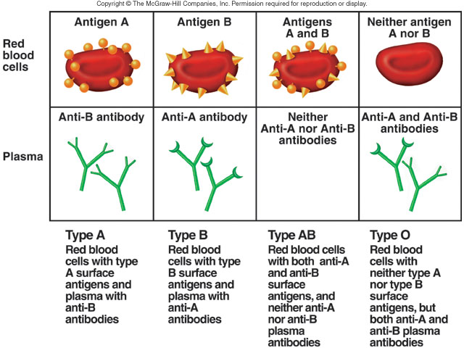

Slide 83
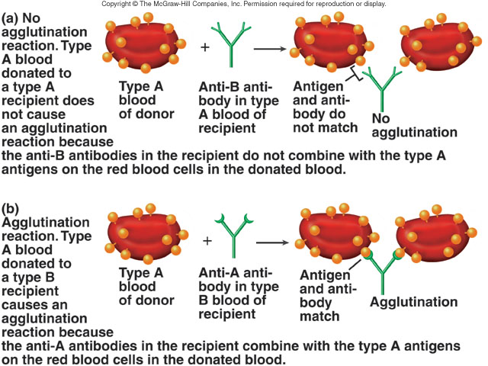
Agglutination

Slide 84




ABO grouping
Blood group A：A antigens on the surface of RBC, B antibodies in blood plasma.
Blood group B：B antigens on the surface of RBC, A antibodies in blood plasma.
Blood group AB：both A and B antigens on the surface of RBC, no A or B antibodies at all in blood plasma.
Blood group O：neither A or B antigens on the surface of RBC, but you have both A and B antibodies in blood plasma

Slide 85
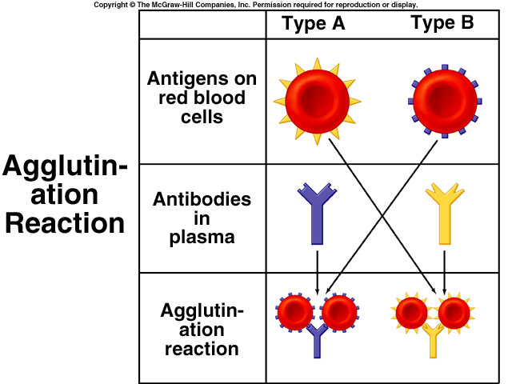

Slide 86
Inheritance of ABO blood group
Genetic relationship of ABO blood group
Parents’ Offspring possible Offspring impossible
blood group blood group blood group
O×O O A, B, AB
A×A O, A B, AB
A×O O, A B, AB
B×B O, B A, AB
B×O O, B A, AB
B×A O, A, B, AB ____
AB×O A , B O, AB
AB×A A , B, AB O
AB×B A , B, AB O
AB×AB A , B, AB O

Slide 87
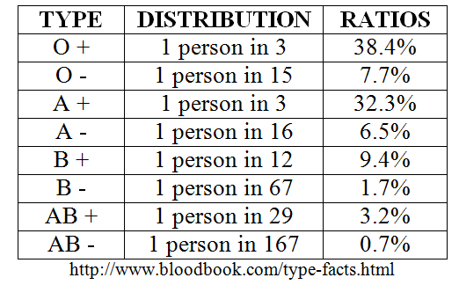
How common is your blood type?
46.1%
38.8%
11.1%
3.9%

Slide 88
Blood transfusion

Slide 89
A blood transfusion is a procedure in which blood is given to a patient through an intravenous (IV) line in one of the blood vessels.
Blood transfusions are done to replace blood lost during surgery or a serious injury. A transfusion also may be done if a person’s body can't make blood properly because of an illness.
Transfusions are preferred between people of the same blood type. (compatible)
If blood types don't match, recipient’s antibodies agglutinate donor’s RBCs

Slide 90
Compatibility involves Matching RBCs of Donor (i.e.Antigens) & Antibodies of Recipient
A can receive from A and O
B can receive from B and O
AB can receive from AB, A, B and O
O can receive only from type O- but can donate to everyone else
People with TYPE O blood are called Universal Donors (they can give blood to any blood type) because of absence of both A & B antigens.
People with TYPE AB blood are called Universal Recipients (they can receive any blood type) because of absence of both A & B antibodies.

Slide 91
O
A
B
AB

Slide 92
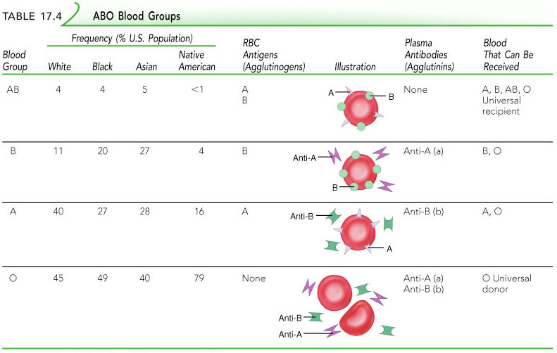
ABO Blood Groups
Table 17.4

Slide 93
Principles of transfusion
1. Identification of blood group must be taken before transfusion.
2. Cross-match test must be done before transfusion.
3. The same types of blood group for transfusion should be firstly considered.
4. The different types of blood group for transfusion should be very careful, small amount and slow import and if condition is better, changes in the same types of blood group for transfusion.

Slide 94
Cross-match test for transfusion
RBC
RBC
Donator
Main side
Receiver
Subordinate side
Serum
Serum
Main side of agglutination
Subordinary side of agglutination
Decision
Perfect match, transfusion
×
No match, transfusion
Transfusion under emergency
+: Agglutination; -: No agglutination

Slide 95
Transfusion reactions
Transfusion reactions occur when mismatched (Incompatible) blood is infused
Donor’s cells are attacked by the recipient’s plasma agglutinins causing:
  Diminished oxygen-carrying capacity
  Clumped cells that impede blood flow
  Ruptured RBCs that release free hemoglobin into the bloodstream
Circulating hemoglobin precipitates in the kidneys and causes renal failure

Slide 96
Rh blood group system
Rh antigen (Rh factor) is about 40 kinds and Rh factors related to clinic are D, E, C, c, e and most important is D antigen.
Membrane of RBC has D antigen meaning Rh Positive, otherwise, Rh negative.
Most of people (99％) are Rh Positive and less than 1% persons are Rh negative.
Anti-Rh antibodies are not normally present.
However, if an Rh– individual receives Rh⁺ blood, anti-Rh antibodies form & second exposure to Rh⁺ blood will result in a typical transfusion reaction.

Slide 97
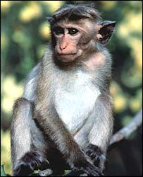
Rh Factors
Scientists sometimes study Rhesus monkeys to learn more about the human anatomy because there are certain similarities between the two species. While studying Rhesus monkeys, a certain blood protein was discovered. This protein is also present in the blood of some people. Other people, however, do not have the protein.
The presence of the protein, or lack of it, is referred to as the Rh (for Rhesus) factor.
If your blood does contain the protein, your blood is said to be Rh positive (Rh+). If your blood does not contain the protein, your blood is said to be Rh negative (Rh-).
A+ A-
B+ B-
AB+ AB-
O+ O-
http://www.fi.edu/biosci/blood/rh.html

Slide 98
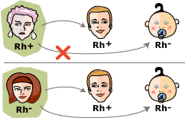

Slide 99
Hemolytic disease of newborn (HDN)/Erythroblastosis foetalis
  Occurs when Rh- Mom Pregnant with Rh+ Fetus
  Mixing of Maternal & Fetal Blood at Birth
  Rh– mother becomes sensitized when Rh⁺ blood causes her body to synthesis Rh⁺ antibodies. no problems with first transfusion or pregnancy
  The sensitized mother (from a previous pregnancy of an Rh⁺ baby or a Rh⁺ transfusion) with subsequent 2nd Rh+ Fetus, Rh⁺ antibodies of a sensitized Rh– mother cross the placenta and attack and destroy the RBCs of an Rh⁺ baby.
The drug RhoGAM can prevent the Rh– mother from becoming sensitized
Treatment of hemolytic disease of the newborn involves pre-birth transfusions and exchange transfusions after birth

Slide 100
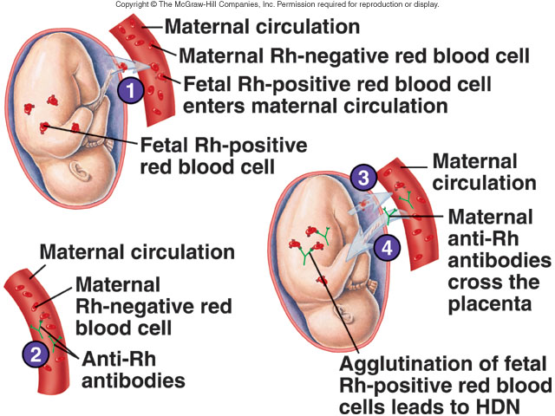

Slide 101
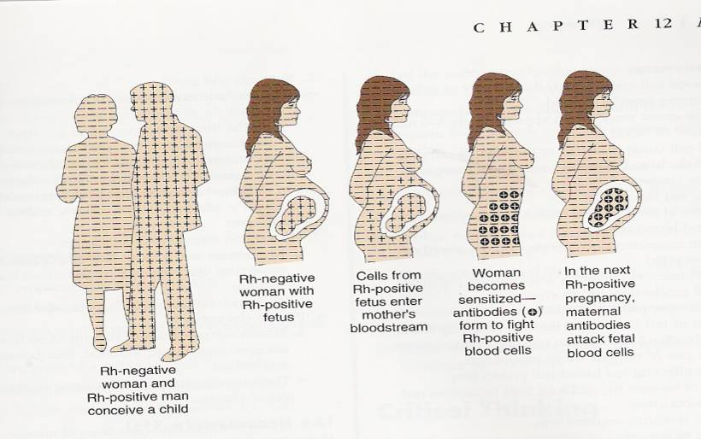

Slide 102
Disorders of Blood
Disorders of RBC
    Anaemia & Polycythemia
Disorders of WBC
    Leucopenia, Leucocytosis, Leukaemia
Disorders of Platelets
    Thrombocytopenia
Disorders of Coagulation
    Hemophilia

Slide 103
Anaemia
It is a complex symptoms/disease recognized by fall in oxygen carrying capacity of blood.
Symptoms- Paleness, weakness, breathlessness, restlessness, loss of appetite, tachycardia, palpitations.
It occurs due to imbalance between rate of erythropoiesis & hemolysis – such that enough Hb is not available resulting in insufficient oxygen supply to the tissues.

Slide 104
Types of Anaemia
A. Due to impaired RBC production
    Iron deficiency Anaemia
    Megaloblastic Anaemia
    Hypoplastic or Aplastic Anaemia
B. Due to increased RBC loss
    Hemolytic Anaemia – Sickle cell A, Thalassaemia,HDN
    Normocytic or post-Hemorrhagic Anaemia

Slide 105
Iron deficiency Anaemia
Most common form – due to deficient intake of iron.
The normal daily requirement of iron intake is 1-2 mg (M) & 3 mg (F).
It leads to decrease in Hb concentration & insufficient supply of oxygen to cells.
It occurs due to either intake of Iron deficient diet or Iron malabsorption due to abnormalities of stomach/intestine.

Slide 106
Megaloblastic Anaemia
It is characterized by presence of abnormal RBC in the form of megaloblasts (Immature, large & fragile RBC with reduced life span).
It occurs due to deficiency of RBC maturation factors such as Vitamin B12 or/and Folic acid. Due to which, the rate of DNA & RNA synthesis reduced, delayed cell division & hence, the cells can grow larger than normal between divisions.
The Hb concentration is either normal or raised.
3 subtypes – Pernicious A, Vit B12 def. A & Folic acid def. A

Slide 107
Pernicious Anaemia – is a autoimmune disorder, in which antibodies destroy the intrinsic factor or parietal cells of stomach causing less or no absorption of Vit. B12
Vitamin B12 deficient Anaemia – is very rare, except in true vegetarians. The other causes may include Chronic gastritis, Gastrectomy, malignant diseases of GIT resulting in less absorption of Vit. B12.
Folic acid deficient Anaemia – due to either dietary deficiency (infants, alcoholics, anorexia, pregnancy) or malabsorption from intestine.

Slide 108
Hypo plastic/Aplastic anaemia
Anaemia due to reduced function of bone marrow or total absent of BM function.
Characterized by Pancytopenia
The condition is idiopatic, but the possible causes include-
    Cytotoxics, some anti-inflammatory, anti-convulsant, & sulphonamide drugs.
    Ionizing radiations.
    Benzene & its derivatives.
    Hepatitis, Nephritis

Slide 109
Hemolytic anaemia
Is due to excessive or abnormal destruction of RBC.
It can be congenital or acquired.
Congenital Hemolytic anaemia – due to genetic abnormality, there is synthesis of abnormal Hb & increased RBC membrane friability leading to reduced oxygen carrying capacity & life span of RBC.
Most common are – Sickle cell A, Thalassemia & HDN

Slide 110
Sickle cell anaemia
results from a defective gene codes for an abnormal hemoglobin called hemoglobin S (HbS)
This defect causes RBCs to become sickle-shaped in low oxygen situations.
Oxygen transport is impeded, capillaries may clog, spleen is enlarged & painful.
Increased viscosity of blood leading to intravascular clotting, ischaemia etc.

Slide 111
Thalassemia
Also called as Cooley’s anaemia.
Reduced globin synthesis or defective globin chain formation leading to reduced Hb & increased friability of RBC – early hemolysis.

Slide 112
Acquired Hemolytic anaemia
Hemolysis due to other causes –
    Ionizing radiations
    Drugs – Phenacetin, Primaquine, Sulphonamides
    Incompatible blood transfusions
    Physical damage to cells – dialysis, artificial valves

Slide 113
Normocytic anaemia
In this type, cells are normal in size with normal Hb concentration but, the numbers are reduced.
It occurs due to acute or chronic hemorrhage – loss of blood due to accidents, injuries or other diseases. (post- Hemorrhagic anaemia)

Slide 114
Polycythemia
Is a disorder of RBC characterized by excess number of RBC in the blood.
This increases viscosity of blood, slow down the rate of flow of blood & increases the risk of intravascular clotting.
The physiological increase occurs in high altitudes & pathological in BM Cancer (Polycythemia rubra vera)& smoking

Slide 115
Leucopenia
Is characterized by decrease in WBC count (less than 4000 per cu.mm)
Most common is Granulocytopenia (Neutropenia)
Cause – Infections – typhoid, pneumonia
cancer, Inflammation,
Drugs- cytotoxics, antibiotics

Slide 116
Leucocytosis
Is increased WBC count (More than 11,000 per cu.mm)
Due to infections

Slide 117
Leukaemia
Leukemia refers to cancerous conditions involving white blood cells
Leukemias are named according to the abnormal white blood cells involved
  Myelocytic leukemia – involves myeloblasts
  Lymphocytic leukemia – involves lymphocytes
Acute leukemia involves blast-type cells and primarily affects children
Chronic leukemia is more prevalent in older people

Slide 118
Immature white blood cells are found in the bloodstream in all leukemias
Bone marrow becomes totally occupied with cancerous leukocytes
Severe anemia & thrombocytopenia occurs due to excess production of WBC’s
The white blood cells produced, though numerous, are not functional
Death is caused by internal hemorrhage and overwhelming infections

Slide 119
Causes – Ionizing radiations, Benzene & its derivatives, viral infections, genetic factors, cytotoxic drugs etc.

Slide 120
Thrombocytopenia
Is reduced platelet count (less than 150000 per cu.mm).
It is due to either reduced rate of platelet production (Pancytopenia due to Leukemia, cancer, IR, cytotoxics) or increased rate of destruction of platelets.
Thrombocytopenia purpura is an autoimmune disease leading to destruction of platelets.
Increased bleeding time & patches of hemorrhage on the skin.

Slide 121
Disorders of coagulation
Hemophilia A:
  Deficiency of clotting factor VIII. The disease severity usually parallels the factor VIII levels.
  Severe (< 1% VIII): with spontaneous bleeding;
  Moderate (1-5% VIII): with occasional bleeding, usually with trauma;
  Mild (6-30% VIII): with bleeding only after surgery or trauma.
  Therapy: administration of FVIII.

Slide 122
Hemophilia B (Christmas Disease):
  Clotting factor IX deficiency.
Decreased production of coagulation factors:
  E.g. Liver disease, vitamin K malabsorption, dietary deficiency of vitamin K.

Slide 123
Questions
Describe the various steps involved in erythropoiesis. Write the general factors influencing erythropoiesis. (10)
Write the composition of blood (5)
Write the normal value & life span of RBC & Platelets. (2)
Discuss the mechanism of blood coagulation (5)
What is ESR. Mention its significance (2)
What is megaloblastic anemia (2)
Write the functions of blood (5)
Write the functions of plasma proteins (2)
Define anemia (2)
Write the composition & functions of blood (5)
Enumerate the types & functions of leucocytes (5)
Define Leukemia (2)
Mention the normal value of Hb & RBC (2)

Slide 124
Explain ABO system of blood grouping (5)
Functions of WBC (2)
What is Rh factor (2)
Describe the structure & functions of Platelets (5)
Classify WBC. Explain the microscopic structure & functions of WBC (5)
What is Anemia. Explain different types (5).

