Slide 1
Nervous system
a) Definition and classification of nervous system
b) Anatomy, physiology and functional areas of cerebrum
c) Anatomy and physiology of cerebellum
d) Anatomy and physiology of mid brain
e) Thalamus, hypothalamus and Basal Ganglia
f) Spinal card: Structure & reflexes – mono-poly-planter
g) Cranial nerves – names and functions
h) ANS – Anatomy & functions of sympathetic & parasympathetic N.S.

Slide 2
What is nervous system?
It is a system, which creates awareness of the surrounding environment & responds to it by altering the anatomy & physiology of other systems.
It works in such a way that, normal physiological functions (homeostasis) are carried out at all the time, both in conscious or unconscious state.
It detects & responds to the changes inside & outside of the body.

Slide 3
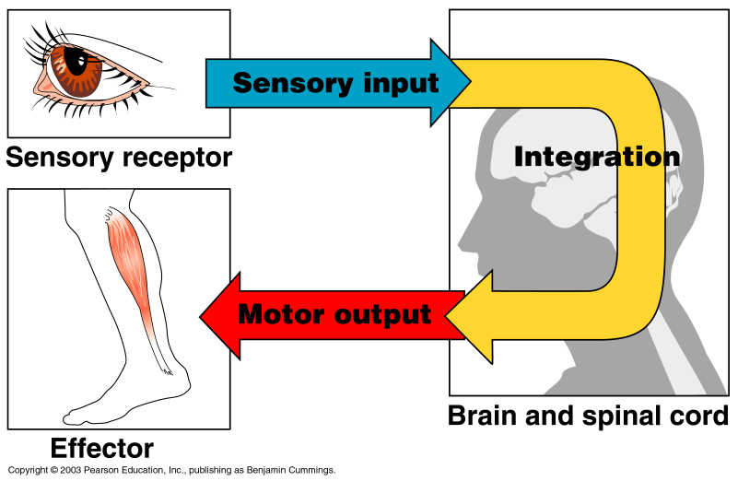
Functions of the Nervous System
1. Sensory input – gathering information
  To monitor changes occurring inside and outside the body (changes = stimuli)
2. Integration –
  To process and interpret sensory input and decide if action is needed.
3. Motor output
  A response to integrated stimuli
  The response activates muscles
  or glands
Copyright © 2003 Pearson Education, Inc. publishing as Benjamin Cummings
Slide 7.1a

Slide 4
Classification of Nervous system
Anatomical classification –
1. Central nervous system (CNS)
  Brain & Spinal cord
2. Peripheral nervous system (PNS)
  Nerves outside the brain and spinal cord (Cranial & Spinal nerves)

Slide 5
Functional Classification of the Peripheral Nervous System
  Two subdivisions
    Somatic nervous system – also called as voluntary NS – which controls the functions of SKM
    Autonomic nervous system – also called as Involuntary NS – which controls the functions of SM, CM & Glands
Figure 7.1
Copyright © 2003 Pearson Education, Inc. publishing as Benjamin Cummings
Slide 7.3c

Slide 6
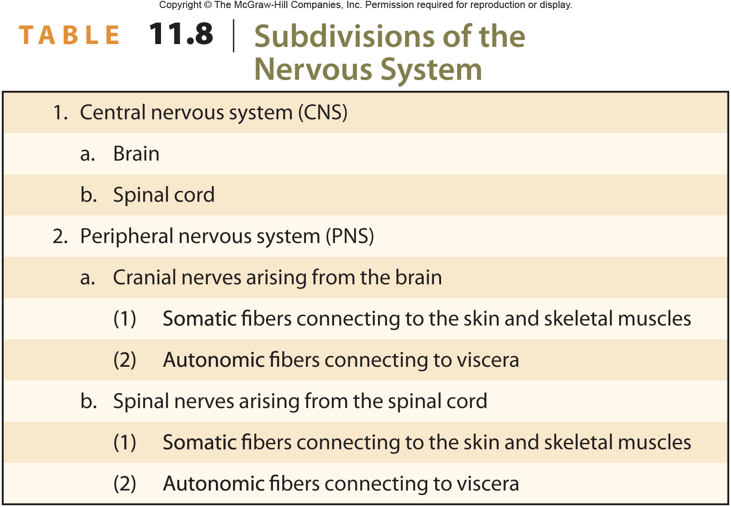
Nervous System Subdivisions

Slide 7
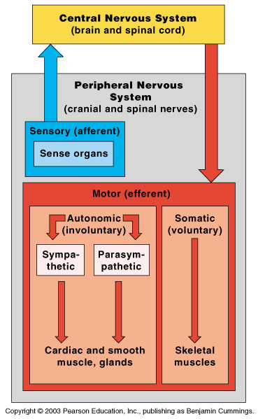
Organization of the Nervous System
Figure 7.2
Copyright © 2003 Pearson Education, Inc. publishing as Benjamin Cummings
Slide 7.4

Slide 8
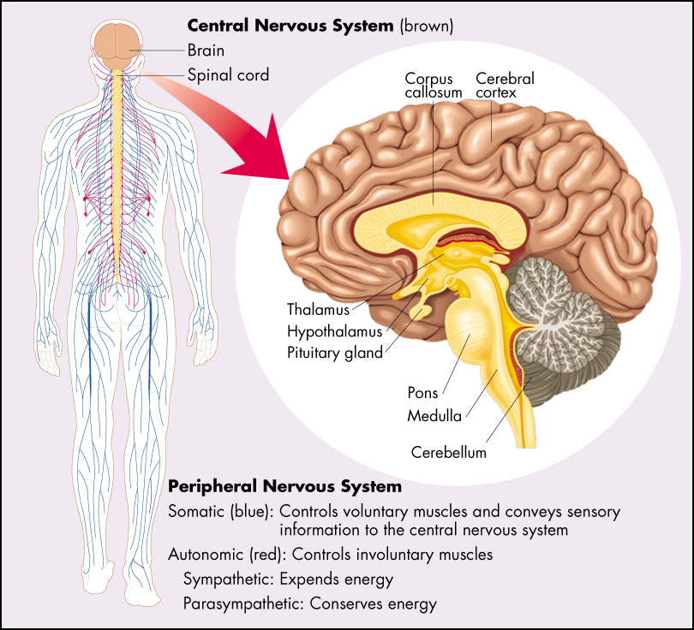

Slide 9
Nervous Tissue: Neurons
Neurons = nerve cells
  Cells specialized to transmit messages
  Major regions of neurons
    Cell body – nucleus and metabolic center of the cell
    Processes – fibers that extend from the cell body (dendrites and axons)
Copyright © 2003 Pearson Education, Inc. publishing as Benjamin Cummings
Slide 7.8

Slide 10
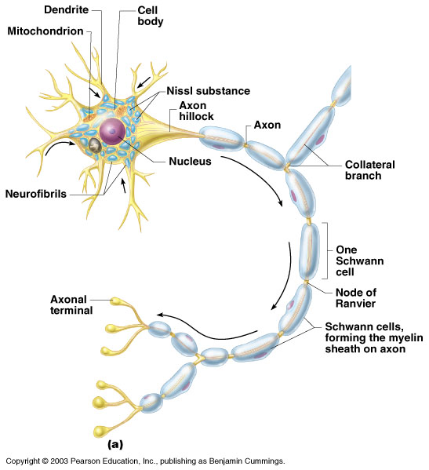
Neuron Anatomy
Cell body
  Nucleus
  Large nucleolus
Figure 7.4a
Copyright © 2003 Pearson Education, Inc. publishing as Benjamin Cummings
Slide 7.9b

Slide 11
Neuron Anatomy
Extensions outside the cell body
  Dendrites – conduct impulses toward the cell body
  Axons – conduct impulses away from the cell body (only 1!)
Figure 7.4a
Copyright © 2003 Pearson Education, Inc. publishing as Benjamin Cummings
Slide 7.10

Slide 12
Axons and Nerve Impulses
Axons end in axonal terminals
Axonal terminals contain vesicles with neurotransmitters
Axonal terminals are separated from the next neuron by a gap
  Synaptic cleft – gap between adjacent neurons
  Synapse – junction between nerves i.e. axon of one neurone & dendrite of other.
Copyright © 2003 Pearson Education, Inc. publishing as Benjamin Cummings
Slide 7.11

Slide 13
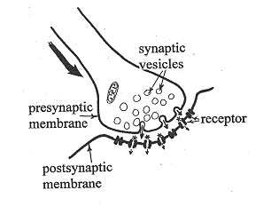

Slide 14
Functional Classification of Neurons
Sensory (afferent) neurons
  Carry impulses from the sensory receptors of periphery to CNS.
Motor (efferent) neurons
  Carry impulses from the central nervous system towards periphery.
Interneurons (association neurons)
  Found in neural pathways in the central nervous system
  Connect sensory and motor neurons
Copyright © 2003 Pearson Education, Inc. publishing as Benjamin Cummings
Slide 7.14a

Slide 15
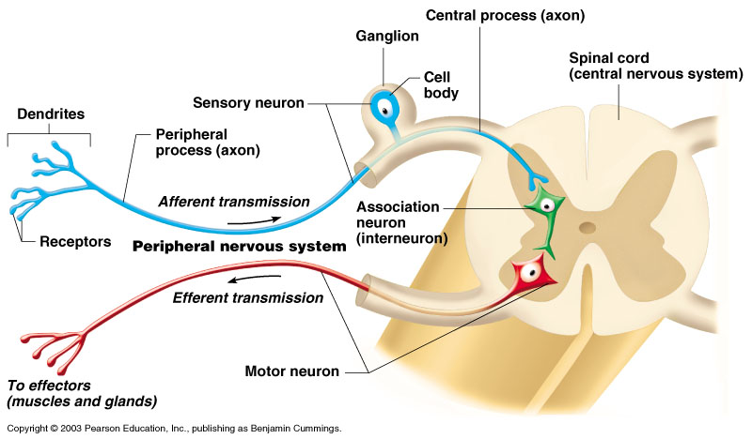
Neuron Classification
Figure 7.6
Copyright © 2003 Pearson Education, Inc. publishing as Benjamin Cummings
Slide 7.15

Slide 16
Transmission of nerve impulse
It occurs by electrochemical method i.e. electrical in neuron & chemical at synapse.
The neuronal membrane at rest is in polarized condition. Sodium is present in excess extracellularly & potassium intracellularly. Due to this, there is +ve charge outside & -ve charge inside.
Copyright © 2003 Pearson Education, Inc. publishing as Benjamin Cummings
Slide 7.17

Slide 17
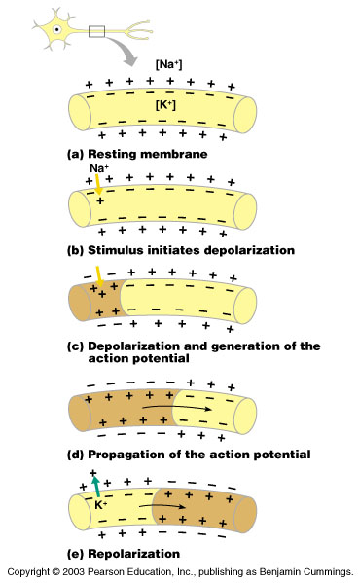
Depolarization – a stimulus depolarizes the neuron’s membrane
A deploarized membrane allows sodium (Na⁺) to flow inside the membrane
The exchange of ions initiates an action potential in the neuron
Figure 7.9a–c
Copyright © 2003 Pearson Education, Inc. publishing as Benjamin Cummings
Slide 7.18

Slide 18
The action potential carries the impulses from depolarized part to next resting part of neuron.
If the action potential (nerve impulse) starts, it is propagated over the entire axon
Potassium ions rush out of the neuron after sodium ions rush in, which repolarizes the membrane
The sodium-potassium pump restores the original configuration
Copyright © 2003 Pearson Education, Inc. publishing as Benjamin Cummings
Slide 7.19

Slide 19
The impulse continues to move toward the cell body
Impulses travel faster when fibers have a myelin sheath
Figure 7.9c–e
Copyright © 2003 Pearson Education, Inc. publishing as Benjamin Cummings
Slide 7.20

Slide 20
Transmission of nerve impulse at synapse
Impulses are able to cross the synapse to another nerve – by neurotransmitters
  Neurotransmitter, which is stored in synaptic vesicles, is released into the synaptic cleft in response to action potential.
  The dendrite of the next neuron has receptors that are stimulated by the neurotransmitter
  An action potential is started in the dendrite
Copyright © 2003 Pearson Education, Inc. publishing as Benjamin Cummings
Slide 7.21

Slide 21
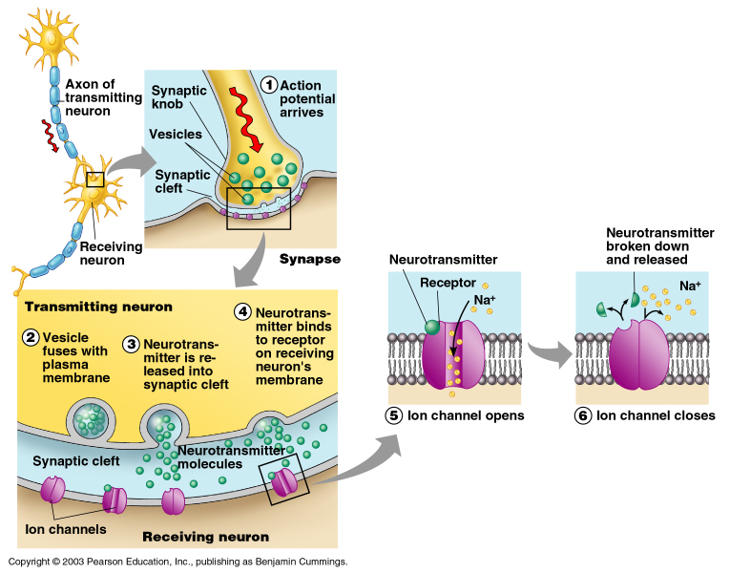
How Neurons Communicate at Synapses
Figure 7.10
Copyright © 2003 Pearson Education, Inc. publishing as Benjamin Cummings
Slide 7.22

Slide 22
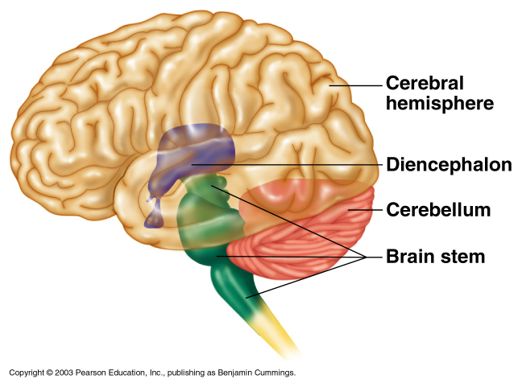
Brain
The brain is the control center of the body
It is about 2% of our body weight and uses 20% of our body’s oxygen.
It is located within cranial cavity & protected by covering layers called as meninges.
Its is divided into 4 parts –
  Cerebrum
  Diencephalon
  Brain stem
  Cerebellum

Slide 23
Functions of the brain:
  Interprets sensations
  Determines perception
  Stores memory
  Reasoning
  Makes decisions
  Coordinates muscular movements
  Regulates visceral activities
  Determines personality

Slide 24
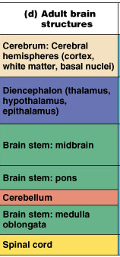
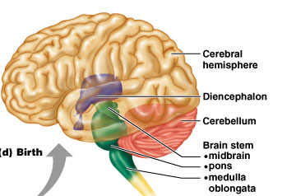
Anatomical classification
Cerebral hemispheres
Diencephalon
  Thalamus
  Hypothalamus
Brain stem
  Midbrain
  Pons
  Medulla
Cerebellum
Spinal cord

Slide 25
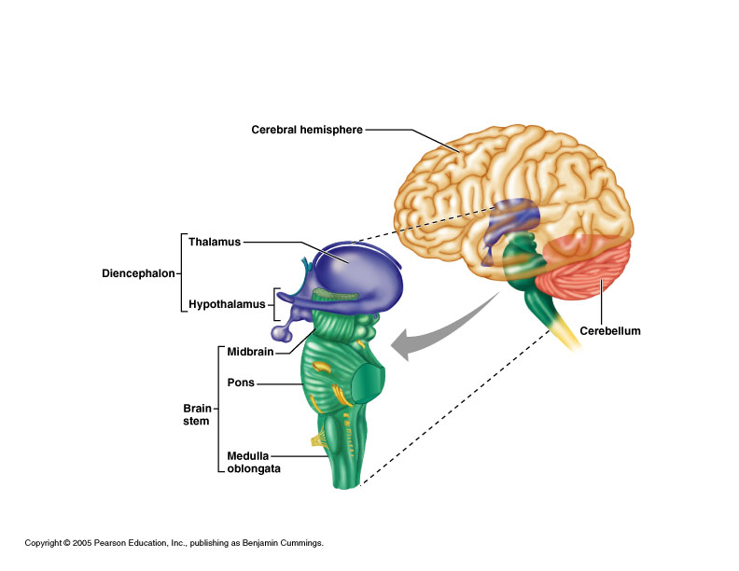
Parts of Brain
Cerebrum
Diencephalon
Brainstem
Cerebellum

Slide 26
Cerebrum
Largest part of the brain.
Divided into 2 halves i.e. right & left hemispheres by a deep longitudinal fissure called as Falx ceribri & these two hemispheres are joined together by a bundle of nerve fibers called as Corpus callosum.
Each hemisphere is further divided into 5 lobes-
  Frontal lobe
  Parietal lobe
  Occipital lobe
  Temporal lobe
  Insula also called as ‘Island of Reil’, present deep in the lateral sulcus (functions in interoceptive awareness & judging intensity of pain, among other things)

Slide 27
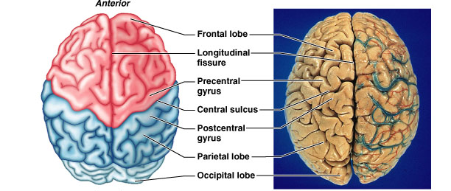

Slide 28
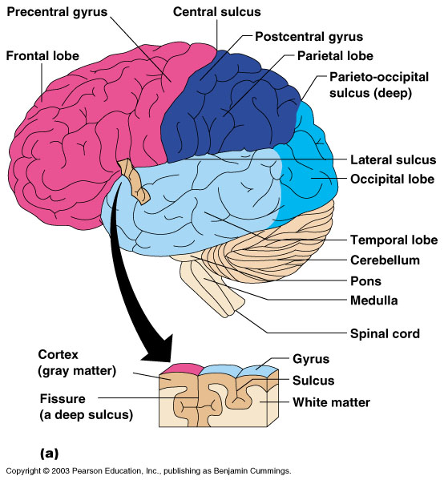

Slide 29
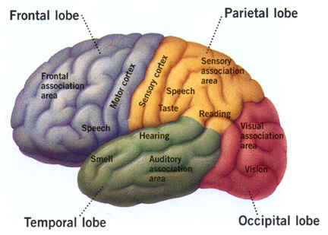

Slide 30
The superficial part of the cerebrum is called as cerebral cortex, which consists of Grey matter (group of nerve cell body) & innermost layer of cerebrum consist of white matter (group of nerve fibers).
The surface is made of many foldings/ridges/convolutions called as gyri & these are separated by grooves called as sulcus or fissures. These convolutions greatly increase the surface area of cerebrum.

Slide 31
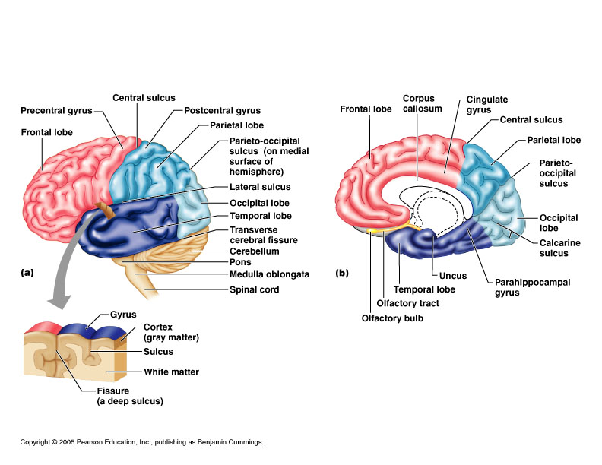
Central sulcus divides frontal from parietal lobes
Lateral sulcus separates temporal lobe from parietal lobe
Parieto-occipital sulcus divides occipital and parietal lobes (not seen from outside)

Slide 32
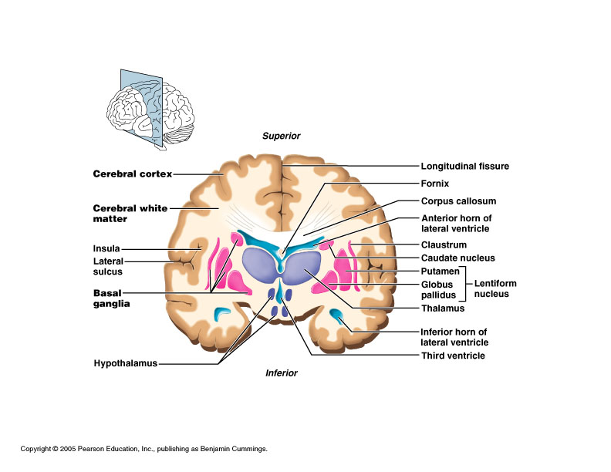
Coronal section of cerebrum

Slide 33
Functions of cerebrum
Sensory function – responsible for interpretation of different types of sensory impulses like pain, touch, pressure, temperature, smell, taste, sound & vision.
Motor function – responsible for initiation of voluntary muscular movements
Mental functions –
  Storing information as memory
  Retrieving stored information
  Reasoning, thinking, judgment
  Seat of intelligence and personality
  Emotional status

Slide 34
Functional areas of cerebrum
Cerebrum is divided into three functional areas such as -
  Motor areas: movement
  Sensory areas: perception
  Association areas: integrate diverse information to enable purposeful action

Slide 35
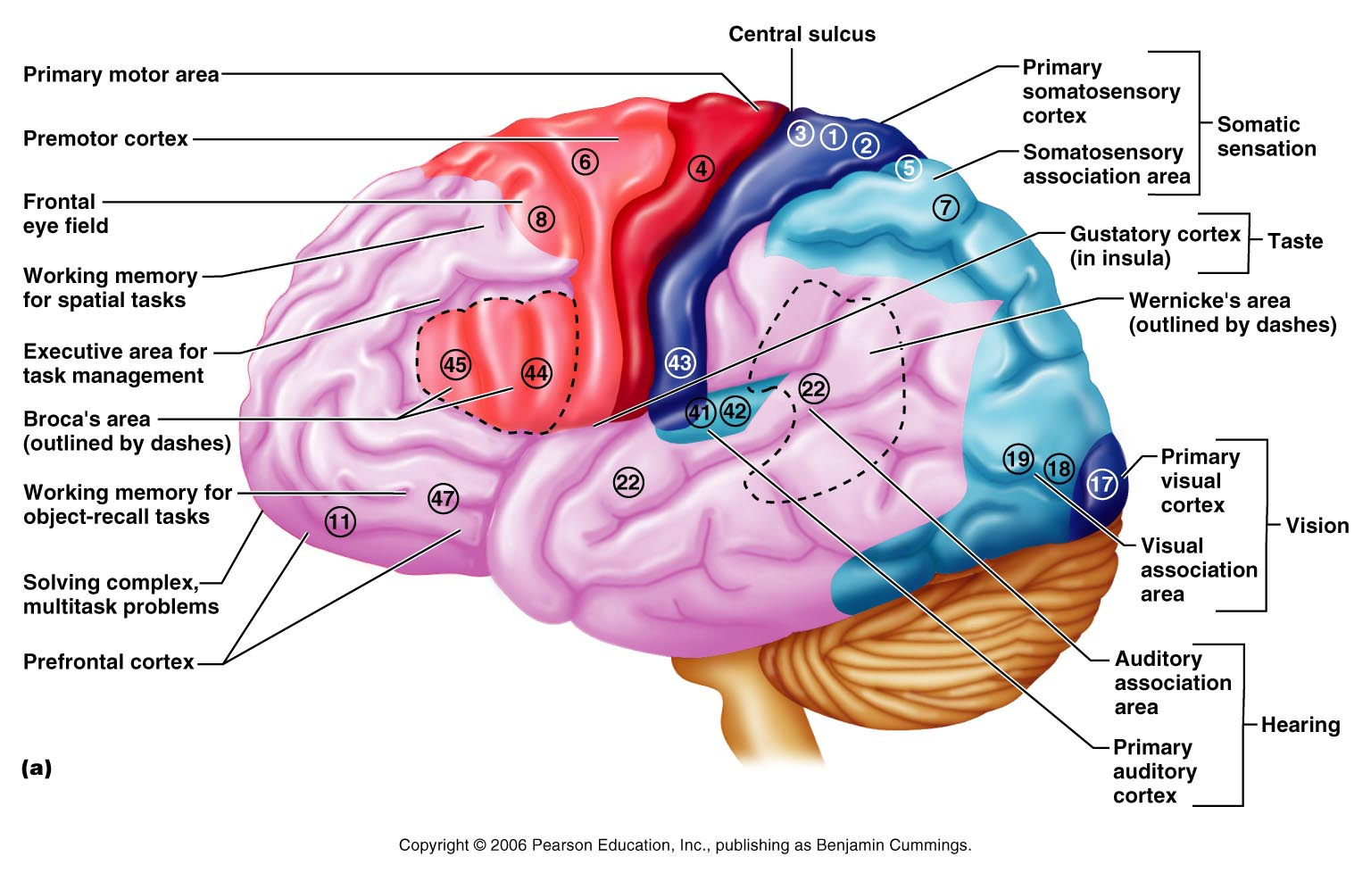
Functional Areas of the Cerebral Cortex
Marieb 12.8a

Slide 36
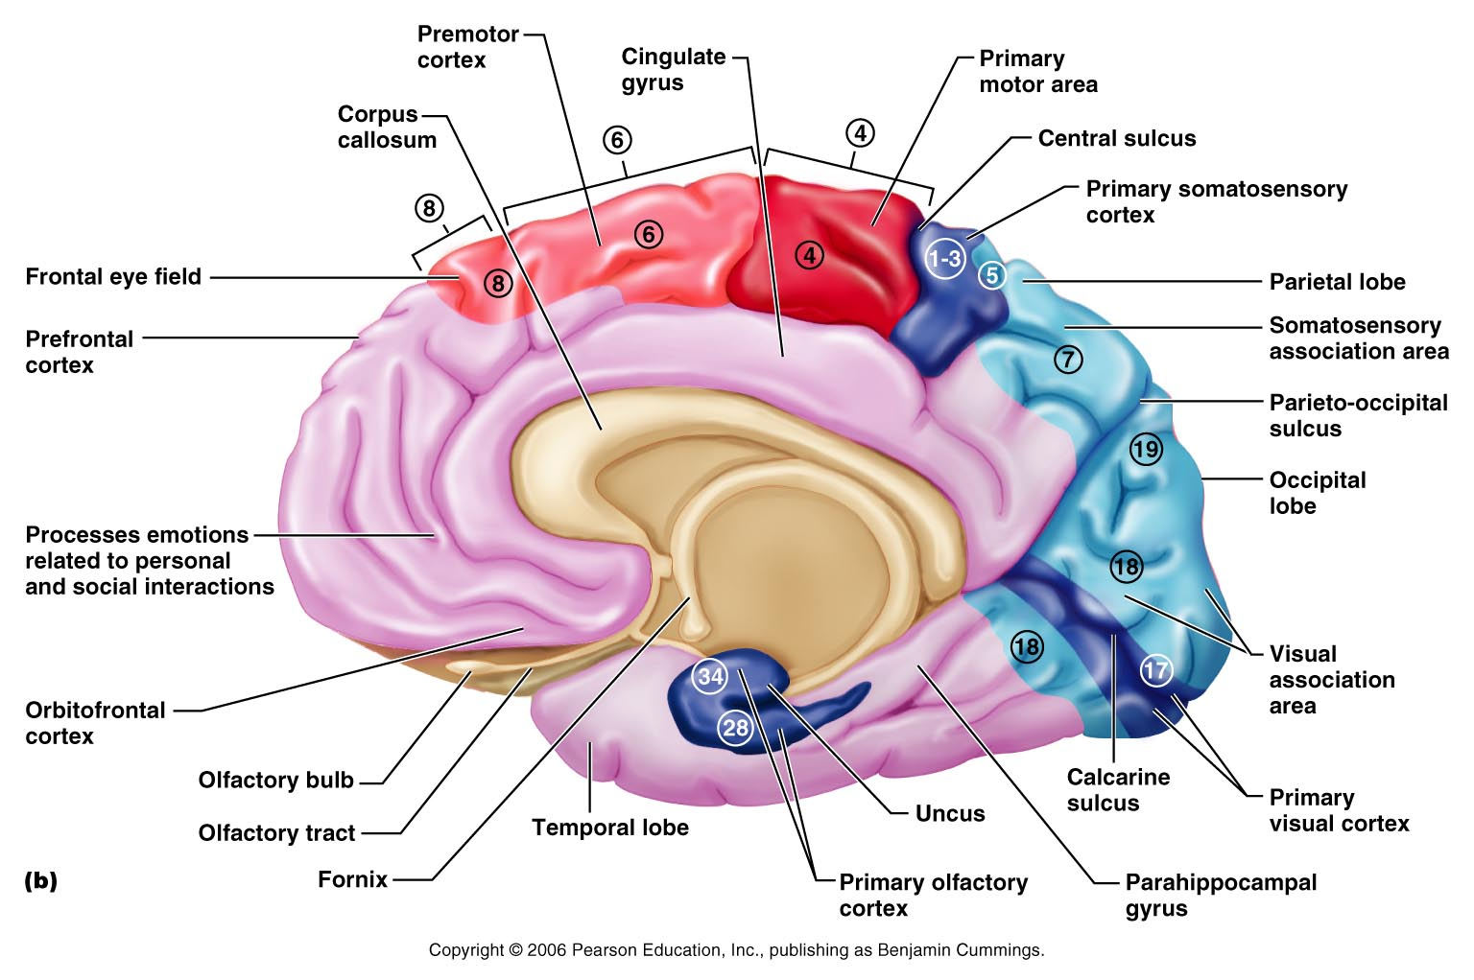
Functional Areas of the Cerebral Cortex
Marieb 12.8b

Slide 37
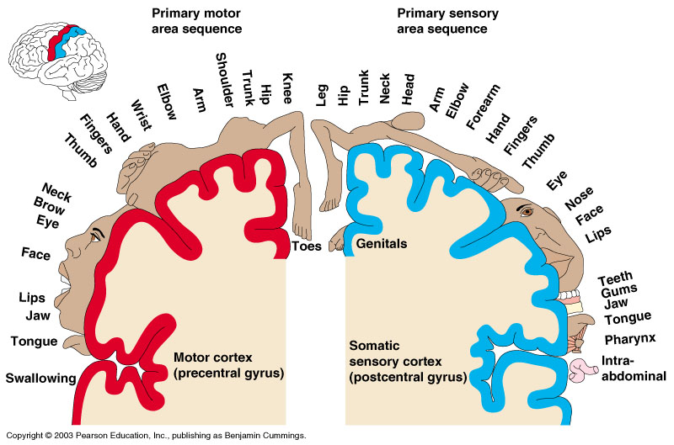
Sensory and Motor Areas of the Cerebrum
Figure 7.14
Copyright © 2003 Pearson Education, Inc. publishing as Benjamin Cummings
Slide 7.31

Slide 38
Motor area
Is present anterior to central sulcus.
Is further divided into –
  Primary motor area (4)
  Pre-Motor area (6)
  Broca’s area (44)
  Frontal eye fields (8)
  Primary motor area – is present in frontal lobe immediately anterior to central sulcus. It controls Conscious or voluntary movement of skeletal muscles.
  It has Large neurons called pyramidal cells & their axons Decend through brain stem and spinal cord
    Cross to contralateral (the other) side in brainstem
    Therefore: right side of the brain controls the left side of the body, and the left side of the brain controls the right side of the body

Slide 39
Pre-motor area – is present in frontal lobe immediately anterior to primary motor area. It influences motor area for ensuring co-ordinated complex movements to occur in a order. (Ex – Tying a lace, writing etc.)
Broca’s area – It is specialized motor speech area
  Is present at the base of primary motor area, just above lateral sulcus in only one hemisphere, usually left.
  It controls the movements necessary for speech
Frontal eye fields – is present above Broca’s area, controls voluntary movements of eyes & eye lids.

Slide 40
Sensory areas
Is present posterior to central sulcus.
Is further divided into –
  Primary somatosensory area
  Somatosensory association area
  Primary visual area & visual association area
  Primary auditory area & auditory association area
  Olfactory area
  Taste area.

Slide 41
Primary somatosensory area- is present just behind the central sulcus.
Also called as cutaneous sensory area.
Is the largest part of sensory area.
It is responsible for conscious awareness of sensation of pain, temperature, pressure & touch and the ability to localize it: where the sensation is from)
The sensory area of right hemisphere receives the impulses from left side of the body & vice versa.
  Somatosensory association area – is present behind primary somatosensory area. It is responsible for understanding of what is being felt: the meaning of it.

Slide 42
  Primary visual area & Visual association area – is present behind the parieto-occipital sulcus & includes greater part of occipital lobe. It receives information from contra-lateral retina & responsible for sensation of vision.
  Visual association area is responsible for face recognition.
  Primary auditory area & auditory association area – is present below the lateral sulcus in the temporal lobe.
  Is responsible for receiving & interpretation of sensory impulses of sound.
  Olfactory area – is present deep in the medial surface of temporal lobe . It is responsible for sensation of smell.
  Taste area – also called as Gustatory area, present above the lateral sulcus. It is responsible for sensation of taste.

Slide 43
Association area
Regions that are not primary motor or primary sensory areas
Widespread throughout the cerebral cortex
Analyze and interpret sensory experiences
Combine together different kinds of sensory input & Associate new input with memories
Is also called as “higher-order processing” areas
Is responsible for memory, reasoning, verbalization, judgment, emotions, Judgment, Personality, Persistence, Complex Reasoning, Complex problem solving Long-term planning etc

Slide 44
Association Areas
Frontal lobe association areas
  Concentrating
  Planning
  Complex problem solving
  Judgment, intellect
  Personality
  Social skills
  Mood, Mental flexibility
Temporal lobe association areas
  Interpret complex sensory experiences
  Store memories of visual scenes, music, and complex patterns
Parietal lobe association areas (Wernicke’s area)
Recognizing & Understanding spoken words
Choosing words to express thought
Occipital lobe association areas
  Analyze and combine visual images with other sensory experiences

Slide 45
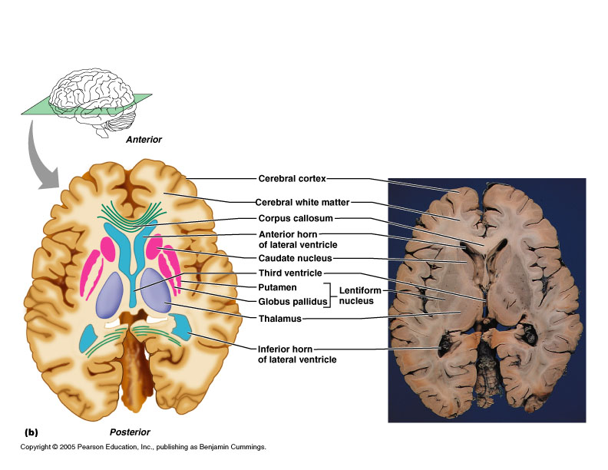
Basal ganglia/nuclei
Is a group of nerve cell body (gray matter) present in depth of cerebral hemispheres.
Part of “extrapyramidal system”, it is connected to cerebral cortex & thalamus.
Cooperate with cerebral cortex in controlling movements
Most important ones: caudate nucleus, lentiform nucleus composed of putamen and globus pallidus
Transverse section

Slide 46
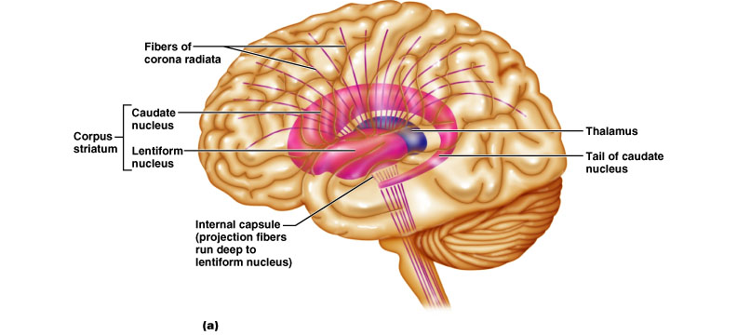
Internal capsule passes between diencephalon and basal ganglia to give them a striped appearance
  Caudate and lentiform sometimes called corpus striatum because of this

Slide 47
Basal ganglia
Cooperate with cerebral cortex in controlling movements & initiation & co-ordination of fine muscular movements.
Communicate with cerebral cortex, receive input from cortical areas, send most of output back to motor cortex through thalamus
Involved with stopping/starting & intensity of movements

Slide 48
Diencephalon
Is group of nuclei of gray matter present in between two cerebral hemispheres and above the brainstem.
Made of 3 parts –
Thalamus
Hypothalamus
Epithalamus

Slide 49
Thalamus
Is made up of egg shaped 2 large lobes of gray matter (over a dozen nuclei)
Is present below corpus callosum, one on each side of 3rd ventricle
It acts as Gateway (relay station) to cerebral cortex: every part of brain that communicates with cerebral cortex relays signals through a nucleus in the thalamus (e.g. certain nucleus for info from retina, another from ears, etc.)
Processing (editing) of sensory impulses occurs also in thalamus.
Transfers impulses to the correct part of the cortex for localization and interpretation

Slide 50
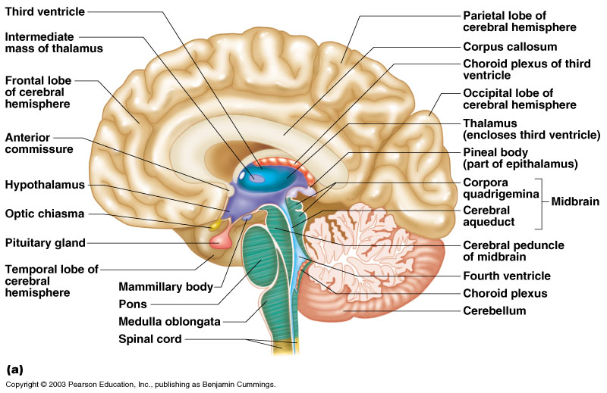
Diencephalon
Figure 7.15
Copyright © 2003 Pearson Education, Inc. publishing as Benjamin Cummings
Slide 7.34b

Slide 51
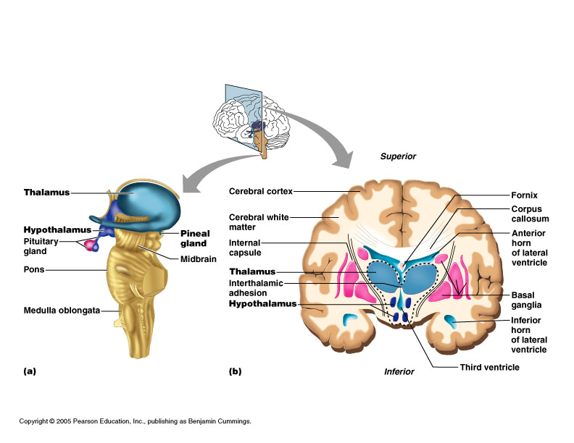

Slide 52
Hypothalamus
These are small, round shaped nerve cell bodies present just under the thalamus & above the pituitary gland.
Functions:
It is the Important center of autonomic nervous system (peripheral motor neurons controlling smooth and cardiac muscle and gland secretions): heart rate, blood pressure, gastrointestinal tract, sweat and salivary glands, etc.
It controls Emotional responses (pleasure, rage, sex drive, fear)
It regulates Body temp & gastric acid secretion
It regulates hunger, Satiety & thirsty sensations
Regulation of sleep-wake centers: circadian rhythm (receives info on light/dark cycles from optic nerve)
Control of endocrine system through pituitary gland
Involved, with other sites, in formation of memory
Synthesizes posterior pituitary hormones
Controls the release of anterior pituitary hormones.

Slide 53
Epithalamus
Third and most dorsal part of diencephalon
It forms the Part of roof of 3rd ventricle
It houses the Pineal gland or body (unpaired): produces melatonin signaling nighttime sleep
It also includes choroid plexuses – producing CSF

Slide 54
Brain stem
Is part of brain which attaches brain to spinal cord.
Parts of the brain stem
  Midbrain
  Pons
  Medulla oblongata

Slide 55
Mid Brain
Is the area of brain present between diencephalon and pons
Contains bundles of nerve fibers that join lower parts of brainstem and spinal cord with higher parts of the brain
It has nerve cell bodies of 3rd & 4th cranial nerves.
It houses Cerebral aqueduct – link between 3rd & 4th ventricle.
It has Cerebral peduncles (bundles of nerve fibers of pyramidal motor tracts)
Corpora quadrigemina (centers for visual and auditory reflexes)

Slide 56
“Pyramidal”=corticospinal tracts; these are motor tracts which cross over in the decussation.
They are named pyramids because they supposedly look like them, and also they originate from “pyramidal” neurons in the motor cortex.
The tracts have the name of origin 1st, therefore “corticospinal” tells you they go from the cortex (“cortico-”) to the spinal cord (“-spinal”)

Slide 57
Pons
Is a rounded bulge on underside of brainstem
It is present in front of cerebellum, between medulla oblongata and midbrain
It has nerve cell bodies of 5, 6, 7 & 8th cranial nerves.
Helps to regulate normal rate and depth of respiration.
It connects the 2 hemispheres of cerebellum.
It relays the nerve impulses to and from medulla oblongata and cerebellum (bridge)

Slide 58
Medulla oblongata
It is the lowest part of the brain stem.
It is pyramid shaped structure with its base upside & present in between Pons & spinal cord
It contains vital autonomic centres like – cardiac centre, Respiratory centre, vasomotor centre.
It also contains reflex centres for vomiting, coughing, sneezing, & swallowing.
It has nerve cell bodies of 9, 10, 11 & 12th cranial nerves.
Decussation of pyramids (crossover of both sensory & motor nerves) takes place.

Slide 59
Functions of Medulla oblongata-
  It acts as relay station for both ascending & descending nerve fibers between brain & spinal cord.
  It control HR & Force of myocardial contraction
  It controls diameter of blood vessels & regulates BP.
  It controls rate & depth of respiration
  It controls reflex activities like vomiting, coughing, sneezing & swallowing.

Slide 60
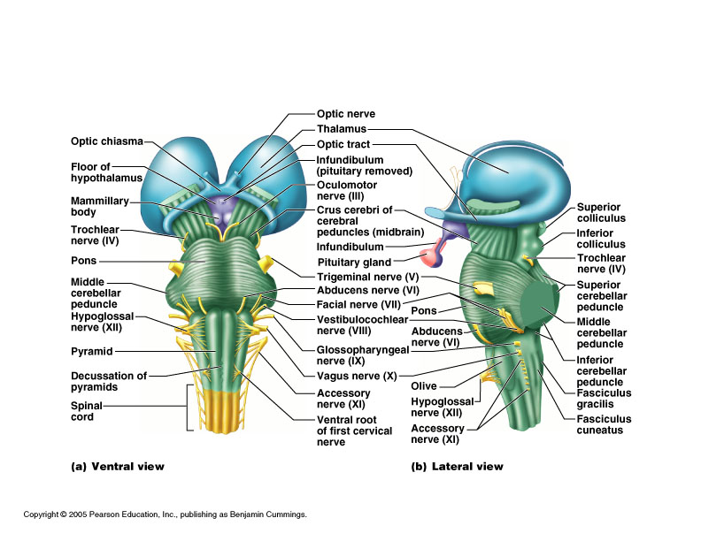

Slide 61
Cerebellum
Also called as Hind Brain
It is situated behind the Pons & Medulla oblongata, below the occipital lobe.
It is oval shaped body, divided into two hemispheres by a fissure called as Vermis / Falx cerebelli. The two hemispheres are held together by Pons.
The outer cortex is made of Gray matter & white matter lies deeply.

Slide 62
Functions of cerebellum
It Smoothes, coordinates & fine tunes body movements
Responsible for maintenance of body posture
Responsible for maintenance of balance & equilibrium of the body.
How?
  Gets info from cerebrum re: movements being planned
  Gets info from inner ear re: equilibrium
  Gets info from proprioceptors (sensory receptors informing where the parts of the body actually are)
  Using feedback, adjustments are made
It also has some role in cognition.

Slide 63
Functional brain systems
Networks of distant neurons that function together
Limbic system
Reticular formation

Slide 64
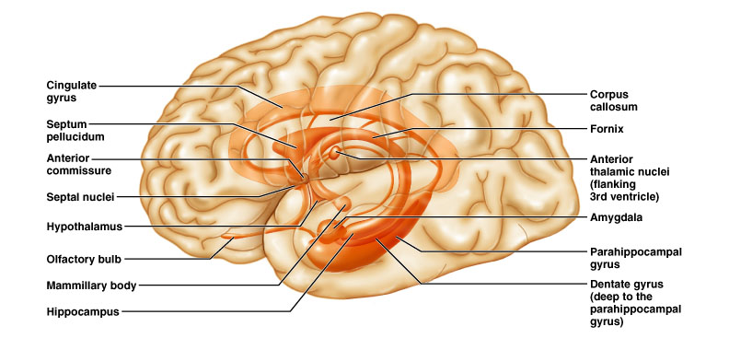
Limbic system
(not a discrete structure - includes many brain areas)
Most important parts:
  Hipocampus, Amygdala, Cingulate gyrus
  Orbitofrontal cortex (not labeled; is behind eyes - part of the prefrontal cortex but connects closely)
  Portions of frontal lobe
  Portions of temporal lobe
  Hypothalamus, Thalamus, Basal nuclei
  Other deep nuclei

Slide 65
Limbic system
Called the “emotional” brain
Is essential for flexible, stable, adaptive functioning
Links different areas so integration can occur
  Integration: separate things are brought together as a whole
  Processes emotions and allocates attentional resources
Necessary for emotional balance, adaptation to environmental demands (including fearful situations, etc.), for creating meaningful connections with others (e.g. ability to interpret facial expressions and respond appropriately), and more…
Produces feelings & controls emotions

Slide 66
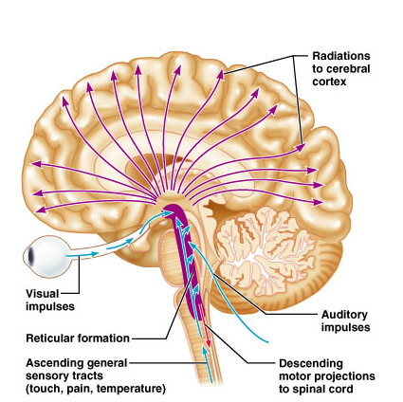
Reticular formation
  Runs through central core of medulla, pons and midbrain
Reticular activating
system (RAS):
keeps the cerebral
cortex alert and
conscious
Some motor control

Slide 67
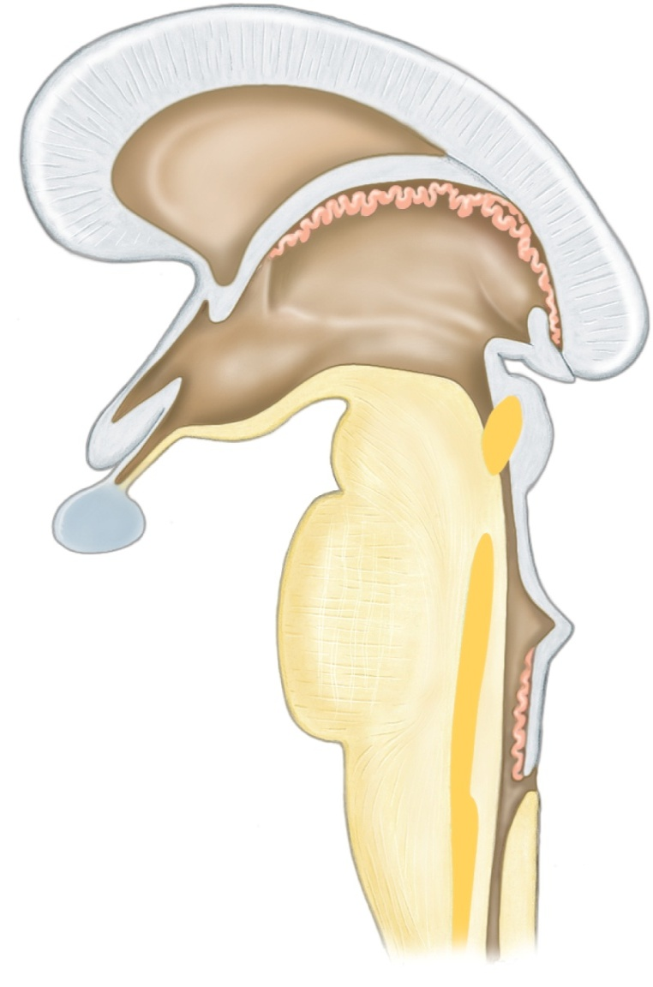
Reticular Formation
Copyright © The McGraw-Hill Companies, Inc. Permission required for reproduction or display.
Complex network of nerve fibers scattered throughout the brain stem
Extends into the diencephalon
Connects to centers of hypothalamus, basal nuclei, cerebellum, and cerebrum
Filters incoming sensory information
Arouses cerebral cortex into state of wakefulness
Hypothalamus
Diencephalon
Thalamus
Corpus
callosum
Corpora
quadrigemina
Midbrain
Cerebral
aqueduct
Pons
Reticular
formation
Medulla
oblongata
Spinal cord

Slide 68
Spinal Cord
It is the long, cylindrical cord like structure of CNS, which is suspended in Vertebral column.
It is approximately 45 cm long & thickness of about little finger.
It begins at foramen magnum and ends at L1/L2 interspace.
The end of the spinal cord at L1/L2 is called as Conus medullaris, below which it continues as bunch of nerve fibers called as Cauda equina, which ends as filum terminale at the level of coccyx.

Slide 69
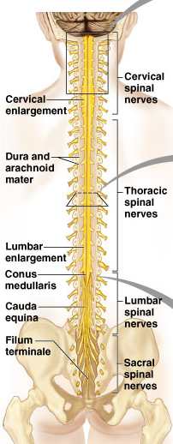
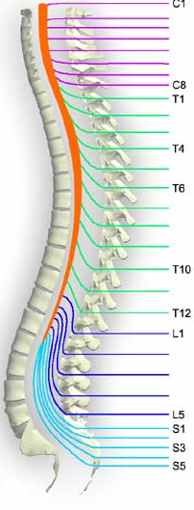
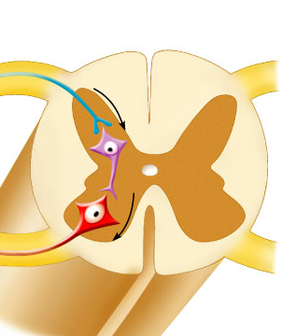

Slide 70
Structure of Spinal cord
The cross section of spinal cord shows that, gray matter is present at the center surrounded by white matter.
The arrangement of gray matter in the spinal cord resemble like letter H, having two posterior, 2 anterior & 2 lateral columns. There is presence of central canal at the centre, which is an extension from ventricle containing CSF.
The cell bodies of gray matter may be of sensory, motor or connector neurones. The posterior column has cell bodies of sensory neurones & anterior column has that of motor neurones. The connector neurones link anterior with posterior column.

Slide 71
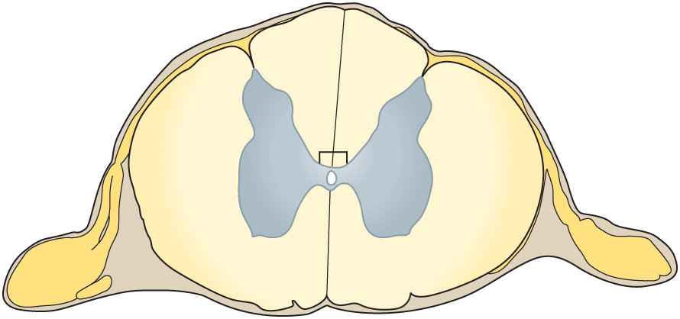
Structure of the Spinal Cord
Copyright © The McGraw-Hill Companies, Inc. Permission required for reproduction or display.
Posterior horn
Posterior funiculus
White matter
Posterior median
sulcus
Gray matter
Gray commissure
Lateral funiculus
Dorsal root
of spinal nerve
Central canal
Anterior
funiculus
Dorsal root
ganglion
Ventral root
of spinal nerve
Anterior
horn
Anterior
median
fissure
Portion of
spinal nerve
(a)

Slide 72
The white matter of spinal cord is arranged in 3 columns – Anterior, Posterior & Lateral columns, which are made up of sensory nerve fibers ascending to the brain, motor nerve fibers descending from brain & fibers of connecting neurones respectively.
All sensory nerve fibers pass through spinal ganglia (Which promotes the onward movement of nerve impulses)

Slide 73
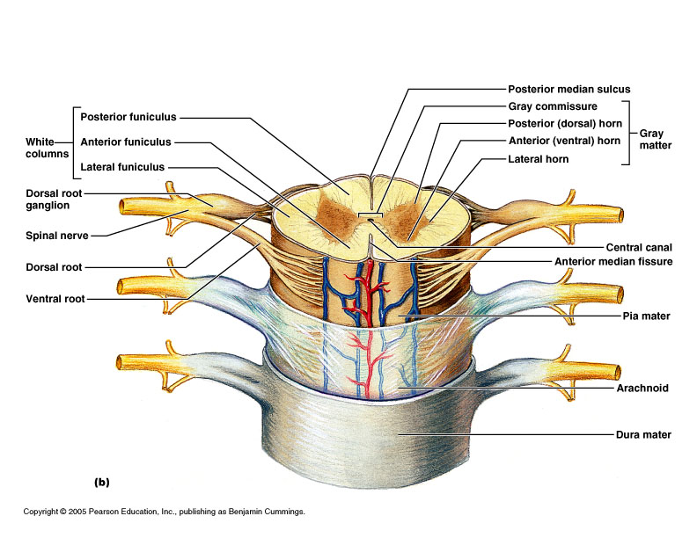

Slide 74
Functions of spinal cord
  Sensory and motor innervation of entire body inferior to the head through the spinal nerves
  It forms Two-way conduction link between the body and the brain
  Major center for reflexes i.e. it mediates reflex actions.

Slide 75
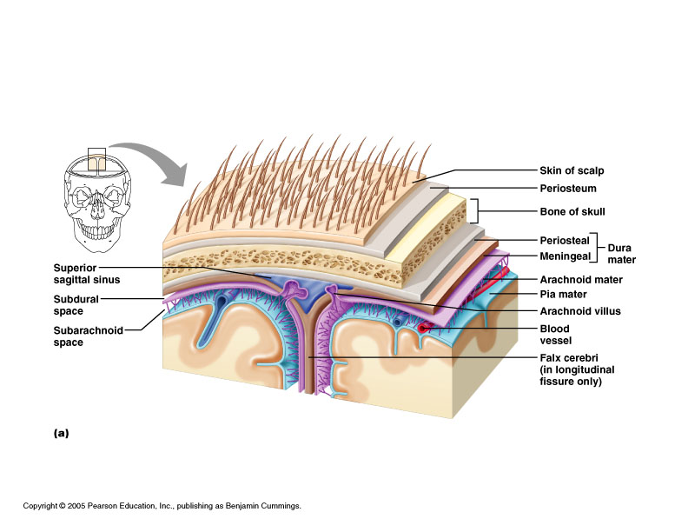
Meninges
These are protective covering membranes of CNS i.e. both brain & spinal cord.
3 layers – Dura mater, Arachnoid mater & Pia mater.

Slide 76
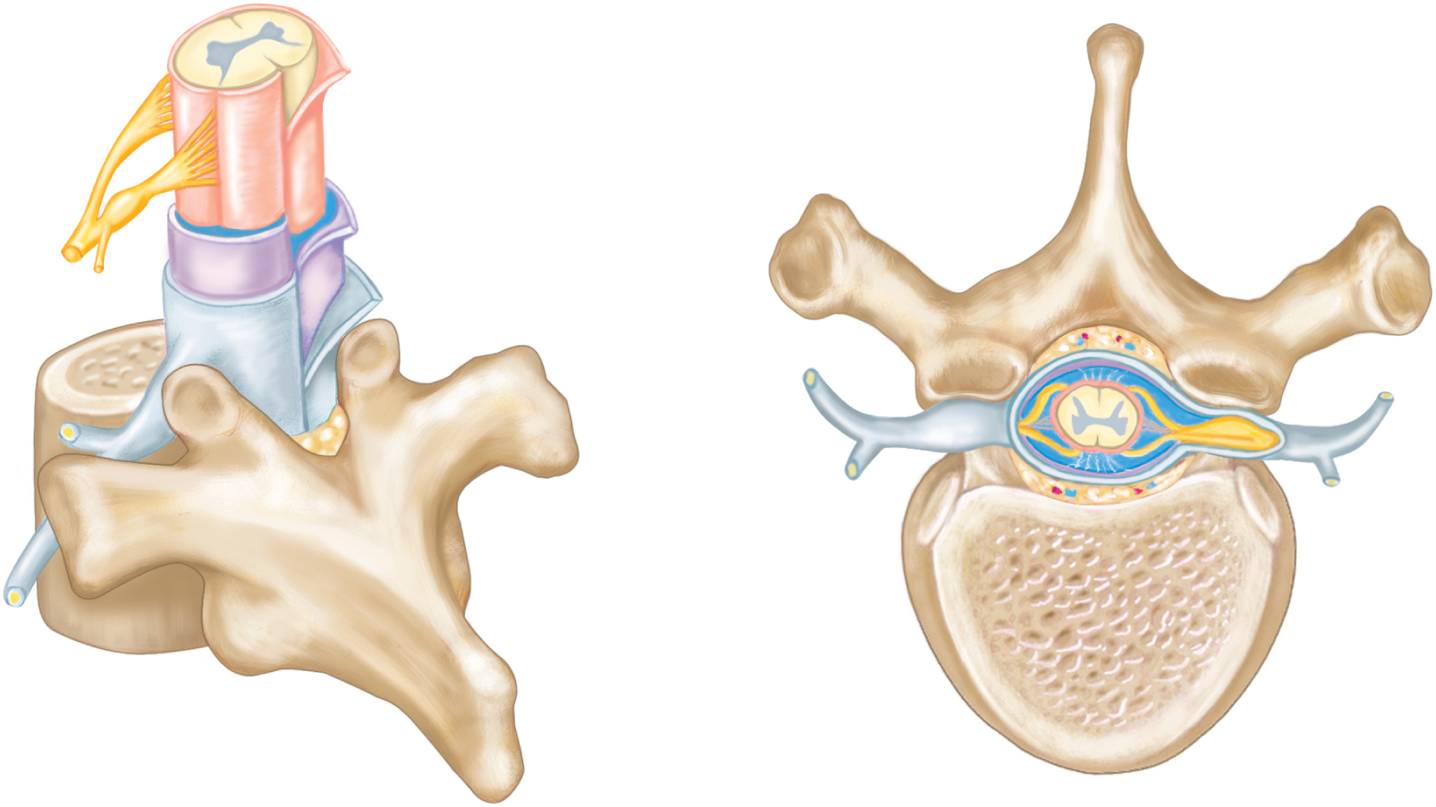
Meninges of the Spinal Cord
Copyright © The McGraw-Hill Companies, Inc. Permission required for reproduction or display.
Spinal cord
Ventral root
Subarachnoid
space
Dorsal root
Pia mater
Spinal nerve
Arachnoid mater
Dorsal root
ganglion
Dura mater
Epidural space
Dorsal root
Spinal
nerve
Dorsal branch
(dorsal ramus)
Dorsal root
ganglion
Ventral branch
(ventral ramus)
Spinal cord
Ventral root
Epidural
space
Thoracic
vertebra
Body of
vertebra
(a)
(b)

Slide 77
Dura mater
Is the tough, outermost covering membrane of CNS.
Consists of 2 layers –
  Periosteal layer – outer layer - attached to inner surface of bone.
  Meningeal layer – inner layer – covering of the brain & spinal cord.
These 2 layers are in close contact except at falx cerebri, falx cerebelli etc.

Slide 78
Arachnoid mater
Is the middle layer, present in between Dura & Pia mater.
Is the spider web like delicate serous membrane.
The space between dura & arachnoid mater is called as Subdural space.

Slide 79
Pia mater
Is a thin delicate innermost layer of CNS.
Made up of loose CT & richly supplied with blood vessels.
The space between arachnoid & pia mater is called as Sub-arachnoid space, which is filled with CSF.

Slide 80
Ventricles of Brain
These are irregular shaped cavities present within cerebral hemispheres & brain stem.
The ventricles are continuous with the central canal of the spinal cord
They are filled with cerebrospinal fluid (CSF)
4 ventricles –
  Lateral ventricles – Right & Left
  3rd ventricle
  4th ventricle

Slide 81
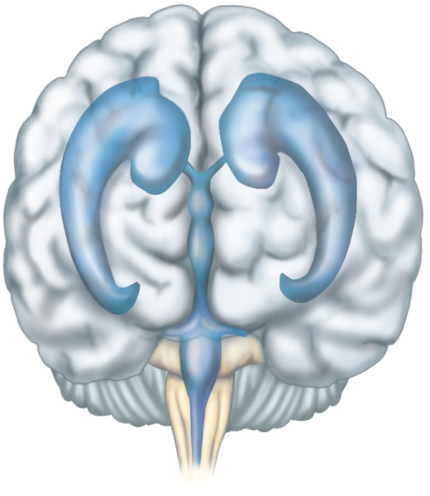
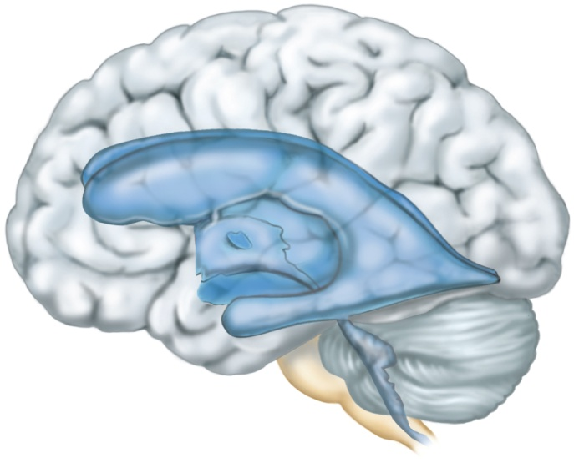
Ventricles and Cerebrospinal Fluid
Copyright © The McGraw-Hill Companies, Inc. Permission required for reproduction or display.
Lateral ventricle
Interventricular
foramen
Third ventricle
Cerebral
aqueduct
Fourth ventricle
To central canal
of spinal cord
(a)
Interventricular
foramen
Lateral
ventricle
Third ventricle
Cerebral
aqueduct
Fourth
ventricle
(b)
To central canal
of spinal cord

Slide 82
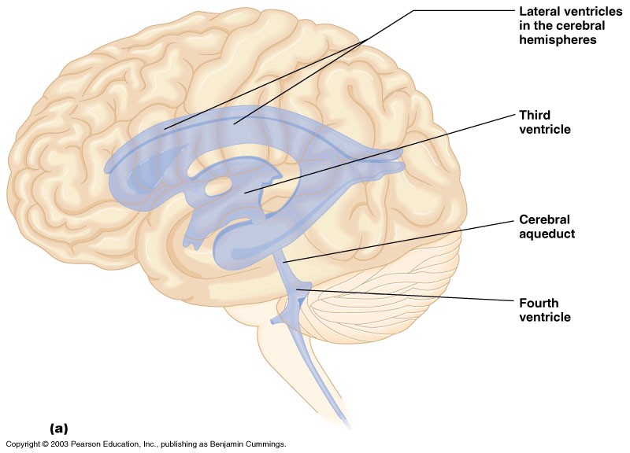
Ventricles and Location of the Cerebrospinal Fluid
Figure 7.17a
Copyright © 2003 Pearson Education, Inc. publishing as Benjamin Cummings
Slide 7.47a

Slide 83
The lateral ventricles are also known as 1st & 2nd ventricles, present within cerebral hemispheres, one on each side of median plane below corpus callosum.
They are separated from each other by a thin membrane called as Septum lucidum.
These two communicate with 3rd ventricle by inter-ventricular foramen.
The 3rd ventricle is situated below the lateral ventricles, between 2 parts of thalamus. It communicates with 4th ventricle by cerebral aqueduct.
The 4th ventricle is a diamond shaped cavity, situated below & behind 3rd ventricle; in between cerebellum & pons. It continues downwards as central canal of spinal cord.

Slide 84
Cerebro-spinal fluid
Is a clear, slightly alkaline, modified tissue fluid, which completely surrounds the CNS.
It is present in –
Ventricles of brain
Sub-arachnoid space of brain & spinal cord
Central canal of spinal cord.
It is formed by network of small blood capillaries called as Choroid plexuses – due to filtration of plasma from capillaries through ependymal cells.
The rate of formation is 0.5 ml/min (720 ml/day), but only 100-160 ml is present at any time. The excess or remaining CSF is absorbed by arachnoid villi into venous system.

Slide 85
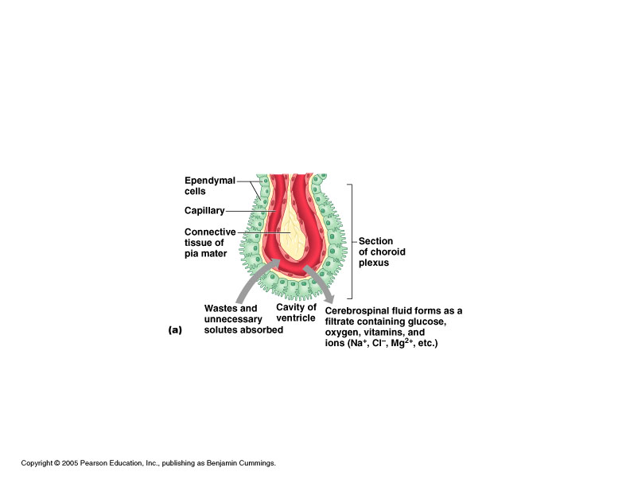
Composition of CSF – similar to plasma - Water, glucose, mineral salts, proteins (PPs like albumin & globulin), Leucocytes (less) & waste products like urea, creatinine etc.

Slide 86
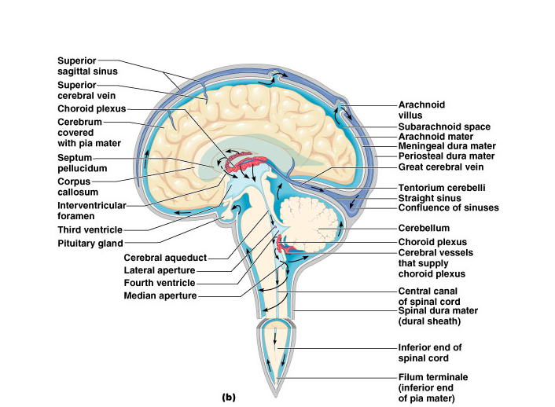
CSF circulation: through ventricles, median and lateral apertures, subarachnoid space, arachnoid villi, and into the blood of the superior sagittal sinus
CSF:
-Made in choroid plexus
-Drained through arachnoid villus

Slide 87
Functions of CSF
It supplies the nutrients to such parts of CNS, where blood cannot reach.
It also removes waste products from CNS
It also gives support & protection to brain & spinal cord.
It acts as cushion & shock absorber between the brain & cranial bones.
It also maintains uniform pressure around brain & spinal cord.
It also helps to maintain stable ionic concentrations in CNS.
Useful as diagnostic material for meningitis

Slide 88
Reflex action
These are automatic, instantaneous, subconscious/involuntary motor responses to sensory stimuli within or outside the body.
Reflexes occur vary rapidly because, sensory impulses are not carried to cerebral cortex, but instead reach only to spinal cord.
Ex: Blinking of eyes (to remove object coming near to eye), Sudden removal of hand when accidentally touches to hot objects.
The mechanism of reflex action is studied by using reflex arc.

Slide 89
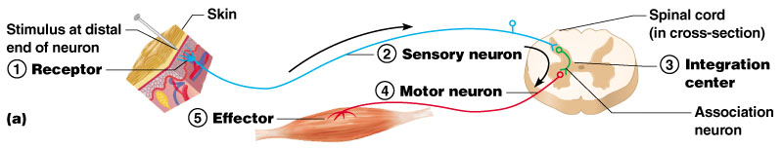
Reflex arc
It is the route, through which reflex action takes place.
It involves –
  Sensory receptor
  Sensory neuron
  Association neuron
  Motor neuron
  Effector

Slide 90
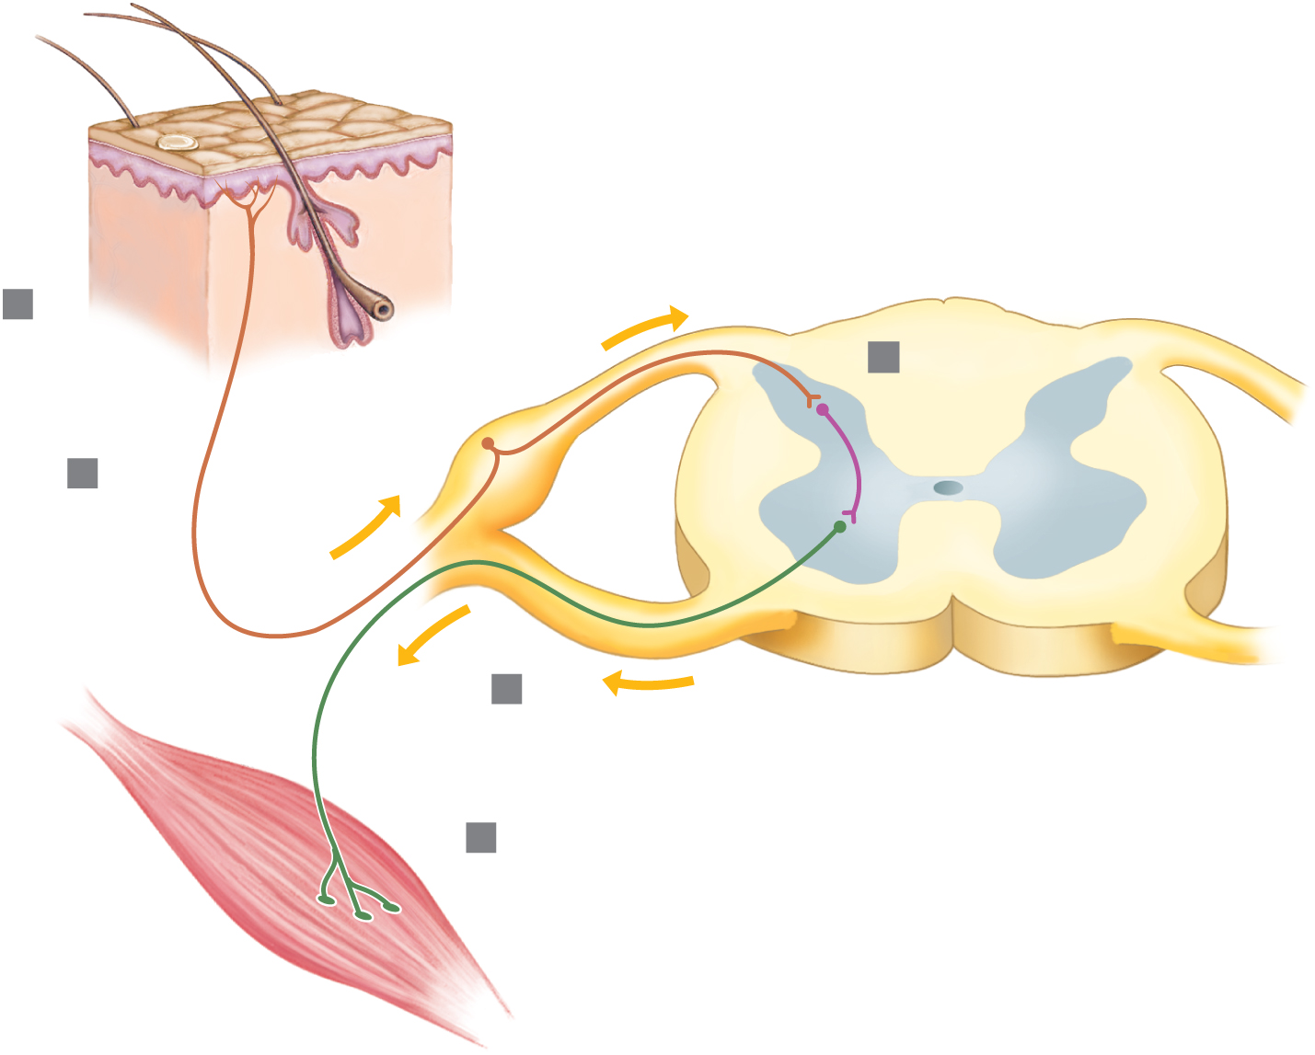
General Components of a Spinal Reflex
Copyright © The McGraw-Hill Companies, Inc. Permission required for reproduction or display.
Spinal cord
Interneuron
Dorsal
1
Receptor
3
Cell body
of sensory
neuron
White matter
2
Sensory neuron
Gray matter
I m p u l s e
4
Ventral
Central
canal
Motor neuron
5
Effector
(muscle
or gland)
(b)

Slide 91
Reflex arc
Sensory receptor – is the sensory nerve ending, which is sensitive to specific type of external or internal change.
Sensory neuron – transmits sensory impulses from receptor to the spinal cord.
Association neuron – serves as processing centre & connects sensory neuron to motor neuron.
Motor neuron – transmits motor impulses from spinal cord to the effector part (Muscle or gland)
Effector – responds to motor impulses & produces reflex behavioral action.

Slide 92
Types of reflex arc
Mono-synaptic
Di-synaptic
Poly-synaptic
Mono- Synaptic reflex arc – is the simple reflex arc, which has only one synapse i.e. between nerve fiber of sensory neuron & body of motor neuron.
There is no presence of connector neuron.
Ex: stretch reflex of muscle at elbow, wrist or knee joint. It helps to maintain upright posture.

Slide 93
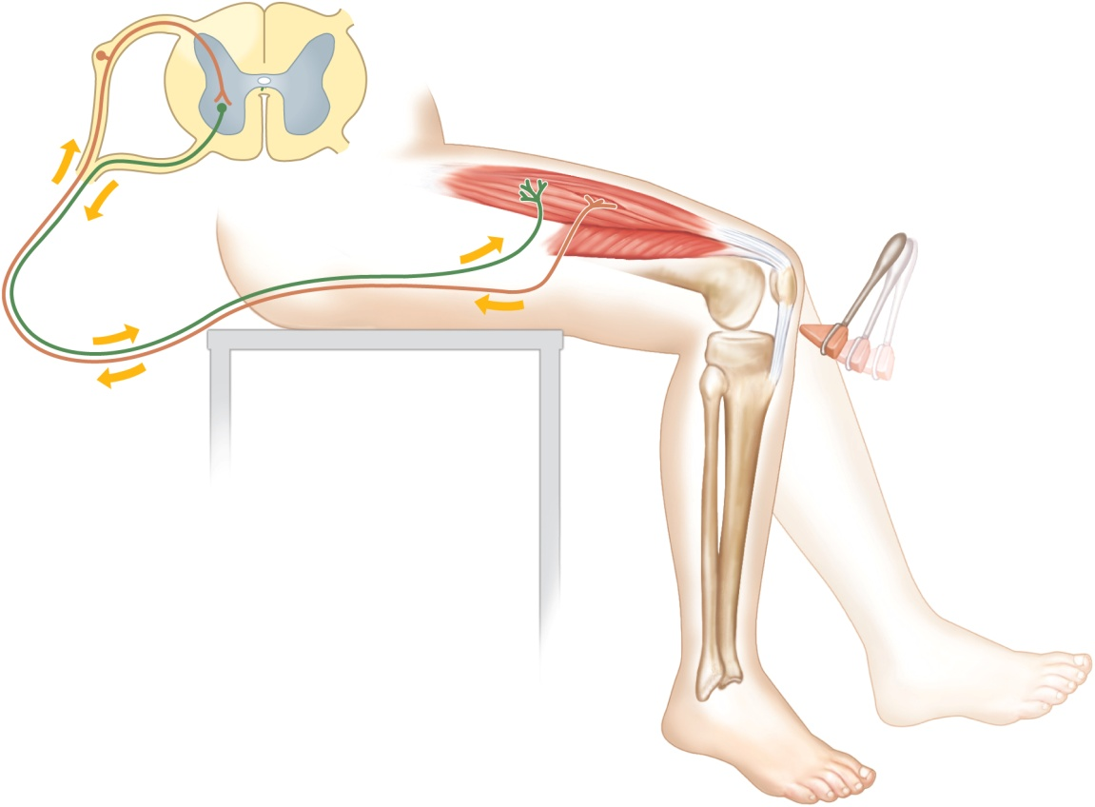
Copyright © The McGraw-Hill Companies, Inc. Permission required for reproduction or display.
Axon of sensory
neuron
Spinal cord
Cell body of
sensory neuron
Cell body of
motor neuron
Effector (quadriceps femoris
muscle group)
Receptor associated with
dendrites of sensory neuron
Axon of motor
neuron
Patella
Direction of impulse
Patellar ligament

Slide 94
Di-synaptic
Presence of two synapses
One between sensory nerve fiber & cell body of connector neuron
Other between nerve fiber of connector neuron & cell body of motor neuron.
Ex: Withdrawal reflex, Corneal reflex etc.
It helps to prevent or limit tissue damage.

Slide 95
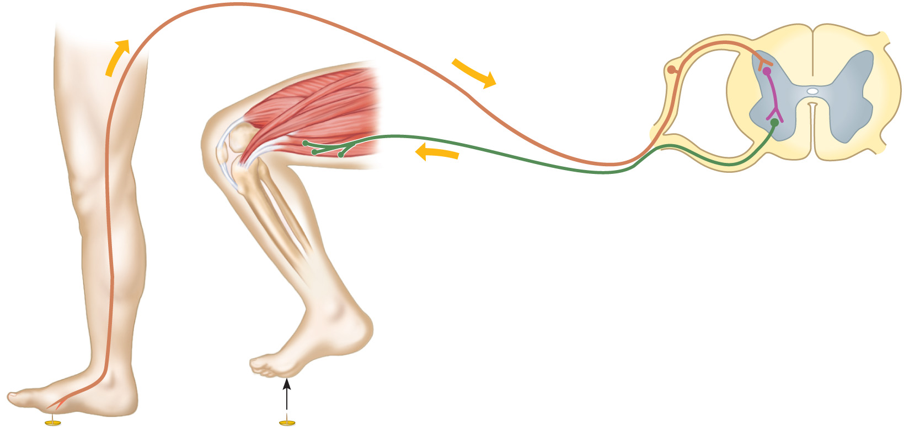
Copyright © The McGraw-Hill Companies, Inc. Permission required for reproduction or display.
Cell body of sensory neuron
Direction
of impulse
Axon of sensory neuron
Interneuron
Effector (flexor
muscle contracts
and withdraws part
being stimulated)
Axon of
motor neuron
Spinal cord
Cell body of
motor neuron
Dendrite of
sensory
neuron
Pain
receptor
in skin
Tack

Slide 96
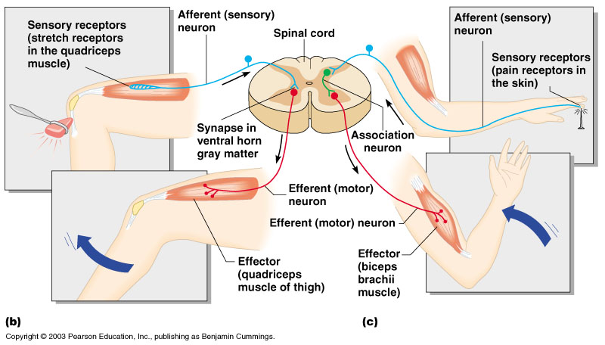
Figure 7.11b, c
Copyright © 2003 Pearson Education, Inc. publishing as Benjamin Cummings
Slide 7.24

Slide 97
Poly-synaptic
Presence of multiple synapses due to involvement of large number of connector & motor neurons but only one sensory neuron.
The sensory impulses may cross to other side of spinal cord to produce effect on opposite side also.
Ex: Crossed extensor reflex

Slide 98
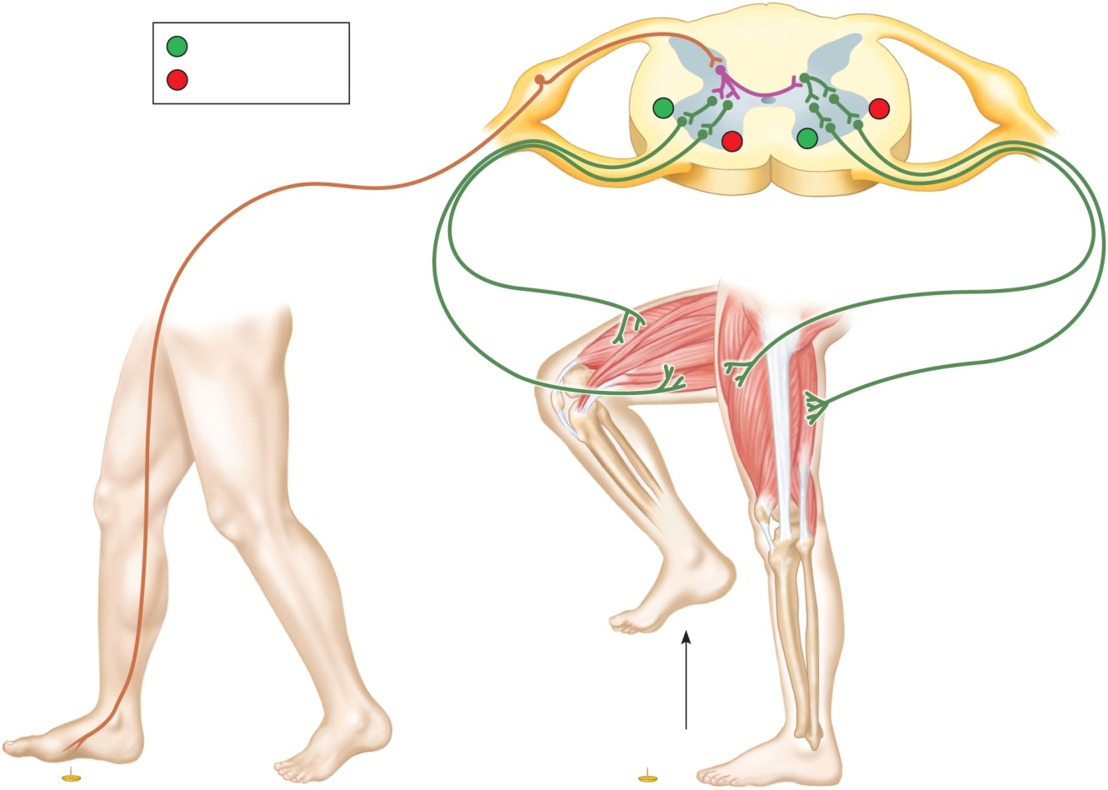
Copyright © The McGraw-Hill Companies, Inc. Permission required for reproduction or display.
Interneuron
+
=
Stimulation
–
=
Inhibition
+
–
–
+
Sensory neuron
Extensor
relaxes
Extensor
contracts
Flexor
relaxes
Motor
neurons
Motor
neurons
Flexor contracts
17

Slide 99
Plantar reflex
It is a superficial reflex present upto the age of first 18 months.
Whenever there is gentle stroking of lateral part of the sole, it produces movement of greater toe with or without movement of other toes.
It occurs due to improper myelination of cortico-spinal nerves.
It is used to detect the disorders of cortico-spinal tract.

Slide 100
Spinal nerves
These are part of PNS.
There are 31 pairs of spinal nerves, which emerges out from either side of vertebral column through inter-vertebral foramina.
All are mixed nerves.
These are named & grouped according to the vertebrae with which they are associated.
  8 cervical nerves (C1 to C8)
  12 thoracic nerves (T1 to T12)
  5 lumbar nerves (L1 to L5)
  5 sacral nerves (S1 to S5)
  1 coccygeal nerve (Co)

Slide 101
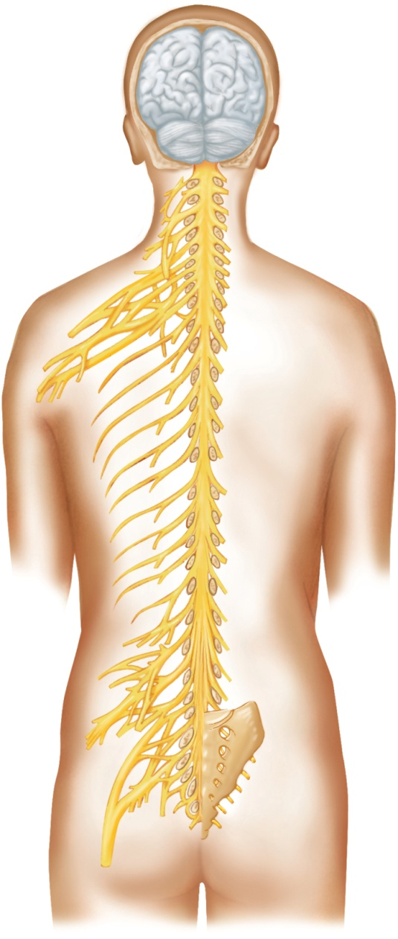
Though there are only seven cervical vertebrae, there are eight cervical nerves bcoz, first pair leaves the vertebral canal between occipital bone & Atlas & the 8th pair leave below the 7th cervical vertebrae.
The lumbar, sacral, & coccygeal nerves leave the spinal cord at L1/L2 & extends downwards inside the vertebral canal to form a bunch of nerve fibers, which resembles like horse tail – hence called as cauda equina.
Copyright © The McGraw-Hill Companies, Inc. Permission required for reproduction or display.
Posterior
view
C1
C2
C3
C4
Cervical
nerves
C5
C6
C7
C8
T1
T2
T3
T4
T5
T6
Thoracic
nerves
T7
T8
T9
T10
T11
T12
L1
Cauda equina
L2
Lumbar
nerves
L3
L4
L5
S1
S2
S3
Sacral
nerves
S5
S4
Co
Coccygeal
nerve

Slide 102
Spinal nerve root
Spinal nerve is a mixed nerve, consisting of union of sensory nerve root (Dorsal root) & Motor nerve root (ventral root)
Sensory nerve root – consists of sensory nerve fibers (axons), which are collected at spinal ganglia, present just outside the spinal cord. From the spinal ganglia, the nerve fibers carry the impulses to posterior gray column of spinal cord.
Motor nerve root – consists of motor nerve fibers coming out from anterior gray column of spinal cord

Slide 103
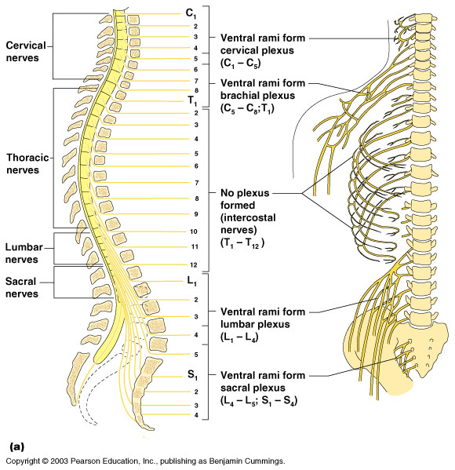

Slide 104
Spinal nerve Plexuses
It is the complex network formed by collection of anterior branches of spinal nerves.
It is present near the origin of spinal nerves in cervical, lumbar & sacral regions.
There are 4 plexuses of spinal nerves formed on each side of vertebral column.
  Cervical plexus
  Brachial plexus
  Lumbar plexus
  Sacral plexus.

Slide 105
Cervical plexus - is formed by the union of anterior branches of c1-c4.
Brachial plexus - is formed by union of anterior branches of c5-c8 & T1 nerves.
Lumbar plexus - is formed by union of anterior branches of L1-L3 & part of L4.
Sacral plexus - is formed by union of anterior branches of part of L4, L5 & S1-S4.

Slide 106
Cranial nerves
Are nerves which originate from inferior surface of brain.
12 pairs – sensory, motor & mixed.
1. Olfactory nerve
2. Optic nerve
3. Oculomotor nerve
4. Trochlear nerve
5. Trigeminal nerve
6. Abducent nerve
7. Facial nerve
8. Auditory nerve
9. Glosso-Pharyngeal nerve
10. Vagus nerve
11. Accessory nerve
12. Hypoglossal nerve

Slide 107
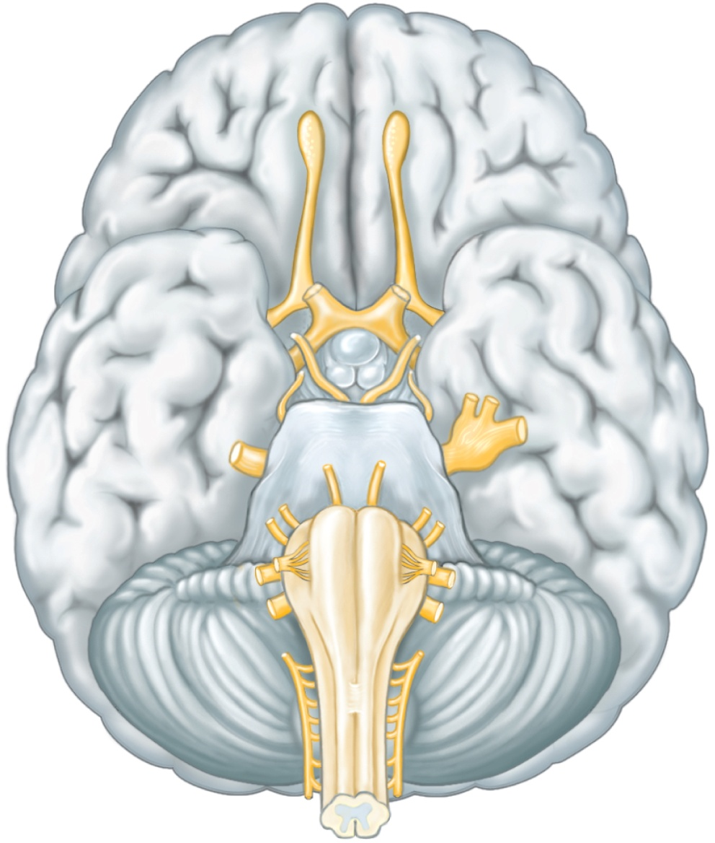
Olfactory bulb
Olfactory (I)
Olfactory tract
Optic (II)
Optic tract
Oculomotor (III)
Trochlear (IV)
Trigeminal (V)
Vestibulocochlear (VIII)
Abducens (VI)
Hypoglossal (XII)
Facial (VII)
Vagus (X)
Glossopharyngeal (IX)
Accessory (XI)

Slide 108
Olfactory nerve – sensory nerve, which carries the sensory smell impulses from nasal mucosa to the smell area of cerebral cortex.
Optic nerve – is sensory nerve, which carries visual impulses from retina to the visual area of cerebrum for vision & also to cerebellum for maintenance of body posture, balance & equilibrium.
Oculomotor nerve – motor nerve, carries motor impulses to muscles of eye ball & eye lids
Extra ocular muscles – superior, medial, & inferior rectus muscle & inferior oblique muscle. (Movement)
Intra-ocular muscles like – a. Ciliary muscle (which alter the shape of lens for focusing) & b. Circular muscle of iris (which adjust light entering the eye).

Slide 109
Trochlear nerve – motor nerve, which carries motor impulses to superior oblique muscles of eye for movement.

Slide 110

Trigeminal nerve
  Mixed nerve, largest
  Three divisions
  (1) Ophthalmic nerve
    Sensory (Pain, pressure, touch & temperature) from surface of eyes, tear glands, scalp, forehead, and upper eyelids to cerebral cortex.
  (2) Maxillary nerve
    Sensory from upper teeth, upper gum, upper lip, cheek, maxilla, palate, and skin of face to cerebral cortex
  (3) Mandibular nerve
    Sensory from scalp, skin of jaw, lower teeth, lower gum, and lower lip
    Motor to muscles of mastication and muscles in floor of mouth
Lacrimal nerve
Ophthalmic
division
Lacrimal
gland
Eye
Maxillary
division
Infraorbital
nerve
Mandibular
division
Maxilla
Lingual
nerve
Inferior
alveolar
nerve
Tongue
Mental
nerve
Mandible

Slide 111

Abducent nerve
  motor nerve
  Motor impulses to lateral rectus muscles that move the eye ball.
Temporal nerve
Facial nerve
  Mixed nerve
  Sensory from taste receptors on anterior 2/3rd of tongue to sensory taste area of cortex.
  Motor to muscles of facial expression, tear glands, and salivary glands
Zygomatic nerve
Buccal nerve
Facial nerve
Posterior auricular
nerve
Parotid salivary
gland
Mandibular nerve
Cervical nerve
68

Slide 112
Auditory nerve
  Also called as Vestibulo-cochlear nerve
  Sensory nerve
  Two branches:
    Vestibular branch
      Sensory impulses from semi-circular canals of ear to cerebellum, associated with maintenance of posture, balance & equilibrium of body.
    Cochlear branch
      Sensory sound impulses from cochlea to sound area of cerebral cortex.
Glossopharyngeal nerve
  Mixed nerve
  Sensory from pharynx, tonsils, tongue and carotid arteries
  Motor to salivary glands and muscles of pharynx & tongue – responsible for mastication.

Slide 113

Vagus nerve
  Mixed nerve
  have extensive distribution.
  forms important part of ANS.
  Somatic motor to muscles of speech and swallowing
  Autonomic motor to viscera of thorax and abdomen
  Sensory from pharynx, larynx, esophagus, and viscera of thorax and abdomen
Meningeal branch
Superior ganglion
of vagus nerve
Auricular branch
Inferior ganglion
of vagus nerve
Pharyngeal branch
Palate
Superior laryngeal
nerve
Nerve XI
Nerve XII
Carotid body
Recurrent laryngeal
nerve
Left vagus
nerve
Cardiac nerves
Lung
Heart
Stomach
Liver
Spleen
Pancreas
Kidney
Small
intestine
Large intestine

Slide 114
Accessory nerve
  motor nerve
  2 branches
  1st branch join vagus nerve & supply to muscles of pharnyx & larynx.
  2nd branch supplies to muscles of shoulder.
Hypoglossal nerve
  Motor nerve
  carries Motor impulses to muscles of the tongue & contributes of deglutition & speech.

Slide 115
Autonomic Nervous System
Involuntary branch of NS - Functions of body automatically,
without conscious effort
Controls visceral activities - Regulates SM, CM and glands
Consists of only motor neurones
It is divided into 2 divisions:
  Sympathetic division (speeds up)
    Prepares body for ‘fight or flight’ situations
  Parasympathetic division (pauses or slows down)
    Prepares body for ‘resting and digesting’ activities

Slide 116
Components of ANS
ANS consists of 4 different structures-
  Pre-ganglionic nerve fibre – originating from CNS
  Ganglion
  Post-ganglionic nerve fibre
  Effector organ – SM/CM/Glands

Slide 117

Anatomy of the Autonomic Nervous System
Figure 7.25
Copyright © 2003 Pearson Education, Inc. publishing as Benjamin Cummings
Slide 7.73

Slide 118
Sympathetic NS - Anatomy
Is a type of ANS, which prepares the body to face the stressful & fearful situations.
Also called as Thoraco-lumbar outflow
Anatomically, it has 3 motor neurones, 1 ganglia & effector organ.
1st neuron has its cell body in hypothalamus & medulla oblongata, which continues up to lateral gray column of spinal cord.
Pre-ganglionic neuron (2nd neuron) – has its cell body in lateral gray column of SC between the level of 1st TV & 2/3rd LV. These neuron leave through anterior nerve root & terminates either in lateral chain of ganglia or passes through it to one of pre-vertebral ganglia sitated in abdominal cavity.

Slide 119
Acetylcholine is acting as neuro-transmitter at the ganglion.
Post-ganglionic neuron (3rd neuron) – has its cell body in the ganglion & terminates at effector organ – SM, CM or glands.
Nor-Adrenaline acts as neuro-transmitter between post-ganglionic nerve fiber & effector organ.
Hence, SNS is also called as Adrenergic NS.

Slide 120
Parasympathetic NS - Anatomy
Is a type of ANS, which acts as peace maker by counteracting/decreasing the sympathetic activity.
Also called as Cranio-sacral outflow.
Anatomically it has 2 motor neurones, 1 ganglia & effector organ.
The pre-ganglionic neuron has its cell body in cranial (3, 7, 9 & 10th ) nerves & lateral gray column of SC in the sacral region.
Ganglia is present very close to the effector organ.
Acetylcholine acts as neuro-transmitter at ganglia.
Post-ganglionic neuron – has its cell body in ganglia (some times within the organ supplied) & terminates at effector organ.

Slide 121
Acetylcholine acts as neuro-transmitter between post-ganglionic nerve fiber & effector organ.
Hence, PSNS is also called as Cholinergic NS.

Slide 122

Martini 16-10

Slide 123
Functions of ANS
Sympathetic – “fight-or-flight”
  Response to unusual stimulus
  Takes over to increase activities
  Remember as the “E” division = exercise, excitement, emergency, and embarrassment
Parasympathetic – “Rest & digest”
  Conserves energy
  Maintains daily necessary body functions
  Remember as the “D” division - digestion, defecation, and diuresis
Copyright © 2003 Pearson Education, Inc. publishing as Benjamin Cummings
Slide 7.74a

Slide 124
Functions of ANS
1. Action on CVS (CM)-
SNS :
  - Increases HR, FOC of CM & CO
  - Dilatation of coronary arteries & bv supplied to SKM – increase blood supply to heart & SKM.
  - Constriction of bv supplying skin – increase BP.
PSNS:
  - Decreases HR, FOC of CM & CO
  - No significant action on blood vessels.

Slide 125
Functions of ANS
2. Action on Respiratory system-
SNS: Dilatation of bronchial SM leading to increase in rate & depth of breathing.
PSNS: Constriction of bronchial SM leading to decrease in rate & depth of breathing.
3. Action on Digestive system-
SNS:
  Decrease in tone & peristaltic movement of GIT SM
  Decrease in rate of digestion & absorption of food.
  Decrease in secretion of gastric juice.
  Stimulates release of glucose by liver
PSNS: opposite functions

Slide 126
Functions of ANS
4. Action on Urinary system-
SNS: relaxation of muscles of bladder & contraction of muscles of sphincters , leading to decrease in micturition.
PSNS: Contraction of muscles of bladder & relaxation of muscles of sphincters , leading to increase in micturition.
5. Action on Eye-
SNS: contraction of radial muscles of Iris – increase in diameter of pupil size – Mydriasis.
PSNS: contraction of circular muscles of Iris – decrease in diameter of pupil size – Miosis.

Slide 127
Functions of ANS
6. Action on Glands-
SNS: decrease the secretion of all the glands except sweat gland & Adrenal medulla.
PSNS: increase the secretion of all glands except sweat glands (no PSNS supply to sweat glands) & Adrenal medulla.
7. Action on reproductive system-
SNS: promote ejaculation & contraction of vagina.
PSNS: promote erection of genitals.

Slide 128

Sympathetic Division
Copyright © The McGraw-Hill Companies, Inc. Permission required for reproduction or display.
Lacrimal gland
Eye
Parotid gland,
submandibular and
sublingual glands
Blood vessels
Heart
Celiac and
pulmonary
plexuses
Trachea
Lungs
Skin
Celiac
ganglion
Liver
Fibers to
skin, blood vessels,
and adipose tissue
Superior
mesenteric
ganglion
Gallbladder
Stomach
Pancreas
Small intestine
Spinal
cord
Inferior
mesenteric
ganglion
Large intestine
Adrenal gland
Sympathetic
chain ganglia
Kidney
Preganglionic
neuron
Postganglionic
neuron
Urinary
bladder
Penis
Ovary
Uterus
Scrotum

Slide 129

Parasympathetic Division
Copyright © The McGraw-Hill Companies, Inc. Permission required for reproduction or display.
Sphenopalatine
ganglion
Lacrimal
gland
Cranial
nerve III
Ciliary ganglion
Eye
Submandibular
ganglion
Submandibular
and sublingual
glands
Cranial
nerve
VII
Otic ganglion
Parotid
gland
Cranial
nerve IX
Cranial nerve X
(Vagus)
Heart
Trachea
Lung
Cardiac and
pulmonary
plexuses
Liver
Celiac
plexus
Gallbladder
Stomach
Spleen
Superior
hypogastric
plexus
Pancreas
Small intestine
Spinal
cord
Inferior
hypogastric
plexus
Large intestine
Kidney
Pelvic
nerves
Urinary
bladder
Preganglionic
neuron
Postganglionic
neuron
Scrotum
Uterus
Penis
Ovary

Slide 130

Freeman 45-20

Slide 131
Control of Autonomic
Activity
Controlled largely by CNS
Medulla oblongata regulates cardiac, vasomotor and respiratory activities
Hypothalamus regulates visceral functions, such as body temperature, hunger, thirst, and water and electrolyte balance
Limbic system and cerebral cortex control emotional responses

Slide 132

Comparison of Somatic and Autonomic Nervous Systems
Copyright © 2003 Pearson Education, Inc. publishing as Benjamin Cummings
Figure 7.24
Slide 7.69

