Slide 1
Urinary System
a) Anatomy and physiology of urinary system
b) Formation of urine
c) Renin Angiotensin system – Juxtaglomerular apparatus - acid base Balance
d) Clearance tests and micturition

Slide 2
Urinary system
Is the chief excretory system of the body.
It consists of –
  2 Kidneys – excretory organs- secrets urine
  2 Ureters – carry urine from kidney to UB
  1 Urinary bladder – reservior of urine
  1 Urethra – excretes urine out of the body

Slide 3
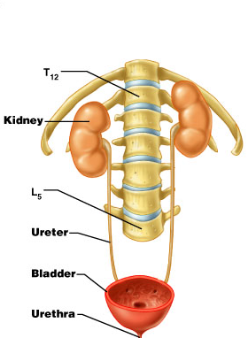
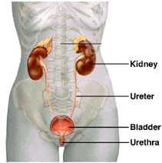

Slide 4
Functions of urinary system
1. Formation & excretion of urine – It filters blood plasma, separate wastes & useful materials, return useful materials to the blood, and eliminate the wastes.
2. Regulating blood volume and pressure
3. Regulating plasma concentrations of water, sodium, potassium, chloride and other ions
4. Stabilizing blood pH (maintenance of acid-base balance)
5. Excretion of metabolic waste products – Ammonia, urea, uric acid, creatinine etc.
6. Conserving nutrients
7. Excretion of poisons & foreign substances – drugs, toxins etc.
8. Production of hormones – Renin & Erythropoietin

Slide 5
Kidney
Is a bean shaped excretory organ present in posterior abdominal cavity, just below the diaphragm; one on either side of the vertebral column.
It occupies the space from 12th TV upto 3rd LV.
11 cm long, 6 cm width, 3 cm thick, 150 g weight.

Slide 6
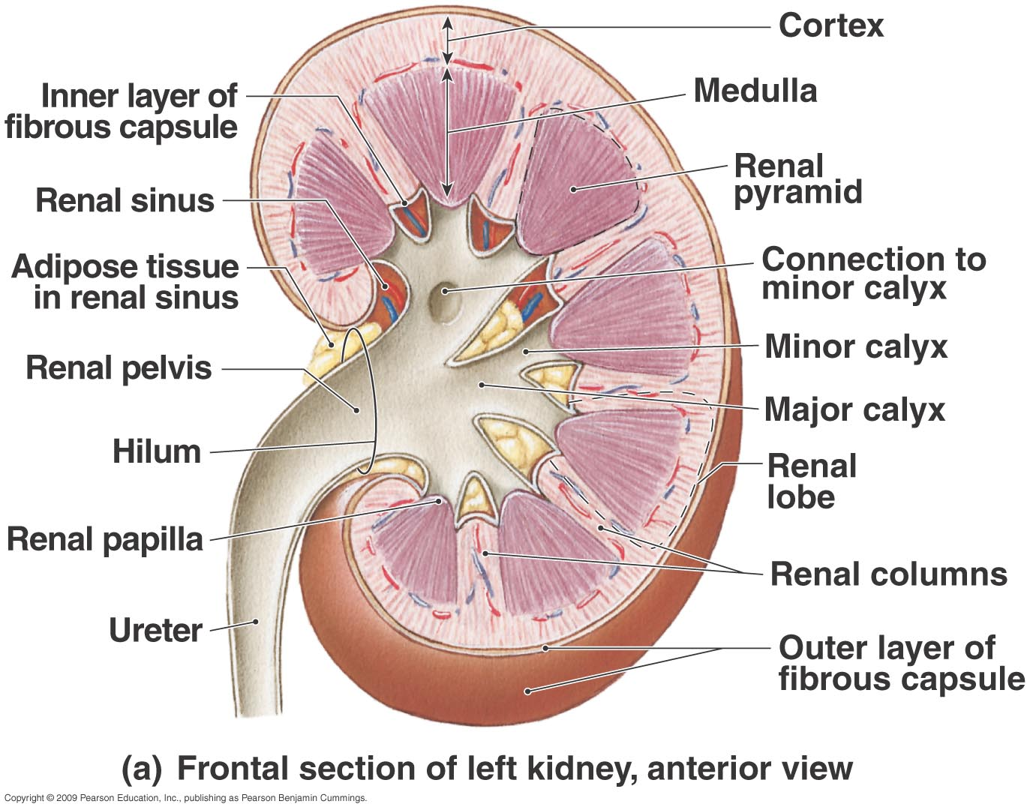

Slide 7
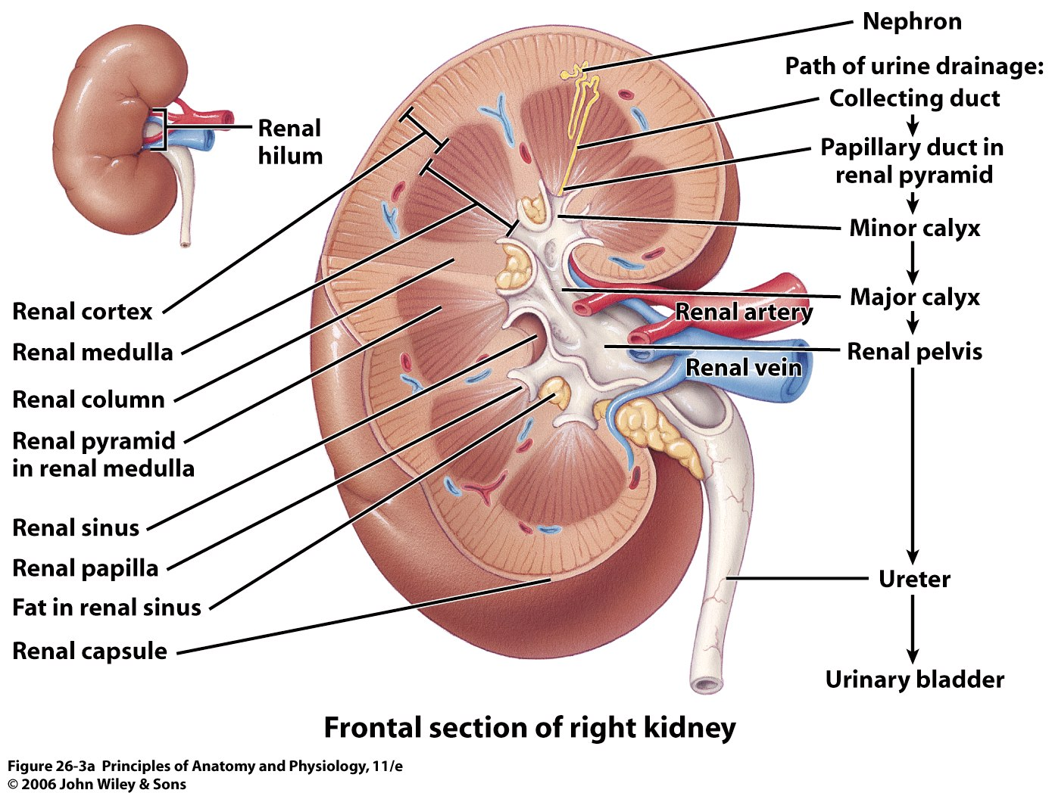

Slide 8
Structure of Kidney
Kidney has two regions – Cortex & Medulla.
Cortex – outer layer – extensions of cortex is called as renal columns.
Medulla – inner layer – divided into 6-10 conical shaped renal pyramids by renal columns.
Renal pelvis – funnel shaped receptacle for urine. It has no. of distal branches called as Calyces, each of which surround the apex of pyramids. (Minor calyx & Major calyx).
Hilum – concave shaped medial border, where BVs, Lvs, Nerves & Ureter pass through.

Slide 9
Microscopic structure of kidney
It shows presence of 1.2 millions of structural & functional units of kidney – Nephron.
Each nephron consists of –
  Renal Corpuscles having –
    Bowman’s capsule
    Glomerulus
  Renal tubules having –
    Proximal Convoluted tubule
    Loop of Henle
    Distal Convoluted tubule
    Collecting duct
Most components of nephron are within the cortex.

Slide 10
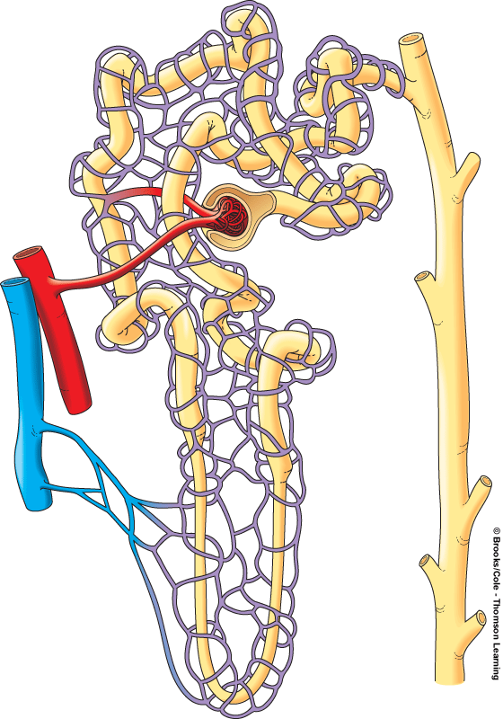
4. Efferent arteriole
3. Glomerulus
2. Afferent arteriole
1. Interlobular Artery
6. Interlobular vein
5. Peritubular capillaries
23-10
To renal pelvis
Notes:
10

Slide 11
1. Bowman’s capsule
4. Distal tubule
2. Proximal tubule
Glomerulus
5. Collecting
duct
Artery
Vein
Cortex
Medulla
3. Loop of Henle (nephron loop)
To renal pelvis
23-11
Notes:
11

Slide 12
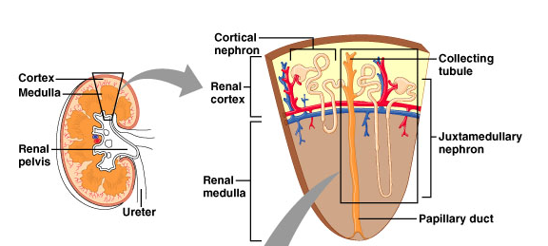
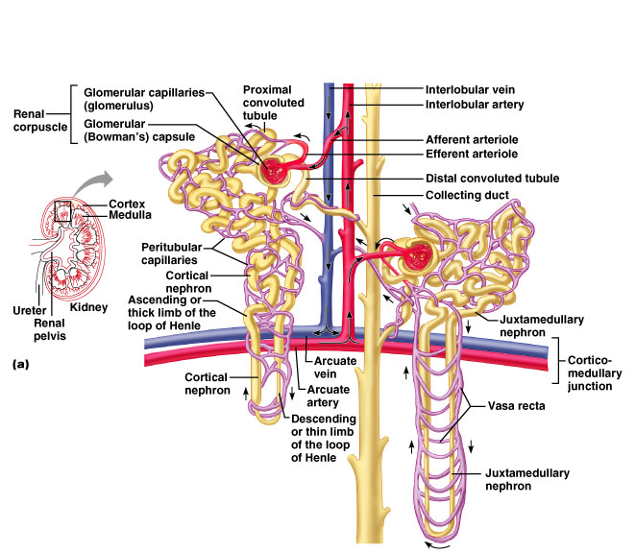
Classes of nephrons
Cortical nephrons
  85% of all nephrons
  Almost entirely within cortex
Juxtamedullary nephrons
  Renal corpuscles near cortex-medulla junction

Slide 13
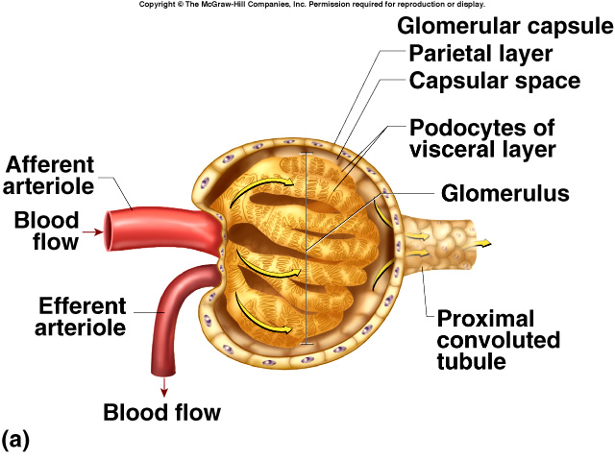
Glomerular capsule & glomerulus together: Renal Corpuscle
23-13
Notes:
13

Slide 14
Nephron
Glomerulus – is a cluster/bunch of capillaries with an Affarent arteriole coming in from the circulation & Efferent arteriole going out into the circulation.
It is enclosed in Bowman’s capsule.
It acts as Ultra filters – where deproteinized plasma is filtered through the Glomerulus into the Bowman’ s capsule.

Slide 15
Nephron
Bowman’s capsule – is a cup shaped, double wall, proximal closed end, which covers like a cap on glomerulus.
It is made of single layer of flattened epithelial cells.
PCT- present in cortex part, present close to the BC, lined by cuboidal epithelial cells with long microvilli.
Plays a important role in reabsorption of water, ions & solutes.

Slide 16
Nephron
LH – U shaped constricted part of the renal tubules.
Present in medulla part.
Has descending & ascending limb
Plays a important role in reabsorption.
DCT – present in cortex part, made of simple cuboidal epithelium.
Plays a role in selective secretion & reabsorption of ions.

Slide 17
Nephron
Collecting tubule – runs straight through cortex into the deep medulla. Each receives urine from several nephrons.
At papilla of pyramid, CDs join to form larger papillary ducts, which empty into minor calices
Role: conserve body fluids

Slide 18
Ureters
are muscular tubes leading from the renal pelvis to the urinary bladder.
Long tubular structure which carries urine from kidneys to urinary bladder present in pelvic cavity.
25-30 cm long.
3 layers of tissue-
  Outer fibrous layer – fibrous CT
  Middle muscular layer – SM
  Inner layer- transitional epithelium
Functions – conveys urine from kidney to UB, due to the peristaltic movement of SM – intrinsic activity, not under voluntary control.

Slide 19
Urinary bladder
Is a reservoir of urine (500 ml) present in pelvic cavity.
Size & shape does not remain constant, it depends on volume of urine present.
Pear shaped (empty/less urine) – Oval shaped (More urine) & can extend to abdominal cavity .
3 layers of tissue-
  Outer layer – loose CT, supplied with Bv, Lv & nerves.
  Middle layer – SM interlaced with elastic fibers – detrusor muscle
  Inner layer - Transitional epithelium

Slide 20
It has two openings for ureters & one for urethra.
The openings of the two ureters and the urethra mark a triangular area called the trigone on the bladder floor.
Functions –
  Storage of urine (500 -600 ml)
  Secretion of urine into urethra.

Slide 22
Urethra
Is a tubular canal, which extends from neck of UB & opens into exterior of the body.
It is different in males & females.
Male urethra is long (20 cm) & performs both urinary & reproductive functions.
Female urethra is short (3-4 cm), does not performs reproductive functions, opens externally near to vaginal canal.

Slide 23
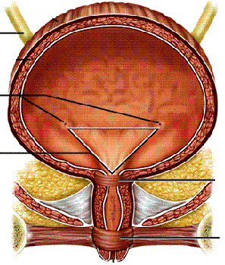
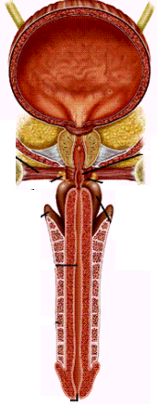
Females male
3-4 cm ~20 cm
greater risk of urinary tract infections

Slide 24
3 layers of tissue –
  Outer muscular layer – upper half is made up of SM & lateral half is made up of SKM.
  Sub-mucosa layer – loose CT with Bv, Lv & nerve supply.
  Inner layer – stratified Sq. epithelium.
It has two sphincters –
  Internal urethral sphincter – involuntary (SM)
  External urethral sphincter – Voluntary control
Functions-
    Male – excretion of urine & reproductive secretion- semen
    Female – excretion of urine

Slide 25
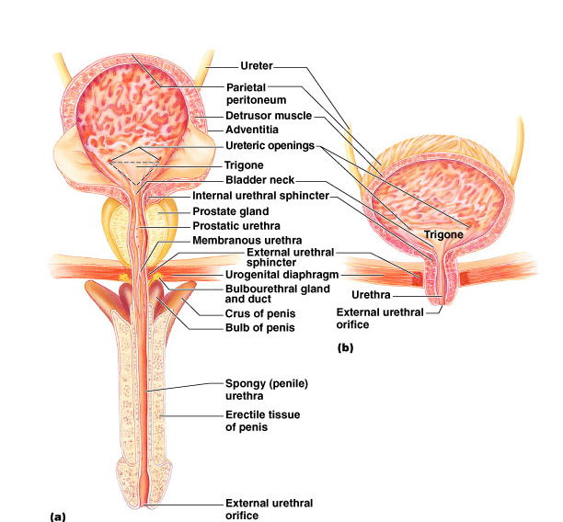
With all the labels

Slide 26
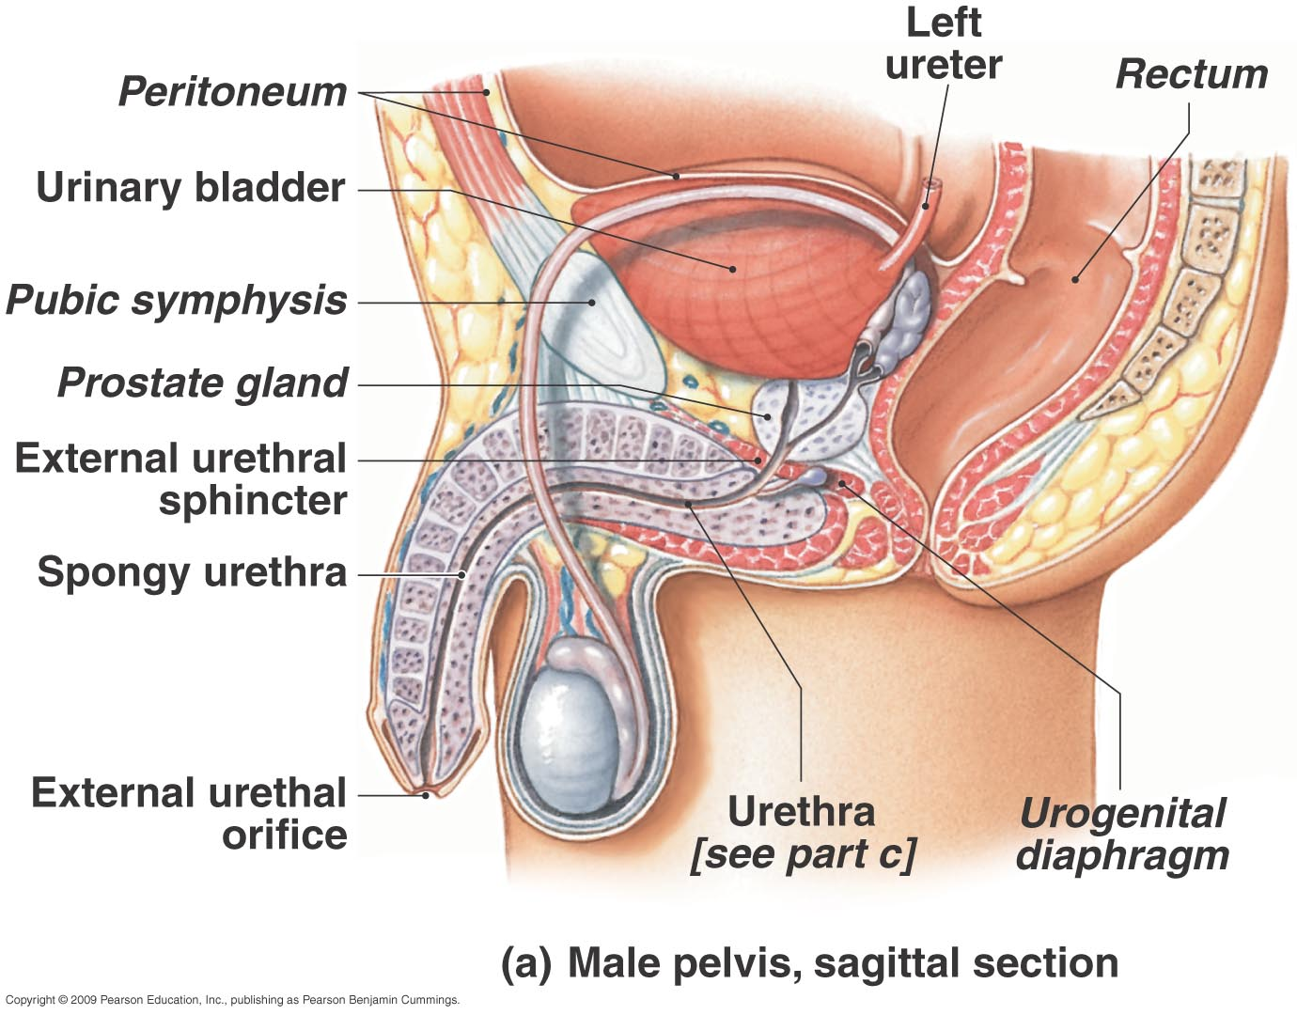

Slide 27
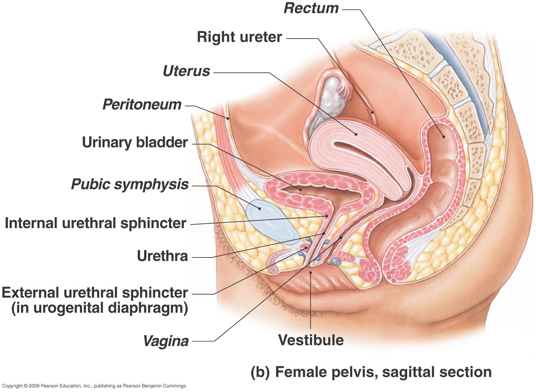

Slide 28
Micturition
Is the act of passing of urine outside the body.
It occurs reflexly in infants & small children.
Whenever 200-300 ml of urine is present in UB, it leads to distension of internal wall of UB activation of stretch receptors afferent nerve fiber carry stretch impulses to the spinal cord Spinal cord send motor impulses through efferent nerve fiber to UB & urethra to cause contraction of detrusor muscle & relaxation of internal urethral sphincter urine is excreted out.

Slide 29
But in adults, this reflex action can be consciously inhibited for some period of time.
In adults, the stretch impulses is also send to the Pons, which gives motor impulse to cause relaxation of external urethral sphincter.

Slide 30
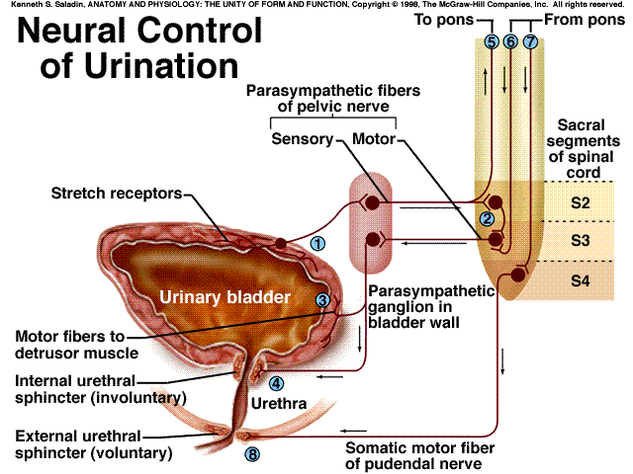
Voiding Urine in infants
micturition reflex
When the bladder contains about 200 ml of urine, stretch receptors in the wall send impulses to the spinal cord. Parasympathetic signals return to stimulate contraction of the bladder and relaxation of the internal urethral sphincter.
Spinal cord

Slide 31
Voiding Urine in adults
2. Once voluntary control has developed, emptying of the bladder is controlled predominantly by a micturition center in the pons. This center receives signals from stretch receptors and integrates this information with cortical input concerning the appropriateness of urinating at the moment. It sends back impulses to stimulate relaxation of the external sphincter.
Once voluntary control has developed, emptying of the bladder is controlled predominantly by a micturition center in the pons. This center receives signals from stretch receptors and integrates this information with cortical input concerning the appropriateness of urinating at the moment. It sends back impulses to stimulate relaxation of the external sphincter.
Voluntary control

Slide 32
Formation of urine
It takes place in nephrons & involves 4 steps –
  Glomerular Filtration
  Tubular Reabsorption
  Tubular secretion
  Concentration

Slide 33
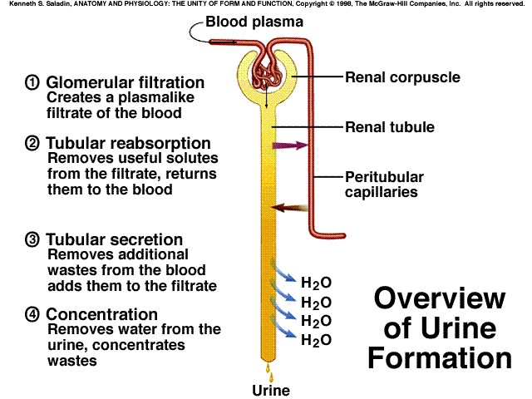
The kidney produces urine through 4 steps.

Slide 34
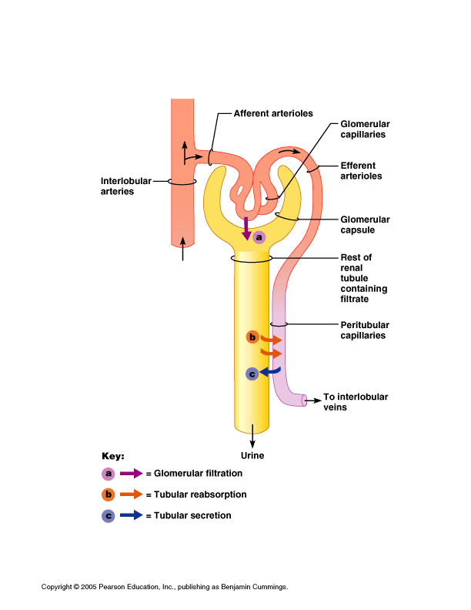
In short……..
Filtration
  a. Fluid is squeezed out of the glomerular capillary bed
Resorption
  b. Most nutrients, water ad essential ions are returned to the blood of the peritubular capillaries
Secretion
  c. Moves additional undesirable molecules into tubule from blood of peritubular capillaries

Slide 35
Glomerular filtration
It is the filtration of water & other soluble substances from glomerulus into BC through the semi-permeable wall.
Almost any thing smaller than 3 nm can undergo filtration.
Filtration of deproteinzed plasma takes place – Water, Glucose, Cholesterol, Lipids, Vitamins amino acids, inorganic ions, urea, uric acid etc.
RBC, WBC, Platelets & Plasma proteins are not filtered.

Slide 36
Why filtration occurs
Filtration occurs due to pressure difference across the BC.
  Hydrostatic pressure of blood in Glomerulus – 60 mm of Hg – due to the diameter difference between afferent & efferent arteriole. This pressure is opposed by following 2 pressure.
  Capsular pressure of filtrate – 18 mm Hg
  Osmotic pressure of blood – 32 mm Hg – due to high concentration of plasma proteins.
Net filtration pressure = 60 – (32+18) = 10 mm Hg

Slide 38
Glomerular Filtration Rate (GFR)
It is the amount of filtrate formed per minute by the two kidneys combined.
For the average adult, GFR is about 125 ml/min.
This amounts to a rate of 180 L/day.
An average of 99% of the filtrate formed is reabsorbed, so that only 1-2 L of urine per day is excreted.

Slide 39
Tubular reabsorption
About 99% of water and other useful small molecules in the filtrate are normally reabsorbed back into plasma (capillaries) by renal tubules.
This is done according to the need of the body to maintain fluid & electrolyte balance & pH of the blood.
Water, Glucose, Amino acids, inorganic ions & other nutrients are reabsorbed back.

Slide 40
Reabsorption in PCT
The PCT is formed by one layer of epithelial cells with long microvilli.
PCT reabsorbs about 65% of the glomerular filtrate and return it to the blood.
Reabsorption takes place by different mechanisms
      1) Solvent drag
      2) Active transport of sodium.
      3) Secondary active transport of glucose, amino acids, and other nutrients.
      4) Secondary water reabsorption via osmosis
      5) Secondary ion reabsorption via electrostatic attraction

Slide 41

1. Solvent drag
Occurs due to high osmotic pressure in the peritubular capillaries.
Water is reabsorbed by osmosis and carries all other solutes along.
low osmolarity
( high H₂O conc.)
H₂O
high osmolarity
( low H₂O conc.)

Slide 42
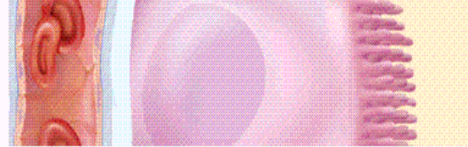
2) Active transport of sodium
Sodium pumps (Na-K ATPase & Na-H ATPase) in basolateral membranes transport sodium out of the cells against its concentration gradient using ATP.
There also pumps for other ions – calcium, phosphate, potassium etc.
Na⁺
Na⁺
K⁺
capillary
PCT cell
Tubular
lumen

Slide 43
3) Secondary active transport of glucose, amino acids, and other nutrients
Various co-transporters can carry both Na+ and other solutes. For example, the sodium-dependent glucose transporter (SDGT) can carry both Na+ and glucose.
Amino acids and many other nutrients are reabsorbed by their specific cotransporters with sodium.
Na⁺
Na⁺
K⁺
Glucose
capillary
PCT cell

Slide 44
4) Secondary water reabsorption via osmosis
Sodium reabsorption makes both intracellular and extracellular fluid hypertonic to the tubular fluid. Water follows sodium into the peritubular capillaries.
Na⁺
Na⁺
H2O
capillary
PCT cell
Tubular
lumen

Slide 45
5) Secondary ion reabsorption via electrostatic attraction
Negative ions tend to follow the positive sodium ions by electrostatic attraction.
Na
Na⁺
Cl⁻
capillary
PCT cell
Tubular
lumen

Slide 46
Transport maximum
There is a limit to the amount of solute that the renal tubule can reabsorb because there are limited numbers of carrier molecules in the plasma membranes.
The maximum capacity of kidney for reabsorption of a substance is called as transport maximum or renal threshold.
If all the transporters are occupied as solute molecules pass through, some solute will remain in the tubular fluid and appear in the urine.

Slide 47
Reabsorption in LH
The primary purpose is to establish a high extracellular osmotic concentration.
The thick ascending limb reabsorbs solutes but is impermeable to water. Thus, the tubular fluid becomes very diluted while extracellular fluid becomes very concentrated with solutes.
The high osmolarity enables the collecting duct to concentrate the urine later.

Slide 48
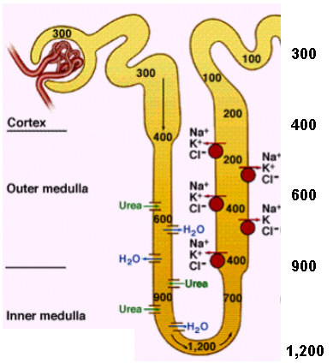

Slide 49
Reabsorption in DCT & CT
Fluid arriving in the DCT still contains about 20% of the water and 10% of the salts of the glomerular filtrate.
A distinguishing feature of these parts of the renal tubule is that they are under hormonal control.
Aldosterone, secreted by adrenal cortex in response to decrease in Na in blood or fall in BP. It acts on DCT & CT to increase reabsorption of water, Na & Cl & excretion of K.
It helps to maintain blood volume & BP via Renin-Angiotensin-Aldosterone system

Slide 50
Atrial natriuretic peptide (ANP), secreted by atrial myocardium in response to high BP.
It inhibits sodium and water reabsorption, increases the output of both in the urine, and thus reduces blood volume and pressure.
Parathyroid hormone & calcitonin together regulate the reabsorption of calcium & phosphate.

Slide 51
Tubular secretion
It is the transfer of selective molecules from capillary blood into the renal tubules.
It occurs in PCT, LH & DCT.
The purpose of this mechanism is to remove the waste products & maintenance of acid-base balance.
The molecules, which are not filtered at Glomerulus like drugs etc are secreted.
K & H is actively secreted by Na-K pump & Na-H pump.

Slide 52
Concentration of fluid in CD
-The collecting duct (CD) begins in the cortex, where it receives tubular fluid from numerous nephrons.
-CD reabsorbs water under the influence of ADH.
-The high osmolarity of extracellular fluid generated by NaCl and urea, provides the driving force for water reabsorption.
-No more reabsorption after tubular fluid leaving CD

Slide 53
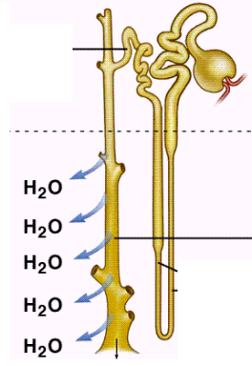

Control of Urine Concentration depends on the body's state of hydration.
a. In a state of full hydration, antidiuretic hormone (ADH) is not secreted and the CD permeability to water is low, leaving the water to be excreted.
Cortex
medulla
b. In a state of dehydration, ADH is secreted; the CD permeability to water increases. With the increased reabsorption of water by osmosis, the urine becomes more concentrated.
mOsm/L
urine

Slide 54
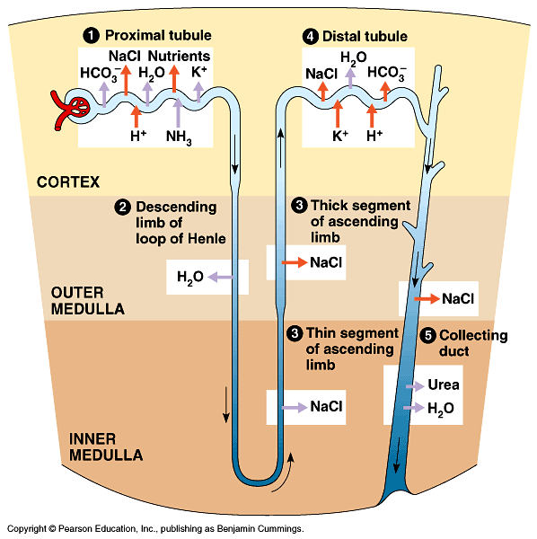
Nephron-Tubular System
Proximal convoluted tubule
Descending loop of Henle
Ascending loop of Henle
Distal convoluted tubule
Collecting duct

Slide 55
Summary so far…..
Blood enters the kidney through the renal artery at the site of the hilum
The renal artery divides in to ever smaller arteries and arterioles
Afferent arterioles take blood to the glomerulus to be filtered
Once blood is filtered efferent arterioles take blood away from the glomerulus
The PCT is concerned with reabsorption- organic nutrients are reabsorbed and water follows because there is a concentration gradient
The filtered substances move into the proximal convoluted tubule
Products which are filtered out: water, mineral salts, amino acids, glucose, hormones, urea, toxins
The glomerulus is a network of capillaries which filters the blood
Products which do not filter and remain in the blood: Leukocytes, erythrocytes, platelets, plasma proteins
The remaining filtrate moves into the descending loop of henle. This is lined with thin cells so water moves out
Because water has been reabsorbed the concentration of the filtrate is not very high
The walls of the ascending loop of henle are lined with thicker cells, so water can’t pass in or out. Instead sodium and chloride is pumped out actively
The filtrate now enters the distal convoluted tubule- is it now only 20% of what it originally was.
A number of other nephrons join up to the cleectig duct which travels through the medulla to the renal papilla wher the filtrate is emptied in the minor calyx
From the DCT the filtrate now passes into the collecting duct.
In the DCT the volume and composition of the filtrate can be adjusted but this is controlled by hormones
4-5 minor calyces join up to make a major calyx
2-3 major calyces join up to form the renal pelvis
The renal pelvis joins the ureter at the hilum
The ureter transport the filtrate/urine from the kidney to the bladder

