Slide 1
NMR SPECTROSCOPY

Slide 2
Contents
Introduction
Theory
Principle
Instrumentation

Slide 3
Definition
NMR Spectroscopy is the study of spin changes at the nuclear level when a radiofrequency energy is absorbed in the presence of magnetic field.
The source of energy in NMR is radio waves which have long wavelengths, and thus low energy and frequency.
NMR involves the interaction between the oscillating magnetic field of EMR and the magnetic energy of the hydrogen nucleus when placed in an external magnetic field.
NMR spectroscopy is a powerful analytical technique used to characterize organic molecules.
Two common types of NMR spectroscopy are used to characterize organic structure:
¹H NMR
¹³C NMR

Slide 4
DEFINITIONS
NUCLEAR SPIN;
Spinning of charged particle generates a magnetic field around the nucleus.
NUCLEAR MAGNETIC MOMENT; (μ)
Property of a magnet that interacts with applied field to give mechanical moment.
PRECESSIONAL FREQUENCY ; (v)
Defined as number of revolutions per second by magnetic vector of nucleus around the external field.
NUCLEAR RESONANCE;
APPLIED FREQUENCY=PRECESSIONAL FREQUENCY

Slide 5
PRINCIPLE
Any proton or nucleus with odd mass number spins on its own axis.
By the application of the magnetic field, the nucleus spins on its own axis and a magnetic moment is created, resulting in an precessional orbit, with a frequency called precessional frequency, this state is called Ground state.
In this state the magnetic field caused by the spin of nuclei is aligned with the external magnetic field.

Slide 6
When energy in the form of radio frequency is applied &
Applied frequency= precessional frequency, the absorption of energy occurs and an NMR signal is recorded.
After the absorption of energy the nucleus moves from ground state to the excited which results in spin reversal or antiparallel orientation in which the magnetic field caused by the spin of nucleus opposes the externally applied magnetic field.
When radio frequency energy is stopped the nucleus returned to ground state

Slide 7
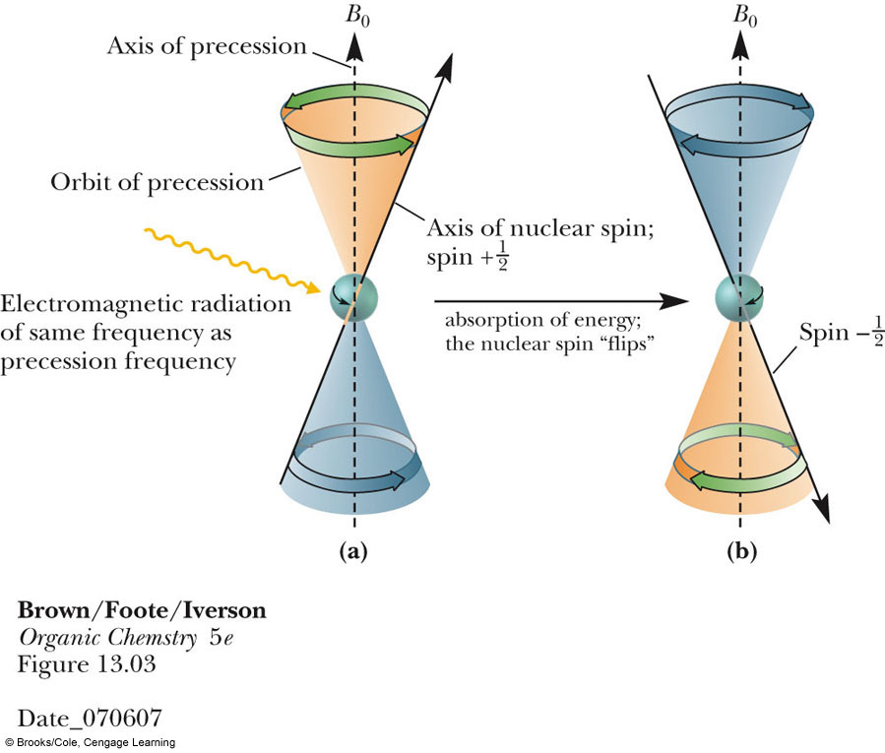

Slide 8
EXAMPLE
Consider a spinning top, it performs waltz like motion in which the spinning axis of the top moves slowly around vertical. this is precessional motion and the top is said to be precessing around the vertical axis of earth gravitational field.

Slide 9
Nuclear Spin Energy Levels
unaligned
N
Excited state
-1/2
In a strong magnetic
field (B_{o}) the two
spin states differ in
energy.
aligned
+1/2
Ground state
S
B_{o}

Slide 10
THEORY
The angular momentum of the charge created by the spinning nucleus are expressed in terms of spin quantum number I .
For a nuclei to exhibit NMR phenomenon the I>0.
Spin quantum number I is associated with mass number and atomic number of the nuclei.
Mass number | Atomic number | Spin quantum number I
Odd | Odd or Even | 1/2, 3/2, 5/2……,
Even | Even | 0
Even | Odd | 1,2,3…..,

Slide 11
Three classes of nuclei may be distinguished
1. A nucleus with an even mass A and even charge Z à nuclear spin I is
Zero :(I=0)
Example: ¹⁶o, ¹²c, ³²s No NMR signal
2. A nucleus with an even mass A and odd charge Z à integer value I :(I=1)
Example: ¹⁰B,¹¹B,³⁵Cl NMR detectable
3. A nucleus with odd mass A à I=n/2, where n is an odd integer :(I=1/2)
Example: ¹H ,³H ,¹³C NMR detectable

Slide 12
Theory can be explained in 4 steps :
Orientation
Transition
Saturation of signal
Energy loss
Orientation:
Under the influence of an external magnetic field, a magnetic nucleus can take up different orientations with respect to the field.

Slide 13
The number of orientations taken up by a spinning nucleus is:
M = 2I + 1,
Ex: For Carbon-13 (¹³C₆) nucleus is 1/2.
Thus, the number of Spin States allowed for Carbon-13 (¹³C₆) nuclei is
[2 * ½ + 1 = 1 + 1 = 2]
Therefore, the two spins states for either nuclei are +1/2 & -1/2 depending upon direction of spin.

Slide 14
Transition:
In an applied magnetic field, magnetic nuclei like proton presses at a frequency ‘v’ & when this frequency matches the radio frequency, the exchange of energy takes place b/w radio waves & spinning nuclei.
This leads to the transition of nuclei from E1→ E2
In general, for a nucleus with spin quantum number, the difference in energy is given by
∆E = µH0
I
The energy of radiowave is given by Einsten Plank equation
E = h√
When resonance take place, these energies are absorbed & bring about nuclear transition.

Slide 15
i.e., Energy of radiation = Transition energy
h√ = µH0
I
√ = µH0
hI
Saturation of signal:
The absorption of energy from radiowaves, boost the nuclei from E1→ E2 level & thus reduces the equilibrium, Ratio of low energy state to high energy state nuclei.
The populations of the two states may approach equality & there is no further net absorption of energy & consequently the intensity of NMR signal diminish. This situation is called as saturation of signal.

Slide 16
RELAXATION PROCESS
It is the process of transition by which the nucleus from excited state to the ground state ,where the absorbed energy can be lost.
Three types :
1.SPIN -SPIN RELAXATION
2.SPIN-LATTICE RELAXATION
3.QUADRUPOLE RELAXATION

Slide 17
SPIN -SPIN RELAXATION
It involves the transfer of energy from one nucleus to other.
There is no net loss of energy
The spread of energy among the nuclei results in broadening of NMR spectra.
SPIN-LATTICE RELAXATION
Transfer of energy from nucleus in its higher energy state to molecular lattice.
Energy is transferred to the components of lattice as additional, rotational, translational, vibrational energy.
Results in broadening of absorption peaks.

Slide 18
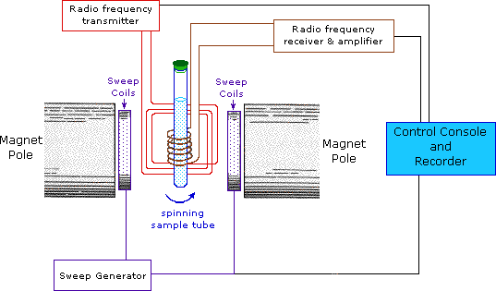
Instrumentation:

Slide 19
INSTRUMENTATION
Magnet poles
Sample cell(tube)
Sweep generator
RF transmitter
RF receiver
Recorder

Slide 20
Magnet poles:
Generation of magnetic field.
Should produce homogenous magnetic field.
Strength of field should be high.
If field is not homogenous broad bands are obtained.
Sweep generator:
A sweep generator is installed to supply a variable dc current to a secondary smaller magnet
To vary the strength of applied magnetic field.

Slide 21
RF receiver:
To Measure the intensity of unabsorbed radio frequency energy.
The coil of the RF receiver or detector is installed perpendicular both the magnetic field and the oscillator coil and is tuned to the same frequency as the transmitter.
When the precession frequency is matched with the radio frequency the nuclei induces EMF in the detector coil by virtue of the change in magnetic flux following nuclear flipover .
This signal is amplified and send to a recorder.

Slide 22
RF transmitter:
The RF oscillator coil is installed perpendicular to the magnetic field
Used to apply radiofrequency radiation.
Eg:60MHz,90MHz,100MHz,220MHz.
Sample cell:
NMR cells is made up of high quality polished Pyrex glass
sample test tube which is about 25mm long and 5mm diameter.
This is kept inside the sample cavity and is spun at 30rps.

Slide 23
Recorder:
Record NMR signal obtained from detector.
The absorption signals received from the RF receiver are extremely weak.
Hence, signals require considerable amplification before it is fed to a chart recorder.
The recorder gives a NMR spectrum as a plot of the strength of resonance signal (Y-axis) Vs strength of the magnetic field (X-axis).

Slide 24

References
Principles of Instrumental Analysis by Skoog . Holler . Nieman, Harcourt College Publishers, 5th Edition.
Elementary organic spectroscopy by Y.R Sharma.
Organic Spectroscopy by William Kemp, 3rd Edition.
Pharmaceutical drug analysis by Austhoshkar.

Slide 25


