Slide 1
Mass spectroscopy

Slide 2
Mass spectrometry
Mass spectrometry is the most accurate method for determining the molecular mass of the compound and its elemental composition.

Slide 3
Technique in which the sample is converted in to rapidly moving positive ion, which are then separated and characterized.
Also called positive ion spectroscopy.
All the samples are not going to be analyzed in the mass spectroscopy.
Which have vapour pressure of 10⁻⁷ mm Hg Molecules which are thermolabile.

Slide 4
Ions can be generated by several ways:
1. By electron bombardment.
2. by exposing sample to high intensity laser light.
Three main process that occur in the mass spectroscopy are:
1. Ionization
2. Sorting of ions
3. Detection

Slide 5
So the technique involves conversion of sample in to ions and ion fragments and deals with the study of charged molecules and fragment ions, the relative intensity was obtained from correlating their mass charge ratio.
Designated as M/e

Slide 6
MECHANISM
If atom or a molecule looses or gains an electron it posses a electrical charge on it.
If it looses an electron it attains a positive charge.
If it gains an electron it attains negative charge, then the resulting charged molecule or atom is called as ion, process is called as ionization.

Slide 7
The mass spectrometer is an instrument which measures the mass of the individual molecules.
It does not measure the molecular mass directly but it measure the mass to charge ratio of the ions

Slide 8
PRINCIPLE:
Principle of Mass Spectra consists of 2 Steps:
Conversion of Neutral Molecule to Charged Molecule, preferably to a positively charged molecule.
Separation of the positively charged fragments formed based on their masses by using electrical or magnetic field or both.

Slide 9
Consider a molecule M, which is bombarded with a high beam of electrons (70eV)
M + e⁻ M⁺ + 2 e⁻
Where M⁺ is an ionized molecule and e⁻ is an electron. The ions are then accelerated in an electric field at voltage V. If this is the condition, the energy given to each particle is eV (Potential energy) and this is equal to kinetic energy = ½ mv² .
Potential Energy = Kinetic energy of molecule
eV = ½ mv² .
v² = 2eV/m ……………….(1)
Where e = Charge of ion,
V = Acceleration Voltage,
m = Mass,
v = Velocity after acceleration

Slide 10
As the value of m varies from particle to particle, the velocity v also changes such that ½ mv² remains constant For the particle of mass m₁ and velocity v₁ the equation becomes ..
After the charged particles have been accelerated by an applied voltage, they enter a magnetic field H. This field attracts the particles and they move in a circle around it. This attractive force, due to magnet is s, where as the balancing centrifugal force of the particle is mv²/r. When the particle starts moving uniformly around the circular path, the two forces become equal.
i.e; Under the magnetic field;
Hev = mv²/r
r = mv/ eH ……………….. ( 2 )
where r is the radius of the circular path of the particle.

Slide 11
On substituting equation ( 2 ) in ( 1 );
r = m/eH (2eV/m)^{1/2}
On squaring both sides;
r² = ( m²/e²H²) (2eV/m)
= (m/e) ( 2V/H²)
... r = [ (2V/ H²) (m/e) ] ^{½}
On simplifying;
m/e = H² r²/ 2V
The radius of the circular path of the particle depends on the accelerating voltage V, the magnetic field strength H, and the ratio m/e. the relationship between m, r, V and H is the basis of separation of particles according to their masses.

Slide 12
THEARY OF MASS SPECTROSCOPY
STEP1-Ionization:
The atom is ionized by knocking or bombarding one or more electrons to give a positive ion.
STEP2-Acceleration:
The ions are accelerated through the slits so that they have the same kinetic energy.

Slide 13
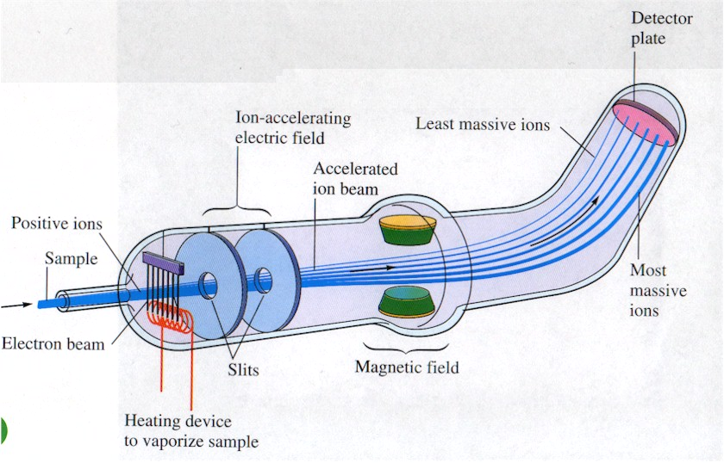

Slide 14
STEP3-DEFLECTION:
The ions are then deflected by the magnetic field according to their masses. The lighter ions they are more deflected.
STEP4-DETECTION
The beam of ions passing through the machine is detected electrically.

Slide 15
INSTRUMENTATION OF MASS SPECTROMETER
Sample inlet system.
Ion source.
Mass analyzers and ion collecting systems/ detectors.
Vacuum system.
Data handling.

Slide 16
1.Sample inlet systems:
The method of sample introduction to the ionization source often depends on the ionization method being used, as well as the type and complexity of the sample
Different sampling systems include:
Direct probe inlet: Non volatile and thermally unstable compounds are often introduced into the ion source by a sample probe which is equipped with a heater to volatize the sample at low pressure.
Batch inlet system.
Introduction of gas samples:
Transfer of sample from small containers of known volume.

Slide 17
Liquids:
Break off devices.
By touching micropipette to sintered glass disc.
Hydrodynamic needle injection
Solids:
Directly introduced on silica or platinum probe.
2.Ion source:
Sample get ionized.

Slide 18
3.Mass analyzers and ion separator:
After passing through the electrostatic slits ions enter in to the analyzers.
Separate the ions according to their mass charge ratio.
Different types of mass analyzers are:
Magnetic deflection or sector mass analyzer .
Double focus mass analyzer .
Quadrapole mass analyzer .
Time of flight mass analyzer.

Slide 19
Magnetic sectors – single focussing
Generally bulky and expensive.
Earliest type of analyser and still popular.
High accelerating potential especially in comparison with other methods.
Magnets wedge shaped and must provide homogeneous fields.
Ion beam enters and exits at exactly 90˚.
Focuses ions according to their momentum.

Slide 20
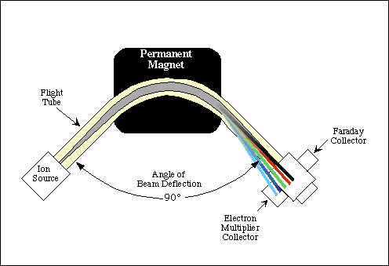

Slide 21
Magnetic sectors – double focussing
Adds a second electric sector to provide energy focussing of ions independent of mass.
Double focussing means that both the energy and momentum focus is designed to coincide at the collector slit.
Very high mass resolution can be achieved by this arrangement.
Very bulky and expensive but high performance.

Slide 22
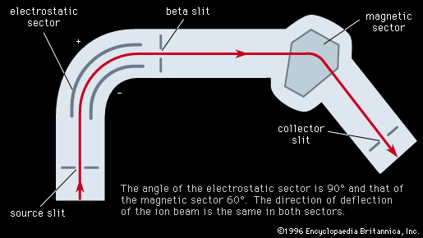

Slide 23
3.Quadrapole mass analyzer:
Ions are resolved according to their mass charge ratio without the need of heavy magnet
It consists of four metallic rods which are straight and parallel.

Slide 24
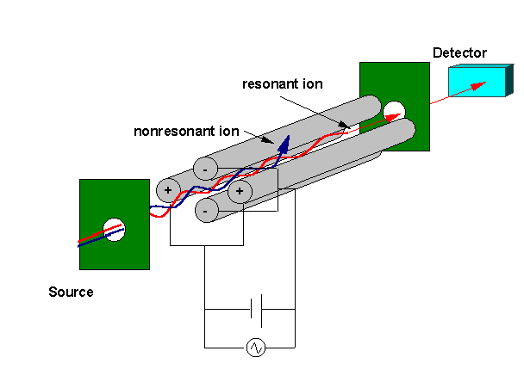
quadrapole working
The quadrapole consists of four parallel rods. The opposing rods
have the same polarity whilst adjacent rods have opposite polarity.
Each rod is applied with a DC and an RF voltage.Ions are scanned by varying the DC/Rf quadrapole voltages.
Only ions with the selected mass to
charge ratio will have the correct
oscillatory pathway in the Rf field.

Slide 25
4. Time of flight mass analyzer:
Ion separation is achieved by non magnetic means.
It consists of field free draft tube.
The ions are accelerated and accelerated particles entering the tube having same kinetic energies their velocities in the draft tube must vary inversely with their masses.
The lighter particles arriving at the collector earlier than heavier.

Slide 26
Ion collecting systems or detectors:
Ions are amplified and recorded.
various detectors used are-
Faraday cup collector.
Electron multiplier.
Ion sensitive photographic plates.
Channel electron multiplier.

Slide 27
1.Faraday cup collector:
Simple and effective means of monitoring ion current.
When sufficient amount of sample is available the measurement can be done by collecting them in single Faraday cup and scanning for different masses charge values.

Slide 28
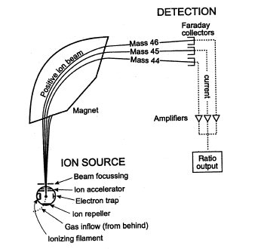
Faraday cup collector

Slide 29
2. Electron multiplier:
When the amount of sample available is small, the ion current produced is such a low current cannot be measured directly with a Faraday cup and further amplification is carried out by the secondary electron multiplier.

Slide 30
3. Ion sensitive photographic plates:
Here the ions directly expose a photographic film.
This type of detectors used in mass analyzers. Which disperse ions according to their mass to charge ratio.
The ion sensitive photographic plate integrate the ions and record them.
This detector provides greater resolution and highest sensitivity.

Slide 31
4.Channel electron multiplier : It consists of regular closed packed array of channels in a flat plate of semi conducting material. The pore diameter of the array is 10 – 25 µm. The plate is of 1 mm thick and each channel is coated with secondary electron emissive material. Thus each channel constitutes an independent electron multiplier.

Slide 32
The vacuum system:
Whole instrument is kept under high vacuum conditions 10⁻⁶ to 10⁻⁷.

Slide 33
Data handling:
Data are digitalized and collected on magnetic tape or stored in a memory of computer.
Recorders:
Multichannel ultraviolet recorder.
tape recorders, oscillators other data collecting systems are used as recording devices.

Slide 34
Molecular ion or Parent ion: When a molecule is bombarded with electrons in high vacuum in Mass spectrometer, it is converted into positive ions by loss of an electron. These ions are called as Molecular or Parent ions.
M + e → M^{+°} + 2e—
Where,
M – represents the Molecule;
M^{+°} – represents the Molecular or Parent ion
The order of energy required to remove electron is as follows—
σ electrons > non-conjugated π > conjugated π > non bonding or lone pair of electrons

Slide 35
Metastable Ions: Fragment of a parent ion will give rise to a new ion (daughter) plus either a neutral molecule or a radical.
M₁⁺ M₂⁺ + non charged particle
An intermediate situation is possible; M₁⁺ may decompose to M₂⁺ while being accelerated. The resultant daughter ion M₂⁺ will not be recorded at either M₁ or M_{2,} but at a position M* as a rather broad, poorly focused peak. Such an ion is called a metastable ion.

Slide 36
Nature of Metastable ions: Metastable ions have lower kinetic energy than normal ions and metastable peaks are smaller than the M₁ and M₂ peaks and also broader. These metastable ions arise from fragmentation that takes place during the flight down through ion rather than in the ionization chamber.

Slide 37
Molecular ions formed in the ionization chamber do one of the following things:
Either they decompose completely and very rapidly in the ion source and never reach the collector (as in case of highly branched molecular ions with life times less than 10⁻⁵ seconds).
Or else they survive long enough to reach the collector and be recorded there (life times longer than 10⁻⁵).
Significance of Metastable ions:
Metastable ions are useful in helping to establish fragments routs.
Metastable ion peak can also be used to distinguish between fragmentation Processes, which occur in few microseconds.

Slide 38
References:
Organic spectroscopy: Y. R. Sharma.
Organic spectroscopy: William Kemp.
(third edition).
Spectroscopy of organic compounds: P.S.Kalsi.
Instrumental methods of chemical analysis:
Gurdeep R.Chatwal, Sham K.Anand.

Slide 39


