Slide 1

MEDICINAL CHEMISTRY
ANTIPROTOZOAL AGENTS
05-08-2020
1

Slide 2
ANTIPROTOZOAL AGENTS
Antiprotozoal agents are also called as Antiamoebic agents.
Amoebiasis is a protozoal disease caused by protozoan Entamoeba histolytica.
Drugs which are used to treat infections of Entamoeba histolytica are called as antiprotozoal agents.
-08-2020
2

Slide 3
ANTIPROTOZOAL AGENTS
Classifications:
1) Drugs used in intestinal amoebiasis (Luminal amoebiasis) :eg. Diloxanide furoate, Iodoquinol, Pentamidine,
Atovaquone, Dimercaprol.
2) Drugs used in extra intestinal amoebiasis (Tissue amoebiasis) :eg. Emetine, Dehydroemetine, Chloroquine.
3) Drugs used for both intestinal and extra intestinal amoebiasis (Mixed amoebiasis) :
eg. Metronidazole, Tinidazole, Furazolidone,
Ornidazole, Nitazoxanide, Satranidazole.
-08-2020
3

Slide 4
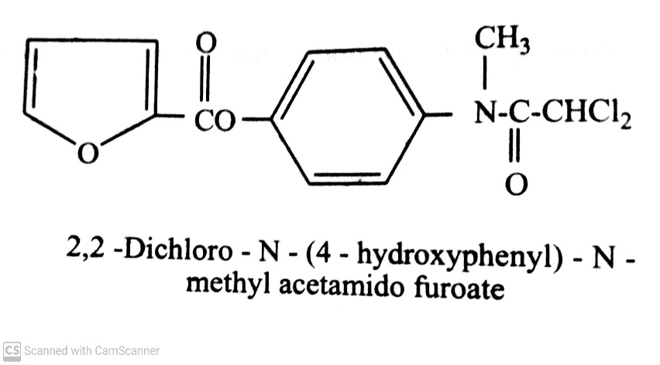
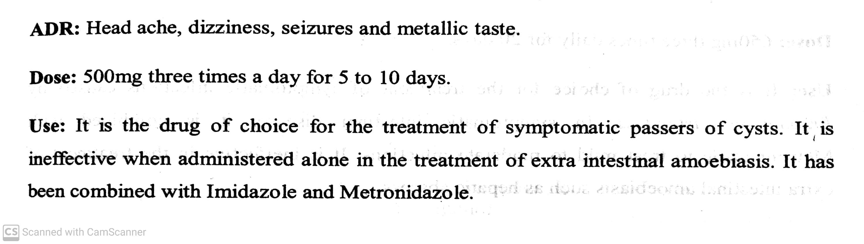
ANTIPROTOZOAL AGENTS
Classifications:
1) Drugs used in intestinal amoebiasis (Luminal amoebiasis) :eg. Diloxanide furoate, Iodoquinol, Pentamidine,
Atovaquone, Dimercaprol.
eg. Diloxanide furoate (Dirade-M, Dialox) :
-08-2020
4

Slide 5
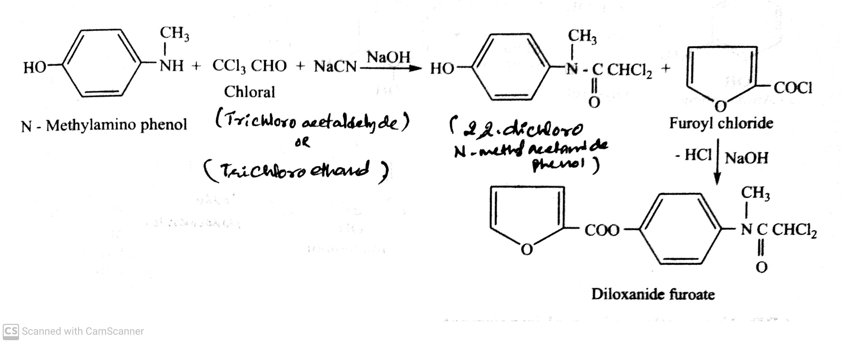
ANTIPROTOZOAL AGENTS
Classifications:
1) Drugs used in intestinal amoebiasis (Luminal amoebiasis) :eg. Diloxanide furoate, Iodoquinol, Pentamidine,
Atovaquone, Dimercaprol.
Synthesis of Diloxanide furoate :
-08-2020
5

Slide 6
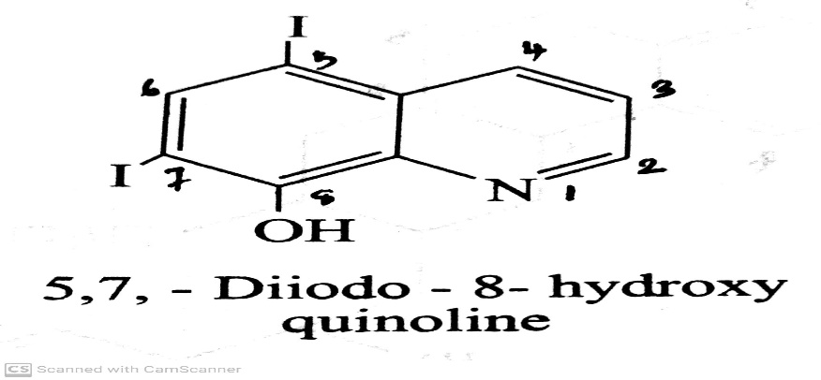
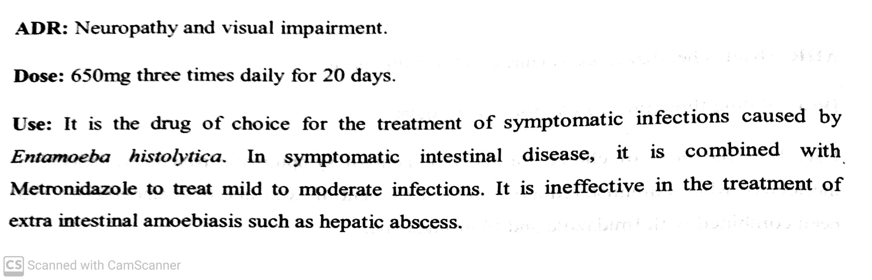
ANTIPROTOZOAL AGENTS
Classifications:
1) Drugs used in intestinal amoebiasis (Luminal amoebiasis) :eg. Diloxanide furoate, Iodoquinol, Pentamidine,
Atovaquone, Dimercaprol.
eg. Iodoquinol ( Diodoquine, Doquinol) :
-08-2020
6

Slide 7
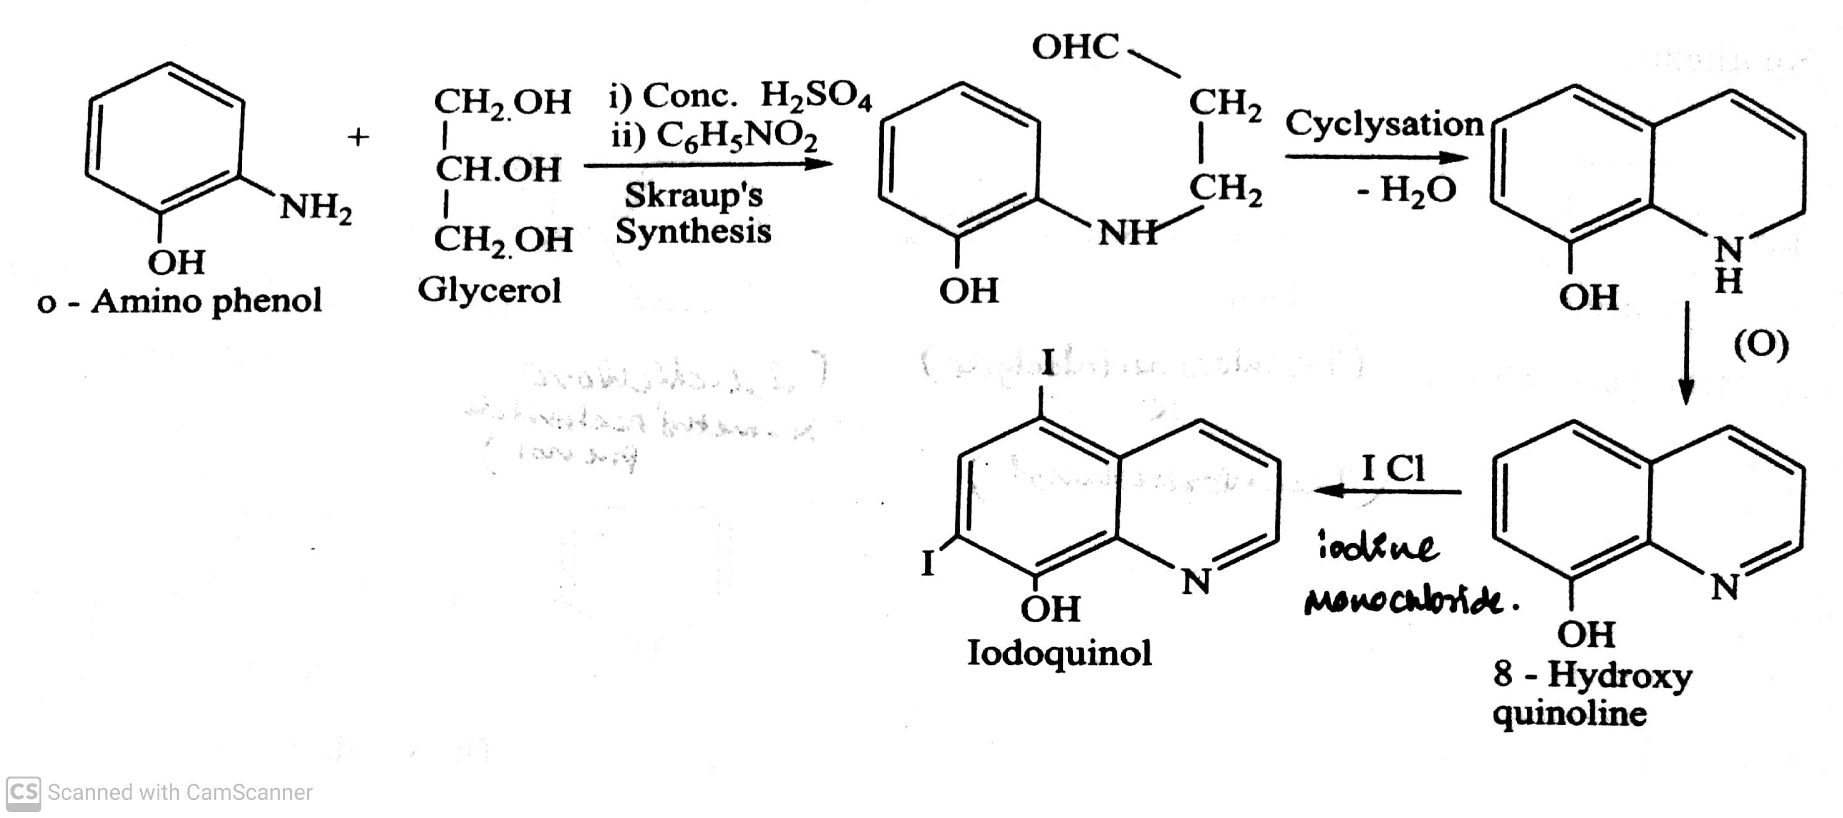
ANTIPROTOZOAL AGENTS
Classifications:
1) Drugs used in intestinal amoebiasis (Luminal amoebiasis) :eg. Diloxanide furoate, Iodoquinol, Pentamidine,
Atovaquone, Dimercaprol.
Synthesis of Iodoquinol :
-08-2020
7

Slide 8
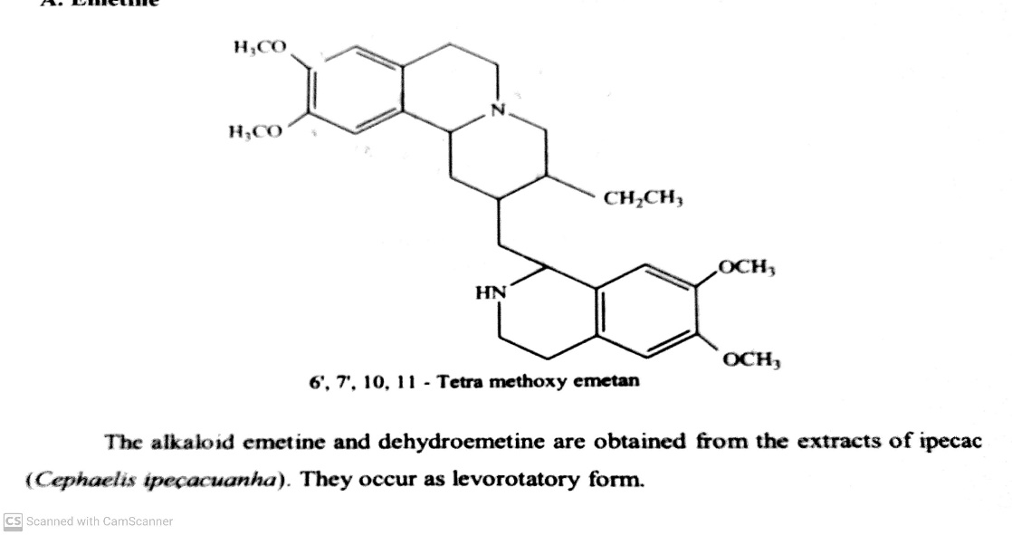
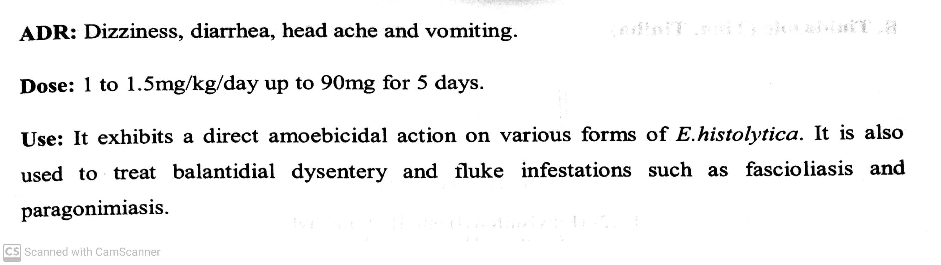
ANTIPROTOZOAL AGENTS
Classifications:
2) Drugs used in extra intestinal amoebiasis (Tissue amoebiasis) :eg. Emetine, Dehydroemetine,
Chloroquine.
eg. Emetine :
-08-2020
8

Slide 9
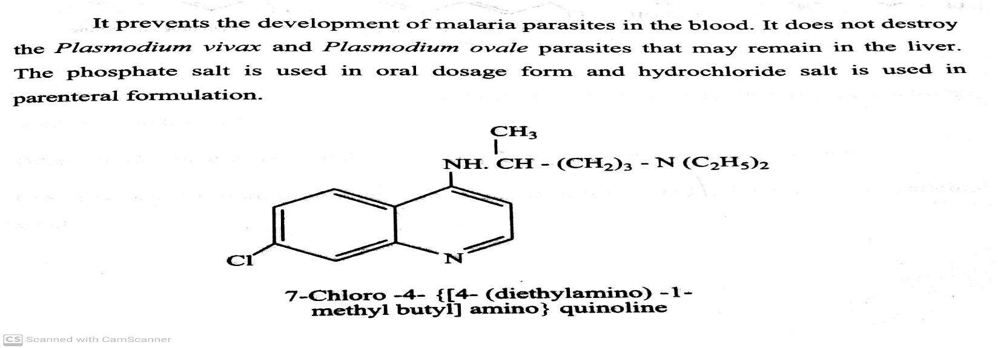
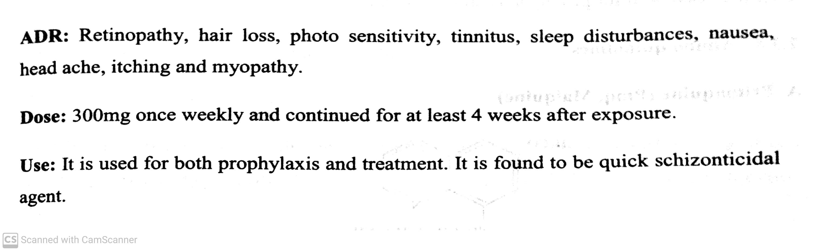
ANTIPROTOZOAL AGENTS
Classifications:
2) Drugs used in extra intestinal amoebiasis (Tissue amoebiasis) :eg. Emetine, Dehydroemetine,
Chloroquine.
eg. Chloroquine :
-08-2020
9

Slide 10
ANTIPROTOZOAL AGENTS
Classifications:
3) Drugs used for both intestinal and extra intestinal amoebiasis (Mixed amoebiasis) :
eg. Metronidazole, Tinidazole, Furazolidone, Ornidazole, Nitazoxanide, Satranidazole.
eg. Metronidazole ( Flagyl, Metrogyl):
-08-2020
10

Slide 11
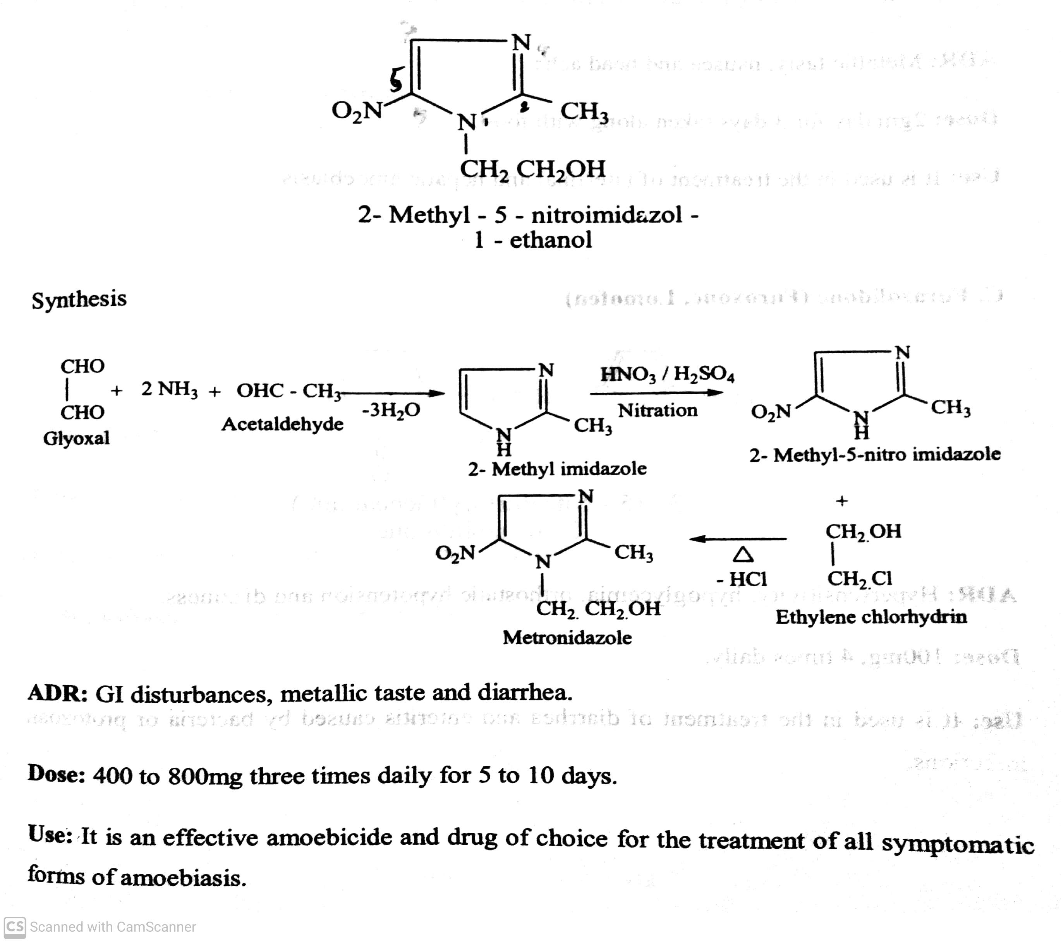
ANTIPROTOZOAL AGENTS
Synthesis of Metronidazole:
-08-2020
11

Slide 12
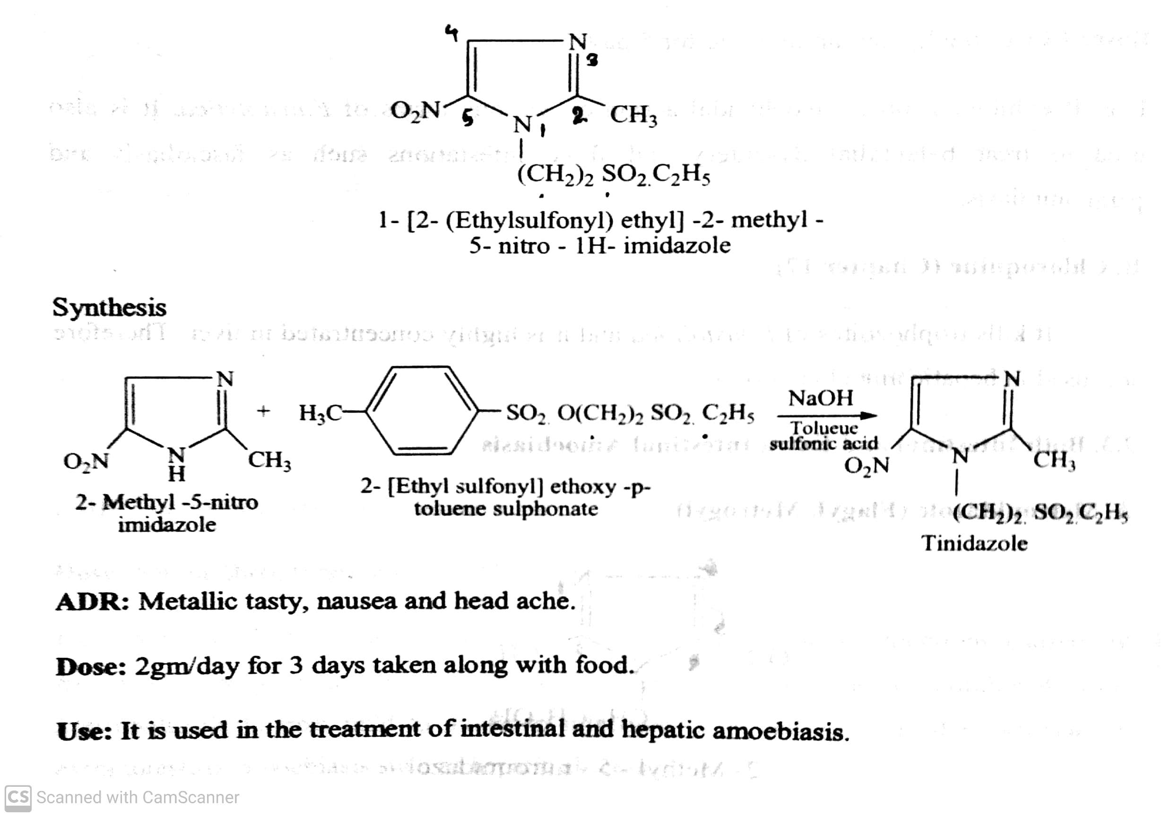
ANTIPROTOZOAL AGENTS
Classifications:
3) Drugs used for both intestinal and extra intestinal amoebiasis (Mixed amoebiasis) :
eg. Metronidazole, Tinidazole, Furazolidone, Ornidazole, Nitazoxanide, Satranidazole.
Eg. Tinidazole (Tina, Tiniba) :
-08-2020
12

Slide 13
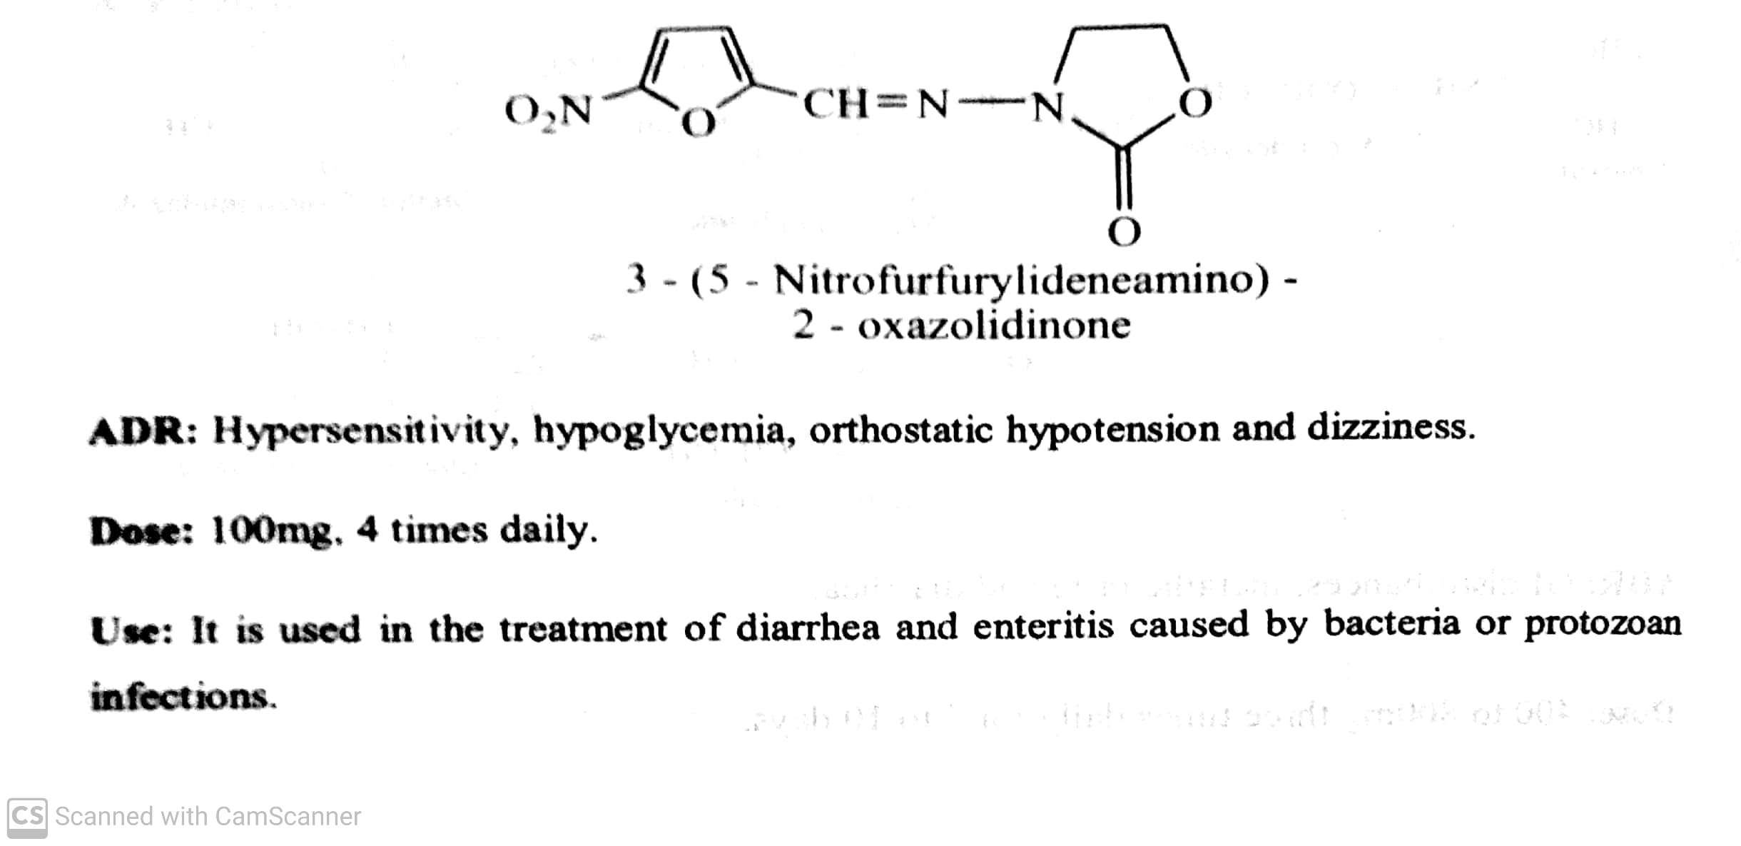
ANTIPROTOZOAL AGENTS
Classifications:
3) Drugs used for both intestinal and extra intestinal amoebiasis (Mixed amoebiasis) :
eg. Metronidazole, Tinidazole, Furazolidone, Ornidazole, Nitazoxanide, Satranidazole.
Eg. Furazolidone (Furoxone, Lomofen) :
-08-2020
13

Slide 14
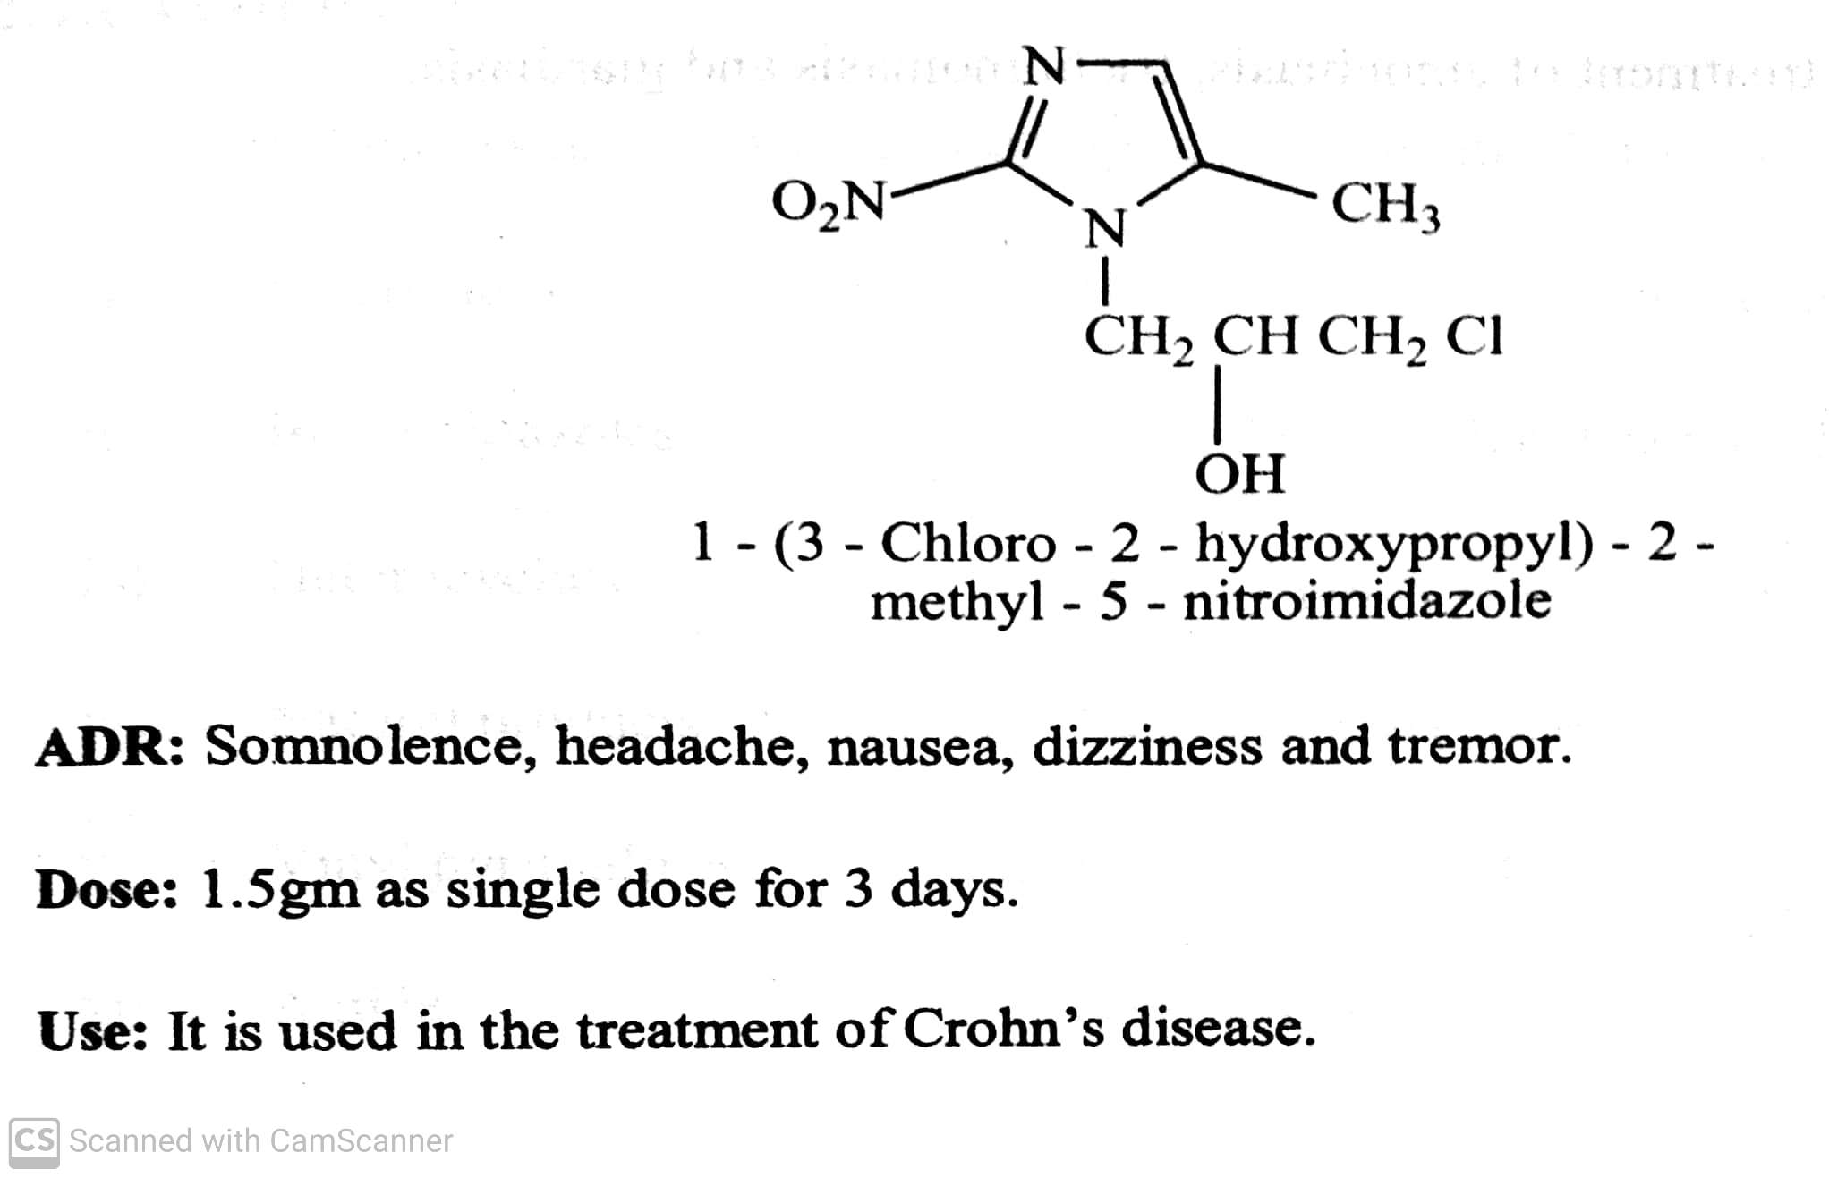
ANTIPROTOZOAL AGENTS
Classifications:
3) Drugs used for both intestinal and extra intestinal amoebiasis (Mixed amoebiasis) :
eg. Metronidazole, Tinidazole, Furazolidone, Ornidazole, Nitazoxanide, Satranidazole.
Eg. Ornidazole (Dazolic, Ornizen) :
-08-2020
14

Slide 15
THANK YOU
-08-2020
15

