Slide 1

MEDICINAL CHEMISTRY
ANTHELMINTICS
05-08-2020
1

Slide 2
ANTHELMINTICS
Helminthiasis is a disease in which a part of the body is infested with worms such as pinworm, round worm
tape worm.
Worms may also be called helminthis.
The term anthelmintic is restricted to drugs acting locally to expel parasites from GIT.
Drugs which act on parasitic infections are known as anthelmintic.
Anthelmintics can be administered by (drench, paste) orally or by injection. The drugs are absorbed in to the blood stream and widely diffused.
They are metabolized in liver and excreted in feces and urine.
-08-2020
2

Slide 3
ANTHELMINTICS
Classifications: Anthelmintics are classified based upon their chemical structure.
i) Piperazines : eg. Diethylcarbamazine citrate, Piperazine citrate.
ii) Benzimidazoles : eg. Albendazole, Mebendazole, Thiabendazole.
iii) Heterocyclics : eg. Oxamniquine, Praziquantel.
iv) Natural products :eg. Ivermectin, Avermectin.
v) Vinyl pyrimidines : eg. Pyrantel, Oxantel.
vi) Amide : eg. Niclosamide.
vii) Nitro derivatives : eg. Niridazoles.
viii) Imidazo thiozole : eg. Levamisole.
-08-2020
3

Slide 4
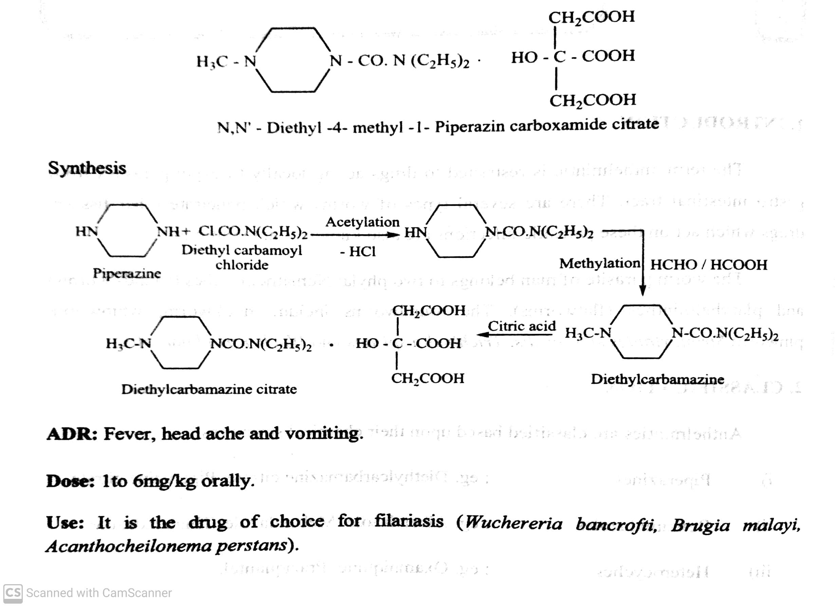
ANTHELMINTICS
Classifications: Anthelmintics are classified based upon their chemical structure.
i) Piperazines : eg. Diethylcarbamazine citrate, Piperazine citrate.
eg. Diethylcarbamazine citrate: (Method –I)
-08-2020
4

Slide 5
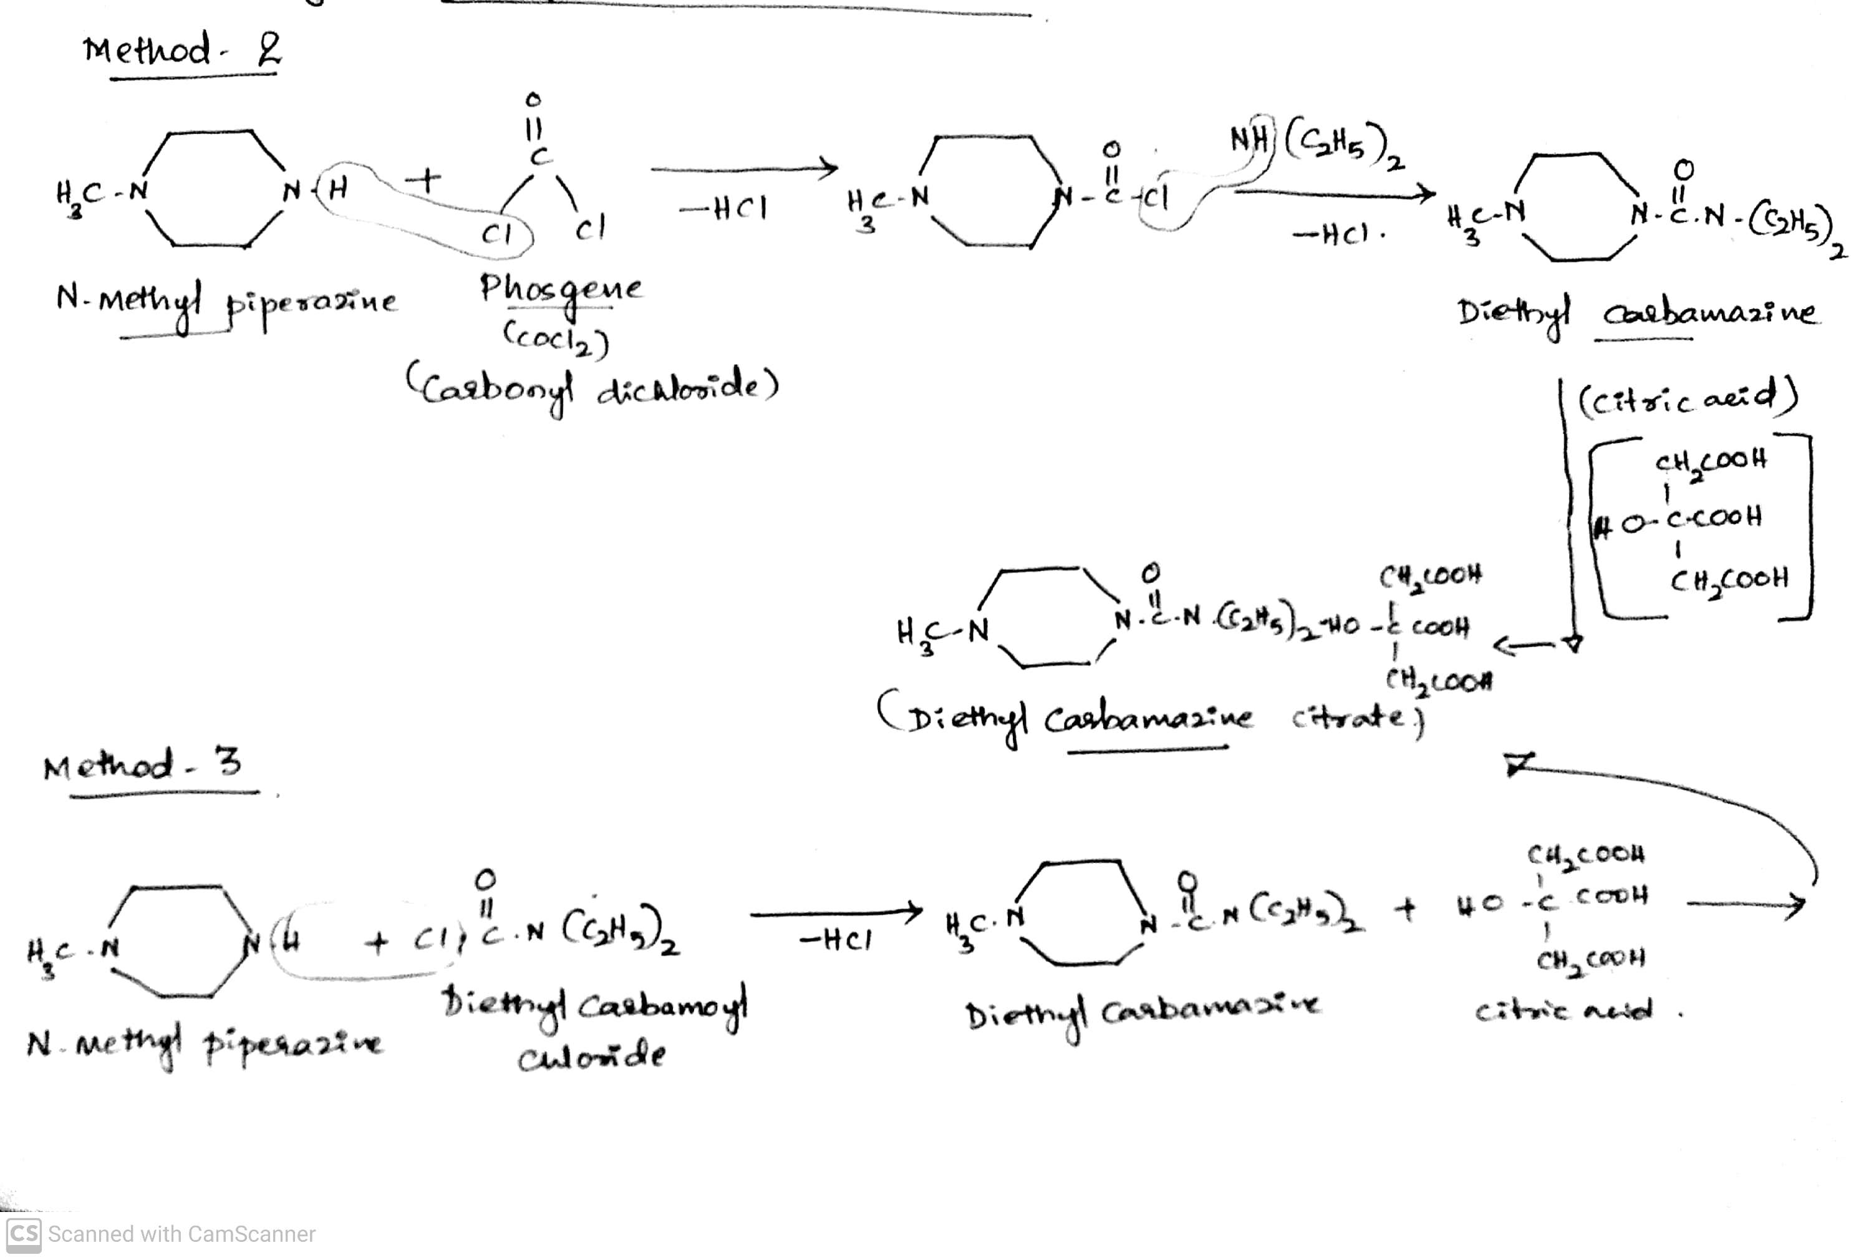
ANTHELMINTICS
Classifications: Anthelmintics are classified based upon their chemical structure.
i) Piperazines : eg. Diethylcarbamazine citrate, Piperazine citrate.
eg. Diethylcarbamazine citrate: (Method –II & III)
-08-2020
5

Slide 6
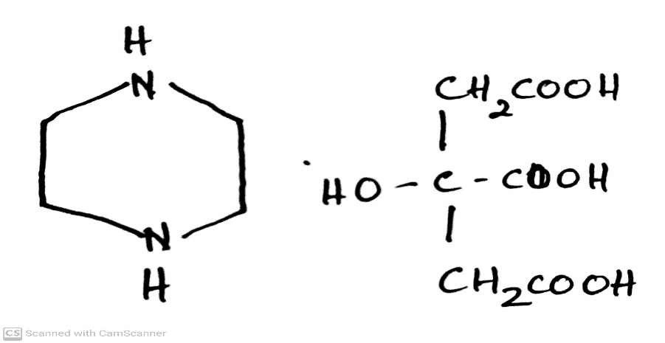
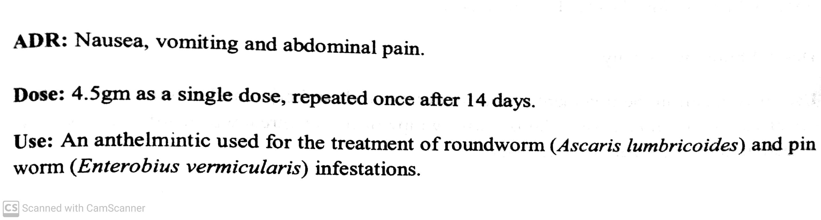
ANTHELMINTICS
Classifications: Anthelmintics are classified based upon their chemical structure.
i) Piperazines : eg. Diethylcarbamazine citrate, Piperazine citrate.
eg. Piperazine citrate :
-08-2020
6

Slide 7
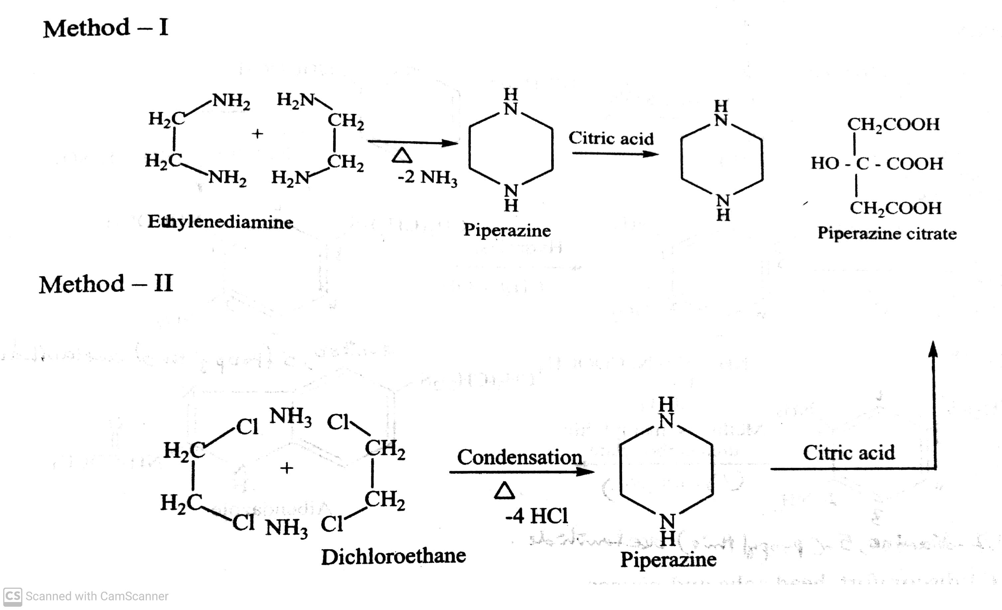
ANTHELMINTICS
Classifications: Anthelmintics are classified based upon their chemical structure.
i) Piperazines : eg. Diethylcarbamazine citrate, Piperazine citrate.
Synthesis of Piperazine citrate :
-08-2020
7

Slide 8
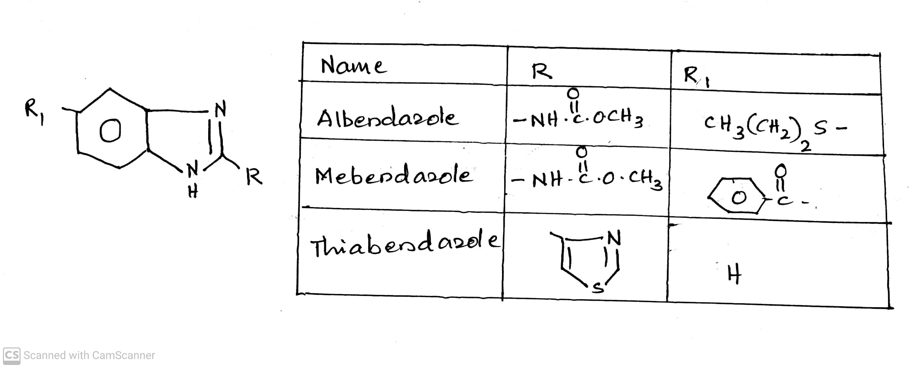
ANTHELMINTICS
Classifications: Anthelmintics are classified based upon their chemical structure.
ii) Benzimidazoles : eg. Albendazole, Mebendazole, Thiabendazole.
All Benzimidazoles have similar mode of action and differ only in its bioavailability.
-08-2020
8

Slide 9
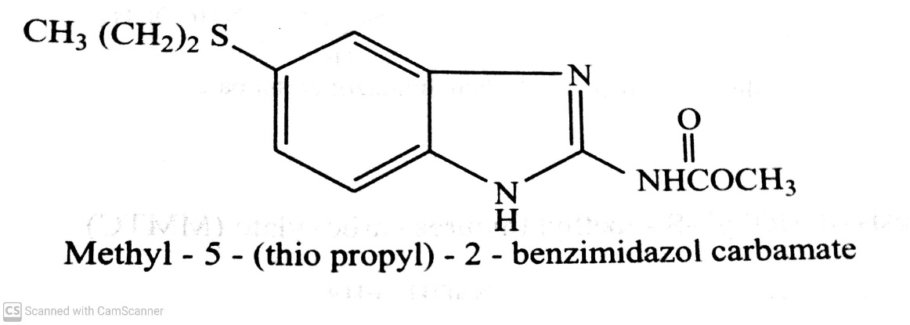
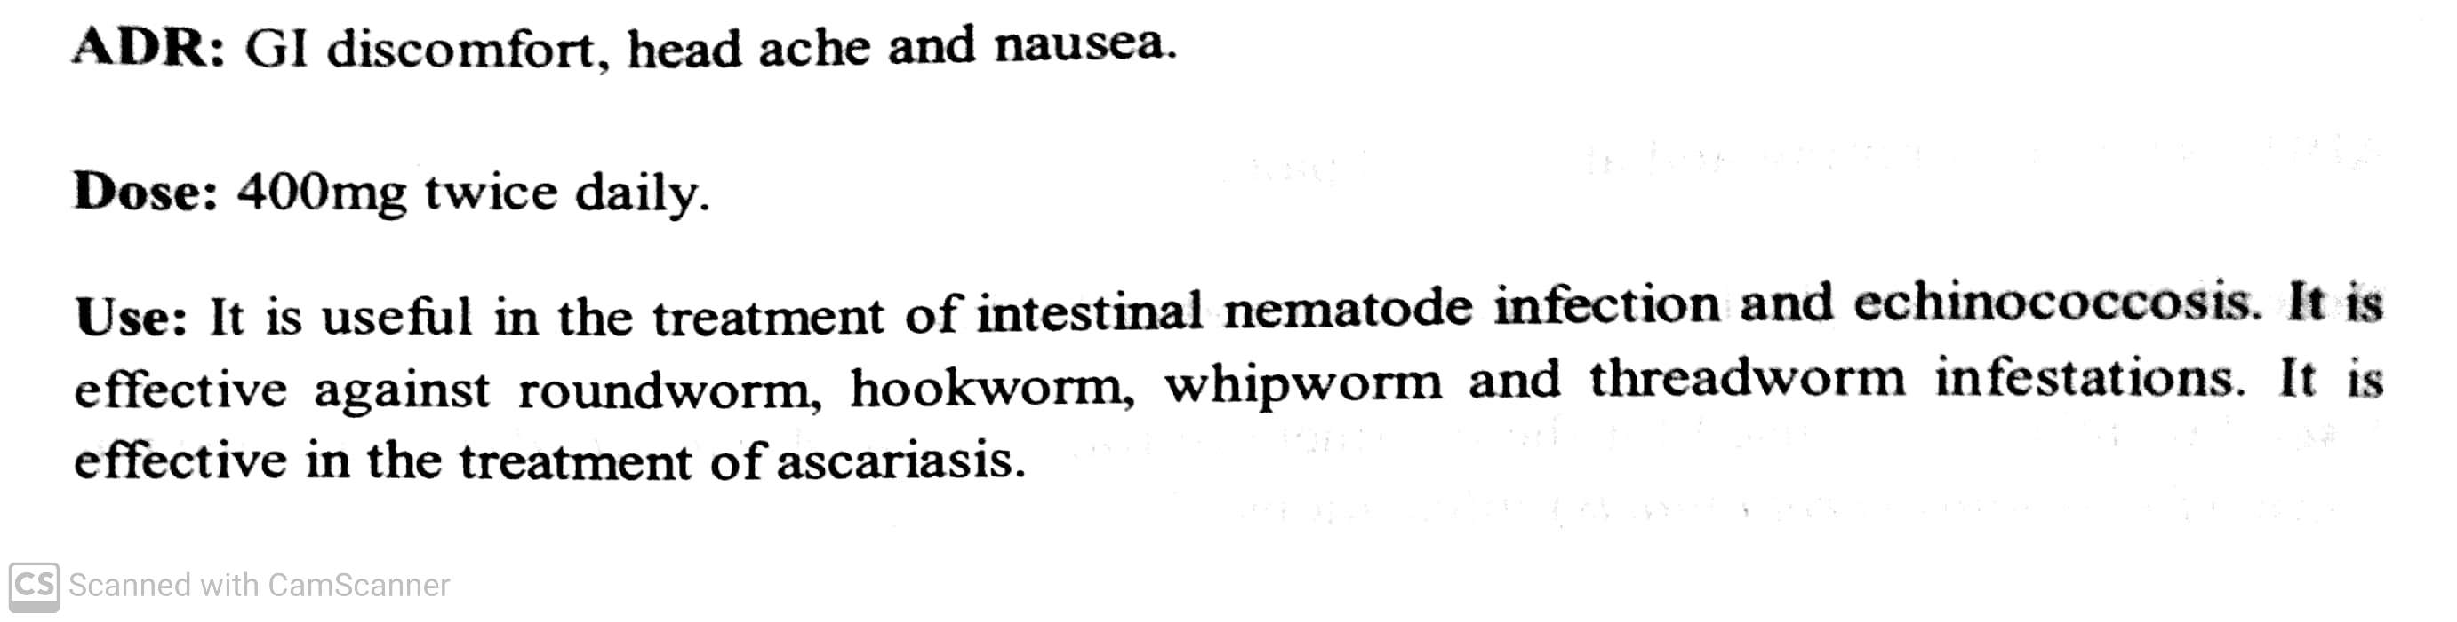
ANTHELMINTICS
Classifications: Anthelmintics are classified based upon their chemical structure.
ii) Benzimidazoles : eg. Albendazole, Mebendazole, Thiabendazole.
eg. Albendazole ( Albendol , Albend) :
-08-2020
9

Slide 10
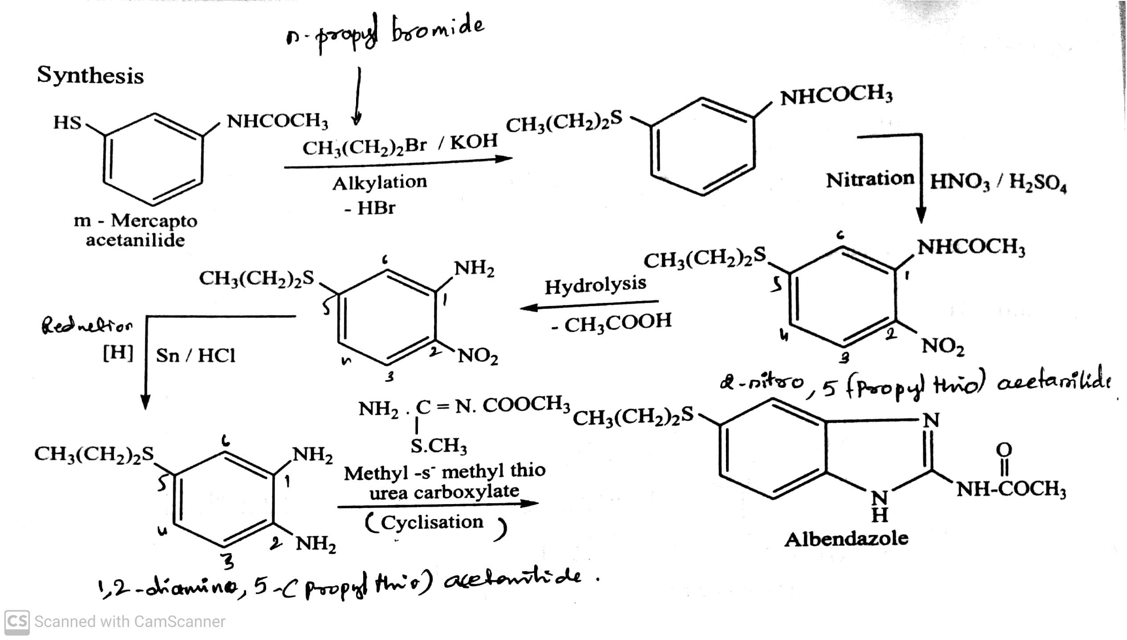
ANTHELMINTICS
Classifications: Anthelmintics are classified based upon their chemical structure.
ii) Benzimidazoles : eg. Albendazole, Mebendazole, Thiabendazole.
Synthesis of Albendazole ( Albendol , Albend) :
-08-2020
10

Slide 11
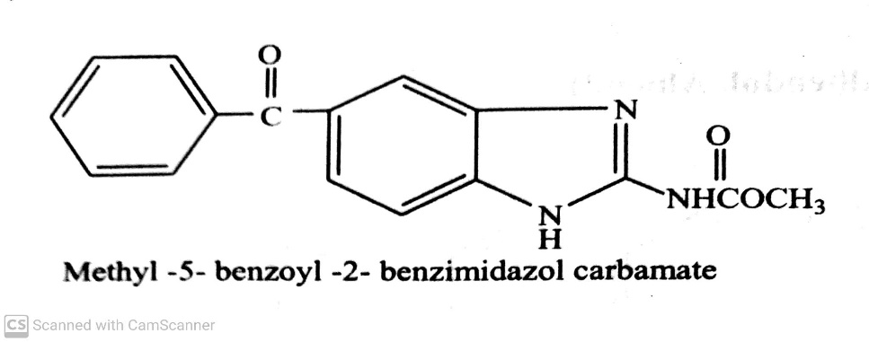
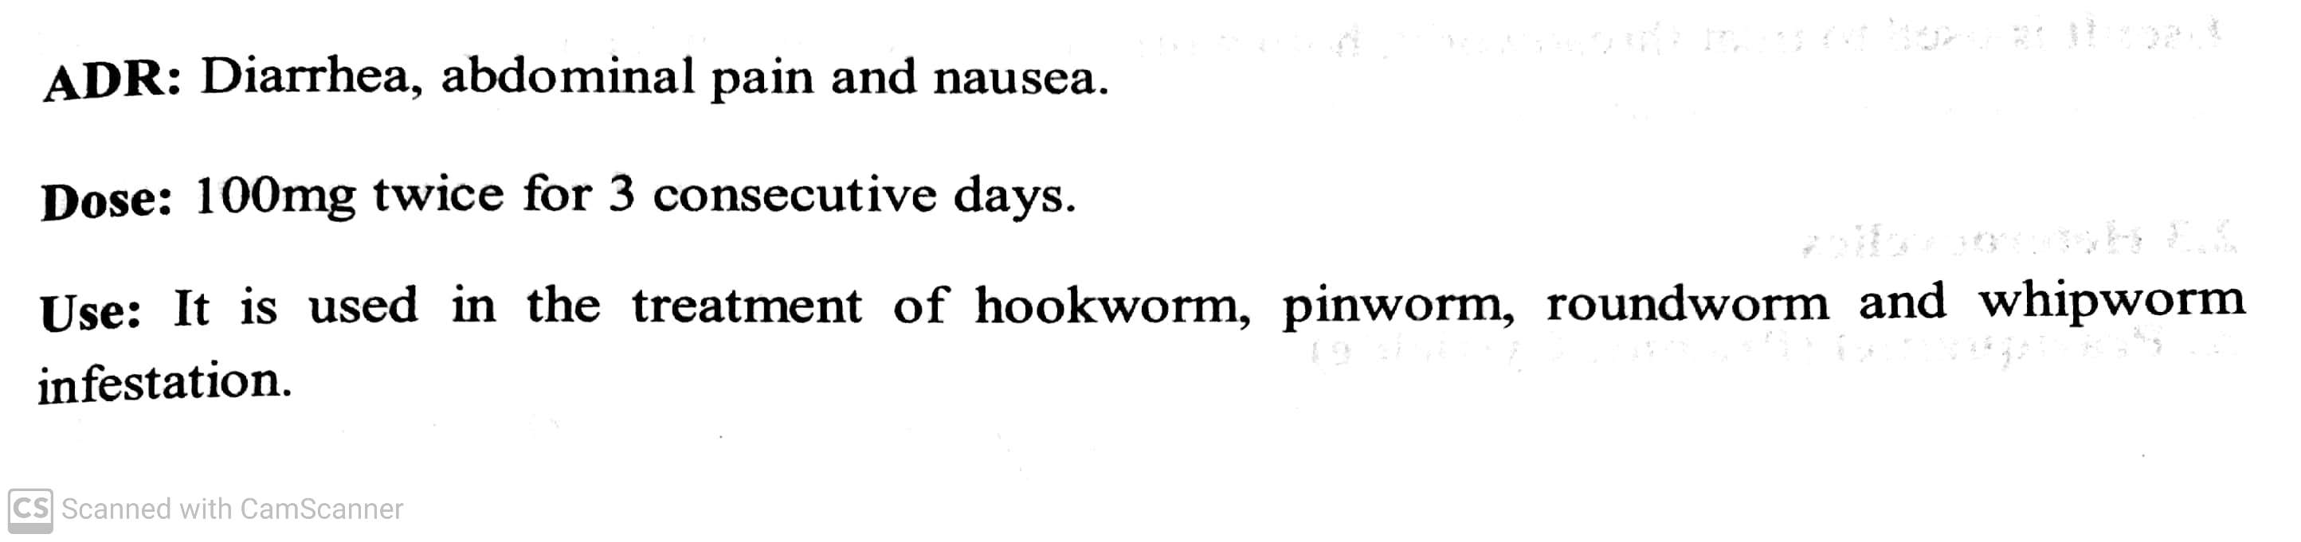
ANTHELMINTICS
Classifications: Anthelmintics are classified based upon their chemical structure.
ii) Benzimidazoles : eg. Albendazole, Mebendazole, Thiabendazole.
eg. Mebendazole ( Mebazole, Mendazole) :
-08-2020
11

Slide 12
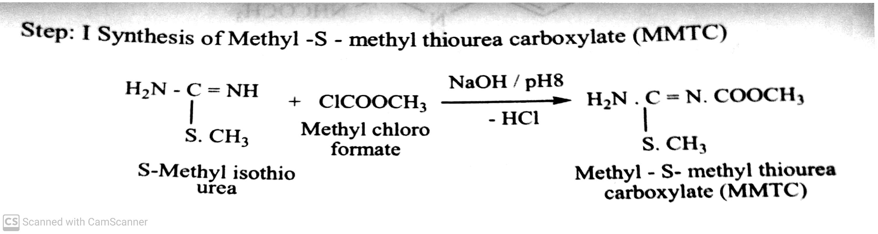
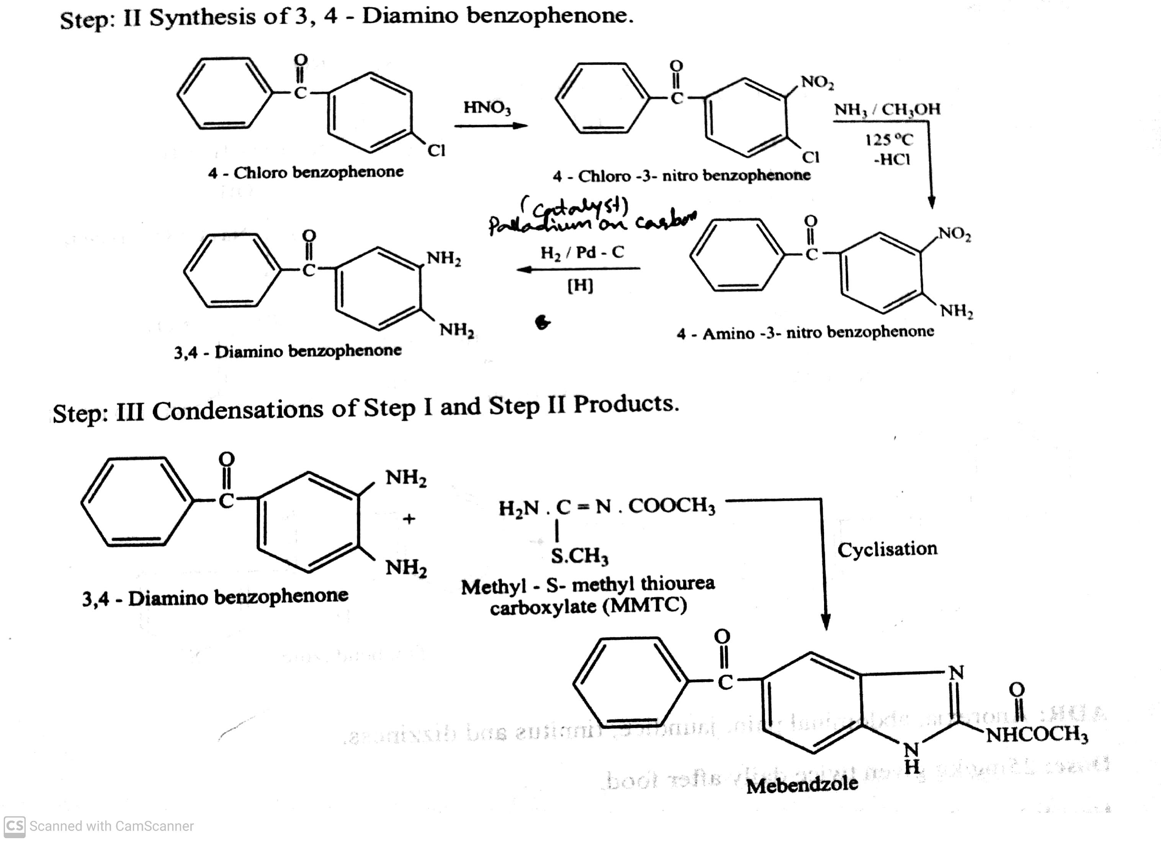
ANTHELMINTICS
Classifications: Anthelmintics are classified based upon their chemical structure.
Synthesis of Mebendazole ( Mebazole, Mendazole) :
-08-2020
12

Slide 13
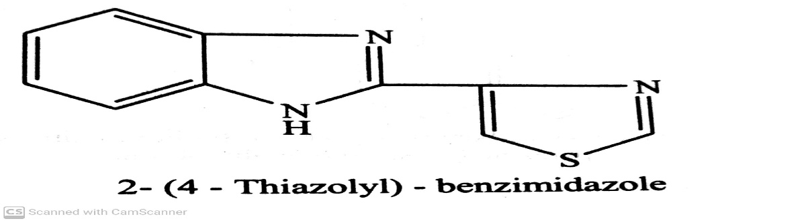
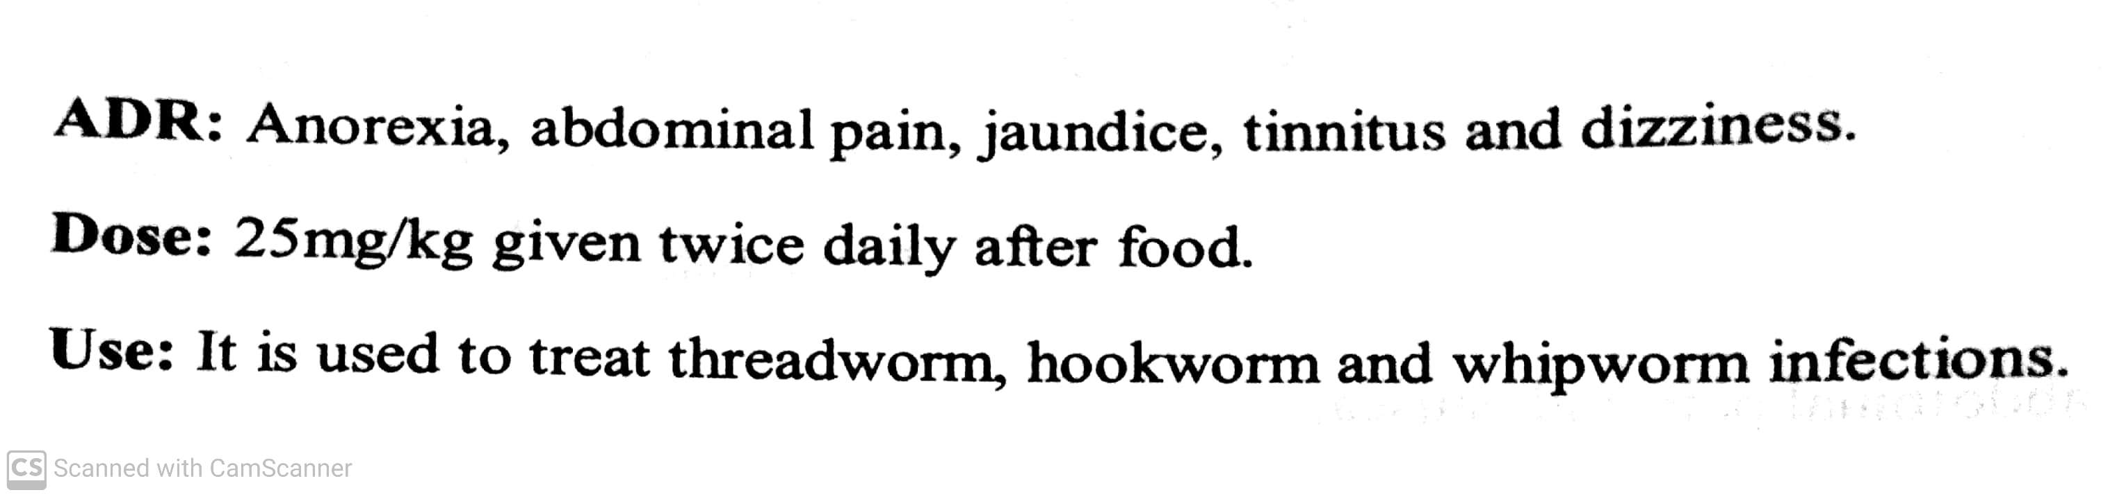
ANTHELMINTICS
Classifications: Anthelmintics are classified based upon their chemical structure.
ii) Benzimidazoles : eg. Albendazole, Mebendazole, Thiabendazole.
eg. Thiabendazole ( Mintezole, Bovizol) :
-08-2020
13

Slide 14
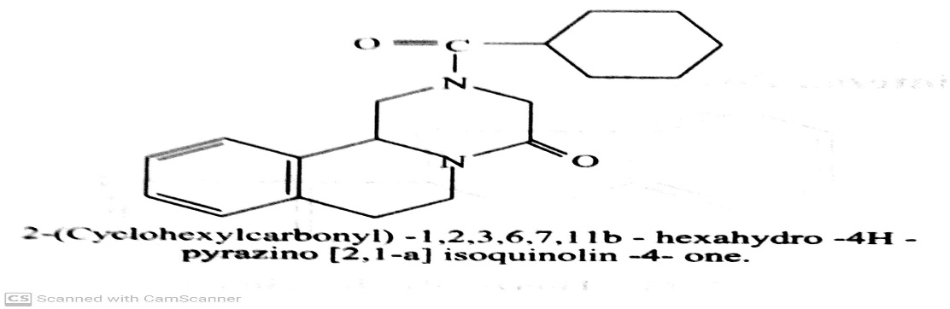
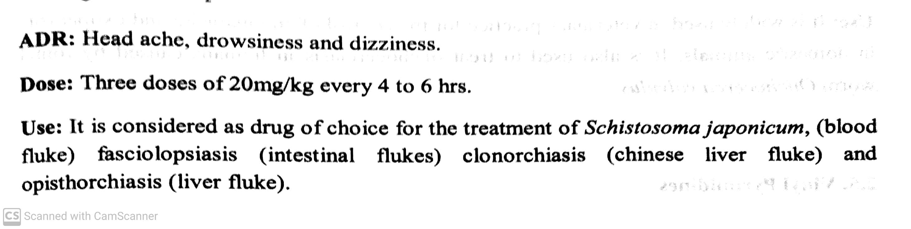
ANTHELMINTICS
Classifications: Anthelmintics are classified based upon their chemical structure.
iii) Heterocyclics : eg. Oxamniquine, Praziquantel.
eg. Praziquantel (Prazine, Cysticide) :
-08-2020
14

Slide 15
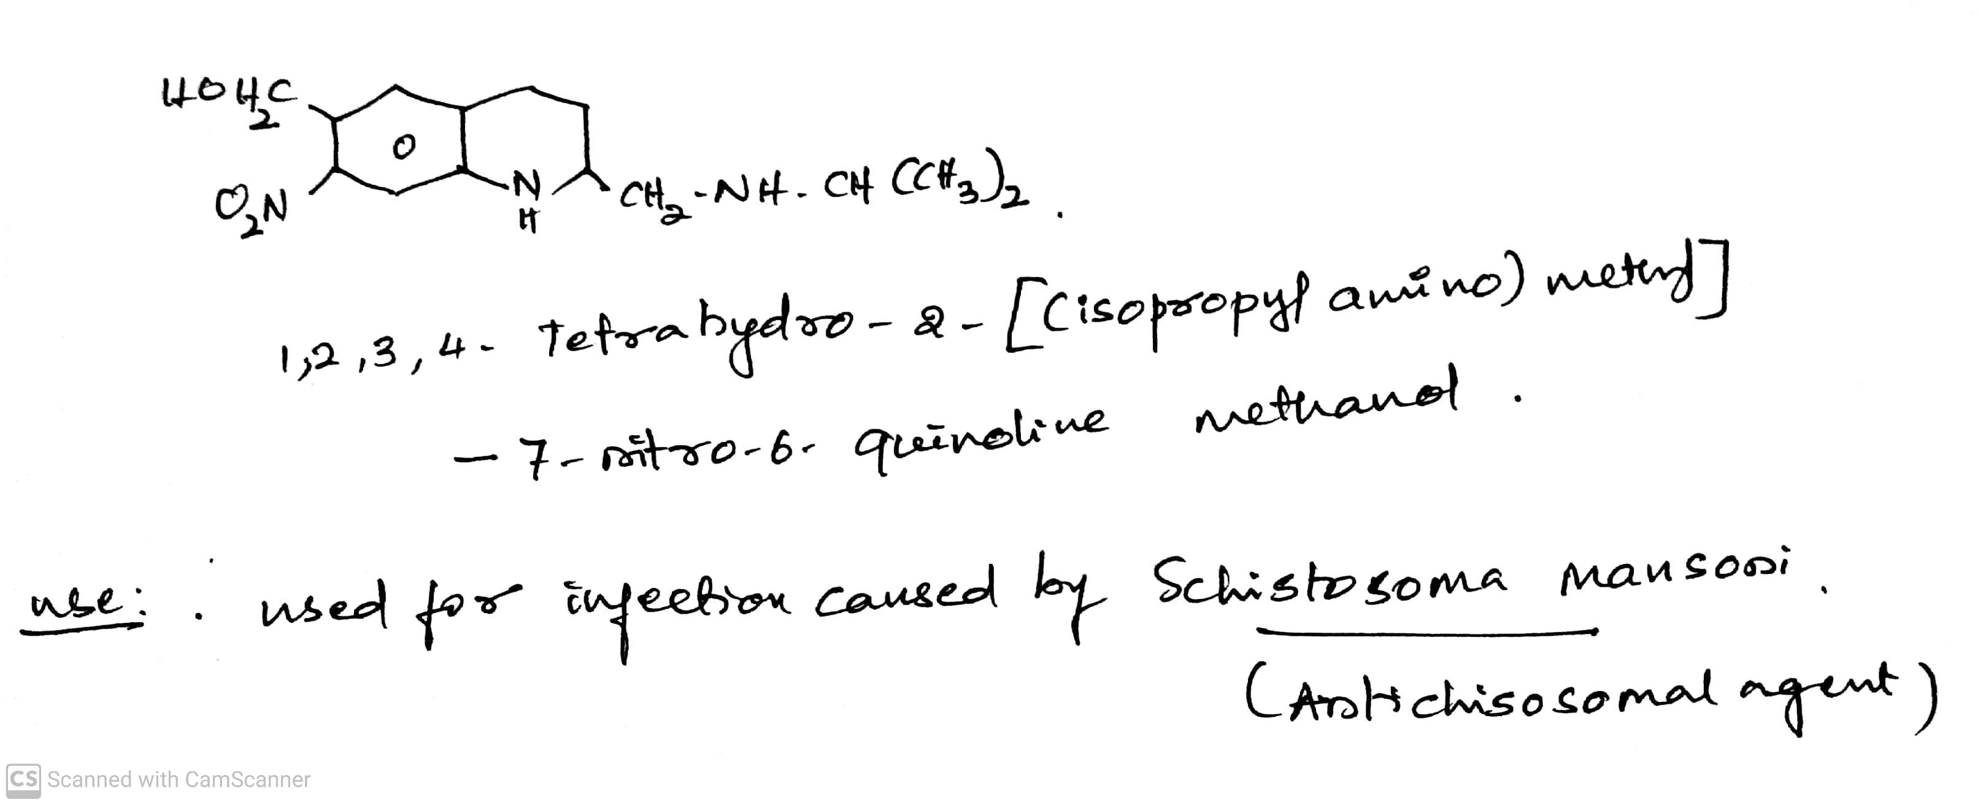
ANTHELMINTICS
Classifications: Anthelmintics are classified based upon their chemical structure.
iii) Heterocyclics : eg. Oxamniquine, Praziquantel.
eg. Oxamniquine :
-08-2020
15

Slide 16
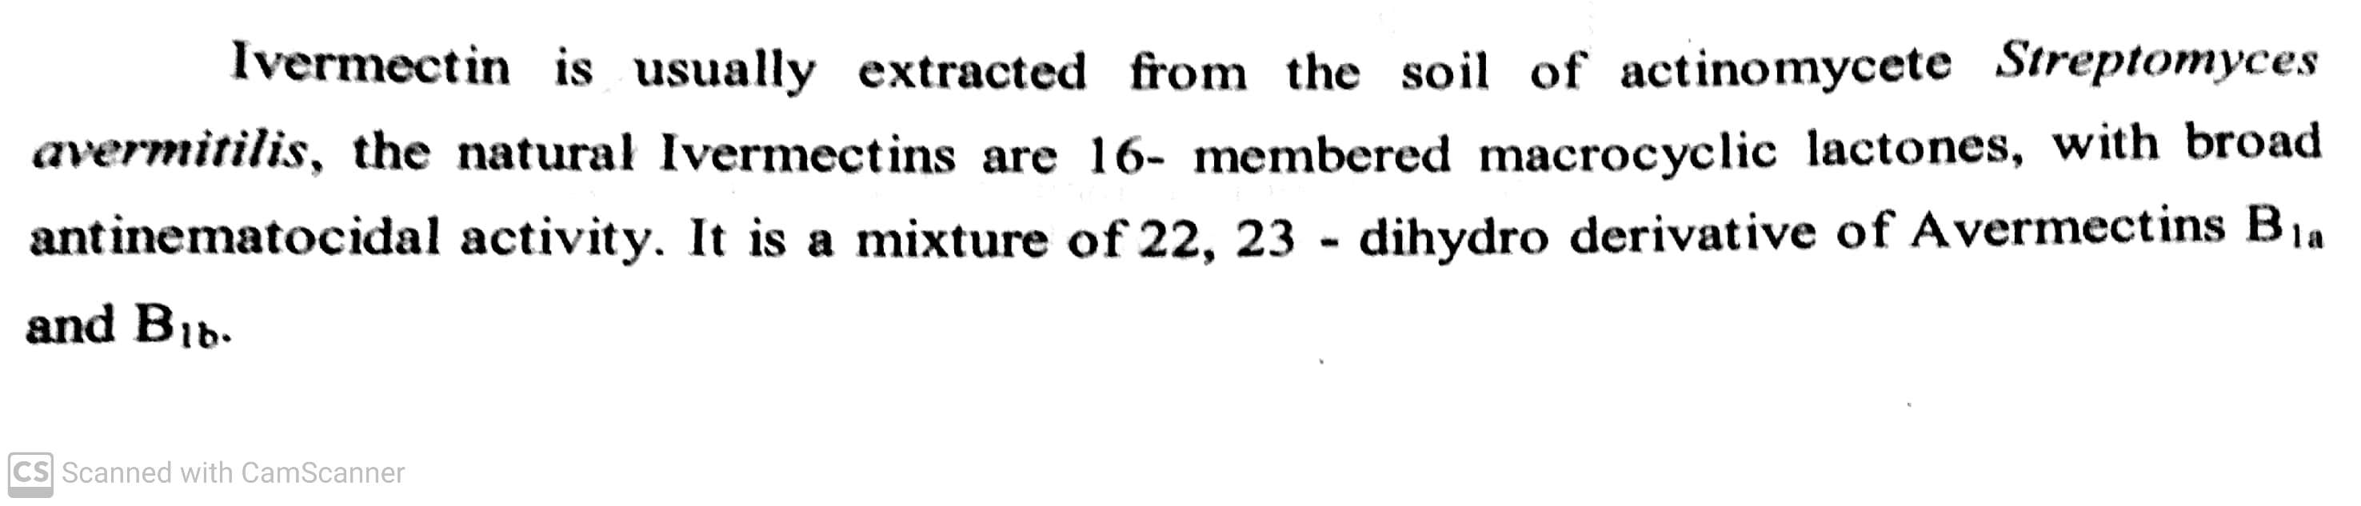
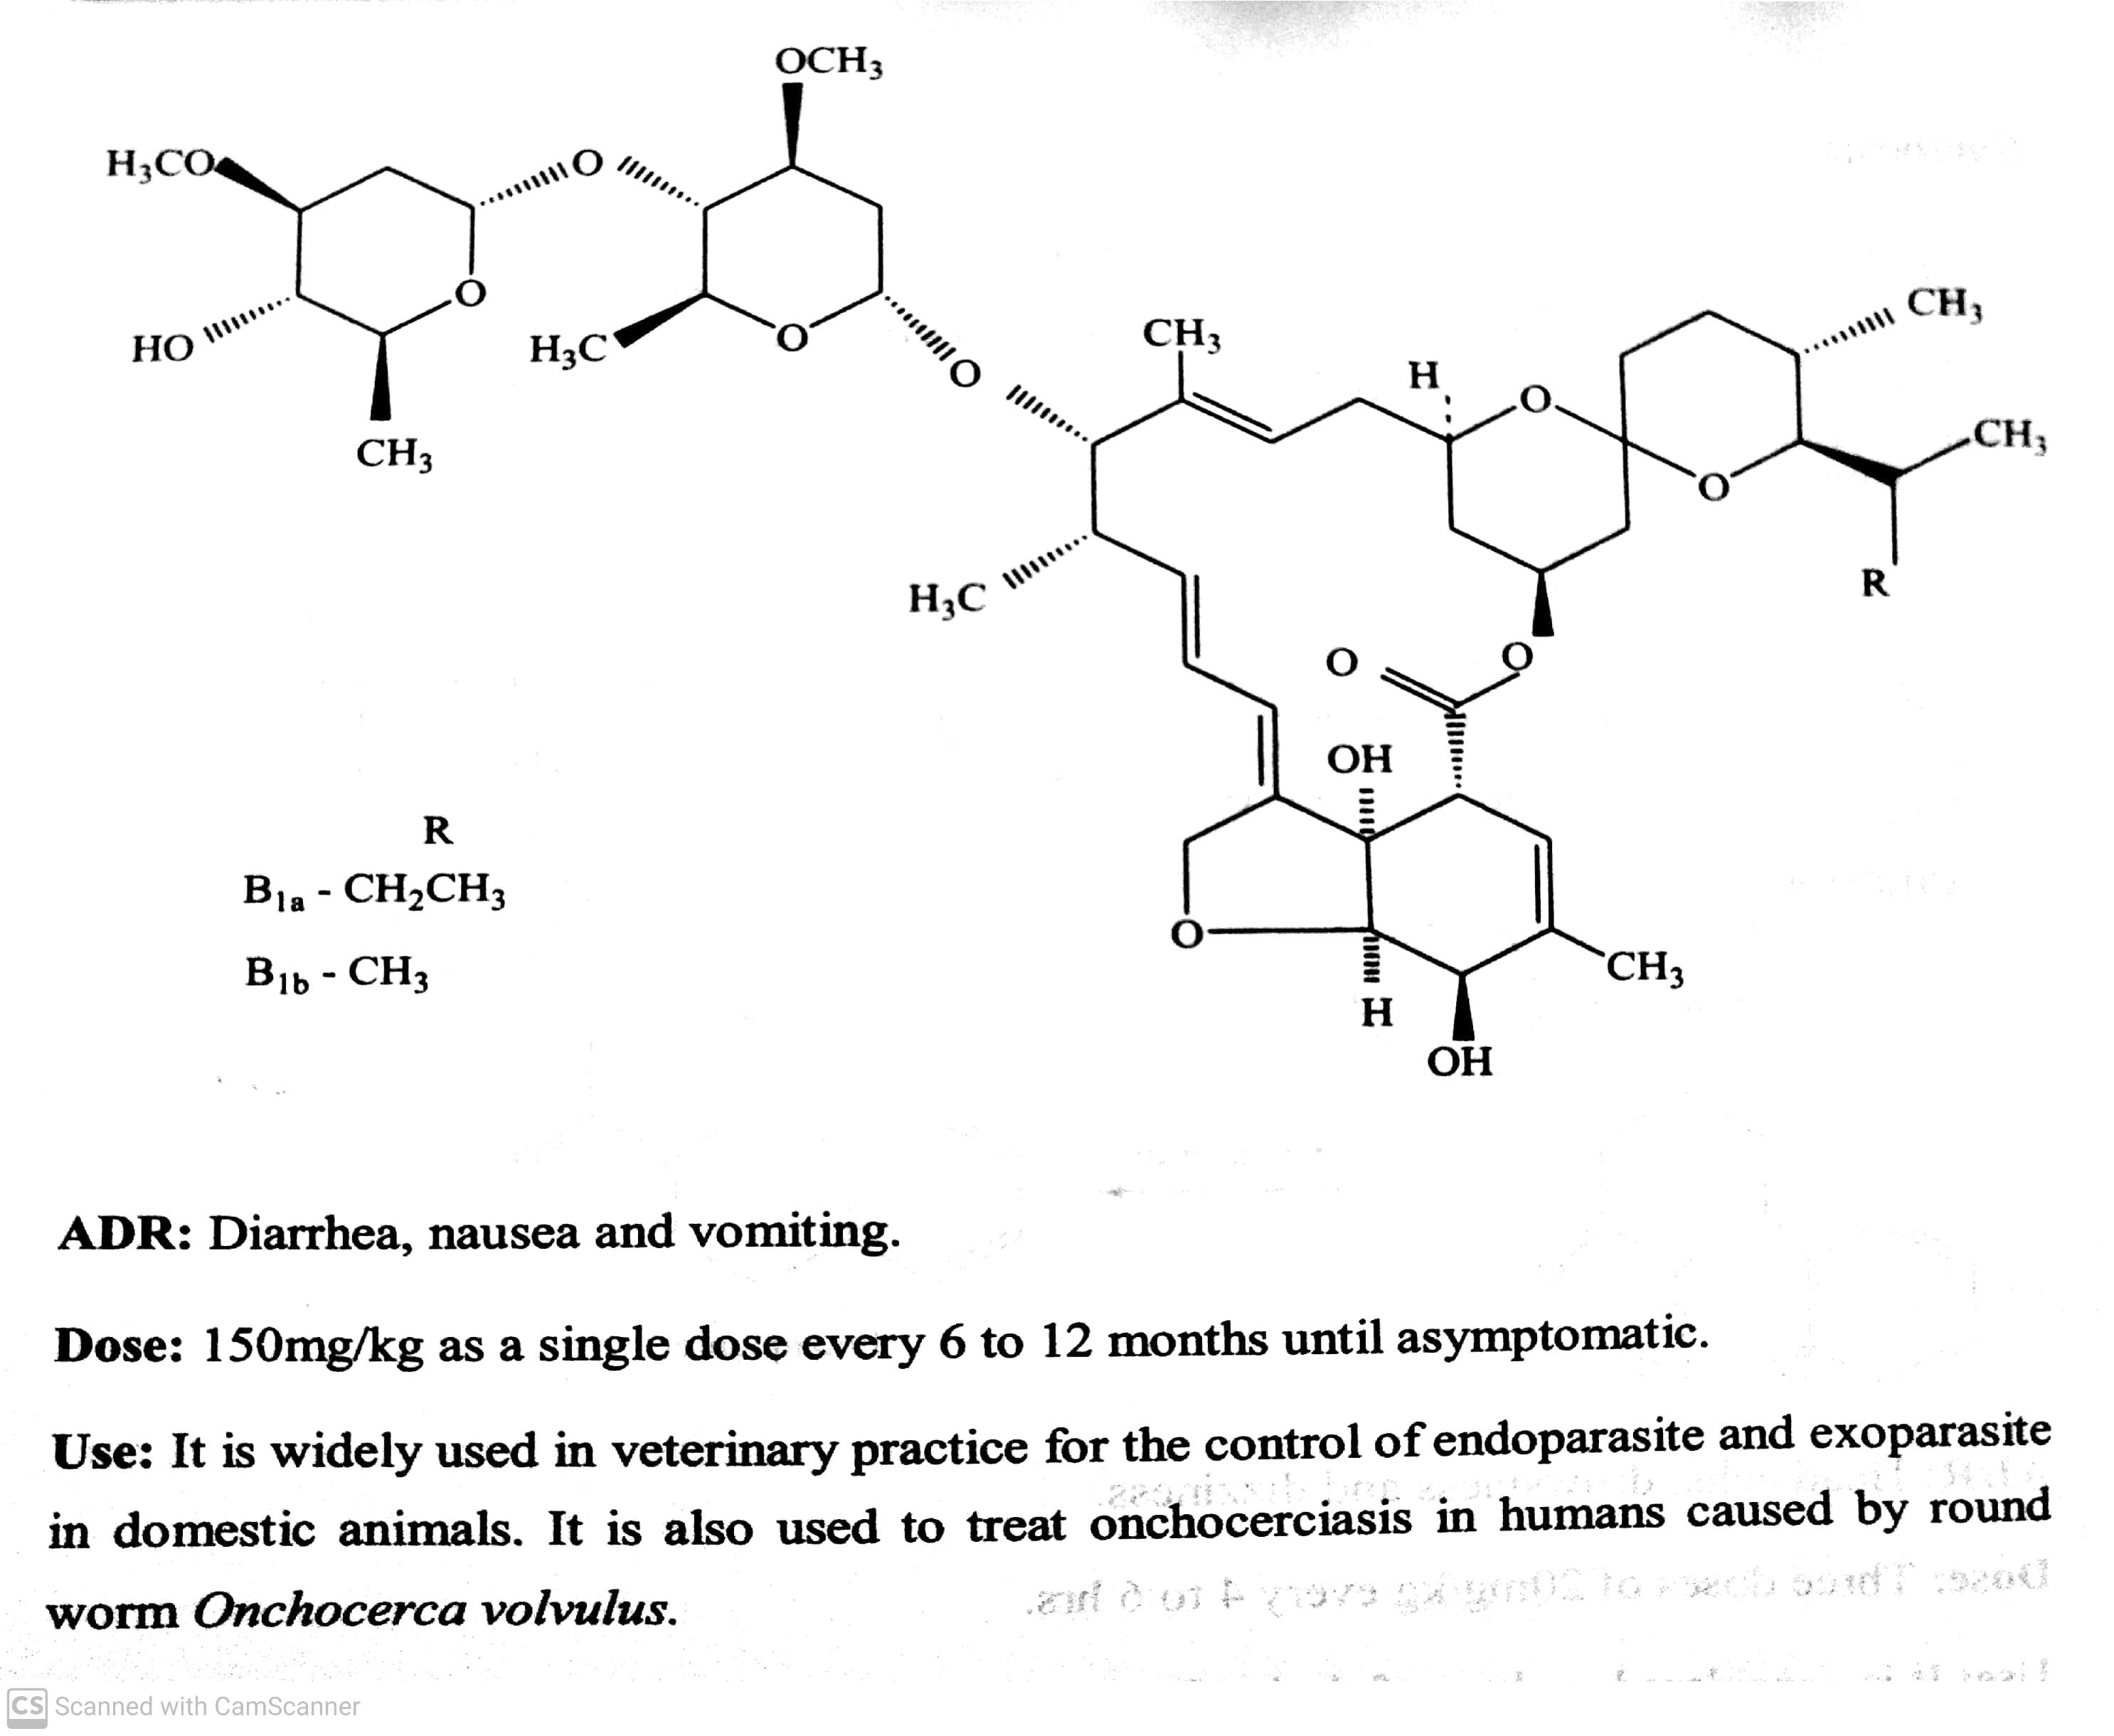
ANTHELMINTICS
Classifications: Anthelmintics are classified based upon their chemical structure.
iv) Natural products :eg. Ivermectin, Avermectin.
-08-2020
16

Slide 17
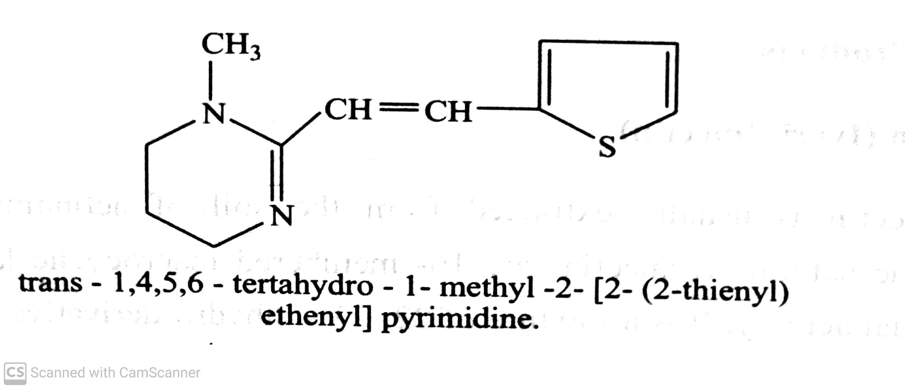
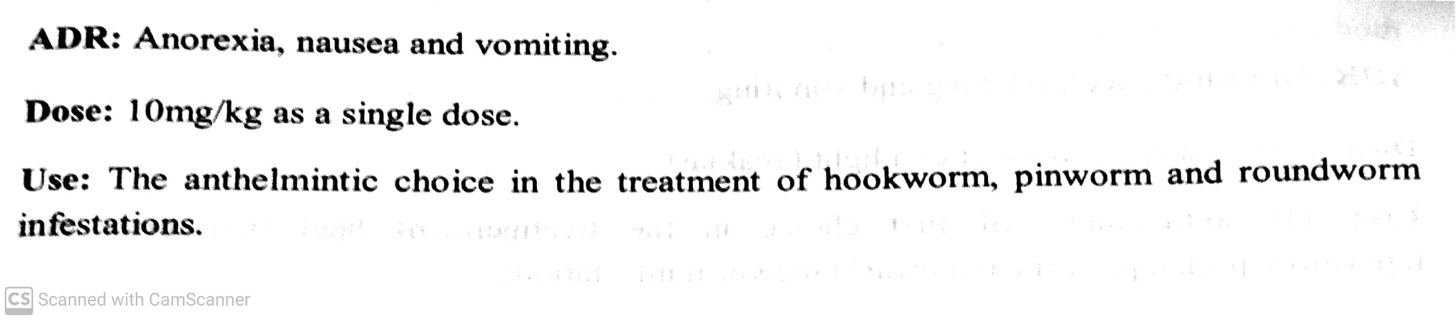
ANTHELMINTICS
Classifications: Anthelmintics are classified based upon their chemical structure.
v) Vinyl pyrimidines : eg. Pyrantel, Oxantel.
eg. Pyrantel :
-08-2020
17

Slide 18
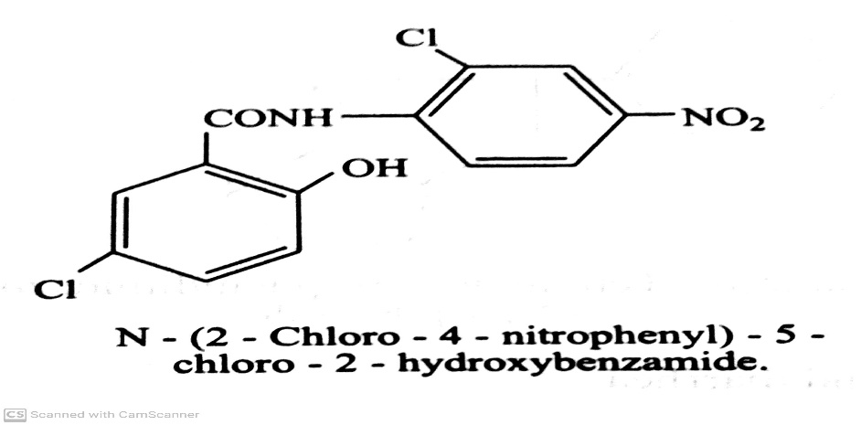
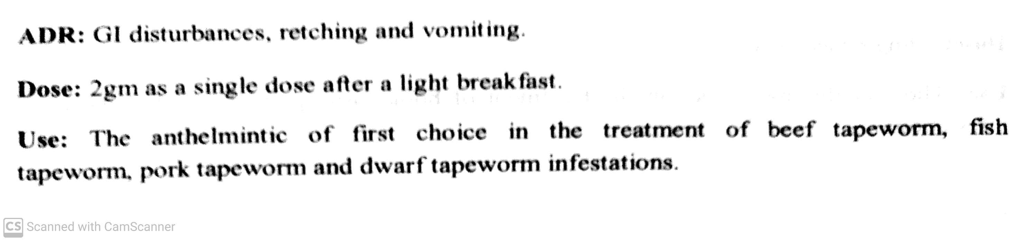
ANTHELMINTICS
Classifications: Anthelmintics are classified based upon their chemical structure.
vi) Amide : eg. Niclosamide.
-08-2020
18

Slide 19
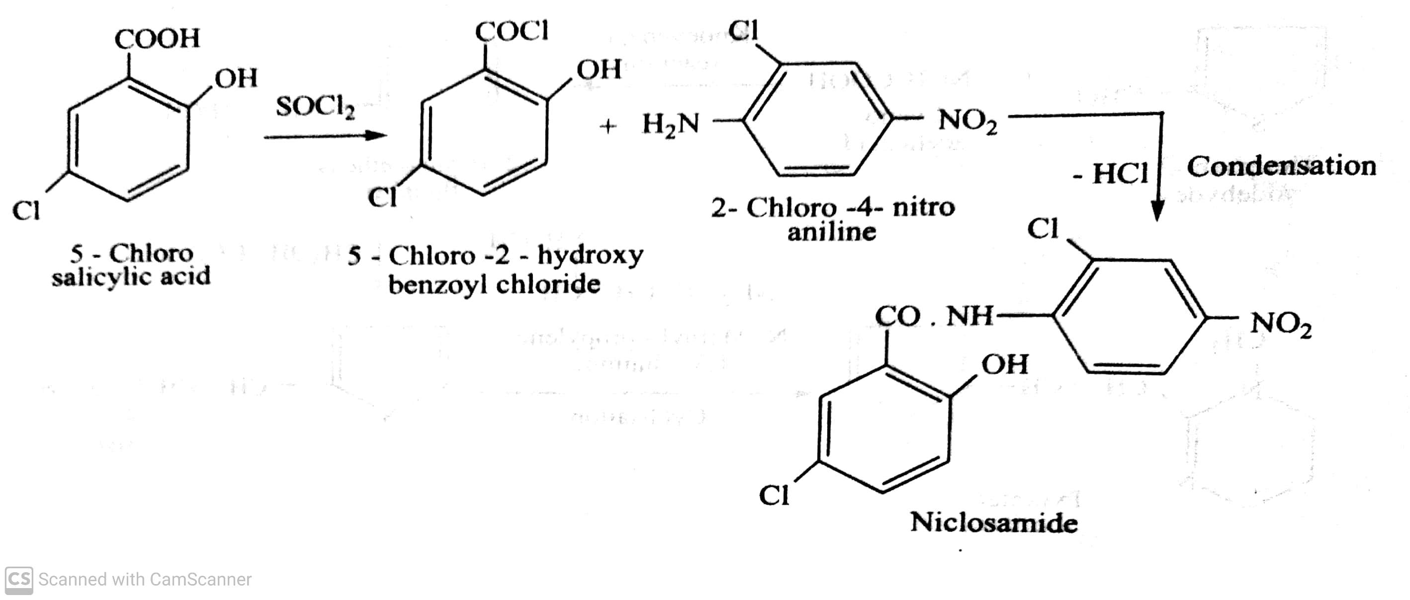
ANTHELMINTICS
Classifications: Anthelmintics are classified based upon their chemical structure.
vi) Amide : Synthesis of Niclosamide.
-08-2020
19

Slide 20
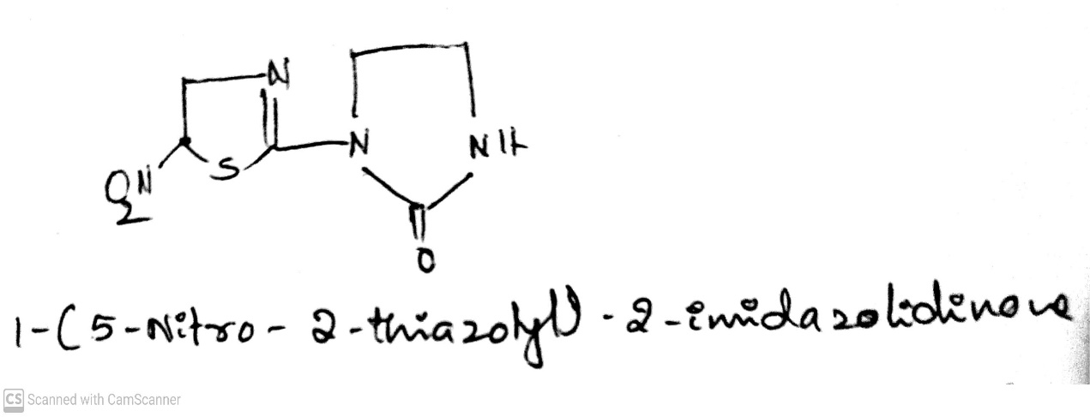
ANTHELMINTICS
Classifications: Anthelmintics are classified based upon their chemical structure.
vii) Nitro derivatives : eg. Niridazoles.
Use: Used to parasite infections ( Giardiasis, amoebiasis)
-08-2020
20

Slide 21
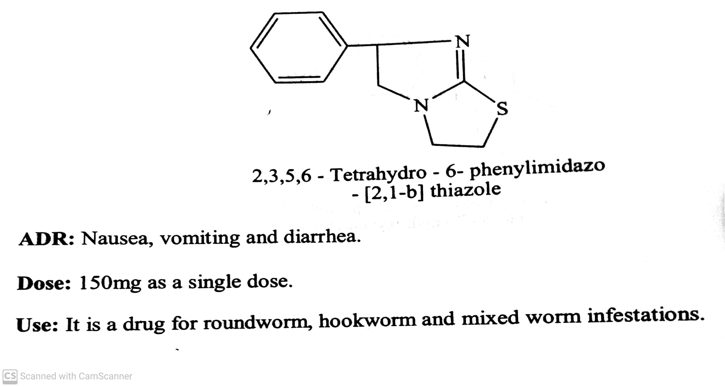
ANTHELMINTICS
Classifications: Anthelmintics are classified based upon their chemical structure.
viii) Imidazo thiozole : eg. Levamisole
-08-2020
21

Slide 22
THANK YOU
-08-2020
22

