Slide 1

MEDICINAL CHEMISTRY
ANTISCABIOUS & ANTIPEDICULAR AGENTS
05-08-2020
1

Slide 2
ANTISCABIOUS & ANTIPEDICULAR AGENTS
Scabicides are agents that are effective against Scarcoptes scabiei, Which is an animal parasite that causes
scabies in man.
Antipedicular agents are compounds effective in the treatment in man caused by three species of suckling
lice known as Pediculus humanus, variety capitis, corporis and phthirius pubis.
Examples: Benzyl benzoate, Gammexane, Chlorophenothane.
-08-2020
2

Slide 3
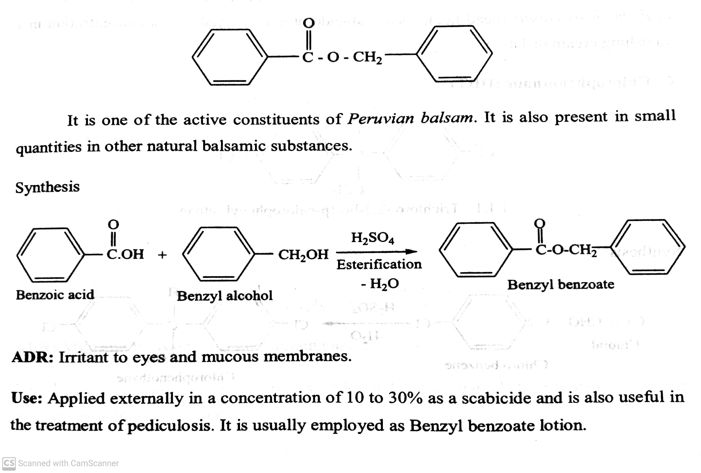
ANTISCABIOUS & ANTIPEDICULAR AGENTS
Examples: Benzyl benzoate, Gammexane, Chlorophenothane.
Eg. Benzyl benzoate ( Dermin lotion):
-08-2020
3

Slide 4
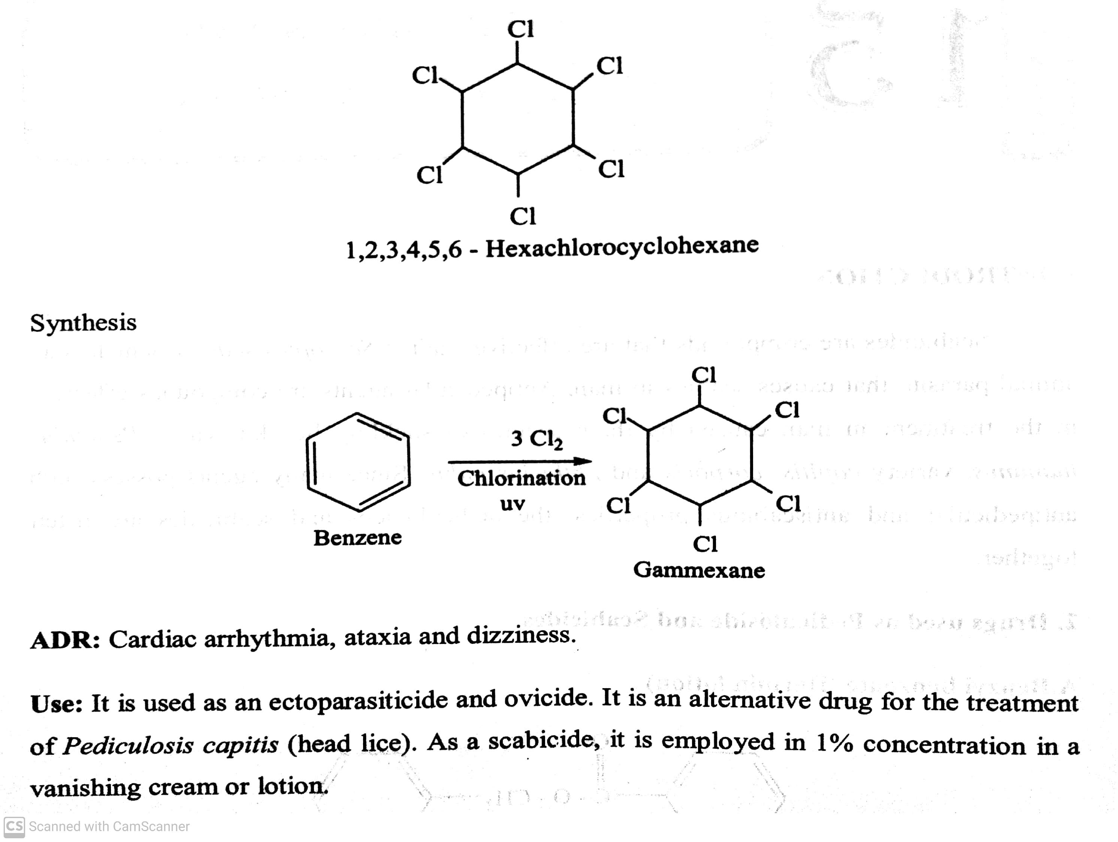
ANTISCABIOUS & ANTIPEDICULAR AGENTS
Examples: Benzyl benzoate, Gammexane, Chlorophenothane.
Eg. Gammexane (Scaboma lotion):
-08-2020
4

Slide 5
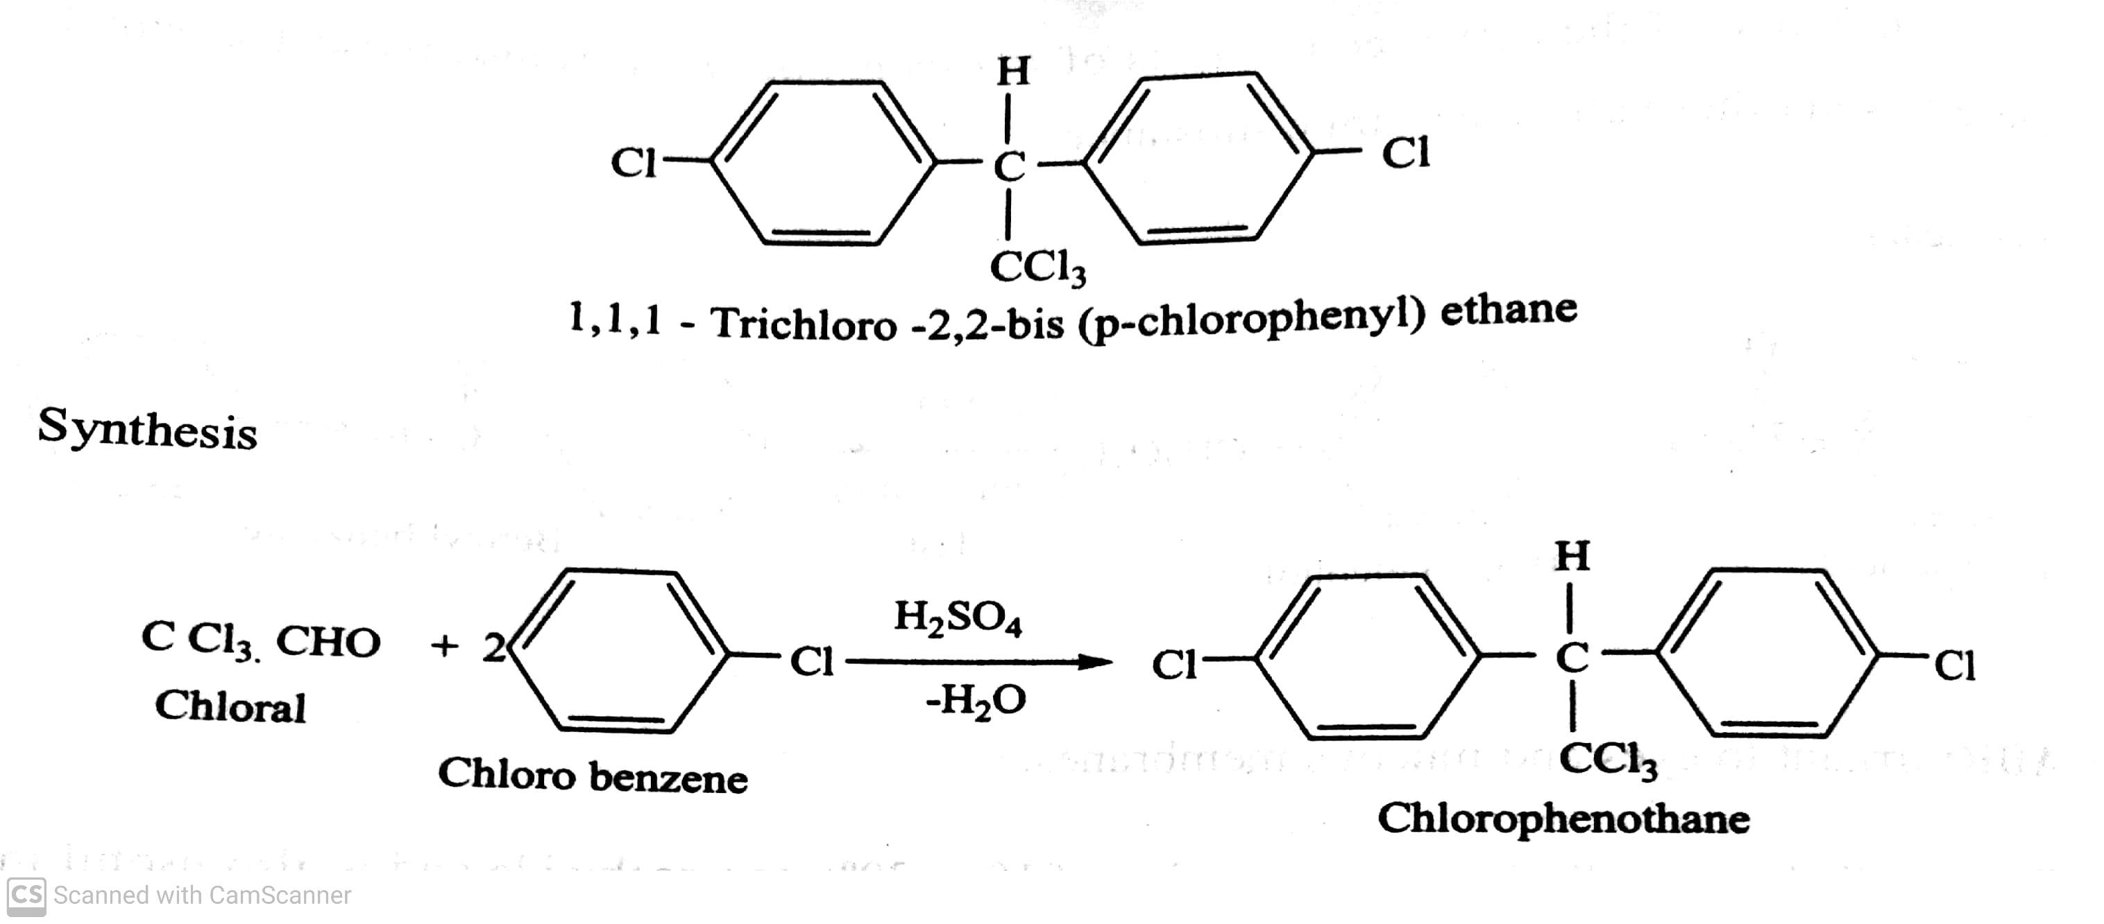
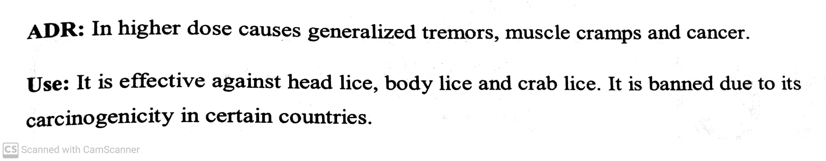
ANTISCABIOUS & ANTIPEDICULAR AGENTS
Examples: Benzyl benzoate, Gammexane, Chlorophenothane.
Eg. Chlorophenothane (DDT- Dichloro Diphenyl Trichloro ethane):
-08-2020
5

Slide 6
THANK YOU
-08-2020
6

