Slide 1

MEDICINAL CHEMISTRY
SULPHONAMIDES AND SULPHONES
05-08-2020
1

Slide 2
SULPHONAMIDES
Antibacterial sulphonamides are first effective chemotherapeutic agents used for bacterial infection in
humans.
The term sulphonamide is usually employed as a generic name for the derivatives of Para Amino Benzene
Sulphonamides.
Sulphonamides inhibits Gram +ve and Gram –ve bacteria, Norcodia, chlamydia trachomatis and some
protozoa.
Sulphonamides are used in the treatment of tonsillitis, septicaemia, meningococcal meningitis, bacillary
dysentery and infections of urinary tract.
-08-2020
2

Slide 3
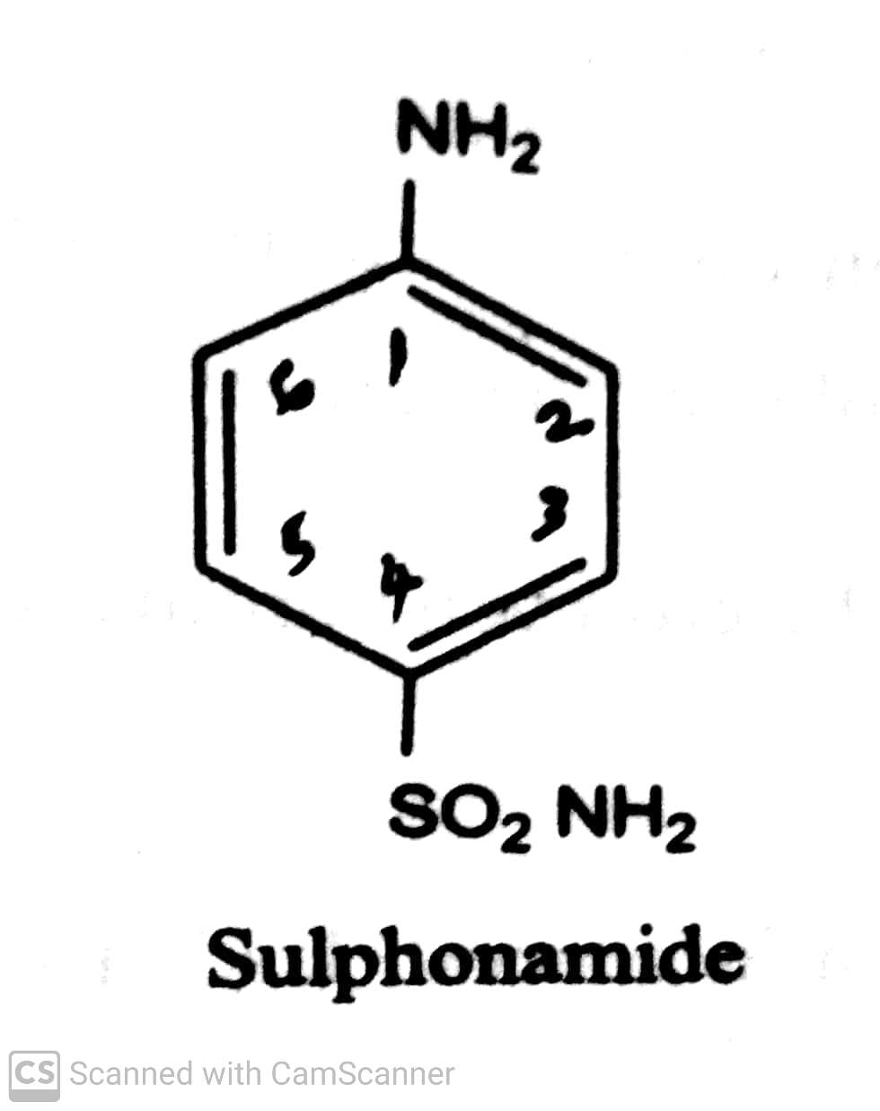
SULPHONAMIDES
Chemistry:
Sulphonamides consists of a benzene ring an amine moiety (-NH2) and sulphonamide group (-SO2 NH2).
-08-2020
3

Slide 4
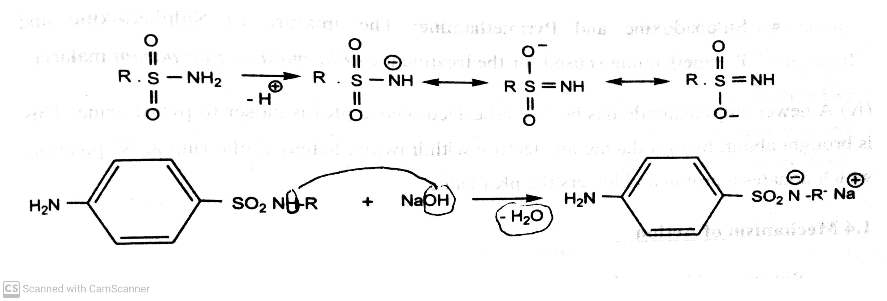
SULPHONAMIDES
Properties:
Sulphonamides are white crystalline powder .
Sparingly soluble in water,
The sulphonamide group -SO2 NH2 loses a proton and form salt, which are more soluble than the free
sulphonamides.
The –ve charge on nitrogen after the loss of proton gain stability by resonance.
-08-2020
4

Slide 5
SULPHONAMIDES
Mechanism of action:
PABA + Pteridine
Inhibited by Pteridine
Sulphonamides synthetase
Dihydropteroic acid
Dihydrofolate
synthetase
Dihdrofolic acid
Trimethoprim Dihydrofolate
reductase
Tetrahydrofolic acid
Thymidine Amino acids
Purines
DNA
-08-2020
5

Slide 6
SULPHONAMIDES
Mechanism of action:
Sulphonamides are bacteriostatic in nature.
The sulphonamide sensitive micro-organisms requires PABA for the synthesis of folic acid which is responsible for the
synthesis of DNA & RNA.
Various folate derivatives like folinic acid, N5, N10- methylene tetra hydro folic acid and N10- formyl tetra hydro folic acid
acts as co-enzymes in transport of one carbon unit in several biochemical reaction in humans and microorganisms.
The one carbon transfer reaction is necessary for the synthesis of purines, thymidine and amino acids.
Sulphonamides blocks the biosynthesis of folate co-enzyme resulting in to the arrest of bacterial growth and cell division.
Folate co-enzymes are biosynthesized from dietary folic acid in human and other cells.
Bacterial and protozoa must biosynthesis it de novo from PABA to pteridine diphosphate and blocking the net
biosynthesis of folate co-enzyme.
The conversion of dihydrofolic acid to tetrahydrofolic acid is catalysed by the enzyme dihydrofolate reductase.
-08-2020
6

Slide 7
SULPHONAMIDES
SAR OF Sulphonamides:
-08-2020
7

Slide 8
SULPHONAMIDES
SAR OF Sulphonamides:
The free amino group (-NH2) is essential for activity.
The amino and sulphonyl groups should be 1,4 position; in order to possess antibacterial activity.
1,2 and 1,3 isomers are therapeutically less active.
Any substitution on aromatic ring/ Replacement of benzene ring by other ring , decreases/ abolishes the activity.
Substitution of heterocyclic aromatic nucleus in N1 position yield highly potent compound.
N1- disustitution in general, leads to inactive compound because one hydrogen is essential for ionization.
Maximum antibacterial activity is exhibited by sulphonamides having pKa value between 6.6-7.4.
The lipid solubility influences the pharmacokinetics and antibacterial activity.
( The lipid solubility increases, the half life and antibacterial activity also increases).
-08-2020
© R R INSTITUTIONS , BANGALORE
8

Slide 9
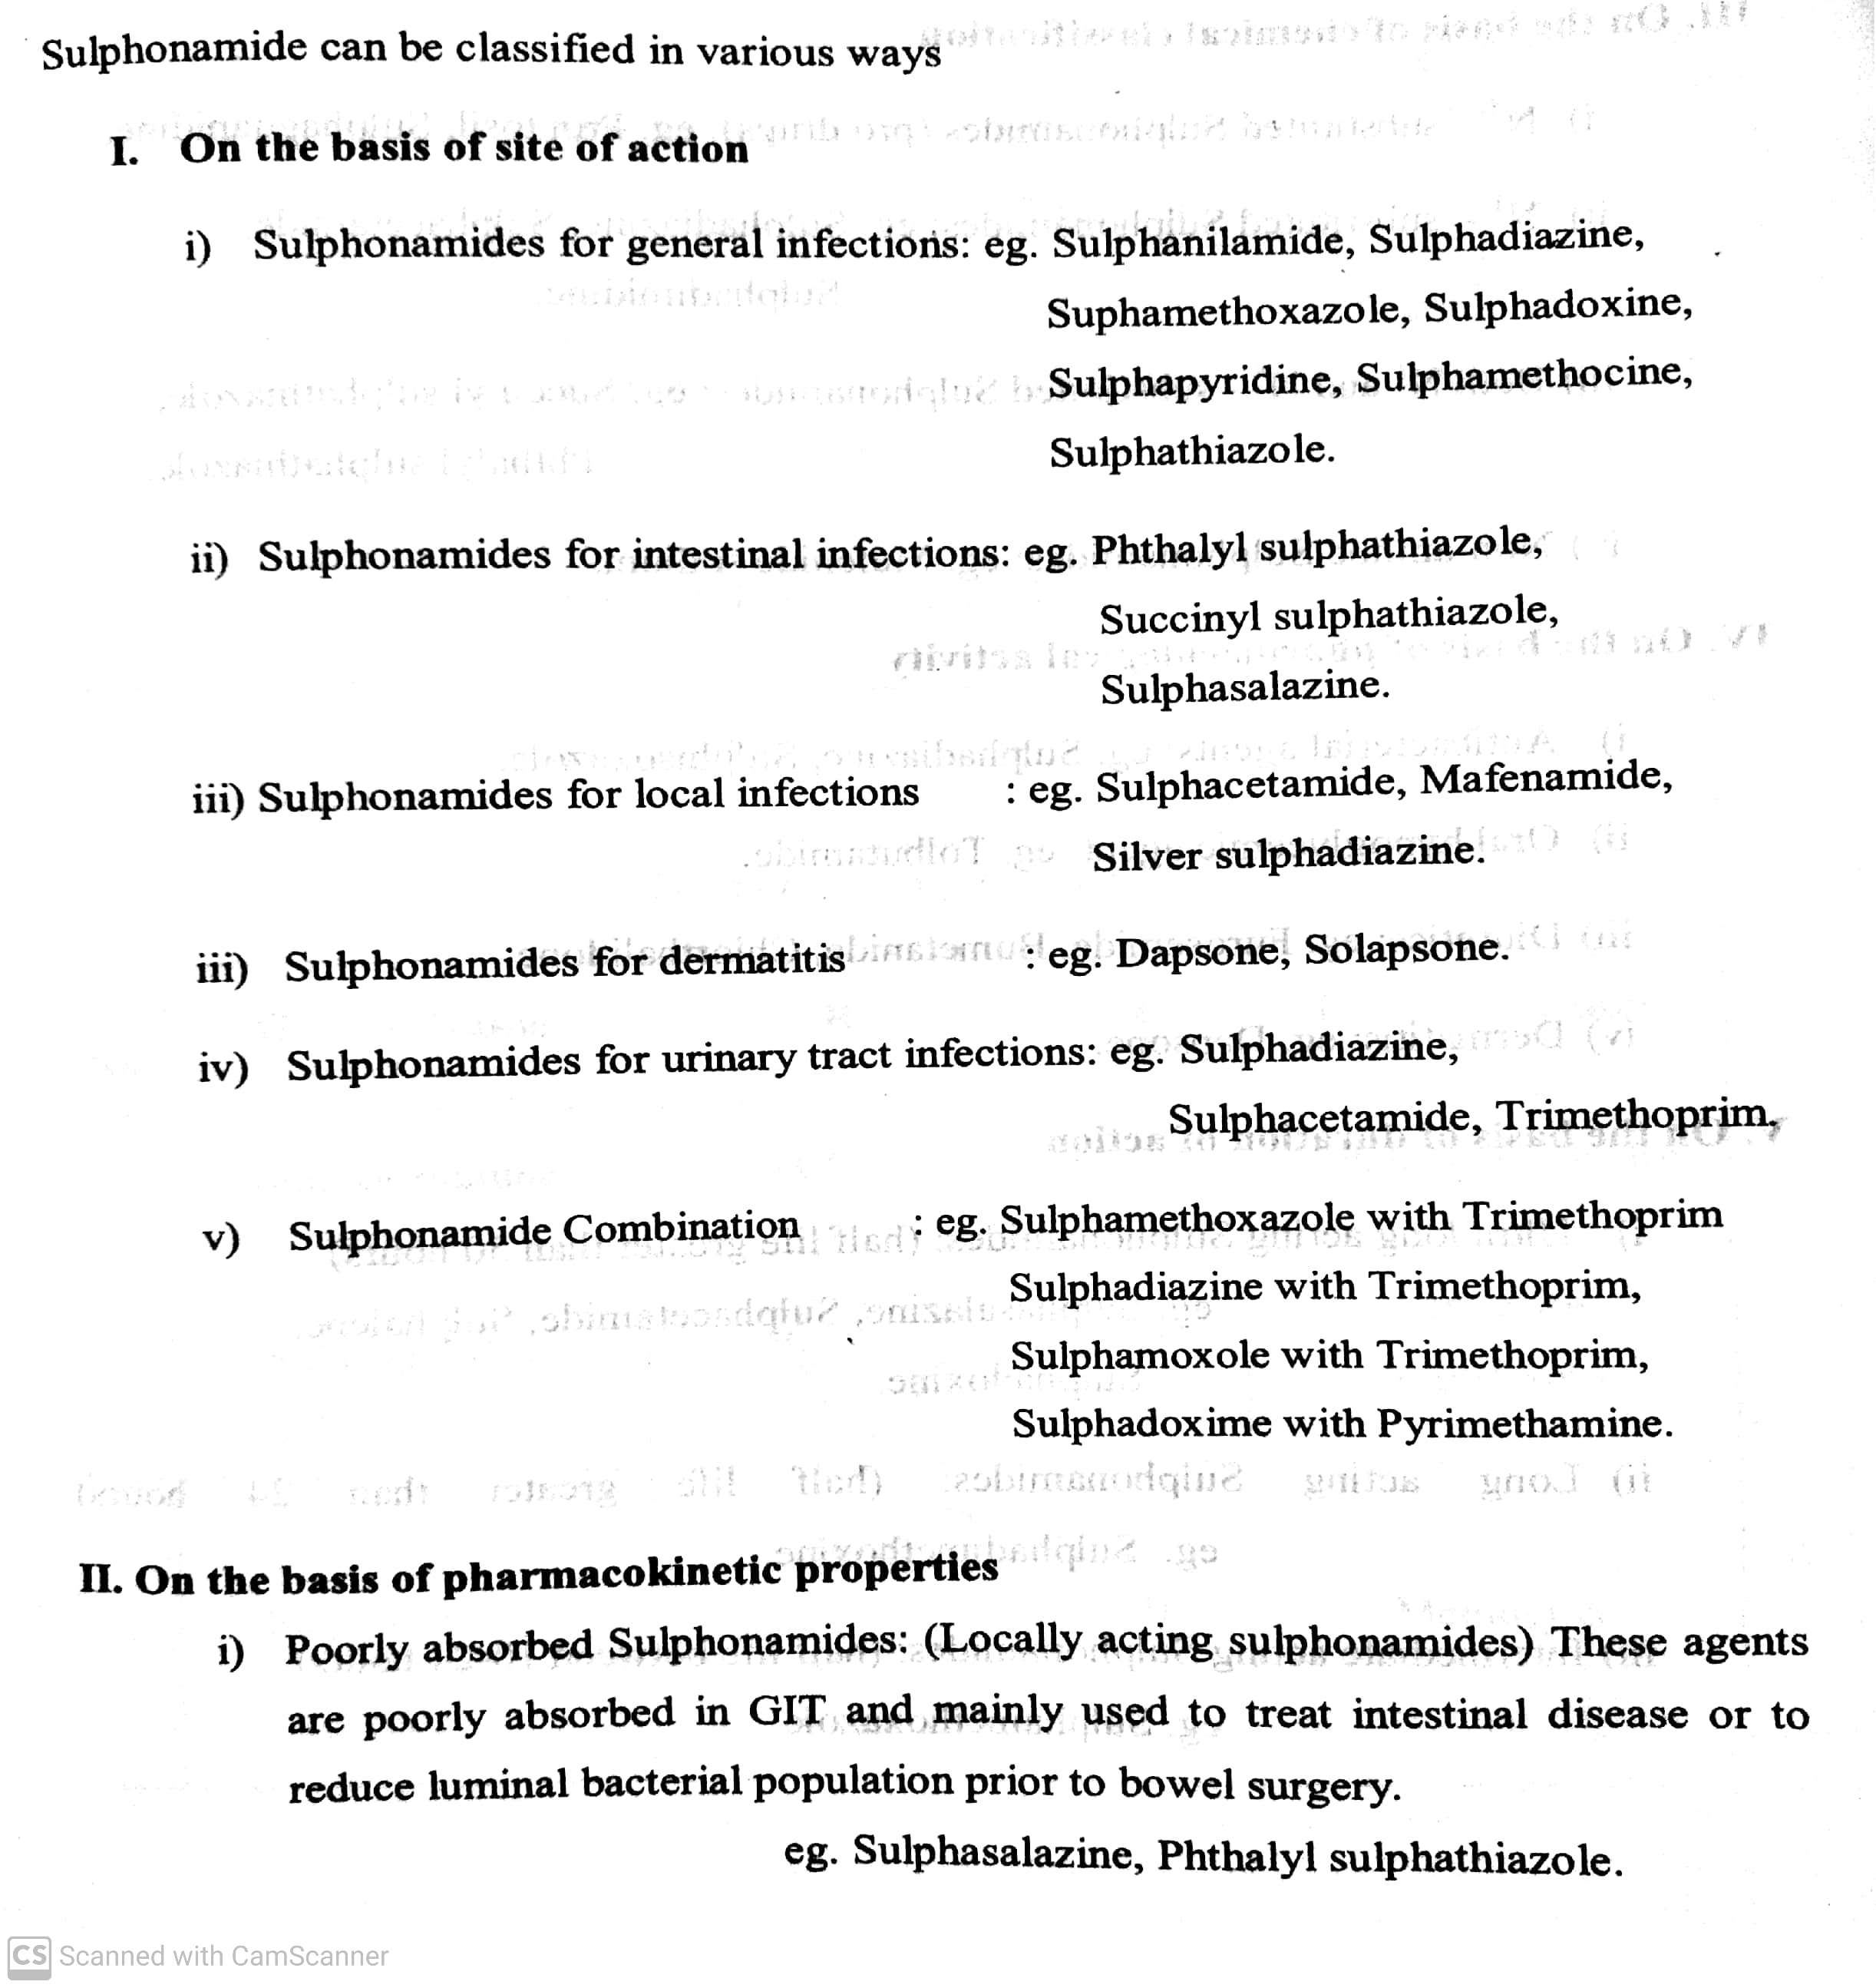
SULPHONAMIDES
Classifications:
-08-2020
9

Slide 10
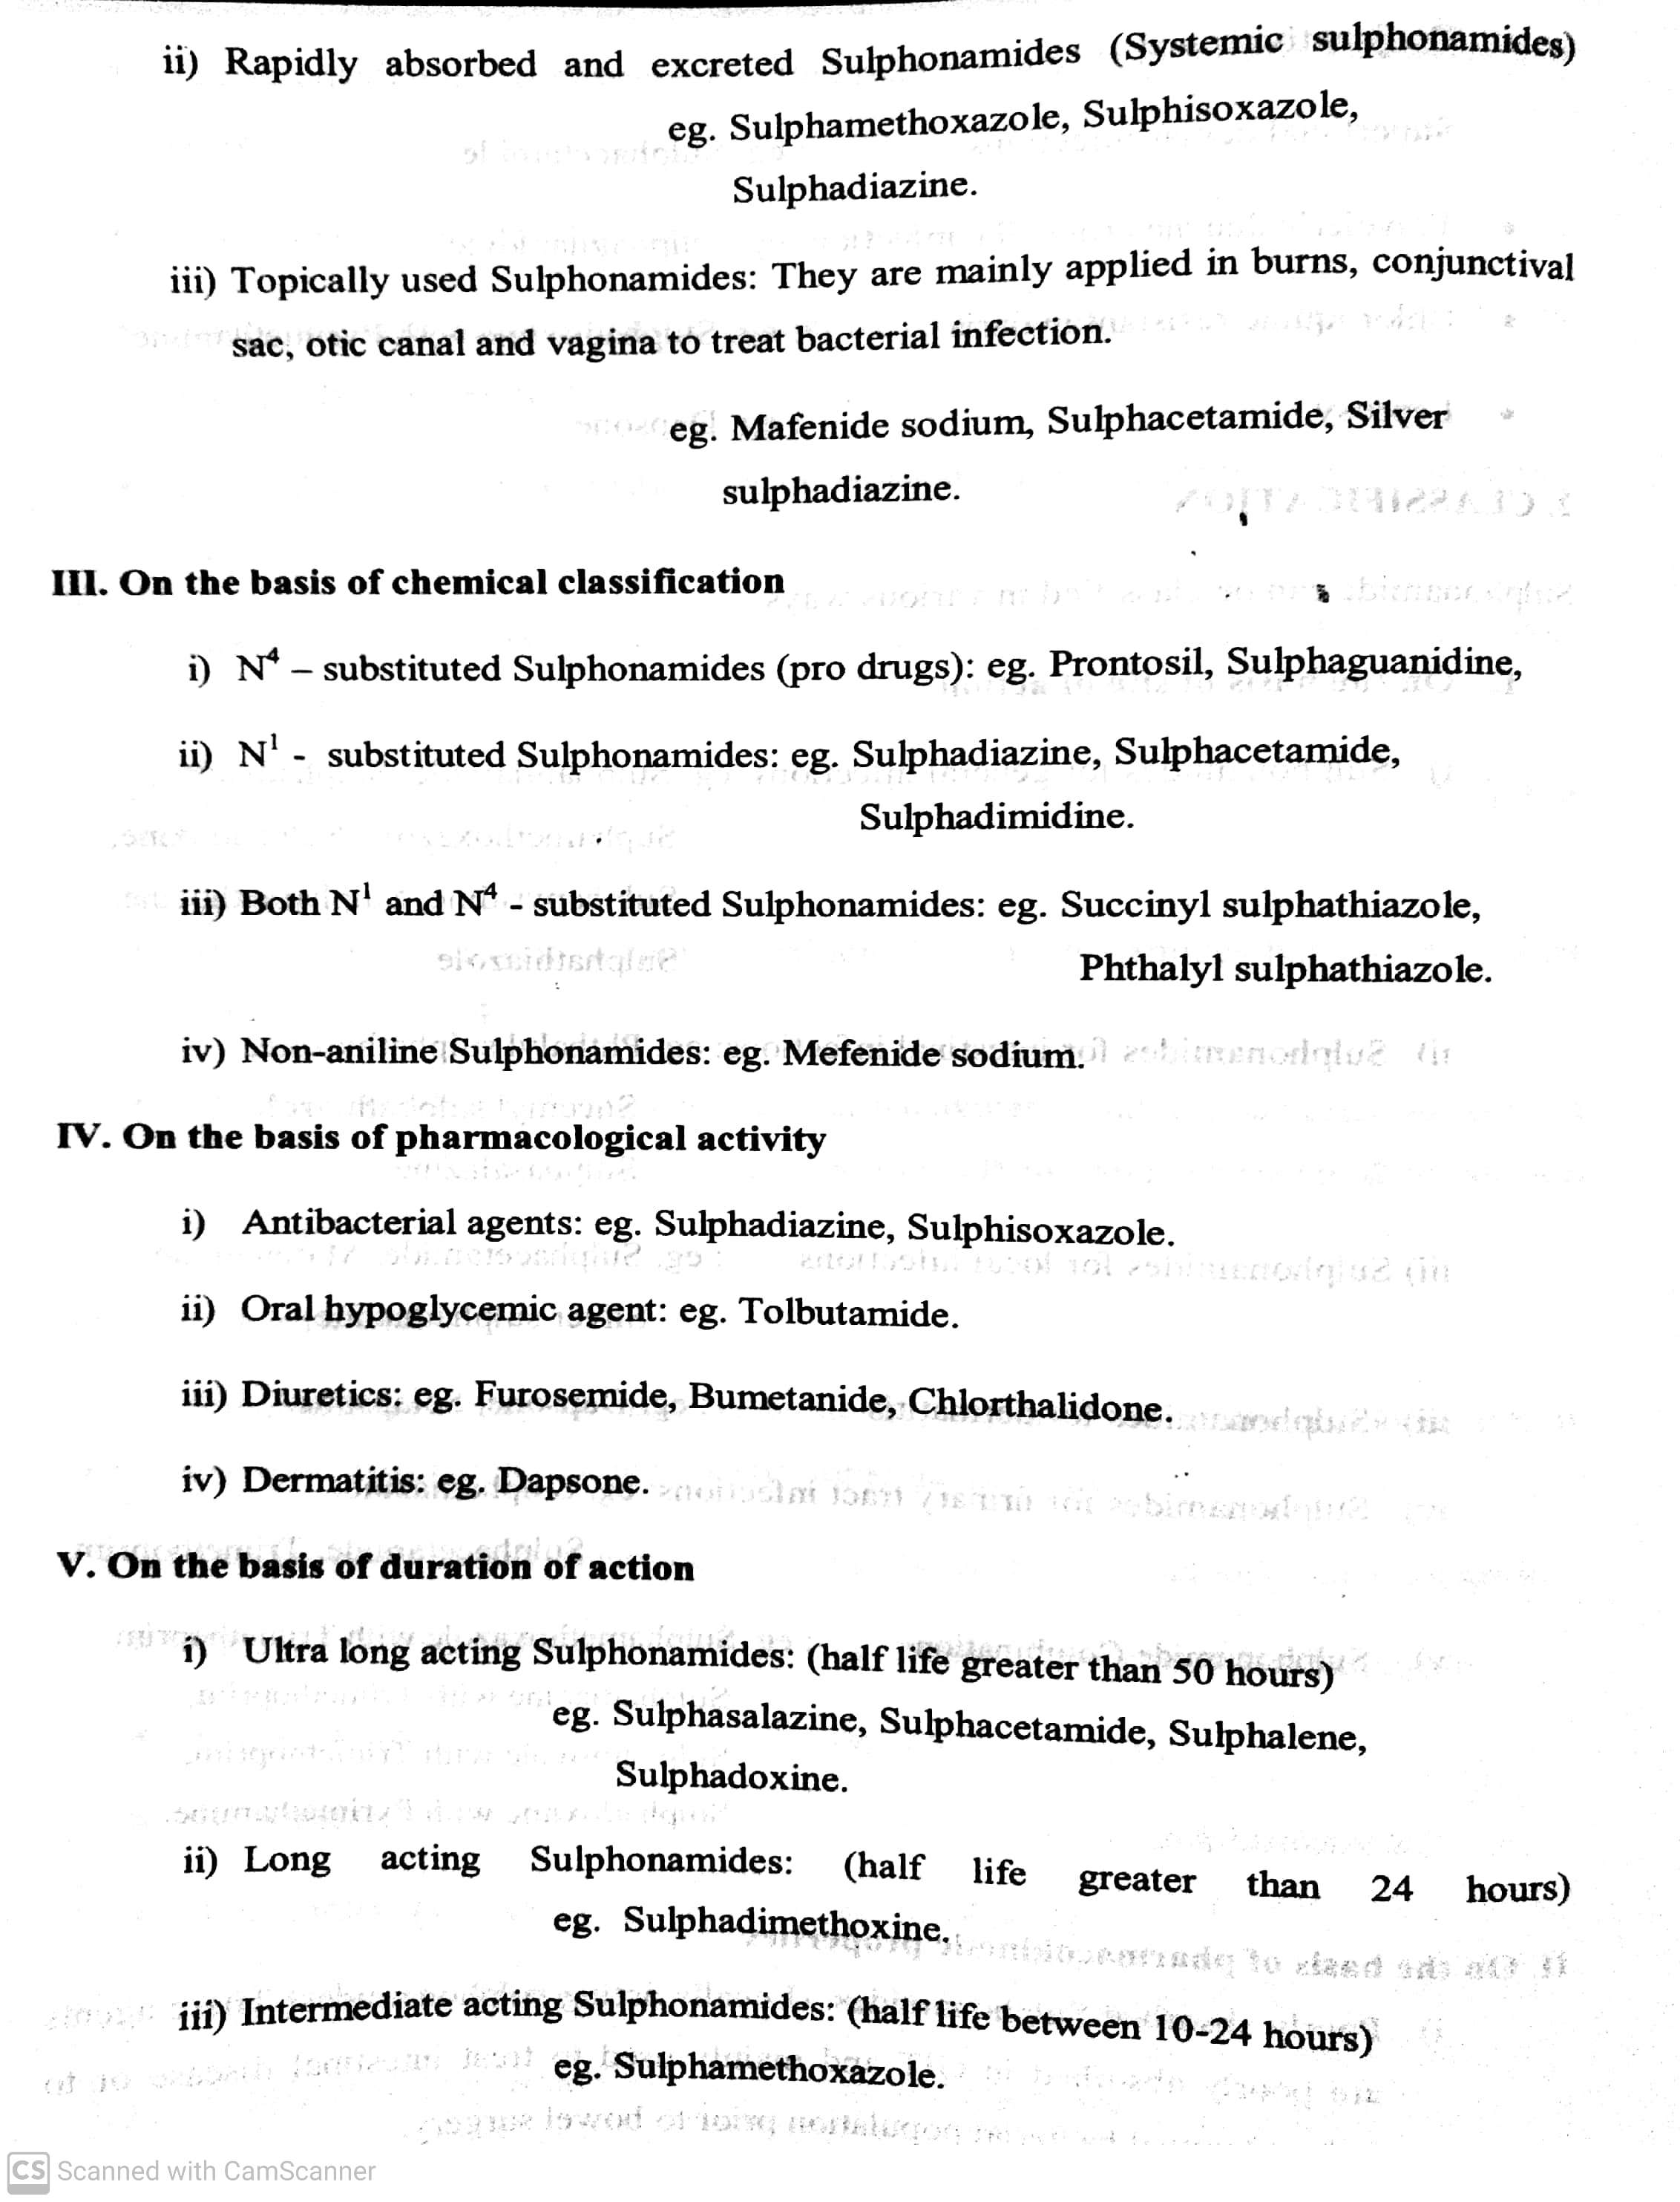
SULPHONAMIDES
Classifications:
iv) Short acting sulphonamides : ( Half life less than 20Hrs): eg. Sulphametizole, Sulphizoxazole.
-08-2020
10

Slide 11
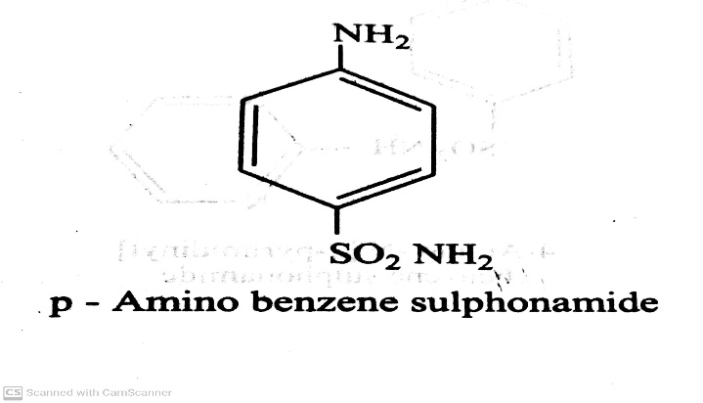
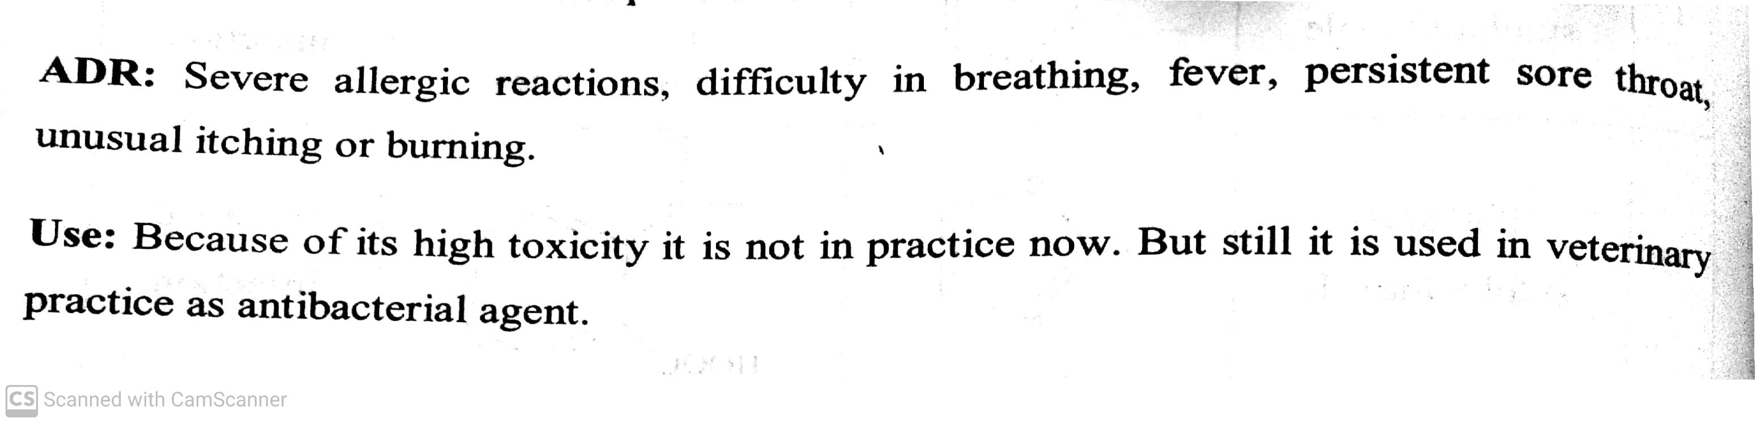
SULPHONAMIDES
Classifications:
On the basis of site of action:
i) Sulphonamides for general infections: eg. Sulphanilamide ( Prontosil album)
-08-2020
© R R INSTITUTIONS , BANGALORE
11

Slide 12
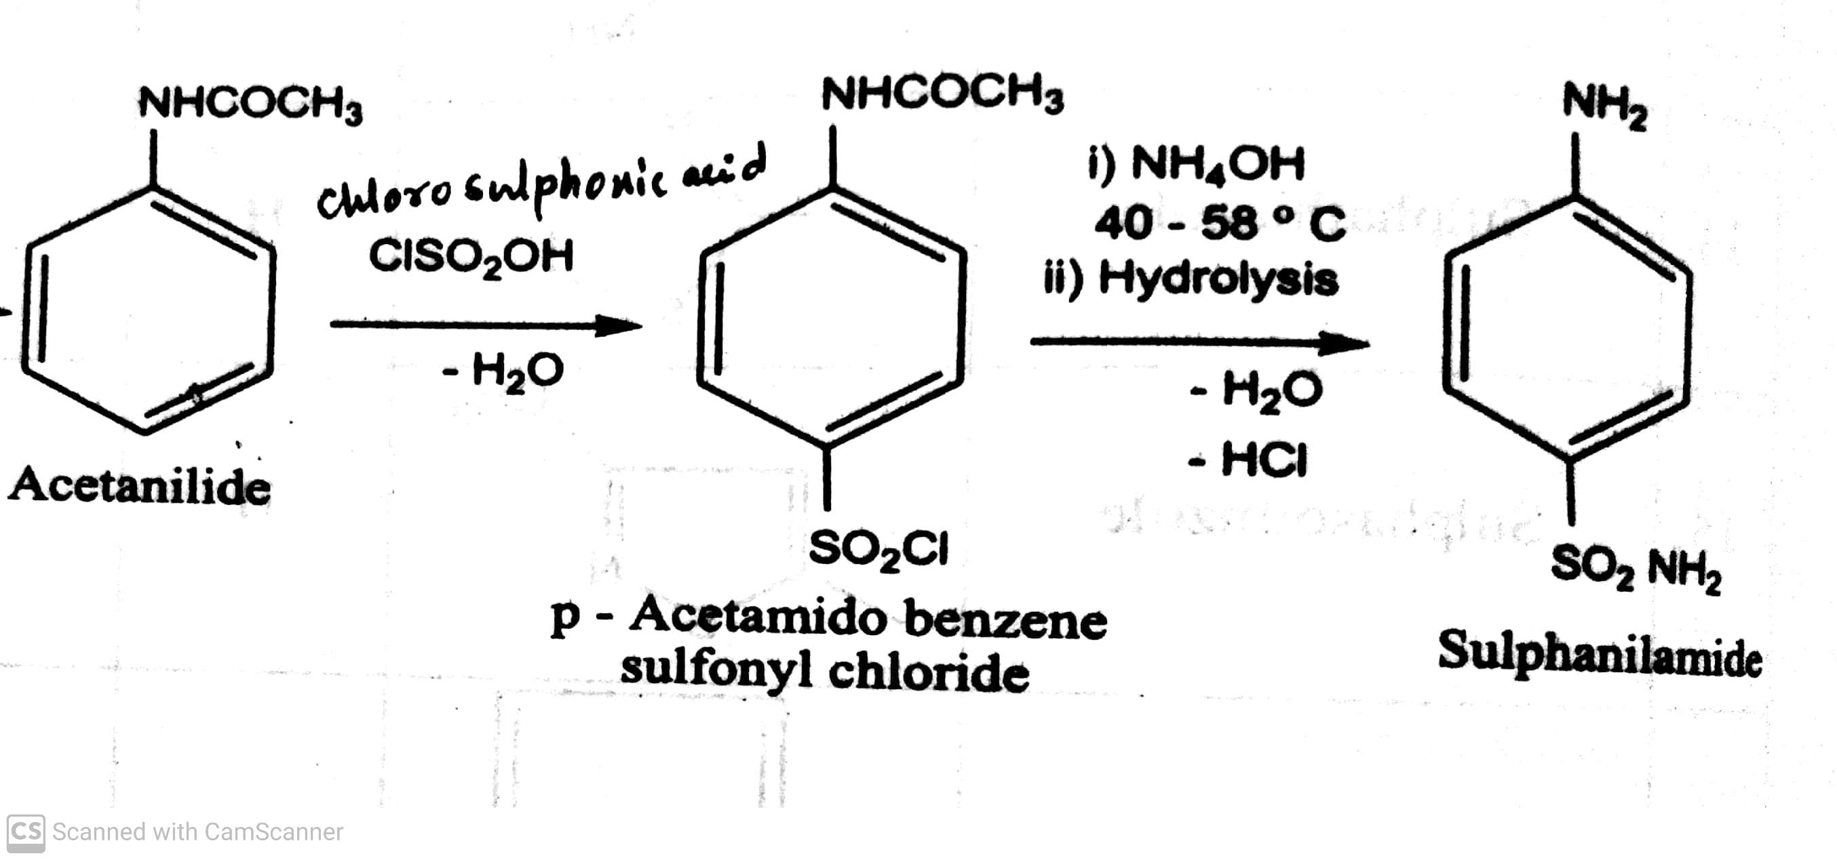
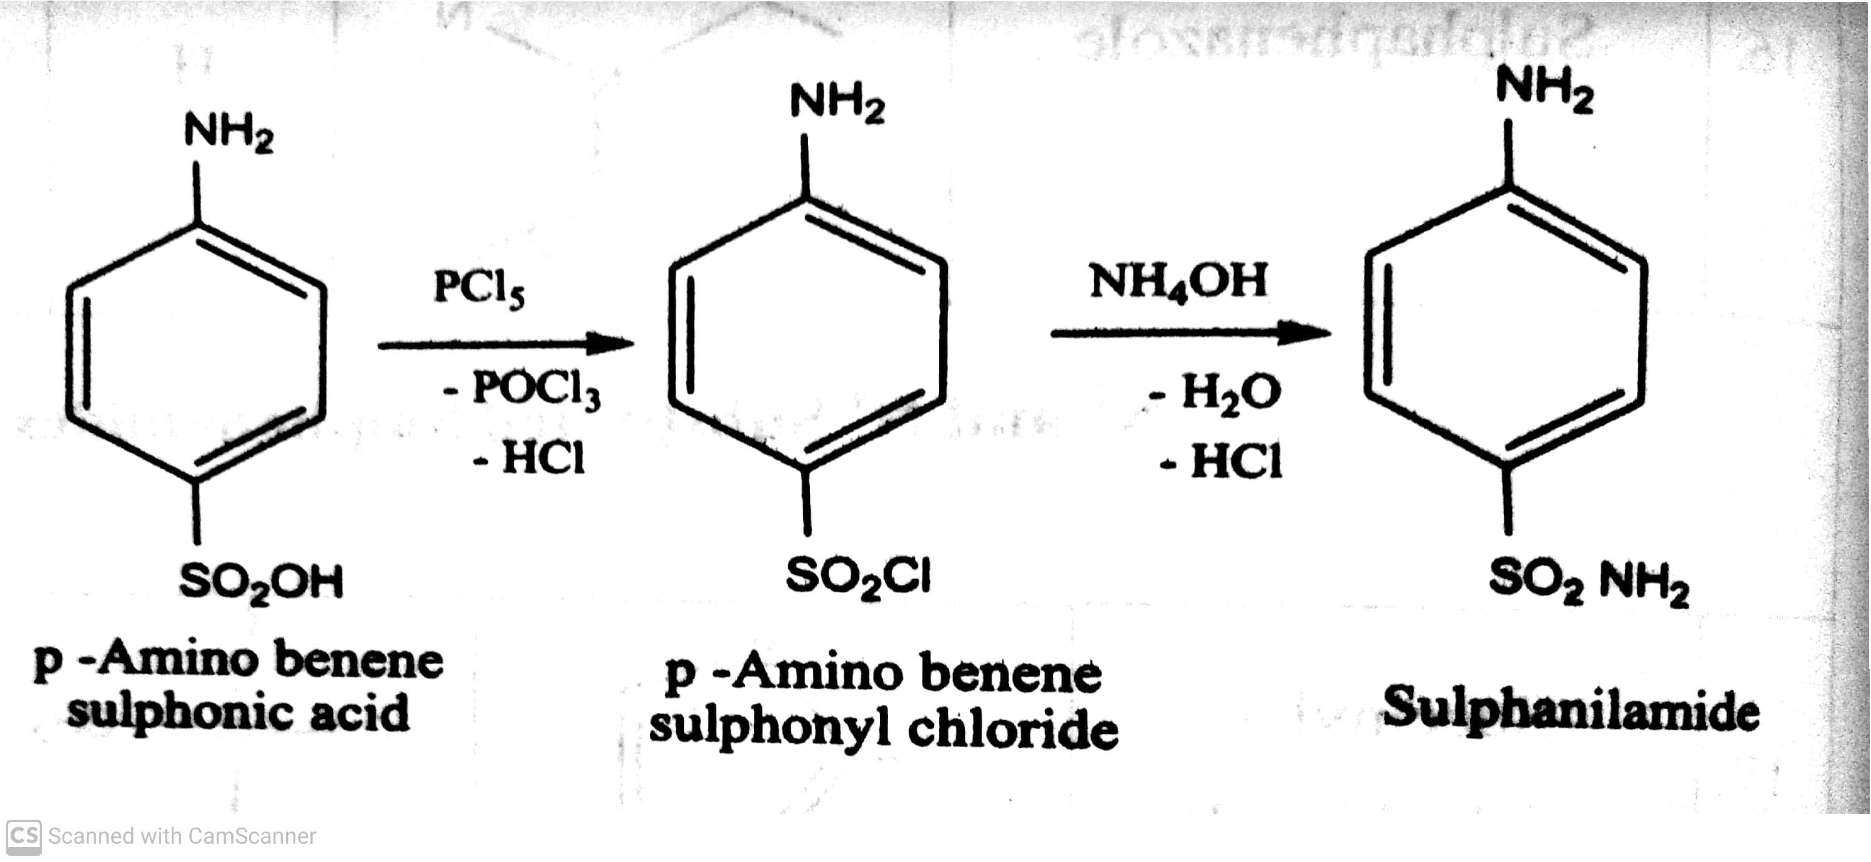
SULPHONAMIDES
Classifications:
On the basis of site of action: Method -I
i) Sulphonamides for general infections: eg. Synthesis of Sulphanilamide
Method-II
-08-2020
© R R INSTITUTIONS , BANGALORE
12

Slide 13
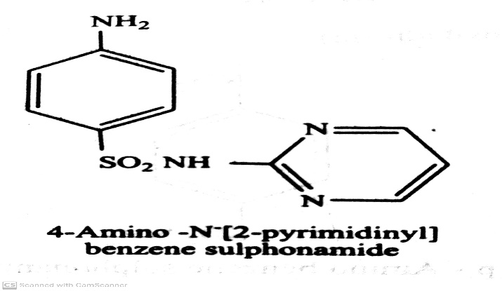
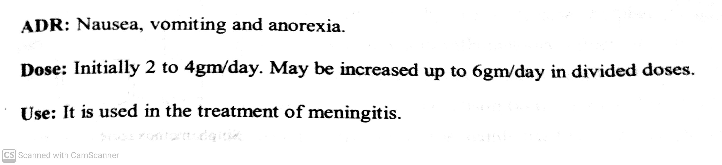
SULPHONAMIDES
Classifications:
On the basis of site of action:
i) Sulphonamides for general infections: eg. Sulphadiazine (Zeotrizine, lantrisul, sulphaloid)
-08-2020
© R R INSTITUTIONS , BANGALORE
13

Slide 14
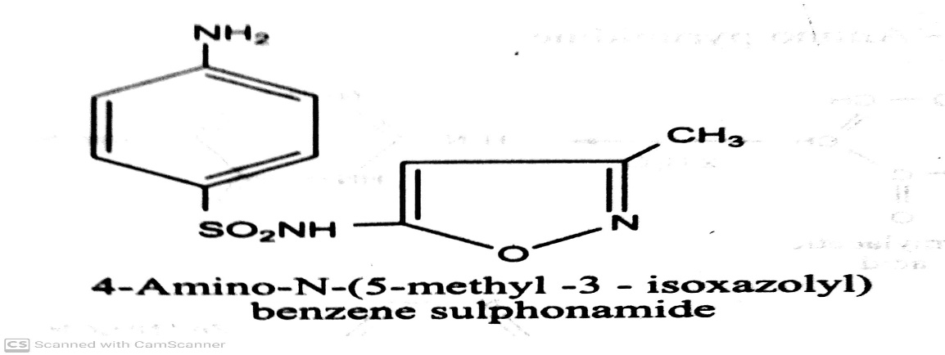
SULPHONAMIDES
Classifications:
On the basis of site of action:
i) Sulphonamides for general infections: eg. Sulphamethoxazole (Gantanal)
ADR: Nausea, vomiting and epigastric pain.
Dose: 1 gm twice daily for 2 days
Use: It is used in the treatment of meningitis, lower urinary tract infection caused by E. Coli and Proteus
mirabilis.
-08-2020
© R R INSTITUTIONS , BANGALORE
14

Slide 15
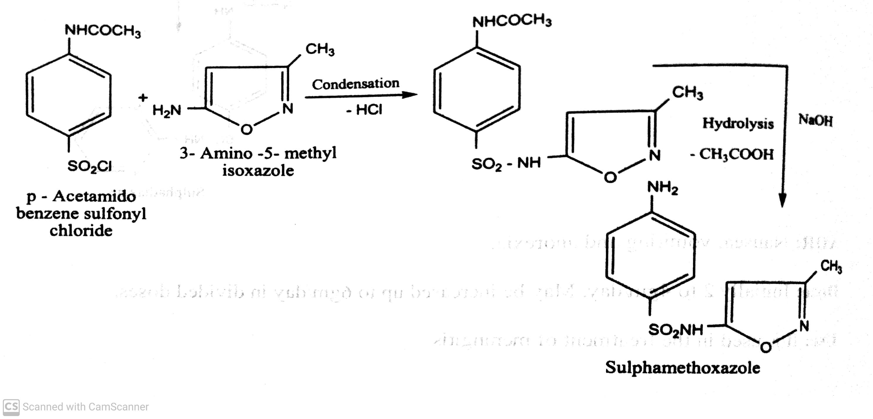
SULPHONAMIDES
Classifications:
On the basis of site of action:
i) Sulphonamides for general infections: eg. Synthesis of Sulphamethoxazole
-08-2020
© R R INSTITUTIONS , BANGALORE
15

Slide 16
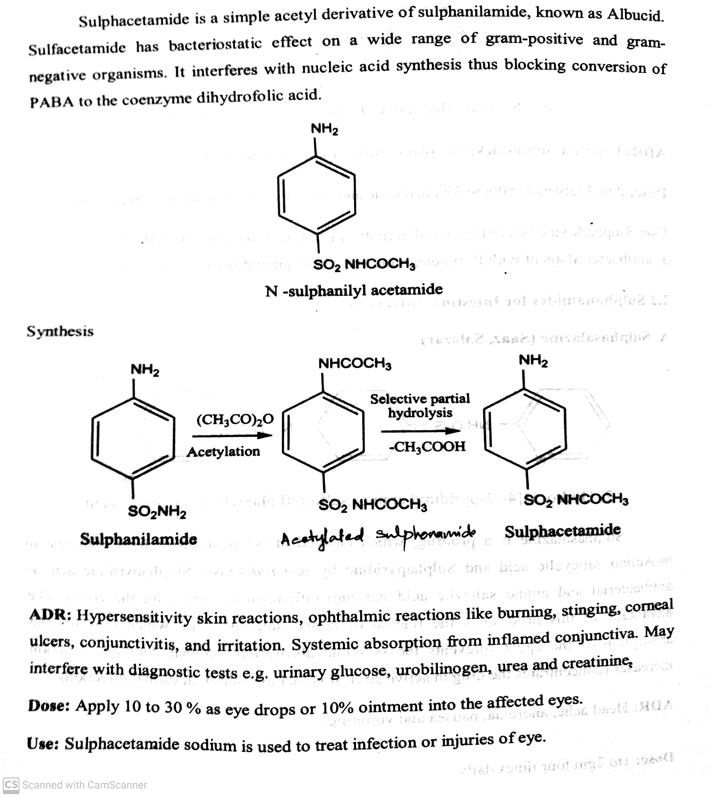
SULPHONAMIDES
Classifications:
On the basis of site of action: ii) Sulphonamides for Local infections: eg. Sulphacetamide (Setride, Zincoren)
-08-2020
© R R INSTITUTIONS , BANGALORE
16

Slide 17
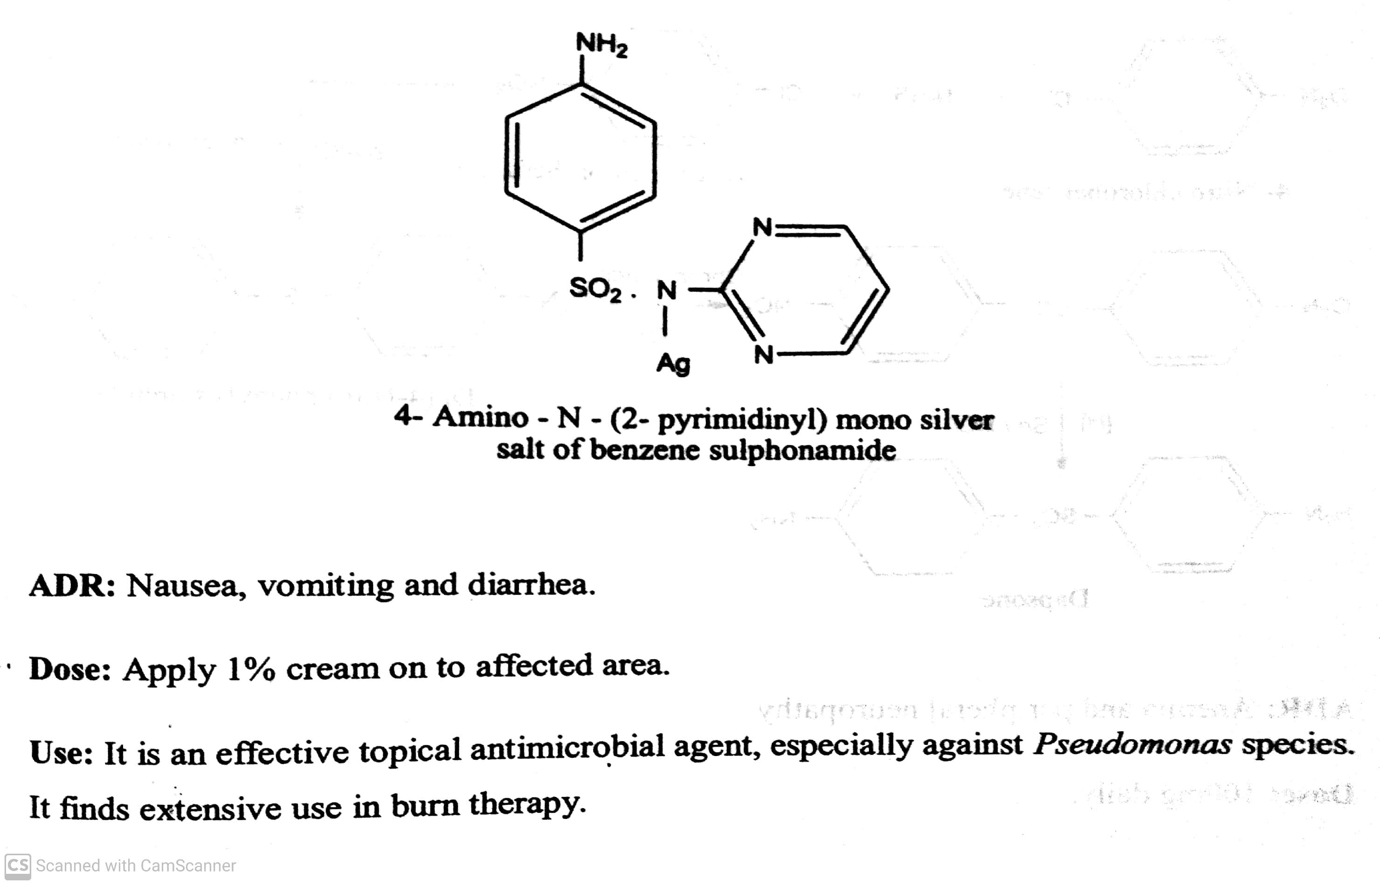
SULPHONAMIDES
Classifications:
On the basis of site of action:
ii) Sulphonamides for Local infections: eg. Silver Sulphadiazine (Silvadene, Silzen)
-08-2020
© R R INSTITUTIONS , BANGALORE
17

Slide 18
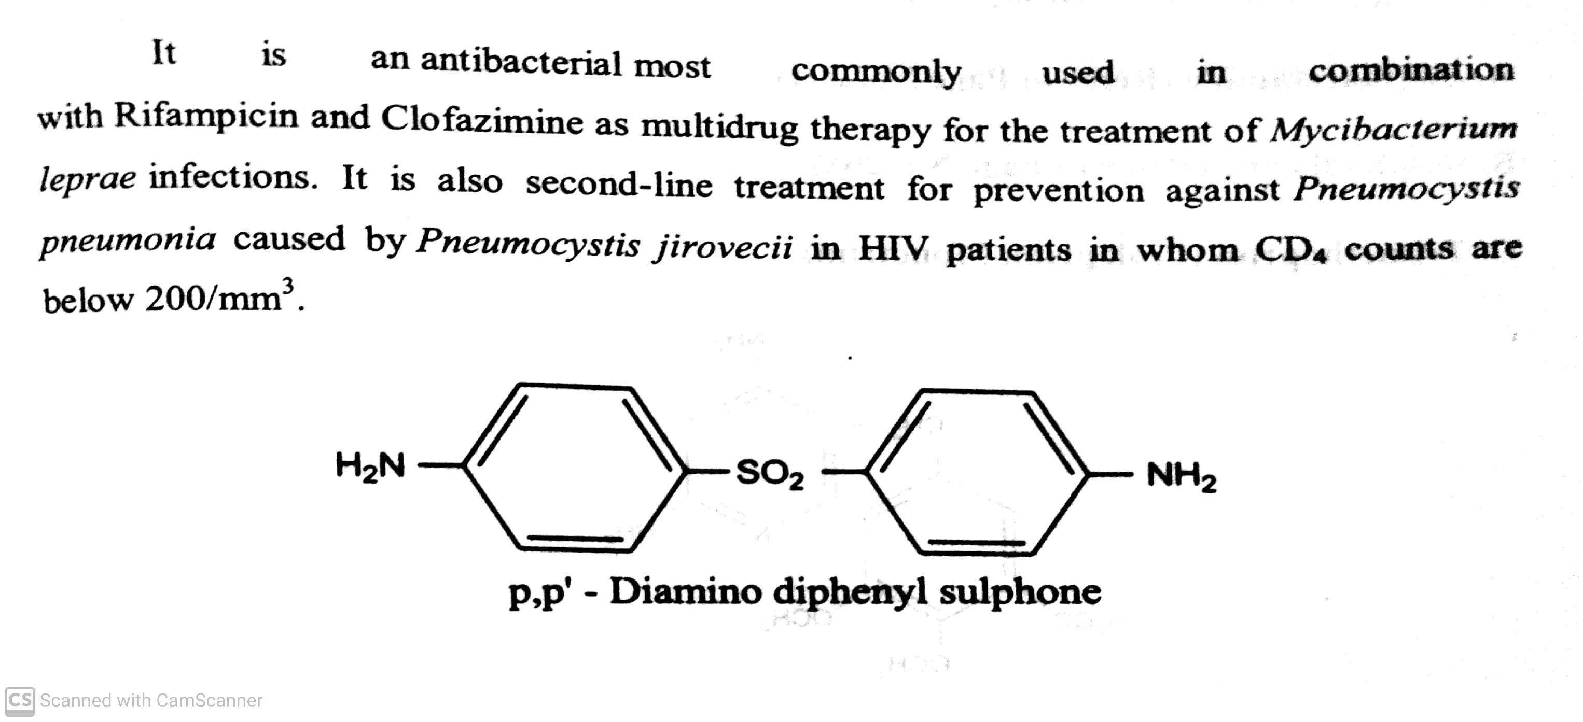
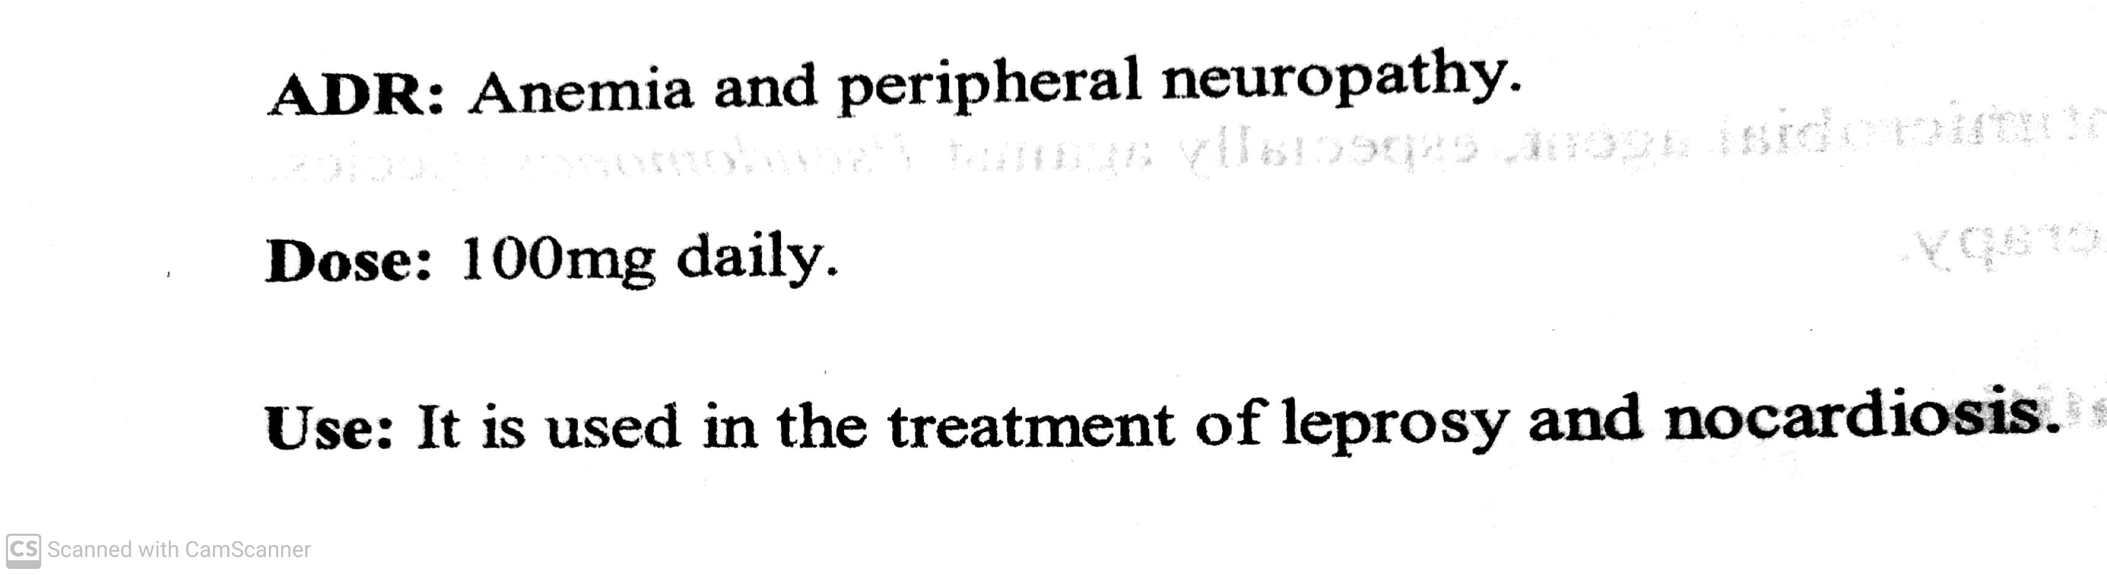
SULPHONAMIDES
Classifications:
On the basis of site of action:
iii) Sulphonamides for Dermatitis: eg. Dapsone (DDS)
-08-2020
© R R INSTITUTIONS , BANGALORE
18

Slide 19
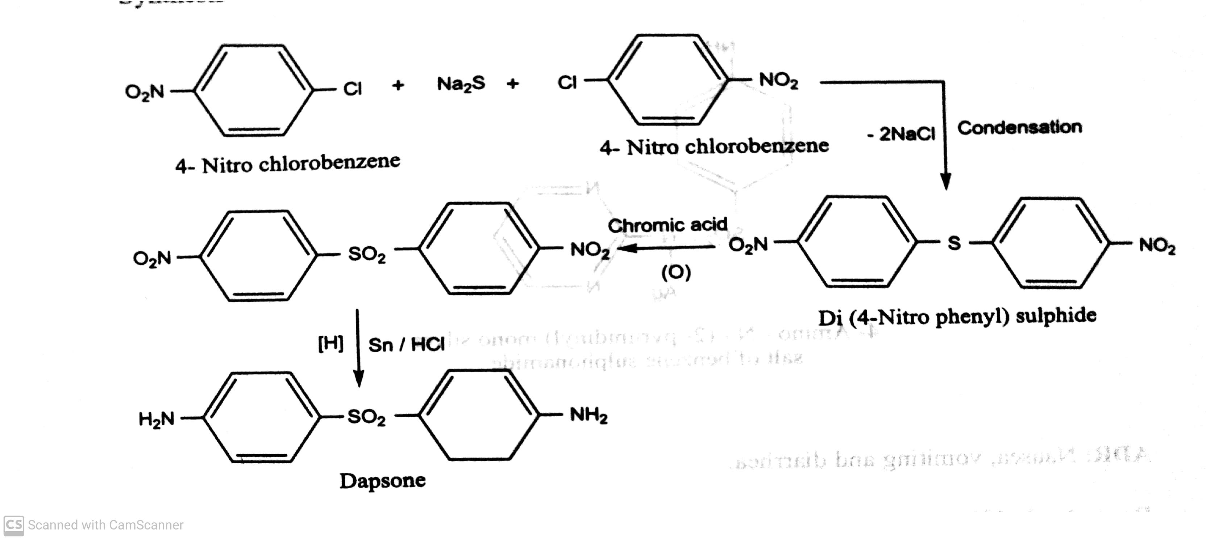
SULPHONAMIDES
Classifications:
On the basis of site of action:
iii) Sulphonamides for Dermatitis: eg. Synthesis of Dapsone (DDS)
-08-2020
© R R INSTITUTIONS , BANGALORE
19

Slide 20
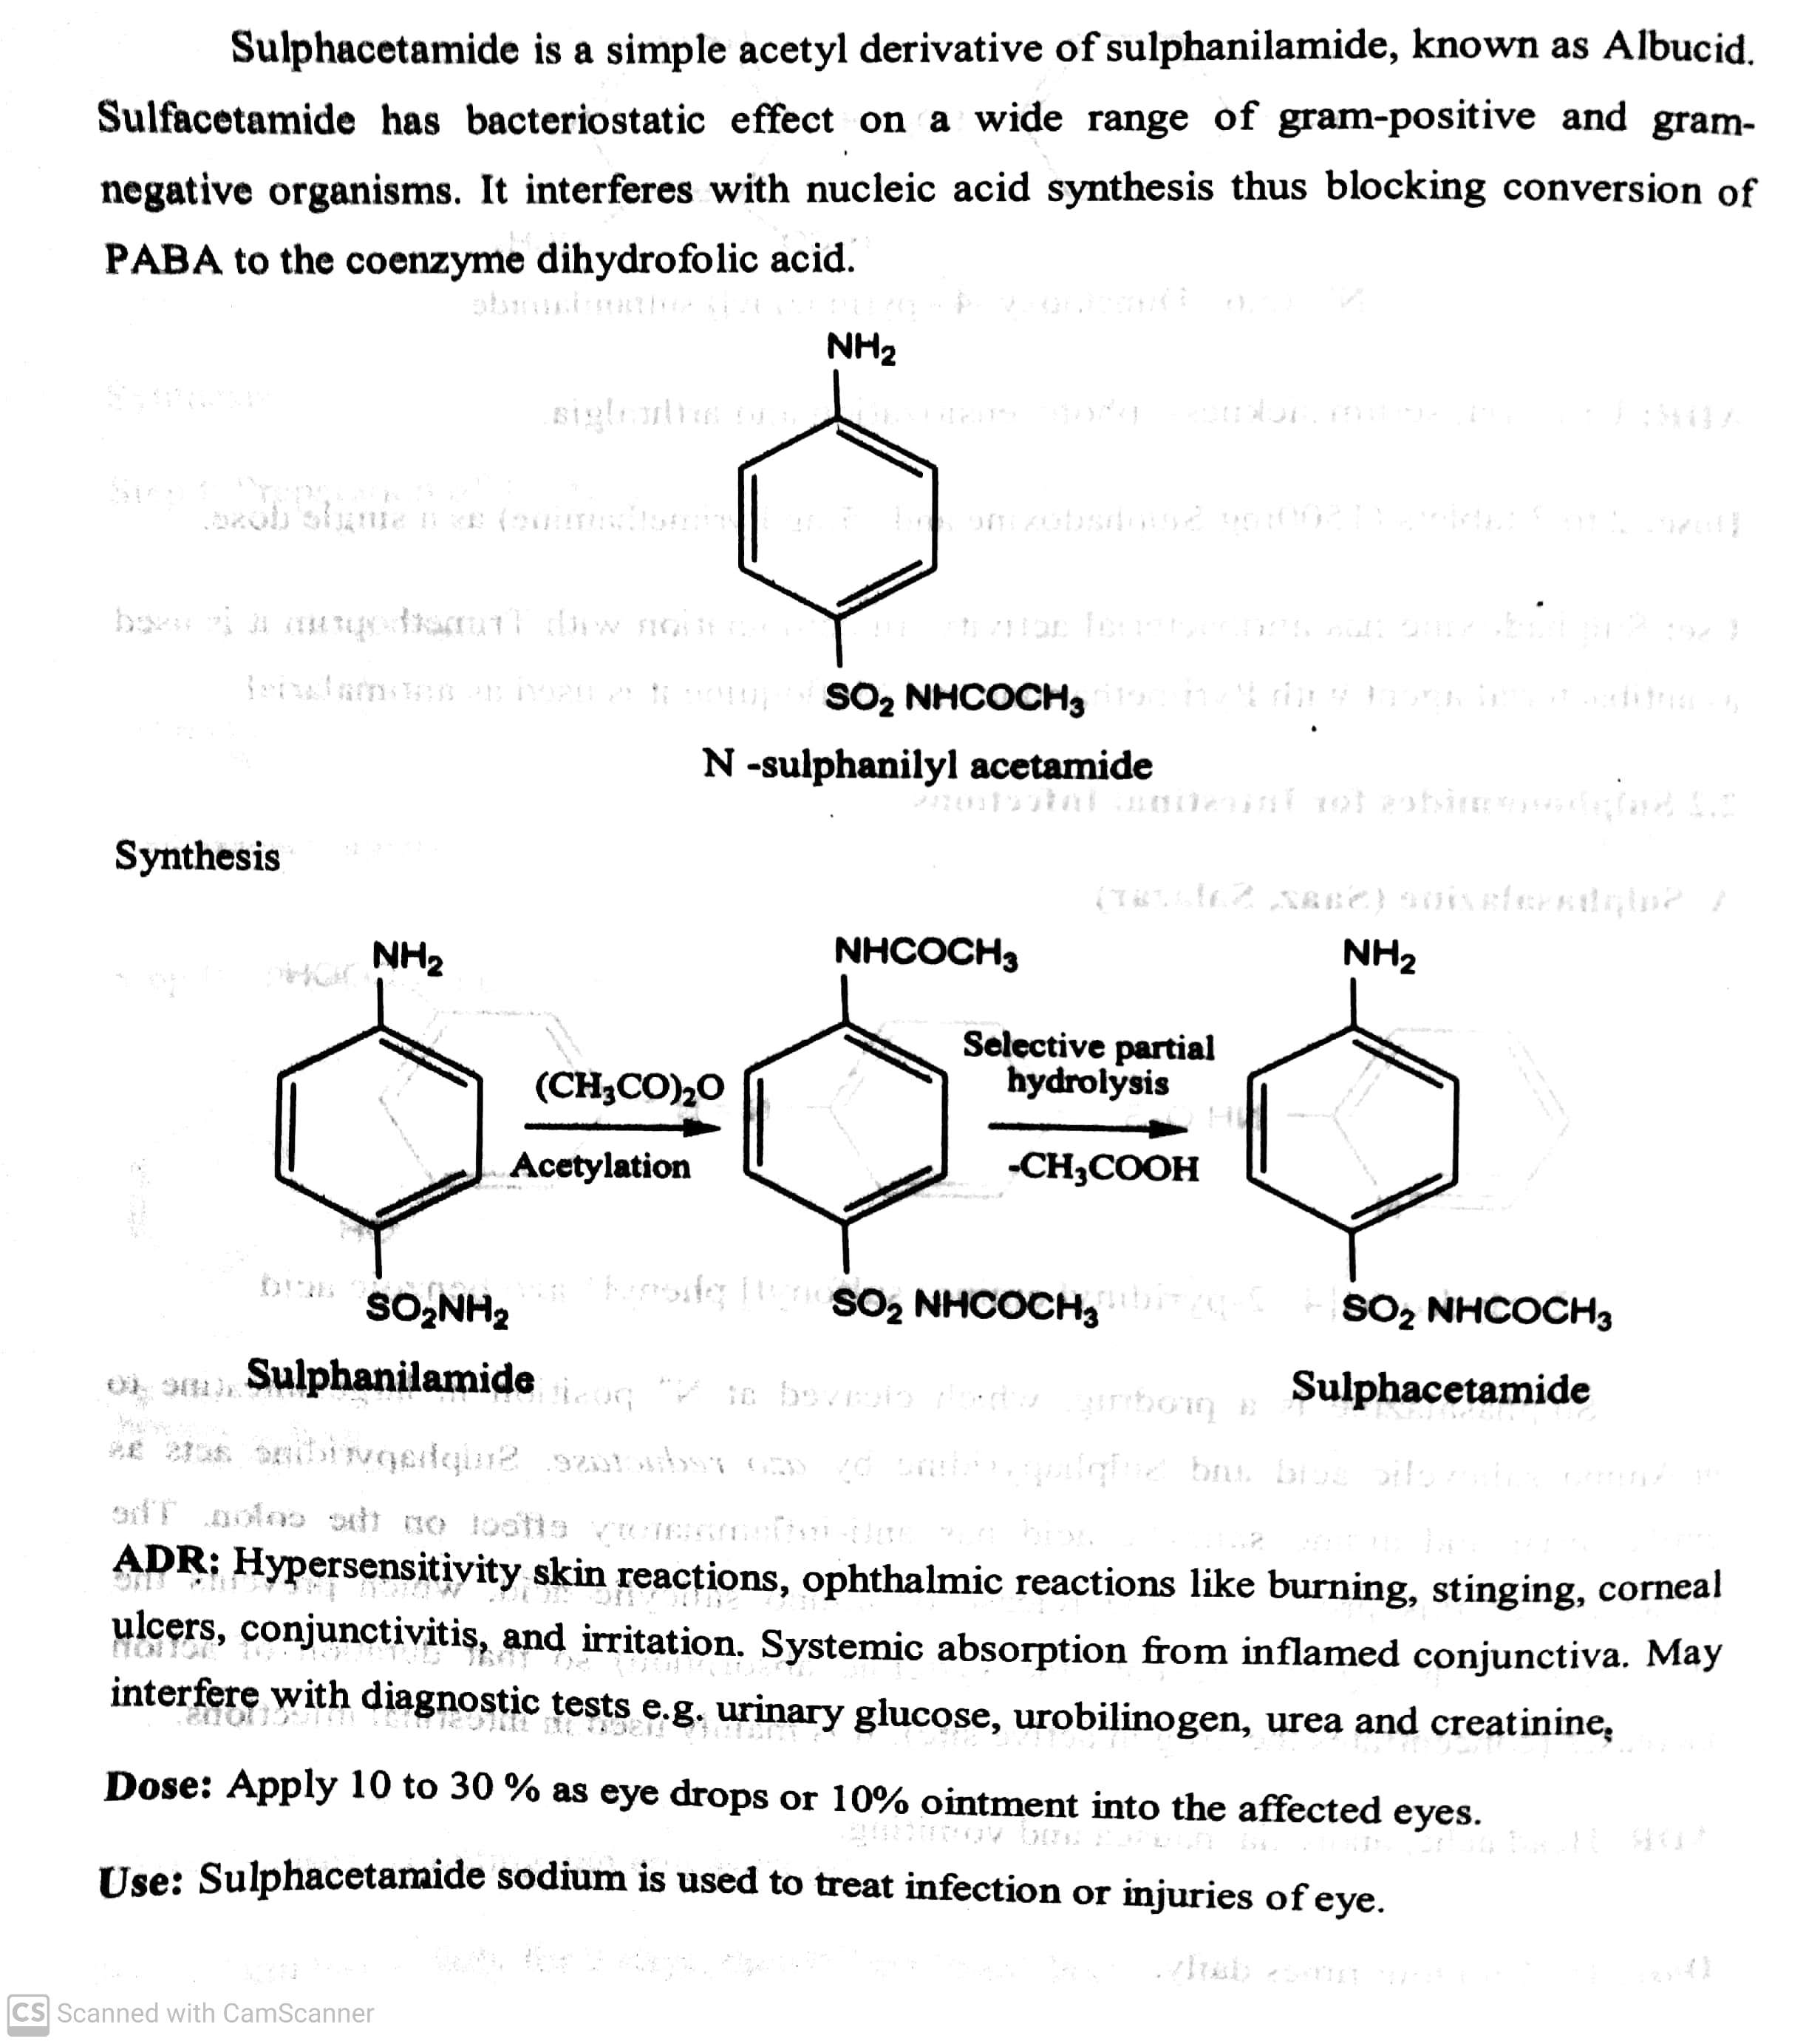
SULPHONAMIDES
Classifications:
On the basis of site of action:
iv) Sulphonamides used for Urinary tract infections: eg. Sulphacetamide.
-08-2020
© R R INSTITUTIONS , BANGALORE
20

Slide 21
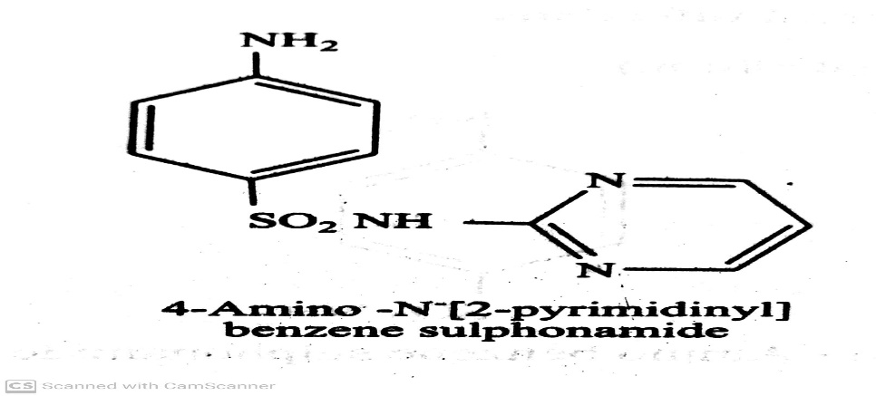
SULPHONAMIDES
Classifications:
On the basis of site of action:
iv) Sulphonamides used for Urinary tract infections: eg. Sulphadiazine
ADR: Nausea, vomiting and anorexia.
Use: It is used in the treatment of meningitis.
-08-2020
© R R INSTITUTIONS , BANGALORE
21

Slide 22
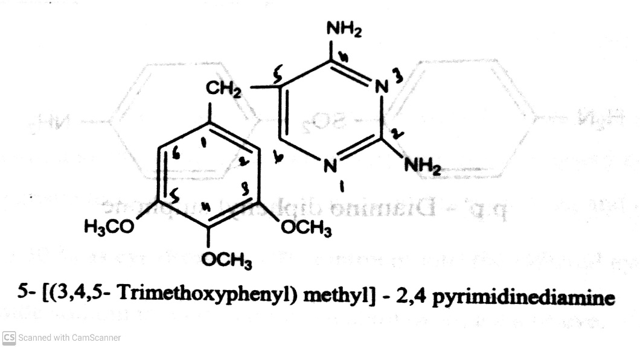
SULPHONAMIDES
Classifications:
On the basis of site of action:
iv) Sulphonamides used for Urinary tract infections: eg. Trimethoprim.
s
ADR: Haemolytic, megaloblastic anaemia, Thrombocytopenia and hypersensitivity reaction.
Dose: 200 mg twice a day.
Use: It ids used in the treatment of urinary tract, Respiratory tract infection and Typhoid.
-08-2020
© R R INSTITUTIONS , BANGALORE
22

Slide 23
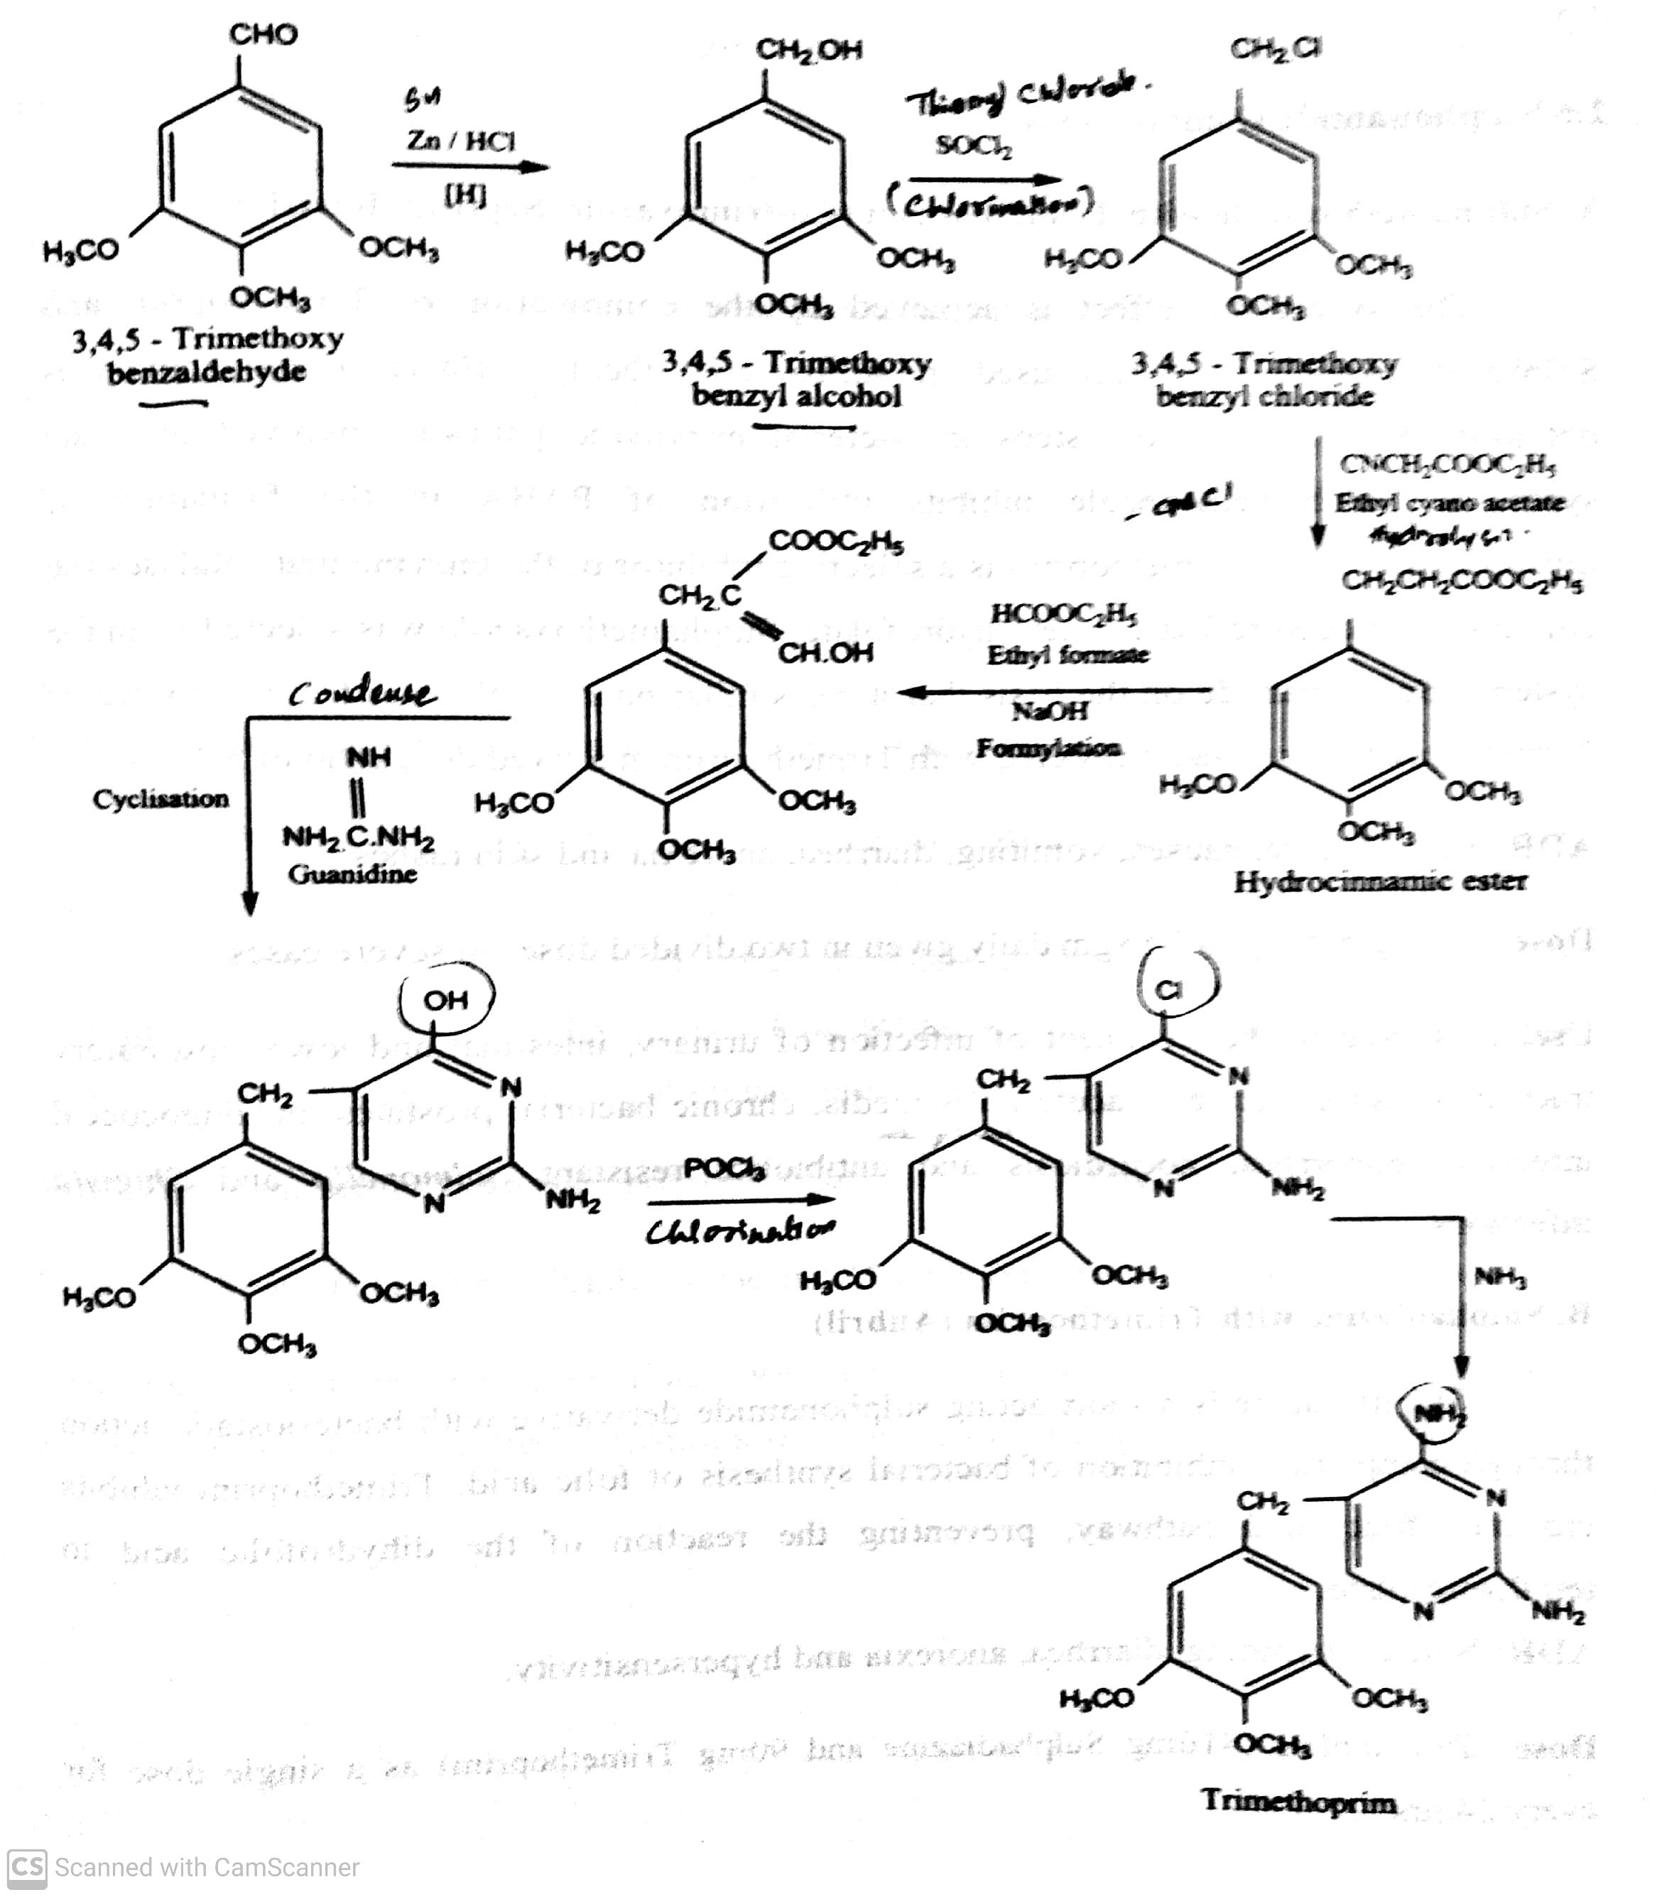
SULPHONAMIDES
Classifications:
I) On the basis of site of action: iv) Sulphonamides used for Urinary tract infections: eg. Synthesis of Trimethoprim.
-08-2020
© R R INSTITUTIONS , BANGALORE
23

Slide 24
SULPHONAMIDES
Classifications:
On the basis of site of action:
iv) Sulphonamide Combination:
eg. Sulphamethoxazole with Trimethoprim
Sulphadiazine with Trimethoprim
Sulphamoxole with Trimethoprim
Sulphadoxime with Trimethoprim
-08-2020
© R R INSTITUTIONS , BANGALORE
24

Slide 25
SULPHONAMIDES
Classifications:
On the basis of site of action:
iv) Sulphonamide Combination: eg. Sulphamethoxazole with Trimethoprim
The fixed dose combination of Trimethoprim and sulphamethoxazole (1:5) is called Co-trimoxazole.
The resulting combination shows greater Antibacterial activity than equivalent quantities of either drug used alone i.e.,
Synergistic effect.
Given alone both Trimethoprim and Sulphamethoxazole are bacteriostatic but Combination is Bactericidal.
Sulphamethoxazole inhibits utilization of PABA in the formation of dihydrofolate, while trimethoprim is a selective inhibitor
of the enzyme that catalyses the conversion of dihydrofolate to tetrahydrofolate.
ADR : Renal failure, nausea, vomiting, diarrhoea, anorexia, and skin rashes.
Dose : 960 mg bid, up to 2.88 gm daily given in two divided doses in severe cases.
Use : It is used in the treatment of infection of urinary, intestinal and lower respiratory tract.
It is also effective in acute otitis media, chronic bacterial prostates, meningococcal infection, nocardiasis and antibiotic
resistant Salmonella and Shigella infections.
-08-2020
© R R INSTITUTIONS , BANGALORE
25

Slide 26
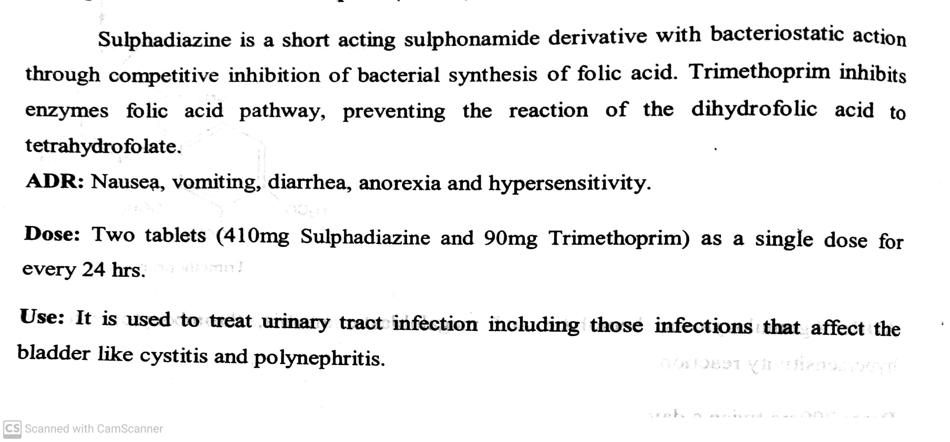
SULPHONAMIDES
Classifications:
On the basis of site of action:
iv) Sulphonamide Combination: eg. Sulphadiazine with Trimethoprim
-08-2020
26

Slide 27
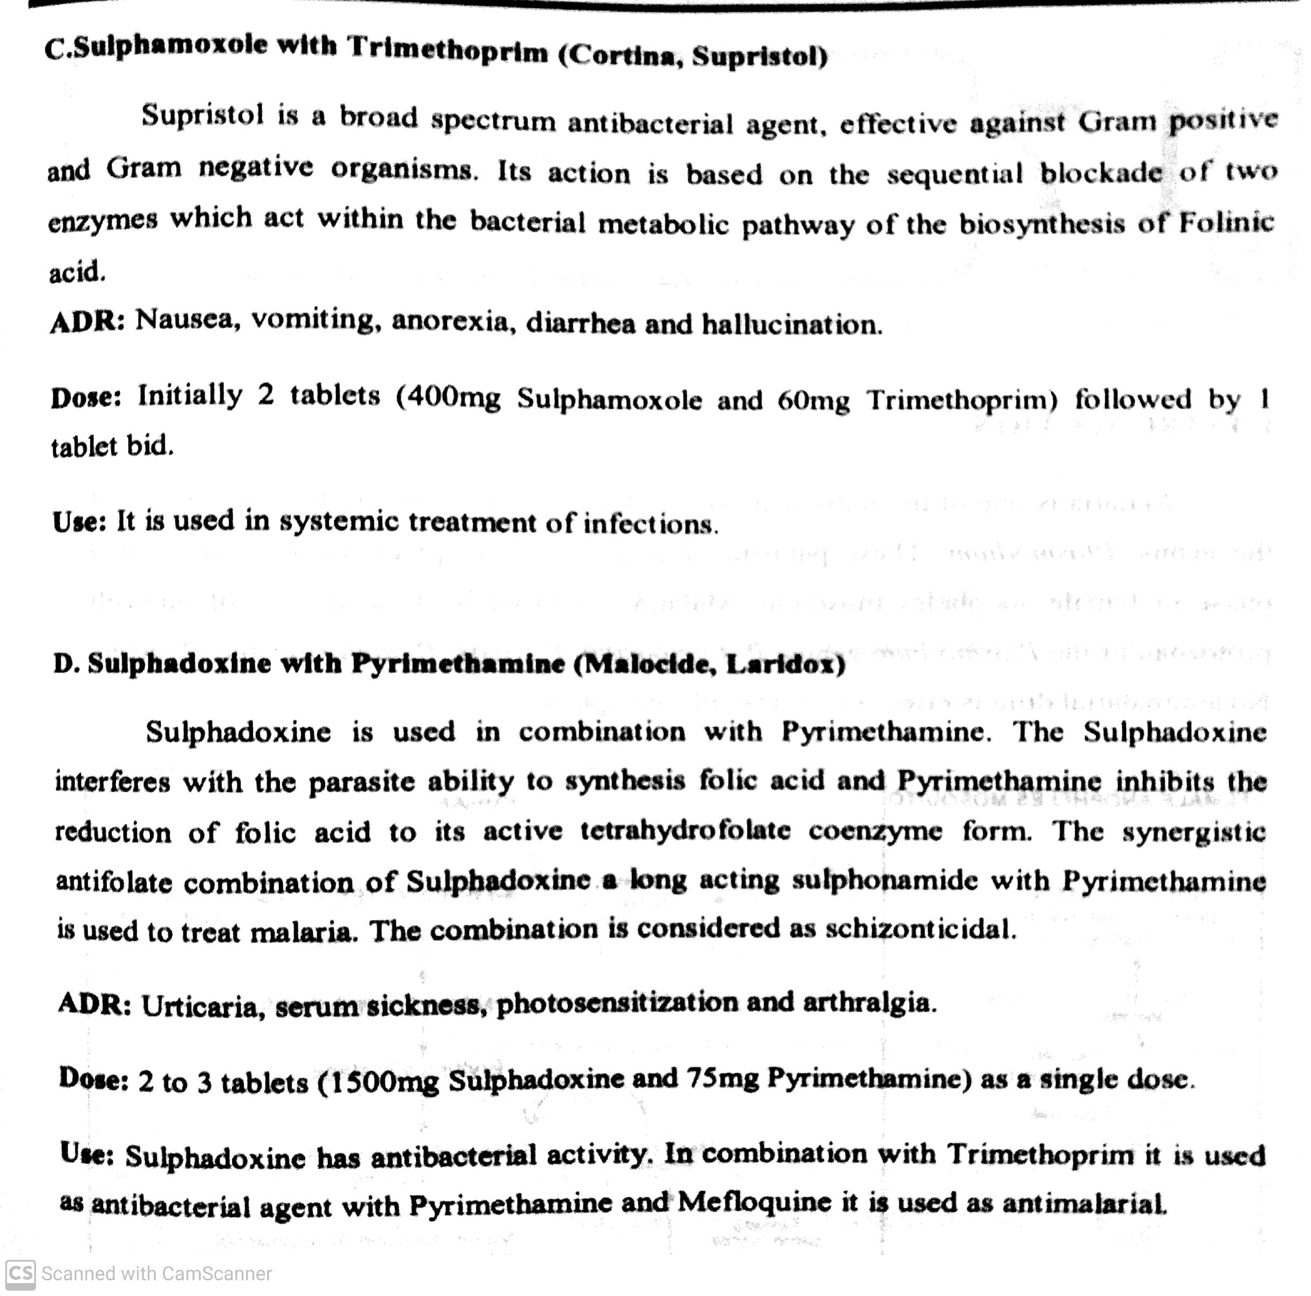
SULPHONAMIDES
Classifications:
On the basis of site of action: iv) Sulphonamide Combination:
-08-2020
27

Slide 28
THANK YOU
-08-2020
28

