Slide 1

MEDICINAL CHEMISTRY
ANTIMALARIAL AGENTS
05-08-2020
1

Slide 2
ANTIMALARIAL AGENTS
Malaria is an infectious disease caused by a protozoan parasite of the genus, Plasmodium.
It is transmitted by infected female anopheles mosquito.
Malaria is caused by four species of one cell protozoan of the plasmodium genus-
Plasmodium Falciparum
Plasmodium Vivax
Plasmodium Malariae
Plasmodium Ovale
Plasmodium Falciparum destroys RBCs of all the ages and multiply infects red cells to a high degree.
Plasmodium Malariae destroys the aged RBCs causing mild infection.
Symptoms: Fever, shivering, joint pain, headache, repeated vomiting and coma.
-08-2020
2

Slide 3
ANTIMALARIAL AGENTS
Antimalarials: Drugs which are used in the treatment of malarial infections are known as antimalarial drugs.
Antimalarial agents are chemically classified as:
i) Cinchona alkaloids : Quinine, Cinchonine.
ii) 4- Amino quinolines : Chloroquine, Amodiaquine, Hydroxy chloroquine.
iii) 8- Amino quinolines : Bulaquine, Primaquine, Pamaquine.
iv) 9- Amino quinolines : Mepacrine.
v) Biguanides : Proguanil, Cycloguanil.
vi) Pyrimidine analogue : Pyrimethamine.
vii) Polycyclics : Doxycycline, Halofantrine.
viii) Newer antimalarial agents : Artemisinin, Fosmidomycin.
ix) Sesquiterpene lactones : Arteether, arteemether.
x) Miscellaneous : Metaloamine, Sulphadoxine, Mefloquine.
-08-2020
3

Slide 4
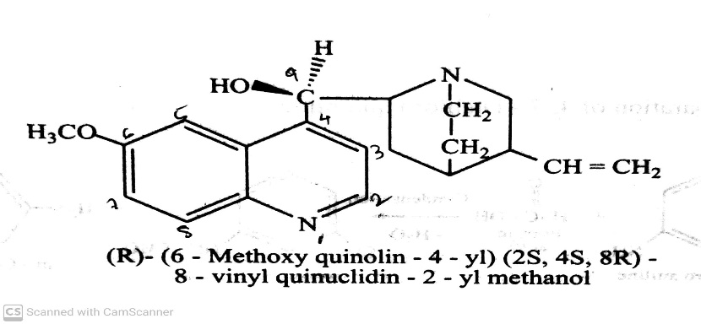
ANTIMALARIAL AGENTS
Antimalarial agents are chemically classified as:
i) Cinchona alkaloids : eg. Quinine, Cinchonine.
eg. Quinine (Quinex, Quiner) :
Quinine was the first known antimalarial obtained from Cinchona officinalis.
It is a 4-Quinoline methanol derivative bearing a substituted quinuclidine ring.
It is derived from bark of cinchona tree.
It is a di-acid tertiary base and it forms salts with two equivalents of acid.
It is a natural white crystalline alkaloid having bitter taste.
It is having antipyretic, analgesic, antimalarial properties.
It contains two major fused ring systems namely aromatic quinolone and bicyclic quinuclidine.
-08-2020
4

Slide 5

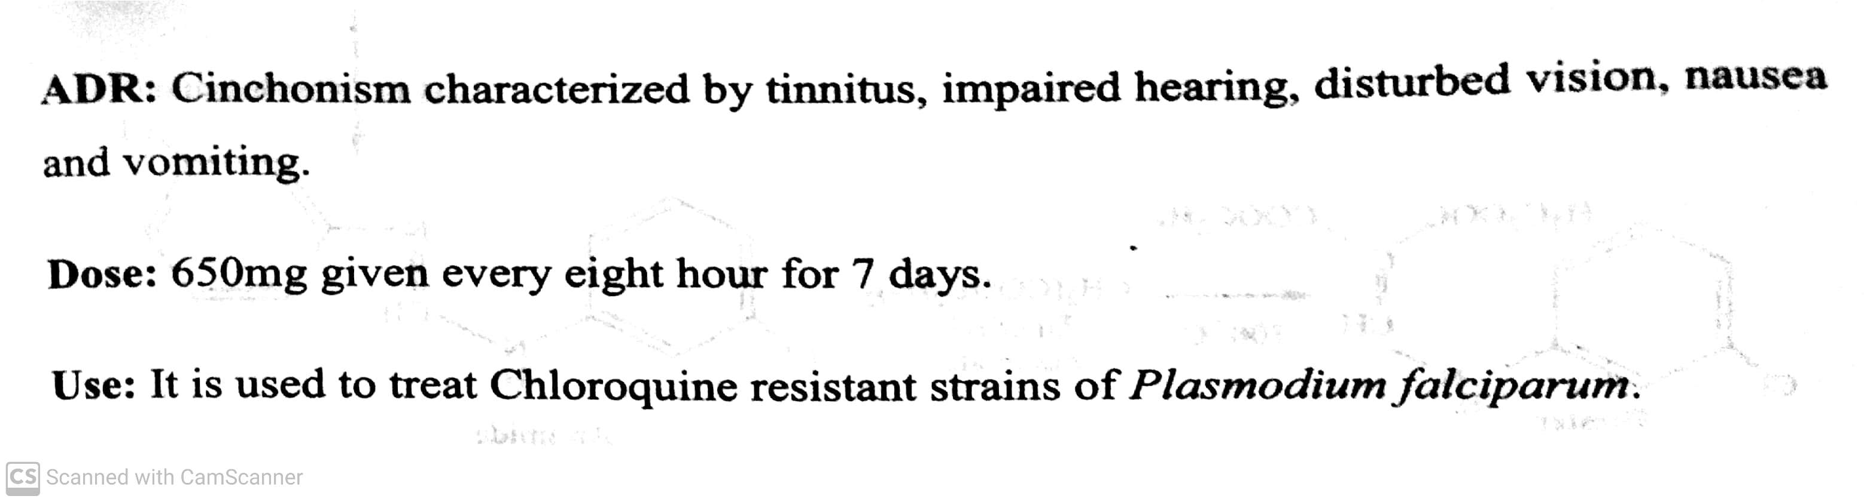
ANTIMALARIAL AGENTS
Antimalarial agents are chemically classified as:
i) Cinchona alkaloids : eg. Quinine, Cinchonine.
eg. Quinine (Quinex, Quiner) :
-08-2020
5

Slide 6
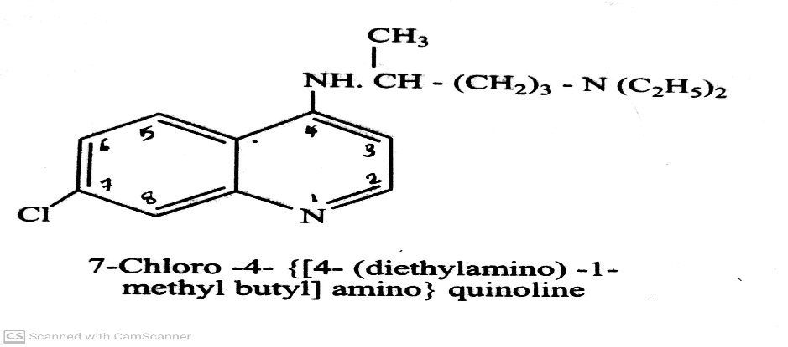
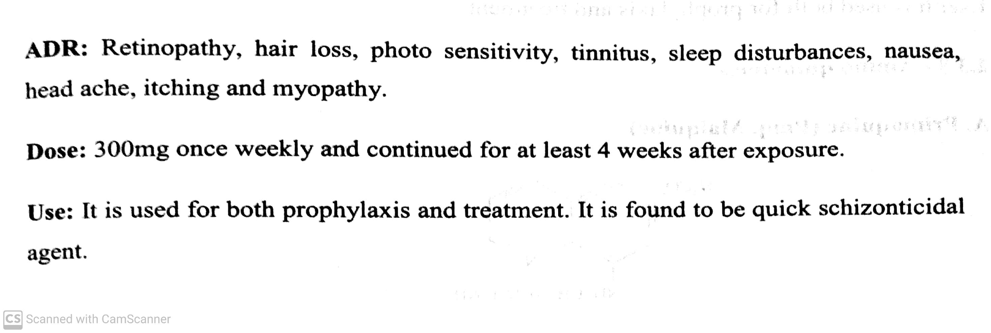
ANTIMALARIAL AGENTS
Antimalarial agents are chemically classified as:
ii) 4- Amino quinolines : Chloroquine, Amodiaquine, Hydroxy chloroquine.
The 4-substituted quinolone rapidly acts against plasmodium in erythrocytic stage. They act by intercalating
in to the DNA of parasite.
eg. Chloroquine (Cadiquin, Melubrin): It prevents the development of malaria parasites in the blood.
-08-2020
6

Slide 7
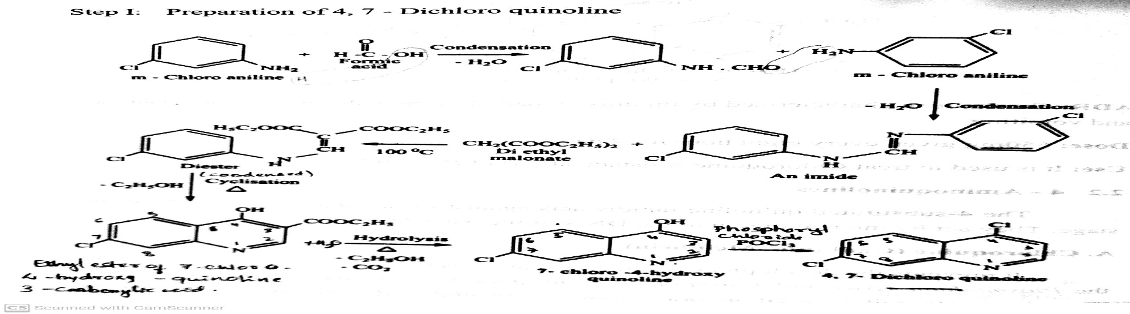
ANTIMALARIAL AGENTS
eg. Synthesis of Chloroquine :
-08-2020
7

Slide 8
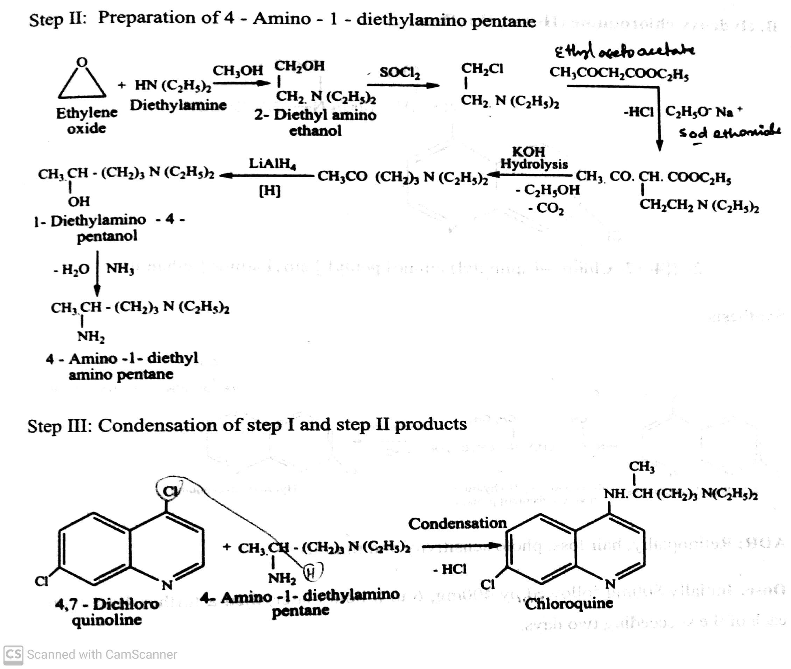
ANTIMALARIAL AGENTS
eg. Synthesis of Chloroquine :
-08-2020
8

Slide 9
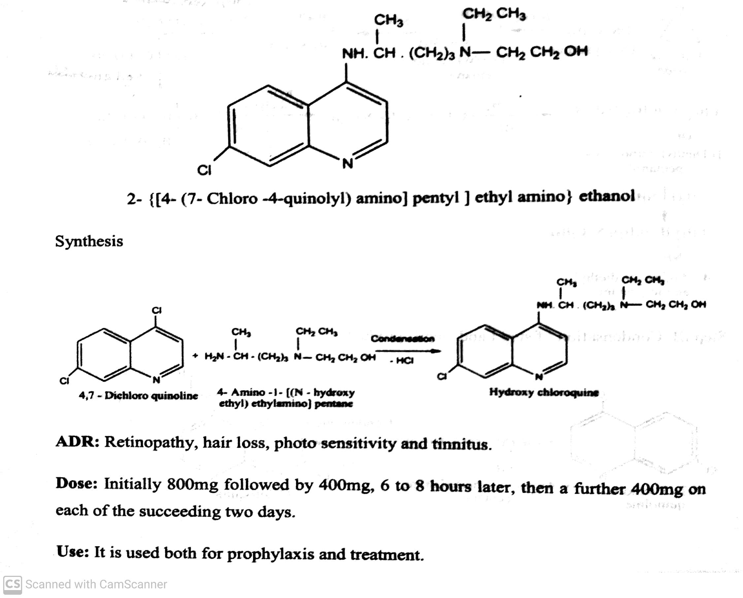
ANTIMALARIAL AGENTS
ii) 4- Amino quinolines : Hydroxy chloroquine(Hqtor, Winflam).
-08-2020
9

Slide 10
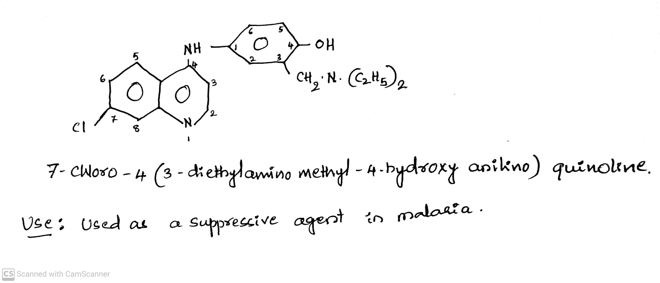
ANTIMALARIAL AGENTS
ii) 4- Amino quinolines : Amodiaquine.
-08-2020
10

Slide 11
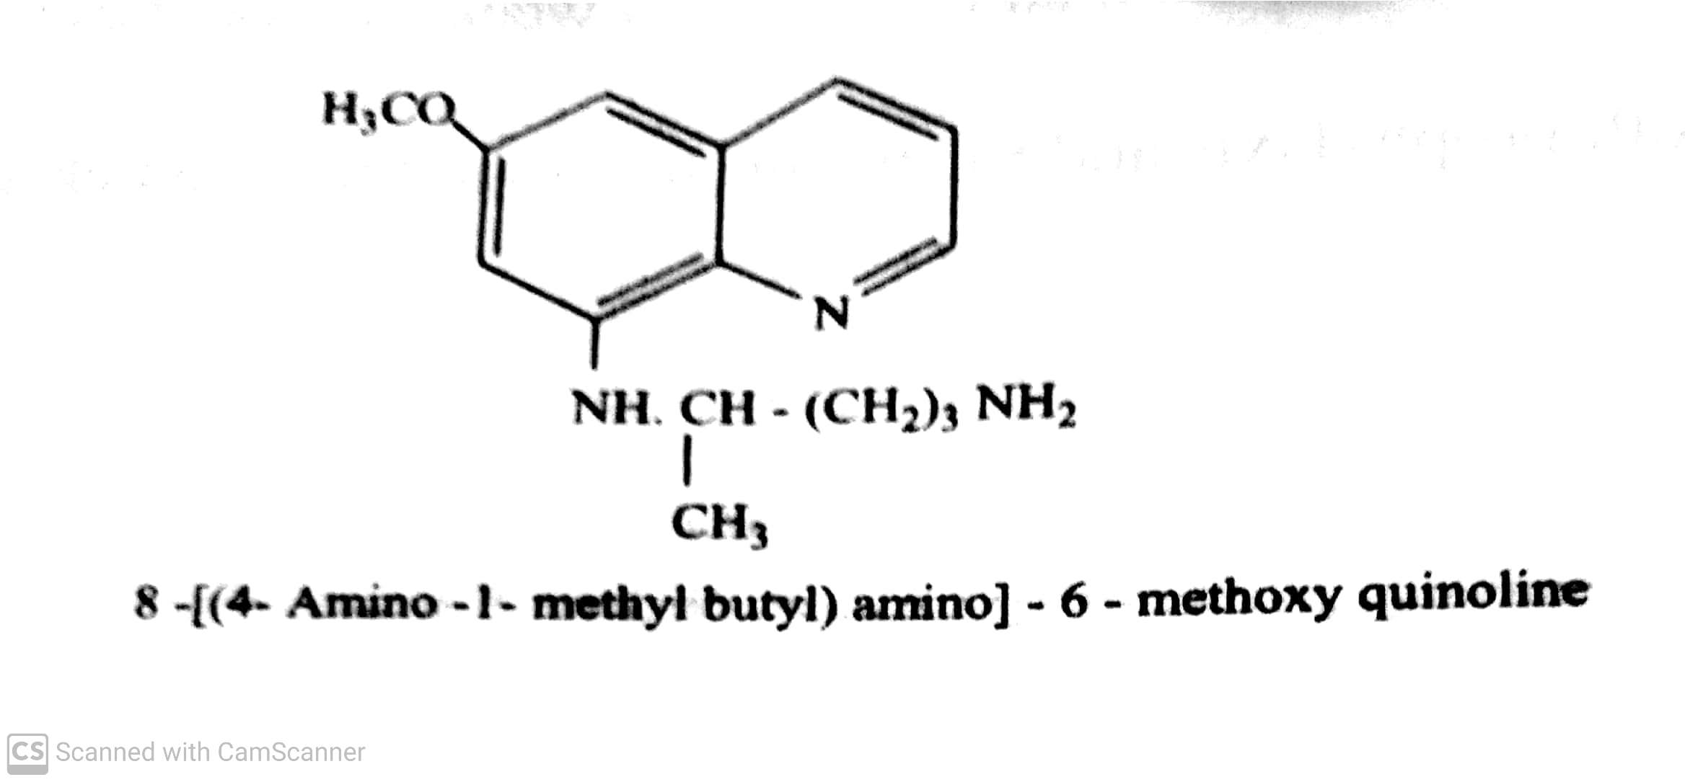
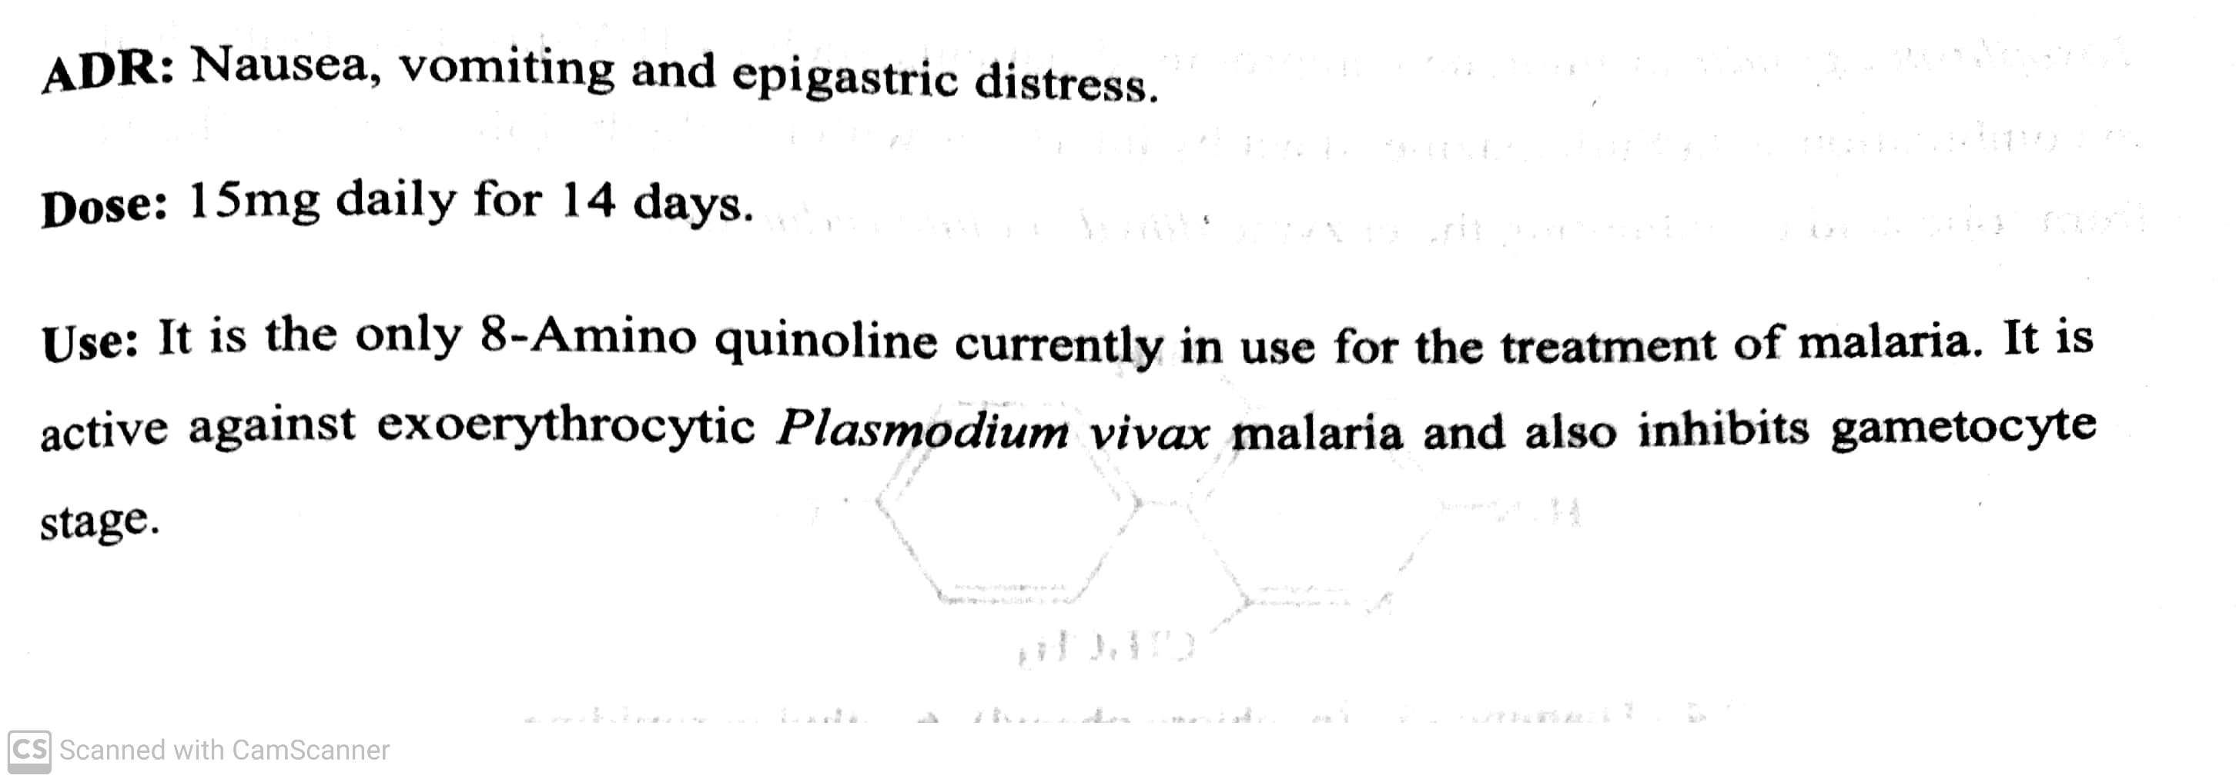
ANTIMALARIAL AGENTS
iii) 8- Amino quinolines : Bulaquine, Primaquine, Pamaquine.
Eg. Primaquine
-08-2020
11

Slide 12
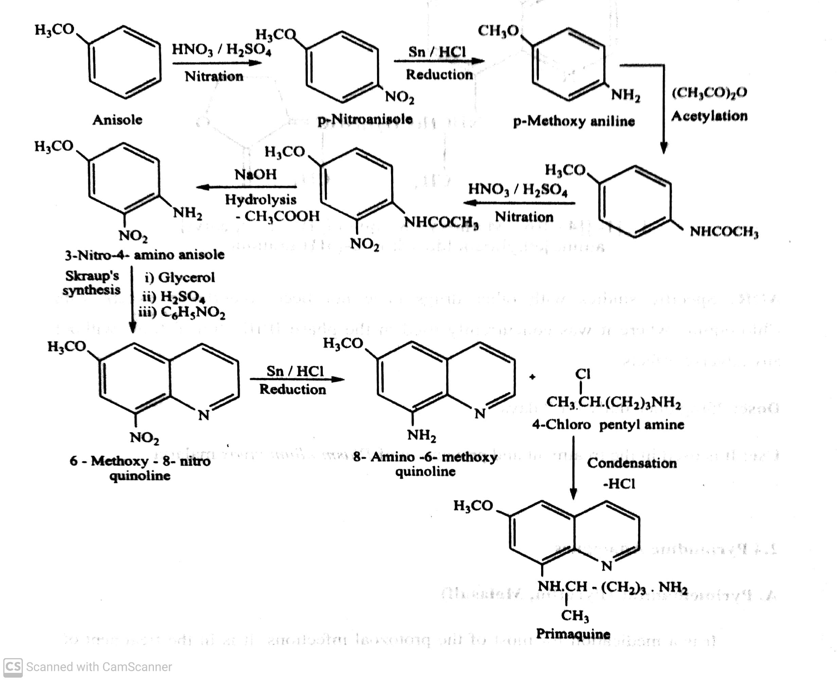
ANTIMALARIAL AGENTS
iii) 8- Amino quinolines : Synthesis of Primaquine
-08-2020
12

Slide 13
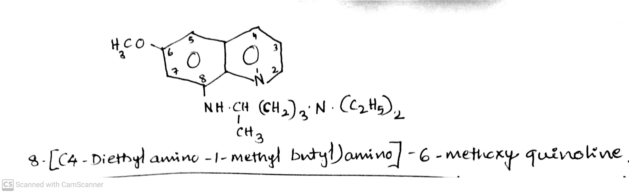
ANTIMALARIAL AGENTS
iii) 8- Amino quinolines : Bulaquine, Primaquine, Pamaquine.
Eg. Pamaquine:
Use: It is used as suppressive agent in malaria.
-08-2020
13

Slide 14
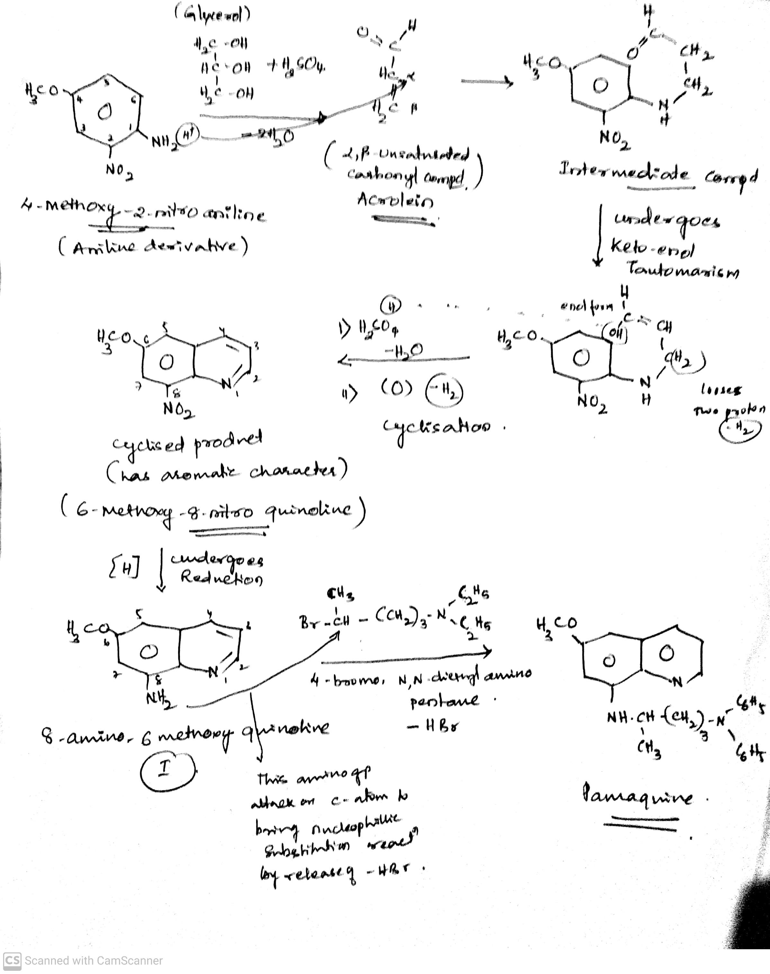
ANTIMALARIAL AGENTS
iii) 8- Amino quinolines : Eg. Synthesis of Pamaquine:
-08-2020
14

Slide 15
ANTIMALARIAL AGENTS
iii) 8- Amino quinolines : Eg. Synthesis of Pamaquine:
Pamaquine is synthesized starting with aniline derivative called as 4-methoxy-2-nitro aniline . This reacts with glycerol. The reaction takes place in presence of sulphuric acid. When sulphuric acid reacts with glycerol, it brings about the removal of two water molecules from glycerol to give Acrolein compound ( it is example of α, β- unsaturated carbonyl compound ).
This aniline derivative undergo nucleophilic addition to this α, β- unsaturated carbonyl compound. The addition takes place in such a way that one of the hydrogen atom from aniline will go on to this α-carbon. While rest of the nucleus will add on to the β-carbon, we will get formation of intermediate compound. This undergo keto-enol tautomerism to give isomers of this compound. Sulphuric acid is treated to this derivative . One of the proton (H) move on to the OH to make it water molecule.
-08-2020
15

Slide 16
ANTIMALARIAL AGENTS
iii) 8- Amino quinolines : Eg. Synthesis of Pamaquine:
This carbon then been electrophile attack on benzene ring to get cyclised product (6-methoxy-8-nitro quinolone). On reduction to give 6-methoxy-8-amino quinolone. From this amino group then attack on carbon atom (from 4-bromo-1-diethylamino pentane) to bring about nucleophilic substitution reaction by releasing –--HBr to give Pamaquine.
-08-2020
16

Slide 17
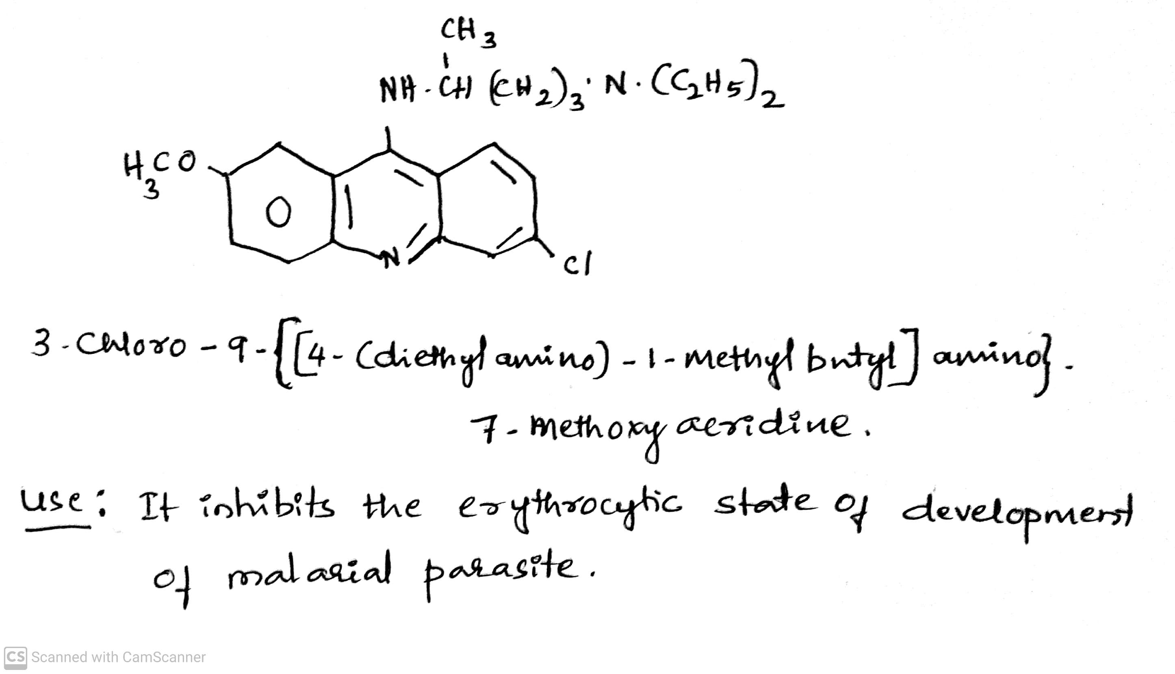
ANTIMALARIAL AGENTS
iv) 9- Amino quinolines : Mepacrine /Quinacrine( Atabrine).
-08-2020
17

Slide 18
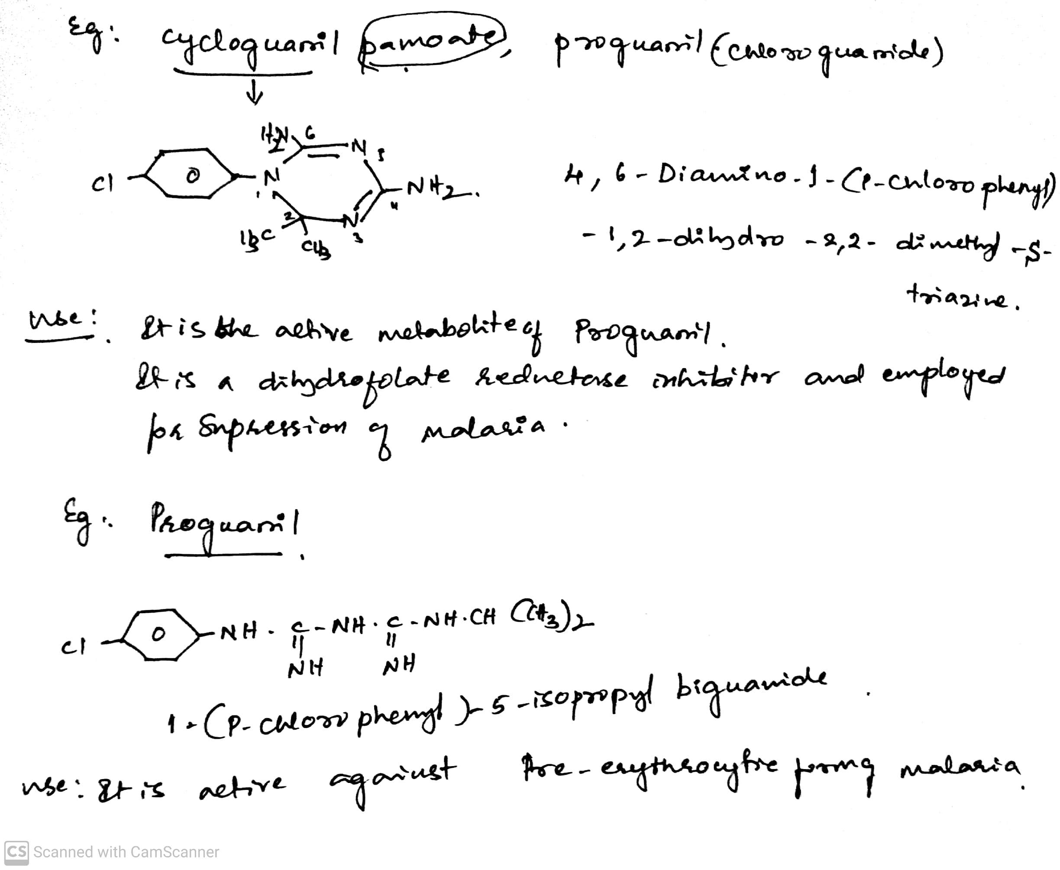
ANTIMALARIAL AGENTS
v) Biguanides : Cycloguanil, Proguanil,.
-08-2020
18

Slide 19
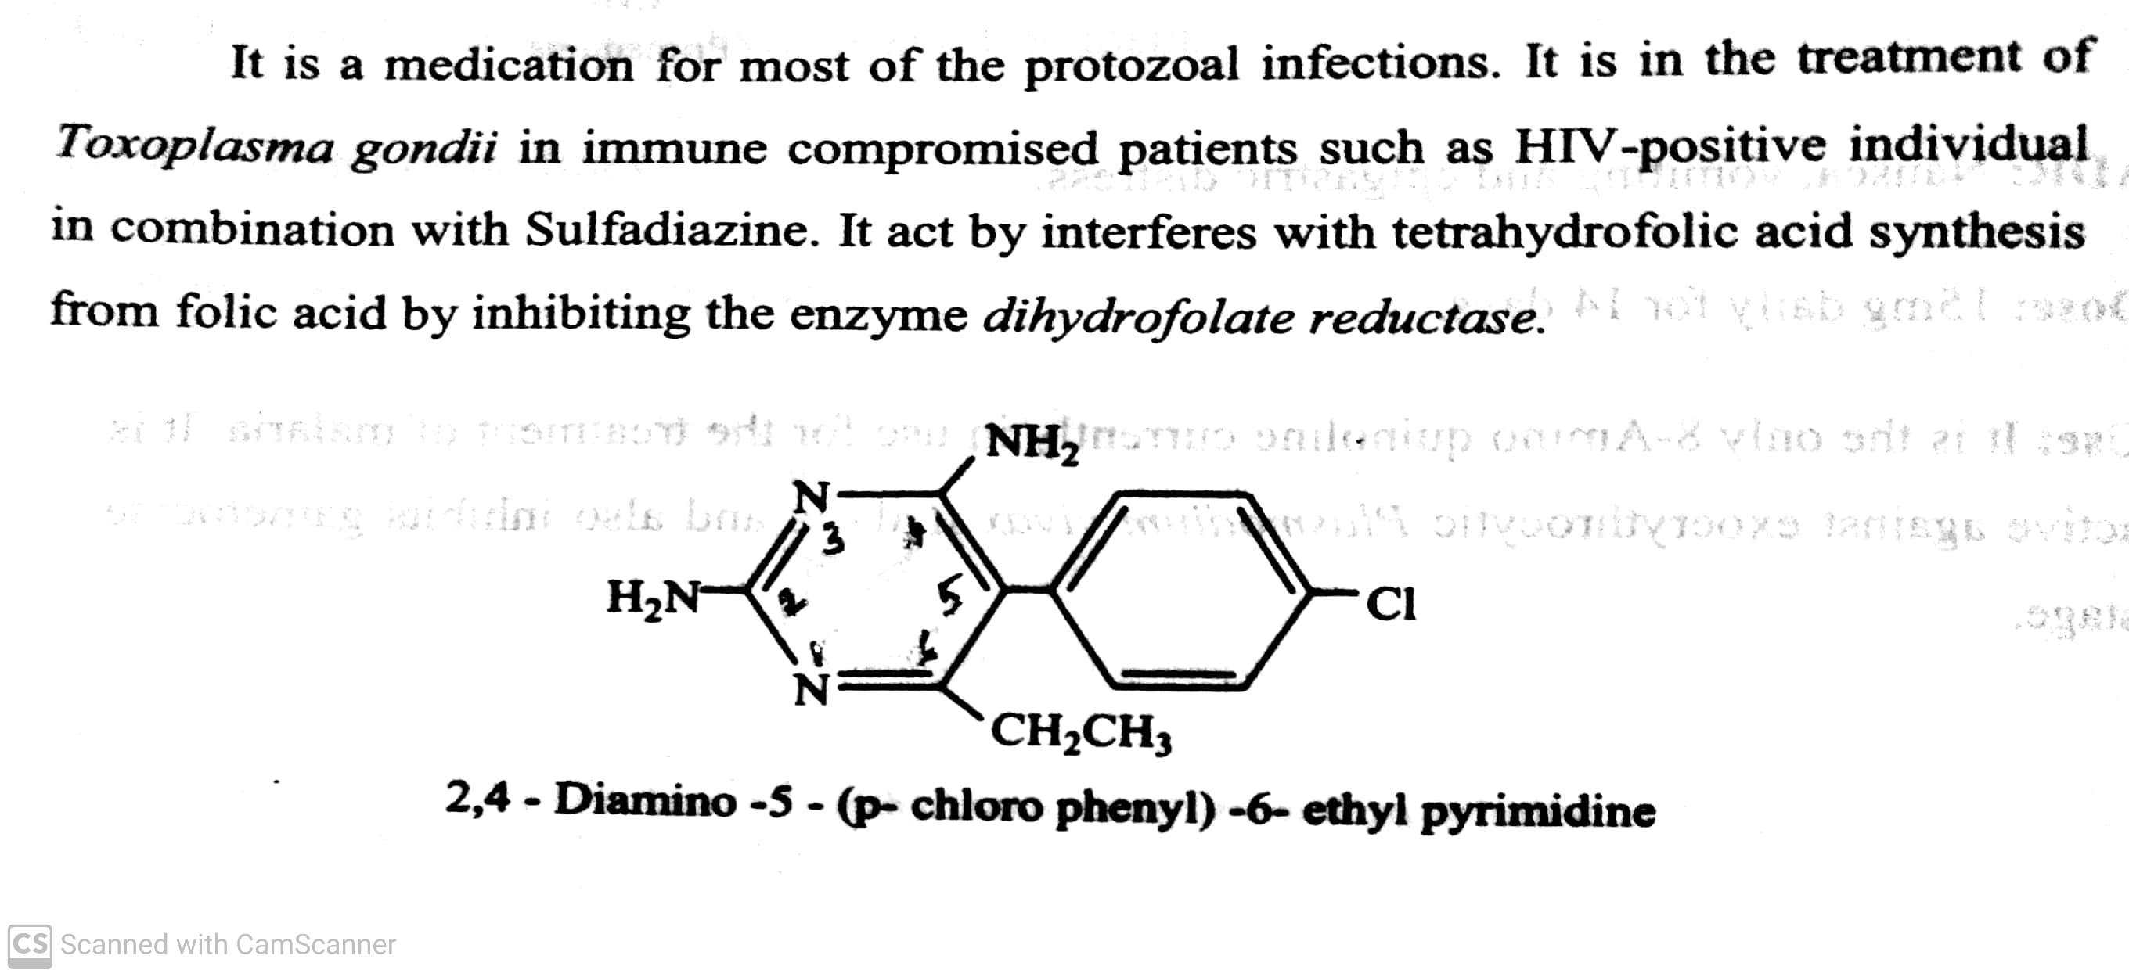
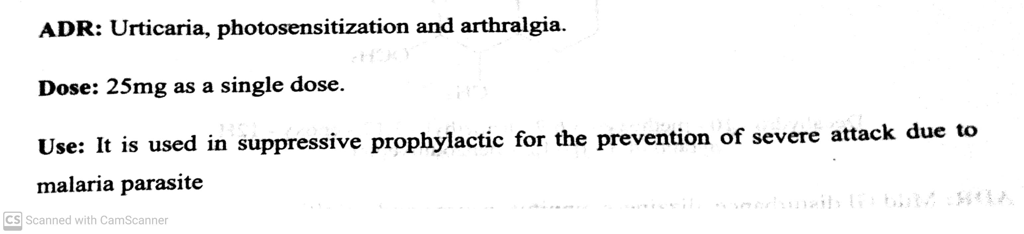
ANTIMALARIAL AGENTS
vi) Pyrimidine analogue : Pyrimethamine.
-08-2020
19

Slide 20
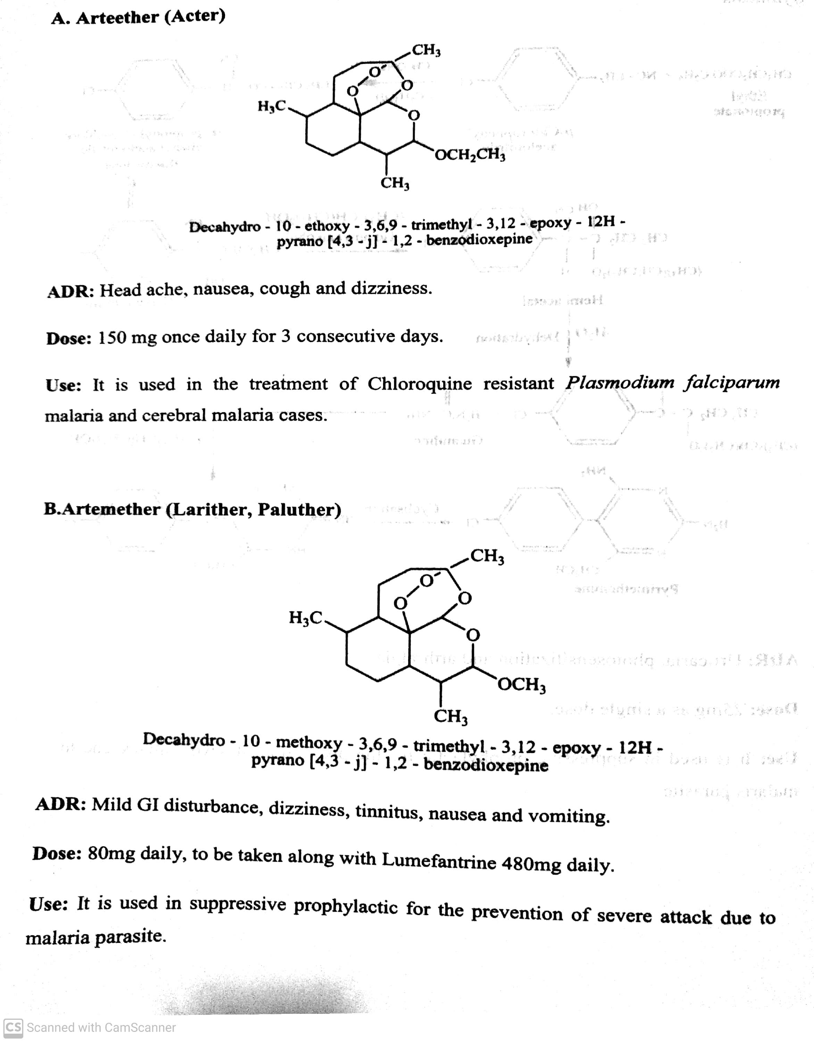
ANTIMALARIAL AGENTS
ix) Sesquiterpene lactones : Arteether, Arteemether.
-08-2020
20

Slide 21
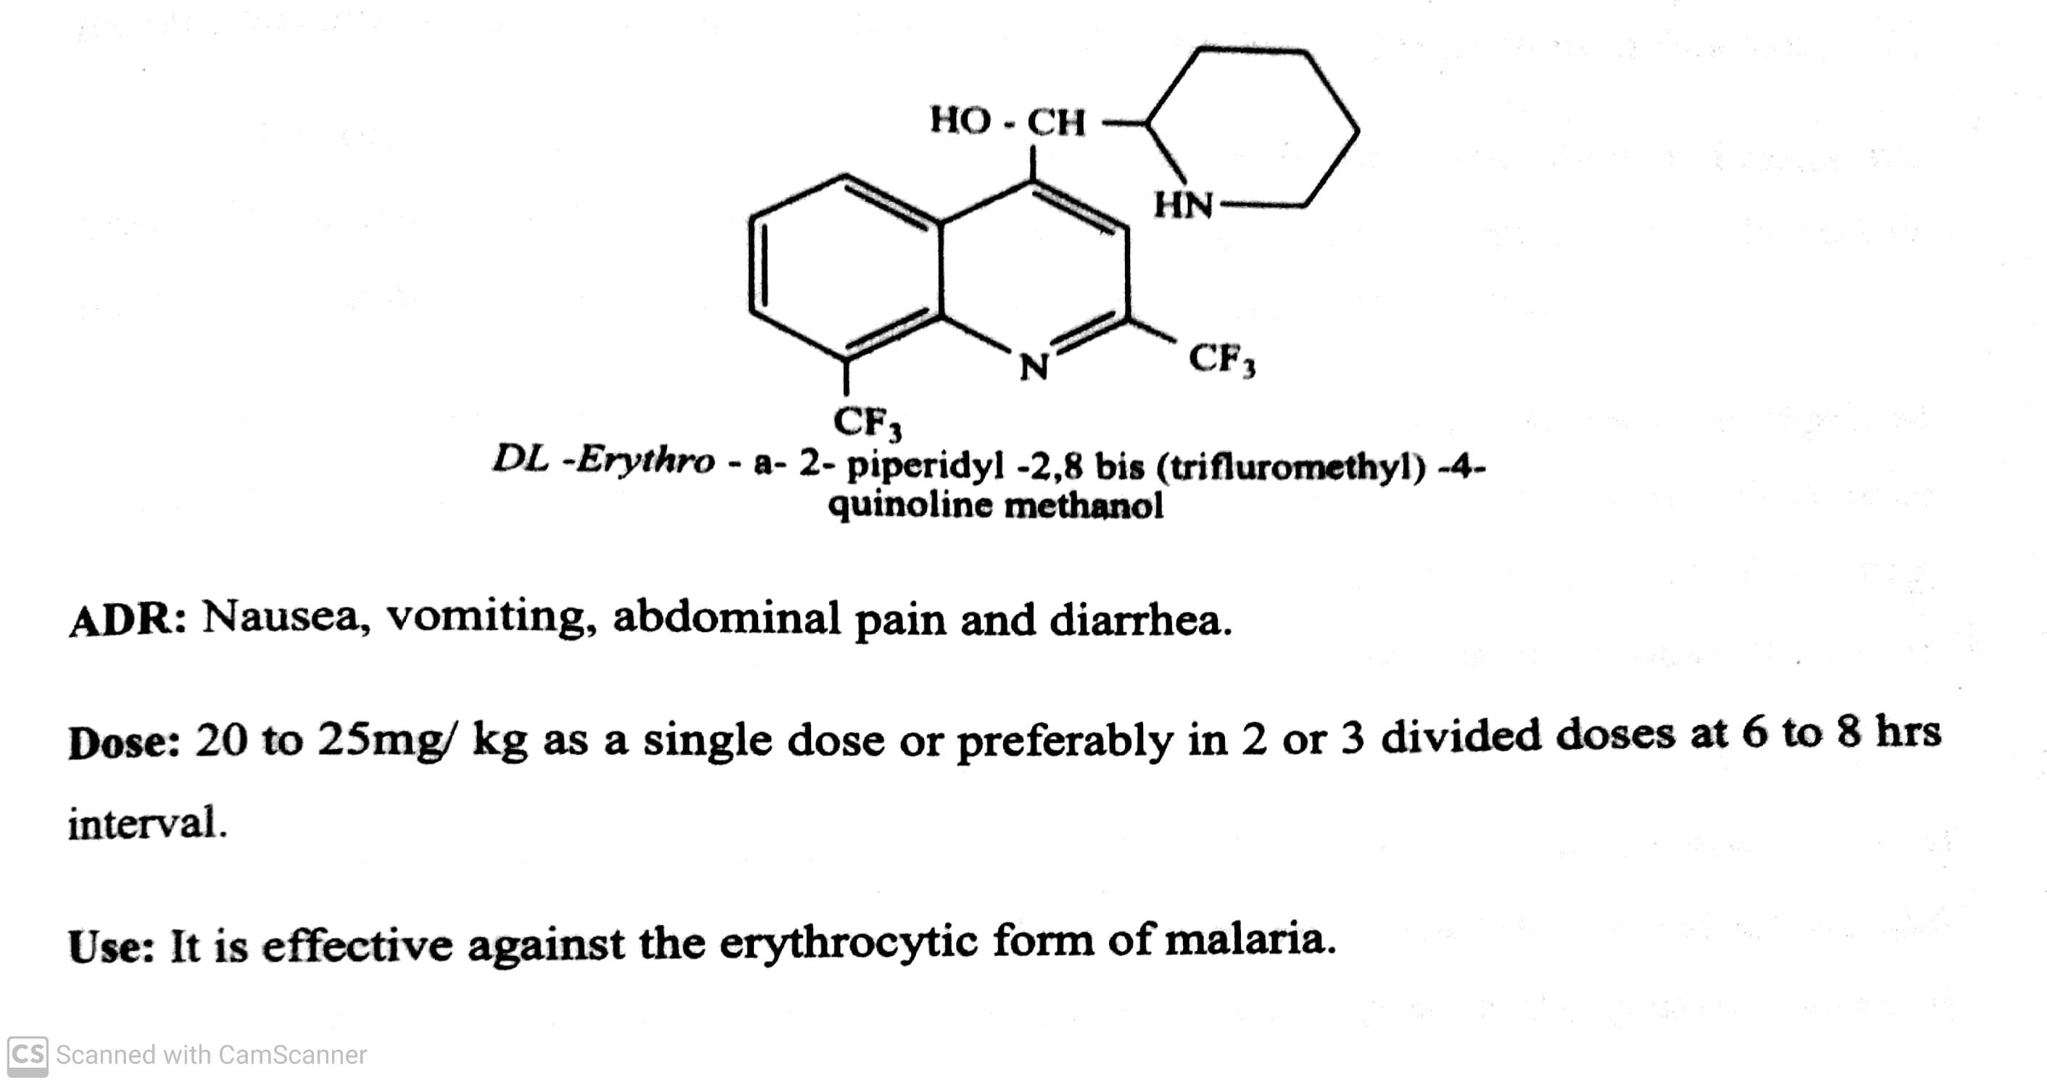
ANTIMALARIAL AGENTS
x) Miscellaneous : Mefloquine, Sulphadoxine.
-08-2020
21

Slide 22
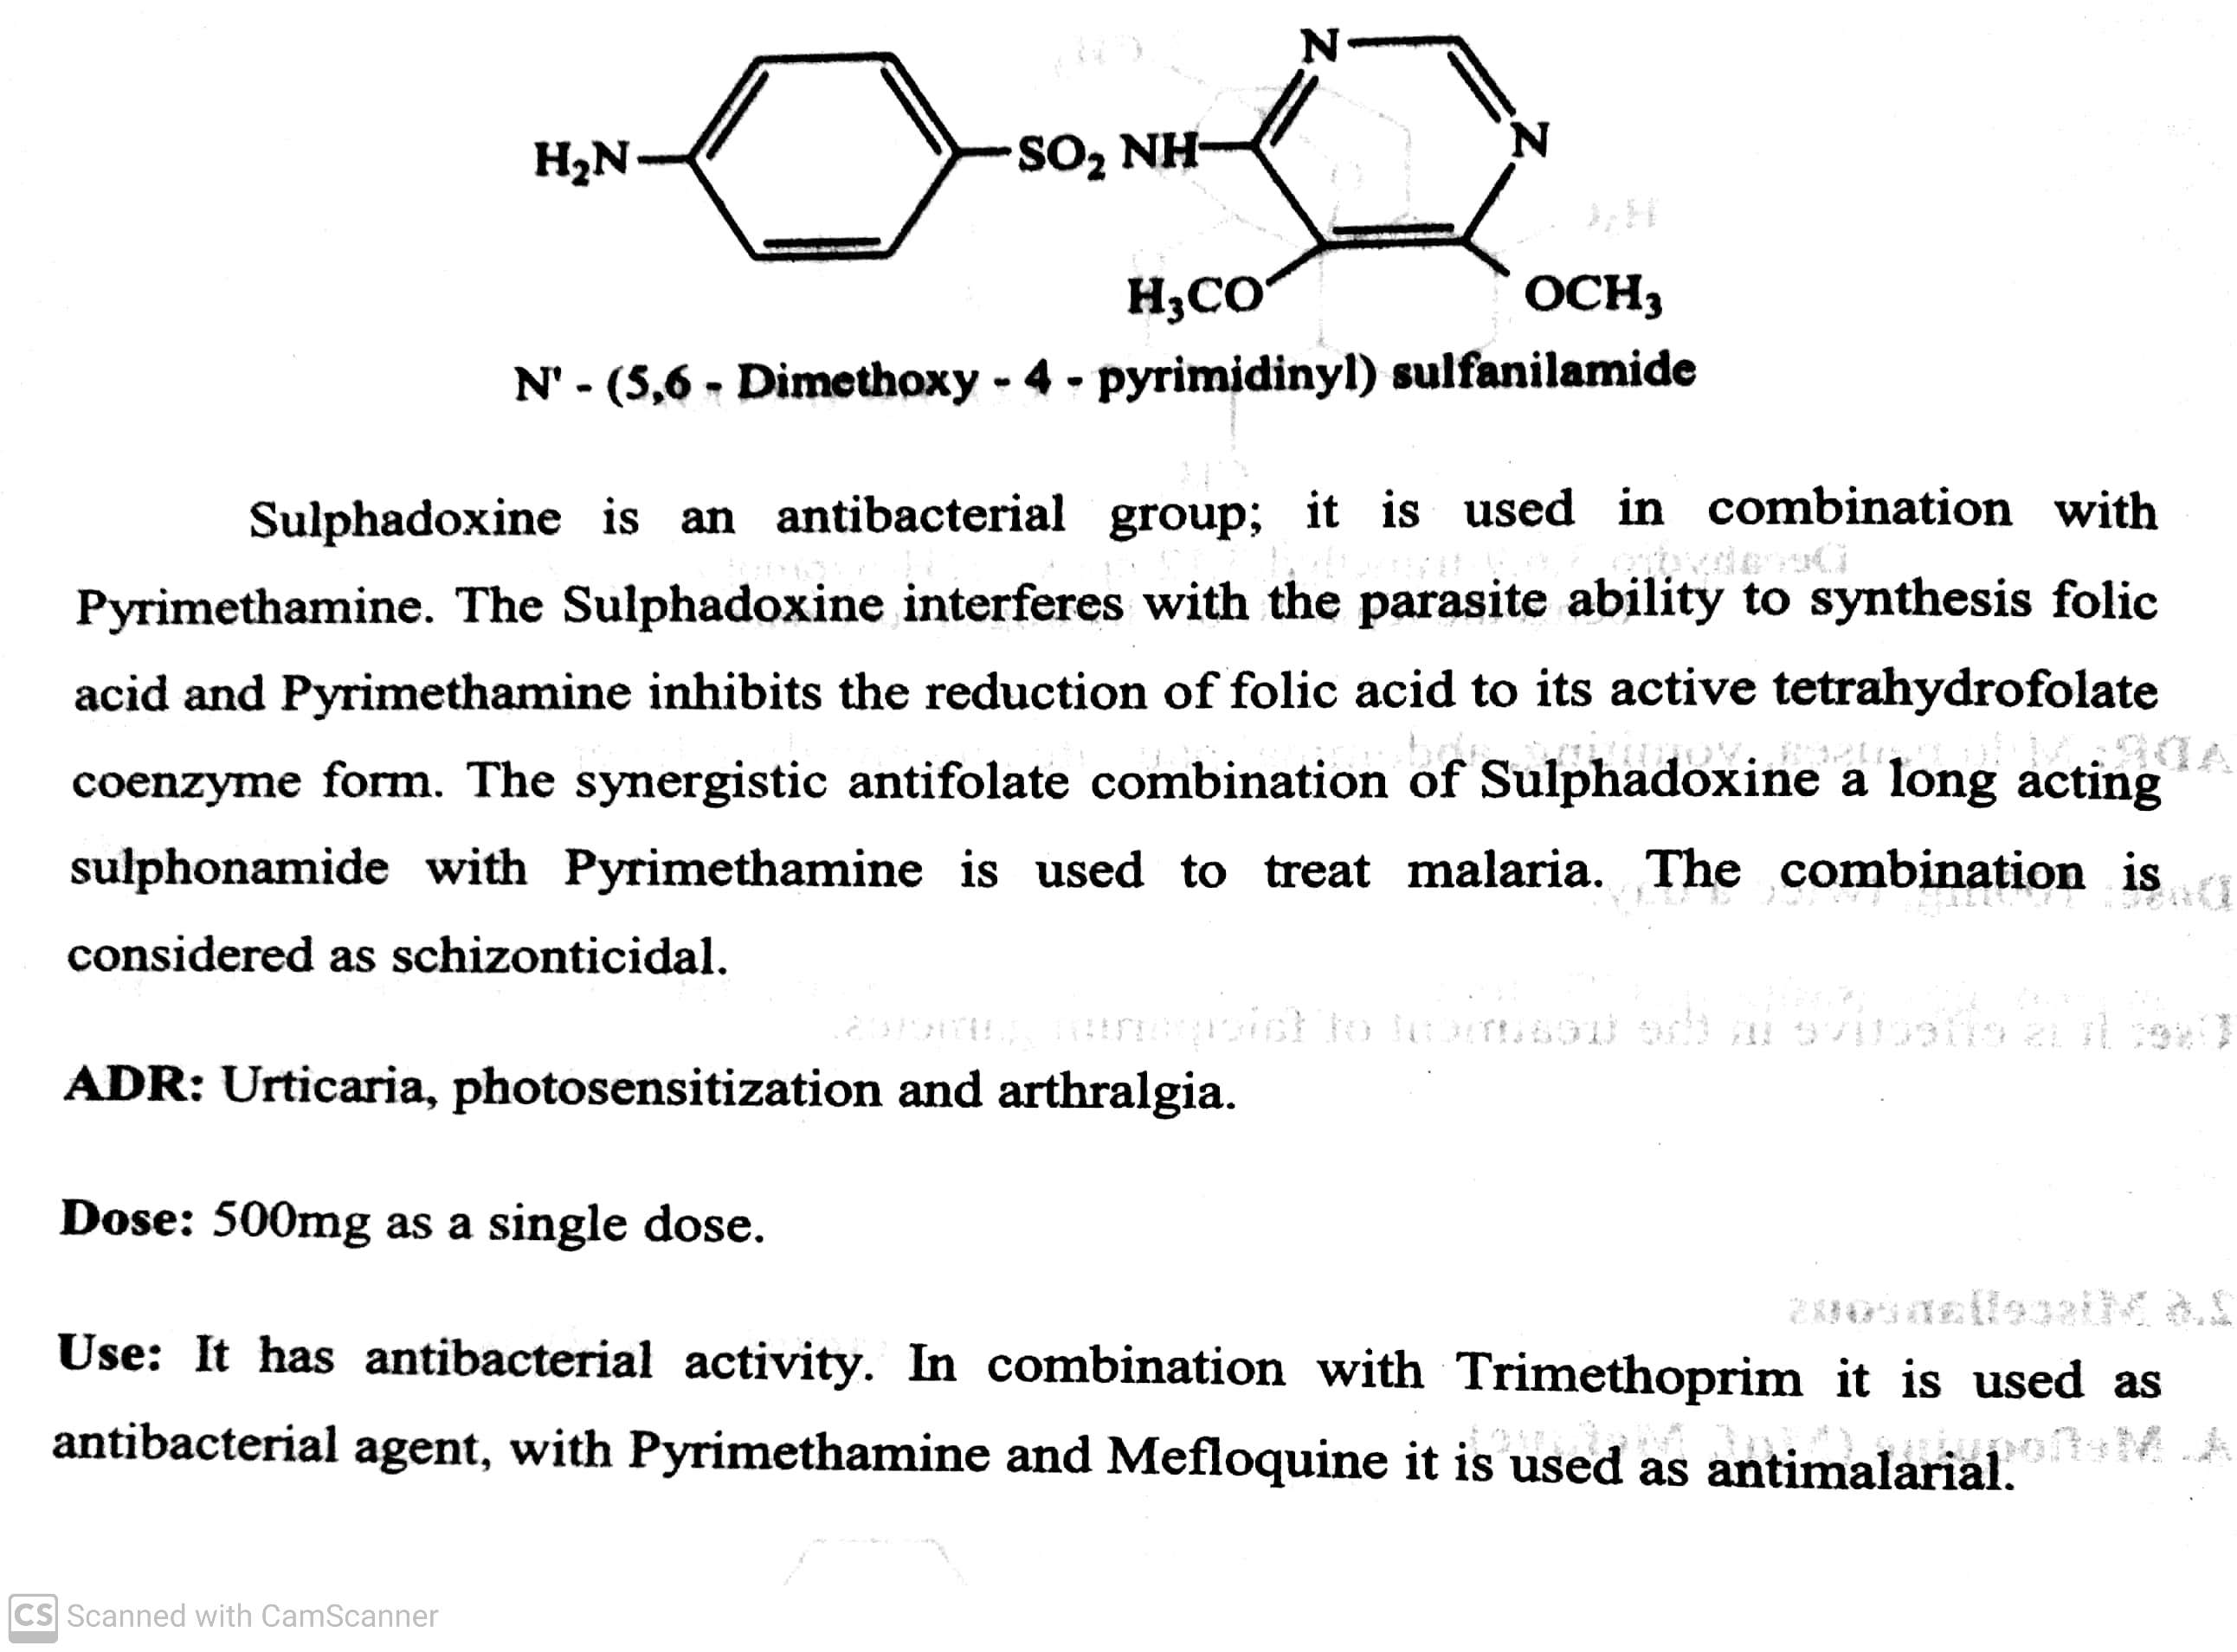
ANTIMALARIAL AGENTS
x) Miscellaneous : Sulphadoxine.
-08-2020
22

Slide 23
THANK YOU
-08-2020
23

