Slide 1

MEDICINAL CHEMISTRY-III
ANTIBIOTICS
-09-2020
1

Slide 2
ANTIBIOTICS
Antibiotic is a chemical compound that inhibits or abolishes the growth of microorganisms, such as bacteria,
fungi or protozoans.
It also includes any agent with biological activity against living organisms.
The term ‘Antibiotic’ commonly used to refer any substance with Antibacterial, Antifungal or Antiparasitical
activity.
-09-2020
2

Slide 3
ANTIBIOTICS
HISTORY
Potent antibiotic compounds for the treatment of human diseases caused by bacteria such as tuberculosis, plague or leprosy were not isolated and identified until twentieth century.
The first known use of antibiotics was by the ancient Chinese over 2,500 years ago.
Many other ancient cultures, including the ancient Egyptians and ancient Greeks already used molds and plants to treat infections, owing to the production of antibiotic substances by these organisms. At that time, however, the compounds having antibiotic activity present in molds or plants were unknown.
The antibiotic properties of Penicillium spp. Were first described in France by Ernest Duchense in 1897. However, his work went by without much notice from the scientific community until Alexander Fleming’s discovered penicillin.
-09-2020
© R R INSTITUTIONS , BANGALORE
3

Slide 4
ANTIBIOTICS
HISTORY
Modern research on antibiotic therapy began in Germany with the development of narrow-spectrum antibiotic Salvarsan by Paul Ehrlich in 1909.
Antibiotics were further developed in Britain following the re-discovery of Penicillin in 1928 by Alexander Fleming.
Antibiotic was originally used to refer only to substances extracted from a fungus or other microorganism, but has come to include also the many synthetic and semisynthetic drugs that have antibacterial effects.
-09-2020
4

Slide 5
ANTIBIOTICS
CLASSIFICATION
Based on chemical structure:
i) β-Lactam antibiotics : Penicillins, Cephalosporins, Monobactams, Carbepenems.
ii) Aminoglycoside antibiotics : Streptomycin, Neomycin, Kanamycin, Paramomycin, Gentamycin,
Amikacin, Tobramycin, Netilmicin, Sisomicin, Spectinomycin.
iii) Tetracyclines : Tetracyclines, Oxytetracyclines, Chlortetracyclines, minocycline,
Doxycyclines,
,Rolitetracyclines, Methacyclines, Demeclocyclines, Meclocyclines.
iv) Macrolide antibiotics : Erythromycin, Clarithromycin, Azithromycin, Dirithromycin,
Troleandomycin.
-09-2020
5

Slide 6
ANTIBIOTICS
CLASSIFICATION
Based on chemical structure:
v) Miscellaneous :
Nitrobenzene derivatives: Chloramphenicol.
Lincomycin : Clindamycn, Lincomycin.
vi) Polypeptide antibiotics : Polymyxin-B, Colistin, Vancomycin, Teicoplanin, Bacitracin.
vii) Steroidal antibiotic : Fusidic acid.
viii) : Novobiocin, mupirocin, Quinupristin.
-09-2020
6

Slide 7
ANTIBIOTICS
CLASSIFICATION
II. Based on Pharmacological activity:
i) Antifungal antibiotics :
a) Polyenes : Amphotericin B, Nystatin, Natamycin, Griseofulvin.
ii) Anticancer antibiotics: Dactinomycin, Daunorubicin, Doxorubicin, Bleomycin, Idarubicin, Mitomycin.
iii) Antityphoid antibiotics: Chloramphenicol.
iv) Antidiarrheal antibiotic: Colistin.
v) Antitubercular antibiotics: Rifampicin, Rifabutin, Cycloserine, Capreomycin.
-09-2020
7

Slide 8
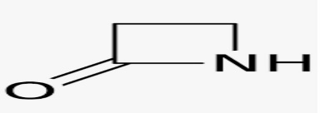
ANTIBIOTICS
CLASSIFICATION
Based on chemical structure:
i) β-Lactam antibiotics : Penicillins, Cephalosporins, Monobactams, Carbepenems.
Any antibiotic agent which contains a β-Lactam nucleus in its molecular structure are called β-Lactam
antibiotics.
β-Lactam antibiotics are a broad class of antibiotics which includes Penicillins derivatives, Cephalosporins,
Monobactams, Carbepenems and β-Lactamase inhibitors.
Clinical Use: β-Lactam antibiotics are indicated for the prophylaxis and treatment of bacterial infection
caused by susceptible organisms.
-09-2020
© R R INSTITUTIONS , BANGALORE
8

Slide 9
ANTIBIOTICS
MODE OF ACTION
β-Lactam antibiotics are bactericidal and act by inhibiting the synthesis of Peptidoglycan layer of bacterial
cell wall.
The peptidoglycan layer is important for cell wall structural integrity , especially in gram- +ve
organisms.
The final transpeptidation step in the synthesis of peptidoglycan is facilitated by transpeptidases known as
penicillin binding proteins.
-09-2020
9

Slide 10
ANTIBIOTICS
PENICILLINS
-09-2020
10

Slide 11
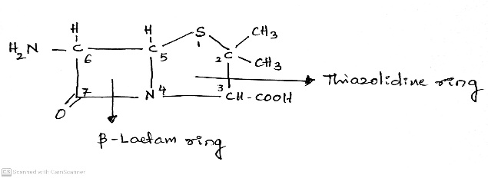
ANTIBIOTICS
CLASSIFICATION
Based on chemical structure:
i) β-Lactam antibiotics : Penicillins, Cephalosporins, Monobactams, Carbepenems.
PENICILLINS
Penicillin refers to a group of β-Lactam antibiotics used in the treatment of bacterial infection caused by
susceptible, usually gram- +ve organisms.
Chemistry:
The structure of Penicillin is composed of Fused four membered β-Lactam ring with Five
membered Thiozolidine nucleus.
It contains Three Chiral carbon atoms (C3, C5 and C6).
All the natural and synthetic penicillins have the same absolute configuration about these three centres.
The C-6 atom bearing the acyl amino group has the L-configuration, where as the C-3 to which the carboxyl group was attached has the D-configuration.
6- Amino Penicillanic Acid (6-APA) is the basic skeleton structure of all penicillins.
-09-2020
11

Slide 12
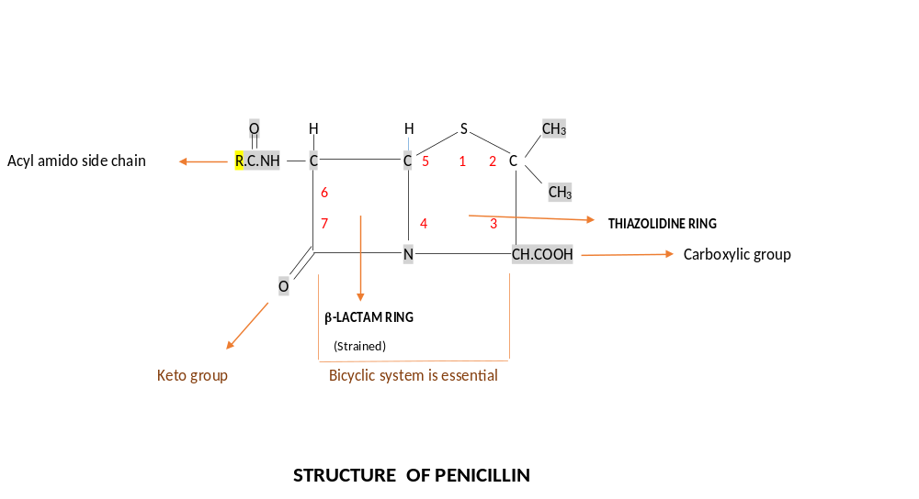
ANTIBIOTICS
CLASSIFICATION
Based on chemical structure:
i) β-Lactam antibiotics : Penicillins, Cephalosporins, Monobactams, Carbepenems.
PENICILLINS
Structure:
-09-2020
12

Slide 13
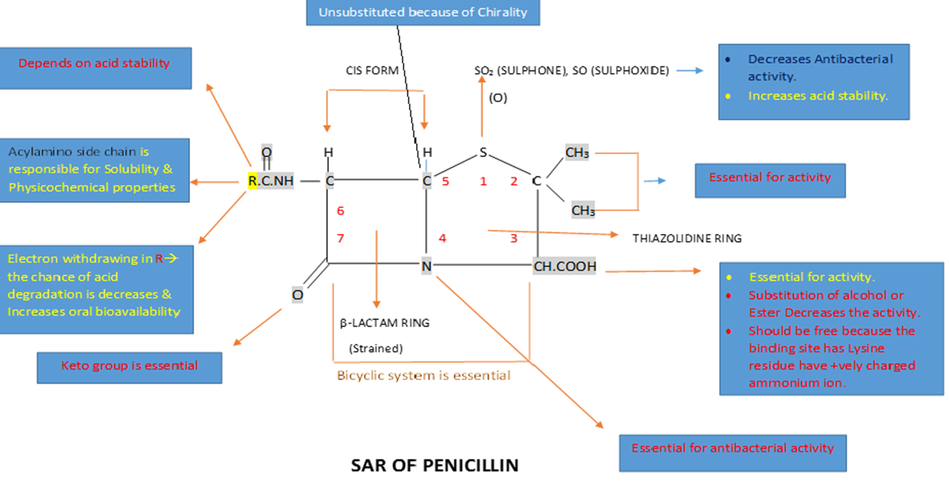
ANTIBIOTICS
SAR OF PENICILLINS
-09-2020
13

Slide 14
ANTIBIOTICS
CLASSIFICATION
Based on chemical structure:
i) β-Lactam antibiotics : SAR OF PENICILLINS
The Penicillin structure composed of fused 4-membered β-Lactam ring with Five
membered Thiazolidine nucleus.
Thiozolidine ring:
Sulphur atom is not essential: Sulphur atom in the 1- position of thiazolidine ring is oxidised to sulphone
(SO2) or sulphoxide (SO) Improves the acid stability but decreases the antibacterial activity.
The Dimethyl substitution at 2-position is necessary for activity. If any other substitution or change in the
position decreases the activity.
The Carboxylic acid group at 3-position is required for the activity. If it is changed to alcohol or ester the
activity is reduced.
-09-2020
14

Slide 15
ANTIBIOTICS
CLASSIFICATION
Based on chemical structure:
i) β-Lactam antibiotics : SAR OF PENICILLINS
β-Lactam ring :
The strained β-Lactam ring is essential. The greater the strain , the greater is activity.
The Nitrogen atom at 4-position is essential for activity.
No substitution is possible at 5-position of β-Lactam ring because of Chirality (C3, C5 and C6).
Acylamino side chain at 6-position is responsible for solubility and physicochemical properties.
(In that ‘R’ depends on acid stability by means of R only we can tell whether it is susceptible or resistance to
β-Lactamase (Penicillinase) enzyme).
If it is having electro withdrawing group in R- The chance of acid degradation that will be reduced and increases the stability and oral bioavailability. Eg. Ampicillin.
-09-2020
15

Slide 16
ANTIBIOTICS
CLASSIFICATION
Based on chemical structure:
i) β-Lactam antibiotics : SAR OF PENICILLINS
β-Lactam ring :
Ketone (=O) group at is 7th Position important for activity.
The gram-ve activity is increased when introducing hydrophilic group ( NH2, OH, COOH) to the α-carbon of
carbonyl group on the side chain. Eg. Ampicillin.
The broad spectrum activity can be increased by introducing strong acidic group to the α-carbon of
carbonyl group on the side chain. Eg. Ampicillin and Carbenicillin.
-09-2020
16

Slide 17
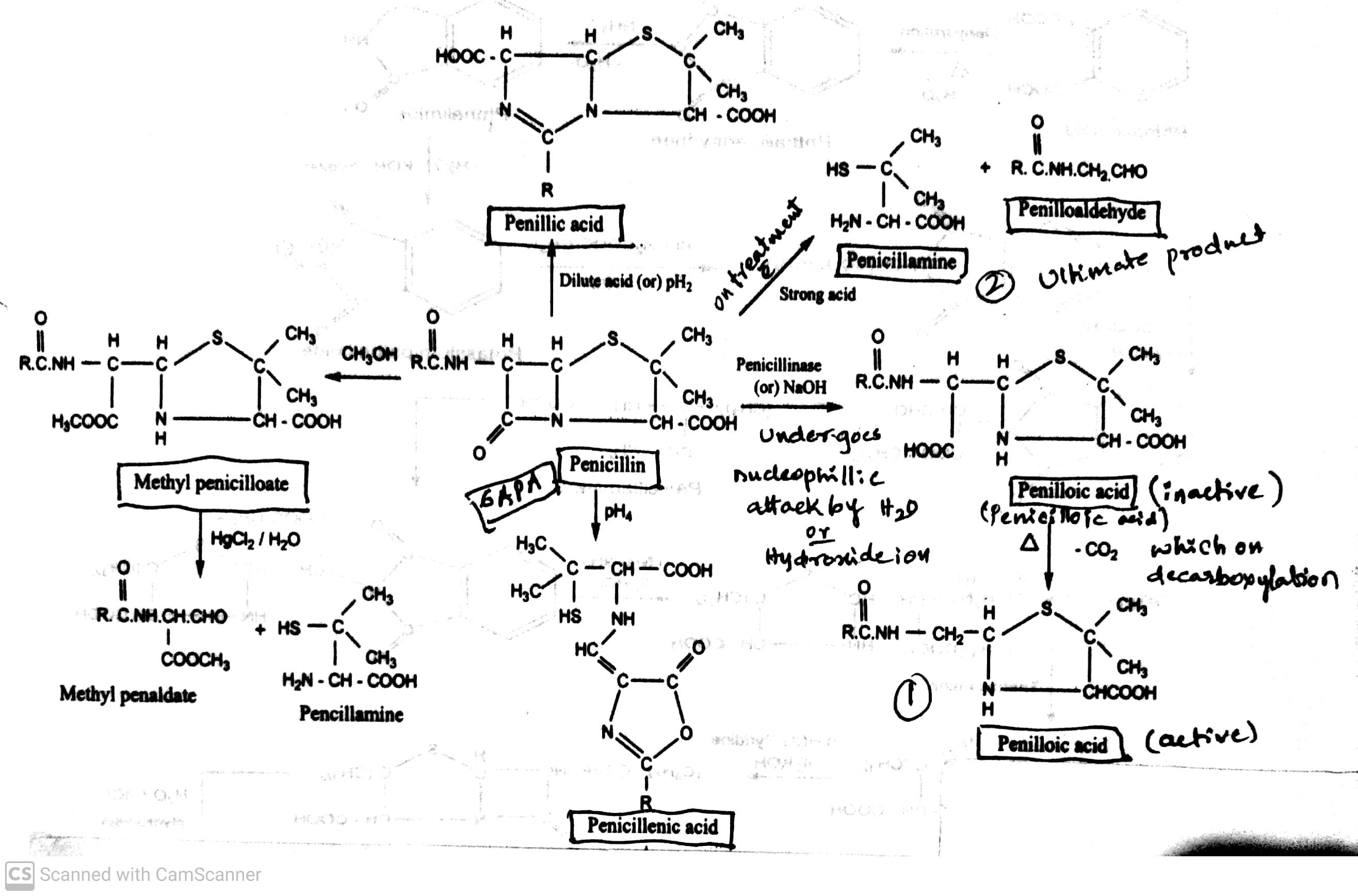
ANTIBIOTICS
CHEMICAL DEGRADATION OF PENICILLIN
-09-2020
17

Slide 18
ANTIBIOTICS
CHEMICAL DEGRADATION OF PENICILLIN
(Degradation/ Deterioration → Decreased in quality)
The main cause of deterioration of Penicillin is the reactivity of strained Lactam ring.
The hydrolysis and the nature of Degradation products are influence by pH of the solution.
Thus the β-Lactam carbonyl group of penicillin readily undergoes nucleophilic attack by water or hydroxide ion
to form inactive Penicilloic compound. Which on Decarboxylation produces Active Penilloic acid.
On treatment with strong acid the ultimate product formed is Penicillamine and Penilloaldehyde.
On subject to pH 2.0 and pH 4.0 gives rise to Penillic acid and Penicillenic acid respectively.
On treatment with Methanol (- CH3OH) the bond between carbon and nitrogen that would be broken to form Methyl penicilloate.
-09-2020
18

Slide 19
ANTIBIOTICS
MECHANISM OF ACTION OF PENICILLIN
β-Lactam antibiotics works by inhibiting the formation of peptidoglycan crosses links in the bacterial cell wall.
The β-Lactam moiety of penicillin binds to the enzyme (transpeptidase) that links the peptidoglycan molecules in bacteria and this weakens the cell wall of the bacterium. In addition, the build- up of peptidoglycan precursors triggers the activation of bacterial cell wall hydrolysis which further digest the bacteria's existing peptidoglycan.
When the bacteria lose their cell walls they are then called spheroplasts.
-09-2020
19

Slide 20
ANTIBIOTICS
CLASSIFICATION OF PENICILLIN
Penicillins are classified based upon the nature and spectrum of activity.
I. Based upon the nature
a) Natural ( Biosynthetic ) Penicillins: eg. Benzyl penicillin (Penicillin-G),
Phenoxy methyl penicillin (Penicillin-V),
2-Pentenyl penicillin ( Penicillin-F),
p- Hydroxy benzyl penicillin.
b) Semi-synthetic Penicillins : eg. Ampicillin, Amoxicillin, Methicillin,
Nafacillin, Oxacillin, Cloxacillin, Dicloxacillin,
Carbenicillin, Piperacillin, and Cyclacillin.
c) Penicillin combination : eg. Benzathine penicillin and Procaine penicillin.
-09-2020
20

Slide 21
ANTIBIOTICS
CLASSIFICATION OF PENICILLIN
II. Penicillins are classified based upon the spectrum of activity.
a) Effective against Gram-positive bacteria : eg. Benzyl penicillin (Penicillin-G),
Ampicillin, Oxacillin
b) Effective against Gram-negative bacteria : eg. Temocillin.
c) Broad spectrum penicillins : eg. Ampicillin, Amoxicillin, Carbenecillin.
d) Penicillinase resistant penicillins : eg. Methicillin, Nafacillin, Oxacillin, Cloxacillin,
Flucloxacillin.
e) Acid resistant penicillins : eg. Benzathine penicillin, Phenoxymethyl penicillin,
Phenoxyethyl penicillin, Phenoxypropyl penicillin
-09-2020
21

Slide 22
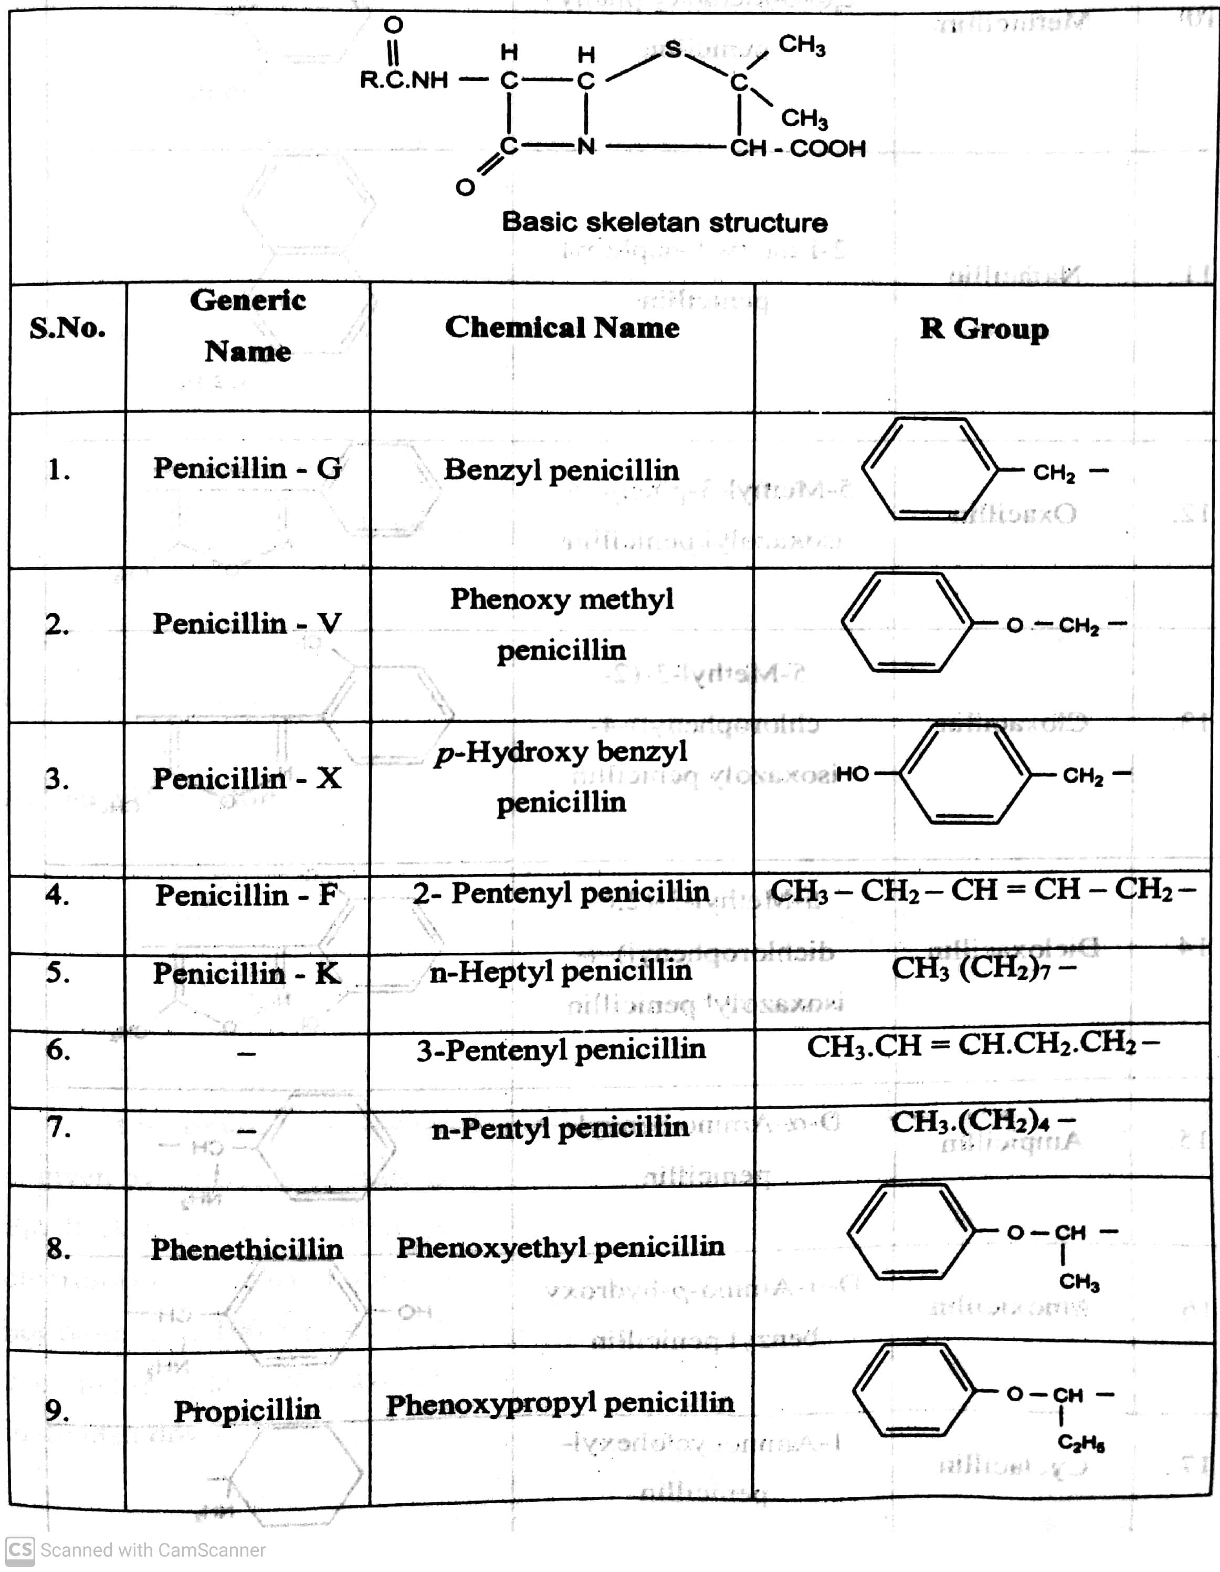
ANTIBIOTICS
-09-2020
22

Slide 23
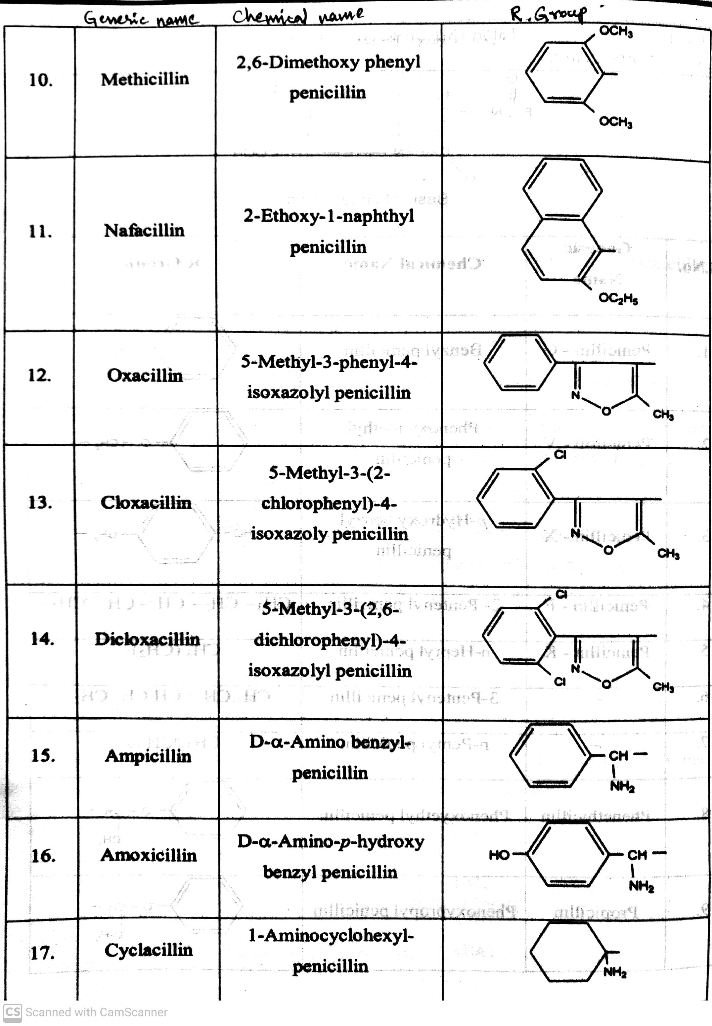
ANTIBIOTICS
-09-2020
23

Slide 24
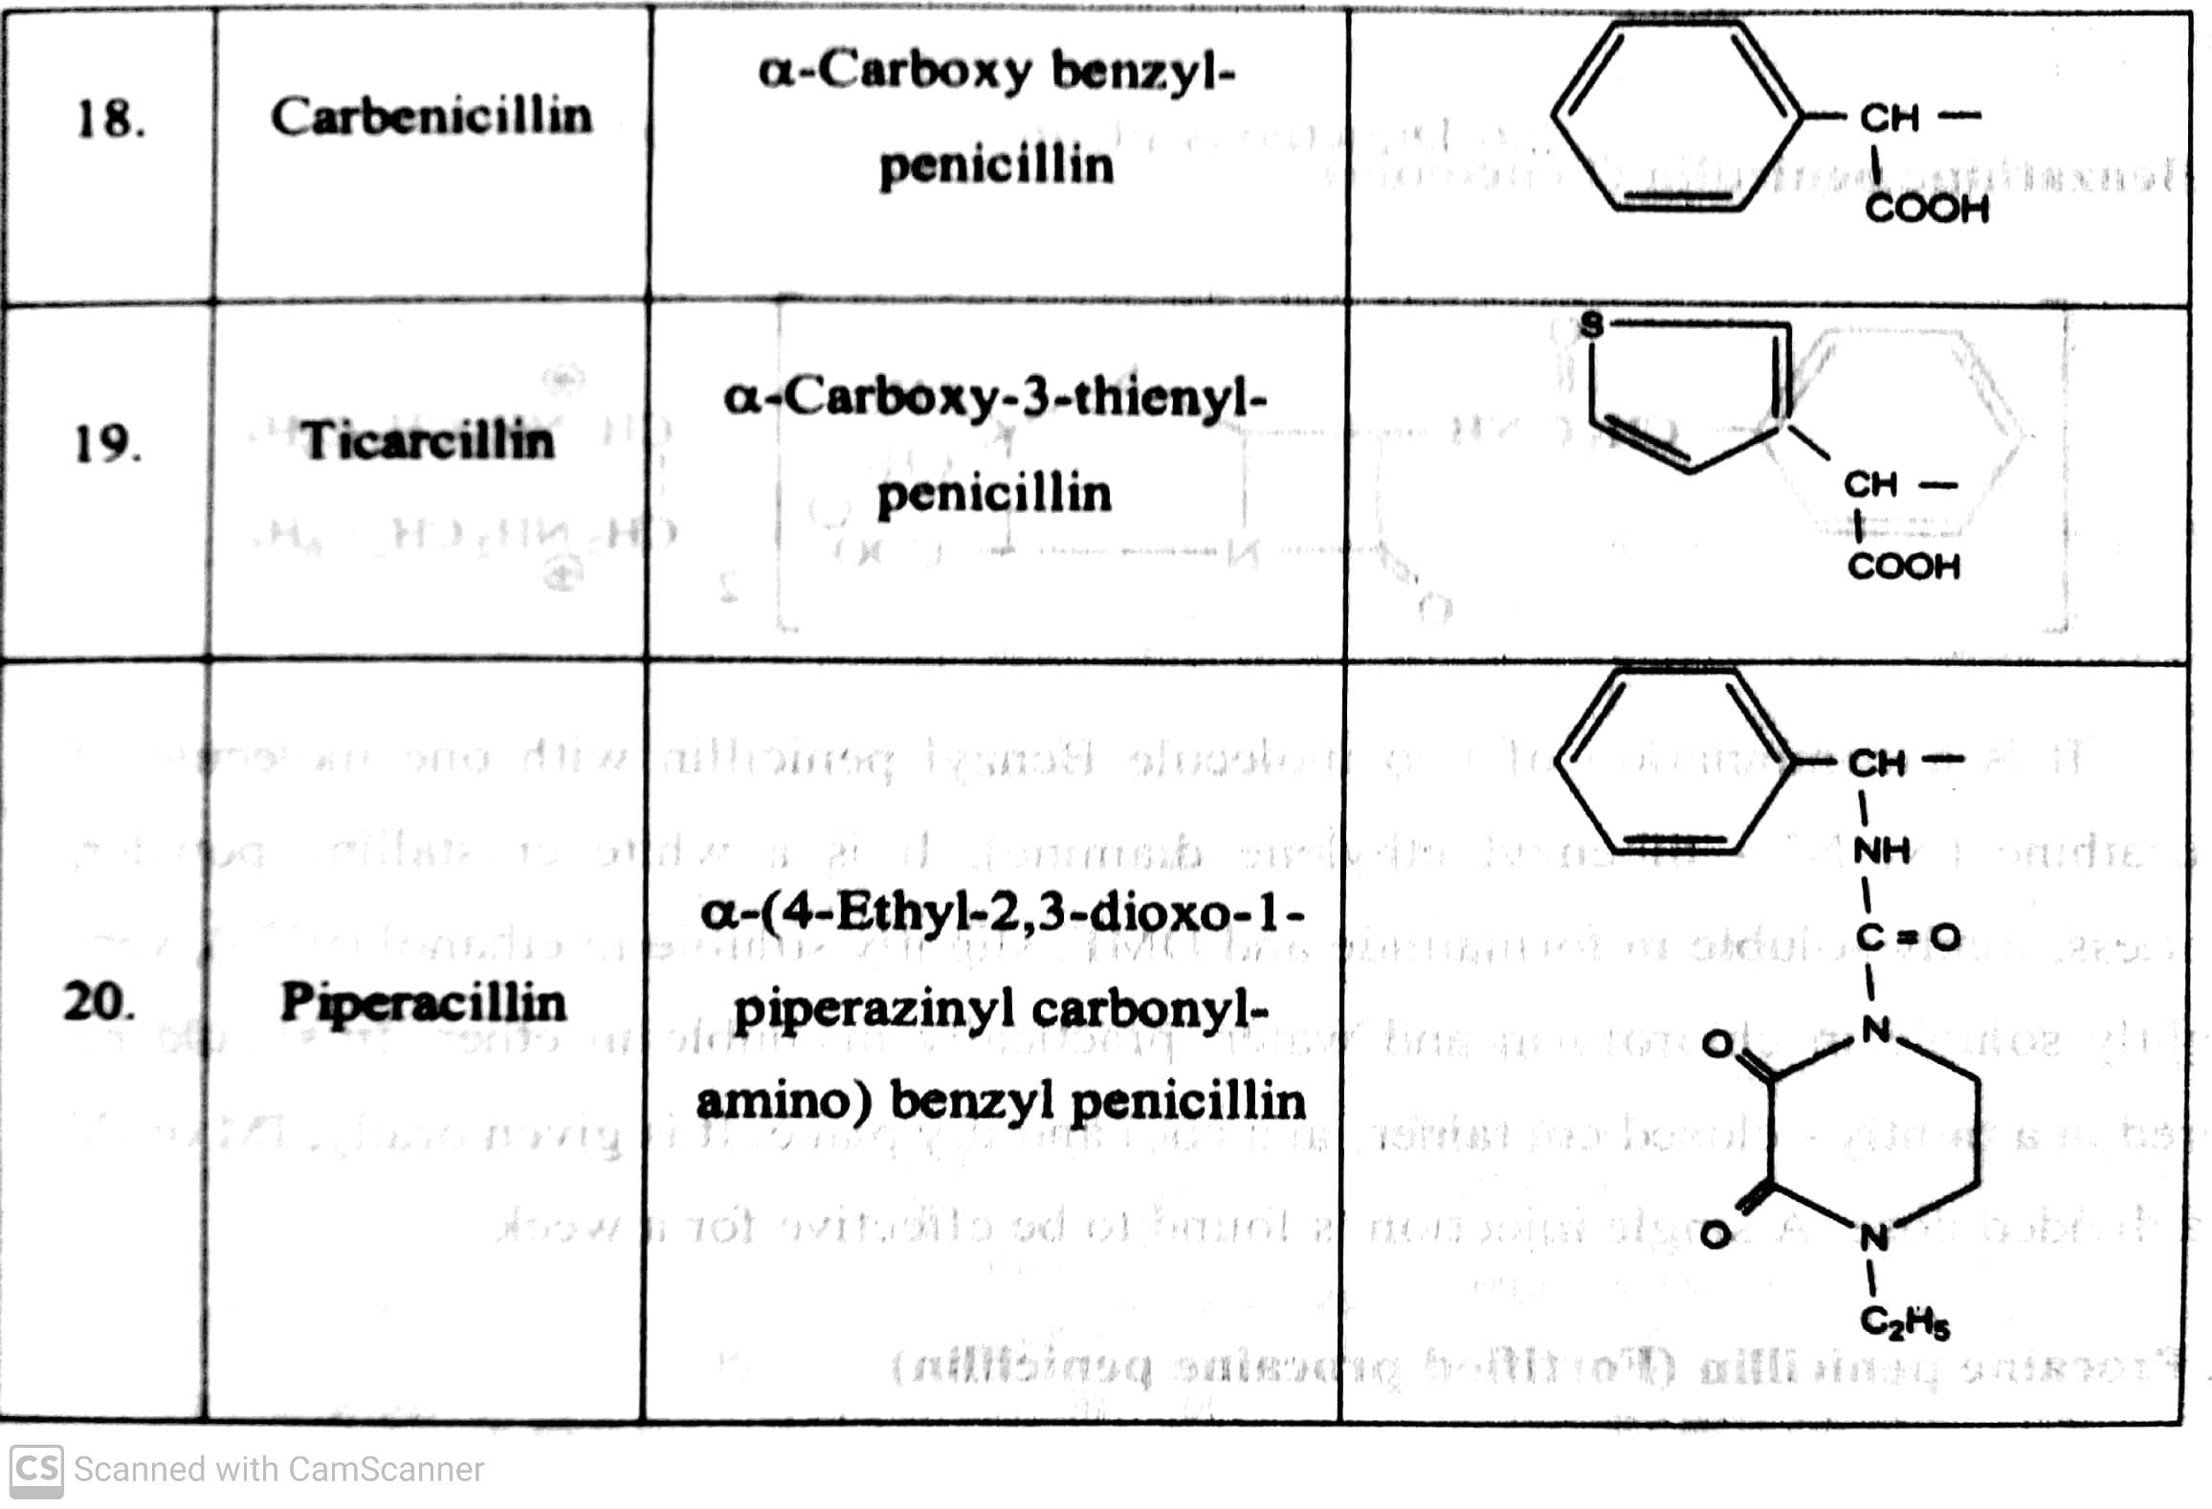
ANTIBIOTICS
-09-2020
24

Slide 25
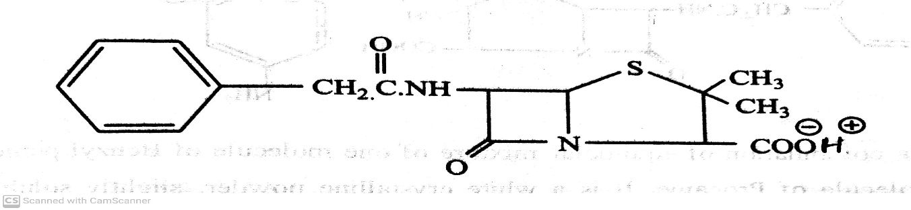
ANTIBIOTICS
CLASSIFICATION OF PENICILLIN
Penicillins are classified based upon the nature and spectrum of activity.
a) Natural ( Biosynthetic ) Penicillins: eg. Benzyl penicillin (Penicillin-G)
It is commonly known as Penicillin-G, is the gold standard type of penicillin.
It is given by parenteral route of administration because of it instability in the stomach pH.
It is white crystalline powder, very soluble in water, practically insoluble in chloroform, ether, fixed oils
And liquid paraffin.
It contains 96-100.5 % of penicillin.
-09-2020
25

Slide 26
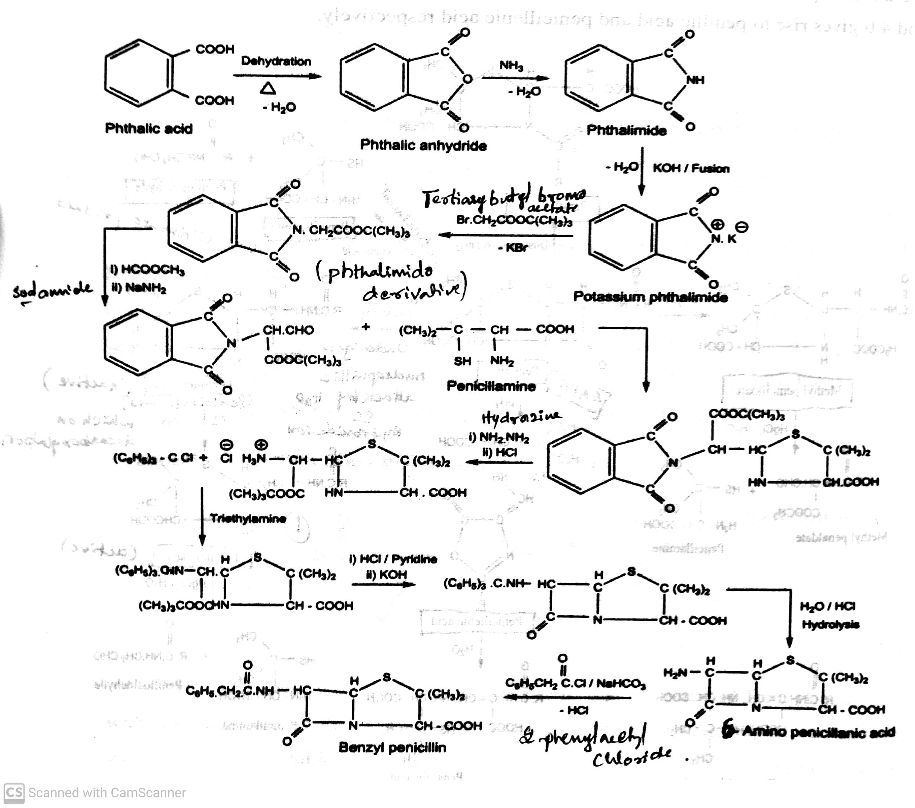
ANTIBIOTICS
CLASSIFICATION OF PENICILLIN
Synthesis Benzyl penicillin (Penicillin-G)
-09-2020
26

Slide 27
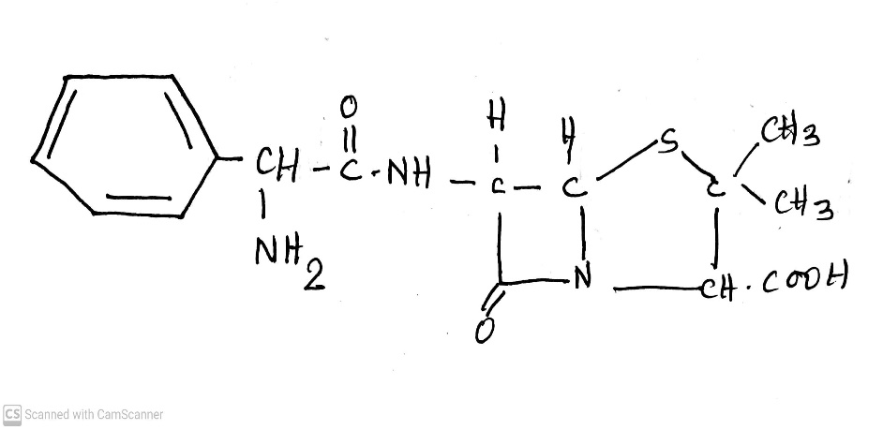
ANTIBIOTICS
CLASSIFICATION OF PENICILLIN
Penicillins are classified based upon the nature and spectrum of activity.
b) Semi-synthetic Penicillins : eg. Ampicillin, Amoxicillin, Methicillin, Nafacillin, Oxacillin,
Cloxacillin, Dicloxacillin, Carbenicillin, Piperacillin, and Cyclacillin.
eg. Ampicillin:
D-α amino benzyl Penicillin
Use : It is used to treat certain infections caused by bacteria such as meningitis, throat, sinuses, lungs,
urinary tract and GIT.
-09-2020
27

Slide 28
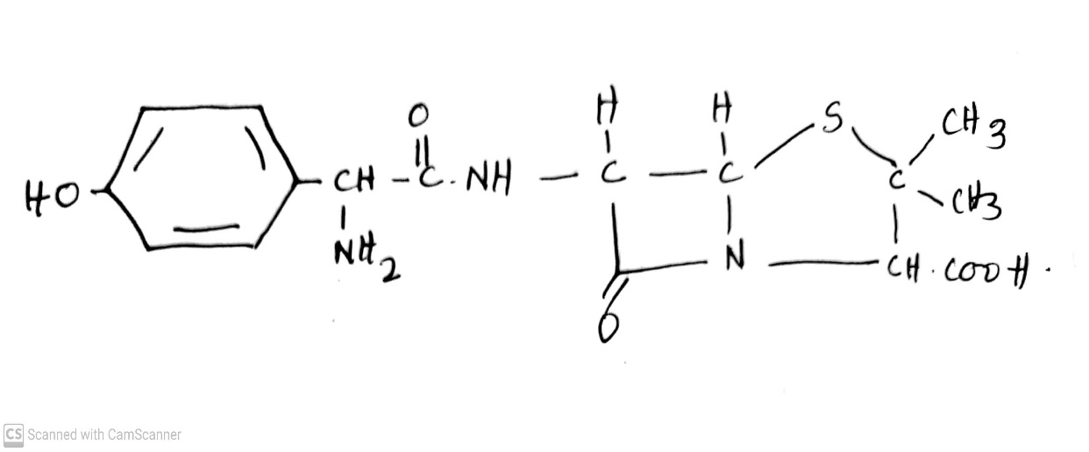
ANTIBIOTICS
CLASSIFICATION OF PENICILLIN
Penicillins are classified based upon the nature and spectrum of activity.
b) Semi-synthetic Penicillins : eg. Ampicillin, Amoxicillin, Methicillin, Nafacillin, Oxacillin,
Cloxacillin, Dicloxacillin, Carbenicillin, Piperacillin, and Cyclacillin.
eg. Amoxicillin :
D-α amino-p-hydroxy benzyl Penicillin
Use : It is used to treat bacterial infections such as chest infection ( including pneumonia),
urinary tract .
-0892020
28

Slide 29
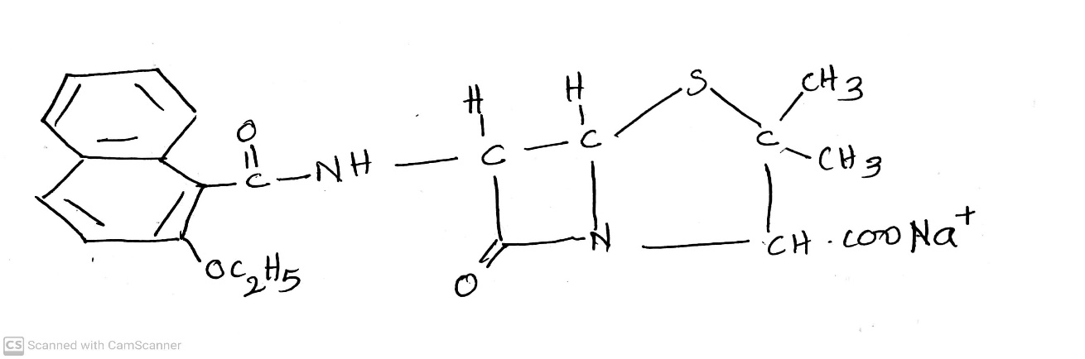
ANTIBIOTICS
CLASSIFICATION OF PENICILLIN
Penicillins are classified based upon the nature and spectrum of activity.
b) Semi-synthetic Penicillins : eg. Ampicillin, Amoxicillin, Methicillin, Nafacillin, Oxacillin,
Cloxacillin, Dicloxacillin, Carbenicillin, Piperacillin, and Cyclacillin.
eg. Nafacillin :
2-Ethoxy-1-naphthyl Penicillin
Use : It is used to treat certain infections caused by staphylococcus bacteria.
-09-2020
29

Slide 30
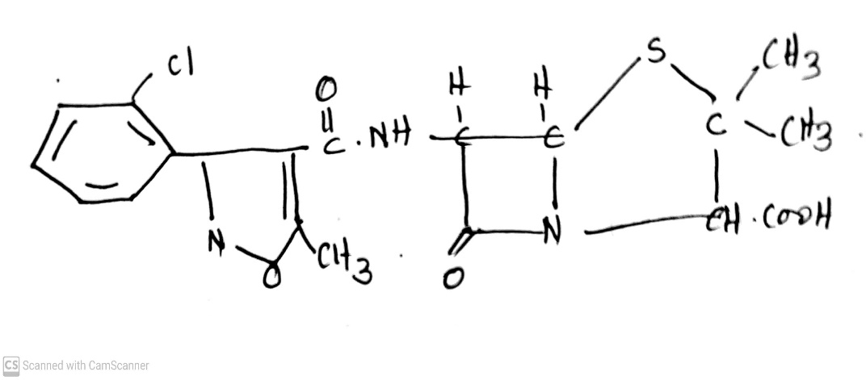
ANTIBIOTICS
CLASSIFICATION OF PENICILLIN
Penicillins are classified based upon the nature and spectrum of activity.
b) Semi-synthetic Penicillins : eg. Ampicillin, Amoxicillin, Methicillin, Nafacillin, Oxacillin,
Cloxacillin, Dicloxacillin, Carbenicillin, Piperacillin, and Cyclacillin.
eg. Cloxacillin :
5-Methyl-3-(2-chlorophenyl)-4-isoxazolyl Penicillin
Use : It is used to treat bacterial infections.
-09-2020
30

Slide 31
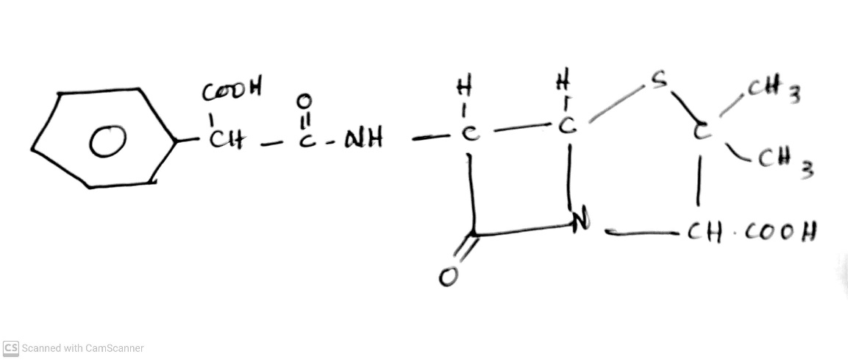
ANTIBIOTICS
CLASSIFICATION OF PENICILLIN
Penicillins are classified based upon the nature and spectrum of activity.
b) Semi-synthetic Penicillins : eg. Ampicillin, Amoxicillin, Methicillin, Nafacillin, Oxacillin,
Cloxacillin, Dicloxacillin, Carbenicillin, Piperacillin, and Cyclacillin.
eg. Carbenicillin :
α-Carboxy benzyl-Penicillin
Use : It is used to treat bladder infections.
-09-2020
31

Slide 32
ANTIBIOTICS
CEPHALOSPORINS
-09-2020
32

Slide 33
ANTIBIOTICS
CLASSIFICATION
Based on chemical structure:
i) β-Lactam antibiotics : Penicillins, Cephalosporins, Monobactams, Carbepenems.
CEPHALOSPORINS
Cephalosporins are β-Lactam antibiotics used in the treatment of bacterial infection caused by susceptible
organism.
Cephalosporins are naturally derived from the fungus Acremonium which was previously known as
Cephalosporium.
They are obtained semisynthetically by chemical attachment of side chain to 7- Amino Cephalosporanic Acid
(7-ACA) .
Modification of 7-ACA side chain resulted in the development of useful antibiotic agents.
-092020
33

Slide 34
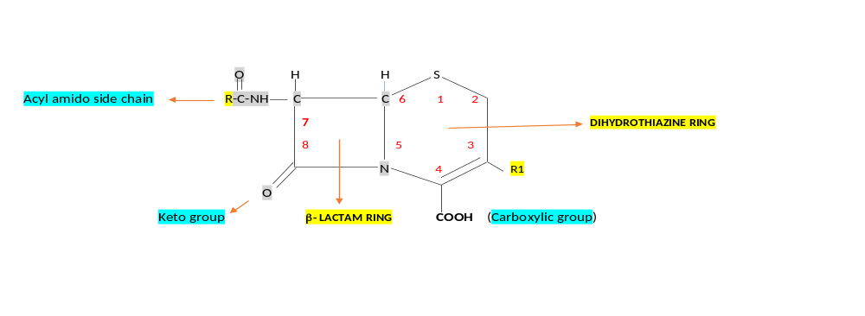
ANTIBIOTICS
STRUCTURE OF CEPHALOSPORINS
Cephalosporin structure contain β-Lactam ring fused with six membered dihydrothiazine ring.
The Dihydrothiazine ring contains sulphur and carboxylic group and it has a double bond.
-08-2020
34

Slide 35
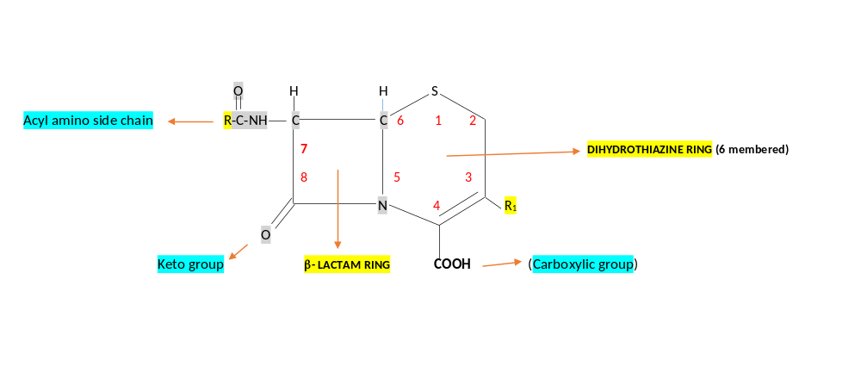
ANTIBIOTICS
CHEMISTRY OF CEPHALOSPORINS
The nomenclature of cephalosporin is more complex than penicillin because of presence of double bond in
dihydrothiazine ring.
The basic nucleus is made up of 7- Amino Cephalosporanic Acid (7-ACA).
Semi synthetic modification of the basic 7-ACA nucleus has resulted from acylation of the 7-amino group
with different acids or nucleophilic substitution or reduction of the acetoxyl group.
-09-2020
35

Slide 36
ANTIBIOTICS
MECHANISM OF ACTION OF CEPHALOSPORINS
Cephalosporins are bactericidal and have the same MOA as Penicillin.
Cephalosporins disrupt the synthesis of the peptidoglycan layer of bacterial cell walls. The peptidoglycan layer
is important for cell wall structural integrity, especially in gram-positive organisms.
The final transpeptidation step in the synthesis of the peptidoglycan is facilitated by transpeptidases known as
penicillin binding proteins.
-09-2020
36

Slide 37
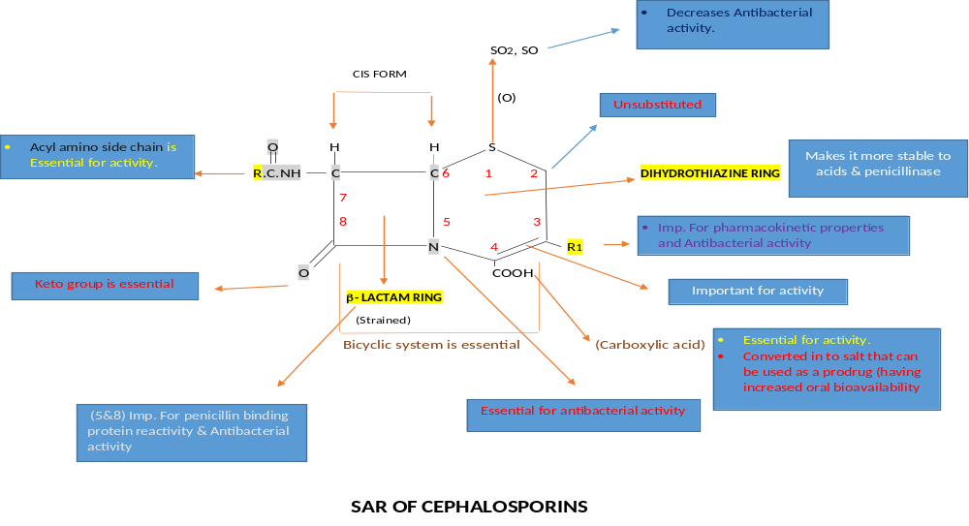
ANTIBIOTICS
SAR OF CEPHALOSPORINS
-09-2020
37

Slide 38
ANTIBIOTICS
SAR OF CEPHALOSPORINS
SAR of Cephalosporins are similar to penicillin.
β-Lactam ring is fused with Dihydrothiazine ring form a bicyclic system which is essential for activity.
β-Lactam ring is important For penicillin binding protein reactivity & Antibacterial activity.
Dihydrothiazine ring :
Sulphur atom : Sulphur atom in the 1- position of Dihydrothiazine ring is oxidised to sulphone
(SO2) or sulphoxide (SO) - Decreases the antibacterial activity.
Any substitution at 2-position decreases the antibacterial activity.
-09-2020
38

Slide 39
ANTIBIOTICS
SAR OF CEPHALOSPORINS
Substitution at 3-position (R1) influences the Pharmacokinetic properties and Antibacterial activity.
If substitute H, CH3, Cl, CH2OCH3 at R1 gives acid stable compound that is metabolically stable and that will
be orally active.
At 3rd position-
If we introduce CH2OCOCH3 ( Acetoxy methyl) gp the compound would be acid unstable , metabolically
unstable and not active orally, eg. Cephahlotin, Cephapirin, Cephotaxime.
If we introduce CH2OCONH2 ( Amino carbonyl oxymethyl) gp the compound would be acid unstable ,
Some what metabolically stable and not active orally, eg. Cephuroxime, cephoxitin.
If we introduce ( Thio thiadiazole) gp the compound would be acid unstable ,
metabolically stable and not active orally, eg. Cephazolin .
-09-2020
© R R INSTITUTIONS , BANGALORE
39

Slide 40
ANTIBIOTICS
SAR OF CEPHALOSPORINS
Double bond between 3 and 4 important for activity. If the position change the activity would be decreases.
The Carboxylic acid at 4th –position is essential for activity. Because it is Converted in to salt that can be used as a prodrug (having increased oral bioavailability). Eg. Cefpodoxime proxitil.
β-Lactam ring :
Position -5th and 8th Important for penicillin binding protein reactivity & Antibacterial activity.
Position 6th is an important for chirality.
-09-2020
40

Slide 41
ANTIBIOTICS
SAR OF CEPHALOSPORINS
At 7th position-
Position 7th Acyl amino side chain is Essential for activity, generally increases the potency against Gram +ve bacteria.
Substitution of Phenyl glycyl group Increases the stability of β-Lactam ring and gives orally active compounds. Eg. Cephalexin, Cephadroxil, Cephaclor, Cefprozil.
Substitution of Heterocyclic ring instead of phenyl ring Increases the Pharmacokinetic properties. Eg. Cephalexin, Cephadroxil, Cephaclor, Cefprozil.
Substitution of Methoxy imine produces good β-Lactamase activity and increased Gram -ve activity and decreased Gram+ve activity . Eg. Cephuroxime, Cephataxime.
-09-2020
© R R INSTITUTIONS , BANGALORE
41

Slide 42
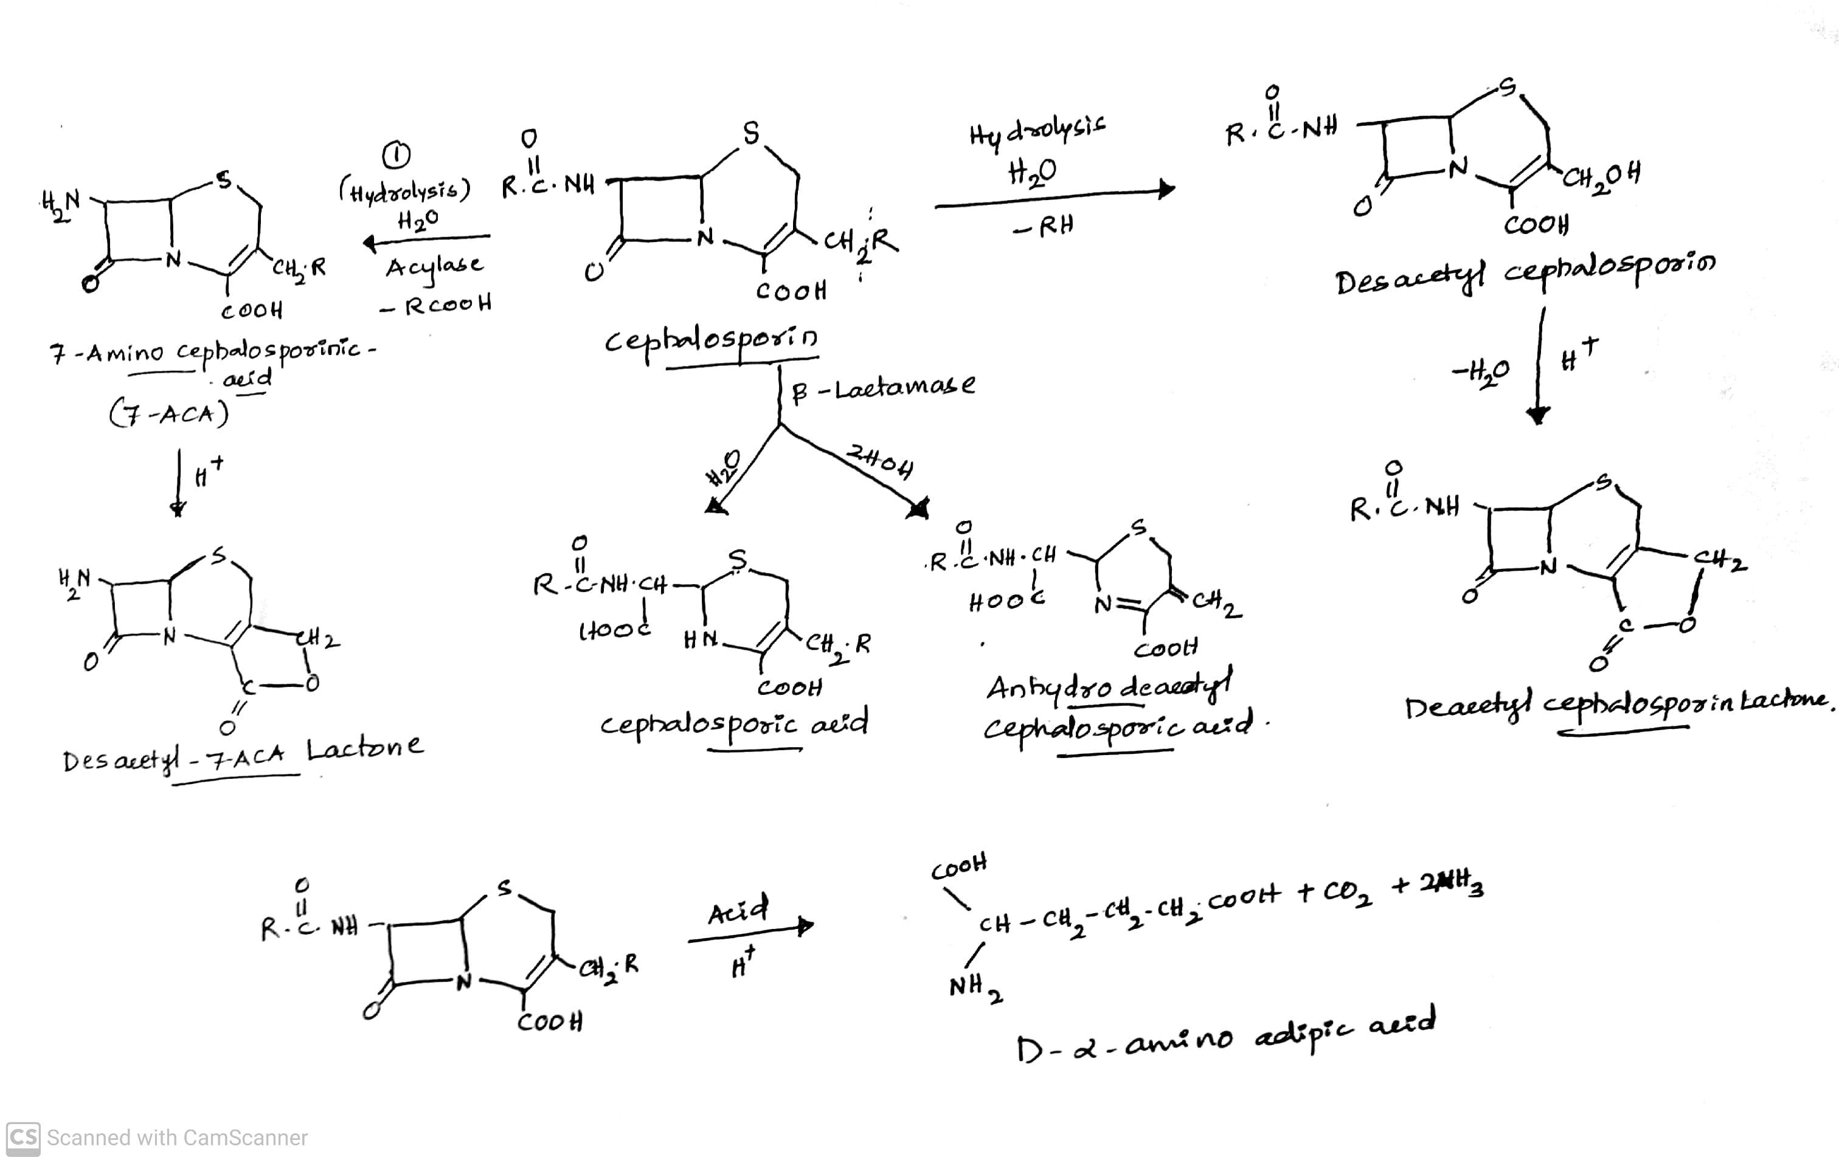
ANTIBIOTICS
DEGRADATION OF CEPHALOSPORINS
-09-2020
42

Slide 43
ANTIBIOTICS
DEGRADATION OF CEPHALOSPORINS
Cephalosporin undergoes hydrolysis by means of an enzyme called as Acylase. Here acylamino side chain in the 7th position is cleaved (Broken) and remove –RCOOH group to yield 7-Amino Cephalosporanic Acid (7-ACA).
7-ACA undergoes hydrolysis and remove acetyl group also form Lactone ( Desacetyl Cephalosporin).
Cephalosporin on hydrolysis to give Desacetyl Cephalosporin. Here the bond between R and CH2 is broken
and acetyl is removed(-RH).
Desacetyl Cephalosporin on hydrolysis (eliminate one water molecule) to give Desacetyl Cephalosporin
lactone.
-09-2020
© R R INSTITUTIONS , BANGALORE
43

Slide 44
ANTIBIOTICS
DEGRADATION OF CEPHALOSPORINS
Cephalosporin ring is cleaved by the enzyme β-Lactamase .
i) On hydrolysis, the bond between Carbon and Nitrogen in the β-Lactam ring is broken to give
Cephalosporic acid.
ii) On hydrolysis to give Anhydrodesacetyl Cephalosporic acid.
In Cephalosporin at 7th position RCONH (α-amino Adipic acid is present) on hydrolysis by means of an
acid to give D-α-amino Adipic acid, CO2 and 2NH2.
-09-2020
44

Slide 45
ANTIBIOTICS
CLASSIFICATION OF CEPHALOSPORINS
I. Based on Generations:
i) First generation : eg. Cefalexin, Cefadroxil, Cefacetrile, Cefaloglycin, Cefaloridine, Cefalitin, Cefapirin,
Cefatrizine, Cefazedone, cefazolin, Cefadrine, Cefraxadine, Ceftezole.
ii) Second generation : eg. Cefuroxime, Cefaclor, Cefanicid, Cefprozil, Cefamandole, Ceforanide, Carbacephems
Loracarbef, Cephamycins, Cefmetazole, Ceminox, Cefotetan, and Cefixitin.
iii) Third generation : eg. Cefixime, Cefcapene, cefdaloxime, Cefetamet, Cefmenoxime, Cefodizime, Cefotaxime,
Ceftizoxime.
iv) Fourth generation : eg. Cefclidine, Cefepime, Cefluprenam, Cefoselis, Cefozopran, and Cefquinome.
v) Fifth generation : eg. Ceptibiprole, Ceftaroline.
-09-2020
© R R INSTITUTIONS , BANGALORE
45

Slide 46
ANTIBIOTICS
CLASSIFICATION OF CEPHALOSPORINS
I. Based on Route of Administration:
i) Oral Cephalosporins : eg. Cefalexin, Cefadroxil, Cefadrine, Cefachlor, Cefprozil Loracarbef,
Cefuroxime, Cefpodoxime proxetil, Cefixime.
ii) Parenteral Cephalosporins : eg. Cephalothin, Cephapirin, Cefazolin, Cefamandole, Cefonicid,
Cefarnide, Cefuroxime, Ceefotoxime, Ceftizoxime.
iii) Cephalosporin Combination: eg. Cefoperazone with Sulbactam,
Cefotaxime with Sulbactam,
Ceftriaxone with Sulbactam
-09-2020
© R R INSTITUTIONS , BANGALORE
46

Slide 47
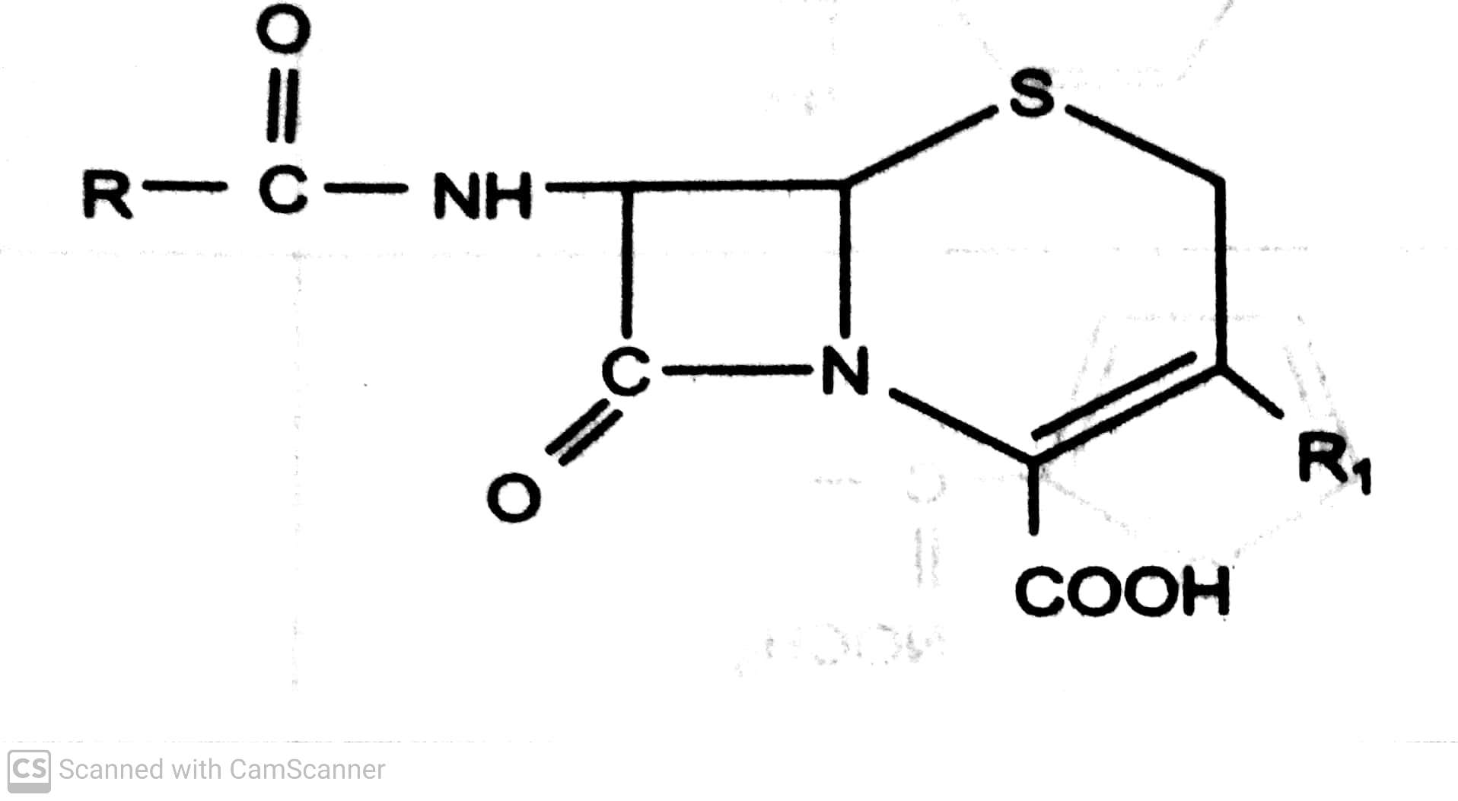
ANTIBIOTICS
STRUCTURE OF CEPHALOSPORINS
-09-2020
47

Slide 48
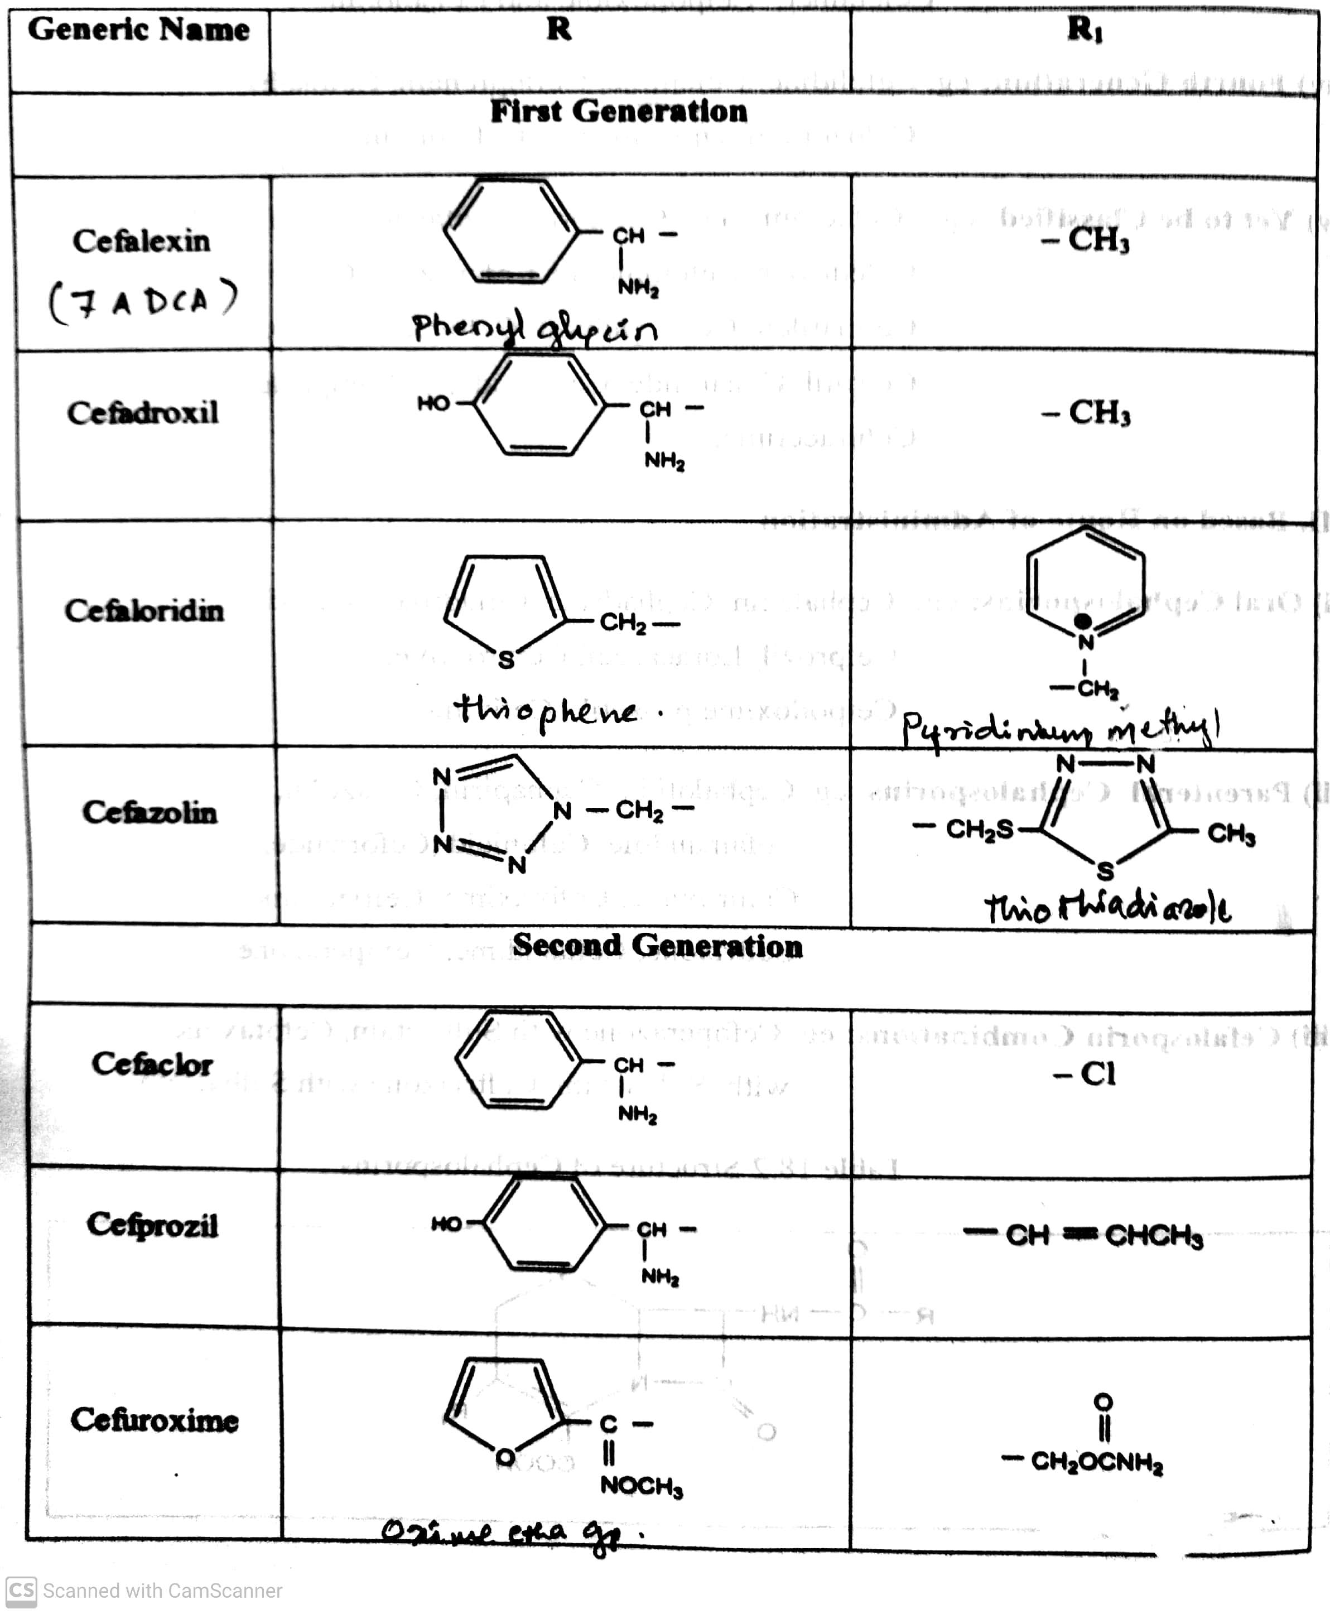
ANTIBIOTICS
STRUCTURE OF CEPHALOSPORINS
-09-2020
48

Slide 49
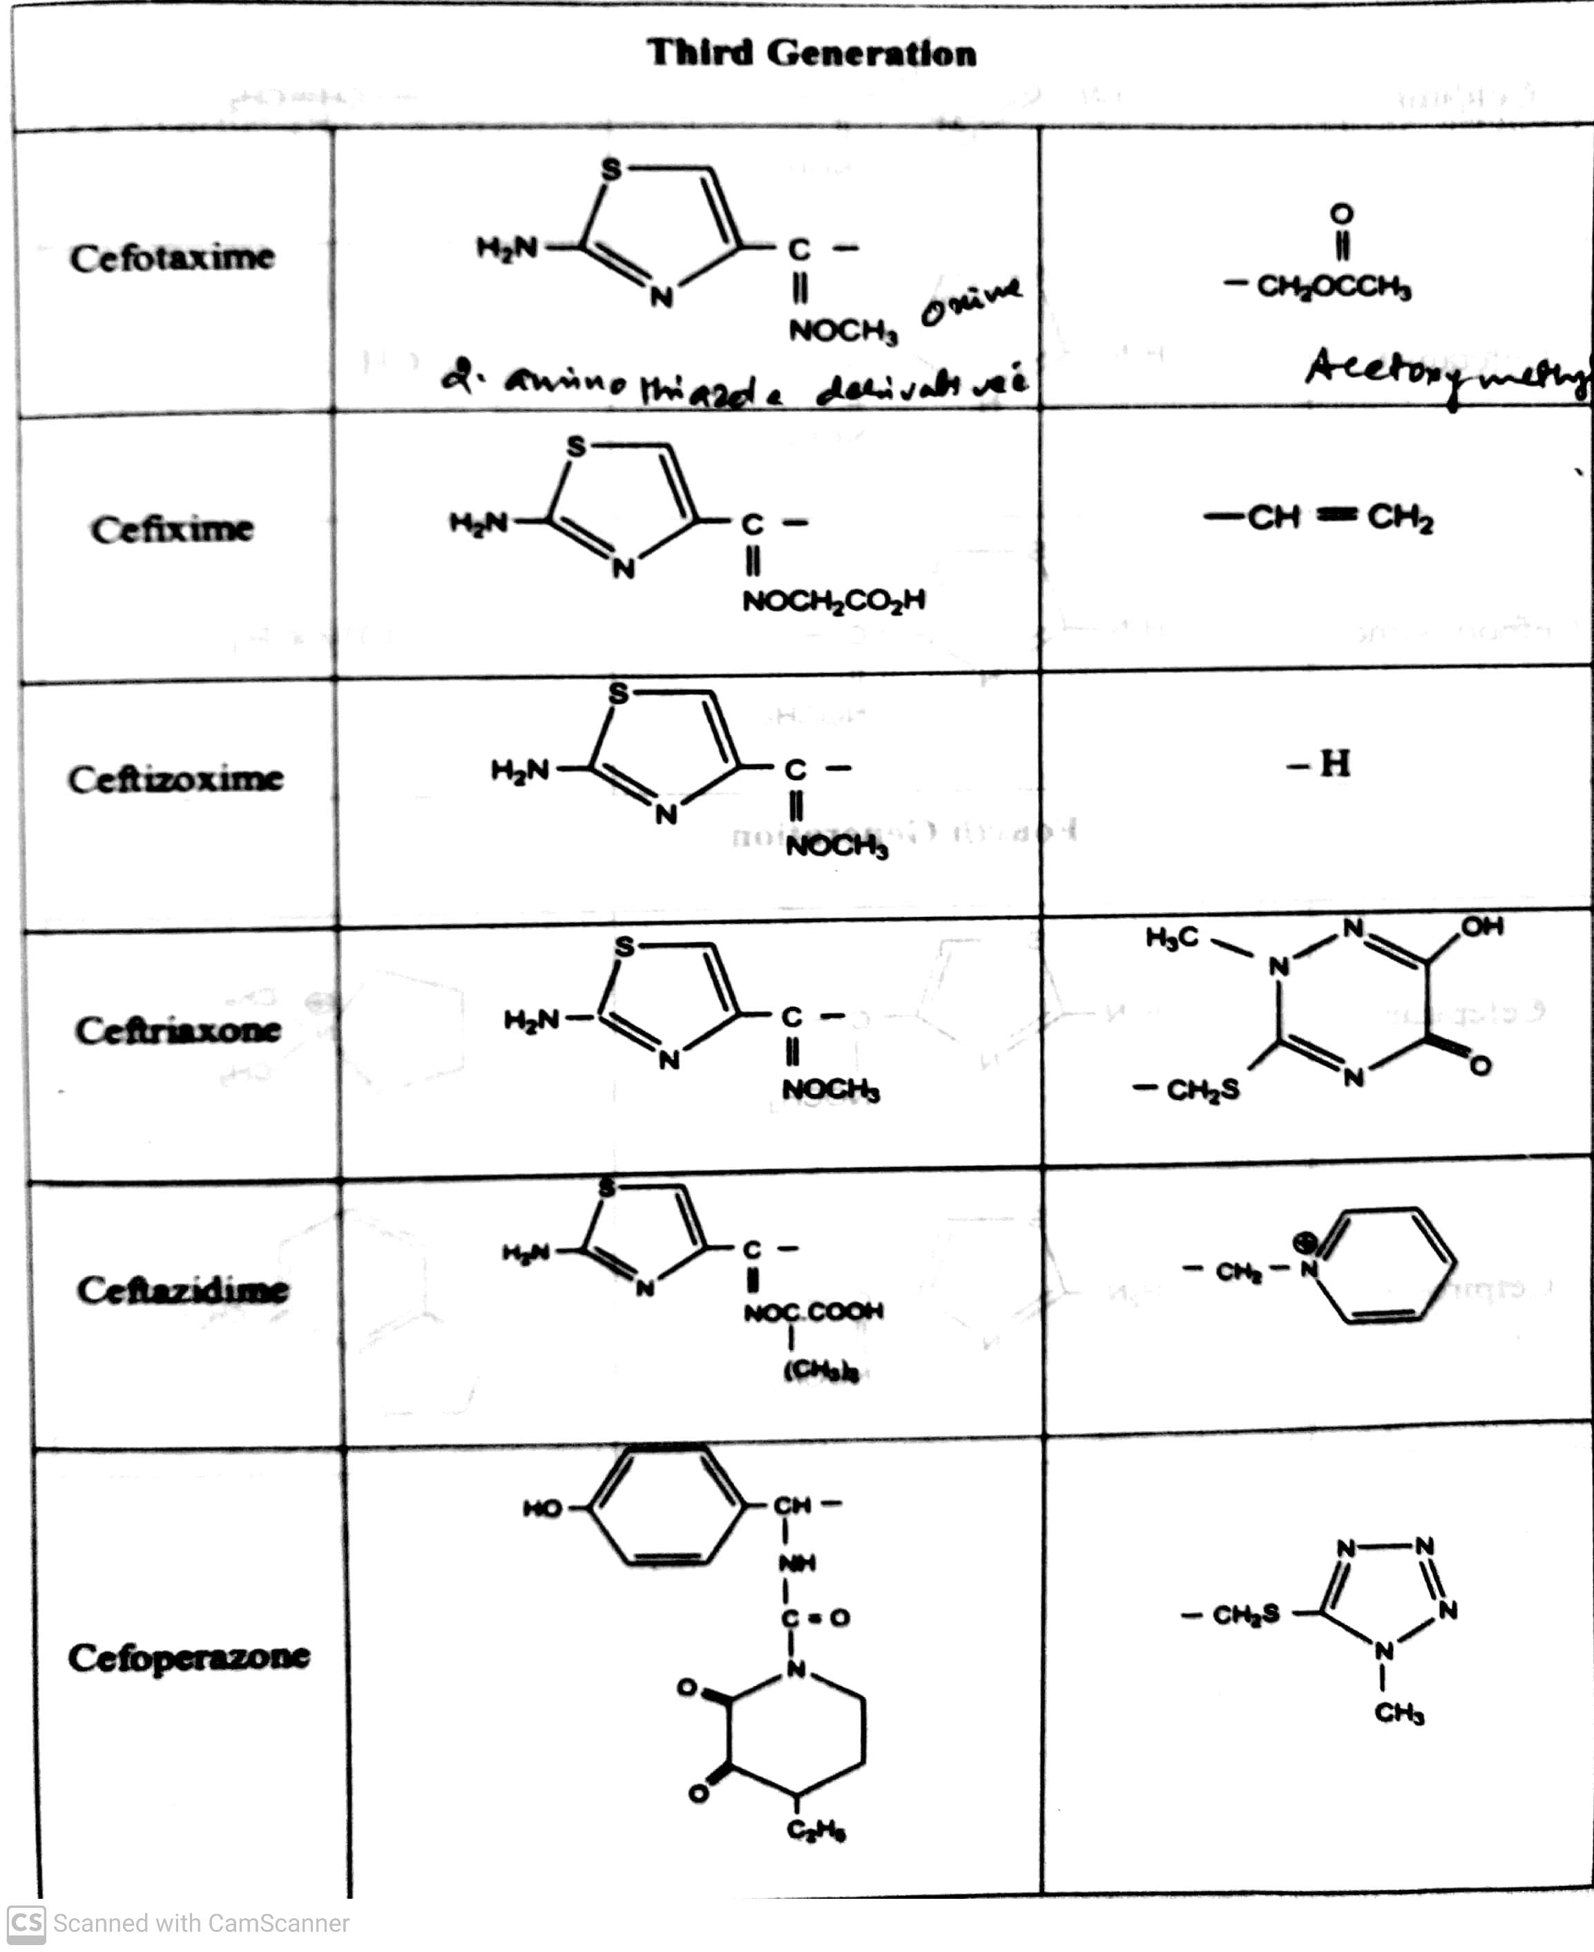
ANTIBIOTICS
STRUCTURE OF CEPHALOSPORINS
-09-2020
49

Slide 50
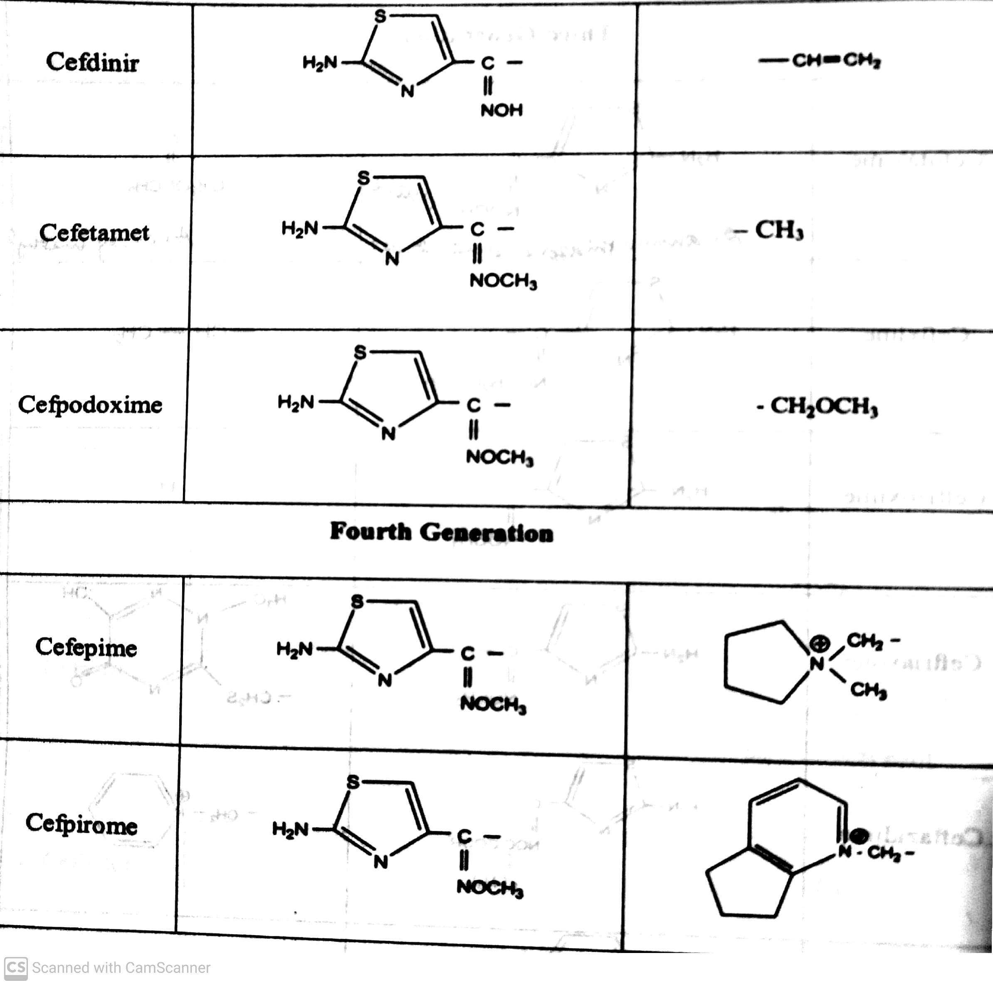
ANTIBIOTICS
STRUCTURE OF CEPHALOSPORINS
-09-2020
50

Slide 51
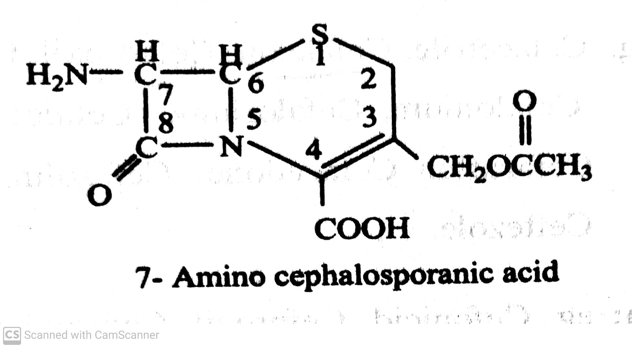
ANTIBIOTICS
STRUCTURE OF 7-AMINO CEPHALOSPORINIC ACID
-09-2020
51

Slide 52
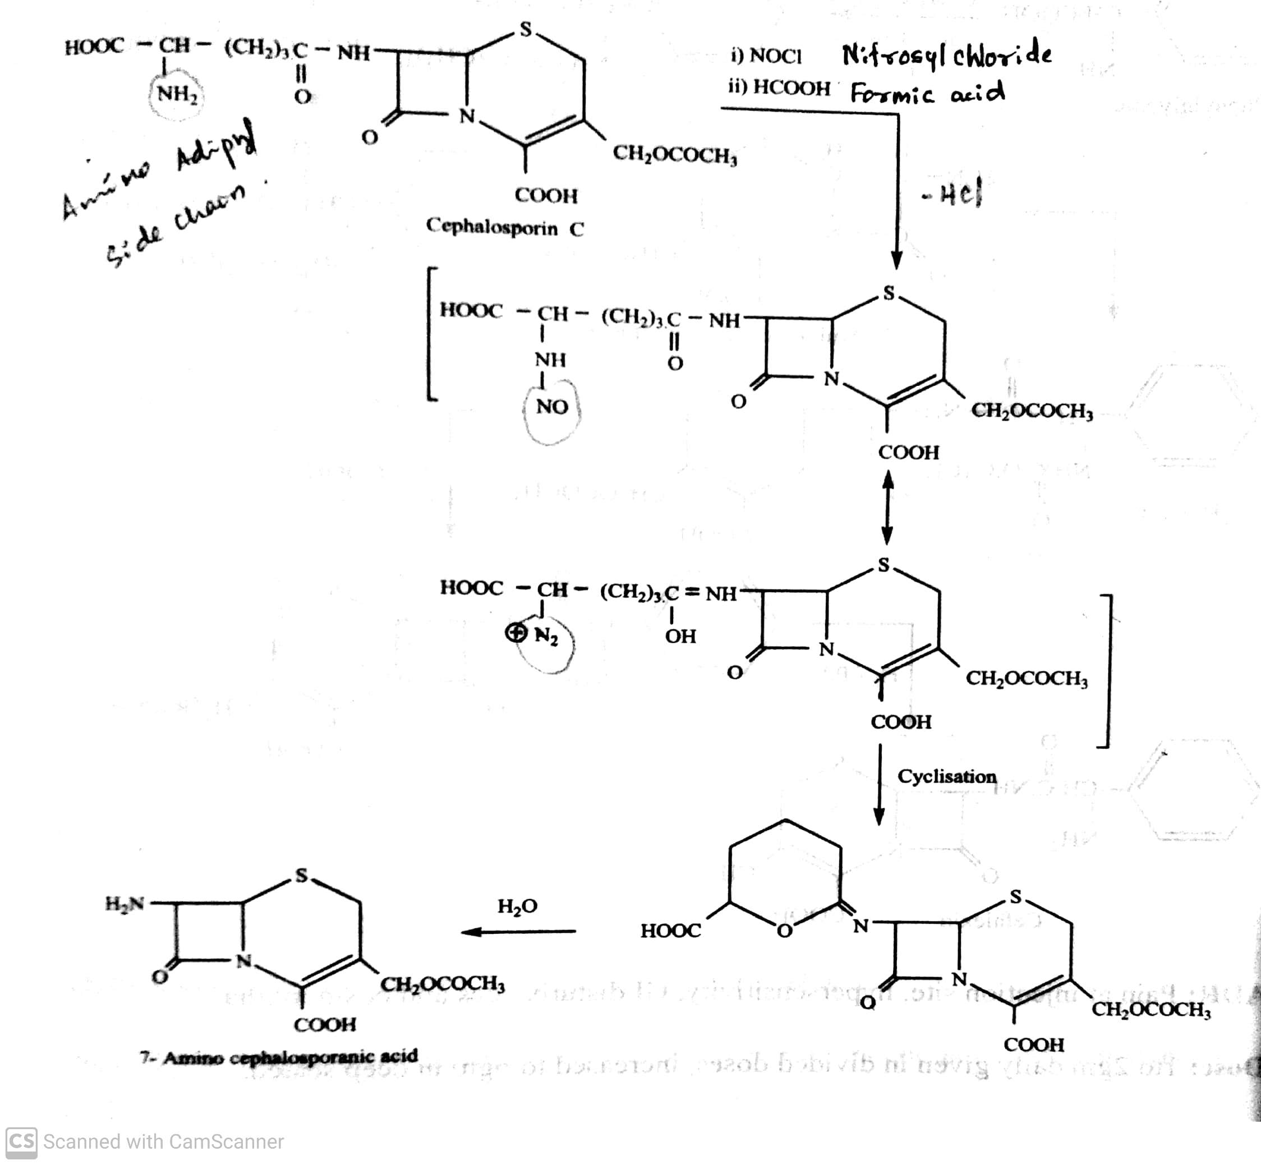
ANTIBIOTICS
SYNTHESIS OF 7-AMINO CEPHALOSPORINIC ACID
-09-2020
52

Slide 53
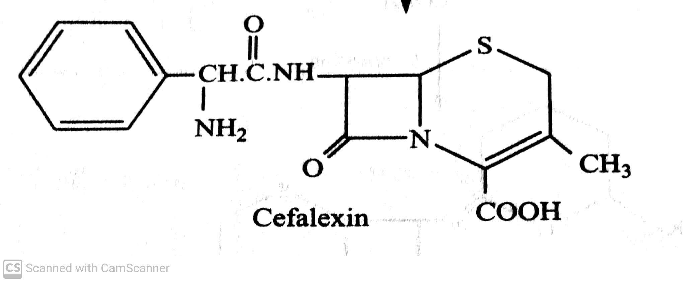
ANTIBIOTICS
CLASSIFICATION OF CEPHALOSPORINS
I. Based on Generations:
i) First generation : eg. Cefalexin, Cefadroxil, Cefacetrile, Cefaloglycin, Cefaloridine, Cefalitin, Cefapirin,
Cefatrizine, Cefazedone, cefazolin, Cefadrine, Cefraxadine, Ceftezole.
eg. Cefalexin : (Cefbact, Keflex)
7-(D-α-amino-α-phenylacetamido)-3-methyl-3-cepham-4-carboxylic acid monohydrate.
ADR : Pain at injection site, hypersensitivity, GI disturbances.
Dose : 1-2 gm daily given in divided doses.
Uses : It is used to treat infections caused by bacteria such as pneumonia and other respiratory tract infections.
-09-2020
© R R INSTITUTIONS , BANGALORE
53

Slide 54
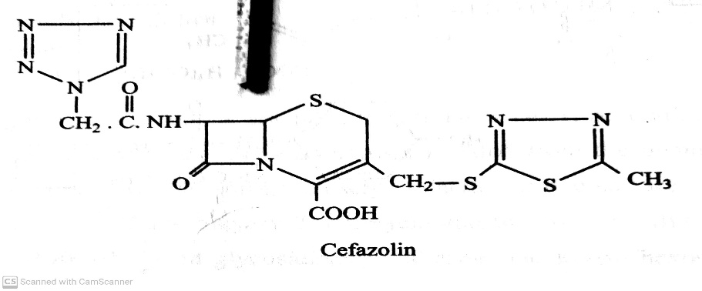
ANTIBIOTICS
CLASSIFICATION OF CEPHALOSPORINS
I. Based on Generations:
i) First generation : eg. Cefalexin, Cefadroxil, Cefacetrile, Cefaloglycin, Cefaloridine, Cefalitin, Cefapirin,
Cefatrizine, Cefazedone, Cefazolin, Cefadrine, Cefraxadine, Ceftezole.
eg. , Cefazolin : (Reflin, Ciprid)
ADR : Super infection, nausea, vomiting and abdominal pain.
Dose : 0.5-1.0 gm deep i.m, slow i.v. injectionover 3-5 mns or as i.v. infusion every 6-12 hrs.
Uses : It is used to treat UTI, pneumonia, endocarditis, joint infection.
-09-2020
© R R INSTITUTIONS , BANGALORE
54

Slide 55
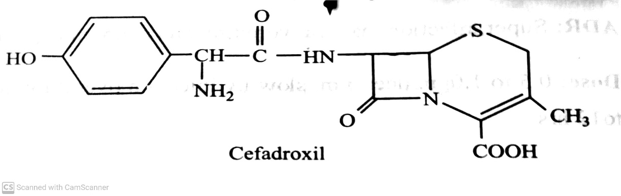
ANTIBIOTICS
CLASSIFICATION OF CEPHALOSPORINS
I. Based on Generations:
i) First generation : eg. Cefalexin, Cefadroxil, Cefacetrile, Cefaloglycin, Cefaloridine, Cefalitin, Cefapirin,
Cefatrizine, Cefazedone, Cefazolin, Cefadrine, Cefraxadine, Ceftezole.
eg. Cefadroxil : (Neodrox, Vistadrox)
ADR : Allergic reaction, nausea, vomiting and candidias.
Dose : 250-500 mg /8hrs , maximum of 4 gm daily.
Uses : It is used to treat infections caused by bacteria such as infection of skin, throat, tonsils and urinary tract.
-09-2020
55

Slide 56
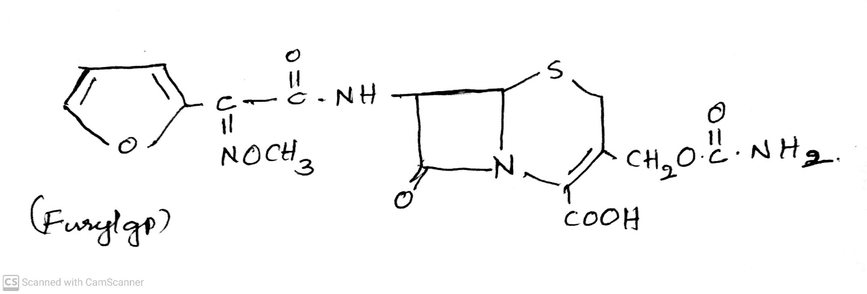
ANTIBIOTICS
CLASSIFICATION OF CEPHALOSPORINS
I. Based on Generations:
ii) Second generation : eg. Cefuroxime, Cefaclor, Cefanicid, Cefprozil, Cefamandole, Ceforanide,
Carbacephems, Loracarbef, Cephamycins, Cefmetazole, Ceminox,
Cefotetan, and Cefixitin.
eg. Cefuroxime : (Ceftin, Zinacef)
Uses : It is used to treat infections caused by bacteria such as infection of skin, throat, tonsils and urinary tract.
-09-2020
56

Slide 57
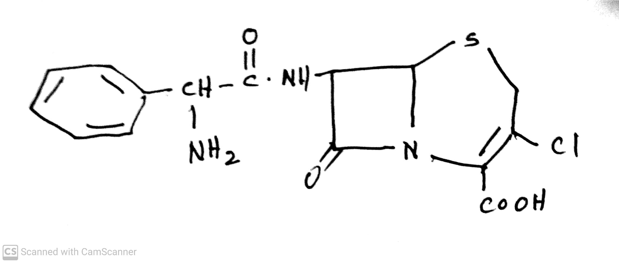
ANTIBIOTICS
CLASSIFICATION OF CEPHALOSPORINS
I. Based on Generations:
ii) Second generation : eg. Cefuroxime, Cefaclor, Cefanicid, Cefprozil, Cefamandole, Ceforanide,
Carbacephems, Loracarbef, Cephamycins, Cefmetazole, Ceminox,
Cefotetan, and Cefixitin.
eg. Cefaclor : (Ceclor, Pulvules)
Uses : It is used to treat infections caused by bacteria such as infection of ear, lung, skin, throat, tonsils and urinary tract.
-09-2020
57

Slide 58
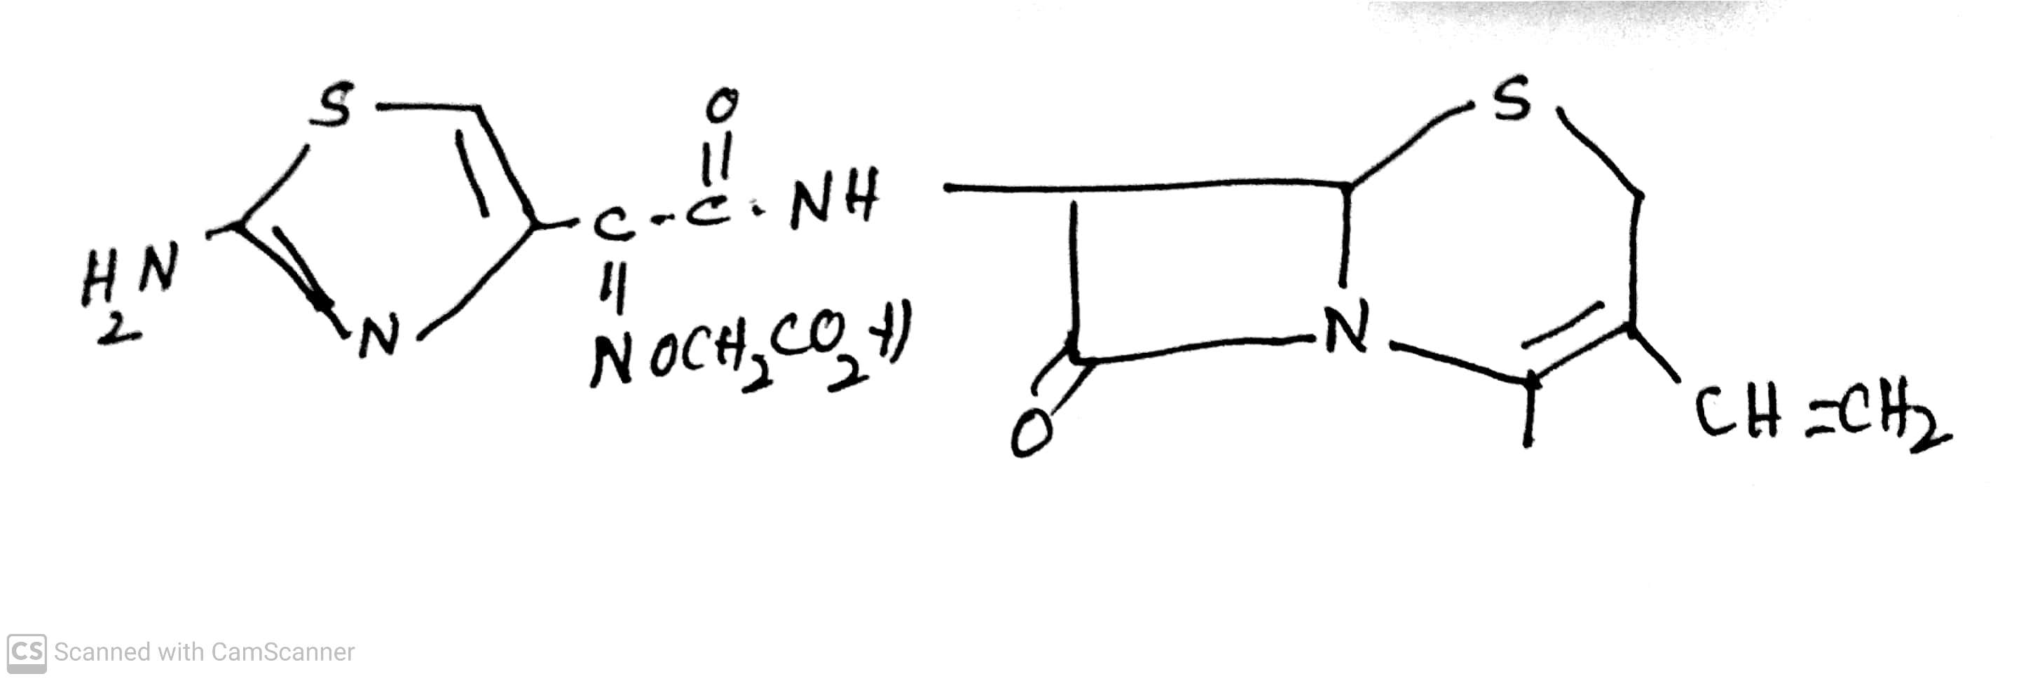
ANTIBIOTICS
CLASSIFICATION OF CEPHALOSPORINS
I. Based on Generations:
iii) Third generation : eg. Cefixime, Cefcapene, cefdaloxime, Cefetamet, Cefmenoxime,
Cefodizime,Cefotaxime, Ceftizoxime.
eg. Cefixime : (Caricef, Cefim)
Uses : It is used to treat infections caused by bacteria such as infection of ear, lung, skin, throat, tonsils and urinary tract.
-09-2020
58

Slide 59
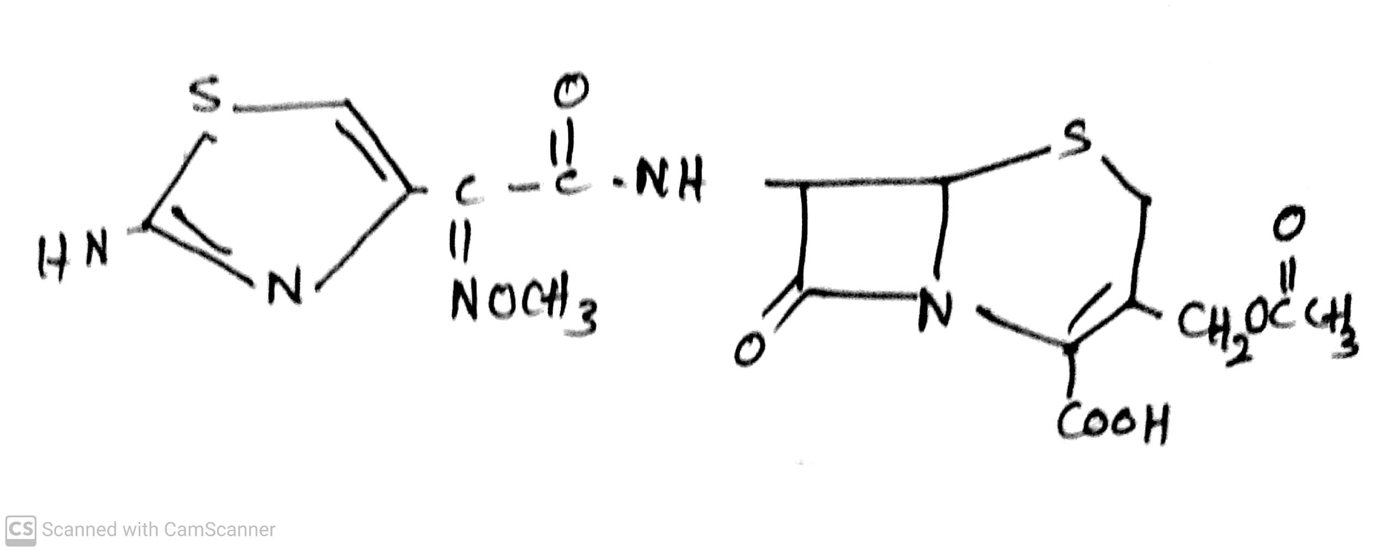
ANTIBIOTICS
CLASSIFICATION OF CEPHALOSPORINS
I. Based on Generations:
iii) Third generation : eg. Cefixime, Cefcapene, cefdaloxime, Cefetamet, Cefmenoxime,
Cefodizime, Cefotaxime, Ceftizoxime.
eg. Cefotaxime : (Caricef, Cefim)
Uses : It is used to treat infections caused by bacteria such as pneumonia, lower respiratory tract (lung),
gonorrhoea (asexually transmitted disease, meningitis and other brain and spinalcard infection.
-09-2020
59

Slide 60
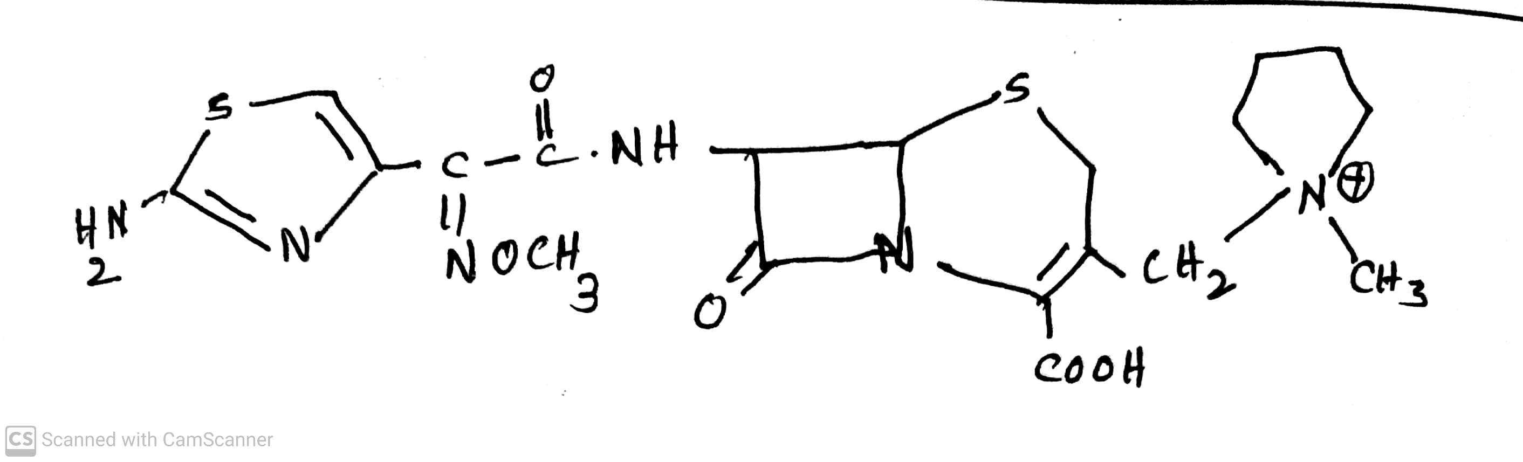
ANTIBIOTICS
CLASSIFICATION OF CEPHALOSPORINS
I. Based on Generations:
iv) Fourth generation : eg. Cefclidine, Cefepime, Cefluprenam, Cefoselis, Cefozopran, and Cefquinome.
eg. Cefepime : (Maxipime, )
Uses : It is used to treat infections caused by bacteria such as pneumonia, skin, urinary tract, and kidney.
Cefepime injection is used in combination with metronidazole (flagyl) to treat abdominal infection.
-09-2020
60

Slide 61
ANTIBIOTICS
i) β-Lactam antibiotics : Penicillins, Cephalosporins, Monobactams, Carbepenems.
MONOBACTAMS
-09-2020
61

Slide 62
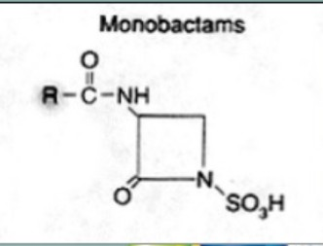
ANTIBIOTICS
MONOBACTAMS
These are monocyclic β-Lactam antibiotics, Where in the β-Lactam is alone and not fused to another ring, in contrast to most Other β-Lactams.
They are isolated from chromo-bacterium viola-ceum. They are effective only against aerobic gram –ve bacteria.
The basic nucleus is 3-amino mono bactamic acid.
These are safe alternative to patients who are allergic to penicillin, cephalosporins or carbepenes.
Uses : They are used to treat pneumonia, meningitis, urinary tract infection and Intra abdominal infection.
Examples: Aztreonam and Tigemonam
-09-2020
© R R INSTITUTIONS , BANGALORE
62

Slide 63
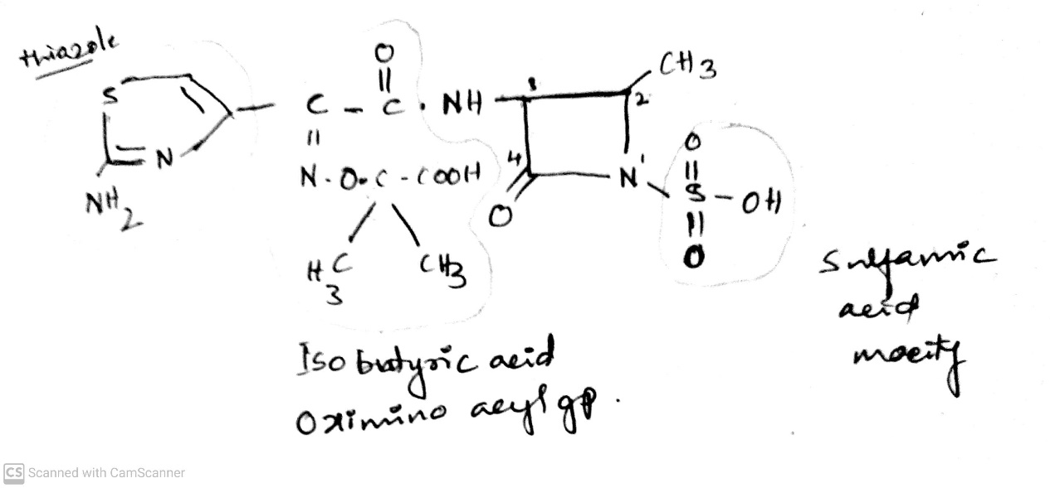
ANTIBIOTICS
MONOBACTAMS
Examples: Aztreonam and Tigemonam
eg. Aztreonam:
Uses : It is used to treat infections caused by bacteria such urinary tract infection, lower respiratory tract infection, Intra abdominal , Gynaecological, Septicemia, meningitis.
-09-2020
63

Slide 64
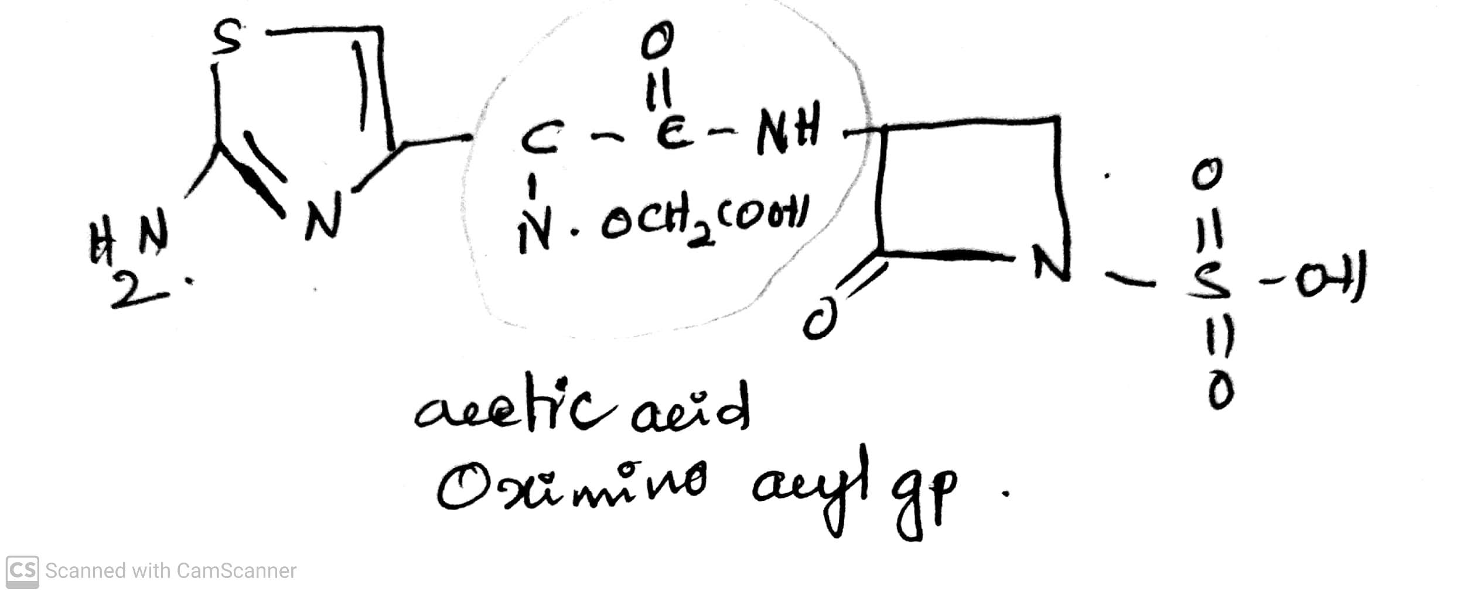
ANTIBIOTICS
MONOBACTAMS
Examples: Aztreonam and Tigemonam
eg. Tigemonam
Uses : Oral treatment of urinary tract infection and other non-life threatening infections caused by
β-Lactamase producing gram –ve bacteria.
-09-2020
64

Slide 65
ANTIBIOTICS
i) β-Lactam antibiotics : Penicillins, Cephalosporins, Monobactams, β-Lactamase inhibitors.
β-LACTAMASE INHIBITORS
-09-2020
65

Slide 66
ANTIBIOTICS
β-Lactamase inhibitors
β-Lactamase inhibitors are the medicines that block the activity of β-Lactamase enzymes and
preventing the degradation of β-Lactam antibiotics.
OR
These are the drugs that inhibit the β-Lactamases enzyme producing by bacteria that inactivate the β-Lactam antibiotics.
These are structurally similar to penicillin's and act as substitutes for penicillinase (β-Lactamase)
causing of the enzyme.
Ex. Sulbactum, Clavulanic acid, Tazobactum.
-09-2020
© R R INSTITUTIONS , BANGALORE
66

Slide 67
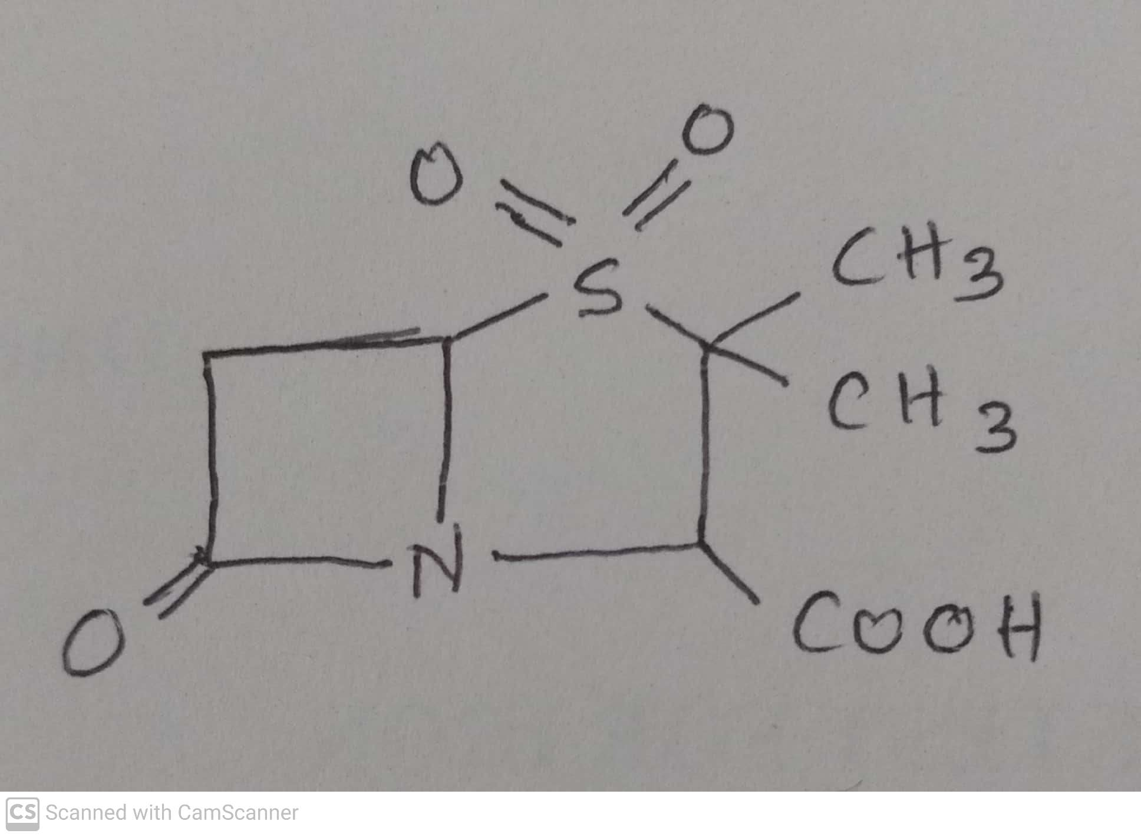
ANTIBIOTICS
β-Lactamase inhibitors
Ex. Sulbactum, Clavulanic acid, Tazobactum.
It is a semisynthetic β-Lactamase inhibitors , related chemically as well as in activity to clavulanic
acid. It is also a progressive inhibitor.
It is combine with ampicillin and preferably for oral and parenteral administration.
Use: Combination of Ampicillin and sulbactum injection is used to treat certain infection caused by bacrteria, including infections of the skin, female reproductive organs and abdomen.
-09-2020
67

Slide 68
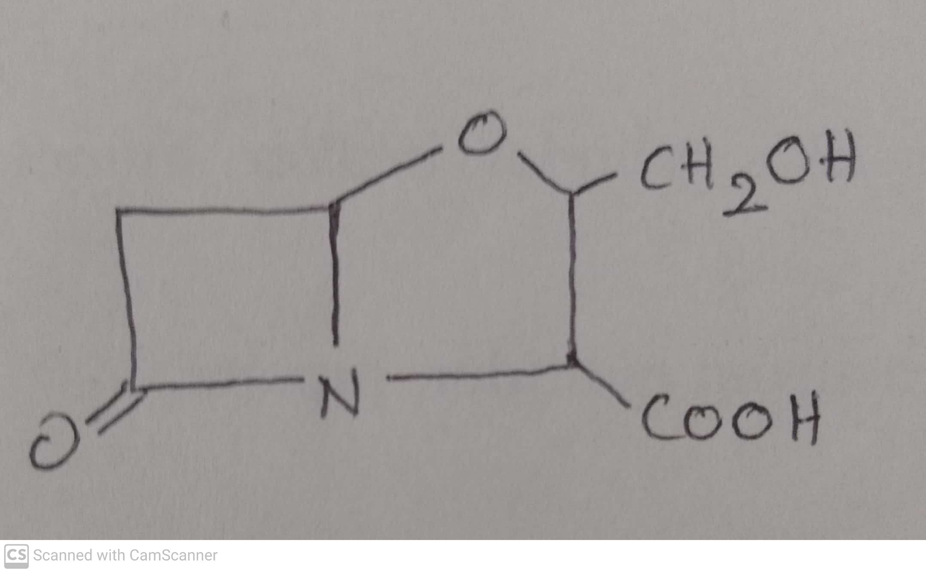
ANTIBIOTICS
β-Lactamase inhibitors
Ex. Sulbactum, Clavulanic acid, Tazobactum.
It is Obtained from Streptomyces clavuligerus, has antibacterial activity of its own.
It is generally combined with amoxicillin (Augmentin) or ticarcillin (Timentin).
Use: Combination of amoxicillin and clavulanic acid is used to treat certain infection caused by bacrteria, including infections of the skin, eaar, lungs,sinus and urinary tract.
-09-2020
68

Slide 69
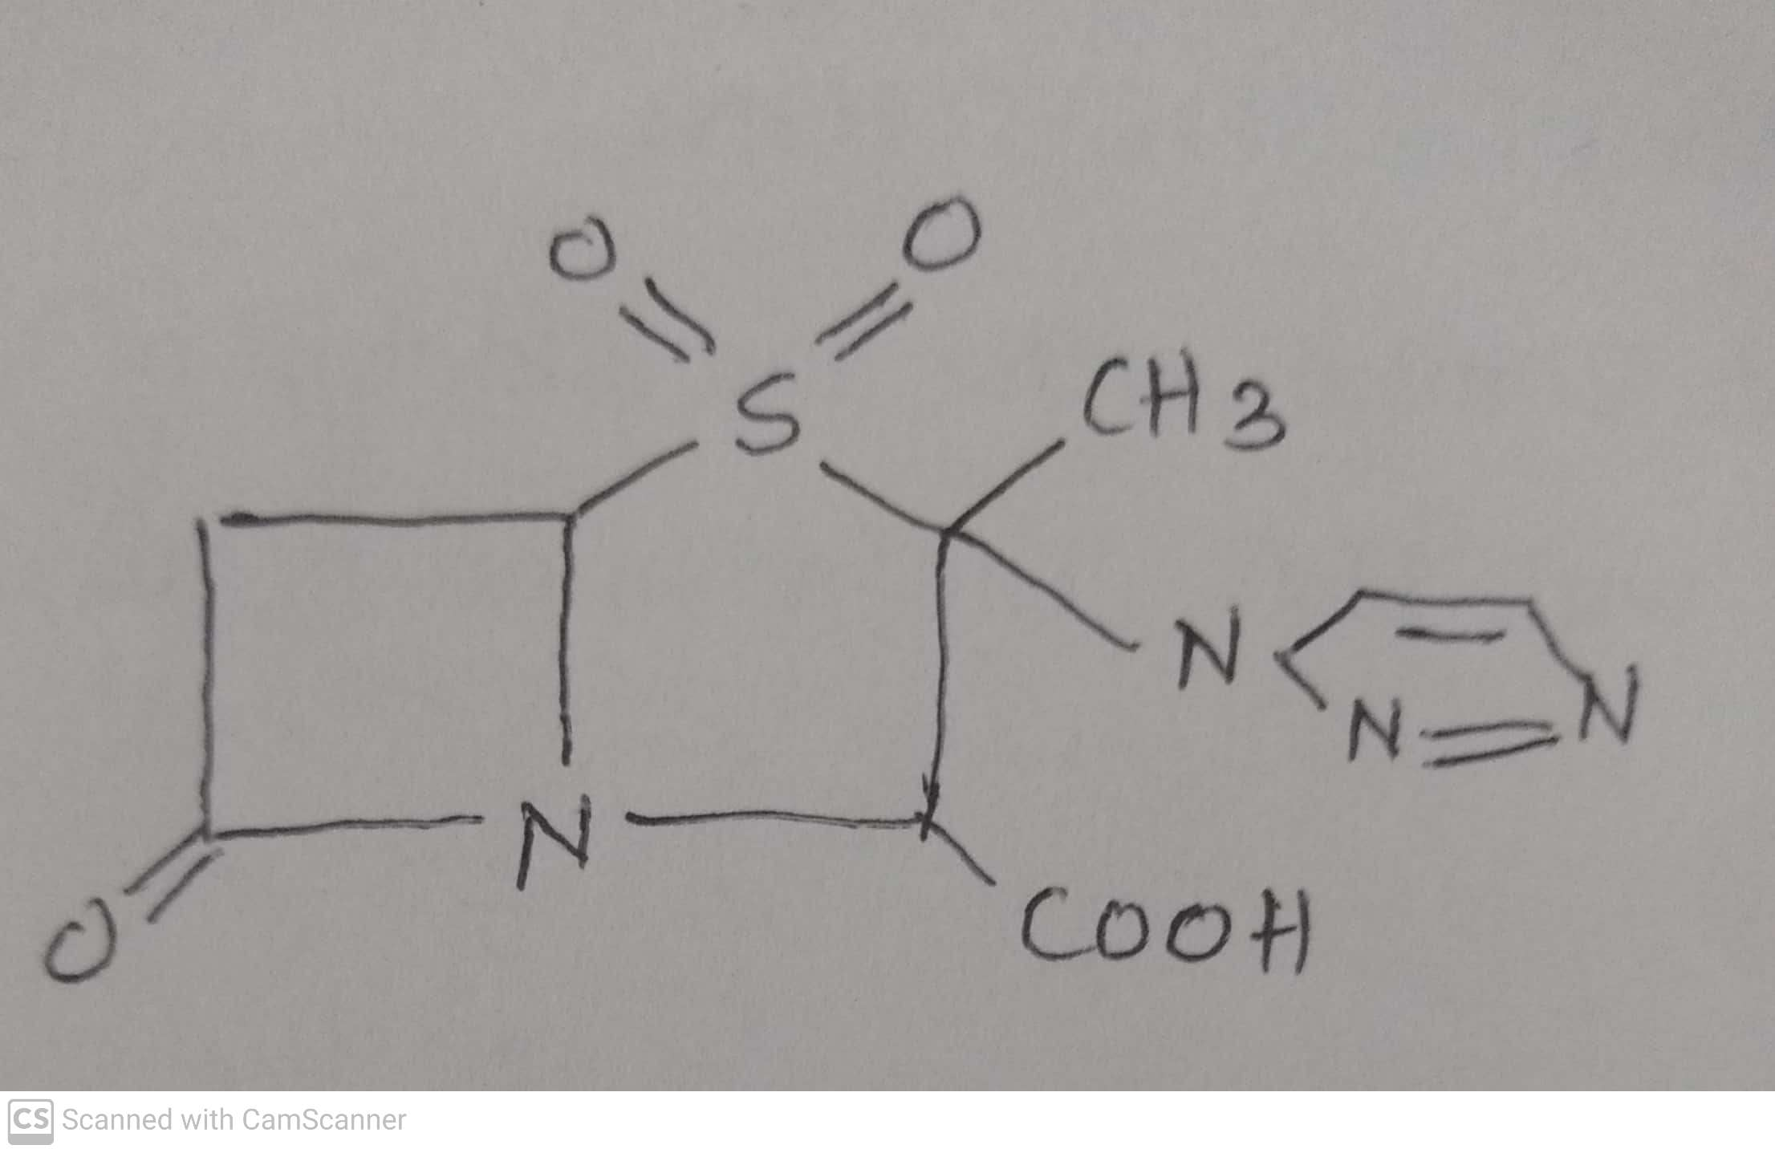
ANTIBIOTICS
β-Lactamase inhibitors
Ex. Sulbactum, Clavulanic acid, Tazobactum.
It is similar to sulbactum and combined with piperacillin + Tazobactum (Zosyn).
Use: Combination of Piperacillin and Tazobactum injection is used to treat pneumonia and skin, gynecological and abdominal infections caused by bacteria.
-09-2020
© R R INSTITUTIONS , BANGALORE
69

Slide 70
ANTIBIOTICS
.
AMINOGLYCOSIDE ANTIBIOTICS
-09-2020
70

Slide 71
ANTIBIOTICS
ii) Aminoglycoside antibiotics : Streptomycin, Neomycin, Paramomycin, Kanamycin, Gentamycin,
Amikacin, Tobramycin, Netilmicin, Sisomicin, Spectinomycin.
.
Aminoglycosides : These are amino sugars that are linked glycosidically.
Glycosides : Having two parts one is sugar part and another is Non sugar part that two are connected
by means of glycosidic linkage or ether linkage.
Glucoside : Glycoside has glucose (Sugar).
Aminoglycoside : Sugar is connected with amino that is amino sugar and it is having aminocyclitol moiety to
which amino sugars are linked glycosidically.
Amino cyclitol : Having carbon cycle that is connected with amino group (NH2). There fore Aminoglycosides
are called as Amino cyclitol antibiotics.
-09-2020
71

Slide 72
ANTIBIOTICS
ii) Aminoglycoside antibiotics : Streptomycin, Neomycin, Paramomycin, Kanamycin, Gentamycin,
Amikacin, Tobramycin, Netilmicin, Sisomicin, Spectinomycin.
.
Amino cyclitol : Having carbon cycle that is connected with amino group (NH2). There fore Aminoglycosides
are called as Amino cyclitol antibiotics.
Amino cyclitol moiety : 1,3-diamino cyclohexane. That is central ring present in Aminoglycoside.
Central ring : eg. In case of Streptomycin the central ring is Streptidine.
For Neomycin, Gentamycin, Kanamycin and Tobramycin the central ring is Deoxy
streptomine.
Aminoglycoside : Having polybasic amino group that is linked to two or more amino sugars by means of a
glycosidic linkage or ether linkage.
-09-2020
72

Slide 73
ANTIBIOTICS
ii) Aminoglycoside antibiotics : Streptomycin, Neomycin, Paramomycin, Kanamycin, Gentamycin,
Amikacin, Tobramycin, Netilmicin, Sisomicin, Spectinomycin.
.
Aminoglycosides antibiotics :
These are from the Actinomycetes, particularly from the genus Streptomyces.
All have one amino hexose and some have a pentose.
Additionally each aminoglycosides contains highly substituted 1,3-diamino cyclohexane central ring.
They are all basic, water soluble compounds or mixture of compounds.
These are broad spectrum antibiotics, particularly effective against Gram –ve bacilli and Gram +ve Cocci.
Streptomycin is particularly active against Mycobacterium tuberculosis.
Paromomycin is used in Amoebic dysentery.
-09-2020
73

Slide 74
ANTIBIOTICS
.
MECHANISM OF ACTION OF AMINOGLYCOSIDES ANTIBIOTICS
They act directly on bacterial ribosome to inhibit the initiation of protein synthesis and to interfere with
translation of the genetic message.
They bind to the 30S ribosomal subunit to form a complex that cannot initiate proper amino acid
polymerization.
-09-2020
74

Slide 75
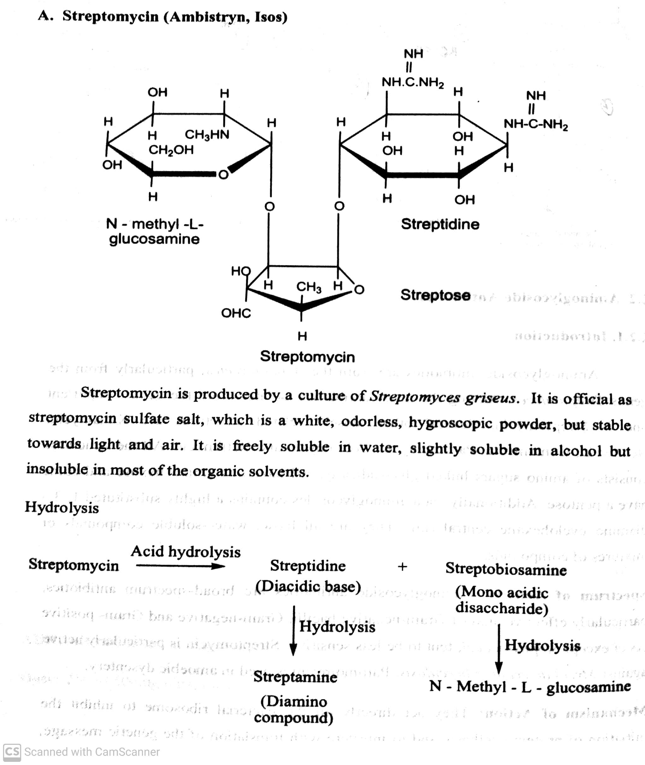
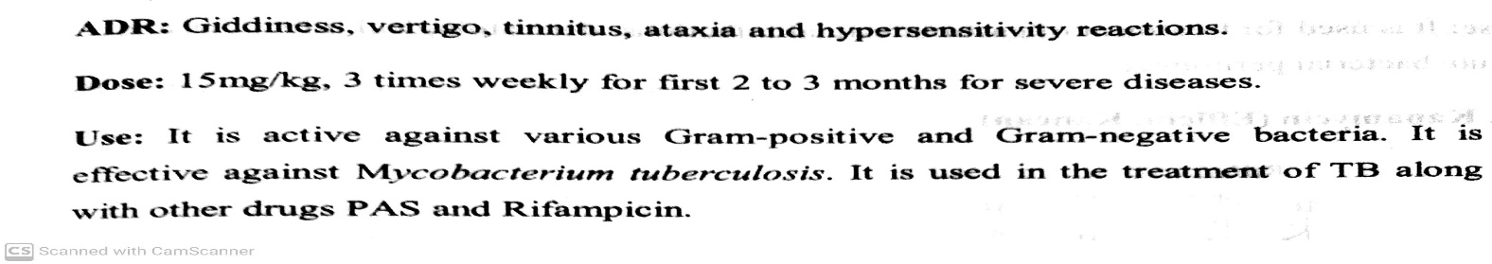
ANTIBIOTICS
ii) Aminoglycoside antibiotics : Streptomycin, Neomycin, Paramomycin, Kanamycin, Gentamycin,
Amikacin, Tobramycin, Netilmicin, Sisomicin, Spectinomycin.
.
-09-2020
75

Slide 76
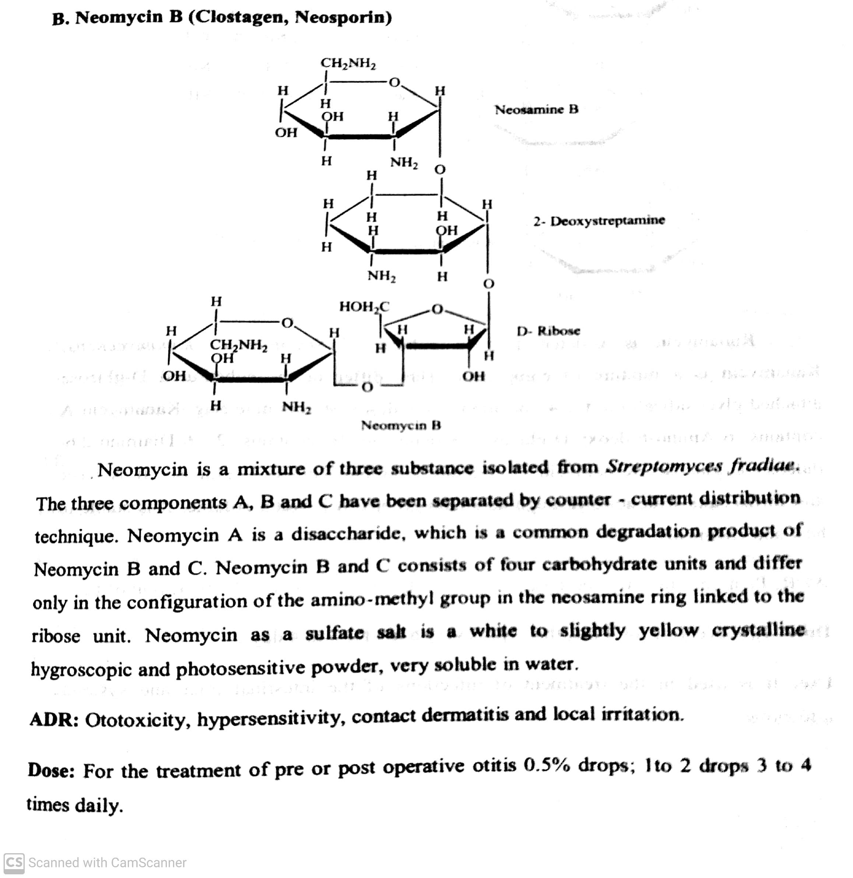
ANTIBIOTICS
ii) Aminoglycoside antibiotics : Streptomycin, Neomycin, Paramomycin, Kanamycin, Gentamycin,
Amikacin, Tobramycin, Netilmicin, Sisomicin, Spectinomycin.
.
Use : It is used for the treatment of GI infections, dermatological infections.
-09-2020
76

Slide 77
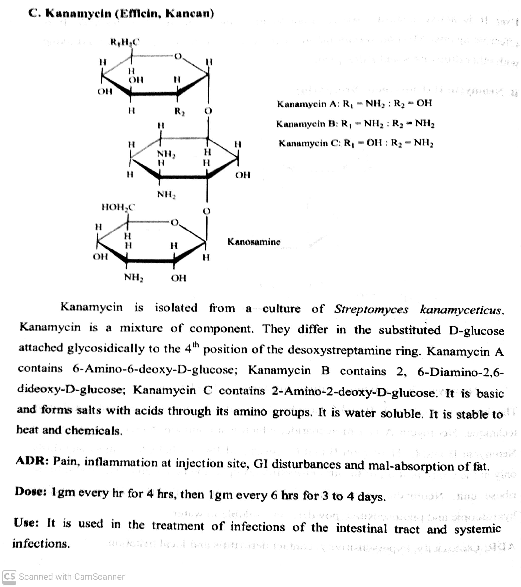
ANTIBIOTICS
ii) Aminoglycoside antibiotics : Streptomycin, Neomycin, Paramomycin, Kanamycin, Gentamycin,
Amikacin, Tobramycin, Netilmicin, Sisomicin, Spectinomycin.
.
-09-2020
© R R INSTITUTIONS , BANGALORE
77

Slide 78
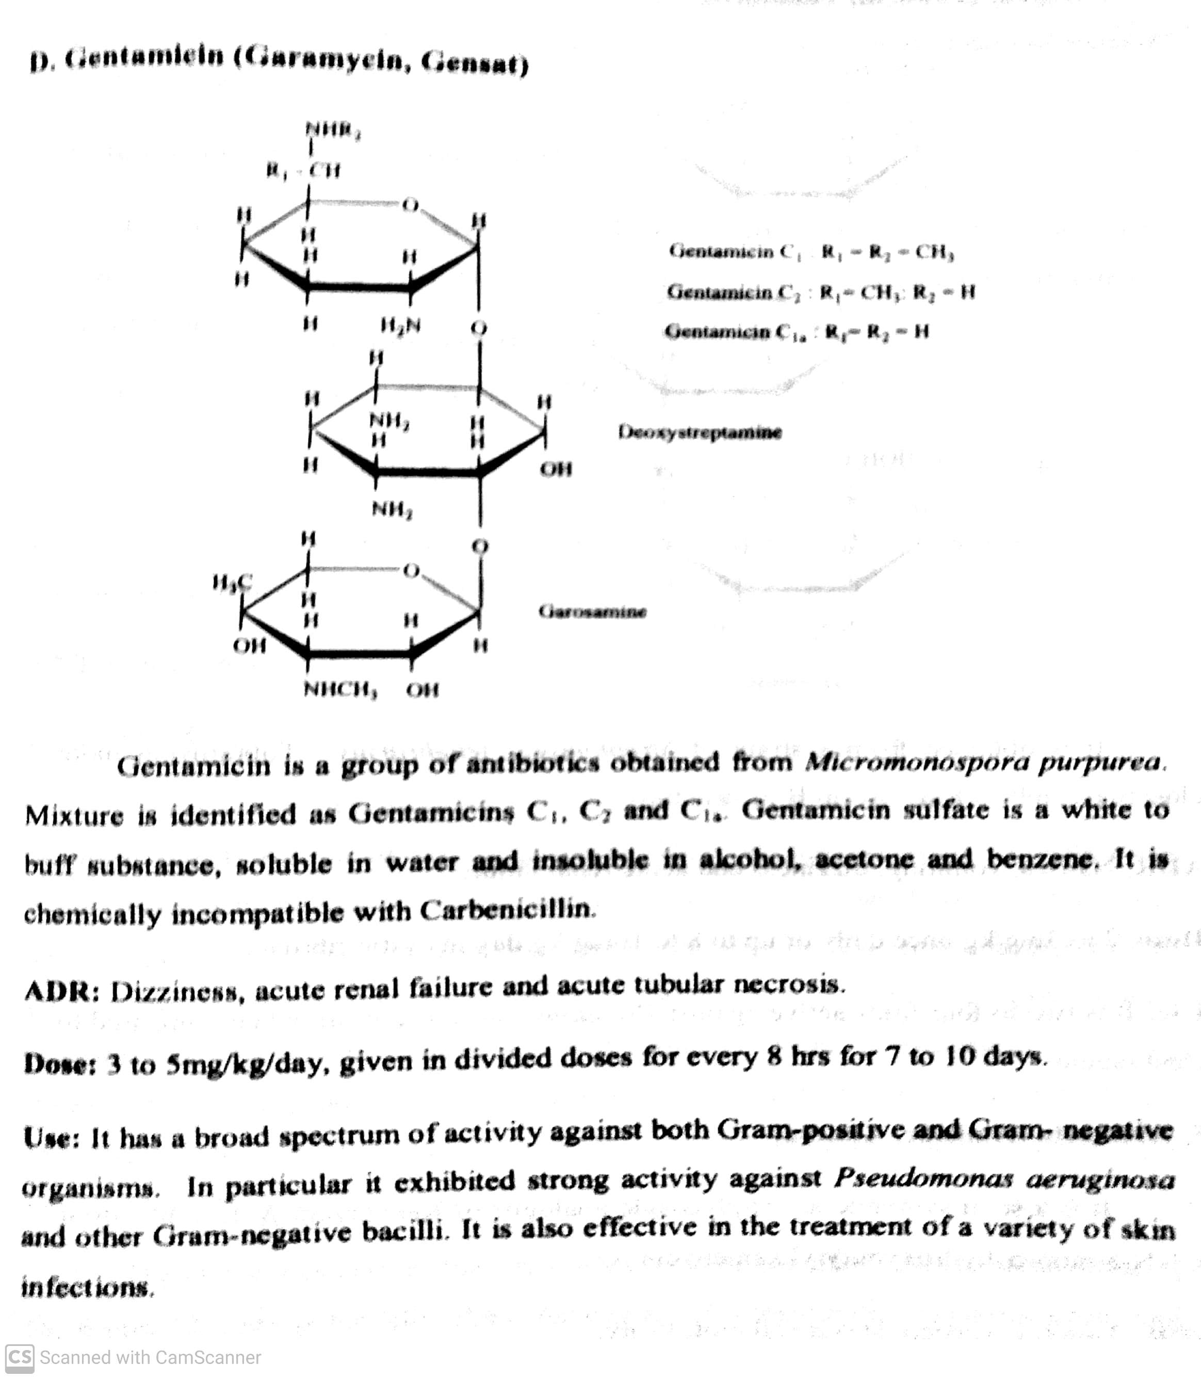
ANTIBIOTICS
ii) Aminoglycoside antibiotics : Streptomycin, Neomycin, Paramomycin, Kanamycin, Gentamycin,
Amikacin, Tobramycin, Netilmicin, Sisomicin, Spectinomycin.
.
-09-2020
© R R INSTITUTIONS , BANGALORE
78

Slide 79
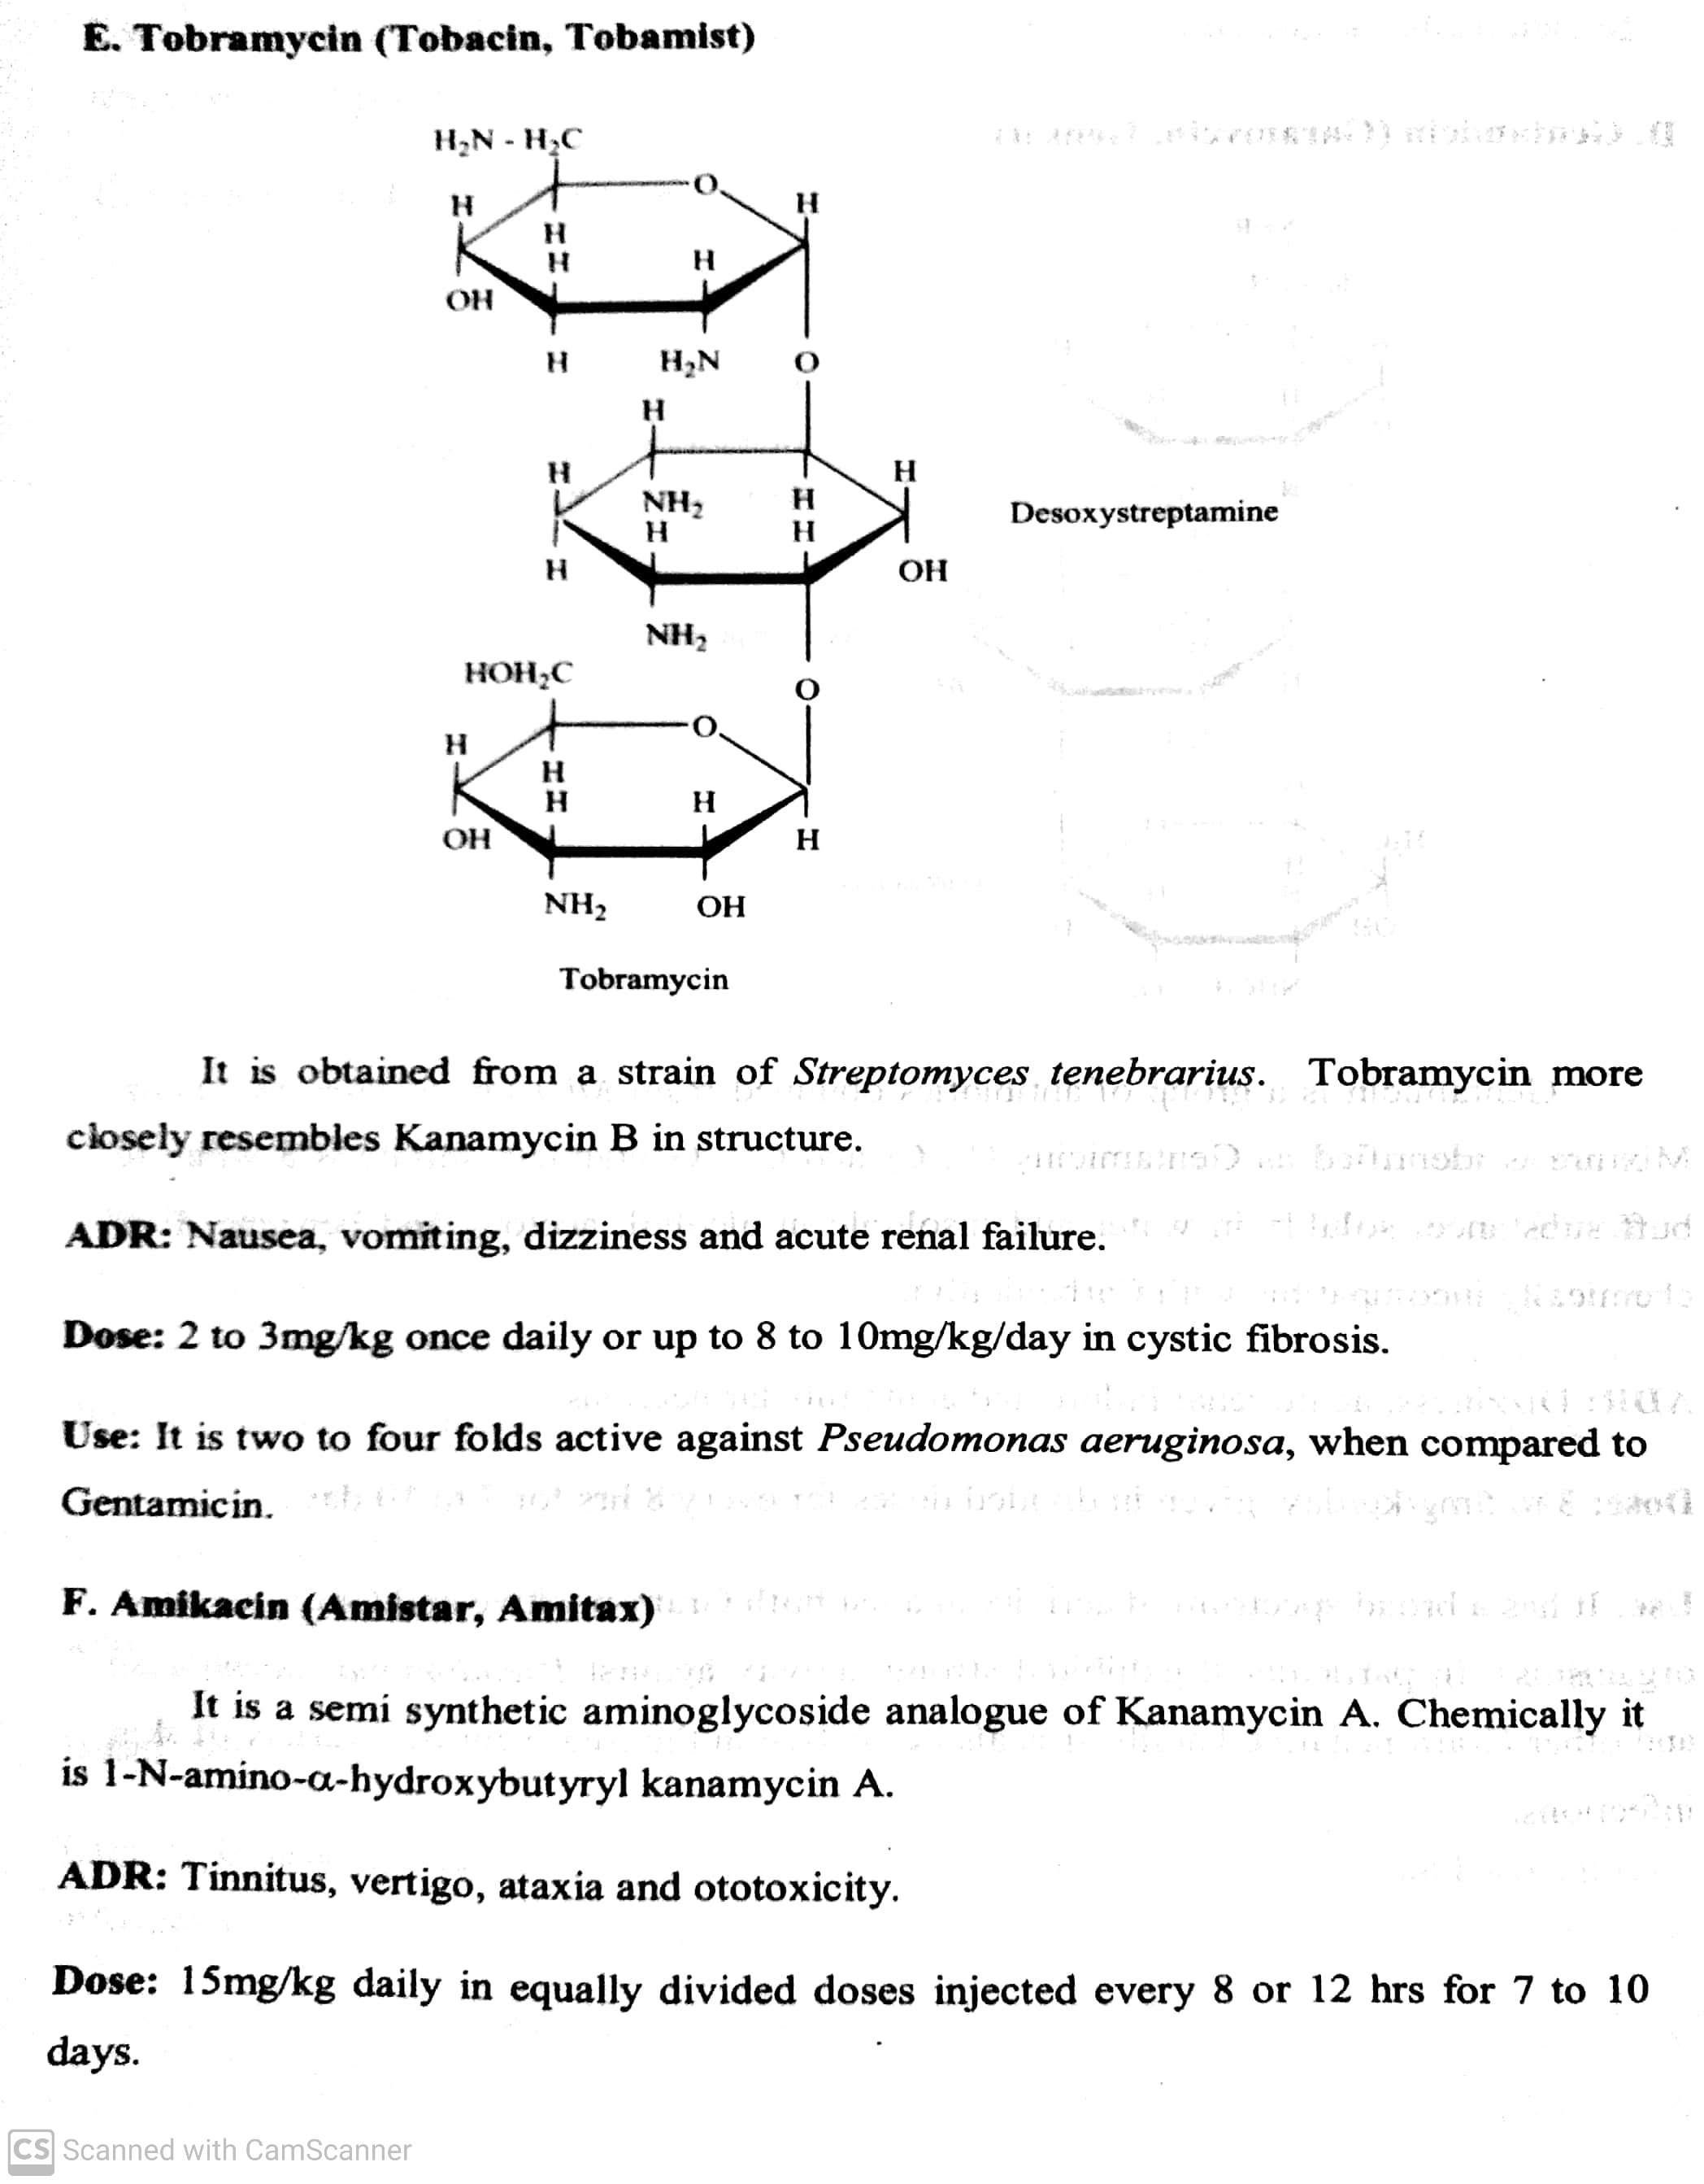
ANTIBIOTICS
ii) Aminoglycoside antibiotics : Streptomycin, Neomycin, Paramomycin, Kanamycin, Gentamycin,
Amikacin, Tobramycin, Netilmicin, Sisomicin, Spectinomycin.
.
Use : It is effective against strains of bacteria that are resistant to other aminoglycoside antibiotics.
-09-2020
© R R INSTITUTIONS , BANGALORE
79

Slide 80
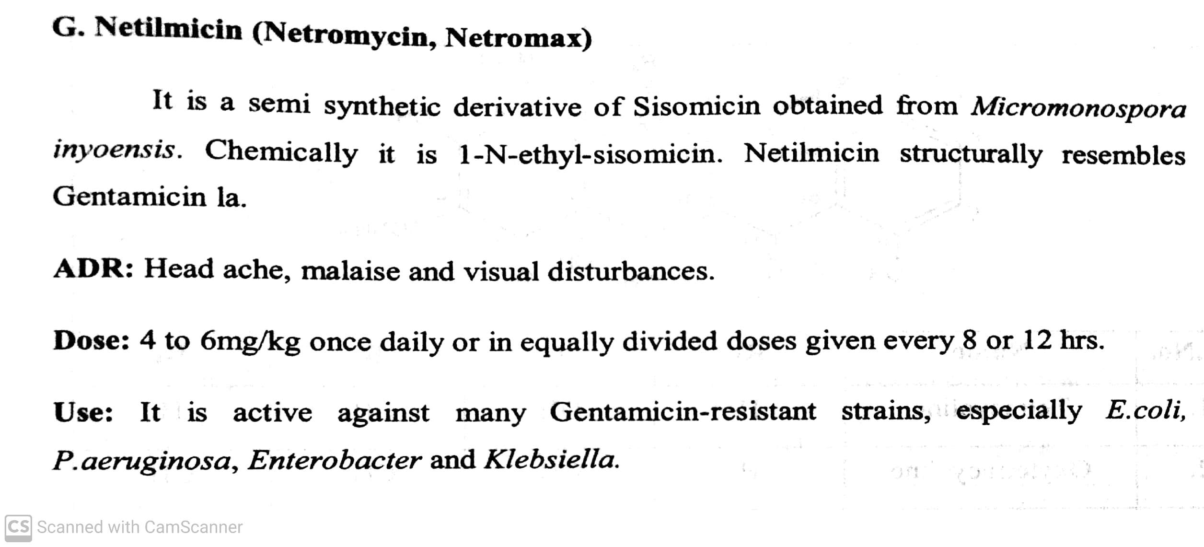
ANTIBIOTICS
ii) Aminoglycoside antibiotics : Streptomycin, Neomycin, Paramomycin, Kanamycin, Gentamycin,
Amikacin, Tobramycin, Netilmicin, Sisomicin, Spectinomycin.
.
-09-2020
© R R INSTITUTIONS , BANGALORE
80

Slide 81
ANTIBIOTICS
TETRACYCLINES
-09-2020
81

Slide 82
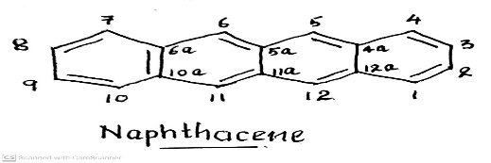
ANTIBIOTICS
iii) Tetracyclines : Tetracyclines, Chlortetracyclines, Rolitetracyclines, Oxytetracyclines,
Methacyclines, Demeclocyclines, Meclocyclines, Doxycyclines, minocycline.
Tetracyclines :
Tetracyclines are obtained by fermentation from Streptomyces or by chemical transformation of natural products.
They are derivatives of an Octahydronaphthacene, a hydrocarbon system that comprises four annulated six member rings.
The first member of the tetracycline group of antibiotic is Chlortetracycline (1948) from the culture of Streptomyces
aureofaciens.
Later Oxytetracycline was isolated from Streptomyces rimosus.
Tetracyclines are broad spectrum antibiotics, active against Gram +ve & Gram- ve bacteria and also Spirochetes,
Mycoplasma, Chlamydia.
These are used in the treatment of life threatening infections such as Septicaemia, endocarditis and meningitis.
.
-09-2020
© R R INSTITUTIONS , BANGALORE
82

Slide 83
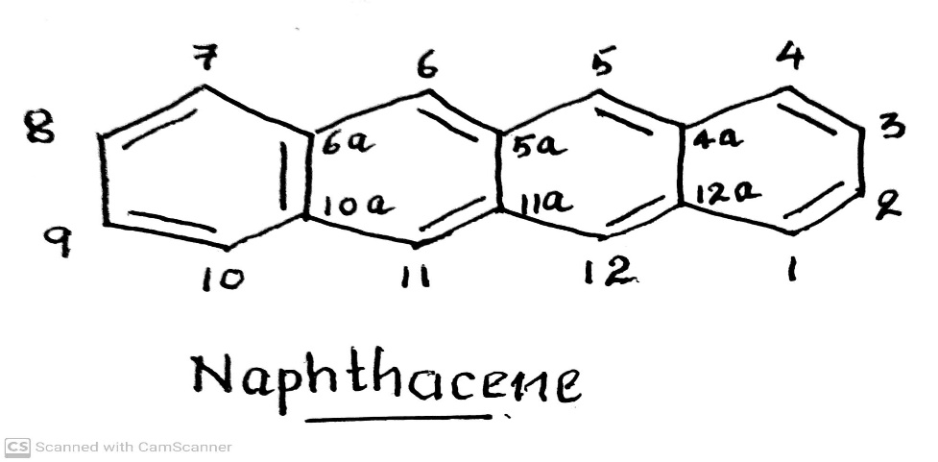
ANTIBIOTICS
TETRACYCLINES
Chemistry of Tetracyclines :
.
They are derivatives of an Octahydronaphthacene / Tetracene.
Stereochemistry of tetracyclines:
Carbon atom 4, 4a, 5, 5a, 6 and 12a are potentially Chiral depending on substitution
Oxytetracycline and Doxycycline possess 5α- Hydroxy substituent have six chiral carbon and other have only five
chiral carbon.
-09-2020
© R R INSTITUTIONS , BANGALORE
83

Slide 84
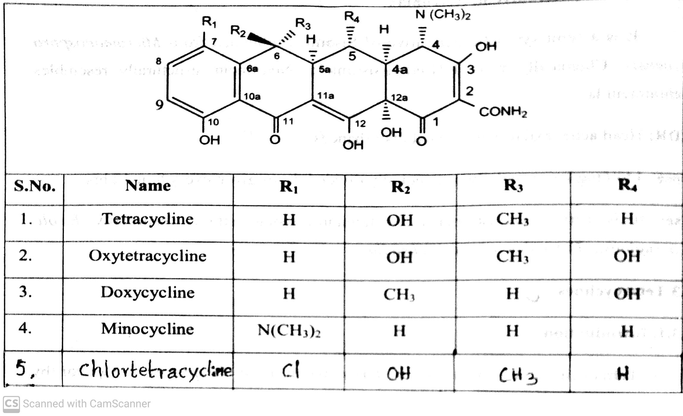
ANTIBIOTICS
STRUCTURE OF TETRACYCLINES:
These are amphoteric compounds, forming salts either acids or bases.
It exists mainly as Zwitter ions in neutral solutions.
They are yellow in colour.
The hydrochloride salts are used for oral administration and usually given in the form of capsule to mask
the bitter taste.
-09-2020
© R R INSTITUTIONS , BANGALORE
84

Slide 85
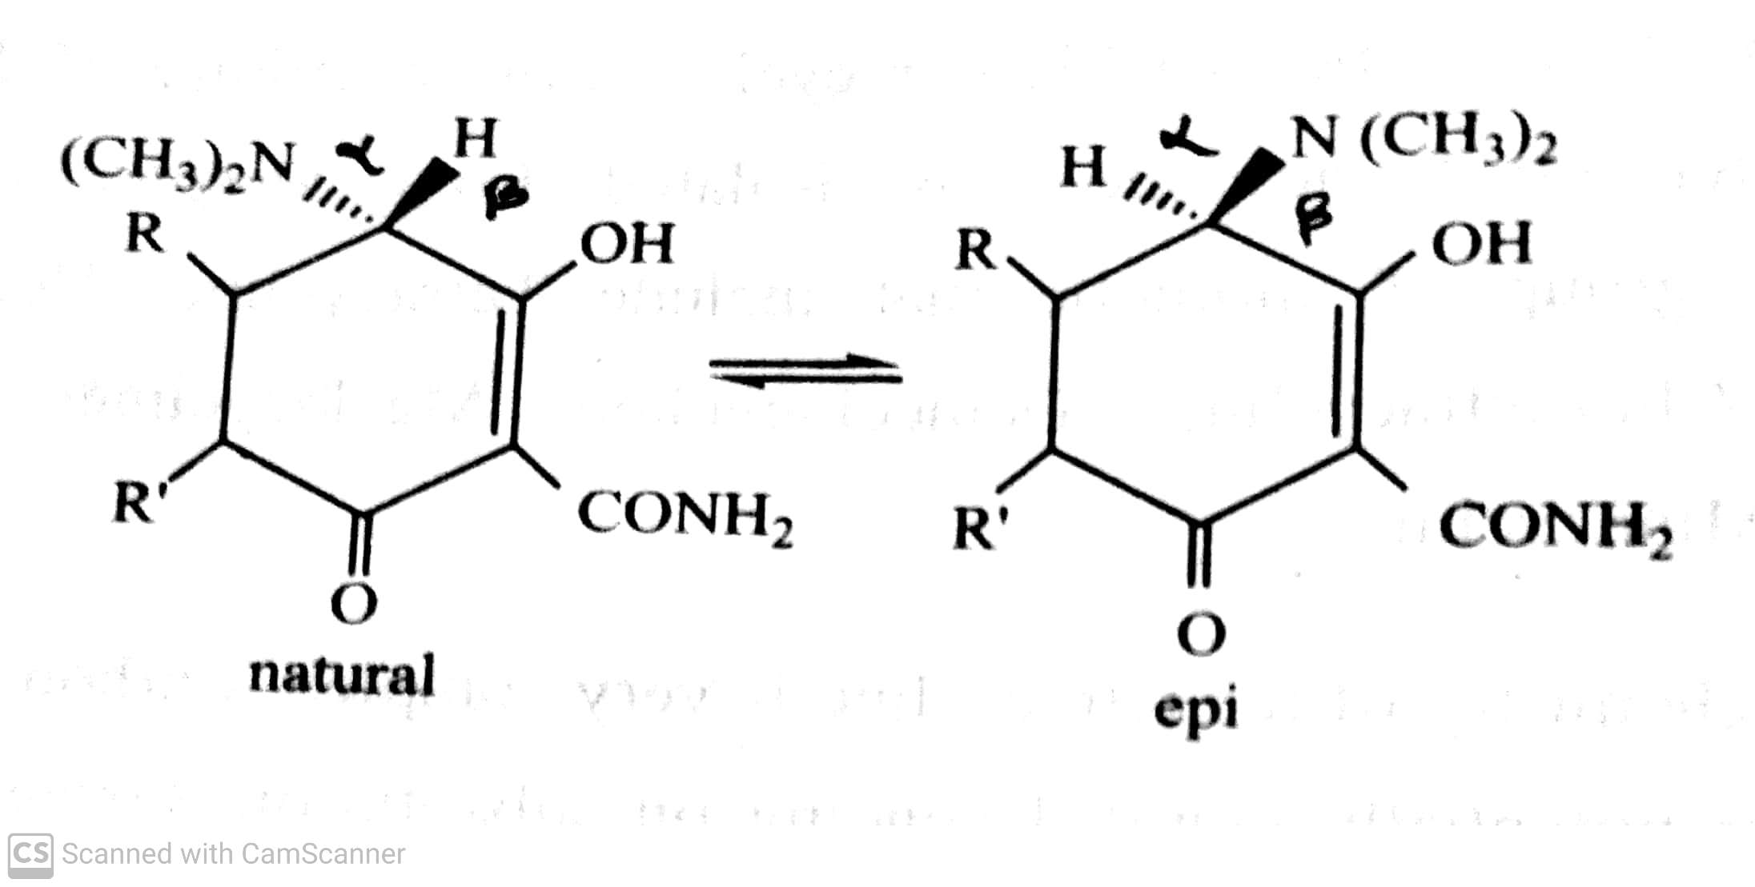
ANTIBIOTICS
EPIMERIZATION (AGING) OF TETRACYCLINES:
Tetracycline having the ability to undergo epimerization at C-4 in solution of intermediate pH range to form a product called epitetracycline.
-09-2020
© R R INSTITUTIONS , BANGALORE
85

Slide 86
ANTIBIOTICS
MECHANISM OF ACTION OF TETRACYCLINES:
Tetracyclines are specific inhibitors of bacterial protein synthesis. They bind to the 30S ribosomal subunit and thereby Prevent the binding of Aminoacyl tRNA to the mRNA ribosome complex.
-09-2020
© R R INSTITUTIONS , BANGALORE
86

Slide 87

ANTIBIOTICS
SAR OF TETRACYCLINES.
-09-2020
© R R INSTITUTIONS , BANGALORE
87

Slide 88
ANTIBIOTICS
SAR OF TETRACYCLINES.
Tetracycline is a derivative of Octahydronaphthacene / Tetracene.
Four Rings are essential for activity and all the rings should be six membered.
Position-1 Keto(=O) gp and Position-3 Enol(-OH) gp are important for activity. Any modification in keto-enol
tautomerism between C2 & C3 leads to the loss of biological activity.
-09-2020
© R R INSTITUTIONS , BANGALORE
88

Slide 89
ANTIBIOTICS
SAR OF TETRACYCLINES.
Position-2 Carboxamide (-CONH2 ) gp is essential. If we replace it by aldehyde or nitrile, Decreases the activity.
From this (-CONH2 ) N undergoes monoalkylation –Decreases the activity.
From this (-CONH2 ) N undergoes Aminoalkylation –getting more water soluble compounds but that would be
hydrolysed in vivo. Eg. Rolitetracycline.
-09-2020
© R R INSTITUTIONS , BANGALORE
89

Slide 90
ANTIBIOTICS
SAR OF TETRACYCLINES.
Position-3 (-OH ) gp and Position-4 (-N(CH3)2 ) dimethylamine gp. These two groups are responsible for
forming Zwitter ion (having both +Ve & -Ve charge) is essential for distributing within the body. If we remove
these two groups the activity will be decreased.
Position-5 – Substitution of –OH gp at P-5 –influence the pharmacokinetic properties there is no change in
the activity. Eg. Oxytetracycline and Doxycycline.
-09-2020
© R R INSTITUTIONS , BANGALORE
90

Slide 91
ANTIBIOTICS
SAR OF TETRACYCLINES.
Position-6 having (-OH ) gp and (-CH3) gp. If the hydroxyl gp is absent means the getting compound is stable
to acids, bases and having long biological half life. Eg. Doxycycline and Minocycline.
If it is having only - CH3 at P-6 and –OH gp at P-5 the activity would be increases 2-3 times. Eg. Doxycycline.
Position-7, if we introduce electron withdrawing group (Cl, NH3 ) or electron donating gp (-N(CH3)2 )
increases the activity. Eg. Chlortetracyclines, Demeclocycline.
-09-2020
© R R INSTITUTIONS , BANGALORE
91

Slide 92

ANTIBIOTICS
DEGRADATION OF TETRACYCLINES.
-09-2020
© R R INSTITUTIONS , BANGALORE
92

Slide 93

ANTIBIOTICS
iii) Tetracyclines : Tetracyclines, Chlortetracyclines, Rolitetracyclines, Oxytetracyclines,
Methacyclines, Demeclocyclines, Meclocyclines, Doxycyclines, Minocycline.
.
-09-2020
© R R INSTITUTIONS , BANGALORE
93

Slide 94


ANTIBIOTICS
iii) Tetracyclines : Tetracyclines, Chlortetracyclines, Rolitetracyclines, Oxytetracyclines,
Methacyclines, Demeclocyclines, Meclocyclines, Doxycyclines, minocycline.
.
-09-2020
© R R INSTITUTIONS , BANGALORE
94

Slide 95

ANTIBIOTICS
iii) Tetracyclines : Tetracyclines, Chlortetracyclines, Rolitetracyclines, Oxytetracyclines,
Methacyclines, Demeclocyclines, Meclocyclines, Doxycyclines, minocycline.
.
-09-2020
© R R INSTITUTIONS , BANGALORE
95

Slide 96

ANTIBIOTICS
iii) Tetracyclines : Tetracyclines, Chlortetracyclines, Rolitetracyclines, Oxytetracyclines,
Methacyclines, Demeclocyclines, Meclocyclines, Doxycyclines, Minocycline.
.
-09-2020
© R R INSTITUTIONS , BANGALORE
96

Slide 97
ANTIBIOTICS
MACROLIDE ANTIBIOTICS
.
-09-2020
© R R INSTITUTIONS , BANGALORE
97

Slide 98
ANTIBIOTICS
iv) Macrolide antibiotics : Erythromycin, Clarithromycin, Azithromycin, Dirithromycin, Troleandomycin.
Macrolides are group of antibiotics containing macrocyclic lactone ring to which a neutral (Cladinose) sugar
and an amino (Desosamine) sugar are attached.
Usually Lactone ring has 12, 14 or 16 atoms in it.
Macrolide antibiotics are produced by various strains of Streptomyces.
They have 3 common chemical characters:
- A large non-planar strain less ring.
- A keto group
- A glycosidically linked amino sugar.
-09-2020
© R R INSTITUTIONS , BANGALORE
98

Slide 99
ANTIBIOTICS
MECHANISM OF ACTION OF MACROLIDE ANTIBIOTICS
Macrolide binds to 50S subunit of the bacterial ribosome, to prevent the translocation step of bacterial protein synthesis. It does not bind to mammalian ribosome.
SPECTRUM OF ACTIVITY
The spectrum of antibacterial activity of macrolides resembles that of penicillin. They are effective against most species of Gram +Ve bacteria , both cocci and bacilli and also Gram –Ve Cocci especially Neisseria. They also active against Treponema palladium, Mycoplasma and Chalmydia.
-09-2020
99

Slide 100


ANTIBIOTICS
iv) Macrolide antibiotics : Erythromycin, Clarithromycin, Azithromycin, Dirithromycin, Troleandomycin.
-09-2020
100

Slide 101


ANTIBIOTICS
iv) Macrolide antibiotics : Erythromycin, Clarithromycin, Azithromycin, Dirithromycin, Troleandomycin.
-09-2020
101

Slide 102


ANTIBIOTICS
iv) Macrolide antibiotics : Erythromycin, Clarithromycin, Azithromycin, Dirithromycin, Troleandomycin.
-09-2020
102

Slide 103
ANTIBIOTICS
MISCELLANEOUS ANTIBIOTICS
.
-09-2020
© R R INSTITUTIONS , BANGALORE
103

Slide 104

ANTIBIOTICS
MISCELLANEOUS ANTIBIOTICS
Eg: Chloramphinicol, Clindamycin.
Nitrobenzene derivatives: Eg. Chloramphenicol (Chloraxin, Paraxin).
Chloramphenicol was isolated from a culture of Streptomyces (salmonella) Venezuelae.
It is a white needle –like crystals, soluble in water and alcohol.
It has no odour, but has a very bitter taste.
It possesses two chiral carbon atoms in the acyl amido propanediol chain.
.
-09-2020
© R R INSTITUTIONS , BANGALORE
104

Slide 105

ANTIBIOTICS
MISCELLANEOUS ANTIBIOTICS
Eg: Chloramphinicol, Clindamycin.
Nitrobenzene derivatives: Eg. Chloramphenicol (Chloraxin, Paraxin).
On hydrolysis (acid / alkali) yielded Dichloroacetic acid and base called 2-Amino-p-nitrophenyl-1,3
- propanediol. This base contains 2 chiral carbon atoms give rise to Threo and Erythro forms.
.
-09-2020
© R R INSTITUTIONS , BANGALORE
105

Slide 106
ANTIBIOTICS
MISCELLANEOUS ANTIBIOTICS
MECHANISM OF ACTION OF CHLORAMPHENICOL
It inhibits protein synthesis in bacteria.
It acts primarily by binding reversibly to 50s ribosomal subunit and appears to prevent the binding of the amino acid containing end of aminoacyl tRNA to the acceptor site on the 50s ribosomal subunit.
.
-09-2020
© R R INSTITUTIONS , BANGALORE
106

Slide 107
ANTIBIOTICS
SAR OF CHLORAMPHENICOL
Modification of para nitrophenyl group:
Modification of dichloroacetamido side chain.
Modification of 1,3-Propanediol.
.
-09-2020
© R R INSTITUTIONS , BANGALORE
107

Slide 108
ANTIBIOTICS
SAR OF CHLORAMPHENICOL
Modification of para nitrophenyl group:
Replacement of –NO2 (nitro) gp by other substituents like –CN, CONH2, NH2, OH, N(CH3)2 resulted in
reduction or complete loss of antibacterial activity.
Shifting of –NO2 (nitro) gp from the p-position also reduces the antibacterial activity.
Replacement of phenyl group by the other aromatic or alicyclic groups like (naphthyl, pyridyl, quinolyl, thienyl, cyclohexyl etc., results in less potent than chloramphenicol.
.
-09-2020
© R R INSTITUTIONS , BANGALORE
108

Slide 109
ANTIBIOTICS
SAR OF CHLORAMPHENICOL
B) Modification of dichloroacetamido side chain.
Other dihalo derivatives of side chain are slightly less active.
The dichloroacetamido group can be replaced with other electro negative groups leads appreciable loss of
activity
.
-09-2020
© R R INSTITUTIONS , BANGALORE
109

Slide 110
ANTIBIOTICS
SAR OF CHLORAMPHENICOL
C) Modification of 1,3-Propanediol.
If the primary alcohol group on C-1 atom is modified, it results in a decrease in activity. Hence the alcoholic
group is essential for activity.
.
-09-2020
© R R INSTITUTIONS , BANGALORE
110

Slide 111
ANTIBIOTICS
Nitrobenzene derivatives: Eg. Chloramphenicol (Chloraxin, Paraxin).
ADR : GI symptoms, bleeding, peripheral and optic neuritis.
Dose : 500 mg per day in divided doses.
Use : It is used in the treatment of typhoid fever caused by Salmonella typhi. It is also effective against bacteria, Haemophilus influenza, Neisseria meningitis.
.
-09-2020
© R R INSTITUTIONS , BANGALORE
111

Slide 112

ANTIBIOTICS
Synthesis of Chloramphenicol
.
-09-2020
© R R INSTITUTIONS , BANGALORE
112

Slide 113
ANTIBIOTICS
MISCELLANEOUS ANTIBIOTICS
Eg: Chloramphinicol, Clindamycin.
Lincomycin : Lincomycin, Clindamycin.
Lincomycins are Suplhur containing antibiotics isolated from Streptomyces lincotensis.
Structural modification of Lincomycin resulted in 7-chloro-7-deoxy derivative called Clindamycin.
Clindamycin possess great antibacterial potency than lincomycin.
They are active against Gram +Ve bacteria particularly Cocci and also effective against non-spore-forming
anaerobic bacteria, Actinomycin, mycoplasma.
Lincomycin binds to 50S ribosomal subunit to inhibit protein synthesis.
.
-09-2020
© R R INSTITUTIONS , BANGALORE
113

Slide 114

ANTIBIOTICS
MISCELLANEOUS ANTIBIOTICS
Eg: Chloramphinicol, Clindamycin.
Lincomycin : Lincomycin, Clindamycin.
.
-09-2020
© R R INSTITUTIONS , BANGALORE
114

Slide 115
ANTIBIOTICS
THANK YOU
.
-09-2020
© R R INSTITUTIONS , BANGALORE
115

Slide 116
ANTIBIOTICS
LINCOMYCINS
.
-09-2020
© R R INSTITUTIONS , BANGALORE
116

Slide 117
ANTIBIOTICS
v) Lincomycin : Lincomycin, Clindamycin.
Lincomycins are Suplhur containing antibiotics isolated from Streptomyces lincotensis.
Structural modification of Lincomycin resulted in 7-chloro-7-deoxy derivative called Clindamycin.
Clindamycin possess great antibacterial potency than lincomycin.
They are active against Gram +Ve bacteria particularly Cocci and also effective against non-spore-forming
anaerobic bacteria, Actinomycin, mycoplasma.
Lincomycin binds to 50S ribosomal subunit to inhibit protein synthesis.
-09-2020
117

Slide 118


ANTIBIOTICS
v) Lincomycin : Lincomycin.
-09-2020
118

Slide 119
ANTIBIOTICS
v) Lincomycin : Clindamycin.
-09-2020
119

Slide 120
ANTIBIOTICS
POLYPEPTIDE ANTIBIOTICS
.
-09-2020
© R R INSTITUTIONS , BANGALORE
120

Slide 121
ANTIBIOTICS
vi) Polypeptide antibiotics : Polymyxin-B, Colistin, Vancomycin, Teicoplanin, Bacitracin.
Polypeptides are composed of amino acids joined by peptide links to cyclic structures with or without branches from the ring.
They contain unusual amino acids such as α,γ- Diaminobutyric acid and α,β- Diamino propionic acid as well as saturated aliphatic acid such as Methyl octanoic acid.
They are isolated from Bacillus Polymyxa (polymyxin), Bacillus Polymyxavar. Colistinus (colistin) , and
Bacillus subtiles (Bacitracin)
-09-2020
121

Slide 122

ANTIBIOTICS
vi) Polypeptide antibiotics : Polymyxin-B, Colistin, Vancomycin, Teicoplanin, Bacitracin.
Use : It is useful against many Gram –Ve organisms. It is mainly used in topical application for local
infection in wounds and burns.
-09-2020
122

Slide 123

ANTIBIOTICS
vi) Polypeptide antibiotics : Polymyxin-B, Colistin, Vancomycin, Teicoplanin, Bacitracin.
-09-2020
123

Slide 124

ANTIBIOTICS
vi) Polypeptide antibiotics : Polymyxin-B, Colistin, Vancomycin, Teicoplanin, Bacitracin.
-09-2020
124

Slide 125
ANTIBIOTICS
NITROBENZENE DERIVATIVES
.
-09-2020
© R R INSTITUTIONS , BANGALORE
125

Slide 126
ANTIBIOTICS
vii) Nitrobenzene derivatives: Eg. Chloramphenicol (Chloraxin, Paraxin).
Chloramphenicol was isolated from a culture of Streptomyces (salmonella) Venezuelae.
It is a white needle –like crystals, soluble in water and alcohol.
It has no odour, but has a very bitter taste.
It possesses two chiral carbon atoms in the acylamido propanediol chain.
-09-2020
© R R INSTITUTIONS , BANGALORE
126

Slide 127
ANTIBIOTICS
vii) Nitrobenzene derivatives: Eg. Chloramphenicol (Chloraxin, Paraxin).
On hydrolysis (acid / alkali) yielded Dichloroacetic acid and base called 2-Amino-p-nitrophenyl-1,3
- propanediol. This base contains 2 chiral carbon atoms give rise to Threo and Erythro forms.
-09-2020
127

Slide 128
ANTIBIOTICS
MECHANISM OF ACTION OF CHLORAMPHENICOL
It inhibits protein synthesis in bacteria.
It acts primarily by binding reversibly to 50s ribosomal subunit and appears to prevent the binding of the amino acid containing end of aminoacyl tRNA to the acceptor site on the 50s ribosomal subunit.
-09-2020
128

Slide 129
ANTIBIOTICS
SAR OF CHLORAMPHENICOL
Modification of para nitrophenyl group:
Modification of dichloroacetamido side chain.
Modification of 1,3-Propanediol.
-09-2020
129

Slide 130
ANTIBIOTICS
SAR OF CHLORAMPHENICOL
Modification of para nitrophenyl group:
Replacement of –NO2 (nitro) gp by other substituents like –CN, CONH2, NH2, OH, N(CH3)2 resulted in
reduction or complete loss of antibacterial activity.
Shifting of –NO2 (nitro) gp from the p-position also reduces the antibacterial activity.
Replacement of phenyl group by the other aromatic or alicyclic groups like (naphthyl, pyridyl, quinolyl, thienyl, cyclohexyl etc., results in less potent than chloramphenicol.
-09-2020
130

Slide 131
ANTIBIOTICS
SAR OF CHLORAMPHENICOL
B) Modification of dichloroacetamido side chain.
Other dihalo derivatives of side chain are slightly less active.
The dichloroacetamido group can be replaced with other electro negative groups leads appreciable loss of
activity
-09-2020
131

Slide 132
ANTIBIOTICS
SAR OF CHLORAMPHENICOL
C) Modification of 1,3-Propanediol.
If the primary alcohol group on C-1 atom is modified, it results in a decrease in activity. Hence the alcoholic
group is essential for activity.
-09-2020
132

Slide 133
ANTIBIOTICS
vii) Nitrobenzene derivatives: Eg. Chloramphenicol (Chloraxin, Paraxin).
ADR : GI symptoms, bleeding, peripheral and optic neuritis.
Dose : 500 mg per day in divided doses.
Use : It is used in the treatment of typhoid fever caused by Salmonella typhi. It is also effective against bacteria, Haemophilus influenza, Neisseria meningitis.
-09-2020
133

Slide 134
ANTIBIOTICS
Synthesis of Chloramphenicol
-09-2020
134

Slide 135

ANTIBIOTICS
viii) Steroidal antibiotic : Fusidic acid.
-09-2020
135

Slide 136

ANTIBIOTICS
ix) Miscellaneous : Novobiocin, mupirocin, Quinupristin.
-09-2020
136

Slide 137
THANK YOU
-09-2020
137

