Slide 1
BIOSTATISTICS AND RESEARCH METHODOLOGY
UNIT -2 BIOSTATISTICS
2.2 Data graphics
15-09-2024
1

Slide 2
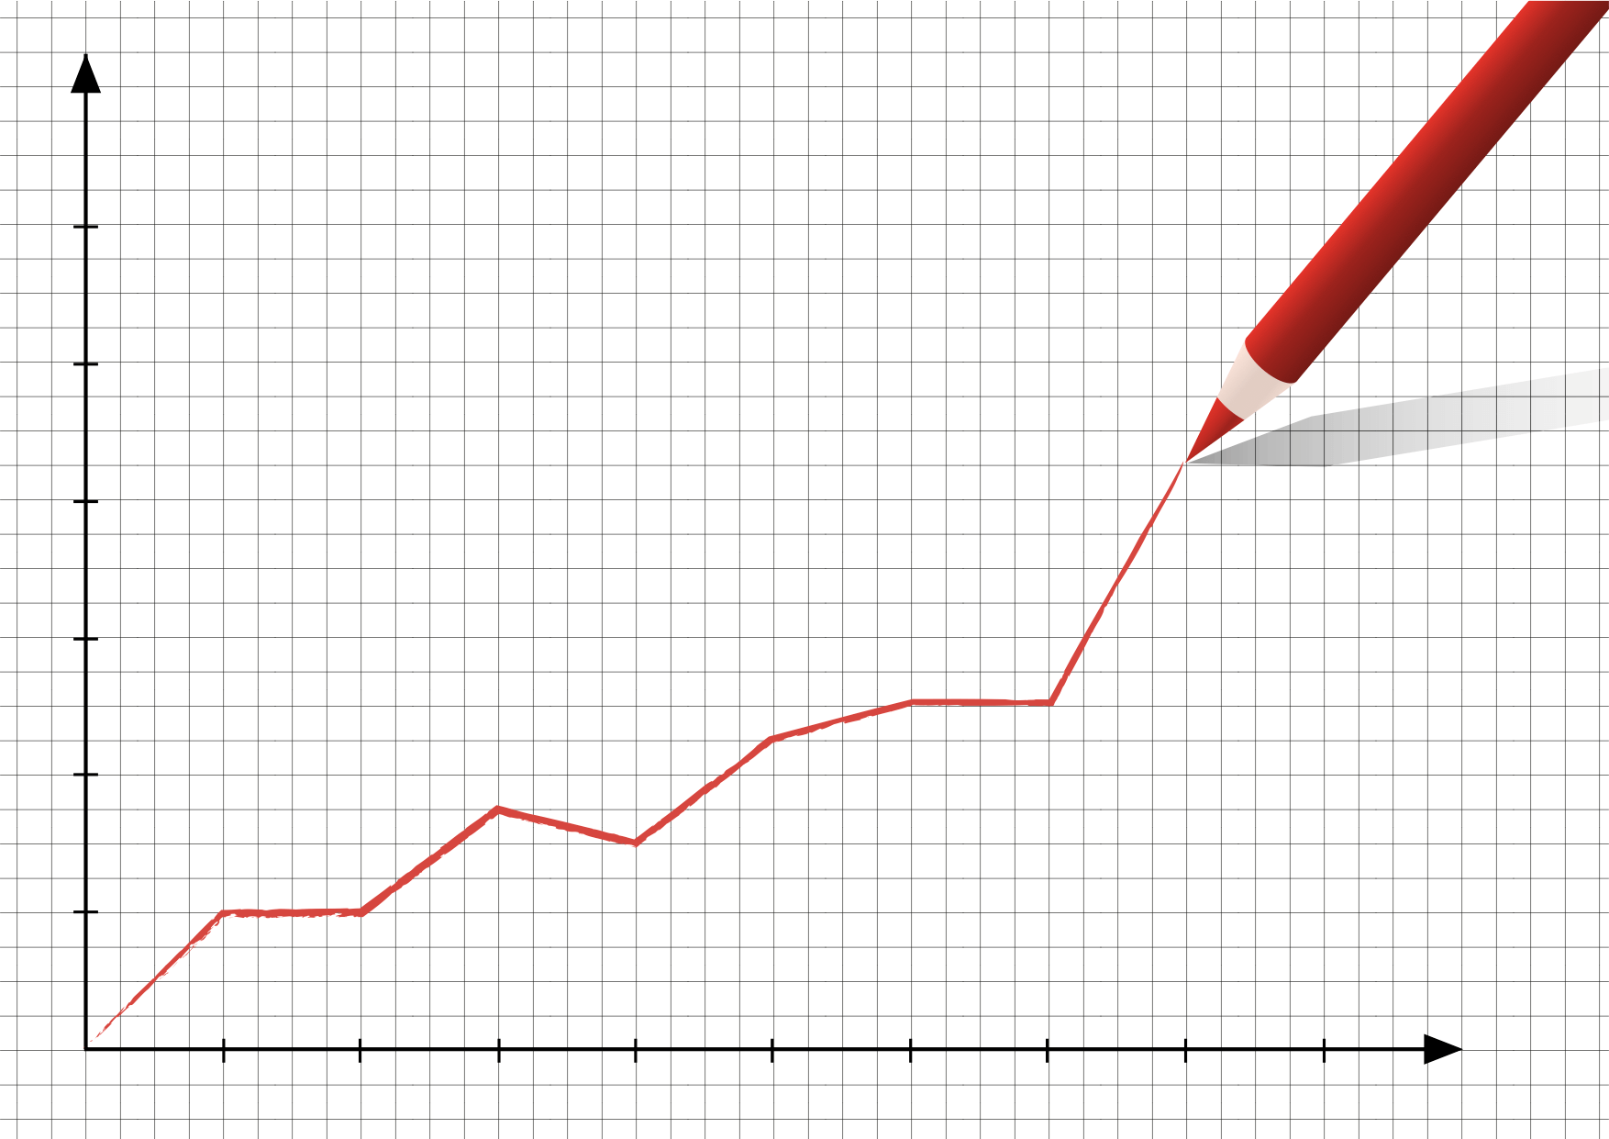
Construction and labeling of graphs, histogram, piecharts, scatter plots, semilogarthimic plots
2.2 DATA GRAPHICS
GRAPH is Two-dimensional drawing showing a relationship (usually between two set of numbers) by means of a line, curve, a series of bars , or other symbols . Also called plot.
A graph is a visual representation of a relationship between, but not restricted to, two variables. A graph commonly consists of two axes called the x-axis (horizontal) and y-axis (vertical).
Each axis corresponds to one variable. The axes are labeled with different names, such as Price and Quantity . The place where the two axes intersect is called the origin. The origin is also identified as the point (0,0).
15-09-2024
2

Slide 3
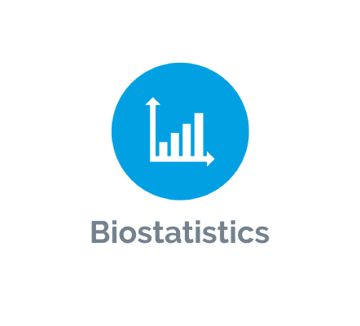
WHY GRAPH ? - Graphs provide a powerful way of summarising data and presenting them in a way that most people find easy to read.
Why use graphs to present data-
They are quick and direct.
It highlight the most important facts.
facilitate understanding of the data.
It can convince readers.
It can be easily remembered.
The preliminary examination of most data is facilitated by the use of diagrams. Diagrams prove nothing, but bring outstanding features readily to the eye; they are therefore no substitute for such critical tests as may be applied to the data, but are valuable in suggesting such tests, and in explaining the conclusions founded upon them.
Summary statistics such as the mean, median, variance, standard deviation, and the range are concise descriptions of the properties of data, but much information is lost in this processing of experimental results. Graphical methods of displaying data are to be encouraged and are important adjuncts to data analysis and presentation. Graphical presentations clarify and also reinforce conclusions based on formal statistical analyses. Finally, the researcher has the opportunity to design aesthetic graphical presentations that command attention.
15-09-2024
3

Slide 4
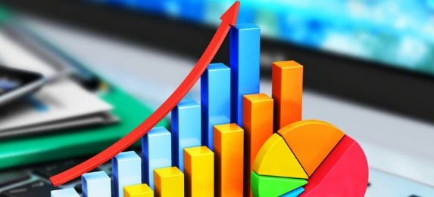
The diagrams and plots that we will be concerned with in our discussion of statistical methods can be placed broadly into two categories:
1. Descriptive plots are those whose purpose is to transmit information. These include diagrams describing data distributions such as histograms and cumulative distribution plots , Bar charts and pie charts are examples of popular modes of communicating survey data or product comparisons.
2. Plots that describe relationships between variables usually show an underlying, but unknown analytic relationship between the variables that we wish to describe and understand. These relationships can range from relatively simple to very complex, and may involve only two variables or many variables. One of the simplest relationships, but probably the one with greatest practical application, is the straight-line relationship between two variables.
15-09-2024
4

Slide 5

In Clinical studies graphs are used for..
Statistical graphics play an important role in clinical research. - Graphical representations to illustrate the effects and safety of treatments are often more easily understood and remembered than tabular forms
To present a large amount of data, such as individual subject data points (e.g., distribution of responses)
To show effects of treatment on major events or survival over time (Kaplan-Meier curves) .
To illustrate changes over time .
To illustrate differences in magnitude of response, particularly where more than two treatment groups are being compared .
To convey dose-response information .
15-09-2024
5

Slide 6
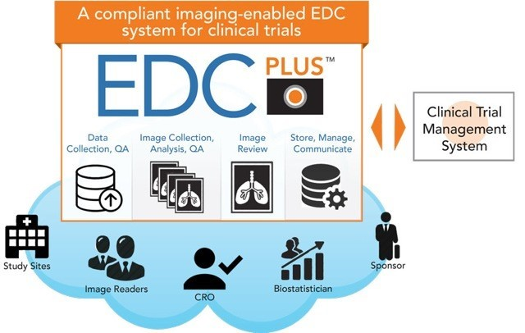
In clinical trial research there are two key areas where statistical graphics provide value:
exploratory data analysis (EDA) and informal clinical review of results by clinicians and management
(2) formal clinical study reports, scientific papers, presentations and submission to regulatory agencies
15-09-2024
6

Slide 7
CONSTRUCTION AND LABELING OF GRAPHS
Proper construction and labeling of graphs are crucial elements in graphical data representation. The design and actual construction of graphs are not in themselves difficult. The preparation of a good graph, however, requires careful thought and competent technical skills.
One needs not only a knowledge of statistical principles, but also, in particular, computer and drafting competency. There are no firm rules for preparing good graphical presentations. Mostly, we rely on experience and a few guidelines. Both books and research papers have addressed the need for a more scientific guide to optimal graphics that, after all, is measured by how well the graph communicates the intended messages(s) to the individuals who are intended to read and
interpret the graphs.
A “good” graph or chart should be as simple as possible, yet clearly transmit its intended message. Superfluous notation, confusing lines or curves, and inappropriate draftsmanship (lettering, etc.) that can distract the reader are signs of a poorly constructed graph.
Illustration :- The plot shows the results of a clinical study that was designed to compare an active drug to a placebo for the treatment of hypertension. This graph was constructed from the X, Y pairs, time and blood pressure, respectively. Each point on the graph (+ , ) is the average blood pressure for either drug or placebo at some point in time subsequent to the initiation of the
study.
)
15-09-2024
7

Slide 8
Diastolic blood pressure (mm Hg)
Proper construction and labeling of the typical rectilinear graph should include the following considerations:
1. A title should be given. The title should be brief and to the point, enabling the reader to understand the purpose of the graph without having to resort to reading the text. The title can be placed below or above the graph.
2. The axes should be clearly delineated and labeled. In general, the zero (0) points of both axes should be clearly indicated. The ordinate (the Y axis) is usually labeled with the description parallel to the Y axis. Both the ordinate and abscissa (X axis) should be each appropriately labeled and subdivided in units of equal width (of course, the X and Y axes almost always have different subdivisions).
115
110
105
100
95
90
85
80
0
Blood pressure as a
function of time in a
clinical study comparing drug and placebo with a
regimen
of one tablet per day. placebo (average of 45 patients); +, drug (average of 50 patients).
Diastolic blood pressure (mm Hg)
2 4 6 8
Time (weeks) after initialion of study
15-09-2024
8

Slide 9
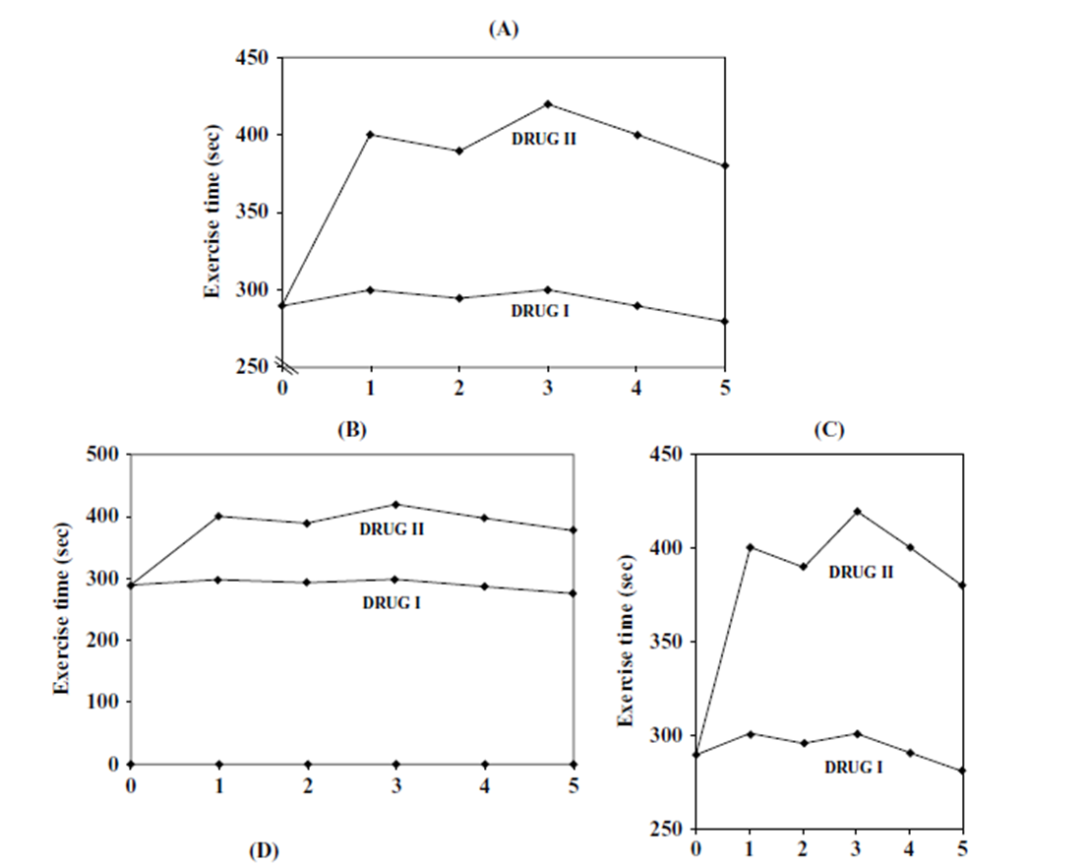
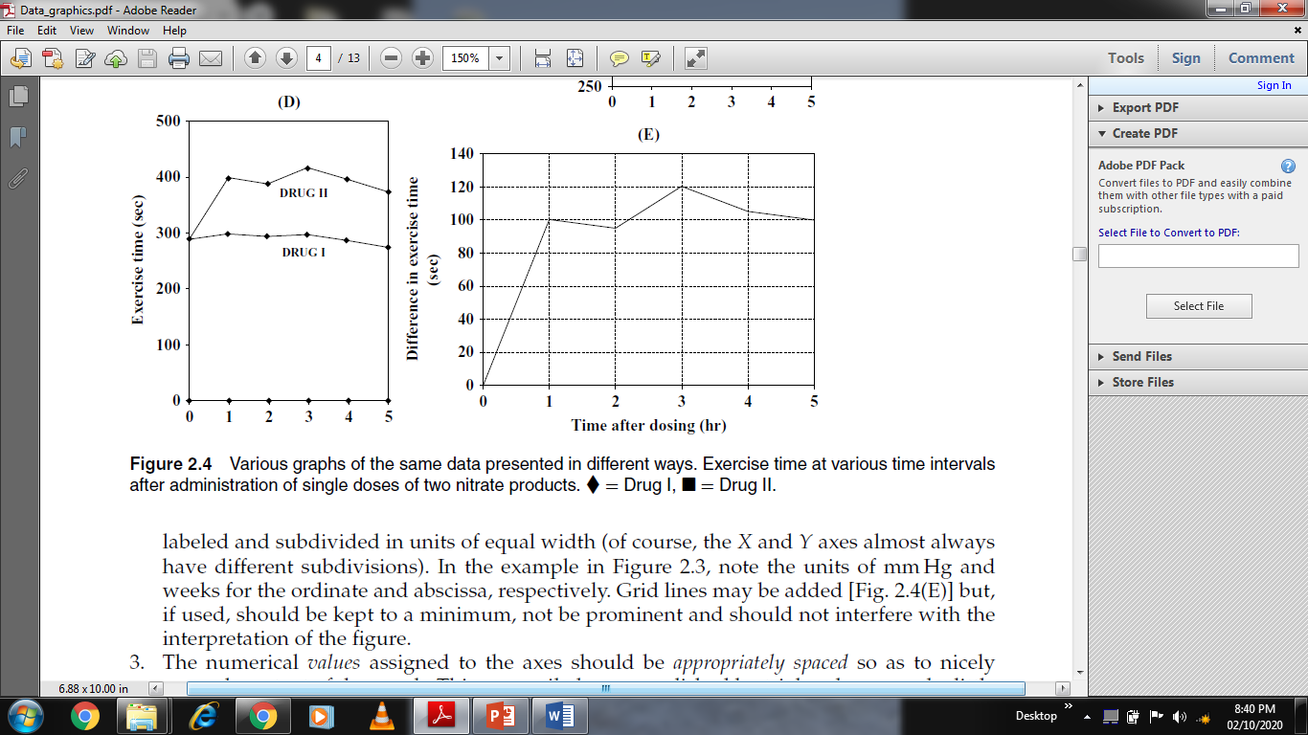
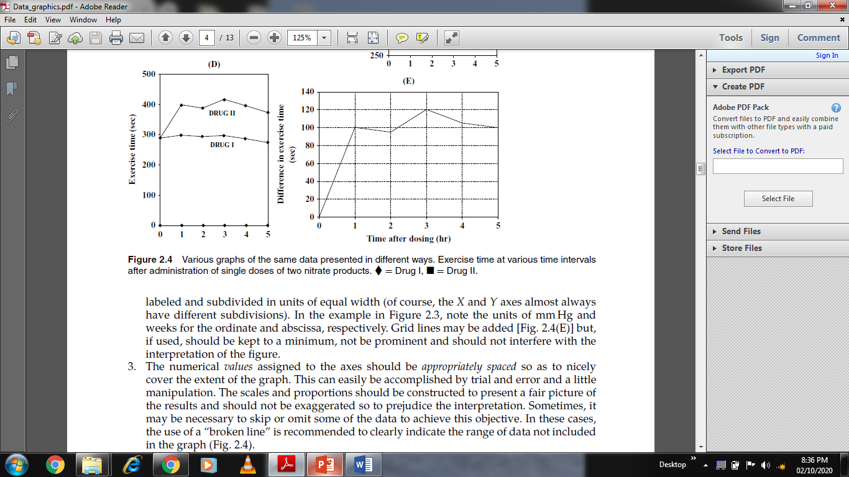
15-09-2024
9

Slide 10
In the example ,note the units of mmHg and weeks for the ordinate and abscissa, respectively. Grid lines (E) may be added but, if used, should be kept to a minimum, not be prominent and should not interfere with the interpretation of the figure.
3. The numerical values assigned to the axes should be appropriately spaced so as to nicely cover the extent of the graph. This can easily be accomplished by trial and error and a little manipulation. The scales and proportions should be constructed to present a fair picture of the results and should not be exaggerated so to prejudice the interpretation. Sometimes, it may be necessary to skip or omit some of the data to achieve this objective. In these cases, the use of a “broken line” is recommended to clearly indicate the range of data not included in the graph (previous slide).
4. If appropriate, a key explaining the symbols used in the graph should be used. For example, at the bottom of Figure in (slide number 8) the key defines as the symbol for placebo and + for drug. In many cases, labeling the curves directly on the graph (Fig) results in more clarity.
5. In situations where the graph is derived from laboratory data, inclusion of the source of the data (name, laboratory notebook number, and page number, for example) is recommended.
6. If more than one curve appears on the same graph, a convenient way to differentiate the curves is to use different symbols for the experimental points (e.g., ◦, ×, , , +) and, if necessary, connecting the points in different ways (e.g., —.—.—., . . . . . ., –.–.–.–). A key or label is used, which is helpful in distinguishing the various curves, as shown in Figures. Other ways of differentiating curves include different kinds of crosshatching and use of different colors.
15-09-2024
10

Slide 11
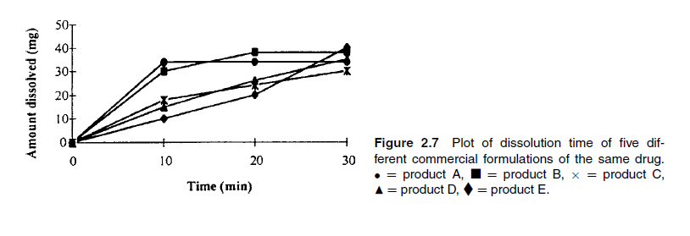
7. One should take care not to place too many curves on the same graph, as this can result in confusion. There are no specific rules in this regard. The decision depends on the nature of the data, and how the data look when they are plotted. The curves graphed in below diagram are cluttered and confusing. The curves should be presented differently or separated into two or more graphs. Figure in next slide is a clearer depiction of the dissolution results of the five formulations shown in below diagram.
15-09-2024
11

Slide 12
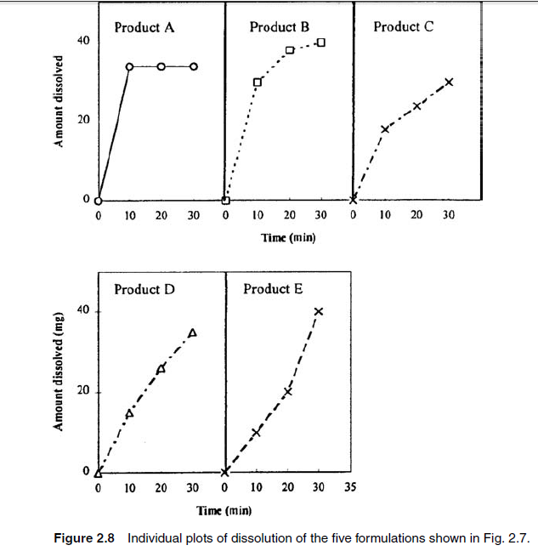
15-09-2024
12

Slide 13
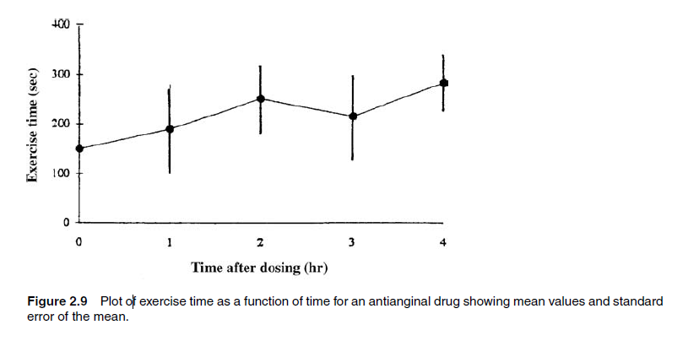
8. The standard deviation may be indicated on graphs as shown in below figure . However, when the standard deviation is indicated on a graph (or in a table, for that matter), it should be made clear whether the variation described in the graph is an indication of the standard deviation (S) or the standard deviation of the mean (S¯x). The standard deviation of the mean, if appropriate, is often preferable to the standard deviation not only because the values on the graph are mean values, but also because S¯x is smaller than the s.d., and therefore less cluttering. Overlapping standard deviations, as shown in Figure (next slide ), should be avoided, as this representation of the experimental results is usually more confusing than clarifying.
15-09-2024
13

Slide 14
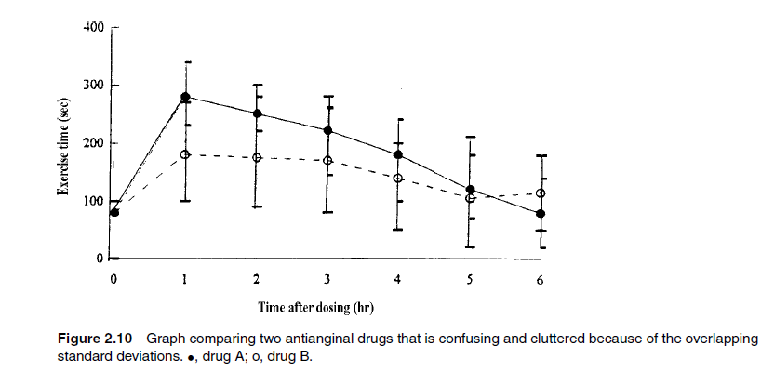
15-09-2024
14

Slide 15
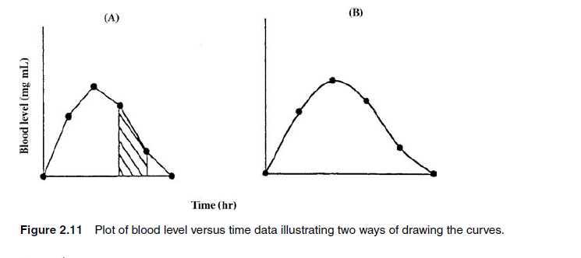
9. The manner in which the points on a graph should be connected is not always obvious. Should the individual points be connected by straight lines, or should a smooth curve that approximates the points be drawn through the data. . (See this slide) If the graphs represent functional relationships, the data should probably be connected by a smooth curve. For example, the blood level versus time data shown in Figure are described most accurately by a smooth curve. Although, theoretically, the points should not be connected by straight lines as shown in Figure (A) , such graphs are often depicted this way. Connecting the individual points with straight lines may be considered acceptable if one recognizes that this representation is meant to clarify the graphical presentation, or is done for some other appropriate reason. In the blood-level example, the area under the curve is proportional to the amount of drug absorbed. The area is often computed by the trapezoidal rule and depiction of the data as shown in Figure (A) makes it easier to visualize and perform such calculations.
15-09-2024
© R R INSTITUTIONS , BANGALORE
15

Slide 16
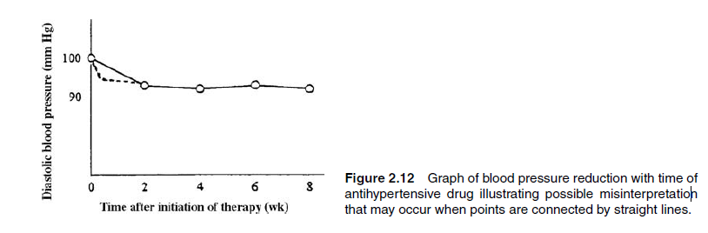
This below example in which connecting points by straight lines is convenient but may not be a good representation of the experimental outcome. The straight line connecting the blood pressure at zero time (before drug administration) to the blood pressure after two weeks of drug administration suggests a gradual decrease (a linear decrease) in blood pressure over the two-week period. In fact, no measurements were made during the initial two-week interval. The 10-mmHg decrease observed after two weeks of therapy may have occurred before the two-week reading (e.g., in one week, as indicated by the dashed line in Fig .One should be careful to ensure that graphs constructed in such a manner are not
misinterpreted.
15-09-2024
16

Slide 17
HISTOGRAM
The histogram, sometimes known as a bar graph, is one of the most popular ways of presenting and summarizing data. All of us have seen bar graphs, not only in scientific reports but also in advertisements and other kinds of presentations illustrating the distribution of scientific data.
The histogram can be considered as a visual presentation of a frequency table. The frequency, or proportion, of observations in each class interval is plotted as a bar, or rectangle, where the area of the bar is proportional to the frequency (or proportion) of observations in a given interval.
An example of a histogram is shown in figure (A) where the data from the frequency table in (Table) have been used as the data source. As is the case with frequency tables, class intervals for histograms should be of equal width. When the intervals are of equal width, the height of the bar is proportional to the frequency of observations in the interval. If the intervals are not of equal width, the histogram is not easily or obviously interpreted, as shown in Figure (B).
The choice of intervals for a histogram depends on the nature of the data, the distribution of the data, and the purpose of the presentation. In general, rules of thumb similar to that used for frequency distribution tables (sect. 1.2) can be used. Eight to twenty equally spaced intervals usually are sufficient to give a good picture of the data distribution.
15-09-2024
17

Slide 18
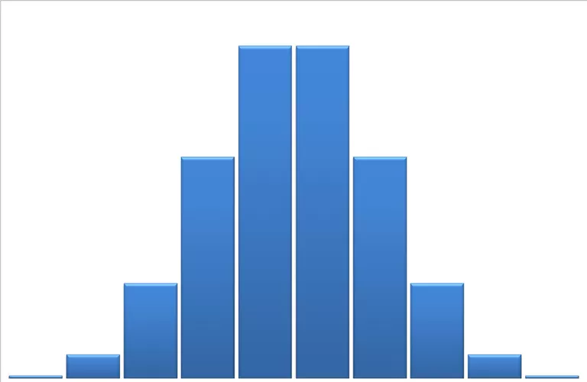
DRAWING THE HISTOGRAM
Draw a horizontal line. This will be where we denote our classes.
Place evenly spaced marks along this line that correspond to the classes.
Label the marks so that the scale is clear and give a name to the horizontal axis.
Draw a vertical line just to the left of the lowest class.
Choose a scale for the vertical axis that will accommodate the class with the highest frequency.
Label the marks so that the scale is clear and give a name to the vertical axis.
Construct bars for each class.
The height of each bar should correspond to the frequency of the class at the base of the bar. We can also use relative frequencies for the heights of our bars.
15-09-2024
18

Slide 19
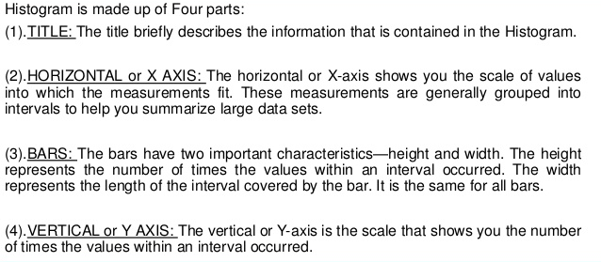
15-09-2024
19

Slide 20
Step I: Observe the class intervals of the distribution. If they are no no verlapping (discontinuous), Change them into overlapping (continuous) classes.
Step II: Locate the class boundaries on the x-axis (horizontal axis).
Step III: Construct a vertical rectangle on each line segment representing a class interval such that the height of the rectangle represents frequency of the class interval.
Step IV: Put a kink mark (N) on the horizontal axis, between the vertical axis and the first rectangle if the leftmost rectangle does not have the vertical axis on its side.
Note: For drawing graphs, a scale of representation is required. Unless given, the choice of scale is made of suit the data.
Different scales can be taken for the two axes.
In the scale for the x-axis is “1 mm = an interval of 5” then the class interval 20 – 40 will be shown by 4-mm-long line segment on the x-axis.
If the scale for the y-axis is “1 mm = frequency 1” (i.e., frequency of 1 is denoted by 1 mm) then the frequency 10 will be shown by 1-cm-long line segment on the y-axis.
15-09-2024
20

Slide 21
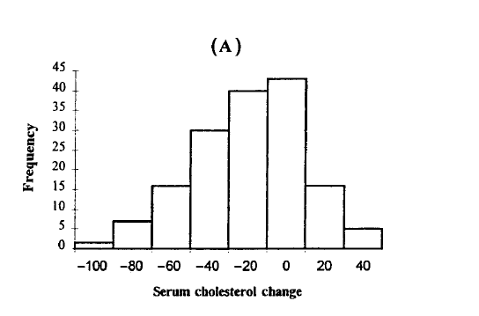
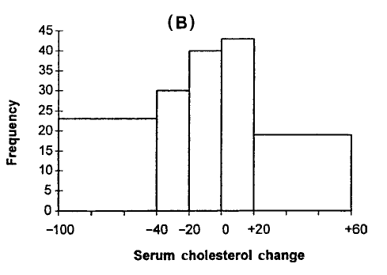
15-09-2024
21

Slide 22
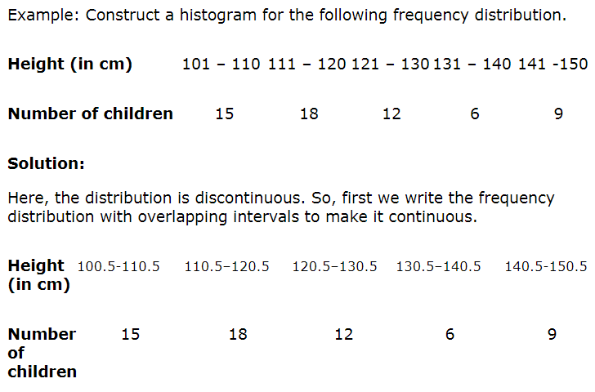
15-09-2024
22

Slide 23
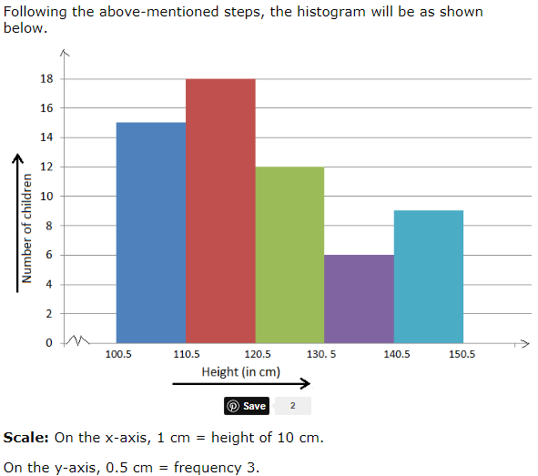
15-09-2024
23

Slide 24
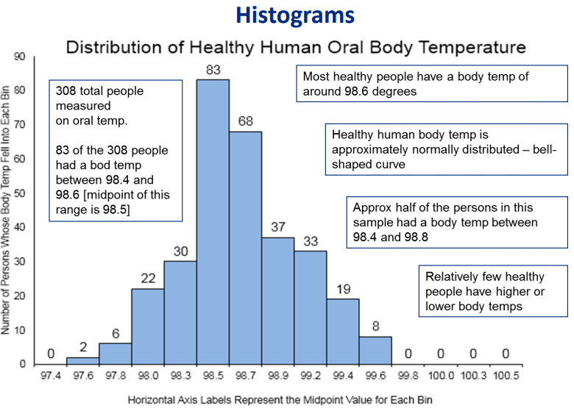
15-09-2024
24

Slide 25
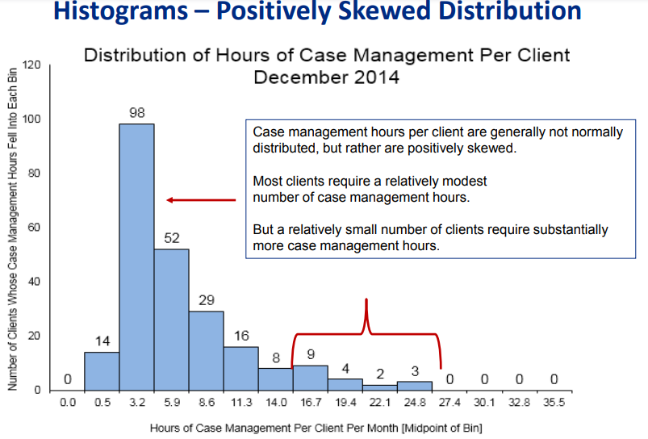
15-09-2024
25

Slide 26
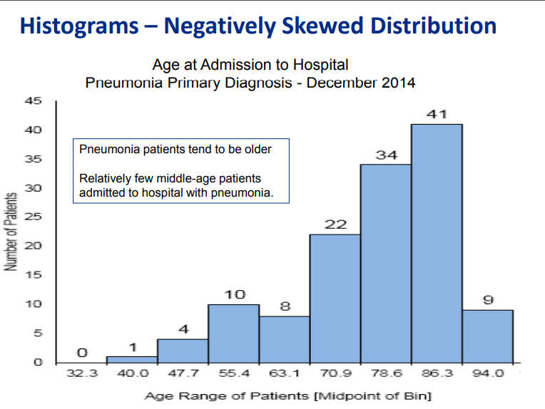
15-09-2024
26

Slide 27
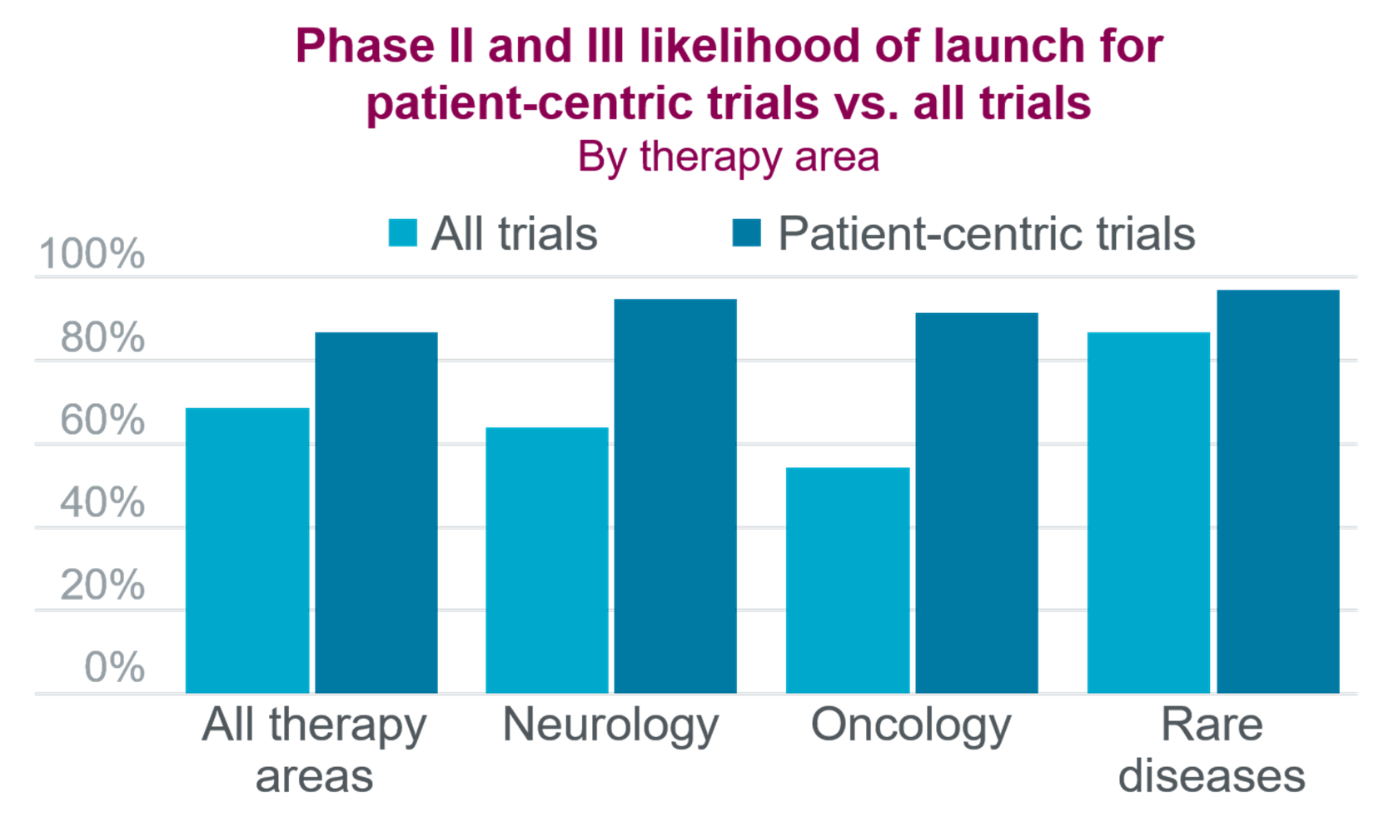
Example of histogram in clinical trails
15-09-2024
27

Slide 28
ADVANTAGES
A bar graph that shows the frequency distribution of values/data.
– To assess process capability & to understand variation.
– Useful to understand the spread or variations, location and shape of the data.
– To know whether process is stable and predictable.
– To know whether process produces within specification.
– Process monitoring and centering.
WHEN TO USE A HISTOGRAM
-To summarize large data sets graphically.
-To compare measurements to specifications.
-Assist in decision making.
DISAVANTAGES
It shows the number of values within an interval and not the actual values.
They are used only for numerical data.
You could change the intervals of the histogram to see which gives a better description of the data.
15-09-2024
28

Slide 29
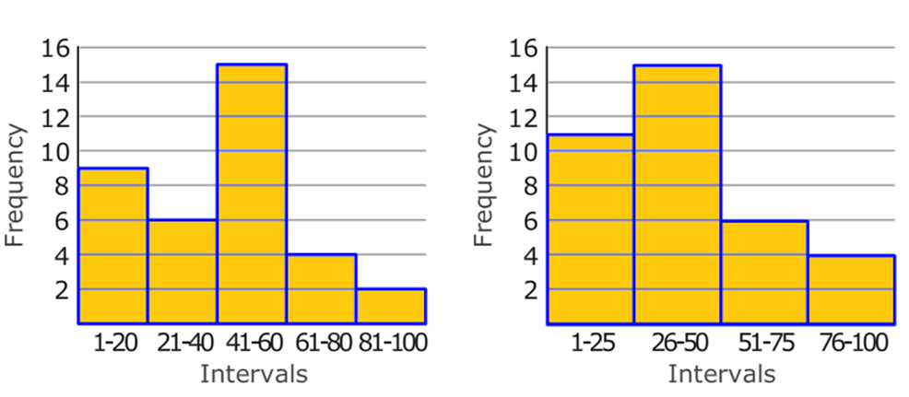
KEY POINTS
Although there are many instances where using a histogram would be considered convenient, there are also many instances where using or interpreting a histogram could be troublesome as well.
For example, (i) when interpreting a histogram, it is extremely difficult and practically impossible to extract the exact amount of "input" in the histogram unless it is a frequency histogram.
(ii) if you are given a histogram and asked how many people gave their data in a survey, it would be extremely difficult to pinpoint an exact number.
Histograms are often considered inconvenient when comparing multiple categories, because even though you can compare several histograms side by side, it doesn't quite create the desired effect.
Although histograms are considered to be some of the most commonly used graphs to display data, the histogram has many pros and cons hidden within its formulaic set up Histograms allow viewers to easily compare data, and in addition, they work well with large ranges of information. They are also provide a more concrete from of consistency, as the intervals are always equal, a factor that allows easy data transfer from frequency tables to histograms.
15-09-2024
29

Slide 30
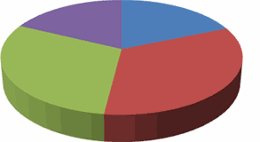
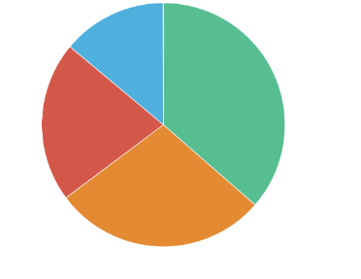
PIECHARTS :- A Pie Chart is a circular chart which is divided into sectors in which the area of each sector represents the size of the data. It is also known as circle graph. In a circle, there are 360 degree in a circle so each group in the pie chart will be a proportion of 360 degree.
Pie charts are popular ways of presenting categorical data. Although the principles used in the construction of these charts are relatively simple, thought and care are necessary to convey the correct message.
For example, dividing the circle into too many categories can be confusing and misleading. As a rule of thumb, no more than six sectors should be used. Another problem with pie charts is that it is not always easy to differentiate two segments that are reasonably close in size, whereas in the bar graph, values close in size are easily differentiated, since length is the critical feature.
15-09-2024
30

Slide 31
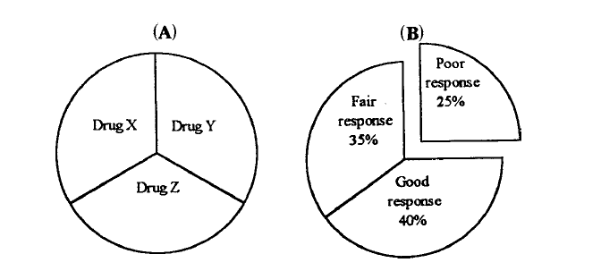
The circle (or pie) represents 100%, or all of the results. Each segment (or slice of pie) has an area proportional to the area of the circle, representative of the contribution due to the particular segment.
In the example shown in Figure (A), the pie represents the anti-inflammatory drug market. The slices are proportions of the market accounted for by major drugs in this therapeutic class. These charts are frequently used for business and economic descriptions, but can be applied to the presentation of scientific data in appropriate circumstances. Figure (B) shows the proportion of patients with good, fair, and poor responses to a drug in a clinical trial.
15-09-2024
31

Slide 32
CONSTRUCTION AND LABELLING OF PIE CHART
In a pie chart, the various observations or components are represented by the sectors of a circle and the whole circle represents the sum of the values of all components.
The central angle for a component is given by:
Central angle for a component = Value of the component × 360 °
Sum of the values of all components
Calculate the central angle for each component, given in above formula
Draw a circle of convenient radius.
Within this circle, draw a horizontal radius.
Starting with the horizontal radius, draw radii making central angles corresponding to the values of the respective components, till all the components are exhausted. These radii divide the whole circle into various sectors.
5. Shade each sector with different design and This will be the required pie chart for the given data.
15-09-2024
32

Slide 33
Example :- There are 216 workers in a company as per list given below:
Cadre | Labourer | Mechanic | Fitter | Supervisor | Clerk
No. of Workers | 75 | 60 | 36 | 27 | 18
Represent the above data by a pie chart.
Solution:
Total number of workers = 216.
Central angle for a cadre = Number of workers in that cadre
Total number of workers × 360°
Calculation of central angles
Cadre | No. of Workers | Central Angle
Labourer | 75 | (^{⁷⁵/}_{₂₁₆ × 360)° = 125°}
Mechanic | 60 | (^{⁶0/}_{₂₁₆ × 360)° = 100°}
Fitter | 36 | (^{³⁶/}_{₂₁₆ × 360)° = 60°}
Supervisor | 27 | (^{²⁷/}_{₂₁₆ × 360)° = 45°}
Clerk | 18 | (^{¹⁸/}_{₂₁₆ × 360)° = 30°}
15-09-2024
33

Slide 34
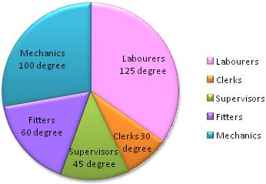
Steps of construction:
1. Draw a circle of any convenient radius.
2. Draw a horizontal radius of this circle.
3. Draw sectors starting from the horizontal radius with central angles of 125 degree, 100 degree, 60 degree, 45 degree and 30 degree respectively.
4. Shade the sectors differently using different colors and label them.
Thus, we obtain the required pie chart, as shown in the given figure.

Slide 35
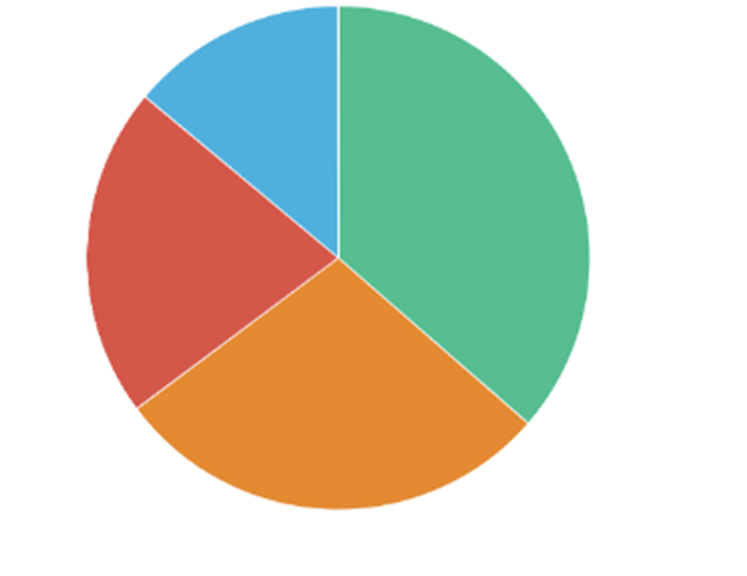
TYPES OF PIE CHART
2 D PIE CHART
3 D PIE CHART
DOUGHNUT PIE CHART
2 DIMENSIONAL PIE CHART
The pie 2D chart comprises of a circle that is divided into sectors, each representing a proportion of the summation of all values in a dataset. The chart is useful in depicting the share of constituents as part of the whole. The magnitude of the dependent variable is proportional to the length of the arc on the circumference of the graph. Radial lines are used to connect the arcs to the center of the circle, thus dividing the pie into slices. It is used to show the percentage split or contribution of for instance split of sales by product category, or market share of brands in a particular industry.
15-09-2024
35

Slide 36
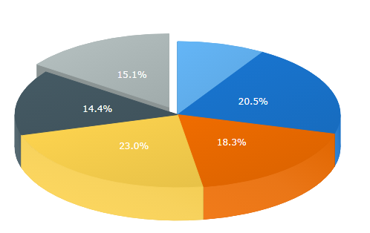
B. 3 DIMENSIONAL PIE CHART
3D Pie Chart is a simple Pie Chart with a 3D feature enabled. As 3D charts are becoming more and more popular, our charts have this feature and can be turned from flat into 3D easily, but we recommend you to use this feature carefully as using 3D might affect the perception of information.
Pie Charts are circular charts, each of which sectors represents a proportion of the whole. Note that there can be no zero or negative values and Pies are not reliable for displaying a big array of data – it’s recommended to have no more than seven points in a Pie.
15-09-2024
36

Slide 37
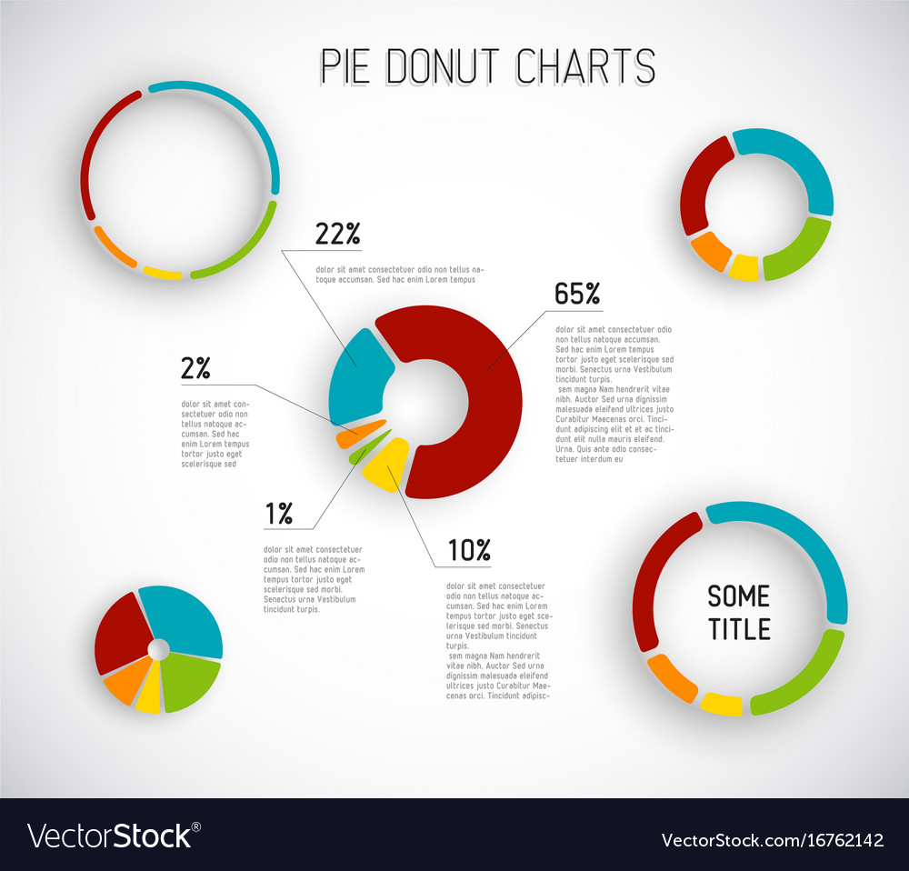
C. Doughnut Pie chart
A doughnut plot (aka donut plot) is simply a pie chart with a central circle removed. For the most part, there aren’t significant differences in readability between a pie chart and donut chart, so the choice of a doughnut over a standard circle is mostly that of aesthetic. One small boon for the ring shape is that the central area can be used for additional information or to report statistics.
15-09-2024
37

Slide 38
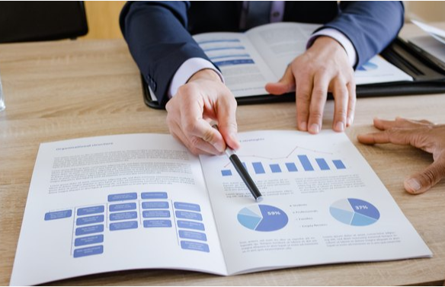
OVERVIEW OF PIE CHAET
A pie chart is a two-dimensional circle, at its most basic, divided into a few slices. As a whole, the chart represents the sum of all its data; individual slices represents a percentage of the whole. For example, if you create a pie chart which shows product line performance, your pie chart will simply have two halves, when you have two lines that each account for 50 percent of turnover. The most prominent effects such as three-dimensional charting, dragging slices, slice pivoting of charts adds more visually appealing.
Advantages
Display relative proportions of multiple classes of data
Size of the circle can be made proportional to the total quantity it represents
Summarize a large data set in visual form
Be visually simpler than other types of graphs
Permit a visual check of the reasonableness or accuracy of calculations
15-09-2024
38

Slide 39
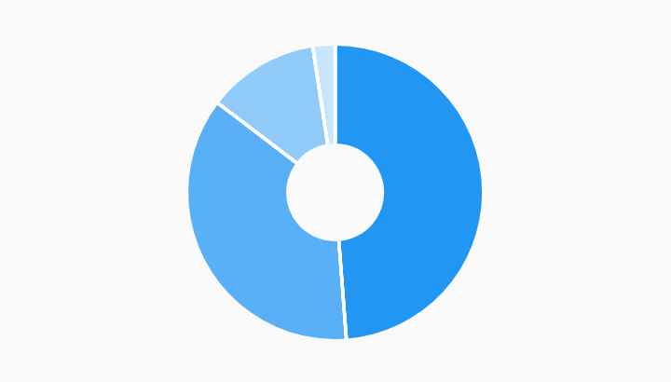
A pie chart presents data as a simple and easy-to-understand picture.
It can be an effective communication tool for even an uninformed audience, because it represents data visually as a fractional part of a whole.
Readers or audiences see a data comparison at a glance, enabling them to make an immediate analysis or to understand information quickly.
This type of data visualization chart removes the need for readers to examine or measure underlying numbers themselves, so it's a good way of presenting data that might otherwise appear in a table.
You can also manipulate pieces of data in the pie circle to emphasize points you want to make.
15-09-2024
39

Slide 40

Disadvantages
Do not easily reveal exact values.
Many pie charts may be needed to show changes over time.
Fail to reveal key assumptions, causes, effects, or patterns.
Be easily manipulated to yield false impressions.
A pie chart becomes less effective if it uses too many pieces of data. For example, a chart with four slices is easy to read; one with more than 10 becomes less so, especially if it contains many similarly sized slices.
Adding data labels and numbers may not help here, as they themselves may become crowded and hard to read. This kind of chart only represents one data set – you'd need a series of pie charts to compare multiple sets. This may make it more difficult for readers to analyze and assimilate information quickly.
Comparing data slices in a circle also has its problems, because the reader has to factor in angles and compare non-adjacent slices. Data manipulation within the chart's design may lead readers to draw inaccurate conclusions or to make decisions based on visual impact rather than data analysis.
15-09-2024
40

Slide 41
Uses of a Pie Charts
At its most basic, a pie chart is a two-dimensional circle divided into a few slices.
The chart as a whole represents the sum of all its data; individual slices show each piece of data as a percentage of the whole. If you create a pie chart showing product line performance, for example, and you have two lines that each account for 50 percent of turnover, your pie chart will simply have two halves.
If there were a 75/25 split, the bigger line would take up three quarters of the chart, leaving one quarter for the other. Effects such as three-dimensional charting, slice pivoting and dragging slices out of the circle adds emphasis to individual data sets and makes charts more visually appealing
15-09-2024
41

Slide 42
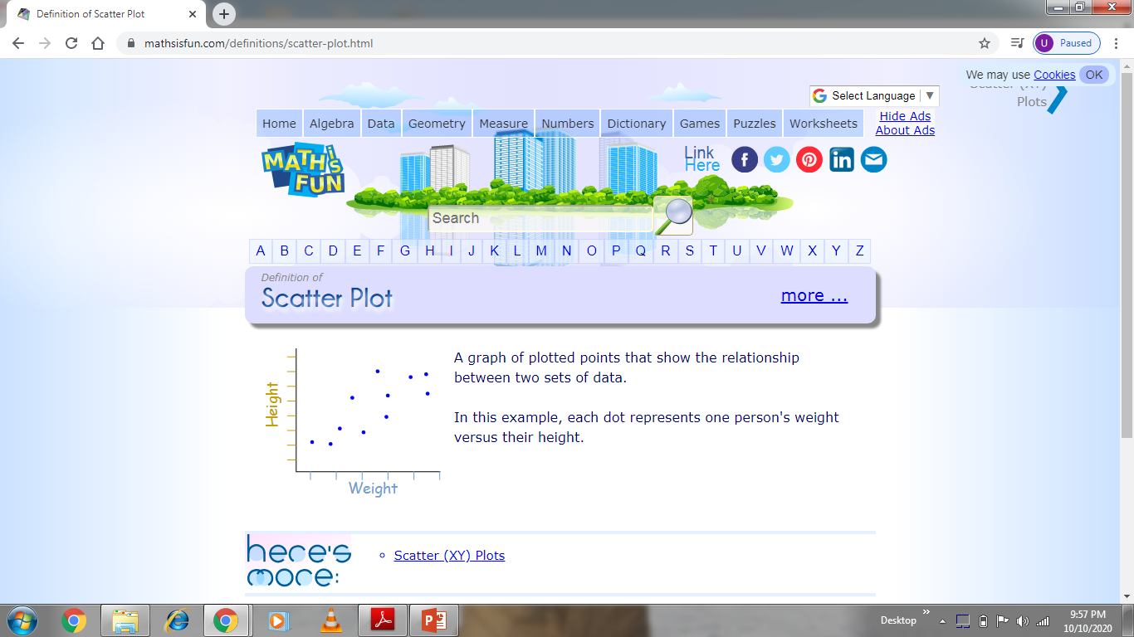
SCATTER PLOTS (CORRELATION DIAGRAMS)
Scatter plots (also called correlation diagrams or scatter diagrams) at this time. This type of plot or diagram is commonly used when presenting results of experiments. A scatter diagram is a graphic representation of the relationship between two variables. Scatter diagrams help teams identify and understand cause-effect relationships.
A typical scatter plot is illustrated in Figure .Data are collected in pairs (X and Y) with the objective of demonstrating a trend or relationship (or lack of relationship) between the X and Y variables. Usually, we are interested in showing a linear relationship between the variables (i.e., a straight line). For example, one may be interested in demonstrating a relationship (or
correlation) between time to 80% dissolution of various tablet formulations of a particular drug.
A graph of plotted points that show the relationship between two sets of data.
In this example, each dot represents one person's weight versus their height.
15-09-2024
42

Slide 43
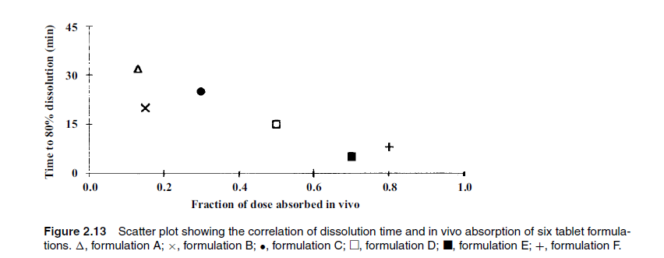
and the fraction of the dose absorbed when human subjects take the various tablets. The data plotted in Figure show pictorially that as dissolution increases (i.e., the time to 80% dissolution decreases) in vivo absorption increases. Scatter plots involve data pairs, X and Y, both of which are variable. In this example, dissolution time and fraction absorbed are both random variables.
15-09-2024
43

Slide 44
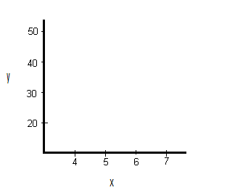
CONSTRUCTION AND LABELLING OF SCATTER PLOTS
Example :-Create a scatter plot for the following data:
X | Y
3 | 25
4.1 | 25
5 | 30
6 | 29
6.1 | 42
6.3 | 46
Step 1: Draw a graph. Label the x- and y- axis. Choose a range that includes the maximums and minimums from the given data. For example, our x-values go from 3 to 6.3, so a range from 3 to 7 would be appropriate.
15-09-2024
44

Slide 45
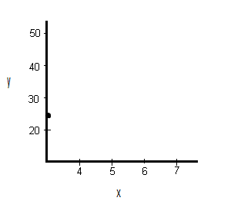
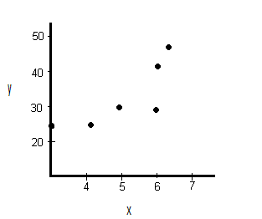
Step 2: Draw the first point on the graph. Our first point is (3,25)
Step 3:. Draw the remaining points on the graph.
15-09-2024
45

Slide 46
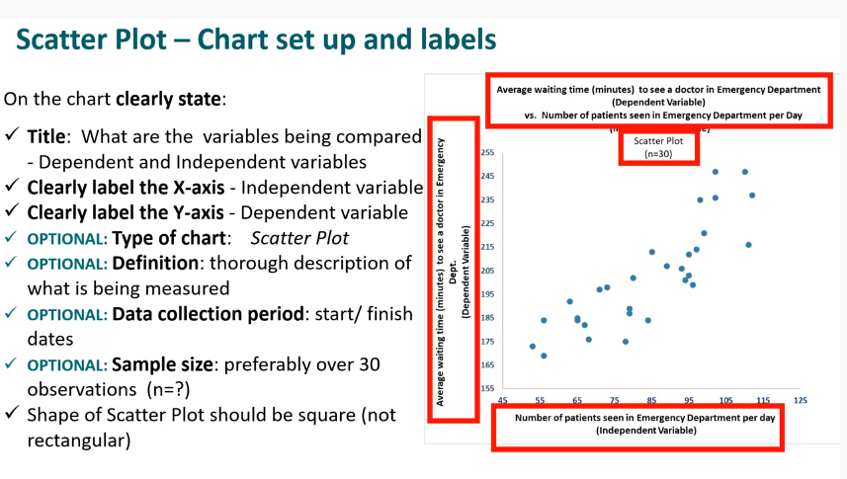
15-09-2024
46

Slide 47
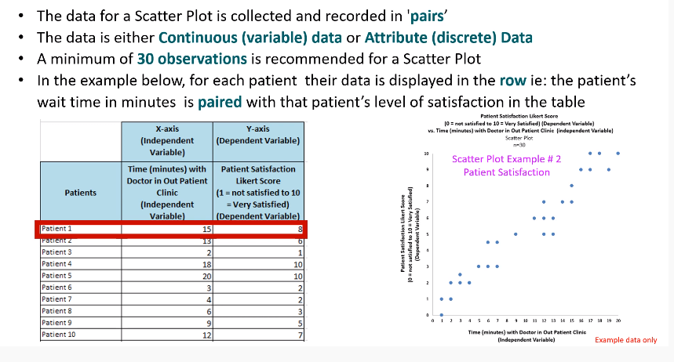
15-09-2024
47

Slide 48
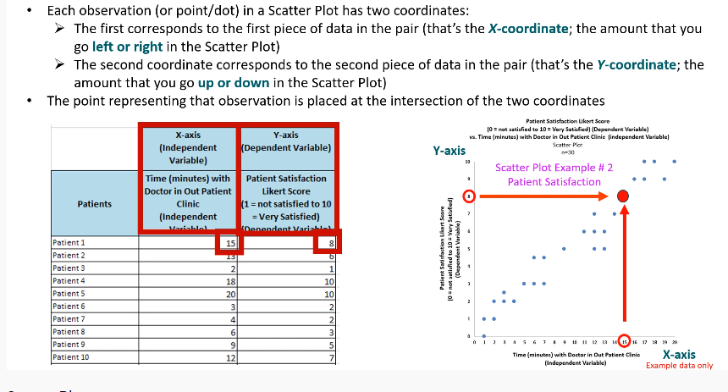
15-09-2024
48

Slide 49

USES OF SCATTER PLOTS
Scatter plots can be used to show how data is correlated or how one set of date depends on another. In medical research, scatter plots can be useful to see whether data may have a relationship. When there is a correlation between two sets of data, dots on a scatter plot will tend to cluster around a line. This can be useful when determining whether a studied medical phenomenon -- like death or disease -- is being caused by a particular disease.
A scatter plot is a type of graph that uses an X-Y coordinate system to show values for a set of data. They show how one variable is related to another variable. Many different types of careers employ the use of scatter plots, including jobs in government and in the private sector.
3. Rates, Ratios and percentage change
Rate: a measure, quantity, or frequency, typically one measured against another quantity or measure. Eg Heart Rate in Beats Per Minute (BPM)
Ratio: A comparison of one quantity with another in the same units.
4. Concentration
A concentration of a drug/medicine is the amount of drug compared to the whole solution, expressed as a rate in mass/volume. E.g. 50mg/mL means 50mg of drug per mL of solution
15-09-2024
49

Slide 50
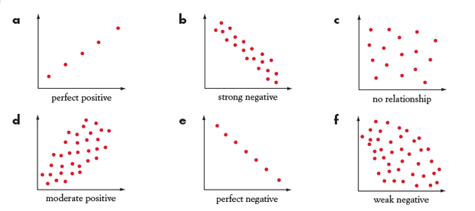
5. Medicine dosage
Medicines can be taken as a liquid, tablet, or IV drip (amongst other ways). A medicine dosage refers to the amount of medicine to be taken. Different formulas exist for calculating the correct dosage, e.g. Fried, Young, and Clark's formulas for calculating dosage for children.
6. Scatter plots of body measurements
A scatter plot is a graph of different points on a number plane. Each point represents two different variables, so scatter plots represent bivariate data (data relating to two values). We can determine the strength and direction of a relationship from a scatter plot
15-09-2024
50

Slide 51
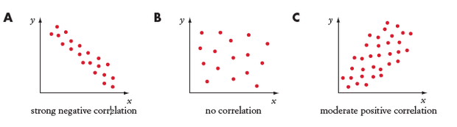
7. Correlation
If two variables are placed on a scatter plot and have a linear relationship they are said to be correlated. Correlation is a measure of the strength of a linear relationship.
However, just because two events are correlated, doesn't mean one event causes another.
15-09-2024
51

Slide 52
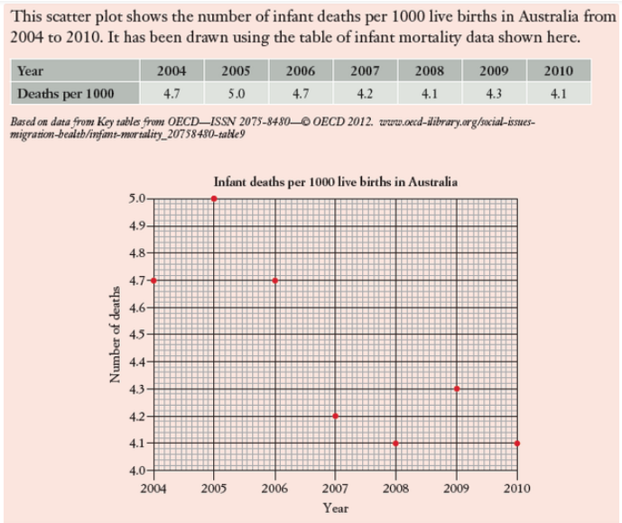
8. Scatter plots of life expectancy
15-09-2024
52

Slide 53
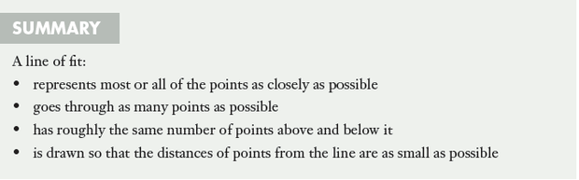
9. Least-squares lines of best fit
If two variables (x and y) that are graphed on a number plane show a strong linear correlation we can approximate the correlation by drawing a line of fit through the points and finding its equation y=mx + b
Least squares regression line
A line of best fit drawn on a scatter plot is called a regression line. The equation of this line represents all data points. Regress means 'to go back' so the points on the scatter plot are 'returning' to the regression line
15-09-2024
53

Slide 54
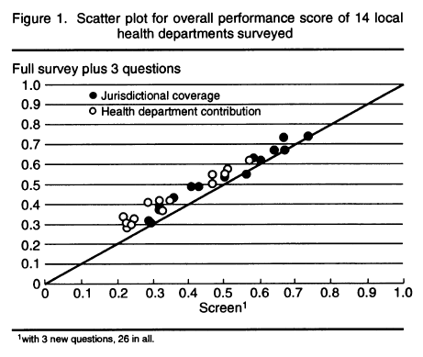
Example of Scatter Plots
1. A Screening Survey to Assess Local Public Health Performance This scatter plot, shows the correlation between survey responses and screening queries for an assessment of local public health performance.
15-09-2024
54

Slide 55
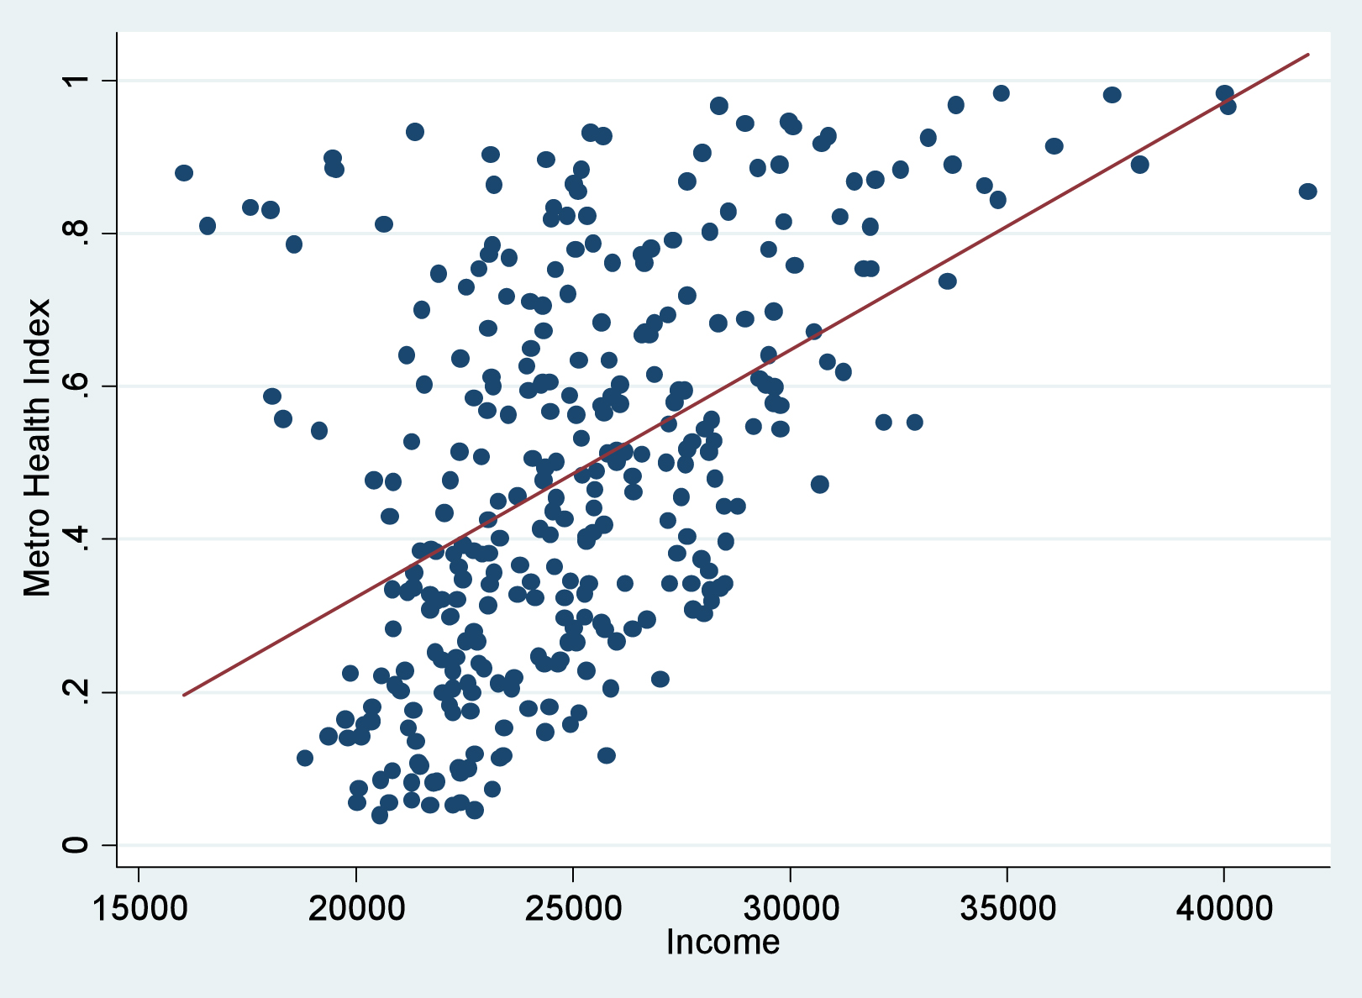
2. Why Some Cities are Healthier than Others
This scatter plot from The Atlantic Cities (2012) plots a city's "Metro Health Index" (a factor measuring the share of people who smoke or are obese) as it correlates to the city's median income. Note that the plot does not prove causation between income and health in this instance—just that the two are related.
15-09-2024
55

Slide 56
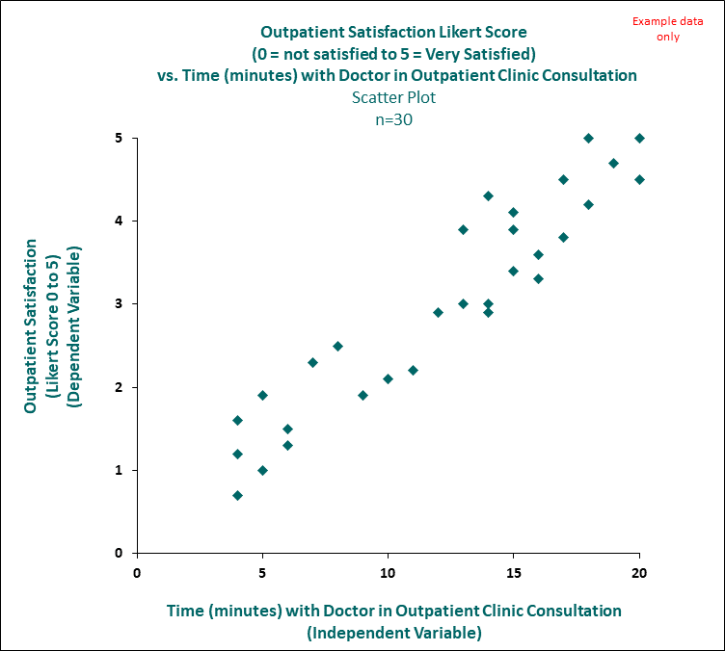
3. Is there a relationship between the length of time of a consultation with a doctor in outpatients and the patients level of satisfaction? The closer the points hug together the more closely there is a one to one relationship.
15-09-2024
56

Slide 57
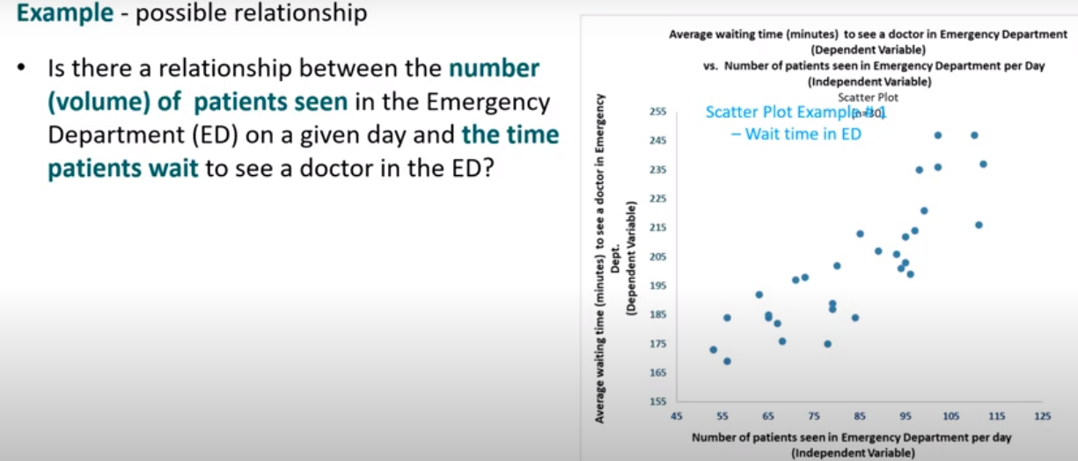
Example 4
15-09-2024
57

Slide 58
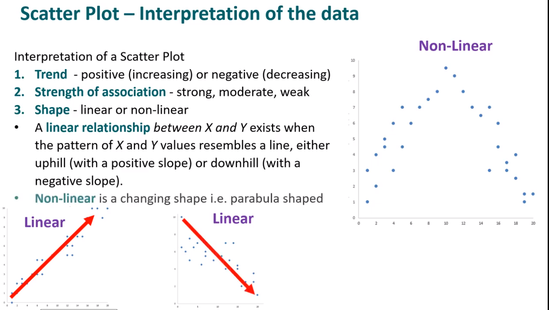

Slide 59

15-09-2024
59

Slide 60

ADVANTAGES
Clearly indicates data correlation (illustrates positive, negative, strong, weak relationships); method of illustration non-linear patterns; shows spread of data, outliers; clearly demonstrate atypical relationships; used for data extrapolation and interpolation
Scatter Diagrams are easy to draw.
It can be easily understood and interpreted.
Values of extreme items do not affect this method. Such points are always isolated in diagram.
DISADVANTAGES
These (sometimes ) diagrams are unable to measure the precise extent of correlation.
It is not a quantitative measure of the relationship between the variables. It is only a quantitative expression of the quantitative change.
Can conceal overprinting which can be significant for multimodal data
With large no of data points reveals little structure
15-09-2024
60

Slide 61
WHEN TO USE A SCATTER PLOT ?
A scatter chart works best when comparing large numbers of data points without regard to time. This is a very powerful type of chart and good when your are trying to show the relationship between two variables (x and y axis).
The type of data used in this chart is generally statistical or scientific, and can suggest various kinds of correlation between the variables. In this type of chart the closer the plotted points are to making a straight line the stronger the relationship is between the two variables.
There are different types of correlation that a scatter chart will show. Correlations have two properties, direction and strength. The direction is determined by whether the correlation is positive or negative and the numeric value is determined by the strength of a correlation.
There are generally three types of correlation to look for:
Positive - This is when the variables move in the same direction. As one variable increases so does the other. Height and shoe size as an example are positively correlated.
Negative - This is when the variables move in opposite directions. As one variable increases, the other decreases. Time spent studying and time spent on playing games as an example are negatively correlated.
No correlation - There is when there is no apparent relationship between the variables. Video game scores and yearly salary as an example will appear to have no correlation; as one increases, the other has no effect.
15-09-2024
61

Slide 62

15-09-2024
62

Slide 63


SEMI LOGARATHIMIC PLOT
A semi logarithmic plot is a graphical representation of a time series. It is defined by an arithmetic scale of time t plotted on the abscissa axis and a logarithmic scale plotted on the ordinate axis, meaning that the logarithm of the observed value Yt will be transcribed in ordinate on an arithmetic scale. In general, printed semi logarithmic sheets of paper are used. In a semi logarithmic graph, one axis has a logarithmic scale and the other axis has a linear scale.
15-09-2024
63

Slide 64

In the following set of axes, the vertical scale is logarithmic (equal scale between powers of 10) and the horizontal scale is linear (even spaces between numbers).
There are no negative numbers on the y-axis, since we can only find the logarithm of positive numbers.
NOTE: The numbers on the y-axis become too close together near each integral power of 10, so they have been removed for readability.

Slide 65

Semi-log plots of plasma concentration versus time data after IV bolus administration of compound: concentrations decrease in either a monoexponential/monophasic (A) or multiexponential/biphasic (B) decline. The PK profile illustrated in panel (A) is consistent with drug distribution into a single compartment similar to that illustrated in Fig. In panel (B), the PK profile is consistent with tissue binding and drug distributed in more than one compartment.
15-09-2024
65

Slide 66
Several important kinds of experiments in the pharmaceutical sciences result in data such that the logarithm of the response (Y) is linearly related to an independent variable, X. The semi logarithmic plot is useful when the response (Y) is best depicted as proportional changes relative to changes in X, or when the spread of Y is very large and cannot be easily depicted on a rectilinear scale.
Semi log graph paper has the usual equal interval scale on the X axis and the logarithmic scale on the Y axis. In the logarithmic scale, equal intervals represent ratios. For example, the distance between 1 and 10 will exactly equal the distance between 10 and 100 on a logarithmic scale. In particular, first-order kinetic processes, often apparent in drug degradation and pharmacokinetic systems, show a linear relationship when log C is plotted versus time.
First-order processes can be expressed by the following equation:
log C = log C0 − kt
2.3
where C is the concentration at time t, C0 the concentration at time 0, k the first-order rate
constant, t the time, and log represents logarithm to the base 10.
15-09-2024
66

Slide 67


Table shows blood-level data obtained after an intravenous injection of a drug described by a one-compartment model
Figure shows two ways of plotting the data in Table to demonstrate the linearity of the log C versus t relationship
15-09-2024
67

Slide 68
Figure (A) shows a plot of log C versus time. The resulting straight line is a consequence of the relationship of log concentration and time as shown in First order process Equation .This is an equation of a straight line with the Y intercept equal to log C0 and a slope equal to −k/2.3
Figure (B) shows a more convenient way of plotting the data of Table , making use of semi log graph paper. This paper has a logarithmic scale on the Y axis and the usual arithmetic, linear scale on the X axis. The logarithmic scale is constructed so that the spacing corresponds to the logarithms of the numbers on the Y axis. For example, the distance between 1 and 2 is the same as that between 2 and 4. (Log 2−log 1) is equal to (log 4−log 2). The semi log graph paper depicted in Figure (B) is two-cycle paper.
The Y (log) axis has been repeated two times. The decimal point for the numbers on the Y axis is accommodated to the data. In our
example, the data range from 1.25 to 20 and the Y axis is adjusted accordingly, as shown in Figure (B). The data may be plotted directly on this paper without the need to look up the logarithms of the concentration values.
Consequently, a semilog-scale line graph has the following features:
The slope of the line indicates the rate of increase or decrease.
A straight line indicates a constant rate (not amount) of increase or decrease in the values.
A horizontal line indicates no change.
Two or more lines following parallel paths show identical rates of change.
15-09-2024
68

Slide 69


ILLUSTRATION – CONSTRUCTION EXAMPLE
A laboratory conducted some observations in an experiment involving growth of a microbial population at different temperatures and obtained data as follows:
15-09-2024
© R R INSTITUTIONS , BANGALORE
69

Slide 70


Now we can see a lot more information for smaller values of x and y. This is the beauty of semi-logarithmic axis plots - you can see more detail in graphs where there is a very wide range of values, but some of the data is close together.
15-09-2024
70

Slide 71
Example 1 ;- COVID – 19
Exponential lines showing increases in COVID-19 cases might not always show the full story. While the raw numbers don’t change, the way they are represented can affect perceptions. Logarithmic scale charts can help show the bigger picture.
The coronavirus pandemic is undoubtedly the greatest challenge the world has faced in over a generation. But is the presentation of data about the outbreak leading us to overlook any cause for optimism?
There is an alternative to the commonly seen linear graph that could help give a more detailed picture. It’s called a logarithmic graph.
Interpreting information - The most common form of a line-graph has a linear scale. Along the Y axis, the numbers progress in a steady, linear form – 1, 2, 3, 4, or 10, 20, 30 and so on
But infectious diseases don’t spread in an even, linear fashion. On a linear scale graph, the rate of growth keeps going up and up – the line can become almost vertical and appear to go on forever. That can create the impression measures like social distancing aren’t working.
On a logarithmic scale, numbers on the Y-axis don’t move up in equal increments but instead each interval increases by a set factor – it’s often 10 but could be a factor of 3 or 350 or 3,500, anything at all. It all depends on what is deemed to be the most effective way of interpreting the data in question. The Richter scale is logarithmic – an earthquake that measures 6 is 10- times more destructive than one that measures 5.
The logarithmic scale is ideal for measuring rates of change, particularly rates of growth,
15-09-2024
71

Slide 72


It “flattens out the rate of growth so it becomes easier to see,", . "On a logarithmic graph of COVID-19 infections, even though the overall numbers are still increasing, you can see the point at which the rate of growth starts to level off when that exponential growth has stopped."
At that point, the logarithmic scale makes it possible to see when public health measures are starting to have the desired effect.
This is what the COVID-19 situation in China looks like when plotted on a linear graph.
15-09-2024
72

Slide 73
Same data, different perspectives
Both charts tell the same story – that China’s coronavirus cases have started to flatline. But the logarithmic graph shows a flattening of the line much earlier because of the way the scale has been compressed. It also makes it possible to fit a large or widespread set of results onto a graph that might otherwise not fit in a linear way.
A logarithmic graph can also help make it clear if the apparent evening-out of the curve started to change. While a linear curve would keep on pushing ever higher regardless, the logarithmic graph would highlight any substantial changes to the trend – whether upward or downward.
It’s an approach that is often preferred when there are huge numbers involved and a linear scale would just produce a dramatic-looking exponential curve.
The raw numbers aren’t affected by the choice of chart. The reality is that (as of 4 April 2020) there are more than 1 million confirmed cases globally and 55,000 deaths. But more than 219,000 people have also recovered – and that’s a part of the coronavirus story that’s just as important to tell.
15-09-2024
73

Slide 74

Example 2 :- The Western Africa Ebola virus disease epidemic
15-09-2024
74

Slide 75

15-09-2024
75

Slide 76
ADVANTAGES
semi log paper is very beneficial for us because when we get a big value of the experiment then we cannot put it easily to a general graph paper because we have to take more than two or three graph paper .so in semi log paper we can easily put the big value of the experiment because we know that log(1)=0.so when the value of log is greater than we can use it.
A wider range of data can be displayed
Increased data for smaller values
DISAVANTAGES
Easy to make errors plotting
Difficult to analyze
Zero cannot be plotted
Negative and positive values cannot be displayed on the same graph
15-09-2024
76

