Slide 1
BASICS OF TESTING HYPOTHESIS

Slide 2
LEVEL OF SIGNIFICANCE (PARAMETRIC DATA)
A parameter in statistics refers to an aspect of a population, as opposed to a statistic, which refers to an aspect about a sample. For example, the population mean is a parameter, while the sample mean is a statistic. A parametric statistical test makes an assumption about the population parameters and the distributions that the data came from. These types of test includes Student’s T tests and ANOVA tests, which assume data is from a normal distribution.
The opposite is a nonparametric test, which doesn’t assume anything about the population parameters. Nonparametric tests include, Fisher’s exact test and the Mann-Whitney test.
Every parametric test has a nonparametric equivalent. For example, if you have parametric data from two independent groups, you can run a 2 sample t test to compare means. If you have nonparametric data, you can run a Wilcoxon rank-sum test to compare means.
Parametric Data Definition
Data that is assumed to have been drawn from a particular distribution, and that is used in a parametric test

Slide 3
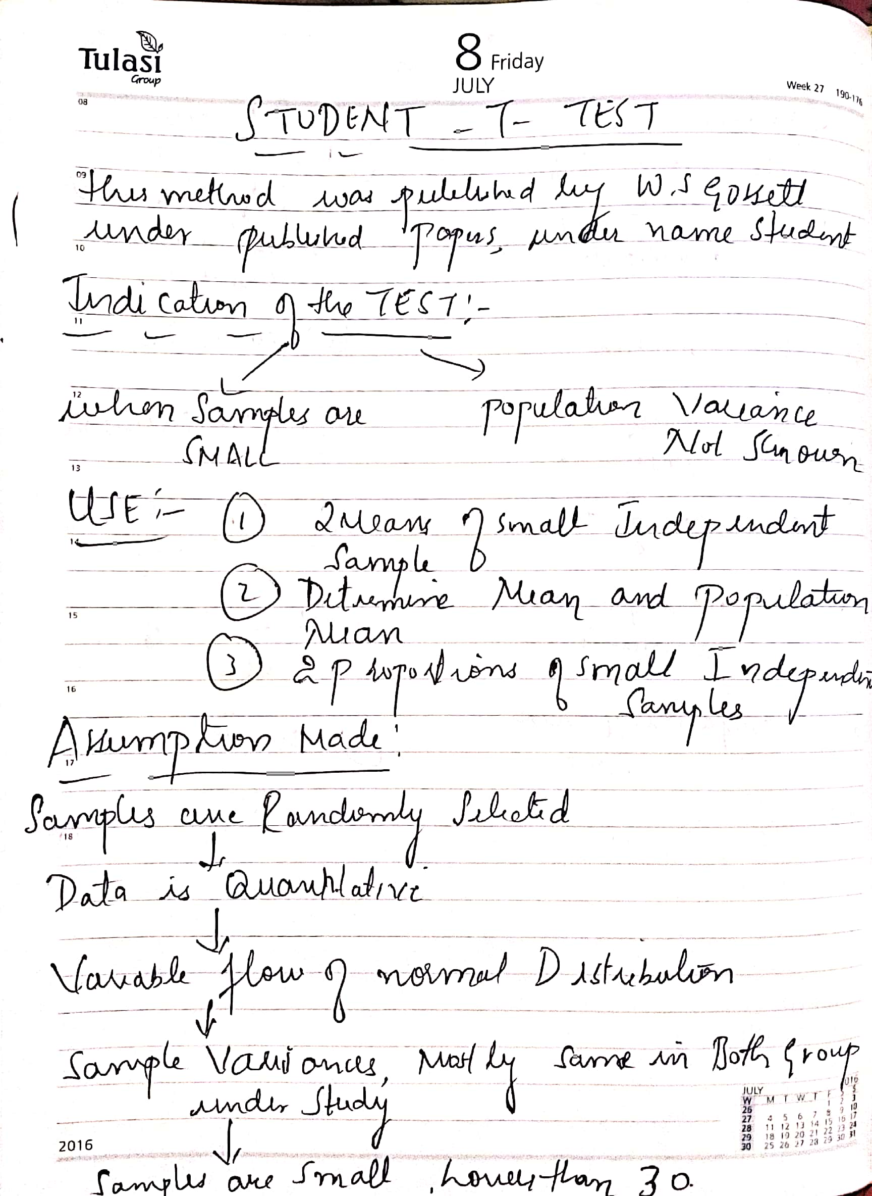

Slide 4
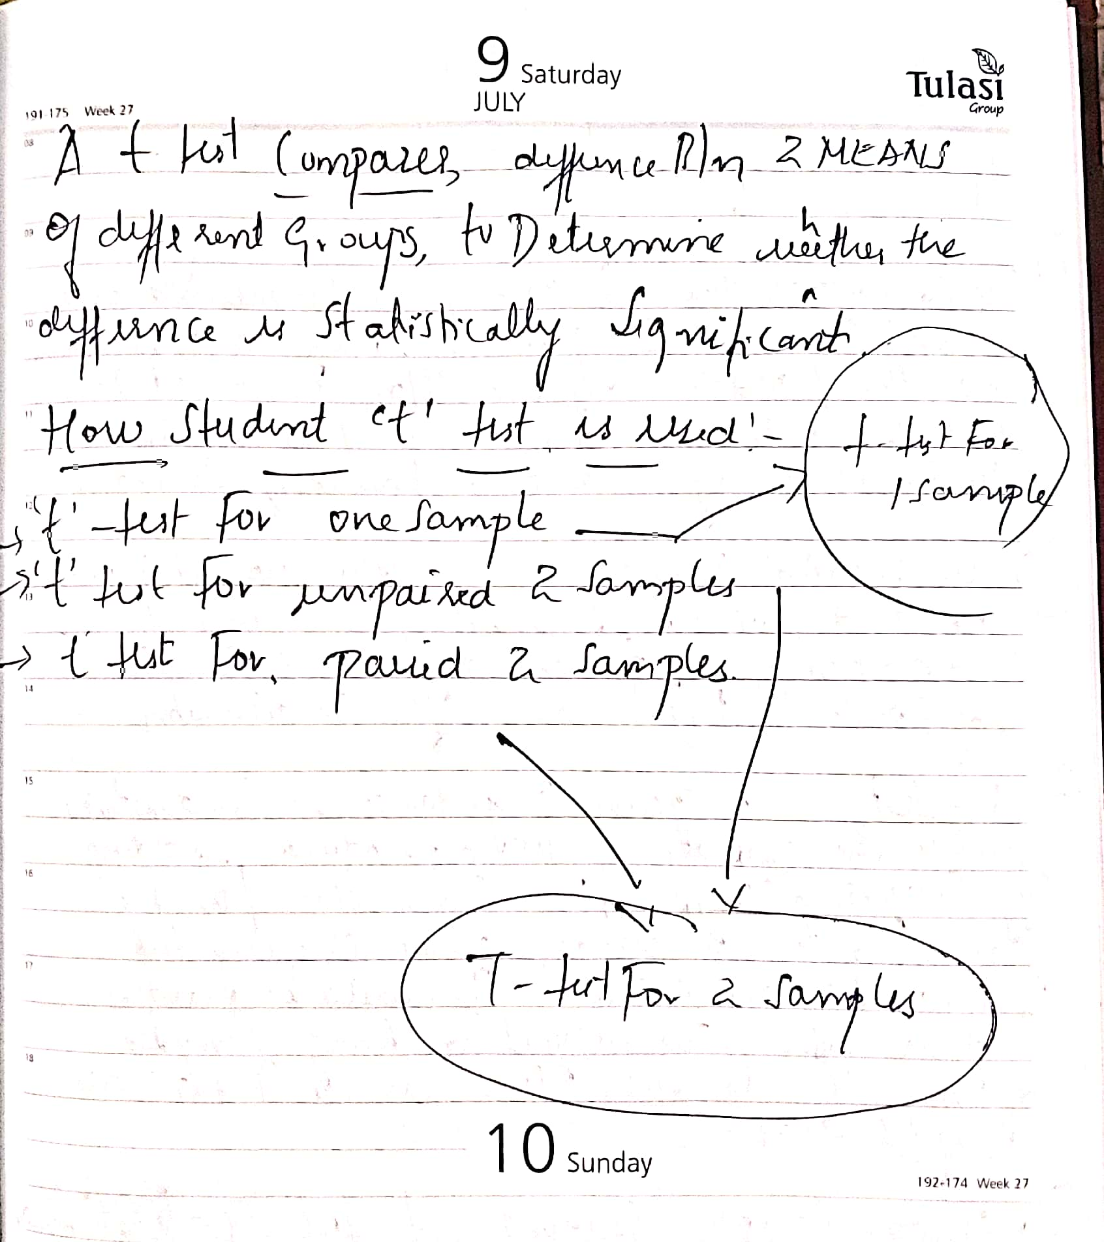

Slide 5
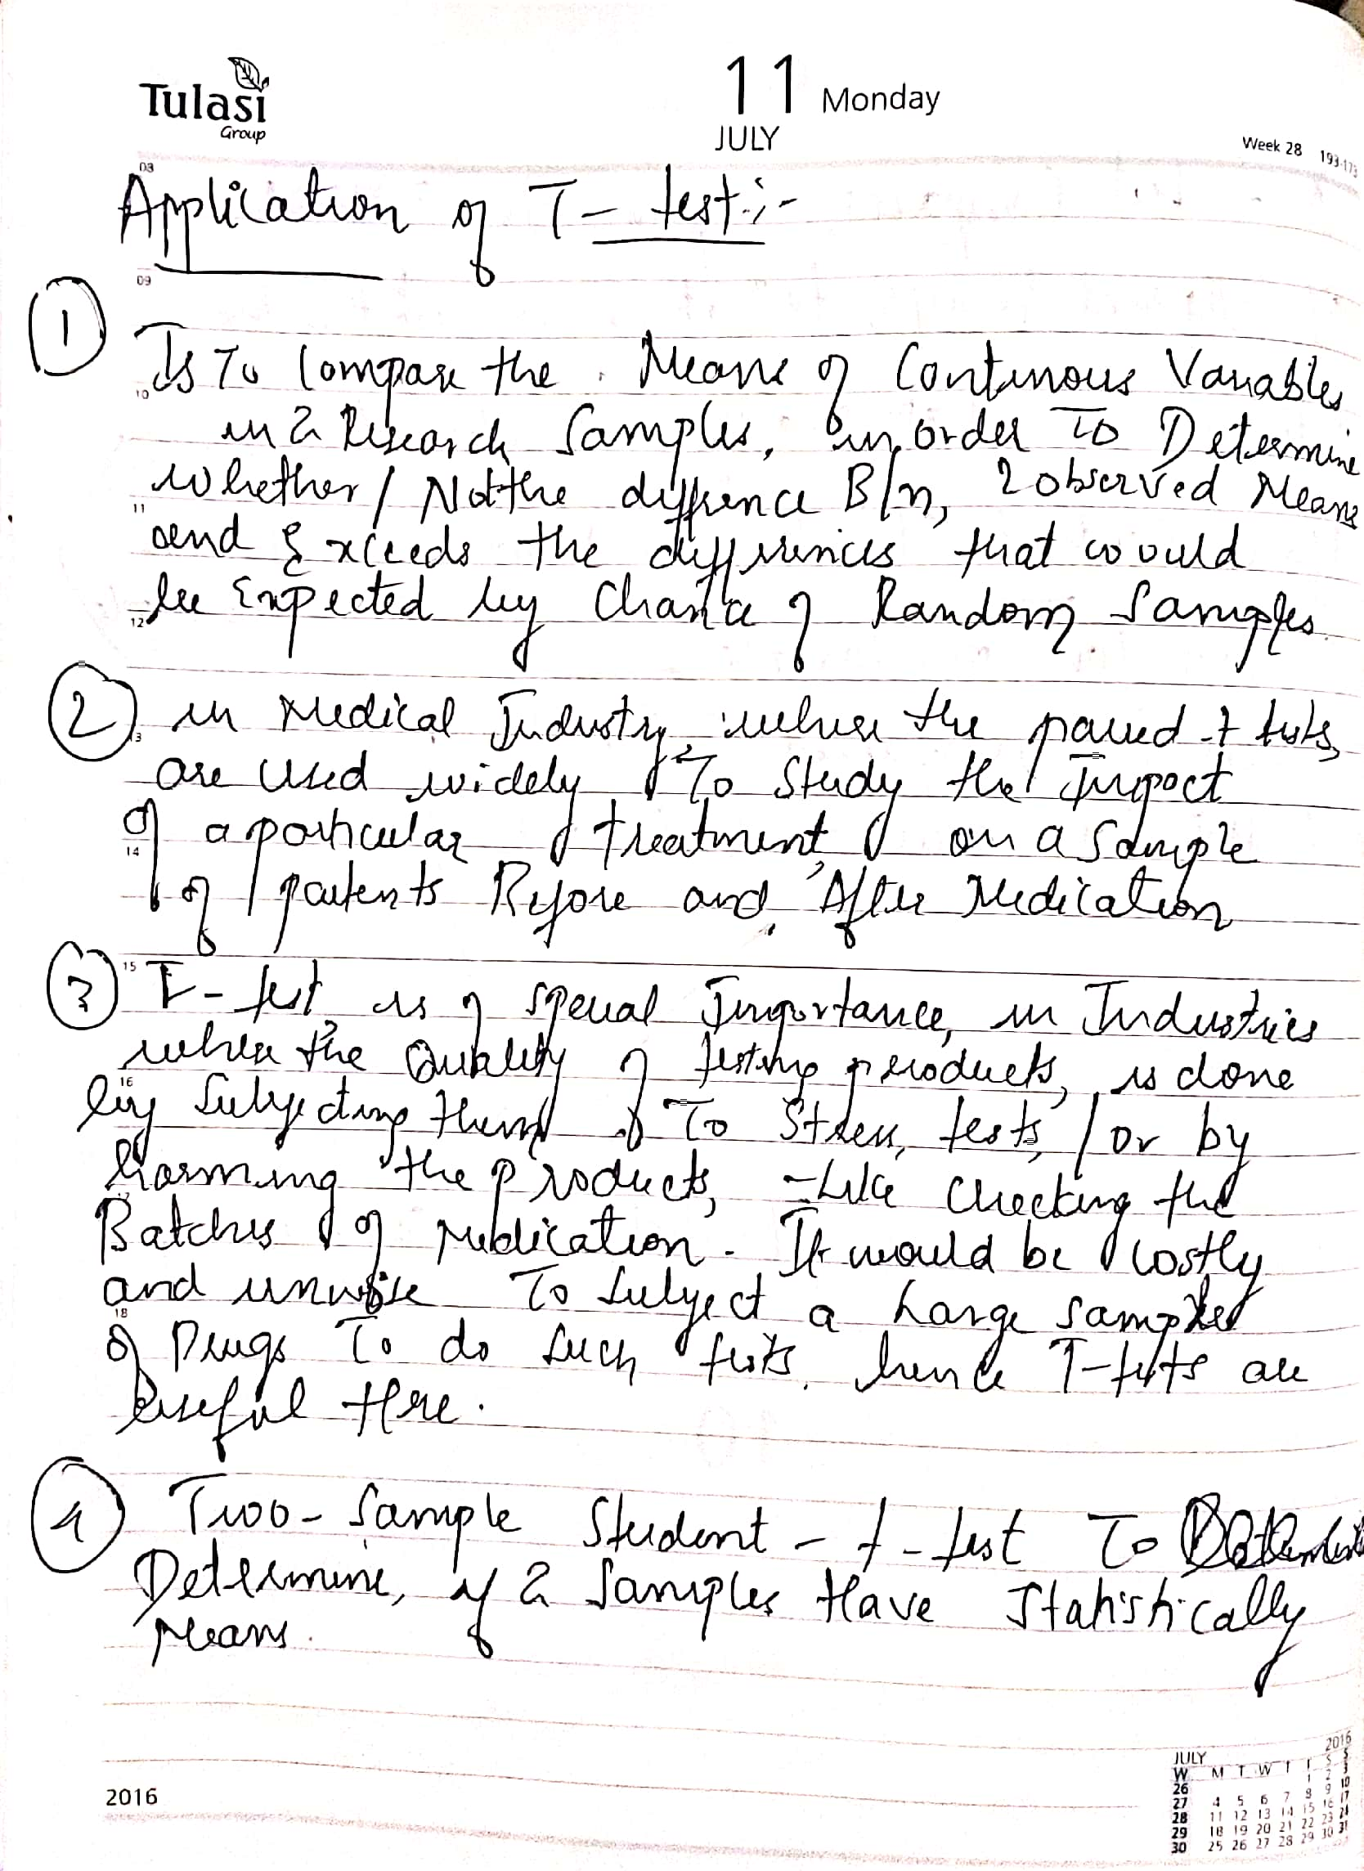

Slide 6
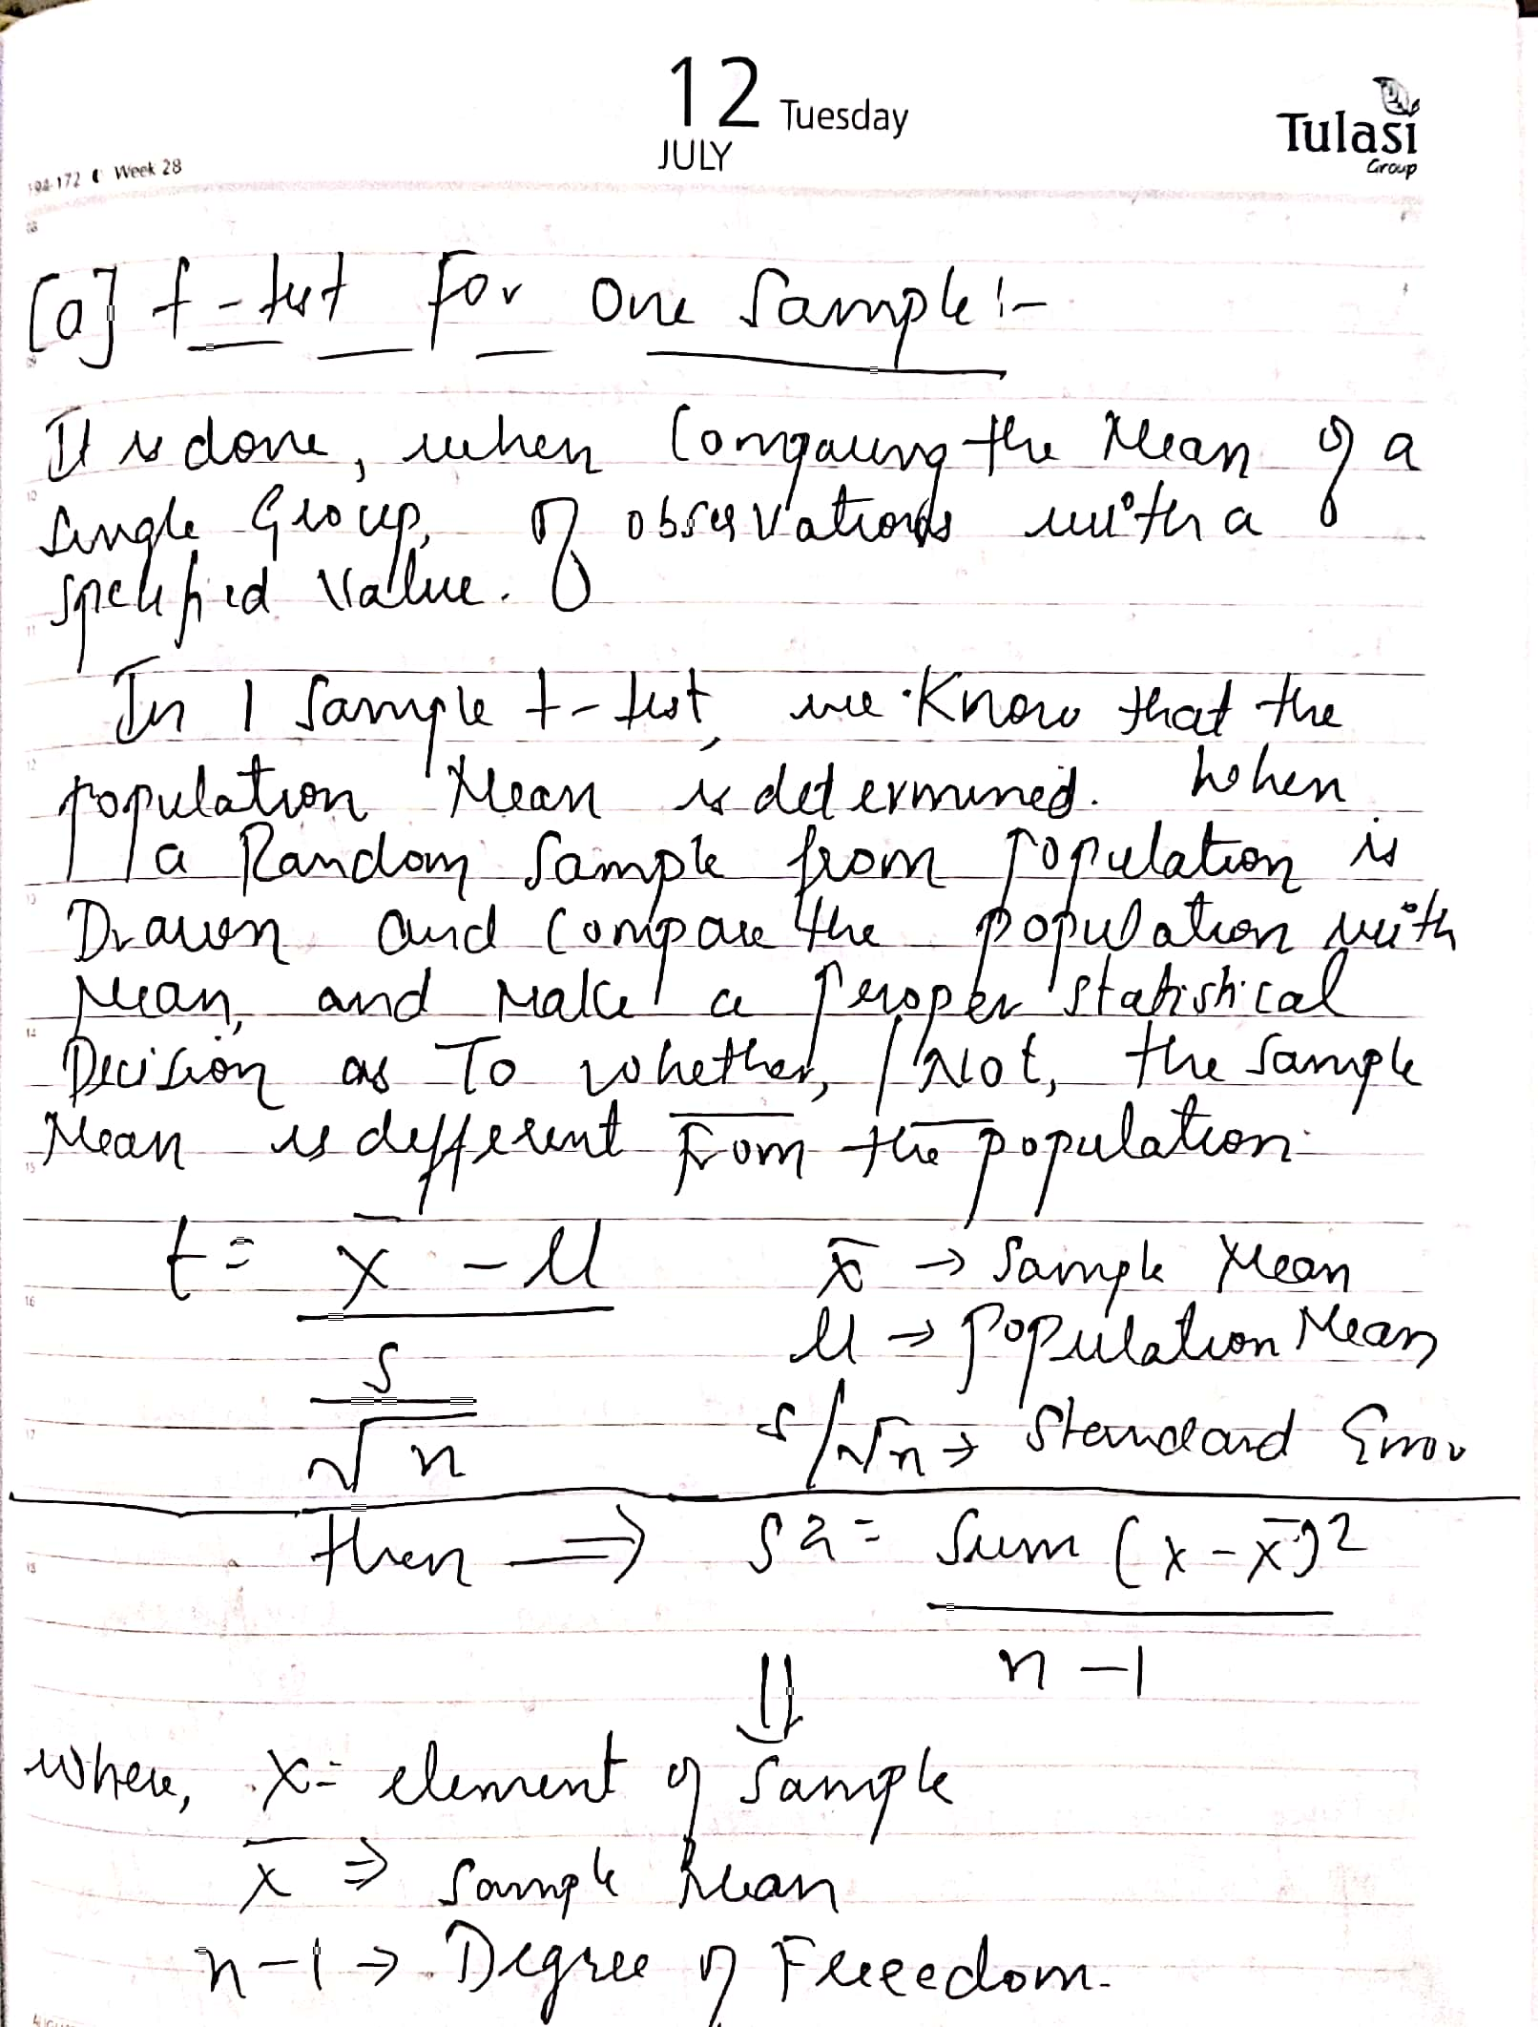

Slide 7
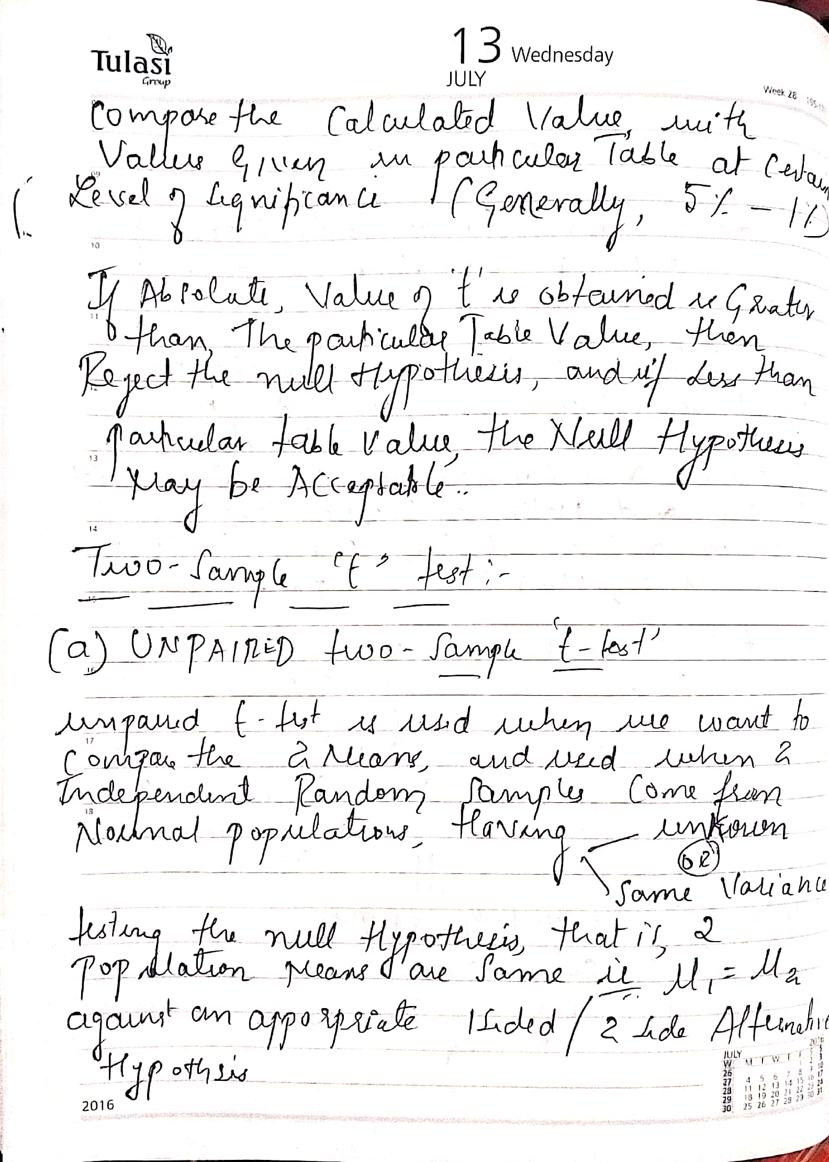

Slide 8
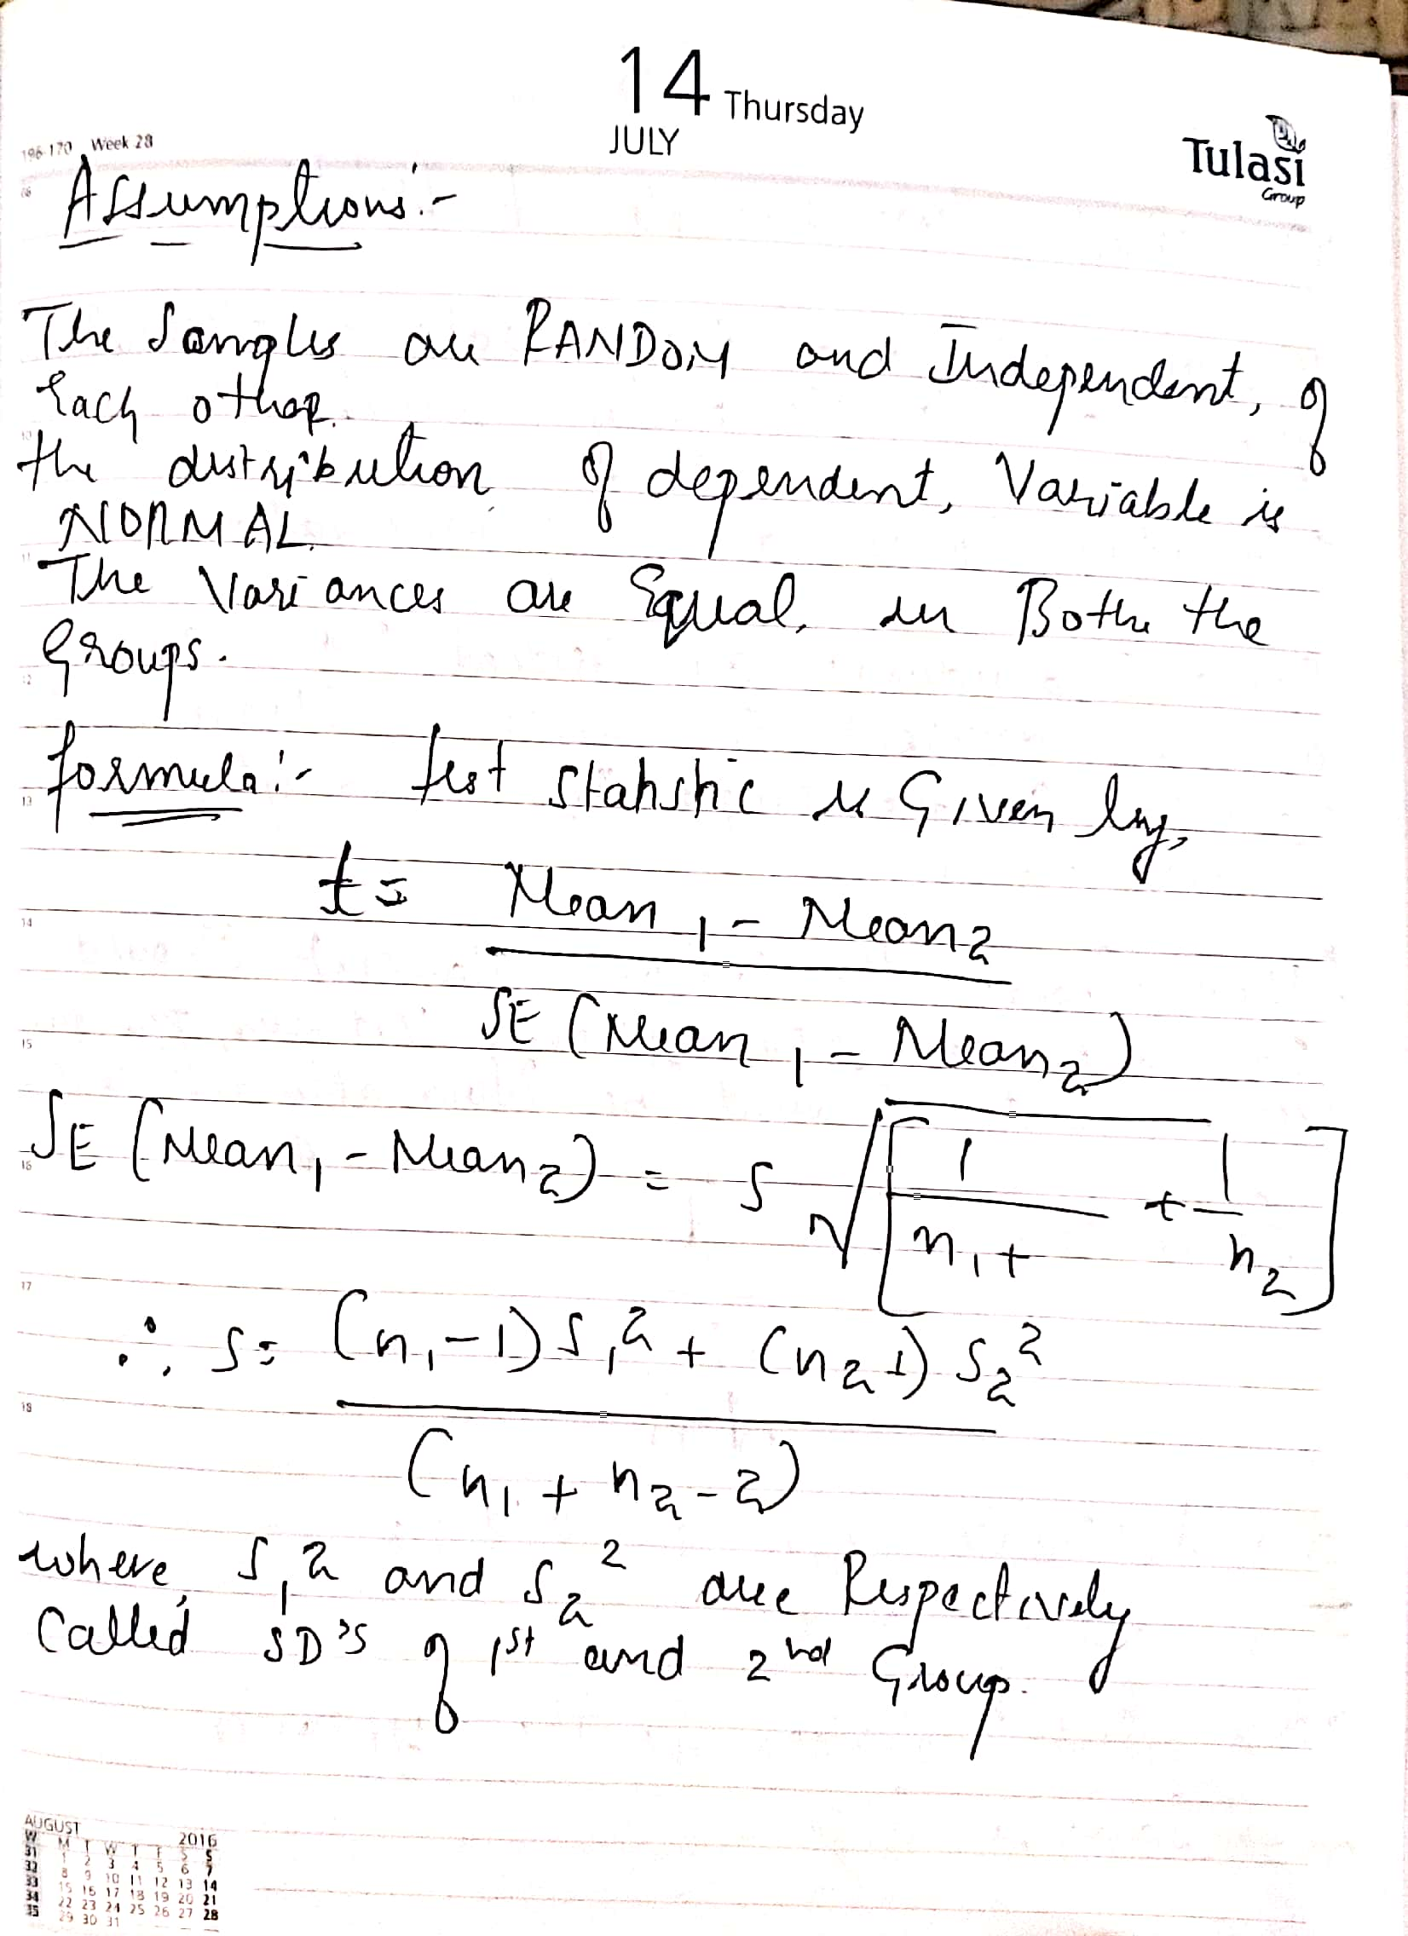

Slide 9
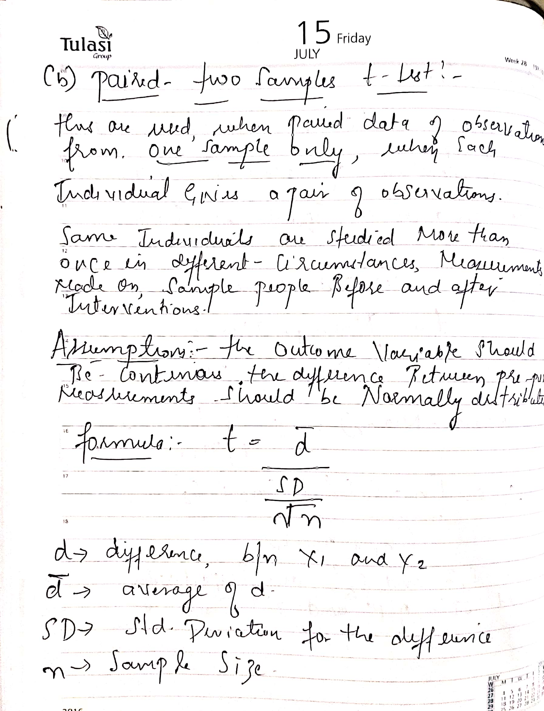

Slide 10

CHI SQUARE TEST
The Chi Square statistic is commonly used for testing relationships between categorical variables. The null hypothesis of the Chi-Square test is that no relationship exists on the categorical variables in the population; they are independent
The Chi-Square statistic is most commonly used to evaluate Tests of Independence when using a cross tabulation (also known as a bivariate table). Cross tabulation presents the distributions of two categorical variables simultaneously, with the intersections of the categories of the variables appearing in the cells of the table. The Test of Independence assesses whether an association exists between the two variables by comparing the observed pattern of responses in the cells to the pattern that would be expected if the variables were truly independent of each other. Calculating the Chi-Square statistic and comparing it against a critical value from the Chi-Square distribution allows the researcher to assess whether the observed cell counts are significantly different from the expected cell counts.
The calculation of the Chi-Square statistic is quite straight-forward and intuitive
where fo = the observed frequency (the observed counts in the cells)
and fe = the expected frequency if NO relationship existed between the variables

Slide 11
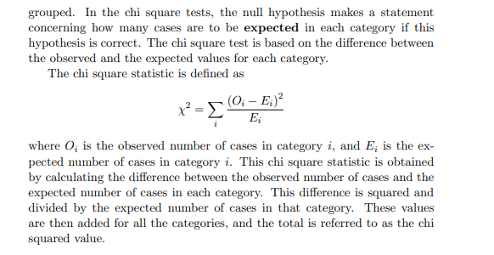

Slide 12
USES :- The chi-squared distribution has many uses in statistics, including:
Confidence interval estimation for a population standard deviation of a normal distribution from a sample standard deviation.
Independence of two criteria of classification of qualitative variables.
Relationships between categorical variables (contingency tables).
Sample variance study when the underlying distribution is normal.
Tests of deviations of differences between expected and observed frequencies (one-way tables).
The chi-square test (a goodness of fit test).

Slide 13
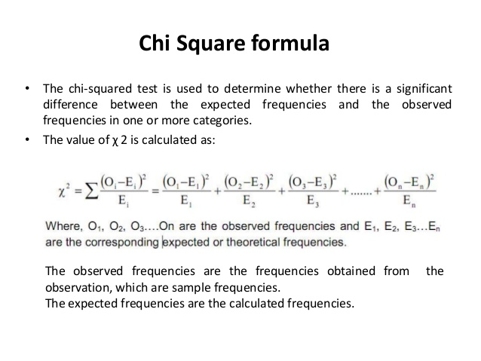

Slide 14
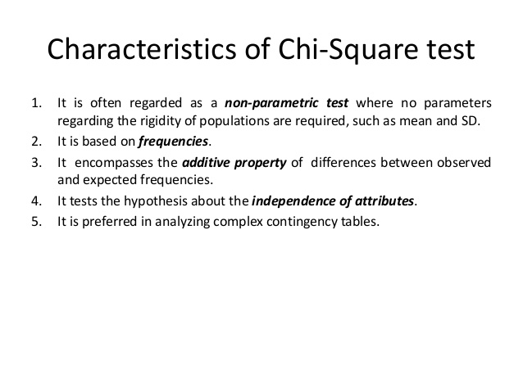

Slide 15
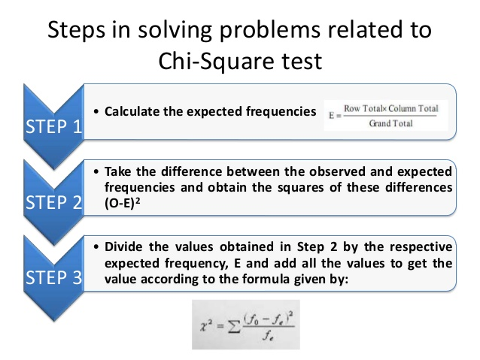

Slide 16
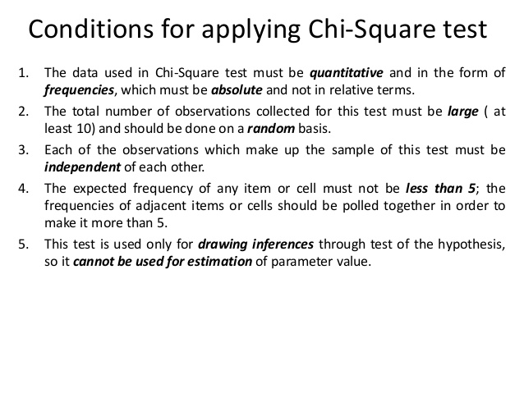

Slide 17
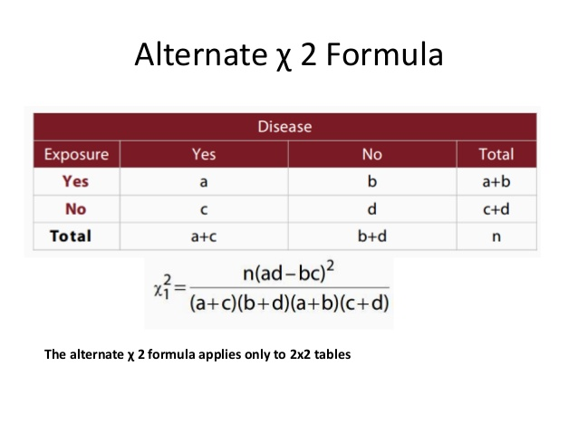

Slide 18
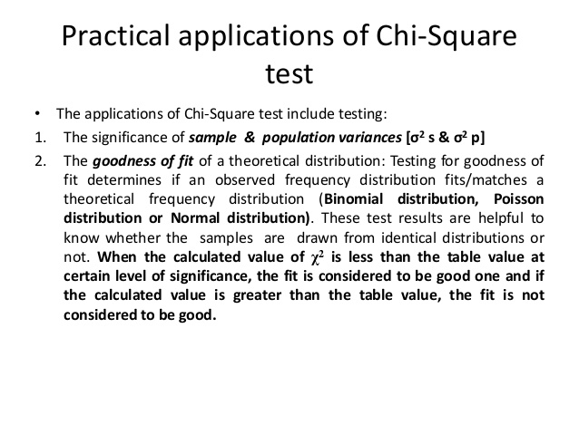

Slide 19
ANOVA TEST
An ANOVA test is a way to find out if survey or experiment results are significant. In other words, they help you to figure out if you need to reject the null hypothesis or accept the alternate hypothesis.
Basically, you’re testing groups to see if there’s a difference between them. Examples of when you might want to test different groups:
A group of psychiatric patients are trying three different therapies: counseling, medication and biofeedback. You want to see if one therapy is better than the others.
A manufacturer has two different processes to make light bulbs. They want to know if one process is better than the other.
What Does “One-Way” or “Two-Way Mean?
One-way or two-way refers to the number of independent variables (IVs) in your Analysis of Variance test.
One-way has one independent variable (with 2 levels). For example: brand of cereal,
Two-way has two independent variables (it can have multiple levels). For example: brand of cereal, calorie

Slide 20
What are “Groups” or “Levels”?
Groups or levels are different groups within the same independent variable. In the above example, your levels for “brand of cereal” might be Lucky Charms, Raisin Bran, Cornflakes — a total of three levels. Your levels for “Calories” might be: sweetened, unsweetened — a total of two levels.
Let’s say you are studying if an alcoholic support group and individual counseling combined is the most effective treatment for lowering alcohol consumption. You might split the study participants into three groups or levels:
Medication only,Medication and counseling,Counseling only.
What Does “Replication” Mean?
It’s whether you are replicating (i.e. duplicating) your test(s) with multiple groups. With a two way ANOVA with replication , you have two groups and individuals within that group are doing more than one thing (i.e. two groups of students from two colleges taking two tests). If you only have one group taking two tests, you would use without replication.

Slide 21
Types of Tests.
There are two main types: one-way and two-way. Two-way tests can be with or without replication.
One-way ANOVA between groups: used when you want to test two groups to see if there’s a difference between them. Two way ANOVA without replication: used when you have one group and you’re double-testing that same group. For example, you’re testing one set of individuals before and after they take a medication to see if it works or not. Two way ANOVA with replication: Two groups, and the members of those groups are doing more than one thing. For example, two groups of patients from different hospitals trying two different therapies.
One Way ANOVA
A one way ANOVA is used to compare two means from two independent (unrelated) groups using the F-distribution. The null hypothesis for the test is that the two means are equal. Therefore, a significant result means that the two means are unequal.
Examples of when to use a one way ANOVA
Situation 1: You have a group of individuals randomly split into smaller groups and completing different tasks. For example, you might be studying the effects of tea on weight loss and form three groups: green tea, black tea, and no tea.
Situation 2: Similar to situation 1, but in this case the individuals are split into groups based on an attribute they possess. For example, you might be studying leg strength of people according to weight. You could split participants into weight categories (obese, overweight and normal) and measure their leg strength on a weight machine

Slide 22
Limitations of the One Way ANOVA
A one way ANOVA will tell you that at least two groups were different from each other. But it won’t tell you which groups were different. If your test returns a significant f-statistic, you may need to run an ad hoc test (like the Least Significant Difference test) to tell you exactly which groups had a difference in means.
Back to Top
Two Way ANOVA
A Two Way ANOVA is an extension of the One Way ANOVA. With a One Way, you have one independent variable affecting a dependent variable. With a Two Way ANOVA, there are two independents. Use a two way ANOVA when you have one measurement variable (i.e. a quantitative variable) and two nominal variables. In other words, if your experiment has a quantitative outcome and you have two categorical explanatory variables, a two way ANOVA is appropriate.
For example, you might want to find out if there is an interaction between income and gender for anxiety level at job interviews. The anxiety level is the outcome, or the variable that can be measured. Gender and Income are the two categorical variables. These categorical variables are also the independent variables, which are called factors in a Two Way ANOVA.
The factors can be split into levels. In the above example, income level could be split into three levels: low, middle and high income. Gender could be split into three levels: male, female, and transgender. Treatment groups are all possible combinations of the factors. In this example there would be 3 x 3 = 9 treatment groups.

Slide 23
Main Effect and Interaction Effect
The results from a Two Way ANOVA will calculate a main effect and an interaction effect. The main effect is similar to a One Way ANOVA: each factor’s effect is considered separately. With the interaction effect, all factors are considered at the same time. Interaction effects between factors are easier to test if there is more than one observation in each cell. For the above example, multiple stress scores could be entered into cells. If you do enter multiple observations into cells, the number in each cell must be equal.
Two null hypotheses are tested if you are placing one observation in each cell. For this example, those hypotheses would be:
H01: All the income groups have equal mean stress.
H02: All the gender groups have equal mean stress.
For multiple observations in cells, you would also be testing a third hypothesis:
H03: The factors are independent or the interaction effect does not exist.
An F-statistic is computed for each hypothesis you are testing.
Assumptions for Two Way ANOVA
The population must be close to a normal distribution.
Samples must be independent.
Population variances must be equal.
Groups must have equal sample sizes.

Slide 24
LEVEL OF SIGNIFICANCE ( NON PARAMETRIC DATA)
A non parametric test (sometimes called a distribution free test) does not assume anything about the underlying distribution (for example, that the data comes from a normal distribution). That’s compared to parametric test, which makes assumptions about a population’s parameters (for example, the mean or standard deviation); When the word “non parametric” is used in stats, it doesn’t quite mean that you know nothing about the population. It usually means that you know the population data does not have a normal distribution.
For example, one assumption for the one way ANOVA is that the data comes from a normal distribution. If your data isn’t normally distributed, you can’t run an ANOVA, but you can run the nonparametric alternative—the Kruskal-Wallis test.
If at all possible, you should us parametric tests, as they tend to be more accurate. Parametric tests have greater statistical power, which means they are likely to find a true significant effect. Use nonparametric tests only if you have to (i.e. you know that assumptions like normality are being violated). Nonparametric tests can perform well with non-normal continuous data if you have a sufficiently large sample size (generally 15-20 items in each group.

Slide 25
Other reasons to run nonparametric tests:
One or more assumptions of a parametric test have been violated.
Your sample size is too small to run a parametric test.
Your data has outliers that cannot be removed.
You want to test for the median rather than the mean (you might want to do this if you have a very skewed distribution).

Slide 26
The main nonparametric tests are:
1-sample sign test. Use this test to estimate the median of a population and compare it to a reference value or target value.
1-sample Wilcoxon signed rank test. With this test, you also estimate the population median and compare it to a reference/target value. However, the test assumes your data comes from a symmetric distribution (like the Cauchy distribution or uniform distribution).
Kruskal-Wallis test. Use this test instead of a one-way ANOVA to find out if two or more medians are different. Ranks of the data points are used for the calculations, rather than the data points themselves.
The Mann-Kendall Trend Test looks for trends in time-series data.
Mann-Whitney test. Use this test to compare differences between two independent groups when dependent variables are either ordinal or continuous.
Mood’s Median test. Use this test instead of the sign test when you have two independent samples.

Slide 27
Advantages and Disadvantages
Compared to parametric tests, nonparametric tests have several advantages, including:
More statistical power when assumptions for the parametric tests have been violated. When assumptions haven’t been violated, they can be almost as powerful.
Fewer assumptions (i.e. the assumption of normality doesn’t apply).
Small sample sizes are acceptable.
They can be used for all data types, including nominal variables, interval variables, or data that has outliers or that has been measured imprecisely.
However, they do have their disadvantages. The most notable ones are:
Less powerful than parametric tests if assumptions haven’t been violated.
More labor-intensive to calculate by hand (for computer calculations, this isn’t an issue).
Critical value tables for many tests aren’t included in many computer software packages. This is compared to tables for parametric tests (like the z-table or t-table) which usually are included.

Slide 28
SIGN TEST
The sign test is a statistical test to compare the sizes of two groups. It is a non-parametric or “distribution free” test, which means the test doesn’t assume the data comes from a particular distribution, like the normal distribution. The sign test is an alternative to a one sample t test or a paired t test. It can also be used for ordered (ranked) categorical data.
The null hypothesis for the sign test is that the difference between medians is zero.
For a one sample sign test, where the median for a single sample is analyzed, see: One Sample Median Tests.
Assumptions for the test (your data should meet these requirements before running the test) are:
The data should be from two samples.
The two dependent samples should be paired or matched. For example, depression scores from before a medical procedure and after.

Slide 29


Procedure:
Calculate the + and – sign for the given distribution. Put a + sign for a value greater than the mean value, and put a – sign for a value less than the mean value. Put 0 as the value is equal to the mean value; pairs with 0 as the mean value are considered ties.
Denote the total number of signs by ‘n’ (ignore the zero sign) and the number of less frequent signs by ‘S.’
Obtain the critical value (K) at .05 of the significance level by using the following formula in case of small samples:
Sign test in case of large sample:
Binomial Distribution formula :-

Slide 30
Compare the value of ‘S’ with the critical value (K). If the value of S is greater than the value of K, then the null hypothesis is accepted. If the value of the S is less than the critical value of K, then the null hypothesis is accepted. In the case of large samples, S is compared with the Z value.
WILCOXAN’S SIGNED RANK TEST
The Wilcoxon signed rank test (also called the Wilcoxon signed rank sum test) is a non-parametric test. When the word “non-parametric” is used in stats, it doesn’t quite mean that you know nothing about the population. It usually means that you know the population data does not have a normal distribution. The Wilcoxon signed rank test should be used if the differences between pairs of data are non-normally distributed.
Two slightly different versions of the test exist:
The Wilcoxon signed rank test compares your sample median against a hypothetical median.
The Wilcoxon matched-pairs signed rank test computes the difference between each set of matched pairs, then follows the same procedure as the signed rank test to compare the sample against some median.
The term “Wilcoxon” is often used for either test. This usually isn’t confusing, as it should be obvious if the data is matched, or not matched.
The null hypothesis for this test is that the medians of two samples are equal. It is generally used:
As a non-parametric alternative to the one-sample t test or paired t test.
For ordered (ranked) categorical variables without a numerical scale.

Slide 31
WILCOXON RANK SUM TEST for Independent Samples
When the requirements for the t-test for two independent samples are not satisfied, the Wilcoxon Rank-Sum non-parametric test can often be used provided the two independent samples are drawn from populations with an ordinal distribution.
For this test we use the following null hypothesis:
H0: the observations come from the same population
From a practical point of view, this implies:
H0: if one observation is made at random from each population (call them x0 and y0), then the probability that x0 > y0 is the same as the probability that x0 < y0
If, in addition, the populations for each sample have the same shape, then this would mean that the two populations have the same median. You would normally judge whether the populations have the same shape based on looking at the shapes of the two samples (e.g. by using histograms or box plots).

Slide 32
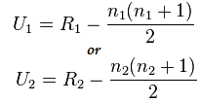
MANN WHITNEY U TEST
The Mann-Whitney U test is the nonparametric equivalent of the two sample t-test. While the t-test makes an assumption about the distribution of a population (i.e. that the sample came from a t-distributed population), the Mann Whitney U Test makes no such assumption.
Null Hypothesis for the Test
The test compares two populations. The null hypothesis for the test is that the probability is 50% that a randomly drawn member of the first population will exceed a member of the second population. An alternate null hypothesis is that the two samples come from the same population (i.e. that they both have the same median).
The result of performing a Mann Whitney U Test is a U Statistic. For small samples, use the direct method (see below) to find the U statistic; For larger samples, a formula is necessary. Or, you can use technology like SPSS to run the test.

Slide 33
Assumptions for the Mann Whitney U Test
The dependent variable should be measured on an ordinal scale or a continuous scale.
The independent variable should be two independent, categorical groups.
Observations should be independent. In other words, there should be no relationship between the two groups or within each group.
Observations are not normally distributed. However, they should follow the same shape (i.e. both are bell-shaped and skewed left).
KRUSKAL -WALL TEST (ONE WAY ANOVA)
The Kruskal Wallis test is the non parametric alternative to the One Way ANOVA. Non parametric means that the test doesn’t assume your data comes from a particular distribution. The H test is used when the assumptions for ANOVA aren’t met (like the assumption of normality). It is sometimes called the one-way ANOVA on ranks, as the ranks of the data values are used in the test rather than the actual data points.
The test determines whether the medians of two or more groups are different. Like most statistical tests, you calculate a test statistic and compare it to a distribution cut-off point. The test statistic used in this test is called the H statistic. The hypotheses for the test are:

Slide 34
H0: population medians are equal.
H1: population medians are not equal.
The Kruskal Wallis test will tell you if there is a significant difference between groups. However, it won’t tell you which groups are different.
Assumptions for the Kruskal Wallis Test :- Your variables should have:
One independent variable with two or more levels (independent groups). The test is more commonly used when you have three or more levels. For two levels, consider using the Mann Whitney U Test instead.
Ordinal scale, Ratio Scale or Interval scale dependent variables.
Your observations should be independent. In other words, there should be no relationship between the members in each group or between groups. For more information on this point, see: Assumption of Independence.
All groups should have the same shape distributions. Most software (i.e. SPSS, Minitab) will test for this condition as part of the test.

Slide 35
Examples
You want to find out how test anxiety affects actual test scores. The independent variable “test anxiety” has three levels: no anxiety, low-medium anxiety and high anxiety. The dependent variable is the exam score, rated from 0 to 100%.
You want to find out how socioeconomic status affects attitude towards sales tax increases. Your independent variable is “socioeconomic status” with three levels: working class, middle class and wealthy. The dependent variable is measured on a 5-point Likert scale from strongly agree to strongly disagree.

Slide 36
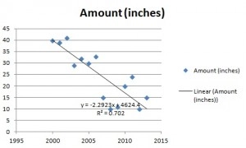
LINEAR REGRESSION AND CORRELATION
Regression analysis is used in stats to find trends in data. For example, you might guess that there’s a connection between how much you eat and how much you weigh; regression analysis can help you quantify that. Regression analysis will provide you with an equation for a graph so that you can make predictions about your data. For example, if you’ve been putting on weight over the last few years, it can predict how much you’ll weigh in ten years time if you continue to put on weight at the same rate. It will also give you a slew of statistics (including a p-value and a correlation coefficient) to tell you how accurate your model is. Most elementary stats courses cover very basic techniques, like making scatter plots and performing linear regression. However, you may come across more advanced techniques like multiple regression.

Slide 37
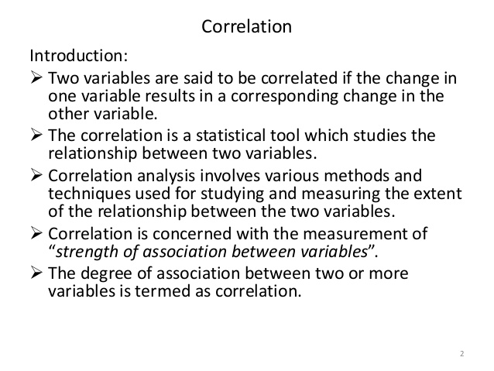

Slide 38
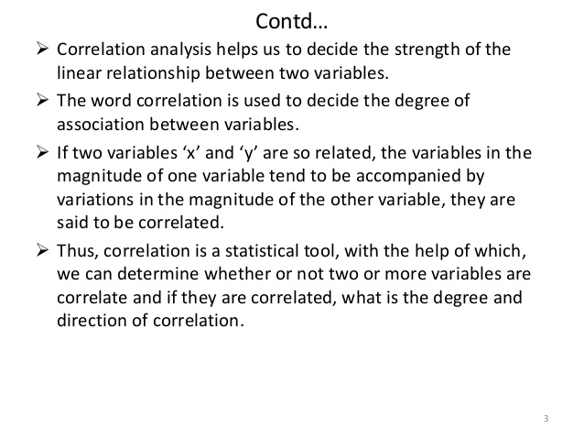

Slide 39
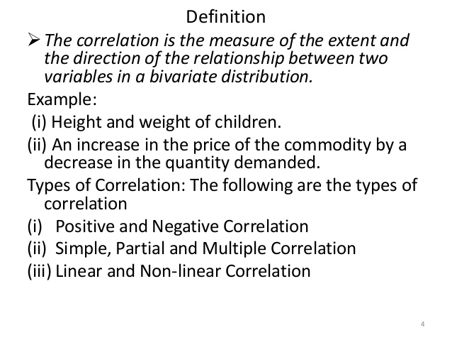

Slide 40
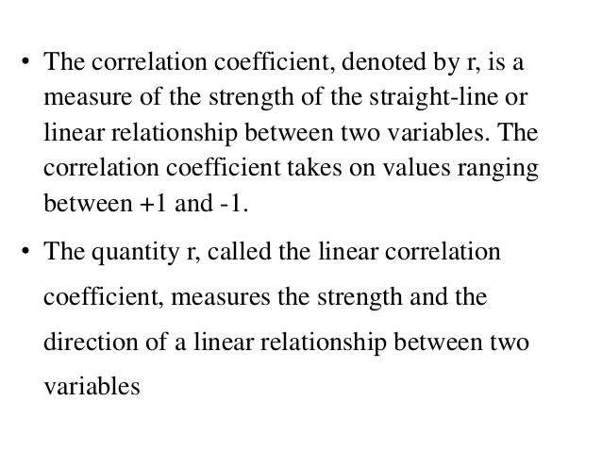

Slide 41
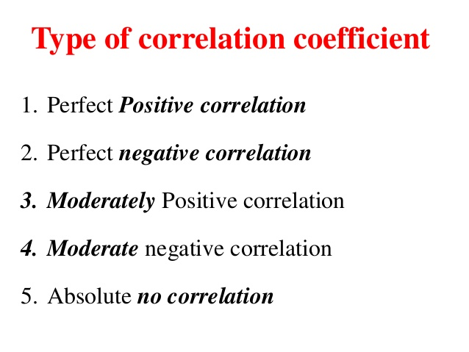

Slide 42
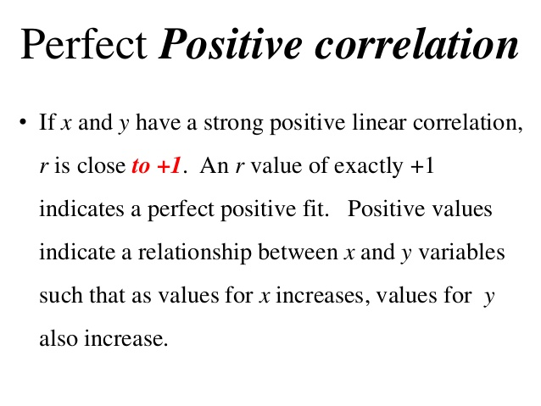

Slide 43
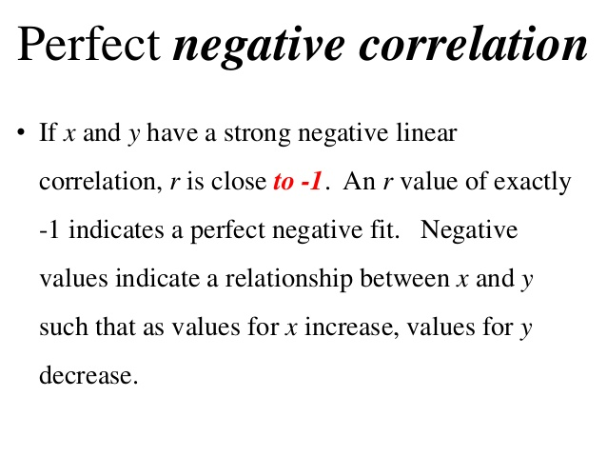

Slide 44
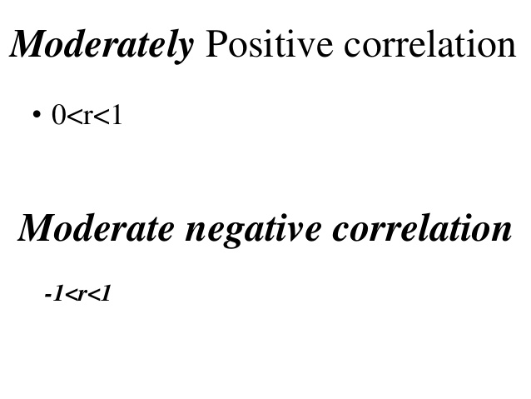

Slide 45
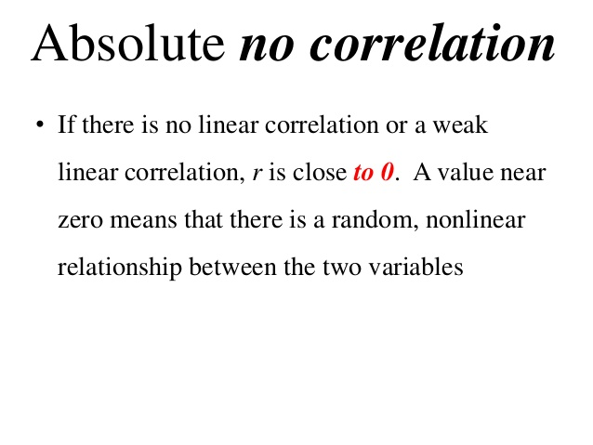

Slide 46
SPEARMANN’S CO RELATION
In statistics, Spearman's rank correlation coefficient or Spearman's ρ, named after Charles Spearman and often denoted by the Greek letter (rho) or as is a nonparametric measure of rank correlation (statistical dependence between the rankings of two variables). It assesses how well the relationship between two variables can be described using a monotonic function.
The Spearman correlation between two variables is equal to the Pearson correlation between the rank values of those two variables; while Pearson's correlation assesses linear relationships, Spearman's correlation assesses monotonic relationships (whether linear or not). If there are no repeated data values, a perfect Spearman correlation of +1 or −1 occurs when each of the variables is a perfect monotone function of the other.
Intuitively, the Spearman correlation between two variables will be high when observations have a similar (or identical for a correlation of 1) rank (i.e. relative position label of the observations within the variable: 1st, 2nd, 3rd, etc.) between the two variables, and low when observations have a dissimilar (or fully opposed for a correlation of −1) rank between the two variables.
Spearman's coefficient is appropriate for both continuous and discrete ordinal variables. Both Spearman's rho and Kendall's tau can be formulated as special cases of a more general correlation coefficient.

Slide 47

The Spearman rank correlation coefficient, rs, is the nonparametric version of the Pearson correlation coefficient. Your data must be ordinal, interval or ratio. Spearman’s returns a value from -1 to 1, where:
+1 = a perfect positive correlation between ranks
-1 = a perfect negative correlation between ranks
0 = no correlation between ranks.
The formula for the Spearman rank correlation coefficient when there are no tied ranks is:

Slide 48
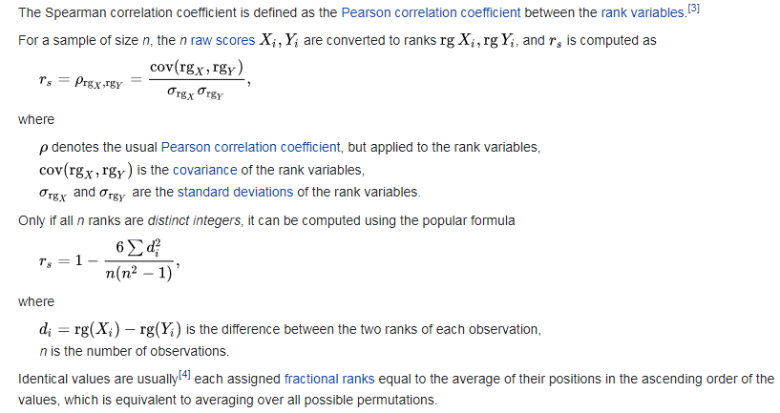

Slide 49
PEARSONN’S CO RELATION
Pearson’s correlation coefficient is the test statistics that measures the statistical relationship, or association, between two continuous variables. It is known as the best method of measuring the association between variables of interest because it is based on the method of covariance. It gives information about the magnitude of the association, or correlation, as well as the direction of the relationship assumptions does Pearson's correlation make.
The first and most important step before analyzing your data using Pearson’s correlation is to check whether it is appropriate to use this statistical test. After all, Pearson’s correlation will only give you valid/accurate results if your study design and data "pass/meet" seven assumptions that underpin Pearson’s correlation.
In many cases, Pearson’s correlation will be the incorrect statistical test to use because your data "violates/does not meet" one or more of these assumptions. This is not uncommon when working with real-world data, which is often "messy", as opposed to textbook examples. However, there is often a solution, whether this involves using a different statistical test, or making adjustments to your data so that you can continue to use Pearson’s correlation.

Slide 50
