Slide 1
NMR SPECTROSCOPY

Slide 2
Chemical shifts
Chemical shift is the difference between the absorption of a sample proton and the absorption of the reference compound.
When a molecule is placed in a magnetic field, its electrons are caused to circulate & they produces the secondary magnetic fields i.e., induced magnetic field.

Slide 3
If the induced field opposes the applied field, then the field actually experienced by the proton is diminished. Then proton is said to be shielded.
If the induced field reinforces the applied field, then the field experienced by the proton is increased. Then proton is said to be deshielded.

Slide 4
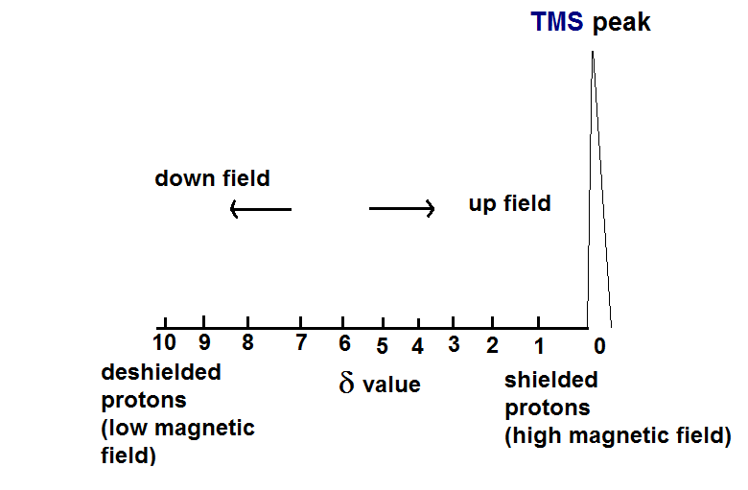
Chemical shift measured in d.
SHIELDING → Shifts absorption UPFIELD(Higher field)
DESHIELDING→Shifts absorption DOWNFIELD (Lower field)

Slide 5
FACTORS AFFECTING CHEMICAL SHIFT
Electro negativity and Inductive Effect
Vanderwaal’s Deshielding
Hydrogen bonding
Anisotropic Effect

Slide 6
Inductive Effect & Electronegativity:
A proton is said to be deshielded if it attached to an electronegative groups [I,Br,Cl,F].
Greater the EN of the atom, greater is the deshielding caused to the proton.
If deshielding is more for the proton, its d value will be more.
Ex: i) CH3-CH2-F ii) CH3-CH2-Cl
b
a
b
a

Slide 7
Two signals are excepted for these ie. deshielding for protons a in compound is more than that for similar protons in compound.
As the distance from EN atom increases the deshielding effect decreases.
Greater the EN of atom, greater will be the deshielding effect on a proton.

Slide 8
Vanderwaal’s Deshielding
In over crowded molecules, it is possible that some proton may be occupying sterically hindered position.
electron cloud of a bulky group (hindering group) will tend to repel the electron cloud surrounding the proton.
Thus, such a proton will be deshielded and will resonate at slightly higher value d.
Ex:- morphine, alkaloids, steroids etc.

Slide 9
Space Effect/ Anisotropic Effect:
Circulation of –π electrons about nuclei generates induced field.
Induced Field - OPPOSE (shielding) or REINFORCE
(Deshielding) the applied field at the PROTON.
Depending on location of proton in SPACE.
π-electrons have pronounced effect on chemical shift of protons

Slide 10
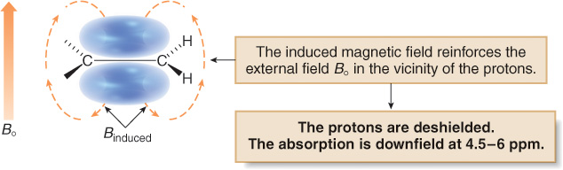
Alkenes:
In a magnetic field, the loosely held π electrons of the double bond create a magnetic field that reinforces the applied field.

Slide 11
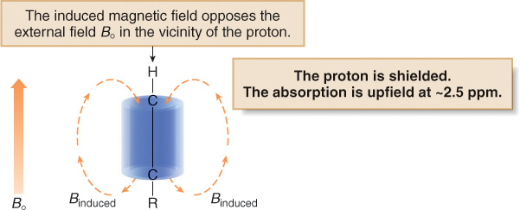
Alkynes (acetylene )
In a magnetic field, π electrons of a carbon carbon triple bond create a magnetic field that opposes the applied field.

Slide 12
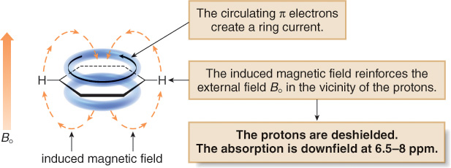
Aromatic (benzene):
In a magnetic field, six π electrons in benzene circulate around the ring creates a a magnetic field that reinforces the applied field.

Slide 13
Hydrogen bonding
The hydrogen atom exhibiting the property of hydrogen bonding absorbs at a lower field compared to other.
The proton if attached to highly EN atom they have smaller electron density around it.
If less shielded the field by proton is more & resonance occurs at downfield.
Ex : In case of OH group attached to ethanol
HO-CH₂-CH₃
low
field
high
field
ω_{o}

Slide 14
REFERENCE STANDARD:
TMS [Tetra methyl silane]
Sodium salt of 3[Trimethyl silyl] propane sulphonate
Reference standard should possess the following characteristics :
Chemical inertness
Magnetic isotropy (magnetically neutral)
Give a single sharp peak
Miscible with wide range of solvents
It should be volatile helps in easy recovery.

Slide 15
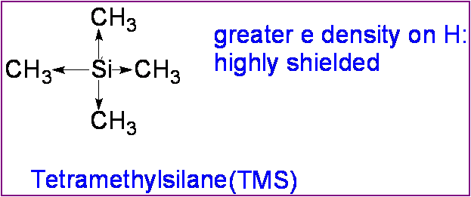
1] Tetra methyl silane:
The reference standard TMS at 0.5% conc is used normally and is added to a sample
Itself so it is called internal std.
It has 12 protons which are uniformly sheilded because of highly electropositive
nature of silicon at centre hence 12 proton give single sharp peak at “0”.
It requires maximum magnetic field than proton of most organic compound.
2] sodium salt of 3[trimethyl silyl] propane sulphate:
It is used as internal std for water soluble substance in deuterium oxide [D2 0] solvent.

Slide 16
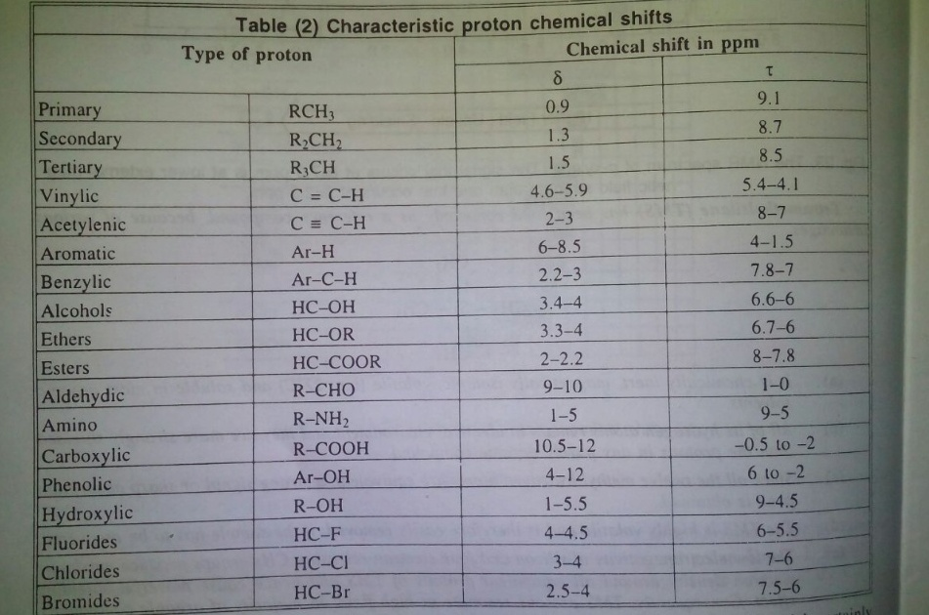

Slide 17
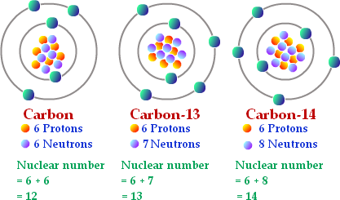
Isotropic nuclei:
Derived from greek word where Iso means “ same” and topos means “Place”.
Isotopes are the variants of a particular chemical element which differ in neutron
number although it has same number of proton in each atom thus different isotopes
of a single element occupy the same position in periodic table.

Slide 18

References
Principles of Instrumental Analysis by Skoog . Holler . Nieman, Harcourt College Publishers, 5th Edition.
Spectrometric Identification of Organic Compounds by Robert .M. Silverstein & Francis .X. Webster, Wiley Publications, 6th Edition.
Elementary organic spectroscopy by Y.R Sharma.
Pharmaceutical drug analysis by Austhoshkar.

Slide 19
Thank You

