Slide 1
MODERN PHARMACEUTICAL ANALYSIS

Slide 2
Ionization Techniques In mass Spectroscopy

Slide 3
Ionization Techniques In Mass Spectroscopy
Mass Spectroscopy
Mass spectroscopy is a technique in which the sample is converted into rapidly moving positive ions which are then separated and characterized.
charged molecules and fragment ions produced from a sample exposed to ionizing conditions.
the relative intensity spectrum which results from the correlation of the ions with their mass to charge ratio (Mass Number), and designated as m/e.
Mass Spectrum
Mass spectrum is a record of relative number of different kinds of ions and is characteristic of every compound.

Slide 4
Mass Spectrometer
It is an instrument which is used to obtain the mass spectra of a sample.
Functions
  Creates gaseous ion fragments from the sample.
  Sorts these ions according to mass.
  Measures the relative abundance of ion fragments.

Slide 5
components of mass spectrometer includes
Mass Analyzer
Ion collection System or Ion detector.
Inlet System
Ion Source
Vacuum System
Data Handling System

Slide 6
ION SOURCE
Liquids and solids are first converted in to gases from the gaseous sample, ions are produced in a Box like enclosure called Ion Source .
Types:-
Gas phase source.
Desoption sources.
Function
  Produces ion without mass discrimination of the sample.
  Accelerates ions into the mass analyzer.

Slide 7
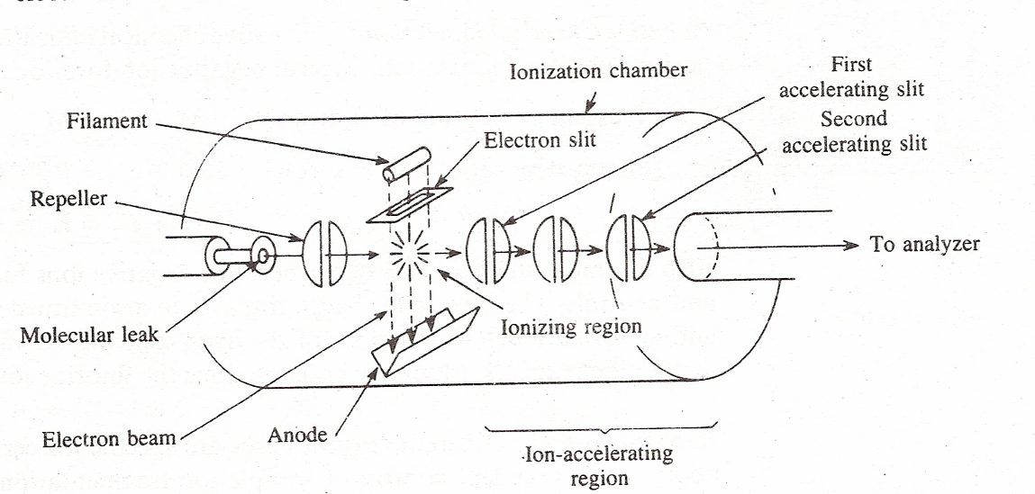
Gas Phase Ionization Methods
Electron Impact Ionization

Slide 8
It is also known as Electron bombardment or Electron Ionization.
Ionizing chamber- pressure 0.005 torr and temperature of 200 ± 0.25 degrees.
Electron gun is located perpendicular to chamber.
Electrons are emitted from a glowing filament (tungsten or rhenium) by thermionic emission and accelerated by a potential of 70 V applied between the filament and anode.
These electrons are drawn in the ionization chamber through positively charged slits.
The number of electrons is controlled by filament temperature and energy of electron is controlled by filament potential.
The sample is brought to a temperature high enough to produce molecular vapors.

Slide 9
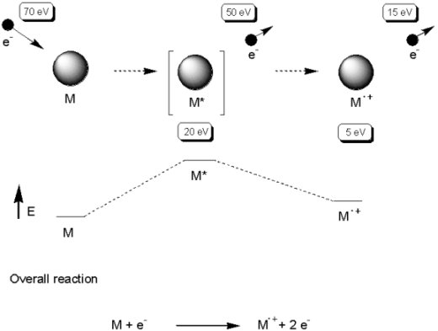
The gaseous Neutral molecules then pass through the molecular leaks and
enter the ionization chamber.
The gaseous sample and the electrons collide at right angles in the chamber
and ions are formed by exchange of energy during these collisions between
electron beam and sample molecules.

Slide 10
The positive ions formed in the chamber are drawn out by a small potential difference ( 5eV) between the large repeller plate and first accelerating plate.
Strong electrostatic field (400 – 4000 V) applied between the first and second accelerating plates accelerates the ions according to their masses (m1, m2, m3 etc) to their final velocities.
The ions emerge from the final accelerating slit as a collimated ribbon of ions. The energy and velocity of ions are given by :-
zV = ½ (m1v1) = ½ (m2v2) = ½ (m3v3)
z = charge of the ion
V = accelerating potential
v = velocity of ion

Slide 11
Advantages
  Gives molecular mass and also the fragmentation pattern of the
  sample.
  Extensive fragmentation and consequent large number of peaks gives
  structural information.
  Gives reproducible mass spectra.
  Can be used as GC/MS interface.
Disadvantages
  Sample must be thermally stable and volatile.
  A small amount of sample is ionized (1 in 1000 molecules).
  Unstable molecular ion fragments are formed so readily that are
  absent from mass spectrum.

Slide 12
Chemical Ionization
In chemical ionization the ionization of the analyte is achieved by interaction of it’s molecules with ions of a reagent gas in the chamber or source.
Chemical ionization is carried out in an instrument similar to electron impact ion source with some modifications such as:-
  Addition of a vacuum pump.
  Narrowing of exit slit to mass analyzer to maintain reagent gas
  pressure of about 1 torr in the ionization chamber.
  Providing a gas inlet.

Slide 13
It is a two part process.
Step-I Reagent gas is ionized by Electron Impact ionization in the source. The primary ions of reagent gas react with additional gas to produce stabilized reagent ions.
step-II Reagent ions interact with sample molecules to form molecular ions.
Depending upon the type of ions formed CI is categorized as:-
  Positive Chemical Ionization.
  Negative Chemical Ionization.

Slide 14
1. Positive Chemical Ionization
In this technique positive ions of the sample are produced. In positive chemical ionization gasses such as Methane, Ammonia, Isobutane etc are used
For example Ammonia is used as reagent gas. First ammonia radical cations are generated by electron impact and this react with neutral ammonia to form ammonium cation (reactive species of ammonia CI).
NH₃ NH₃^{.+} + 2 e⁻
NH₃^{.+} NH₄⁺ + NH₂
NH₄⁺ reacts with the sample molecules by proton transfer or Adduct formation to produce sample ions
M + NH₄⁺ [M + H]⁺ + NH₃ Proton transfer
M + NH₄⁺ [M + NH₄]⁺ Adduct formation
e⁻

Slide 15
When Methane is used as Reagent gas. Methane is ionized by electron impact:
CH₄ e⁻ CH₄⁺ + 2e⁻
Primary ions react with additional reagent gas molecules to produce stabilized reagent ions:
CH₄⁺ + CH₄ CH₅⁺ + CH₃
CH₃⁺ + CH₄ C₂H₅⁺ + H₂
The reagent ions then react with the sample molecules to ionize the sample molecules:
CH₅⁺ + MH CH₄ + MH₂⁺ (Proton transfer)
CH₃⁺ + MH CH₄ + M⁺ (hydride abstraction)
CH₄⁺ + MH CH₄ + MH⁺ (Charge transfer)

Slide 16
2. Negative Chemical Ionization
Negative chemical ionization is counterpart of Positive chemical ionization.
This method is used for ionization of highly electronegative samples.
The negative ions are formed by following reactions :-
Resonance electron capture
M + e⁻ M⁻
Dissociative electron capture
RCl + e⁻ R + Cl⁻
H₂O + e⁻ H + OH⁻
Charge transfer.
Hydride transfer.

Slide 17
Advantages
  Used for high molecular weight compounds.
  Used for samples which undergo rapid fragmentation in EI.
Limitations
  Not suitable for thermally unstable and non-volatile samples.
  Relative less sensitive then EI ionization.
  Samples must be diluted with large excess of reagent gas to prevent
  primary interaction between the electrons and sample molecules

Slide 18
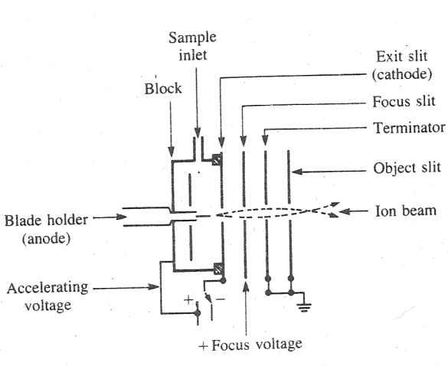
Field Ionization
FI is used to produce ions from volatile compounds that do not give molecular ions by EI.
It produces molecular ions with little or no fragmentation.

Slide 19
Application of very strong electric field induces emission of electrons.
Sample molecules in vapour phase is brought between two closely spaced electrodes in the presence of high electric field (10⁷ - 10⁸ V/cm) it experiences electrostatic force.
If the metal surface (anode) has proper geometry (a sharp tip, cluster of tips or a thin wire ) and is under vacuum (10⁻⁶ torr) this force is sufficient to remove electrons from the sample molecule without imparting much excess energy.
The electric field is produced by applying high voltage ( 20 KV ) to these specially formed emitters ( made up of thin tungsten wire ).

Slide 20
In order to achieve high potential gradients necessary to effect ionization, the anode is activated by growing carbon microneedles or whiskers.
These whiskers are 10 micro meters in length and greater than 1µm in diameters. These whiskers are capable of removing valence electrons from the organic molecules by quantum mechanical tunneling mechanism.
As concentration of sample molecules is high at the anode ion-molecule reactions often occur which results in formation of protonated species (M+H)⁺. Thus both M⁺ and (M+H)⁺ is observed in FI spectrum.

Slide 21
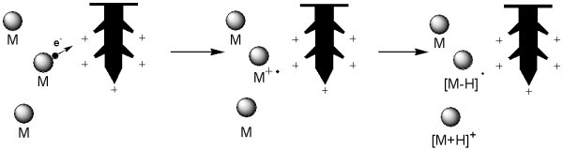
These cations are accelerated out of the source and their mass is analyzed by analyzer .
.

Slide 22
Advantages
  As fragmentation is less, abundance of molecular ions (M⁺) is
  enhanced, hence this method is useful for relative molecular
  mass and empirical formula determination
Disadvantages
  Not suitable for thermally unstable and non volatile samples.
  Sensitivity is les than EI ion source.
  No structural information is produced as very little fragmentation
  occurs

Slide 23
Field desorption
In field desorption method a multitipped emitter (made up of tungsten wire with carbon or silicon whiskers grown on its surface).
The electrode is mounted on a probe that can be removed from the sample compartment and coated with the solution of the sample.
The sample solution is deposited on the tip of the emitter whiskers either by dipping the emitter into analyte solution or by using a microsyringe.
The probe is then reinserted into the sample compartment which is similar to CI or EI unit.
Then the sample is ionized by applying a high voltage to the emitter.
In some cases it is necessary to heat the emitter by passing a current through the wire to evaporate the sample.

Slide 24
Ionization takes place by quantum mechanical tunneling mechanism which involves transfer of ions from the sample molecule to the anode (emitter).
This results in formation of positive ions which are radical ions (M⁺) and cations attached species such as (M+Na)⁺. (M+Na)⁺ are produced during desorption by attachment of trace alkali metal ions present in analyte.
Advantages
  Works well for small organic molecules, low molecular weight
  polymers and petrochemical fractions.

Slide 25
Disadvantages
  Sensitive to alkali metal contamination.
  Sample must be soluble in a solvent.
  Not suitable for thermally unstable and non volatile samples.
  Structural information is not obtained as very little
  fragmentation occurs.

Slide 26
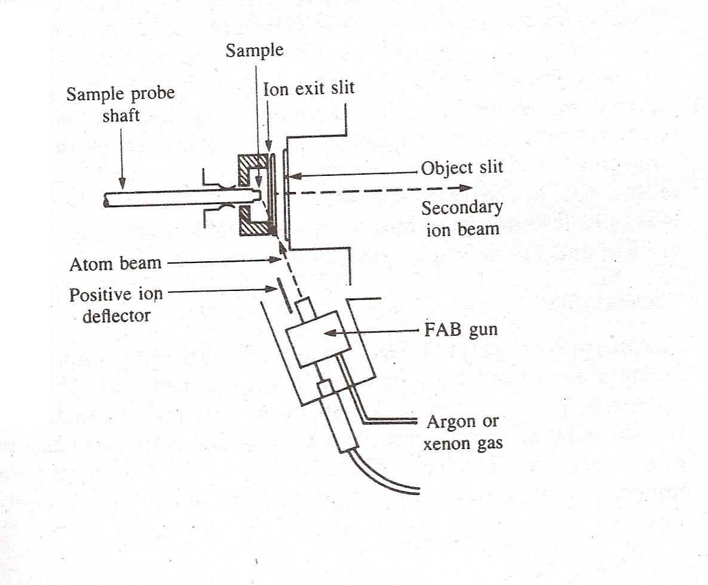
Fast Atom Bombardment
It is an ionization technique in which the analyte and non-volatile liquid matrix mixture is bombarded by a high energy beam of inert gas such as Argon or Xenon.
.

Slide 27
This technique is used for ionization of polar high molecular weight compounds such as polypeptides. Commonly used matrices include :-
Glycerol, Monothioglycerol,
Carbowax,
2,4 – dipentyl phenol
  3 – nitrobenzyl alcohol (3 – NBA)
This beam is produced by first ionizing the Xenon (or Argon atoms with electrons to give Xenon radical cations.
Xe ⁺ e⁻ = Xe^{.+} +2e⁻
The radical cations are then accelerated to 6 – 10 KeV to give radical cations of high translational energy (Xe)⁺⁺, which are then passed through a chamber containing Xenon atoms at a pressure of 10-5 torr.

Slide 28
During this passage high energy cation obtain electrons from Xenon atoms to become high energy atoms (Xe). The lower energy ions are removed by electrostatic deflector.
(Xe)⁺⁺ Xe^{.+} + Xe
(Xe)^{.+} + Xe (Xe) + Xe^{.+}
The analyte is dissolved in the liquid matrix such as glycerol and applied as a thin layer on the sample probe shaft.
The mixture is bombarded with the high energy beam of Xenon atoms. Xenon ionizes the glycerol molecules to give glycerol ions. These ions react with the surrounding glycerol molecules to produce (G+H)+ as reactant ions.
The sample molecules then undergo proton transfer or hydride transfer or ion-pair interaction with reactant ions to give quassimolecular or psuedomolecular ions such as (M+H)⁺, (M-H)⁻ or (M+G+H)⁺.
These ions are then extracted from slit lens system designed to collect ions and directed to mass analyzer.

Slide 29
Advantages
  Used for ionization of polar high molecular weight samples.
  Provides rapid heating of samples and reduces sample fragmentation.
  Rapid ionization.
Disadvantages
  Difficult to distinguish between low molecular weight compounds.
  Compounds must be soluble in liquid matrix.
  Not good for multiply charged compounds

Slide 30
Secondary ion mass spectrometry
Secondary ion mass spectrometry is nearly identical to FAB except the primary ionizing beam is an ion beam rather than a neutral atom beam. The Cesium or
Argon ions are most commonly used.
The source consists of a cylindrical grid and a vertically placed ion gun or filament.
Argon or Cesium gas is ionized by heating the filament to produce monoenergetic noble gas ions. The ion gun can produce an ion beam of diameter ranging from 0.1mm to 1mm.
The ions are accelerated to a potential of 300 to 3000 eV.
This ion beam is then bombarded on to the surface of the sample.
This results in the formation of secondary sample ions by charge transfer interaction between the sample molecules and the primary gas ions.

Slide 31
The ions formed in the cylindrical grid are then extracted from one end and focused on the target or mass analyzer by an electrostatic lens system.
Advantages
  Higher sensitivity.
  Selection of Beam diameter permits for rapid transition from a small.
  surface analysis with a small beam to a large surface area.
Thermal ionization or Surface ionization
Thermal surface ionization source is useful for inorganic solid materials.
Samples are coated on a tungsten ribbon filament and then the filament is heated until the sample is evaporates.
As the sample evaporates it undergoes ionization.

Slide 32
The probability of ionization is predictable and is a function of work function of:-
  Ionization potential of the sample E1
  Work function of the filament material Φ
  Filament temperature T
This can be summarized as follows
n+/n0 = exp[z(Φ – E1)/KT]
z = electronic charge
K = Boltzmann’s constant
n+ = Number of ions formed
n0 = Number of neutral species

Slide 33
References
Principles of Instrumental analysis. Fifth Edition by Douglas. A. Skoog, F. James Holler and Timothy A. Nieman. Page No. 499 – 511.
Instrumental Methods Of Analysis. Seventh Edition by Willard Meritt. Page No. 468 – 74.
http://www.chem.ox.ac.uk/spectroscopy/mass-spec/Lecture/oxmain_lectureCI.html
http://www.astbury.leeds.ac.uk (A.E. Ashcroft's MS web pages and tutorial)
"http://en.wikipedia.org/wiki/Atmospheric_pressure_chemical_ionization

Slide 34


