Slide 1
MEDICINAL CHEMISTRY-III
INTRODUCTION, DRUG DESIGN AND QSAR AND COMBONATORIAL CHEMISTRY
16-07-2020
1

Slide 2
INTRODUCTION TO MEDICINAL CHEMISTRY
Medicinal Chemistry is a science that deals with the Discovery or Design of new therapeutic chemicals and development of
chemicals in to useful medicine.
( Involved with designing, synthesizing and developing pharmaceutical drugs )
It is multidisciplinary subject involving
Organic chemistry
Biochemistry
Physiology
Microbiology
Pharmacology
Toxicology
Genetics and
Computer modelling
16-07-2020
2

Slide 3

INTRODUCTION TO MEDICINAL CHEMISTRY
It explains the design and production of compounds, which can be used for prevention and treatment
of human or animal diseases.
It also includes the study of existing drugs, their biological properties and Quantitative Structure
Activity Relationship (QSAR).
16-07-2020
3

Slide 4
DRUG DESIGN
The drug design was based on Modification of the structure of compounds.
Drug design involves four phases:
1) Discovery and Research
    Target identification
    Understanding
    Testing
Drug development: Such as
  Metabolism (Pharmacodynamics and Pharmacokinetics)
  Safety
  Toxicity
  Dosage and Efficacy
  Potential benefits
  Mechanism of action
  Route of administration
  Its effects on different groups of people such as (by genders, Race etc)
  Drug-Drug interaction and its effectiveness as compared with similar drugs.
  Preclinical phase and Clinical testing
3) Regulatory Review and Approval
4) Marketing
16-07-2020
© R R INSTITUTIONS , BANGALORE
4

Slide 5
QSAR (Quantitative Structure Activity Relationship)
Introduction:
Relationship between Chemical structure and Biological, physicochemical and pharmacological Activity.
BA = f (c)
Biological activity must be the function of chemical structure
QSAR involves the derivation of mathematical formula
BA = function (parameters)
BA of a drug is a function of chemical features (ie., Lipophilicity, electronic and steric) of the substituents and skeleton of the
molecules.
16-07-2020
5

Slide 6

QSAR
PARAMETERS:
Used to modify the structure of drugs.
Various parameters:
i) Lipophilic parameters: Partition coefficient
Chromatographic parameters
$π$- substituents constant
ii) Polarizability parameters: Molar refraction
Molar value
16-07-2020
6

Slide 7
QSAR
PARAMETERS:
iii) Electronic parameters: Hametts constant
Field and resonance parameters
parameters derived from Spectroscopic data
Charge-transfer constant
Dipole moment
Quantum chemical parameters
iv) Steric parameters : Tafts steric constant
Vander waals radii
v) Miscellaneous parameters : Mol. Wt
Geometric parameters
16-07-2020
7

Slide 8
METHODS:
Various methods are used to draw QSAR model
Hansch Analysis
Free Wilson analysis
Fujita-Ban modification
Mixed approach
Topliss Decision Tree
16-07-2020
8

Slide 9
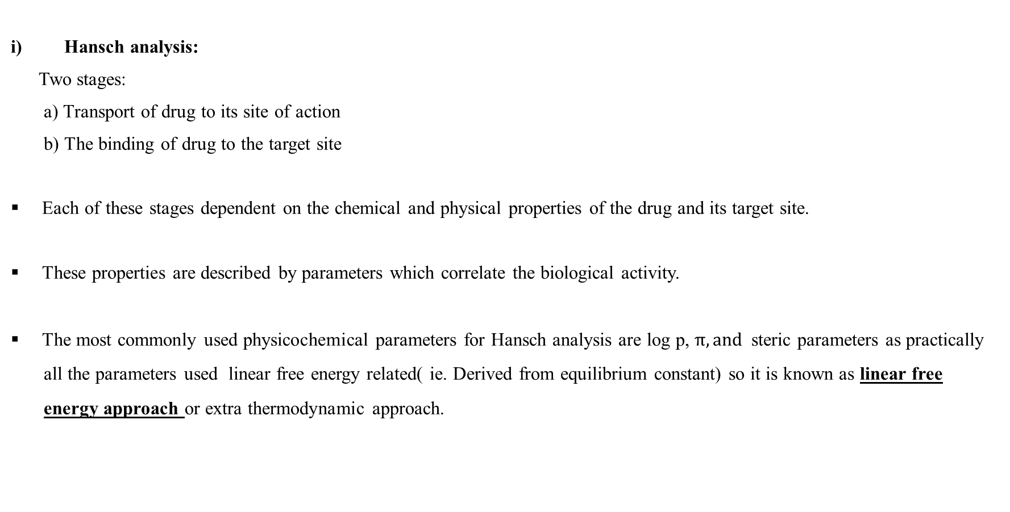
HANSCH ANALYSIS:
Hansch analysis:
Two stages:
a) Transport of drug to its site of action
b) The binding of drug to the target site
Each of these stages dependent on the chemical and physical properties of the drug and its target site.
These properties are described by parameters which correlate the biological activity.
The most commonly used physicochemical parameters for Hansch analysis are log p, $π, and$steric parameters as practically
all the parameters used linear free energy related( ie. Derived from equilibrium constant) so it is known as linear free
energy approach or extra thermodynamic approach.
16-07-2020
9

Slide 10
HANSCH ANALYSIS:
If the hydrophobicity values are limited to a small range, then the
equation will be Linear as follows:
log (1/c) = k1 log p + k2 σ +k3 E3+k4
Where k1 , k2, k3 are constant obtained by least square procedure,
C is a molar constant that produce certain biological action
The molecule which is too hydrophilic or too lipophilic will not be able to cross the lipophilic or hydrophilic barriers respectively. There fore the p values are spread over a large range, then the equation will be parabolic and given as:
Log (1/c) = -k (log p)2 + k2 log p +k3 σ +k4εs + k5
The constant K1=K5 are obtained by least square method
16-07-2020
10

Slide 11
APPLICATIONS OF HANSCH ANALYSIS:
Used to predict the activity of an as yet unsynthesized compound.
Used to give an indication of the importance of the influence of parameters on the mechanism by which a drug acts.
Applied to various problems in order to correlate the biological activity with chemical structure.
Hansch analysis serves as guide in future testing and synthesis of new compound and to play roles of hydrophobic, electronic
and stericfactors in drug receptor interaction.
16-07-2020
11

Slide 12
II) FREE WILSON ANALYSIS:
ii) Free Wilson analysis: ( Mathematical model OR Additivity model OR De-novo)
The Free Wilson analysis is truly a structure-activity based methodology in which the biological activity of the parent structure
is measured and compared with the activity of analogues bearing different substituents.
Parent structure Activity of analogues bearing
different substituents
Biological activity
Measured & compared with
16-07-2020
12

Slide 13
II) FREE WILSON ANALYSIS:
Free Wilson analysis method is based on additive mathematical model in which a particular substituent in a specific position is assumed to make an additive and constant contribution to biological activity of a molecule in series of chemically related molecule.
BA = μ + Ʃ aij
BA = Biological activity
μ = contribution of unsubstituted compounds
Ʃ aij = contribution of substituted compounds
i = number of position the substituents occurs
j = number of substituent at that position
Applications of Free Wilson analysis :
It is easy to apply. Especially, in the early phases of structure activity analysis.
It is a simple method to derive substituent contribution and to have a first look on their possible dependence on different
physicochemical properties.
16-07-2020
13

Slide 14
APPLICATIONS OF QSAR:
To predict the biological activity
To estimate physicochemical properties using substituents constants
To reduce number of compounds to be synthesized
To detect the active compound very fast
To avoid and detect the inactive compounds
To obtain pharmacokinetics information
16-07-2020
14

Slide 15
COMBINATORIAL CHEMISTRY
16-07-2020
15

Slide 16
COMBINATORIAL CHEMISTRY
The concept of combinatorial synthesis:
Combinatorial chemistry is an approach of synthetic chemistry that allows simultaneous synthesis of a large number of the possible compounds.
Simultaneous synthesis is achieved by addition of a range of closely related building blocks and optimal environment.
The products resulting from combinatorial synthesis are together called combinatorial library.
Libraries may be a collection of individual compounds or mixture of compounds.
Libraries are then subjected to high throughput screening to identify potentially bioactive compounds.
16-07-2020
16

Slide 17
COMBINATORIAL CHEMISTRY
The concept of combinatorial synthesis:
Combinatorial chemistry is one of the important new methodologies developed by researchers in the pharmaceutical industry to reduce the time and costs associated with producing effective and competitive new drugs.
16-07-2020
17

Slide 18
COMBINATORIAL CHEMISTRY
The concept of combinatorial synthesis:
In the drug design process. Traditionally, potential lead compounds were synthesized one at a time. The biological activity of this compound was assayed, and the results would be reflected in the next round of design. This traditional method was useful, but time consuming and expensive. Computational chemistry led to more rational design of compounds to be tested, and high throughput screening led to quick in vitro assays.
Synthesis of one compound at a time could no longer keep up, and thus became the rate limiting step in the process. Combinatorial chemistry was the solution to this problem. In combinatorial approach, one can cover many combinations An x Bn in one reaction Instead of doing multiple A x B type reactions.
Conventional Reaction: A + B------------------->AB
Combinatorial Chemistry: A_{1- n} + B_{1- n}--------->A_{1- n} B_{1- n}
Hence, In combinatorial chemistry, large numbers of compounds are made at the same time in small amounts, forming libraries which can be assayed for desired properties all at once. Finally the active compound is identified and made in quantity as a single compound
16-07-2020
18

Slide 19
COMBINATORIAL CHEMISTRY
Applications of combinatorial synthesis:
The combinatorial chemistry first shows its presence in synthesis of peptide libraries. The peptide plays varying role in body.
By the use of combinatorial chemistry we can generate vast peptide, which may be active. Biologically active peptide hormones play an important role in regulating a multitude of human physiological response and many low molecular weight bioactive peptides can act as a hormone receptor against or antagonists. In addition, peptide structure commonly is found in molecules designed to inhibit enzymes that catalyze proteolysis, phosphorylation and other past translational protein modification that may play important role in pathologies of various disease states.
Lead optimization of Histamine H3 receptor antagonism.
Lead optimization of Dihydrofolate reductase inhibitors.
16-07-2020
19

Slide 20
COMBINATORIAL CHEMISTRY
TYPES OF COMBINATORIAL SYNTHESIS
Combinatorial chemistry is of two types:
(1) Solid phase combinatorial chemistry (The compound library have been synthesized on solid phase
such as resin bead)
(2) Solution phase combinatorial chemistry (The compound library have been synthesized in solvent
in the reaction flask) de
16-07-2020
20

Slide 21
COMBINATORIAL CHEMISTRY
TYPES OF COMBINATORIAL SYNTHESIS
(1) Solid phase combinatorial chemistry: In solid phase combinatorial chemistry, the starting compound is attached to an insoluble resin bead, reagents are added to the solution in excess, and the resulting products can be isolated by simple filtration, which traps the beads while the excess reagent is washed away.
Eg. Polystyrene resins, Tenta Gel resins, Poly acrylamide resins, Glass and ceramic beads.
16-07-2020
21

Slide 22
COMBINATORIAL CHEMISTRY
TYPES OF COMBINATORIAL SYNTHESIS
(2) Solution phase combinatorial chemistry:
The solution phase synthesis involves conducting chemical reaction simultaneously, preferably in well-ordered sets (arrays) of reaction vessels in solution.
In solution phase synthesis we use soluble polymer as support for the product. PEG (Polyethylene glycol) is a common vehicle which is used in solution phase synthesis it can be liquid or solid at room temperature and show varying degrees of solubility in aqueous and organic solvent.
16-07-2020
22

Slide 23
COMBINATORIAL CHEMISTRY
Characteristics of solid phase and solution phase combinatorial chemistry
SOLID PHASE | SOLution PHASE
Make a mixture of products | Makes only one product
Small amounts of products formed | Large amounts of products formed
Simple isolation of product by filtration | Work-up and purification more difficult
Requires two extra reaction steps: linkage & cleavage | No extra steps for attachment & cleavage needed
Limits to chemistry which can be performed | Wide range of reactions can be utilized
Automation possible | Automation difficult
Large excesses of reagent can be used to drive the reaction to completion | Large excesses of reagent cannot be used as it causes subsequent separation problem.
Longer reaction time than in solution phase | Less reaction time
Monitoring of reaction very difficult | Monitoring of reaction easy
Split and mix technique as well as parallel synthesis can be applied | Split and mix strategy not possible Parallel synthesis can be applied
16-07-2020
23

Slide 24
THANK YOU
16-07-2020
24

