Slide 1
FRAGMENTATION

Slide 2
CONTENTS:
FRAGMENTATION
RULES OF FRAGMENTATION
FRAGMENTATION PATTERNS
FACTORS AFFECTING FRAGMENTATION

Slide 3
  Fragmentation :
  The fragmentation patterns i.e the break up process of the molecular ion into smaller ions, called fragment ions or daughter ions.
  There are two important type of fragmentation :
  A neutral molecule such as – H₂O, CO, HCl etc. Is eliminated. This loss of a neutral molecule gives a new fragment (radical cation) Which is known as odd electron fragments.
  Fragment process may involve the separation into, the ion part and the radical part ,these fragments are called even electron fragments.

Slide 4
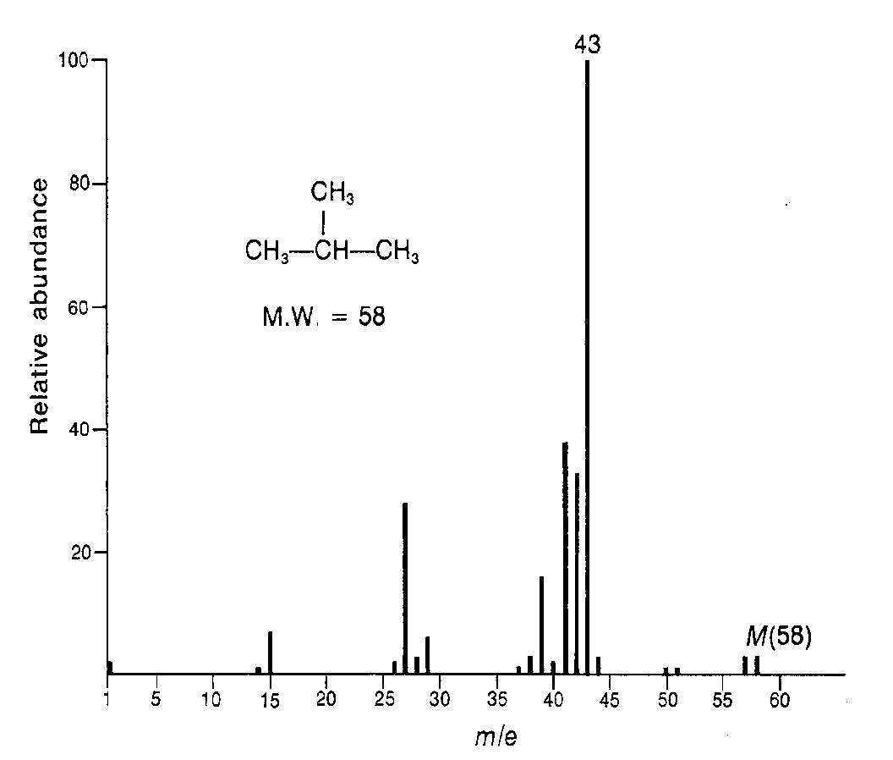
RULES OF FRAGMENTATION
The relative height of molecular ion peak [M⁺] is greater for straight chain compounds and decreases as the degree of branching increases
Ex: Butane and Isobutane
Butane
Isobutane

Slide 5
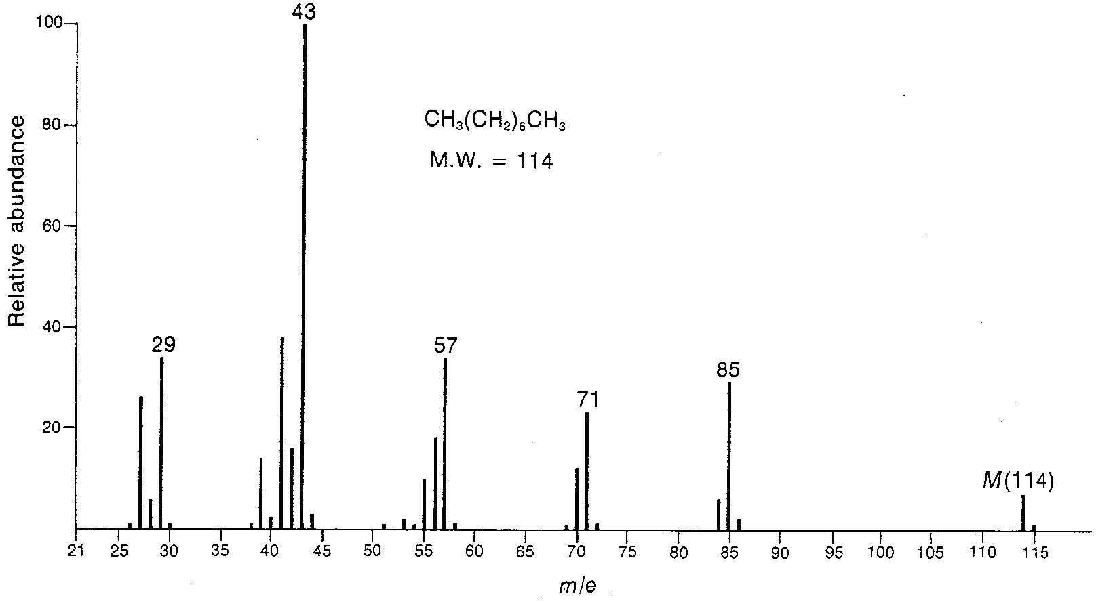
The relative abundance of molecular ion peak [M⁺] decreases with increasing molecular weight in a homologous series.
Ex: Butane and Octane
Octane
Butane

Slide 6
The cleavage is favored at alkyl substituted carbon atom. The more substituted the carbon, more likely the cleavage.
Order of stability of cation
3º > 2º > 1º >Methyl
[R₃C⁺> R₂CH⁺>RCH₂⁺>CH₃]
Ex: Isopentane gives much more intense peak at m/e=43 &57 than at m/e=15 & 29
Note :
The largest substituent at a branch is eliminated most readily as a radical because a long chain radical can acquire some stability by delocalization of the lone pair of electron.

Slide 7
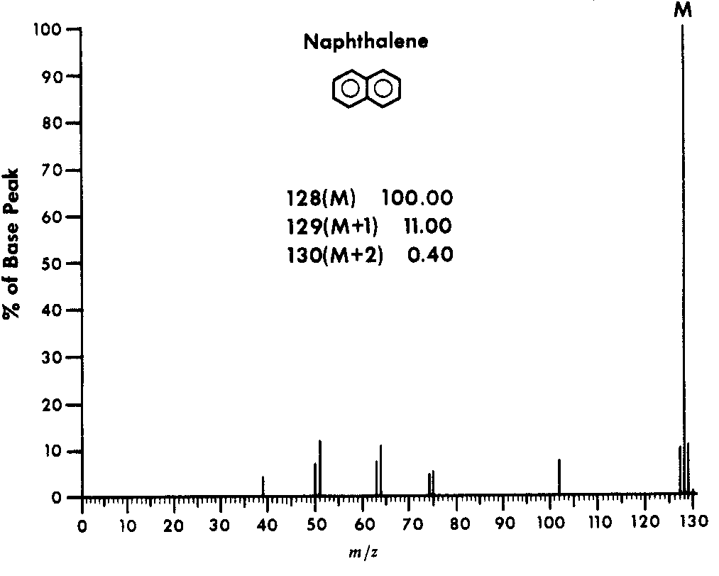
A substance having ring contains strong molecular ion peak.
The stronger the ring ,more intense the peak.

Slide 8
Aromatic ring compounds will stabilizes the molecular ion and increases its probability of appearance of molecular ion.

Slide 9
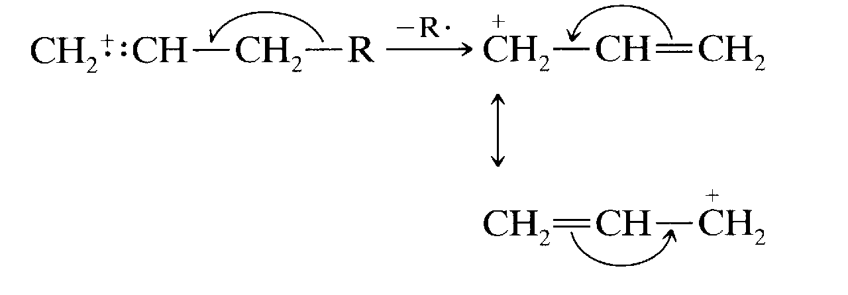
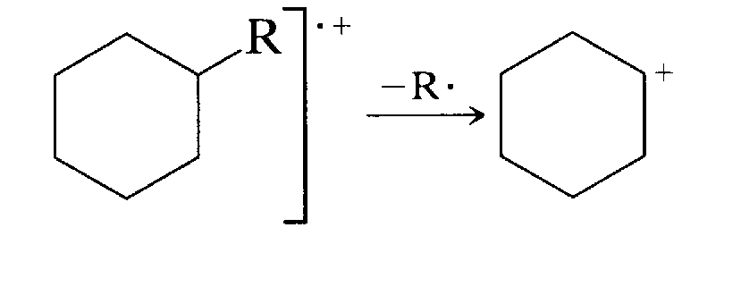
Double bond will favors allylic cleavage and gives resonance stabilized allyl carbonium ion.
Saturated ring having a side chain, tend to lose side chain at the α carbon. The positive charge tends to stay with the ring fragment.

Slide 10
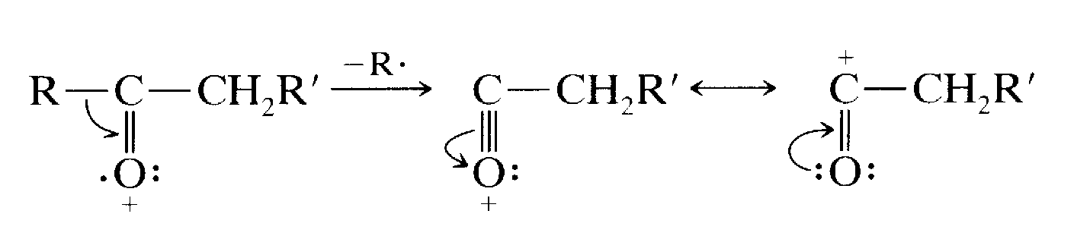
The compounds containing carbonyl group tend to break at this group leaving the positive charge with carbonyl portion.
acetophenone

Slide 11
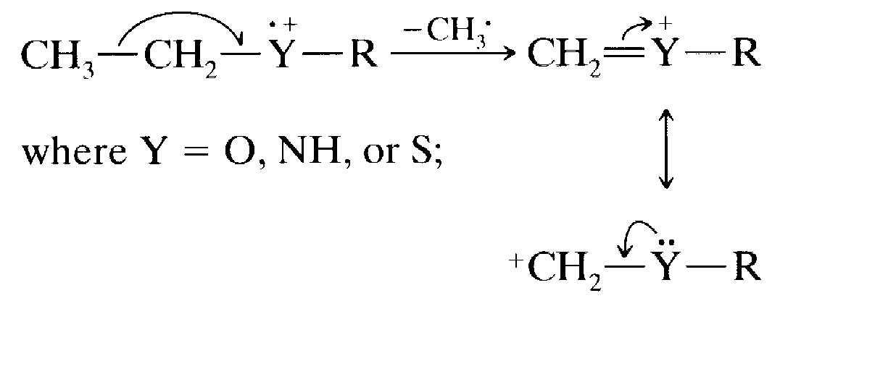
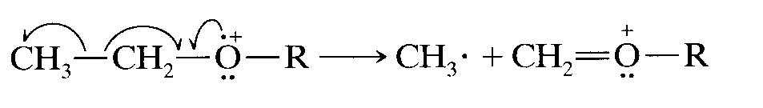
Carbon-Carbon bond next to heteroatom (α position) are frequently cleaved leaving a charge on the fragment containing the hetero atom whose non bonding electron provides resonance stabilization.
Small stable neutral molecule such as H₂O, NH₃, CO etc can be eliminated from the appropriate ion during cleavage. These cleavages often takeplace with rearrangements.

Slide 12
GENERAL MODES OF FRAGMENTATION:
Fragmentation of the molecular ion takes place in following modes:
* Simple cleavage
1. Homolytic cleavage
2. Heterolytic cleavage
3. Retro Diels-Alder reaction
* Rearrangement reactions accompanied by transfer of atoms.
1. Scrambling
2. Mc Lafferty rearrangement
3. Elimination

Slide 13
FRAGMENTATION PATTERNS OR FRAGMENTATION TYPES:
A) Simple cleavage
1. Homolytic cleavage:
Fragmentation by movement of one electron:
In a Molecular ion when the bonds are ruptured by moving one electron and the movement is generally indicated by fishhook arrows. The bond cleavage may involve the σ bond rupture and the net result is formation of a stable carbocation.
Ex:
R-CH₂-CH₂-R’ Ξ R-CH₂:CH₂-R’ -e R-CH₂-CH₂-R’ R-CH₂⁺+ .CH₂-R
2. Heterolytic cleavage:
Cleavage of C-X bond is more difficult than that of a C-C bond.

Slide 14
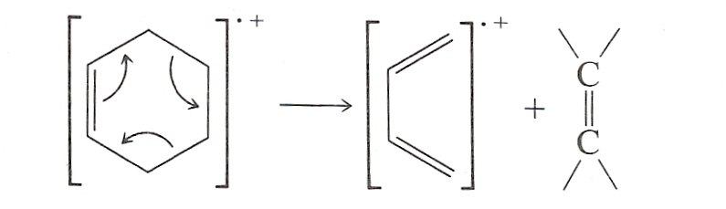
3.Retro Diels-Alder reaction:
Elimination by multiple σ bond rupture:
Unsaturated rings undergo Retro – Diels – Alder reaction.
Ex: cyclohexene is broken down to Diene and Dienophile.
B) Rearrangement reactions accompanied by transfer of atoms:
1. Scrambling:
It takes place by rupture and reformation of C-C bonds.

Slide 15
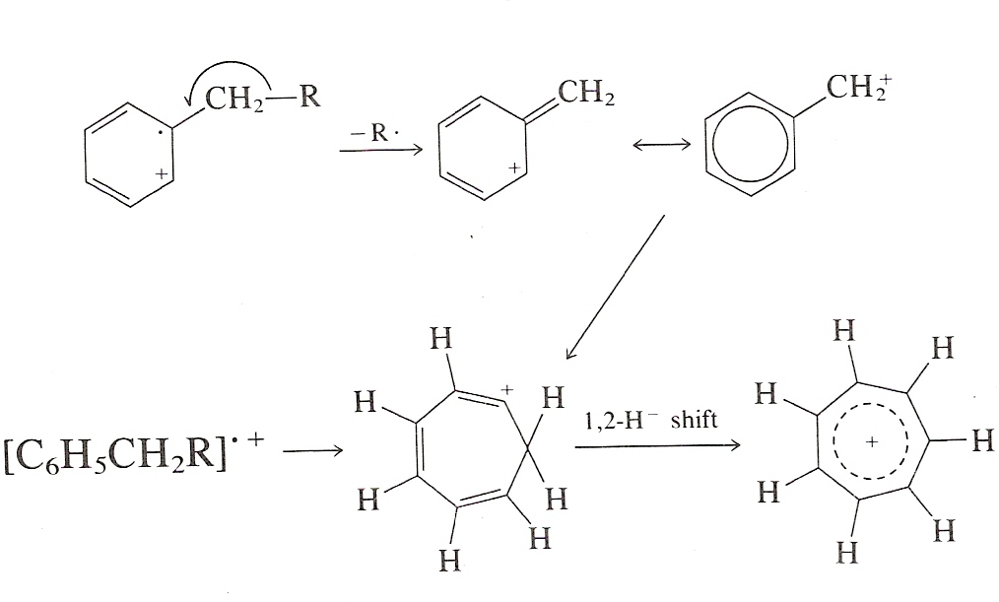
Ex- Molecular ion from the alkyl benzene undergoes fragmentation at the benzylic bond and final product is seven membered cyclic ion known as Tropylium ion.
2. Mc Lafferty rearrangement:
Fragmentation due to rearrangement of Molecular or Parent ion:
Here cleavage of bonds in Molecular ion is due to the intramolecular atomic rearrangement.
Such rearrangement involves the transfer of hydrogen from one part of the molecular ion to another via, preferably, a six-membered cyclic transition state.

Slide 16
Compounds containing hydrogen atom at position gamma to carbonyl group have been found to a relative intense peak. This is probably due to rearrangement and fragmentation is accompanied by the loss of neutral molecule.
The rearrangement results-charged enols and a neutral olefins.
To undergo McLafferty rearrangement, a molecule must posses
Unsaturated carbonyl, alkyl group
γ-Hydrogen
β-cleavage.

Slide 17
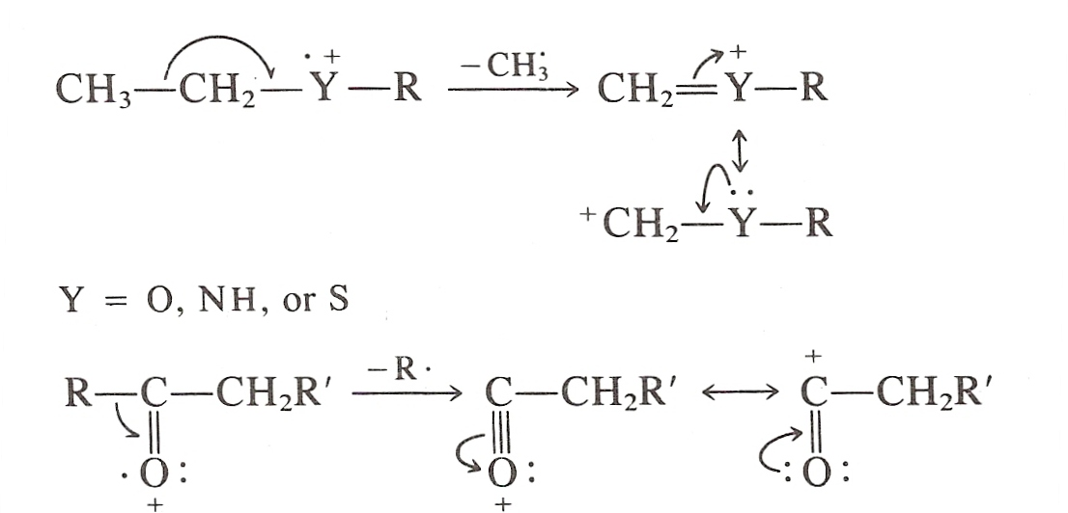
The C – C bonds next to a hetero atom are frequently cleaved, leaving the charge on the fragment containing the heteroatom whose non bonding electrons provide resonance stabilization.
Cleavage is often associated with elimination of small stable neutral molecules, such as carbon monoxide, olefins, water, ammonia, hydrogen sulfide, hydrogen cyanide, mercaptans, ketones or alcohol, often with rearrangement.

Slide 18
The Nitrogen rule :
  It provides information regarding possible formulas of the compound whose molecular weight has been determined.
  It states that a molecule of even numbered molecular mass must contain no nitrogen atom or an even number of nitrogen atoms.
  An odd numbered molecular mass requires an odd number of nitrogen atoms.
  An important proposition of this rule states that , the fragmentation at a single bond gives an odd numbered ion fragment from an even numbered molecular ion.
  Similarly, an even numbered ion fragment results from odd numbered molecular ion.
  Eg. Nitrobenzene (C₆H₅NO₂). The signal for molecular ion m/e=123 ; at odd numbered molecular mass as the compound contains only 1 nitrogen atom.
  Two important ion fragments are formed – NO₂⁺ at m/e = 46
  And NO⁺ at m/e=30.Both these fragment ions appear at even mass number.

Slide 19
Ring rule:
  It gives the index of hydrogen deficiency.
  It is the number of pairs of hydrogen atoms that must be removed from the corresponding saturated formula to produce the molecular formula of the compound of interest.
  No. of sites or degree of unsaturation.
  R is equal to the number of rings in the molecule plus the number of double bonds plus twice the number of triple bonds.
  R = no. of rings + no. of double bonds + 2(no. of triple bond)

Slide 20
Fragmentation patterns of some chemical groups:
1) Saturated Hydrocarbons-
a. Straight chain compounds: Following are the features of the mass spectra of Alkanes
The relative height of the parent peak decreases as the molecular mass increases in the homologous series.
The Molecular ion peak (although weak) is normally present.
The spectra generally consist of clusters of peaks separated by 14 mass units corresponding to differences of CH₂ groups.
The largest peak in each cluster represents C_{n}H_{2n+1} fragment. This is accompanied by C_{n}H_{2n} and C_{n}H_{2n-1} fragment corresponding to the loss of one and H atoms respectively.
A series of peaks separated by 14 mass units due to CH₂ group includes CH₃⁺, C₂H₅⁺, C₃H₇⁺, C₄H₉⁺.

Slide 21
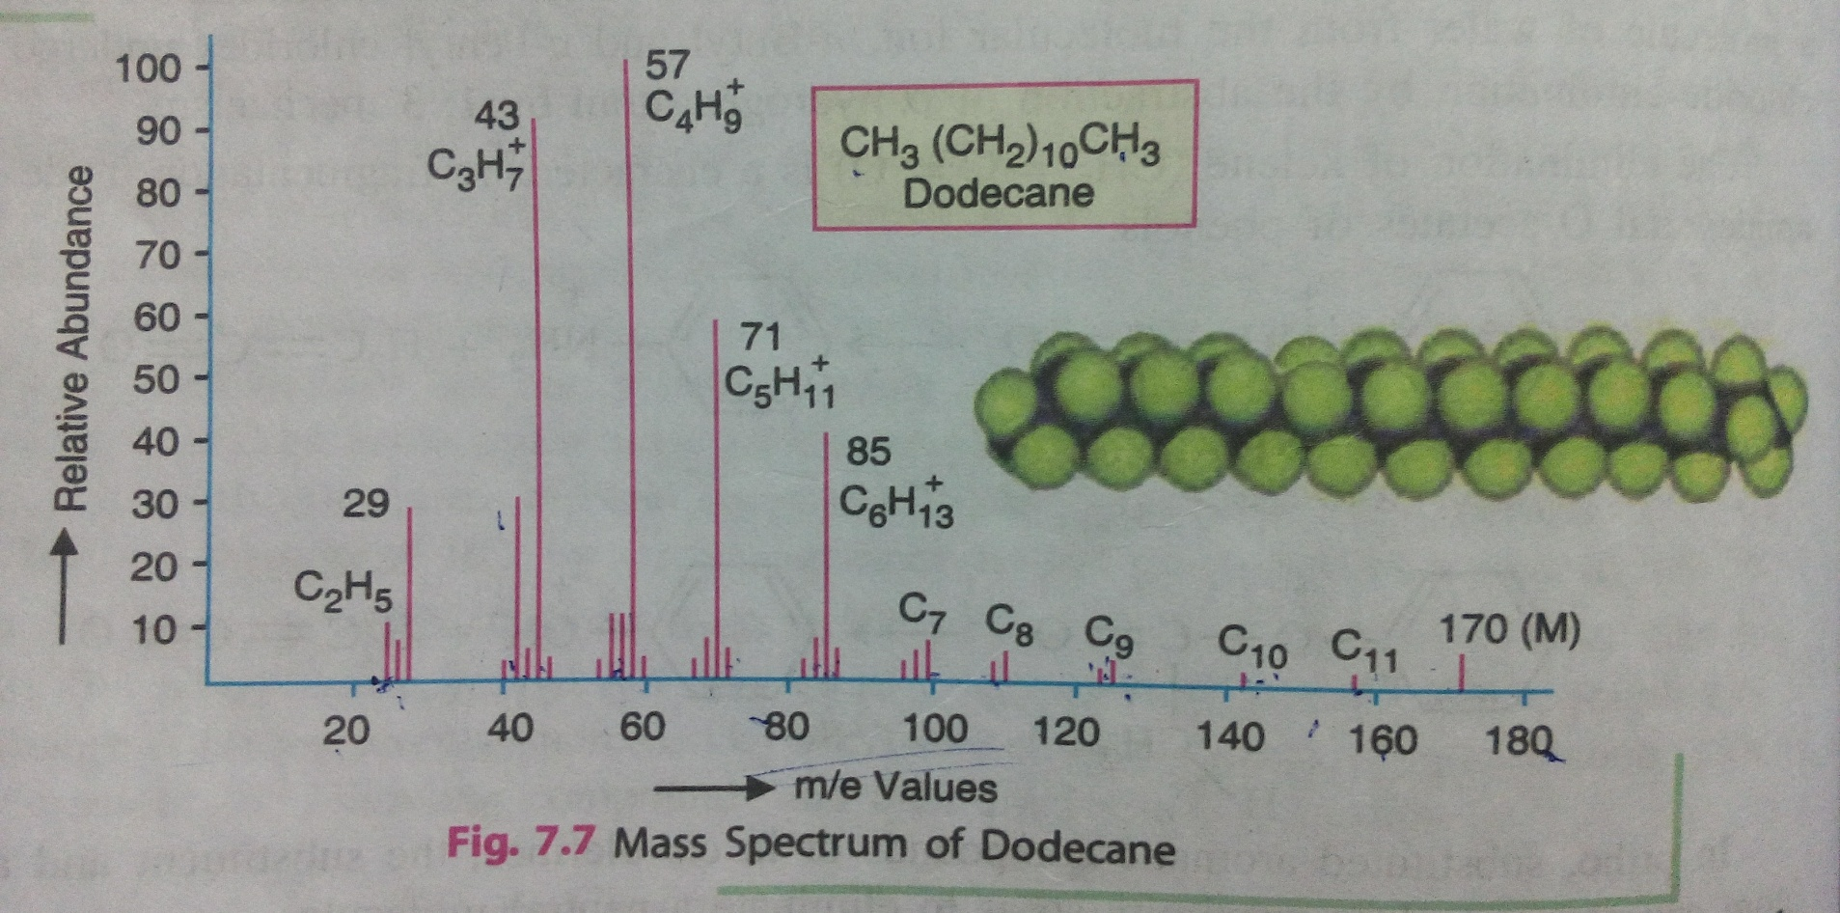
Example: Dodecane

Slide 22
b. Branched Chain Hydro Carbons:
Greater the branching in Alkanes less is the appearance of the molecular ion and if it appears, intensity will be low.
Bond cleavage takes place preferably at the site of branching. Due to such cleavage, more stable secondary or tertiary carbonium ions results.
Generally, largest substituent at a branch is eliminated readily as a radical. The radical achieves stability by the de-localization of lone electron.
Greater number of fragments results from the branched chain compound compared to the straight compound. This is due to greater pathways available for cleavage.
Ex:5-methyl pentadecane

Slide 23
2. AROMATIC HYDROCARBONS
An aromatic hydrocarbon generally shows a prominent molecular ion peak because of stabilizing effect of ring.
Alkyl substituted aromatic compounds undergo beta cleavage in the side chain and give resonance stabilized benzyl cation or more likely the tropylium ion. A prominent peak (m/e = 91) indicates the presence of an alkyl substituted benzyl ring.
m/e=91 m/e=65

Slide 24
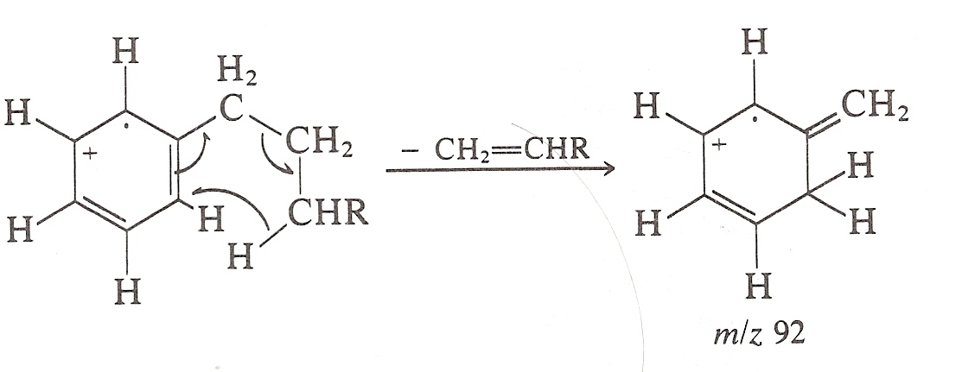
Aromatic compounds with alkyl groups having a chain of atleast three carbon atoms can undergo a shift of γ-hydrogen probably according to McLafferty rearrangement.
As a result, a prominent peak at m/e = 92 is obtained.

Slide 25
3. Cycloalkanes:
In case of cycloalkanes, the molecular ions are more abundant because the ring structures are more stable. Skeletal fissions occur which involves the fission of atleast two bonds.
It favors cleavage at the bond connecting the ring to the rest of the molecules.
The stability of the fragment ion depend upon the size of the ring.
Fragment ions are commonly observed by the loss of alkenes ions.

Slide 26
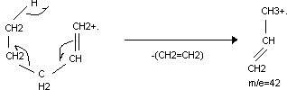
4. ALKENES:
The molecular ion of alkenes containing one double bond tends to undergo allylic cleavage i.e. at the beta bond without the double bond and gives resonance structure.
The relative abundance of the molecular ion peak decreases with increase in molecular mass.
The cyclic olefin also shows group of peaks which are 14 mass units apart.
The general mode of fragmentation is the allylic cleavage.
The fragments formed by Mc Lafferty rearrangement are intense.
Ex: 1-pentene

Slide 27
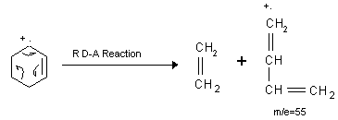
5. Cycloalkenes:
Cycloalkenes usually show a distinct molecular ion peak. A unique mode of cleavage is a type of Retro Diels-Alder reaction. The fragmentation mode involves the cleavage of two bonds of a cyclic system resulting in the formation of two stable unsaturated fragments in which two new bonds are formed.

Slide 28
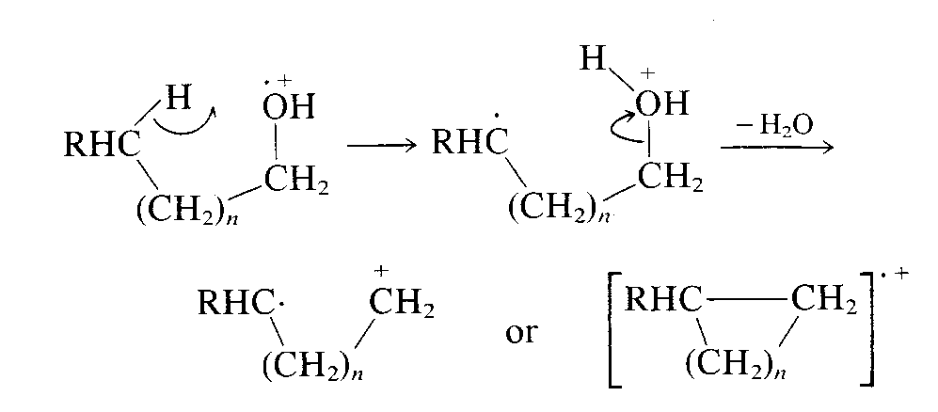
6. Alcohols
The molecular ion peak of 1º and 2ºalcohol is usually of low abundance. It is not detected in 3º alcohols.
The fragmentation modes in alcohols depend upon the fact whether it is 1º, 2º or 3º alcohols.
The fragmentation of C-C bond adjacent to oxygen atom is the preferred fragmentation mode i.e. α cleavage.
1º alcohols shows M-18 peaks, corresponding to the loss of water.

Slide 29
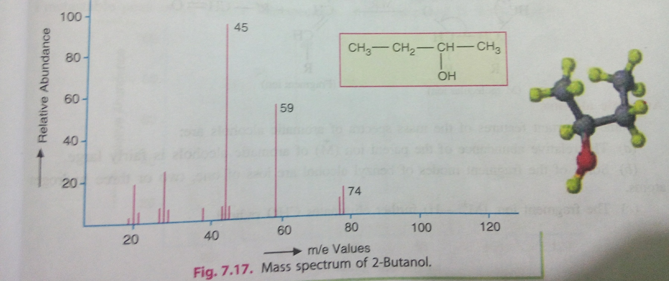
Long chain members may show peaks corresponding to successive loss of H radicals at M-1, M-2 and M-3.
The CH₂=OH is the most significant peak in the spectra of 1º alcohols.
Secondary alcohols cleave to give prominent peaks due R-CH=OH at m/z=45,59,73.
Tertiary alcohols fragment to give prominent peaks due to RR’C=OH⁺ at m/z 45,59,73.

Slide 30
7. PHENOLS:
The molecular ion peak is intense.
The peak due to the loss of hydrogen radical, M⁺ - H is small.
The fragment ion due to the loss of carbon monoxide is significant M-28 (Loss of CO) & M-29 (Loss of CHO) peaks.
M-29
m/e=65
M-28

Slide 31
8. Aliphatic acids:
The molecular ion peak in aliphatic acids is less intense as compared to that of aromatic acids.
Carboxyl group is directly eliminated by α cleavage and a signal is formed at m/e 45.
If α carbon atom is not substituted in aliphatic acids containing a gamma hydrogen atom, Mc Lafferty rearrangement ion is formed at m/e 60. It is often the base peak.
In short chain acids, M-OH and M-COOH peaks are prominent.

Slide 32
9. Ethers
Aliphatic ethers undergo facile fragmentation and exhibit a weak molecular ion peak because the resultant ion is highly stabilized by resonance.
The major fragmentation modes occur through α and β cleavages
α cleavage :
Cleavage of a bond α to oxygen occurs, the positive charge being retained on the carbon rather than on oxygen.
β cleavage:
A heteroatom induces cleavage at a bond β to it. Such a cleavage favors the loss of larger group as a radical. The ion undergoes further fragmentation to give the series of ions at m/z 45, 59, 73, 87.
Ex: Ethyl sec-butyl ether.

Slide 33
FACTORS AFFECTING FRAGENTATION
Thermal decomposition:
Thermolabile compounds may undergo thermal decomposition before ionisation, which may lead to difficulty in the interpretation of the mass spectra of compounds
Bombardment energies:
Compounds are bombarded with a beam of energetic electron from a filament to energy of 70eV. If this energy is reduced to 20eV fragmentation pattern changes, the concentration of ions reduced and the spectra intensity is also reduced

Slide 34
Reference :
Instrumental method of chemical analysis by , B.K.Sharma .
Spectrometric identification of organic compound by , R.M.Silverstein.
Element organic spectroscopy by Y.R.Sharma.
Introduction of spectroscopy by Pavia.
Text book of pharmaceutical analysis by Dr.S.Ravishankar.

Slide 35


