Slide 1

MEDICINAL CHEMISTRY
PRODRUG
17-07-2020
1

Slide 2
PRODRUG
Prodrug is defined as a Pharmacologically inactive compound that is converted in to an active drug by a chemical or enzymatic process (metabolic reaction)
The prodrug to drug conversion can occur before absorption, during absorption, after absorption or at a specific site in the
body.
+
PRODRUG DRUG CAP
( CONCEPT OF PRODRUG)
17-07-2020
2

Slide 3
PRODRUG
Generally prodrugs are designed to improve patient acceptability such as to reduce pain during
administration or alter the absorption, distribution, metabolism and elimination (ADME) of the drug.
Prodrugs are also designed based on the aspects of the drugs action that requires improvement and the
type of functionality that is present in the drug.
17-07-2020
3

Slide 4
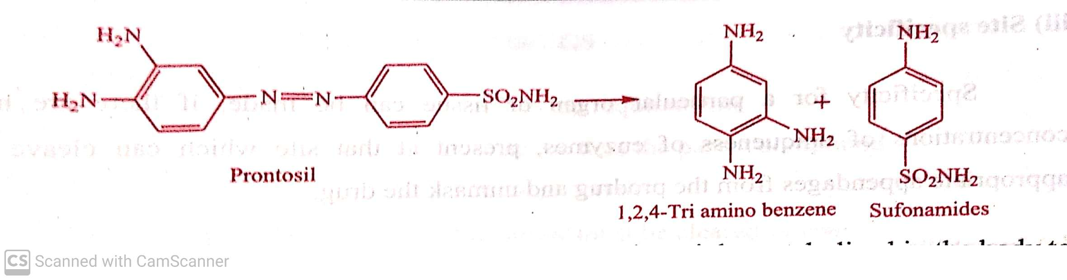
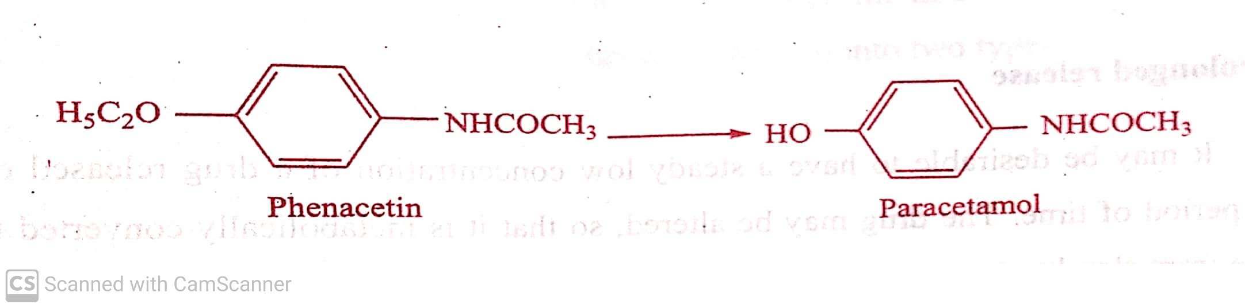
PRODRUG
Ex. i) Azo-dye Prontosil had Antibacterial activity, is a prodrug for sulphonamide which led to subsequent development of wide
range of therapeutically superior sulphonamides through the modification of Amino benzene sulphonamides.
ii) Phenacetin, an analgesic and antipyretic agent is mainly metabolized in the body to active metabolite N- acetyl-p-amino
phenol(paracetamol).
Paracetamol has replaced phenacetin therapy because it is free from toxic effects associate with phenacetin (Methaemoglobin
formation).
17-07-2020
© R R INSTITUTIONS , BANGALORE
4

Slide 5
PRODRUG
Utility of prodrugs: There are many reasons why one may wish to utilize a prodrug strategy in drug design.
Few examples:
Solubility
Absorption and distribution
Site of specificity
Instability
Prolonged release
Toxicity
Poor patient acceptability
Formulation problems
17-07-2020
5

Slide 6
PRODRUG
Ideal requirements of Prodrugs:
An ideal prodrug must meet the following requirements.
The prodrug should be inactive or less active than the parent compound.
It should not have intrinsic (natural) Pharmacological activity.
The linkage between the drug and the carrier must be cleared in vivo.
The carrier molecule released in vivo must be non toxic.
17-07-2020
6

Slide 7
PRODRUG
TYPES OF PRODRUG: Depending upon the constitution, lipophilicity, method of bio-activation and catalyst involved in bio-activation, prodrugs are classified into two types
Carrier linked prodrugs
Bio-precursors
a) Carrier linked prodrug: Is a compound that contains an active drug linked to a carrier group that can be removed enzymatically, such as ester which is hydrolysed to active carboxylic acid containing drug.
Enzyme Spontaneous
Carrier—Linker–--Drug Carrier + Linker ---Drug Linker + Drug
17-07-2020
7

Slide 8
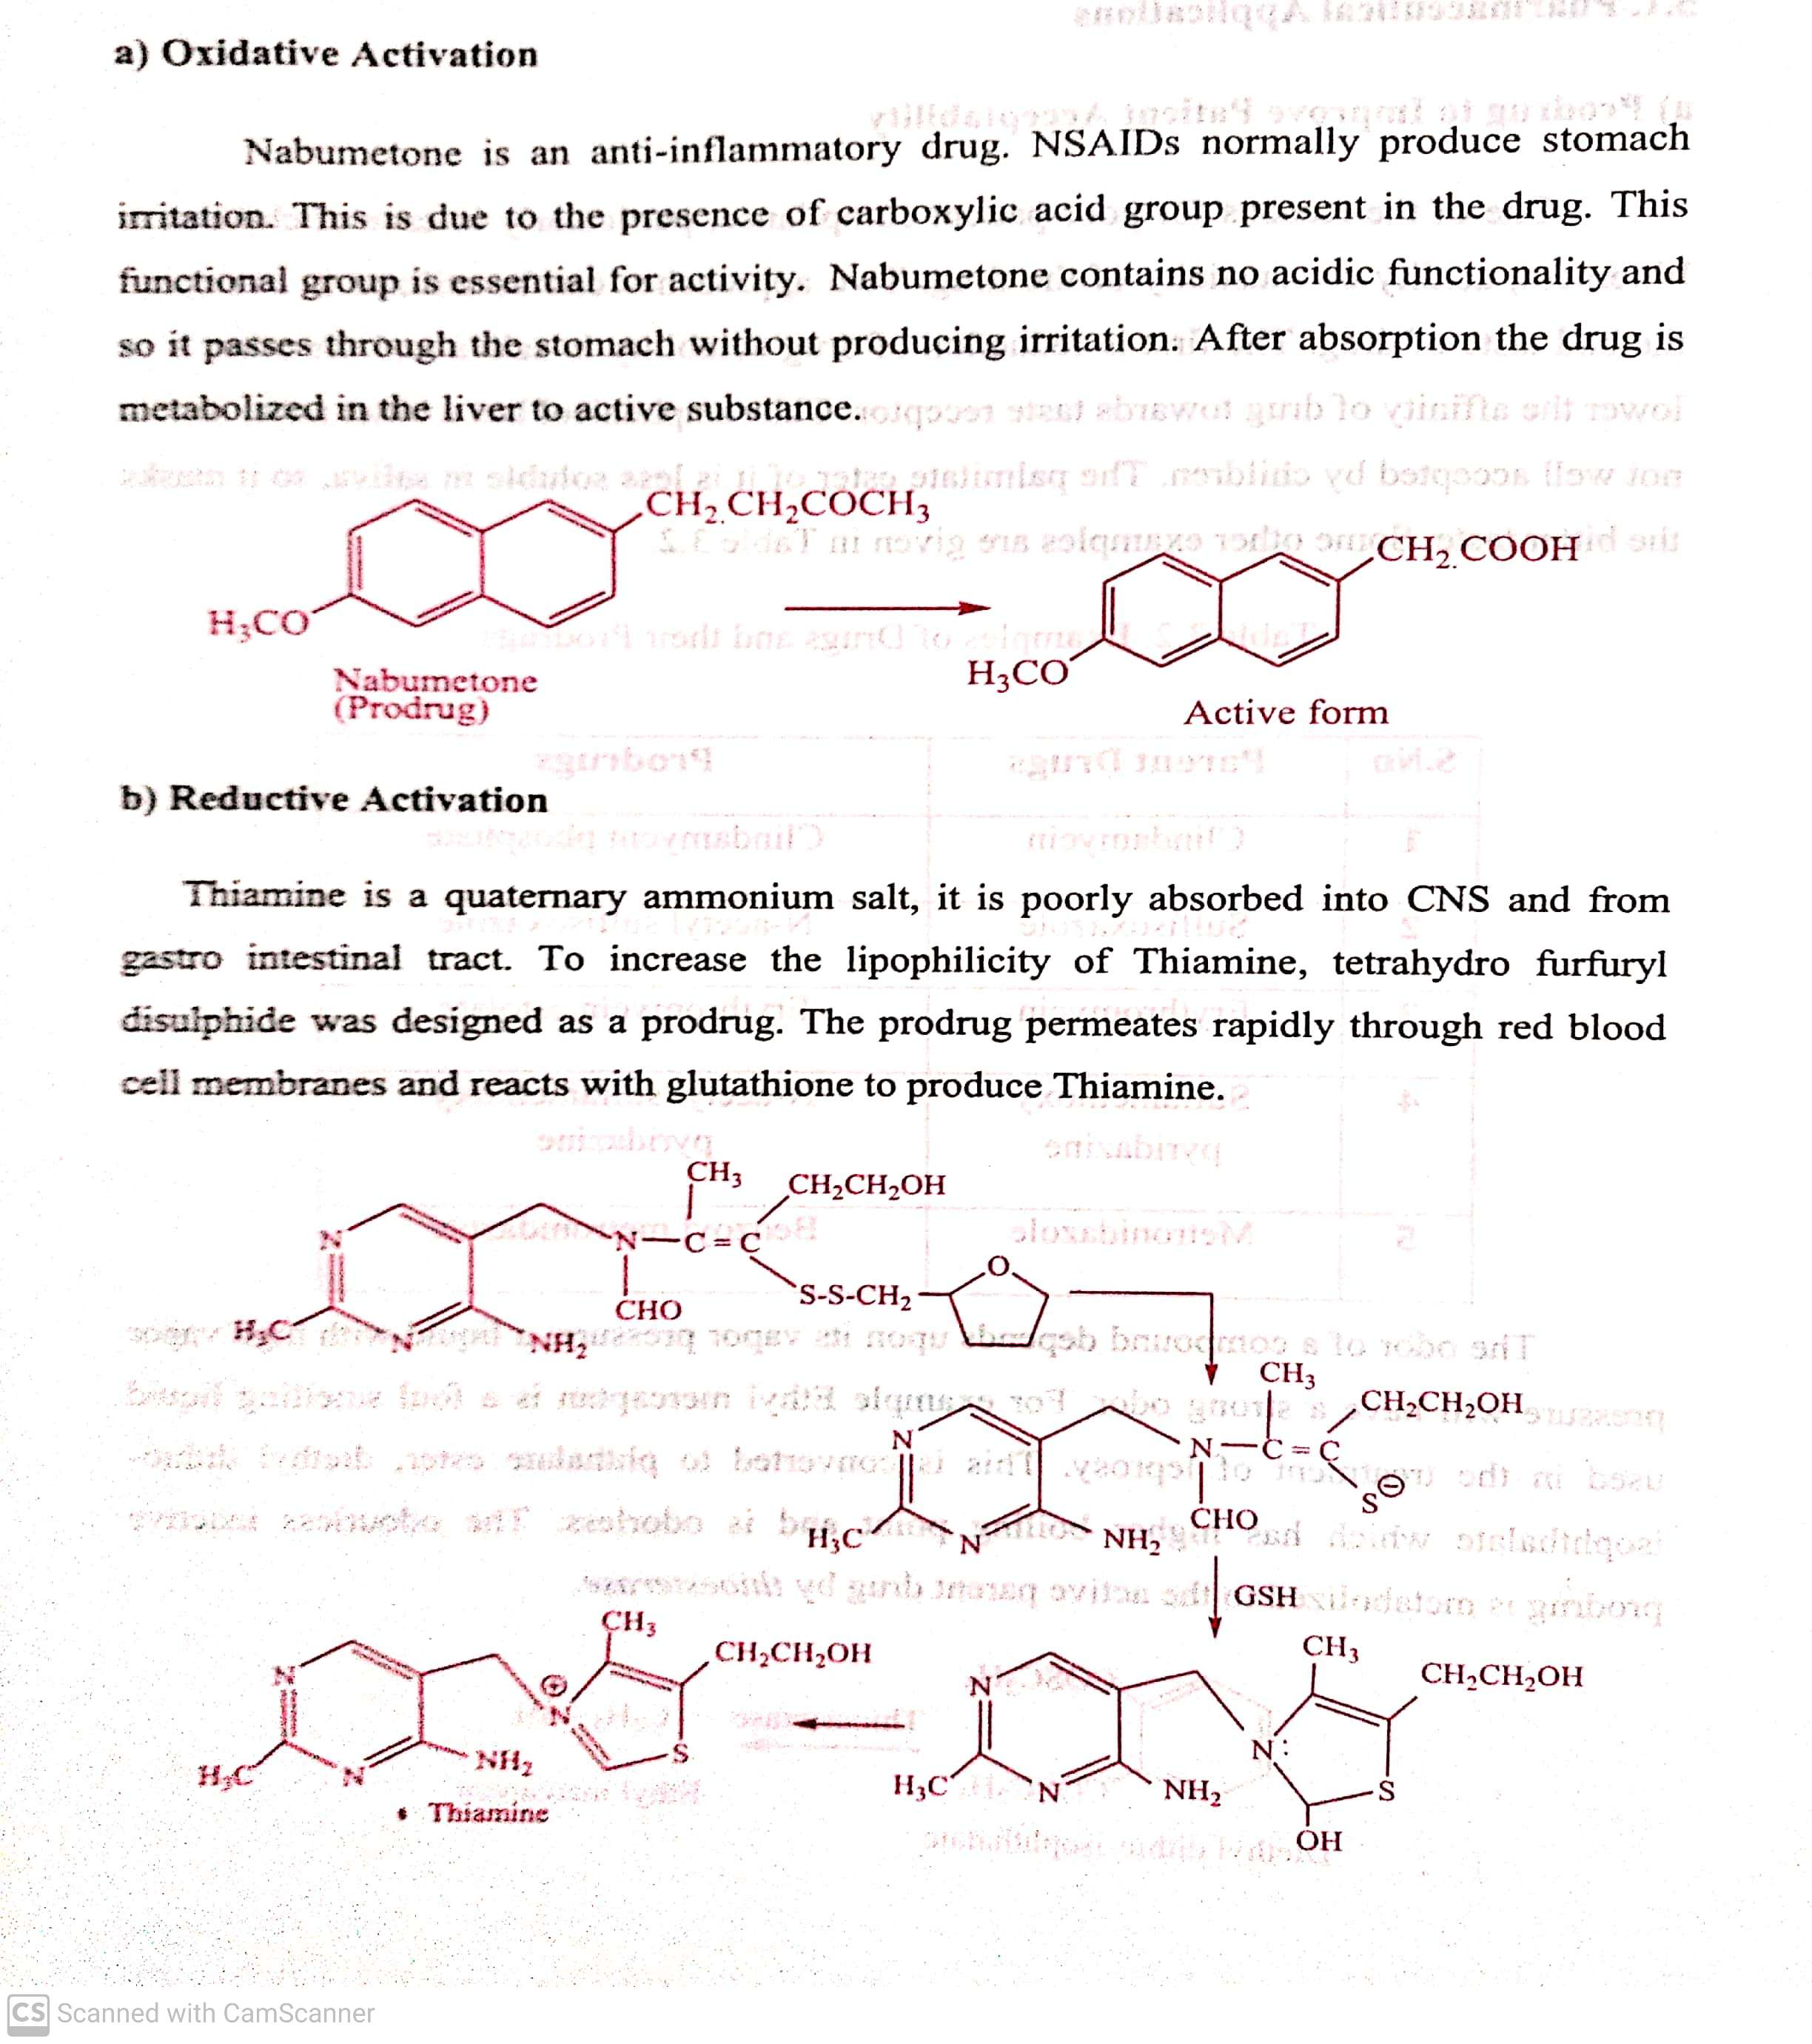
PRODRUG
b) Bio-precursors: These are inert molecule obtained by chemical modification of the drugs but do not contain a carrier.
For Ex. If the drug contains carboxylic acid group, the bio precursor may be primary amine, which is metabolized by oxidation to
aldehyde which is further metabolized to carboxylic acid drug.
17-07-2020
8

Slide 9
PRODRUG
APPLICATIONS OF PRODRUGS:
Pharmaceutical applications
a) Prodrug to improve Patient Acceptability
b) Prodrug to improve Stability
c) Prodrug to Overcome Formulation problem
2) Pharmacological applications
a) Prodrug to improve Absorption:
i) Oral absorption
ii) Dermal absorption
iii) Ocular absorption
b) Prodrug for site specific drug delivery
i) Site directed drug delivery
ii) Site specific Bio-activation
c) Prodrug for slow and Prolonged Release (sustained release action)
d) Prodrug to improve Membrane Transport
e) Prodrug for Prolonged Duration of action
17-07-2020
9

Slide 10
THANK YOU
17-07-2020
10

