Slide 1

MEDICINAL CHEMISTRY
ANTI-INFECTIVE AGENTS
20-07-2020
1

Slide 2
A) LOCAL ANTI-INFECTIVE AGENTS
Disinfectants and Antiseptics are the chemical agents used as Anti-infective.
Employed to destroy / inhibit the growth of pathogenic microorganism in the non sporing / vegetative spores.
Disinfection :
Disinfectants:
Antiseptics :
20-07-2020
2

Slide 3
A) LOCAL ANTI-INFECTIVE AGENTS
Classification
1. Alcohol and related compounds: Ethyl alcohol ( Dehydrated ethanol), Isopropyl alcohol, Ethylene oxide.
2. Aldehydes : Formaldehyde , Glutaraldehyde.
3. Phenols and their derivatives: Phenol, p-Chlorophenol, Hexachlorophene, Resorcinol, Cresol, Hexylresorcinol.
4. Oxidising agents: Hydrogen peroxide, Hydrous benzoyl peroxide.
5. Halogen containing compounds:
a) Iodine compounds : Povidone-iodine.
b) Chlorine containing compounds: Halazone, Chloroazodin .
6. Cationic surfactants: Benzalkonium chloride, Cetyl pyridinium chloride
7. Dyes: Gentian violet and Methylene blue.
8. Mercury compounds: Nitromersol, Thiomersol, Nitrofurazone, Nitrofurantoin .
9. Preservatives: a) P-Hydroxy benzoic acid derivatives: Methyl paraben, Propyl paraben
Ethyl paraben, Butyl paraben.
b) Others: Sodium benzoate, phenyl mercuric acetate, phenyl mercuric nitrate
Chlorobutanol, Benzyl alcohol.
20-07-2020
3

Slide 4
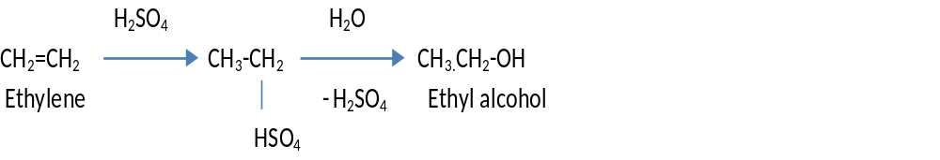
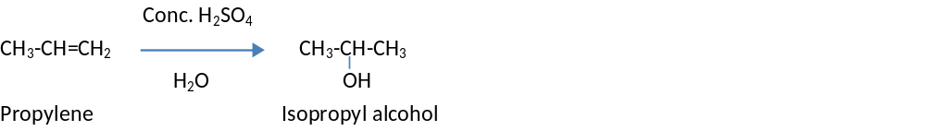
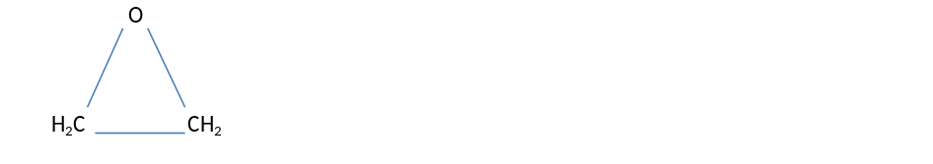
A) LOCAT ANTI-INFECTIVE AGENTS
Alcohol and related compounds: a) Ethyl alcohol : CH₃-CH₂-OH It is clear, colourless, volatile liquid with burning taste.
It has a characteristic odour. It is flammable and miscible with water.
Synthesis :
Uses: Used as Antiseptic, Preservatives, Mild counter irritant, Astringent and mild local anaesthetics.
Also used for the preparation of Spirits, Tinctures and fluid extracts.
b) Isopropyl alcohol: CH₃-CH-CH₃
OH
Synthesis :
Uses : Used in Pharmaceuticals and Toiletries as solvent & Preservatives.
Used for disinfection of hypodermic syringes & needle & as rubbing alcohol, a skin antiseptic
c) Ethylene oxide : Uses : Used to sterilize temperature sensitive medical
equipment and certain pharmaceuticals that cannot
be heat sterilized in an autoclave.
20-07-2020
© R R INSTITUTIONS , BANGALORE
4

Slide 5
A) LOCAT ANTI-INFECTIVE AGENTS
Aldehydes : a) Formaldehyde : HCHO It is colourless aqueous solution, containing not less than 37% w/v of formaldehyde.
O
H-C-OH (Formic Acid)
(O)
HCHO
(Polymerization) O
O O ( Paraformaldehyde)
Uses : Used as disinfectant, active against Gram +ve & -ve bacteria, spores & Fungi.
b) Glutaraldehyde: CHO
(CH2)3.CHO
1,5- Pentanedial
Uses : Its dilute solution is used for sterilization of equipment's & instruments that cannot be autoclaved
20-07-2020
5

Slide 6
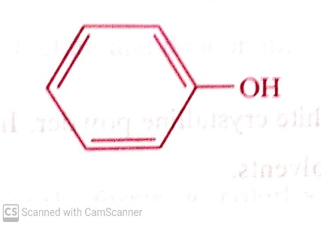
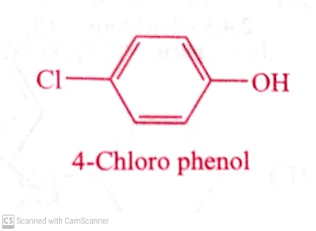
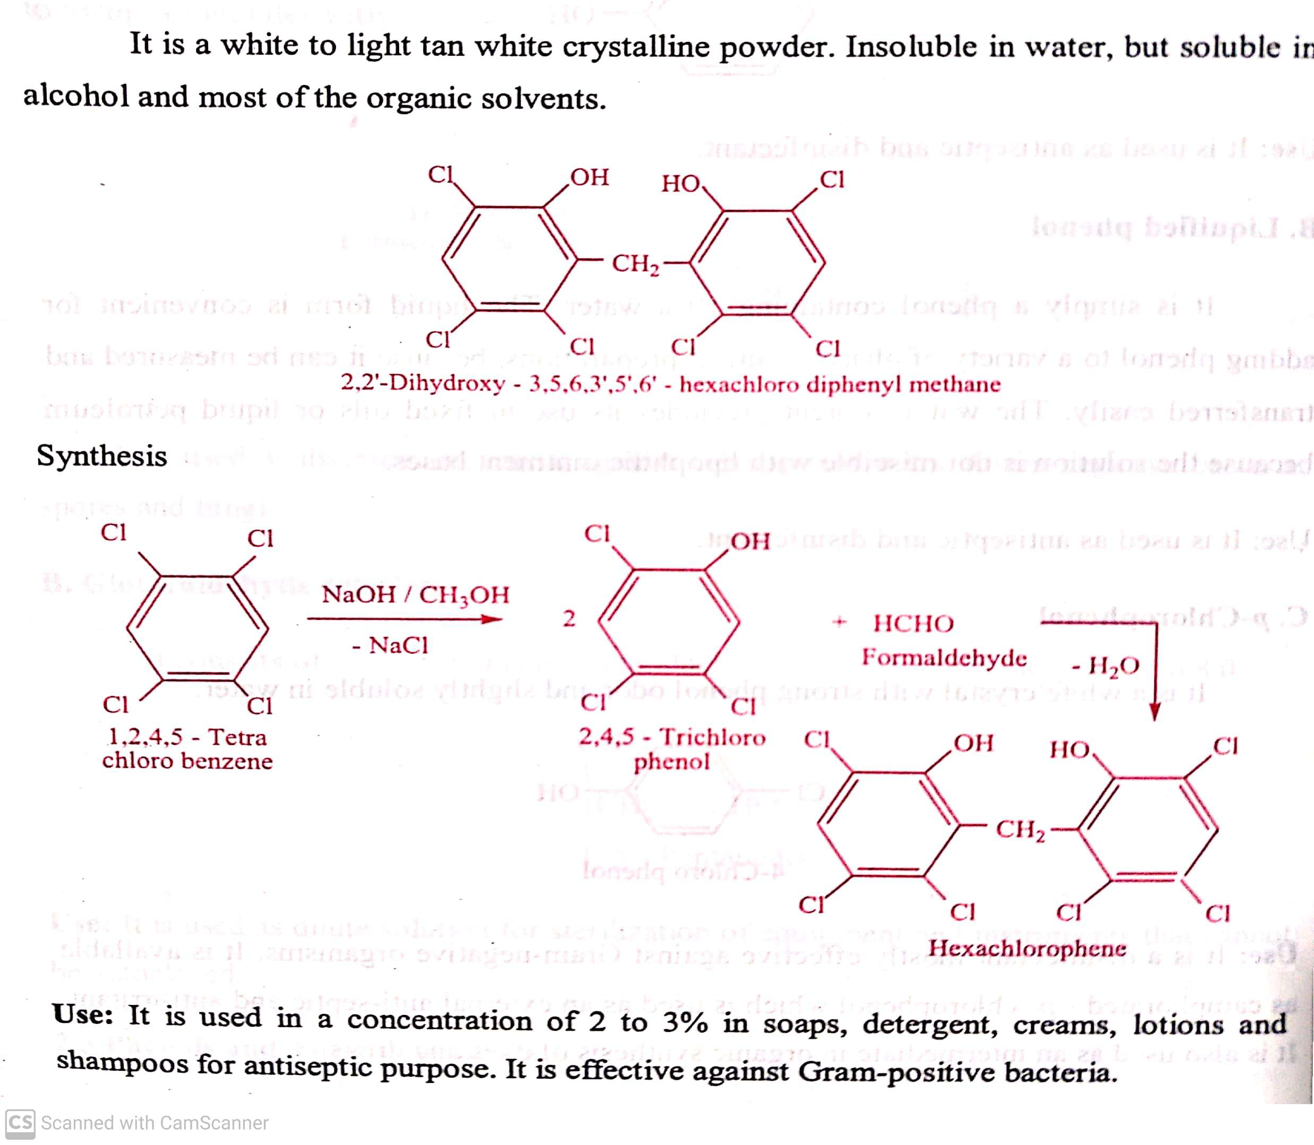
A) LOCAT ANTI-INFECTIVE AGENTS
3. Phenols and their derivatives: Phenol, p-Chlorophenol, Hexachlorophene, Resorcinol, Cresol, Hexylresorcinol.
Phenol : It is also known as carbolic acid.
It is colourless – pale pink crystalline material with a characteristic odour.
It is soluble in water & Methanol.
Use: it is used as antiseptic and disinfectant.
b) p-Chlorophenol : It is a white crystal with strong phenol odour and slightly soluble in water.
Use: It is a Disinfectant effective against Gram –ve organism.
Hexachlorophene :
20-07-2020
6

Slide 7
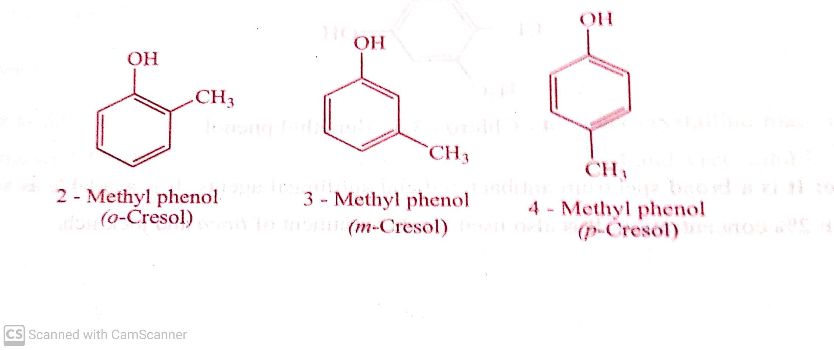
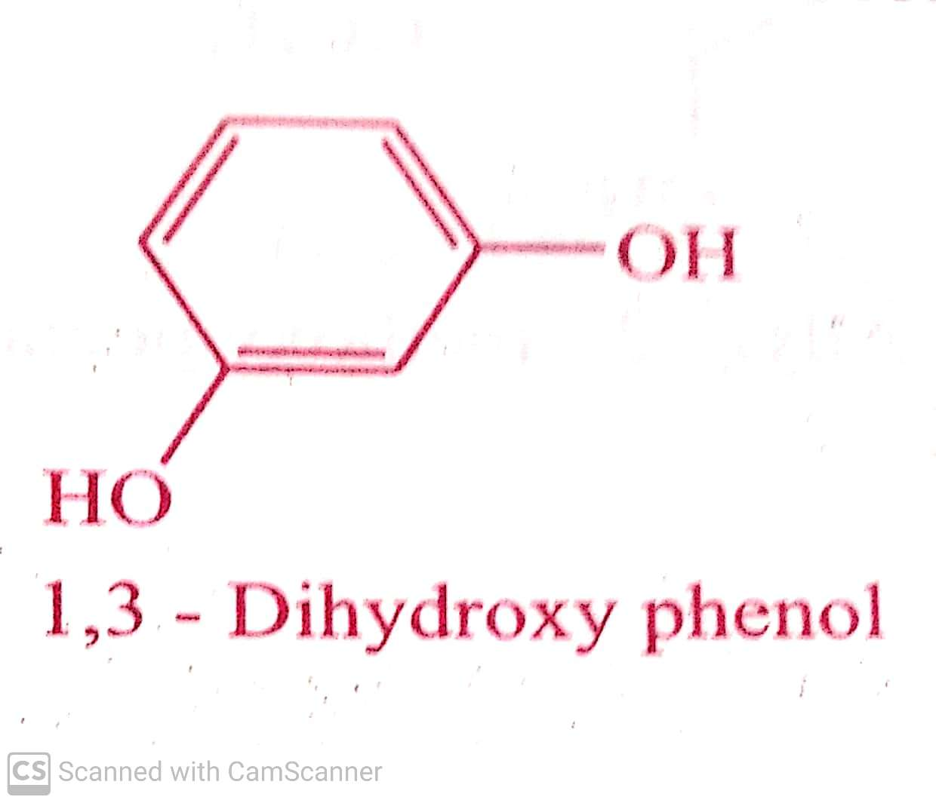
A) LOCAT ANTI-INFECTIVE AGENTS
d) Cresol : Chemically it is a methyl phenols. Depending upon the temperature it may be solid or liquid. On exposure to air , it
slowly oxidises.
Use : it is used as antiseptic, disinfectant and deodorant.
e) Resorcinol : It is a Dihydroxy phenol. It is readily soluble in water, alcohol & ether but insoluble in chloroform.
Use: It is a weak antiseptic and used in the treatment of skin infection such as ringworm, eczema, psoriasis etc.,
20-07-2020
7

Slide 8
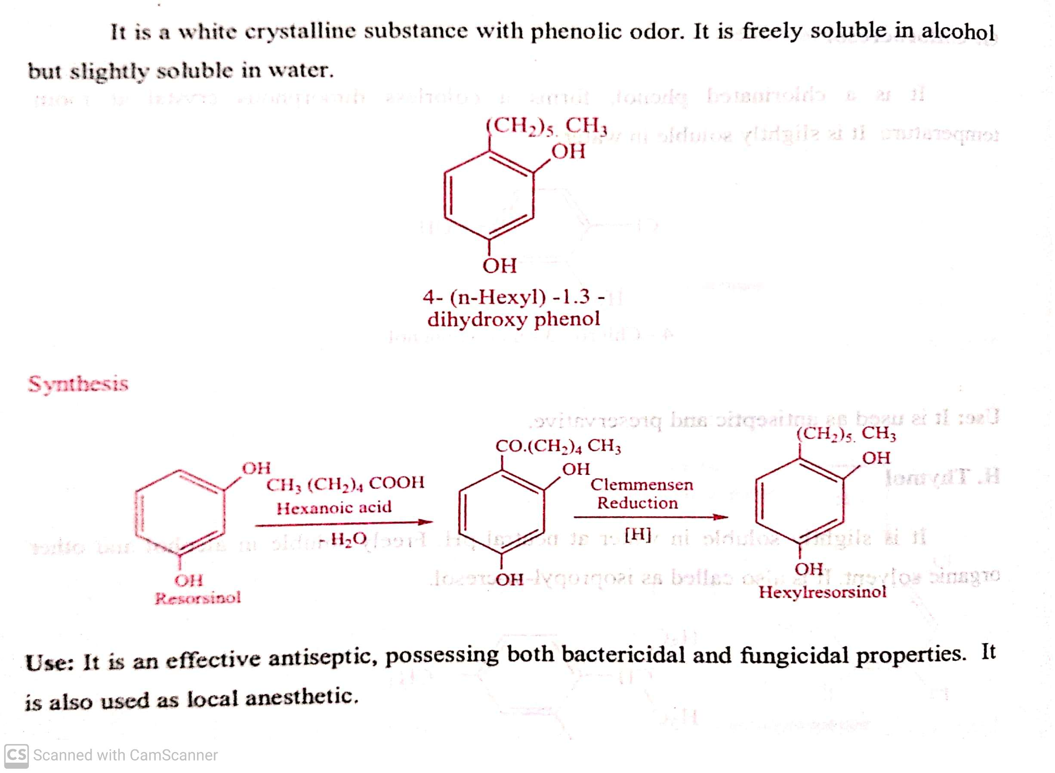
A) LOCAT ANTI-INFECTIVE AGENTS
f) Hexylresorcinol :
20-07-2020
8

Slide 9
A) LOCAT ANTI-INFECTIVE AGENTS
Clemmensen Reduction
Is a chemical reaction, Reduction of Ketone or Aldehyde to Alkanes using Zinc amalgam and Hydrochloric acid.
O Zn(Hg) X X
-------------------------→
HCl
R1 R2 R1 R2
20-07-2020
9

Slide 10
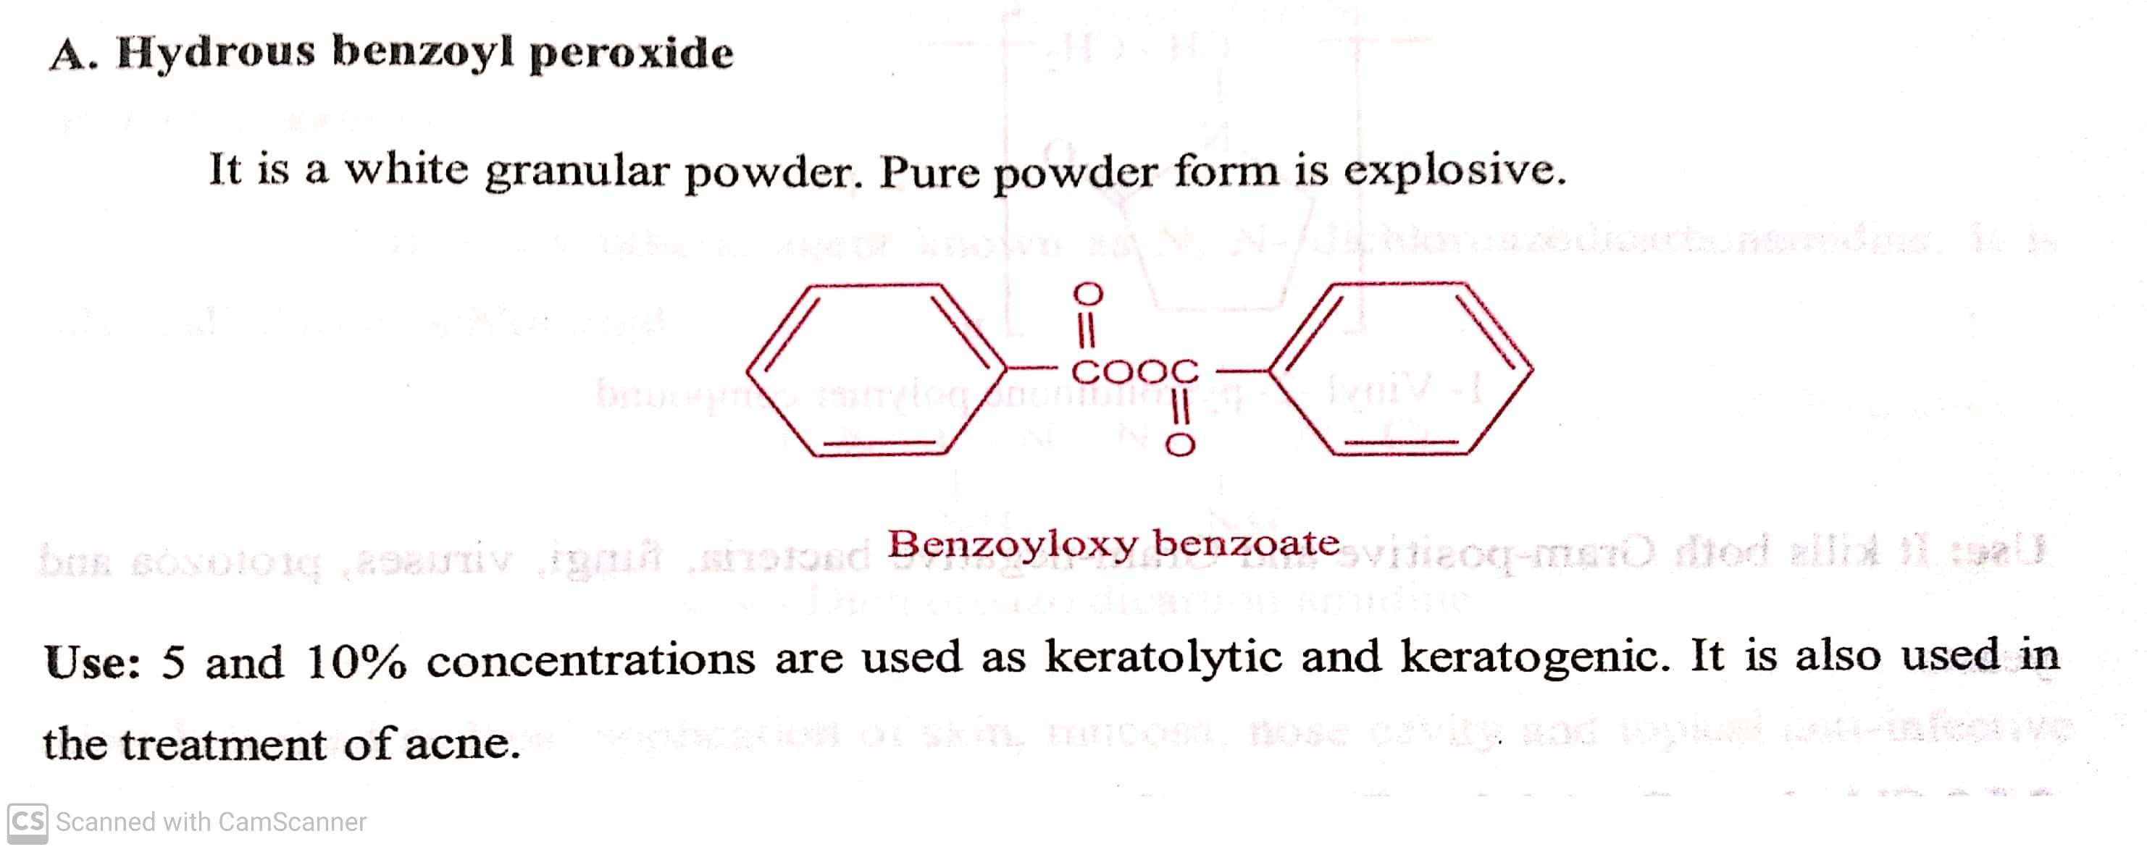
A) LOCAT ANTI-INFECTIVE AGENTS
Oxidising agents: a) Hydrous benzoyl peroxide b) Hydrogen peroxide.
Oxidizing agents acts as germicide and its activity depends on their ability to liberate oxygen in the host.
20-07-2020
10

Slide 11
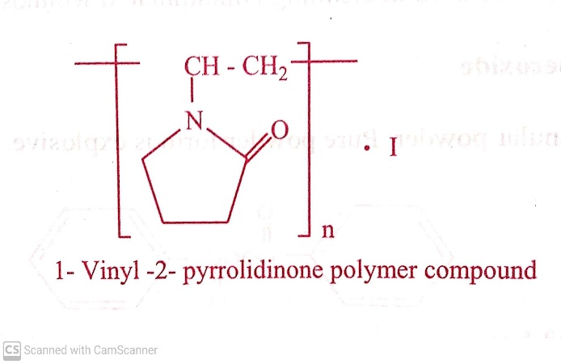
A) LOCAT ANTI-INFECTIVE AGENTS
5. Halogen containing compounds: a) Iodine compounds : Povidone-iodine.
b) Chlorine containing compounds: Halazone, Chloroazodin .
Iodine compounds : Povidone-iodine.
It is a complex of iodine with polymeric compound (1-Vinyl-2-pyrolidinone).
It is a Yellowish – brown amorphous powder, have slight characteristic odour.
It is soluble in water, alcohol but insoluble in chloroform, ether, hexane and acetone.
Use: It kills both gram +ve and gram –ve bacteria, fungi, viruses, protozoa and yeast.
20-07-2020
11

Slide 12
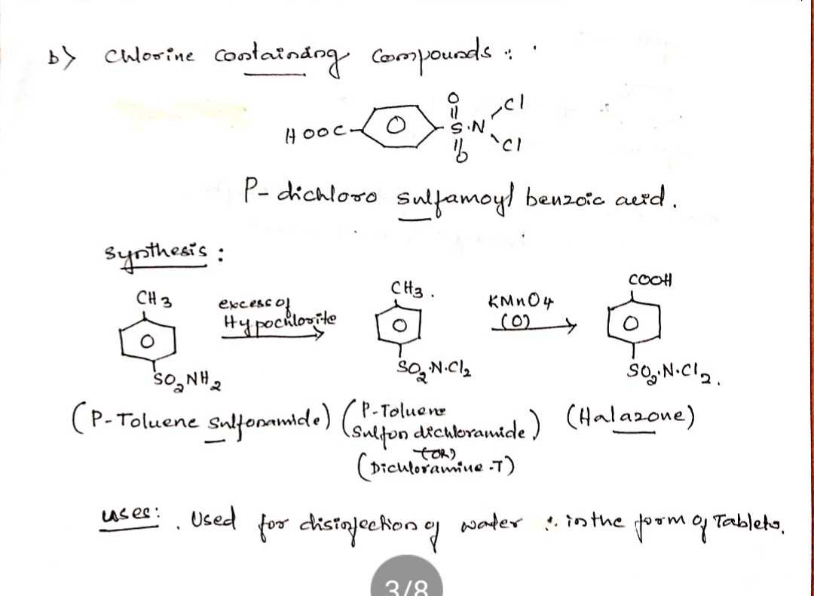
A) LOCAT ANTI-INFECTIVE AGENTS
b) Chlorine containing compounds: a) Halazone, Chloroazodin .
a) Halazone: It is a white crystalline powder having chlorine like odour. It is slightly soluble in water.
Use : It is used for disinfection of water in form of tablet.
20-07-2020
12

Slide 13
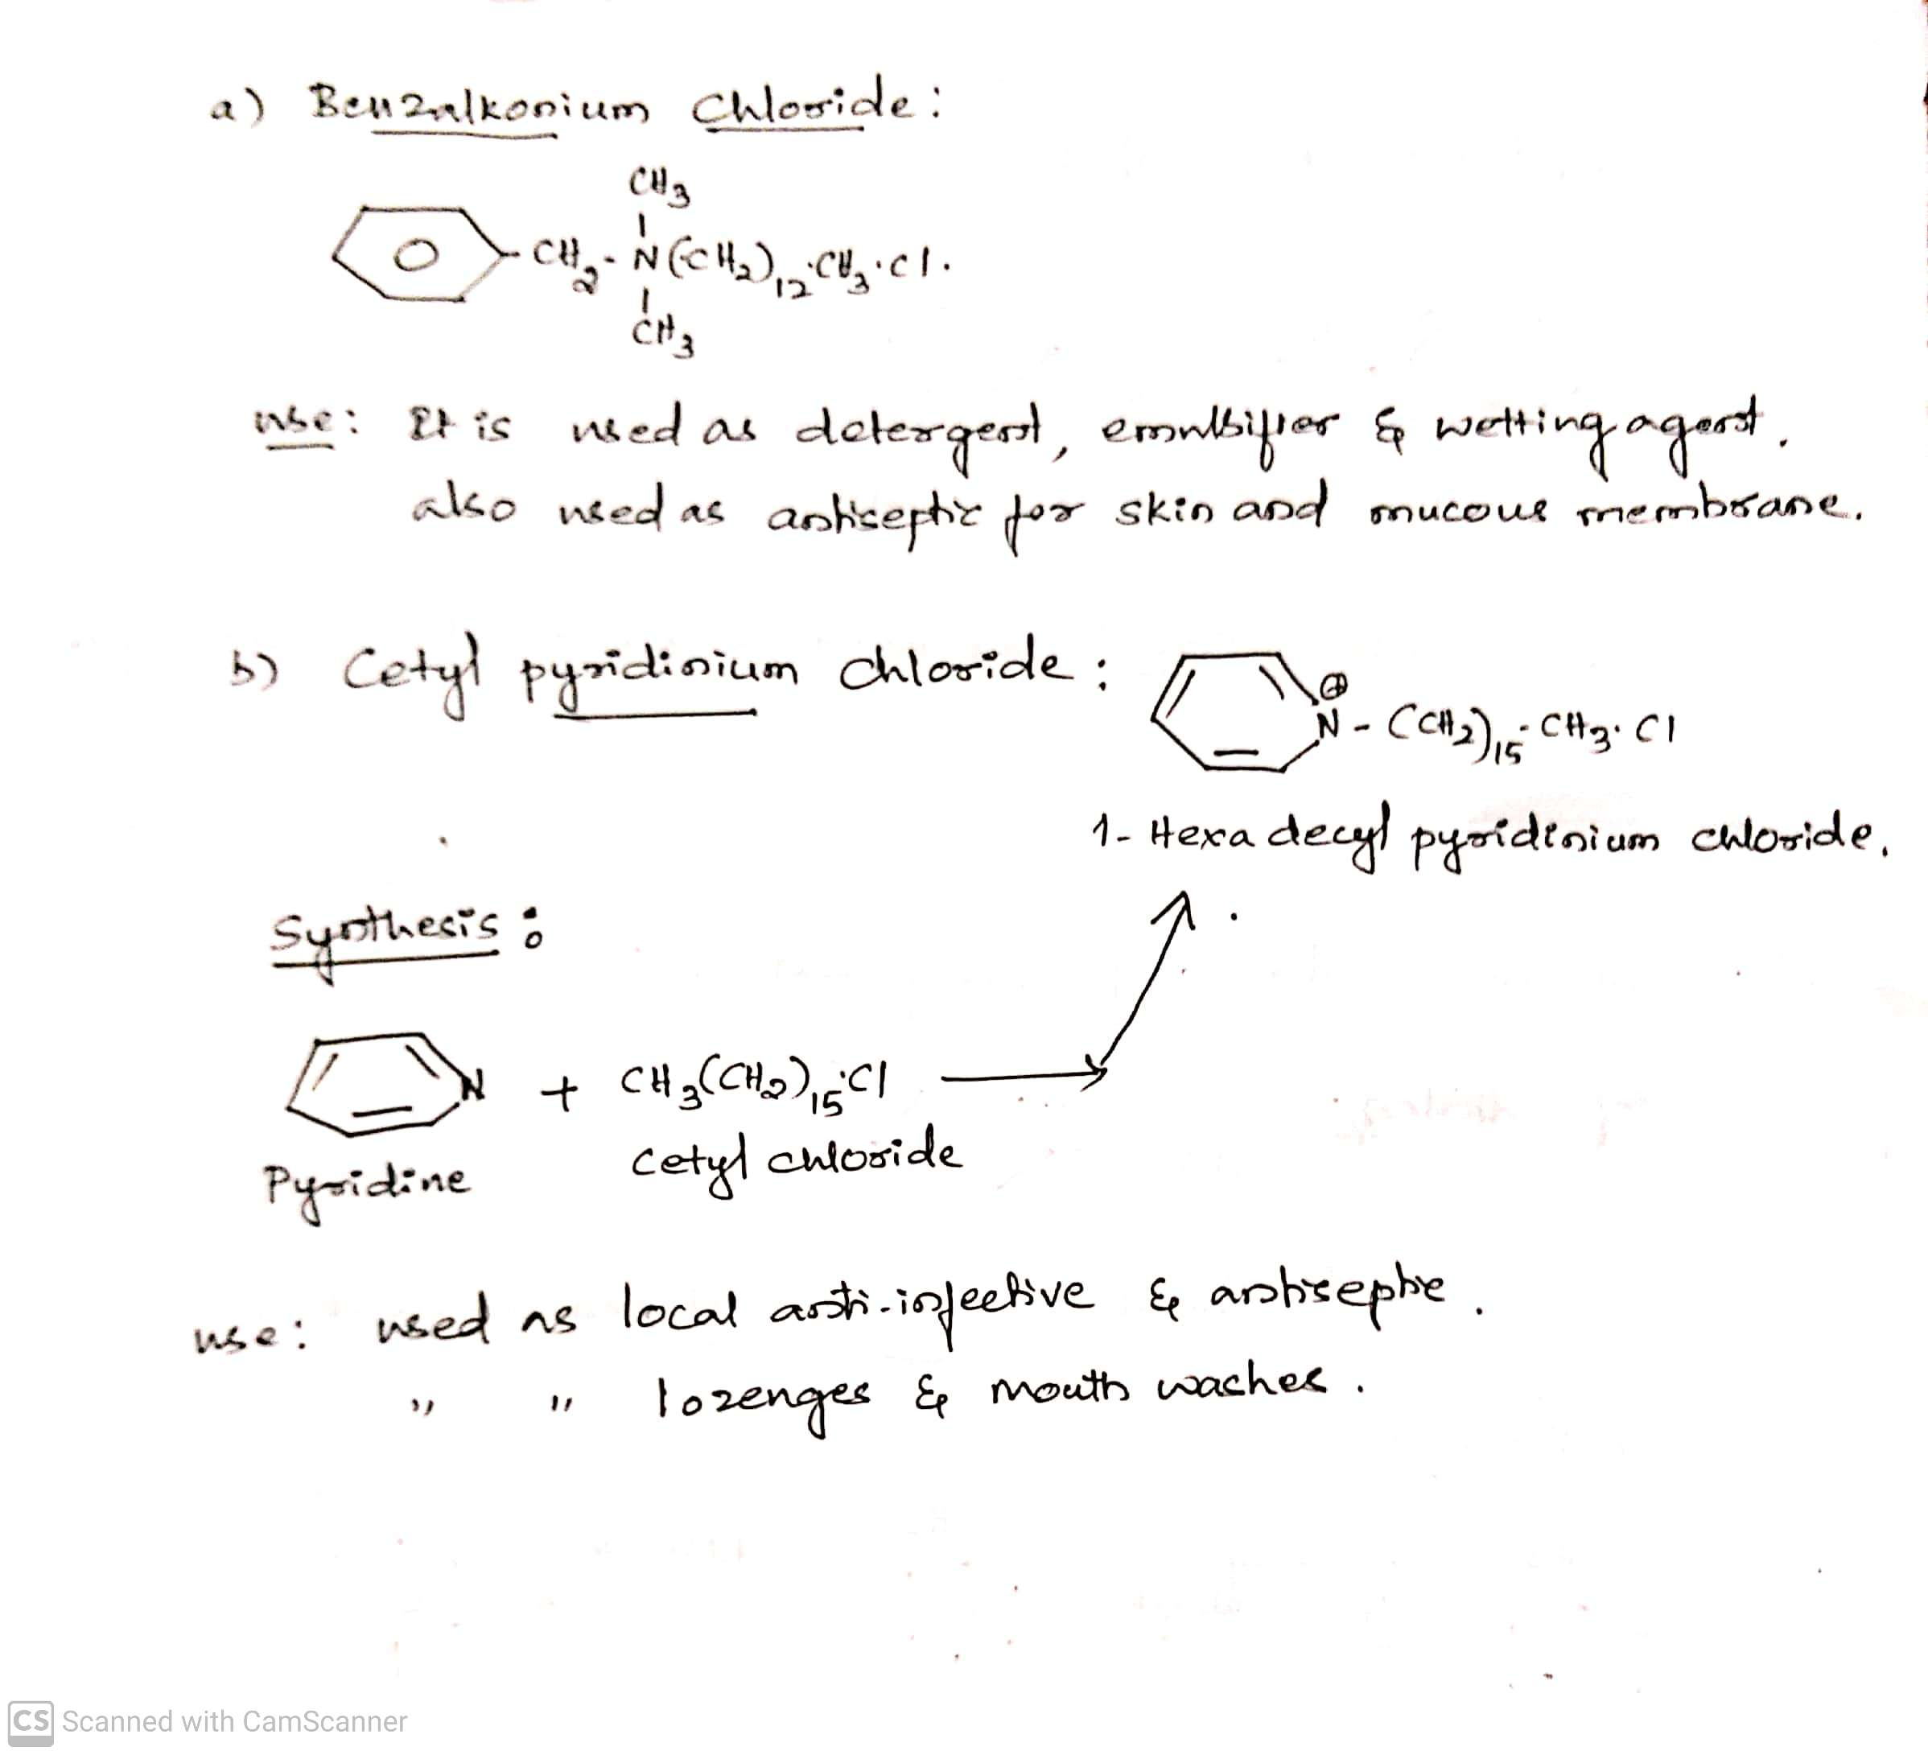
A) LOCAT ANTI-INFECTIVE AGENTS
Cationic surfactants: Benzalkonium chloride, Cetyl pyridinium chloride,
Methylbenzethonium chloride.
These are quaternary ammonium compounds. The surfactants exert a bacterial action against a broad spectrum of Gram +ve and
gram –ve bacteria.
20-07-2020
13

Slide 14
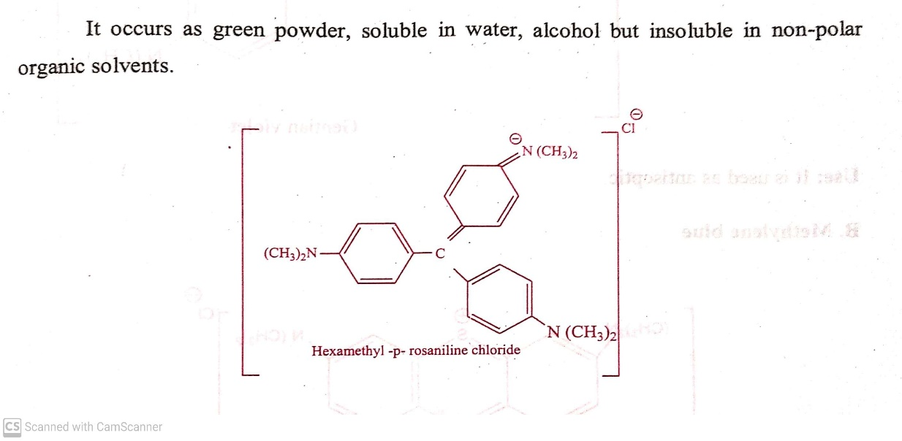
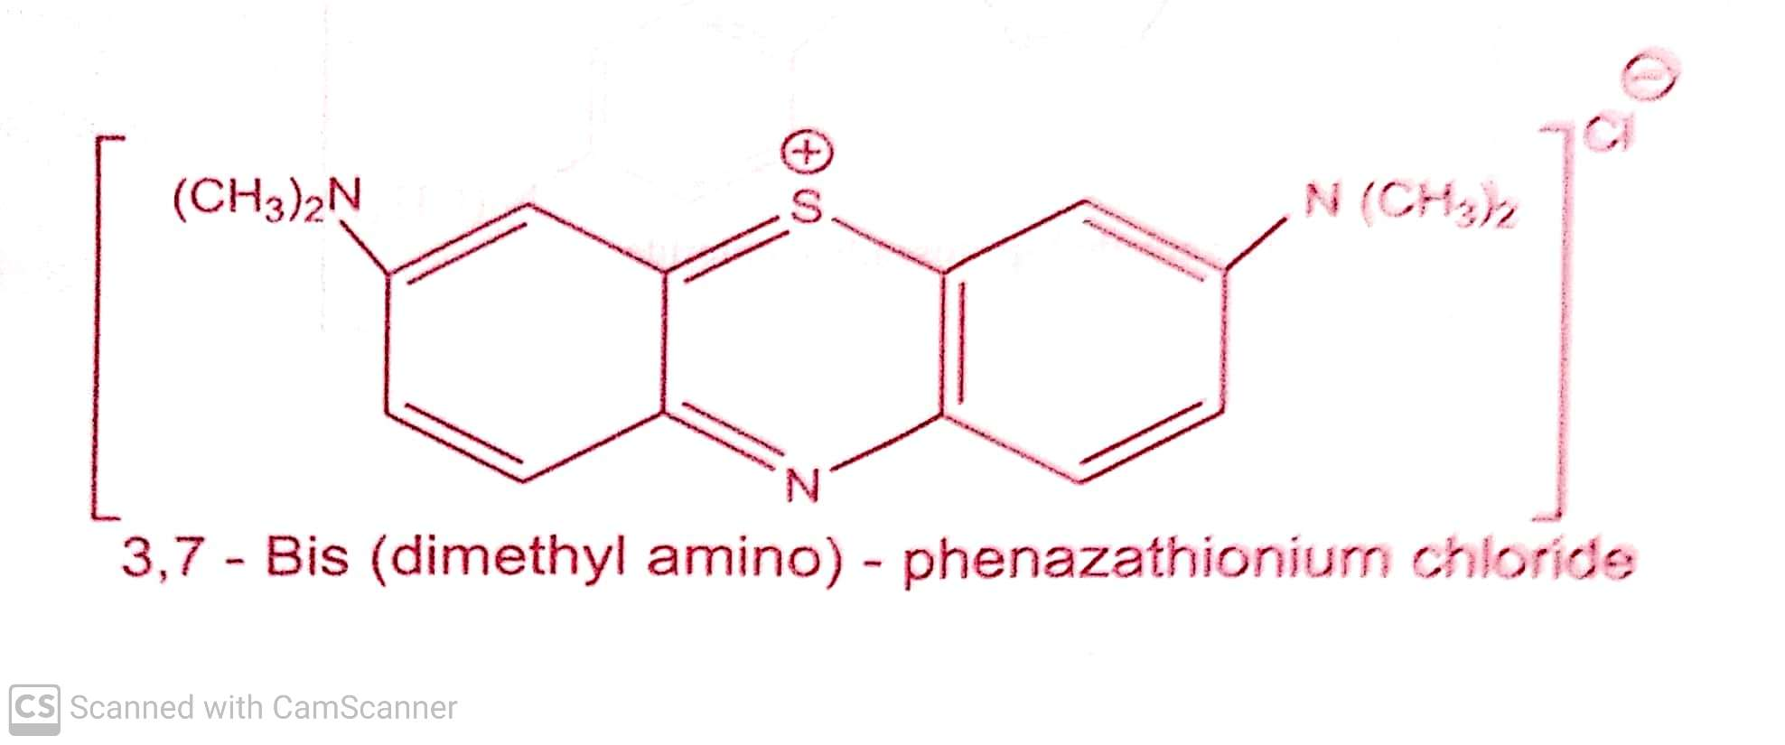
A) LOCAT ANTI-INFECTIVE AGENTS
Dyes: eg. a) Gentian violet b) Methylene blue.
Cationic dyes like Gentian violet and Methylene blue are active against gram +ve bacteria and fungi but gram –ve bacteria are
resistant.
Gentian violet ( Crystal Violet): b) Methylene blue:
Use: Used as antiseptic Use: Used as antiseptic
20-07-2020
14

Slide 15
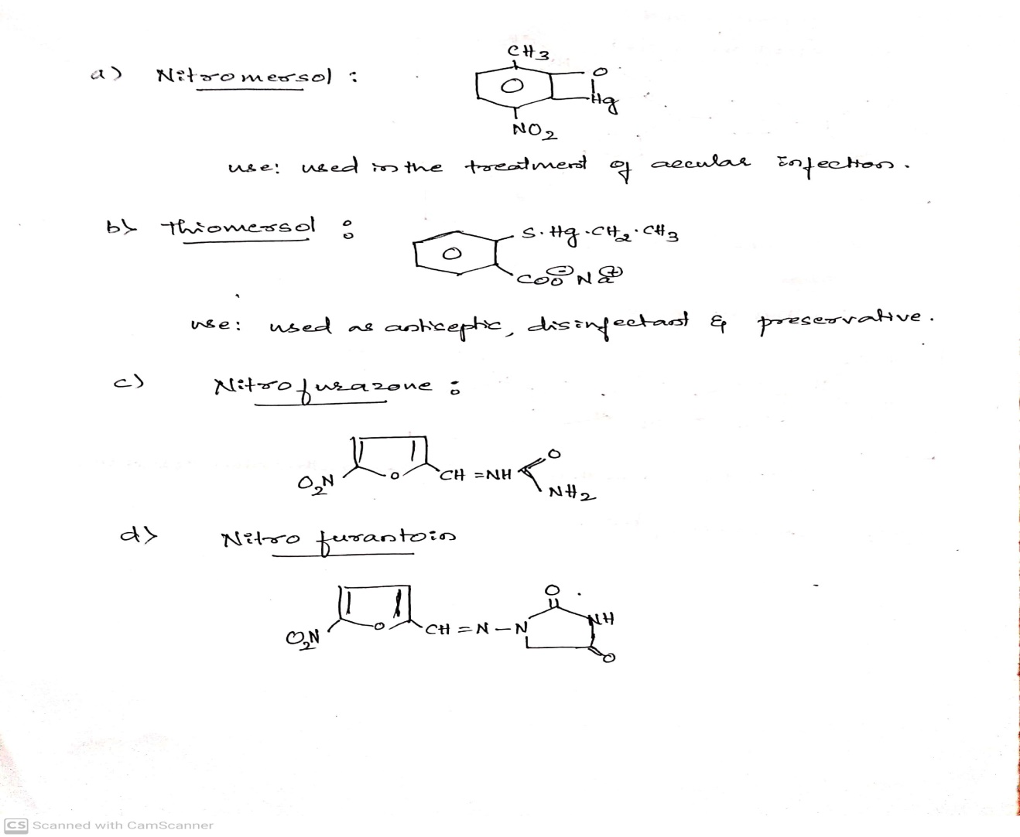
A) LOCAT ANTI-INFECTIVE AGENTS
Mercury compounds: Nitromersol, Thiomersol, Nitrofurazone, Nitrofurantoin .
Mercury & its derivatives are used as antiseptic and disinfectant.
The antibacterial action of mercury compound is due to their reaction with sulfhydryl (-SH) groups in enzymes to form
covalent compounds of the type R-S-Hg-R’.
20-07-2020
15

Slide 16
A) LOCAT ANTI-INFECTIVE AGENTS
Preservatives: These are the substances added to various Pharmaceutical dosage forms and cosmetic preparations to prevent
microbial growth.
Ideal properties of Preservatives:
It should be effective in low concentrations.
It should be effective against micro-organisms
It should be non-toxic and compatible with other constituents of the preparation.
It should be stable throughout the shelf life of preparations.
Classification:
a) P-Hydroxy benzoic acid derivatives: Methyl paraben, Propyl paraben, Ethyl paraben, Butyl paraben.
b) Others: Sodium benzoate, phenyl mercuric acetate, phenyl mercuric nitrate, Chlorobutanol, Benzyl alcohol.
20-07-2020
16

Slide 17
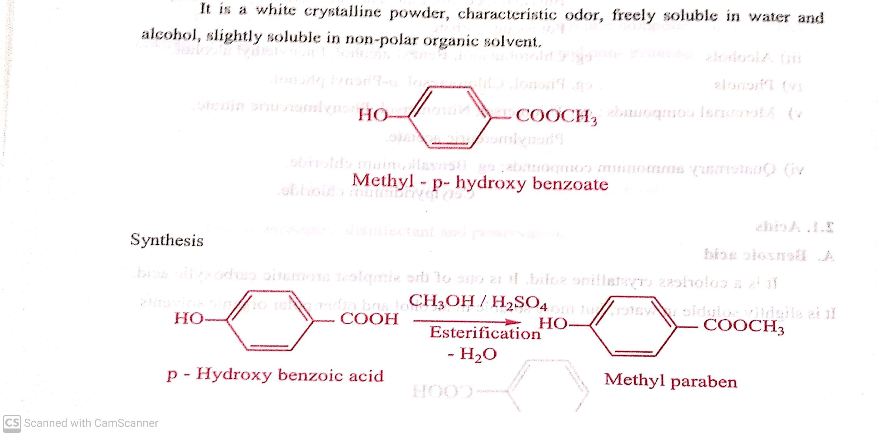
A) LOCAT ANTI-INFECTIVE AGENTS
Preservatives: (Classification)
a) P-Hydroxy benzoic acid derivatives: i) Methyl paraben, ii) Propyl paraben, iii) Ethyl paraben and iv)Butyl paraben.
i) Methyl paraben :
Uses: It is used as antiseptic and preservative in various pharmaceutical preparations.
It also used in cosmetic preparations containing vegetable and animal fats and oils that are susceptible to decomposition.
20-07-2020
17

Slide 18
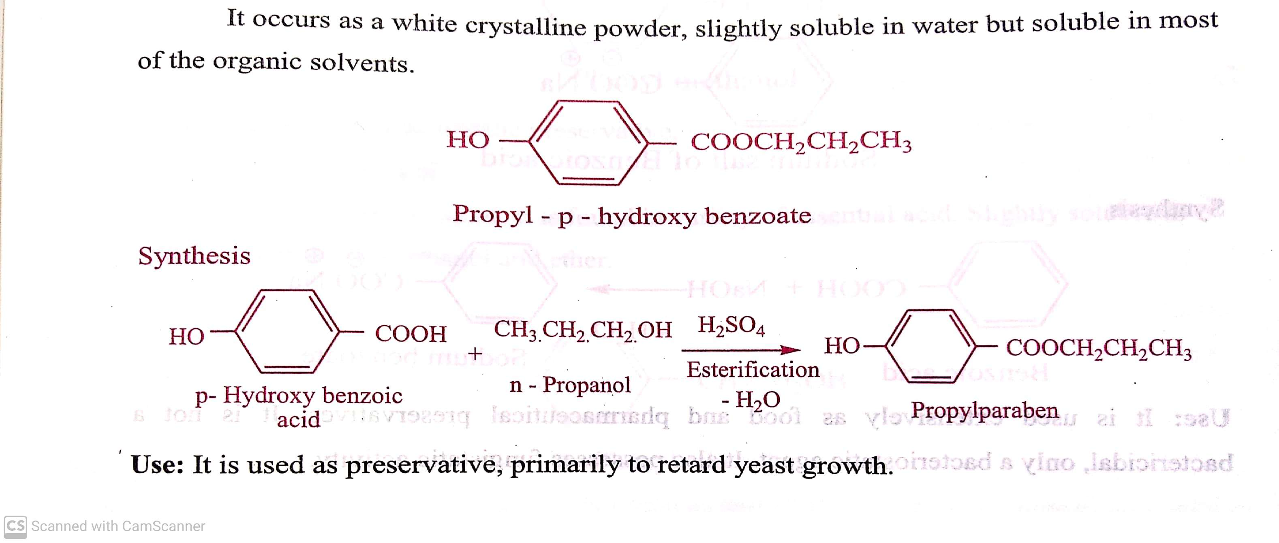
A) LOCAT ANTI-INFECTIVE AGENTS
Preservatives: (Classification)
a) P-Hydroxy benzoic acid derivatives: i) Methyl paraben, ii) Propyl paraben, iii) Ethyl paraben and iv)Butyl paraben.
ii) Propyl paraben :
20-07-2020
18

Slide 19
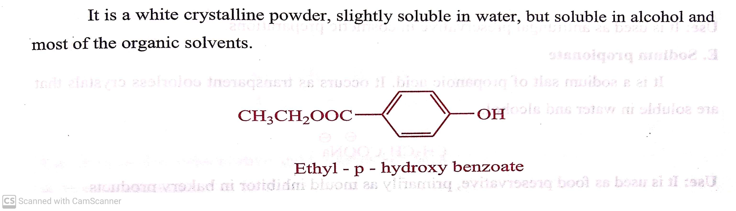
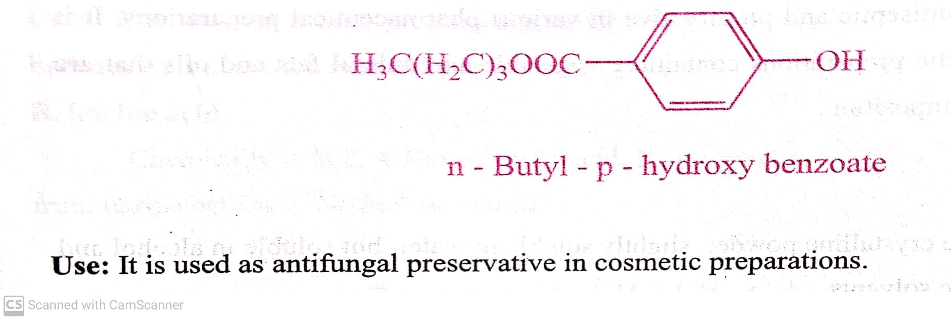
A) LOCAT ANTI-INFECTIVE AGENTS
Preservatives: (Classification)
a) P-Hydroxy benzoic acid derivatives: i) Methyl paraben, ii) Propyl paraben, iii) Ethyl paraben and iv)Butyl paraben.
iii) Ethyl paraben :
Uses: It is used as a preservative and food additives.
iv) Butyl paraben:
Uses: It is used as a antifungal preservative in cosmetic preparations.
20-07-2020
© R R INSTITUTIONS , BANGALORE
19

Slide 20
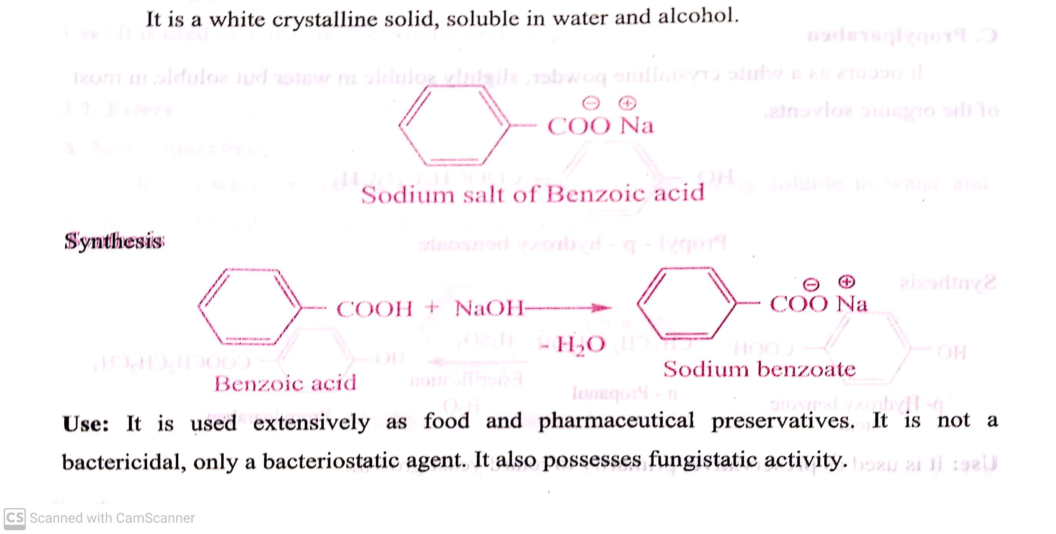
A) LOCAT ANTI-INFECTIVE AGENTS
Preservatives: (Classification)
b) Others: Sodium benzoate, phenyl mercuric acetate, phenyl mercuric nitrate, Chlorobutanol, Benzyl alcohol.
Sodium benzoate:
20-07-2020
20

Slide 21
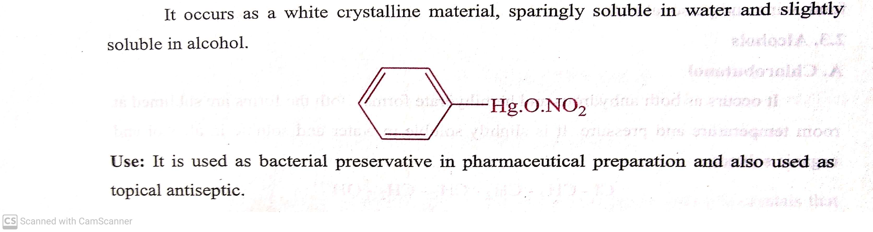
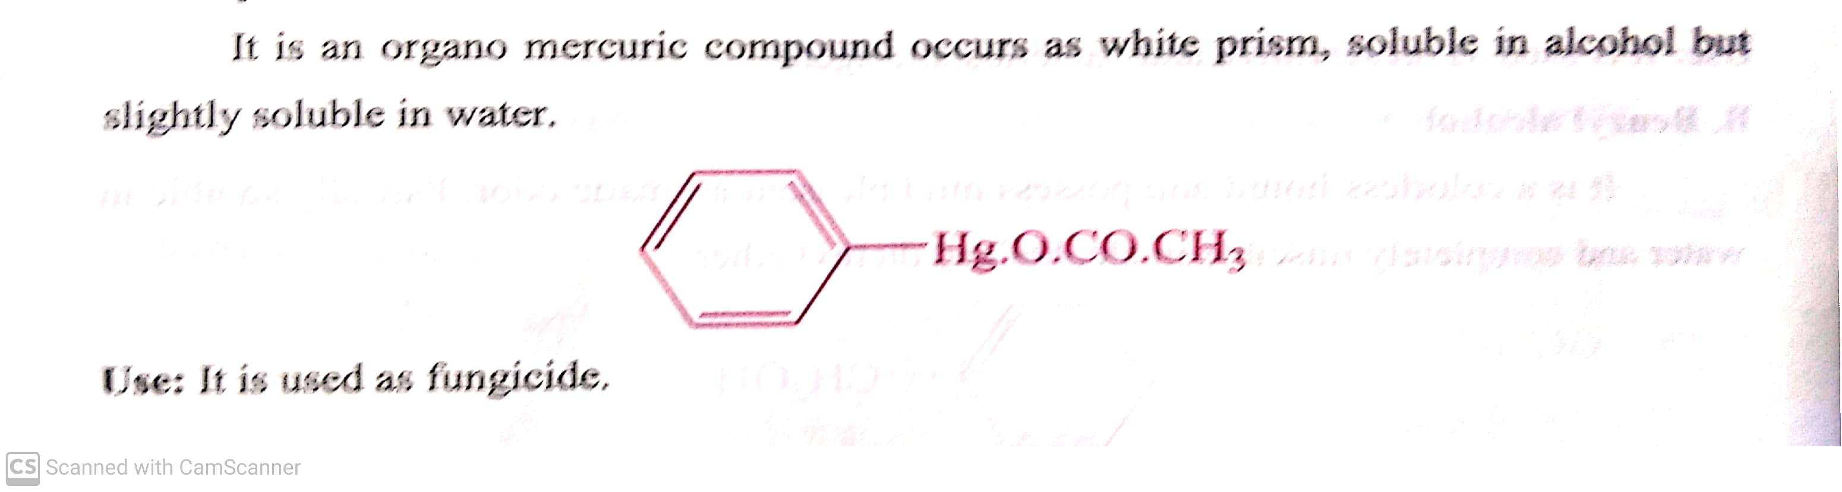
A) LOCAT ANTI-INFECTIVE AGENTS
Preservatives: (Classification)
b) Others: Sodium benzoate, phenyl mercuric acetate, phenyl mercuric nitrate, Chlorobutanol, Benzyl alcohol.
Phenyl mercuric nitrate :
Phenyl mercuric acetate:
20-07-2020
21

Slide 22
THANK YOU
20-07-2020
22

