Slide 1

IONIZATION TECHNIQUES IN MASS SPECTROSCOPY
Notes:
Chemical Ionization: What It Is and How It Works.

Slide 2
Diagram of a simple mass spectrometer
Illustration of the basic components of a mass spectrometry system.
Ionization
Source
Mass
Analzyer
Detector
Inlet
selected
ions
Data
System
all ions

Slide 3
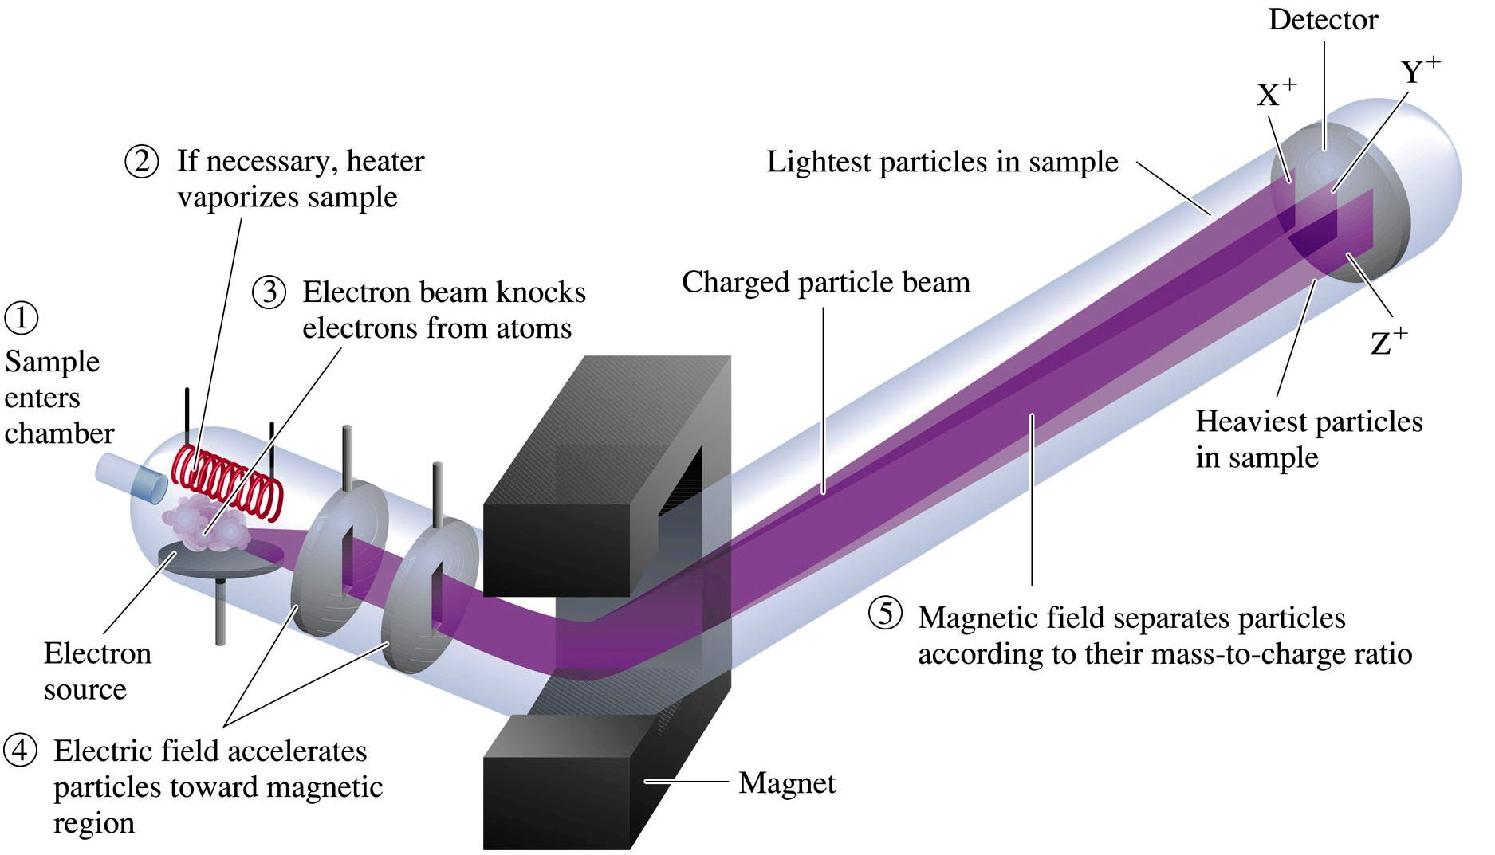
OVERVIEW
Notes:
This presentation introduces the concept of chemical ionization for the formation of positive ion spectra in GC/MS.
Chemical Ionization is an alternative to Electron Ionization.
This presentation explains the CI process and briefly introduces some of its uses.

Slide 4
TYPES OF IONIZATION
ION SOURCE:
Liquids and solids are first converted into gases. From the gaseous sample, ions are produced in a box like enclosure called Ion Source.
Function
  Produces ion without mass discrimination of the sample.
  Accelerates ions into the mass analyzer.
Ionisation methods in mass spectroscopy are divided into two types.
1.Gas phase ionization technique:
These techniques are used for volatile samples.
The sample is vaporised outside the ion source.
2.Desorption technique:
the ions are formed in condensed phase inside the ion source

Slide 5
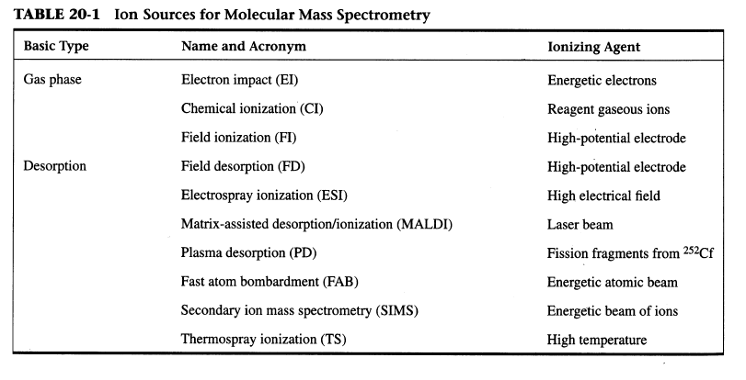

Slide 6
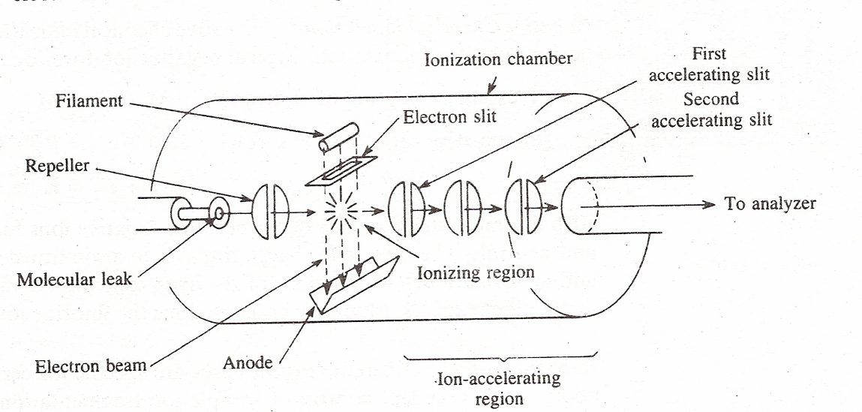
GAS PHASE IONIZATION METHODS
Electron Impact Ionization

Slide 7
It is the most widely used and highly developed method. It is also known as Electron bombardment or Electron Ionization.
Electron impact ionization source consists of a ionizing chamber which is maintained at a pressure of 0.005 torr and temperature of 200 ± 0.25 degrees.
Electron gun is located perpendicular to chamber.
Electrons are emitted from a glowing filament (tungsten or rhenium) by thermionic emission and accelerated by a potential of 70 V applied between the filament and anode. These electrons are drawn in the ionization chamber through positively charged slits.
The number of electrons is controlled by filament temperature and energy .

Slide 8
A beam of electrons passes through the gas-phase sample. An electron that collides with a neutral analyte molecule can knock off another electron, resulting in a positively charged ion.
The ionization process can either produce a molecular ion which will have the same molecular weight and elemental composition of the starting analyte, or it can produce a fragment ion which corresponds to a smaller piece of the analyte molecule.
The Ionization potential is the electron energy that will produce a molecular ion. The Appearance potential for a given fragment ion is the electron energy that will produce that fragment ion.
Most mass spectrometers use electrons with an energy of 70 electron volts (eV) for EI.
Decreasing the electron energy can reduce fragmentation, but it also reduces the number of ions formed.

Slide 9
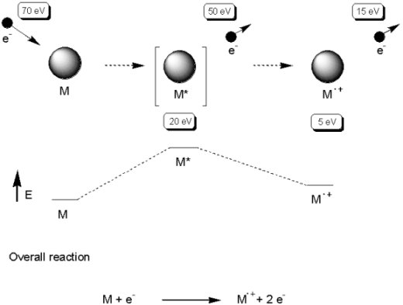
The gaseous Neutral molecules then pass through the molecular leaks and enter the ionization chamber.
The gaseous sample and the electrons collide at right angles in the
chamber and ions are formed by exchange of energy during these
collisions between electron beam and sample molecules.

Slide 10
Atom or molecule is hit by high-energy electron
e–
electron is deflected but transfers much of its energy to the molecule

Slide 11
This energy-rich species ejects an electron.

Slide 12
This energy-rich species ejects an electron.
forming a positively charged, odd-electron species called the molecular ion
e–

Slide 13
Atom or molecule is hit by high-energy electron from an electron beam at 10ev
forming a positively charged, odd-electron species called the molecular ion
e–
e–
beam
+
•

Slide 14
Molecular ion passes between poles of a
magnet and is deflected by magnetic field
amount of
deflection depends
on mass-to-charge
ratio
highest m/z
deflected least
lowest m/z
deflected most
+
•

Slide 15
If the only ion that is present is the molecular ion, mass spectrometry provides a way to measure the molecular weight of a compound and is often used for this purpose.
However, the molecular ion often fragments to a mixture of species of lower m/z.

Slide 16
The molecular ion dissociates to a cation and a radical.
+
•

Slide 17
The molecular ion dissociates to a cation and a radical.
+
•
Usually several fragmentation pathways are available and a mixture of ions is produced.

Slide 18
mixture of ions of
different mass
gives separate peak
for each m/z
intensity of peak
proportional to
percentage of each
ion of different
mass in mixture
+
+
+
+
+
+
Notes:
6

Slide 19
separation of peaks
depends on relative
mass
+
+
+
+
+
+
Notes:
6

Slide 20
Benefits
well-understood
can be applied to virtually all volatile compounds
fragmentation provides structural information
Limitations
sample must be thermally volatile and stable
the molecular ion may be weak or absent for many compounds.

Slide 21
CHEMICAL IONIZATION
Chemical ionization uses ion-molecule reactions to produce ions from the analyte.
The chemical ionization process begins when a reagent gas such as methane, isobutane, or ammonia is ionized by electron impact.
A high reagent gas pressure (or long reaction time) results in ion-molecule reactions between the reagent gas ions and reagent gas neutrals.
Some of the products of these ion-molecule reactions can react with the analyte molecules to produce analyte ions.
Example (R = reagent, S = sample, e = electron, . = radical electron , H = hydrogen):
R + e ---> R+. + 2e
R+. + RH ---> RH+ + R.
RH+ + S ---> SH+ + R

Slide 22
Benefits
often gives molecular weight information through molecular-like ions such as [M+H]+, even when EI would not produce a molecular ion.
simple mass spectra, fragmentation reduced compared to EI.
Limitations
sample must be thermally volatile and stable.
results depend on reagent gas type, reagent gas pressure or reaction time, and nature of sample.

Slide 23
Positive Chemical Ionization :
In this technique positive ions of the sample are produced. In positive chemical ionization gasses such as Methane, Ammonia, Isobutane etc are used
When Methane is used as Reagent gas. Methane is ionized by electron impact:
CH4 + e- CH4+ + 2e-
Primary ions react with additional reagent gas molecules to produce stabilized reagent ions:
CH4+ + CH4 CH5+ + CH3
The reagent ions then react with the sample molecules to ionize the sample molecules:
CH5+ + MH CH4 + MH2+ (Proton transfer)
CH3+ + MH CH4 + M+ (hydride abstraction)
CH4+ + MH CH4 + MH+ (Charge transfer)

Slide 24
2. Negative Chemical Ionization
Negative chemical ionization is counterpart of Positive chemical ionization.
Negative ions of the sample are formed and oxygen and Hydrogen are used
as reagent gasses.
This method is used for ionization of highly electronegative samples.
The negative ions are formed by following reactions :-
Resonance electron capture
M + e⁻ M⁻
Dissociative electron capture
H₂O + e⁻ H + OH⁻
The ion molecule reaction occurring between negative ion formed in the
chamber source and the sample molecule include:-
Charge transfer.
Hydride transfer.
Anion- Molecule adduct formation.

Slide 25
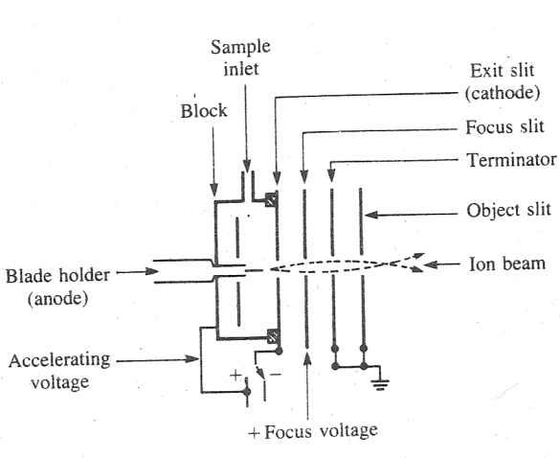
FIELD IONIZATION
FI is used to produce ions from volatile compounds that do not give molecular ions by EI.
It produces molecular ions with little or no fragmentation.

Slide 26
FIELD IONIZATION
It involves the application of very strong electric field induces the emission of electrons.
When a molecule is brought between two closely placed electrodes in the presence of high electric field (10⁷ to 10⁸ V/cm), it experiences an electro static force.
If the metal surface anode has proper geometry and is under high vacuum (10⁻⁶ tor), this force can be sufficient to remove an electron from the molecule without imparting much excess energy.
In absence of electron collisions there is little or no fragmentation of the ion.
In field ionization source, a thin needle of few micrometers diameter constitutes the anode and is located 1mm away and immediately behind the exit slit of the ion chamber. The exit slit serves as cathode.
The remainder of the source serves as focusing slits common to all ion sources.

Slide 27
These cations are accelerated out of the source and their mass is analyzed by analyzer .
Advantages
  As fragmentation is less, abundance of molecular ions (M⁺) is
  enhanced, hence this method is useful for relative molecular
  mass and empirical formula determination.
  Disadvantages
  Not suitable for thermally unstable and non volatile samples.
  Sensitivity is less than EI ion source.
  No structural information is produced as very little fragmentation occurs.

Slide 28
DESORPTION TECHNIQUES
Field desorption:
In field desorption, a high-potential electric field is applied to an emitter with a sharp surface, such as a razor blade, or more commonly, a filament from which tiny "whiskers" have formed.
This results in a very high electric field which can result in ionization of gaseous molecules of the analyte.

Slide 29
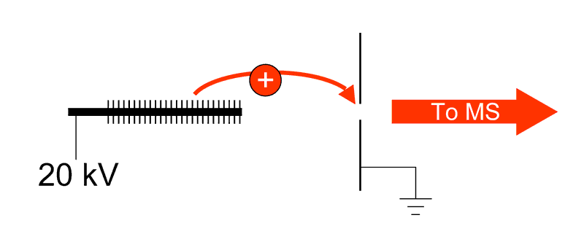
MECHANISM:
In FD, the analyte is applied as a thin film directly to the emitter, or small crystals of solid materials are placed onto the emitter.
Slow heating of the emitter then begins, by passing a high current through the emitter, which is maintained at a high potential
As heating of the emitter continues, low-vapor-pressure materials get desorbed and ionized.

Slide 30
Sample introduction
The sample is deposited onto the tip of the emitter by
. dipping the emitter into an analyte solution
. depositing the dissolved or suspended sample onto the emitter with a microsyringe
Benefits
simple mass spectra
little or no chemical background
works well for small organic molecules, many organometallics, low molecular weight polymers and some petrochemical fractions

Slide 31
Limitations
sensitive to alkali metal contamination and sample overloading
emitter is relatively fragile
relatively slow analysis
the sample must be thermally volatile to some extent to be ionised.

Slide 32
ELECTROSPRAY IONIZATION (E.S.I)
The electron spray ion source is operated at or near atmospheric pressure and thus is called as atmospheric pressure ionization or A.P.I.
The sample in solution form ( usually a polar, volatile solvent) enters the ion source through a stainless steel capillary, which is surrounded by a co-axial flow of nitrogen called the nebulizing gas.
The tip of the capillary is maintained at a high potential with respect to a counter-electrode. The potential difference produces a field gradient upto 5KV / cm.
As the solution exits the capillary, an aerosol of charged droplets forms. The flow of nebulizing gas directs the effluent toward the mass spectrometer.

Slide 33
Droplets in the aerosol shrink as the solvent evaporates, thereby concentrating the charged sample ions.
When the electrostatic repulsion among the charged sample ions reaches a critical point, the droplet under goes a so called “Coulumbic explosion,” which releases the sample ions into the vapor phase.
The vapor phase ions are focused with a number of sampling orifices into the mass analyzer.

Slide 34
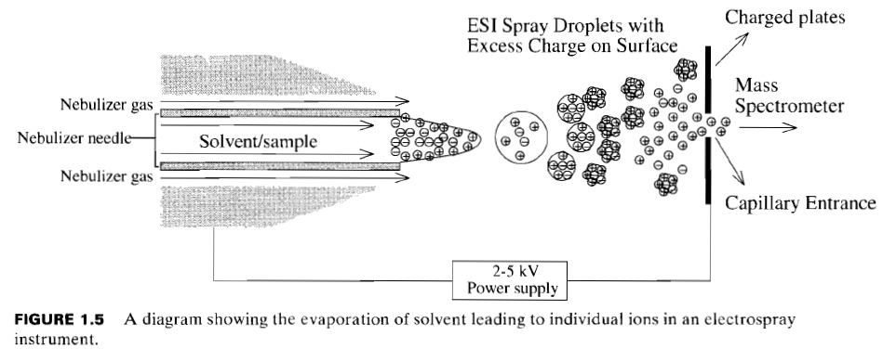
ELECTROSPRAY PROCESS

Slide 35
PLASMA DESORPTION IONIZATION
Plasma desorption ionization is a highly specialized technique used almost exclusively with a time of fight mass analyzer. The fission products from califormnium²⁵², with energies in the range of 80-100 MeV, are used to bombard and ionize the sample.
Each time ²⁵²Cf splits, two particles are produced moving in opposite directions.
One of the particles hits a triggering detector and signals a start time.
The other particle strikes the sample matrix ejecting some sample ions into a time of flight mass spectrometer.
The sample ions are most often released as singly, doubly or triply protonated moieties.

Slide 36
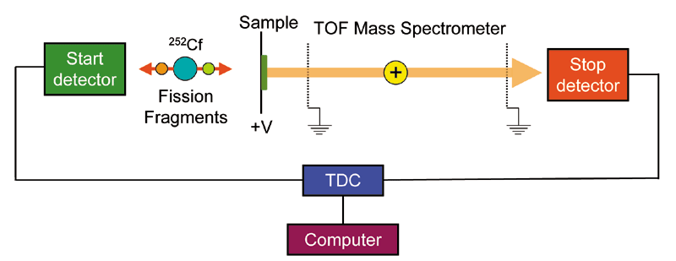

Slide 37
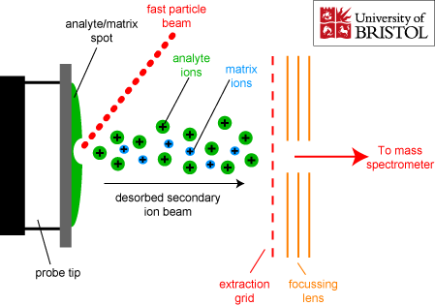
Fast Atom Bombardment
It is an ionization technique in which the analyte and non-volatile liquid matrix mixture is bombarded by a high energy beam of inert gas such as Argon or Xenon.

Slide 38
Used for large compounds with low volatility (eg: peptides, proteins, carbohydrates).
Solid or liquid sample is mixed with a non-volatile matrix (eg: glycerol, crown ethers, nitrobenzyl alcohol)
Immobilised matrix is bombarded with a fast beam of Argon or Xenon atoms.
Charged sample ions are ejected from the matrix and extracted into the mass analysers.
Choosing correct matrix is difficult

Slide 39
This technique is used for ionization of polar high molecular weight compounds such as polypeptides. Commonly used matrices include Glycerol
  Monothioglycerol
  Carbowax
  2,4 – dipentyl phenol
  3 – nitrobenzyl alcohol (3 – NBA)
These solvents easily dissolve organic compounds and do not evaporate in vacuum.
The bombarding beam consists of Xenon or Argon atoms of high translational energy.
This beam is produced by first ionizing the Xenon (or Argon atoms with electrons to give Xenon radical cations.
Xe ⁺ e⁻ = Xe^{.+} +2e⁻
The radical cations are then accelerated to 6 – 10 KeV to give radical cations of high translational energy (Xe)⁺⁺, which are then passed through a chamber containing Xenon atoms at a pressure of 10-5 torr.

Slide 40
During this passage high energy cation obtain electrons from Xenon atoms to become high energy atoms (Xe). The lower energy ions are removed by electrostatic deflector.
(Xe)^{.+} + Xe (Xe) + Xe^{.+}
The compound of interest is dissolved in high boiling point viscous solvent such as glycerol; a drop is placed on a thin metal sheet, and the compound is ionized by the high energy beam of xenon atoms ( xe ).
Xenon ionizes the glycerol molecules to give glycerol ions. These ions react with the surrounding glycerol molecules to produce (G+H)+ as reactant ion.
These ions are then extracted from slit lens system designed to collect ions and directed to mass analyzer.

Slide 41
Benefits
rapid
simple
good for a large variety of compounds
Limitations
high chemical backgrond, hence difficult to distinguish low-molecular-weight compounds from chemical background
analyte must be soluble in the liquid matrix
not good for multiple charged compounds with more than 2 charges

Slide 42
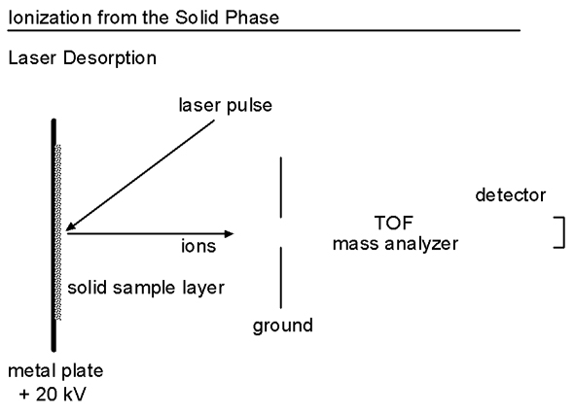
Matrix AssistedLaser Desorption/Ionization:

Slide 43
Matrix Assisted Laser Desorption/Ionization
(MALDI) is used to analyze extremely large molecules.
MALDI is often used for the analysis of synthetic and natural polymers, proteins, and peptides.
In MALDI, both desorption and ionization are induced by a single laser pulse
The sample is prepared by mixing the analyte and a matrix compound chosen to absorb the laser wavelength.
This is placed on a probe tip and dried.
A vacuum lock is used to insert the probe into the source region of the mass spectrometer

Slide 44
.
A laser beam is then focused on this dried mixture and the energy from a laser pulse is absorbed by the matrix.
This energy ejects analyte ions from the surface so that a mass spectrum is acquired for each laser pulse.
The mechanism for this process is not well understood
This technique is more universal (works with more compounds) than other laser ionization
Typical MALDI spectra include the molecular ion, some multiple charged ions, and very few fragments.
Benefits
. rapid and convenient for molecular weight determination
Limitations
. requires a mass analyzer that is compatible with pulsed ionization techniques
The sample is prepared by mixing the analyte and a matrix compound chosen to absorb the laser wavelength. This is placed on a probe tip and dried.
A vacuum lock is used to insert the probe into the source region of the mass spectrometer.
A laser beam is then focused on this dried mixture and the energy from a laser pulse is absorbed by the matrix.
This energy ejects analyte ions from the surface so that a mass spectrum is acquired for each laser pulse.

Slide 45
REFERENCES
INSTRUMENTAL METHODS OF CHEMICAL ANALYSIS BY Gurudeep R. Chatwal, sham K. Anand.
ELEMENTARY ORAGANIC SPECTROSCOPY – PRINCIPLES AND CHEMICAL APPLICATIONS by S. Chand, Y.R. Sharma.
SPECTROSCOPIC IDENTIFICATION OF ORGANIC COMPOUNDS by Robert M. Silverstein, Francis X. Webster, David J. Kiemle
INTERNET ( Wikipedia )

Slide 46

THANK YOU…

