Slide 1

MEDICINAL CHEMISTRY
ANTIFUNGAL AGENTS
23-07-2020
1

Slide 2
ANTIFUNGAL AGENTS
A fungus is a colourless plant lacking Chlorophyll.
Fungi that causes disease in humans may be like yeast or hyphae (mould) and are called mycotic infections or
fungal infections.
Types of fungal infections:
1) Superficial mycotic infection: Occurring on the surface or just below the skin/ nail.
2) Systemic mycotic infection : Occurring inside the body, such as in lungs and other body organs.
23-07-2020
2

Slide 3
ANTIFUNGAL AGENTS
Fungal diseases: Fungal diseases are termed as mycosis and mycotic infections of human beings are broadly
categorised as
> Dermatophytes are fungi causing infections on skin, hair and nail.
> Dermatophytic infections are caused by Trichophyton, Microsporum and Epidermophyton.
> Candidiasis – Candida albicans is normally found as a part of flora of the GIT and Vegina and it causes
diseases like ring worm.
> Aspergillosis is a disease caused by aspergillus is a major source of infection in persons with leukaemia,
receiving organ transplants and bone marrow transplants.
23-07-2020
3

Slide 4
ANTIFUNGAL AGENTS
Antifungal agents: Drugs used to treat infections caused by fungi.
Classifications:
Antifungal agents are classified according to chemical structure as:
i) Fatty acids and carboxylic acid : Sodium caprylate, Triacetin, Benzoic acid, salicylic acid.
ii) Phenols and their derivatives : Haloprogin (Halotex), Clioquinol (vioform), Resorcinol.
iii) Nucleoside antifungal agents : Flucytosine.
iv) Antifungal antibiotics : Amphotericin B, Nystatin, Natamycin.
v) Allylamine and related compounds: Naftifine, Tolnaftate, terbinafine.
vi) Azole antifungal agents : Clotrimazole, Econazole, Oxyconazole, Miconazole, Ketoconazole, Fluconazole,Terconazole.
vii) Newer antifungal agents: Echinocandins, Capsofungin, Micafungin.
23-07-2020
4

Slide 5
ANTIFUNGAL AGENTS
Antifungal agents: Drugs used to treat infections caused by fungi.
Classifications:
2) According to the mechanism of action antifungal agents are classified as:
i) Inhibition of cell wall synthesis: Polyoxins, Nikkomycin Z, Echinocandins.
ii) Inhibition of ergosetrol biosynthesis : Polynes azoles, Amorolfine, Allylamines, Thiocarbamates.
iii) Inhibition of protein synthesis : Sordarins.
iv) Inhibition of RNA/DNA synthesis : Griseofulvin, Flucytosine.
23-07-2020
5

Slide 6
ANTIFUNGAL AGENTS
Classifications:
Antifungal agents are classified according to chemical structure as:
i) Fatty acids and carboxylic acid : Sodium caprylate, Triacetin, Benzoic acid, salicylic acid.
Mainly fatty acid derivatives are used as dermatophytosis.
Dermatophytosis is called tinea or ring worm and these infections tend to be topical, their treatment has been directed to surface of the skin.
Eg, Sodium caprylate : It is prepared from caprylic acid which is a component of coconut and palm oil.
ONa
O= C-CH₂-CH₂-CH₂-CH₂-CH₂-CH₂-CH₂ (Sodium octanoate)
Use: Used topically to treat superficial dermatophytes caused by Candida albicans.
Eg, Triacetin : CH₂OCOCH₃
CHOCOCH₃
CH₂OCOCH₃
(Glyceryl triacetate)
23-07-2020
6

Slide 7
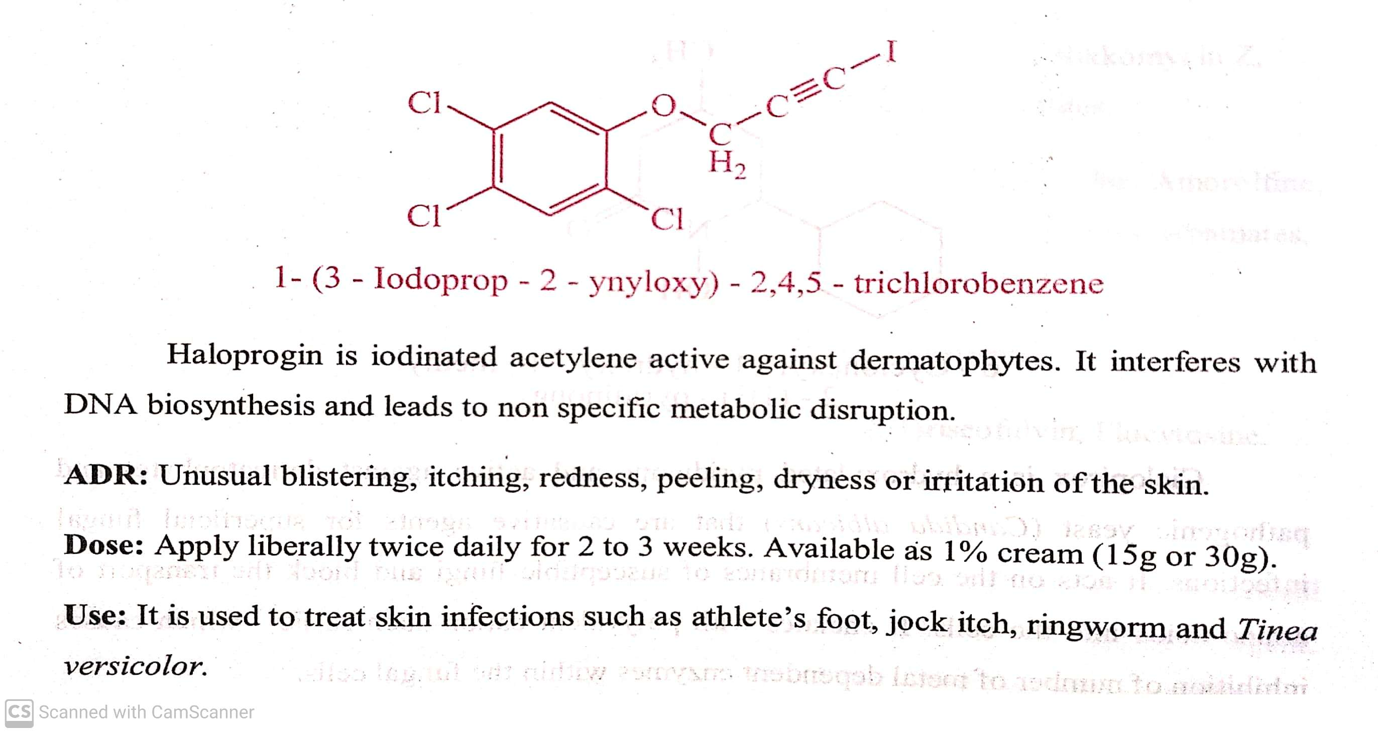
ANTIFUNGAL AGENTS
Classifications:
ii) Phenols and their derivatives : Haloprogin (Halotex), Clioquinol (vioform), Resorcinol.
Phenols interfere with cell membrane integrity and function in susceptible fungi.
Eg, : Haloprogin (Halotex) :
23-07-2020
7

Slide 8
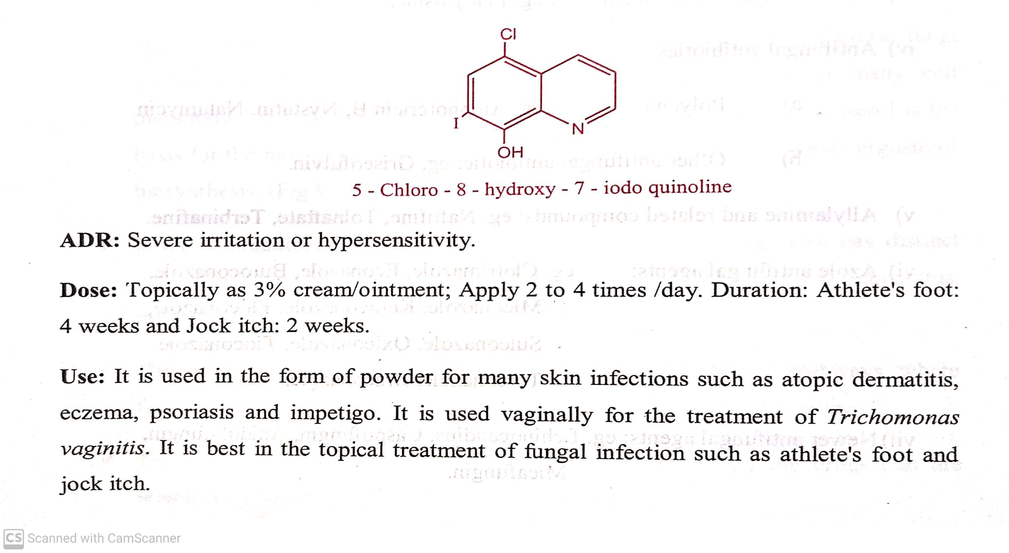
ANTIFUNGAL AGENTS
Classifications:
ii) Phenols and their derivatives : Haloprogin (Halotex), Clioquinol (vioform), Resorcinol.
Phenols interfere with cell membrane integrity and function in susceptible fungi.
Eg, : Clioquinol (vioform) :
23-07-2020
8

Slide 9
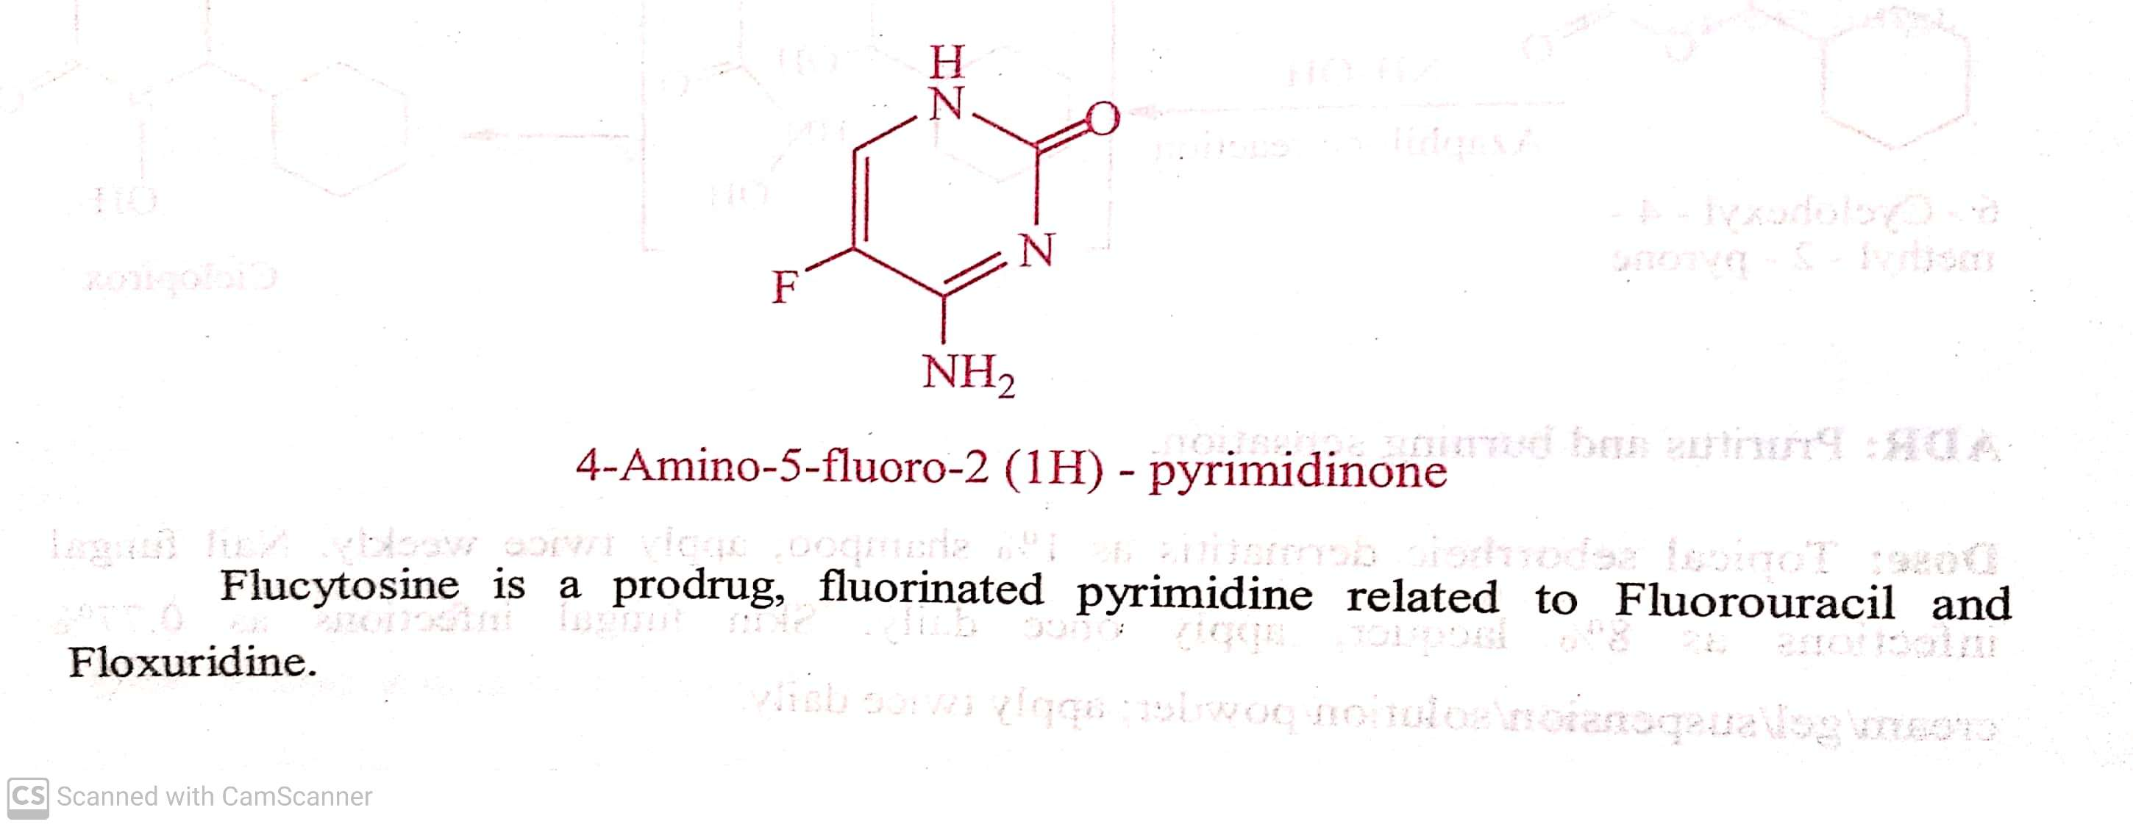
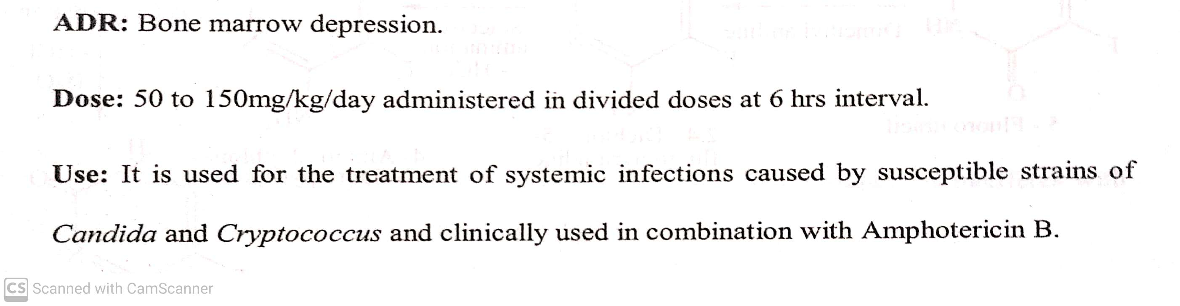
ANTIFUNGAL AGENTS
Classifications:
iii) Nucleoside antifungal agents : Flucytosine.
23-07-2020
9

Slide 10
ANTIFUNGAL AGENTS
Classifications:
iv) Antifungal antibiotics :( polyenes) - Amphotericin B, Nystatin, Natamycin.
These complex antifungal antibiotics are isolated from soil bacteria of the genus Streptomyces. Polyenes are divided into two
groups.
a) 38- membered ring polyenes, Eg, Amphotericin B, Nystatin.
b) 26- membered ring polyenes, Eg, Natamycin.
Polyenes are macrocyclic lactones with distinct hydrophilic and lipophilic region.
The lipophilic region contains conjugated double bonds in macrocyclic lactone ring. Hence they are called as polyene antibiotics.
The hydrophilic region contains
a) a hydroxy group on the acid derived portion of the ring.
b) a glycosidically linked deoxy amino hexose called mycosamine.
Mechanism of action :They bind to fungal membrane, act as a false membrane component, bind closely to ergosterol and
produce a change in cell permeability. This leaks out the cytoplasmic content and causes cell lysis.
23-07-2020
© R R INSTITUTIONS , BANGALORE
10

Slide 11
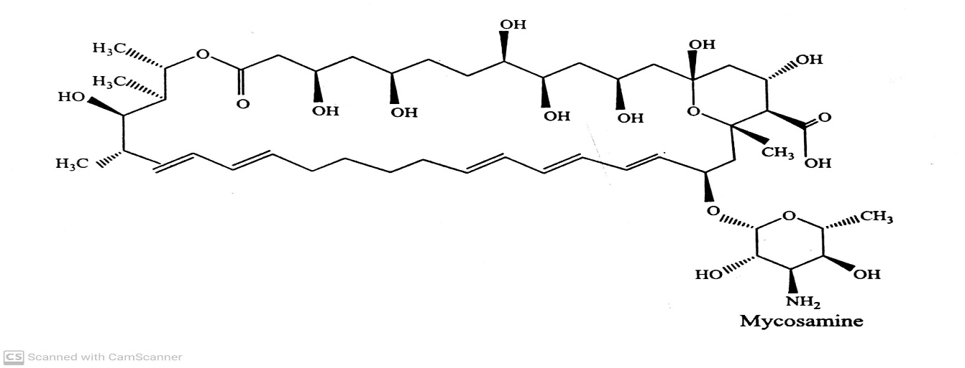
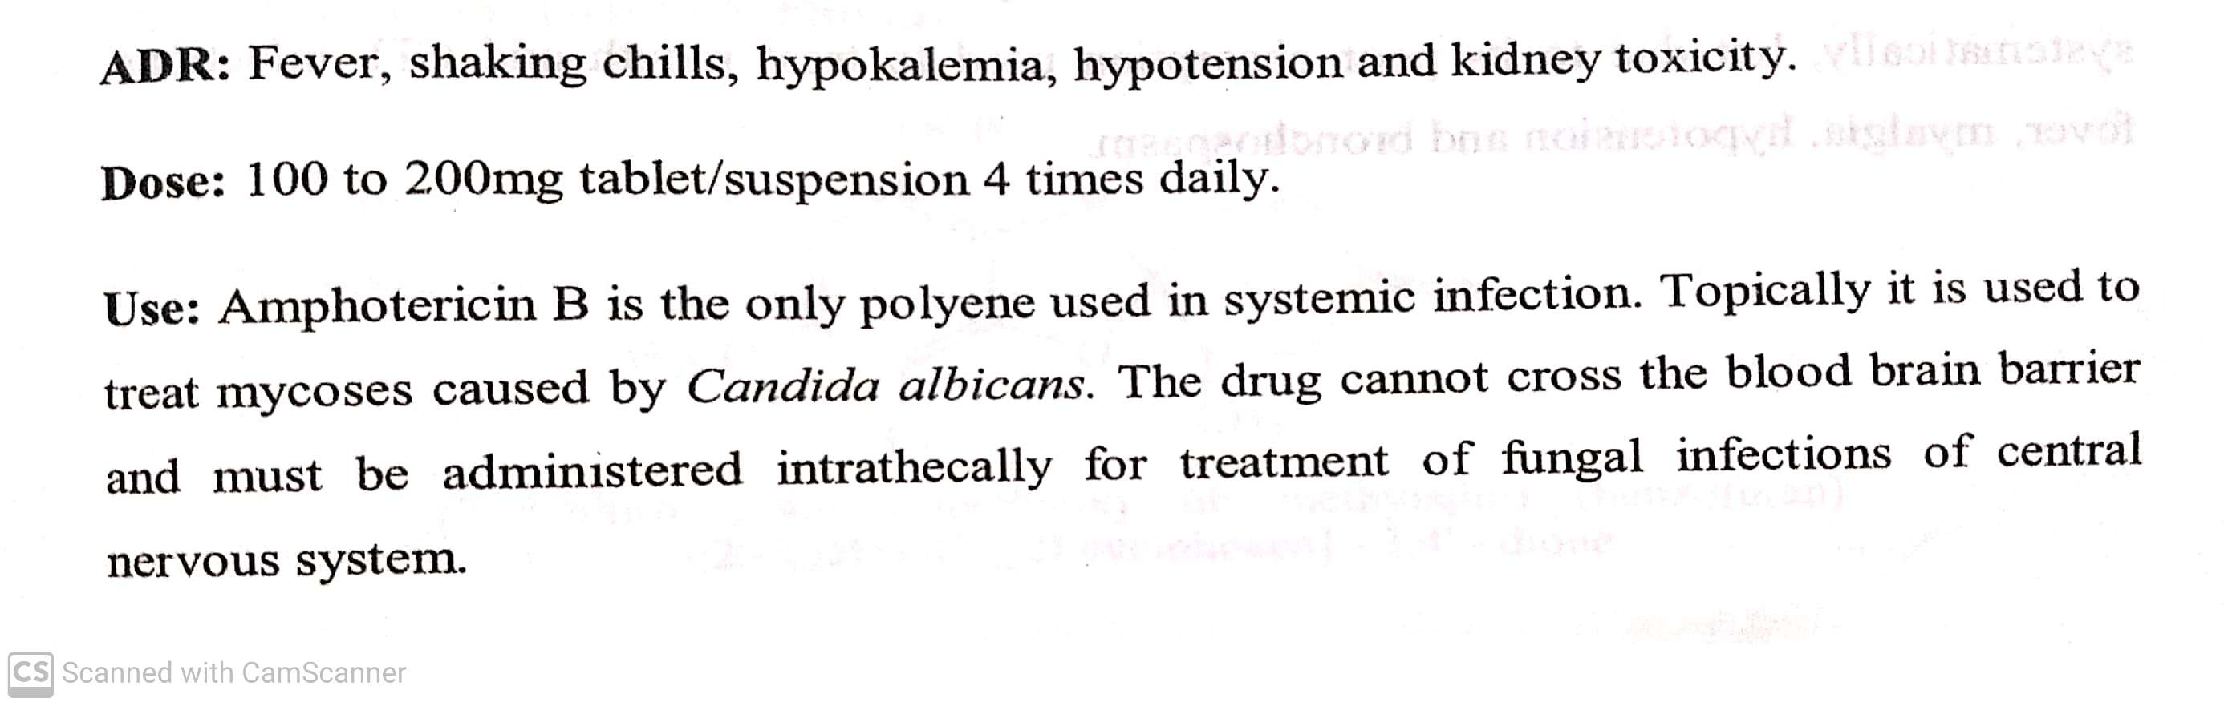
ANTIFUNGAL AGENTS
Classifications:
iv) Antifungal antibiotics :( polyenes) - Amphotericin B, Nystatin, Natamycin.
Amphotericin B : Amphotericin B was isolated from Streptomyces nodosus. It interact with ergosterol in fungi and forms a
trans membrane channel.
23-07-2020
11

Slide 12
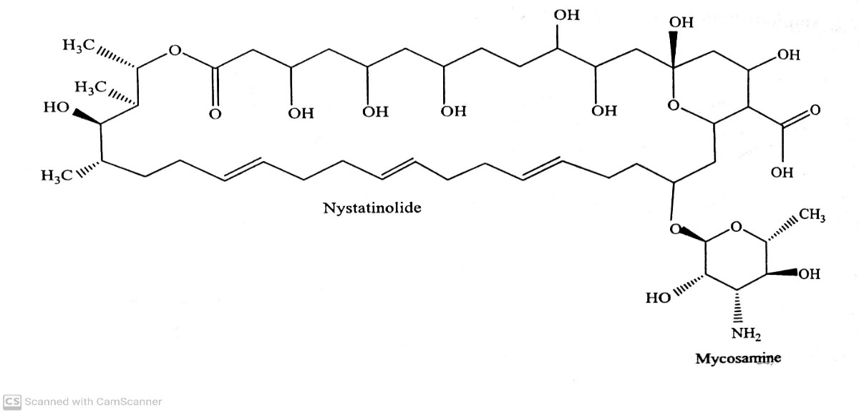
ANTIFUNGAL AGENTS
Classifications:
iv) Antifungal antibiotics :( polyenes) - Amphotericin B, Nystatin, Natamycin.
Nystatin ( Mycostatin):
ADR: Nephrotoxicity
Dose : 1-4 mg/kg/day
Use : It is used in the treatment of local and gastro intestinal infection caused by candida albicans and Candida species.
23-07-2020
12

Slide 13
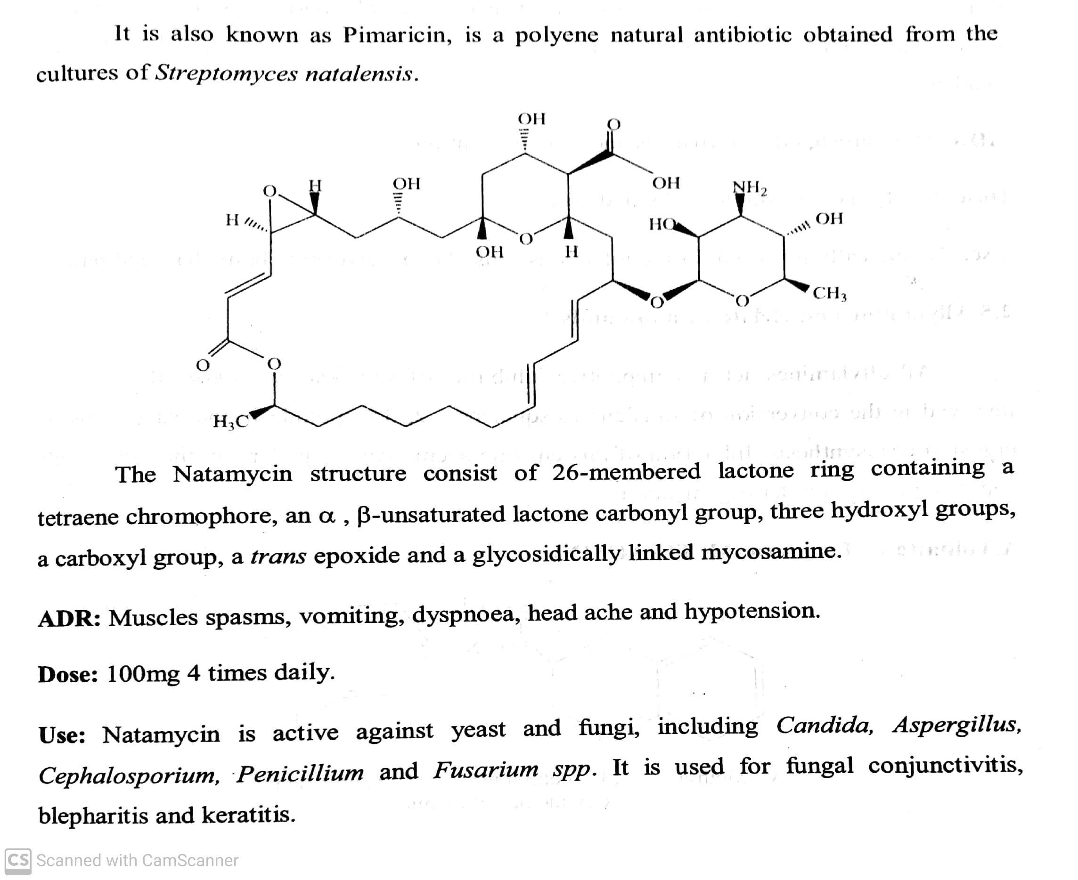
ANTIFUNGAL AGENTS
Classifications:
iv) Antifungal antibiotics :( polyenes) - Amphotericin B, Nystatin, Natamycin.
Natamycin:
23-07-2020
13

Slide 14
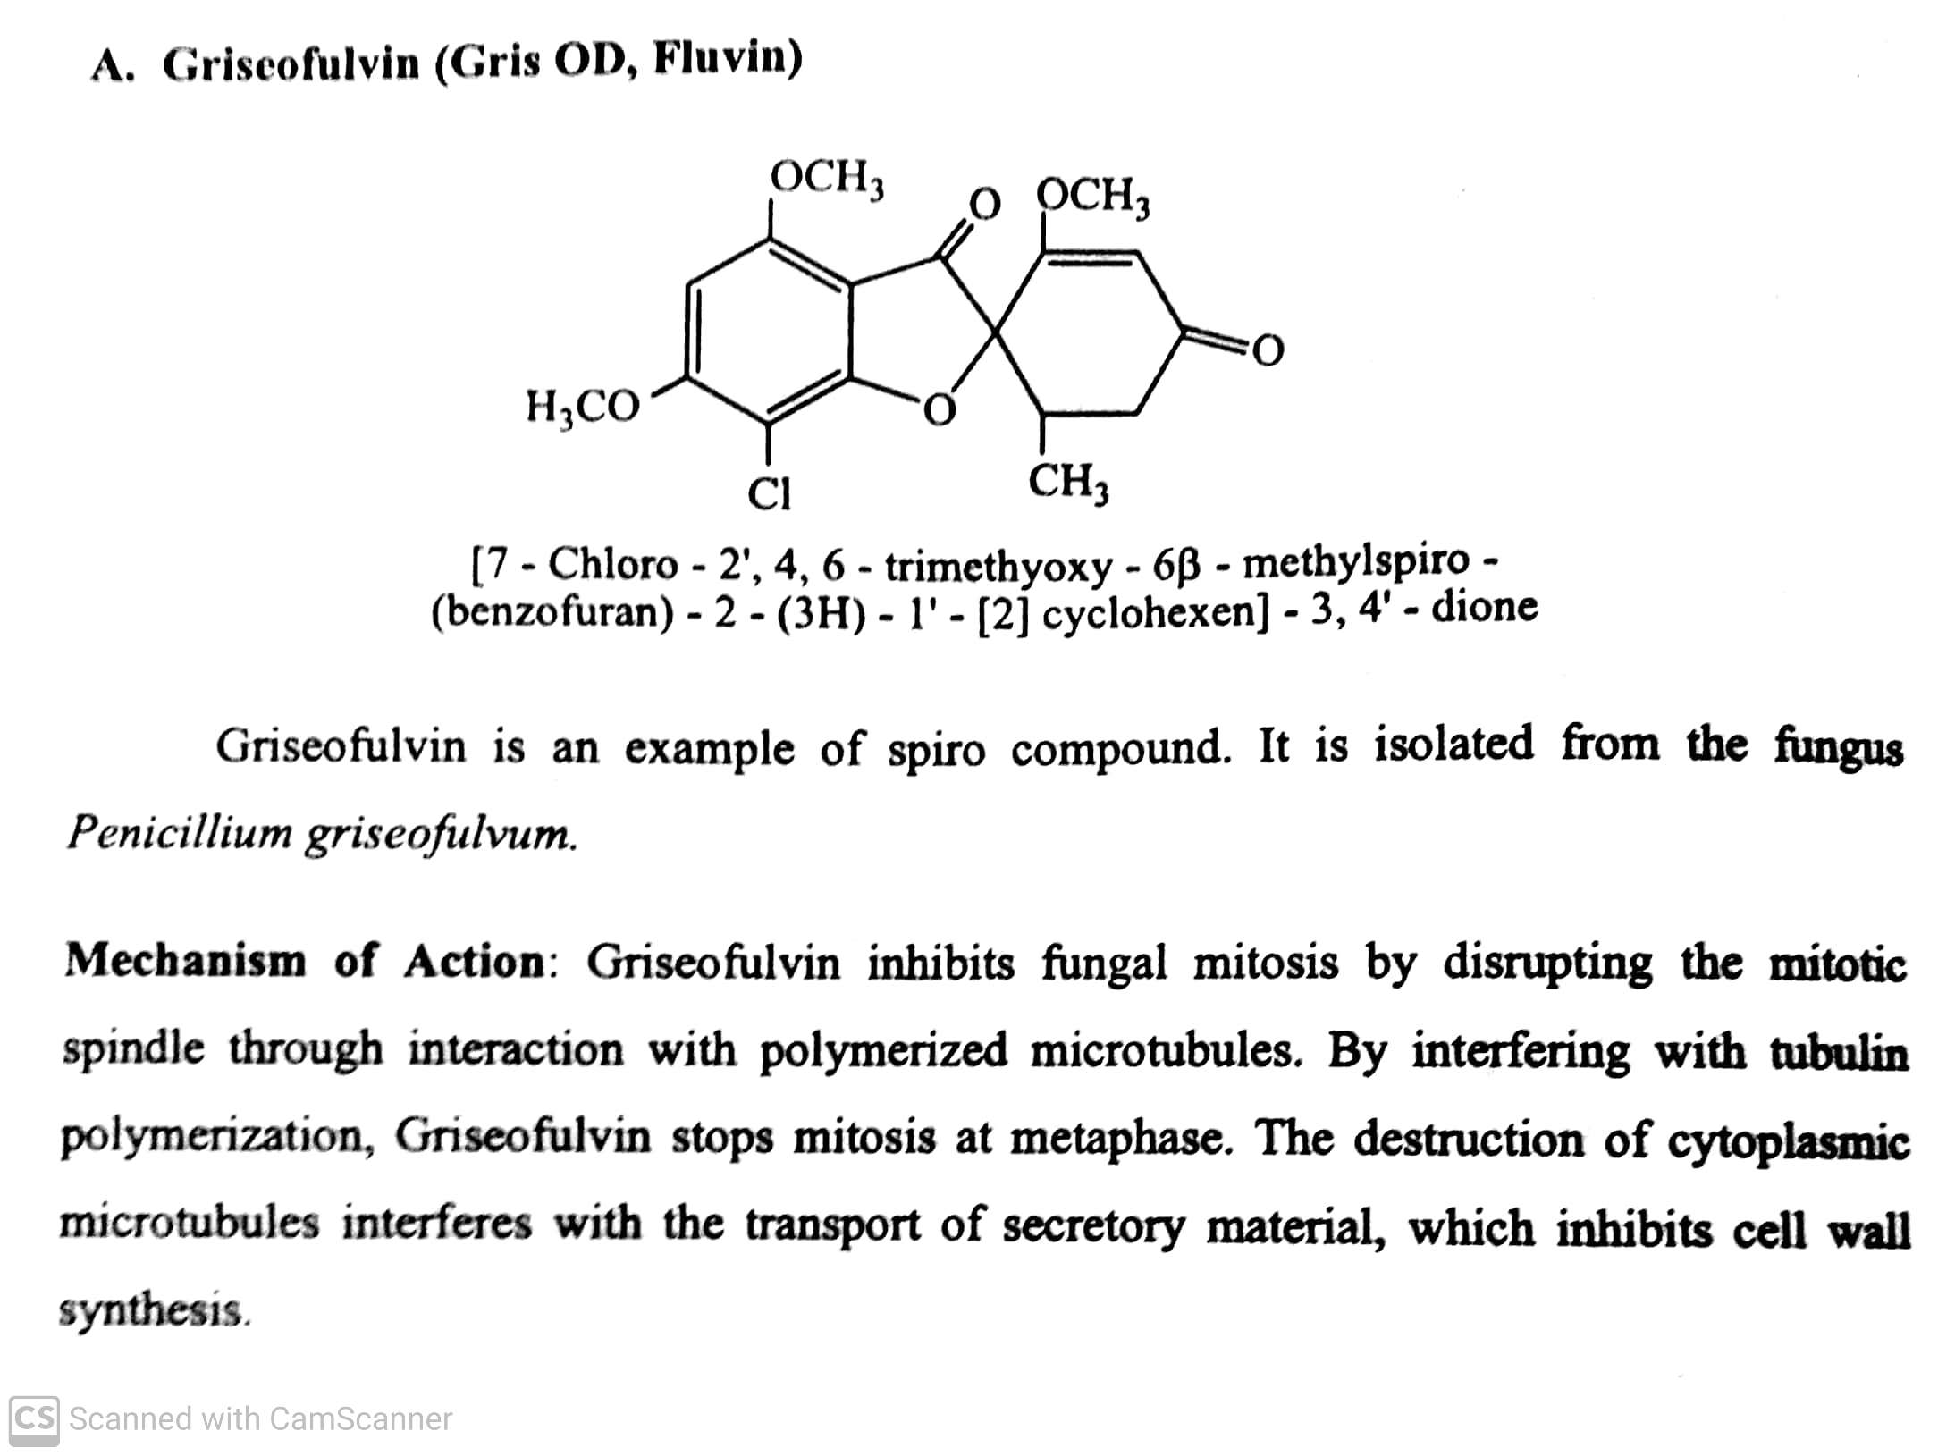
ANTIFUNGAL AGENTS
Classifications:
Other antifungal antibiotics: Griseofulvin :
ADR: Oral thrush, GI disturbances and taste prevention.
Dose: 0.5 – 1g daily in single or divided dose.
Use : Used for the infection caused by ringworm in the body, hair and nail.
23-07-2020
© R R INSTITUTIONS , BANGALORE
14

Slide 15
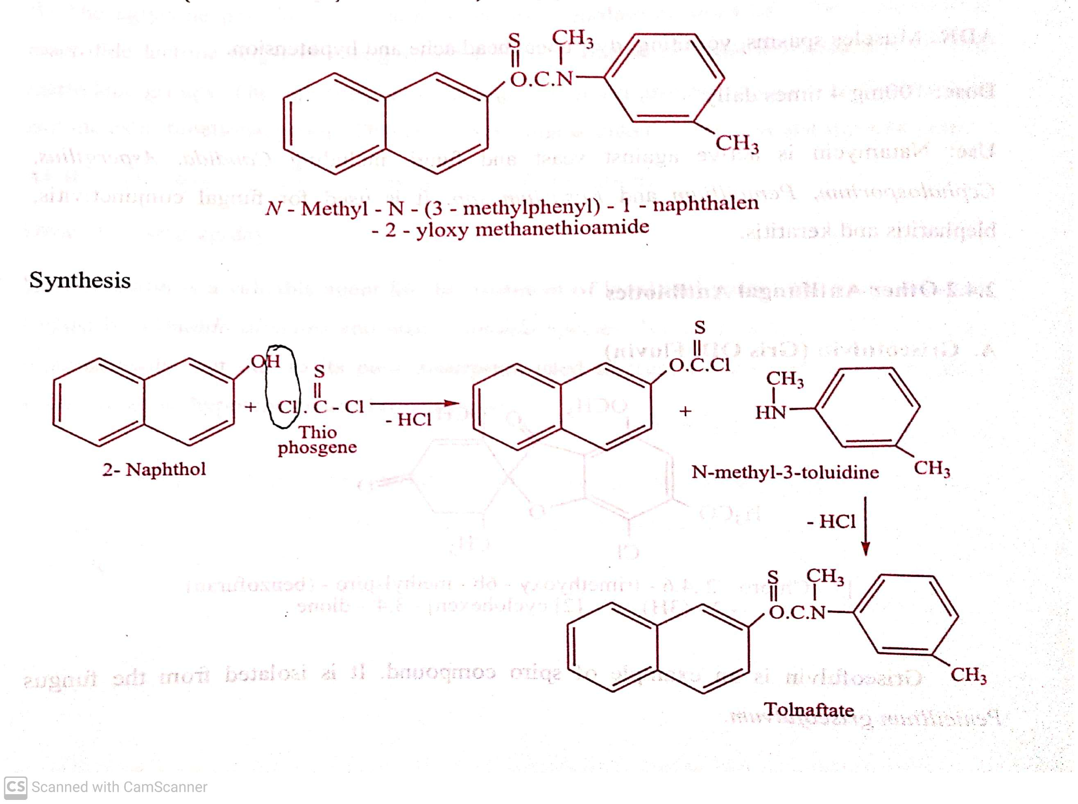
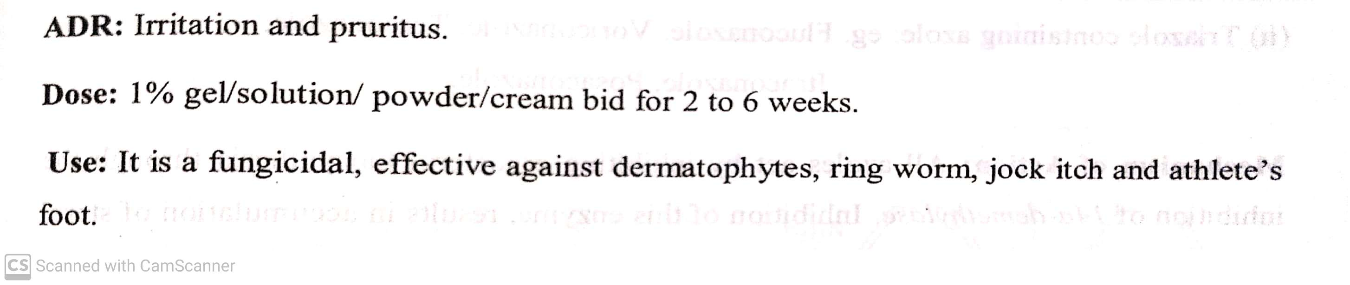
ANTIFUNGAL AGENTS
Classifications:
v) Allylamine and related compounds: Tolnaftate, terbinafine, Naftifine .
Tolnaftate: ( Tinaderm-M, Tinactin)
23-07-2020
© R R INSTITUTIONS , BANGALORE
15

Slide 16
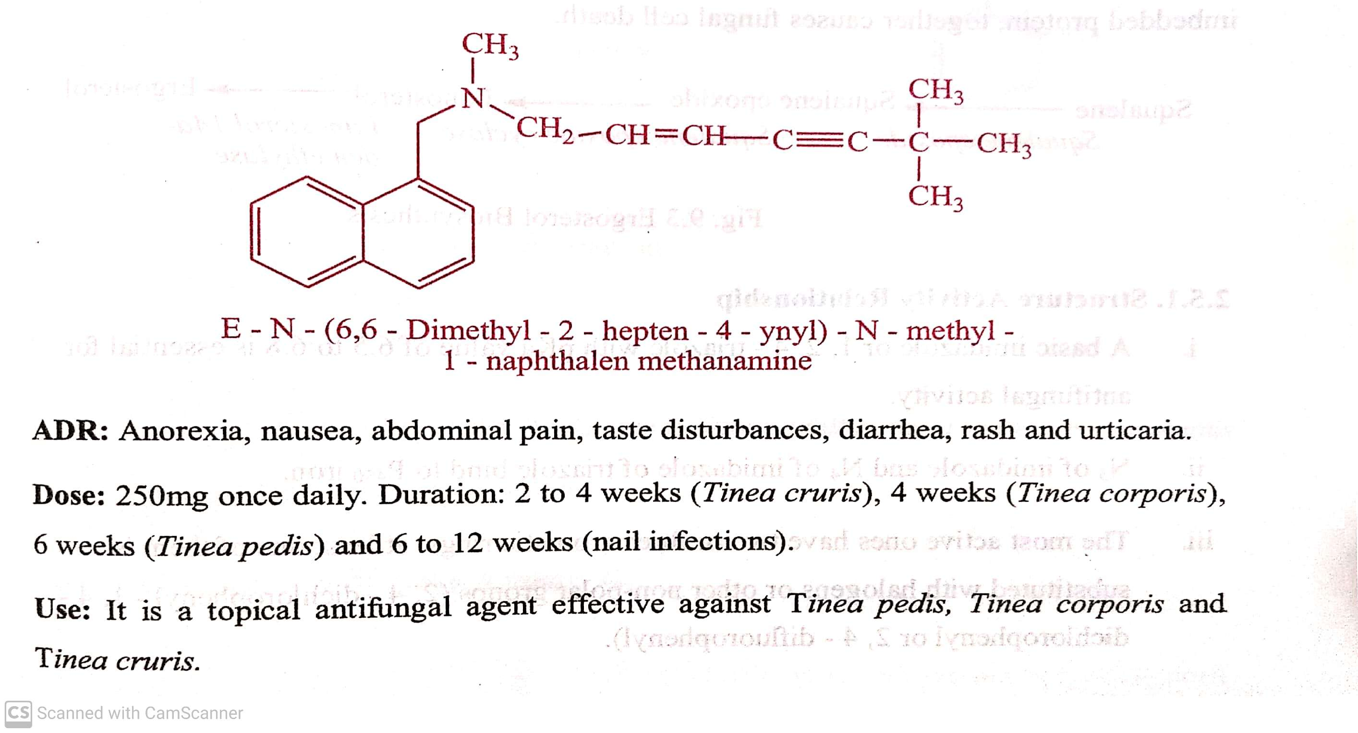
ANTIFUNGAL AGENTS
Classifications:
v) Allylamine and related compounds: Tolnaftate, terbinafine, Naftifine .
Terbinafine:
23-07-2020
© R R INSTITUTIONS , BANGALORE
16

Slide 17
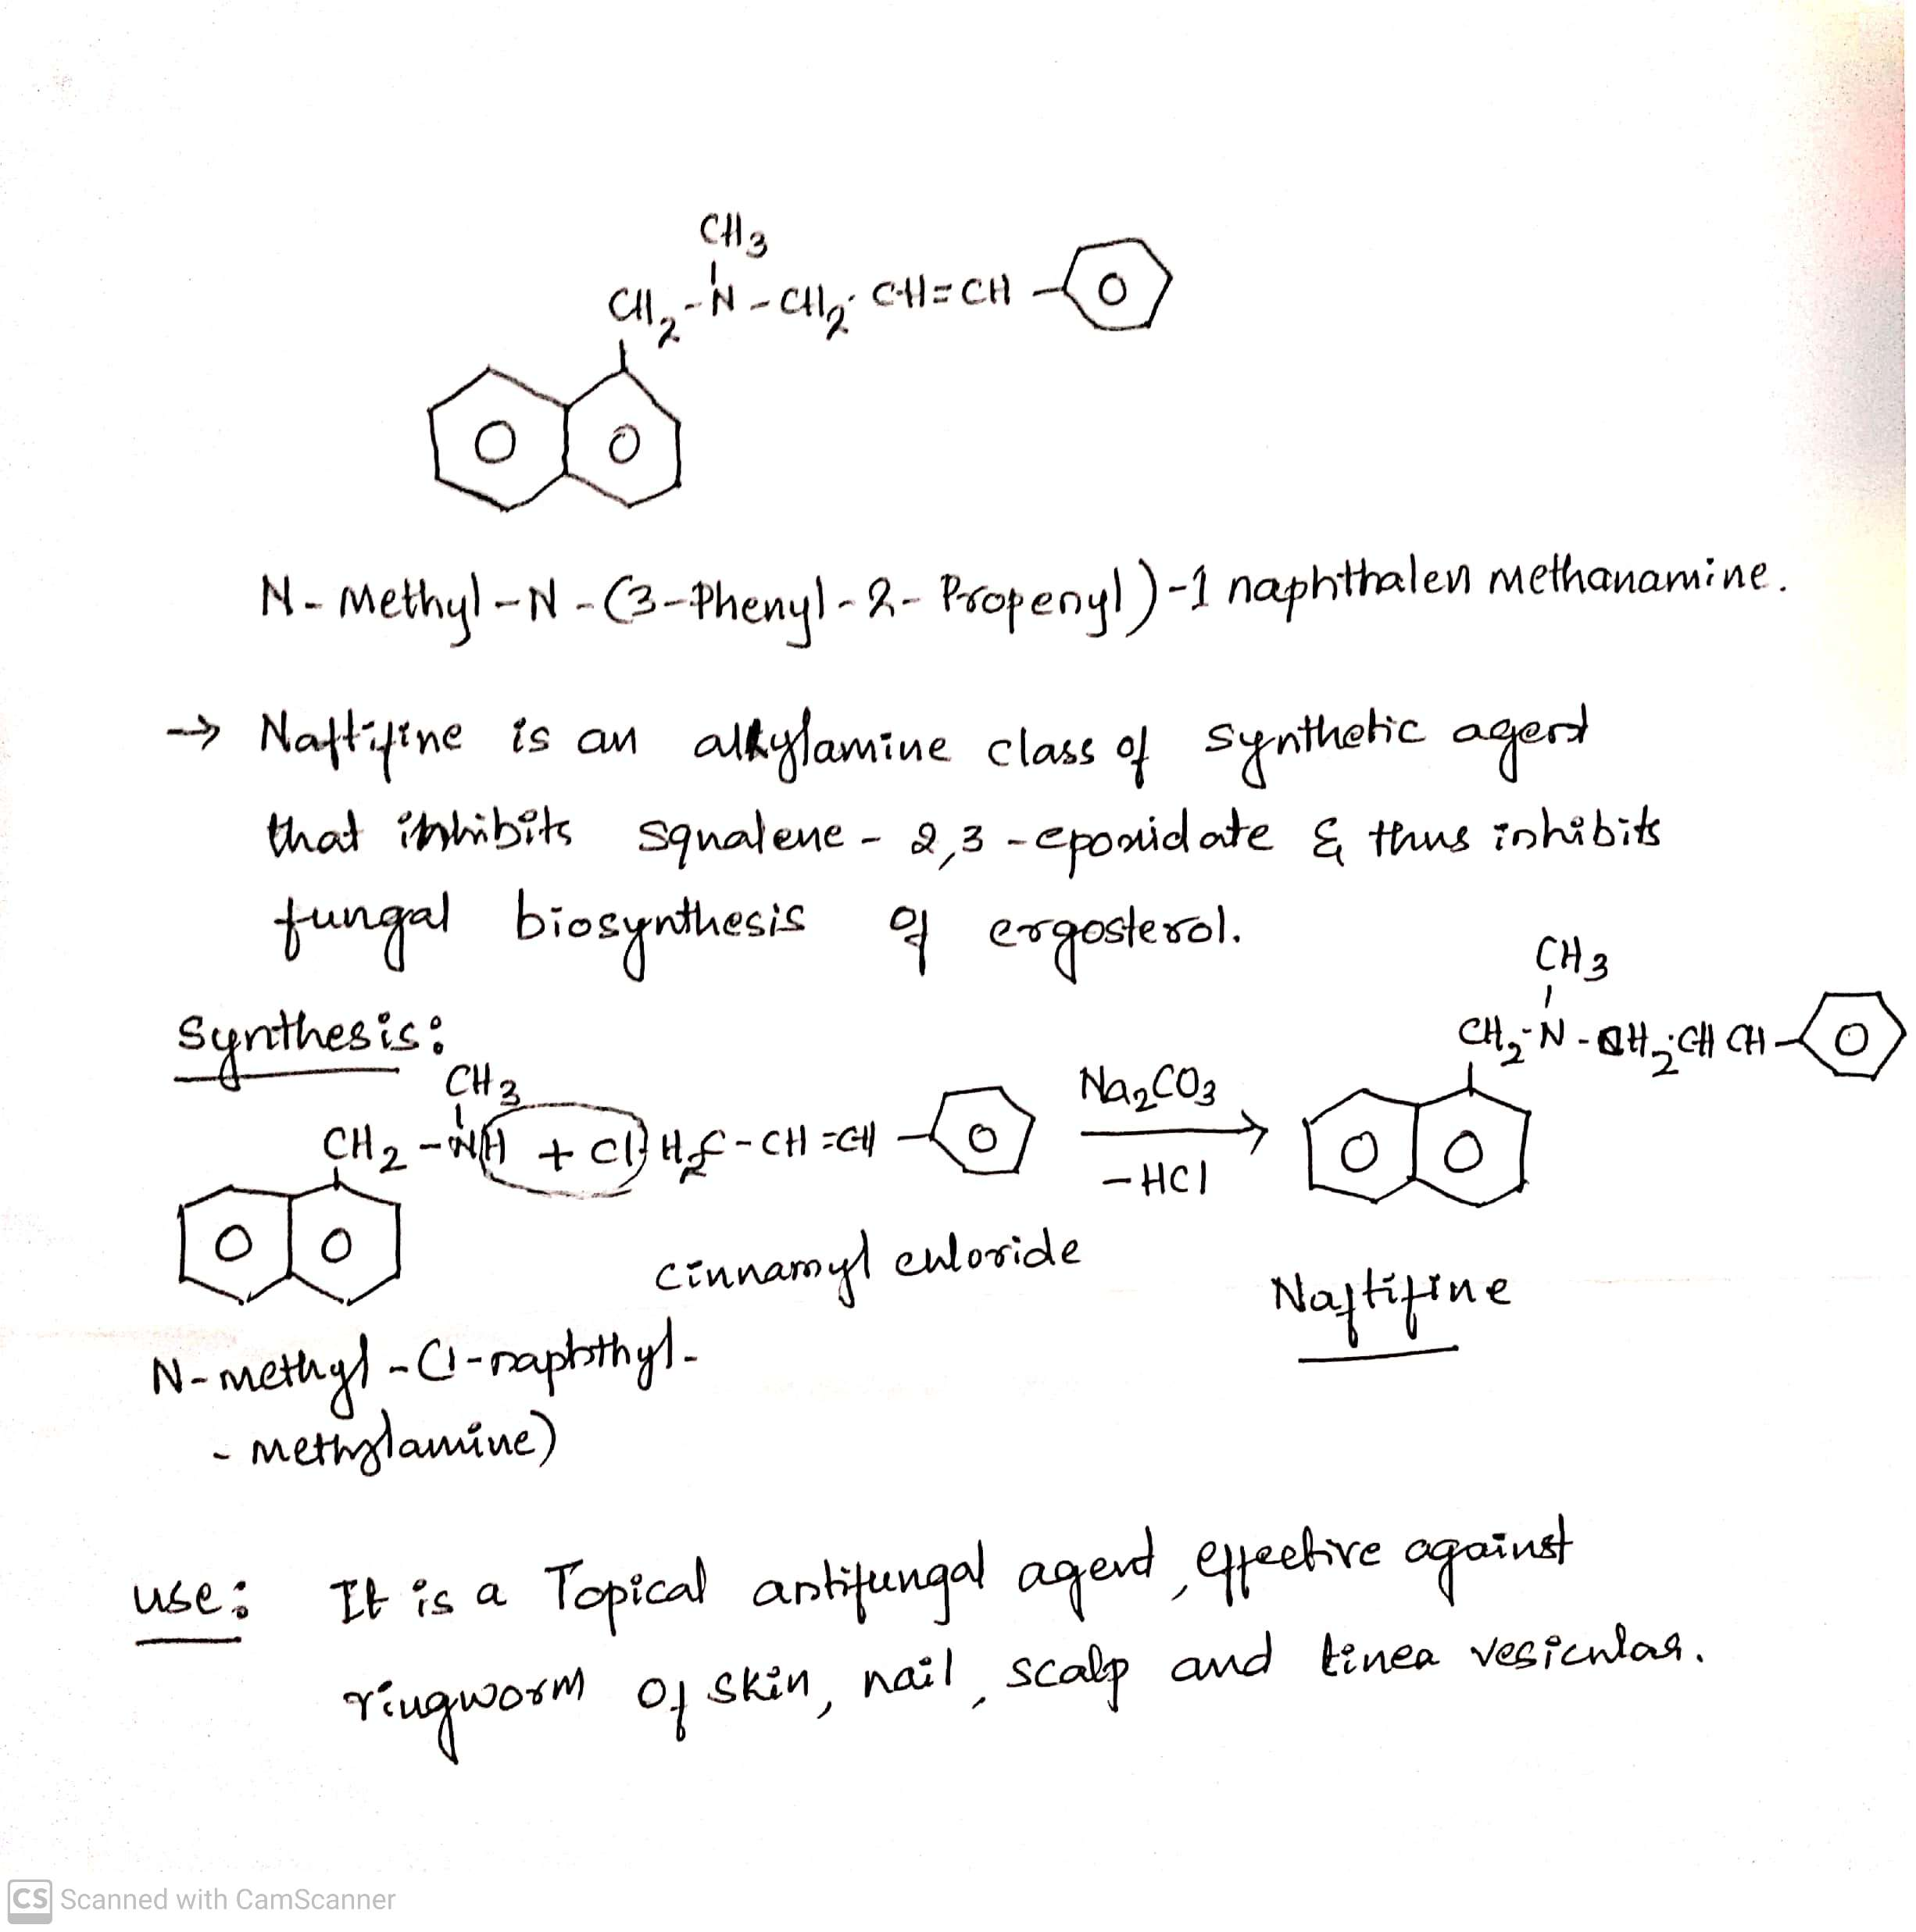
ANTIFUNGAL AGENTS
Classifications:
v) Allylamine and related compounds: Tolnaftate, terbinafine, Naftifine .
Naftifine:
23-07-2020
17

Slide 18
ANTIFUNGAL AGENTS
Classifications:
vi) Azole antifungal agents : Clotrimazole, Econazole, Oxiconazole, Miconazole, Ketoconazole, Fluconazole, Ticonazole.
Azoles are five membered aromatic rings containing either two nitrogen (imidazole) or three nitrogen (triazole) with side
chain at N, containing at least one aromatic ring.
Azole can be further classified as:
i) Imidazole containing azole: eg, Clotrimazole, Econazole, Oxiconazole, Miconazole, Ketoconazole.
ii) Triozole containing azole : eg, Fluconazole, Terconazole, Voriconazole, Itraconazole.
23-07-2020
© R R INSTITUTIONS , BANGALORE
18

Slide 19
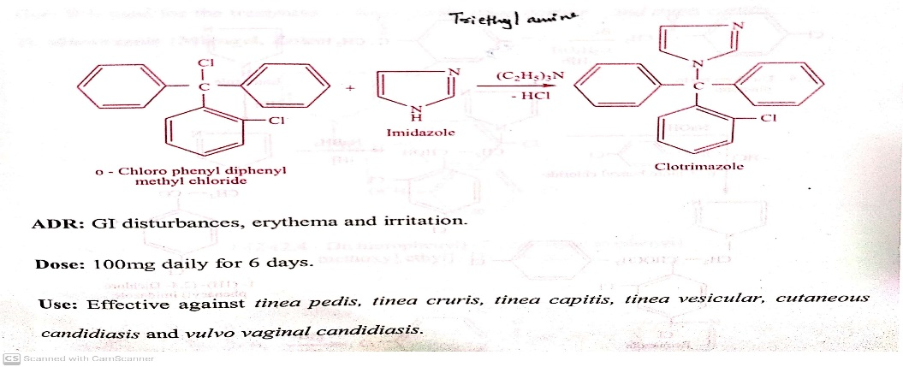
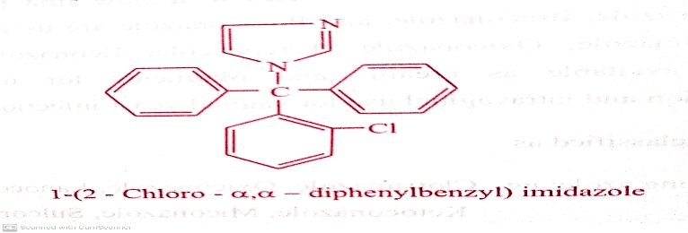
ANTIFUNGAL AGENTS
Classifications:
vi) Azole antifungal agents : Clotrimazole, Econazole, Oxiconazole, Miconazole, Ketoconazole, Fluconazole, Ticonazole.
Azole can be further classified as:
i) Imidazole containing azole: eg, Clotrimazole, Econazole, Oxiconazole, Miconazole, Ketoconazole.
eg, Clotrimazole:
23-07-2020
19

Slide 20


Slide 21
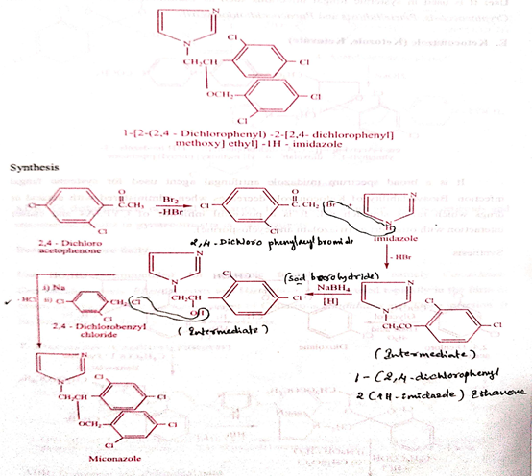
ANTIFUNGAL AGENTS
eg, Miconazole:
23-07-2020
© R R INSTITUTIONS , BANGALORE
21

Slide 22
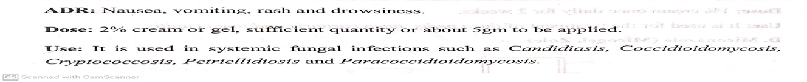

Slide 23
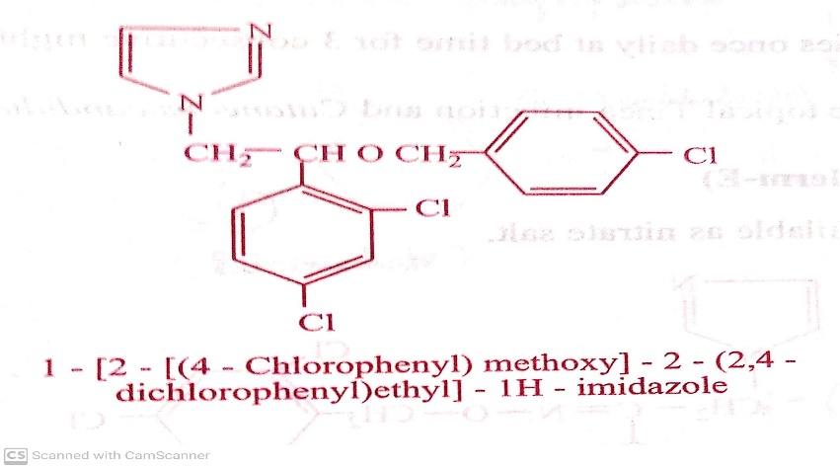
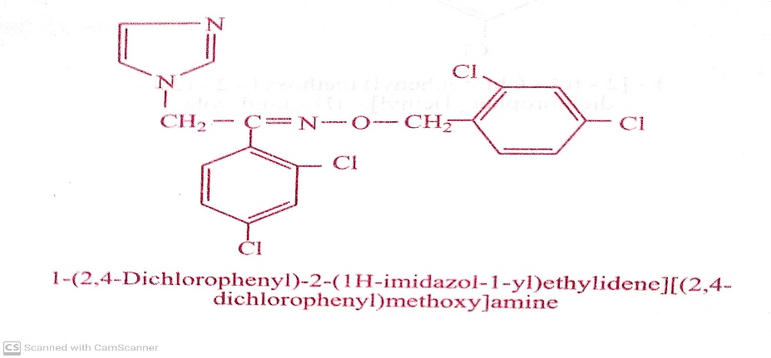
ANTIFUNGAL AGENTS
Classifications:
vi) Azole antifungal agents : Clotrimazole, Econazole, Oxiconazole, Miconazole, Ketoconazole, Fluconazole, Ticonazole.
Azole can be further classified as:
a) Imidazole containing azole: eg, Clotrimazole, Econazole, Oxiconazole, Miconazole, Ketoconazole.
eg, Econazole : Oxiconazole :
ADR: Vaginal burning
Use : It is used for the topical Tinea infection and Use: Used in the treatment of tinea pedis, tinea coporis
Cutaneous candidiasis. tinea capitis.
23-07-2020
© R R INSTITUTIONS , BANGALORE
23

Slide 24
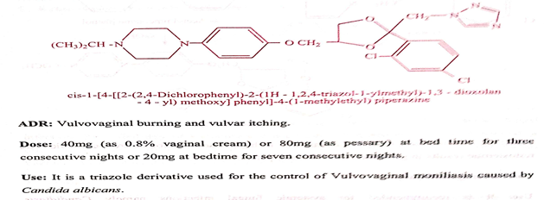
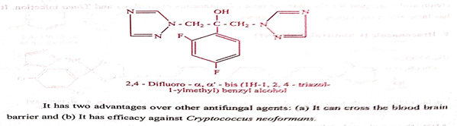
ANTIFUNGAL AGENTS
Classifications:
vi) Azole antifungal agents : Clotrimazole, Econazole, Oxiconazole, Miconazole, Ketoconazole, Fluconazole, Ticonazole.
Azole can be further classified as:
b) Triozole containing azole : eg, Fluconazole, Terconazole, Voriconazole, Itraconazole.
Fluconazole : Terconazole :
Use: It is used to control esophageal and
oropharyngeal candidiasis.
23-07-2020
24

Slide 25
ANTIFUNGAL AGENTS
Classifications:
vii) Newer antifungal agents: Echinocandins, Capsofungin, Micafungin.
Echinocandins : It is a new class of antifungal.
Echinocandins are group of cyclic peptides with long lipophilic side chain called as lipopeptides.
Use : It is used in the treatment of Candidiasis and aspergillosis.
Capsofungin : It is a polypeptide antifungal related to pneumonia used in life threatening systemic fungal innfections.
It is effective against a variety of candida species that are resistant to other agents as well as effective against
Cryptococcus neoformans.
It is Orally inactive and administered by IV infusion.
Use : It is used to treat oesophageal Candidiasis and invasive aspergillosis.
23-07-2020
25

Slide 26
THANK YOU
23-07-2020
26

