Slide 1

FRAGMENTATION RULES
&
PATTERNS

Slide 2
➢Mass Spectrum
It is a plot of the amount of each ion
(abundance) against the amount of m/e
ratio of the ion.
➢Base Peak
It is the peak corresponding to the
most abundant ion in the spectrum 100%
abundance.
i.e. The tallest peak in the mass spectrum

Slide 3
➢Molecular Ion
It is the ion formed by removal of one
electron from the original molecule.
➢Molecular Ion Peak
It is a peak corresponding to the
radical cation with the highest molecule
weight. It is the heaviest peak in the
spectrum.
➢Fragmentation Ions:
Ions formed by fragmentation of the
molecular ion.

Slide 4
Fragmentation
To attain high efficiency of molecular ion formation and give reproducible mass spectra, it is common to use electrons with energies of approximately 70 eV [6750 kJ (1600 kcal)/mol].
  This energy is sufficient not only to dislodge one or more electrons from a molecule, but also to cause extensive fragmentation.
  These fragments may be unstable as well and, in turn, break apart to even smaller fragments.

Slide 5
Fragmentation of M
Fragmentation of a molecular ion, M, produces a radical and a cation.
  Only the cation is detected by MS.

Slide 6
RULES FOR FRAGMENTATION
The relative height of the molecular ion peak is greatest for the straight chain compound and decreases as the degree of branching increases.
The relative height of the molecular ion peak usually decreases with increasing molecular weight in a homologous series.
Cleavage is favored at alkyl substituted carbon atoms; the more substituted the more likely to cleavage. This is a consequence of the increased stability of a tertiary carbon over a secondary, which in turn is more stable than a primary.
Double bonds, cyclic structures and especially aromatic or (heteroaromatic) rings stabilize the molecular ion, and thus increase the probability of its appearance.

Slide 7
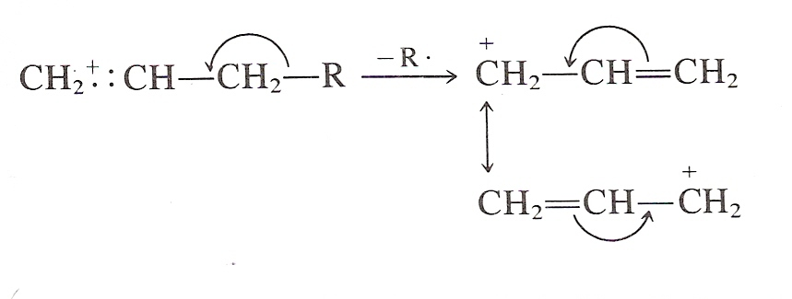
Double bonds favor allylic cleavage and give the resonance stabilized allylic carbocation.
β-bond is more susceptible to cleavage in unsaturated compounds.

Slide 8
Largest substituent at a branch is eliminated as a radical because long chain radical can achieve stabilization by delocalization.
Prominent peaks in the mass spectrum are on account of stable carbocation, cation stabilized by resonance structure, cyclic structure, unsaturated fragments & ions derived from aromatic rings.
Saturated rings or partially saturated rings tends to lose side chains if present at alpha bonds. The positive charge in such cases stays with the ring fragments.
Cleavage is often associated with elimination of small stable neutral molecules, such as carbon monoxide, olefins, water, ammonia, hydrogen sulfide, hydrogen cyanide, mercaptans, ketones or alcohol, often with rearrangement.

Slide 9
Loss of small molecules, such as H₂O, CO, C₂H₄

Slide 10
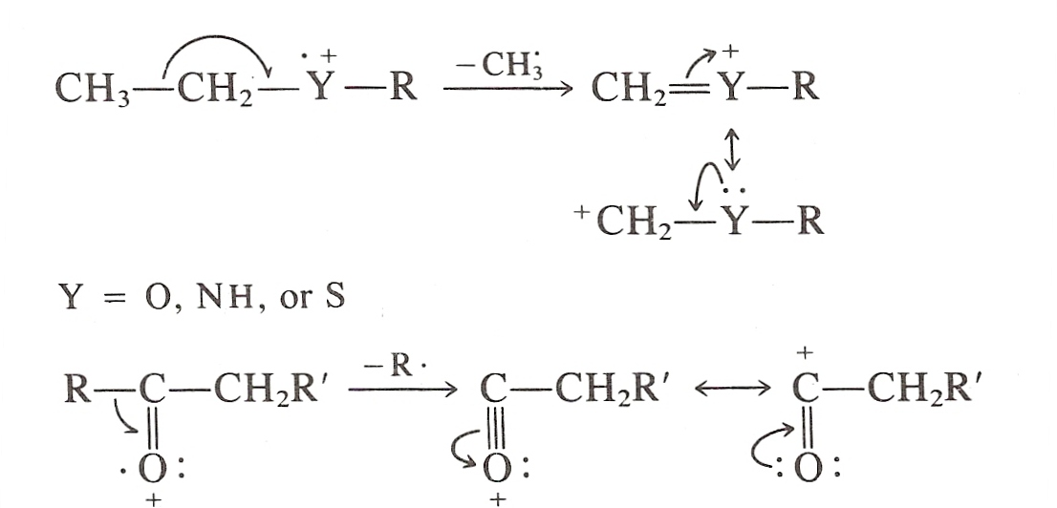
The C – C bonds next to a hetero atom are frequently cleaved, leaving the charge on the fragment containing the heteroatom whose non bonding electrons provide resonance stabilization.

Slide 11
GENERAL MODES OF FRAGMENTATION:
Fragmentation of the molecular ion takes place in following modes:
* Simple cleavage
1. Homolytic cleavage
2. Heterolytic cleavage
3. Retro Diels-Alder reaction
* Rearrangement reactions accompanied by transfer of atoms.
1. Scrambling
2. Mc Lafferty rearrangement
3. Elimination

Slide 12
A) Simple cleavage
1. Homolytic cleavage:
Fragmentation by movement of one electron:
In a Molecular ion when the bonds are ruptured by moving one electron and the movement is generally indicated by fishhook arrows. The bond cleavage may involve the σ bond rupture and the net result is formation of a stable carbocation.
2. Heterolytic cleavage:
Fragmentation by movement of two electrons

Slide 13
  Fragmentation – Chemistry of Ions
    One bond σ-cleavages:
      cleavage of C-C
      b. cleavage of C-heteroatom

Slide 14
    One bond σ-cleavages:
    c. α-cleavage of C-heteroatom

Slide 15
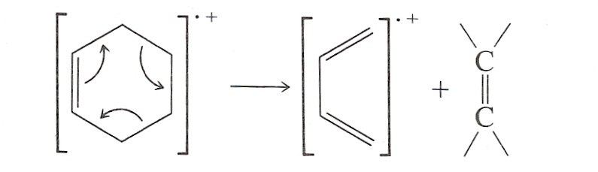
3.Retro Diels-Alder reaction:
Elimination by multiple σ bond rupture:
Unsaturated rings undergo Retro – Diels – Alder reaction.
Ex: cyclohexene is broken down to Diene and Dienophile.
B) Rearrangement reactions accompanied by transfer of atoms:
1. Scrambling:
Fragmentation giving rise to stable carbocation:
In certain cases fragmentation takes place at bond, which gives stable carbocation.

Slide 16
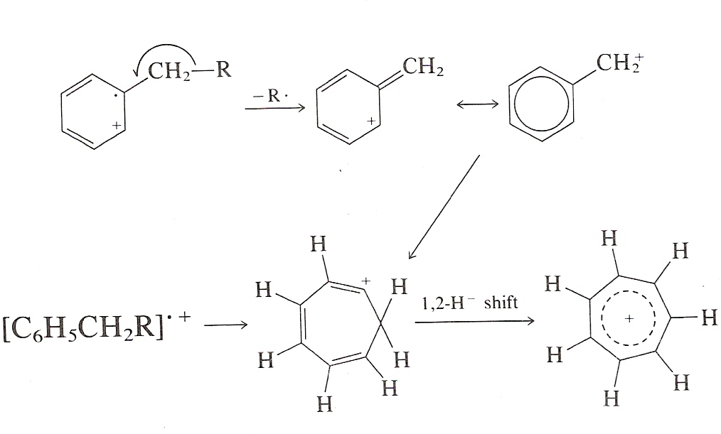
Ex- Molecular ion from the alkyl benzene undergoes fragmentation at the benzylic bond and final product is seven membered cyclic ion known as Tropylium ion.
2. Mc Lafferty rearrangement:
Fragmentation due to rearrangement of Molecular or Parent ion:
Here cleavage of bonds in Molecular ion is due to the intramolecular atomic rearrangement.
Such rearrangement involves the transfer of hydrogen from one part of the molecular ion to another via, preferably, a six-membered cyclic transition state.

Slide 17
Compounds containing hydrogen atom at position gamma to carbonyl group have been found to a relative intense peak. This is probably due to rearrangement and fragmentation is accompanied by the loss of neutral molecule.
The rearrangement results-charged enols and a neutral olefins.

Slide 18
2. Rearrangement
McLafferty rearrangement
Pattern I

Slide 19
Is the mass of the molecular ion odd or even ?
Nitrogen Rule:
If a compound has:
  Zero or an even number of nitrogen atoms, its molecular ion will have an even m/z value.
  An odd number of nitrogen atoms, its molecular ion will have an odd m/z value.

Slide 20
  Fragmentation Patterns of Groups
    Alkanes
      Very predictable – apply the lessons of the stability of carbocations (or radicals) to predict or explain the observation of the fragments
      Method of fragmentation is single bond cleavage in most cases
      This is governed by Stevenson’s Rule – the fragment with the lowest ionization energy will take on the + charge – the other fragment will still have an unpaired electron
      Example: iso-butane

Slide 21
  Fragmentation Patterns of Groups
    Alkanes
      Fragment Ions : n-alkanes
        For straight chain alkanes, a M⁺ is often observed
        Ions observed: clusters of peaks C_{n}H_{2n+1} apart from the loss of –CH₃, -C₂H₅, -C₃H₇, etc.
        Fragments lost: ·CH₃, ·C₂H₅, ·C₃H₇, etc.
        In longer chains – peaks at 43 and 57 are the most common

Slide 22
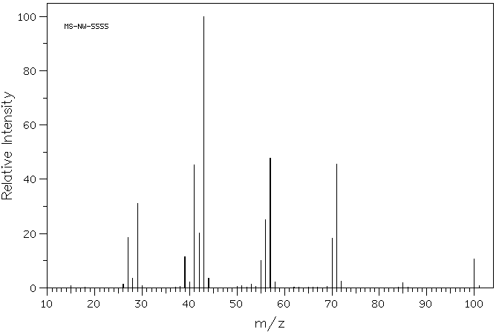
    Alkanes
    Example MS: n-alkanes
      n-heptane
M⁺

Slide 23
    Alkanes
      Fragment Ions : branched alkanes
        Where the possibility of forming 2° and 3° carbocations is high, the molecule is susceptible to fragmentation
        Whereas in straight chain alkanes, a 1° carbocation is always formed, its appearance is of lowered intensity with branched structures
        M+ peaks become weak to non-existent as the size and branching of the molecule increase
        Peaks at 43 and 57 are the most common as these are the iso-propyl and tert-butyl cations

Slide 24
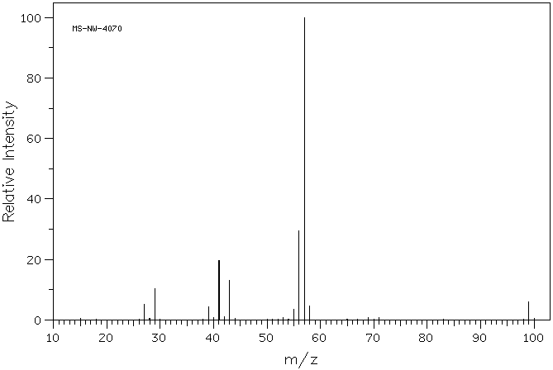
  Fragmentation Patterns of Groups
    Alkanes
      Example MS: branched alkanes – 2,2-dimethylhexane
M⁺ 114

Slide 25
  Fragmentation Patterns of Groups
    Alkanes
    Fragment Ions : cycloalkanes
        Molecular ions strong and commonly observed – cleavage of the ring still gives same mass value
        A two-bond cleavage to form ethene (C₂H₄) is common – loss of 28
        Side chains are easily fragmented

Slide 26
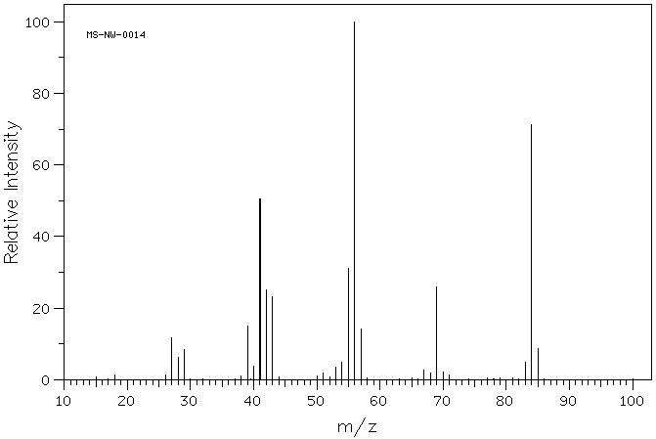
  Fragmentation Patterns of Groups
    Alkanes
      Example MS: cycloalkanes – cyclohexane
M - 28 = 56
M⁺ 84

Slide 27
  Fragmentation Patterns of Groups
    Alkenes
      The π-bond of an alkene can absorb substantial energy – molecular ions are commonly observed
      After ionization, double bonds can migrate readily – determination of isomers is often not possible
      Ions observed: clusters of peaks C_{n}H_{2n-1} apart from -C₃H₅, -C₄H₇, -C₅H₉ etc. at 41, 55, 69, etc.
      Terminal alkenes readily form the allyl carbocation, m/z 41

Slide 28
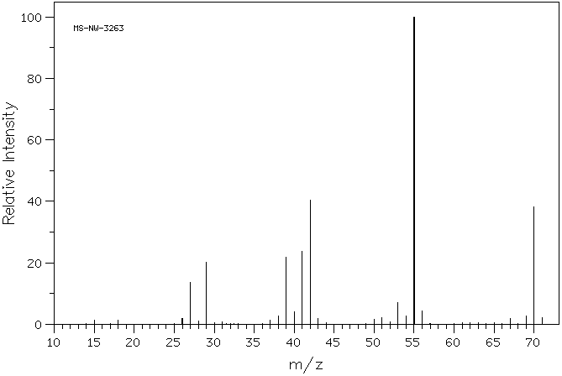
  Fragmentation Patterns of Groups
    Alkenes
      Example MS: alkenes – cis- 2-pentene
M⁺ 70

Slide 29
  Fragmentation Patterns of Groups
    Alkenes
    Fragment Ions : cycloalkenes
        Molecular ions strong and commonly observed – cleavage of the ring still gives same mass value
        Retro-Diels-Alder is significant
        observed loss 28
        Side chains are easily fragmented

Slide 30
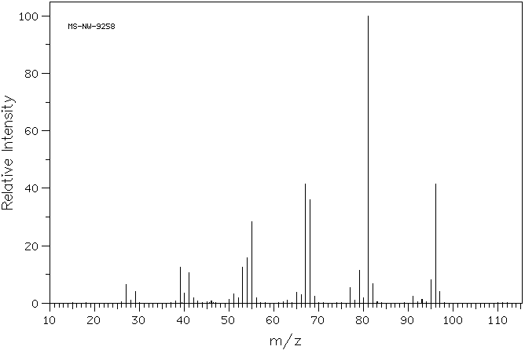
  Fragmentation Patterns of Groups
    Alkenes
      Example MS: cycloalkenes –1-methyl-1-cyclohexene
68
M⁺ 96

Slide 31
  Fragmentation Patterns of Groups
    Alkynes – Fragment Ions
      The π-bond of an alkyne can also absorb substantial energy – molecular ions are commonly observed
      For terminal alkynes, the loss of terminal hydrogen is observed (M-1) – this may occur at such intensity to be the base peak or eliminate the presence of M⁺
      Terminal alkynes form the propargyl cation, m/z 39 (lower intensity than the allyl cation)

Slide 32
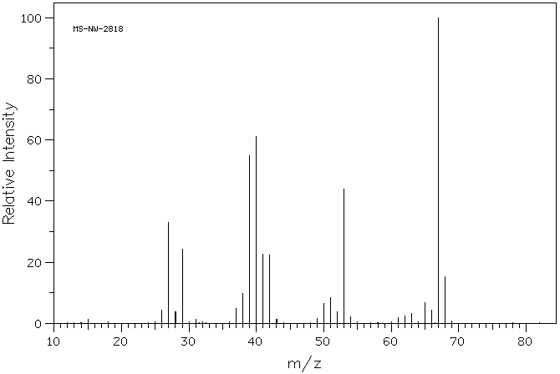
  Fragmentation Patterns of Groups
    Alkynes
      Example MS: alkynes – 1-pentyne
M⁺ 68

Slide 33
AROMATIC HYDROCARBONS
An aromatic hydrocarbon generally shows a prominent molecular ion peak because of stabilizing effect of ring.
Alkyl substituted aromatic compounds undergo beta cleavage in the side chain and give resonance stabilized benzyl cation or more likely the tropylium ion. A prominent peak (m/e = 91) indicates the presence of an alkyl substituted benzyl ring.
m/e=91 m/e=65

Slide 34
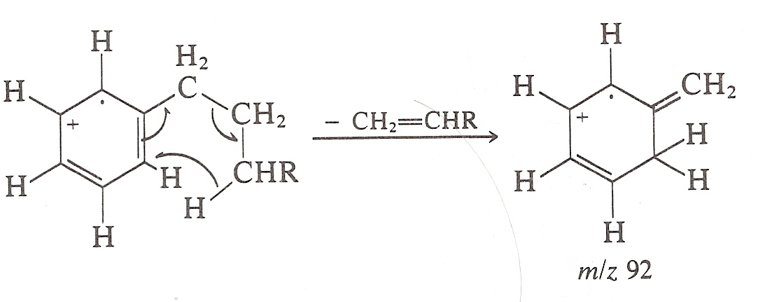
Aromatic compounds with alkyl groups having a chain of at least three carbon atoms can undergo a shift of γ-hydrogen probably according to McLafferty rearrangement.
As a result, a prominent peak at m/e = 92 is obtained.

Slide 35
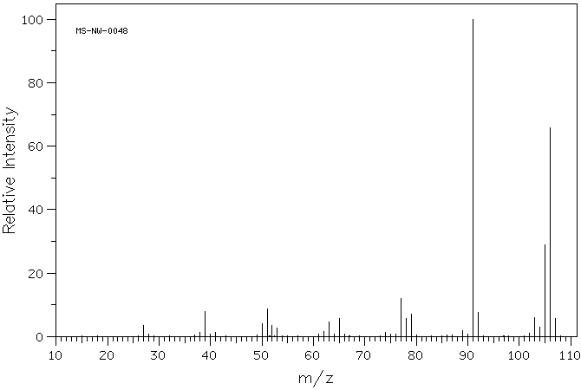
  Fragmentation Patterns of Groups
    Aromatic Hydrocarbons
      Example MS: aromatic hydrocarbons – p-xylene
m/z 91
M⁺ 106

Slide 36
  Fragmentation Patterns of Groups
    Alcohols– Fragment Ions
      Additional modes of fragmentation will cause lower M⁺ than for the corresponding alkanes
      1° and 2° alcohols have a low M⁺, 3° may be absent
      The largest alkyl group is usually lost; the mode of cleavage typically is similar for all alcohols:
      primary
      secondary
      tertiary
m/z
31
45
59

Slide 37
  Fragmentation Patterns of Groups
    Alcohols– Fragment Ions
      Dehydration (M - 18) is a common mode of fragmentation – importance increases with alkyl chain length (>4 carbons)
        1,2-elimination – occurs from hot surface of ionization chamber
        1,4-elimination – occurs from ionization
        both modes give M - 18, with the appearance and possible subsequent fragmentation of the remaining alkene
      For longer chain alcohols, a McLafferty type rearrangement can produce water and ethylene (M - 18, M - 28)

Slide 38
  Fragmentation Patterns of Groups
    Alcohols– Fragment Ions
      Loss of H is not favored for alkanols (M – 1)
      Cyclic alcohols fragment by similar pathways
        α-cleavage
        dehydration
m/z 57
M - 18

Slide 39
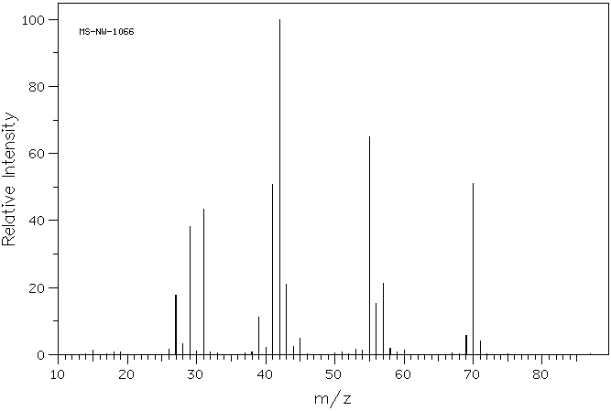
  Fragmentation Patterns of Groups
    Alcohols
      Example MS: alcohols – n -pentanol
42
-H₂O
70
M⁺ 88

Slide 40
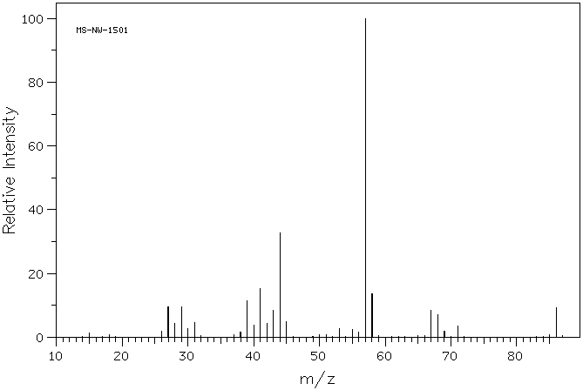
  Fragmentation Patterns of Groups
    Alcohols
      Example MS: alcohols – cyclopentanol
57
M⁺ 86

Slide 41
  Fragmentation Patterns of Groups
    Phenols– Fragment Ions
      Do not fully combine observations for aromatic + alcohol; treat as a unique group
      For example, loss of H· is observed (M – 1) – charge can be delocalized by ring – most important for rings with EDGs
      Loss of CO (extrusion) is commonly observed (M – 28); Net loss of the formyl radical (HCO·, M – 29) is also observed from this process

Slide 42
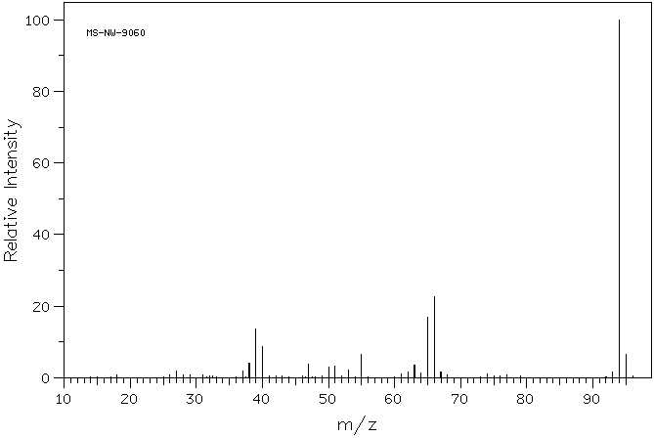
  Fragmentation Patterns of Groups
    Example MS: phenols – phenol
-CO 66
-HCO 65
M⁺ 94

Slide 43
  Fragmentation Patterns of Groups
    Ethers– Fragment Ions
      Slightly more intense M⁺ than for the corresponding alcohols or alkanes
      The largest alkyl group is usually lost to α-cleavage; the mode of cleavage typically is similar to alcohols:
      Cleavage of the C-O bond to give carbocations is observed where favorable

Slide 44
  Fragmentation Patterns of Groups
    Ethers– Fragment Ions
      Rearrangement can occur of the following type, if α-carbon is branched:
      Aromatic ethers, similar to phenols can generate the C₆H₅O⁺ ion by loss of the alkyl group rather than H; this can expel C≡O as in the phenolic degradation

Slide 45
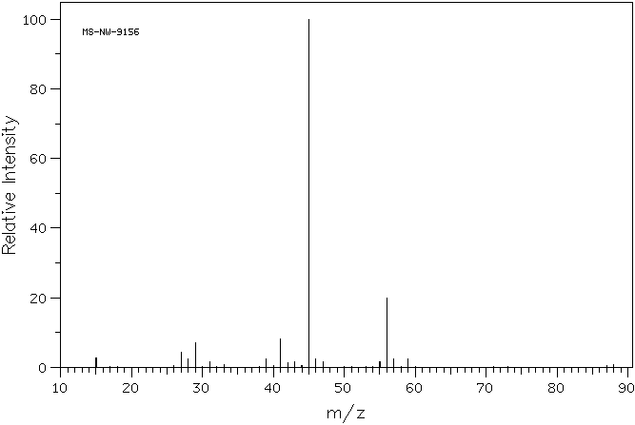
  Fragmentation Patterns of Groups
    Example MS: ethers – butyl methyl ether
M⁺ 88

Slide 46
  Fragmentation Patterns of Groups
    Aldehydes - Fragment Ions
      Weak M⁺ for aliphatic, strong M⁺ for aromatic aldehydes
      α-cleavage is characteristic and often diagnostic for aldehydes – can occur on either side of the carbonyl
      c) β-cleavage is an additional mode of fragmentation
M-1 peak
m/z 29
m/z R⁺
M - 41
can be R-subs.

Slide 47
  Fragmentation Patterns of Groups
    Aldehydes - Fragment Ions
      McLafferty rearrangement observed if γ-Hs present
      Aromatic aldehydes – a-cleavages are more favorable, both to lose H· (M - 1) and HCO· (M – 29)
m/z 44
m/z R⁺
Remember: aromatic ring can be subs.

Slide 48
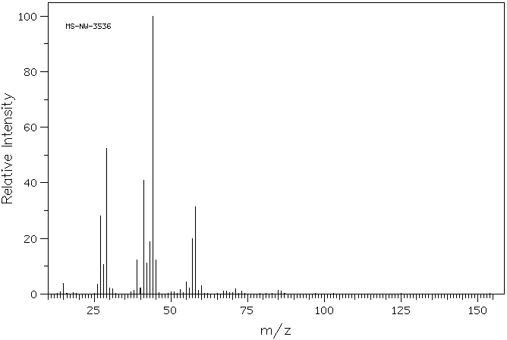
  Fragmentation Patterns of Groups
  Example MS: aldehydes (aliphatic) – pentanal
m/z 44
M-1
85
M⁺ 86

Slide 49
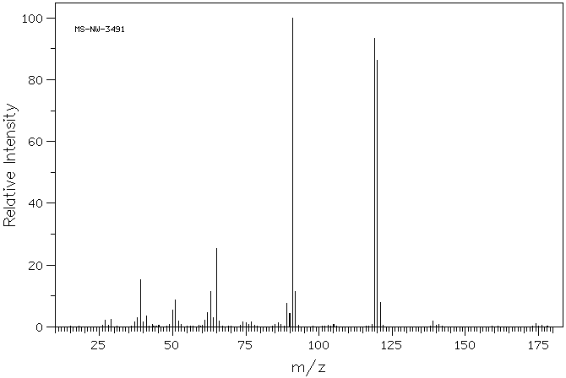
  Fragmentation Patterns of Groups
    Example MS: aldehydes (aromatic) – m-tolualdehyde
M-1
119
M⁺ 120

Slide 50
  Fragmentation Patterns of Groups
    Ketones - Fragment Ions
      Strong M⁺ for aliphatic and aromatic ketones
      α-cleavage can occur on either side of the carbonyl – the larger alkyl group is lost more often
      c) β-cleavage is not as important of a fragmentation mode for ketones compared to aldehydes – but sometimes observed
M – 15, 29, 43…
m/z 43, 58, 72, etc.

Slide 51
  Fragmentation Patterns of Groups
    Ketones - Fragment Ions
      McLafferty rearrangement observed if γ-H’s present – if both alkyl chains are sufficiently long – both can be observed
      Aromatic ketones – α-cleavages are favorable primarily to lose R· (M – 15, 29…) to form the C₆H₅CO⁺ ion, which can lose C≡O
Remember: aromatic ring can be subs.

Slide 52
  Fragmentation Patterns of Groups
    Ketones - Fragment Ions
      cyclic ketones degrade in a similar fashion to cycloalkanes and cycloalkanols:
m/z 55
m/z 70
m/z 42

Slide 53
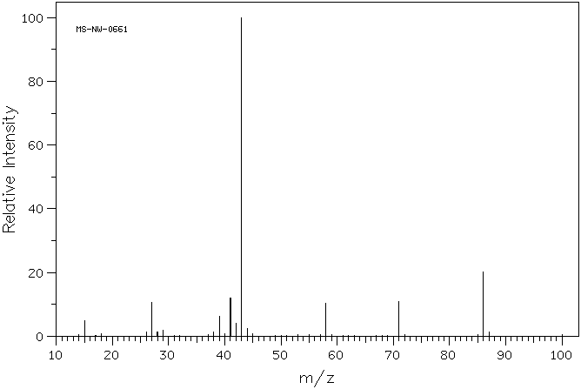
  Fragmentation Patterns of Groups
    Example MS: ketones (aliphatic) – 2-pentanone
M⁺ 86
M-15

Slide 54
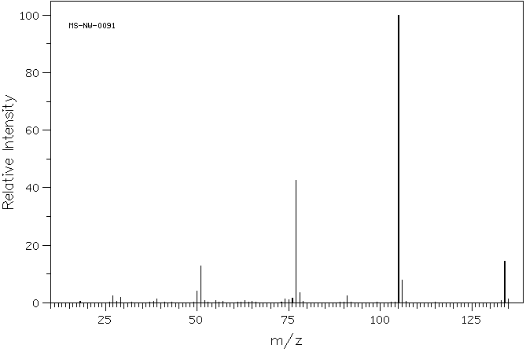
  Fragmentation Patterns of Groups
    Example MS: ketones (aromatic) – propiophenone
M⁺ 134

Slide 55
  Fragmentation Patterns of Groups
    Esters - Fragment Ions
      M⁺ weak in most cases, aromatic esters give a stronger peak
      Most important α-cleavage reactions involve loss of the alkoxy- radical to leave the acylium ion
      The other α-cleavage (most common with methyl esters, m/z 59) involves the loss of the alkyl group

Slide 56
  Fragmentation Patterns of Groups
    Esters - Fragment Ions
      McLafferty occurs with sufficiently long esters
      Ethyl and longer (alkoxy chain) esters can undergo the McLafferty rearrangement

Slide 57
  Fragmentation Patterns of Groups
    Esters - Fragment Ions
      The most common fragmentation route is to lose the alkyl group by α-cleavage, to form the C₆H₅CO⁺ ion (m/z 105)
Can lose CO to give m/z 77

Slide 58
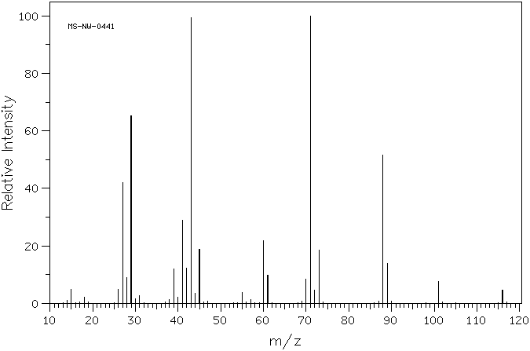
  Fragmentation Patterns of Groups
    Example MS: esters (aliphatic) – ethyl butyrate
both McLafferty (take home exercise)
m/z 88
M⁺ 116

Slide 59
  Fragmentation Patterns of Groups
    Carboxylic Acids - Fragment Ions
      As with esters, M⁺ weak in most cases, aromatic acids give a stronger peak
      Most important α-cleavage reactions involve loss of the alkoxy- radical to leave the acylium ion
      The other α-cleavage (less common) involves the loss of the alkyl radical. Although less common, the m/z 45 peak is somewhat diagnostic for acids.

Slide 60
  Fragmentation Patterns of Groups
    Carboxylic Acids - Fragment Ions
      McLafferty occurs with sufficiently long acids
      aromatic acids degrade by a process similar to esters, loss of the HO· gives the acylium ion which can lose C≡O:
m/z 60
+ further loss of CO to m/z 77

Slide 61
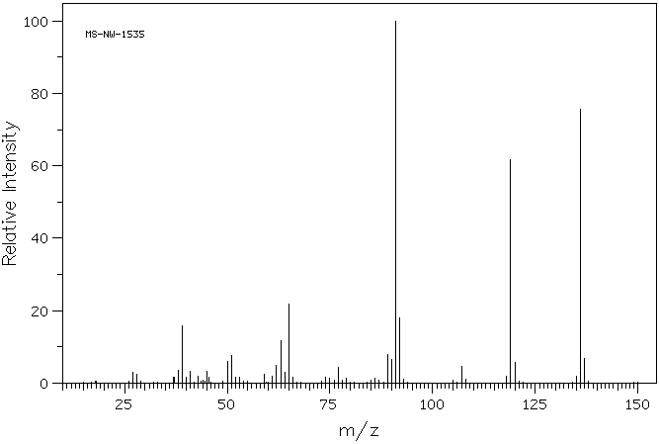
  Fragmentation Patterns of Groups
    Example MS: carboxylic acids (aromatic) –
    p-toluic acid
M⁺ 136

Slide 62
  Fragmentation Patterns of Groups
    Amines - Fragment Ions
      Follow nitrogen rule – odd M⁺, odd nitrogens; nonetheless, M⁺ weak in aliphatic amines
      α-cleavage reactions are the most important fragmentations for amines; for 1° n-aliphatic amines m/z 30 is diagnostic
      McLafferty not often observed with amines, even with sufficiently long alkyl chains
      Loss of ammonia (M – 17) is not typically observed

Slide 63
  Fragmentation Patterns of Groups
    Amines - Fragment Ions
      Mass spectra of cyclic amines is complex and varies with ring size
      Aromatic amines have intense M⁺
      Loss of a hydrogen atom, followed by the expulsion of HCN is typical for anilines
      Pyridines have similar stability (strong M⁺, simple MS) to aromatics, expulsion of HCN is similar to anilines

Slide 64
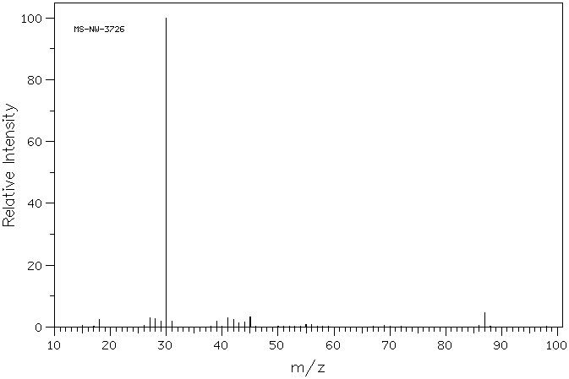
  Fragmentation Patterns of Groups
    Example MS: amines, 1° – pentylamine
M⁺ 87

Slide 65
  Fragmentation Patterns of Groups
    Amides - Fragment Ions
      Follow nitrogen rule – odd M⁺, odd # of nitrogens; observable M⁺
      α-cleavage reactions afford a specific fragment of m/z 44 for primary amides
      McLafferty observed where γ-hydrogens are present

Slide 66
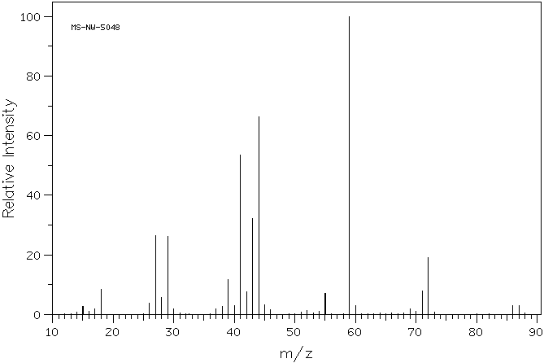
  Fragmentation Patterns of Groups
    Example MS: amides – butyramide
M⁺ 87

Slide 67
  Fragmentation Patterns of Groups
    Nitriles - Fragment Ions
      Follow nitrogen rule – odd M⁺, odd # of nitrogens; weak M⁺
      Principle degradation is the loss of an H-atom (M – 1) from α-carbon:
      Loss of HCN observed (M – 27)
      McLafferty observed where γ-hydrogens are present
      Aromatic nitriles give a strong M⁺ as the strongest peak, loss of HCN is common (m/z 76) as opposed to loss of CN (m/z 77)

Slide 68
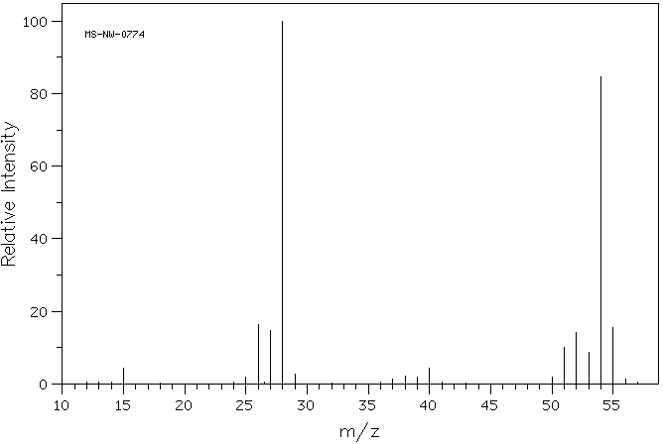
  Fragmentation Patterns of Groups
    Example MS: nitriles – propionitrile
M-1 54
- HC≡N
M⁺ 55

Slide 69
  Fragmentation Patterns of Groups
    Nitro - Fragment Ions
      Follow nitrogen rule – odd M⁺, odd # of nitrogens; M⁺ almost never observed, unless aromatic
      Principle degradation is loss of NO⁺ (m/z 30) and NO₂⁺ (m/z 46)

Slide 70
  Fragmentation Patterns of Groups
    Nitro - Fragment Ions
      Aromatic nitro groups show these peaks as well as the fragments of the loss of all or parts of the nitro group

Slide 71
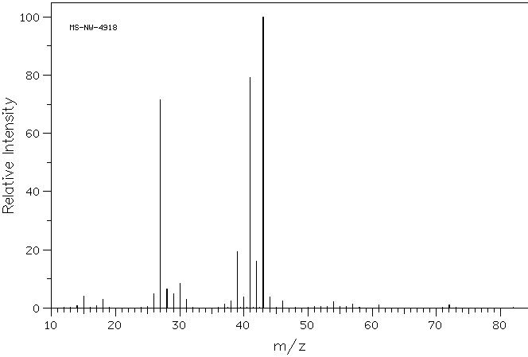
  Fragmentation Patterns of Groups
    Example MS: nitro – 1-nitropropane
NO⁺ 30
NO₂⁺ 46
M⁺ 89

Slide 72
  Fragmentation Patterns of Groups
    Halogens - Fragment Ions
      Halogenated compounds often give good M⁺
      Fluoro- and iodo-compounds do not have appreciable contribution from isotopes
      Chloro- and bromo-compounds are unique in that they will show strong M+2 peaks for the contribution of higher isotopes
      For chlorinated compounds, the ratio of M⁺ to M+2 is about 3:1
      For brominated compounds, the ratio of M⁺ to M+2 is 1:1
      An appreciable M+4, 6, … peak is indicative of a combination of these two halogens – use appropriate guide to discern number of each

Slide 73
  Fragmentation Patterns of Groups
    Halogens - Fragment Ions
      Principle fragmentation mode is to lose halogen atom, leaving a carbocation – the intensity of the peak will increase with cation stability
      Leaving group ability contributes to the loss of halogen most strongly for -I and -Br less so for -Cl, and least for –F
      Loss of HX is the second most common mode of fragmentation – here the conjugate basicity of the halogen contributes (HF > HCl > HBr > HI)

Slide 74
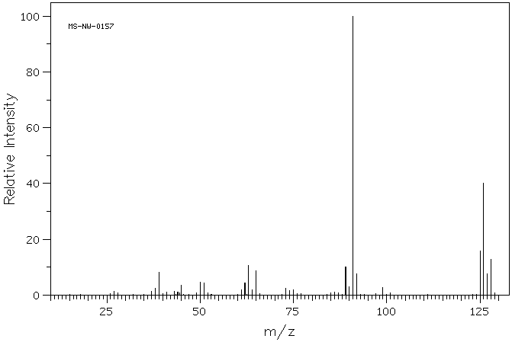
  Fragmentation Patterns of Groups
    Example MS: chlorine – p-chlorotoluene
M⁺ 126
M+2

Slide 75
REFERENCES
ELEMENTARY ORGANIC SPECTROSCOPY BY Y.R. SHARMA.
ORGANIC SPECTROSCOPY BY WILLIAM KEMP.
INTERNET.

Slide 76

Thank
you

