Slide 1

MEDICINAL CHEMISTRY
URINARY TRACT ANTI-INFECTIVE AGENTS
29-07-2020
1

Slide 2
URINARY TRACT ANTI-INFECTIVE AGENTS
Urinary tract consists of Kidneys, Bladders, Ureters and Urethra.
Kidneys produce urine by removing waste and water from the blood.
The urine travels down to the ureters and is stored in a bladder before being excreted through the urethra.
Normal urine contains no bacteria but germs may be introduced from the skin of genital area. These bacteria's can travel up
the urethra in to bladder. When it happens, inflammation of the bladder can occurs.
Bladder inflammation (Cystitis) are usually very uncomfortable as they cause burning when passing urine.
Majority of the urinary tract infections are caused by Escherichia Coli, Staphylococcus faecalis, Staph aurens, Proteus,
Mirabilis etc.,
29-07-2020
2

Slide 3
URINARY TRACT ANTI-INFECTIVE AGENTS
Signs and symptoms:
Pain or burning when urinating,
Need to urinate more often than usual.
A feeling of urgency when you urinate.
Blood or pus in urine.
Fever.
strong smelling urine.
Pain during sexual intercourse.
29-07-2020
3

Slide 4
URINARY TRACT ANTI-INFECTIVE AGENTS
URINARY TRACT ANTI-INFECTIVE AGENTS
Drugs which are used in the treatment of Urinary tract infection are known as UTAI agents.
Classifications:
Chemical classification of synthetic antibacterial agents includes:
i) Quinolones:
a) First generation quinolones : eg, Nalidixic acid, Cinoxacin.
b) Second generation quinolones : eg, Norfloxacin, Ciprofloxacin, Ofloxacin, Levofloxacin, Lomefloxacin,
Gatifloxacin, Sparfloxacin, Enoxacin.
ii) Nitrofurans: eg, Nitrofurazone, Furazolidone, Nitrofurantoin,
iii) Sulfonamides :eg, Sulfadiazine, Sulfaacetamide, Trimethoprim.
iv) Methenamine and its salt: eg, Methenamine, Methenamine mandelate, Methenamine hippurate.
29-07-2020
4

Slide 5
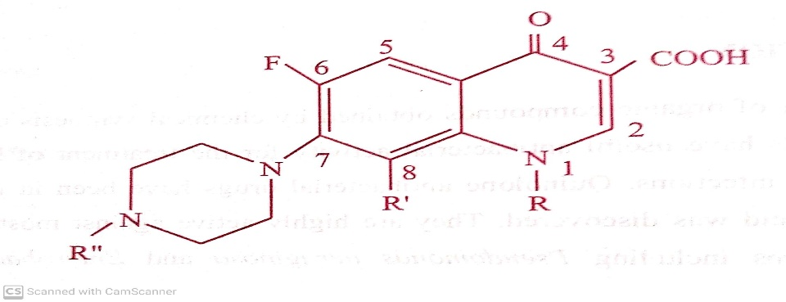
URINARY TRACT ANTI-INFECTIVE AGENTS
URINARY TRACT ANTI-INFECTIVE AGENTS
Drugs which are used in the treatment of Urinary tract infection are known as UTAI agents.
Classifications:
Chemical classification of synthetic antibacterial agents includes:
i) Quinolones:
Quinolones are family of synthetic broad spectrum antibiotic with antibacterial activity, possessing a common
N-1-alkylated-3-carboxy-4-one ring fused with another aromatic ring.
Quinolones binds to the bacterial enzymes DNA gyrase (topoisomerase II) and topoisomerase IV and prevent supercoiling
of DNA ( required for normal transcription) thereby inhibiting DNA synthesis.
Quinolones have fluorine atom attached to the central ring system, typically at the C-6 position or C-7 position.
Quinolones are used in the treatment of Urinary tract infection.
29-07-2020
© R R INSTITUTIONS , BANGALORE
5

Slide 6
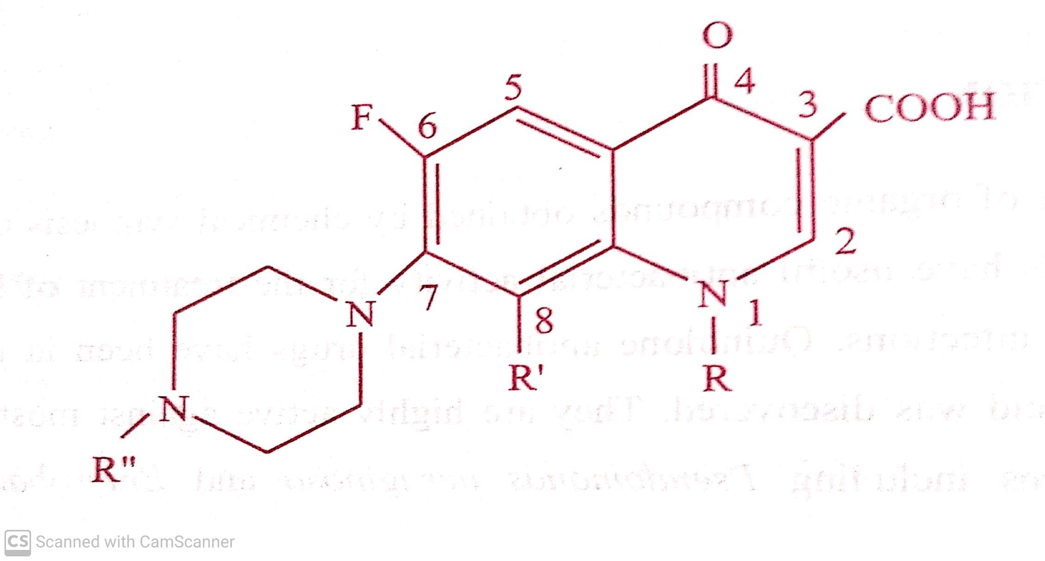
URINARY TRACT ANTI-INFECTIVE AGENTS
( SAR) Structural Activity Relationship of Quinolones.
The general structural requirements for Antibacterial activity are:
29-07-2020
© R R INSTITUTIONS , BANGALORE
6

Slide 7
URINARY TRACT ANTI-INFECTIVE AGENTS
( SAR) Structural Activity Relationship of Quinolones.
The general structural requirements for Antibacterial activity are:
1) 1,4-Dihydro-4-Oxo pyridine – 3-carboxylic acid moiety is essential for antibacterial activity.
2) The pyridine system must be annulated with an aromatic ring.
3) Position -4 keto (=O) group is essential for antibacterial activity.
29-07-2020
7

Slide 8
URINARY TRACT ANTI-INFECTIVE AGENTS
( SAR) Structural Activity Relationship of Quinolones.
The general structural requirements for Antibacterial activity are:
4) Replacement of nitrogen for carbon at position 2,5,6 & 8 leads to retention of antibacterial activity.
at -2-( Cinnolines / Cinoxin),
5-( 1,5-naphthyridine)
6-( 1,6-naphthyridine)
8-( 1,8-naphthyridine)
29-07-2020
8

Slide 9
URINARY TRACT ANTI-INFECTIVE AGENTS
( SAR) Structural Activity Relationship of Quinolones.
The general structural requirements for Antibacterial activity are:
5) Substitution at position-2 reduces the activity.
6) Reduction of 2,3 double bond eliminate activity.
7) Replacement of 3-Carboxylic acid function by acidic gps such as sulfonic acid, Acetic acid, sulfonamide and Phosphoric
acid resulted in decrease in antibacterial activity.
29-07-2020
9

Slide 10
URINARY TRACT ANTI-INFECTIVE AGENTS
( SAR) Structural Activity Relationship of Quinolones.
The general structural requirements for Antibacterial activity are:
8) Alkyl Substitution at position-1 is essential for activity. Lower alkyl gp (methyl, ethyl, cyclopropyl) compounds are
optimal for activity.
9) Aryl Substituents like ( Phenyl, naphthyl, indolyl etc.,) at position-1 is also having consistent activity.
10) Amino substitution at position -5 gives active compound.
29-07-2020
10

Slide 11
URINARY TRACT ANTI-INFECTIVE AGENTS
( SAR) Structural Activity Relationship of Quinolones.
The general structural requirements for Antibacterial activity are:
11) Substitution at position -6 with fluorine atom ( Fluoro quinolones) is significantly enhances the AB activity.
12) Chlorine substitution at position -6 results in an active compound.
13) Substitution at position -7 with Piperazine, N-methyl piperazine and Pyrrolidine ring gives active compound.
29-07-2020
11

Slide 12
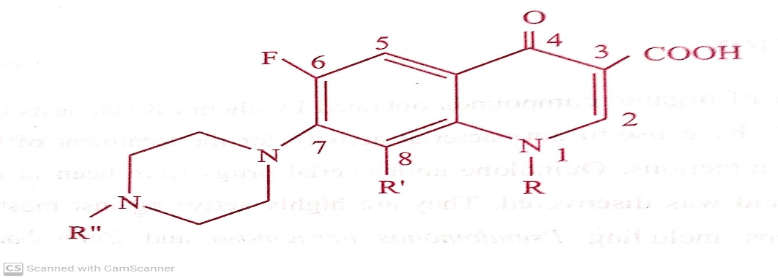
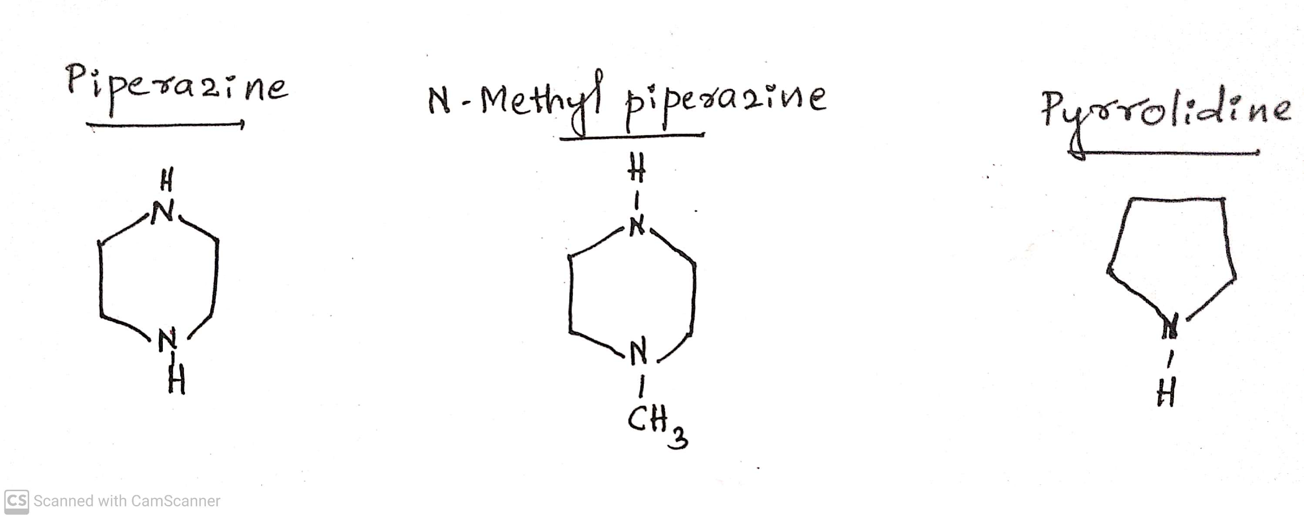
URINARY TRACT ANTI-INFECTIVE AGENTS
( SAR) Structural Activity Relationship of Quinolones.
The general structural requirements for Antibacterial activity are:
13) Substitution at position -7 with Piperazine, N-methyl piperazine and Pyrrolidine ring gives active compound.
29-07-2020
12

Slide 13
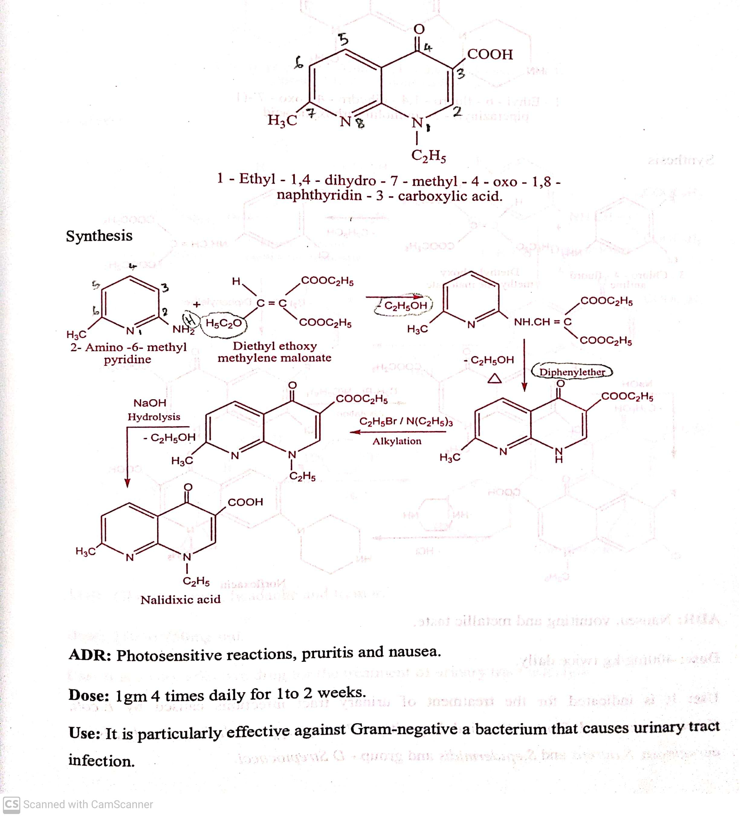
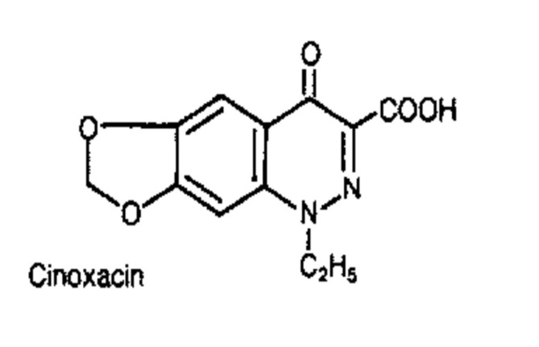
URINARY TRACT ANTI-INFECTIVE AGENTS
Classifications:
Chemical classification of synthetic antibacterial agents includes:
i) Quinolones: a) First generation quinolones: eg, Nalidixic acid, Cinoxacin ( Non-fluorinated quinolones).
eg, Nalidixic acid :
eg., Cinoxacin :
Use: Used in the treatment of UT infection.
29-07-2020
13

Slide 14
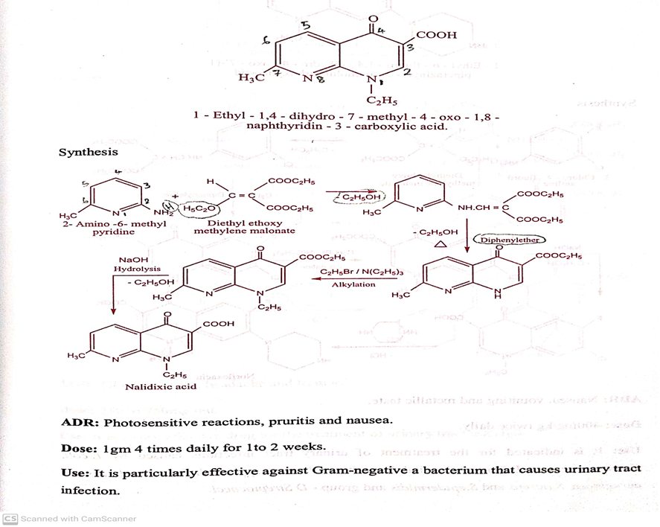

Slide 15
URINARY TRACT ANTI-INFECTIVE AGENTS
Classifications:
Chemical classification of synthetic antibacterial agents includes:
i) Quinolones:
b) Second generation quinolones : eg, Norfloxacin, Ciprofloxacin, Ofloxacin, Levofloxacin, Lomefloxacin,
Gatifloxacin, Sparfloxacin, Enoxacin. (Fluorinated quinolones).
29-07-2020
15

Slide 16
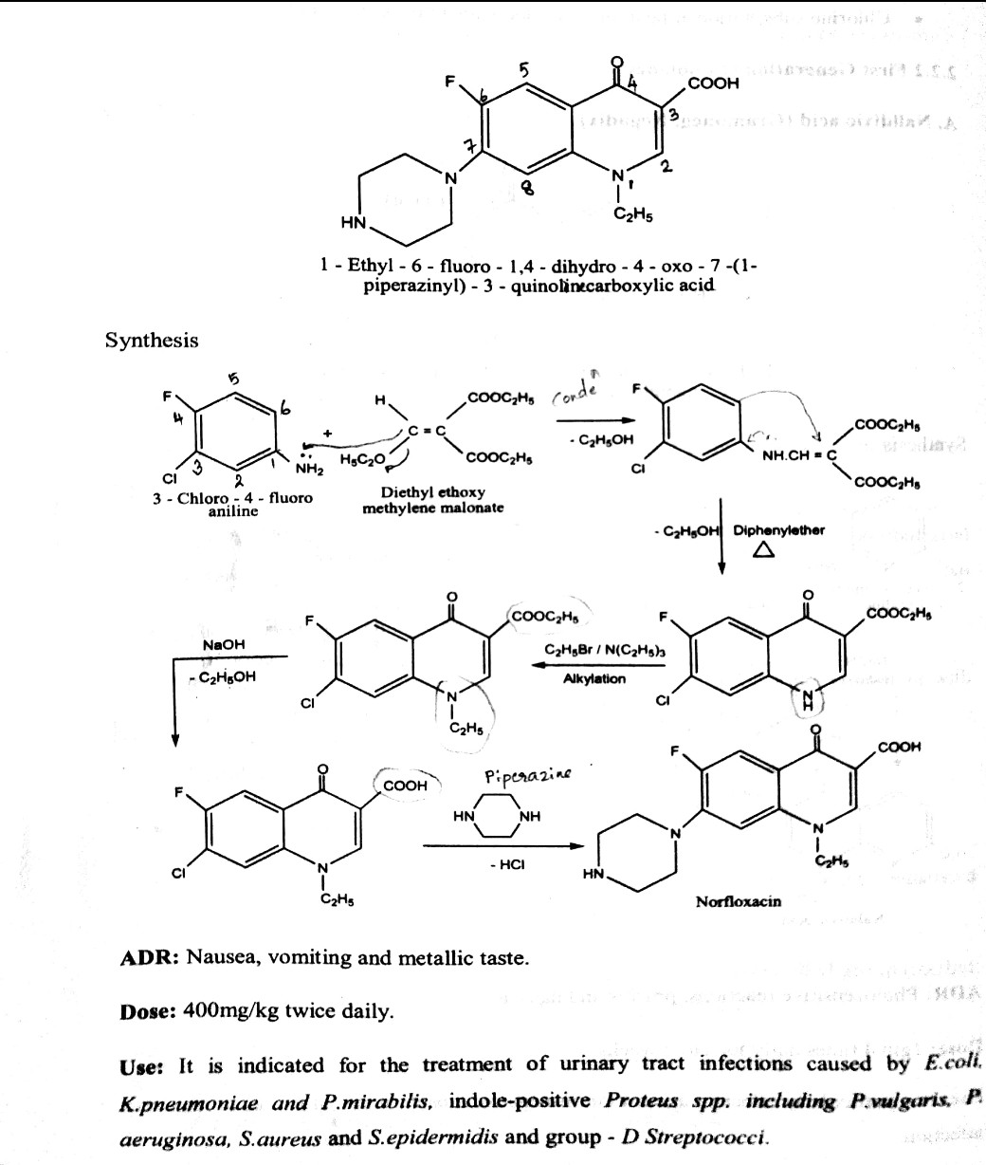
URINARY TRACT ANTI-INFECTIVE AGENTS
eg, Norfloxacin : ( Norbactin, Norflox)
29-07-2020
16

Slide 17


Slide 18
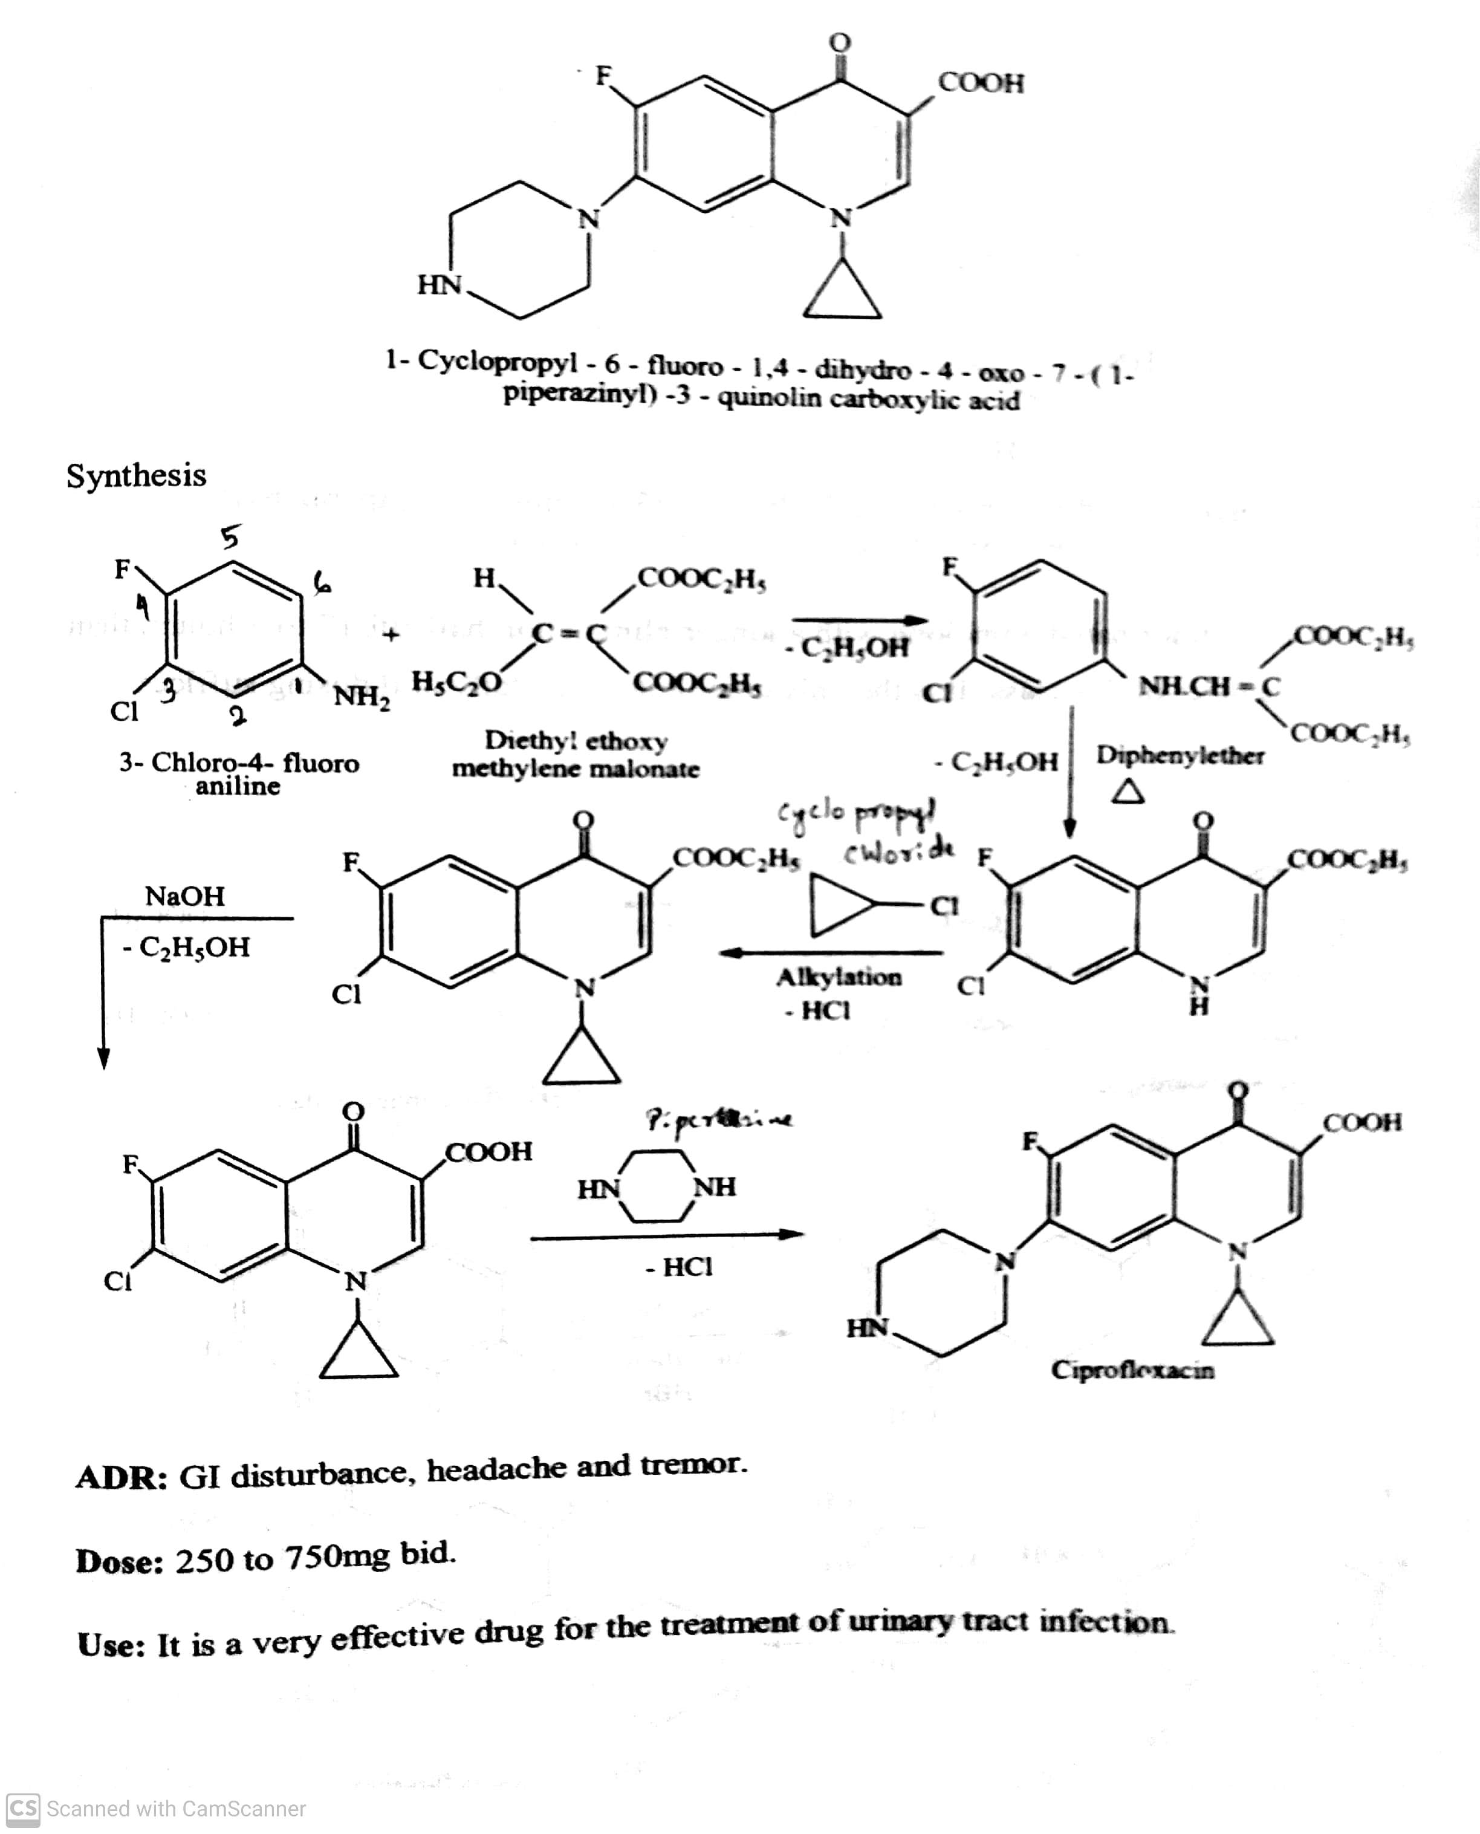
URINARY TRACT ANTI-INFECTIVE AGENTS
eg, Ciprofloxacin :
29-07-2020
© R R INSTITUTIONS , BANGALORE
18

Slide 19
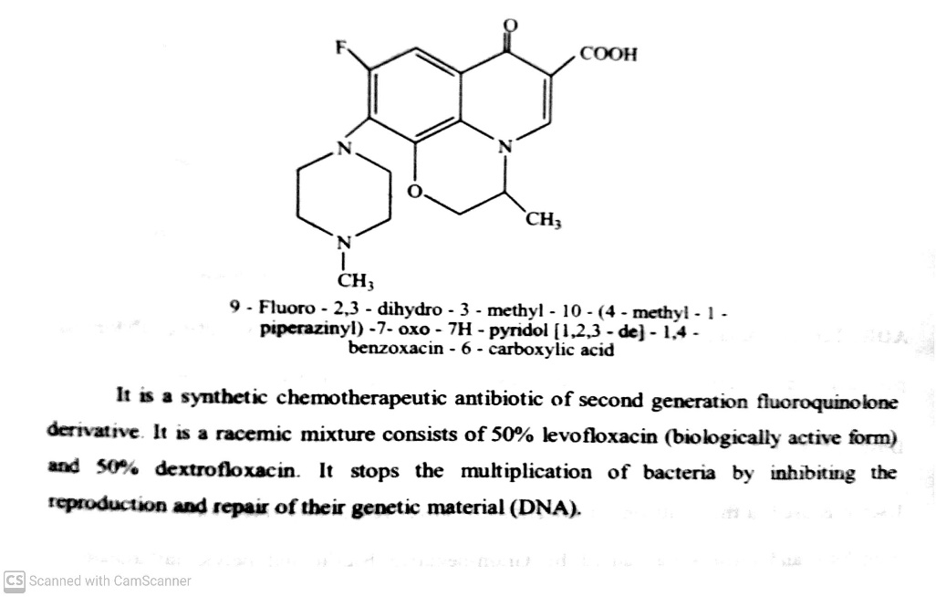
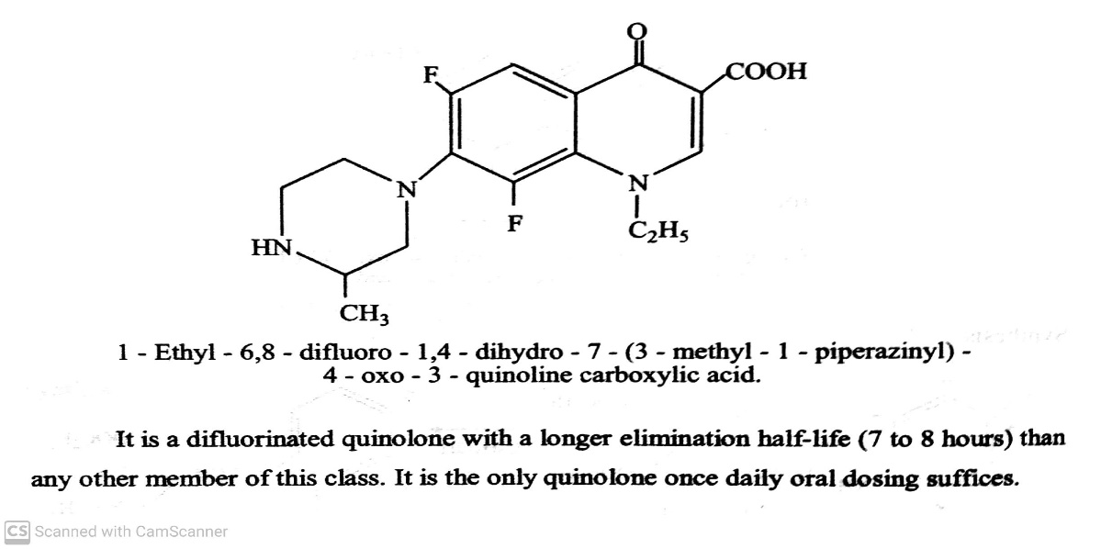
URINARY TRACT ANTI-INFECTIVE AGENTS
Classifications:
i) Quinolones:
b) Second generation quinolones : eg, Ofloxacin, Lomefloxacin,
Gatifloxacin, Sparfloxacin, Enoxacin. (Fluorinated quinolones).
Ofloxacin Lomefloxacin,
Use: It is used to treat infection like lower respiratory tract, Use: It is used in the treatment of acute cystitis, bronchitis and
including chronic bronchitis and pneumonia caused by chronic urinary tract infections.
Gram –ve bacilli and pelvic inflammatory disease.
29-07-2020
19

Slide 20
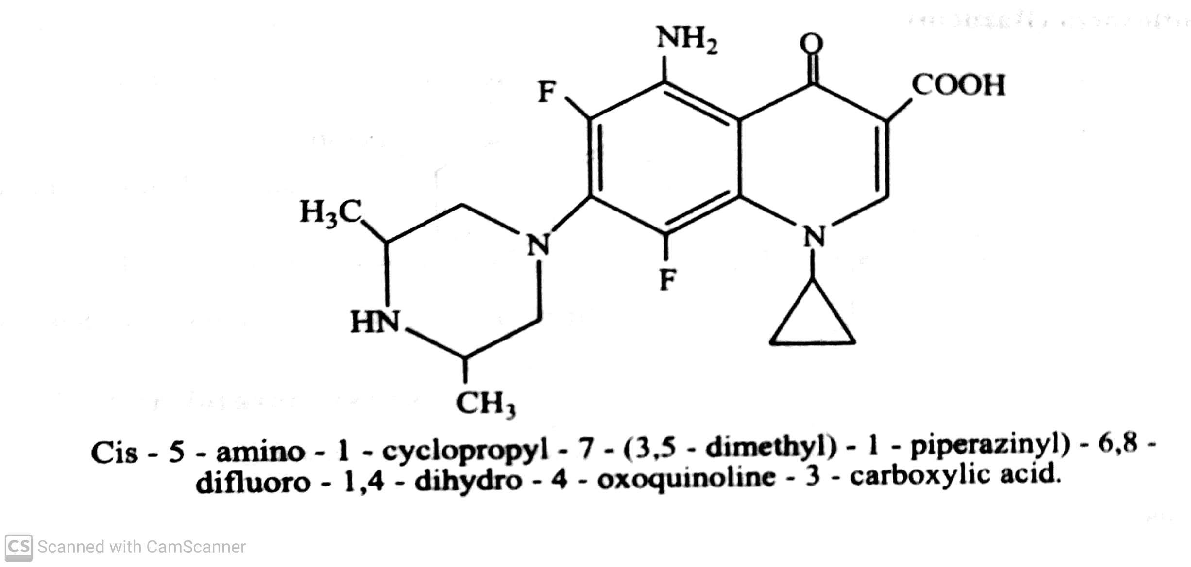
URINARY TRACT ANTI-INFECTIVE AGENTS
Classifications:
Chemical classification of synthetic antibacterial agents includes:
i) Quinolones:
b) Second generation quinolones : eg, Gatifloxacin, Sparfloxacin, Enoxacin. (Fluorinated quinolones).
Sparfloxacin
Use: It is a newer fluoroquinolone, effective against Staphylococci, Streptococci and Chlamydia.
29-07-2020
20

Slide 21
URINARY TRACT ANTI-INFECTIVE AGENTS
Classifications:
Chemical classification of synthetic antibacterial agents includes:
Quinolones:
ii) Nitrofurans: eg, Nitrofurazone, Furazolidone, Nitrofurantoin,
Nitrofurans:
Nitrofurans are the first heterocyclic compound introduced in chemotherapy.
They are used for the treatment of various kinds of bacterial infections.
Nifurimox is used as an antiprotozoal agent used to treat trypanosomiasis and leishmaniasis.
(trypanosomiasis- is disease in vertebrates caused by parasitic protozoan trypanosomes of the genus trypanosoma)
(leishmaniasis - is disease in caused by the protozoan leishmania parasites.)
Nirofurans are the derivatives of 5-Notro-2-furaldehyde. Antimicrobial activity is present only when the nitro group is
in 5th position.
29-07-2020
© R R INSTITUTIONS , BANGALORE
21

Slide 22
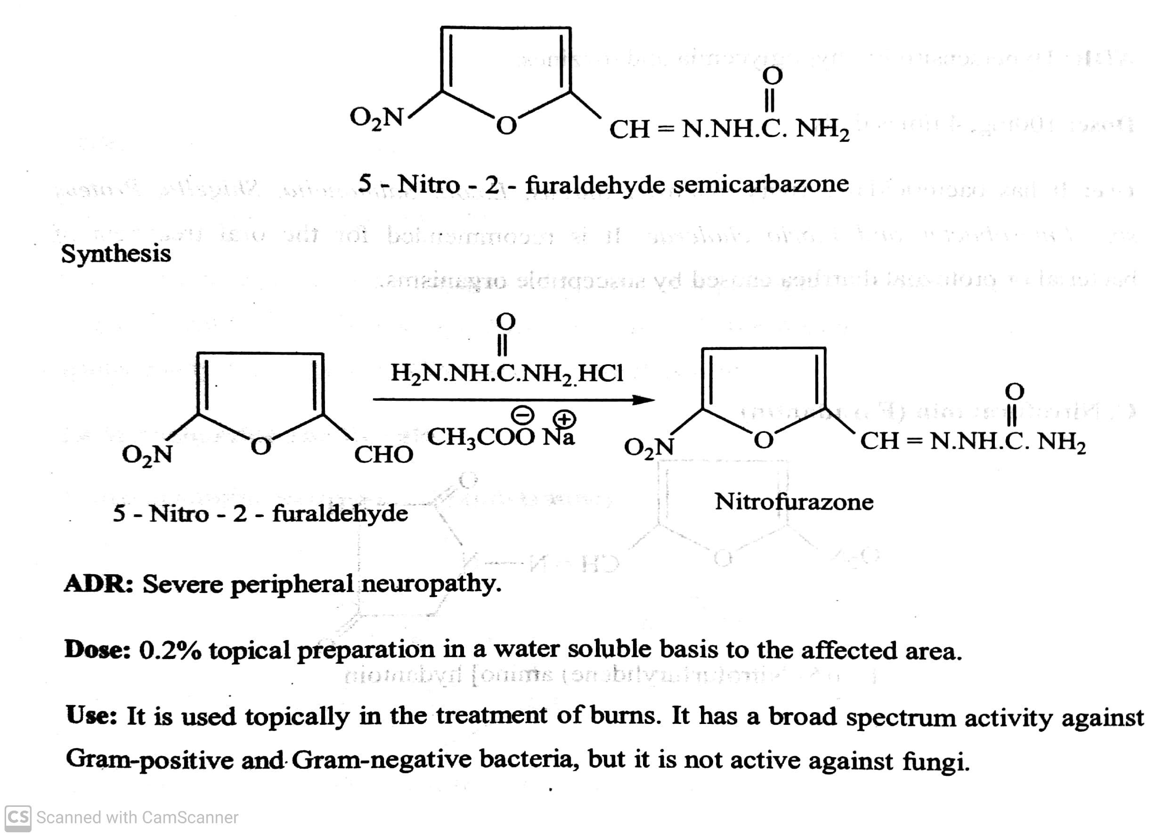
URINARY TRACT ANTI-INFECTIVE AGENTS
Classifications:
Chemical classification of synthetic antibacterial agents includes:
Quinolones:
ii) Nitrofurans: eg, Nitrofurazone, Furazolidone, Nitrofurantoin,
Eg : Nitrofurazone ( Furacin) :
29-07-2020
22

Slide 23
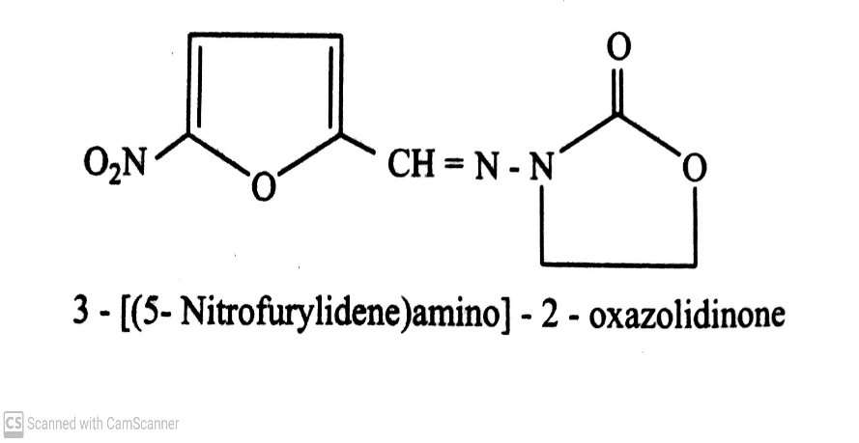
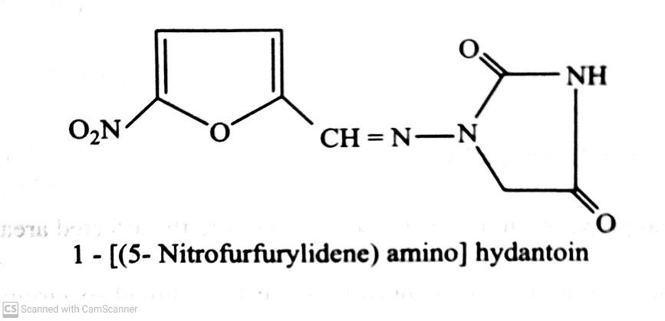
URINARY TRACT ANTI-INFECTIVE AGENTS
Classifications:
Chemical classification of synthetic antibacterial agents includes:
Quinolones:
ii) Nitrofurans: eg, Nitrofurazone, Furazolidone, Nitrofurantoin,
Eg : Furazolidone ( Furoxone, Lomofen) : Nitrofurantoin
Use: It has a bactericidal activity against S.aureus, E. Coli Use: It is effective against urinary tract pathogens
Salmonella.
29-07-2020
23

Slide 24
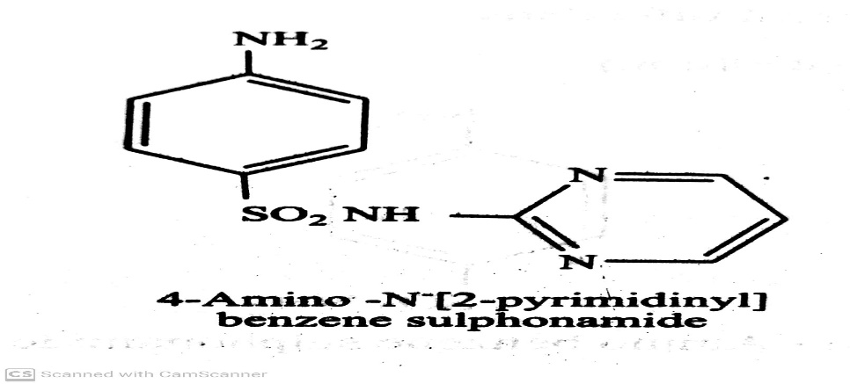
URINARY TRACT ANTI-INFECTIVE AGENTS
Classifications:
Chemical classification of synthetic antibacterial agents includes:
Quinolones:
iii) Sulfonamides :eg, Sulfadiazine.
ADR: Nausea, vomiting and anorexia.
Use: It is used in the treatment of meningitis.
29-07-2020
© R R INSTITUTIONS , BANGALORE
24

Slide 25
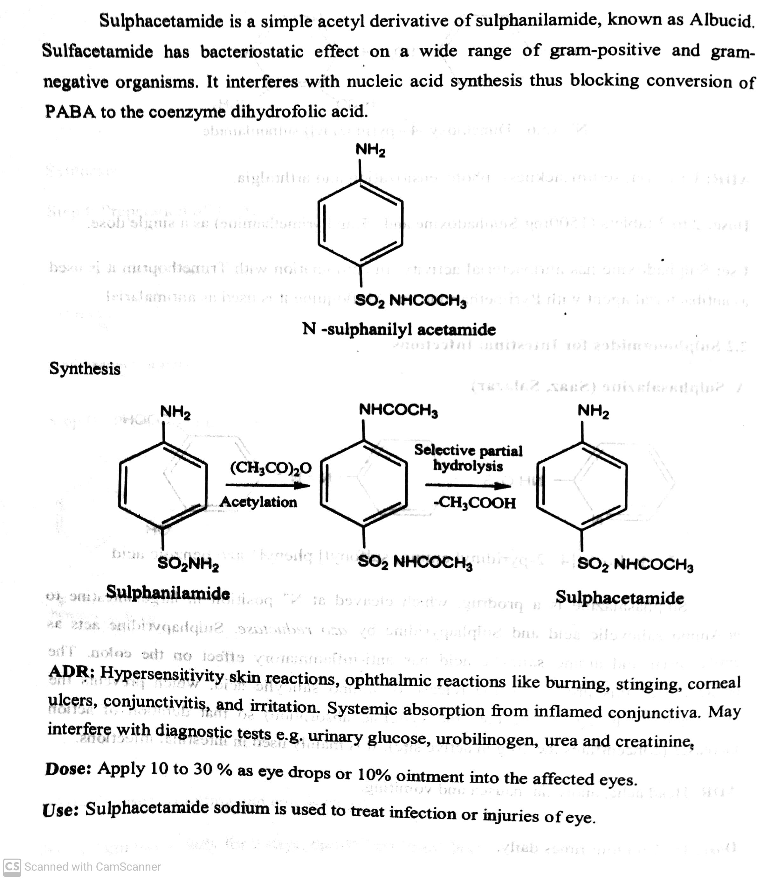
URINARY TRACT ANTI-INFECTIVE AGENTS
Classifications:
Chemical classification of synthetic antibacterial agents includes:
Quinolones:
iii) Sulfonamides :eg, Sulfacetamide :
29-07-2020
25

Slide 26
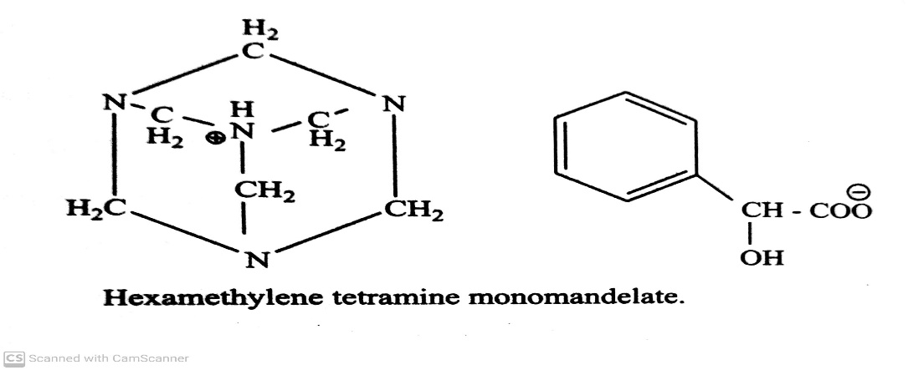
URINARY TRACT ANTI-INFECTIVE AGENTS
Classifications:
Chemical classification of synthetic antibacterial agents includes:
Quinolones:
iv) Methenamine and its salt: eg, Methenamine, Methenamine mandelate, Methenamine hippurate.
Methenamine mandelate :
Use: It is used as urinary tract anti-infective agent.
29-07-2020
© R R INSTITUTIONS , BANGALORE
26

Slide 27
THANK YOU
29-07-2020
27

