Slide 1

MEDICINAL CHEMISTRY-III
ANTITUBERCULAR AGENTS
s-07-2020
1

Slide 2
ANTITUBERCULAR AGENTS
Tuberculosis (TB)
Tuberculosis is chronic infections disease caused by various strains of Mycobacterium especially-
Mycobacterium tuberculosis.
It is usually attacks the lungs, but can also affects CNS (meningitis), lymphatic system to the brain, bones, eyes and skin. Circulatory system 9military tuberculosis), genito urinary system.
Tuberculosis spread from person to person through air.
Symptoms of tuberculosis :
An unproductive Cough.
Feeling tired all the time.
Weight loss and gradually loss of function of Vital (imp) organs.
Loss of appetite ( a desire for food/drink).
Fever
Coughing up blood.
Night sweats, tachycardia, cyanosis, respiratory failure.
-07-2020
2

Slide 3
ANTITUBERCULAR AGENTS
Antitubercular agents : The agents which are used in the treatment of tuberculosis are called antitubercular
agents.
Classification :
I) First line drugs : (Synthetic antitubercular agents) -They have high level efficacy and less toxicity.
eg: Isoniazid, Ethionamide, Ethambutol, Pyrazinamide,
Para amino salicylic acid. etc.,
II) Second line drugs : (Antitubercular antibiotics)-These are less tolerated and have higher toxicity.
eg: Rifampicin, Rifabutin, Cycloserine, streptomycin, Capreomycin sulphate,
Viomycin. etc.,
-07-2020
3

Slide 4
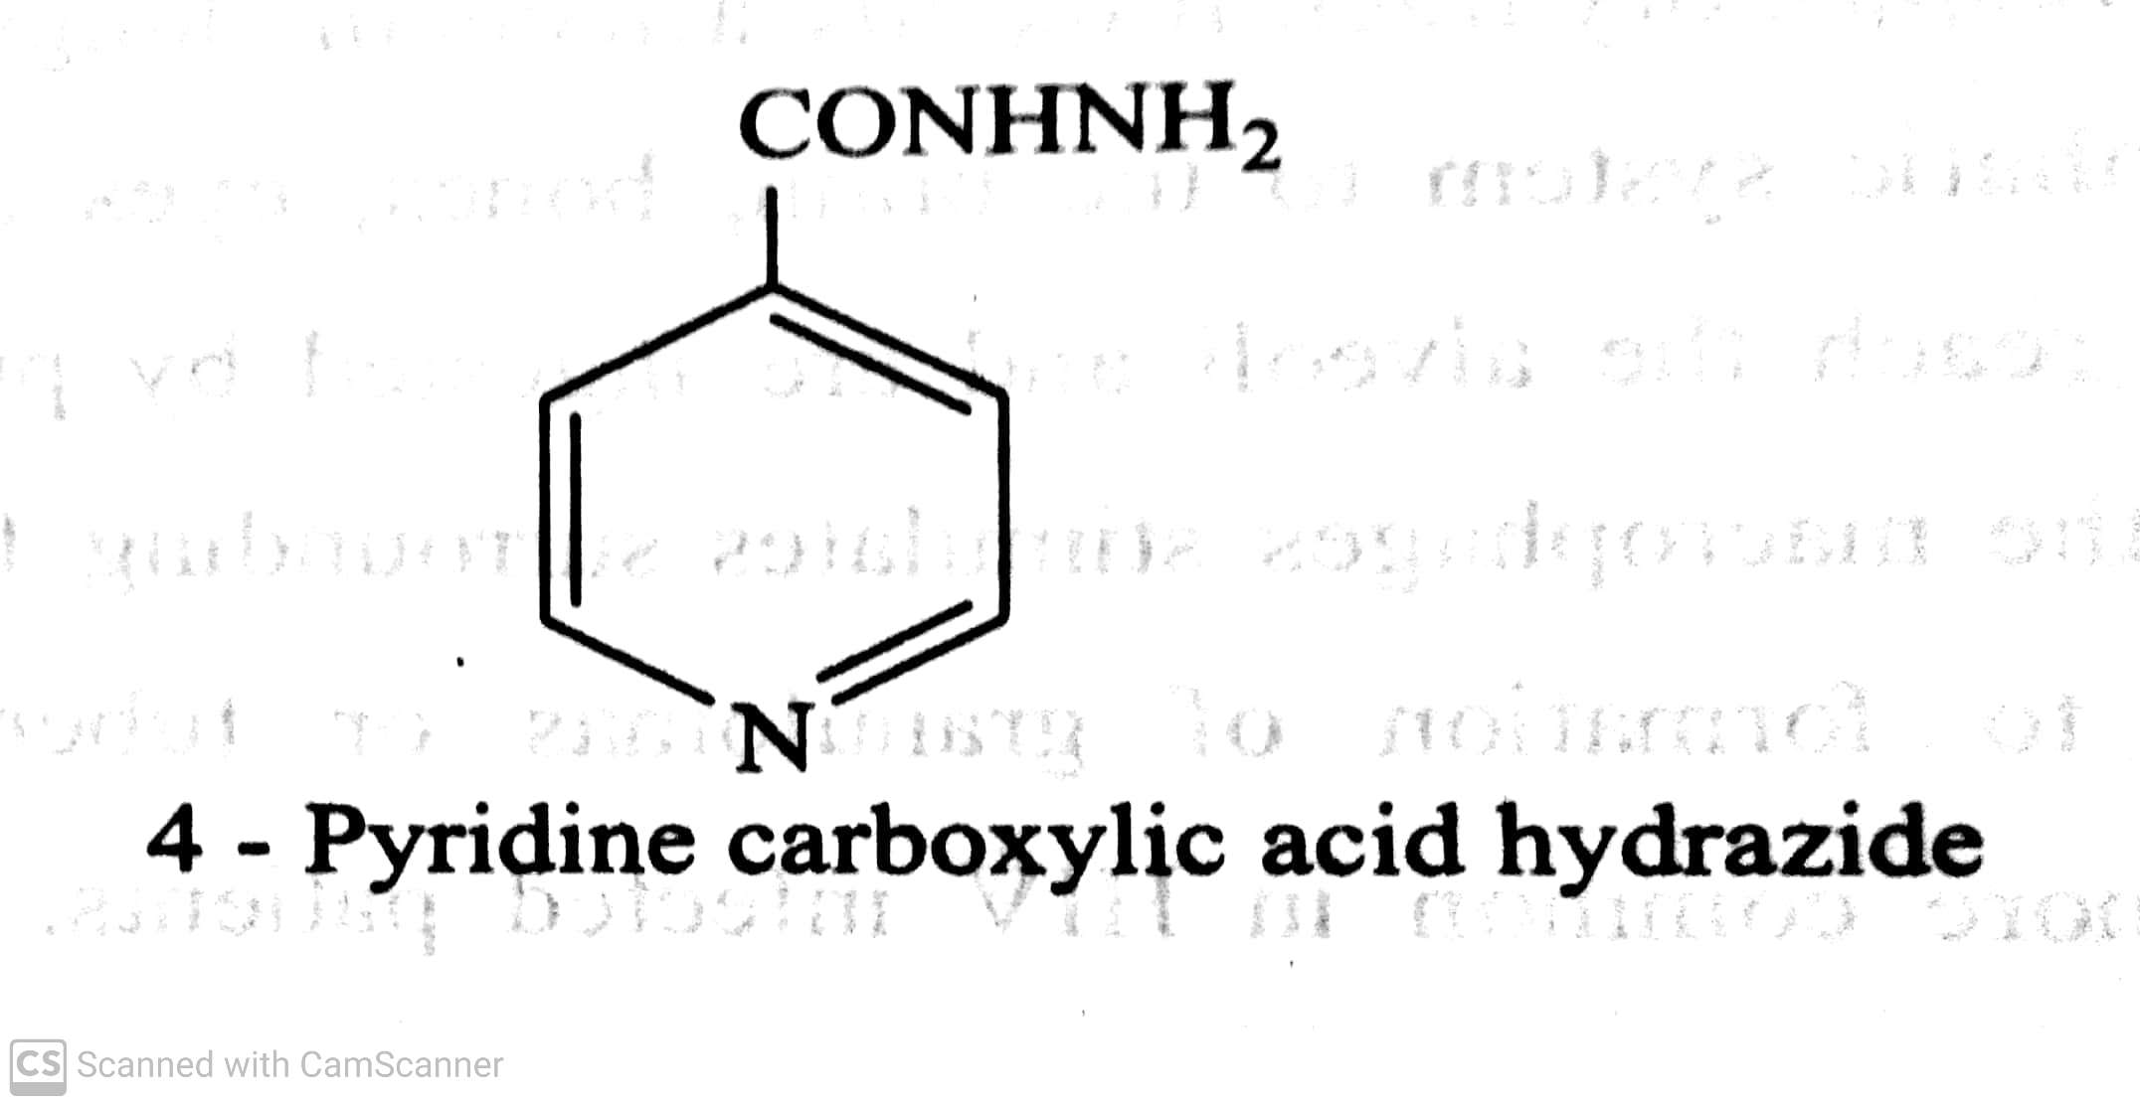
ANTITUBERCULAR AGENTS
Classification :
I) First line drugs : They have high level efficacy and less toxicity.
Synthetic antitubercular agents: eg: Isoniazid, Ethambutol, Rifampicin, streptomycin, Pyrazinamide. etc.,
eg: Isoniazid (INH – Isonicotinic acid Hydrazide) (Isonex, Tubernex forte, Laniazid):
INH is completely absorbed on oral administration.
It is metabolized in liver largely by acetylation and is excreted in urine.
-07-2020
4

Slide 5
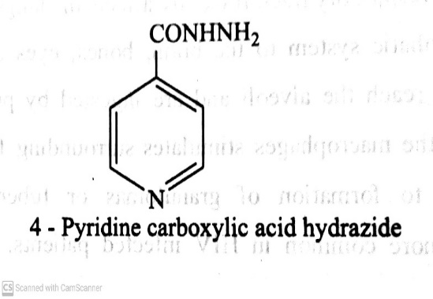
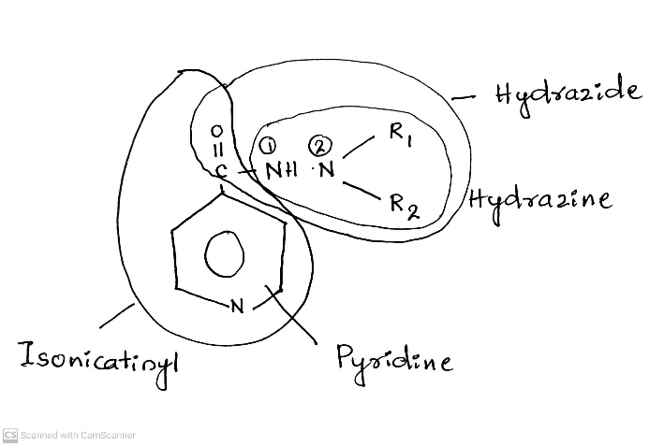
ANTITUBERCULAR AGENTS
SAR of Isoniazid
-07-2020
5

Slide 6

ANTITUBERCULAR AGENTS
SAR of Isoniazid
The N-1 nitrogen in hydrazine side chain should be unsubstituted.
The N-2 nitrogen can be substituted with alkyl groups to get active compounds.
Replacement of pyridine nucleus with other aromatic ring such as benzene or piperidine or thiazole ring
diminished the antitubercular activity.
Isonicotinic acid hydrazines are active but they are decomposed to INH in gastric acid pH medium,
-07-2020
6

Slide 7
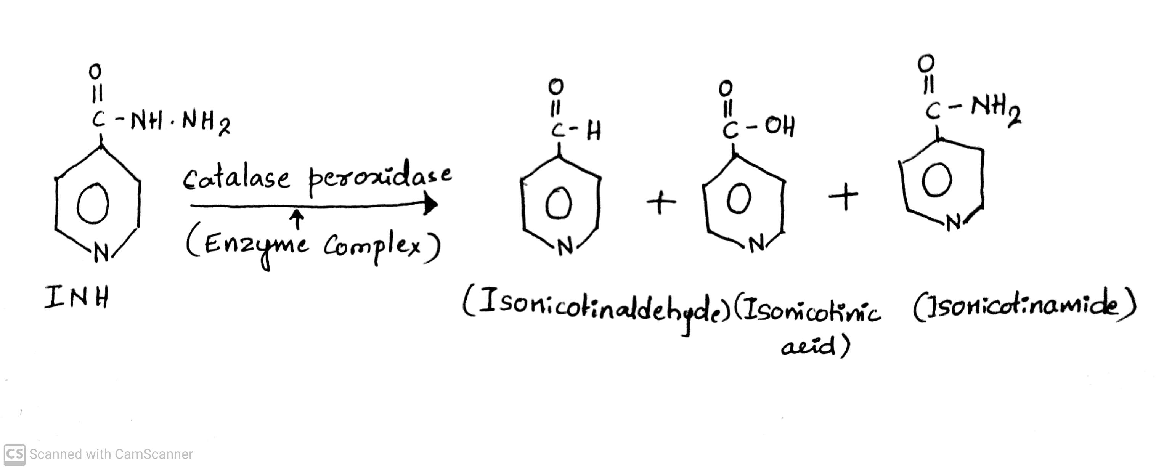
ANTITUBERCULAR AGENTS
Mechanism of action
Basically INH is a prodrug and is activated by oxidation of Isonicotinaldehyde, Isonicotinic acid and
Isonicotinamide.
The enzyme complex (catalase peroxidase) is responsible for oxidation. Which is found in bacilli present in
mycobacterium.
The reactive species generated attacks critical enzyme required for mycolic acid synthesis in mycobacterium.
mycolic acids are important constituents of bacterial cell wall.
-07-2020
© R R INSTITUTIONS , BANGALORE
7

Slide 8
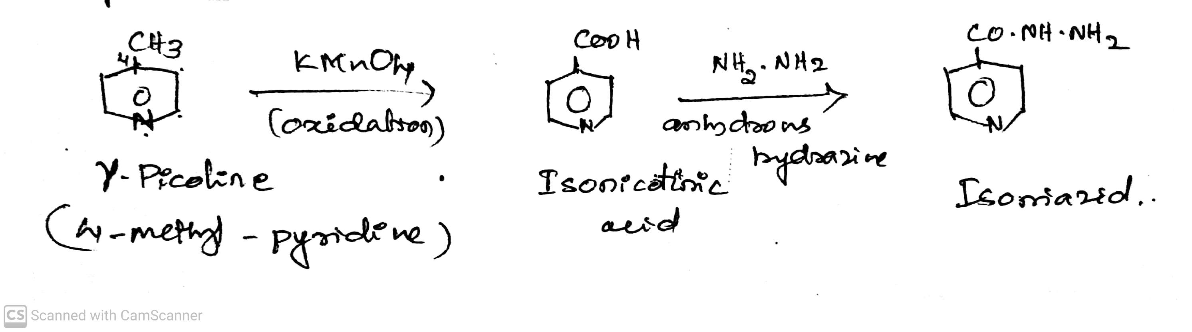
ANTITUBERCULAR AGENTS
Synthesis of Isoniazid
ADR: Peripheral neuritis and optic neuritis.
Dose: 5 mg/kg daily.
Use: It is used in the treatment of TB- Usually two/ three agents together or alone for prevention of TB.
-07-2020
8

Slide 9
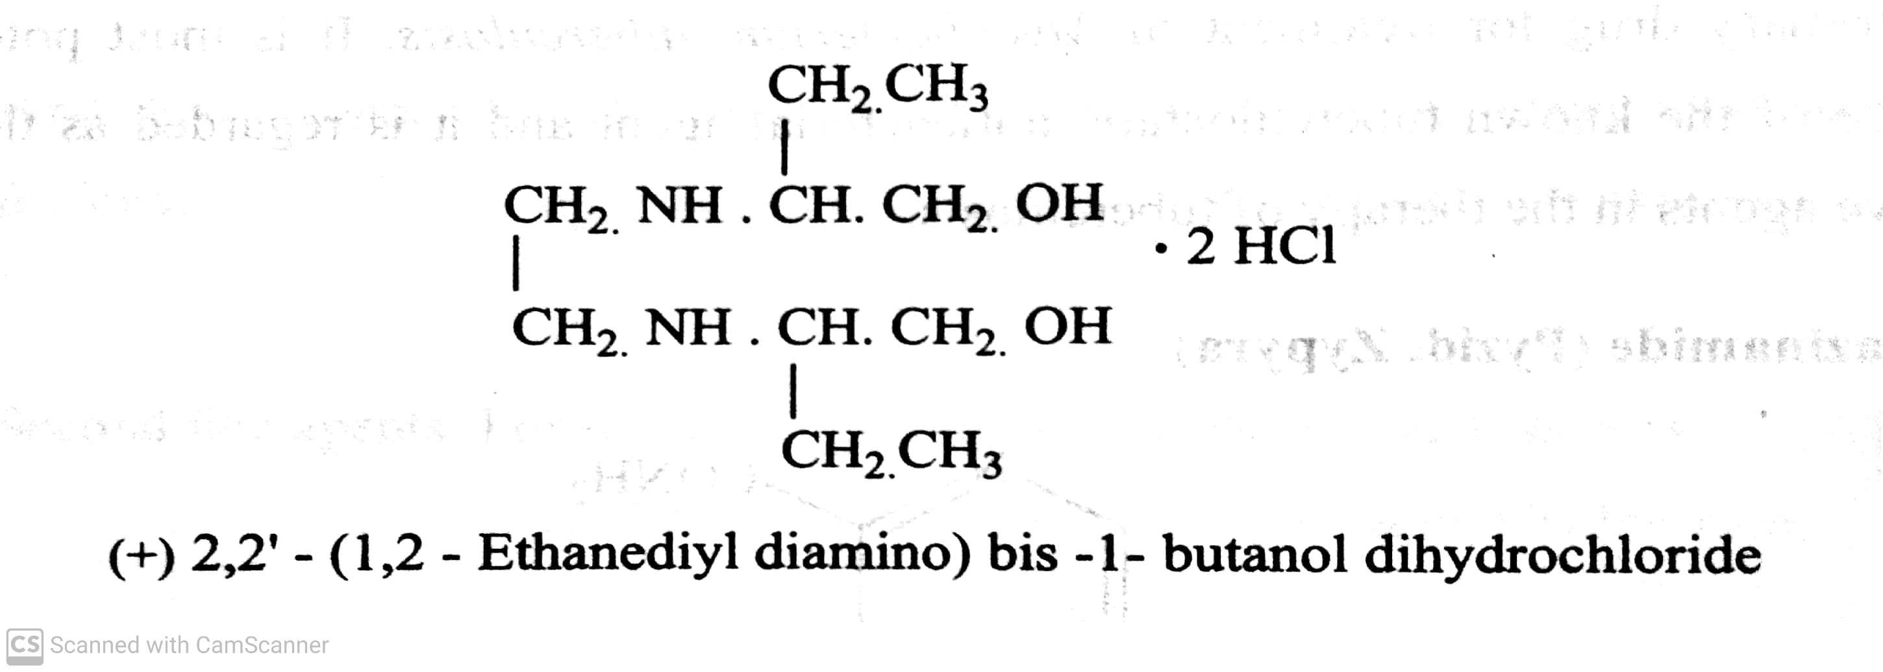
ANTITUBERCULAR AGENTS
Eg., Ethambutol Hydrochloride
ADR: It is not recommended for children's under 5 year of age. Retrobulbar neuritis with a reduction in visual acuity, constriction of visual field, central or peripheral scotoma and green-red colour blindness.
Dose: 15 mg/kg/day
Use: It is a tuberculostatic drug that is effective against tubercle bacilli resistant to Isoniazid or streptomycin.
-07-2020
© R R INSTITUTIONS , BANGALORE
9

Slide 10
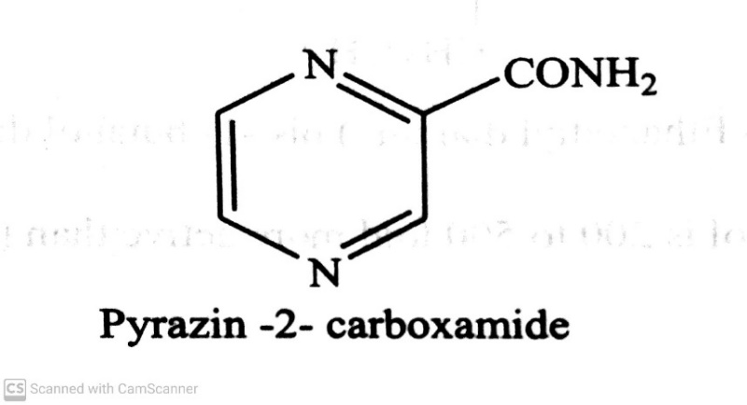
ANTITUBERCULAR AGENTS
Eg., Pyrazinamide :
MOA: Pyrazinamide is converted to Pyrazinoic acid but pyrazine amidase produced by susceptible organism.
The pyrazinoic acid lowers the pH of the surrounding M. tuberculosis, to such an extent that the organism is
unable to grow.
ADR: Hepatotoxicity and jaundice
Dose: 75 kg/ twice daily.
Use: It is used in combination with other antitubercular drugs.
-07-2020
10

Slide 11
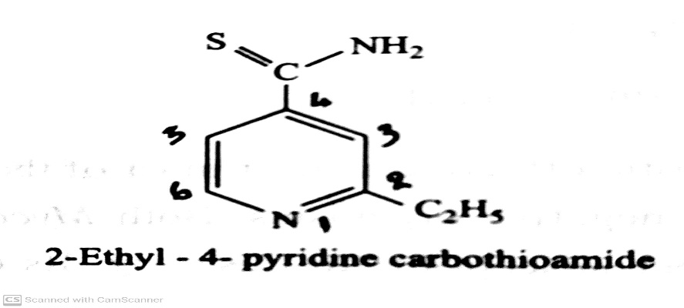
ANTITUBERCULAR AGENTS
Classification :
II) Second line drugs : These are less tolerated and have higher toxicity.
eg: Ethionamide, Para amino salicylic acid, Cycloserine, Capreomycin, Viomycin. etc.,
eg: Ethionamide (Ethide, Mycotul) :
ADR: Anorexia, excessive salivation and metallic taste.
Dose: 15-20 mg/kg/day
Use: It is less potent and more toxic than INH, so its general use should be avoided.
It should be used only when the usual combination of streptomycin, PAS and INH are ineffective or cannot
be tolerated.
-07-2020
© R R INSTITUTIONS , BANGALORE
11

Slide 12
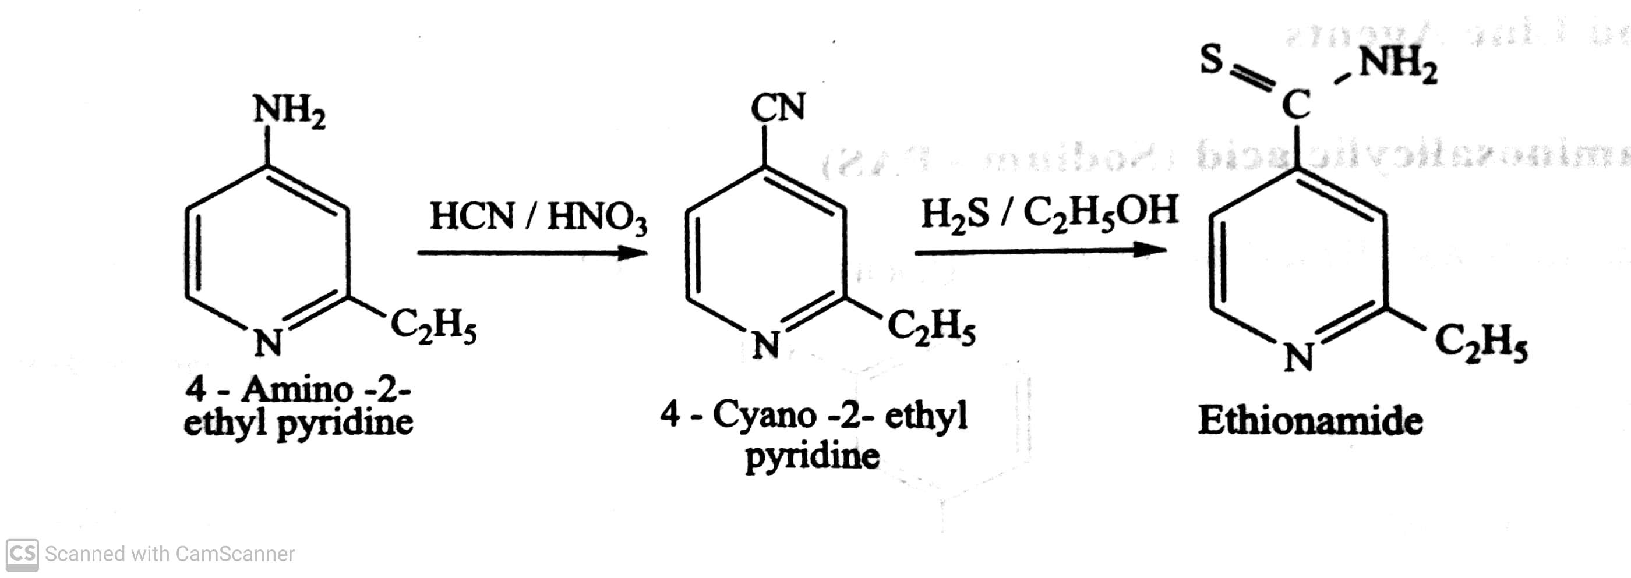
ANTITUBERCULAR AGENTS
Classification :
II) Second line drugs : These are less tolerated and have higher toxicity.
eg: Ethionamide, Para amino salicylic acid, Cycloserine, Capreomycin, Viomycin. etc.,
Synthesis of Ethionamide :
-07-2020
12

Slide 13
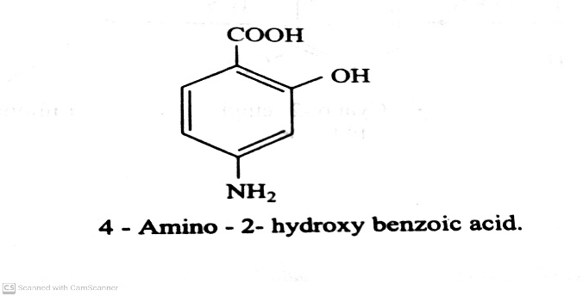
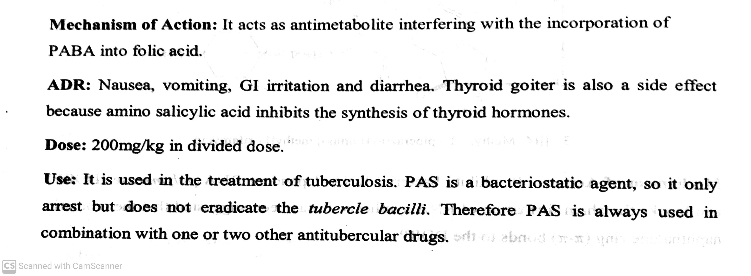
ANTITUBERCULAR AGENTS
Classification :
II) Second line drugs : These are less tolerated and have higher toxicity.
eg: Ethionamide, Para amino salicylic acid, Cycloserine, Capreomycin, Viomycin. etc.,
eg: Para amino salicylic acid :
-07-2020
13

Slide 14
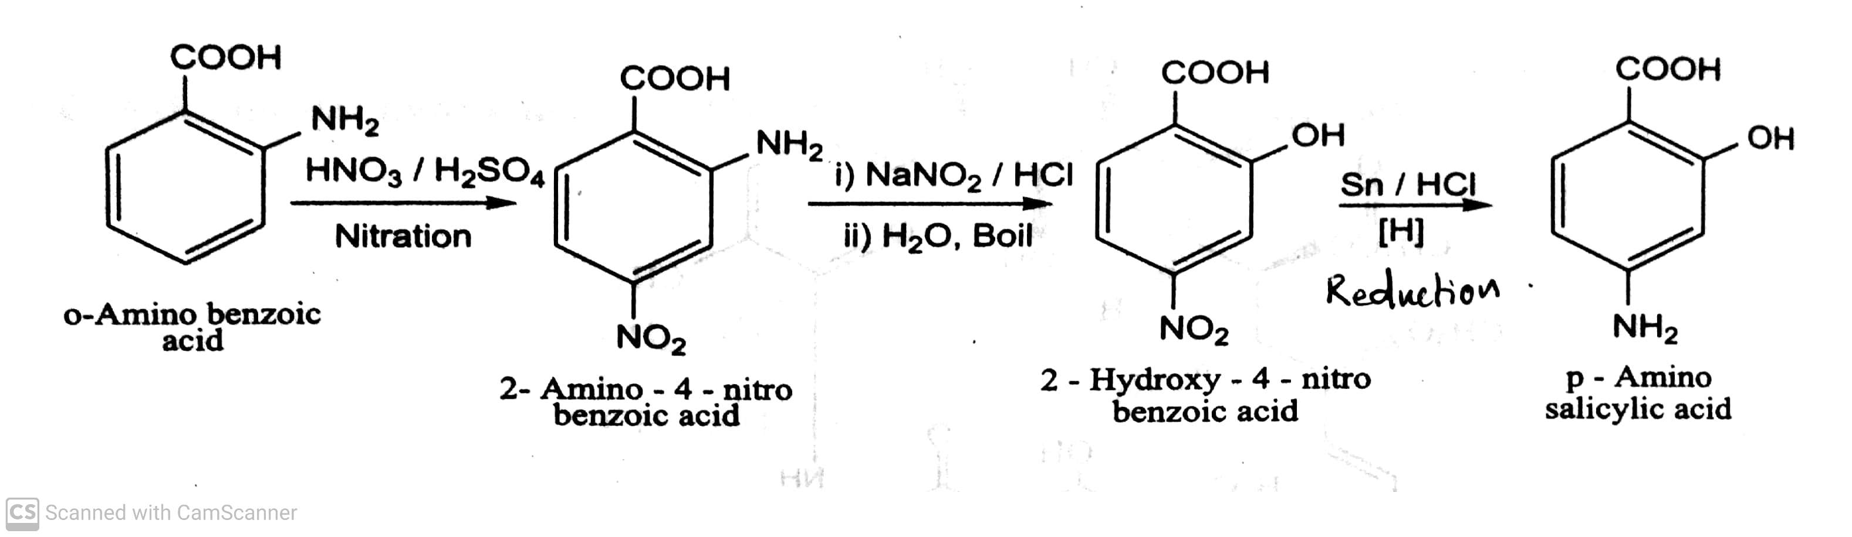
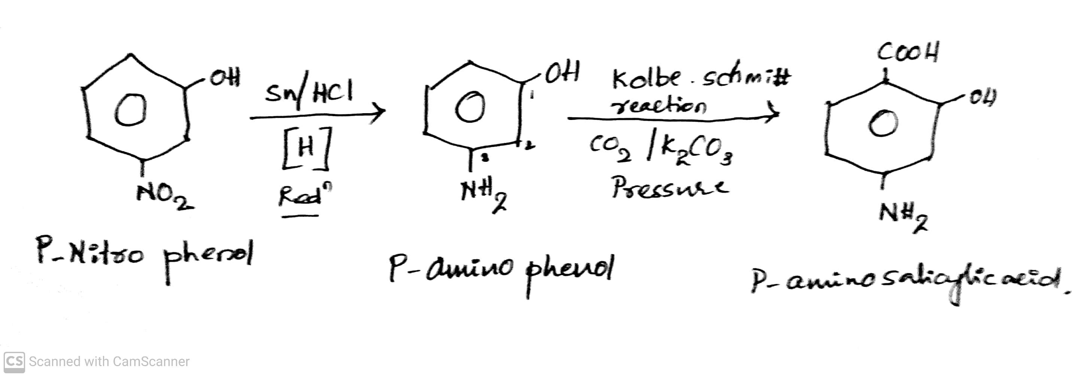
ANTITUBERCULAR AGENTS
Classification :
Synthesis of Para amino salicylic acid : (Method-I)
(Method-II)
-07-2020
14

Slide 15
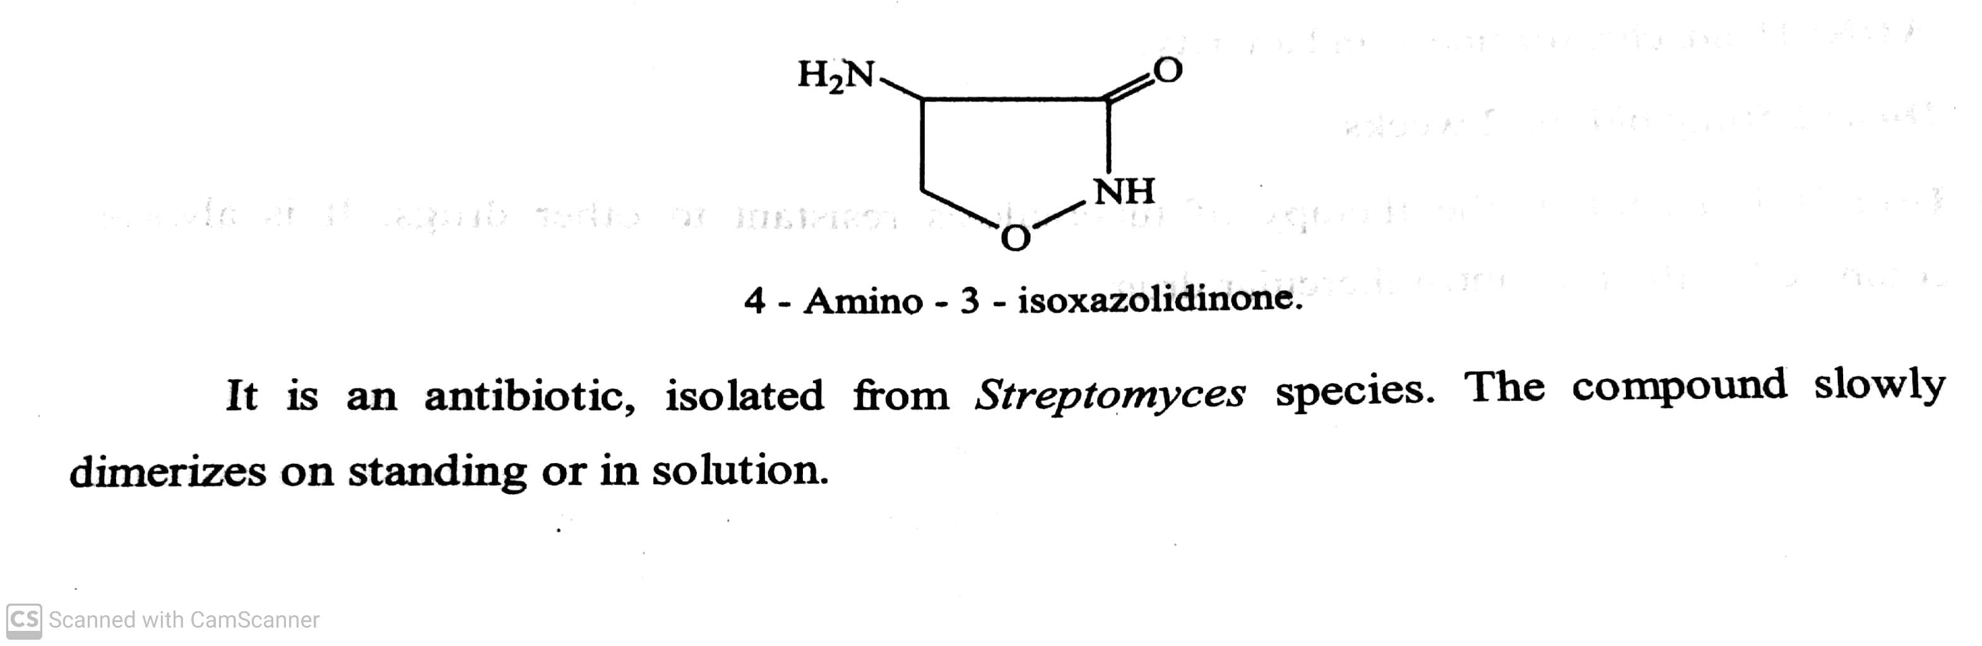
ANTITUBERCULAR AGENTS
Classification :
II) Second line drugs : These are less tolerated and have higher toxicity.
eg: Ethionamide, Para amino salicylic acid, Cycloserine, Capreomycin, Viomycin. etc.,
eg: Cycloserine :
ADR: Headache, Dizziness and anxiety.
Dose: 250 mg bid for 2 weeks.
Use: It is useful in the therapy of tuberculosis resistant to other drugs.
It is always combined with other anti-tubercular drug.
-07-2020
© R R INSTITUTIONS , BANGALORE
15

Slide 16
THANK YOU
23-07-2020
16

