Slide 1
A Seminar on
NMR Spectroscopy

Slide 2
CONTENTS:
Spin – spin coupling
Coupling constant
Decoupling
C – 13 NMR
Principle of FT -NMR
Free induction decay
Nuclear over hauser effect
Interpretation of NMR spectrum
Applications of magnetic resonance spectral data
Introduction to 2D - NMR

Slide 3
Spin – spin coupling:
The magnetic moments of nuclei interact with each other through strongly magnetic electrons in the intervening bonds and these cause mutual splitting of the otherwise sharp resonance lines into multiples. Sometimes called J coupling.
J α spacing of multiples
Coupling depends on geometry of molecule.
Adjacent axial – axial protons with dihedral angle 180ºc – strongly coupled.
Axial – equitorial , equitorial - equitorial - moderately coupled.

Slide 4
Cause of Splitting
Splitting of signal can be determined by the environment of the absorbing proton with respect to neighbouring proton.
Because of different spin states of neighbouring protons ,
the actual magnetic field experienced by given proton may
be modified in number of way.
Absorbing proton may experience each of the modified field
& it’s absorption signal may be split up into different peaks.
This is the spin-spin coupling of absorbing and neighbouring proton which is responsible for splitting of peak.

Slide 5
THE COUPLING CONSTANT
J
J
J
J
J
J
Coupling constant (J): The distance between centers of 2 adjacent peaks in a split signal, expressed in hertz & is a measure of magnitude of splitting effect.
  The value is a quantitative measure of the magnetic interaction of nuclei with coupled spins.
  Value of J lies between 0 – 20 Hz.

Slide 6
Types of coupling:
Geminal:
protons attached to same carbon and depends on bond angle and over all structure.
J- 2 – 20Hz.
Geminal coupling does not occur when the two hydrogens are equivalent due to rotations around the other two bonds.
Vicinal:
protons attached to adjacent carbon atoms. J – 2 – 18Hz depending on spatial positions.
²J
³J

Slide 7
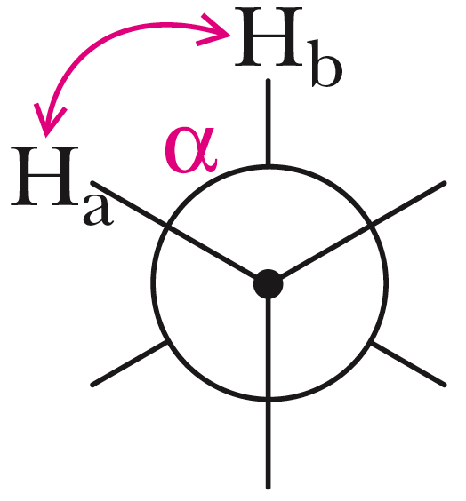
  An important factor in vicinal coupling is the angle a between the C-H sigma bonds and whether or not it is fixed.
  Coupling is maximum when alpha is 0° and 180°; it is minimum when alpha is 90°.

Slide 8
Spin-Spin Splitting in ¹H NMR Spectra
Peaks are often split into multiple peaks due to magnetic interactions between nonequivalent protons on adjacent carbons, The process is called spin-spin splitting
The splitting is into one more peak than the number of H’s on the adjacent carbon(s), This is the “n+1 rule”
The relative intensities are in proportion of a binomial distribution given by Pascal’s Triangle
The set of peaks is a multiplet (2 = doublet, 3 = triplet, 4 = quartet, 5=pentet, 6=hextet, 7=heptet…..)

Slide 9
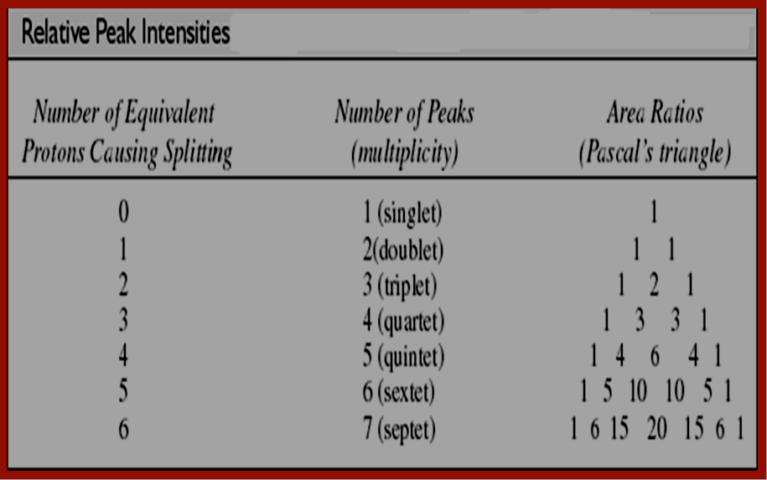

Slide 10
Signal Splitting; the (n + 1) Rule
MULTIPLETS
(n + 1) rule: If a hydrogen has n hydrogens nonequivalent to it but equivalent among themselves on the same or adjacent atom(s), its ¹H-NMR signal is split into (n + 1) peaks.
n – number of nuclei producing splitting.
singlet
doublet
triplet
quartet
quintet
sextet
septet
this hydrogen’s peak
is split by its two neighbors
these hydrogens are split by their neighbours
two neighbors n + 1 =3
triplet
one neighbor n + 1 =2
doublet

Slide 11
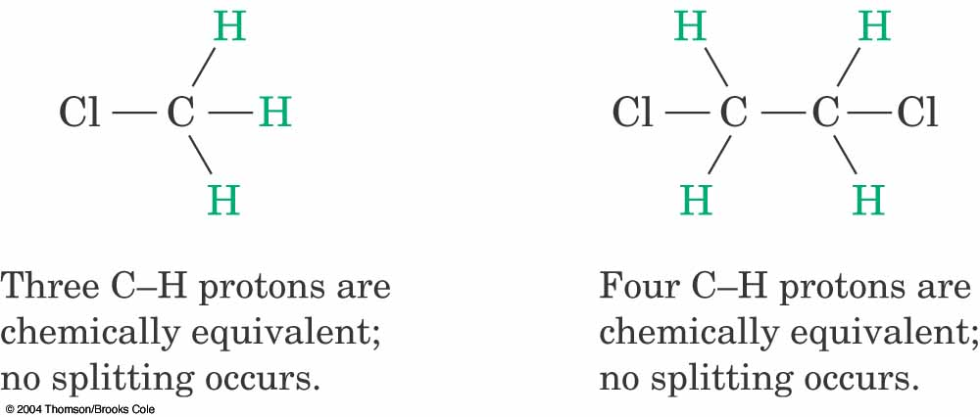
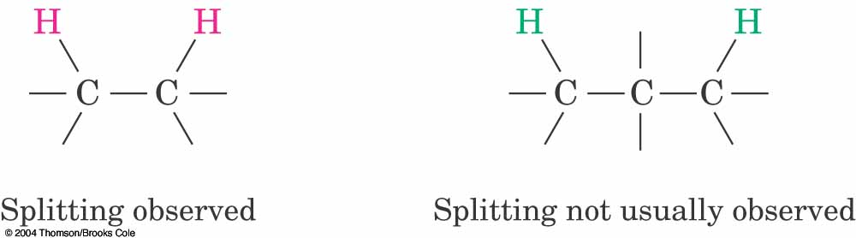
Rules for Spin-Spin Splitting
Equivalent protons do not split each other
Protons that are farther than two carbon atoms apart do not split each other

Slide 12
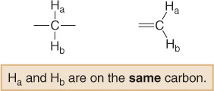
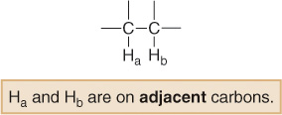
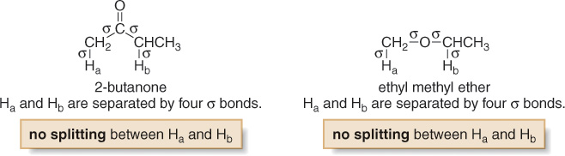
¹H NMR—Spin-Spin Splitting
If H_{a} and H_{b} are not equivalent, splitting is observed when:
Splitting is not generally observed between protons separated by more than three σ bonds.
12

Slide 13
The Origin of ¹H NMR—Spin-Spin Splitting
Spin-spin splitting occurs only between nonequivalent protons on the same carbon or adjacent carbons.
Let us consider how the doublet due to the CH₂ group on BrCH₂CHBr₂ occurs:
When placed in an applied field, (B₀), the adjacent proton (CHBr₂) can be aligned with (↑) or against (↓) B₀. The likelihood of either case is about 50% (i.e., 1,000,006↑ vs 1,000,000↓).
Thus, the absorbing CH₂ protons feel two slightly different magnetic fields—one slightly larger than B₀, and one slightly smaller than B₀.
Since the absorbing protons feel two different magnetic fields, they absorb at two different frequencies in the NMR spectrum, thus splitting a single absorption into a doublet, where the two peaks of the doublet have equal intensity.

Slide 14
The Origin of ¹H NMR—Spin-Spin Splitting
The frequency difference, measured in Hz, between two peaks of the doublet is called the coupling constant, J.

Slide 15

The Origin of ¹H NMR—Spin-Spin Splitting
Let us now consider how a triplet arises:
When placed in an applied magnetic field (B₀), the adjacent protons H_{a} and H_{b} can each be aligned with (↑) or against (↓) B₀.
Thus, the absorbing proton feels three slightly different magnetic fields—one slightly larger than B₀(↑_{a}↑_{b}). one slightly smaller than B₀(↓_{a}↓_{b}) and one the same strength as B₀ (↑_{a}↓_{b}).

Slide 16
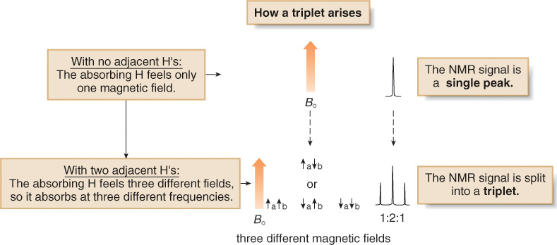
The Origin of ¹H NMR—Spin-Spin Splitting

Slide 17
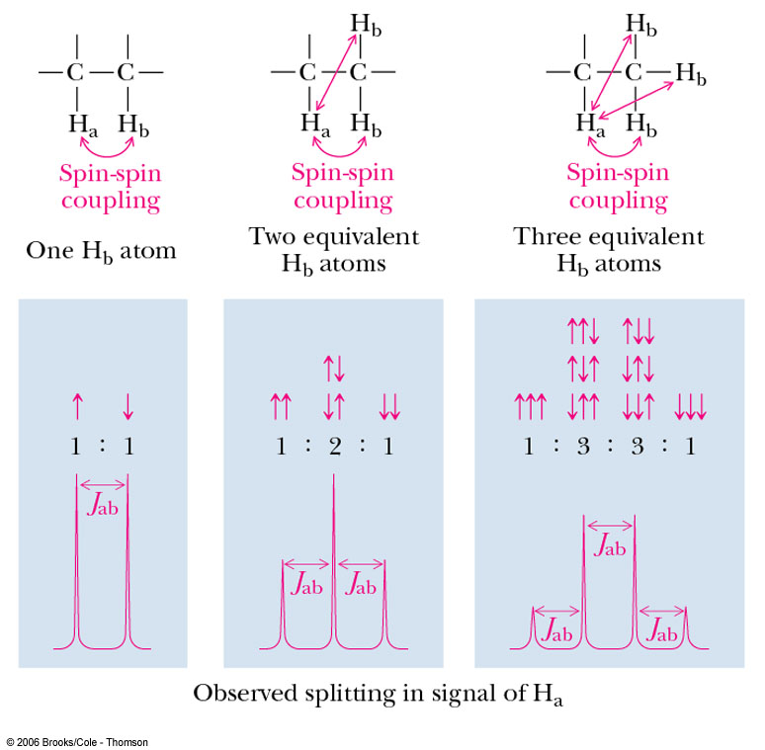
The Origin of ¹H NMR—Spin-Spin Splitting

Slide 18
EXCEPTIONS TO THE N+1 RULE
3)
The n+1 rule applies principally to protons in
aliphatic (saturated) chains or on saturated rings.
or
YES
YES
but does not apply (in the simple way shown here)
to protons on double bonds or on benzene rings.
NO
NO

Slide 19
Decoupling:
This involves irradiation of a proton or group of protons with intense RF energy to completely eliminate coupling to neighbouring protons.
Signal for single proton / set of equivalent is split into multiplet under influence of neighbouring proton / under different environments.
If we irradiate Ha with intense RF, its rate of transitions become larger , and life of one nucleus in any 1 spin states will be too short to resolve coupling with Hb will have one time average view of Ha & Hb comes to resonance once, therefore Hb appear as singlet.

Slide 20
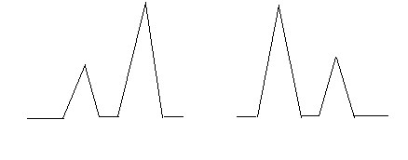
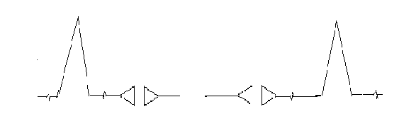
Here, simultaneously two RF sources are needed , the 2nd RF (tunable) irradiates Ha at necessary frequency and recording is done in same way.
It is called double resonance .As multiplet collapses to singlet it is called Spin Decoupling.
Ha Hb
Hb signal collapes to
singlet
DI of Ha
DI of Hb
Ha signal collapes to
singlet

Slide 21
METHODS OF DECOUPLING
Field sweep method:
In this method both the applied frequency (Vl) &the irradiation frequency (V2) are Kept constant the magnetic field is varied until a characteristic change occurs in the lines of particular- multiplies.
Frequency sweep method:
In this method the applied magnetic field and the irradiation frequency (VI) is kept constant and the applied frequency is varied the irradiation frequency (V2) be changed after each scan, permitting an extensive investigation of spin spin coupling.

Slide 22
Shift Reagent
Shift reagents, provides a useful technique for spreading out PMR absorption patterns which normally overlap, without increasing the strength of the applied magnetic field.
The PMR spectrum of n-hexanol is reproduced in figure, which is normal record.
When the same spectrum is recorded after the addition of a soluble europium (111) complex, Eu (DMP)3i.e, the shift-reagent the spectrum is spread out over a wide range of frequencies so that it is new simplified almost to first order.

Slide 23
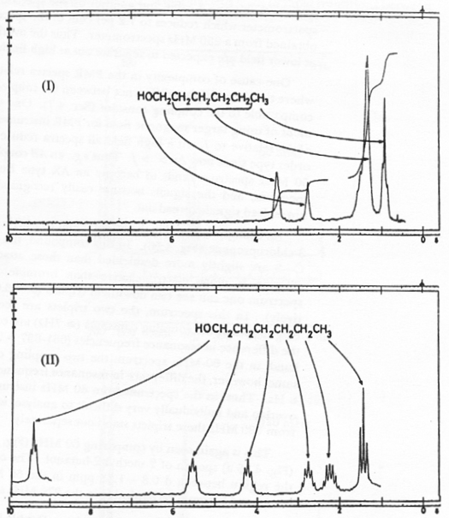

Slide 24
INTRODUCTION
Carbon-13 (¹³C) is a natural and stable isotope of carbon.
¹²C is the most abundant isotope of carbon and is inactive since it has nuclear spin of Zero, & is only 1% of the carbon in a sample.
¹³C however has odd mass and is active with nuclear spin , with I=½
The gyromagnetic ratio of ¹³C is one-fourth of that of ¹H 0.25.
The chemical shift range is 200ppm compared to proton it is 10 – 15 ppm.

Slide 25
DIFFICULTIES ENCOUNTERED IN ¹³C NMR
1.Natural Abundance:-
1.1% than that of ¹²C.
magnetic resonance of ¹³C is much weaker i.e sensitivity is only 1.6% than that of ¹H nuclei which is not adequate for its study.
2.Magnetic moment and Gyro magnetic ratio:-
The magnetic moment of ¹³C is much weaker due to low natural abundance of ¹³C nucleus.
The Gyro magnetic ratio of ¹³C is 1.4043 as compared to 5.5854 of a proton ¹H .
3. Signals are weak, getting lost in noise.
4.Hundreds of spectra are taken, averaged.

Slide 26
Differences in ¹³C Technique
Resonance frequency is ~ one-fourth, 15.1 MHz instead of 60 MHz.
Peak areas are not proportional to number of carbons.
Carbon atoms with more hydrogens absorb more strongly.

Slide 27
¹³C- ¹³C COUPLING
The concentration of carbon-13 in a compound is very small.
Therefore chances of having more than one carbon-13 nucleus in the same molecule are small.
Hence homonuclear coupling is rarely observed.
Therefore ¹³C- ¹³C coupling is ignored.

Slide 28
Spin-Spin Splitting
It is unlikely that a ¹³C would be adjacent to another ¹³C, so splitting by carbon is negligible.
¹³C will magnetically couple with attached protons and adjacent protons.
These complex splitting patterns are difficult to interpret.
PROTON SPIN DE -COUPLING:
To simplify the spectrum, protons are continuously irradiated with “noise,” so they are rapidly flipping.
The carbon nuclei see an average of all the possible proton spin states.
Thus, each different kind of carbon gives a single, unsplit peak.

Slide 29
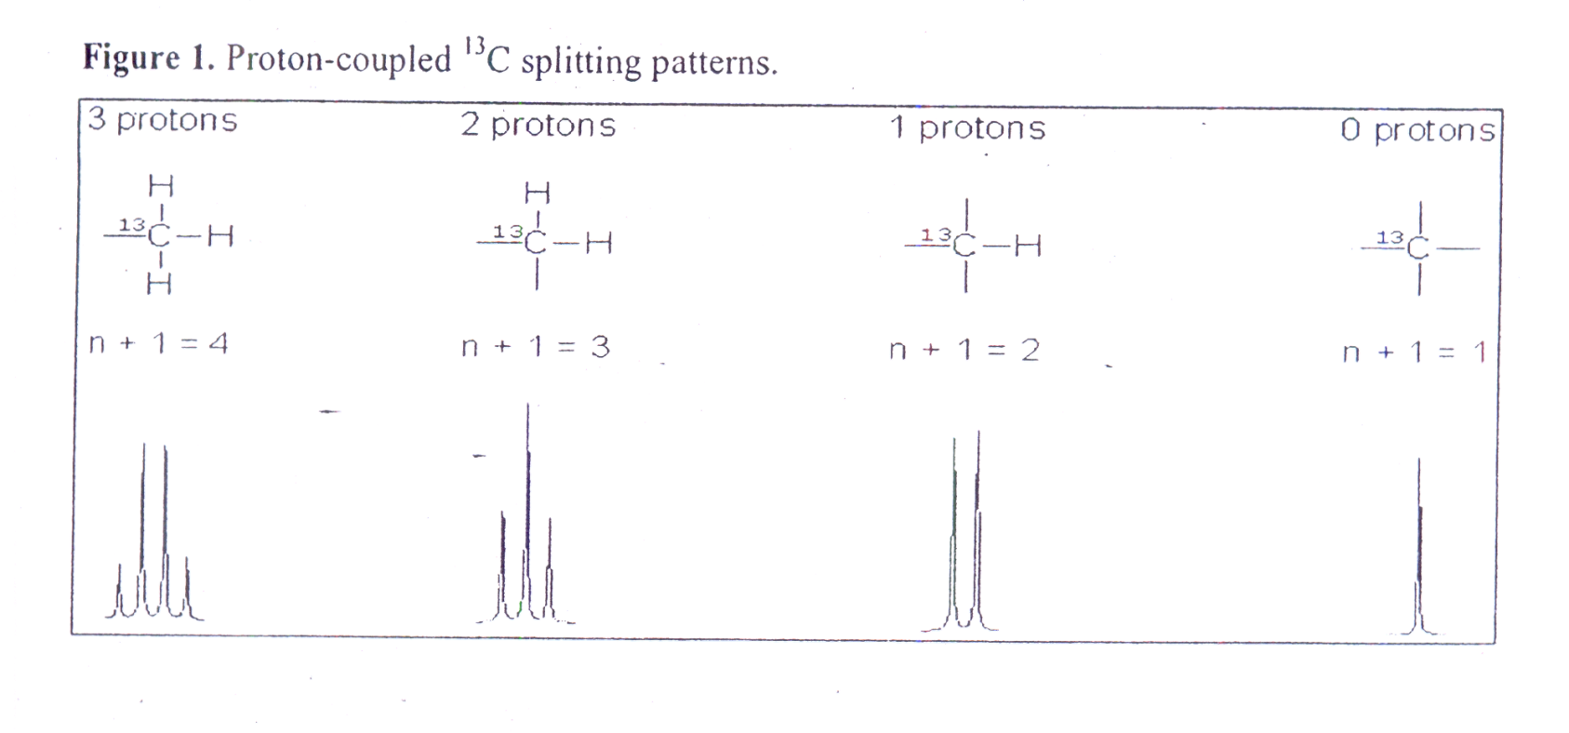
PROTON COUPLED ¹³C SPECTRA
(¹³C-¹H COUPLING)
Protons attached to carbon-13 atoms will couple carbon nucleus to split the resonance peaks observed for these carbon atoms
Fig shows how attached hydrogen atoms will split a carbon-13 nucleus.

Slide 30
The problem arises during recording of CMR spectra can be eliminated by the following methods:
FOURIER TRANSFORM TECHNIQUE
DE COUPLING
NUCLEAR OVER HAUSER PHENOMENON

Slide 31
Fourier Transform NMR
Nuclei in a magnetic field are given a radio-frequency pulse close to their resonance frequency.
The nuclei absorb energy and precess (spin) like little tops.
A complex signal is produced, then decays as the nuclei lose energy.
Free induction decay is converted to spectrum.

Slide 32
The Fourier Transform Pulsed NMR Technique
time
Delay
Pulse
Delay
Acquisition
time

Slide 33
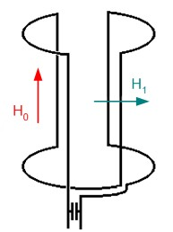

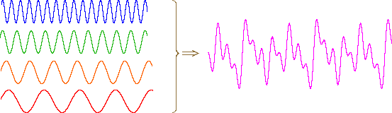
Basics of Fourier Transform NMR: Measuring the Precession Frequency

Slide 34
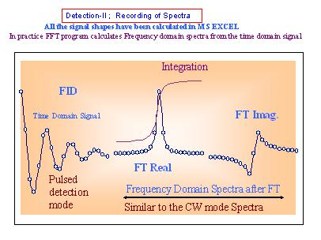

Slide 35
Free induction decay:
In Fourier Transform NMR, free induction decay (FID) is the observable NMR signal generated by non-equilibrium nuclear spin magnetization precessing about the magnetic field (conventionally along z).
This non-equilibrium magnetization can be induced, generally by applying a pulse of resonant radio-frequency close to the Larmour frequency of the nuclear spins.
If the magnetization vector has a non-zero component in the xy plane, then the precessing magnetization will induce a corresponding oscillating voltage in a detection coil surrounding the sample.
This time-domain signal is typically digitized and then Fourier transformed in order to obtain a frequency spectrum of the NMR signal i.e. the NMR spectrum.

Slide 36
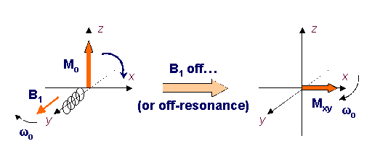
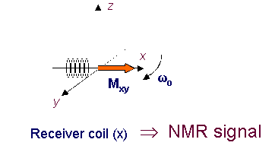
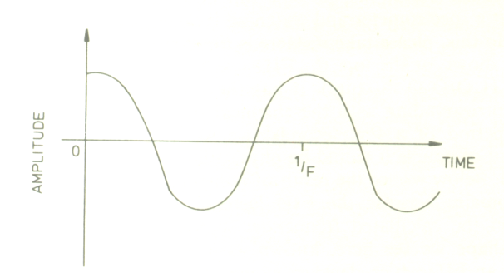
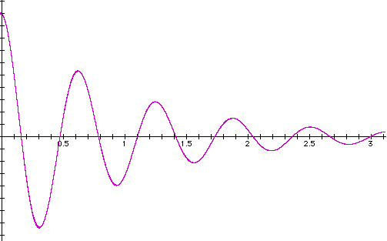
The detection of NMR signal is on the xy plane. The oscillation of Mxy generate a current in a coil , which is the NMR signal.
Due to the “relaxation process”, the time dependent spectrum of nuclei can be obtained. This time dependent spectrum is called “free induction decay” (FID)
M_{xy}
time
(if there’s no relaxation )
(the real case with T1 &T2)
time

Slide 37
In addition, most molecules examined by NMR have several sets of nuclei, each with a different precession frequency.
Time (sec)
The FID (free induction decay) is then Fourier transform to frequency domain to obtain each v_{pression} ( chemical shift) for different nuclei.
frequency (Hz)

Slide 38


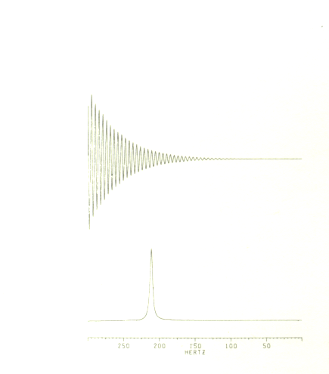
Fourier transformation (FT)
FT
FT

Slide 39
DECOUPLING
The decoupling simplifies ¹³C spectra by removing the multiplet.
Principle:-
In addition to basic NMR spectrometer it requires tunable radio frequency source to irradiate a particular nucleus at a desired frequency, while scanning nucleus.
It is also known as double resonance as sample is irradiated by two frequencies:-
Observation frequency
Decoupling frequency

Slide 40
TYPES OF DECOUPLING
Homonuclear decoupling
Heteronuclear decoupling
Homonuclear decoupling :- It is a selective decoupling where the type of nucleus being decoupled is same as that being observed.
Ex:- Decoupling one proton while observing other proton.¹H[¹H]
Heteronuclear decoupling:-It occurs when decoupled nuclei are different from the observed one.
Ex:- Decoupling of ¹H while observing ¹³C. ¹³C[¹H]

Slide 41
Hetero nuclear decoupling is of different types:-
Proton decoupling or Noise decoupling
Broad band decoupling
Off resonance decoupling.
Proton decoupling or Noise decoupling:-
The coupling from ¹³C-¹H makes the CMR spectrum very complex. The coupling constant for ¹³C-¹H is very large (125 – 500 Hz), hence there is an overlap of multiplets.

Slide 42
Principle
The spectra is recorded by irradiating the sample at two frequencies:-
First radiofrequency - to affect carbon magnetic resonance .
Second signal - causes all the protons to be in resonance at the same time & flip to their spins very fast.
Carbon atoms are devoid of neighboring hydrogen spins. But see only an average of possible combination of spin states.
As a result there is no coupling and each proton appears as a single unsplit peak at the position corresponding to its chemical shifts.

Slide 43
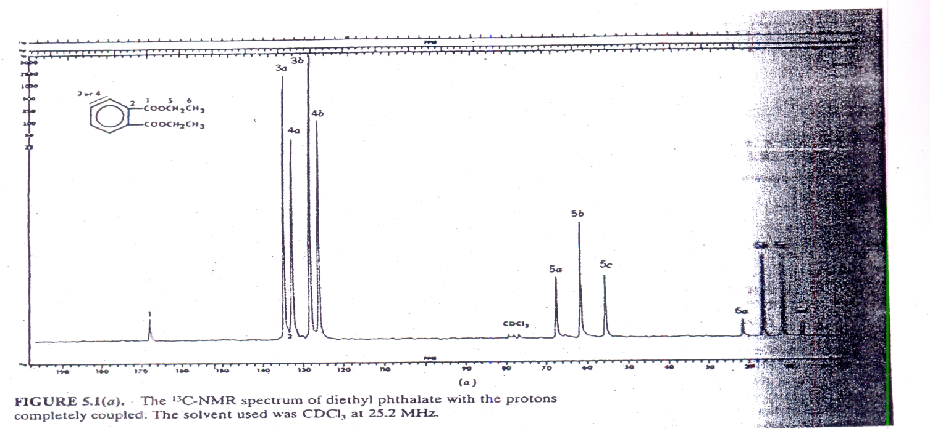
Ex:- Proton decoupled spectra of Diethyl phthalate

Slide 44
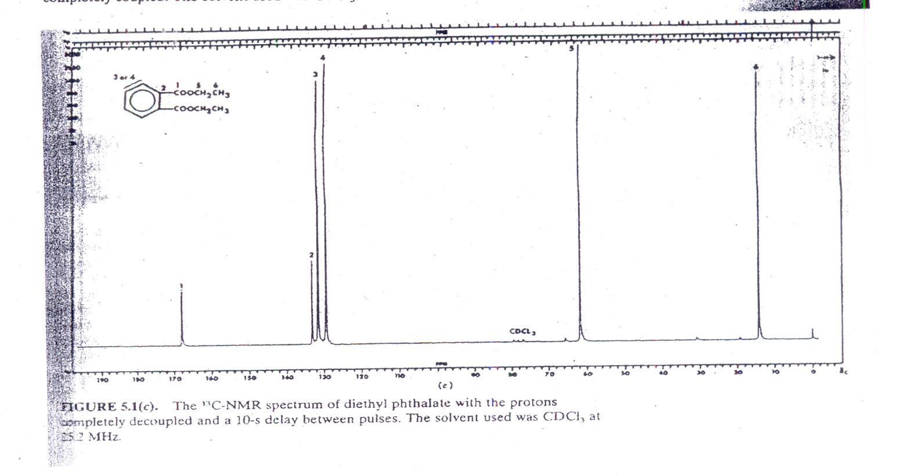

Slide 45
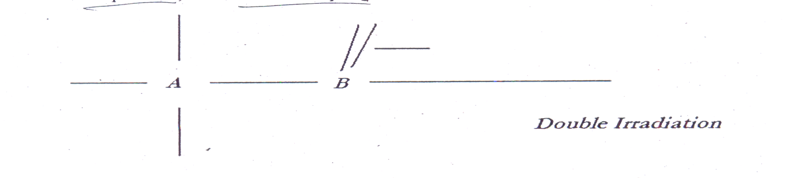
BROAD BAND DECOUPLING
In this, all the protons resonance can be reduced to get sharp CMR peaks each directly reflecting a 13C chemical shift.
The NMR spectrum of nucleus “A” is split by nucleus “B” because A can see B in different magnetic orientation .
The splitting will be maintained only if the life time of B in any spin states is sufficient long for coupling to be measured.
If the double irradiation is sufficiently intense, the transition will be rapid and lifetime of specific spin states is shortened.
13C NMR spectra can be simplified by simultaneous decoupling of all the protons of carbon, therefore it is called as Broad band decoupling.
This technique simplifies the spectrum and increases the peak height of spectra.

Slide 46
OFF RESONANCE DECOUPLING
The technique that is used to obtain typical proton decoupled spectra that all peak becomes singlets.
It is achieved by off setting the high power proton decoupler by:-
About 1000-2000Hz upfield or 2000-3000Hz downfield from the frequency of TMS without using noise generator.
In this, sample is irradiated at a frequency close to resonance frequency of protons.
Consequently, the multiplets become narrow and not removed altogether as in fully decouple spectra.

Slide 47
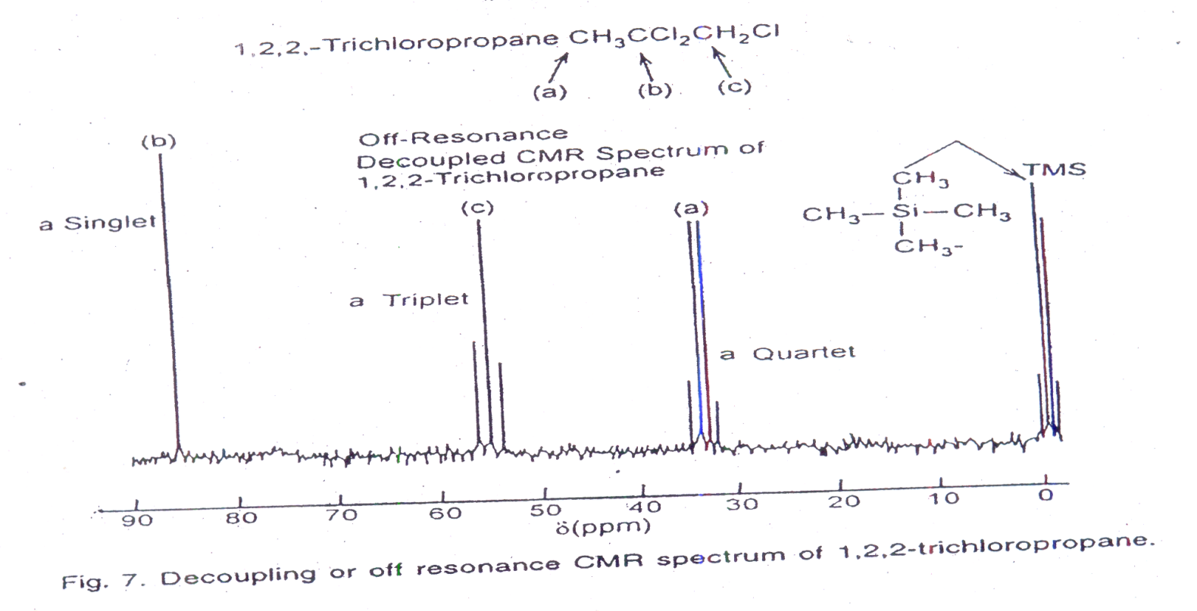
Ex:- Off resonance CMR spectra of 1,2,2-trichloropropane.
In this methyl carbon atoms appear as quartets, methylene as triplets, methines as doublets and quarternary as singlet.
In conclusion, off resonance decoupling simplifies the spectrum by permitting some splitting information.

Slide 48
Nuclear over Hauser effect
First observed by Albert W Over Hauser – 1953
Molecular geometry of compounds
Proximity of protons
Line intensities are not similar to normal spectrum
Consider a molecule where protons are close enough to allow space interactions of fluctuating magnetic vector
DI Hb - stimulated transfers stimulation through space to relaxation of Ha.
Thus due to increase in spin lattice relaxation of Ha signal intensity increases by 15 – 50%
If intensity of Ha increased due to DI of Hb then protons are in close proximity.

Slide 49
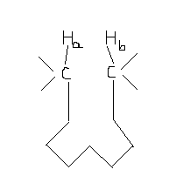
Conditions:
DI
Spin lattice relaxation

Slide 50
RELAXATION PHENOMENON
The transitions occurring from one spin state to another is directly proportional to state from which transition takes place.
However while lower energy state is more populated than upper energy state, upward transition predominates slightly.
Hence absorption of energy from radiation beam takes place.

Slide 51
The excited nucleus can undergo energy loss by transition from high energy state to low energy state is called Relaxation.
The energy difference E can be reemitted by nucleus as radio frequency radiation.
There are 2 types of relaxation process:-
Spin-Lattice relaxation
Spin-Spin relaxation

Slide 52
CHEMICAL SHIFTS IN ¹³C NMR
Chemical shifts of ¹³C nuclei are expressed in units of parts per million(ppm).
The range of ¹³C chemical shifts is much greater 200ppm compared to 20ppm range of proton chemical shifts.
Carbons of the methyl groups of TMS are used for reference.
Because of wide spread of signals it is unlikely that two ¹³C nuclei will have identical chemical shifts.

Slide 53
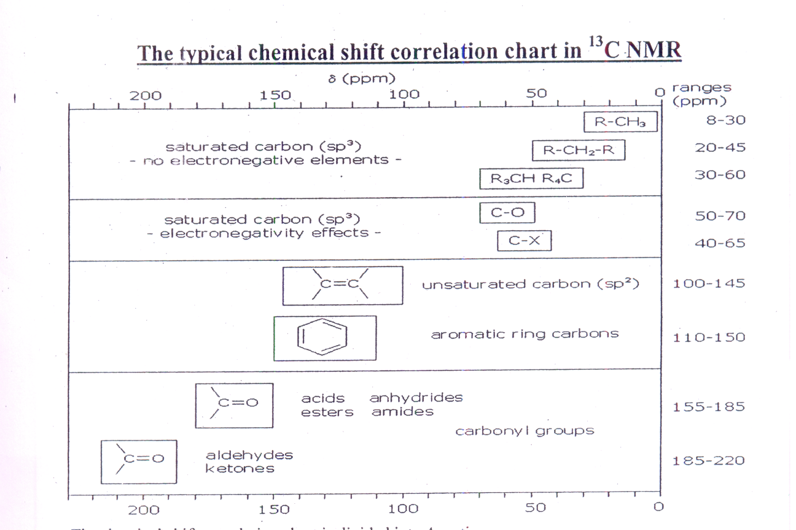

Slide 54
PROPERTIES
¹³C spectra has long relaxation times means no integrations.
Normal ¹³C spectra are broadband, proton decoupled, so the peaks show as single lines.
Number of peaks indicates the number of types of carbon.
Decoupling simplifies the spectrum and increases peak height.

Slide 55
Interpreting NMR Spectra
Alkanes
  ¹H-NMR signals appear in the range of δ 0.8-1.7.
  ¹³C-NMR signals appear in the considerably wider range of δ 10-60.
Alkenes
  ¹H-NMR signals appear in the range δ 4.6-5.7.
  ¹H-NMR coupling constants are generally larger for trans-vinylic hydrogens (J= 11-18 Hz) compared with cis-vinylic hydrogens (J= 5-10 Hz).
  ¹³C-NMR signals for sp² hybridized carbons appear in the range δ 100-160, which is to higher frequency from the signals of sp³ hybridized carbons.

Slide 56
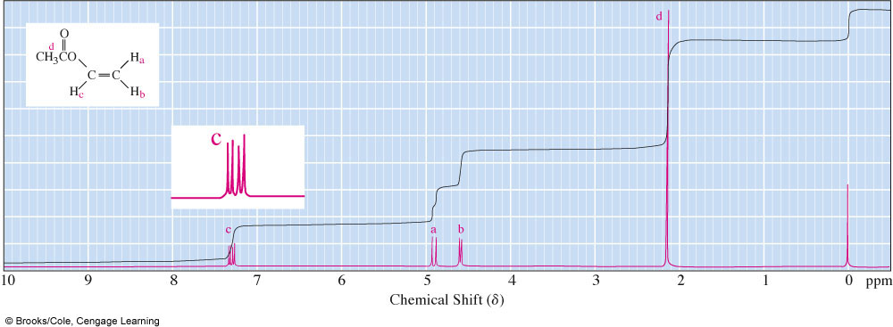
Interpreting NMR Spectra
  ¹H-NMR spectrum of vinyl acetate.

Slide 57
Interpreting NMR Spectra
Alcohols
¹H-NMR O-H chemical shift often appears in the range 3.0-4.0, but may be as low as  0.5.
¹H-NMR chemical shifts of hydrogens on the carbon bearing the -OH group are deshielded by the electron-withdrawing inductive effect of the oxygen and appear in the range  3.0-4.0.
Ethers
  A distinctive feature in the ¹H-NMR spectra of ethers is the chemical shift,  3.3-4.0, of hydrogens on the carbons bonded to the ether oxygen.

Slide 58
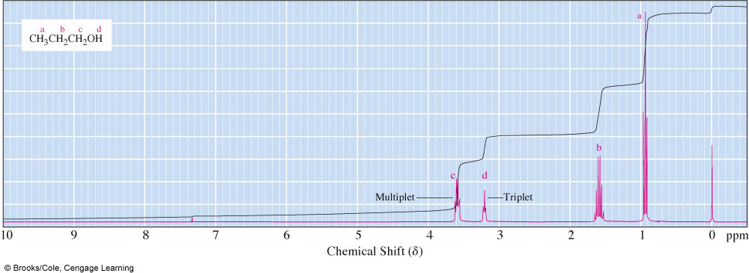
Interpreting NMR Spectra
  ¹H-NMR spectrum of 1-propanol.

Slide 59
Interpreting NMR Spectra
Aldehydes and ketones
  ¹H-NMR: aldehyde hydrogens appear at δ 9.5-10.1.
  ¹H-NMR: α-hydrogens of aldehydes and ketones appear at δ 2.2-2.6.
  ¹³C-NMR: carbonyl carbons appear at δ 180-215.
Amines
  ¹H-NMR: amine hydrogens appear at δ 0.5-5.0 depending on conditions.

Slide 60
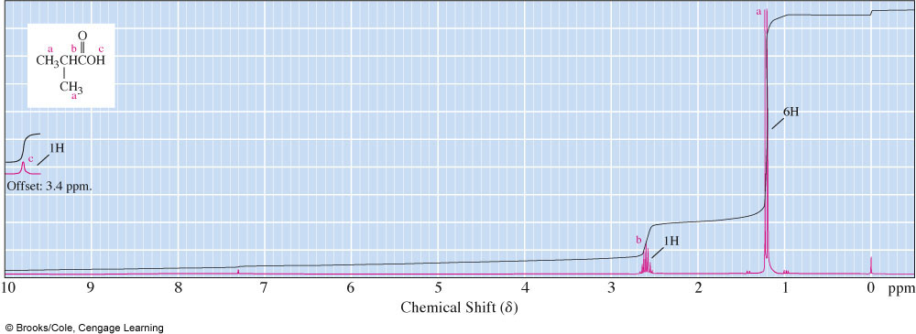
Interpreting NMR Spectra
Carboxylic acids
  ¹H-NMR: carboxyl hydrogens appear at δ 10-13, higher than most other types of hydrogens.
  ¹³C-NMR: carboxyl carbons in acids and esters appear at δ 160-180.

Slide 61
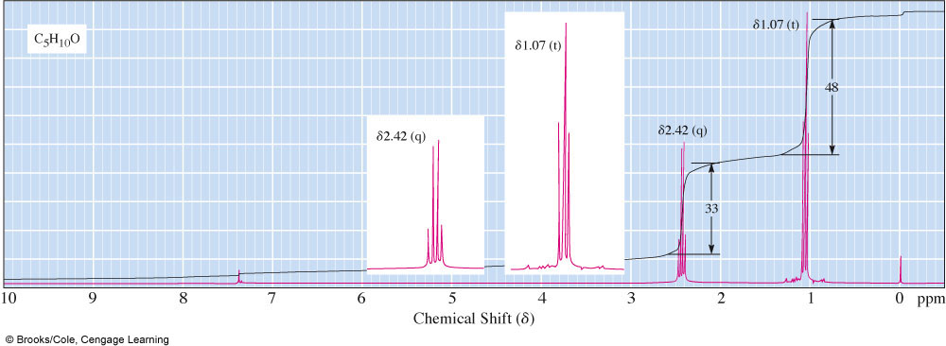
Interpreting NMR Spectra
Spectral Problem 1; molecular formula C₅H₁₀O.

Slide 62
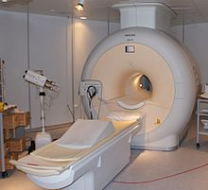
MRI – magnetic resonance imaging
Magnetic resonance imaging, noninvasive
Only protons in one plane can be in resonance at one time.
Computer puts together “slices” to get 3D.
Tumors readily detected. MRIs are administered to patients suffering from the following:
inflammation or infection in an organ
degenerative diseases
strokes , musculoskeletal disorders ,tumors
other irregularities that exist in tissue or organs in their body

Slide 63
In magnetic resonance, free induction decay (or FID) is the temporal profile of induction of sample placed in the magnetic field in the absence of external radio-frequency (in NMR or microwave frequency in EPR) irradiation after some irradiation has been applied and then interrupted.
Also, spectrocopists often refer to FID as a recording of the actual FID signal sampled in time. FID is almost never sampled directly as larmor precession frequecies of nuclear and electron are too high to be sampled that way.
Oscillations in the recorded FID's occur at frequencies equal the difference between the larmor frequency and the radio- (or microwave) frequencies of the applied pulses.

Slide 64
Applications:
widely used in chemical studies, notably in NMR spectroscopy such as proton NMR, carbon-13 NMR, deuterium NMR and phosphorus-31 NMR.
Biochemical information can also be obtained from living tissue (e.g. human brain tumors) with the technique known as in vivo magnetic resonance spectroscopy

Slide 65
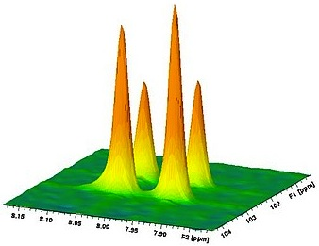
2D - NMR
In normal NMR spectrum has an amplitude plotted against just one frequency ppm scale.
But in 2D NMR amplitude is plotted against two frequency dimensions ppm scale i.e., as counter plot.
2D NMR shows relation between peaks in an NMR spectrum.

Slide 66
In two-dimensional NMR the signal is recorded as a function of two time variables, t1 and t2.
The resulting data Fourier transformed twice to yield a spectrum which is a function of two frequency variables
In the first period, called the preparation time, the sample is excited by one or more pulses. The resulting magnetization is allowed to evolve for the first time period, t1.
Then another period follows, called the mixing time which consists of a further pulse or pulses. After the mixing period the signal is recorded as a function of the second time variable, t2.
This sequence of events is called a pulse sequence and the exact nature of the preparation and mixing periods determines the information found in the
spectrum.
It is important to realize that the signal is not recorded during the time t1,

Slide 67
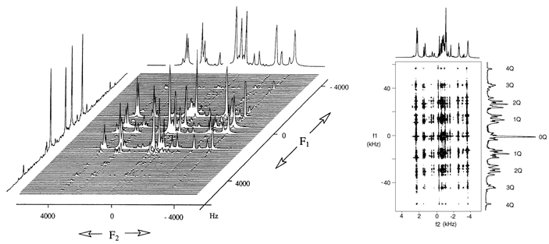

Slide 68
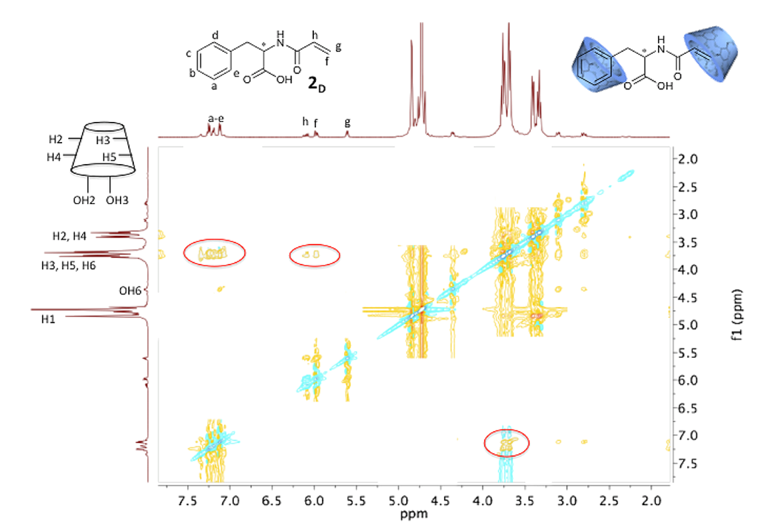

Slide 69
References:
Instrumental methods of analysis by – Skoog
Analytical chemistry – Conners
Organic spectroscopy – Y.R.Sharma
T.B of analytical chemistry – Beckett & Stanlake
Internet source.

