Slide 1

MEDICINAL CHEMISTRY
ANTIVIRAL AND ANTI AIDS AGENTS
-07-2020
1

Slide 2
ANTIVIRAL AND ANTI AIDS AGENTS
Viruses are non-cellular obligate intracellular parasites. They lack both a cell wall and a cell membrane and do not carryout
metabolic processes on their own. They invade the host cell, which may be bacteria, animal or plant cell.
The virus turns the biochemical system of the host cell to its own purposes completely subverting the infected cell.
Viral diseases include influenza, rabies, poliomyelitis, yellow fever, measles, Ebola human immune deficiency syndrome, herpes and small pox.
Adult viruses possess only one type of nucleic acid either DNA or RNA. They contain protein coat that surrounds nucleic
acid. The protein coat is known as Capsid. Which is made up of smaller units (Capsomers).
-07-2020
2

Slide 3
ANTIVIRAL AND ANTI AIDS AGENTS
Depending upon the nucleic acid content viruses are classified as RNA viruses and DNA viruses.
RNA viruses
a) RNA viruses
Retro viruses
RNA viruses includes: Picorna virus, Polio, hepatitis, pneumonia rabies.
Retro viruses includes: AIDS, and T-cell leukaemia.
b) DNA viruses includes: the herpes viruses (eye infection, genital infection), Varicella zoster ( chicken pox).
-07-2020
3

Slide 4
ANTIVIRAL AND ANTI AIDS AGENTS
Antiviral agents: Drugs used for Prophylaxis (prevention) and Therapy (treatment) of viral diseases are called antiviral
agents.
General approaches for treating the virus infection by antiviral agents are:
Interference or inhibition of virus attachment to the host receptors, virus penetration and uncoating .
Inhibition of virus associated enzymes.
Inhibition of transcription and translation process.
Interference with viral regulatory process.
Interference with release of virus from cell surface membrane.
-07-2020
4

Slide 5
ANTIVIRAL AND ANTI AIDS AGENTS
Ideal properties of Antiviral agents:
It must possess broad spectrum of antiviral properties.
It should completely inhibit viral replication (reproduction).
It should reach target organ without interfering immune system of patient.
It should have minimum toxicity to the host cells.
It should be effective against resistant viruses.
-07-2020
5

Slide 6
ANTIVIRAL AND ANTI AIDS AGENTS
Classifications:
Purine nucleoside and nucleotides : eg. Acyclovir, Ganciclovir, Famciclovir, Valacyclovir,
Vidarabin, Abacavir, Penciclovir.
II) Pyrimidine nucleoside and nucleotides : eg. Iodoxuridine, Trifluridine, Cidofovir.
III) Thio-semicarbazone : eg. Methisazone.
IV) Adamantane amines : eg. Amantadine, Rimantadine, Somantadine.
V) Miscellaneous agents : eg. Foscarnet sodium, Ribavirin.
-07-2020
6

Slide 7
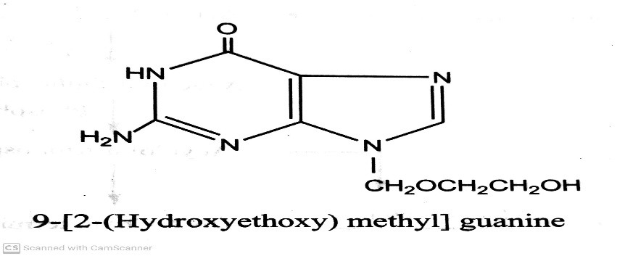
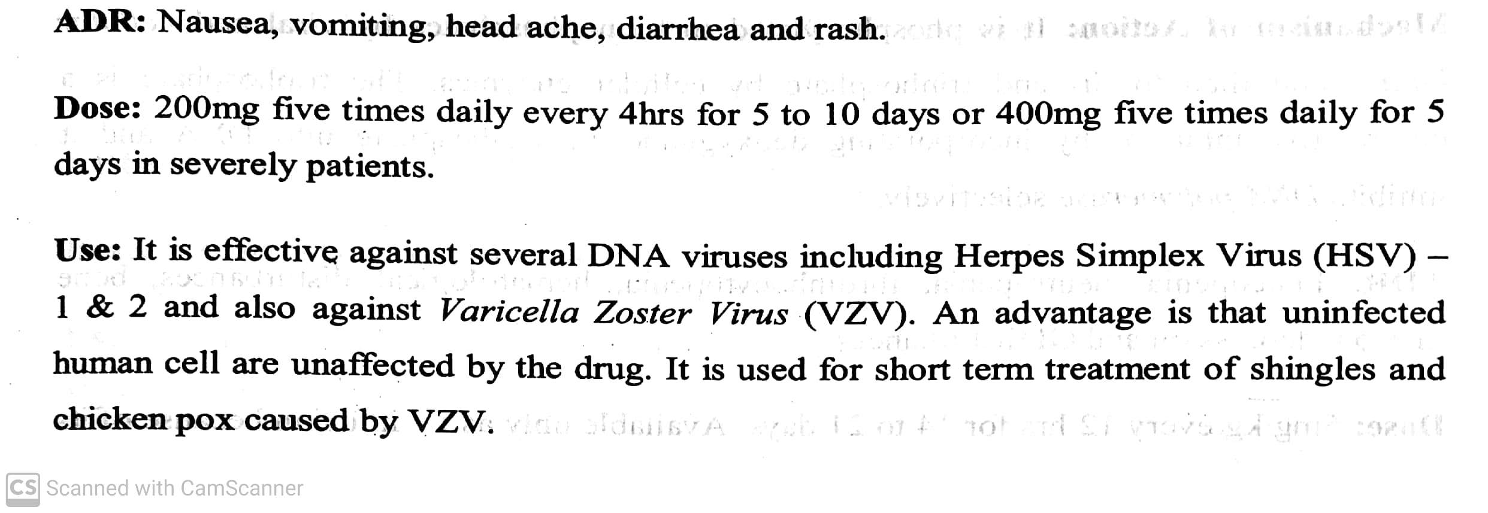
ANTIVIRAL AND ANTI AIDS AGENTS
Classifications:
Purine nucleoside and nucleotides : eg. Acyclovir, Ganciclovir, Famciclovir, Valacyclovir,
Vidarabin, Abacavir, Penciclovir.
eg. Acyclovir (Acivir, Cyclovir, Zovirax) : ( Acycloguanosone)
-07-2020
7

Slide 8
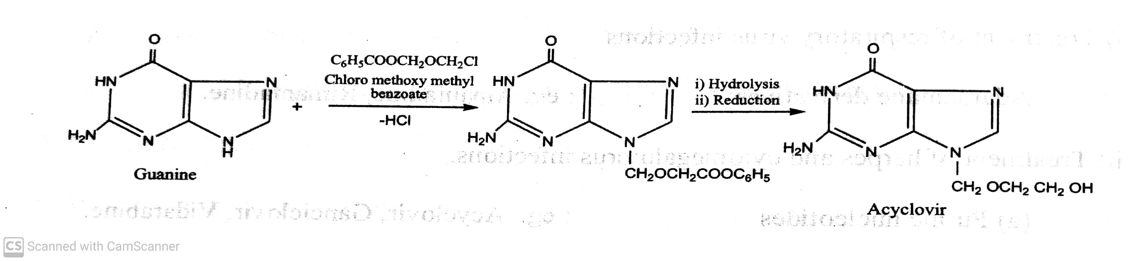
ANTIVIRAL AND ANTI AIDS AGENTS
Classifications:
Purine nucleoside and nucleotides : eg. Acyclovir, Ganciclovir, Famciclovir, Valacyclovir,
Vidarabin, Abacavir, Penciclovir.
Synthesis of Acyclovir :
-07-2020
8

Slide 9
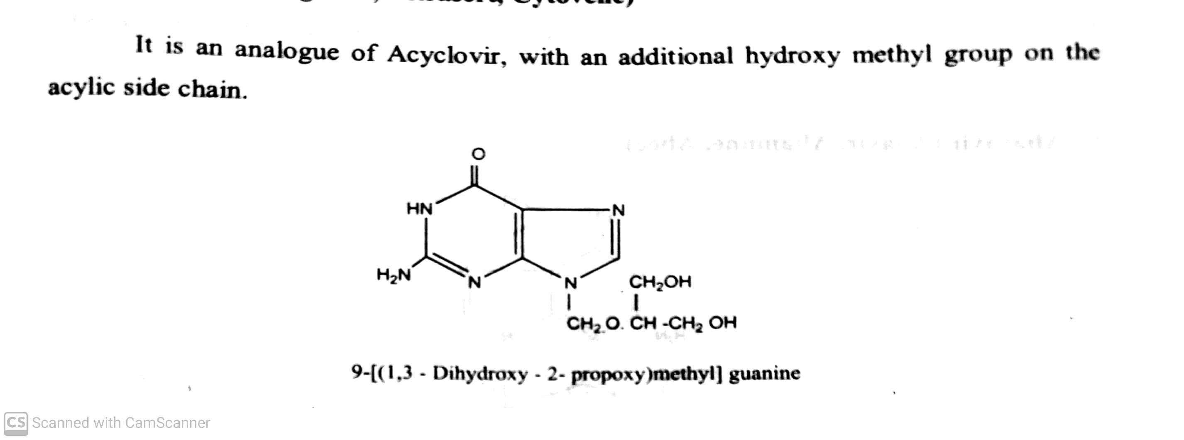
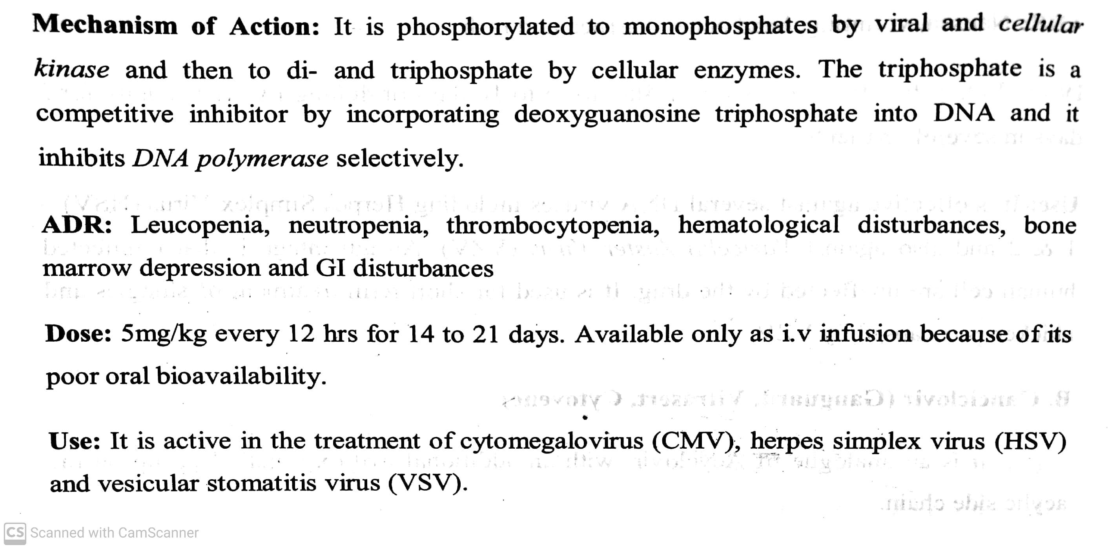
ANTIVIRAL AND ANTI AIDS AGENTS
Classifications:
Purine nucleoside and nucleotides : eg. Acyclovir, Ganciclovir, Famciclovir, Valacyclovir,
Vidarabin, Abacavir, Penciclovir.
eg. Ganciclovir (Ganguard, Vitrasert, Cytovene) :
-07-2020
9

Slide 10
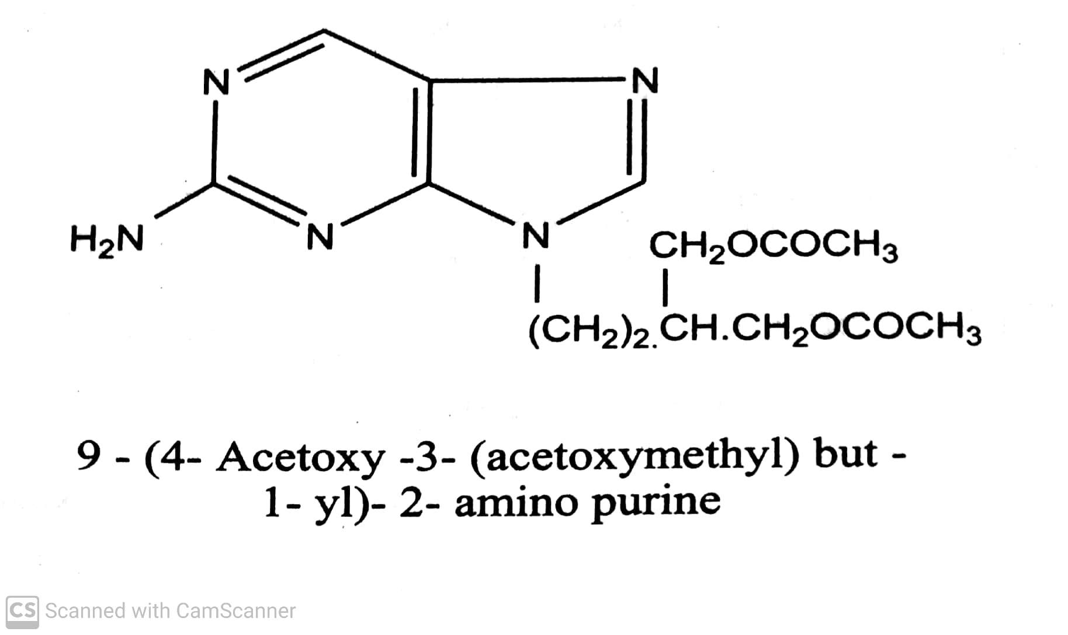
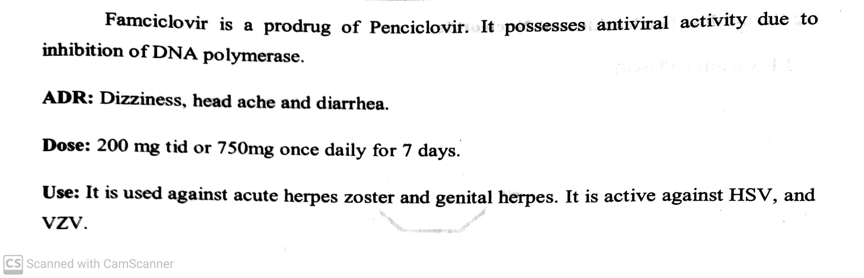
ANTIVIRAL AND ANTI AIDS AGENTS
Classifications:
Purine nucleoside and nucleotides : eg. Acyclovir, Ganciclovir, Famciclovir, Valacyclovir,
Vidarabin, Abacavir, Penciclovir.
eg. Famciclovir ( Famdrex, Microvir) :
-07-2020
10

Slide 11
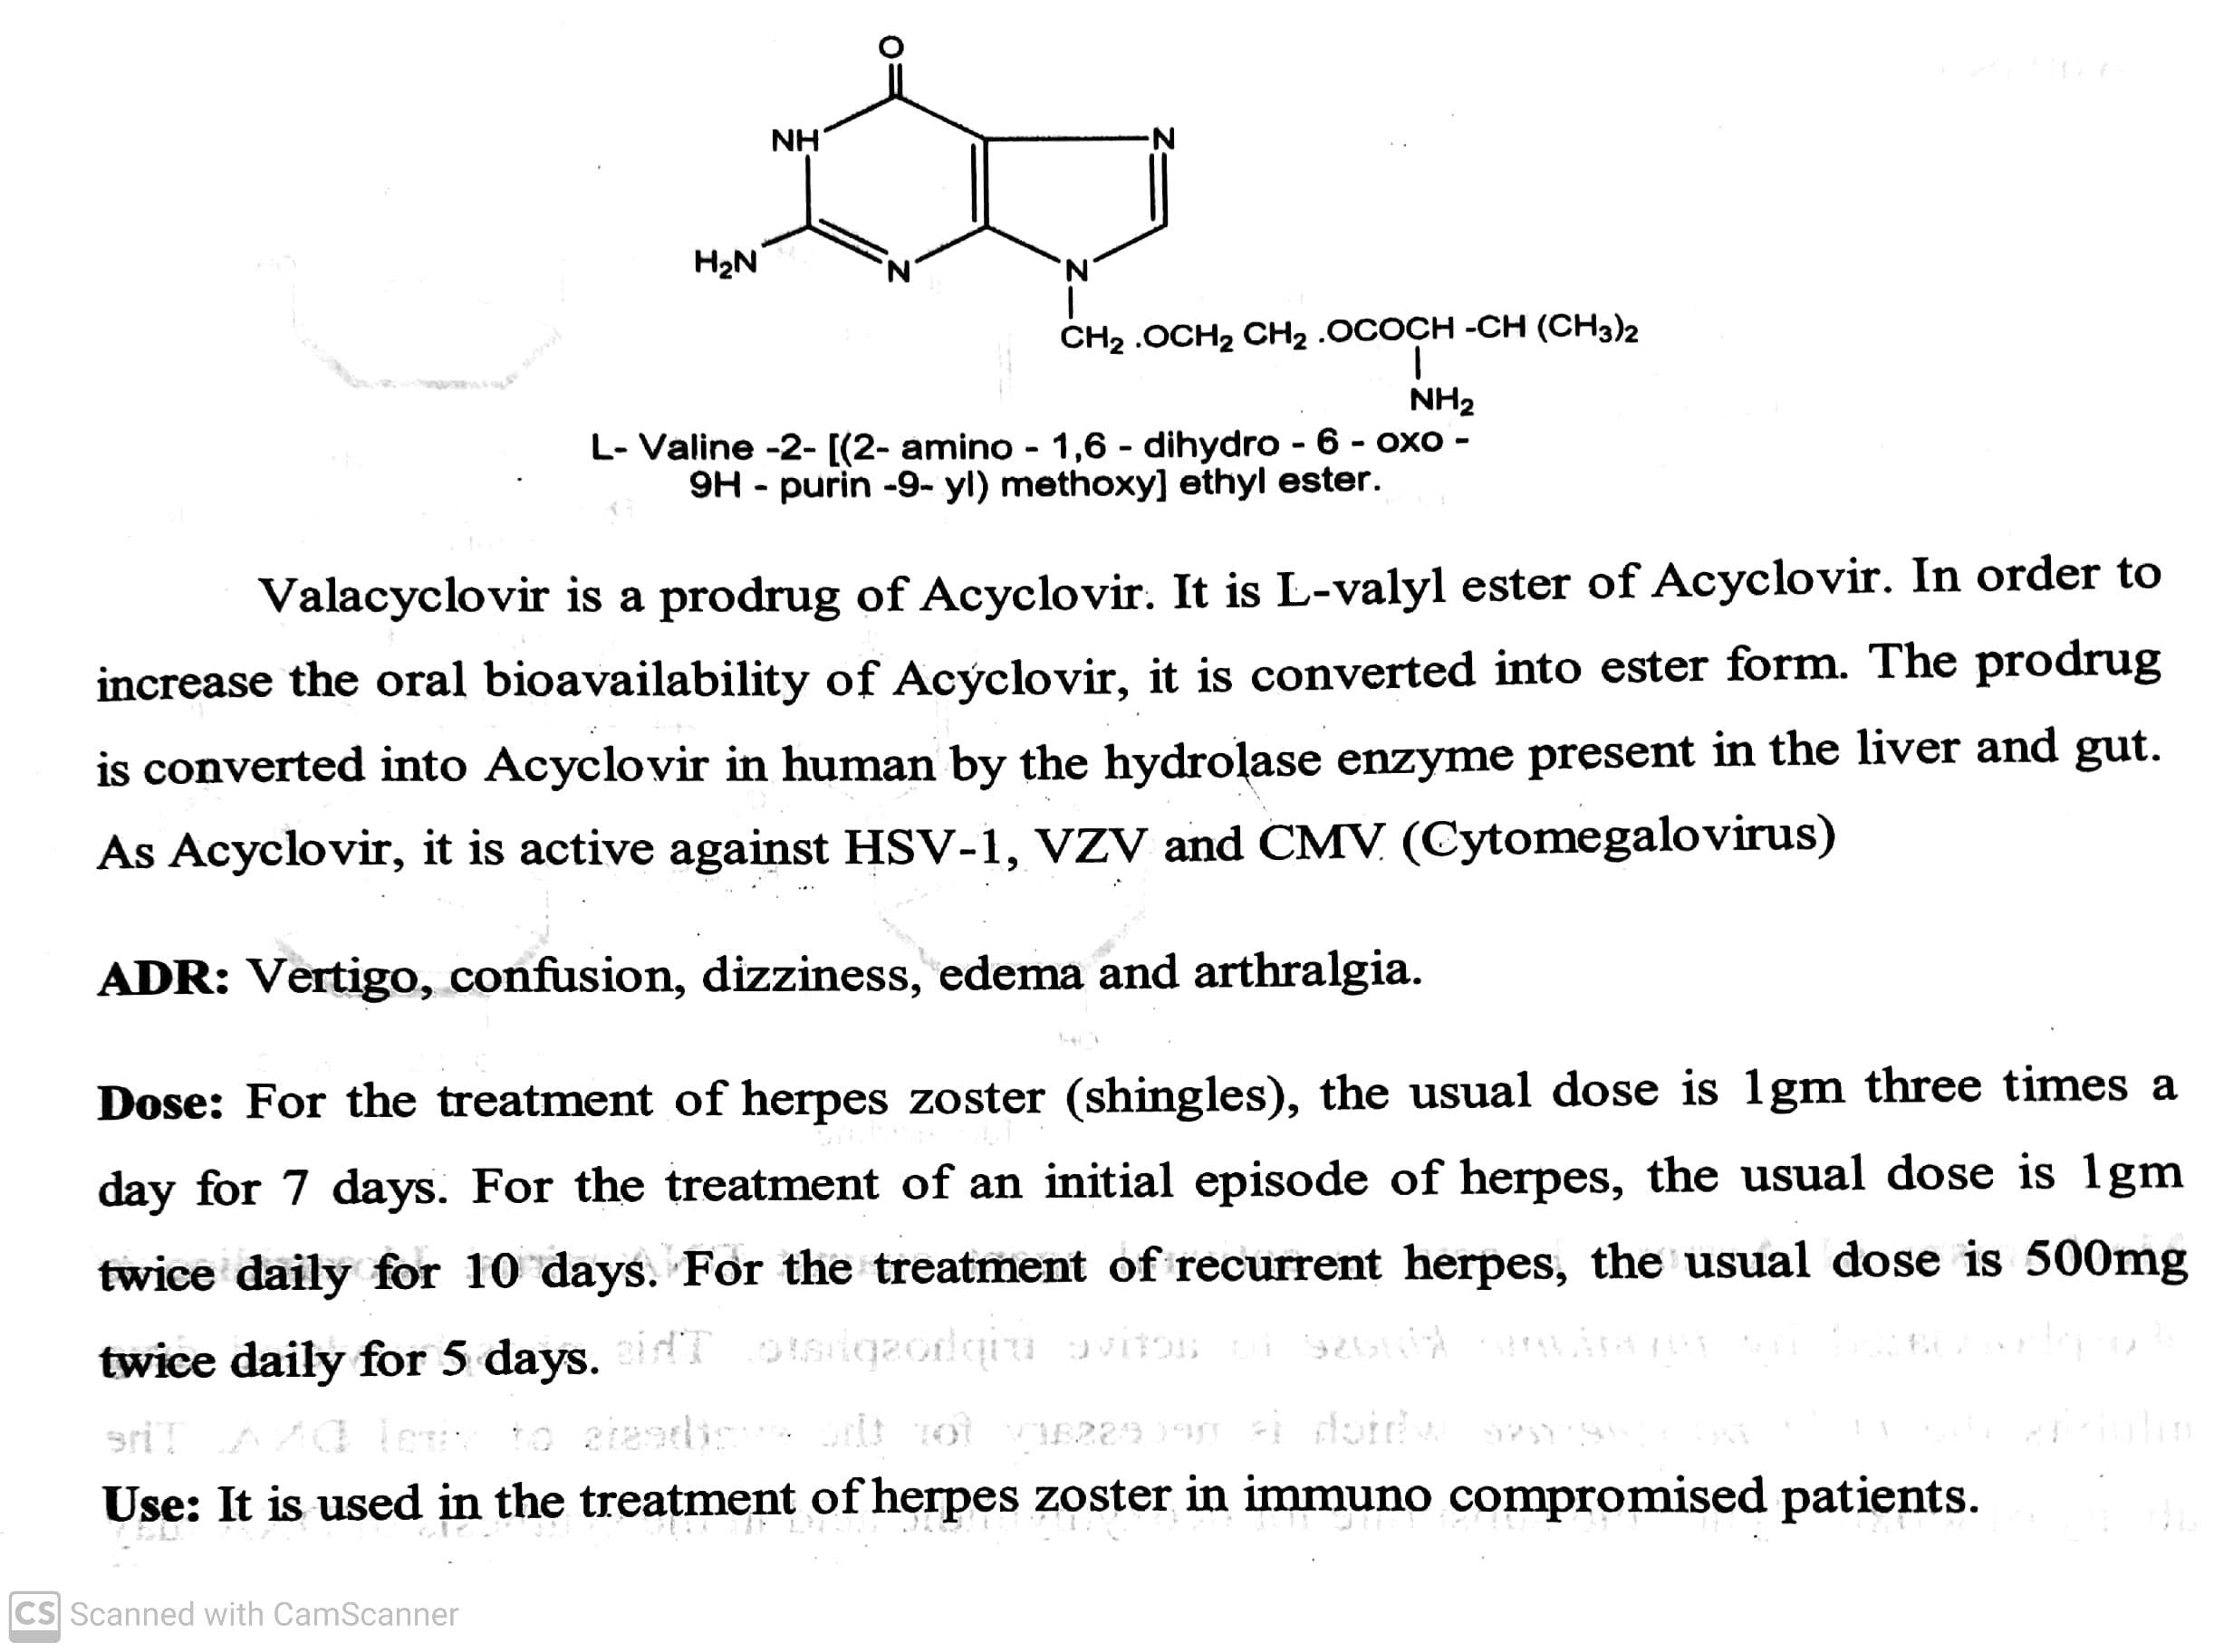
ANTIVIRAL AND ANTI AIDS AGENTS
Classifications:
Purine nucleoside and nucleotides : eg. Acyclovir, Ganciclovir, Famciclovir, Valacyclovir,
Vidarabin, Abacavir, Penciclovir.
eg. Valacyclovir ( Valtrex, Zelitrex) :
-07-2020
11

Slide 12
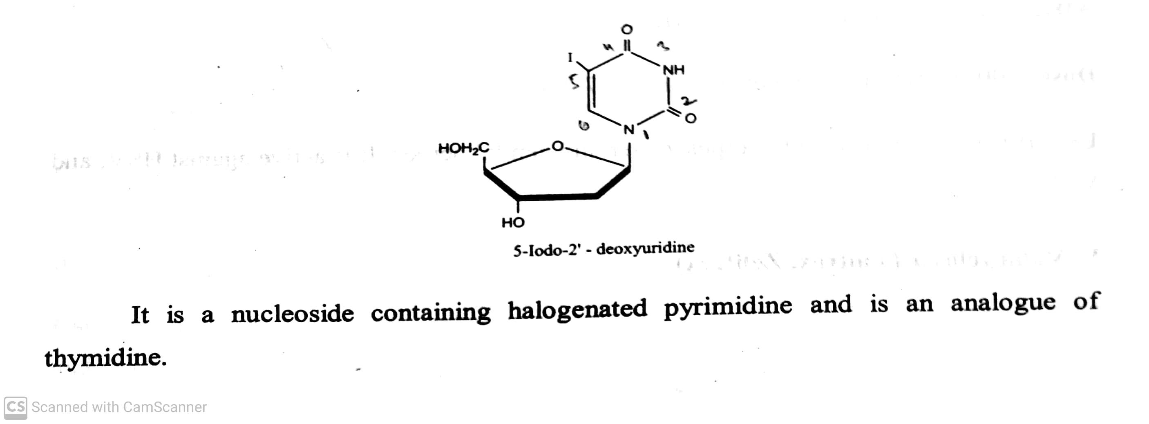
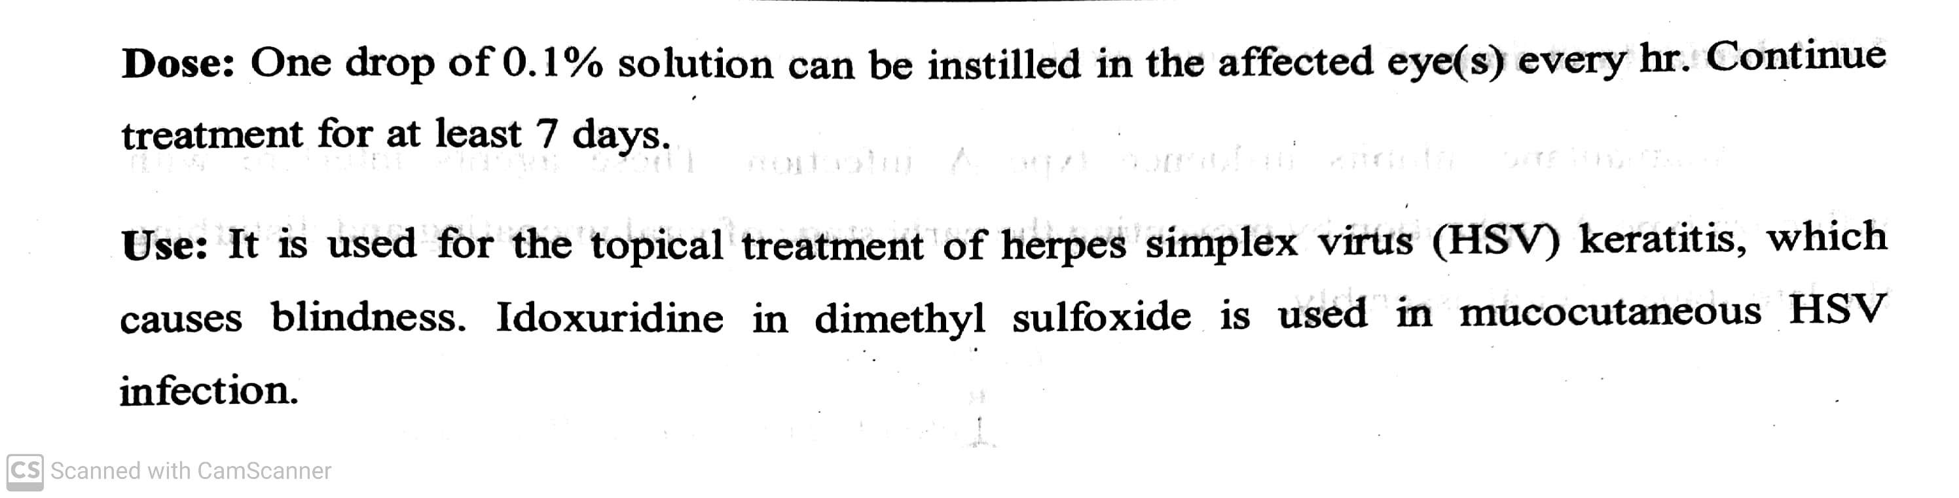
ANTIVIRAL AND ANTI AIDS AGENTS
Classifications:
II) Pyrimidine nucleoside and nucleotides : eg. Iodoxuridine, Trifluridine, Cidofovir.
eg. Iodoxuridine (Toxil) :
ADR: Irritation, or inflammation of the eye or eyelids.
-07-2020
12

Slide 13
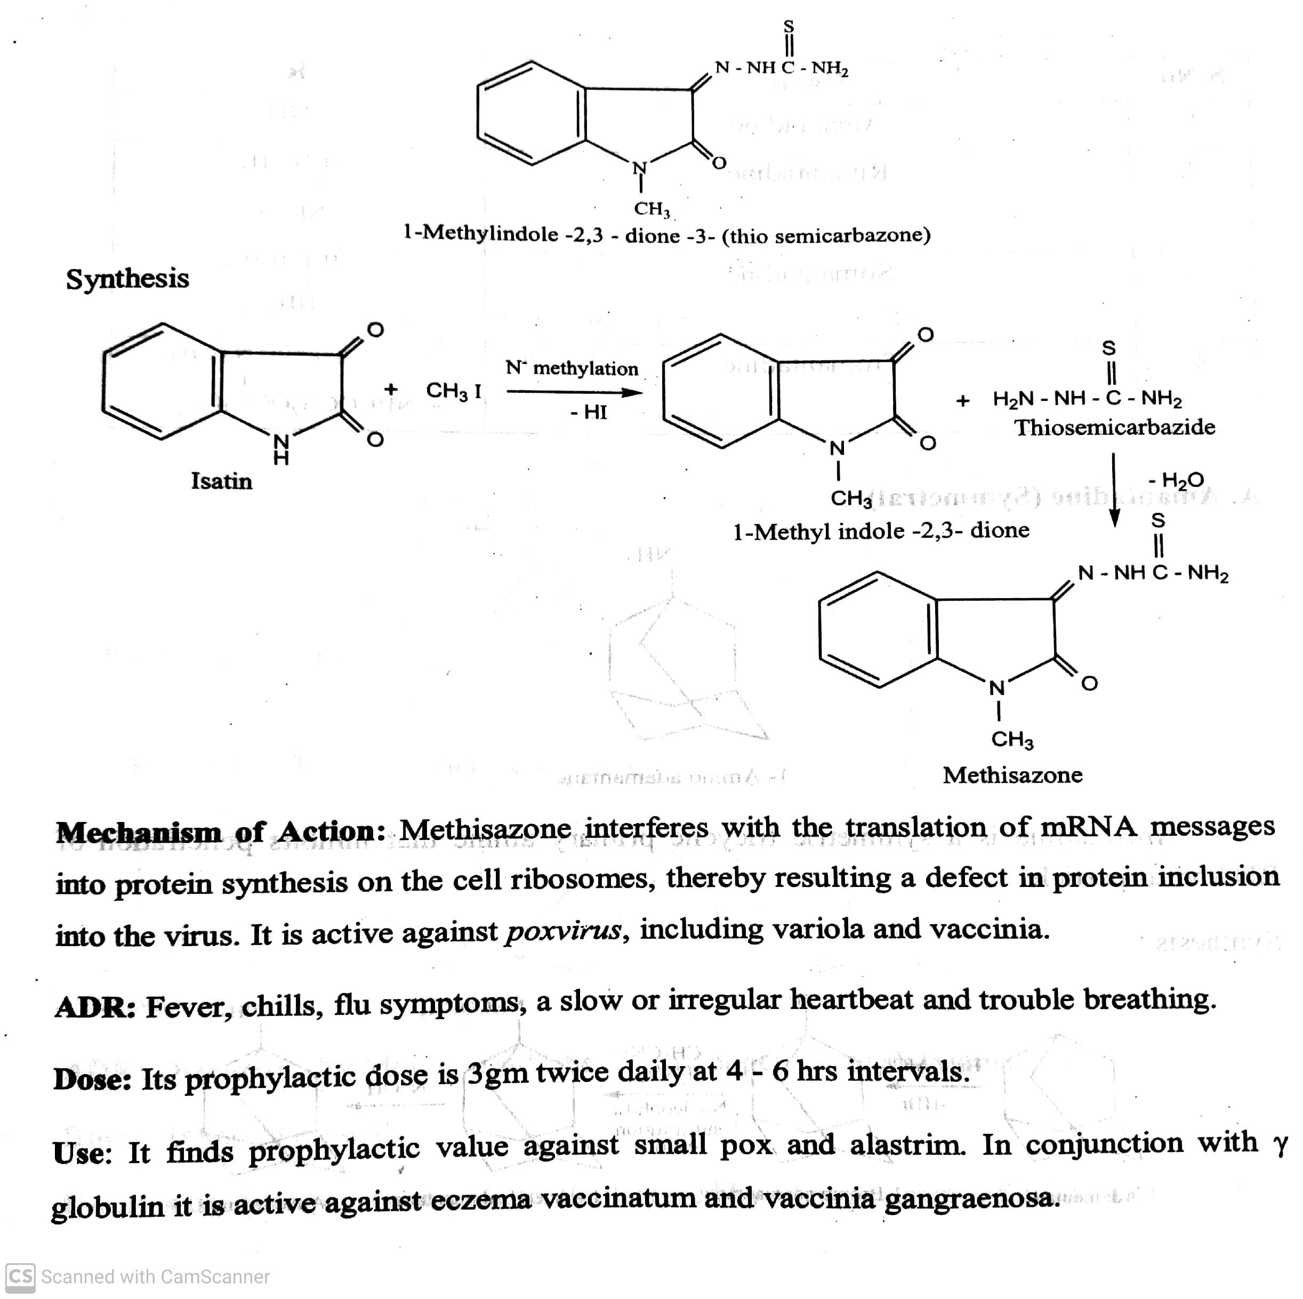
ANTIVIRAL AND ANTI AIDS AGENTS
Classifications: III) Thio-semicarbazone : eg. Methisazone ( Marboran).
-07-2020
13

Slide 14
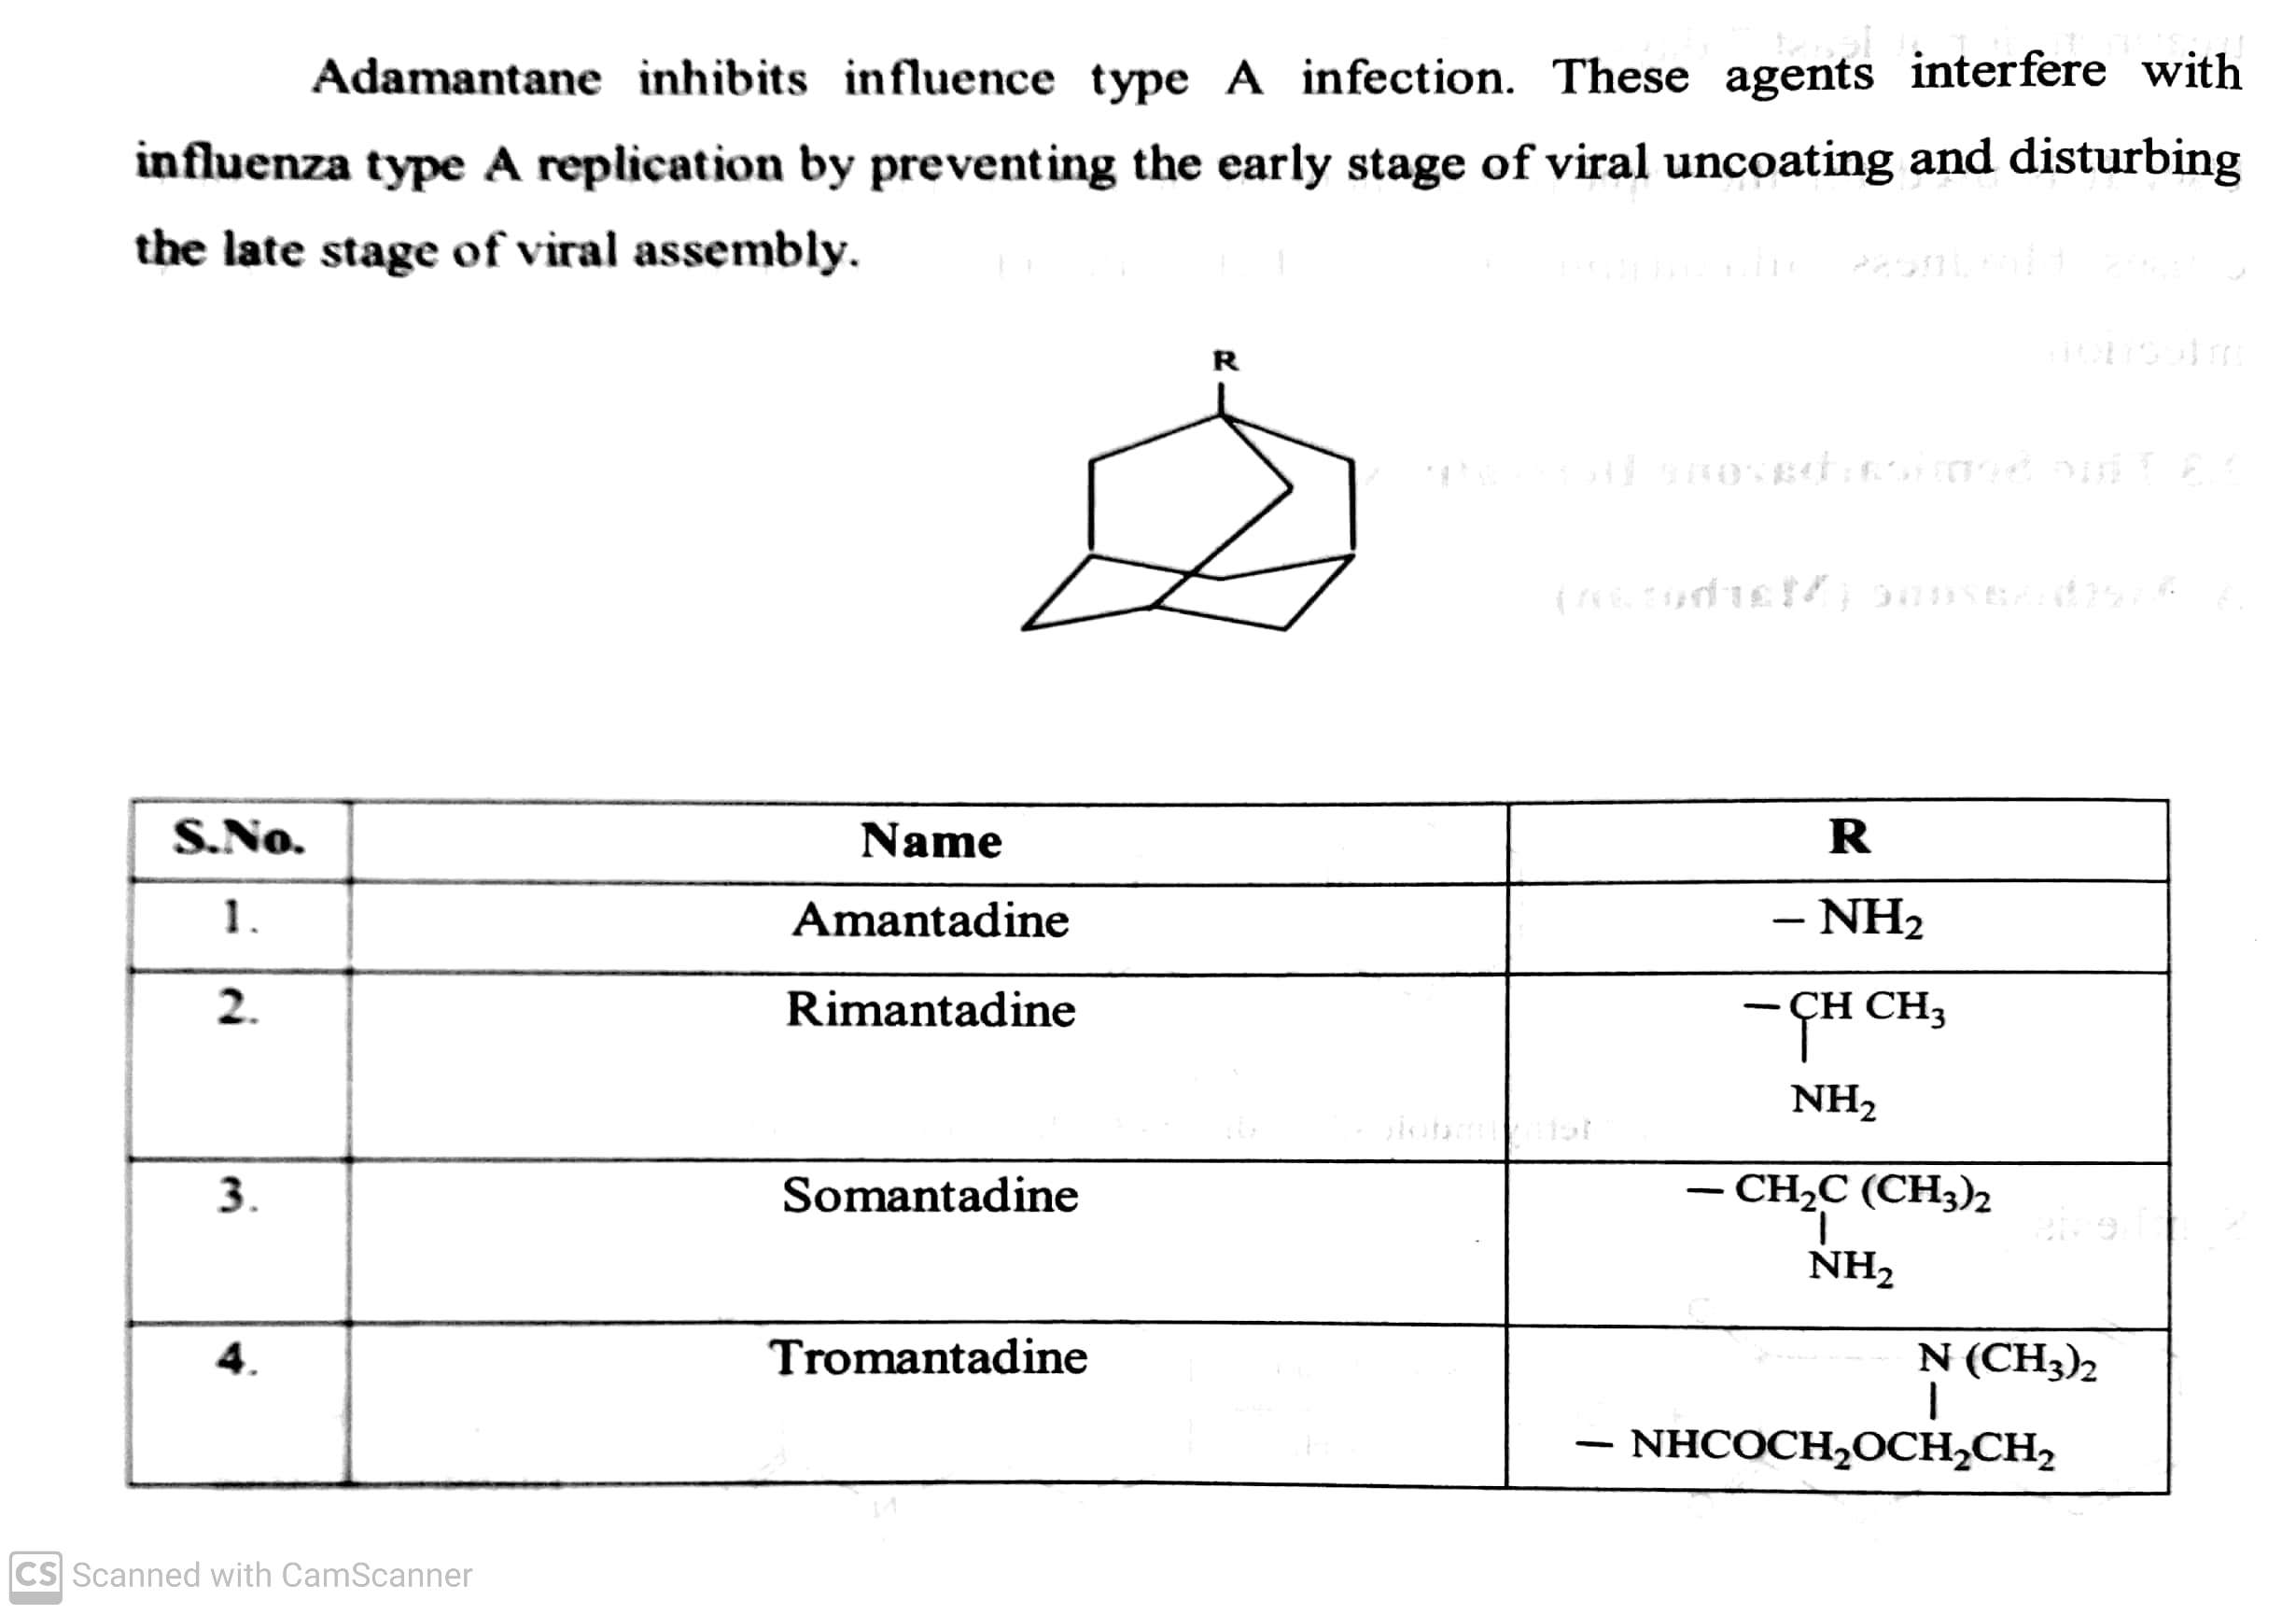
ANTIVIRAL AND ANTI AIDS AGENTS
Classifications:
IV) Adamantane amine : eg. Amantadine, Rimantadine, Somantadine.
-07-2020
14

Slide 15
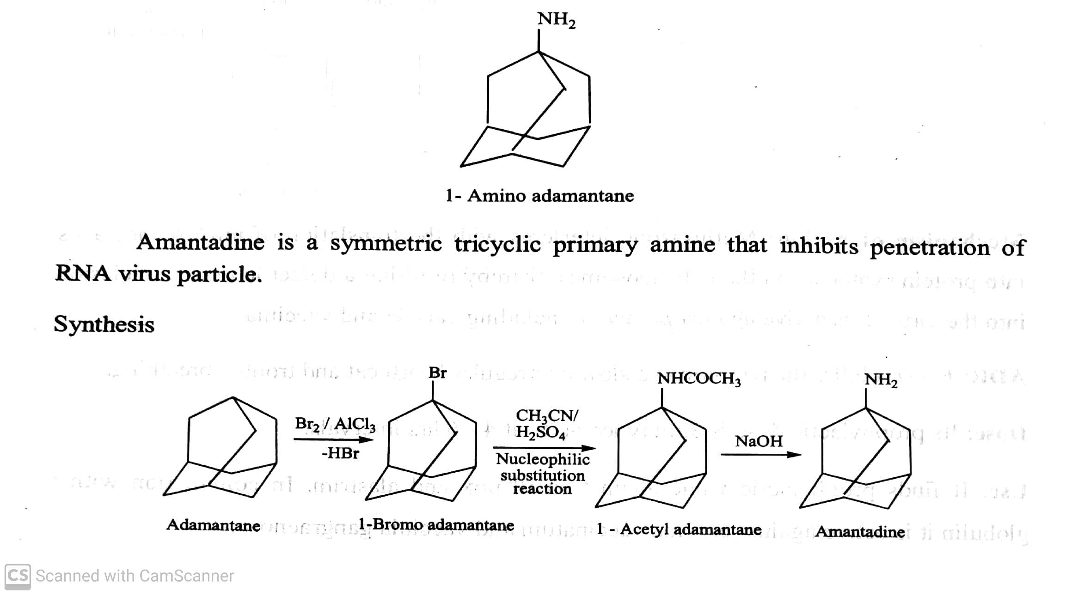
ANTIVIRAL AND ANTI AIDS AGENTS
Classifications:
IV) Adamantane amine : eg. Amantadine, Rimantadine, Somantadine.
eg. Amantadine (Symmetral):
-07-2020
15

Slide 16
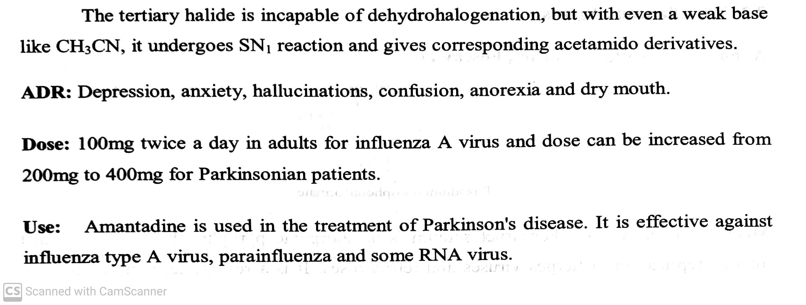
ANTIVIRAL AND ANTI AIDS AGENTS
Classifications:
IV) Adamantane amine : eg. Amantadine, Rimantadine, Somantadine.
eg. Amantadine (Symmetral):
-07-2020
16

Slide 17
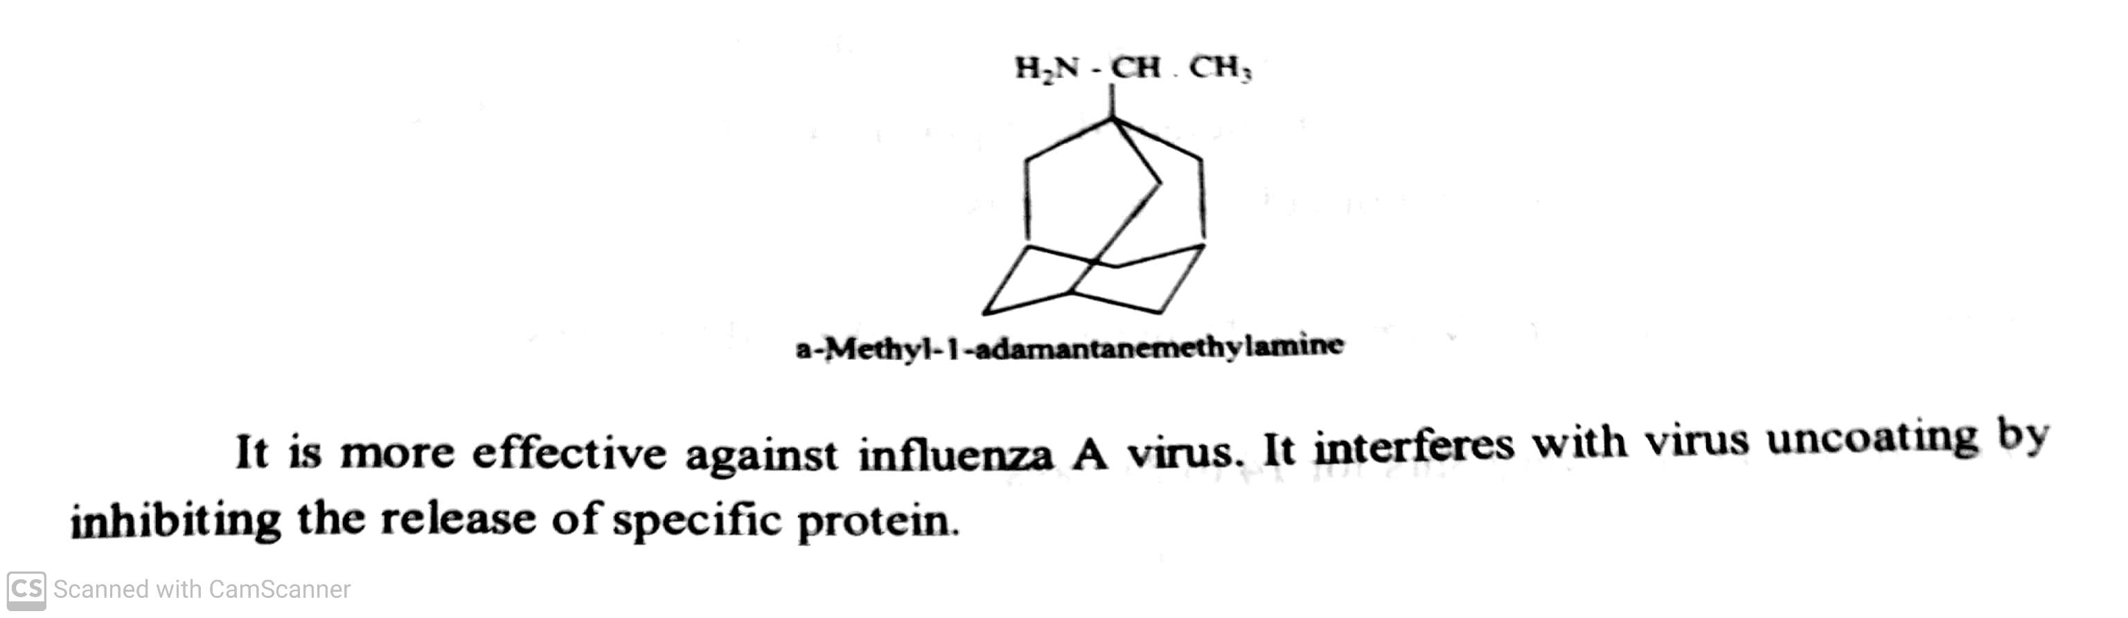
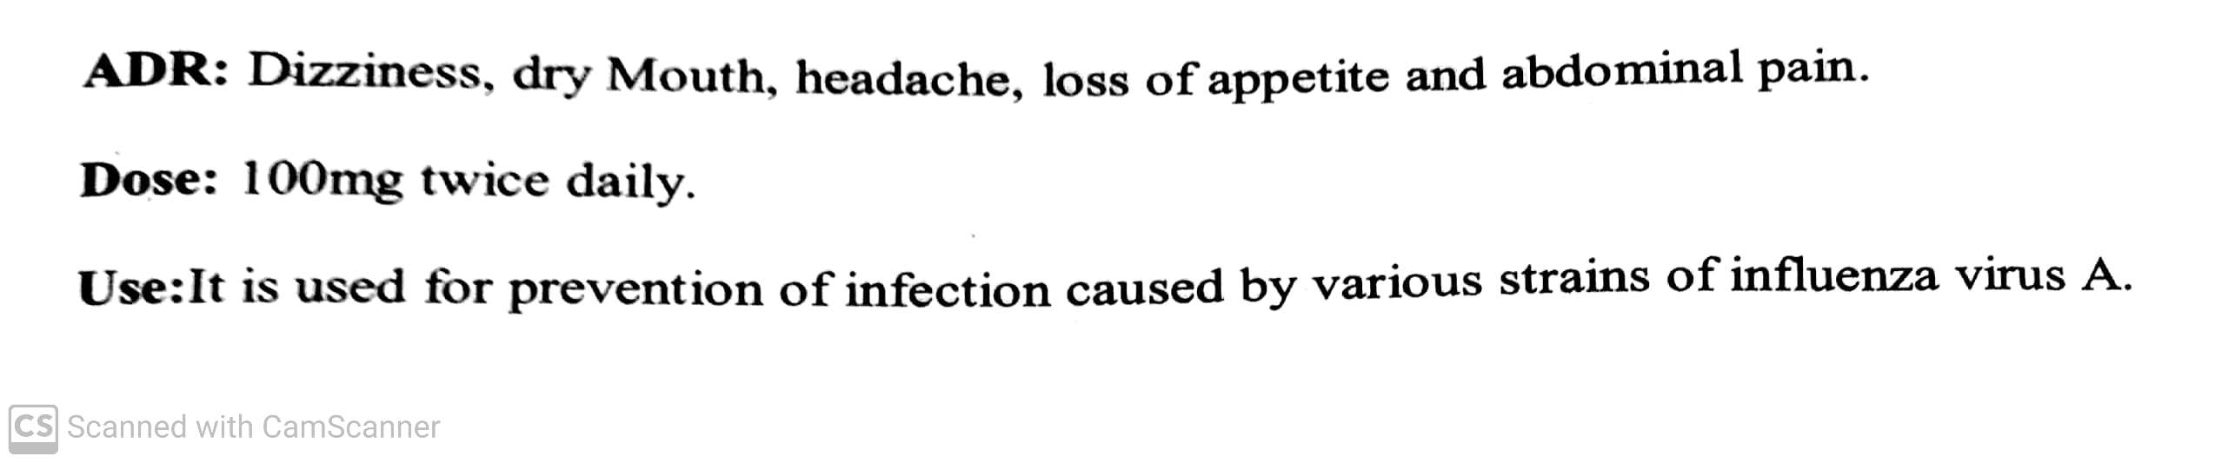
ANTIVIRAL AND ANTI AIDS AGENTS
Classifications: IV) Adamantane amine : eg. Amantadine, Rimantadine, Somantadine.
eg. Rimantadine (Flumadine):
-07-2020
17

Slide 18
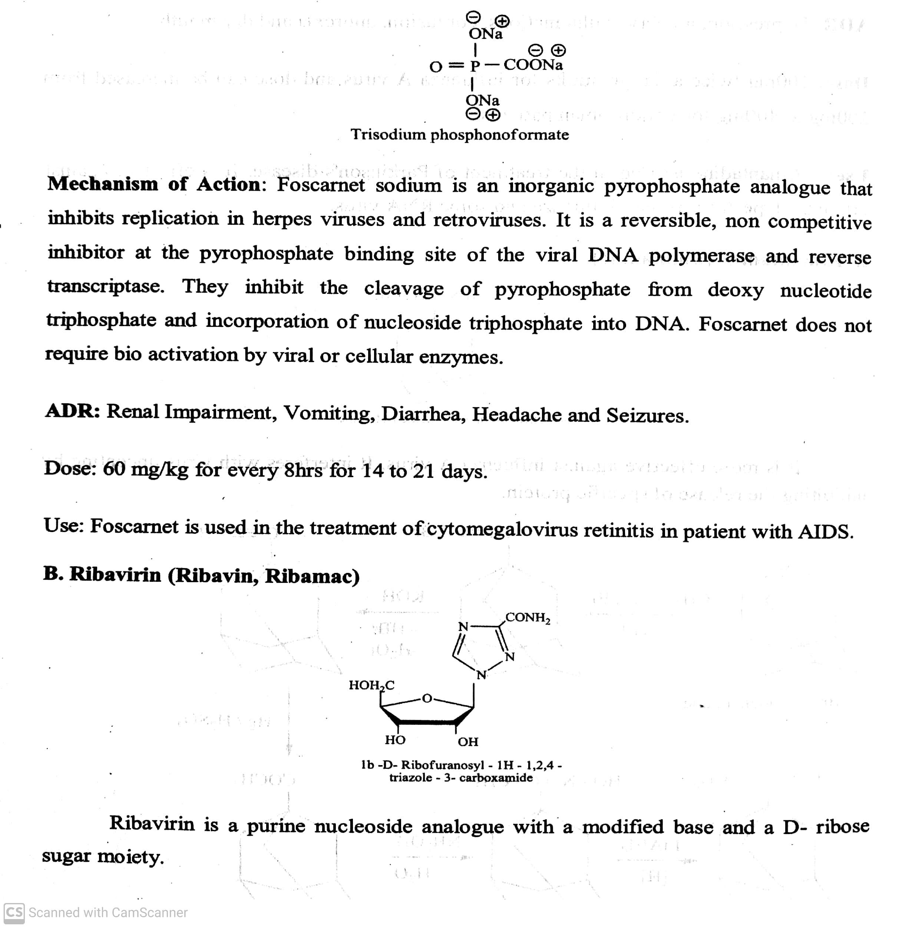
ANTIVIRAL AND ANTI AIDS AGENTS
Classifications:Miscellaneous agents : eg. Foscarnet sodium ( Carnet, Foscavir ) , Ribavirin( Ribavin, Ribamac).
-07-2020
18

Slide 19
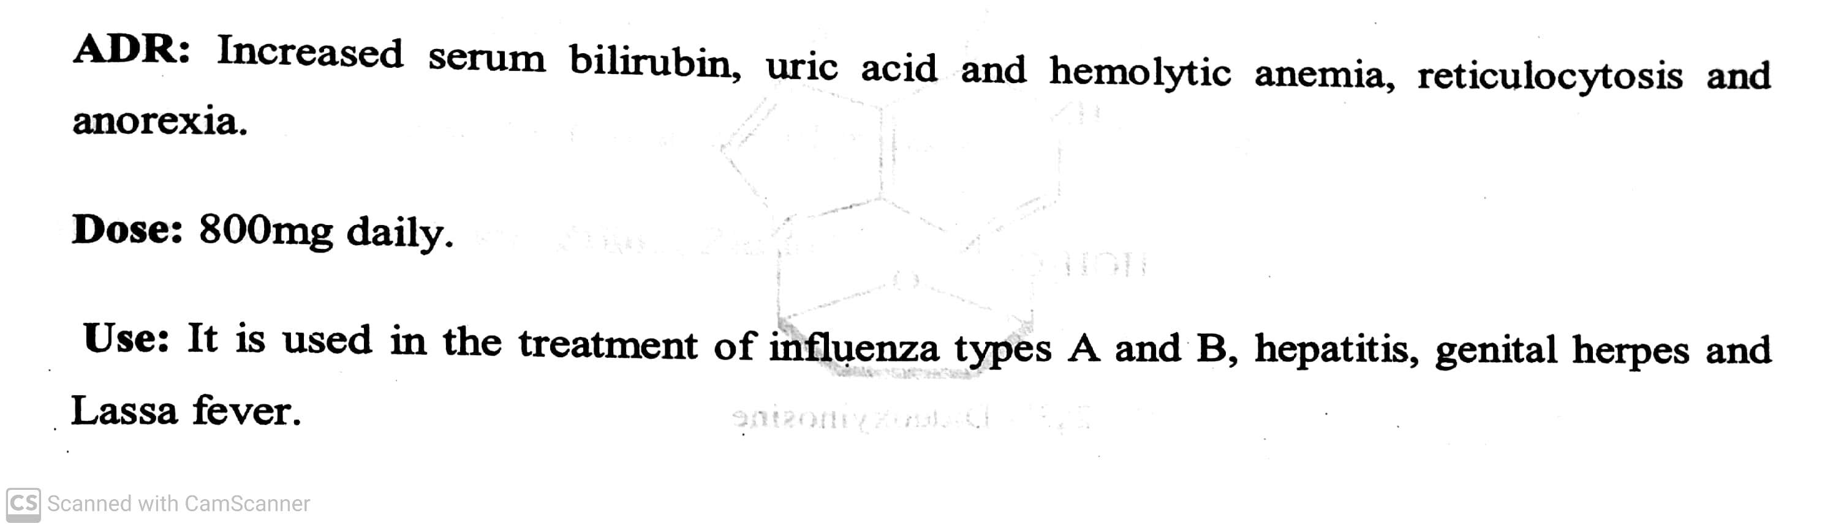
ANTIVIRAL AND ANTI AIDS AGENTS
Classifications:
V) Miscellaneous agents Ribavirin( Ribavin, Ribamac).
-07-2020
19

Slide 20
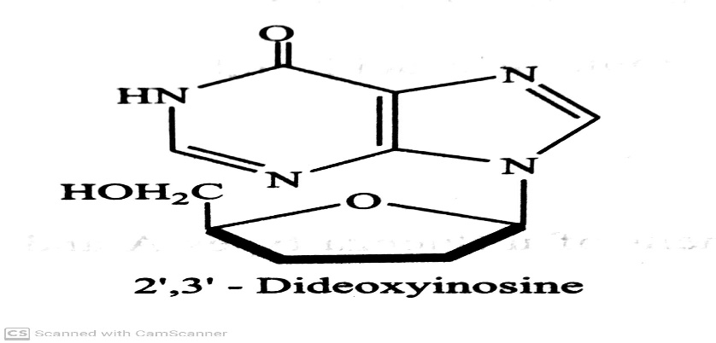
ANTI AIDS AGENTS
Human immunodeficiency virus (HIV) is the cause of acquired immunodeficiency syndrome (AIDS).
The agents which are used to treat and prevention of HIV disease are called as anti AIDS agents.
Classifications:
I) Reverse transcriptase (RT) Inhibitors : Reverse transcriptase is RNA –dependent DNA polymerase. The drugs
inhibiting RT interferes with replication of HIV and stops the synthesis of infective viral particle.
They are further classified into nucleoside and non-nucleoside RT inhibitors.
eg. Didanosine ( Dinex, Dinosin):
ADR : Pancreatitis, Peripheral neuropathy and diarrhoea.
Dose : 400 mg daily as a single dose or in two divided doses.
Use : it is recommended for treatment of patients with advanced HIV infections.
-07-2020
20

Slide 21
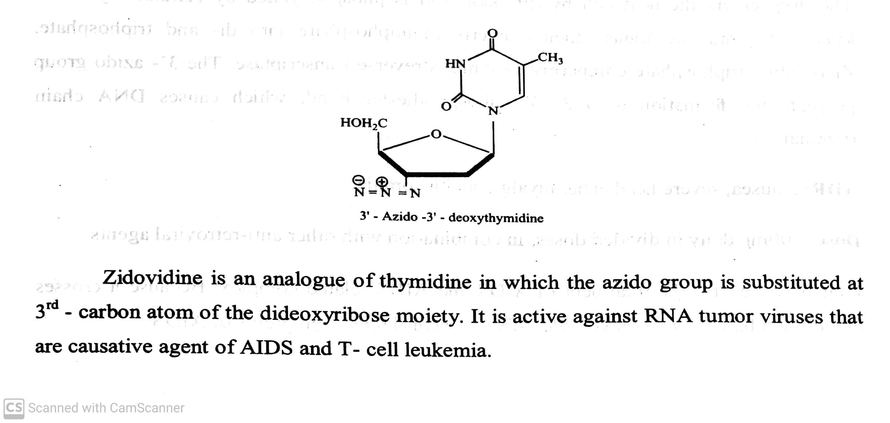
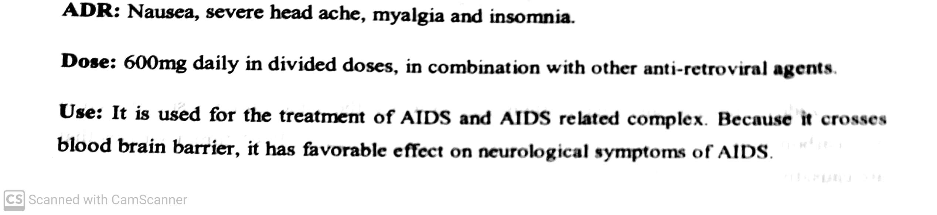
ANTI AIDS AGENTS
eg. Zidovudine ( Zidovir, Zilion):
-07-2020
21

Slide 22
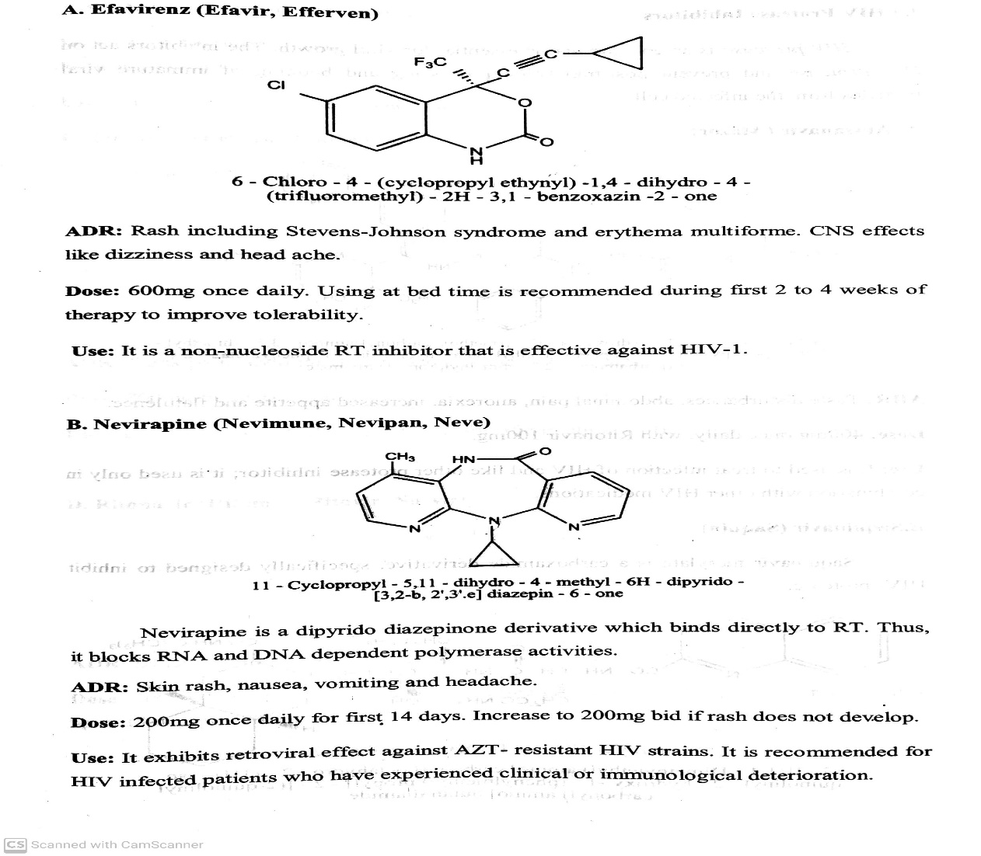
ANTI AIDS AGENTS
II) Non-Nucleotide reverse transcriptase ( RT) inhibitors: These are used with nucleoside drug tp obtain synergistic
activity. These drugs do not require bio-activation by kinase to yield phosphate ester.
-07-2020
22

Slide 23
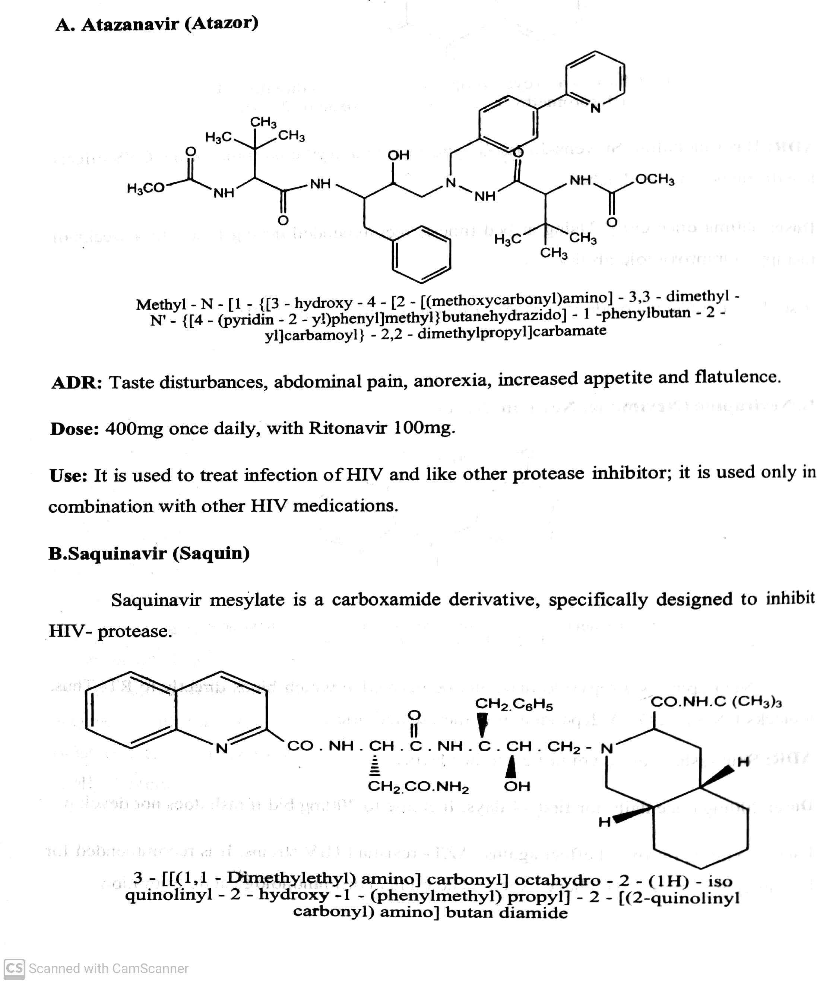
ANTI AIDS AGENTS
III) HIV protease Inhibitors: HIV protease is an enzyme that is essential for viral growth. The inhibitors act as HIV protease ant prevent post translation processing
-07-2020
23

Slide 24
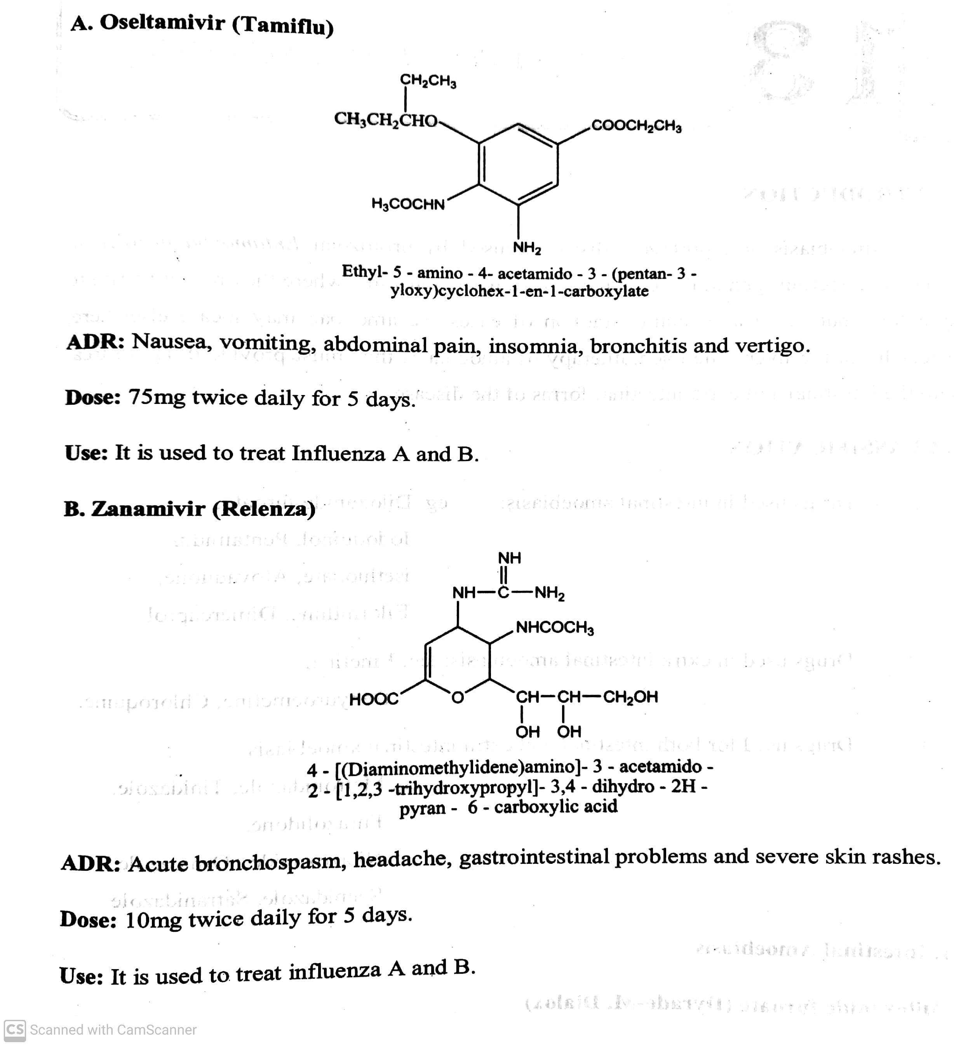
ANTI AIDS AGENTS
IV) Neuroamidase Inhibitors:
-07-2020
24

Slide 25
THANK YOU
23-07-2020
25

