Slide 1
ACUTE RENAL FAILURE

Slide 2
DEFINITION
Acute kidney injury (AKI) is characterized clinically by an abrupt decrease in renal function over a period of hours to days, resulting in the accumulation of nitrogenous waste products (azotemia) and the inability to maintain and regulate fluid, electrolyte, and acid-base balance.
A wide rage of factors precipitate AKI, including trauma, obstruction of urine flow or any event that causes reduction in renal blood flow, including surgery and medical conditions, for example, sepsis, diabetes, acute liver disease, rapidly progressive, glomerularnephritis.
Many patients become oligoruic with subsequent salt and water retention.
In patients with pre-exixting renal impairment, a rapid decline in reanl function is termed as ”ACUTE ON CHRONIC RENAL FAILURE”.

Slide 3
Risk factors
Older age
Higher base line serum creatinine(Scr)
CKD
Diabetes
Chronic respiratory illness
Underlying cardiovascular surgery
Prior heart surgery
Dehydration resulting in oliguria
Acute infections
Exposure to nephrotoxins

Slide 4
Phases of aki
The clinical course of the disease has 3 distinct phases.
Oligouric phase: A progressive decrease in urine production after the kidney injury.
Urine production of less than 400 mL/day is termed oliguria, and urine production of less than 50 mL/day is termed anuria. The oliguric stage may last from days to several weeks. this is probably because the renal insults (e.g., dehydration, nephrotoxin exposure, postrenal obstruction) in these cases are less severe. Strict fluid and electrolyte monitoring and management are required during this phase until renal function normalizes.

Slide 5
Diuretic phase: initial repair of the kidney insult with resultant diuresis of accumulated uremic toxins, waste products, and fluid.
This phase signals the initial repair of the kidney insult. The diuretic phase can result, in part, from a return to normal GFR before tubular reabsorptive capacity has fully recovered.
The elevated osmotic load from uremic toxins and the increased fluid volume retained during the oliguric phase may also contribute to the diuretic phase.
Despite the increased urine production, patients may remain markedly azotemic for several days.
The increase in urine output may lead to volume depletion and electrolyte loss if patients are not given adequate replacement therapy.
Daily modifications in the fluid and electrolyte requirements are necessary based on urine output.

Slide 6
Recovery phase: return of kidney function depending on the severity of injury.
The recovery phase occurs over the course of several weeks to months, depending on the severity of the patient's AKI. This phase signals the return to the patient's baseline kidney function, normalization of urine production, and the return of the diluting and concentrating abilities of the kidneys.

Slide 7
Causes of aki
Pre-renal azotemia: decreased renal blood flow
Functional: impairment of glomerular ultra filtrate production or intraglomerular hydrostatic pressure.
Intrinsic: damage to the kidneys
Postrenal: outflow obstruction in the urinary tract.

Slide 8
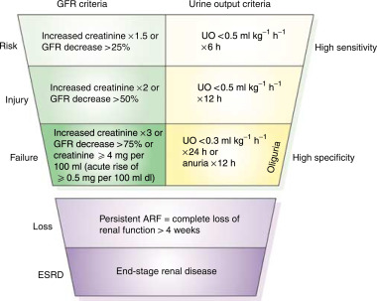
Rifle(risk, injury, failure, loss of kidney function)

Slide 9
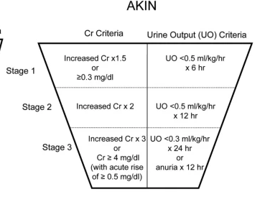
Acute kidney injury network(akin)

Slide 10
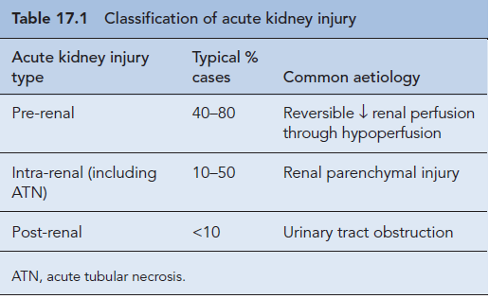
Classification of acute kidney injury

Slide 11
Classification | Common Clinical Disorders
Prerenal Azotemia | Intravascular Volume Depletion Hemorrhage (surgery, trauma) Dehydration (gastrointestinal losses, aggressive diuretic administration) Severe burns Hypovolemic shock Sequestration (peritonitis, pancreatitis) Decreased Effective Circulating Volume Cirrhosis with ascites Congestive heart failure Hypotension, Shock Syndromes Antihypertensive vasodilating medications Septic shock Cardiomyopathy Increased Renal Vascular Occlusion or Constriction Bilateral renal artery stenosis Unilateral renal stenosis in solitary kidney Renal artery or vein thrombosis (embolism, atherosclerosis) Vasopressor medications (phenylephrine, norepinephrine)

Slide 12
Classification | Common Clinical Disorders
Functional Acute Kidney Injury | Afferent Arteriole Vasoconstrictors Cyclosporine Nonsteroidal anti-inflammatory drugs Efferent Arteriole Vasodilators Angiotensin-converting enzyme inhibitors Angiotensin II receptor antagonists
Classification | Common Clinical Disorders
Intrinsic Acute Kidney Injury | Glomerular Disorders Glomerulonephritis Systemic lupus erythematosus Malignant hypertension Vasculitic disorders (Wegener granulomatosis) Acute Tubular Necrosis Prolonged prerenal states Drug induced (contrast media, aminoglycosides, amphotericin B) Acute Interstitial Nephritis Drug induced (quinolones, penicillins, sulfa drugs)

Slide 13
Classification | Common Clinical Disorders
Postrenal Acute Kidney Injury | Ureter Obstruction (Bilateral or Unilateral in Solitary Kidney) Malignancy (prostate or cervical cancer) Prostate hypertrophy Anticholinergic drugs (affect bladder outlet muscles) Renal calculi

Slide 14
PATHOGENESIS
The production and elimination of urine requires three basic physiologic events:
• Blood flow to the glomeruli
• The formation and processing of ultrafiltrate by the glomeruli and tubular cells
• Urine excretion through the ureters, bladder, and urethra
Many conditions can alter these physiologic events leading to AKI. These are classified as prerenal azotemia, and functional, intrinsic, and postrenal AKI .

Slide 15
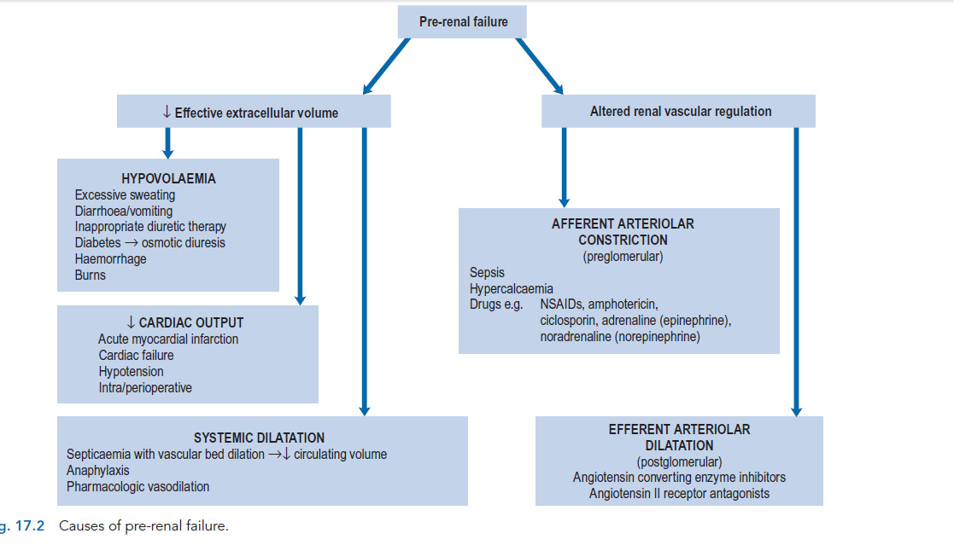
Pre-renal failure

Slide 16
PRE-RENAL AZOTEMIA
Normal renal function depends on adequate renal perfusion. The kidneys receive up to 25% of cardiac output, which is greater than 1L/lminute of blood flow.
Prerenal ARF results from hypoperfusion of the renal parenchyma, with or without systemic arterial hypotension.
Renal hypoperfusion with systemic arterial hypotension may be caused by a decline in intravascular volume (e.g., hemorrhage or dehydration) or a decline in effective blood volume (i.e., the blood volume perceived by the arterial baroreceptors). Examples of disease states in which there is a decline in effective blood volume without a decrease in intravascular volume include congestive heart failure (CHF) and liver failure.
Because the kidney is initially undamaged, the urinalysis will be normal. Eventually, the fractional excretion of sodium will be low, reflecting an increase in the concentrations of the sodium-retentive hormones renin, angiotensin, and aldosterone. Urinary solutes will be concentrated as a result of the increased circulating levels of antidiuretic hormone that is released in response to the diminished arterial blood pressure.

Slide 17
Renal hypoperfusion without systemic hypotension most commonly results from bilateral renal artery occlusion, or unilateral occlusion in a patient with a single functioning kidney. In these conditions, the sodium-retentive hormones are activated by the decline in renal parenchymal perfusion. However, systemic arterial blood pressure is usually elevated, leading to an inhibition of antidiuretic hormone release. Consequently, the urinary indices will reflect enhanced sodium reabsorption (i.e., a low fractional excretion of sodium), but the urinary solutes may not be maximally concentrated.

Slide 18
FUNCTIONAL AKI
Functional ARF refers to those entities that result in a decline in glomerular ultrafiltrate production secondary to a reduced glomerular hydrostatic pressure without damage to the kidney itself.
The decline in glomerular hydrostatic pressure is a direct consequence of changes in glomerular afferent (vasoconstriction) and efferent (vasodilation) arteriolar circumference. These clinical conditions most commonly occur in individuals who have reduced effective blood volume (e.g., CHF, cirrhosis, severe pulmonary disease, or hypoalbuminemia) or renovascular disease (e.g., renal artery stenosis), and cannot compensate for changes in afferent or efferent arteriolar tone.
Examples of disorders that result in afferent arteriolar vasoconstriction (and an increase in afferent arteriolar resistance) include hypercalcemia and the administration of certain medications (e.g., Cyclosporine and NSAIDs). A decrease in efferent arteriolar resistance usually results from the administration of an angiotensin-converting enzyme inhibitor (ACEI) or angiotensin II receptor antagonist.

Slide 19
With correction of the underlying pathologic process or discontinuation of the responsible medication, renal function rapidly returns to baseline. The hepatorenal syndrome is included in this classification scheme since the kidney itself is not damaged and there is intense afferent arteriolar vasoconstriction leading to a decline in glomerular filtration. In all the above conditions, the urinalysis is no different from its baseline state and the urinary indices suggest prerenal azotemia.
This syndrome of functional ARF is very common in individuals with CHF who receive an ACEI in an attempt to improve left ventricular function. The decline in efferent arteriolar resistance resulting from the inhibition of angiotensin II occurs rapidly. Therefore, if the dose of the ACEI is increased too rapidly, there will be a decline in glomerular ultrafiltrate production with a concomitant rise in the serum creatinine, leading to functional ARF. If the increase in the serum creatinine is not too severe (usually <1 mg/dL) the medication can be continued. Renal function should gradually improve as renal parenchymal perfusion pressure increases with improvement in left ventricular function.

Slide 20
INTRINSIC AKI
Intrinsic AKl can occur at the microvascular level of the nephron, glomeruli, renal tubules, or interstitium. Vasculitic diseases (e.g., Wegener granulomatosis, cryoglobulinemic vasculi- tis) involve the small vessels of the kidney. Glomerulonephritis and systemic lupus erythematosus, although relatively uncommon, result in glomerular damage.
ATN is by far the most common cause of intrinsic AKI. In fact, the term acute tubular necrosisis often used interchangeably with AKI. ATN occurs in part because the renal tubules require high oxygen delivery to maintain their metabolic activity. Consequently, any condition that causes ischemia to the tubules (e.g., hypotension, decreased blood flow) can induce ATN. Moreover, the tubules may be exposed to exceedingly high concentrations of nephrotoxic drugs (e.g., aminoglycosides). Interstitial nephritis or inflammation within the renal parenchyma is most often associated with drug administration (e.g., penicillins).

Slide 21
Post-renal aki
ARF resulting from obstruction may occur at any level within the urinary system from renal tubule to urethra. However, to cause ARF, the obstructing process must involve both kidneys, or one kidney in a patient with a single functioning kidney. Bladder outlet obstruction is the most common cause of obstructive uropathy. Crystal deposition within the tubules (e.g., secondary to uric acid, oxalate, acyclovir, sulfonamide, indinavir, or methotrexate), and ureteral obstruction (e.g., secondary to shed renal papilla or calculi) are infrequent causes of obstructive ARF.
Lower tract obstruction is most common and can be caused by prostatic hypertrophy, prostate or cervical cancer, anTicholinergic drugs that cause bladder sphincter spasm, or renal calculi.

Slide 22
Signs and symptoms
SYMPTOMS
Outpatient: Change in urinary habits, weight gain, or flank pain
Bladder distension
Hyperkalemia
Uremia
Hyponatremia
Prostrate hypertrophy
Inpatient: Typically ARF is noticed by clinicians before it is noticed by the patient

Slide 23
SIGNS
Patient may have Oedema
urine may be coloured or foamy.
Vital signs may indicate orthostatic hypotension in volume- depleted patients

Slide 24
Diagnosis and clinical evaluation
Physical findings:
Urine out put is typically low (20-500ml)
Neuromuscular- depression , diarrhoea, slow and irregular pulse– indicates metabolic acidosis.
Depress cardiac contraction, decreased vascular resistance, hypotension, respiratory, abnormalities, coma, and lethargy indicates metabolic acidosis.
Hypotension, soft tissue calcification, mental status changes(confusion, mood changes, loss of memory), abdominal cramps--- hyerphosphatemia.

Slide 25
Diagnosis and clinical evaluation
Urinalysis:
urinary sedimentation examination; pigmented cellular casts and renal tubular epithelial cells appear .
RBC &WBC cells
the presence of blood in the urine or proteinuria
Measurement of urine sodium and Creatinine level
Creatinine clearance
Renal failure index
Radiological finding ECG
Ultrasound (obstruction)
Kidney , urethra or bladder radiography show calculi and obstruction.
CT scan (obstruction)

Slide 26
Glomerular Filtration Rate (GFR)
GFR is the volume of water filtered from the plasma per unit of time.
  It gives a rough measure of the number of functioning nephrons
  Normal GFR:
    Men: 130 mL/min./1.73m2
    Women: 120 mL/min./1.73m2
  Cannot be measured directly, so we use creatinine and creatinine clearance to estimate.
Creatinine Clearance
  Best way to estimate GFR
  GFR = (creatinine clearance) x (body surface area in m²/1.73)
  Ways to measure:
    24-hour urine creatinine:
      Creatinine clearance = (Ucr x Uvol)/ plasma Cr
    Cockcroft-Gault Equation:
      (140 - age) x lean body weight [kg]
      CrCl (mL/min) = ——————————————— x 0.85 if
      Cr [mg/dL] x 72 female
      Limitations: Based on white men with non-diabetes kidney disease
    Modification of Diet in Renal Disease (MDRD) Equation:
      GFR (mL/min./1.73m2) = 186 X (SCr)-1.154 X (Age)-0.203 X (0.742 if female) X (1.210 if African-American )

Slide 27
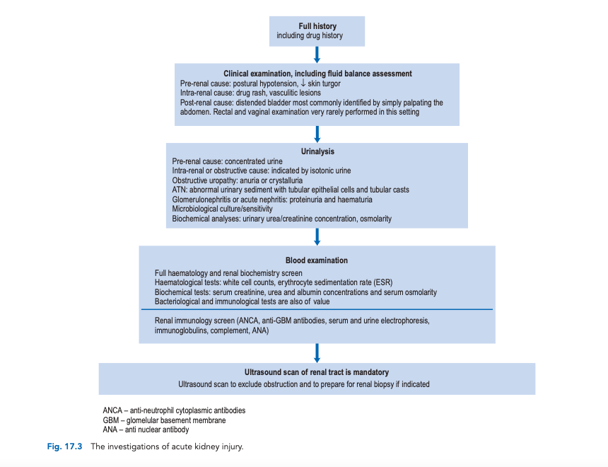

Slide 28
Monitoring of fluid electrolyte balance in aki
Measuremnet of BP which needs to be interpreted in respect of the baseline for the affected patients together with the patients heart rate.
Auscultation of the heart for the pressure of the 3rd and 4th sounds, the presence of these indicates cardiac strain associated with fluid overload.
Presence of added sounds in the chest, in particular fine inspiratory b crackles that are found in some patients with pulmonary oedema.
A chest X-ray for the presence of pulmonary oedema.
Pulse oximetry for the presence to assess arterial oxygen saturation.
Whilst the presence of pitting oedema of the legs or sacrum indicates long term fluid overload. It may be a useful marker of overall endothelial function and potential for extravascular fluid accumulation.
Decreased skin turgor is a sign of fluid loss.

Slide 29
Intravascular monitoring
Central venous pressure(CVP) can be measured following the insertion of a central venous cathether, and is the measure of the pressure in the large systemic viens and the right atrium produced by venous return. CVP assesses circulating volume and therefore, the degree of the fluid deficit, and reduces the risk of pulmonary oedema following over rapid transfusion .cvp should usually be maintained with in the normal range of 5-12cmH₂O.
Most patients with AKI do not require invasive monitoring and will recover with the supportive care based on the carefull clinical observations.

Slide 30
Monitoring key parameters in AKI
Serum electrolytes including potassium , bicarbonate, calcium, phosphate and acid base balance should be measured on daily basis. In patients with severe AKI, acid base balance may need assessing every few hours as this may direct fluid replacement, respiratory support and dialysis treatment.

Slide 31
treatment
Goal of therapy-
Correct reversible causes of AFR, preventing or minimizing further renal damage or complication ie. Discontinue nephrotoxic drugs, treat underlying condition, remove any urinary tract obstruction
To correct and maintain proper fluid and electrolyte balance. Match fluid, electrolyte and nitrogen intakes to urine output
Treat body chemistry alteration, especially hyperkalaemia and metabolic acidosis, when present. Treatment include renal dialysis
Improve urine output
Treat systemic manifestations of ARF

Slide 32
Non Pharmacological Approach
Supportive care : Goals for the critically ill patient with ARF include aggressive fluid management. Cardiac output and blood pressure must be supported to allow for adequate tissue perfusion. However, a fine balance must be struck in this regard. For example, fluids must be typically restricted in anuric and oliguric patients unless the patient is hypovolemic or is able to achieve fluid balance via renal replacement therapy. If fluid intake is not minimized, oedema rapidly occurs, especially in hypoalbuminemic patients. In contrast, vasopressors like dopamine ≥2 mcg/kg per minute or norepinephrine are used to maintain adequate tissue perfusion, but may also induce kidney hypoxia via a reduction in renal blood flow. Consequently, Swan-Ganz monitoring is essential for critically ill patients.

Slide 33
electrolyte management: Hyperkalemia, hypermagnesemia, and hyperphosphatemia are common electrolyte disorders in patients with ARF who are unable to use their kidneys to maintain electrolyte balance.
RENAL REPLACEMENT THERAPY(RRT)
Renal replacement therapies come in two different forms, intermittent therapies like hemodialysis, and continuous RRTs like continuous hemofiltration or peritoneal dialysis.

Slide 34
Pharmacotherapy/ MANAGEMENT
EARLY PREVENTIVE AND SUPPORTIVE STRATERGIES
Identification of patients at risk
Any patient who has the concurrent or pre-existing conditions that increase the risk of development and progression of AKI must be identified and this includes those with pre-existing CKD, diabetes, jaundice myeloma and in elderly.
These patients either have the baseline impaired renal function or are sensitised to the development of AKI by the comorbid condition. meticulous attention to the fluid balance , assessment of infection and the use of drugs in crucial to minimize the risk in the development of AKI.

Slide 35
Withdrawal and avoidance of Nephrotoxic Agents
Irrespective of whether the aetiology of AKI directly involves nephrotoxic drugs, the drug and the treatment regimens should be examined so that potential nephron-toxins are withdrawn and avoided in the future in order to avoid exacerbating the condition. particular care should be taken with ACE inhibitors, NSAIDs, radiological contrast media and aminoglycosides. The doses should be adjusted of any drugs that are renally excreated or have active metabolite that are excreted renally.
Optimisation of renal perfusion
Initial treatment should include rapid correction of fluid and electrolyte balance to maximize renal perfusion. A central line may be considered to facilitate ease of fluid infusion and monitoring of intravascular volumes.
In patients where it is difficult to assess fluid balance by use of clinical examination a urinary cathether- related bacteraemia, central lines are seldom used outside specialist renal and intensive care units.

Slide 36
A diagnosis of acute deterioration of renal function caused by renal under perfusion implies that restoration of renal perfusion would reverse impairment by improving renal blood flow, reducing renal vasoconstriction and flushing nephrotoxins from the kidney.
The use of crystalloids in the form of 0.9% sodium chloride is an appropriate choice of intravenous fluid since it replaces both water and sodium ions in a concentration approximately equal to serum.
The effect of fluid replacement on urine flow and intravascular pressures should be carefully monitored. However, fluid loading with 1–1.5L saline at <0.5L/h is unlikely to cause harm in most patients who do not show signs of fluid overload. There is no evidence that colloids such as gelofusin or albumin provide any additional benefit for volume expansion and renal recovery over the use of 0.9% sodium chloride.
The use of inotropes such as noradrenaline and cardiac doses of dopamine should be restricted to non-renal indication

Slide 37
Establishing and maintaining an adequate diuresis
Loop diuretics- Furesamide
Most commonly used diuretic because its active in patients with relatively severe renal failure
Indication – diuretics
Mechanism of action:
    The major site of action is the thick ascending loop of henle (ASCLH) from the luminal side of the membrane.
    A glycoprotein with 12 membrane spanning domains has been found to function as Na⁺-K⁺-2Cl co-transporter at the luminal membrane of thick ASCLH performs secretary/absorbing function.
    Furesamide attaches to the chlorine binding sites of this protein and inhibits Na⁺-K⁺-2Cl co transporter providing water excretion.
Standard dose-40-80mg daily
    600mg max.
    Available dose-40mg tab, 2ml inj, 15 ml inj
Contraindication-severe sodium, water depletion, hypersensitivity to furesamide and sulphonamides, hypokalaemia, hyponatraemia, pre-comatose states associated with liver cirrhosis, anuria, renal failure, Addision’s disease
Interactions- analgesics reduce natriuretic effect of furesamide, hyperglycaemia with antihypertensive agent diazoxide
Side effects- GIT reaction, abdominal pain, diarrhoea
ADR-higher infusion may cause transient deafness, bolus dose of loop diuretics may induce renal vasoconstriction, hypotension, fluid- electrolyte abnormalities

Slide 38
Mannitol
It is an osmotic diuretic and removes the intrarenal obstruction
Indication- osmotic diuretic
MOA- it increases the osmotic pressure of glomerular filtrate, fluid from interstitial spaces is drawn into blood vessels expanding plasma volume maintaining or increasing urine flow
Standard dose
    initially- 12.5-25gm (IV)
    available dose-100 ml inj (IV)
CI-pulmonary congestion or oedema, intracranial bleeding, CHF, metabolic oedema with abnormal capillary fragility, anuria due to severe renal disease, severe dehydration
Side effects- fluid and electrolyte imbalance, acidosis, nausea, vomiting, thirst, headache, dizziness, convulsion
ADR- fever, tachycardia, chest pain, blurred vision, urticarial, hypo or hypertension, ARF, skin necrosis, thrombophlebitis

Slide 39
Dopamine- Fenoldopam
This is a vasopressor agent
MOA
Dopamine stimulates dopaminergic receptor at low doses producing renal and mesenteric vasodilation.
The D1 receptors in the renal and mesenteric blood vessels are the most sensitive to IV infusion of low dose of dopamine and gets dilated (by the raise of cAMP). This causes increase in GFR and Na⁺ excretion and increased urine output
Indication- vasopressor agent
Std dose- initially 2-5 mcg/kg/min (IV)
- ↑ed to 5-10mcg/kg/min
- 50mcg/kg/min max.
- available dose- 5 ml inj
CI- pheochromocytoma, uncorrected tachyarrhythmias, ventricular fibrillation, hypersensitivity
Interaction- phenytoin, alpha- adrenergic and beta adrenergic blockers, general anaesthesia and MAOIs increase and prolong effects
Side effect- nausea, vomiting
ADRs- tachycardia, palpitation, anginal pain, hypotension, vasoconstriction, bradycardia, hypertension, dyspnoea

Slide 40
Drug therapy and renal auto-regulation
Intra-renal blood flow is controlled by an auto-regulatory mechanism unique to the kidney called tubuloglomerular feed- back (TGF). This mechanism produces arteriolar constriction in response to an increased solute load to the distal nephrons. Glomerular filtration rate and kidney workload are thus reduced. It has been proposed that oliguria is an adaptive response to renal ischaemia and therapy designed to improve glomerular filtration rate would increase solute load to the nephrons and might increase kidney workload and worsen AKI. Clearly, reversal of a pre-renal state with fluids is a logical therapeutic aim.

Slide 41
Non-dialysis treatment of established acute kidney injuRY
Uraemia and intravascular volume overload
In renal failure, the symptoms of uraemia include nausea, vomiting and anorexia, and result principally from accumulation of toxic products of protein metabolism including urea.
TREATMENT: Intravascular fluid overload must be managed by restricting NaCl intake to about 1–2g/day if the patient is not hyponatraemic and total fluid intake to less than 1L/day plus the volume of urine and/or loss from dialysis. Care should be taken with the so-called ‘low salt’ products, as these usually contain KCl, which will exacerbate hyperkalaemia.

Slide 42
Hyperkalaemia
Causes: urinary excretion is reduced but also because intracellular potassium may be released. Rapid rises in extracellular potassium are to be expected when there is tissue damage, as in burns, crush injuries and sepsis. Acidosis also aggravates hyperkalaemia by provoking potassium leakage from healthy cells. The condition may be life-threatening causing cardiac arrhythmias and, if untreated, can result in asystolic cardiac arrest.
Treatment:
Dietary potassium should be restricted to less than 40 mmol/ day and potassium supplements and potassium-sparing diuretics removed from the treatment schedule. Emergency treatment is necessary if the serum potassium level reaches 7.0mmol/L (normal range 3.5–5.5mmol/L) or if there are the progressive changes in the electrocardiogram (ECG) associated with hyperkalaemia. These include tall, peaked T waves, reduced P waves with increased QRS complexes or the ‘sine wave’ appearance that often presages cardiac arrest.
Emergency treatment of hyperkalaemia consists of the following:
10–30 mL (2.25–6.75 mmol) of calcium gluconate 10% intravenously over 5–10 min; this improves myocardial stability but has no effect on the serum potassium levels. The protective effect begins in minutes but is short lived (<1 h), although the dose can be repeated.
50 mL of 50% glucose together with 8–12 units of soluble insulin over 10 min. Endogenous insulin, stimulated by
a glucose load or administered intravenously, stimulates intracellular potassium uptake, thus removing it from
the serum. The effect becomes apparent after 15–30 min, peaks after about 1 h and lasts for 2–3 h and will decrease serum potassium levels by around 1 mmol/L.
Nebulised salbutamol has also been used to lower potassium; however, this is not effective for all patients and does not permanently lower potassium. If used it is seen as a temporary emergency measure.

Slide 43
Acidosis
The inability of the kidney to excrete hydrogen ions may result in a metabolic acidosis. This may contribute to hyper- kalaemia.
Treatment:
It may be treated orally with sodium bicarbonate 1–6 g/day in divided doses (though this is not appropriate for acute metabolic acidosis seen in AKI), or 50–100mmol of bicarbonate ions (preferably as isotonic sodium bicarbonate 1.4% or 1.26%, 250–500mL over 15–60 min) intravenously may be used. The administration of bicarbonate in acidotic patients will also tend to reduce serum potassium concentrations. Bicarbonate will cause an increase in intracellular Na+ through activation of the cell membrane Na+/H+ exchanger, which promotes increased activity of Na-K ATPase producing increased intracellular sequestration of K+.
If calcium gluconate is used to treat hyperkalaemia, care should be taken not to mix it with the sodium bicarbonate (by giving this through the same intravenous access site) as the resulting calcium bicarbonate forms an insoluble precipitate. If elevation of serum sodium or fluid overload precludes the use of sodium bicarbonate, extreme acidosis (serum bicarbonate of less than 10mmol/L) is best treated by dialysis.

Slide 44
Hypocalcaemia
Calcium malabsorption, probably secondary to disordered vitamin D metabolism, can occur in AKI. Hypocalcaemia usually remains asymptomatic, as tetany of skeletal muscles or convulsions does not normally occur until serum concentrations are as low as 1.6–1.7 mmol/L (normal 2.20–2.55 mmol/L).
Treatments: Oral calcium supplementation with calcium carbonate is used and although vitamin D may be used to treat the hypocalcaemia of AKI, it rarely has to be added. Effervescent calcium tablets should be avoided as they contain a high sodium or potassium load.
Hyperphosphataemia
As phosphate is normally excreted by the kidney, hyperphosphataemia can occur in AKI but rarely requires treatment. Treatment: phosphate-binding agents may be used to retain phosphate ions in the gut. The most commonly used agents are calcium containing such as calcium carbonate or calcium acetate and are given with food.
Infection
Patients with AKI are prone to infection and septicaemia, which can ultimately cause death. Bladder catheters, central cathe- ters and even peripheral intravenous lines should be used with care to reduce the chance of bacterial invasion. Leucocytosis is sometimes seen in AKI and does not necessarily imply infection. However, pyrexia must be immediately investigated and treated with appropriate antibiotic therapy if accompanied by toxic symptoms such as disorientation or hypotensive episodes. Samples from blood, urine and any other material such as catheter tips should be sent for culture before antibiotics are started. Antibiotic therapy should be broad spectrum until a causative organism is identified.

Slide 45
Uraemic gastro-intestinal erosions
These are a recognised consequence of AKI, probably as a result of reduced mucosal cell turnover owing to high circulating levels of uraemic toxins.
Treatment: Proton pump inhibitors are effective and H2 antagonists are an appropriate alternative.

Slide 46
nutrition
There are two major constraints concerning the nutrition of patients with AKI:
patients may be anorexic, vomiting and too ill to eat.
oliguria associated with renal failure limits the volume of enteral or parenteral nutrition that can be given safely.
The use of parenteral nutrition is rare but where appropriate factors to be considered include fluid balance, calorie/protein requirements, electrolyte balance/requirements, and vitamin and mineral requirements.
The basic calorie requirements are similar to those in a non-dialysed patient, although the need for protein may occasionally be increased in haemodialysis and haemofiltration because of amino acid loss. In all situations, protein is usually supplied as 12–20 g/day of an essential amino acid formulation, although individual requirements may vary.
electrolyte-free amino acid solutions should be used in parenteral nutrition formulations for patients with AKI as they allow the addition of electrolytes as appropriate.
Potassium and sodium requirements can be calculated on an individual basis depending on serum levels.

Slide 47
5.There is usually no need to try to normalise serum calcium and phosphate levels as they will stabilise with the appropriate therapy, or, if necessary, with haemofiltration or dialysis.
6.Water-soluble vitamins are removed by dialysis and haemofiltration but the standard daily doses normally included in parenteral nutrition fluids more than compensate for this loss. Magnesium and zinc supplementation may be required, not only because tissue repair often increases requirements but also because they may be lost during dialysis or haemofiltration.
7.It is necessary to monitor the serum urea, creatinine and electrolyte levels daily to make the appropriate alterations in the required nutritional support. The glucose concentration should also be checked daily as patients in renal failure sometimes develop insulin resistance.
8.The plasma pH should be checked initially to determine if addition of amino acid solutions is causing or aggravating metabolic acidosis. It is also valuable to check calcium, phosphate and albumin levels regularly, and when practical, daily weighing gives a useful guide to fluid balance.

Slide 48
RENAL REPLACEMENT THERAPY/RENAL DIALYSIS
Renal replacement therapy is indicated in a patient with AKI when kidney function is so poor that life is at risk. However, it is desirable to introduce renal replacement therapy early in AKI, as complications and mortality are reduced if the serum urea level is kept below 35mmol/L.
Generally, replacement therapy is urgently indicated in AKI to:
remove uraemic toxins when severe symptoms are apparent, for example, impaired consciousness, seizures, pericarditis, rapidly developing peripheral neuropathy
remove fluid resistant to diuretics, for example, pulmonary oedema
correct electrolyte and acid–base imbalances, for example, hyperkalaemia >6.5 mmol/L or 5.5–6.5 where there are ECG changes, increasing acidosis (pH < 7.1 or serum bicarbonate <10 mmol/L) despite bicarbonate therapy,
or where bicarbonate is not tolerated because of fluid overload.

Slide 49
RENAL REPLACEMENT THERAPY(RRT)
Indication for renal replacement therapy
Indication for Renal Replacement Therapy | Clinical Setting
A Acid-base abnormalities E Electrolyte imbalance I Intoxications O fluid Overload U Uremia | Metabolic acidosis resulting from the accumulation of organic and inorganic acids Hyperkalemia, hypermagnesemia Salicylates, lithium, methanol, ethylene glycol, theophylline, phenobarbital Postoperative fluid gain High catabolism of acute renal failure

Slide 50
Forms of renal replacement therapy
The common types of renal replacement therapy used in clinical practice are:
• haemodialysis
• haemofiltration
• haemodiafiltration • peritoneal dialysis
In all types of renal replacement therapy, blood is presented to a dialysis solution across some form of semi-permeable membrane that allows free movement of low molecular weight compounds. The processes by which movement of substances occur are:
• Diffusion. Diffusion depends upon concentration differences between blood and dialysate and molecule size. Water and low molecular weight solutes (up to a molecular weight of about 5000) move through pores in the semi-permeable membrane to establish equilibrium. Smaller molecules can be cleared from blood more effectively as they move more easily through pores in the membrane.
• Ultrafiltration. A pressure gradient (either +ve or −ve) across a semi-permeable membrane will produce a net directional movement of fluid from relative high to low pressure regions. The quantity of fluid dialysed is the ultrafiltration volume.
• Convection. Any molecule carried by ultrafiltrate may move passively with the flow by convection. Larger molecules are cleared more effectively by convection.

Slide 51
Replacement fluid composition
An isotonic replacement fluid is added to the blood to replace fluid volume and electrolytes. The replacement fluid must be of high purity, because it is infused directly into the blood line of the extracorporeal circuit. The replacement hemofiltration fluid usually contains lactate or acetate as a bicarbonate-generating base, or bicarbonate itself. Use of lactate can occasionally be troublesome in patients with lactic acidosis or with severe liver disease, because in such cases the conversion of lactate to bicarbonate can be impaired. In such patients use of bicarbonate as a base is preferred.

Slide 52
haemodialysis
It is a medical procedure to remove fluid and waste products from the blood and to correct electrolyte.
Hemodialysis is used to treat both acute (temporary) and chronic (permanent) kidney failure.
Hemodialysis requires to follow a strict treatment schedule, take medications regularly and, usually, make changes in the diet.
PRINCIPLE
The principle of hemodialysis involves diffusion of solutes across a semipermeable membrane. Hemodialysis utilizes counter current flow, where the dialysate is flowing in the opposite direction to blood flow in the circuit. Counter-current flow maintains the concent ration gradient across the membrane at a maximum and increases the efficiency of the dialysis.
The hemodialysis machine pumps the patient's blood and the dialysate through the dialyzer. The newest dialysis machines on the market are highly computerized and continuously monitor an array of safety-critical parameters, including blood and dialysate flow rates; dialysis solution conductivity, temperature, and pH; and analysis of the dialysate for evidence of blood leakage or presence of air. Any reading that is out of normal range triggers an audible alarm to alert the patient-care technician who is monitoring the patient.

Slide 53
METHOD:
In haemodialysis, the form of access used in AKI is a dialysis line. This is placed in a vein (the jugular, femoral or sub- clavian), which has an arterial lumen through which the blood is removed from the patient and a venous lumen by which it is returned to the patient after passing through a dialyser.
The terms arterial and venous lumen can be misleading as both lumens are situated in the same vein. They are part of the same line which bifurcates and has two lumens, the lon- ger lumen is the ‘arterial’ lumen and the shorter the ‘venous’ lumen.
Heparin is added to the blood as it leaves the body to prevent the dialyser clotting. Blood is then actively pumped through the artificial kidney before being returned to the patient . In those patients at high risk of haemorrhage, the amount of heparin used can be reduced or even avoided altogether.
The dialyser consists of a cartridge comprising either a bundle of hollow tubes (hollow fibre dial- yser) or a series of parallel flat plates (flat-plate dialyser) made of a synthetic semi-permeable membrane. Flat-plate dialysers are now rarely used.
Dialysis fluid flows around the membrane countercurrent (opposite) to the flow of blood in order to maximise diffusion gradients. The dialysis solution is essentially a mixture of electrolytes in water with a composition approximating to extracellular fluid into which solutes diffuse. The ionic concentration of the dialysis fluid can be manipulated to control the rate and extent of electrolyte transfer. Calcium and bicarbonate concentrations can also be increased in dialysis fluid to promote diffusion into blood as replacement therapy. By manipulating the hydrostatic pressure of the dialysate and blood circuits, the extent and rate of water removal by ultrafiltration can be controlled.

Slide 54
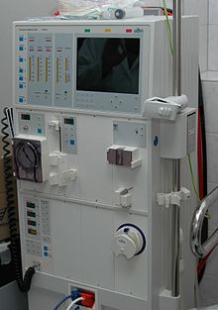
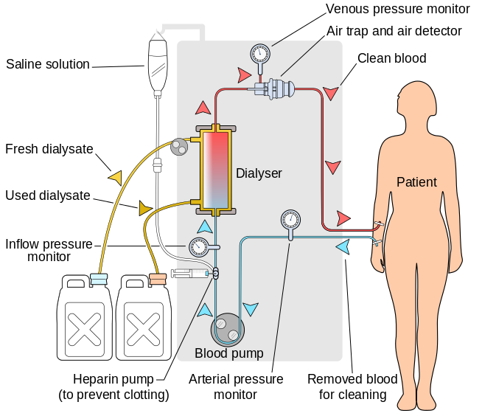

Slide 55
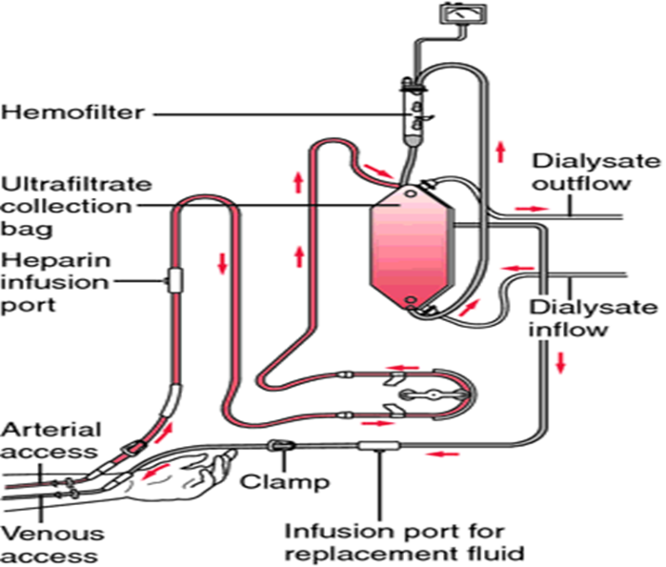

Slide 56
COMPLICATIONS OF HAEMODIALYSIS
Low blood pressure (hypotension). This is the most common complication of hemodialysis.
Muscle cramps. If cramps occur, they usually happen in the last half of a dialysis session.
Irregular heartbeat (arrhythmia).
Nausea, vomiting, headache, or confusion (dialysis disequilibrium).
Infection, especially if a central venous access catheter is used for hemodialysis.
Blood clot (thrombus) formation in the venous access catheter.
Technical complications, such as trapped air (embolus) in the dialysis tube.

Slide 57
DISADVANTAGES
Restricts independence, as people undergoing this procedure cannot travel around because of supplies' availability
Requires more supplies such as high water quality and electricity
Requires reliable technology like dialysis machines
The procedure is complicated and requires that care givers have more knowledge
Requires time to set up and clean dialysis machines, and expense with machines and associated staff

Slide 58
ADVANTAGES
Low mortality rate
Better control of blood pressure and abdominal cramps
Less diet restriction
Better solute clearance effect for the daily hemodialysis: better tolerance and fewer complications with more frequent dialysis

Slide 59
haemofiltration
Hemofiltration is an alternative technique to dialysis where simplicity of use, fine fluid balance control and low cost have ensured its widespread use in the treatment of acute kidney failure.
PRINCIPLE
The hydrostatic pressure of the blood drives a filtrate, similar to interstitial fluid, across a high permeability dialyser (passes substances of molecular weight up to 30,000) by ultrafiltration.
Solute clearance occurs by convection. Commercially prepared haemofiltration fluid may then be introduced into the filtered blood in quantities sufficient to maintain optimal fluid balance. As with haemodialysis, haemofiltration can be intermittent or continuous.

Slide 60
In continuous arterio-venous haemofiltration (CAVH), blood is diverted, usually from the femoral artery, and returned to the femoral vein; this is now very seldom used.
In continuous venovenous haemofiltration (CVVH), a dual lumen vascular catheter is inserted into a vein (as described above). Blood is removed from the body via the distal lumen (the one furthest from the right side of the heart) in a process assisted by a blood pump, passed through a haemofilter and returned to the body via the proximal lumen.
In slow continuous ultrafiltration (SCU or SCUF), the process is performed so slowly that no fluid substitution is necessary.
In addition to avoiding the expense and complexity of haemodialysis, this system enables continuous but gradual removal of fluid, thereby allowing very fine control of fluid balance in addition to electrolyte control and removal of metabolites. This control of fluid balance often facilitates the use of parenteral nutrition. Because of the advantages of haemofiltration over peritoneal dialysis and haemodialysis, continuous haemofiltration is currently the commonest type of renal replacement therapy used in patients in intensive care units.

Slide 61
ADVANTAGES, disadvantages OF HEMOFILTERATION
Advantages
Heart failure due to hypovolemia , hemodialysis worsen the heart failure while hemofilteration can treat heart failure.
Refractory hypertension can be lowered.
Hypotension & severe retention of sodium and water
Disadvantages
Haemofiltration restricts patient’s mobility and necessitates constant patient centred activity, which can disrupt rest and sleep patterns.
The patient has to be anticoagulated with the occasional exception of mechanical valve patients whose INR allows effective running of the pump.
Fluid balance is open to potential error.

Slide 62
hemodiafiltration
Haemodiafiltration is a technique that combines the ability to clear small molecules, as in haemodialysis, with the large molecule clearance of haemofiltration.
It is a logical step to combine the respective advantages of both procedures by doing HD and HF in parallel. This procedure is called hemodiafiltration (HDF)
Advantages of HDF
  Clearance of uraemic solutes across a wide molecular weight range
  Biocompatibility
  Hemodynamic stability
During HDF, the machine removes more water from the blood than during "normal" haemodialysis. The additional liquid is continually replaced with an ultra-pure electrolyte solution. Thus, the machine exchanges a high volume of fluid during treatment and removes the liquid together with metabolic toxins from the blood.
As in normal dialysis, differences in concentration between the dialysis solution and the blood are also used to filter the toxins from the blood. Overall, ONLINE HDF allows for a more efficient and gentle treatment.

Slide 63
Acute peritoneal dialysis
It is a treatment for patients with severe chronic kidney disease. The process uses the patient's peritoneum in the abdomen as a membrane across which fluids and dissolved substances (electrolytes, urea, glucose, albumin and other small molecules) are exchanged from the blood. Fluid is introduced through a permanent tube in the abdomen and flushed out either every night while the patient sleeps (automatic peritoneal dialysis) or via regular exchanges throughout the day (continuous ambulatory peritoneal dialysis).
The abdomen is cleaned in preparation for surgery, and a catheter is surgically inserted with one end in the abdomen and the other protruding from the skin
Before each infusion the catheter must be cleaned, and flow into and out of the abdomen tested. A large volume of fluid is introduced to the abdomen over the next ten to fifteen minutes.
The total volume is referred to as a dwell while the fluid itself is referred to as dialysate. The dwell can be as much as 2.5 litres, and medication can also be added to the fluid immediately before infusion.^{[3]}
] The dwell remains in the abdomen and waste products diffuse across the peritoneum from the underlying blood vessels. After a variable period of time depending on the treatment (usually 4–6 hours), the fluid is removed and replaced with fresh fluid. This can occur automatically while the patient is sleeping (automated peritoneal dialysis, APD), or during the day by keeping two litres of fluid in the abdomen at all times, exchanging the fluids four to six times per day (continuous ambulatory peritoneal dialysis, CAPD).

Slide 64
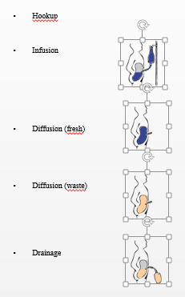
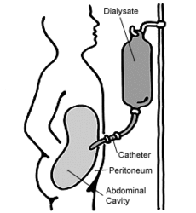

Slide 65
ADVANTAGES OF PERITONEAL DIALYSIS
A flexible lifestyle and independence
Centre visits at regular intervals
Doesn't use needles
Provides continuous therapy, which is more like your natural kidneys
Don't have to travel to dialysis unit for treatment
Easy to do your therapy while you travel
Can do therapy while sleeping (APD)
DISADVANTAGES OF PERITONEAL DIALYSIS
Need to schedule exchanges into your daily routine, seven days a week
Requires a permanent catheter, outside the body
Runs some risk of infection
May gain weight/have a larger waistline
Very large people may need extra therapy
Need storage space in your home for supplies
Need space in your bedroom for equipment (APD)

