Slide 1
PHARMACOTHERAPEUTICS-III
AFFECTIVE DISORDER

Slide 2
Mood Disorders
Two broad types:
  Involves only depressive symptoms
  Involves manic symptoms (bipolar disorders)
DSM-5 depressive disorders:
  Major depressive disorder
  Persistent depressive disorder
  Premenstrual dysphoric disorder
  Disruptive mood dysregulation disorder
DSM-5 Bipolar Disorders:
  Bipolar I disorder
  Bipolar II disorder
  Cyclothymia

Slide 3
Overview of the DSM-5 Mood Disorders
DSM-5 Diagnoses | Major Features
Major depressive disorder | • Five or more depressive symptoms, including sad mood or loss of pleasure, for 2 weeks
Persistent depressive disorder | • Low mood and at least two other symptoms of depression at least half of the time for 2 years
Premenstrual dysphoric disorder | • Mood symptoms in the week before menses
Disruptive mood dysregulation disorder | • Severe recurrent temper outbursts and persistent negative mood for at least 1 year beginning before age 10
Bipolar I disorder | • At least one lifetime manic episode
Bipolar II disorder | • At least one lifetime hypomanic episode and one major depressive episode
Cyclothymia | • Recurrent mood changes from high to low for at least 2 years, without hypomanic or depressive episodes

Slide 4
DSM-5 Criteria for
Major Depressive Disorder
Sad mood OR loss of interest or pleasure (anhedonia)
  Symptoms are present nearly every day, most of the day, for at least 2 weeks
  Symptoms are distinct and more severe than a normative response to significant loss
PLUS four of the following symptoms:
  Sleeping too much or too little
  Psychomotor retardation or agitation
  Poor appetite and weight loss, or increased appetite and weight gain
  Loss of energy
  Feelings of worthlessness or excessive guilt
  Difficulty concentrating, thinking, or making decisions
  Recurrent thoughts of death or suicide

Slide 5
Major Depressive Disorder (MDD)
Episodic
  Symptoms tend to dissipate over time
Recurrent
  Once depression occurs, future episodes likely
    Average number of episodes is 4
Subclinical depression
  Sadness plus 3 other symptoms for 10 days
  Significant impairments in functioning even though full diagnostic criteria are not met

Slide 6
DSM-5 Criteria for
Persistent Depressive Disorder
Depressed mood for at least 2 years; 1 year for children/adolescents
PLUS 2 other symptoms:
  Poor appetite or overeating
  Sleeping too much or too little
  Poor self-esteem
  Trouble concentrating or making decisions
  Feelings of hopelessness
Symptoms do not clear for more than 2 months at a time
Bipoloar disorders are not present

Slide 7
DSM-5 Criteria for
Premenstrual Dysphoric Disorder
In most menstrual cycles during the past year, at least five of the following symptoms were present in the final week before menses and improved within a few days of menses onset:
  Affective lability
  Irritability
  Depressed mood, hopelessness, or self-deprecating thoughts
  Anxiety
  Diminished interest in usual activities
  Difficulty concentrating
  Lack of energy
  Changes in appetite, overeating, or food craving
  Sleeping too much or too little
  Subjective sense of being overwhelmed or out of control
  Physical symptoms such as breast tenderness or swelling, joint or muscle pain, or bloating

Slide 8
DSM-5 Criteria for Disruptive Mood Dysregulation Disorder
Severe recurrent temper outbursts, including verbal or behavioral expressions of temper that are out of proportion in intensity or duration to the provocation.
Temper outbursts are inconsistent with developmental level.
The temper outbursts tend to occur at least three times per week.
Negative mood between temper outbursts most days.
These symptoms have been present for at least 12 months and do not clear for more than 3 months at a time.
Temper outbursts and negative mood are present in at least two settings (at home, at school, or with peers) and are severe in at least one setting.
Age 6 or older (or equivalent developmental level).
Onset before age 10.
There has never been a distinct period lasting more than 1 day during which elevated mood and at least three other manic symptoms were present.
The behaviors do not occur exclusively during the course of major depressive disorder and are not better accounted for by another mental disorder.
This diagnosis cannot coexist with oppositional defiant disorder, attention-deficit/hyperactivity disorder, intermittent explosive disorder, or bipolar disorder.

Slide 9
EPIDEMIOLOGY AND CONSEQUENCES
Depression is common
  Lifetime prevalence (Kessler et al., 2005):
    16.2% MDD
    2.5% Dysthymia
  Twice as common in women as in men
  Three times as common among people in poverty
Prevalence varies across cultures
  MDD
    1.5% in Taiwan
    19% in Beirut, Lebanon
    People who move to the U.S. from Mexico have lower rates than people of Mexican descent who were born in the United States

Slide 10
EPIDEMIOLOGY AND CONSEQUENCES
Symptom variation across cultures
  Latino cultures
    Complaints of nerves and headaches
  Asian cultures
    Complaints of weakness, fatigue, and poor concentration
  Smaller distance from equator (longer day length) and higher fish consumption associated with lower rates of MDD
Symptom variation across life span
  Children
    Stomach and headaches
  Older adults
    Distractibility and forgetfulness
Co-morbidity
  2/3 of those with MDD will also meet criteria for anxiety disorder at some point

Slide 11
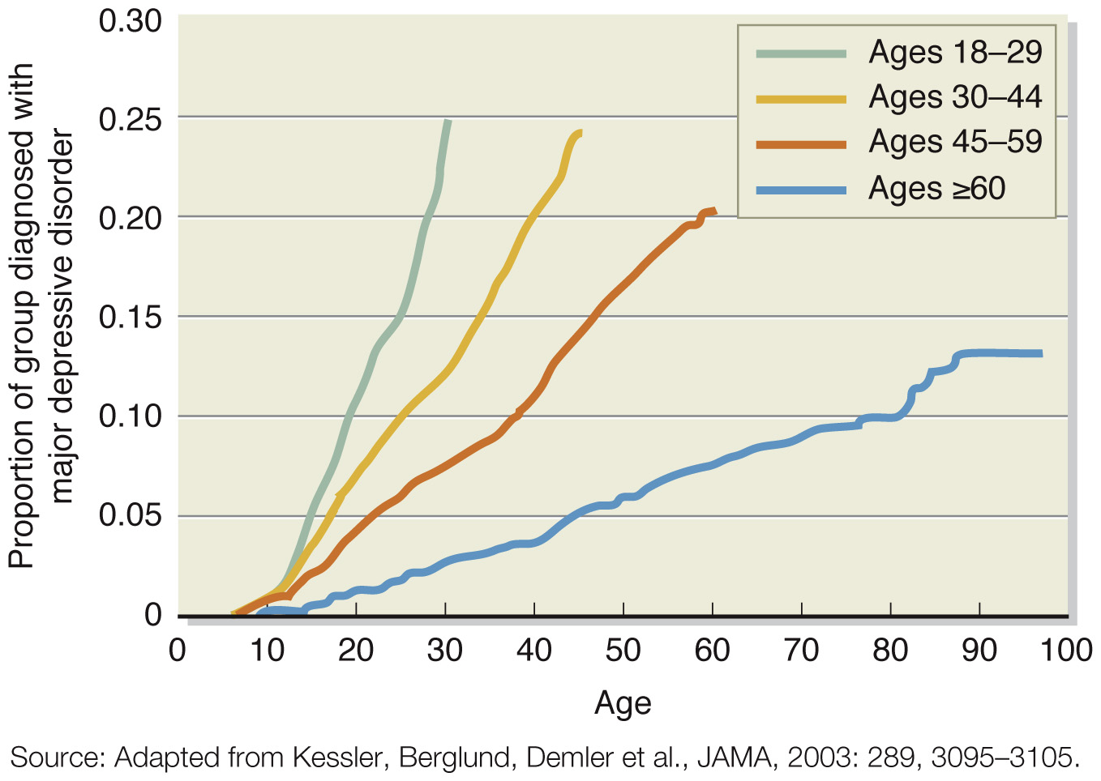
MEDIAN AGE OF MDD ONSET BY GENERATION

Slide 12
BIPOLAR DISORDERS
Three forms:
  Bipolar I, Bipolar II, and Cyclothymia
    Mania defining feature of each
    Differentiated by severity and duration of mania
  Usually involve episodes of depression alternating with mania
    Depressive episode required for Bipolar II, but not Bipolar I
Mania
  State of intense elation or irritability
  Hypomania (hypo = “under”; hyper = “above”)
    Symptoms of mania but less intense
    Does not involve significant impairment, mania does

Slide 13
DSM-5 CRITERIA FOR MANIC AND HYPOMANIC EPISODES
Distinctly elevated or irritable mood for most of the day nearly every day
Abnormally increased activity and energy
At least three of the following are noticeably changed from baseline (four if mood is irritable):
  Increase in goal-directed activity or psychomotor agitation
  Unusual talkativeness; rapid speech
  Flight of ideas or subjective impression that thoughts are racing
  Decreased need for sleep
  Increased self-esteem; belief that one has special talents, powers, or abilities
  Distractibility; attention easily diverted
  Excessive involvement in activities that are likely to have undesirable consequences, such as reckless spending, sexual behavior, or driving
For a manic episode:
  Symptoms last for 1 week or require hospitalization or include psychosis
  Symptoms cause significant distress or functional impairment
For a hypomanic episode:
  Symptoms last at least 4 days
  Clear changes in functioning that are observable to others, but impairment is not marked
  No psychotic symptoms are present

Slide 14
DSM-5 CRITERIA FOR BIPOLAR DISORDERS
Bipolar I
  At least one episode or mania
Bipolar II
  At least one major depressive episode with at least one episode of hypomania
Cyclothymic disorder (Cyclothymia)
  Milder, chronic form of bipolar disorder
    Lasts at least 2 years in adults, 1 year in children/adolescents
  Numerous periods with hypomanic and depressive symptoms
    Does not meet criteria for mania or major depressive episode
    Symptoms do not clear for more than 2 months at a time
    Symptoms cause significant distress or impairment

Slide 15
EPIDEMIOLOGY AND CONSEQUENCES
Prevalence rates lower than MDD
  1% in U. S.; 0.6% worldwide for Bipolar I
  0.4% – 2% for Bipolar II
  4% for Cyclothymia
Average age of onset in 20s
No gender differences in rates of bipolar disorders
  Women experience more depressive episodes
Severe mental illness
  A third unemployed a year after hospitalization (Harrow et al., 1990)
  Suicide rates high (Angst et al., 2002)

Slide 16
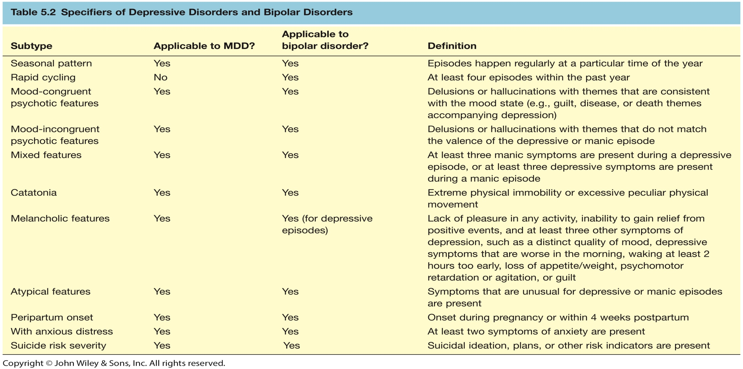
SUBTYPES OF MAJOR DEPRESSIVE DISORDER AND BIPOLAR DISORDERS

Slide 17
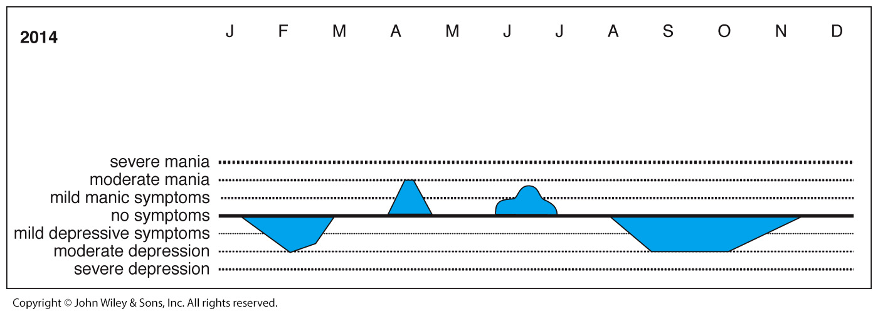
RAPID CYCLING SUBTYPE OF BIPOLAR DISORDER

Slide 18
Etiology of Mood Disorders

Slide 19
ETIOLOGY OF MOOD DISORDERS
What factors contribute to onset of mood disorders?
  Neurobiological factors
  Psychosocial factors

Slide 20
ETIOLOGY OF MOOD DISORDERS:
NEUROBIOLOGICAL FACTORS
Genetic factors
  Heritability estimates
    37% MDD (Sullivan et al., 2000)
    93% Bipolar Disorder (Kieseppa et al., 2004)
  Much research in progress to identify specific genes involved but the results of most studies have not been replicated (Kato, 2007)
DRD4.2 gene, which influences dopamine function, appears to be related to MDD (Lopez Leon et al., 2005).

Slide 21
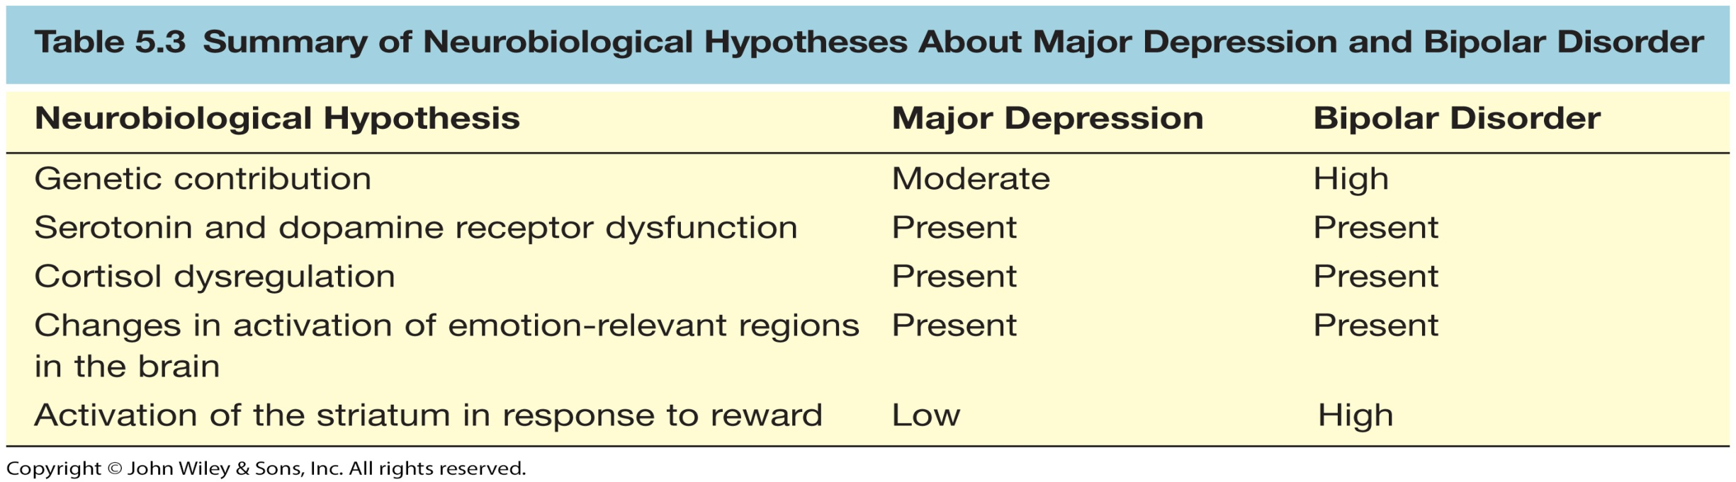
NEUROBIOLOGICAL HYPOTHESES ABOUT MAJOR DEPRESSION AND BIPOLAR DISORDER

Slide 22
ETIOLOGY OF MOOD DISORDERS:
NEUROBIOLOGICAL FACTORS
      Neurotransmitters (NTs): norepinephrine, dopamine, and serotonin
  Original models focused on absolute levels of NTs
    MDD
      Low levels of norepinephrine, dopamine, and serotonin
    Mania
      High levels of norepinephrine and dopamine, low levels of serotonin
  However, medication alters levels immediately, yet relief takes 2-3 weeks
New models focus on sensitivity of postsynaptic receptors
  Dopamine receptors may be overly sensitive in BD but lack sensitivity in MDD
  Depleting tryptophan, a precursor of serotonin, causes depressive symptoms in individuals with personal or family history of depression
    Individuals who are vulnerable to depression may have less sensitive serotonin receptors (Sobczak et al., 2002)

Slide 23
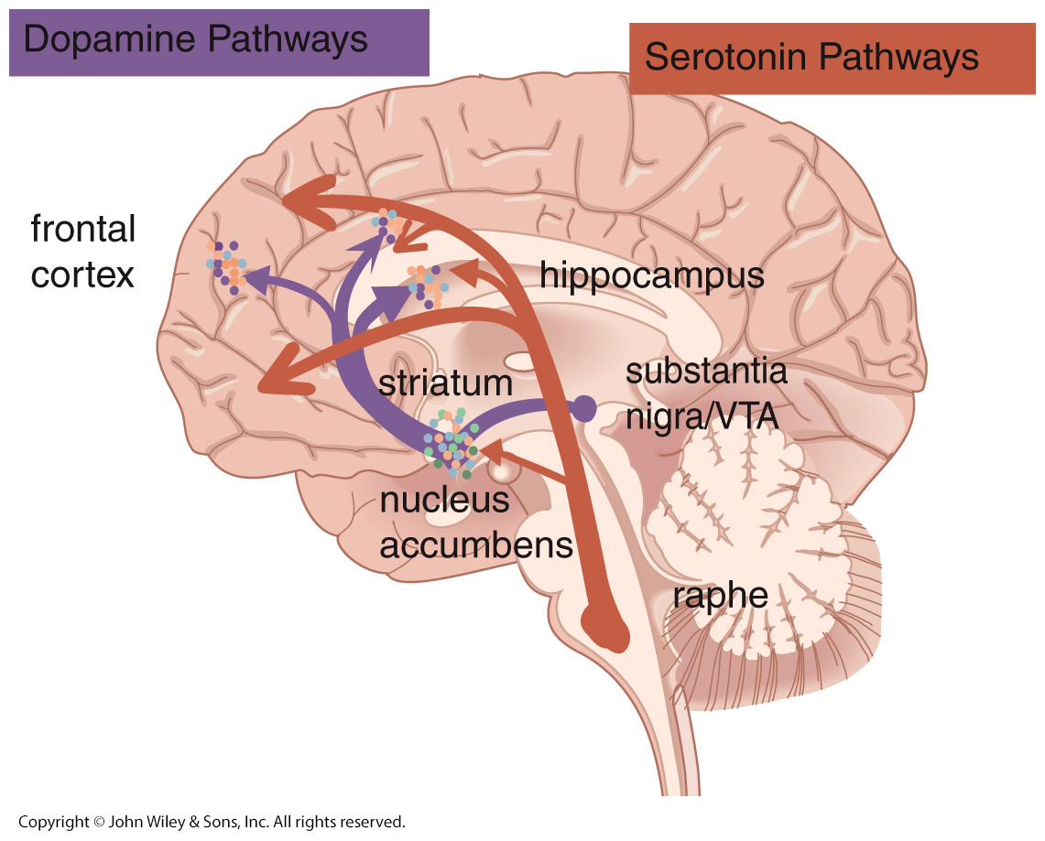
SEROTONIN AND DOPAMINE PATHWAYS

Slide 24
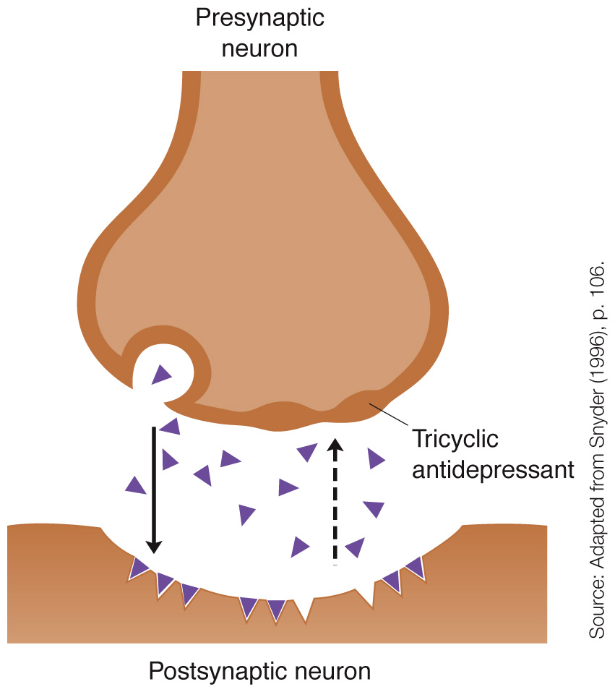
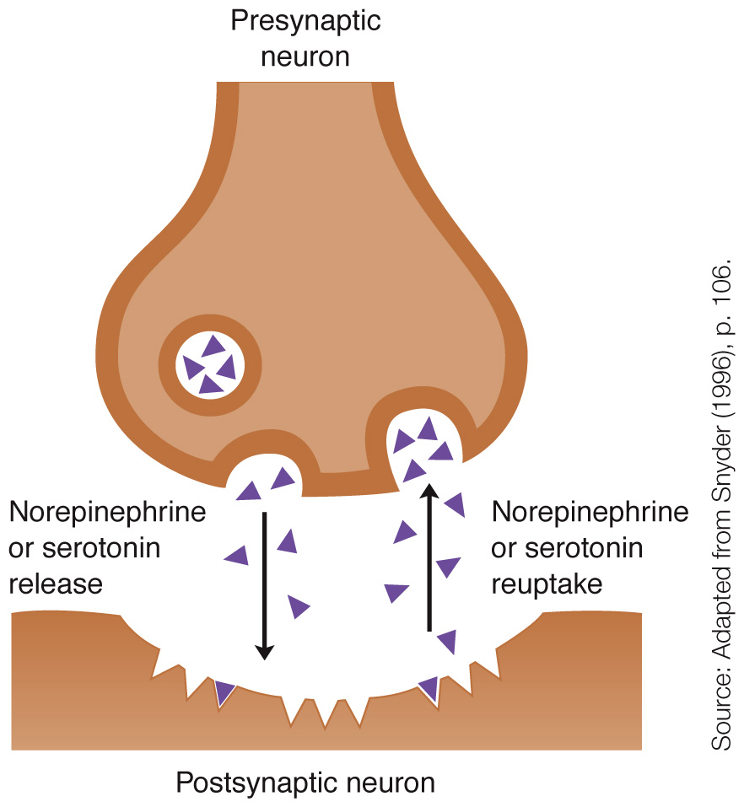
DRUG ACTION ON SYNAPTIC ACTIVITY

Slide 25
ETIOLOGY OF MOOD DISORDERS:
NEUROBIOLOGICAL FACTORS
Brain Imaging
  Structural studies
    Focus on number of or connections among cells
  Functional activation studies
    Focus on activity levels
Activity of Brain Structures Involved in Emotion Responses among People with Mood Disorders
Brain Structure | Level in Depression | Level in Mania
Amygdala | Elevated | Elevated
Subgenual anterior cingulate | Elevated | Elevated
Dorsolateral prefrontal cortex | Diminished | Diminished
Hippocampus | Diminished | Diminished
Striatum | Diminished | Elevated

Slide 26
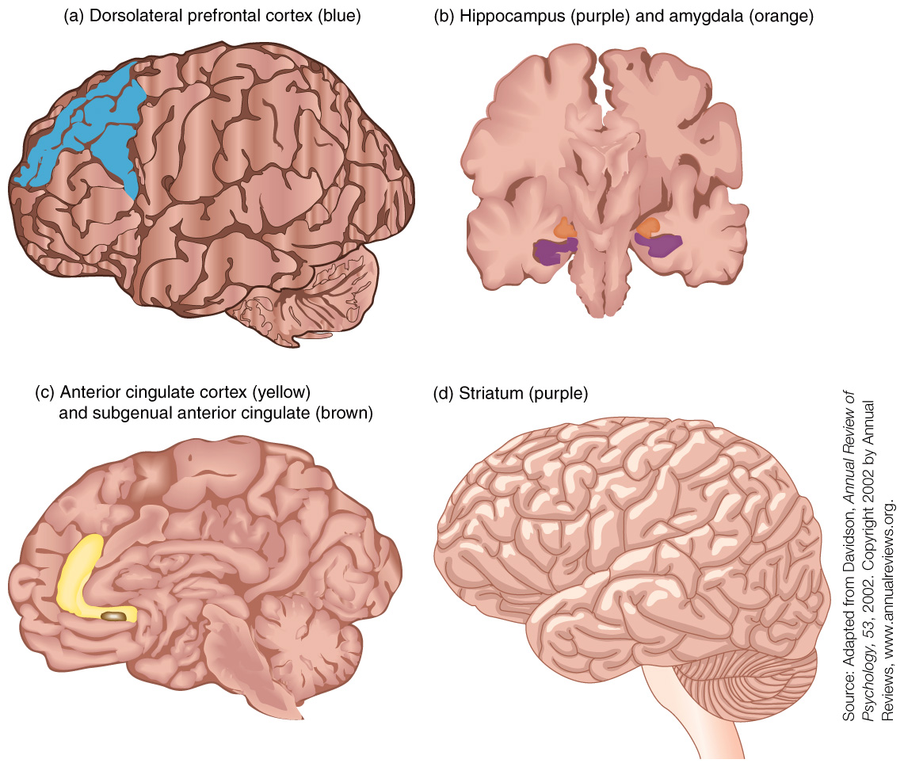
KEY BRAIN STRUCTURES INVOLVED IN MOOD DISORDERS

Slide 27
ETIOLOGY OF MOOD DISORDERS:
NEUROENDOCRINE SYSTEM
Overactivity of HPA axis
  Triggers release of cortisol, stress hormone
    Amygdala overreactive
Findings that link depression to high cortisol levels
  Cushing’s syndrome
    Causes oversecretion of cortisol
    Symptoms include those of depression
  Injecting cortisol in animals produces depressive symptoms
  Dexamethasone suppression test
    Lack of cortisol suppression in people with history of depression

Slide 28
ETIOLOGY OF MOOD DISORDERS:
SOCIAL FACTORS
Life events
  Prospective research
    42-67% report a stressful life event in year prior to depression onset
      e.g., romantic breakup, loss of job, death of loved one
    Replicated in 12 studies across 6 countries (Brown & Harris, 1989b)
  Lack of social support may be one reason a stressor triggers depression
Interpersonal difficulties
  High levels of expressed emotion by family member predict relapse
  Marital conflict also predicts depression
Behavior of depressed people often leads to rejection by others
  Excessive reassurance seeking
  Few positive facial expressions
  Negative self-disclosures
  Slow speech and long silences

Slide 29
ETIOLOGY OF MOOD DISORDERS:
PSYCHOLOGICAL FACTORS
Why do some people become depressed after a stressful life event and others do not?
  Social support
  Neuroticism
  Cognitive theories

Slide 30
ETIOLOGY OF MOOD DISORDERS:
PSYCHOLOGICAL FACTORS
Neuroticism
  Tendency to react with higher levels of negative affect
  Predicts onset of depression (Jorm et al., 2000)

Slide 31
ETIOLOGY OF MOOD DISORDERS:
PSYCHOLOGICAL FACTORS
Cognitive theories
  Beck’s Theory
    Negative triad: negative view of self, world, future
    Negative schema: underlying tendency to see the world negatively
    Negative schema cause cognitive biases: tendency to process information in negative ways
  Hopelessness Theory
    Most important trigger of depression is hopelessness
      Desirable outcomes will not occur
      Person has no ability to change situation
    Attributional Style
      Stable and global attributions can cause hopelessness
  Rumination Theory
    A specific way of thinking: tendency to repetitively dwell on sad thoughts (Nolen-Hoeksema, 1991)
    Most detrimental is to brood over causes of events

Slide 32
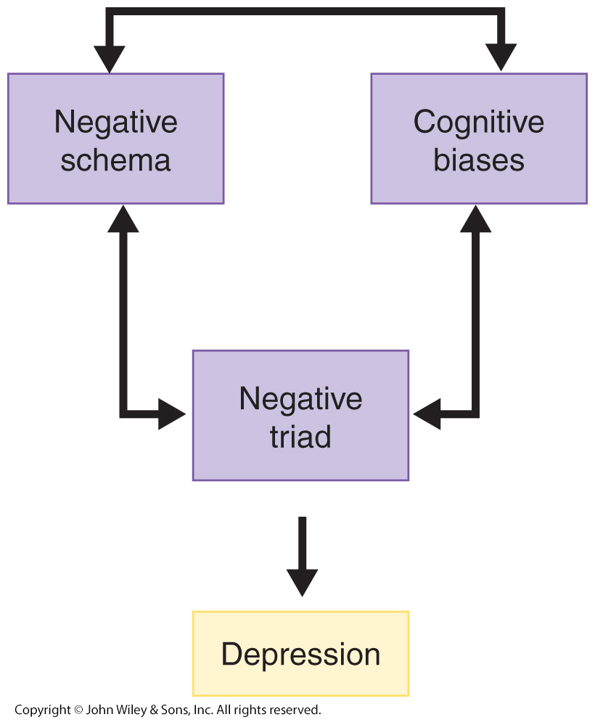
BECK’S THEORY OF DEPRESSION

Slide 33
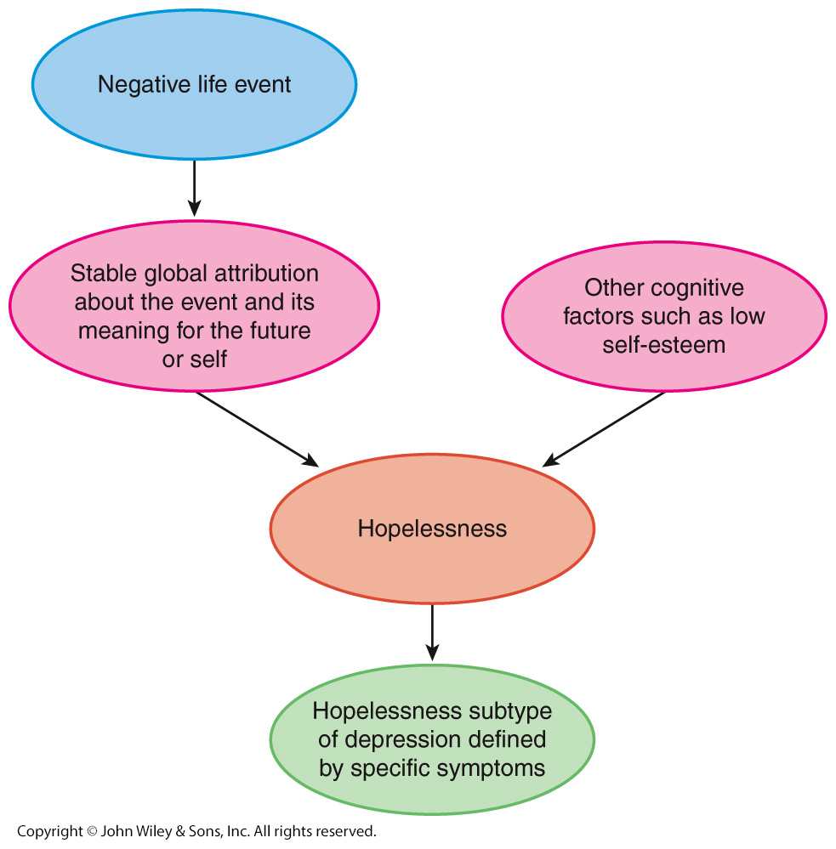
HOPELESSNESS THEORY

Slide 34
An Example of Attributions:
Why I Failed My GRE Math Exam
 | Stable | Unstable
Global | I lack intelligence. | I am exhausted.
Specific | I lack mathematical ability. | I am fed up with math.

Slide 35
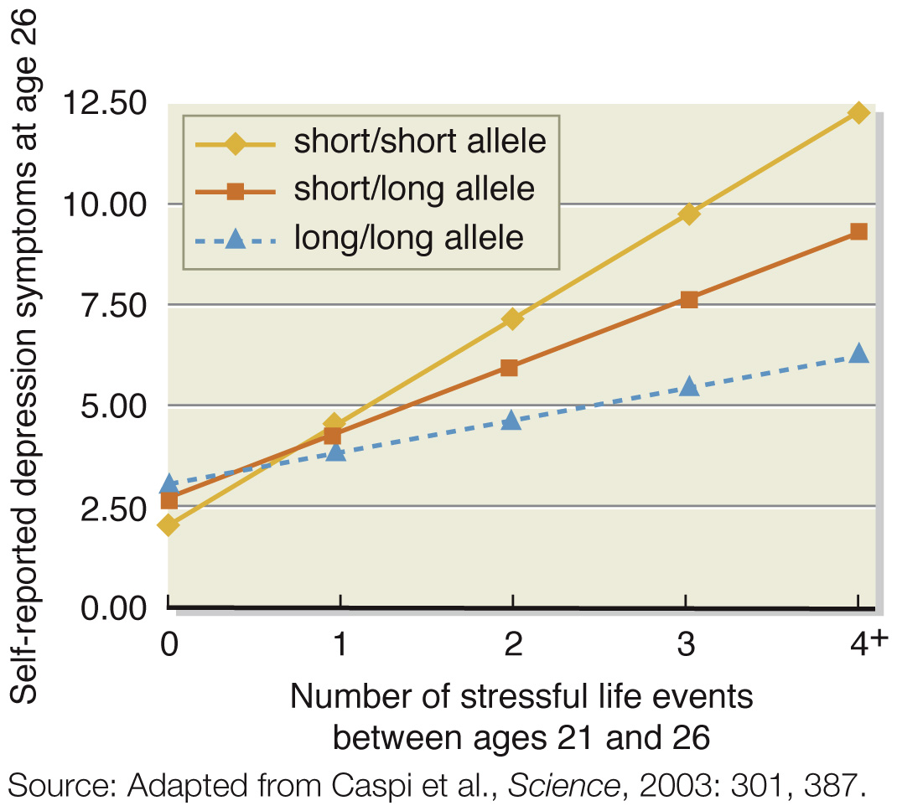
LIFE EVENTS INTERACT WITH SEROTONIN TRANSPORTER GENE
TO PREDICT SYMPTOMS OF DEPRESSION

Slide 36
SOCIAL AND PSYCHOLOGICAL FACTORS IN BIPOLAR DISORDER
Triggers of depressive episodes in bipolar disorder appear similar to the triggers of major depressive episodes
  Negative life events, neuroticism, negative cognitions, expressed emotion, and lack of social support
Predictors of mania
  Reward sensitivity
  Sleep disruption

Slide 37
Treatment of Mood Disorders

Slide 38
PSYCHOLOGICAL TREATMENT OF MOOD DISORDERS
Interpersonal psychotherapy (IPT)
  Short-term psychodynamic therapy
  Focus on current relationships
Cognitive therapy
  Monitor and identify automatic thoughts
    Replace negative thoughts with more neutral or positive thoughts
Mindfulness-based cognitive therapy (MBCT)
  Strategies, including meditation, to prevent relapse
Behavioral activation (BA) therapy
  Increase participation in positively reinforcing activities to disrupt spiral of depression, withdrawal, and avoidance
Behavioral couples therapy
  Enhance communication and satisfaction

Slide 39
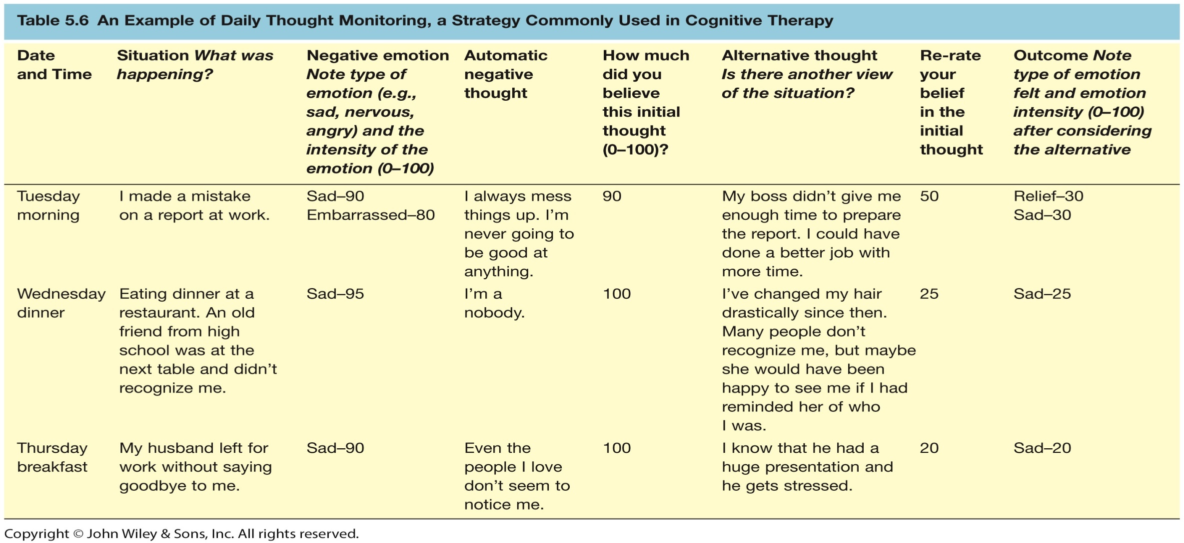
EXAMPLE OF COGNITIVE THERAPY’S THOUGHT MONITORING/CHALLENGING

Slide 40
TREATMENT OF MOOD DISORDERS
Psychological treatment of bipolar disorder
  Psycho-educational approaches
    Provide information about symptoms, course, triggers, and treatments
  Family-focused treatment (FFT)
    Educate family about disorder, enhance family communication, improve problem solving

Slide 41
BIOLOGICAL TREATMENT OF MOOD DISORDERS
Electroconvulsive therapy (ECT)
  Reserved for treatment non-responders
  Induce brain seizure and momentary unconsciousness
    Unilateral ECT
  Side effects
    Memory loss
  ECT more effective than medications
    Unclear how ECT works
Transcranial Magnetic Stimulation for Depression (rTMS)
  Electormagnetic coil placed against scalp
  For those that fail to respond to first antidepressent

Slide 42
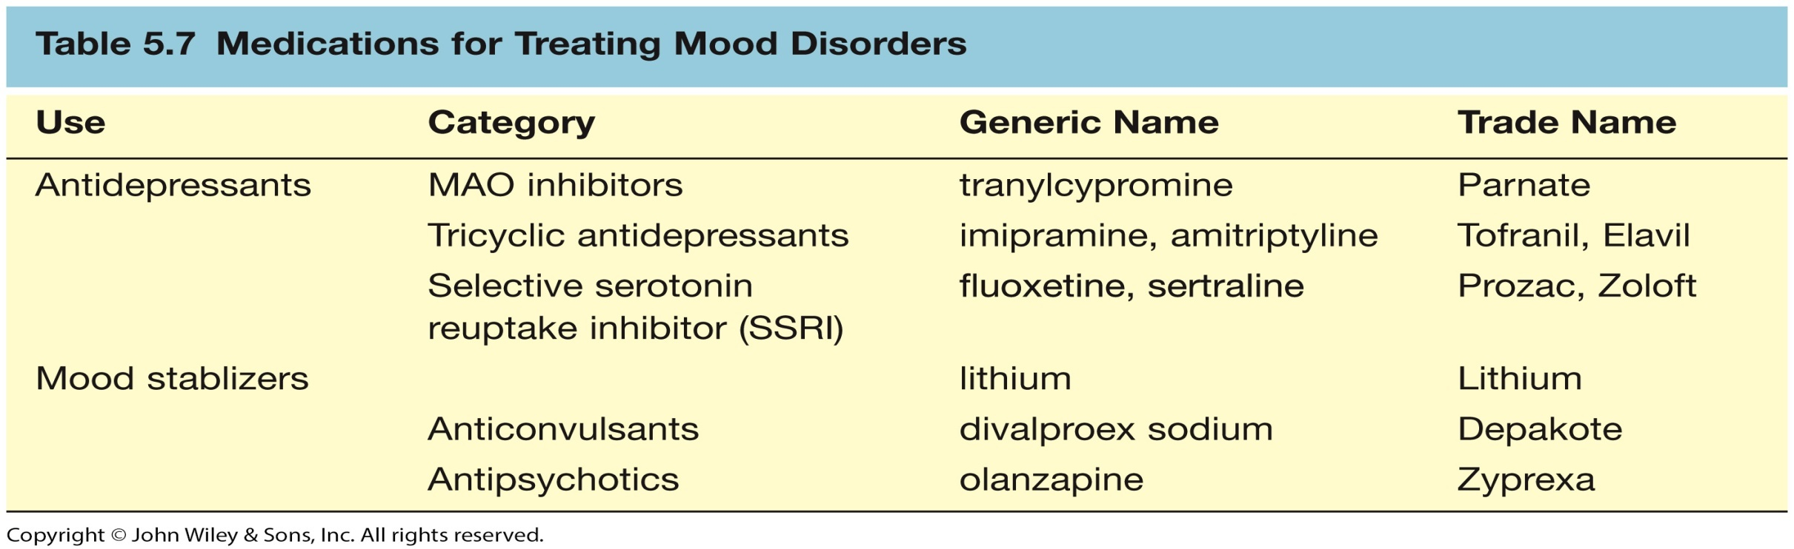
MEDICATIONS FOR TREATING MOOD DISORDERS

Slide 43
BIOLOGICAL TREATMENT OF MOOD DISORDERS
Published studies may overestimate the effectiveness of medication (Turner et al., 2008)
STAR-D (Rush et al., 2006)
  Sequenced Treatment Alternatives to Relieve Depression
  Attempted to evaluate effectiveness of antidepressants in real-world settings
    3671 patients across 41 sites
    Only 33% achieved full symptom relief with citalopram (the SSRI Celexa)
    About 30% of non-responders achieved remission with a different anti-depressant

Slide 44
RESEARCH COMPARING TREATMENTS
FOR MAJOR DEPRESSIVE DISORDER
Combining psychotherapy and antidepressant medications increases odds of recovery over either alone by 10-20%
  Medications quicker, therapy longer-lasting effects
Later studies (Hollon & DeRubeis, 2003)
  CT as effective as medication for severe depression
  CT more effective than medication at preventing relapse

Slide 45
MEDICATIONS FOR BIPOLAR DISORDER
Lithium
  Up to 80% receive at least some relief with this mood stabilizer
  Potentially serious side effect
    Lithium toxicity
Newer mood stabilizers
  Anticonvulsants
    Depakote
  Antipsychotics
    Zyprexa
  Both also have serious side effects

Slide 46
Suicidality

Slide 47
KEY TERMS IN THE STUDY OF SUICIDALITY
Suicide ideation: thoughts of killing oneself
Suicide attempt: behavior intended to kill oneself
Suicide: death from deliberate self-injury
Non-suicidal self-injury: behaviors intended to injure oneself without intent to kill oneself

Slide 48
EPIDEMIOLOGY OF SUICIDE AND SUICIDE ATTEMPTS
Suicide rate in US is 1 per 10,000 in a given year; worldwide, 9% report suicidal ideation at least once in their lives, and 2.5% have made at least one suicide attempt
Men are four times more likely than women to kill themselves; women are more likely than men are to make suicide attempts that do not result in death
Guns are by far the most common means of suicide in the United States (60%); men usually shoot or hang themselves; women more likely to use pills
The suicide rate increases in old age. The highest rates of suicide in the United States are for white males over age 50
The rates of suicide for adolescents and children in the United States are increasing dramatically
Being divorced or widowed elevates suicide risk four- or fivefold

Slide 49
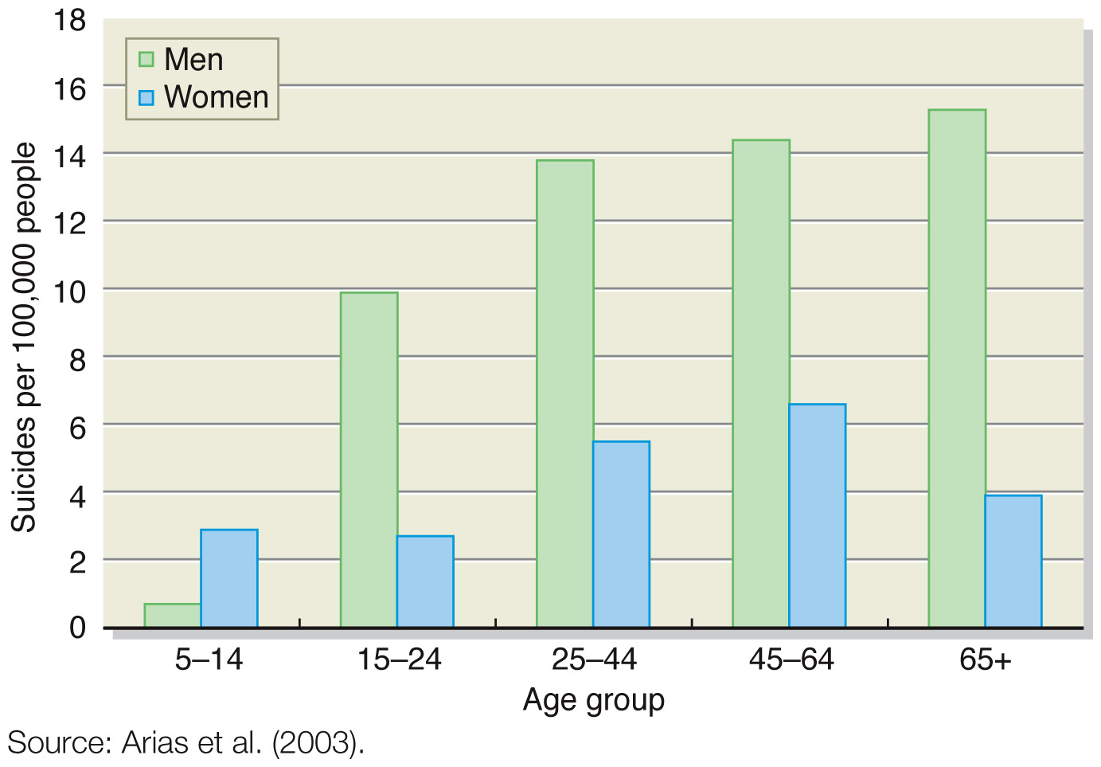
ANNUAL DEATHS DUE TO SUICIDES PER 100,000 PEOPLE

Slide 50
RISK FACTORS FOR SUICIDE
Psychological Disorders
  Half of suicide attempts are depressed at the time of the act
Neurobiological Models
  Heritability of 48% for suicide attempts
  Low levels of serotonin
  Overly reactive HPA system
Social Factors
  Economic recessions
  Media reports of suicide
  Social isolation and a lack of social belonging
Psychological Models
  Problem-solving deficit
  Hopelessness
  Life satisfaction
  Impulsivity

Slide 51
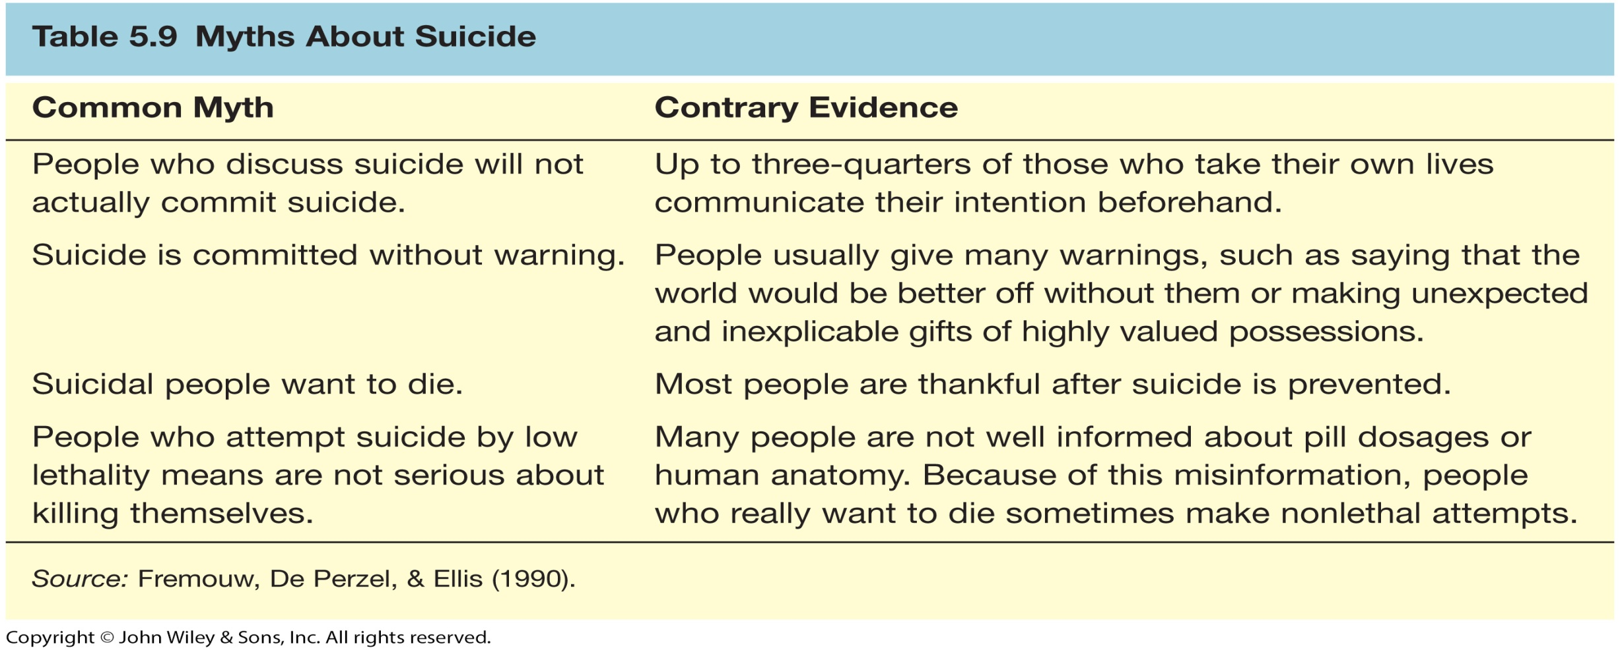
MYTHS ABOUT SUICIDE

Slide 52
PREVENTING SUICIDE
Talk about suicide openly and matter-of-factly
Most people are ambivalent about their suicidal intentions
Treat the associated mental disorder
Treat suicidality directly
Suicide prevention centers

