Slide 1

SUBJECT NAME –PHARMACEUTICAL MICROBIOLOGY
UNIT NO & NAME – 8 ANTIGEN ANTIBODY REACTION
17-09-2024
1

Slide 2
TOPIC NAME – ANTIGEN AND ANTIBODY REACTION
Antigen-antibody interaction, or antigen-antibody reaction, is a specific chemical interaction between antibodies produced by B cells of the white blood cells and antigens during immune reaction.
The antigens and antibodies combine by a process called agglutination.
It is the fundamental reaction in the body by which the body is protected from complex foreign molecules, such as pathogens and their chemical toxins.
In the blood, the antigens are specifically and with high affinity bound by antibodies to form an antigen-antibody complex. The immune complex is then transported to cellular systems where it can be destroyed or deactivated.
There are several types of antibodies and antigens, and each antibody is capable of binding only to a specific antigen.
The specificity of the binding is due to specific chemical constitution of each antibody.
The antigenic determinant or epitope is recognized by the paratope of the antibody, situated at the variable region of the polypeptide chain.
The variable region in turn has hyper-variable regions which are unique amino acid sequences in each antibody.
Antigens are bound to antibodies through weak and noncovalent interactions such as electrostatic interactions, hydrogen bonds, Van der Waals forces, and hydrophobic interactions.
17-09-2024
2

Slide 3
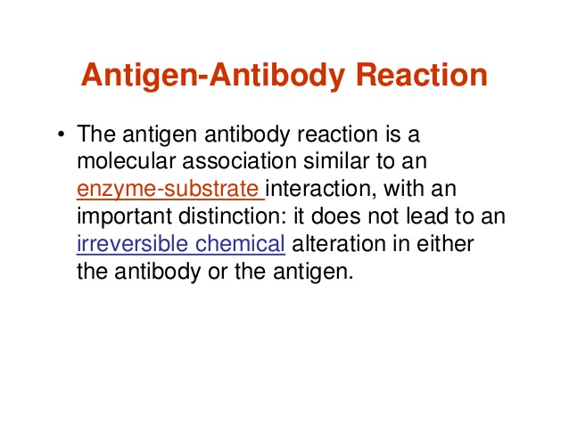

Slide 4
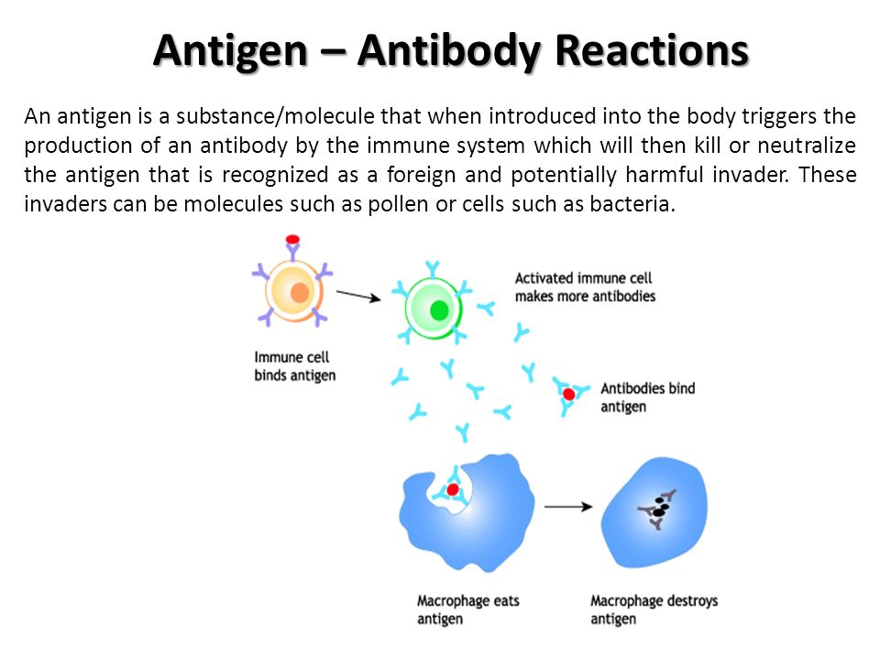

Slide 5
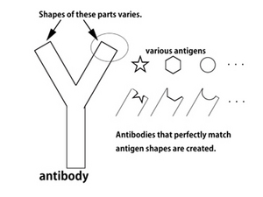

Slide 6
Immunity developed as an individual is exposed to antigens is called adaptive or acquired immunity, in contrast to immunity developed at birth, which is innate immunity.
Acquired immunity depends upon the interaction between antigens and a group of proteins called antibodies produced by B cells of the blood.
There are many antibodies and each is specific for a particular type of antigen. Thus immune response in acquired immunity is due to the precise binding of antigens to antibody.
Only very small area of the antigens and antibody molecules actually interact through complementary binding sites, called epitopes in antigens and paratopes in antibody
Antibodies bind antigens through weak chemical interactions, and bonding is essentially non-covalent Electrostatic interactions hydrogen bonds van der Waals force and hydrophobic interaction are all known to be involved depending on the interaction sites.
Non-covalent bonds between antibody and antigen can also be mediated by interfacial water molecules. Such indirect bonds can contribute to the phenomenon of cross-reactivity, i.e. the recognition of different but related antigens by a single antibody

Slide 7
Normally antibodies can detect and differentiate molecules from outside of the body and those produced inside the body as a result of cellular activities.
Self molecules as ignored by the immune system. However, in certain conditions, the antibodies recognise self molecules as antigens and triggers unexpected immune responses.
This results in different autoimmune diseases depending on the type of antigens and antibodies involved.
Such conditions are always harmful and sometimes deadly. The exact nature of antibody-antigen interaction in autoimmune disease is not yet understood
Antigen-antibody interaction is used in laboratory techniques for serological test of blood compatibility and various pathogenic infections.
The most basic is ABO blood group determination, which is useful for blood transfusion
Sophisticated applications include ELISA, enzyme-linked immunospot (Elispot), immunofluorescence, and immunoelectrophoresis.

Slide 8
Precipitation reaction
Soluble antigens combine with soluble antibodies in presence of an electrolyte at suitable temperature and pH to form insoluble visible complex. This is called a precipitation reaction.
It is used for qualitative and quantitative determination of both antigen and antibody. It involves the reaction of soluble antigen with soluble antibodies to form large interlocking aggravated called lattice.
It occurs in two distinct stages. Firstly, the antigen and antibody rapidly form antigen-antibody complexes within few seconds and this is followed by a slower reaction in which the antibody-antigen complexes forms lattices that precipitate from the solution.
A special ring test is useful for diagnosis of anthrax and determination of adulteration in food.
Agglutination reaction
It acts on antigen-antibody reaction in which the antibodies cross-link particulate antigens resulting in the visible clumping of the particle. There are two types, namely active and passive agglutination. They are used in blood tests for diagnosis of enteric fever.

Slide 9
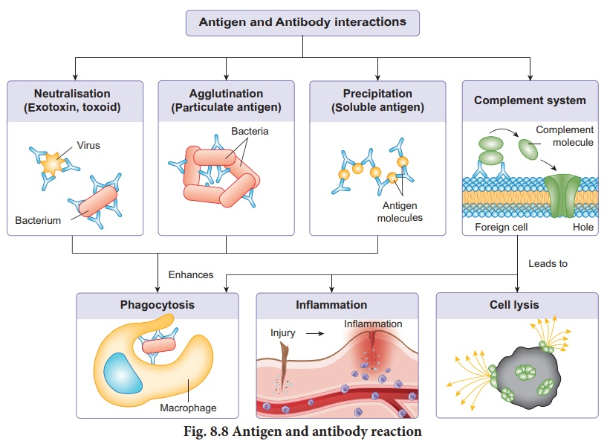

Slide 10
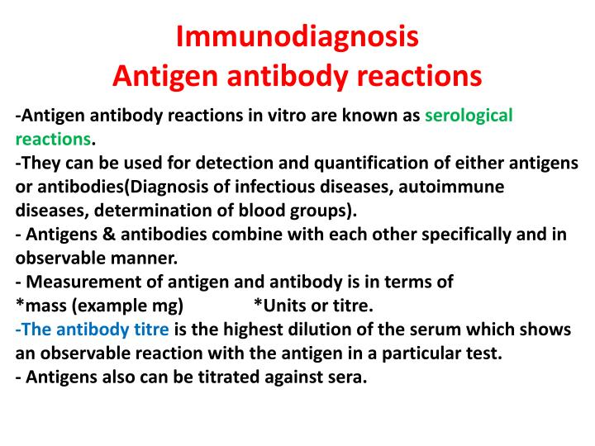

Slide 11
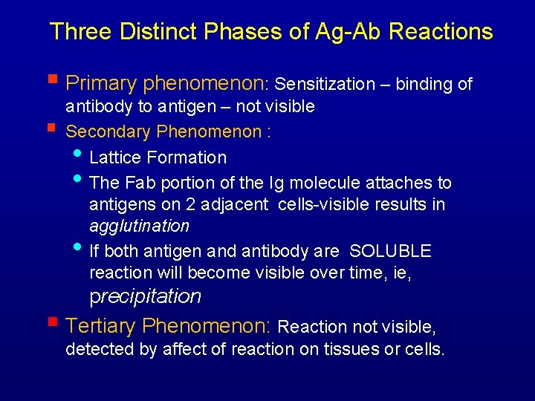

Slide 12
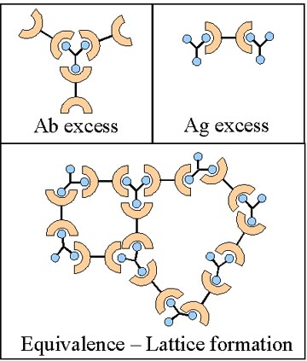

Slide 13
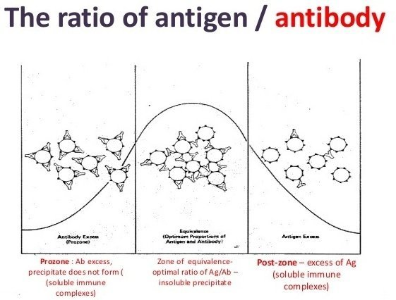

Slide 14
