Slide 1
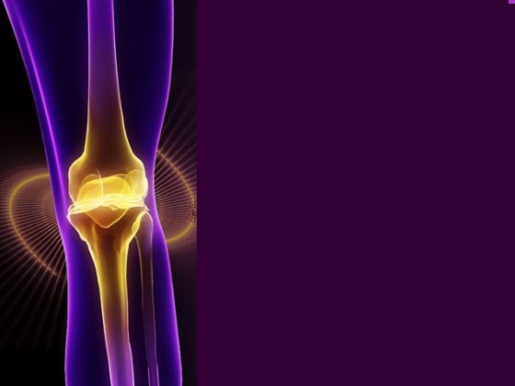
Rheumatoid Arthritis
Osteoarthritis
&
Systemic Lupus Erythematosus

Slide 2
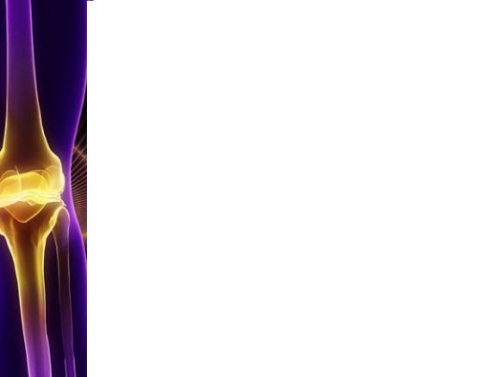
Objectives
Understand the pathophysiology of RA,OA, & SLE.
Review signs and symptoms of RA, OA, & SLE.
Understand how these conditions affects a persons everyday life.
Understand the treatments available for RA, OA, & SLE.

Slide 3
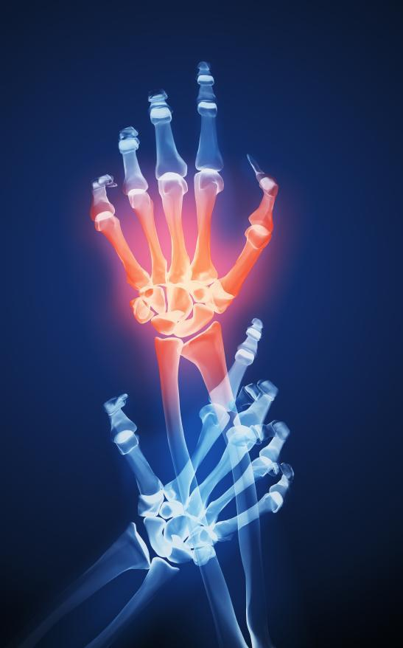
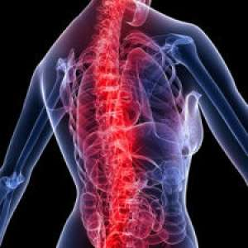
Arthritis
“arthr” = joint
“itis” = inflammation
“Arthritis can affect babies and children, as well as people in the prime of their lives”
Osteoarthritis
Rheumatoid Arthritis
Systemic Lupus Erythematosus
Gout
Childhood Arthritis (Juvenile Idiopathic Arthritis)
(The Arthritis Society, 2012)

Slide 4
Facts
Leading cause of disability
Affects 1 in 6 individuals
Costs 33 billion each year
2/3 individuals with arthritis are women
By 2031 approximately 7 million people will be living with Arthritis
Has caused more deaths than melanoma, asthma, or HIV/AIDS
Only 1.3% of research is dedicated to arthritis.
(The Arthritis Society , 2012; Statistics Canada, 2012; Canadian Arthritis Network, 2007)

Slide 5
Myths
# 1: Arthritis isn’t serious
#2: Arthritis is an old person’s disease
#3:Arthritis is a normal part of aging
#4: Not much can be done for those living with arthritis
#5: People with arthritis can’t exercise
(Arthritis Foundation, 2012)

Slide 6
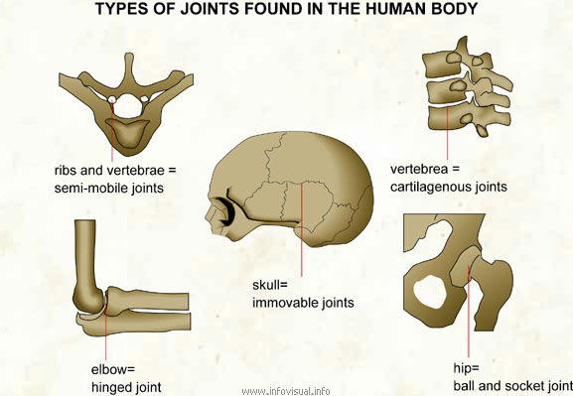
What are joints?
Joint pain is an early symptom of Arthritis
The joint is the area where bones meet!
Synovial joints are responsible for movement
The joint is the area most commonly targeted by inflammation
(American Academy of Orthopaedic Surgeons, 2012; Day et al., 2010)

Slide 7
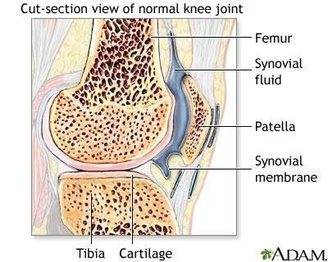
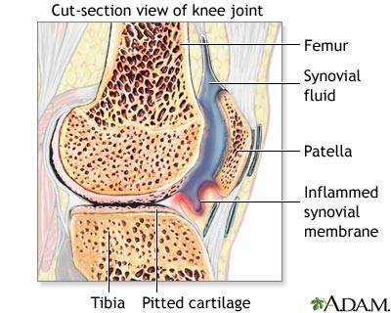
Anatomy of the Joint
Articular/hyaline cartilage
-acts as a shock absorber
- allows for friction-free movement
- not innervated!
Synovial membrane/synovium
-secretes synovial fluid
-nourishes cartilage
-cushions the bones
(Day et al., 2010; Cartilage Health, 2008)

Slide 8
Diversity of Rheumatologic Diseases:
Common and Uncommon Diseases Involving
Inflammatory and Immune Responses
Inflammatory Diseases (innate immunity)
Osteoarthritis*
Gout*
Pseudogout
Immunologically-Mediated Diseases (adaptive immunity)
Rheumatoid Arthritis*
Systemic Lupus Erythematosus*
Spondyloarthropathies*
Ankylosing spondylitis
Reactive Arthritis (Reiter’s Syndrome)
Psoriatic Arthritis
Spondylitis associated with IBD
Sjogren’s Syndrome
Polymositis/Dematomyositis
Lyme Disease
Rheumatic Fever
Behcet’s Syndrome
Systemic Sclerosis (Scleroderma)
Wegener’s Granulomatosis
Giant Cell Arteritis*
.

Slide 9
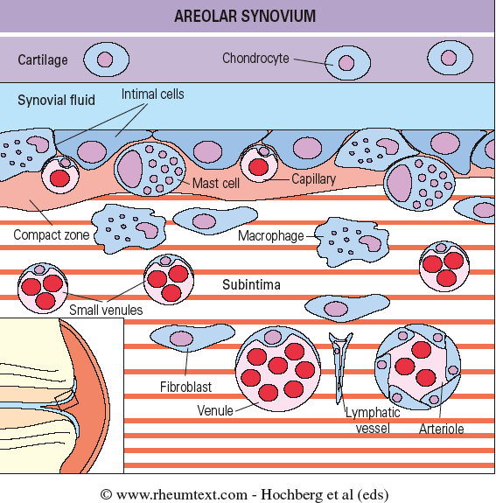
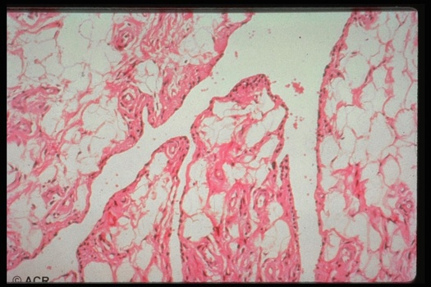
The Normal Synovium
Function of Normal Synovium:
maintenance of intact non-adherent tissue
surface
lubrication of cartilage
control of synovial fluid volume and
composition (plasma and hyaluronan)
nutrition of chondrocytes within joints

Slide 10
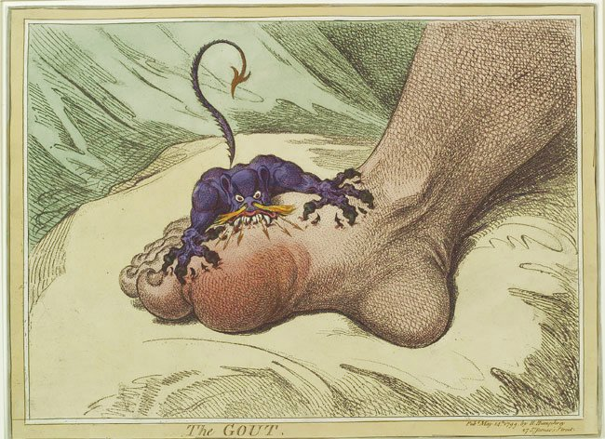
Arthralgia vs Arthritis
Arthralgia: Joint pain (there may not be any inflammation)
Arthritis: Inflammation of the Joint
- Pain
- Redness
- Swelling
- Increased warmth
- Fluid accumulation (synovial effusion)
- Stiffness (especially in the AM)

Slide 11
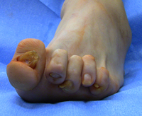
Rheumatoid Arthritis
“A chronic autoimmune disease characterized by the inflammation of the synovial joints”
Has a symmetrical bilateral effect on joints
Results in joint deformity and immobilization
Multiple factors increase one’s risk
(The Arthritis Society, 2012; Gulanick & Myers, 2011; Firth, 2011)

Slide 12
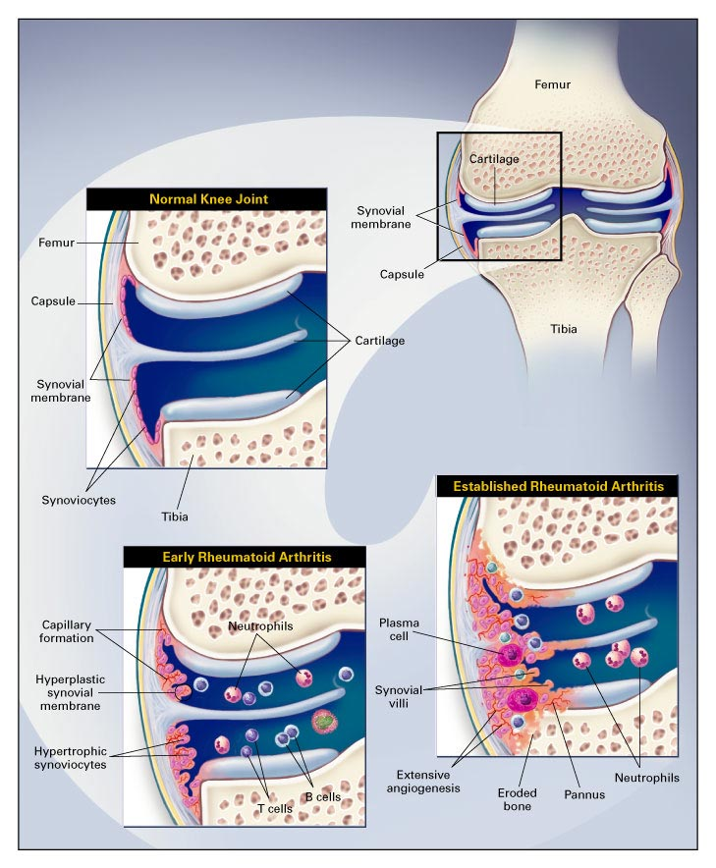
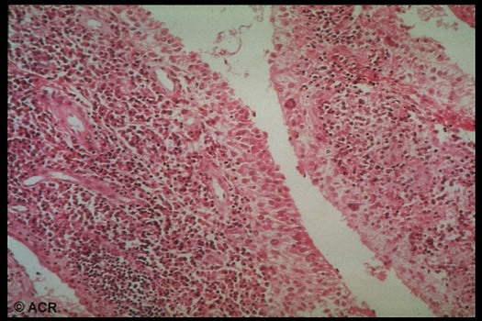
Pathogenesis of Rheumatoid Arthritis
Choy, E. H.S. et al. N Engl J Med 2001;344:907-916
Inflammed synovial tissue (synovitis)
Villous hyperplasia
Intimal cell proliferation
Inflammatory cell infiltration
T cells, B cells, macrophages and
plasma cells
Production of cytokines and proteases
Increased vascularity
Self-amplifying process

Slide 13
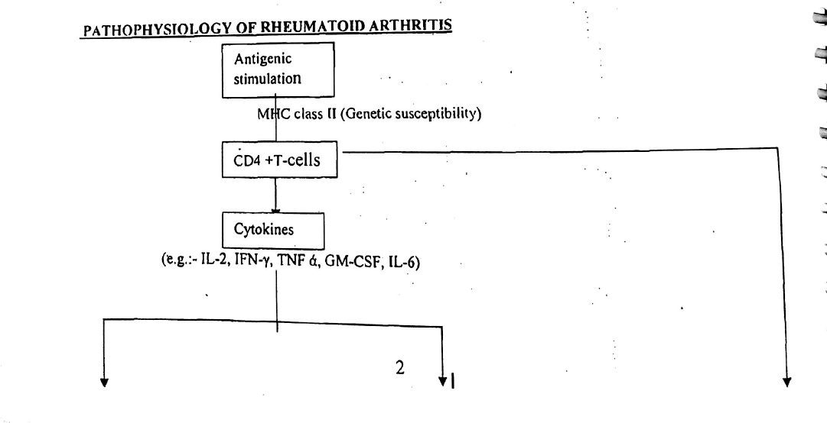

Slide 14
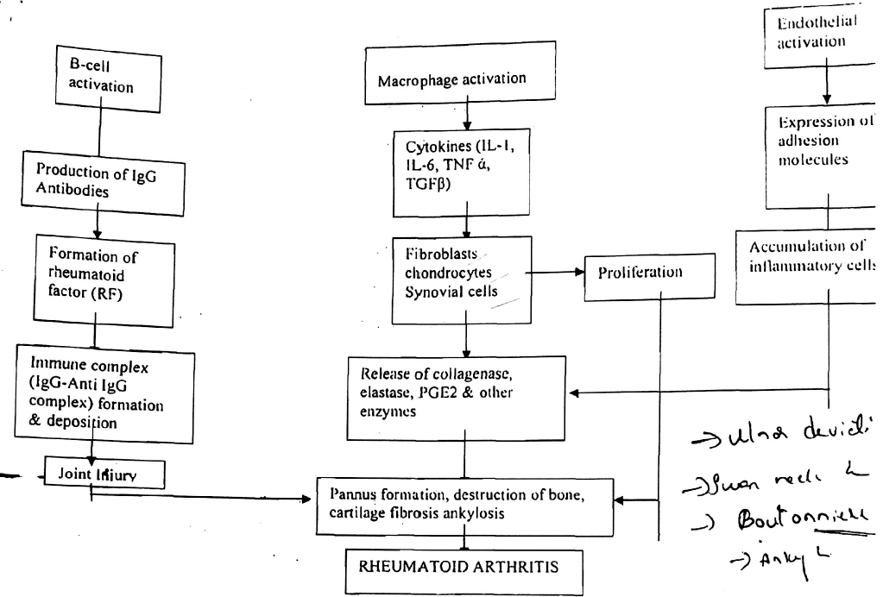

Slide 15
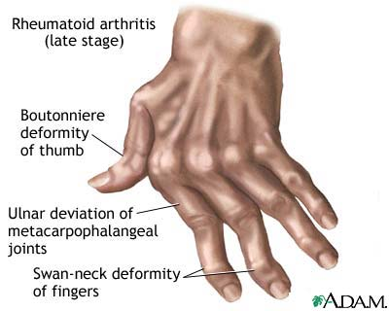
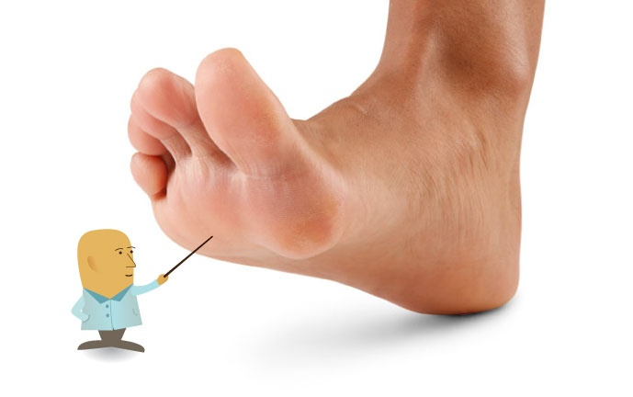
Symptoms
Morning stiffness lasting more than half an hour
Simultaneous symmetrical joint swelling
Not relieved by rest
Fever
Weight loss
Fatigue
Anemia
Lymph node enlargement
Nodules
(The Arthritis Society, 2012; Firth, 2011; Oliver, 2010; Day et al., 2010)

Slide 16
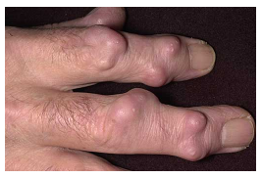
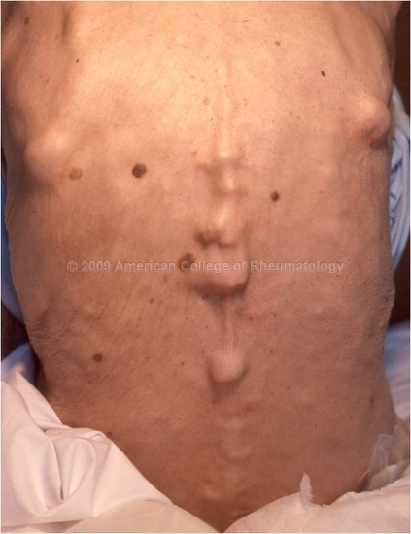
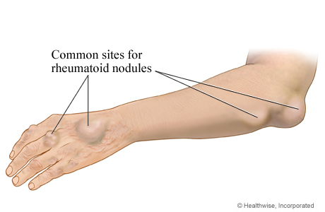
Nodules
(Arthritis Foundation, 2012; Day et al., 2010; American College of Rheumatology, 2009)

Slide 17
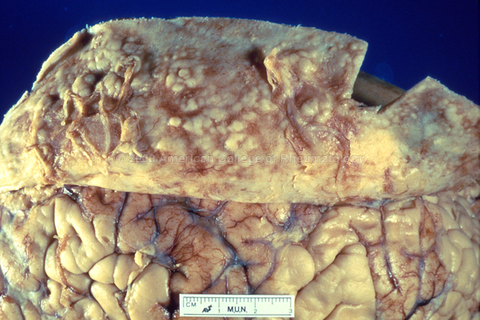

Slide 18
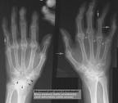
Diagnosis
No single test is specific to Rheumatoid Arthritis
CBC
Radiographs of involved joints
CT/MRI scans
Direct arthroscopy
Synovial/Fluid aspirate
Synovial membrane biopsy
Arthrocentesis
(National Institute of Arthritis and Musculoskeletal and Skin Diseases, 2012)

Slide 19
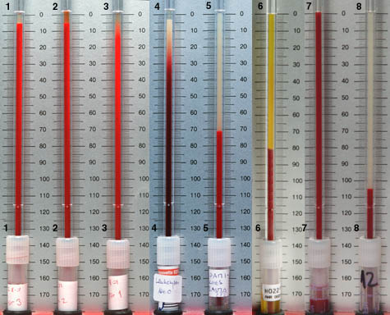
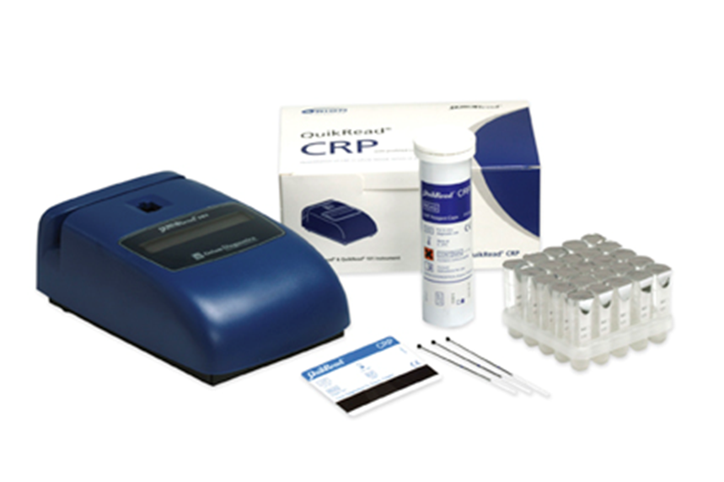
Inflammatory Markers: ESR and CRPTest
The level of CRP in the blood is normally low
Increasing amount
suggests inflammation
ESR rates for men: 0-15mm/hr
ESR rates for women: 0-20mm/hr
(Day et al., 2010)

Slide 20
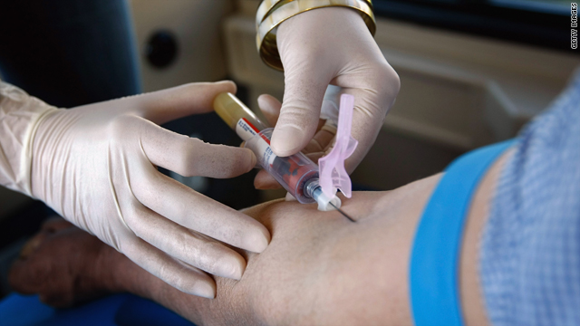
Antibody Tests:
Rheumatoid Factor Test and CCP
Other blood tests check for the presence of antibodies that are not normally present in the human body
(National Rheumatoid Arthritis Society, 2012; Day et al., 2010)

Slide 21
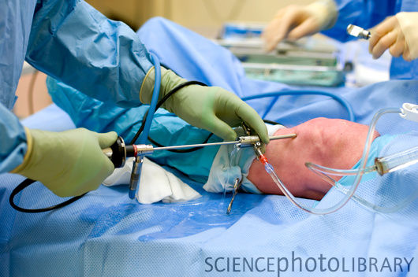
Direct arthroscopy
Benefits
Minimally invasive
Less tissue damage
Fewer complications
Reduced pain
Quicker recovery time
Outpatient basis
(American Academy of Orthopaedic Surgeons, 2012; Day et al., 2010)

Slide 22
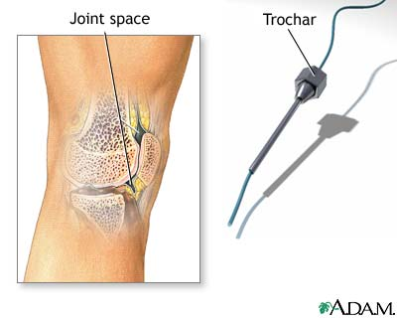
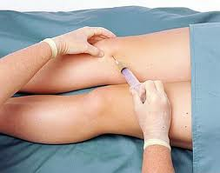
Synovial/Fluid aspirate
Synovial membrane biopsy
Arthrocentesis
Athrocentesis: synovial fluid is aspirated and analysed for inflammatory components
Abnormal synovial fluid: cloudy, milky, or dark yellow containing leukocytes
(Day et al., 2010)

Slide 23
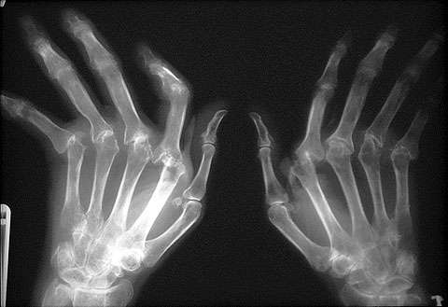
X-Ray
X-rays are an important diagnostic test for monitoring the disease progression
Patients may reveal NO changes on an X-ray in the early stages
(Gulanick & Myers, 2011; Day et al., 2010)

Slide 24
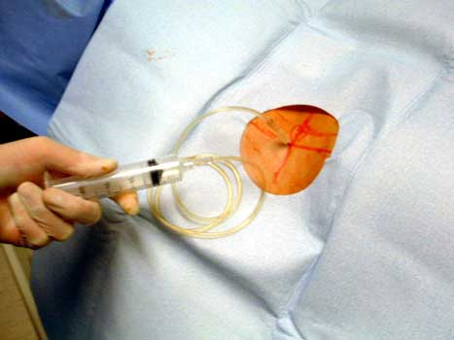
Arthography
A radiopaque substance or air is injected into the joint, which outlines soft tissue structures surrounding the joint
http://www.youtube.com/watch?v=2YJsuDxxNJE&feature=related
(Day et al, 2010)

Slide 25
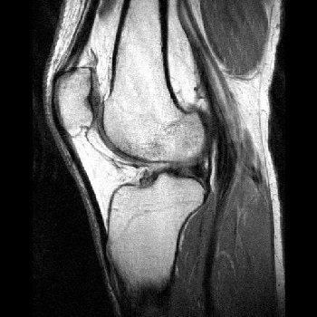
CT/MRI scans
Used for better visualization of soft tissue
MRI is particularly sensitive for the early and subtle features of RA
Can detect changes of Rheumatoid Arthritis prior to an X-Ray
(Radiopaedia, 2010; Dat et al., 2010)

Slide 26

Newly Diagnosed
The major goal is to relieve pain and inflammation and prevent further joint damage
Anxiety, depression, and a low self esteem commonly accompanies Rheumatoid Arthritis
(Walker, 2012; Gulanick & Myers, 2011; The Arthritis Society, 2011; Firth, 2011)

Slide 27
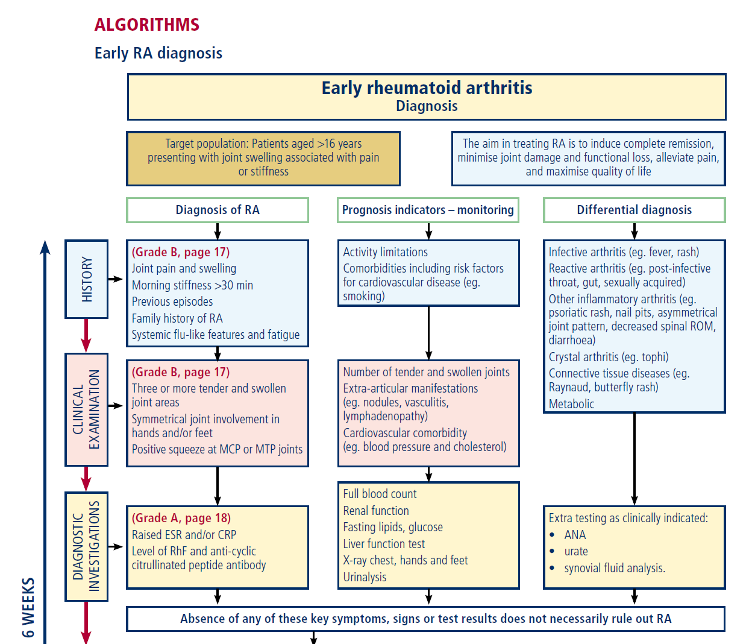

Slide 28
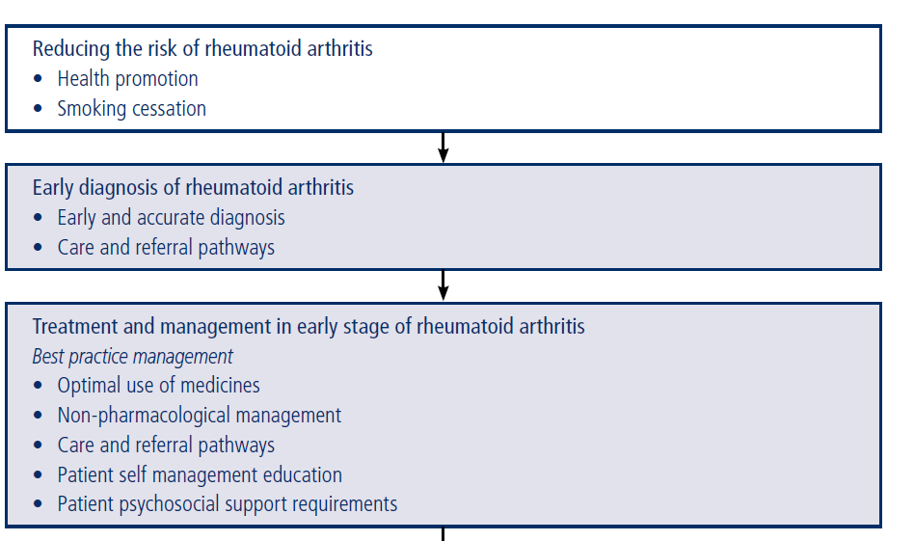

Slide 29
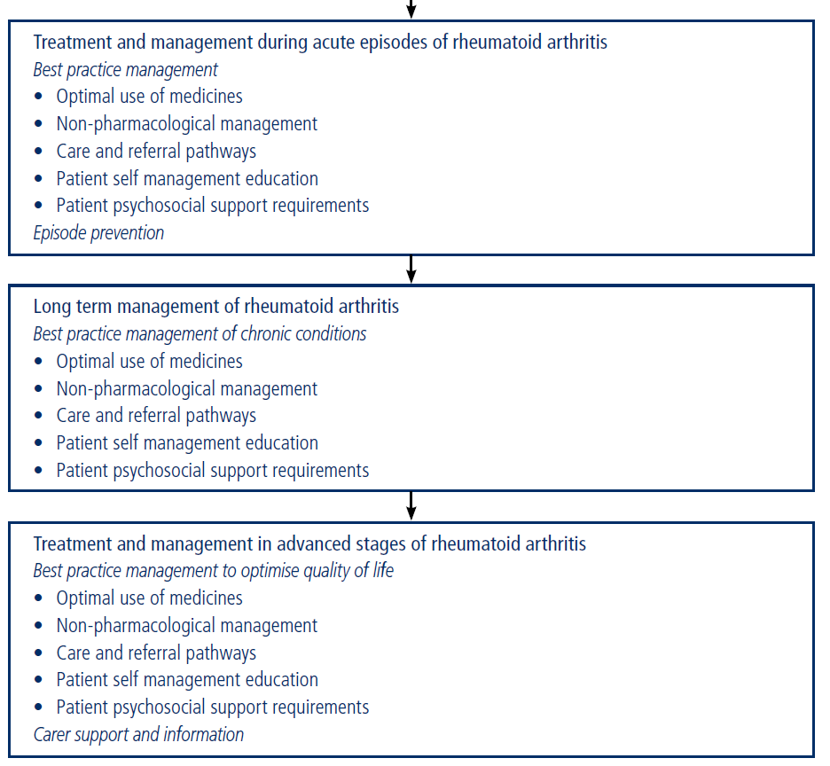

Slide 30
Medications
There are four types of medications used to treat RA:
  Non-steroidal anti-inflammatory drugs (NSAIDs)
  Disease-modifying anti-rheumatic drugs(DMARDS).
  Corticosteroids
  Biologic Response Modifiers (“Bioligics”)
(Arthritis Foundation, 2012; Gulanick & Myers 2011)

Slide 31
Therapeutic Strategies
Reagents that blunt inflammation but don’t have effects on disease progression:
Aspirin
Nonsteroidal anti-inflammatory drugs (NSAIDs)
Non-selective and selective COX-2 antagonists
Steroids (prednisone)
Disease Modifying Anti-Rheumatic Drugs (DMARDs):
Broad Acting:
Methotrexate
Hydroxychloroquin
Azathoprine
Cyclophosphamide
Cyclosporin
More selective biologics:
TNF antagonists
IL-6R antagonists
IL-1R antagonists
anti-B cell (CD20) therapy
costimulatory inhibitors (CTLA4-Ig)
Intravenous Immunoglobulin (iv Ig)

Slide 32
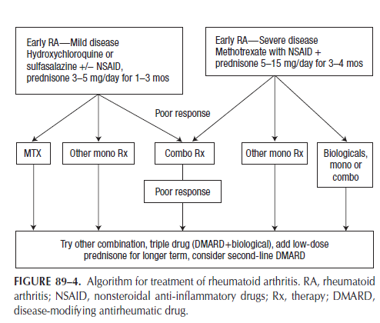

Slide 33
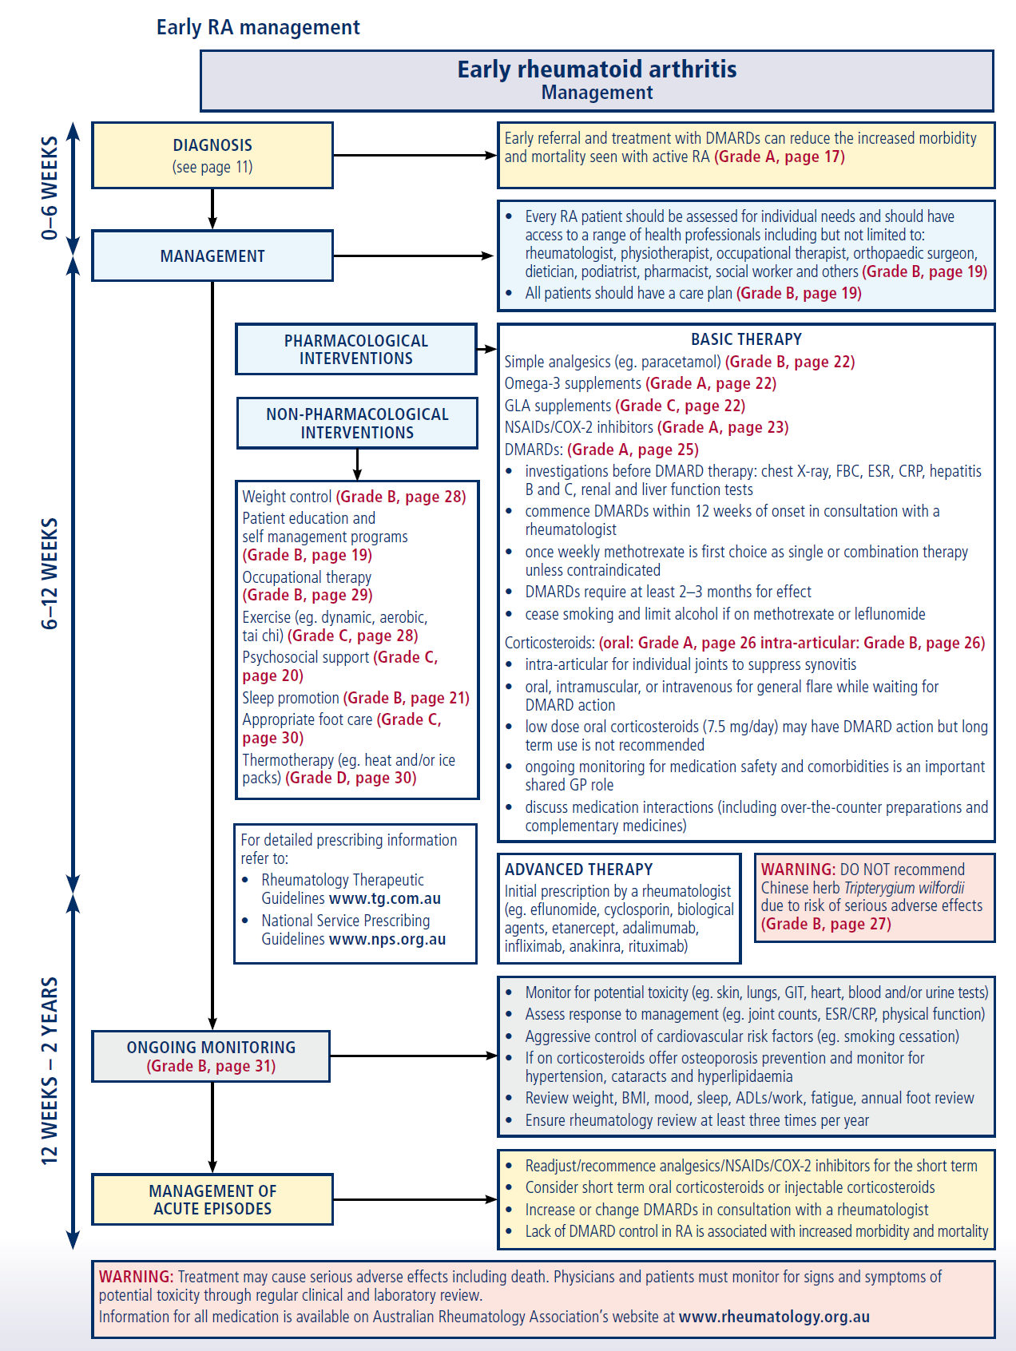

Slide 34
Non-steroidal anti-inflammatory drugs (NSAIDs)
Examples | General Use | Side Effects | Nursing Considerations
Aspirin, ibuprofen, naproxen, COX-2 inhibitors, propionic acid, phenylacetic acid | anti-inflammatory: Used in the management inflammatory conditions Antipyretic: used to control fever Analgesic: Control mild to moderate pain | Nausea Vomiting Diarrhea Constipation Dizziness Drowsiness Edema Kidney failure Liver failure Prolonged bleeding Ulcers | Use cautiously in patients with hx of bleeding disorders Encourage pt to avoid concurrent use of alcohol NSAIDs may decrease response to diuretics or antihypertensive therapy
(The Arthritis Society, 2011; Day et al., 2010)

Slide 35
Corticosteroids
Examples | General Use | Side Effects | Nursing Considerations
Cortisone, hydrocortisone, prednisone, betamethasone,dexa-methasone | Used in the management inflammatory conditions When NSAIDS may be contraindicated Promptly improve symptoms of RA | Increased appetite Weight gain Water/salt retention Increased blood pressure Thinning of skin Depression Mood swings Muscle weakness Osteoporosis Delayed wound healing Onset/worsening of diabetes | Take medications as directed (adrenal suppression) Used with caution in diabetic patients Encourage diet high in protein, calcium, potassium and low in sodium and carbohydrates Discuss body image Discuss risk for infection
(The Arthritis Society, 2011; Day et al., 2010)

Slide 36
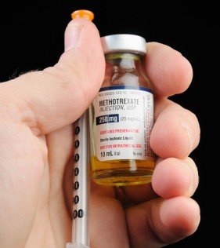
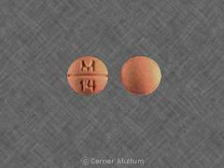
Disease-modifying anti-rheumatic drugs(DMARDS)
Examples | General Use | Side Effects | Nursing Considerations
Methotrexate (the gold standard) , gold salts, cyclosporine, sulfasalazine, azathioprine | immunosuppressive activity Reduce inflammation of rheumatoid arthritis Slows down joint destruction Preserves joint function | Dizziness, drowsiness, headache Pulmonary fibrosis Pneumonitis Anorexia Nausea Hepatotoxicity Stomatitis Infertility Alopecia Skin ulceration Aplastic anemia Thrombocytopenia Leukopenia Nephropathy fever photosensitivity | May take several weeks to months before they become effective Discuss teratogenicity, should be taken off drug several months prior to conception Discuss body image
(The Arthritis Society, 2011; Day et al., 2010)

Slide 37
Biologic Response Modifiers (“Bioligics”)
Examples | General Use | Side Effects | Nursing Considerations
Etanercept, anakinra, abatacipt, adalimumab, Infliximab (Remicade) | Used in the management inflammatory conditions When NSAIDS may be contraindicated Promptly improve symptoms of RA | Increased appetite Weight gain Water/salt retention Increased blood pressure Thinning of skin Depression Mood swings Muscle weakness Osteoporosis Delayed wound healing Onset/worsening of diabetes | Take medications as directed (adrenal suppression) Encourage diet high in protein, calcium, potassium and low in sodium and carbohydrates Discuss body image Discuss risk for infection
(The Arthritis Society, 2011; Day et al., 2010)

Slide 38
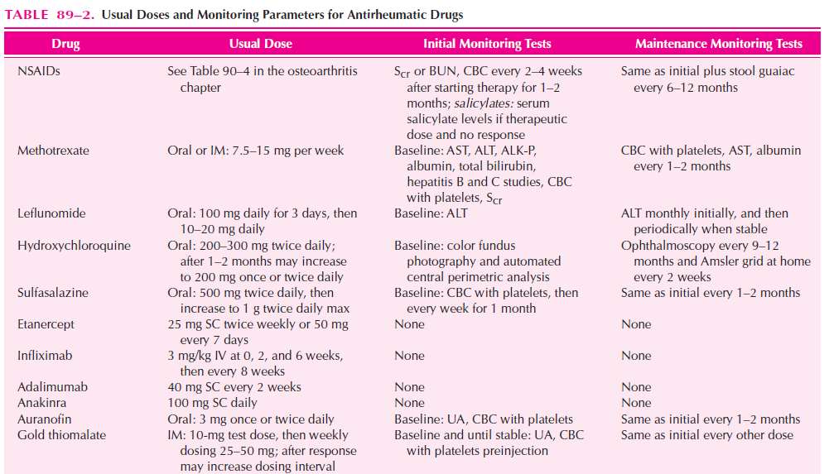

Slide 39
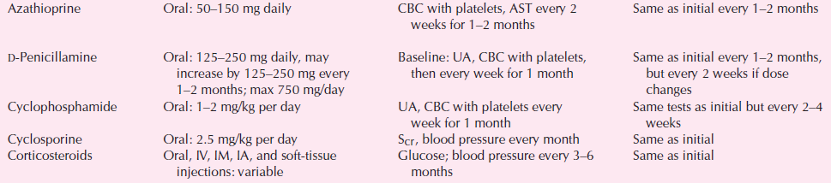

Slide 40
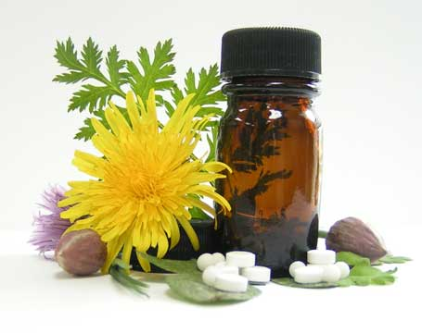
Alternative Medicine
Olive leaf extract
Aloe Vera
Green Tea
Omega 3
Ginger Root Extract
Omega 3 interferes with blood clotting drugs!
(American College of Rheumatology, 2012)

Slide 41
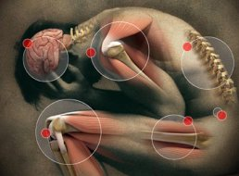
Pain
Pain is subjective and influenced by multiple factors
Lack of
control
Helpless
Stressful events can increase symptoms of arthritis
(Day et al., 2010; Canadian Psychological Association, 2009)

Slide 42

Exercise
Being overweight strains joints and leads to further inflammation
Walking
Light jogging
Water aerobics
Cycling
Yoga
stretching
4 times a week for
30 minutes
(Arthritis Foundation, 2012)

Slide 43
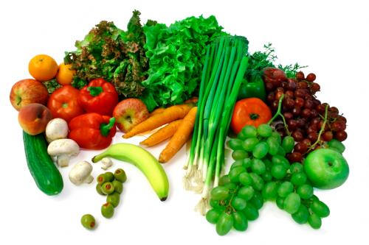
Nutrition
The most commonly observed vitamin and mineral deficiencies in patients with RA are:
folic acid
vitamin C
vitamin D
vitamin B₆
vitamin B₁₂
vitamin E
calcium
magnesium
zinc
(Johns Hopkins Arthritis Center, 2012)

Slide 44
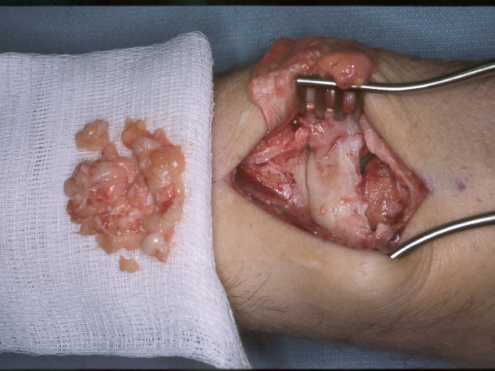
Synovectomy
Increases function of the joint
Decreases pain and inflammation
Beneficial as an early treatment option
Not a cure!
(Day et al., 2010; Sung-Jae, 2007)

Slide 45
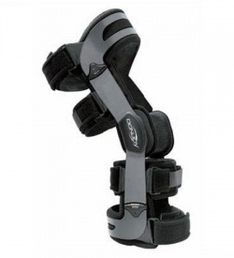
Braces/casts/splints
Support injured joints and weak muscles
Improve joint mobility and stability
Help to alleviate pain, swelling and muscle spasm
May prevent further damage and deformity
(Johns Hopkins Arthritis Center, 2012)

Slide 46
Osteoarthritis
Most common form of arthritis
Over 3 million Canadians affected (1/10)
Osteoarthritis is defined as “a degenerative joint disease characterized by destruction of the articular cartilage and overgrowth of bone”
(Arthritis Society, 2011; Day et al., 2010)

Slide 47
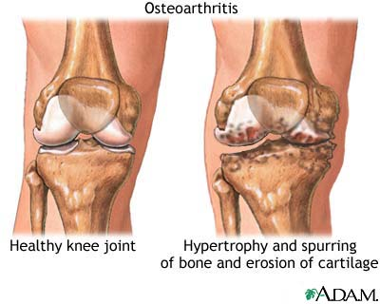
Pathophysiology
Normal Joint: Cartilage covers the end of bones to act as a shock absorber and to promote smooth movement of the joint.
Osteoarthritis: Cartilage wears down over time. Patients may experience a painful bone-on-bone articulation.
(Arthritis Society, 2011)
Notes:
47

Slide 48
Mechanical injury
Previous Joint Damage
Genetic & hormonal factors
Chondrocyte response
Release of cytokines
Release of proteolytic enzymes, metalloproteases, collagenase
Resulting damage predisposes to a further chondrocyte response
(Day et al., 2010; Mosby, 2009)

Slide 49
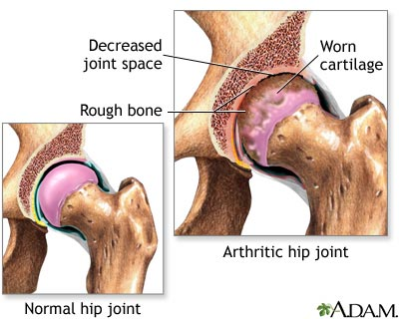

Slide 50
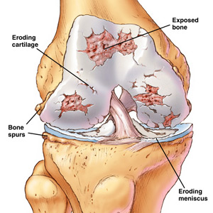
Primary & Secondary Osteoarthritis
Primary Osteoarthritis – no identifiable reason for arthritis development.
Secondary Osteoarthritis – a likely cause for osteoarthritis exists (e.g. joint injury among professional athletes).
(Arthritis Society, 2011)

Slide 51
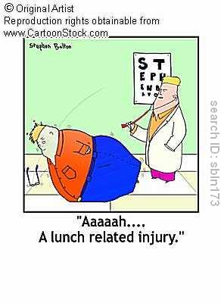
Risk Factors for OA
Age
Family History
Excess weight
Joint injury
Complications of other
types of arthritis
MYTH – Normal wear and tear
(Arthritis Society, 2011; Day et al., 2010)

Slide 52
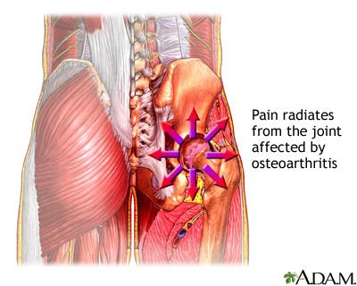
Signs & Symptoms of OA
Joint pain
Feeling joints “locking”
Joint “creaking”
Stiff joints in the morning
Joint swelling
Loss of joint flexibility or strength
(Arthritis Society, 2011)

Slide 53


Diagnosis
A Complicated Process
(Day et al., 2010; National Institute of Arthritis & Musculoskeletal & Skin Diseases, 2010).
Clinical history
X-rays
Physical Assessment
MRIs
Joint Aspirate

Slide 54


Non-Pharmacological Management
Exercise
Weight loss
Heat & Cold Therapy
Activity pacing
Maintaining proper joint alignment
Use of assistive devices
Relaxation Exercises
(Day et al., 2010; Arthritis Society, 2011; Walker, 2011)
Notes:
54

Slide 55


Pharmacological Management
Acetaminophen
NSAIDs
Opioids
Corticosteroid injections
Topical analgesics
Glucosamine and chondroitin
(Day et al., 2010; Arthritis Society, 2011)

Slide 56

Surgical Management
Osteotomy
Arthrodesis
Arthroplasty
  Total knee replacement
  Total hip replacement
(Day et al, 2010)

Slide 57


Osteotomy
“The surgical cutting of a bone”
One of the most common surgeries for osteoarthritis
Displacement osteotomy: a bone is “redesigned surgically to alter the alignment or weight-bearing stress areas”
(Day et al., 2010; Mosby, 2009)

Slide 58



Arthrodesis
Fusion of bones in a joint
Bones are held together by plates, screws, pins, wires, or rods
New bone begins to grow
Limited joint motion
Pain reduction
(Day et al., 2010; Eustice, 2008)
Notes:
58

Slide 59


Arthroplasty
Athro=joint
Plasty=remodelling
For partial or total replacement of a joint.
(Day et al., 2010)
Notes:
59

Slide 60

Nursing Considerations
Total Knee Replacement
Compression bandage & ice may be applied
Active ROM of the foot q1h while patient is awake.
Wound suction drain – 200-400 mL in first 24 hours is considered normal
Continuous passive motion (CPM) device may be used
Nurse assists patients in ambulating evening of or day after surgery
Elevate knee while patient sits
(Day et al., 2010)

Slide 61

Total Hip Replacement
Hip replacements involve replacement of a damaged hip with an artificial acetabulum and femoral component.
Often performed for patients with osteoarthritis or rheumatoid arthritis, femoral neck fractures, and problems related to congenital hip disease.
(Day et al., 2010)

Slide 62

Nursing Considerations
Total Hip Replacement
Hip precautions
Monitor for dislodgement
Abduct leg
Keep HOB less than 60 degrees
Use of fracture bedpan
High-seat surfaces
Sleep on unaffected side
Avoid crossing legs
No bending at the waist
(Day et al., 2010)

Slide 63

Pre-op Care
Educating Patient
Discharge planning
Evaluating patient risks
(Walker, 2012)

Slide 64
Post-op Care
Monitor VS
Wound assessments
Neurovascular assessments
Monitor wound drainage
Pain relief
Infection/Osteomyelitis prevention
Promote early ambulation
Ensure physiotherapy is consulted
(Walker, 2012; Day et al., 2010)

