Slide 1

ASTHMA

Slide 2
Bronchial asthma defined as
“A chronic inflammatory disorder of the airways in which many cells and cellular elements play a role, in particular, mast cells, eosinophil's, T lymphocytes, and epithelial cells.”
This inflammatory process produces recurrent episodes of airway obstruction, characterized by wheezing, breathlessness, chest tightness, and a cough that often is worse at night and in the early morning.

Slide 3
Based on the stimuli initiating asthma it is categorized in to
  Extrinsic (allergic, atopic ) asthma
  Intrinsic (idiosyncratic, non-atopic) asthma
  Mixed type
Extrinsic/atopic:
Initiated by type I hypersensitivity (IgE mediated) reaction induced by extrinsic antigen or allergen
Usually its onset is in childhood or adolescence
Seen in persons with family history of atopic allergy.
Eg: house dust, pollens, animal danders, moulds, fumes, gases,
Mechanisms after exposure to antigen is expressed as
  Early/acute-phase response
  Late-phase response

Slide 4
Intrinsic/non-atopic:
Initiated by diverse non-immune mechanisms, including respiratory tact infections, exercise, emotional stress, ingestion of aspirin, exposure to bronchial irritants cigarette smoke.

Slide 5
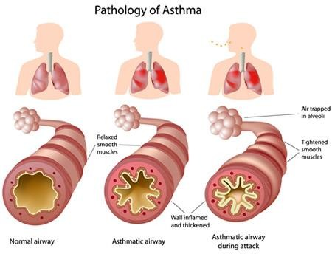

Slide 6
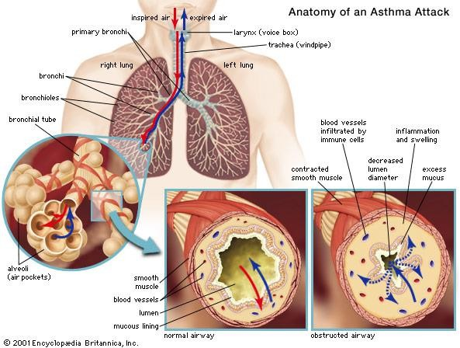

Slide 7
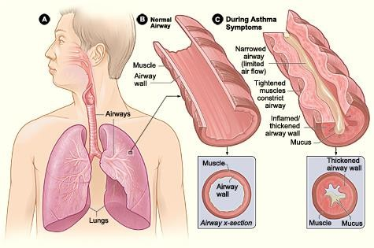

Slide 8
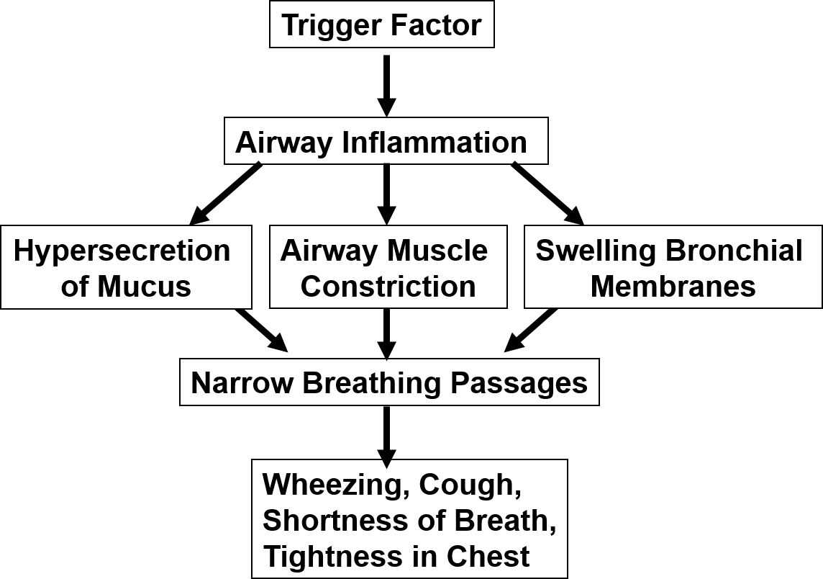

Slide 9
Early- or acute-phase response (develop within 10 to 20min)
Antigen binds to IgE-coated mast cells on the mucosal surface of the airways
Release of chemical mediators from IgE-coated mast cells
Opening of the mucosal intercellular junctions and enhancement of antigen movement to the more prevalent subucosal mast cells

Slide 10
Stimulation of parasympathetic receptors, increased vascular permeability, increased mucus secretions
Bronchoconstriction , mucosal edema

Slide 11
late-phase response (develops 4 to 8 hours after exposure to an
asthmatic trigger and persist for 12-24hrs or more
Initial trigger
Release of inflammatory mediators from mast cells, macrophages, and epithelial cells
Migration and activation of other inflammatory cells (e.g., basophils, eosinophils, macrophages, neutrophils and T- lymphocytes

Slide 12
1. Eosinophils (migrate to the airways)
inflammatory mediators (leukotrienes and granule proteins), cytotoxic mediators, and cytokines.
Cell injury

Slide 13
2. T-lymphocyte activation
Release of [IL]-4, IL-5, and IL-13 from(TH2)
Allergic inflammation
T-helper (TH 1 ) cells produce IL-2 and interferon- γ that are essential for cellular defense mechanisms.
Imbalance between TH 1 and TH2 Allergic asthma

Slide 14
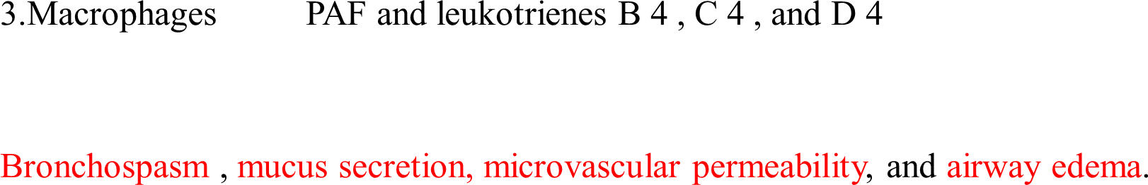

4.Neutrophils leukotrienes
PAFs, prostaglandins, thromboxanes,
BHR, bronchoconstriction and airway inflammation.

Slide 15
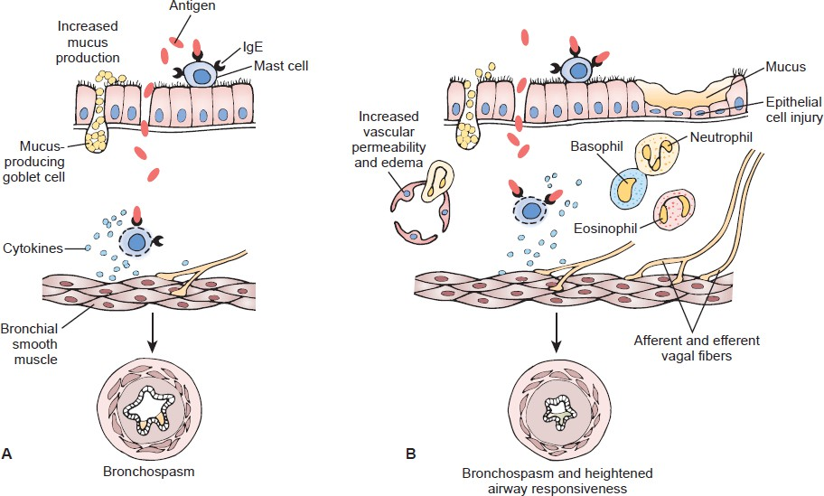

Slide 16
Epithelial injury and edema,
Changes in mucociliary function and reduced clearance of respiratory tract secretions
Impaired mucociliary transport.
Increased bronchial glands size and number.
Sub-basement membrane thickening, sub epithelial fibrosis.
AIRWAY REMODELLING

Slide 17
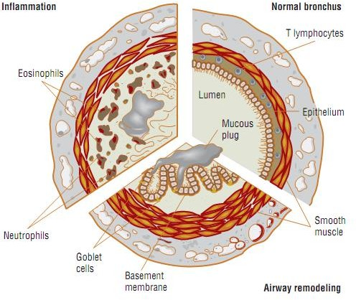

Slide 18
Intrinsic/non-atopic
1. Respiratory tract infections (mainly viruses)
Epithelial damage, production of IgE antibodies, response to other triggers
airway
Exercise induced asthma:
  Vigorous exercise inhalation of increased volumes of relatively cold and dry air and loss of body heat from respiratory mucosa

Slide 19
Induces mast and epithelial cells to release proinflammatory mediators( histamine & leukotrienes)
This occurs especially in cold climates
Airway cooling stimulates cholinergic receptors.
3. Inhaled irritants (tobacco smoke, strong odors)
Activate vagal reflex and irritant receptors Bronchospasm

Slide 20
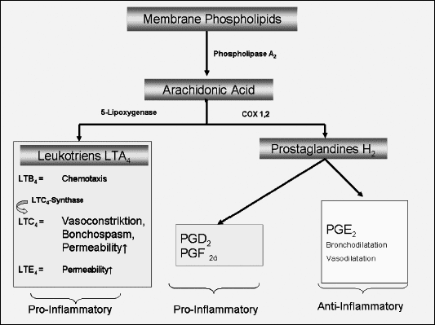
4. Aspirin and NSAID
NSAID & Aspirin

Slide 21
5. Emotional factors
Activates vagal pathway
Bronchospasm
6. Gastric secretions
Bronchospasmic trigger

Slide 22
CLINICAL MANIFESTATIONS
CHRONIC
Persistent cough (particularly night time)
Recurrent episodes of difficulty in breathing associates with
wheezing
Chest tightness
Shortness of breath
Acute severe asthma
Breathlessness at rest
Severe dyspnea, shortness of breath,
Chest tightness, or burning.
Increased pulse rate, tachypnea, tachycardia
Cyanotic skin, hyperinflated chest

