Slide 1
BIOPHARMACEUTICS AND PHARMACOKINETICS
1: ABSORPTION OF DRUGS
14-09-2024
1

Slide 2
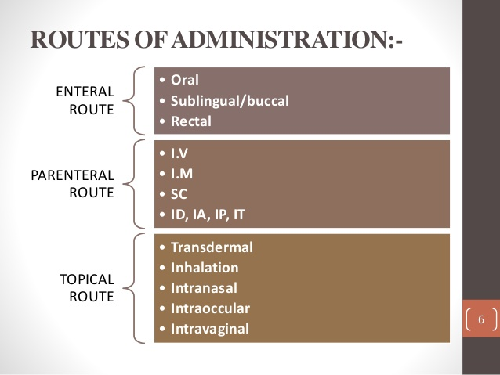
The majority of drug are administered generally orally. But in some cases it is not good route of administration. For reason like patient noncompliance, first pass effect, immediate drug action etc.
In that cases other route are preferable are s follows
14-09-2024
2

Slide 3
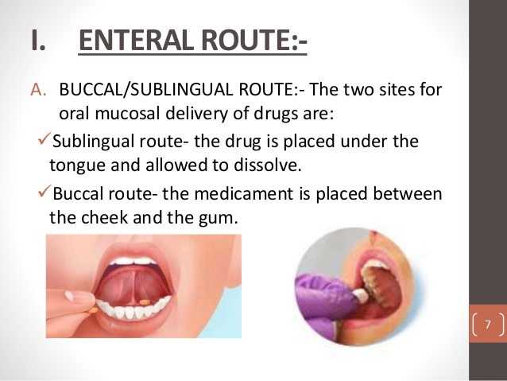
14-09-2024
3

Slide 4
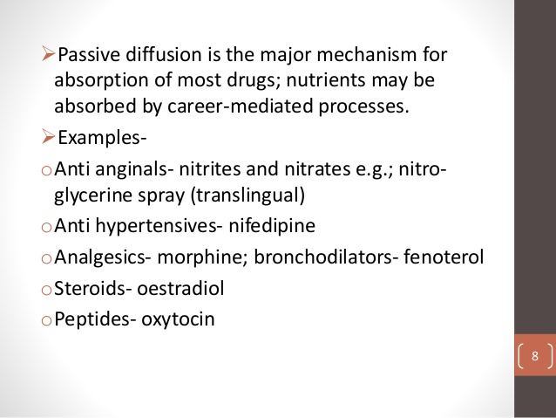
14-09-2024
4

Slide 5
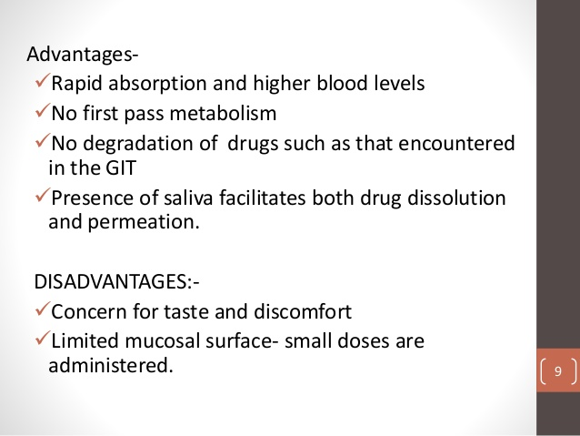
14-09-2024
5

Slide 6
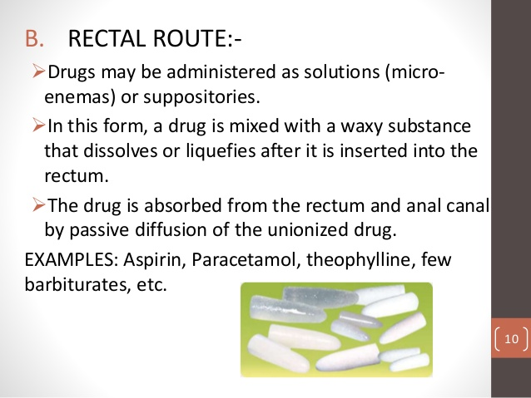
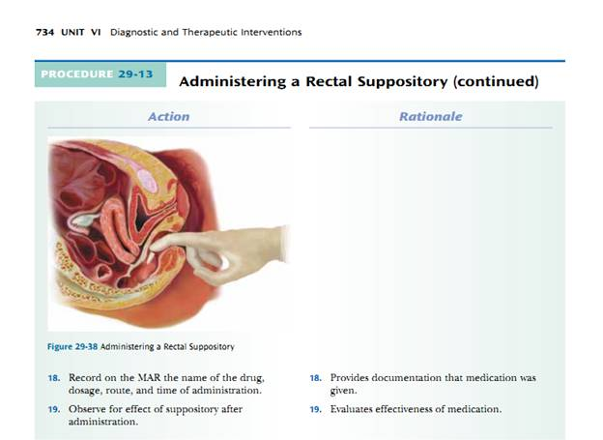
14-09-2024
6

Slide 7
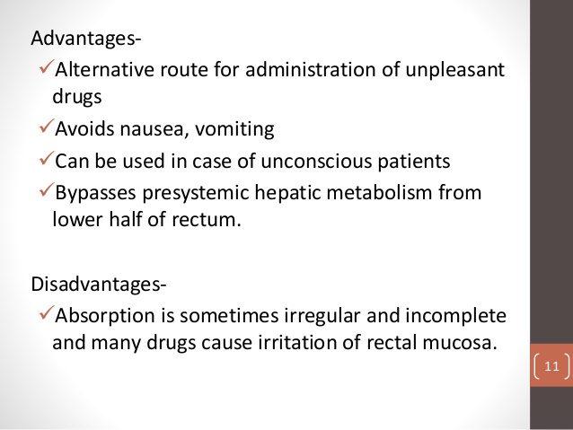
14-09-2024
7

Slide 8
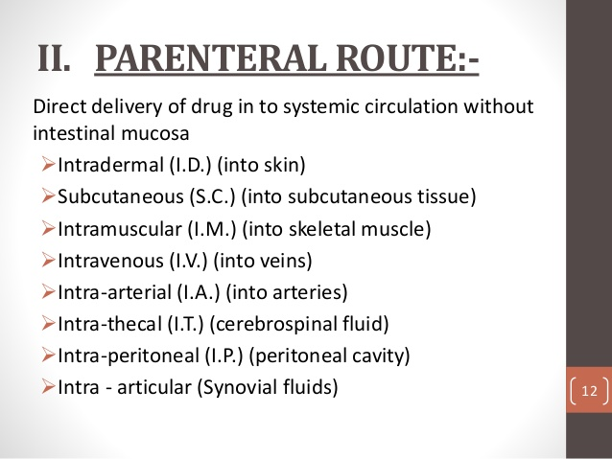
14-09-2024
8

Slide 9
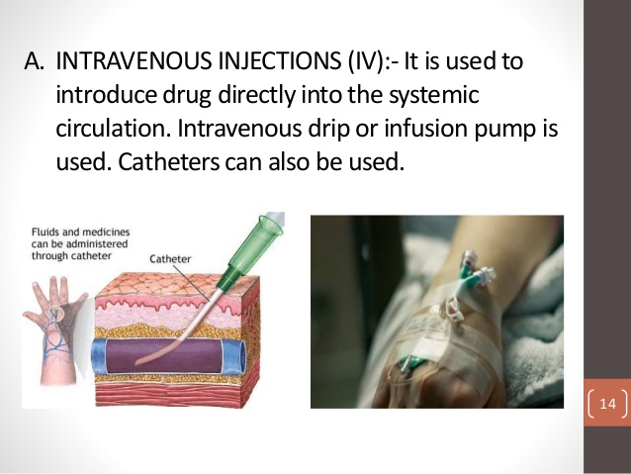
14-09-2024
9

Slide 10
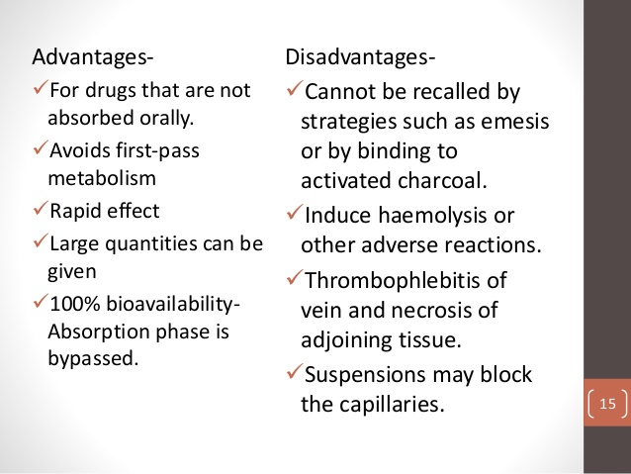
14-09-2024
10

Slide 11
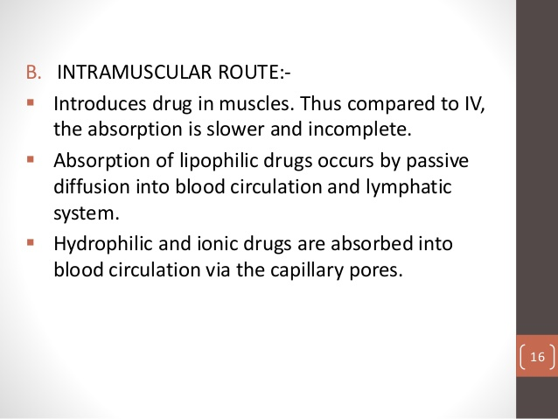
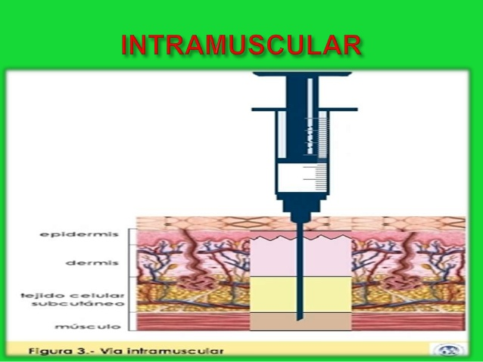
14-09-2024
11

Slide 12
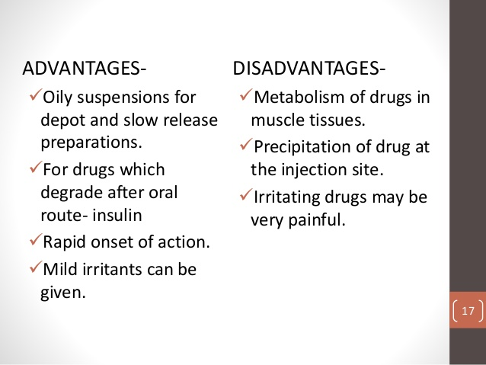
14-09-2024
12

Slide 13
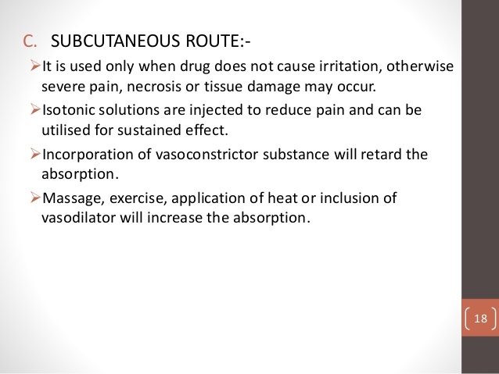
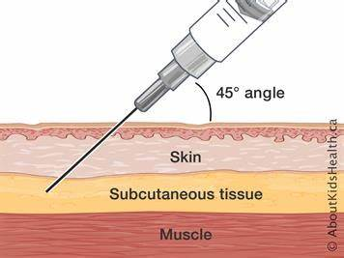
14-09-2024
13

Slide 14
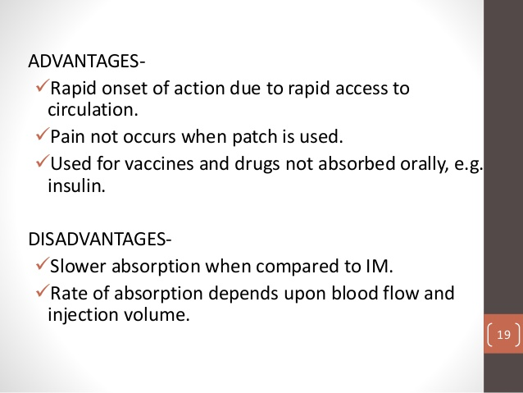
14-09-2024
14

Slide 15
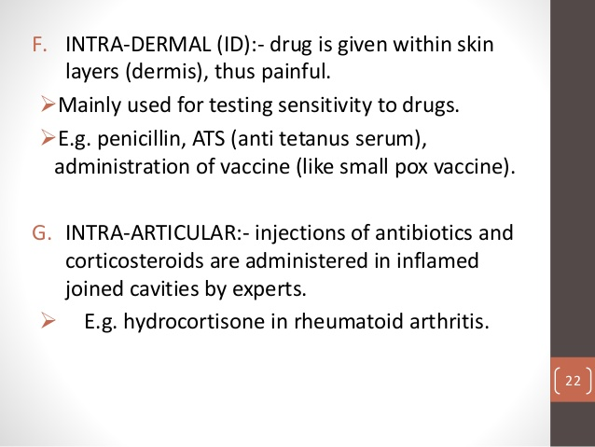
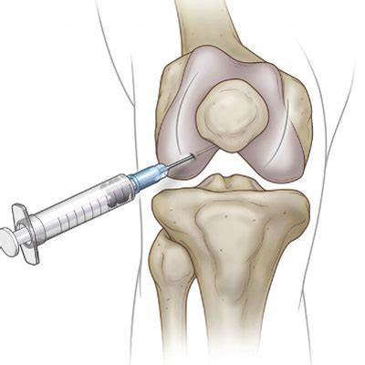
14-09-2024
15

Slide 16
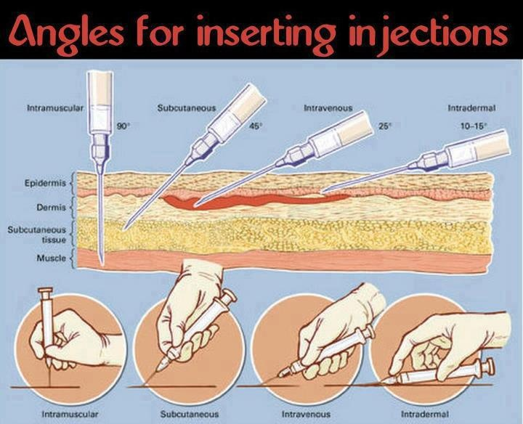
14-09-2024
16

Slide 17
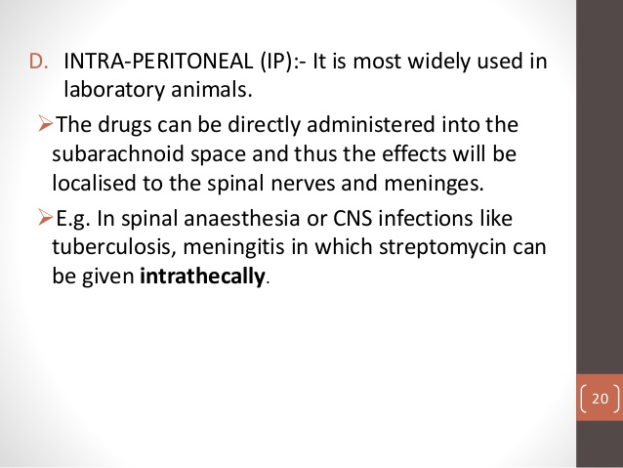
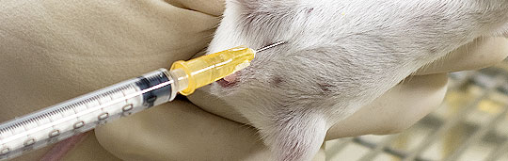
14-09-2024
17

Slide 18
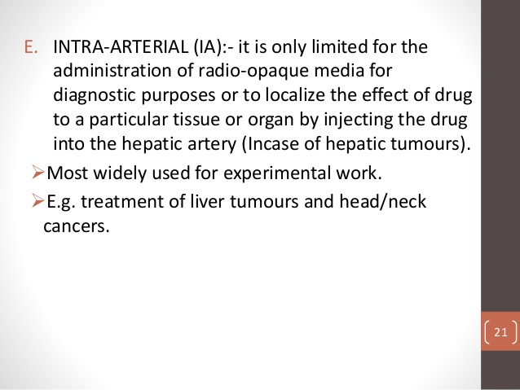
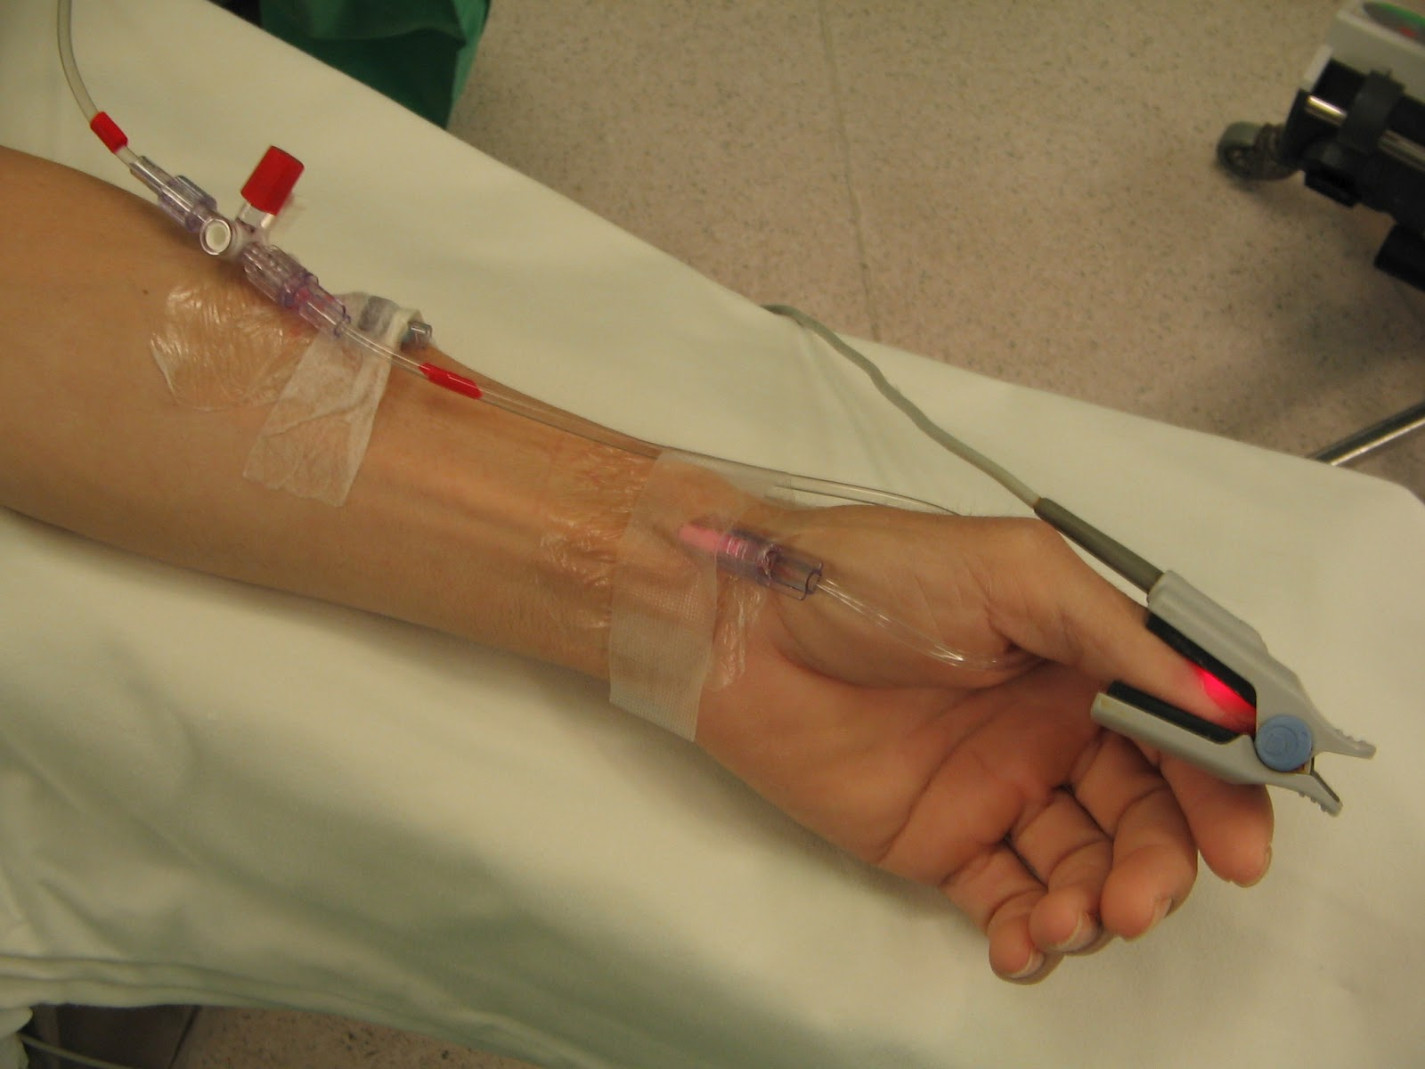
14-09-2024
18

Slide 19
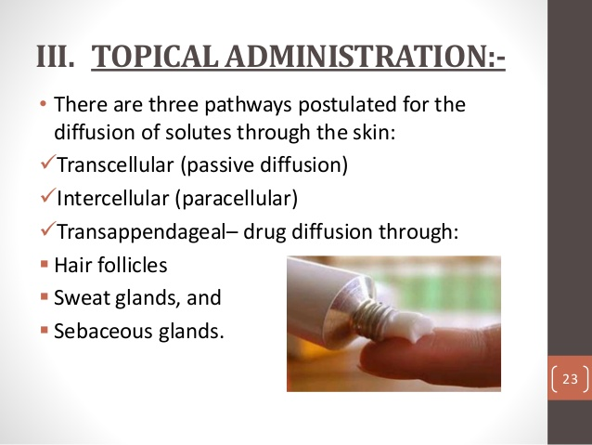
14-09-2024
19

Slide 20
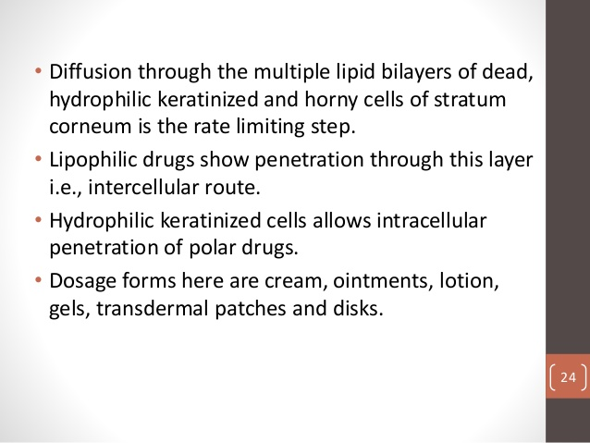
14-09-2024
20

Slide 21
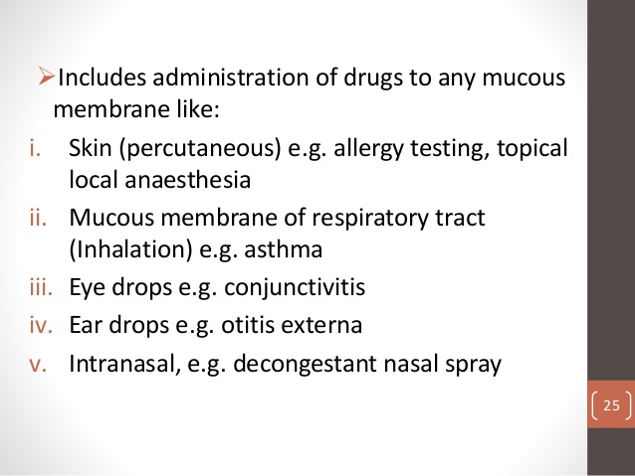
14-09-2024
21

Slide 22
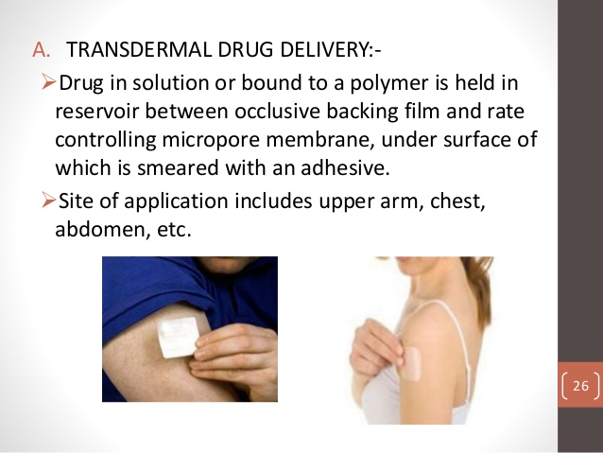
14-09-2024
22

Slide 23
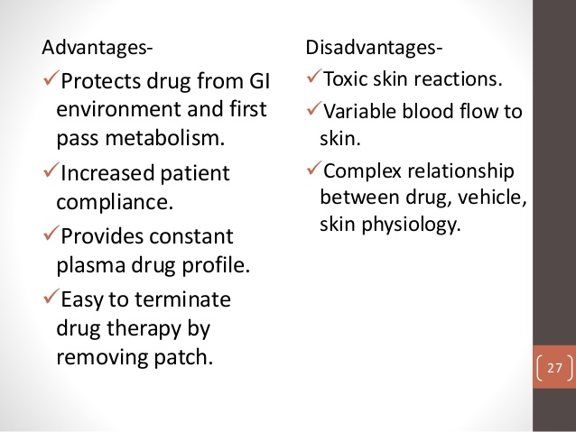
14-09-2024
23

Slide 24
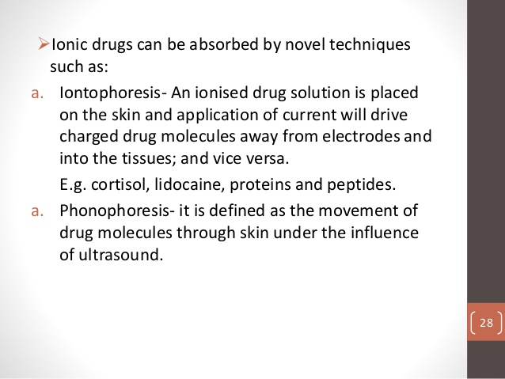
14-09-2024
24

Slide 25
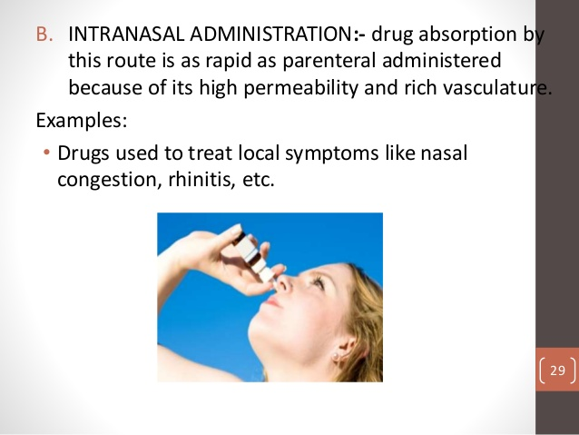
14-09-2024
25

Slide 26
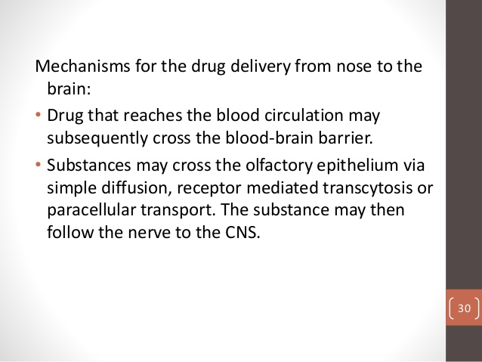
14-09-2024
26

Slide 27
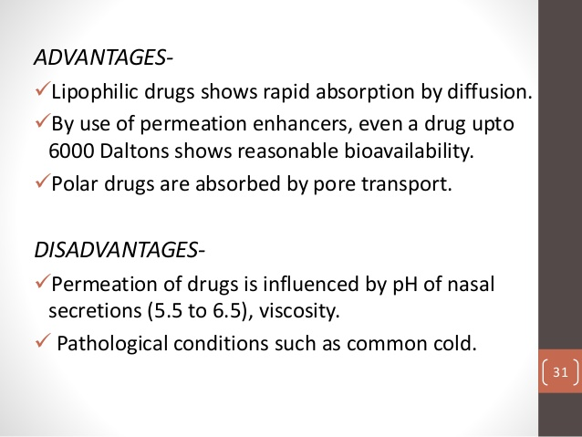
14-09-2024
27

Slide 28
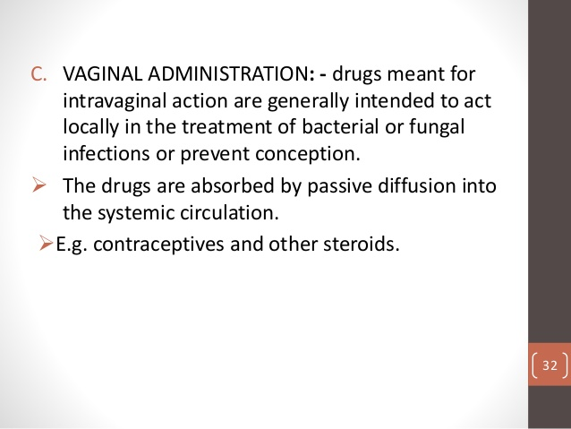
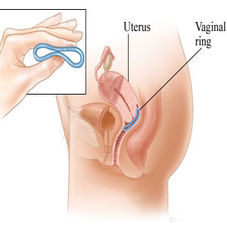
14-09-2024
28

Slide 29
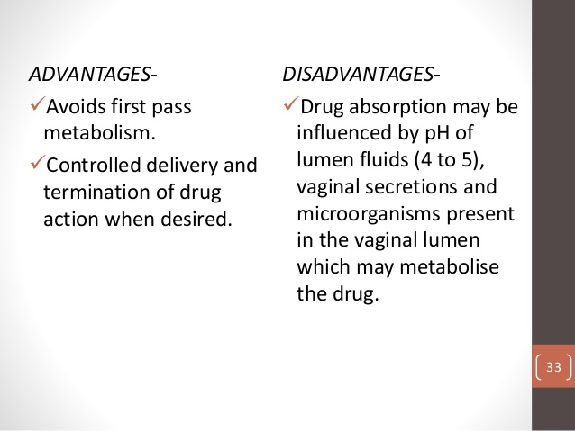
14-09-2024
29

Slide 30
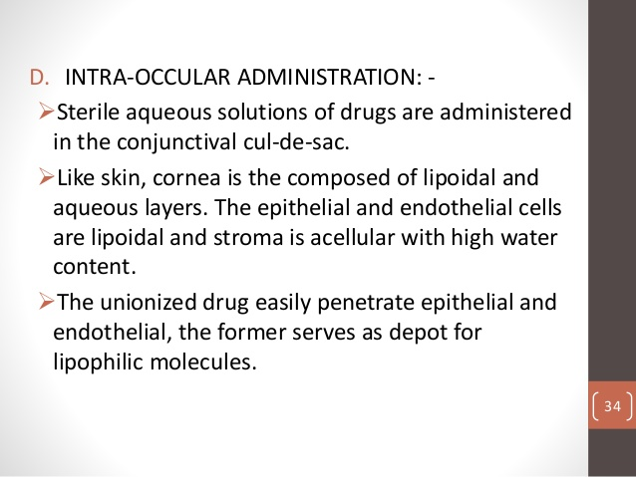
14-09-2024
30

Slide 31
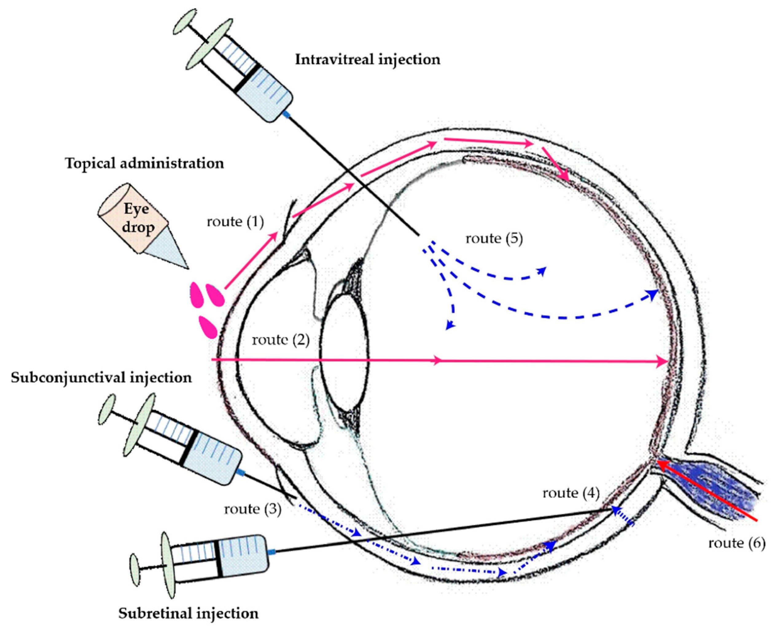
14-09-2024
31

Slide 32
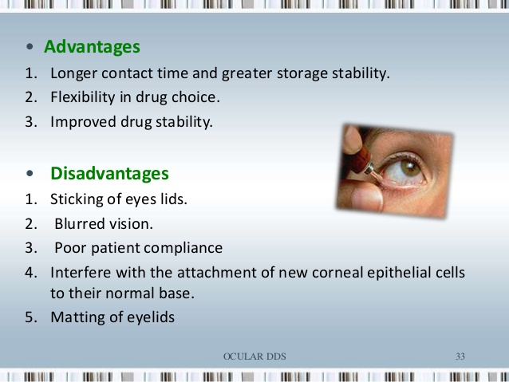
14-09-2024
32

Slide 33
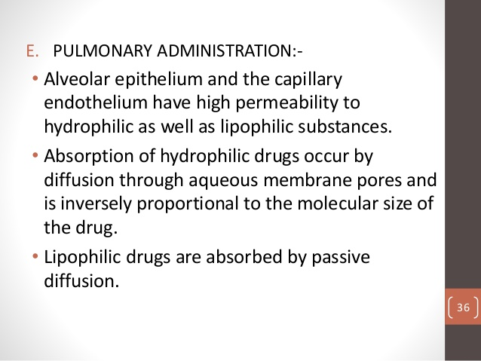
14-09-2024
33

Slide 34
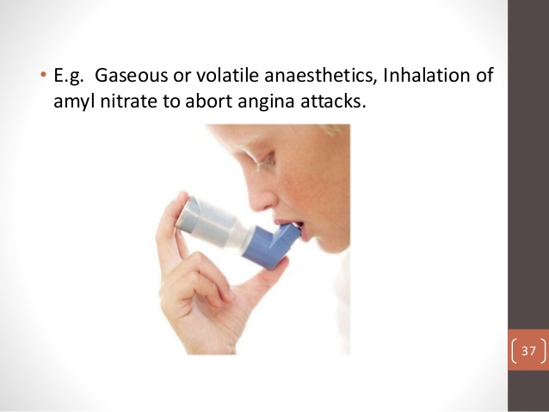
14-09-2024
34

Slide 35
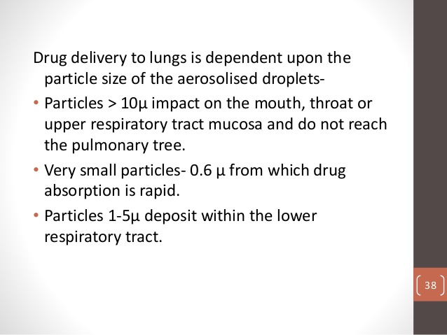
14-09-2024
35

Slide 36
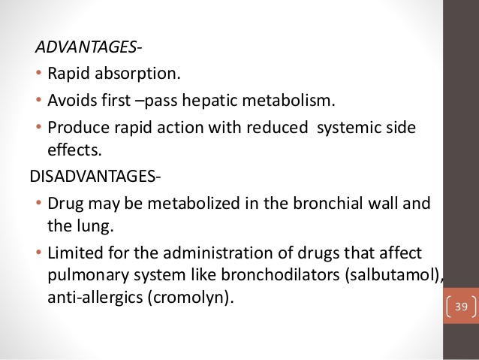
14-09-2024
36

