Slide 1

ARF

Slide 2
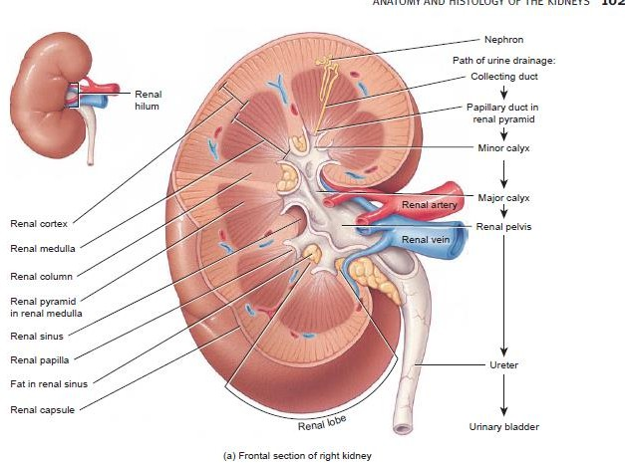

Slide 3
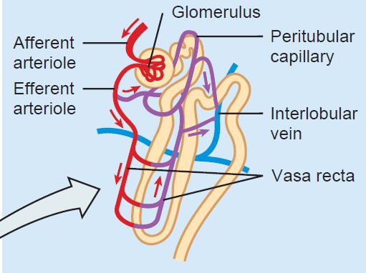

Slide 4
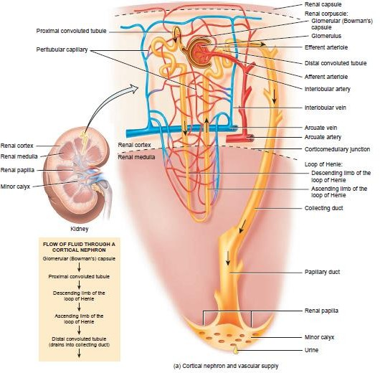

Slide 5
Production and elimination of urine requires 3 basic physiologic events
Blood flow to glomeruli
Formation and processing of ultrafiltrate by glomeruli and tubular cells
Urine excretion through ureters, bladder and urethra
Alteration in these physiological events leads to ARF or CRF

Slide 6
Renal failure is a condition in which the kidneys fail to remove metabolic end products from the blood and regulate the fluid, electrolyte, and pH balance of the extracellular fluids.
Renal failure can occur as an acute or a chronic disorder
ARF is broadly defined as a decrease in glomerular filtration rate (GFR), generally occurring over hours to days, sometimes over weeks, that is associated with an accumulation of waste products, including urea and creatinine.

Slide 7
Acute renal failure often is reversible if recognized early and treated appropriately
Chronic kidney disease, also called chronic renal insufficiency or progressive kidney disease by some, is defined as a progressive loss of function occurring over several months to years, and is characterized by the gradual replacement of normal kidney architecture with interstitial fibrosis.

Slide 8
Chronic renal failure is the end result of irreparable damage
ARF is predominantly categorized based on the anatomic area of injury or malfunction:
prerenal—decreased renal blood flow,
Functional –impaired glomerular ultrafiltrate production or intraglomerular pressure
intrinsic—a structure within the kidney is damaged, and
postrenal—an obstruction is present within the urine collection system.
Normal urine output of ≥1,200 mL/day

Slide 9
Patients with ARF are often categorized as being
anuric (urine output <50 mL/day),
oliguric (urine output <500 mL/day), or
nonoliguric (urine output >500 mL/day).
The most common indicator of acute renal failure is azotemia, an accumulation of nitrogenous wastes (urea nitrogen,uric acid, and creatinine) in the blood.

Slide 10
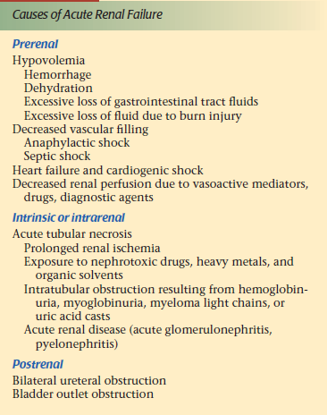

Slide 11
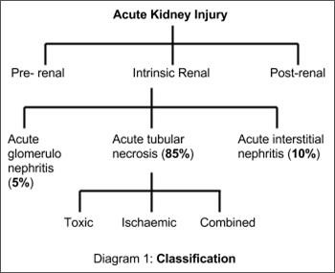

Slide 12
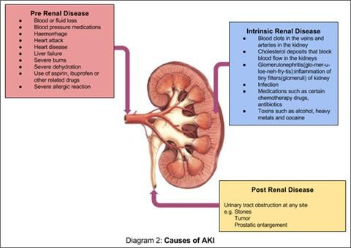

Slide 13
Prerenal ARF
Results from hypoperfusion of the renal parenchyma, with or without systemic arterial hypotension.
Renal hypoperfusion with systemic arterial hypotension may be caused by a decline in intravascular or effective blood volume that can occur in those with acute blood loss (hemorrhage), dehydration, hypoalbuminemia, or diuretic therapy.

Slide 14
Renal hypoperfusion without systemic hypotension is most commonly associated with Renal artery stenosis bilateral renal artery occlusion, or unilateral occlusion in a patient with a single functioning kidney.
The most common cause is atherosclerosis, with severe abrupt occlusion sometimes occurring as the result of an embolism.
Homeostatic mechanisms are often able to maintain arterial pressure and renal perfusion, potentially averting the progression to ARF

Slide 15
If, however, the decreased renal perfusion is severe or prolonged, these compensatory mechanisms may be overwhelmed and ARF will then be clinically evident.

Slide 16
Functional
Impaired glomerular ultrafiltrate production or impaired intraglomerular pressure
The afferent and efferent arterioles work in concert to maitain adequate glomerular capillary hydrostatic pressure to form ultrafiltrate
Many drugs reduce this intraglomerular hydrostatic pressure.

Slide 17
NSAID and cyclosporine—afferent vasoconstriction
ACE inh ARB ---efferent vasodilation.

Slide 18
Intrinsic ARF
Renal vasculature damage
Glomeruli damage
Tubular damage (ATN)
Interstitial damage

Slide 19
Renovascular damage
Occlusion large atheroemboli or thromboemboli in the bilateral renal arteries, or one vessel of the patient with a single kidney.
Susceptible to inflammatory processes that lead to microvascular damage and vessel dysfunction when the renal capillaries are affected.
Neutrophils invade the vessel wall, causing damage that can include thrombus formation, tissue infarction, and collagen deposition within the vessel structure

Slide 20
Diffuse renal vasculitis can be mild or severe, with severe forms promoting concomitant ischemic acute tubular necrosis (ATN).
Accelerated hypertension that is not treated may also compromise renal microvascular blood flow, and thus cause diffuse renal capillary damage.

Slide 21
Glomerular Damage
Only 5% of the cases of intrinsic ARF are of glomerular origin.
The glomerulus serves to filter fluid and solute into the tubules while retaining proteins and other large blood components in the intravascular space.
glomerular damage can occur by the same mechanisms described for the renal vasculature, and severe inflammatory processes specific to the glomerulus.

Slide 22
Immune mediated injury
Antigen-antibody complexes localize in glomerulus lead to triggering of biological events cell injury and proteinuria.

Slide 23
Tubular damage
85% of all cases of intrinsic ARF are caused by ATN
50% are a result of renal ischemia
35% are the result of exposure to direct tubule toxins,
–endogenous (myoglobin, hemoglobin, or uric acid)
–exogenous (contrast agents, heavy metals, or aminoglycoside antibiotics).

Slide 24
The tubules located within the medulla of the kidney are particularly at risk from ischemic injury, as this portion of the kidney is metabolically active and thus has high oxygen requirements.
Thus, ischemic conditions affect the tubules more than any other portion of the kidney.

Slide 25
Initial injury causing tubule epithelial cell necrosis or apoptosis, followed by an extension phase with continued hypoxia and an inflammatory response involving the nearby interstitium.
The onset of ATN can occur over days to weeks, and rarely longer than that depending on the factors responsible for the damage to the tubular epithelial cells.

Slide 26
Once tubular cells die
They slough off into the tubular lumen.
The debris causes increased tubular pressure and reduces glomerular filtration
The loss of epithelial cells leaves only the basement membrane between the filtrate and the interstitium
Which results in dysregulation of fluid and electrolyte transfer across the tubular epithelium

Slide 27
Tubular injury leads to a loss in the ability to concentrate urine
Defective distal sodium reabsorption, and, ultimately, to a reduction in the GFR
Continued kidney hypoxia or toxin exposure after the original insult, kills more cells and propagates the inflammatory response
Extend the injury and delay the recovery Process
With prolonged ischemia, the tubular epithelial cells in the cortico-medullary junction are damaged and die

Slide 28
When the toxin or ischemia is removed, a maintenance phase ensues (typically 2 to 3 weeks), followed by a recovery phase (2 to 3 weeks) during which new tubule cells are regenerated.
The recovery phase is associated with a notable diuresis, which requires attention to fluid balance to ensure that a secondary prerenal injury does not occur.
if the ischemia or injury is extremely severe or prolonged, cortical necrosis may occur, preventing any tubule cell regrowth in the affected areas.

Slide 29
Interstitial Damage
The interstitium of the kidney is rarely the primary cause of end-stage renal disease (ESRD)
Acute interstitial nephritis is most commonly caused by medications or bacterial or viral infections
Up to 30% of cases have no identifiable cause

Slide 30
Interstitial nephritis is characterized by lesions comprised of monocytes, macrophages, B cells, or T cells, clearly identifying an immunologic response as the injurious process affecting the interstitium
Widespread inflammation and edema affect the function of the tubules, and may cause fibrosis if the administration of the nephrotoxin is not discontinued and inflammation quickly

Slide 31
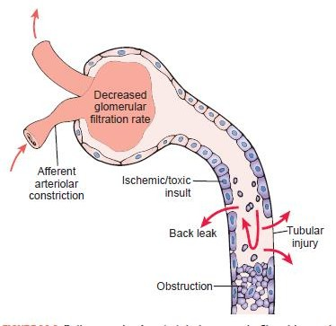

Slide 32
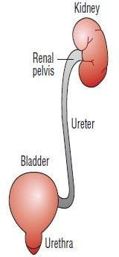

Slide 33
POSTRENAL ACUTE RENAL FAILURE
Postrenal ARF may develop as the result of obstruction at any level within the urinary collection system from the renal tubule to urethra
Wherever the location of the obstruction, urine will accumulate in the renal structures above the obstruction and cause increased pressure upstream.
The ureters, renal pelvis, and calyces all expand, and the net result is a decline in GFR.
•

Slide 34
The blockage may occur at the ureter level, secondary to nephrolithiasis, blood clots, a sloughed renal papillae, or physical compression by an abdominal process such as retroperitoneal fibrosis, cancer, or an abscess
Bladder outlet obstruction, the most common cause of obstructive uropathy, is often caused by a prostatic process (hypertrophy, cancer or infection)
Improperly placed urinary catheter.

Slide 35
Neurogenic bladder or anticholinergic medications may also prevent bladder emptying and cause ARF.
Crystal deposition within the tubules from oxalate
Insufficient urine volume to prevent crystal precipitation in the urine
Extremely elevated uric acid concentrations from chemotherapy- induced tumor lysis syndrome

Slide 36
Clinical presentation
Acute change in urinary habits,
Weight gain, and flank pain.
Signs include edema, colored or foamy urine, and, in volume depleted patients, orthostatic hypotension.

Slide 37
Complications of ARF?

