Slide 1
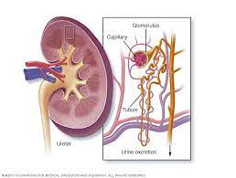
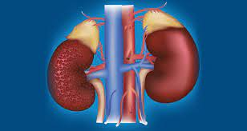
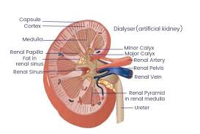
Acute Renal Failure
ARF
Renal System Disorder
By Animesh Das

Slide 2
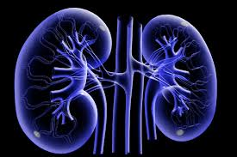
Definition
It is a condition in which the kidneys suddenly can’t filter waste from the blood , also called as ARF . It develops rapidly over a few hours or days .
Affected organ – Kidneys

Slide 3

Type / Classification
There are 3 type of ARF --
prerenal
intrinsic
postrenal

Slide 4
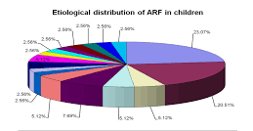
Epidemiology
5 % of all hospitalised patient and 35 % intensive care units .
Mortality is High .
ARF zone – India , Africa , UK .

Slide 5

Sings and symptoms
Decreased urine output, although occasionally urine output remains normal.
Fluid retention, causing swelling in your legs, ankles or feet.
Shortness of breath.
Fatigue.
Confusion.
Nausea.
Weakness.
Irregular heartbeat

Slide 6
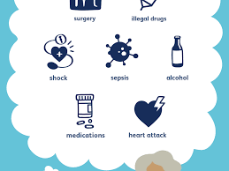
Risk factor
Age
metabolic abnormalities
Hemodynamic
Drugs
toxins
trauma
Renal cause

Slide 7

Phases of ARF
There are 4 phases present of ARF --
Initiation phase
Oliguric phase
Diuretic phase
Recovery phase

Slide 8
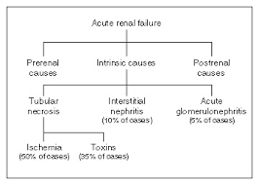
Pathophysiology

Slide 9
Management
Diagnosis
Treatment

Slide 10
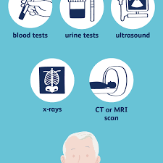
Diagnosis
History and physical test
Urine test
US of kidneys
Renal CT / MRI
KUB radiotherapy
Creatinine , sodium , potassium test

Slide 11
Treatment
Category | Drug Name
Diuretics | Thiazide
Calcium channel blocker | Nifedipine , Verapamil
Vasodilators | Fenoldopam
Antidots | N-acetylcysteine
Loop
Inotropic agent | dopamine

Slide 12
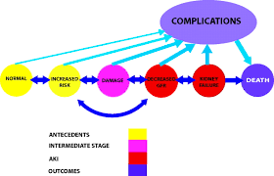
Complication
ARF can effect the entire body .
Infections
Hyperkalaemia
Hyperphosphatemia
Pulmonary Oedema

Slide 13
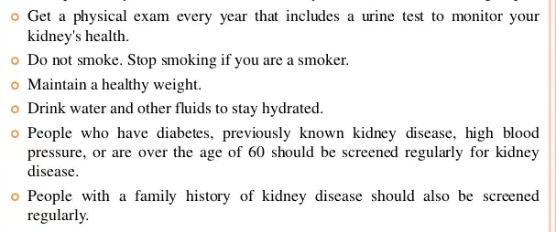
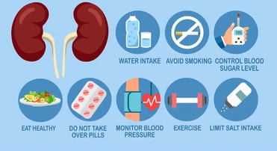
Prevention

Slide 14
Thank
you

