Slide 1
PHARMACOGNOSY AND PHYTOCHEMISTRY
ANALYSIS OF PROTIENS
17-09-2024
1

Slide 2
ANALYSIS OF PROTIENS
Proteins are polymers of amino acids. Twenty different types of amino acids occur naturally in proteins. Proteins differ from each other according to the type, number and sequence of amino acids that make up the polypeptide backbone.
As a result they have different molecular structures, nutritional attributes and physiochemical properties. Proteins are important constituents of foods for a number of different reasons.
They are a major source of energy, as well as containing essential amino-acids, such as lysine, tryptophan, methionine, leucine, isoleucine and valine, which are essential to human health, but which the body cannot synthesize. Proteins are also the major structural components of many natural foods, often determining their overall texture, e.g., tenderness of meat or fish products. Isolated proteins are often used in foods as ingredients because of their unique functional properties, i.e., their ability to provide desirable appearance, texture or stability.
Typically, proteins are used as gelling agents, emulsifiers, foaming agents and thickeners. Many food proteins are enzymes which are capable of enhancing the rate of certain biochemical reactions.
These reactions can have either a favorable or detrimental effect on the overall properties of foods. Food analysts are interested in knowing the total concentration, type, molecular structure and functional properties of the proteins in foods.
17-09-2024
2

Slide 3
Determination of Overall Protein Concentration
Kjeldahl method
The Kjeldahl method was developed in 1883 by a brewer called Johann Kjeldahl. A food is digested with a strong acid so that it releases nitrogen which can be determined by a suitable titration technique.
The amount of protein present is then calculated from the nitrogen concentration of the food. The same basic approach is still used today, although a number of improvements have been made to speed up the process and to obtain more accurate measurements. It is usually considered to be the standard method of determining protein concentration.
Because the Kjeldahl method does not measure the protein content directly a conversion factor (F) is needed to convert the measured nitrogen concentration to a protein concentration.
A conversion factor of 6.25 (equivalent to 0.16 g nitrogen per gram of protein) is used for many applications, however, this is only an average value, and each protein has a different conversion factor depending on its amino-acid composition.
The Kjeldahl method can conveniently be divided into three steps: digestion, neutralization and titration.
17-09-2024
3

Slide 4
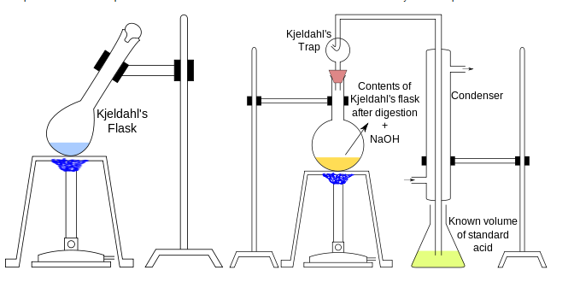
17-09-2024
4

Slide 5
Digestion
The food sample to be analyzed is weighed into a digestion flask and then digested by heating it in the presence of sulfuric acid (an oxidizing agent which digests the food), anhydrous sodium sulfate (to speed up the reaction by raising the boiling point) and a catalyst, such as copper, selenium, titanium, or mercury (to speed up the reaction). Digestion converts any nitrogen in the food (other than that which is in the form of nitrates or nitrites) into ammonia, and other organic matter to C02and H20. Ammonia gas is not liberated in an acid solution because the ammonia is in the form of the ammonium ion (NH4+) which binds to the sulfate ion (SO42-) and thus remains in solution:
N(food) → (NH₄)₂SO₄ (1)
Neutralization
After the digestion has been completed the digestion flask is connected to a recieving flask by a tube. The solution in the digestion flask is then made alkaline by addition of sodium hydroxide, which converts the ammonium sulfate into ammonia gas:
(NH₄)₂SO₄ + 2 NaOH → 2NH₃ + 2H₂O + Na₂SO₄ (2)
The ammonia gas that is formed is liberated from the solution and moves out of the digestion flask and into the receiving flask - which contains an excess of boric acid. The low pH of the solution in the receiving flask converts the ammonia gas into the ammonium ion, and simultaneously converts the boric acid to the borate ion:
NH₃ + H₃BO₃ (boric acid) → NH₄⁺ + H₂BO₃⁻ (borate ion) (3)
17-09-2024
5

Slide 6

Titration
The nitrogen content is then estimated by titration of the ammonium borate formed with standard sulfuric or hydrochloric acid, using a suitable indicator to determine the end-point of the reaction.
H₂BO₃⁻ + H⁺ → H₃BO₃ (4)
The concentration of hydrogen ions (in moles) required to reach the end-point is equivalent to the concentration of nitrogen that was in the original food (Equation 3). The following equation can be used to determine the nitrogen concentration of a sample that weighs m grams using a x M HCl acid solution for the titration.
Where vs and vb are the titration volumes of the sample and blank, and 14g is the molecular weight of nitrogen N. A blank sample is usually ran at the same time as the material being analyzed to take into account any residual nitrogen which may be in the reagents used to carry out the analysis. Once the nitrogen content has been determined it is converted to a protein content using the appropriate conversion factor: % Protein = F %N.
17-09-2024
6

Slide 7
Advantages and Disadvantages
Advantages. The Kjeldahl method is widely used internationally and is still the standard method for comparison against all other methods. Its universality, high precision and good reproducibility have made it the major method for the estimation of protein in foods.
Disadvantages. It does not give a measure of the true protein, since all nitrogen in foods is not in the form of protein. Different proteins need different correction factors because they have different amino acid sequences. The use of concentrated sulfuric acid at high temperatures poses a considerable hazard, as does the use of some of the possible catalysts The technique is time consuming to carry-out.
17-09-2024
7

