Slide 1
Anemia

Slide 2
In adults, RBCs are formed in the marrow of the vertebrae, ribs, sternum, clavicle, pelvic (iliac) crest, and proximal epiphyses of the long bones.
The hormone EPO, 90% of which is produced by the kidneys, initiates and stimulates the production of RBCs.

Slide 3
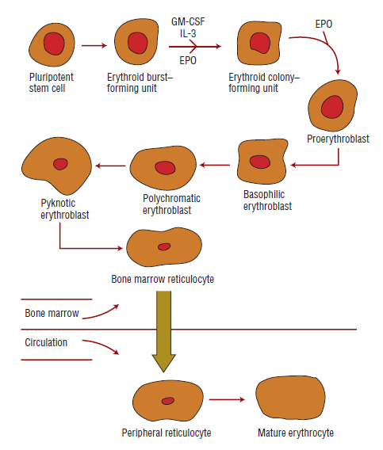
Erythrocyte maturation sequence

Slide 4
Hb and iron are incorporated into the gradually maturing RBC, which eventually is released from the marrow into the circulating blood as a reticulocyte.
More than 90% of the protein content of the erythrocyte consists of the oxygen-carrying molecule Hb.
Normal survival time is 120 days.

Slide 5
Under normal conditions, the body produces approximately 6.25 g of Hb daily.
The normal iron content of the body is approximately 3 to 4 g. Iron is a component of Hb
Approximately 2.5 g of the iron exists in the form of Hb
Iron is a component of Hb, myoglobin, and cytochromes.

Slide 6
Another 3 to 7 mg of iron is bound to transferrin in plasma, and the remaining iron exists as storage iron in the form of ferritin or hemosiderin
Hepcidin is a regulator of intestinal iron absorption, iron recycling and iron mobilization from hepatic stores.

Slide 7
Hepcidin is induced during infections and inflammation, which allows iron to sequester in macrophages, hepatocytes, and enterocytes
Plasma transport protein transferrin delivers iron to the bone marrow for incorporation into the Hb molecule.

Slide 8

Anemia is defined as an abnormally low number of circulating red blood cells or level of hemoglobin, or both, resulting in diminished oxygen-carrying capacity
Introduction

Slide 9
Anemia usually results from
Excessive loss (bleeding) or
Destruction (hemolysis) of red blood cells or
Deficient red blood cell production because of a lack of nutritional elements or bone marrow failure.

Slide 10
Anemia may result from the decreased production of erythrocytes by the bone marrow.
A deficiency of nutrients for hemoglobin synthesis (iron) or DNA synthesis (cobalamin or folic acid) may reduce red cell production by the bone marrow
A deficiency of red cells also results when the marrow itself fails or is replaced by nonfunctional tissue.
Anemia's of Deficient Red Cell Production

Slide 11
IRON DEFICIENCY ANEMIA

Slide 12
Iron deficiency is a common worldwide cause of anemia affecting people of all ages.
Because iron is a component of heme, a deficiency leads to decreased hemoglobin synthesis and consequent impairment of oxygen delivery.
Iron Deficiency Anemia

Slide 13
Malabsorptive syndromes
Diets limited in meat or fresh fruits and vegetables
Diets high in substances that form complexes with iron
Situations that increase the demand for iron (menstruation, lactation, infancy, adolescence, pregnancy)
Blood loss (trauma, hemorrhoids, peptic ulcers, gastritis, gastrointestinal malignancies, postpartum Bleeding )
ACD, Thalassemia, Sideroblastic anemia, and heavy metal (mostly lead) poisoning
IDA Etiopathogenesis

Slide 14
Risk of iron deficiency is related to
levels of iron loss,
Iron intake,
Iron absorption, and
Physiologic demands.
Iron deficiency usually is the result of a long period of negative iron balance
Manifestations of iron deficiency occur in three stages: prelatent, latent, and IDA.

Slide 15
Prelatent iron deficiency: This first stage, iron stores can be depleted without causing anemia.
Once stores are depleted, there still is adequate iron from daily RBC turnover for Hb synthesis.
Further iron losses would make the patient vulnerable to anemia development.

Slide 16
Latent iron deficiency occurs when iron stores are depleted, but Hb is above the lower limit of normal for the population.
IDA occurs when the Hb falls to less than normal values.

Slide 17
When red cells become senescent and are broken down, their iron is released and reused in the production of new red cells.
Despite this efficiency, small amounts of iron are lost in the feces and need to be replaced by dietary uptake.
Iron balance is maintained by the absorption of 1 to 2 mg daily to replace the iron lost in the feces.
The usual reason for iron deficiency in adults is chronic blood loss because iron cannot be recycled to the pool.

Slide 18
Pregnant women with iron deficiency anemia without iron supplementation had a slightly higher rate of preterm infants and lower birth rates than those supplemented with iron.

Slide 19
The manifestations of anemia depend on its severity, the rapidity of its development, and the person’s age and health status.

Slide 20
Lethargy
Pale complexion
Shortness of breath
Heart palpitations
Altered sense of taste
Rapid heartbeat
Headache
Craving for ice or clay - "picophagia”
Sore or smooth tongue
Brittle nails or hair loss
Clinical presentation

Slide 21
MEGALOBLASTIC ANEMIA

Slide 22
Macrocytic anemia divided into megaloblastic and nonmegaloblastic anemias.
Megaloblastic anemias are caused by impaired DNA synthesis that results in enlarged red cells due to impaired maturation and division
Megaloblastic anemias, results from vitamin B12 or folate deficiency.

Slide 23
Megaloblastic anemia is of two types
Vitamin B12 deficiency anemia
Folate deficiency anemia

Slide 24
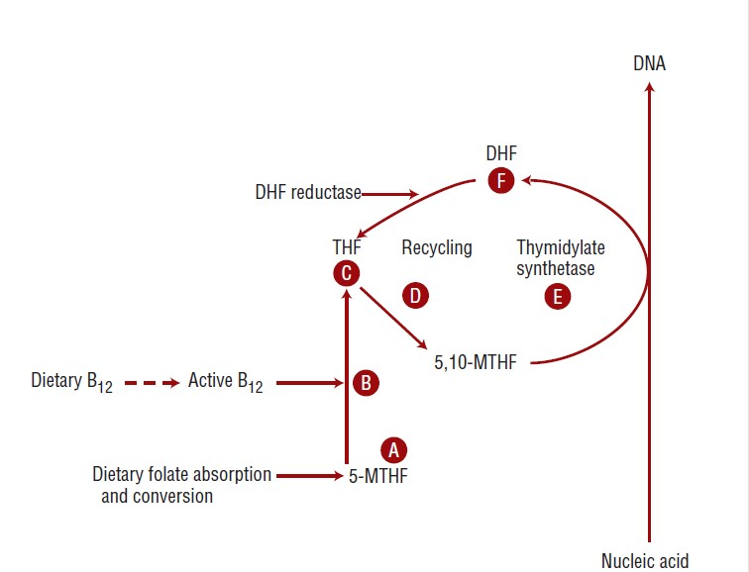

Slide 25
Dietary folates are absorbed in this process and converted to 5- methyl-tetrahydrofolate (A), which then is converted via a B12- dependent reaction (B) to tetrahydrofolate (C). After gaining a carbon, tetrahydrofolate is converted to 5,10-methyl- tetrahydrofolate (D), a folate cofactor used by thymidylate synthetase (E) in the biosynthesis of nucleic acids. The 5,10-methyl-tetrahydrofolate cofactor is converted to dihydrofolate (F) during biosynthesis.Dihydrofolate reductase normally reduces dihydrofolate back to tetrahydrofolate (C), which can again pick up a carbon and be recycled to produce more 5,10- methyl-tetrahydrofolate (D).

Slide 26
VIT B12 deficiency
anemia

Slide 27
Vitamin B12, also known as cobalamin
Serves as a cofactor for two important reactions in humans.
It is essential for DNA synthesis and nuclear maturation, which in turn leads to normal red cell maturation and division.

Slide 28
Inadequate Intake
Malabsorption syndromes,
Inadequate utilization
Chronic alcoholics
Pernicious anemia (Absence of intrinsic factor due to autoimmune destruction of the gastric parietal cells, atrophy of the gastric mucosa, or stomach surgery)
Inadequate gastric acid production (subtotal gastrectomy,
Atrophic gastritis, Acid suppression therapy)
Helicobacter pylori
Blind loop syndrome, Whipple disease, Zollinger-Ellison syndrome,
Tapeworm Infestations
Inflammatory bowel disease
Etiology

Slide 29
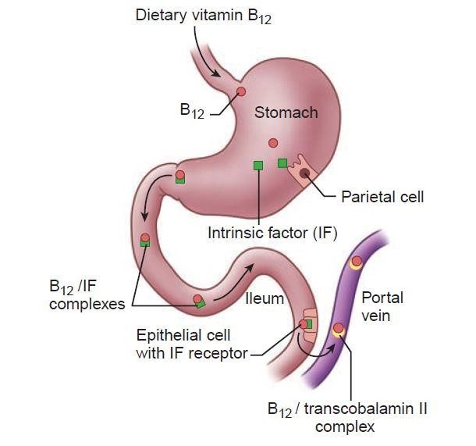
Absorption of vitamin B12

Slide 30
Vitamin B12 works closely with folate in the synthesis of building blocks for DNA and RNA, is essential in maintaining the integrity of the neurologic system, and plays a role in fatty acid biosynthesis and energy production.
Once dietary cobalamin enters the stomach, pepsin and hydrochloric acid release the cobalamin from animal proteins.
The free cobalamin then binds to R-protein, which is released from parietal and salivary cells.
Pathophysiology

Slide 31
In the duodenum, the cobalamin bound to R-protein is joined by cobalamin–R-protein complexes that have been secreted in the bile.
Pancreatic enzymes degrade both biliary and dietary cobalamin– R-protein complexes, releasing free cobalamin.
The cobalamin then binds with intrinsic factor that serves as a cell-directed carrier protein similar to transferrin for iron.

Slide 32
This complex attaches to mucosal cell receptors (cubilin) in the distal ileum, the intrinsic factor is discarded, and the cobalamin is bound to transport proteins (transcobalamin I, II, and III).
The cobalamin bound to transcobalamin II is secreted into the circulation and is taken up by the liver, bone marrow, and other cells via endocytosis
The cobalamin then is converted into its two coenzyme forms (methylcobalamin and adenosylcobalamin).

Slide 33
All three of the transport proteins prevent loss of vitamin B12 in the urine, sweat, and other body secretions.
In the liver, vitamin B12 is converted to coenzyme B12, which is essential for hematopoiesis, maintenance of myelin throughout the entire nervous system, and production of epithelial cells

Slide 34
An alternate pathway for vitamin B12 absorption independent of intrinsic factor or an intact terminal ileum accounts for a small amount of vitamin B12 absorption.
This alternate pathway involves passive diffusion and accounts for approximately 1% absorption of the ingested vitamin B12.

Slide 35
When vitamin B12 is deficient, the red cells that are produced are abnormally large because of excess cytoplasmic growth and structural proteins
The cells have immature nuclei and show evidence of cellular destruction.
They have flimsy membranes and are oval rather than biconcave.
These oddly shaped cells have a short life span that can be measured in weeks rather than months.

Slide 36
MCV is elevated
MCHC is normal
Mild jaundice
Mild leukopenia and thrombocytopenia,pancytopenia
Symmetric paresthesias of the feet and Fingers loss of vibratory and position sense, eventual spastic ataxia
More advanced cases, cerebral function may be altered
Confusion and dementia and other neuropsychiatric changes may precede hematologic changes.
Clinical Manifestations

Slide 37
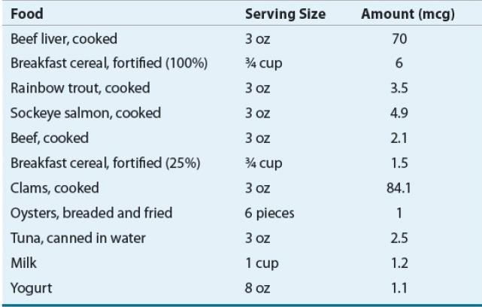
DIETARY VIT B12

Slide 38
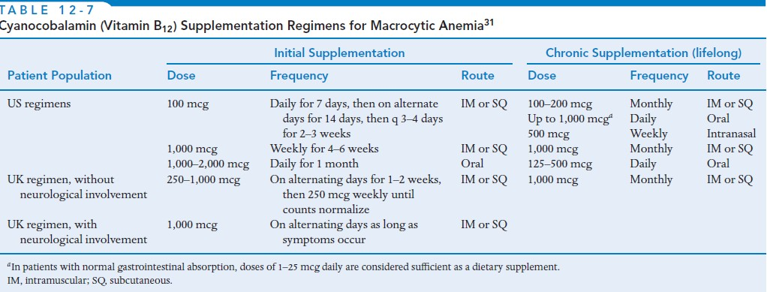

Slide 39
FOLIC ACID DEFICIENCY
ANEMIA

Slide 40
Folic acid is also required for DNA synthesis and red cell maturation
Adults need to absorb approximately 400 mcg of folate per day in order to replenish the daily degradation and loss through urine and bile.

Slide 41
Inadequate intake
Decreased absorption
Hyperutilization (rate of cellular division is increased--- adolescents and infants, psoriasis, rheumatoid arthritis, chronic inflammatory Disorders, malignancy, myelofibrosis, hemolytic anemia, pregnant women)
Inadequate utilization
Malabsorption syndromes
Alcoholics (interferes with folic acid absorption, folic acid utilization at the cellular level, decreases hepatic stores of folic acid)
Drugs (azathioprine, 6-mercaptopurine, 5-fluorouracil, hydroxyurea, zidovudine, methotrexate )
Etiopathogenesis

Slide 42
Humans are unable to synthesize sufficient folate to meet total daily requirements, they depend on dietary sources.
Major dietary sources of folate include fresh, green, leafy vegetables, citrus fruits, yeast, mushrooms, dairy products, and animal organs such as liver and kidney.

Slide 43
Most folate in food is present in the polyglutamate form, which must be broken down into the monoglutamate form prior to absorption in the small intestine.
Once absorbed, dietary folate must be converted to the active form tetrahydrofolate through a cobalamin- dependent reaction.

Slide 44
The recommended daily allowance for folate is 600 mcg for pregnant females, and 500 mcg for lactating females.

Slide 45
Fatigue
Headache
Pallor
Sore mouth and tongue
Nausea, vomiting, abdominal pain, and diarrhea
Anorexia
Symptoms similar to vit B12 def anemia except neurological manifestations.
Clinical presentation

Slide 46
