Slide 1



Slide 2
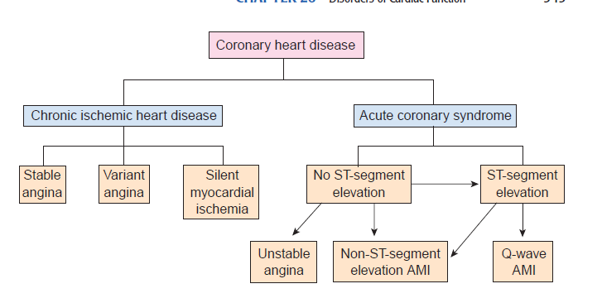

Slide 3
Introduction
Coronary artery disease is caused by impaired coronary blood flow
Ischemic heart disease (IHD) is a condition in which there is an inadequate supply of blood and oxygen to a portion of the myocardium; it typically occurs when there is an imbalance between myocardial oxygen supply and demand.
Angina pectoris is a “clinical syndrome characterized by discomfort in the chest, jaw, shoulder, back, or arm.”

Slide 4
Types of angina
Stable Angina
Stable angina is the most common type of angina. It occurs when the heart is working harder than usual. Stable angina has a regular pattern refers to how often the angina occurs, how severe it is, and what factors trigger it
The pain usually goes away a few minutes after rest or medication use.
Unstable Angina
There is no predictable pattern to this kind of angina; it can just as easily occur during exercise and in rest.
It should always be treated as an emergency.
People with unstable angina are at increased risk for heart attacks, cardiac arrest, or severe cardiac arrhythmias

Slide 5
Variant angina
Also known as Prinzmetal’s angina.
It often occurs in rest
It has no predictable pattern .
This kind of angina may cause severe pain, and is usually caused by a spasm in a coronary artery.

Slide 6
Microvascular angina —sometimes referred to as Syndrome X— occurs when tiny vessels in the heart become
narrow and stop functioning properly, even if the bigger arteries are not blocked by plaque.
Atypical angina
Often doesn’t cause pain, but you may feel a vague discomfort in your chest, experience shortness of breath, feel tired or nauseous, have indigestion, or pain in your back or neck.

Slide 7

Reduced coronary blood flow
  Coronary atherosclerosis
  Vasospasm
  Thrombosis.
  Arteritis,
  Emboli,
  Hypotension
Increased myocardial demand
  Tachycardia,
  Hypertrophy
Hypoxia due to diminished oxygen transport
  Anemia,
  Lung disease,
  Cyanotic CHD,
  Carbon monoxide (CO) poisoning,
  Cigarette smoking.

Slide 8

Intraplaque hemorrhage,
Plaque erosion, or
Plaque rupture with superimposed thrombosis
Vasospasm
Embolization
smaller vessel obstruction
  Vasculitis,
  Amyloidosis,
  Sickle cell disease

Slide 9
Acute coronary syndrome
ACS represents a spectrum of ischemic heart diseases ranging from unstable ischemia to acute MI
Myocardial infarction (MI) (ie, heart attack) is the irreversible necrosis of heart muscle secondary to prolonged ischemia.
OR
Myocardial infarction (MI) is myocyte cell death caused by vascular occlusion.

Slide 10
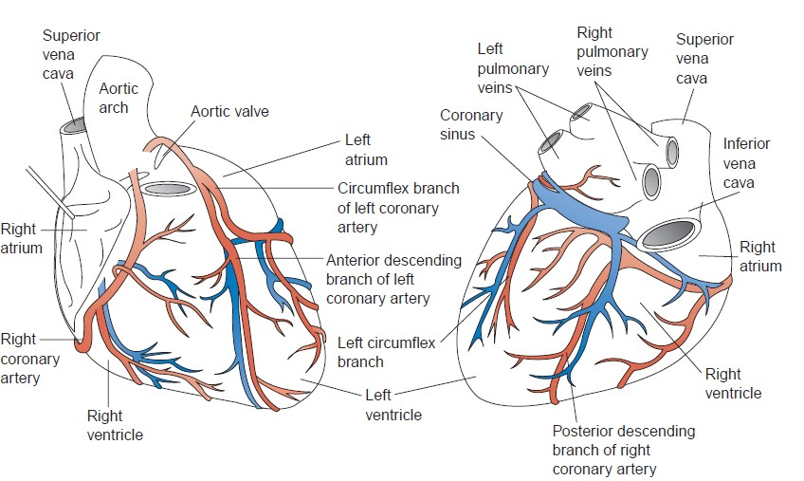

Slide 11
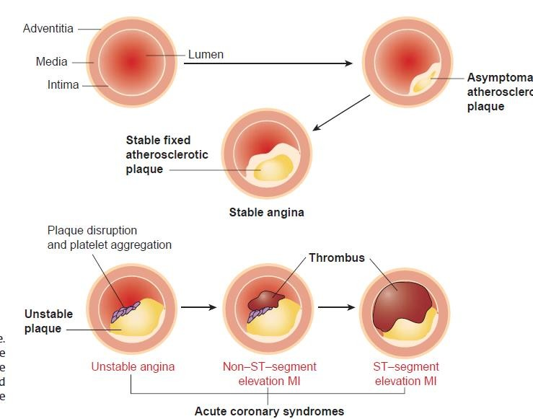

Slide 12
Myocardial ischemia can result from
(1) A reduction of coronary blood flow caused by fixed and/or dynamic epicardial coronary artery (ie, conductive vessel) stenosis,
(2) Abnormal constriction or deficient relaxation of coronary microcirculation (ie, resistance vessels), or
(3) Reduced oxygen-carrying capacity of the blood.

Slide 13
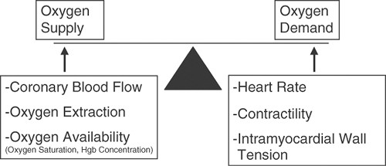
Pathophysiology
Angina pectoris typically occurs when myocardial oxygen demand exceeds myocardial oxygen supply (perfusion).

Slide 14
Under normal conditions, the myocardium will be supplied with oxygen-rich blood to prevent underperfusion of myocytes and the subsequent development of ischemia and infarction.
Blood flows through the coronary arteries in a phasic fashion, with the majority occurring during diastole.

Slide 15
About 75% of the total coronary resistance to flow occurs across three sets of arteries: (1) large epicardial arteries (Resistance 1 = R₁), (2) prearteriolar vessels (R₂), and (3) arteriolar and intramyocardial capillary vessels (R₃).
Under normal circumstances, the resistance in R 2 is much greater than that in R 1.
Myocardial blood flow is inversely related to arteriolar resistance and directly related to the coronary driving pressure.

Slide 16
Atherosclerotic lesions occluding R 1 increase arteriolar resistance, and R2 can vasodilate to maintain coronary blood flow
The ability of the coronary arteries to increase blood flow in response to increased cardiac metabolic demand is referred to as coronary flow reserve (CFR)
With greater degrees of obstruction, the coronary flow reserve afforded by R2 vasodilation is insufficient to meet oxygen demand.

Slide 17
If the diameter of an epicardial artery is reduced by 50%, there is a limitation in increasing the flow to meet increased myocardial demand.
When the diameter is reduced by ~80%, it can decrease coronary flow dramatically and cause myocardial ischemia.

Slide 18
Patients with a fixed coronary atherosclerotic lesion of at least 50% or more show myocardial ischemia during increased myocardial metabolic demand as the result of a significant reduction in CFR and hence, angina pectoris
Fixed atherosclerotic lesions of at least 90% almost completely abolish the flow reserve; patients with these lesions may experience angina at rest thus unstable angina.
Coronary spasm can also reduce CFR significantly by causing dynamic stenosis of coronary arteries. Prinzmetal angina is defined as resting angina associated with ST- segment elevation caused by focal coronary artery spasm.

Slide 19
Myocardial ischemia can also be the result of factors affecting blood composition, such as reduced oxygen- carrying capacity of blood, as is observed with severe anemia (hemoglobin, < 8 g/dL), or elevated levels of carboxyhemoglobin.
The latter may be the result of inhalation of carbon monoxide in a closed area or of long-term smoking.
If ischemia is prolonged it can lead to myocyte necrosis results in myocardial infarction.

Slide 20
Pathophysiology continues for Myocardial infarction
Severe ischemia leads to ATP depletion and loss of contractile function (but not cell death) within 60 seconds.
This may precipitate myocardial failure long before there is cell death.
Complete deprivation of blood flow for 20 to 30 minutes leads to irreversible myocardial injury

Slide 21
Pathophysiology continues for Myocardial infarction
Severe compromise of flow for prolonged periods (i.e., 2 to 4 hours) can also cause irreversible injury
Necrosis is usually complete within 6 hours of severe ischemia.
The distribution of myocardial necrosis depends on the vessel involved

Slide 22
Pathophysiology continues for Myocardial infarction
The distribution of a single coronary artery and are transmural (the full thickness of the ventricular wall)- show “ST elevation MI”
Subendocardial MIs are limited to the inner 30% to 50% of the ventricle-show “Non ST elevation MI”

Slide 23
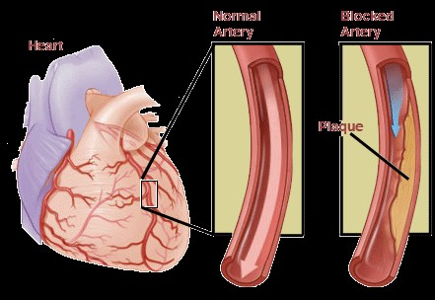

Slide 24
Grading of Angina Pectoris by the Canadian Cardiovascular Society Classification System
Class I
Ordinary physical activity does not cause angina. Angina occurs with strenuous, rapid, or prolonged exertion at work.
Class II
Slight limitation of ordinary activity. Angina occurs On walking or climbing stairs rapidly, walking uphill, walking or stair climbing after meals, or in cold, or in wind, or under emotional stress, or only during the few hours after wakening.

Slide 25
Class III
Marked limitations of ordinary physical activity. Angina occurs on walking 1 to 2 blocks on the level and climbing flight of stairs in normal conditions and at a normal pace.
Class IV
Inability to carry on any physical activity without discomfort— anginal symptoms may be present at rest.

Slide 26
Reduction in the oxygen-carrying capacity of blood, such as elevated carboxyhemoglobin or severe anemia (hemoglobin, < 8 g/dL)
Congenital anomalies of the origin and/or course of the major epicardial coronary arteries

Slide 27
Symptoms for angina
Reproducible pattern of pain after specific amount of exertion.
Pain radiation patterns include anterior chest pain (96%), left upper arm pain (83.7%), left lower arm pain (29.3%), and neck pain at some time (22%).
Increased frequency, severity, duration, or symptoms at rest suggest an unstable angina
Sensation of pressure or burning over the sternum or near it, often but not always radiating to the left jaw, shoulder and arm

Slide 28
Pain usually lasts from 0.5 to 30 minutes
Palpitations
Fatigue
Chest tightness
Shortness of breath
Signs
Abnormal precordial (over the heart) systolic bulge
Abnormal heart sounds

Slide 29
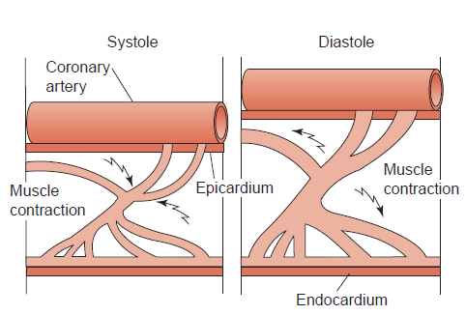

Slide 30
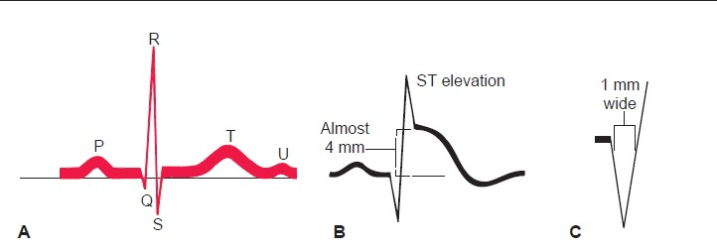

Slide 31
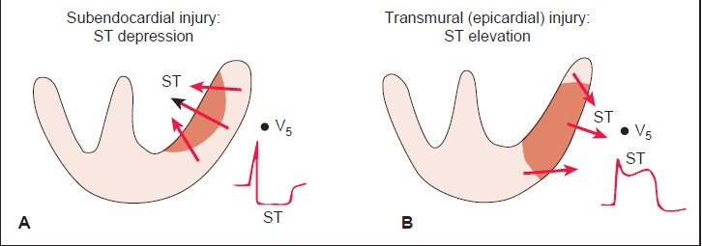

Slide 32
NSTEMI differs from UA in that ischemia is severe enough to produce myocardial necrosis, resulting in release of detectable amounts of biochemical markers, primarily troponin I or T and creatine kinase myocardial band (CK-MB) from the necrotic myocytes into the bloodstream.

Slide 33
Clinical Presentation Symptoms
Anterior chest discomfort.
Arm, back, or jaw pain,
Nausea,
Vomiting, or
Shortness of breath.
Signs
Patients with ACS may present with signs of acute HF including jugular venous distention and an S3 sound on auscultation.
Patients may also present with arrhythmias, and therefore may have tachycardia, bradycardia, or heart block

Slide 34
Complications

