Slide 1
BIOPHARMACEUTICS AND PHARMACOKINETICS
4. APPLICATIONS OF PHARMACOKINETICS
14-09-2024
1

Slide 2
APPLICATIONS OF PHARMACOKINETICS
○ Design and development of new drugs for improving therapeutic effectiveness.
○ Design and development of an optimum formulation for better use of the drug.
○ Design and development of controlled/targeted release formulation.
○ Select the appropriate route for drug administration.
○ Select the right drug for a particular illness.
○ Predict and explain drug-food and drug-drug interactions.
○ Design an appropriate multiple dosage regimen.
○ Therapeutic drug monitoring in individual patients.
○ Dosage adjustments in situations of altered physiology and drug interactions.
14-09-2024
2

Slide 3
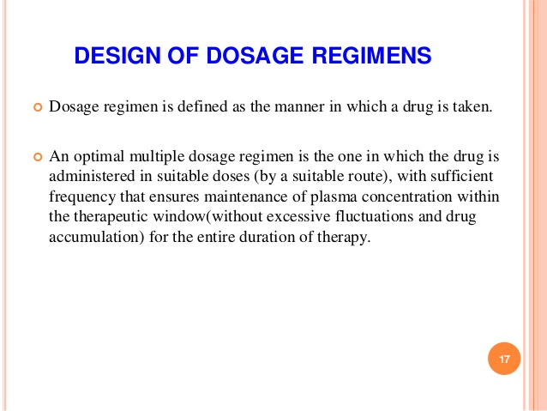
14-09-2024
3

Slide 4
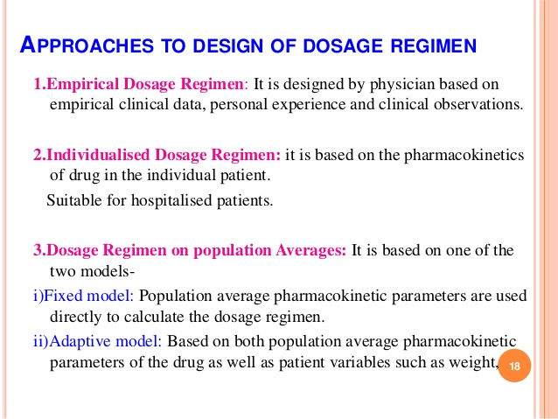
14-09-2024
4

Slide 5
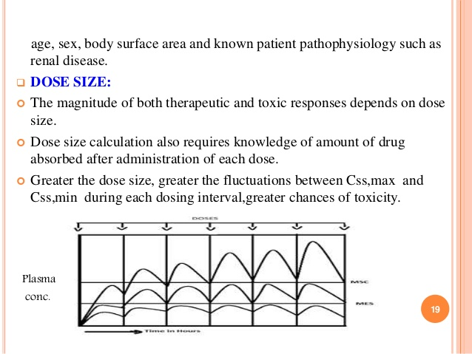
14-09-2024
5

Slide 6
FACTORS TO BE CONSIDERED
1.Pharmaceutical factors
o Type of dosage form
o Route of administration
2. Patient related factors
o Individual patient’s tolerance of the drug
o Genetic predisposition
o Concurrent administration of other drugs
o Patient’s age, bodyweight, gender
o Length of illness
o General physical health
o Liver and kidney function in the patient
14-09-2024
6

Slide 7
3.Pharmacokinetic factors
Rate and extent of
▪ Absorption
▪ Distribution
▪ Metabolism and
▪ Excretion of drugs in patients
14-09-2024
7

Slide 8
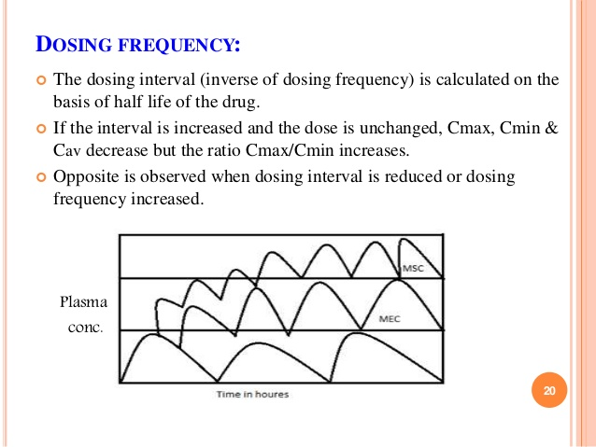
14-09-2024
8

Slide 9
FACTORS AFFECTING DOSAGE INTERVAL
Half-life : dosage interval can generally be extended in relation to half-life
Therapeutic index : the higher the TI ,the longer an interval can be spaced with higher doses
Body clearance : to evaluate accumulation
Side effects which may require special administration times, e.g. bed time to avoid sedation
14-09-2024
9

Slide 10
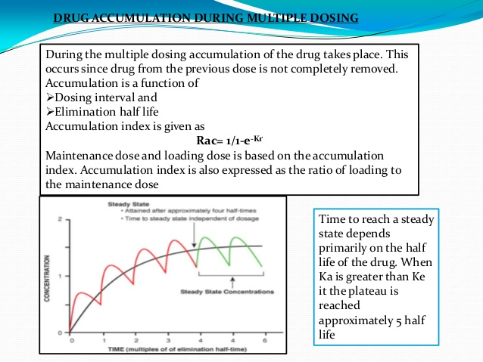
14-09-2024
10

Slide 11
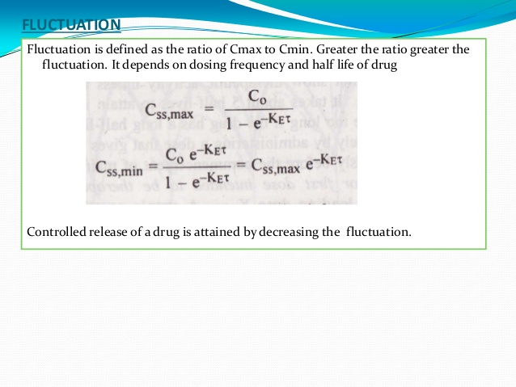
14-09-2024
11

Slide 12
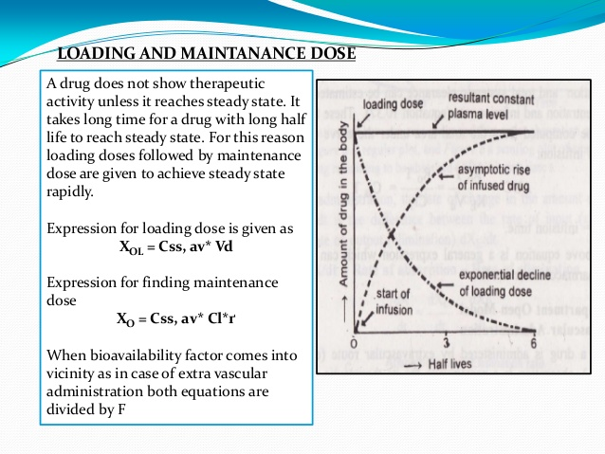
14-09-2024
12

Slide 13
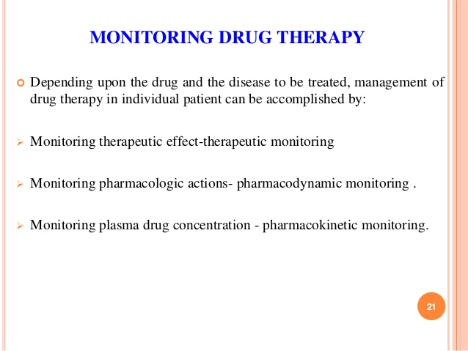
14-09-2024
13

Slide 14
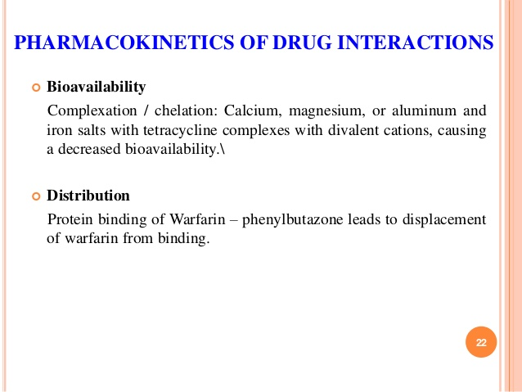
14-09-2024
14

Slide 15
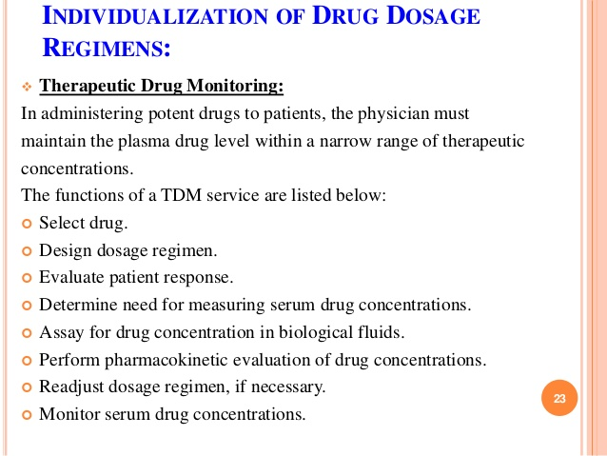
14-09-2024
15

Slide 16
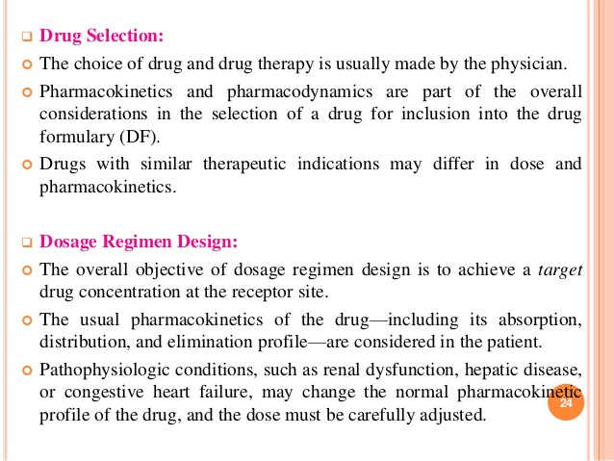
14-09-2024
16

Slide 17
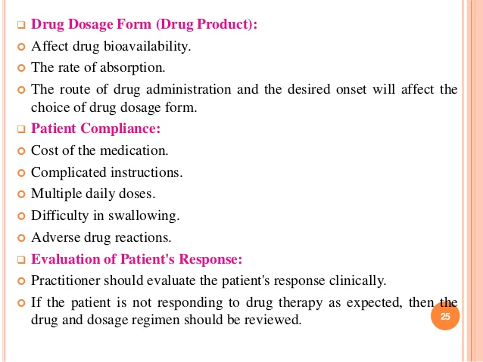
14-09-2024
17

Slide 18
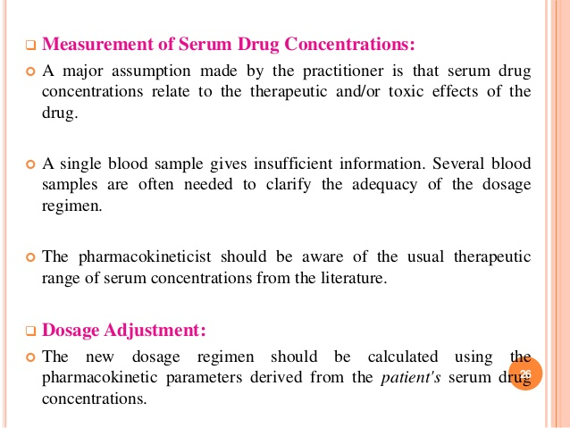
14-09-2024
18

Slide 19
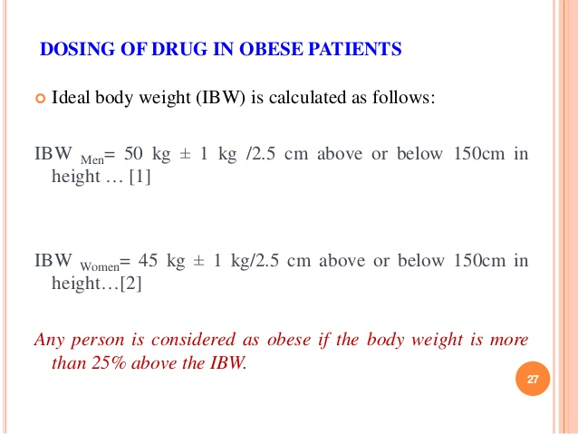
14-09-2024
19

Slide 20
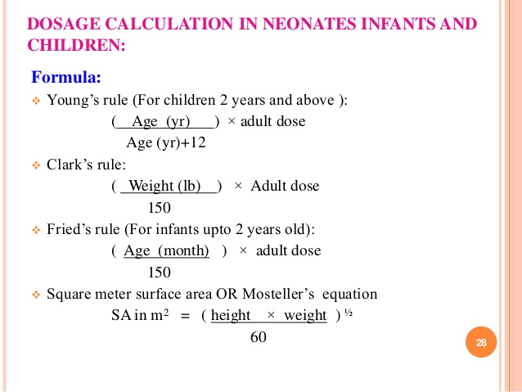
14-09-2024
20

Slide 21
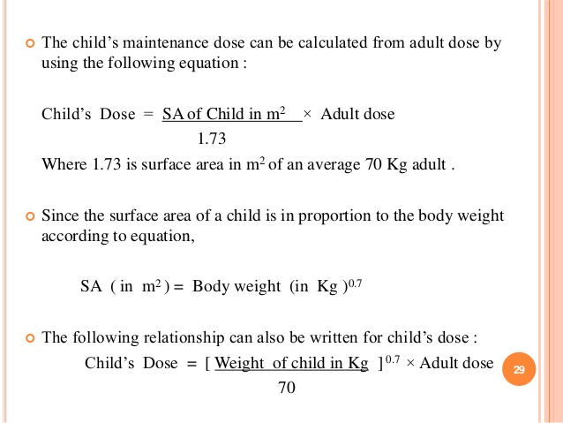
14-09-2024
21

Slide 22
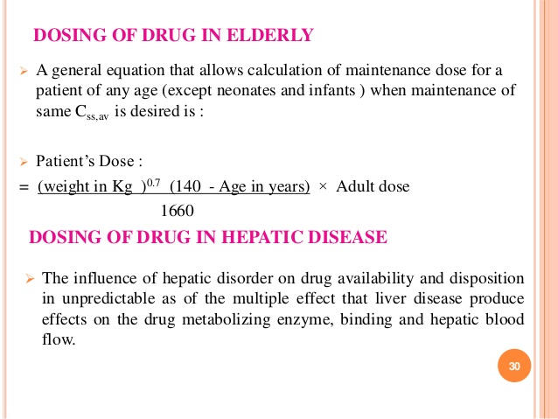
14-09-2024
22

Slide 23
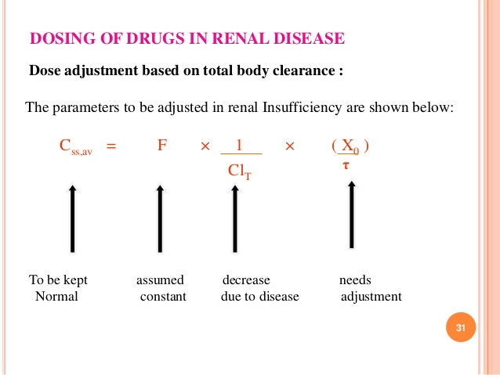
14-09-2024
23

