Slide 1
PHARMACEUTICAL MICROBIOLOGY
1 STUDY OF BACTERIA
17-09-2024
1

Slide 2

BACTERIA
Bacteria are unicelled organism They constitute a large domain of prokaryotic microorganisms.
Typically a few micrometres in length, bacteria have a number of shapes, ranging from spheres to rods and spirals.
Bacteria were among the first life forms to appear on Earth, and are present in most of its habitats
Bacteria inhabit soil, water, acidic hot springs, radioactive waste, and the deep biosphere of the earth's crust.
Bacteria also live in symbiotic and parasite relationships with plants and animals.
Most bacteria have not been characterised, and only about 27 percent of the bacterial phyla have species that can be grown in the laboratory.
The study of bacteria is known as bacteriology, a branch of microbiology.
17-09-2024
2

Slide 3
Nearly all animal life is dependent on bacteria for survival as only bacteria and some archaea possess the genes and enzymes necessary to synthesize vitamin B₁₂, also known as cobalamin, and provide it through the food chain.
Vitamin B₁₂ is a water-soluble vitamin that is involved in the metabolism of every cell of the human body.
It is a cofactor in DNA synthesis, and in both fatty acid and amino acid metabolism.
It is particularly important in the normal functioning of the nervous system via its role in the synthesis of myelin.
There are typically 40 million bacterial cells in a gram of soil and a million bacterial cells in a millilitre of fresh water.
There are approximately 5×10³⁰ bacteria on Earth, forming a biomass which is only exceeded by plants.
Bacteria are vital in many stages of the nutrient cycle by recycling nutrients such as the fixation of nitrogen from the atmosphere.
The nutrient cycle includes the decomposition of dead bodies; bacteria are responsible for the putrefaction stage in this process.
In the biological communities surrounding hydrothermal vents and cold seeps, extremophile bacteria provide the nutrients needed to sustain life by converting dissolved compounds, such as hydrogen sulphide and methane, to energy.

Slide 4
In humans and most animals, the largest number of bacteria exist in the gut, and a large number on the skin.
The vast majority of the bacteria in the body are rendered harmless by the protective effects of the immune system, though many are beneficial, particularly in the gut flora. However, several species of bacteria are pathogenic and cause infectious diseases, including cholera, syphilis, anthrax, leprosy, and bubonic plague.
The most common fatal bacterial diseases are respiratory infections.
Tuberculosis alone kills about 2 million people per year, mostly in sub-Saharan Africa.
Antibiotics are used to treat bacterial infections and are also used in farming, making antibiotic resistance a growing problem.
In industry, bacteria are important in sewage treatment and the breakdown of oil spills, the production of cheese and yogurt through fermentation, the recovery of gold, palladium, copper and other metals in the mining sector, as well as in biotechnology, and the manufacture of antibiotics and other chemicals.

Slide 5
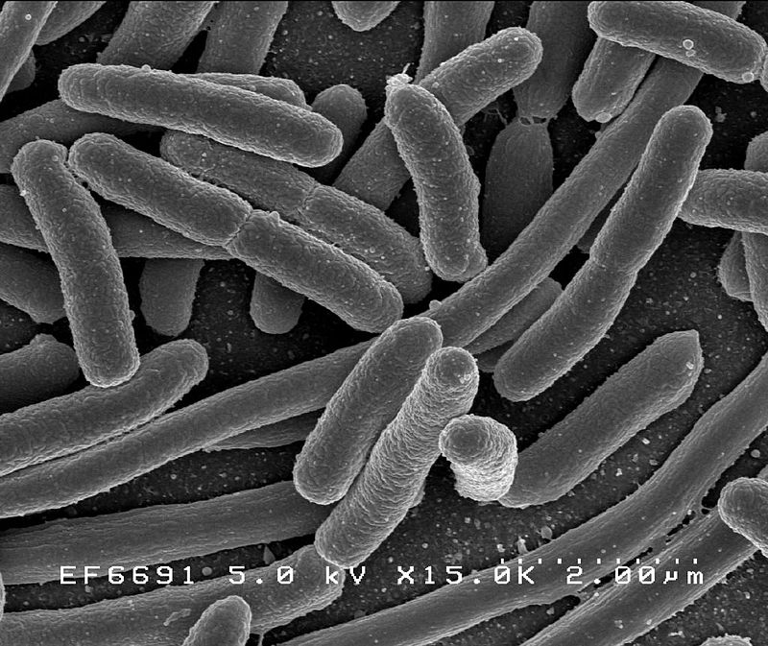
Once regarded as plants constituting the class Schizomycetes ("fission fungi"), bacteria are now classified as prokaryotes.
Unlike cells of animals and other eukaryotes, bacterial cells do not contain a nucleus and rarely harbour membrane-bound organelles.
Although the term bacteria traditionally included all prokaryotes, the scientific classification changed after the discovery in the 1990s that prokaryotes consist of two very different groups of organisms that evolved from an ancient common ancestor.
These evolutionary domains are called Bacteria and Archaea.

Slide 6
ORIGIN AND EARLY EVOLUTION
The ancestors of modern bacteria were unicellular microorganisms that were the first forms of life to appear on Earth, about 4 billion years ago.
For about 3 billion years, most organisms were microscopic, and bacteria and archaea were the dominant forms of life.
Although bacterial fossils exist, such as stromatolites, their lack of distinctive morphology prevents them from being used to examine the history of bacterial evolution, or to date the time of origin of a particular bacterial species.
However, gene sequences can be used to reconstruct the bacterial phylogeny, and these studies indicate that bacteria diverged first from the archaeal/eukaryotic lineage.
The most recent common ancestor of bacteria and archaea was probably a hyperthermophile that lived about 2.5 billion–3.2 billion years ago.
The earliest life on land may have been bacteria some 3.22 billion years ago.

Slide 7
Bacteria were also involved in the second great evolutionary divergence, that of the archaea and eukaryotes.
Here, eukaryotes resulted from the entering of ancient bacteria into endosymbiotic associations with the ancestors of eukaryotic cells, which were themselves possibly related to the Archaea.
This involved the engulfment by proto-eukaryotic cells of alphaproteobacterial symbionts to form either mitochondria or hydrogenosomes, which are still found in all known Eukarya (sometimes in highly reduced form, e.g. in ancient "amitochondrial" protozoa).
Later, some eukaryotes that already contained mitochondria also engulfed cyanobacteria-like organisms, leading to the formation of chloroplasts in algae and plants. This is known as primary endosymbiosis

Slide 8
Morphology
Bacteria display a wide diversity of shapes and sizes, called morphologies.
Bacterial cells are about one-tenth the size of eukaryotic cells and are typically 0.5–5.0 micrometres in length.
However, a few species are visible to the unaided eye—for example, Thiomargarita namibiensis is up to half a millimetre long and Epulopiscium fishelsoni reaches 0.7 mm.
Among the smallest bacteria are members of the genus Mycoplasma, which measure only 0.3 micrometres, as small as the largest viruses. complete action of bacteria
Some bacteria may be even smaller, but these ultramicrobacteria are not well-studied.
Most bacterial species are either spherical, called cocci (singular coccus, from Greek kókkos, grain, seed), or rod-shaped, called bacilli (sing. bacillus, from Latin baculus, stick).
Some bacteria, called vibrio, are shaped like slightly curved rods or comma-shaped; others can be spiral-shaped, called spirilla, or tightly coiled, called spirochaetes.
A small number of other unusual shapes have been described, such as star-shaped bacteria
This wide variety of shapes is determined by the bacterial cell wall and cytoskeleton, and is important because it can influence the ability of bacteria to acquire nutrients, attach to surfaces, swim through liquids and escape predators.

Slide 9
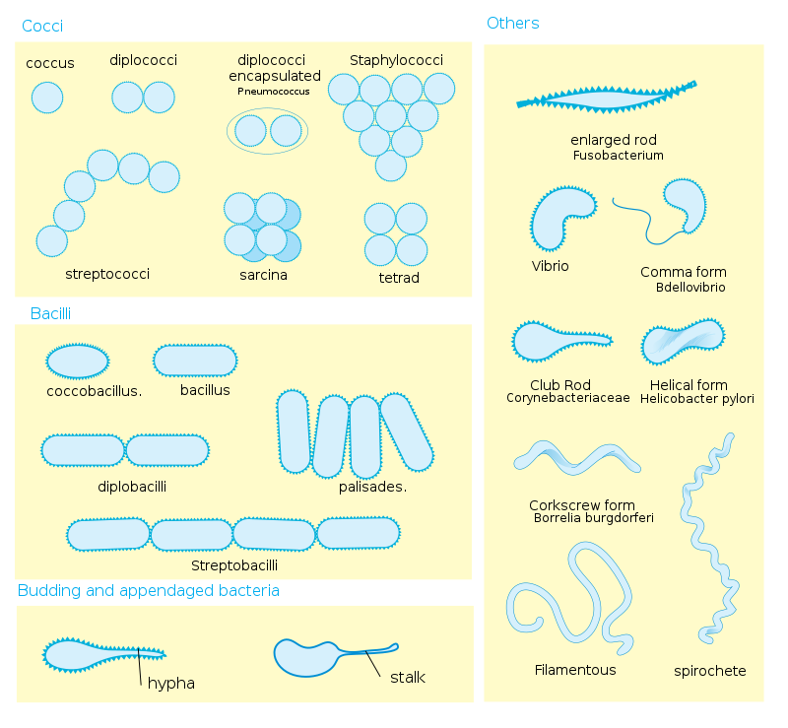

Slide 10
Many bacterial species exist simply as single cells, others associate in characteristic patterns: Neisseria form diploids (pairs), Streptococcus form chains, and Staphylococcus group together in "bunch of grapes" clusters.
Bacteria can also group to form larger multicellular structures, such as the elongated filaments of Actinobacteria, the aggregates of Myxobacteria, and the complex hyphae of Streptomyces.
These multicellular structures are often only seen in certain conditions.
For example, when starved of amino acids, Myxobacteria detect surrounding cells in a process known as quorum sensing, migrate towards each other, and aggregate to form fruiting bodies up to 500 micrometres long and containing approximately 100,000 bacterial cells.
In these fruiting bodies, the bacteria perform separate tasks; for example, about one in ten cells migrate to the top of a fruiting body and differentiate into a specialised dormant state called a myxospore, which is more resistant to drying and other adverse environmental conditions.

