Slide 1
SUBJECT NAME- PHARMACEUTICAL MICROBIOLOGY
UNIT NO & NAME- 1 BACTERIAL GROWTH CURVE
08-09-2024
1

Slide 2
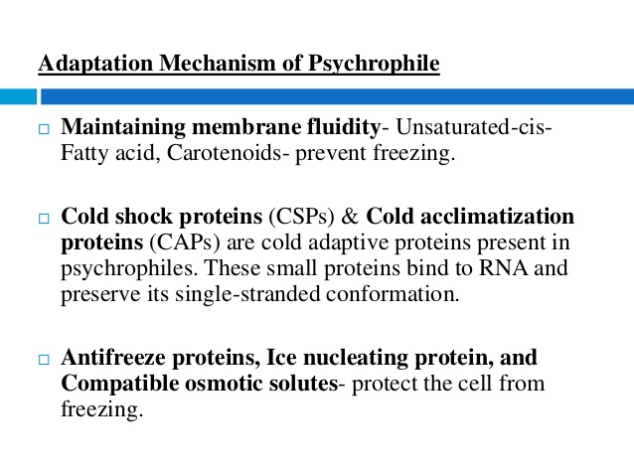
TOPIC NAME – BACTERIAL GROWTH CURVE
Physical conditions required for growth of bacteria
Temperature
Temperature is one of the most important physical factors that has a great influence on the growth of microorganisms. The temperature that allows for rapid growth during a short period of time is known as the optimum growth temperature
Psychrophiles : Psychrophiles are able to grow at 0°C but have an optimum temperature of 15°C or lower
08-09-2024
2

Slide 3
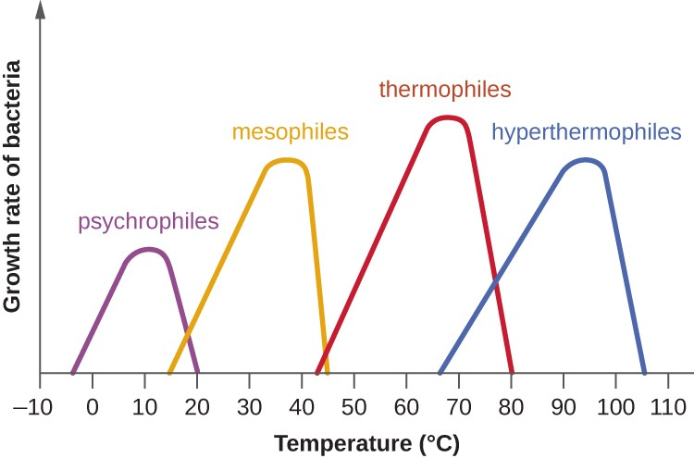
ii. Mesophiles : Mesophiles are growing within the range of 20 to 40° C . All bacteria that are pathogenic for humans and warm-blooded animals are mesophiles

Slide 4
iii. Thermophiles : Thermophiles prefers high temperature for growth . The growth range of many thermophiles extends into the mesophilic region . These species are called facultative thermophiles

Slide 5
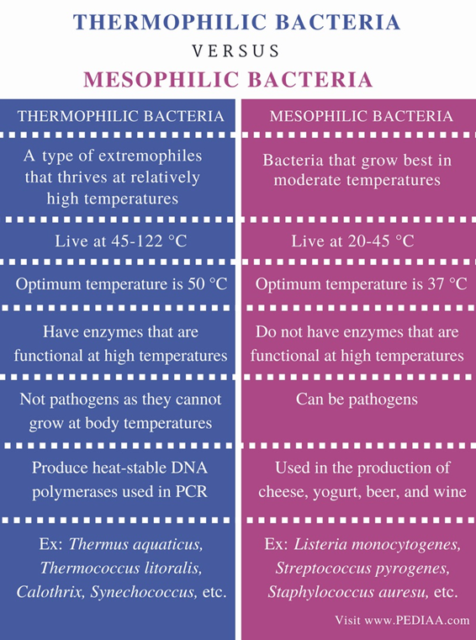

Slide 6
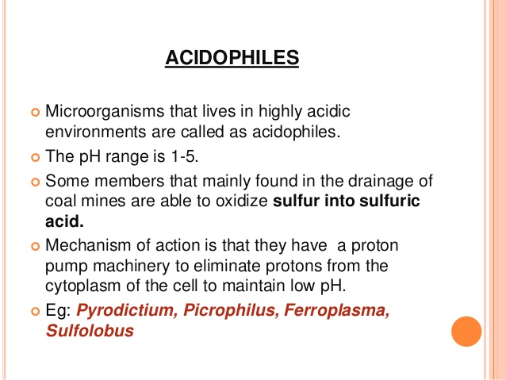
pH
The pH of the growth medium of bacteria has a profound effect upon the multiplication of microorganisms. Each microbial species has definite pH value of microorganisms, they can be classified as follows :
Acidophiles : These microorganisms have an optimum pH range between 1 to 6.5

Slide 7
ii . Neutrophiles : Most bacteria grow in a narrow pH range between 6.5 and 7.5, such bacteria are called neutrophiles
iii. Alkalophiles : These microorganisms have an optimum pH range in between 7.5 to 14
Gaseous requirement :
Aerobic bacteria : These bacteria require oxygen for growth and can grow when incubated in an air atmosphere
Anaerobic bacteria : These bacteria do not use oxygen for energy and growth. Oxygen is toxic to such cells and they cannot grow when incubated in an air atmosphere
Facultatively anaerobic bacteria : These bacteria do not require oxygen for growth but if oxygen is available, is used for energy production
Microaerophilic bacteria : These bacteria requires low levels of oxygen for growth but cannot tolerate the levels of oxygen present in an air atmosphere

Slide 8
Growth curve of bacteria
Normal growth curve of bacteria can be determined by inoculating a small number of bacterial cells into a suitable culture medium and counting the bacteria in aliquot samples at regular intervals
When logarithms of the viable cells are plotted against time on a graph paper, it gives a typical curve called as bacterial growth curve or growth cycle of bacteria
Lag phase
Log or logarithmic or exponential phase
Stationary phase
Death or decline phase

Slide 9


Slide 10


Slide 11
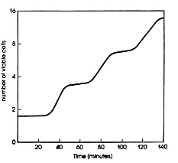

Slide 12
