Slide 1
SUBJECT NAME- PHARMACEUTICAL MICROBIOLOGY
UNIT NO & NAME - 1 STUDY OF SPORES
08-09-2024
1

Slide 2
TOPIC NAME - STUDY OF SPORES
Bacterial species produces spores
Endospores
Exospores
They are thick walled ,highly refractile ,produced one per cell.
On germination forms the single cell .
They are extremely resistance to stanning ,chemicals,radition ,heat and disinfection.
They are viable for centuries.
Spores are destroyed by moist heat sterilization in autoclave 121 C
It contains large amounts of dipicolinic acid and calcium
08-09-2024
2

Slide 3
Endospores have a core or envelop or protoplast
DNA and protein synthesis components ( like ribosomes, t-RNA, and enzymes) are present in the protoplast
The spore envelope is comprised of the inner membrane, cortex, outer membrane, and spore coat
Some bacterial species have outer layer developed into exosporium, bearing ridges and folds

Slide 4
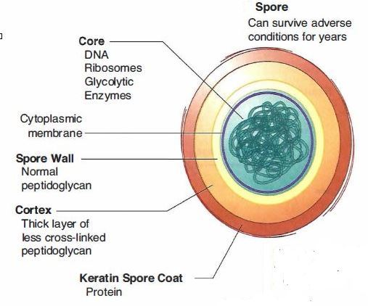

Slide 5
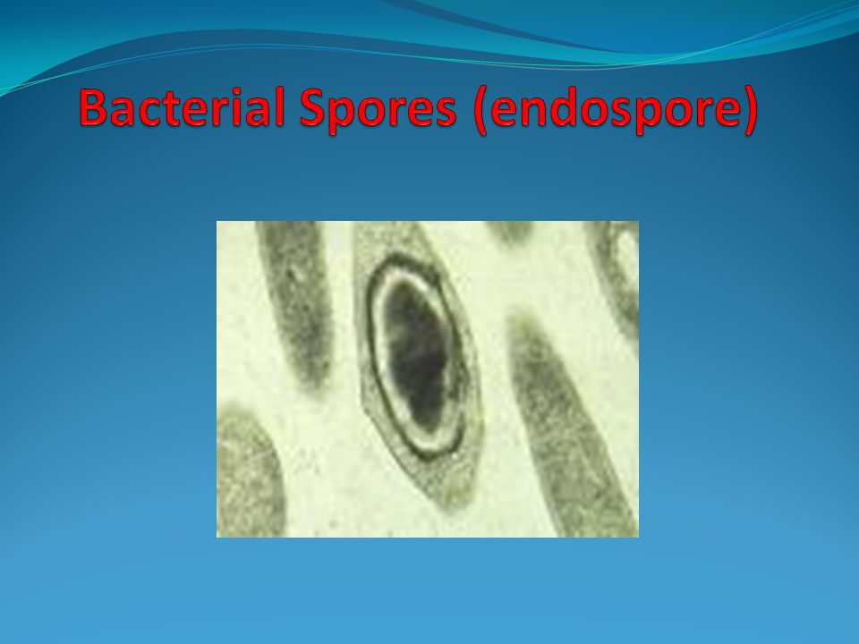

Slide 6
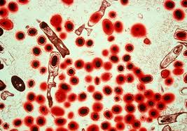

Slide 7
Reproduction of bacteria
A bacterium doubles itself by simply dividing into two
The newly formed bacterium has same copy of DNA as its parent, thus newly formed bacterium is the cloned form of its original
Such processes of division is known as binary fission
Under favourable conditions, binary fission can be produce a billion bacteria from a single one, in a time as less as 10 hours
Bacteria may also undergo sexual reproduction called conjugation
Pilus ( a thread-like structure which acts as an appendage for bacterial conjugation) is formed, and transfer of DNA from one bacterium to other takes place through it
This exchange of DNA facilitates quick transfer of new characters that helps them in adaption of diverse environment conditions

Slide 8
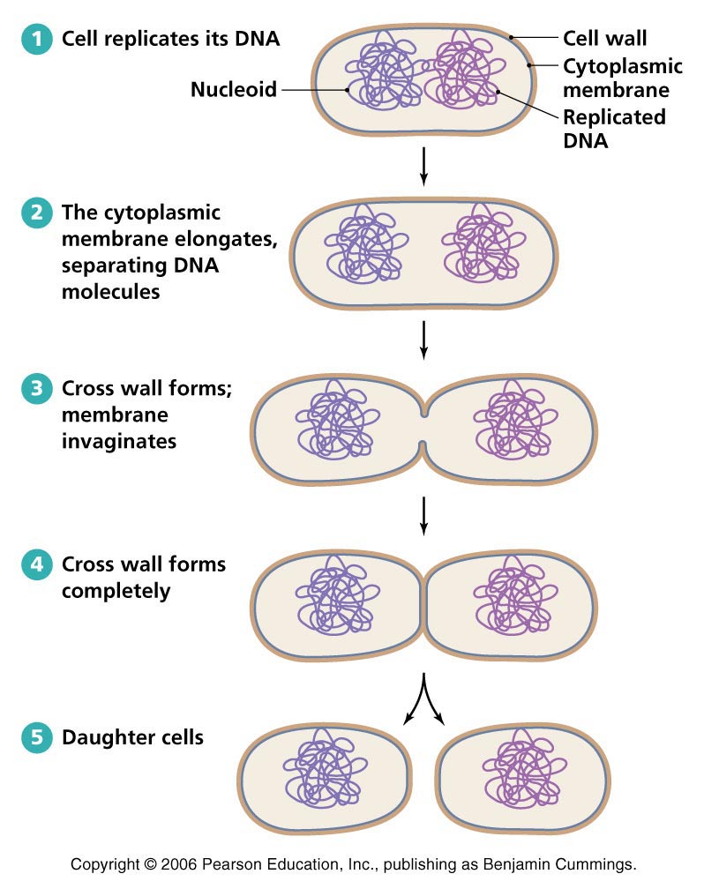

Slide 9
Binary fission
It is most common type of reproduction occurring under favourable conditions
Binary fission involves division of bacterial cell into two similar daughter cells, during which the bacterial chromosomes get attached to the cell membrane and replicants
With the enlargement of cell, the daughter chromosomes separate
A cross- wall builds up between the separating daughter chromosomes, thus dividing the cell into two daughter cells
The daughter cells mature within 20-30 minutes and under favourable conditions some of them divide within 20-30 minutes

Slide 10
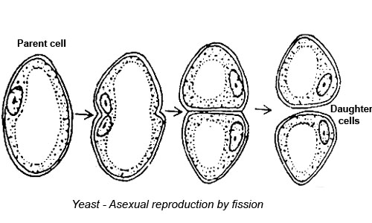

Slide 11
Budding
Budding is a form of vegetation reproduction in which some reproductive anatomical point in the parent organism gives rise to a new organism
It is a characteristic feature of few unicellular organisms and few gram-positive bacteria
It facilitates by the formation of a small protuberance called bud, which develops at one end of the cell
Followed by replication of genome ( where on copy of the genome gets into the bud), bud then increases in size, and develops into a daughter cell, and lastly separates from the parent cell, forming an off- spring

Slide 12
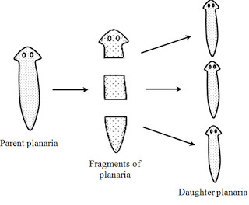

Slide 13
Fragmentation
It is a vegetative means of reproduction in which a fragment of the parent give rise to a new organism
Many organisms like animals, fungi, and plants reproduce by means of fragmentation
In case of unfavourable conditions, compartments are formed by fragmentation, resulting in minute bodies known as gonidia
When conditions favour, each gonidium develops into a new bacterium
The bacterial genome should undergo recurrent replications prior to fragmentation so that each fragment acquires a copy of it

