Slide 1

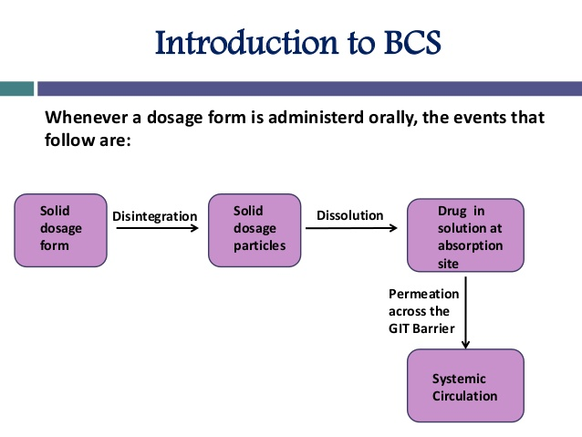
RR COLLEGE OF PHARMACY
HOSPITAL PHARMACY
BIO CLASSIFICATION SYSTEMS
K.MAHALINGAN
14-09-2024
1

Slide 2
The oral route of drug administration is the route of choice for the formulators and continues to dominate the area of drug delivery technologies.
However, though popular, this route is not free from limitations of absorption and bioavailability in the milieu of gastrointestinal tract.
The drug in the dosage form is released and dissolves in the surrounding gastrointestinal fluid to form a solution and this process is solubility limited.
Once the drug is in the solution form, it passes across the membranes of the cells lining the Gastro-Intestinal tract and t his process is permeability limited.
Then, the drug is absorbed into systemic circulation.
14-09-2024
2

Slide 3
In short, the oral absorption and hence bioavailability of drug is determined by the extent of drug solubility and permeability
The BCS is a scientific framework for classifying drug substances based on their aqueous solubility as related to dose and intestinal permeability.
• When combined with the dissolution of the drug product, the BCS takes into account three major factors that govern the rate and extent of drug absorption from IR solid oral dosage forms: dissolution, solubility, and intestinal permeability.
The biopharmaceutics classification system is guidance for Predicting the intestinal drug absorption provided by the U.S. Food and Drug Administration. The fundamental basis for the BCs was established by Dr. Gordon Amidon.
14-09-2024
3

Slide 4
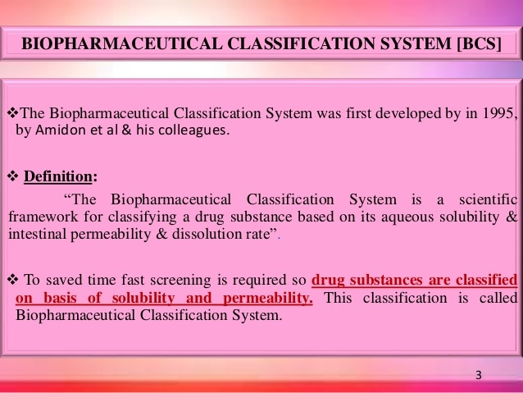
14-09-2024
4

Slide 5
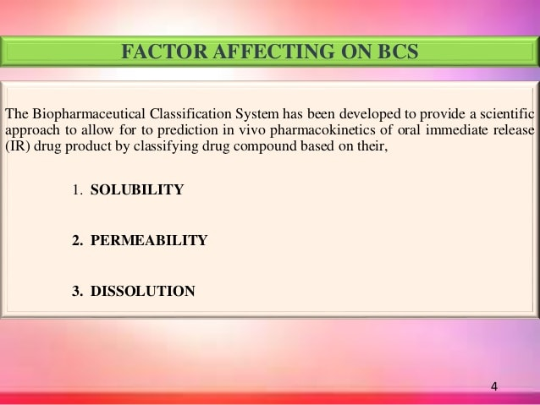
14-09-2024
5

Slide 6
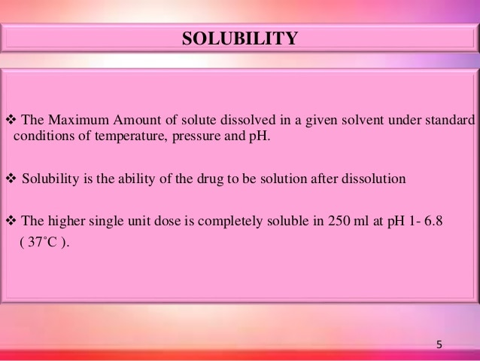
14-09-2024
6

Slide 7
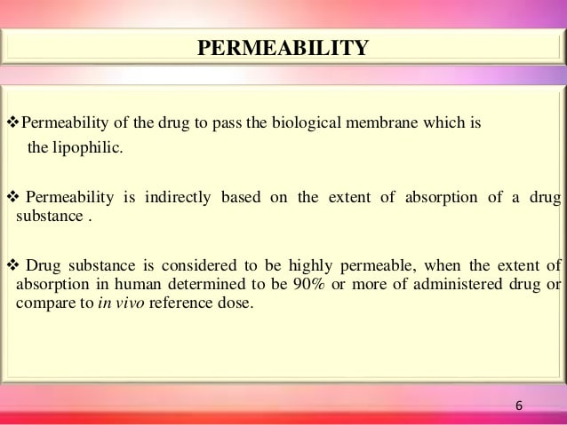
14-09-2024
7

Slide 8
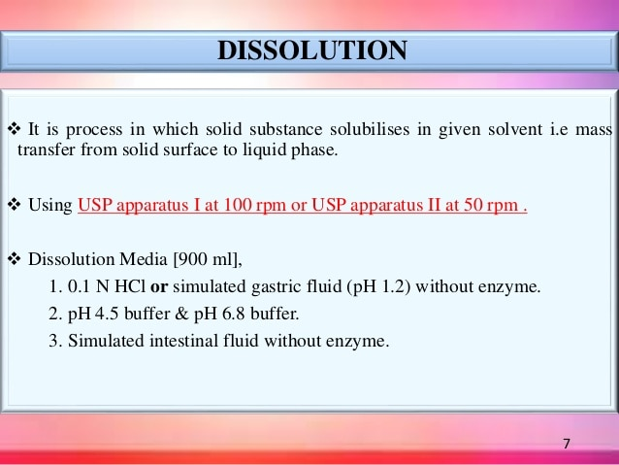
14-09-2024
8

Slide 9
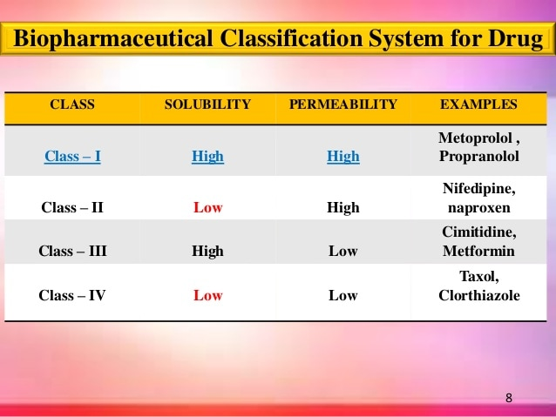
14-09-2024
9

Slide 10
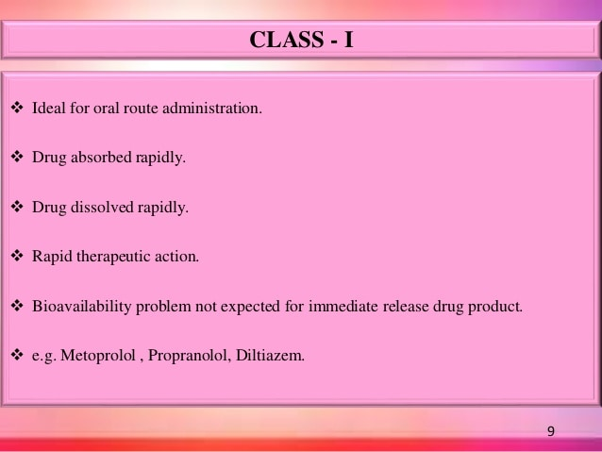
14-09-2024
10

Slide 11
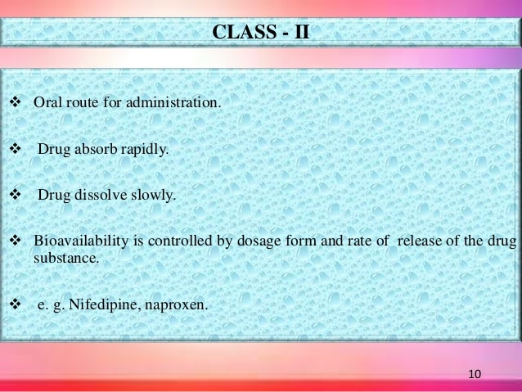
14-09-2024
11

Slide 12
Formulations designed to overcome solubility or dissolution rate problems:
Salt formation
Particle size reduction
Metastable forms
Solid dispersion
Complexation
Lipid based formulations
Precipitation inhibitors
14-09-2024
12

Slide 13
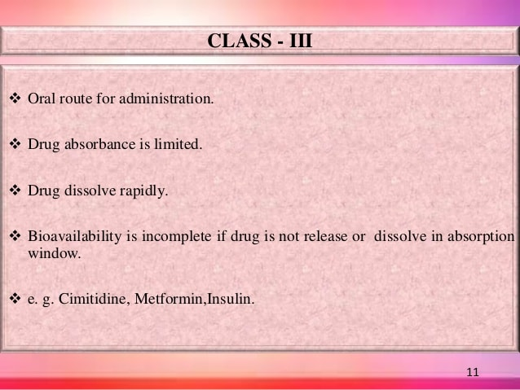
14-09-2024
13

Slide 14
Since passive diffusion is the rate-limiting step for oral absorption of BCS class III compounds, the most effective way to improve absorption and bioavailability of this class of compounds is to increase the membrane permeability
Approaches to improve permeability:
Prodrugs
Permeation enhancers
14-09-2024
14

Slide 15
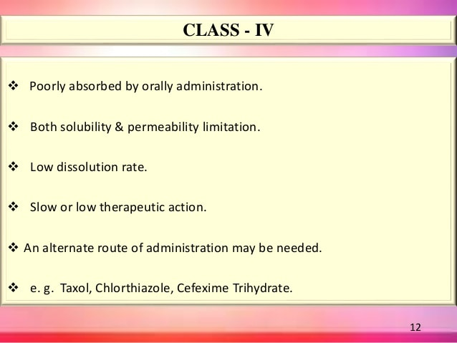
14-09-2024
15

Slide 16
Class IV compounds exhibit both poor solubility and poor permeability, and they pose tremendous challenges to formulation development
As a result, investment in dosage form development with no guarantee of success should be expected
A combination of class II and class III technologies could be used to formulate class IV compounds, although the success rate is not expected to be high
14-09-2024
16

Slide 17
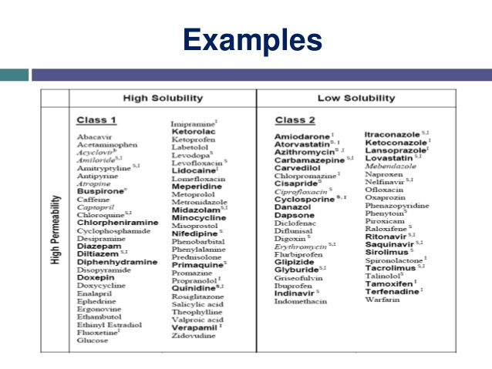
14-09-2024
17

Slide 18
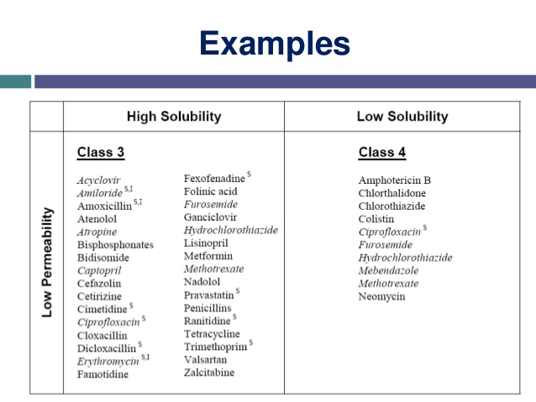
14-09-2024
18

Slide 19
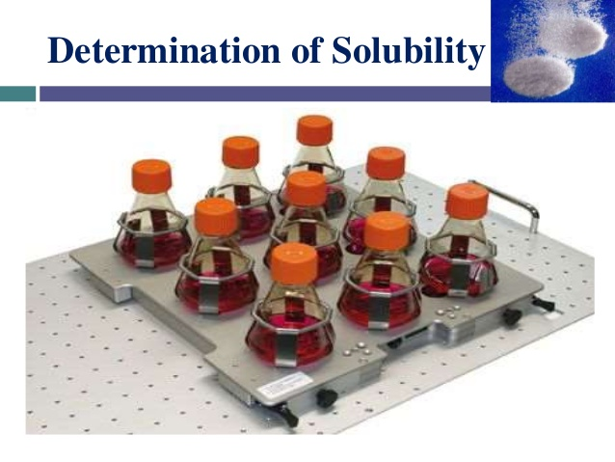
14-09-2024
19

Slide 20
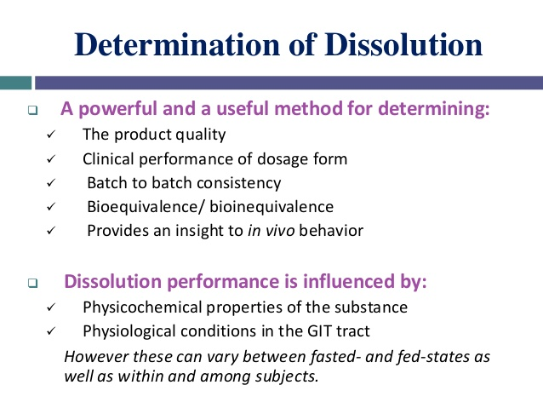
14-09-2024
20

Slide 21
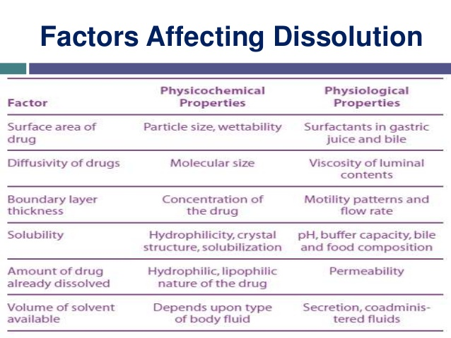
14-09-2024
21

Slide 22
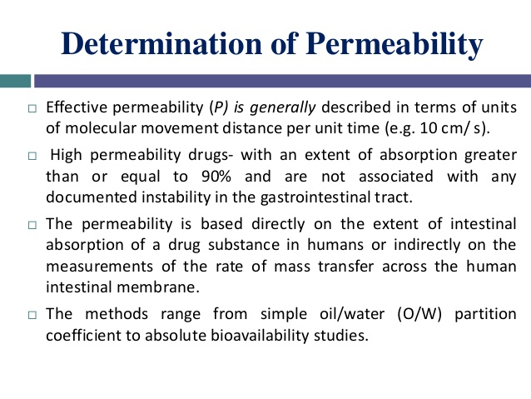
14-09-2024
22

Slide 23
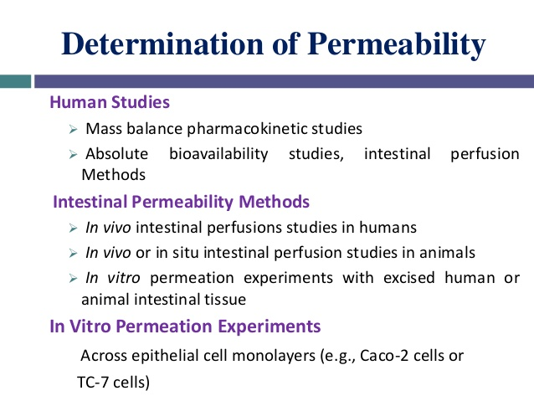
14-09-2024
23

Slide 24
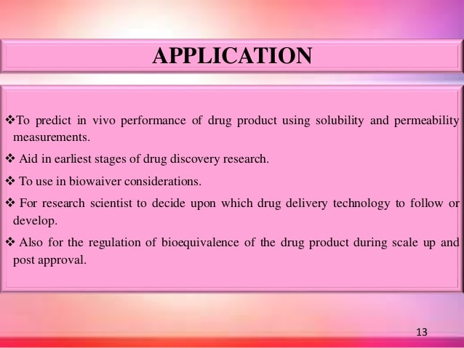
14-09-2024
24

Slide 25
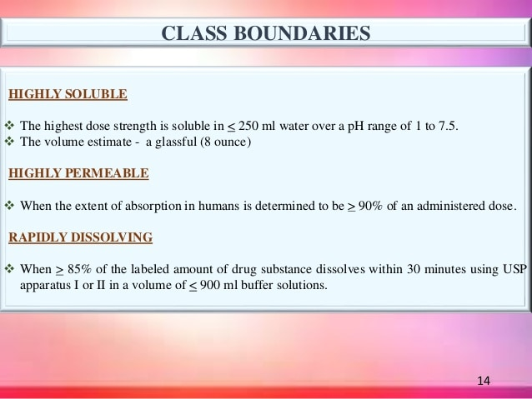
14-09-2024
25

Slide 26
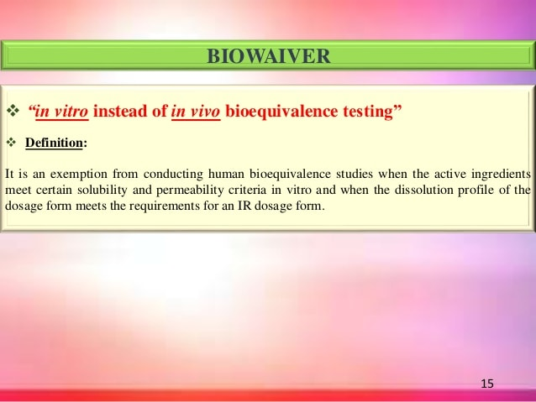
14-09-2024
26

Slide 27
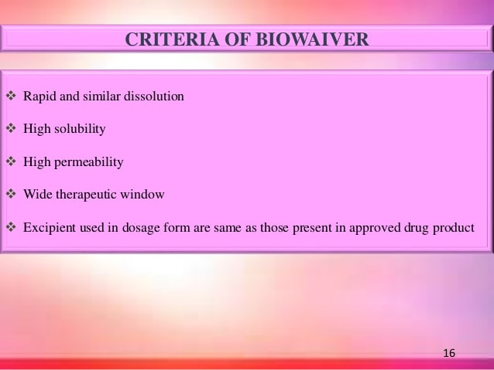
14-09-2024
27

Slide 28
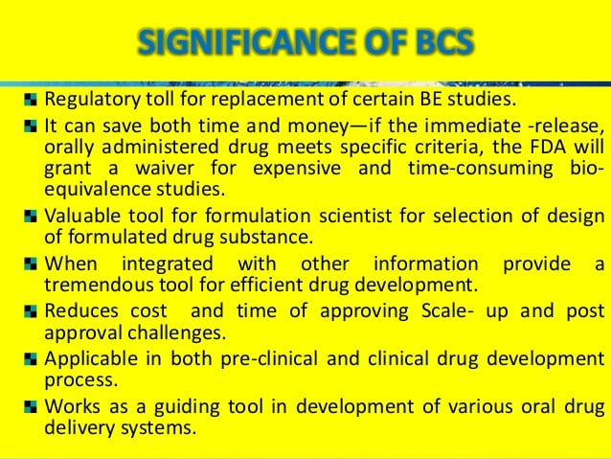
14-09-2024
28

