Slide 1
BIOSTATISTICS AND RESEARCH METHODOLOGY
UNIT – 2 BIOSTATISTICS
STATISTICAL SOFTWARES
11-08-2023
1

Slide 2

SAS

Slide 3
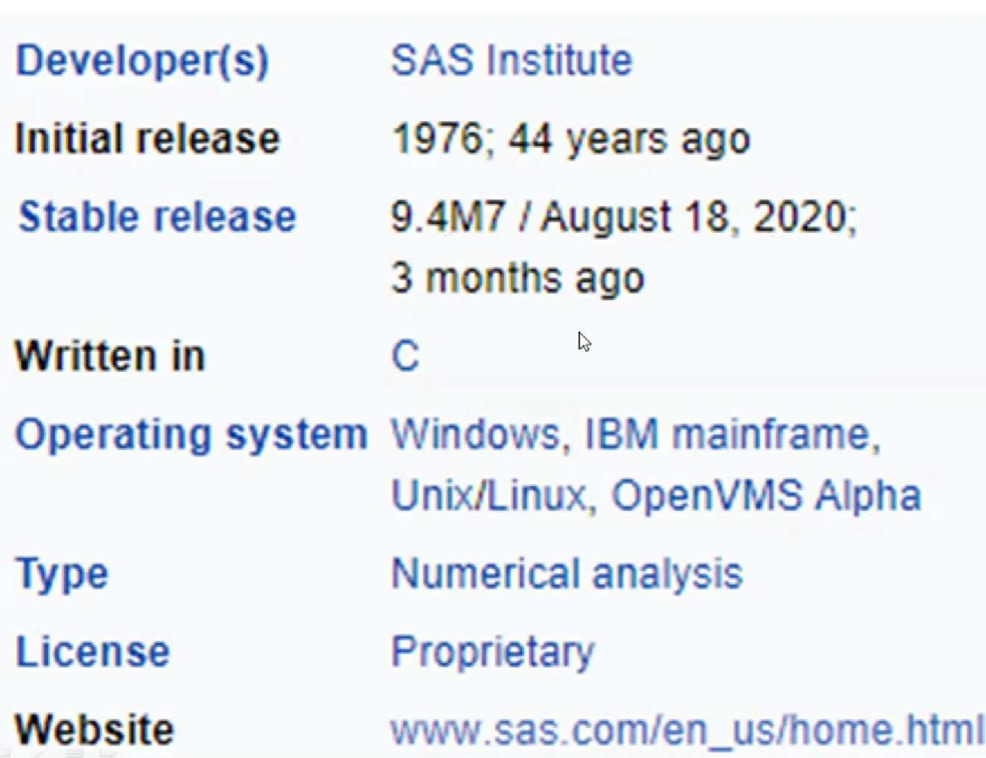

Slide 4


Slide 5
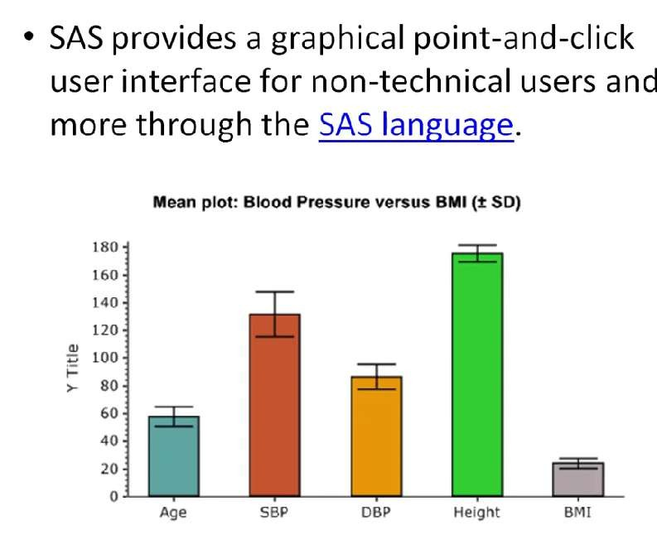

Slide 6


Slide 7
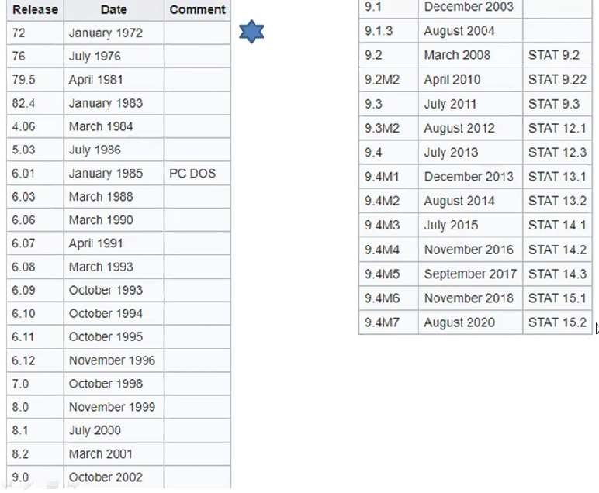

Slide 8
FEATURES OF SAS………..

Slide 9
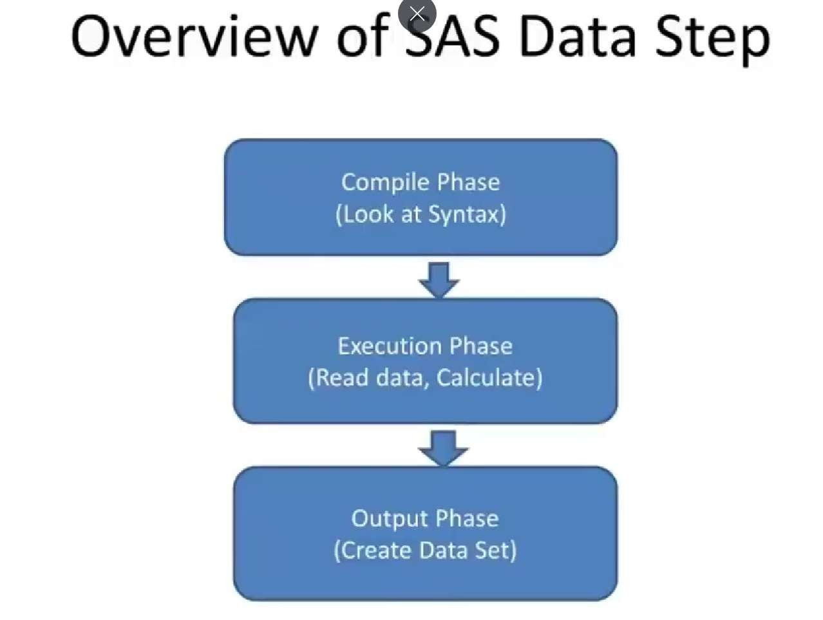

Slide 10
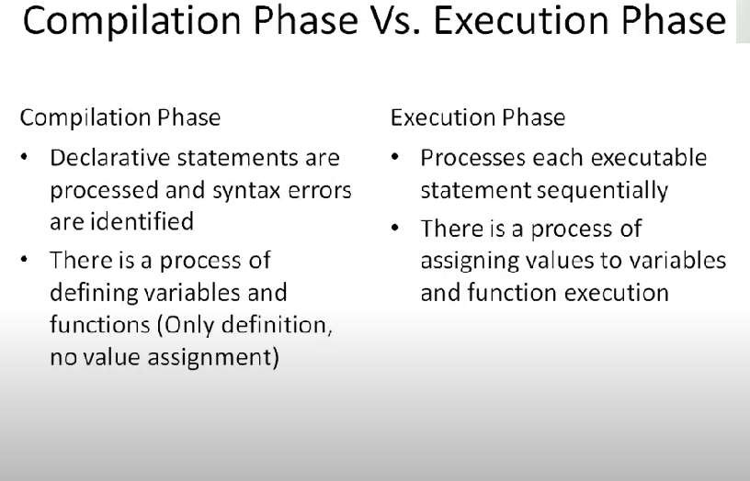

Slide 11
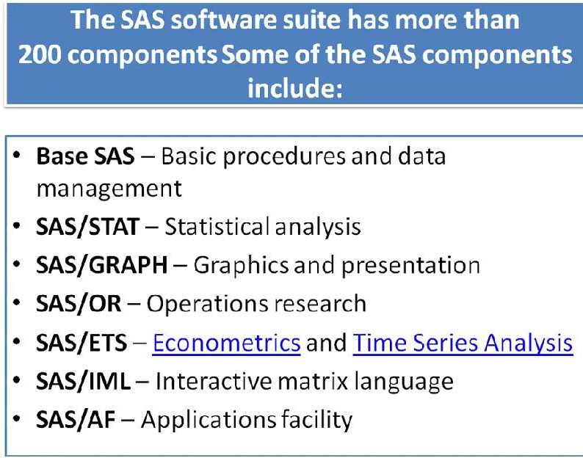

Slide 12
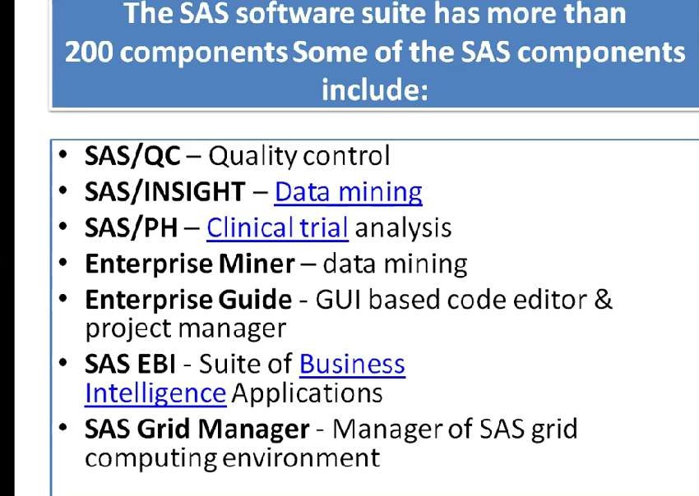

Slide 13
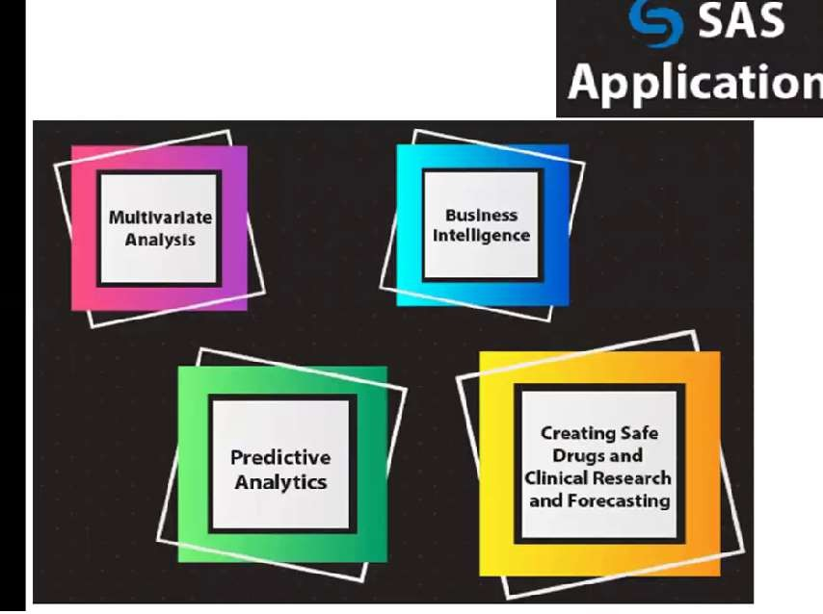

Slide 14
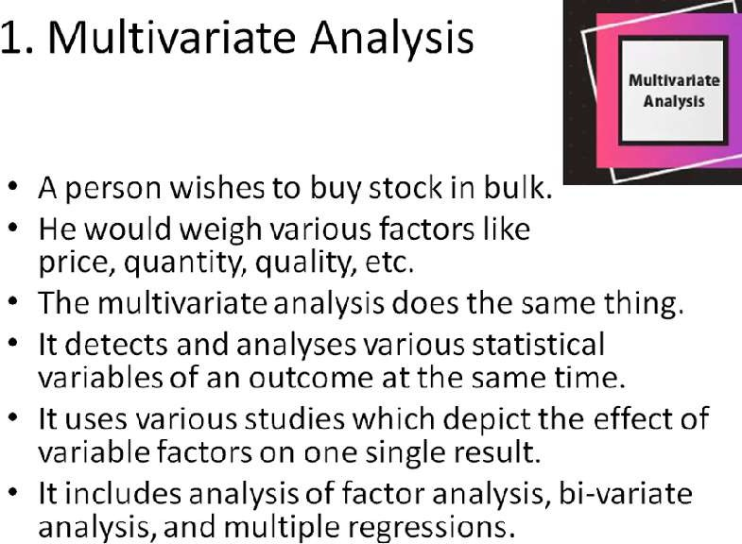

Slide 15


Slide 16
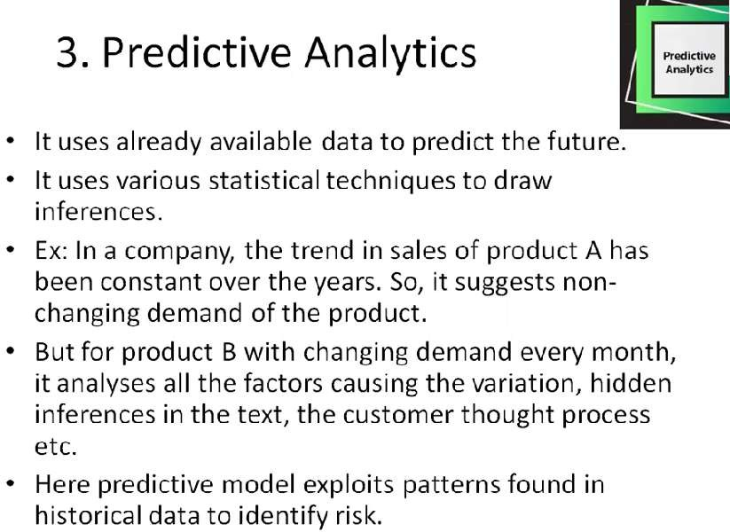

Slide 17
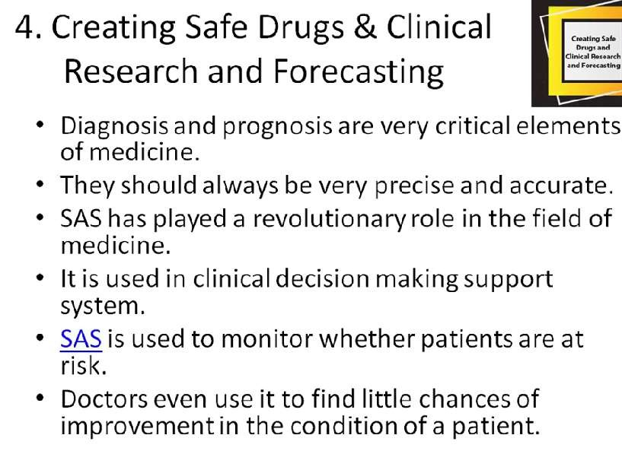

Slide 18

SPSS

Slide 19


Slide 20
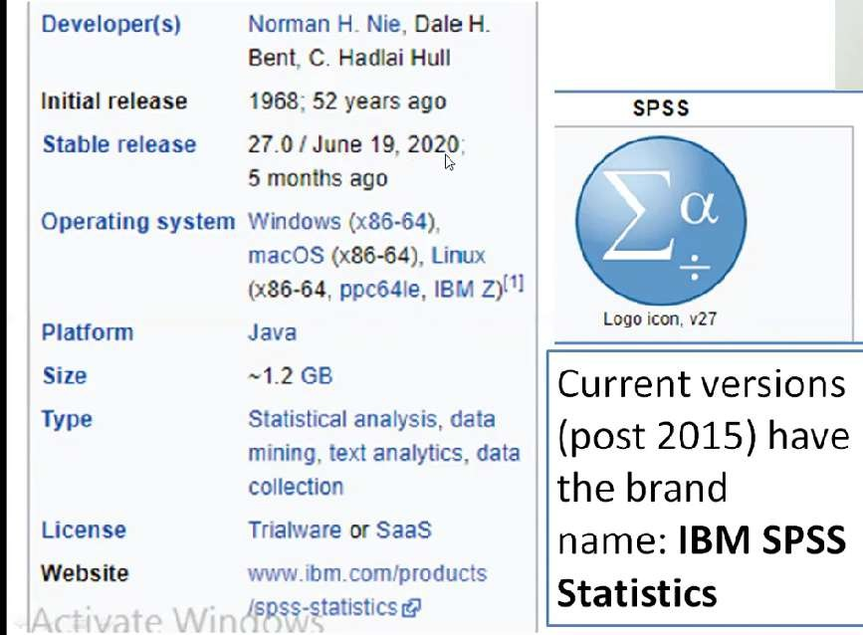

Slide 21
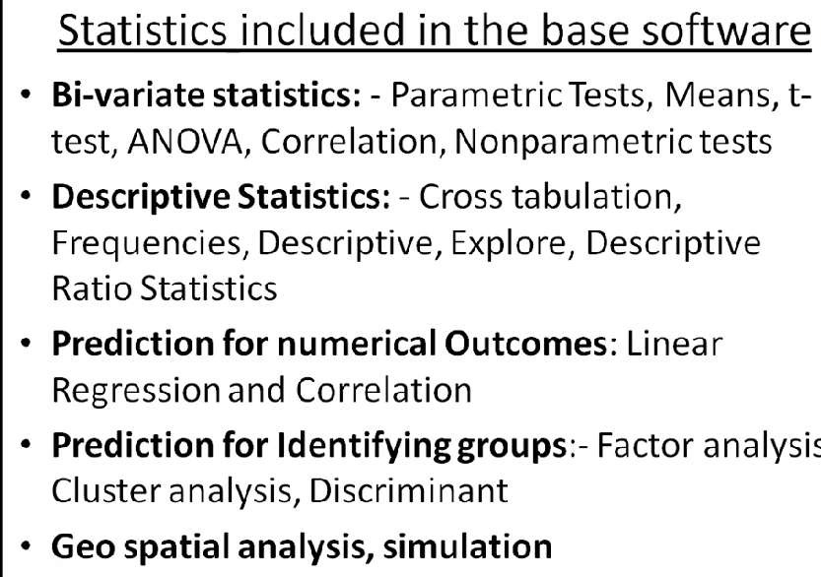

Slide 22
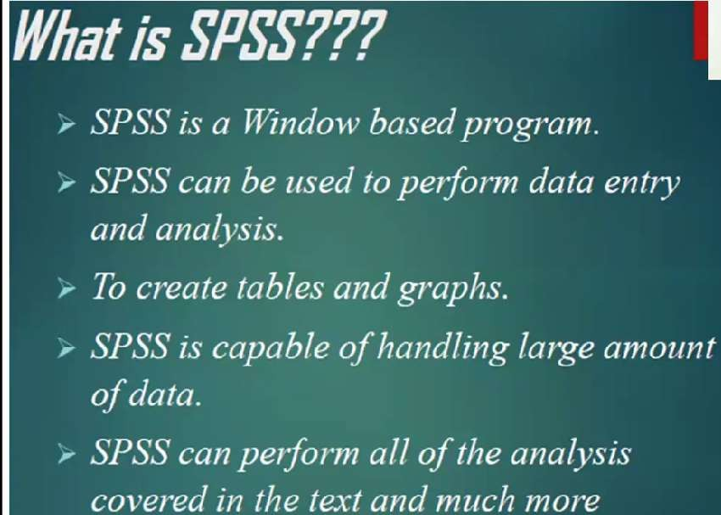

Slide 23
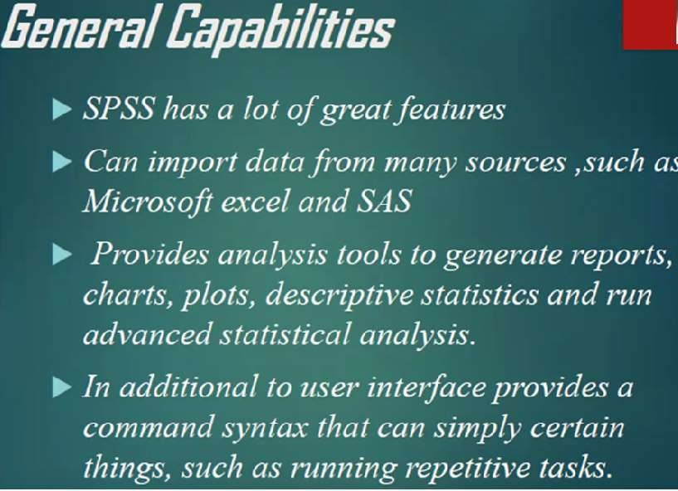

Slide 24
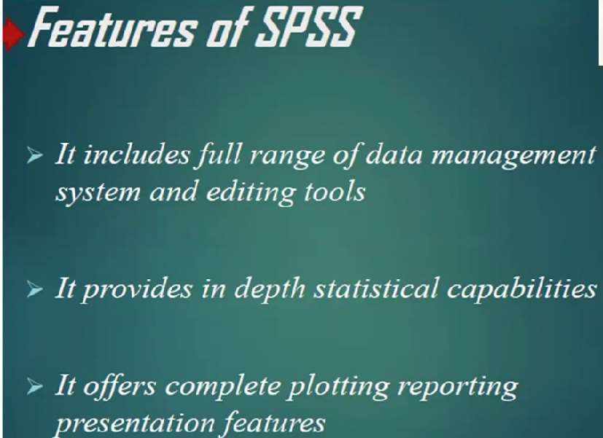
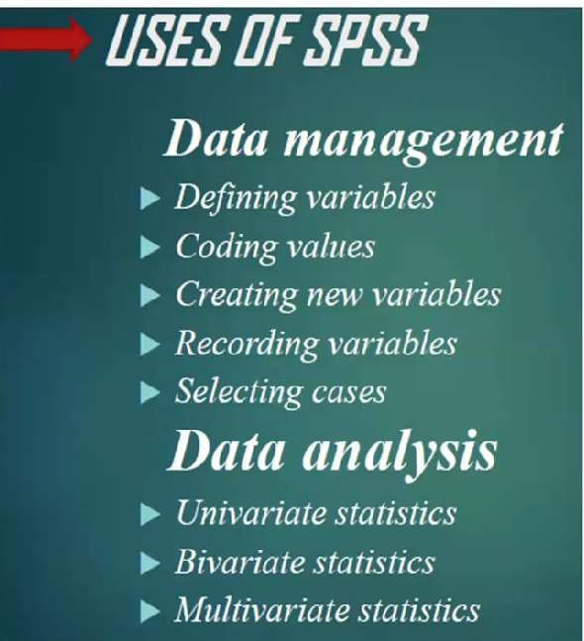

Slide 25
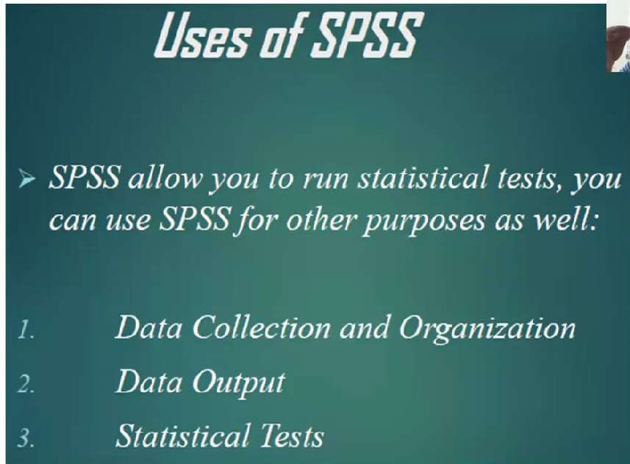
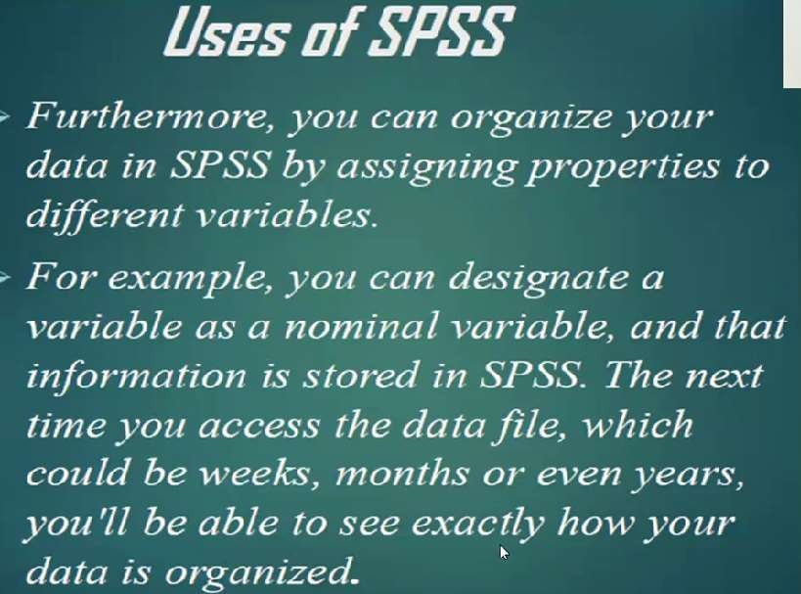

Slide 26
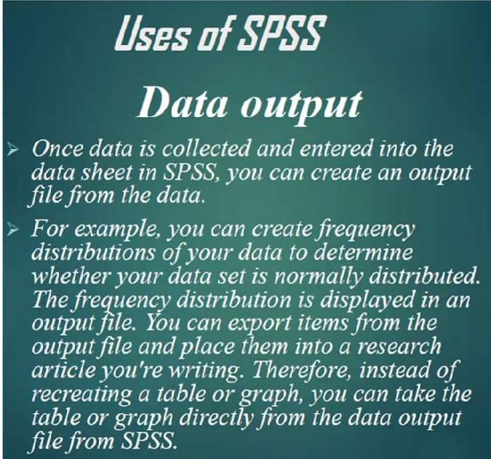

Slide 27


Slide 28
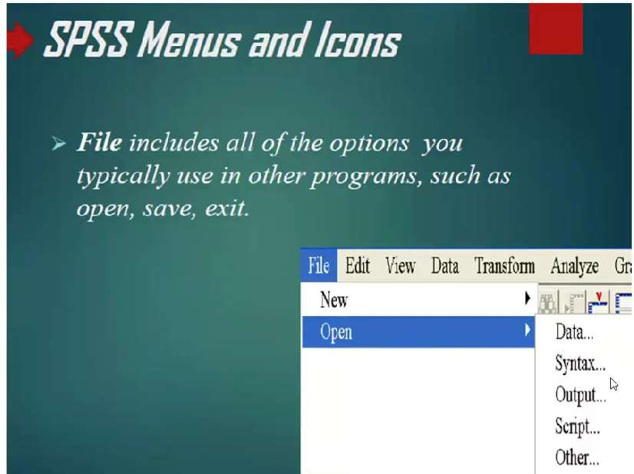
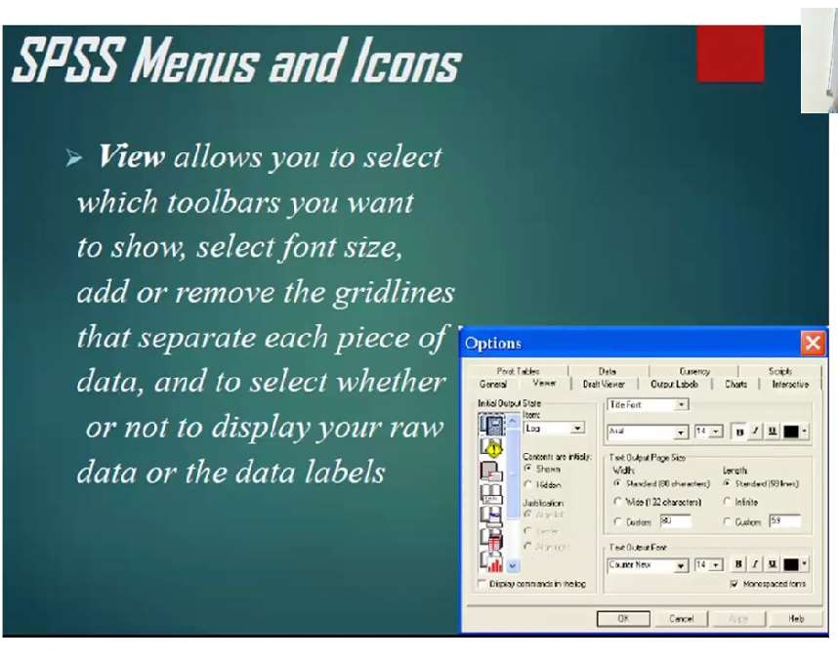

Slide 29
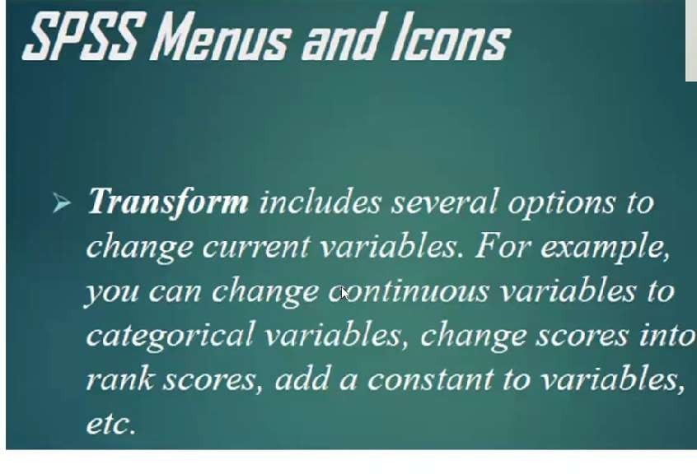
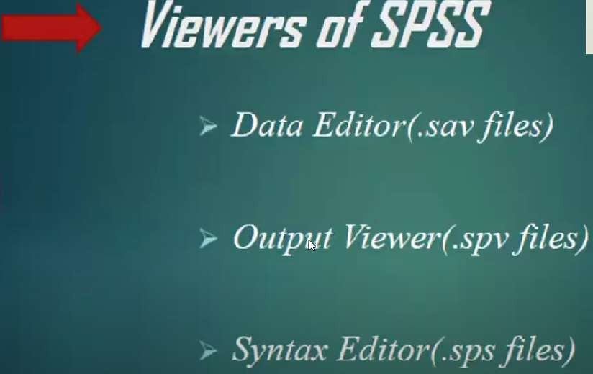

Slide 30
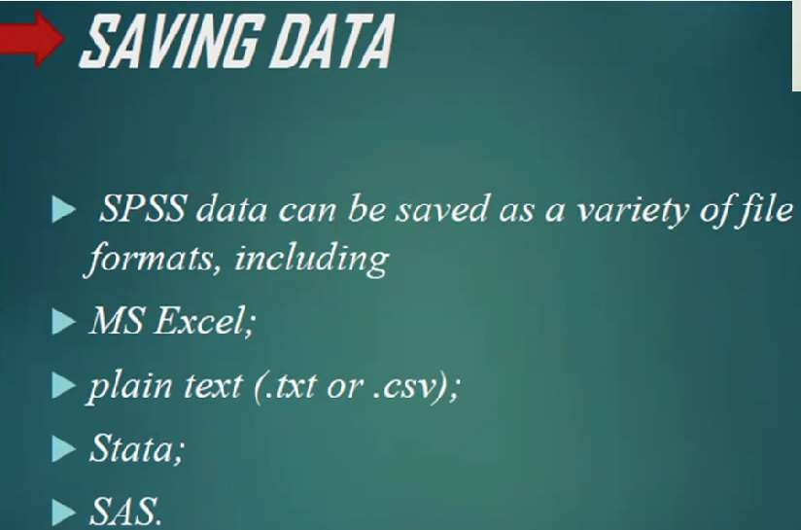

Slide 31



Slide 32
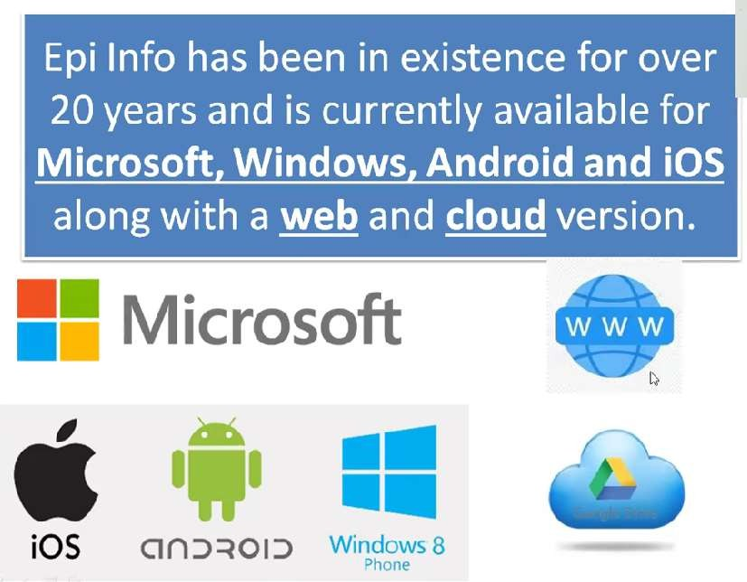

Slide 33
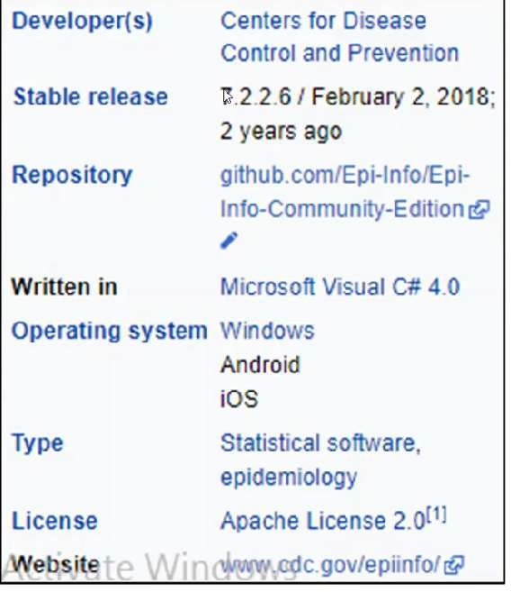

Slide 34
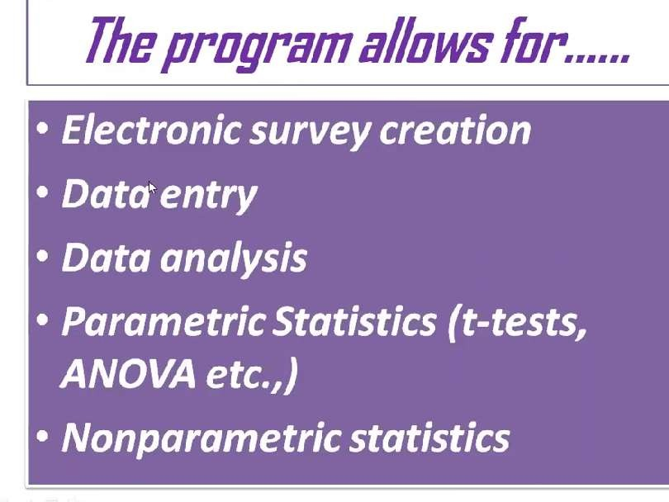
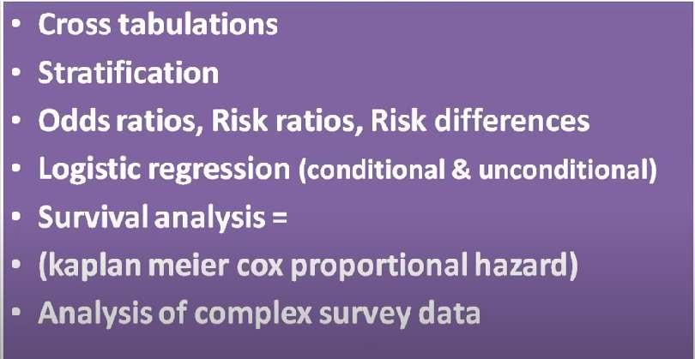

Slide 35
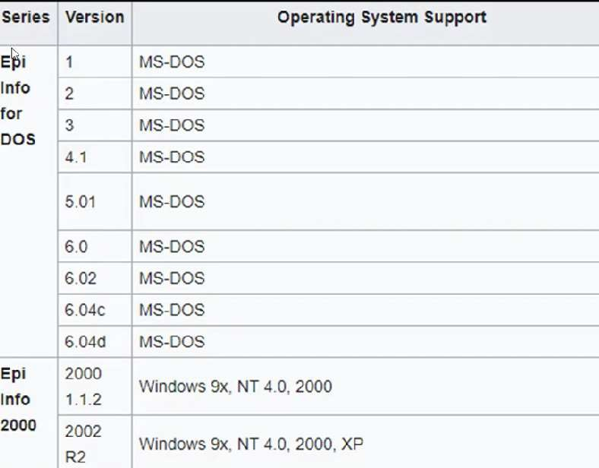

Slide 36
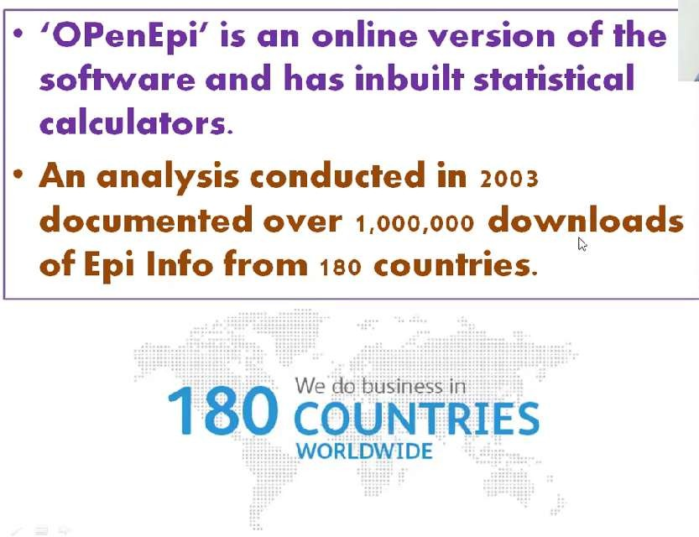

Slide 37
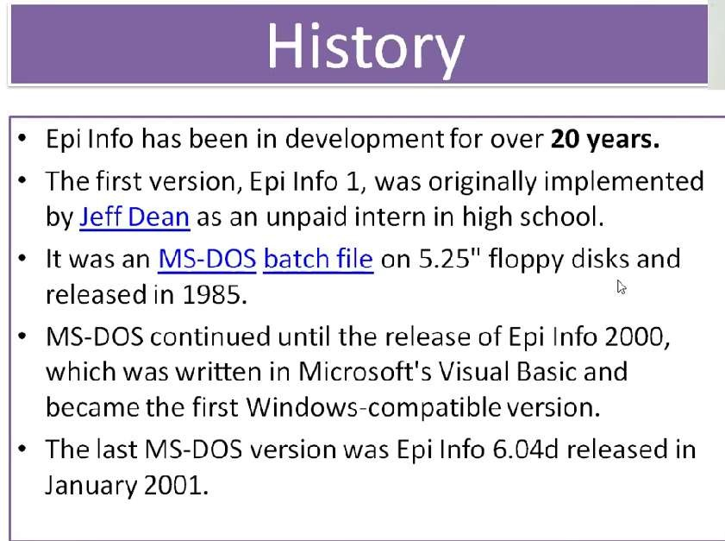
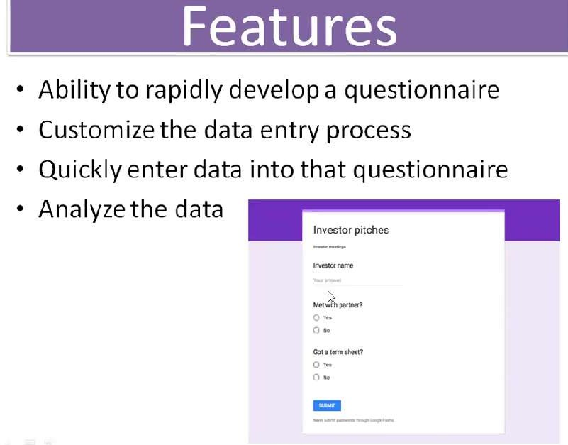

Slide 38
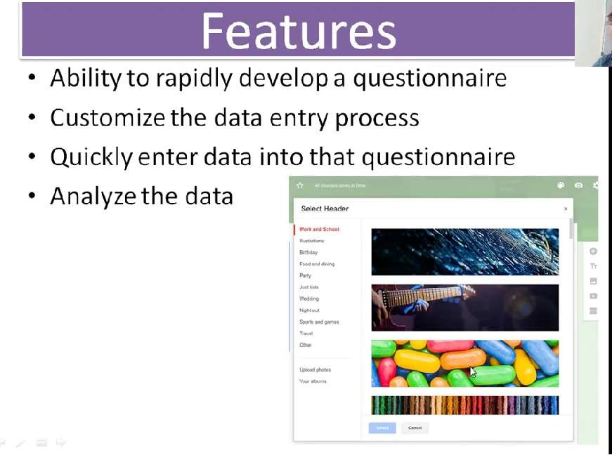

Slide 39
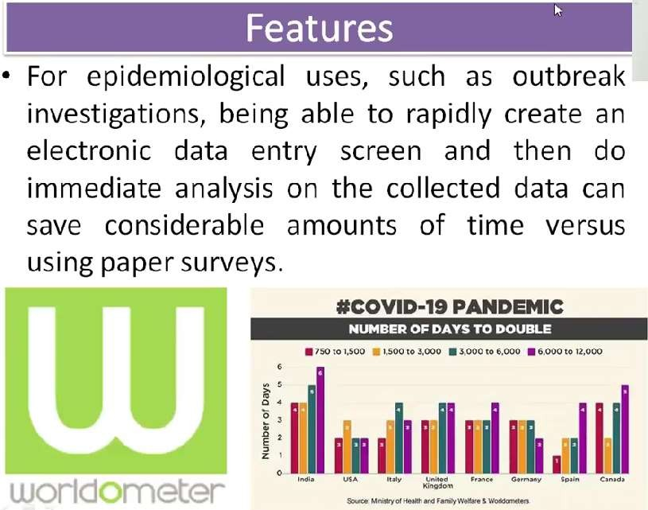

Slide 40
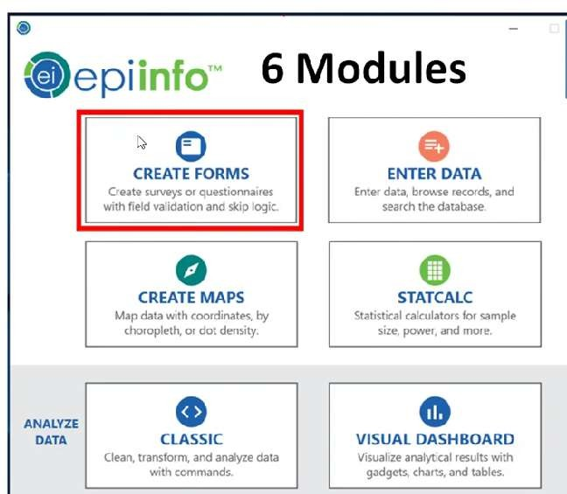

Slide 41
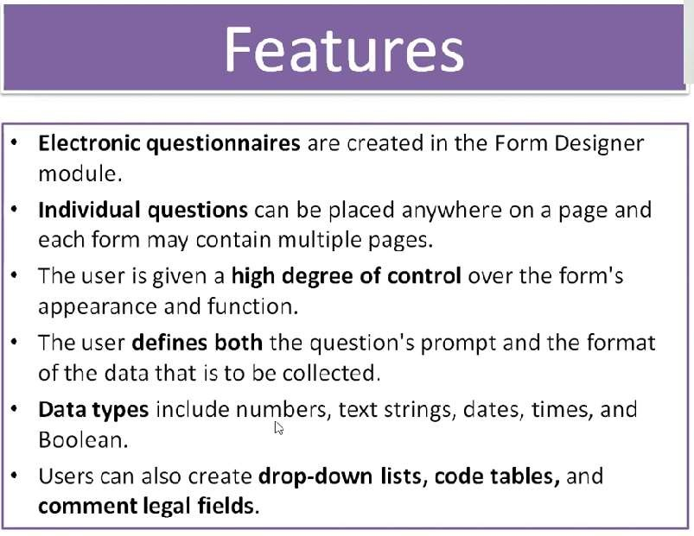

Slide 42
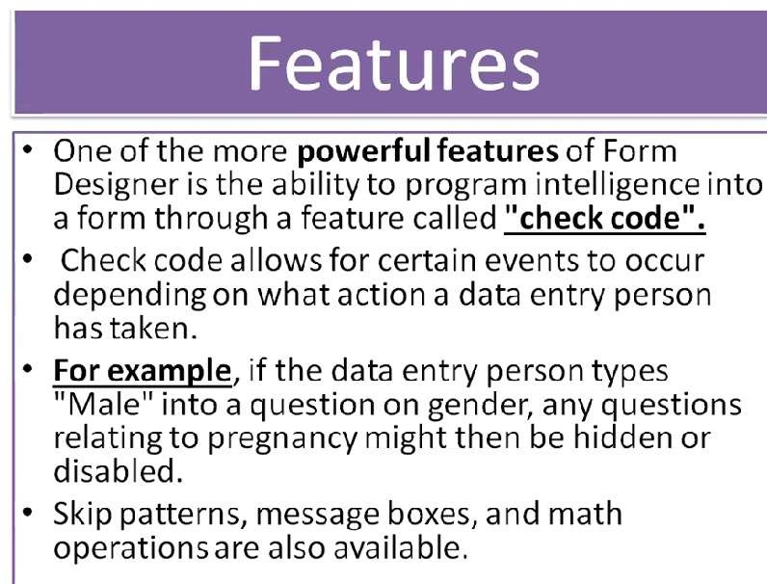

Slide 43
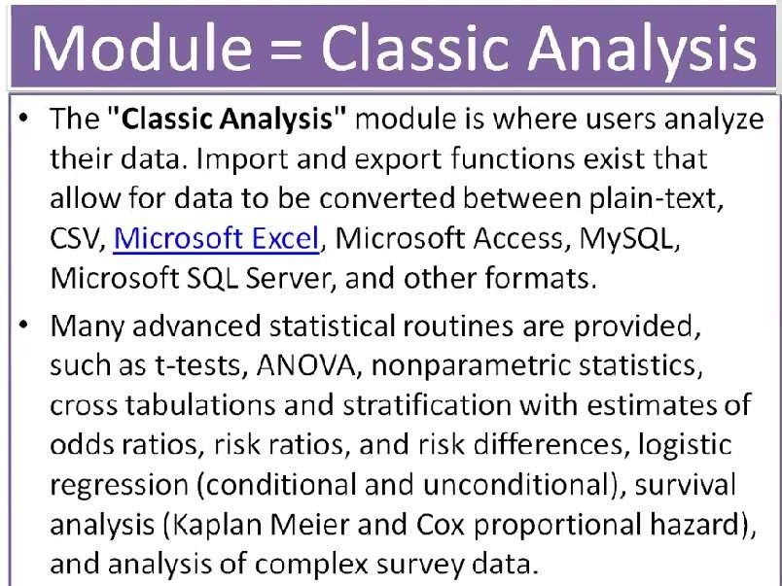

Slide 44
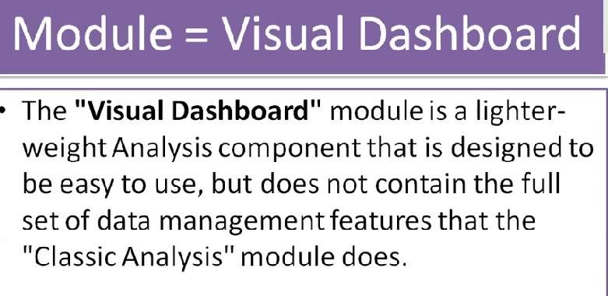

Slide 45
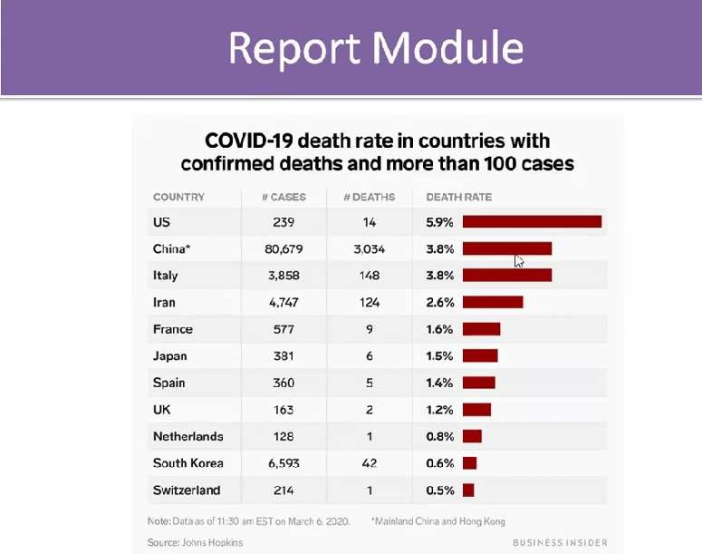
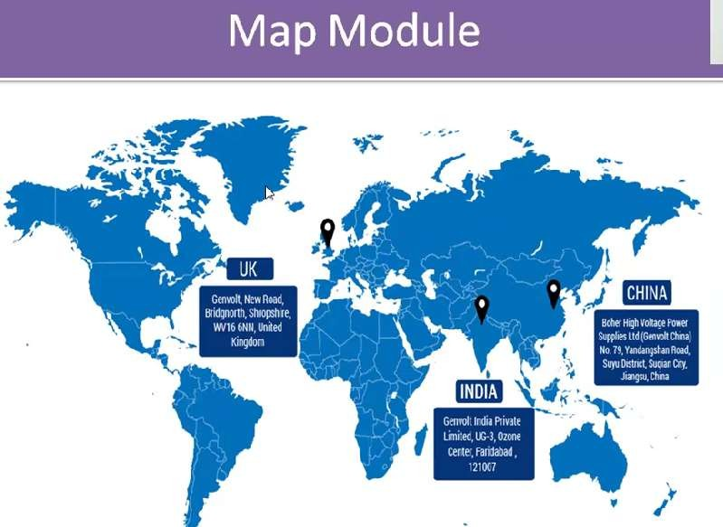

Slide 46
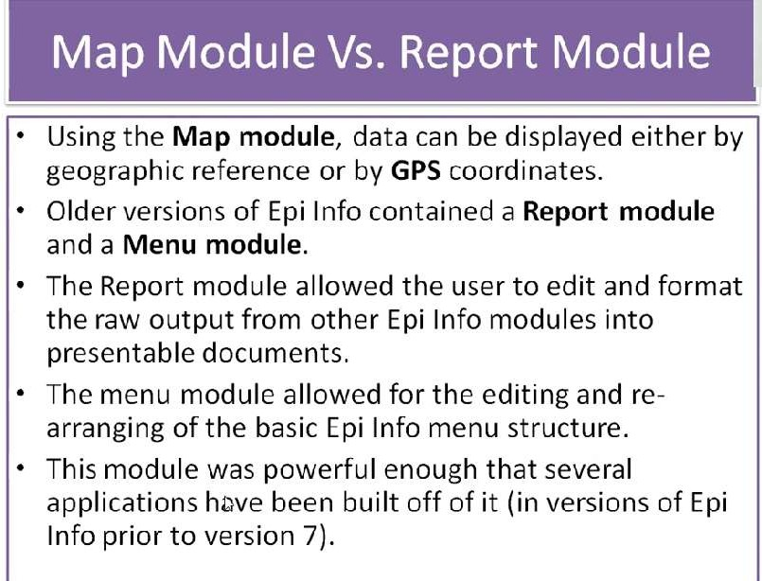

Slide 47
Some of the tools used in quantitative analysis include the following:
SPSS (Statistical Package for the Social Sciences) allows for many types of statistical analysis like chi square, T-test, ANOVA, factor analysis, etc. It is appropriate for complex types of data and applicable to fields of medicine or social science.
R is an open-source language for manipulating and visualizing data.
STATA works best with simpler datasets in econometrics and has an easy-to-use interface offering “graphs” and “statistics”
features. Like SPSS, it also allows for programming.
SAS is helpful in business contexts because you can use it for forecasting, improving efficiency and quality, and measuring
performance.
Excel has many formulas that can lead to data-driven insights. You can also learn specific data programming languages within Excel like VBA.
Once data needs to be taken to the next level and re-created, data scientists or data engineers use programming tools like
Python, R, and Matlab/ID for coding.

