Slide 1

BASIC PRINCIPLES OF CANCER
By Dr. Swathi Swaroopa. B
BASIC PRINCIPLES OF CANCER

Slide 2
Introduction
Cancer (neoplasm, tumor, or malignancy) is not a single disease; rather, it is a group of diseases characterized by uncontrolled growth and spread of abnormal cells.
Cancer cells do not respond to the normal processes that regulate cell growth, proliferation, and survival, and they cannot carry out the physiologic functions of their normal differentiated (mature) counterparts.
Cancer cells are described as poorly differentiated or immature.

Slide 3
Cont...
Other characteristics of cancer cells include metastasis (their ability to invade adjacent normal tissues and break away from the primary tumor (metastasize) and travel through the blood or lymph to establish new tumors (metastases) at a distant site.)
Their ability to stimulate the formation of new blood vessels (angiogenesis) and their endless replication potential further contribute to their continued growth and survival.

Slide 4
Cancers can arise in any tissue in the body and may be classified as benign or malignant.
An initial “event” causes damage or mutation to the cell’s DNA and convert normal cell to cancer cell.

Slide 5
CELL CYCLE
The cell cycle contains four phases (M, G1, S, and G2), each responsible for a different task necessary for cell division.
During the first activity phase, the M phase, the cell undergoes mitosis, the process of cell division.

Slide 6

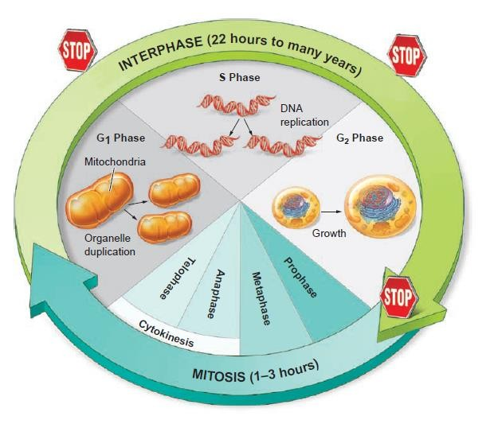

Slide 7
After mitosis, the cell enters the first gap or resting phase (G1).
During the G1 resting (or gap) phase, the cell makes the enzymes
necessary for DNA synthesis.
The synthesis of DNA occurs during the S phase.
After the S phase, the cell enters a second resting phase (G2).
RNA and other proteins are synthesized to prepare for cell division
during the Mphase.

Slide 8
The cells that complete mitosis may either continue to proceed through the cell cycle to divide again or mature into specialized cells and eventually die, or enter a third resting phase called G0
G0 is the stage after mitosis during which a cell may leave the cell cycle and either remain in a state of inactivity or reenter the cell cycle at another time
Labile cells, such as blood cells and those that line the gastrointestinal tract, do not enter G0 but continue cycling.

Slide 9
Stable cells, such as hepatocytes, enter G0 after mitosis but can reenter the cell cycle when stimulated by the loss of other cells.
Proliferation of normal cells is carefully controlled to balance the loss of mature functional cells with the production of new cells.

Slide 10
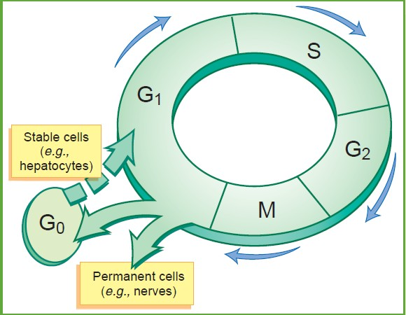

Slide 11
The transition of cells through the cell cycle is an ordered, tightly regulated process, which involves a series of checkpoints that assess these signals and the number and integrity of the cells
In most cells, there are several checkpoints in the cell cycle, at which time the cycle can be arrested if previous events have not been completed.

Slide 12
For example, the G1/S checkpoint monitors whether the DNA in the chromosomes is damaged by radiation or chemicals, and the G2/M checkpoint prevents entry into mitosis if DNA replication is not complete.
The cyclins are a family of proteins that control entry and progression of cells through the cell cycle.
They function by activating proteins called CDKs.

Slide 13
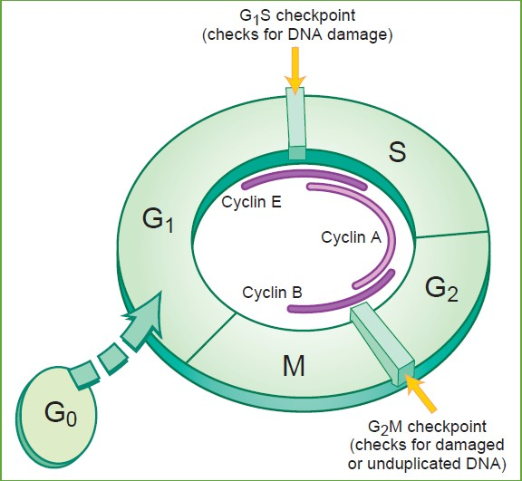

Slide 14
Cyclins bind to proteins called cyclin-dependent kinases (CDKs).
Cyclin–CDK complexes generate phosphate groups from molecules of adenosine triphosphate (ATP)
Transfer them to a protein called a retinoblastoma protein (pRb).
Phosphorylated pRb promotes cell cycle progression

Slide 15
A decline in the level of the CDK complex signals the end of the phase.
The cyclin–CDK complexes are regulated by the binding of CDK inhibitors (CKIs).
The CKIs are particularly important in regulating cell cycle
checkpoints during which mistakes in DNA replication are repaired
If insufficient amounts of cyclins or CDK are present during any phase, the cell will not enter the next phase..

Slide 16
CDK inhibitors inhibit cell proliferation by dephosphorylating pRb

Slide 17
Proto-oncogenes and tumor-suppressor genes provide the stimulatory and inhibitory signals, respectively, that regulate the cell cycle.
Protooncogenes encode for normal cell proteins such as growth factors, growth factor receptors, growth factor signaling molecules, and transcription factors that promote cell growth or increase growth factor–dependent signaling

Slide 18
Growth and proliferation of normal cells are influenced by proteins, known as growth factors.
When growth factors bind to receptors on the cell surface, they activate a series of enzymes within the cell that stimulate cell signaling pathways and gene transcription.
These genes encode for proteins that regulate cell growth and proliferation.

Slide 19
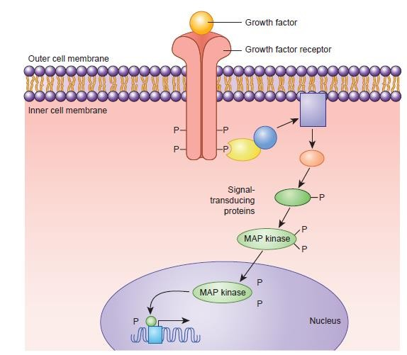

Slide 20
The coordination and integration of cellular signaling processes are referred to as signal transduction.
Proto-oncogenes are responsible for encoding several components of signal transduction pathways.
Abnormal forms or excessive quantities of these stimulatory proteins disrupt normal cell growth-signaling pathways, leading to excessive growth and proliferation and, ultimately, a malignant transformation.

Slide 21
Tumor suppressor genes include the
Retinoblastoma (RB) gene, which normally prevents cell division that encodes for pRb
P53 gene, which normally becomes activated in DNA-damaged cells
p53 gene is responsible for temporarily arresting cell growth in response to biochemical or molecular damage until the DNA damage can be repaired
If the damage cannot be repaired, apoptosis (programmed cell death) occurs to prevent genetically damaged cells from growing uncontrollably.

Slide 22
Etiolpathogenesis of Cancer
The causes of cancers are very diverse and complex. It is useful to discuss causation in terms of:
  The genetic and molecular mechanisms that are involved and that characterize the transformation of normal cells to cancer cells
  The external and more contextual factors such as age, heredity, and environmental agents that contribute to the development and progression of cancer.

Slide 23
Cancer-Associated Genes
Originate with genetic damage or mutation
Gene overactivity
  Protooncogenes
Oncogenes arise from normal genes called proto-oncogenes through genetic alterations such as chromosomal translocations, deletions, insertions, and point mutations.
Gene underactivity
  Tumor suppressor genes
    P53 gene
    Retinoblastoma (RB) gene

Slide 24
Etiology of Cancer
Carcinogenic Risk Factor | Associated Cancer(s)
Environmental
Ionizing radiation (radon gas emitted from soil containing uranium deposits) | Leukemia, breast, thyroid, lung
Ultraviolet radiation | Skin melanoma
Viruses | Leukemia, lymphoma, nasopharyngeal, liver, cervix
Occupational
Asbestos | Lung, mesothelioma
Chromium, nickel | Lung
Vinyl chloride | Liver
Aniline dye | Bladder
Benzene | Leukemia
Lifestyle
Alcohol | Esophagus, liver, stomach, oropharynx, larynx
Dietary factors | Colon, breast, gallbladder, gastric
Tobacco | Lung, oropharynx, pharynx, larynx, esopha₂g₄ us, bladder

Slide 25
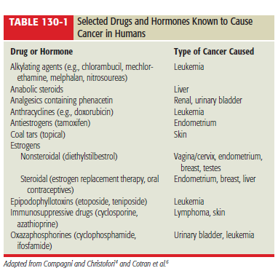
Etiology of Cancer

Slide 26
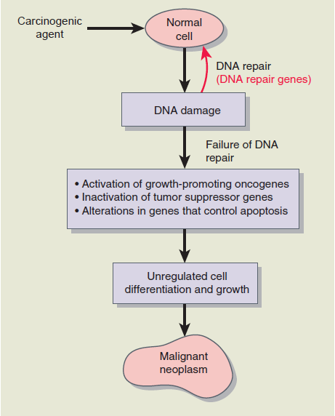

Slide 27
CARCINOGENESIS
Carcinogenesis is the process by which normal cells are transformed into cancer cells.
If the balance of stimulatory and inhibitory growth signals becomes dysregulated, carcinogenesis may occur
In carcinogenesis, normal mechanisms such as apoptosis and senescence (aging) do not function properly and cannot control excessive cell division.

Slide 28
Cont...
Hence Carcinogenesis is a multistep process that includes initiation, promotion, conversion, and progression.

Slide 29
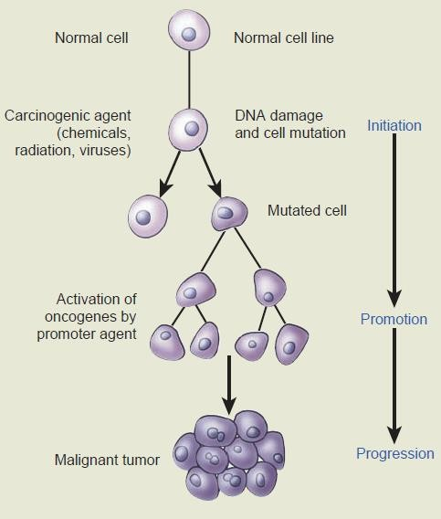

Slide 30
Pathology of Cancer
Origin of tumor
Tumor characteristics
Invasion and Metastasis

Slide 31
Origin of Tumor
Tumors may arise from any of four basic tissue types:
Epithelial tissue
Connective tissue (i.e., muscle, bone, and cartilage)
Lymphoid tissue
Nerve tissue

Slide 32
Tumor Characteristics
Noncancerous growths that are often encapsulated, localized, and indolent.
Cells of benign tumors resemble the cells from which they developed. These masses seldom metastasize, and once removed they
rarely recur.
i. Invade and destroy the surrounding tissue.
ii. The cells of malignant tumors are genetically unstable and loss of normal cell architecture results in cells that are atypical of their tissue or cell of origin.
iii.
iii.
Malignant tumors tend to metastasize, and consequently, recurrences are common after removal or destruction of the primary tumor.
Benign
Malignant

Slide 33
Invasion & Metastases
Cells must break away from the primary tumor and travel to other sites in the body to form metastases
Normally, cells adhere to one another and the extracellular matrix.
The cell-to-cell adhesion molecules are called cadherins
Cell-to-extracellular matrix molecules are called integrins.
In cancer cells, these molecules are often absent, allowing tumor cells to easily move away from the primary tumor mass.

Slide 34
Metastases cont….
The blood vessels and the lymphatics are the primary pathways by which cells metastasize
After a cancer cell establishes a metastatic site, it must again undergo angiogenesis to ensure continued growth.
Together, angiogenesis and hematogenous or lymphatic spread help cancer cells invade healthy tissues

Slide 35
Initially after neoplastic transformation, the malignant cells and surrounding host tissue secrete substances that stimulate the formation of new blood vessels to provide oxygen and nutrients. This process is known as angiogenesis or neovascularization

Slide 36
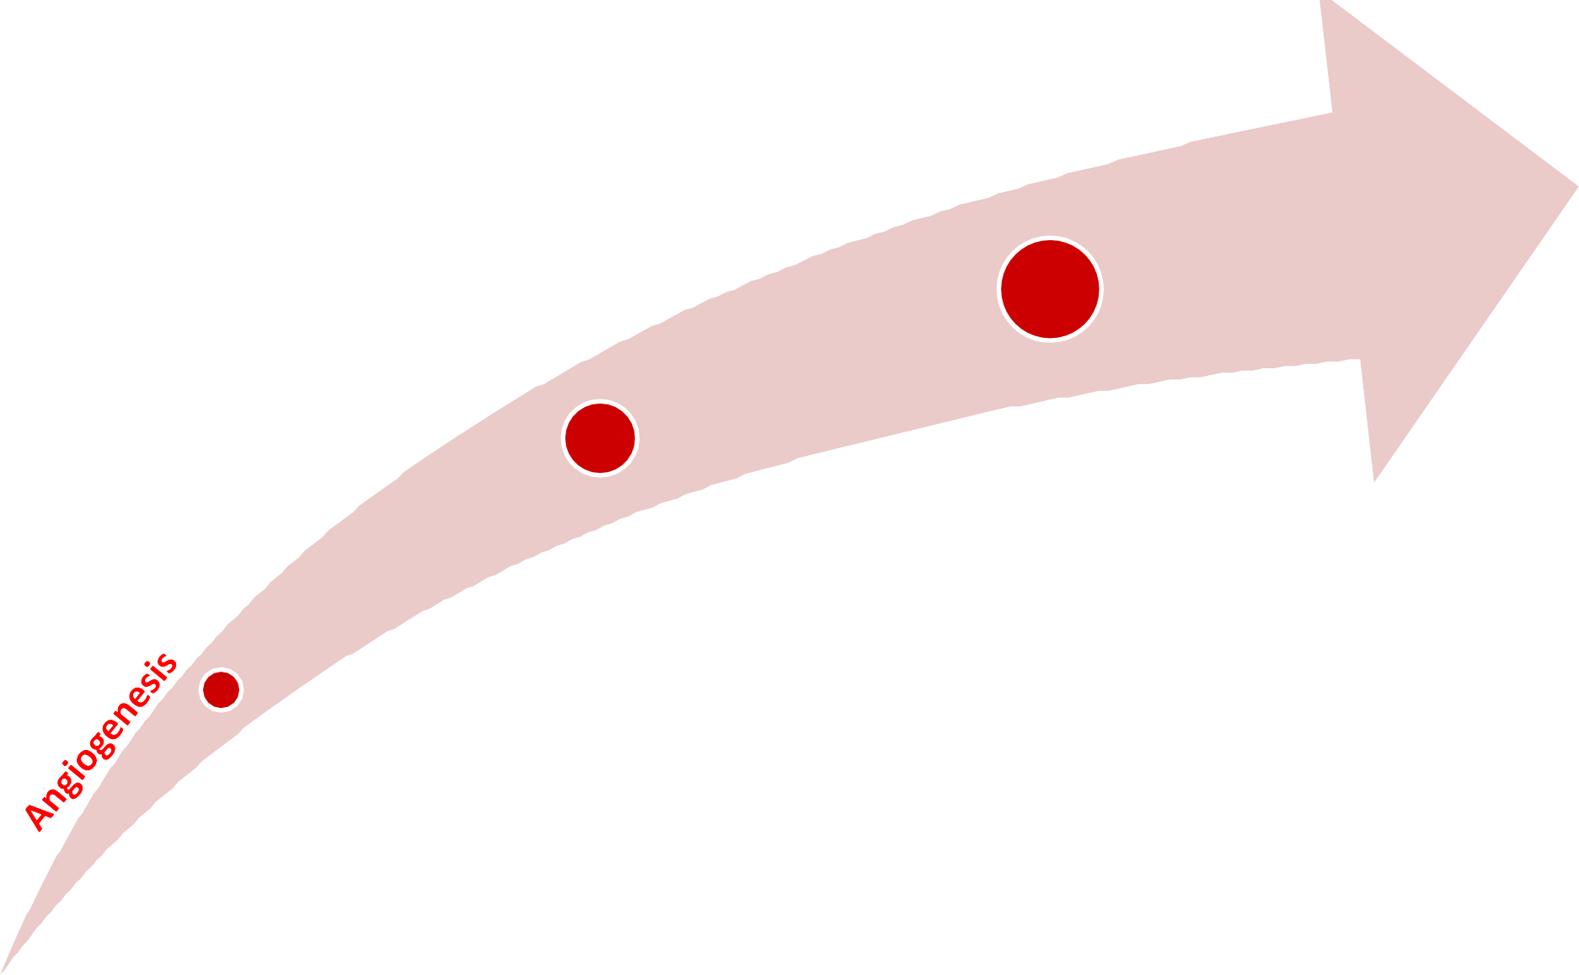
The cells may proliferate within the lumen of the vessel, but most commonly extravasate into the surrounding tissue. The local microenvironment may provide growth factors that
can serve as “fertilizer” to potentiate the proliferation of
the metastasis.
Tumor cells must then detach from the primary mass and invade surrounding blood and lymph vessels. The tumor cells or cell aggregates detach and embolize through these vessels, but most do not survive circulation. The disseminated cells must then attach to the vascular endothelium.
After neoplastic transformation, the malignant cells and surrounding host tissue secrete substances that stimulate the formation of new blood vessels to provide oxygen and nutrients.

Slide 37
Cont...
At every step of the way, the potential metastatic cell must fight the host immune system. Last, the metastasis must again initiate angiogenesis to ensure continued growth and proliferation.
Because angiogenesis has been recognized as a critical element in primary tumor growth as well as metastasis, it has become a target for development of new anticancer agents

Slide 38
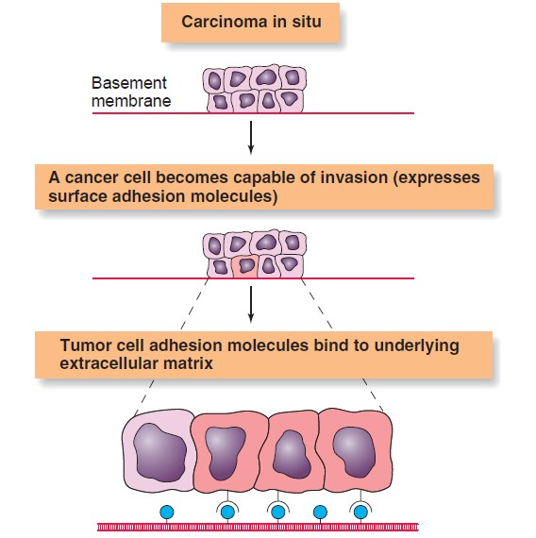

Slide 39
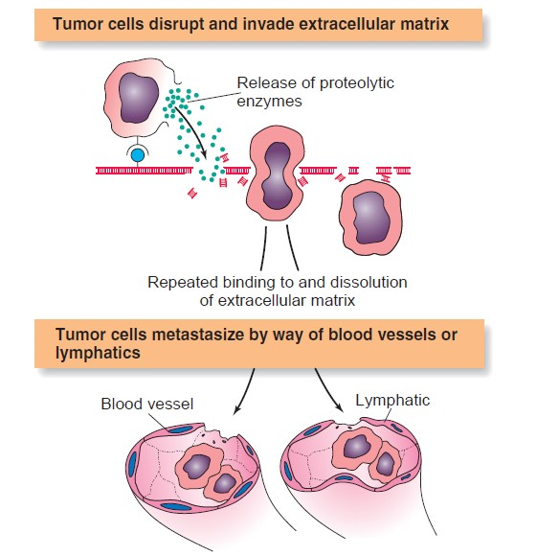

Slide 40
Cancer cells
Less dependent on receiving stimulatory signals from external growth factors
Capable of immortality through their ability to maintain their telomeres indefinitely and Possess unlimited replication potential (activate telomerase)
Balance between cell renewal and loss of mature (senescent) cells is disrupted (due to oncogenes and tumor suppressor genes)

Slide 41
Develop new blood vessels to obtain nutrients and to spread to distant sites (metastasize).
Secrete growth factors (VEGF, PDGF, bFGF) that stimulate the growth of the new blood vessels (angiogenesis) from existing blood vessels
The regulation and function of cyclins, CDK, and inhibitory proteins may be disrupted by a malignant transformation

Slide 42
Deletion of the RB gene, a tumor suppressor gene that encodes for pRb if this molecule becomes inactive, excessive cell proliferation can occur.
Loss or mutation of a second tumor suppressor gene, p53, is also common in human cancers, and is associated with the resistance of cancer cells to undergo cell cycle arrest or apoptosis

Slide 43
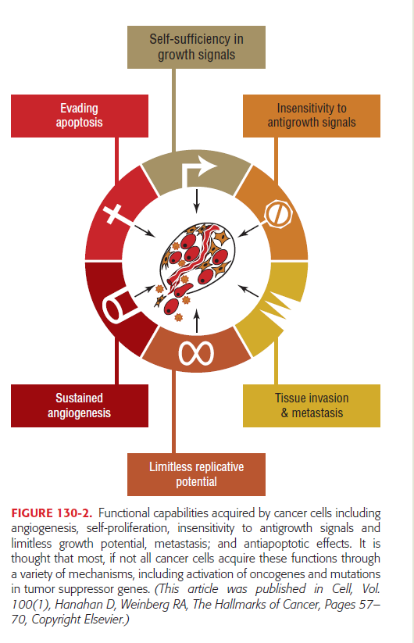
Acquired capabilities of cancer cells that differ from normal cellular function

Slide 44
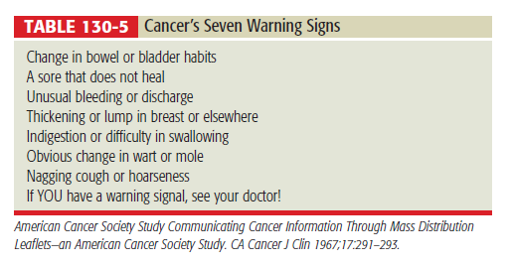
Diagnosing and staging of Cancer
The presentation in adults may include any of cancer’s seven warning signs as well as pain or loss of appetite

Slide 45
Diagnosing and staging of Cancer
The definitive diagnosis of cancer relies on the procurement of a sample of the tissue or cells suspected of malignancy and pathologic assessment of this sample. This sample can be obtained by numerous methods, including biopsy, exfoliative cytology, or fine-needle aspiration. A tissue diagnosis is essential, because many benign conditions can masquerade as cancer. Definitive treatment should not begin without a pathologic diagnosis.

Slide 46
Staging of Cancer
The most commonly applied staging system for solid tumors is the TNM classification, where T = tumor, N = node, and M = metastases.
A numerical value is assigned to each letter to indicate the size or extent of disease. The designated rating for tumor describes the size of the primary mass and ranges from T1 to T4.

Slide 47
Nodes are described in terms of the extent and quality of nodal involvement (N0 to N3).
Metastases are generally scored depending on their presence or absence (M0 or M1).

Slide 48
Staging of Cancer
To simplify
the staging process, most cancers are classified
according to the extent of disease by a numerical system involving stages I through IV. Stage I usually indicates localized tumor, stages II and III represent local and regional extension of disease, and stage IV denotes the presence of distant metastases.

Slide 49
The assigned TNM rating translates into a particular stage classification. For example, T3N1M0 describes a moderate to large-sized primary mass, with regional lymph node involvement and no distant metastases, and for most cancers is stage III.

Slide 50
Staging of Cancer
TNM Classification
Primary Tumor (T)
T1 | Tumor ≤2 cm in greatest dimension
T2 | Tumor >2 cm but not >5 cm in greatest dimension
T3 | Tumor >5 cm in greatest dimension
T4 | Tumor of any size with direct extension to chest wall or skin
Regional Lymph Nodes (N)
N0 | No regional lymph node metastasis
N1 | Metastasis to movable ipsilateral axillary lymph node(s)
N2 | Metastasis to ipsilateral axillary lymph node(s) fixed to one another or other structures
N3 | Metastasis to ipsilateral internal mammary lymph node(s)

Slide 51
Staging of Cancer
Distant Metastasis (M)
M0 | No distant metastasis
M1 | Distant metastasis (includes metastasis to ipsilateral supra-clavicular lymph nodes)
Stage Grouping
Stage I | T1 | N0 | M0
Stage II_{A} | T0 | N1 | M0
 | T1 | N1 | M0
 | T2 | N0 | M0

Slide 52
Staging of Cancer
Stage II_{B} | T2 | N1 | M0
 | T3 | N0 | M0
Stage III_{A} | T0 | N2 | M0
 | T1 | N2 | M0
 | T2 | N2 | M0
 | T3 | N1, N2 | M0
Stage III_{B} | T4 | N0, N1, N2 | M0
Stage III_{C} | Any T | N3 | M0
Stage IV | Any T | Any N | M1

Slide 53
THANK YOU
86

