Slide 1
Pathophysiology introduction

Slide 2
▶ Pathology is literally the study (logos) of suffering (pathos).
▶ Pathology: scientific study of changes in the structure and function of the body in disease.
General
▶ Pathology
Special/systemic
▶ General: concerned with basic reactions of cell and tissue to abnormal stimuli
▶ Systemic: concerned with specific organs and tissues to more or less well- defined stimuli

Slide 3
Pathophysiology: study of disordered function (physiological changes) and breakdown of homeostasis in diseases (biochemical changes)
Four aspects of a disease process that form the core of pathology
▶ Etiology
▶ Pathogenesis
▶ Morphological changes
▶ Clinical significance

Slide 4
Genetic
1. Etiology
Acquired
Pathogenesis: sequence of events in response of cell/tissue to etiological agent
Morphologic changes: structural alterations in cells or tissues characterstic of disease.
Clinical manifestations: morphologic changes influence normal function and determine the clinical features (symptoms and signs)

Slide 5
Basic principles of cell injury and adaptation

Slide 6
Homeostasis

Slide 7
Homeostasis
▶ Homeostasis (ho¯ me¯-o¯-STA¯ -sis; homeo- sameness; -stasis standing still) is the condition of equilibrium (balance) in the body’s internal environment due to the constant interaction of the body’s many regulatory processes
▶ Homeostasis is a dynamic condition.
▶ In response to changing conditions, the body’s equilibrium can shift among points in a narrow range that is compatible with maintaining life

Slide 8
▶ An important aspect of homeostasis is maintaining the volume and composition of body fluids.
Control of Homeostasis
▶ Disruptions in homeostasis come from the external environment in the form of physical insults, from internal environment and from psychological stresses.
▶ Most cases the disruption of homeostasis is mild and temporary, and the responses of body cells quickly restore balance in the internal environment

Slide 9
▶ Some cases the disruption of homeostasis may be intense and prolonged
▶ The body has many regulating systems that can usually bring the internal environment back into balance
▶ Mainly the nervous system and the endocrine system

Slide 10
Feedback Systems
A feedback system or feedback loop is a cycle of events in which the status of a body condition is
▶ Monitored,
▶ Evaluated,
▶ Changed,
▶ Remonitored,
▶ Reevaluated, and so on.
▶ Each monitored variable, such as body temperature, blood pressure, or blood glucose level, is termed a controlled condition.

Slide 11
▶ Any disruption that changes a controlled condition is called a stimulus
Feedback system includes three basic components—
▶ Receptor,
▶ Control center, and
▶ Effector

Slide 12
▶ Receptor: is a body structure that monitors changes in a controlled condition and sends input to a control center
▶ Input is in the form of nerve impulses or chemical signals
▶ Control center (in body): sets the range of values within which a controlled condition should be maintained, evaluates the input it receives from receptors, and generates output commands when they are needed
▶ Output from the control center typically occurs as nerve impulses, or hormones or other chemical signals

Slide 13
▶ Effector: is a body structure that receives output from the control center and produces a response or effect that changes the controlled condition.
▶ Nearly every organ or tissue in the body can behave as an effector

Slide 14
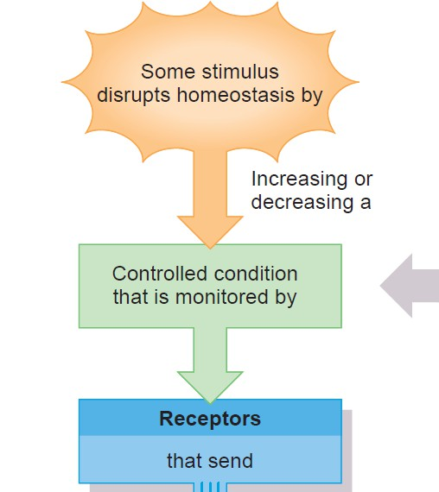

Slide 15
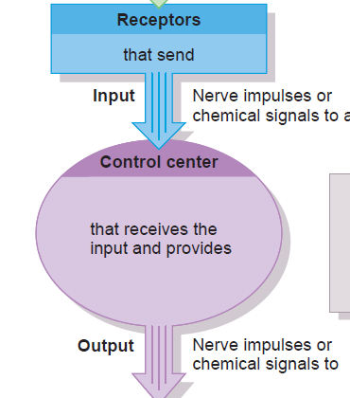

Slide 16
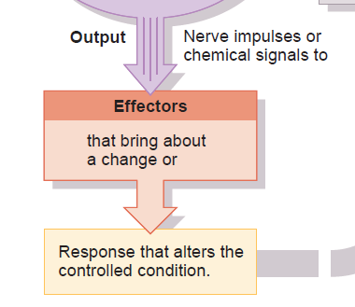

Slide 17
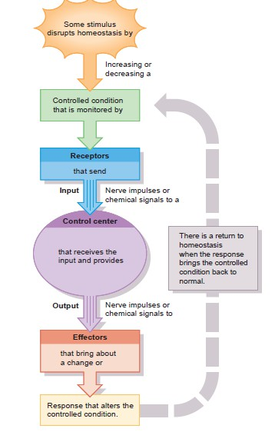

Slide 18
▶ A group of receptors and effectors communicating with their control center forms a feedback system that can regulate a controlled condition in the body’s internal environment.
▶ In a feedback system, the response of the system “feeds back” information to change the controlled condition in some way, either negating it (negative feedback) or enhancing it (positive feedback).

Slide 19
Types of feed back system
NEGATIVE FEEDBACK SYSTEMS:
▶ A negative feedback system reverses a change in a controlled condition.
POSITIVE FEEDBACK SYSTEMS:
▶ The feedback is used to increase the size of the input. By nature, such systems are unstable, and they are most often associated with pathological conditions.
▶
▶ A positive feedback system tends to strengthen or reinforce a change in one of the body’s controlled conditions.

Slide 20
▶ A positive feedback system operates similarly to a negative feedback system, except for the way the response affects the controlled condition
▶ The control center still provides commands to an effector, but this time the effector produces a physiological response that adds to or reinforces the initial change in the controlled condition.
▶ The action of a positive feedback system continues until it is interrupted by some mechanism

Slide 21
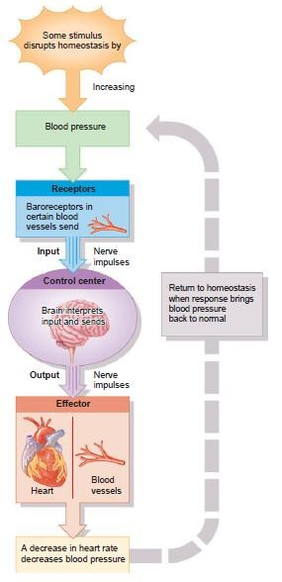
Homeostatic regulation of blood pressure by a negative feedback system.

Slide 22
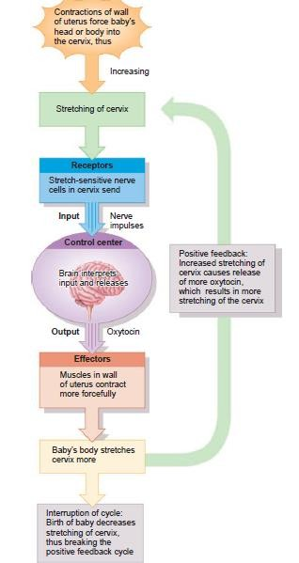
Positive feedback control of labor contractions during birth of a baby.

Slide 23
Difference between positive and negative
feedback systems
POSITIVE
a positive feedback system continually reinforces a change in a controlled condition, some event outside the system must shut it off.
If the action of a positive feedback system is not stopped, it can “run away” and may even produce life-threatening conditions in the body.
Positive feedback systems reinforce conditions that do not happen very often.
NEGATIVE
The action of a negative feedback system, by contrast, slows and then stops as the controlled condition returns to its normal state.
Negative feedback systems regulate conditions in the body that remain fairly stable over long periods

Slide 24
Cell responses to stress
▶ Severe physiologic stresses and some pathologic stimuli may bring about a number of physiologic and morphologic cellular adaptations
▶ A new but altered steady states are achieved, preserving the viability of the cell and modulating its function as it responds to such stimuli
▶ In certain pathologic conditions, when cells are damaged beyond repair, and especially if the damage affects the cell's nuclear DNA

Slide 25
Cell responses to stress
▶ Exposed to sublethal or chronic stimuli may not be damaged but may show a variety of subcellular alterations.
▶ Metabolic derangements in cells may be associated with intracellular accumulations

Slide 26
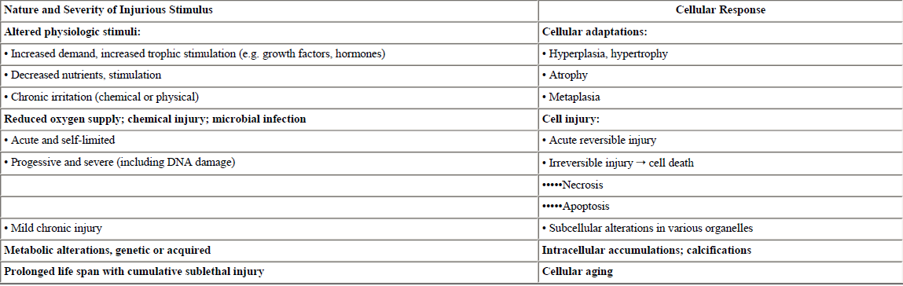

Slide 27
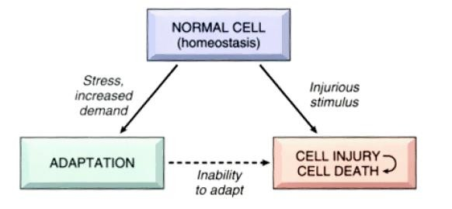
Cell responses to stress

Slide 28
Adaptation
Cell injury
Subcellular alterations
Intracellular accumulations
Calcification
Cell aging

Slide 29
Adaptations induced by
Factors produced by the responding cells themselves
Factors produced by other cells in the environment
Activation of various cell surface receptors and downstream signaling pathways

Slide 30
Adaptations associated with
Induction of new protein synthesis by the target cells
The induction of cellular proliferation
Shifting cells from producing one type of proteins to another
Markedly overproducing one protein

Slide 31
Types of adaptations
▶ Hyperplasia: increase in number of cells in an organ or tissue (increase volume of organ)
▶ Hypertrophy: increase in size of cells, resulting in an increase in size of organ
▶ Atrophy: shrinkage in size of cells
▶ Metaplasia: reversible change of one adult cell type( epithelial /mesenchymal) is replaced by another cell type.
▶ Dysplasia: disordered cellular development (also called atypical hyperplasia) Both meta and hyperplasia are seen in this.

Slide 32
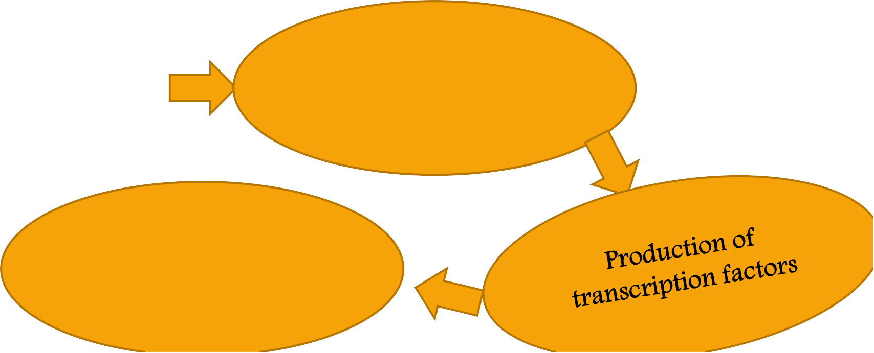
Hyperplasia
Hormonal
Physiologic
▶ Hyperplasia
Compensatory
Pathologic
Mechanism-
▶ •
Activation of particular intracellular signaling pathways
Increased local production of growth factors
Increased levels of growth factor receptor
Turn on many cellular genes that encode growth factors
Cellular
proliferation

Slide 33







Hyperplasia classification
Physiologic |  | Pathologic
Hormonal Occurs with influence of hormones e.g. Hyperplasia of female breast at puberty, pregnancy and lactation Hyperplasia of pregnant uterus | Compensatory Hyperplasia occurs due to removal or damage of part of n organ e.g. Regeneration of liver following partial hepatectomy Regeneration of epidermis after skin abrasion | Due to excessive hormonal stimulation and growth factors acting on target cells e.g. Endometrial hyperplasia following oestrogen excess Formation of skin warts or lesions (hyperplasia of epidermis) due to papilloma virus

Slide 34
Hypertrophy
Physiologic
▶ Hypertrophy
Pathologic
Mechanism-1.
Stimulate synthesis of numerous proteins
Signal transduction pathways
Induction of new genes
▶
Increase organelle-mitochondria, ER, myofibrils.
Increase synthesis of DNA & RNA

Slide 35
2.
Early development genes re-
expressed in hypertrophic cells
Product of these genes participate in cellular response to stress
Genes that are induced during hypertrophy include-
Encoding transcription factors
Growth factors
Vasoactive substances

Slide 36
Hypertrophy classification
Physiologic | Pathologic
Most common stimulus is work load. Work load is shared by greater mass of cellular components and each muscle fiber is spared excess work &so escapes injury e.g. Enlarged size of uterus in pregnancy(hormone induced hypertrophy) Hypertrophy of breast during lactation due to prolactin and estrogen. | Hypertrophy of cardiac muscle due to chronic hemodynamic overload, resulting from Hypertension Aortic valve disease (stenosis)

Slide 37
Atrophy
Physiologic
Decrease of uterus size after
parturition
▶ Atrophy
Pathologic
Depends on underlying cause

Slide 38
Mechanism of atrophy
Results from
▶ Decreased protein synthesis
▶ Increased protein degradation
Due to decreased metabolic activity
Decreased protein synthesis

Slide 39
Mechanism of atrophy
Protein degradation
1. Ubiquitin-protease pathway
Nutrition deficiency and disuse
Activate ubiquitin ligases
Attach to multiple copies of small peptide ubiquitin to cellular proteins
Target these proteins for degradation in proteosomes

Slide 40
Mechanism of atrophy
Protein degradation
2. Increased autophagy (self eating)
Increased autophagy
Increased autophagic vacuoles
Autophagy: starved cells eats its own components to find nutrients and survive.

Slide 41
Causes of pathological atrophy
Disuse atrophy-wasting or muscle atrophy in complete bed rest
Denervation atrophy-rapid atrophy of muscle fibers due to damage of nerve which innervated them
Ischemic atrophy-atrophy due to decreased blood supply to tissue (atrophy of brain in cerebral atherosclerosis)
Inadequate nutrition /starvation atrophy-muscle wasting due to malnutrition (seen in cancer and chronic inflammatory disease)

Slide 42
Causes of pathological atrophy
Endocrine atrophy-loss of endocrine stimulation leads to decreased metabolic activity of tissue (hypopituitarism may lead to atrophy of thyroid, adrenal & gonads)
Pressure atrophy- Tissue compression for long time (enlarging benign tumor can cause
atrophy in surrounding compressed tissues)
Idiopathic atrophy- No obvious cause (e.g. myopathies, testicular atrophy)

Slide 43
Metaplasia
Columnar to squamous
Epithelial metaplasia
Squamous to columnar
▶ Metaplasia
Osseous metaplasia
Connective tissue metaplasia
Cartilaginous metaplasia

Slide 44
Mechanism of Metaplasia
Signals generated by cytokines, growth factors, extracellular matrix components
Reprogramming of stem cells
Metaplasia

Slide 45
Epithelial metaplasia
Columnar to squamous- In cigarette smoking ciliated epithelial cells of trachea & bronchi replaced by stratified squamous epithelial cells
In cholelithiasis-replacement of normal secretory columnar epithelium by non functioning stratified squamous epithelium.
Squamous to columnar
In barett esophagus squamous is replaced by intestine like columnar cells under the influence of refluxed gastric acid

Slide 46
Connective tissue metaplasia
Osseous metaplasia: Formation of cartilage, bone or adipose tissue (mesenchymal tissue) in tissues that generally don’t contain them. Formation of bone in muscle in myositis ossificans.
Cartilaginous metaplasia: occurs where there is less mobility during the healing of fractures In synovial chondromatosis, cells of the synovial membrane undergo metaplasia to become
cartilage-producing chondrocytes. .

Slide 47
Dysplasia
▶ Disordered cellular development also called as atypical hyperplasia
▶ Both metaplasia and hyperplasia are seen
▶ Caused by chronic irritation and prolonged inflammation.
▶ Epithelial dysplasia of the cervix (cervical intraepithelial neoplasia – a disorder commonly detected by an abnormal pap smear)

Slide 48
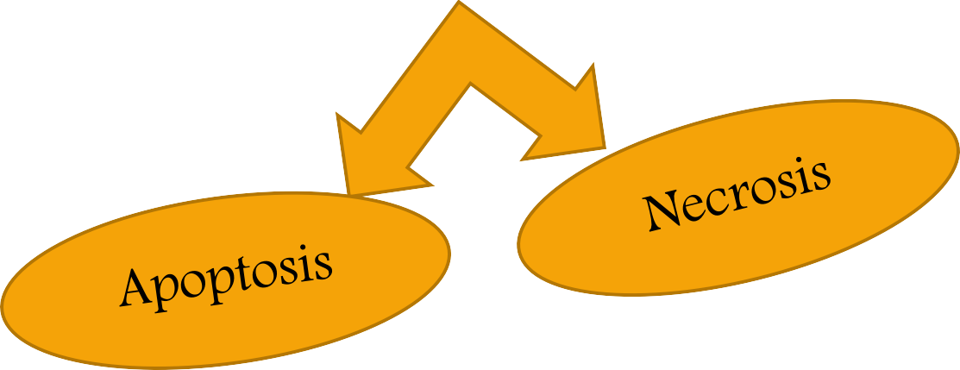
Cell injury and death
▶ Results when cells are stressed so severely that they are no longer able to adapt or when cells are exposed to inherently damaging agents.
Reversible cell injury
▶ Cell injury
Irreversible cell injury and death

Slide 49
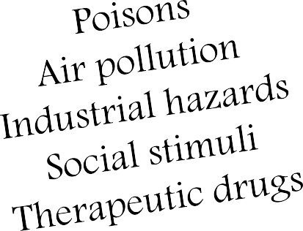
Causes of cell injury
Hypoxia
1. Oxygen deprivation
Ischemia
Mechanical trauma Temperature extremes
Change in atmosphere pressure
Radiation
Electric shock
2. Physical agents-
3. Chemical agents & drugs-

Slide 50
4. Infectious agents & immunologic rxn’s-
Virus, fungi, bacteria parasites and anaphylactic rxn’s
Enzymatic abnormalities Variations in genetic make up
5. Genetic derangements
6. Nutritional imbalances
Nutritional excess
Nutritional deficiency

Slide 51
Mechanism of cell injury
Cell response to injury depends on
▶ Type of injury
▶ Its duration
▶ Severity
Consequences of cell injury depends on
▶ Type
▶ State
▶ Adaptability of injured cell

Slide 52
▶ Cell injury results from functional & biochemical abnormalities in one or more of several essential cellular components
Important targets of injurious stimuli
▶ Aerobic respiration (oxidative phosphorylation in mitochondria)
▶ Cell membrane integrity
▶ Protein synthesis
▶ Cytoskeleton
▶ Genetic apparatus integrity

Slide 53
Biochemical mechanisms responsible for cell injury
Depletion of ATP
Mitochondrial damage
Influx of intracellular Ca+2 & loss of Ca+2 homeostasis
Oxidative stress
Defects in membrane permeability.

Slide 54

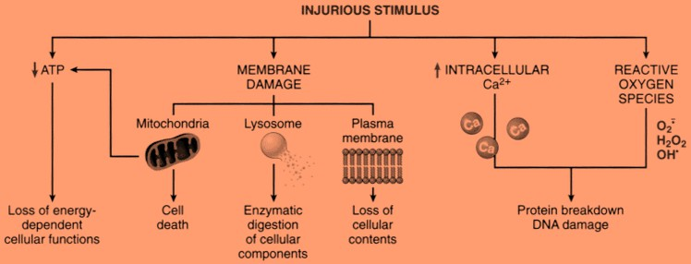

Slide 55
Depletion of ATP
▶ ATP produced in 2 ways
Oxidative phosphorylation Glycolytic pathway
▶ Depletion of ATP is associated with both hypoxia and chemical stimuli
▶ ATP required for many synthetic & degradation process within the cell
▶ It involves in –membrane transport, protein synthesis, lipogenesis, deacylation & reacylation rxns, phospholipid turnover.

Slide 56
Ischemia
oxidative phosphorylation
ATP
Na+ pump
activation
Ca++ pump fail
switch to
glycolytic pathway
disruption of protein synthesis
proteins misfolded

Slide 57
Ischemia
oxidative phosphorylation
ATP
Na+ pump activation
switch to glycolytic pathway
Ca++ pump fail
Na+, Ca++, H2O,
K+ intracellularly
Ca++ influx
anaerobic pathway
glucose metabolism from glycogen
ER & Cellular swelling

Slide 58
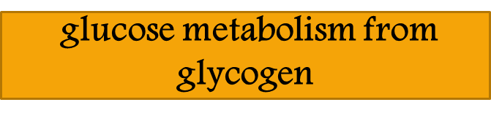


glycogen( glycolysis)
accumulation of lactic acid &
inorganic phosphates
PH
activity of many cellular enzymes & clumping of nuclear chromatin

Slide 59
ATP
disruption of protein
synthesis
proteins misfolded
Detachment of ribosomes from rough ER & dissociation of polysomes to monosomes
trigger a cell reaction- unfolded protein response
Cell injury & death
Protein synthesis
Necrosis (irreversible damage)

Slide 60
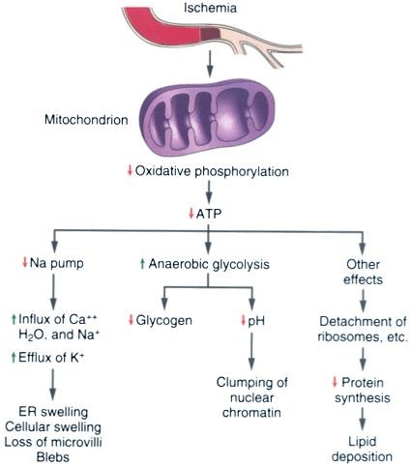

Slide 61

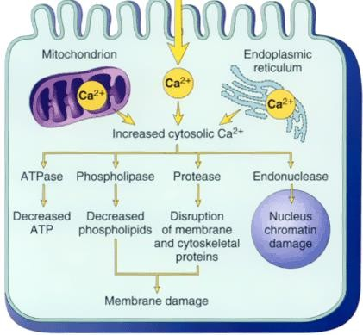
Influx of intracellular calcium

Slide 62
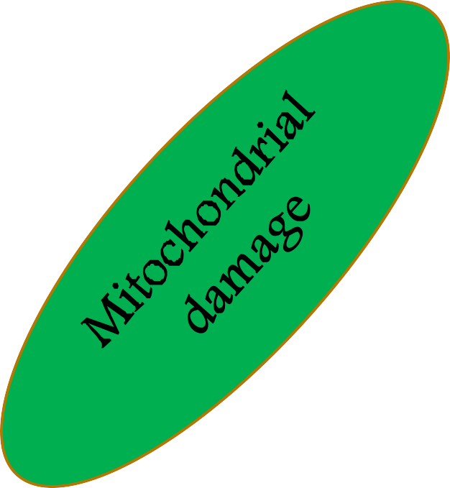
Hypoxia or toxins increased cytosolic Ca2+
, oxidative stress, or phospholipid breakdown
Formation of a high conductance channel (mitochondrial permeability transition
pore)
Leaks protons and dissipates the electromotive potential (which drives oxidative phosphorylation)
Damaged mitochondria
Irreversible mitochondrial transition
Leak cytochrome c
Death of cell
Apoptosis

Slide 63

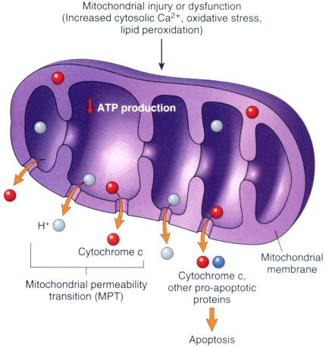
Mitochondrial dysfunction

Slide 64
Oxidative stress
▶ Cell generate energy by reducing molecular oxygen to water
▶ During this process, small amounts of partially reduced reactive oxygen forms are produced as an unavoidable by product of mitochondrial respiration.
Some of these forms can damage
▶ Lipids
▶ Proteins
▶ Nucleic acids

Slide 65
▶ Imbalance between free radical generating and radical scavenging system results in oxidative stress.
▶ Free radicals initiate auto catalytic rxn’s, where by molecules with which they react are themselves converted into free radicals to propagate the chain of damage.

Slide 66
Free radicals may be initiated within cells in several ways
▶ Absorption of radiant energy
▶ Enzymatic metabolism of exogenous chemicals or drugs
▶ The reduction-oxidation reactions that occur during normal metabolic processes
▶ Transition metals such as iron and copper donate or accept free electrons during intracellular reactions and catalyze free radical formation
▶ Nitric oxide (NO), an important chemical mediator can act as a free radical

Slide 67
Three reactions of reactive species are particularly relevant to cell injury
▶ Lipid peroxidation of membranes.
▶ Oxidative modification of proteins
▶ Lesions in DNA

Slide 68
Lipid peroxidation of membranes.
Double bonds in unsaturated fatty acids of
membrane lipids are attacked by oxygen-derived
free radicals
Lipid-free radical interactions yield peroxides
Peroxides unstable and reactive
Autocatalytic chain reaction ensues (called
propagation)
Extensive membrane, organelle, and cellular damage

Slide 69
Oxidative modification of proteins
Oxidation of amino acid residue side chain
Formation of protein protein cross linkages
Free radicals
Oxidation of protein backbone
This oxidative modification of proteins Increase its
degradation by multicatalytic proteasome complex.
Protein fragmentation

Slide 70
Lesions in DNA
Free Radicals React with thiamine in nuclear & mitochondrial DNA
Produce single stranded
breaks in DNA

Slide 71
▶ Cells have developed multiple mechanisms to remove free radicals and thereby minimize injury.
▶ Free radicals are inherently unstable and generally decay spontaneously
▶ Several non enzymatic and enzymatic systems that contribute to inactivation of free radical reactions

Slide 72
▶ Antioxidants (non enzymatic )-Vit E & A, ascorbic acid, glutathione.
▶ Enzymes-catalase, superoxide dismutase, glutathione peroxidase.
▶ In many pathologic processes, the final effects induced by free radicals depend on the net balance between free radical formation and termination

Slide 73
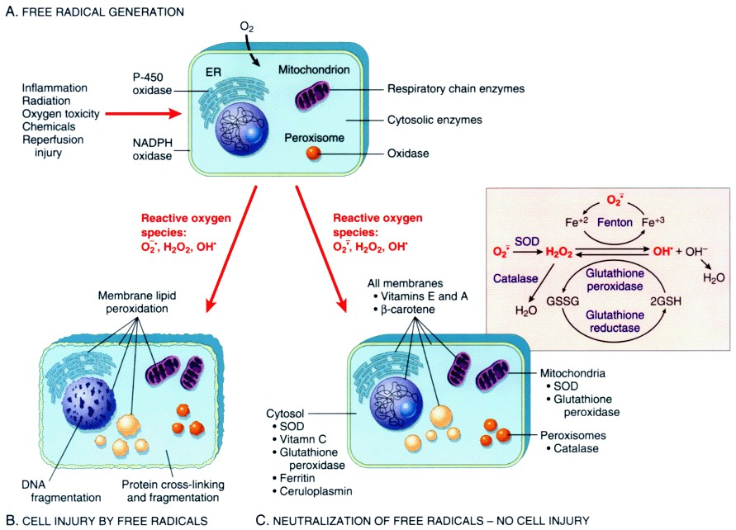

Slide 74
Membrane permeability defects
Bacterial toxins Viral proteins
Lytic complement components Physical & chemical agents
Damage plasma
membrane
Directly
Mitochondrial dysfunction
Loss of membrane phospholipids
Cytoskeleton abnormalities
Reactive O2 species
Lipid break down products
Others include

Slide 75
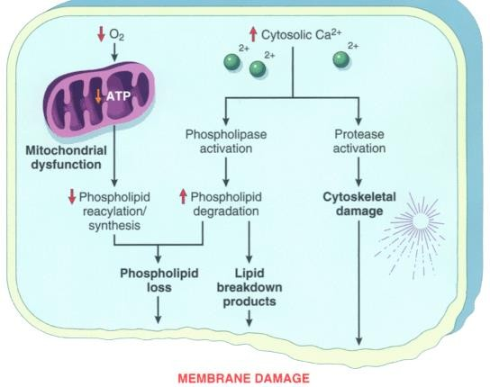
Reactive oxygen sps
Peroxidation of lipids in plasma & organelle membrane
Detergent effect on membrane Insert in to lipid bilayer or exchange with membrane phospholipids

Slide 76
Consequences of loss of membranes
▶ Plasma membrane damage results in loss of osmotic balance and influx of fluids and ions, as well as loss of proteins, enzymes, coenzymes, and ribonucleic acids.
▶ The cells may also leak metabolites, which are vital for the reconstitution of ATP, thus further depleting net intracellular high-energy phosphates.

Slide 77
Consequences of loss of membranes
▶ Injury to lysosomal membranes results in leakage of their enzymes into the cytoplasm and activation of these enzymes.
▶ Lysosomes contain RNases, DNases, proteases, phosphatases, glucosidases, and cathepsins.
▶ Activation of these enzymes leads to enzymatic digestion of cell components, resulting in loss of ribonucleoprotein, deoxyribonucleoprotein, and glycogen, and the cells die by necrosis.

Slide 78
Reversible and Irreversible Cell Injury
▶ Persistent or excessive injury, however, causes cells to pass the threshold into irreversible injury
Two phenomena consistently characterize irreversibility.
▶ Inability to reverse mitochondrial dysfunction (lack of oxidative phosphorylation and ATP generation)
▶ Profound disturbances in membrane function.

Slide 79
Whatever the mechanism(s) of membrane damage, the end result is
▶ Massive leak of intracellular materials and
▶ A massive influx of calcium

Slide 80
Morphology of Reversible injury
Two patterns of reversible cell injury (seen under the light microscope)
▶ Cellular swelling and
▶ Fatty change

Slide 81
▶ Plasma membrane alterations, such as blebbing, blunting, and distortion of microvilli; creation of myelin figures; and loosening of intercellular attachments
▶ Mitochondrial changes, including swelling, rarefaction, and the appearance of small phospholipid-rich amorphous densities
▶ Dilation of the endoplasmic reticulum, with detachment and disaggregation of polysomes
▶ Nuclear alterations, with disaggregation of granular and fibrillar elements.

Slide 82
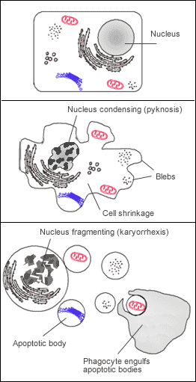

Slide 83
Necrosis
▶ Necrosis refers to a spectrum of morphologic changes that follow cell death in living tissue, largely resulting from the progressive degradative action of enzymes on the lethally injured cell.
▶ Necrotic cells are unable to maintain membrane integrity and their contents often leak out
▶ The morphologic appearance of necrosis is the result of denaturation of intracellular proteins and enzymatic digestion of the cell.

Slide 84
▶ Ultimately, in the living patient, most necrotic cells and their debris disappear by a combined process of enzymatic digestion and fragmentation, followed by phagocytosis of the particulate debris by leukocytes
▶ If necrotic cells and cellular debris are not promptly destroyed and reabsorbed, they tend to attract calcium salts and other minerals and to become calcified. This phenomenon, called dystrophic calcification

Slide 85
Morphology of necrosis
Necrotic cells show
▶ Increased eosinophilia
▶ Glassy homogenous appearance (due to glycogen loss)
▶ Moth-eaten appearance of cytoplasm (digested cytoplasm)
▶ Calcification
▶ Replacement by phospholipid masses (myelin figures )
▶ Dilation of mitochondria with large amorphous densities
▶ Amorphous osmiophilic debris
▶ Discontinuities in plasma and organelle membranes
▶ Aggregates of fluffy material probably representing denatured protein

Slide 86
Nuclear change
▶ Karyolysis (basophilia of chromatin fade)
▶ Pyknosis (nuclear shrinkage & increased basophilia)
▶ Karyorrhexis (pyknotic nucleus undergo fragmentation)

Slide 87
Types of necrosis
▶ Coagulative necrosis
▶ Liquefactive necrosis
▶ Caseous necrosis
▶ Fat necrosis

Slide 88
Examples of cell injury and necrosis
▶ ?????????????????

Slide 89
Apoptosis
▶ Programmed cell death
▶ Pathway of cell death that is induced by a tightly regulated intracellular program in which cells destined to die by activate enzymes that degrade the cells' own nuclear DNA and nuclear and cytoplasmic proteins
▶ In apoptosis dead cells rapidly cleared before its contents leaked out
▶ Apoptosis occurs when cells are damaged beyond repair (esp when DNA affected)

Slide 90
It occurs in
Pathological conditions
▶ Cell death produced by a variety of injurious stimuli
▶ Cell death in tumors
Physiological conditions
▶ Cell death induced by cytotoxic T cells, a defense mechanism
▶ Hormone-dependent involution in the adult, such as endometrial cell breakdown during the menstrual cycle

Slide 91
Mechanism of apoptosis
Divided into two phases
▶ Initiation phase- Capases become catalytically active
▶ Execution phase-Capases act to cause cell death.

Slide 92
Initiation phase
Acts by 2 pathways
▶ Extrinsic or receptor mediated pathway
▶ Intrinsic or mitochondrial pathway

Slide 93
Execution phase
▶ Procaspases get activated (executor caspase) by caspase 8 0r 10 in extrinsic pathway or by caspase 9 in intrinsic pathway
▶ Executor caspase formed will further give +ve feed back to produce massive of active caspases
▶ This leads to activation of death program in which the activated caspases act on many cellular components ( cleave cytoskeleton ,nuclear protein, breakdown of nuclear matrix ) resulting in cell death.

Slide 94
Removal of dead cells
▶ Dying cells secrete soluble factors which recruit phagocytes
▶ Apoptotic cells have marker molecules on surface which facilitate early recognition by adjacent cells/phagocytes.
▶ Macrophages secrete substance which specifically binds to dead cells

Slide 95
Morphology of cell undergoing apoptosis
▶ Cell shrinkage
▶ Chromatin condensation, nucleus break down
▶ Cytoplasmic blebs
▶ Apoptotic bodies
▶ Phagocytosis of apoptotic cells or cell bodies by macrophages Biochemical features
▶ Protein cleavage
▶ DNA breakdown
▶ Phagocytic recognition

