Slide 1
BIOPHARMACEUTICS AND PHARMACOKINETICS
MEASUREMENT OF BIOAVAILABILITY
14-09-2024
1

Slide 2
Equivalence:
It is a relative term that compares drug products with respect to a specific characteristic or function or to a defined set of standards.
There are several types of equivalences:
• Chemical equivalence:
It indicates that two or more drug products contain the same labeled chemical substance as an active ingredient in the same amount.
Pharmaceutical equivalence:
This term implies that two or more drug products are identical in strength, quality, purity, content uniformity and disintegration and dissolution characteristics. They may, however differ in containing different excipients.
14-09-2024
2

Slide 3
Bioequivalence: denotes that the drug substance in two or more identical dosage forms, reaches the systemic circulation at the same relative rate and to the same relative extent i.e. their plasma concentration-time profiles will be identical without significant statistical differences. When statistically significant differences are observed in the bioavailability of two or more drug products, bio-in equivalence is indicated
• Therapeutic Equivalence:
This term indicates that two or more drug products that contain the same therapeutically active ingredient elicit identical pharmacological effects and can control the disease to the same extent.
14-09-2024
3

Slide 4
NEED FOR BIOEQUIVALENCE STUDIES:
New product is intended to be a substitute for an approved medicinal product as a pharmaceutical equivalent or alternative
To ensure clinical performance of such drug products
Bioequivalence studies are conducted if there is:
A risk of bio-in equivalence and/or
A risk of pharmacotherapeutics failure or diminished clinical safety
14-09-2024
4

Slide 5
In vivo bioavailability / bioequivalence studies and in vitro dissolution testing recommended to applicants intending to submit Investigational new drug application (INDs)New drug applications (NDAs)Abbreviated new drug applications (ANDAs) for conventional and extended release dosage forms administered orally.
In conditions where a suitable method for determining active drug is not available, an indirect indication of bioavailability and bioequivalence by comparing the pharmacodynamic responses of the formulations may be possible
14-09-2024
5

Slide 6
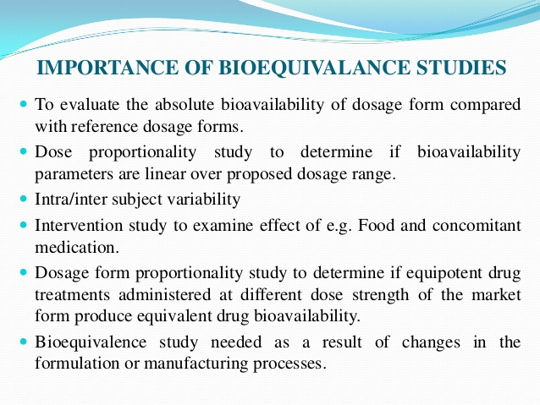
14-09-2024
6

Slide 7
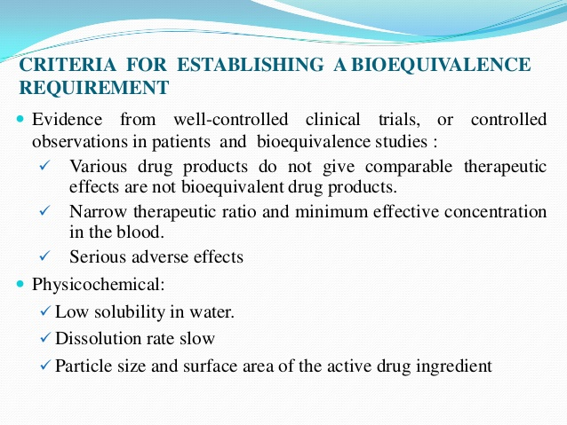
14-09-2024
7

Slide 8
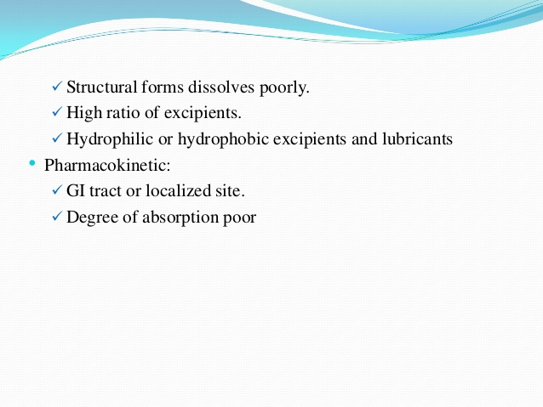
14-09-2024
8

Slide 9
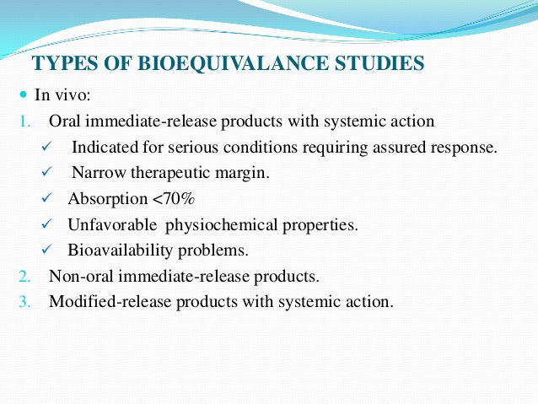
14-09-2024
9

Slide 10
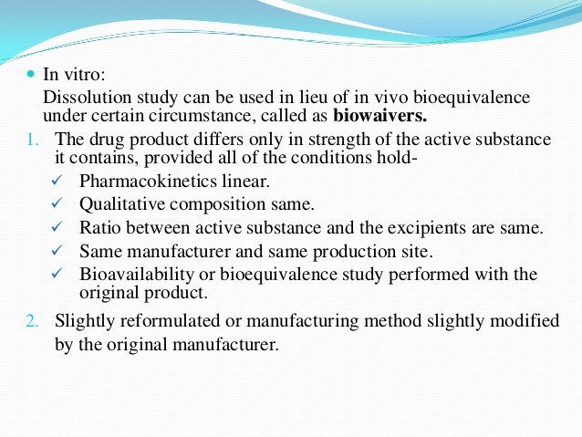
14-09-2024
10

Slide 11
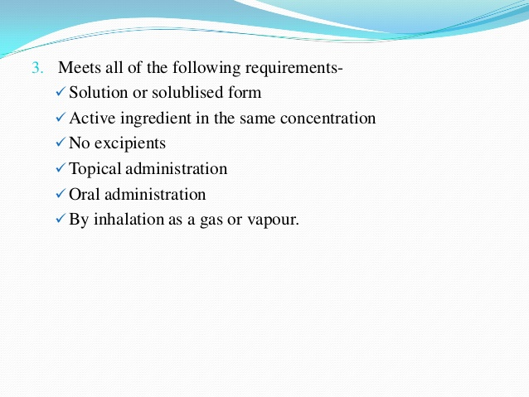
14-09-2024
11

Slide 12
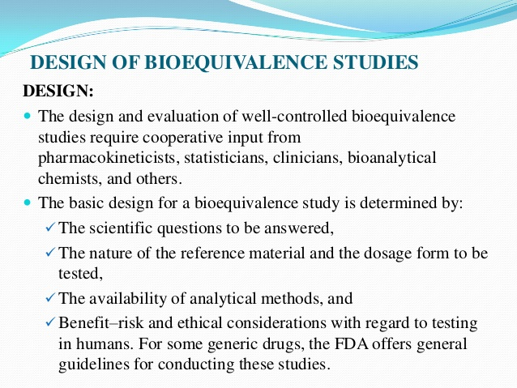
14-09-2024
12

Slide 13
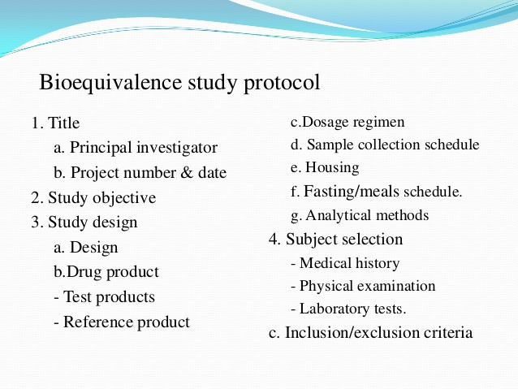
14-09-2024
13

Slide 14
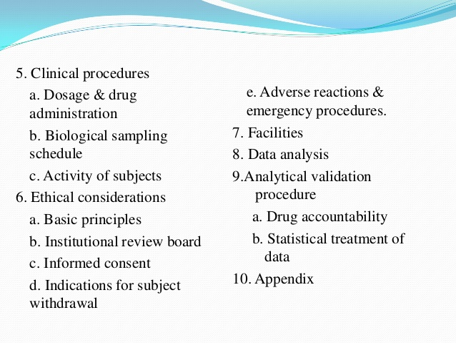
14-09-2024
14

Slide 15
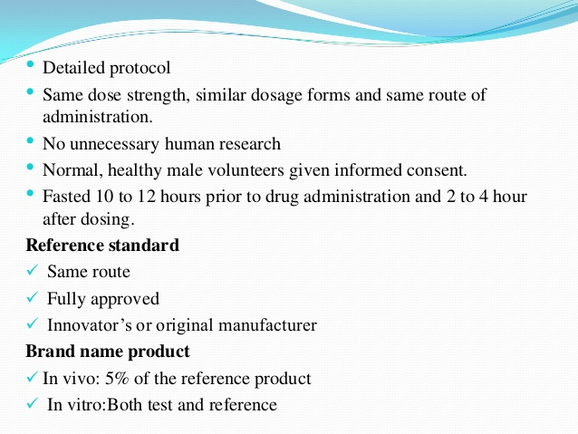
14-09-2024
15

Slide 16
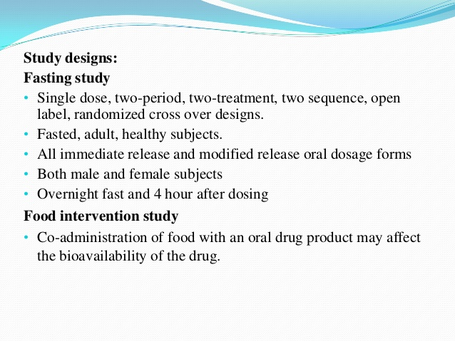
14-09-2024
16

Slide 17
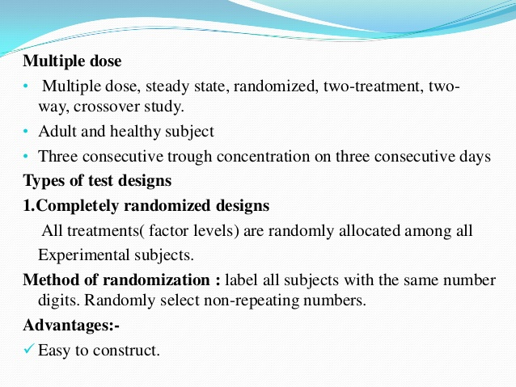
14-09-2024
17

Slide 18
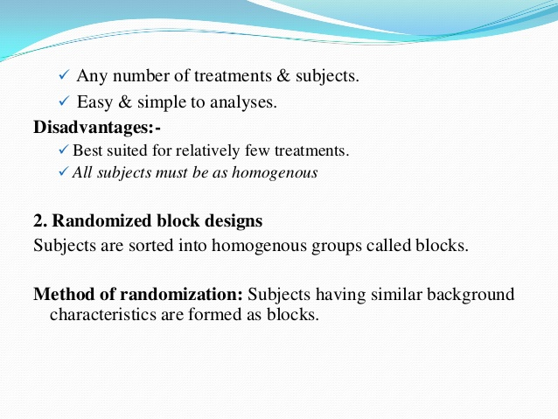
14-09-2024
18

Slide 19
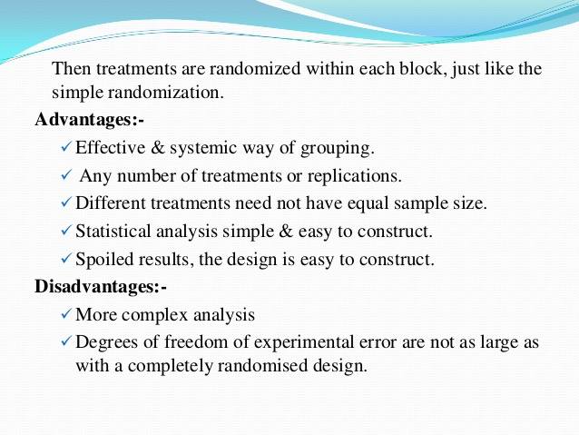
14-09-2024
19

Slide 20
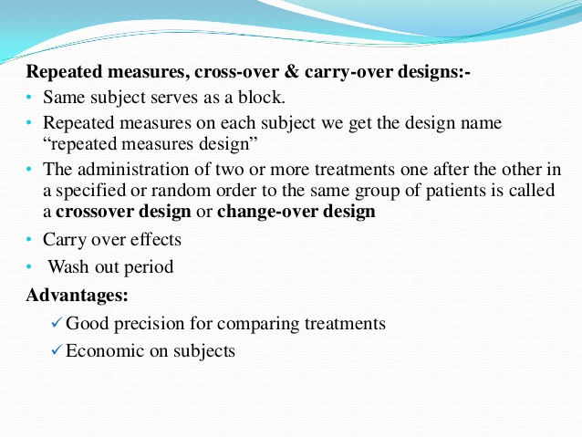
14-09-2024
20

Slide 21
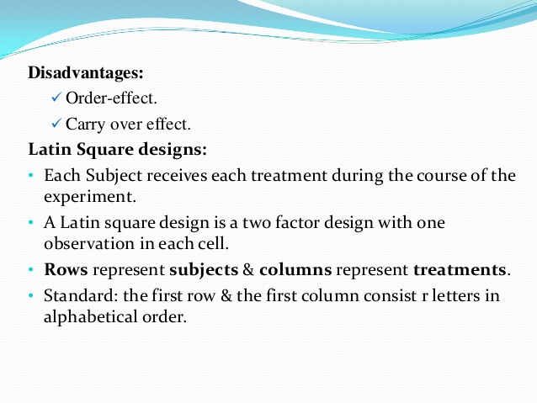
14-09-2024
21

Slide 22
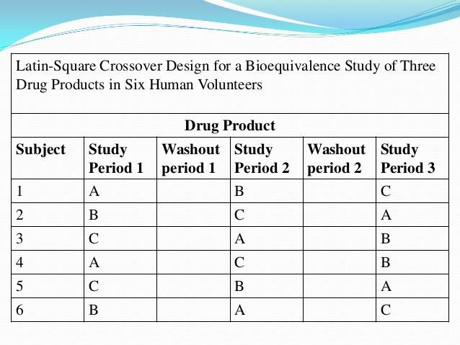
14-09-2024
22

Slide 23
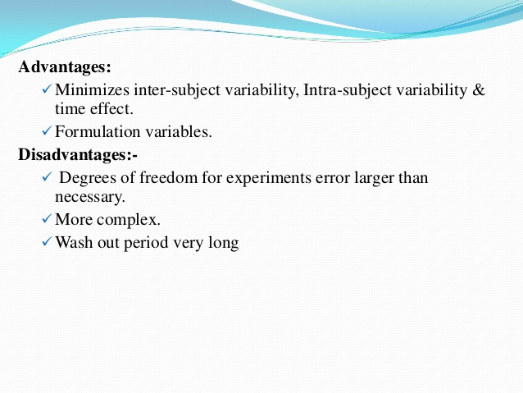
14-09-2024
23

Slide 24
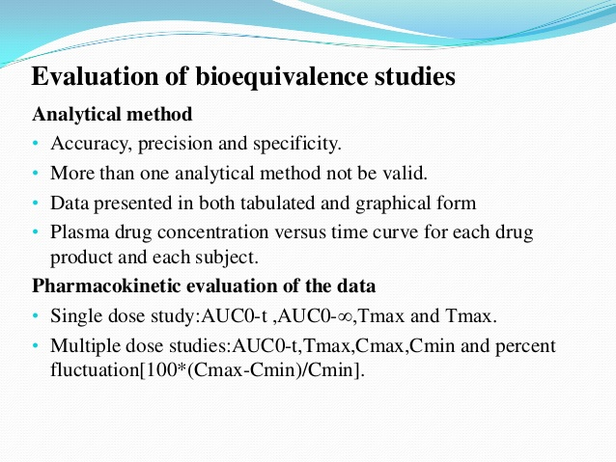
14-09-2024
24

Slide 25
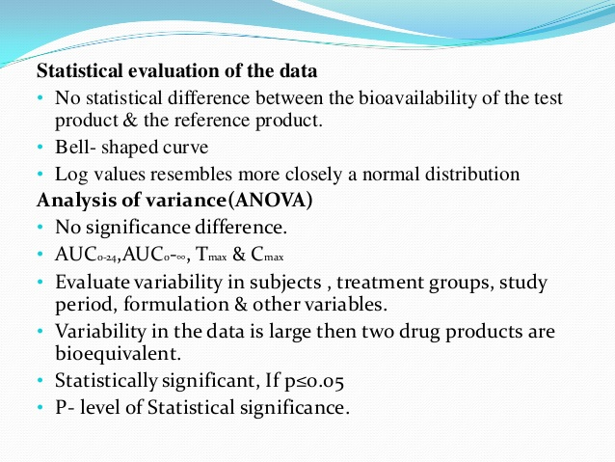
14-09-2024
25

Slide 26
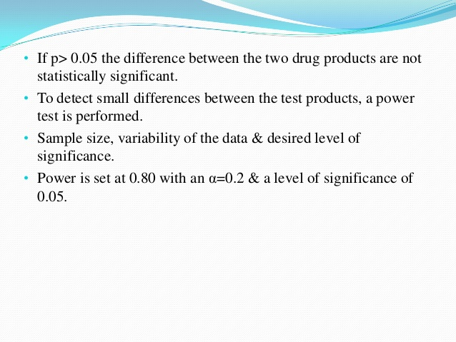
14-09-2024
26

Slide 27
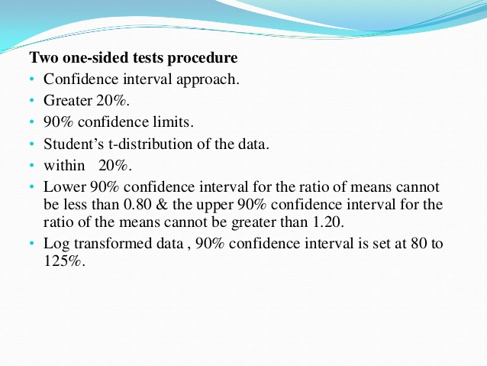
14-09-2024
27

Slide 28
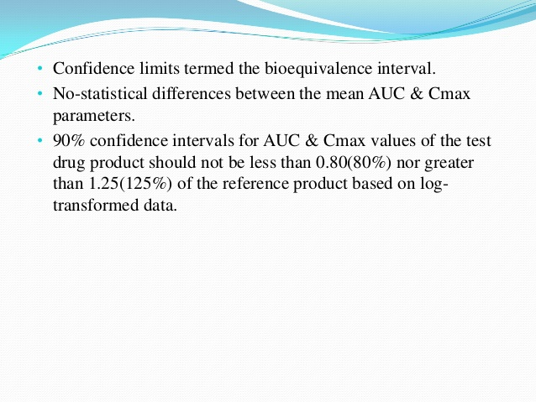
14-09-2024
28

Slide 29
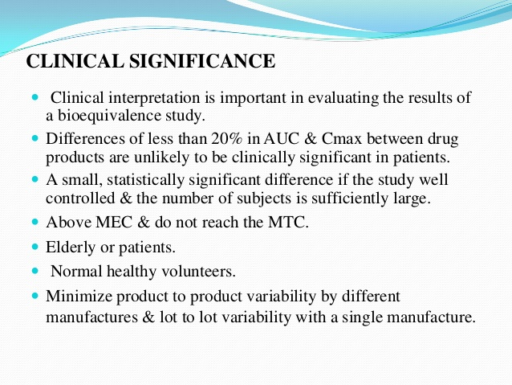
14-09-2024
29

