Slide 1
BIOPHARMACEUTICS AND PHARMACOKINETICS
1. BIOPHARMACEUTICS - INTRODUCTION
14-09-2024
1

Slide 2
INTRODUCTION TO BIOPHARMACEUTICS
Biopharmaceutics: is define as the study of how the physicochemical properties of drugs, dosage forms and routes of administration affect the rate and extent of the drug absorption.
Thus, biopharmaceutics involves factors that influence the:
protection and stability of the drug within the product;
2) the rate of drug release from the product;
3) the rate of dissolution of the drug at the absorption site; and
4) the availability of the drug at its site of action .
Generally, the GOAL of biopharmaceutical studies is to develop a dosage form that will provide consistent bioavailability at a desirable rate.
14-09-2024
2

Slide 3
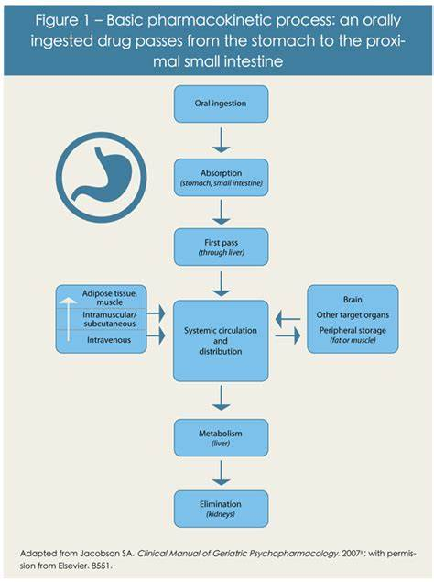
.
Pharmacokinetics – is define as the “what the
body DOES to the drug”.
This phase of drug delivery system involves
Absorption, Distribution,Metabolism and Execration
Therefore,
Pharmacokinetics: is defined as the study of time
course of drug ADME and their relationship with its
therapeutic and toxic effects of the drug.
Simply, Pharmacokinetics: is kinetics of ADME
14-09-2024
3

Slide 4
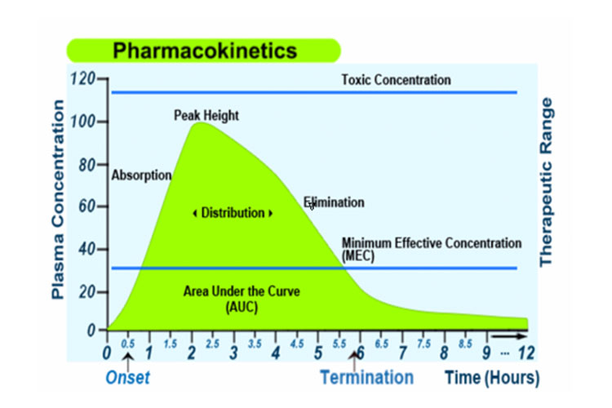
14-09-2024
4

Slide 5
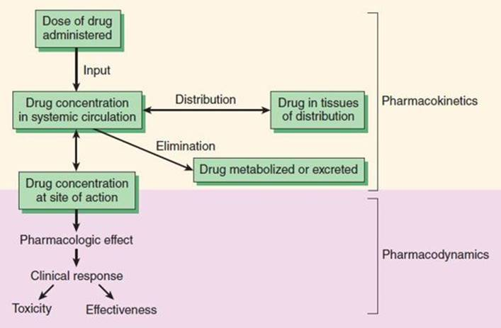
Pharmacodynamics – is define as the “what the drug DOES to the body”; the biochemical & physical effects of drugs on the body & the mechanism of drug action.
14-09-2024
5

Slide 6
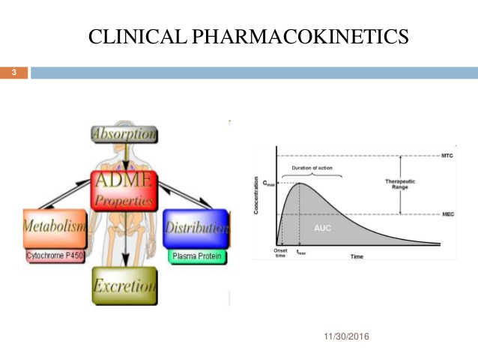
Clinical Pharmacokinetics: is the use of Pharmacokinetics principles in optimizing the drug dosage to suit individual patients needs
and achieving maximum therapeutic utility is called Clinical Pharmacokinetics
14-09-2024
6

Slide 7
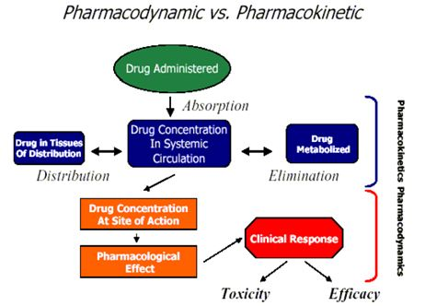
14-09-2024
7

Slide 8
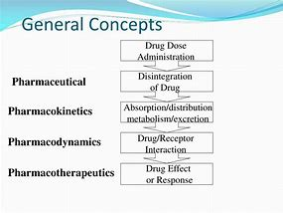
Pharmacotherapeutics – is define as the use of drugs to prevent and treat diseases.
“Scheme demonstrating the dynamic relationships among the drug product, pharmacologic and therapeutics effect.
14-09-2024
8

Slide 9
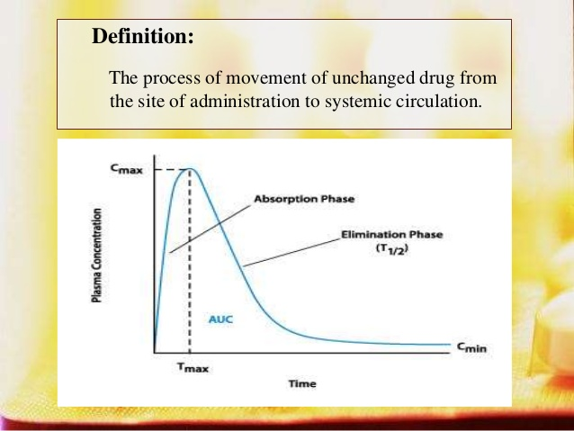
Absorption - Introduction
There always present a correlation between plasma concentration of a drug & the therapeutic response & thus, absorption can also be defined as the process of movement of unchanged drug from the site of administration to the site of measurement. i.e., plasma.
14-09-2024
9

Slide 10
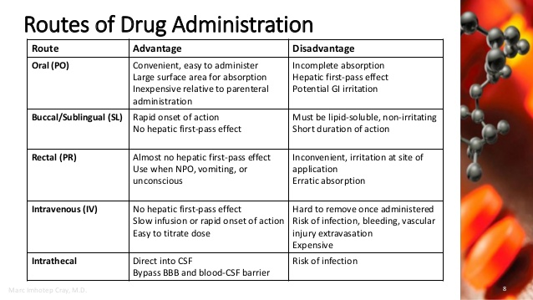
14-09-2024
10

Slide 11
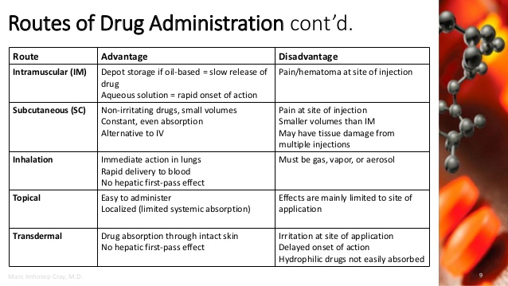
14-09-2024
11

