Slide 1
PHARMACEUTICAL JURISPRUDENCE
BRIEF STUDY OF PRESCRIPTION AND NON-PRESCRIPTION PRODUCTS

Slide 2
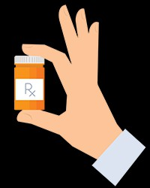
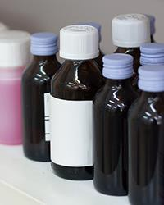
A drug is a substance intended for use in the diagnosis, cure, mitigation, treatment, or prevention of disease.
Prescription drugs are: Hand holding prescription drug bottle Prescribed by a doctor
Bought at a pharmacy
Prescribed for and intended to be used by one person
OTC drugs are: Non Prescription drugs
Drugs that do NOT require a doctor's prescription
Bought off-the-shelf in stores
OTC drug monographs are a kind of "recipe book" covering acceptable ingredients, doses, formulations, and labeling. Monographs will continually be updated adding additional ingredients and labeling as needed. Products conforming to a monograph may be marketed without further FDA clearance.

Slide 3
Over-the-counter (OTC) medications—drugs available to
consumers without a prescription—play an increasingly vital role in our healthcare system and are the most prevalent means of treating the majority of common health problems. There are over 80 therapeutic categories of OTC drugs which can be grouped in 12 broad therapeutic classes
Broad Therapeutic Classes of OTC Medications
Analgesics and antipyretics • Cold, cough, and allergy products • Nighttime sleep- aids •Gastrointestinal products • Dermatological products • Other topical products (including dermal and vaginal antifungals, anorectic medications, head lice products, hair loss products, and otics) • Ophthalmic products • Oral health care products • Menstrual products • Nicotine replacement products • Weight loss aids • Vaginal contraceptives and emergency contraceptives OTC retail

Slide 4
The Center for Drug Evaluation and Research (CDER) division of the Food and Drug Administration (FDA) regulates OTC medications to ensure that they are properly labeled, their benefits outweigh their risks, their potential for misuse and abuse is low, and that health practitioners are not needed for their safe and effective use.
The Center for Drug Evaluation and Research (CDER) division of the Food and Drug Administration (FDA) regulates OTC medications to ensure that they are properly labeled, their benefits outweigh their risks, their potential for misuse and abuse is low, and that health practitioners are not needed for their safe and effective use. The benefits of over-the-counter availability include:
Direct, rapid access to effective medicines • Wide availability • Decreased healthcare system utilization (fewer physician visits, lower healthcare system costs) • Allowing individuals to be in charge of their own health However, there are risks associated with OTC use, such as:
Incorrect self diagnosis delaying diagnosis and treatment of serious illnesses (delay
in seeking advice from a healthcare professional) • Increased risk of drug-drug interactions • Increased risk of adverse
events when not used appropriately • Potential for misuse and abuse .

Slide 5
USE IN THE GENERAL POPULATION The use of OTC medications is one aspect of a growing movement toward medical self-care and has become a tool in gaining control over one’s health. OTC analgesics were the most frequently used of all medications (OTC or prescription), taken by approximately 20% of the population in a given week. OTC decongestants and antihistamines followed analgesics in frequency of use. Female individuals are more likely to use OTC medications. survey, 87% of women reported the use of an OTC pain medication in the past
year compared to 80% of men. most popular treatment choice for common ailments
such as headache, heartburn, allergies, and colds.
OTC MEDICATIONS FOR ORAL INGESTION o Cough/cold
and allergy remedies Analgesics Antacids and anti-gas products Laxatives Diarrhea remedies
OTC MEDICATIONS FOR TOPICAL USE o Toothpastes Oral antiseptics and rinses
First aid treatments Lip remedies Eye care
products Including germicidal antiseptics and topical hydrocortisone

Slide 6
USE IN SPECIAL POPULATIONS Children. The number of children ages 12 and younger being administered an OTC medication in a given time period is more than twice that of prescription medications. The most commonly used OTC medications in children are the analgesics/antipyretics acetaminophen and ibuprofen. Adolescents.
Compared to the general population, adolescents 12–17 years of age use more OTC products for acne and less for allergies and pain relief. Use by adolescents accounts for 38% of acne remedies’ sales volume, but for only 7% of the total internal analgesics category volume.
Of particular concern
are adolescents who abuse alcohol, illicit OTC cough medicines containing
drugs, and
medications including
dextromethorphan.
approximately 5% of the was 49% for alcohol, 25% for marijuana, 6% and 4% for the prescription analgesics Vicodin® and OxyContin® , respectively. Older adults. Adults ages 65 years and over generally have more medical problems and use more medications, both prescription and OTC, when compared to younger adults. In this group, polypharmacy is common including multiple OTC preparations
and prescription drugs. Age-related changes occur in the elderly, predisposing this population to greater risks of adverse events, drug-drug interactions, therapeutic errors, and misuse.

Slide 7
OTC medications of particular concern include diphenhydramine (can cause confusion and sedation), nonsteroidal anti-inflammatory drugs (renal dysfunction, gastrointestinal bleeding, hypertension, exacerbation of heart failure), ferrous sulfate (constipation), and mineral oil (aspiration, lipid pneumonia) due to their increased risk of adverse events in older adults.
THERAPEUTIC ERRORS AND MISUSE While the public acknowledges the need to be careful with using OTC medications, therapeutic errors and misuse occur with these products. The root causes of therapeutic errors and misuse of OTC medicines are attributable to inaccurate attitudes and wrong beliefs. For instance: thinking it will help with severe symptoms, or o because they did not obtain relief after taking
the recommended dose. • Given the scale of OTC medication use, a significant
number of individuals are likely to take more than one prescription or OTC drug simultaneously, which can increase the risk of drug-drug interactions. • Areas of intentional incorrect use or misuse of OTC medicines include: o using more than the recommended doses of pain relievers using laxatives to lose weight and to “feel thin” (in particular by individuals with eating disoders.

Slide 8
STORAGE AND DISPOSAL Medications need to be properly stored for maximal safety and efficacy. If incorrectly stored, children may ingest harmful doses of OTC drugs. As the aforementioned study by the CDC showed, All rights reserved overdoses resulting from unsupervised ingestions of OTC and prescription products is a main cause of emergency department visits by young children. For proper disposal, the Environmental Protection Agency recommends that drugs be taken out of their containers, mixed with undesirable substances, (e.g., cat litter, used coffee grounds) and put into a disposable container with a lid or into a sealed bag before putting in the trash. Advise patients to remove any personal information from any labels by covering the information with black marker, or duct tape, or by scratching it off. Environmentally, it is irresponsible to “flush” OTC medications. Most sewage treatment plants are not equipped to extract pharmaceutical compounds from wastewater and the impact of these drugs in public drinking water is unknown.

Slide 9
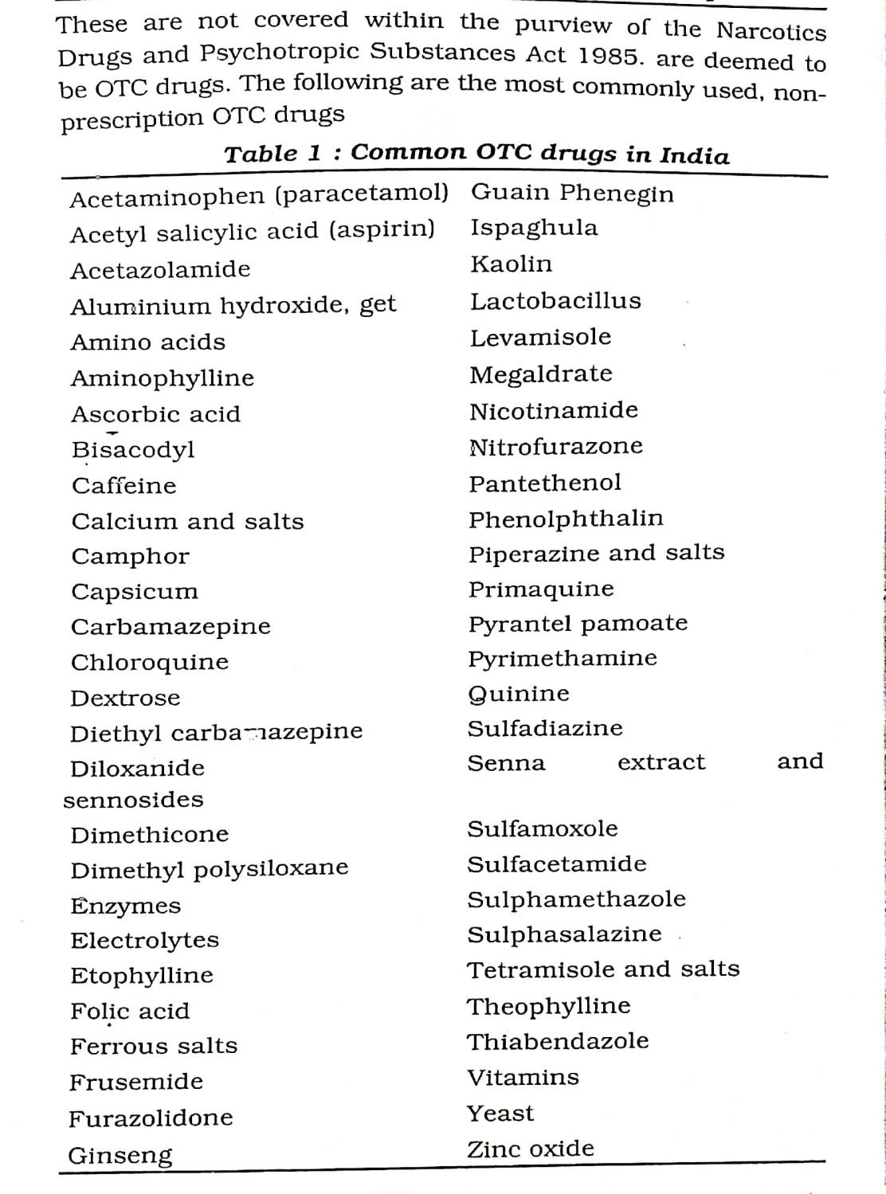

Slide 10
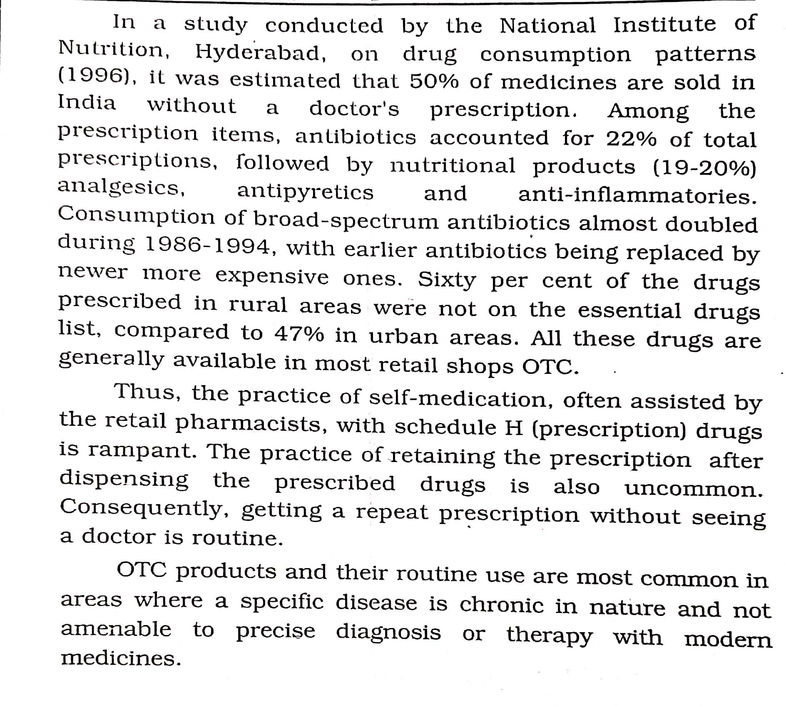

Slide 11
DOCTOR/PATIENT COMMUNICATION GAPS As common as OTC use is, there appear to be significant challenges for doctors to communicate with their patients about it. For instance: • While three-quarters of physicians report that they ask their patients directly about OTC drug use, one-quarter waits for patients to volunteer this information.
[22] • Americans are least likely to talk with a medical professional about taking more than the recommended dose of an OTC medication (30%), the use of leftover prescription antibiotics (33%), the use of OTC pain relievers (36%), and the use of more than one OTC product at a time. [22] • Only 18% of physicians educate their patients about safe drug taking, storing, and disposal practices.

Slide 12
PHYSICIAN’S ROLE – WHAT DOCTORS SHOULD TELL THEIR PATIENTS
Due to the high prevalence of OTC medication use, physicians need to stay abreast of the trends in OTC usage patterns as well as the risks associated with incorrect use and storage of OTC drugs. Physicians need to participate in efforts to prevent adverse events, therapeutic errors, misuse, and unsupervised pediatric ingestions of OTC medicines.
Routinely document OTC use in the medical history: o to detect incorrect use, o to detect potential drug-drug interactions, and o to identify therapeutic duplication.
Discuss with patients the potential risks of the OTC medications they have disclosed
during history taking.
Provide alternative medication choices if you suspect misuse of an OTC medication.
  Teach patients how to read package labeling with special emphasis on the sections “Warnings” and “Directions” (dosage instructions).
Teach parents and caregivers about the use of OTC medications in children. o Emphasize the importance of heeding the dosage instructions of the package labeling..
Teach parents and caregivers about the
handling and storage of OTC medications. o Tell your patients to put the entire container up, away, and out of sight after every use. o Tell your patients to correctly replace the child-resistant caps on all medicines.

Slide 13
Refer patients to Internet educational. Following are a few scripted conversations that may help with the discussion.
“Tell me about the types of OTC medications you take.”
“Read the entire package label and follow its instructions each time a dose is taken. In particular, if you take more than one medicine, pay attention to the active ingredients stated on the label to avoid taking too much of the same active ingredient.” 3. “Contact me at any time if you have questions about the choice or use of an OTC medication.”
“Contact me if you feel you need a dose that is higher than the one recommended on
the package label.”
“Keep all medications in their original container.”
“Correctly replace the child-resistant caps on all medicines after every use.”
“Keep OTC and prescription drugs out of reach and sight of
children after every use.”
“Make a general house policy that all drugs are stored in one well controlled location such as a locked drawer or cabinet, and that no drugs are stored in bedrooms, automobiles, backpacks, or school lockers.”
“Discard all medications that have expired.
” 10. “To discard drugs take them out of their containers, mix them with undesirable
substances (e.g., cat litter, used coffee grounds), and put
them into a disposable container with a lid or into a sealed bag before putting in the
VISHAL CS,RRCP
trash.

Slide 14
BOTTOM LINE OTC medications represent a diverse group of
widely available drugs. OTC use is ever increasing and expected to continue to rise. These drugs are safe and effective when used as directed. However, physicians must be aware that some people--with or without intention--use OTC medications incorrectly. Instruct all patients on the safe and appropriate storage and disposal of all types of medicines. Stay abreast of trends in OTC usage, therapeutic errors, misuse, and abuse. Routinely incorporate OTC conversations during
office visits. A list of physician and patient resources is below. Each of these efforts will help your patients to get the maximum benefit out of OTC use while minimizing the risks of incorrect OTC use.
A prescription drug (also prescription medication or prescription medicine) is a pharmaceutical drug that legally requires a medical prescription to be dispensed. In contrast, over-the-counter drugs can be obtained without a prescription. The reason for this difference in substance control is the potential scope of misuse, from drug abuse to practicing medicine without a license and without sufficient education. Different jurisdictions have different definitions of what constitutes a prescription drug. Prescription drugs are often dispensed together with a monograph (in Europe, a Patient Information Leaflet or PIL) that gives detailed in^{VI}f^{SH}o^{AL}rm^{CS,R}a^{R}t^{CP}ion about the drug. The use of prescription drugs has been increasing sinc¹e⁴ the 1960

Slide 15
Some medications have psychoactivem (mind-altering) properties and, because of that, are sometimes abused—that is, taken for reasons or in ways or amounts not intended by a doctor, or taken by someone other than the person for whom they are prescribed. In fact, prescription and overthe-counter (OTC) drugs are, after marijuana (and alcohol)
How Are Prescription Drugs Abused? Prescription and OTC drugs may be abused in one or more of the following ways: Taking a medication that has been prescribed
for somebody else. Unaware of the dangers of sharing medications, people often unknowingly contribute to this form of abuse by sharing their unused pain relievers with their family members. Most teenagers who abuse prescription drugs are given them
for free by a friend or relative. Taking a drug in a higher quantity or in
another manner than prescribed. Most prescription drugs are dispensed orally in tablets, but abusers sometimes crush the tablets and snort or inject the powder. This hastens the entry of the drug into the bloodstream and the brain and amplifies its Effects.

Slide 16
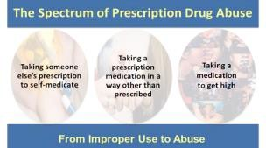
Taking a drug for another purpose than prescribed. All of the drug types mentioned can produce pleasurable effects at sufficient quantities, so taking them for the purpose of getting high is one of the main reasons people abuse them.
ADHD drugs like Adderall are also often abused by students seeking to improve
their academic performance. However, although they may boost alertness, there is little evidence they improve cognitive functioning for those without a medical
condition.

Slide 17
How Do Prescription and OTC Drugs Affect the Brain?
Taken as intended, prescription and OTC drugs safely treat specific mental or physical symptoms. But when taken in different quantities or when such symptoms aren’t present, they may affect the brain in ways very similar to illicit drugs.
For example, stimulants such as Ritalin achieve their effects by acting on the same neurotransmitter systems as cocaine. Opioid pain relievers such as Oxy Contin attach to the same cell receptors targeted. by illegal opioids like heroin. Prescription
depressants produce sedating or calming effects in the same manner as the club drugs GHB and rohypnol. And when taken in very high doses, dextromethorphan acts
on the same cell receptors as PCP or ketamine, producing similar out-of-body experiences. When abused, all of these classes of drugs directly or indirectly cause a pleasurable increase in the amount of dopamine in the brain’s reward pathway.
Repeatedly seeking to experience that feeling can lead to addiction.

Slide 18
What Are the Other Health Effects of Prescription and OTC Drugs? Opioids can
produce drowsiness, cause constipation, and—depending upon the
amount taken—depress breathing. The latter effect makes opioids particularly dangerous, especially when they are snorted or injected or combined with other drugs or alcohol.

