Slide 1
HOSPITAL PHARMACY
UNIT 5: HOSPITAL PHARMACY SEVICES
16-09-2024
1

Slide 2
PLANNING OF CSSR
Modern CSSR: Consists of a series of special work stations in a ‘dirty area’ which is separated from the ‘clean area’ by autoclaving and sterilising equipments.
Contaminated or non- sterile material and supplies entering one end of the room, passing through the various work stations.
Sterilisers and finally reposing in a sterile storage area ready to be dispensed from the clean side of the room.
Purpose: Minimise the cross – flow of contaminated or non- sterile goods with those that are clean or sterile
Eliminating the possibility of cross contamination or even the dispensing of a ‘dirty kit’ for a clean one.
16-09-2024
2

Slide 3
The plan of CSSR differs from the type of hospital and the size of the hospital .
Small hospital: 10 work stations
Medium size hospital: 18 stations
Large Size hospital: 23 stations
The purpose of such a layout is to minimise cross flow of contaminated or non sterile material with clean or sterile material .

Slide 4
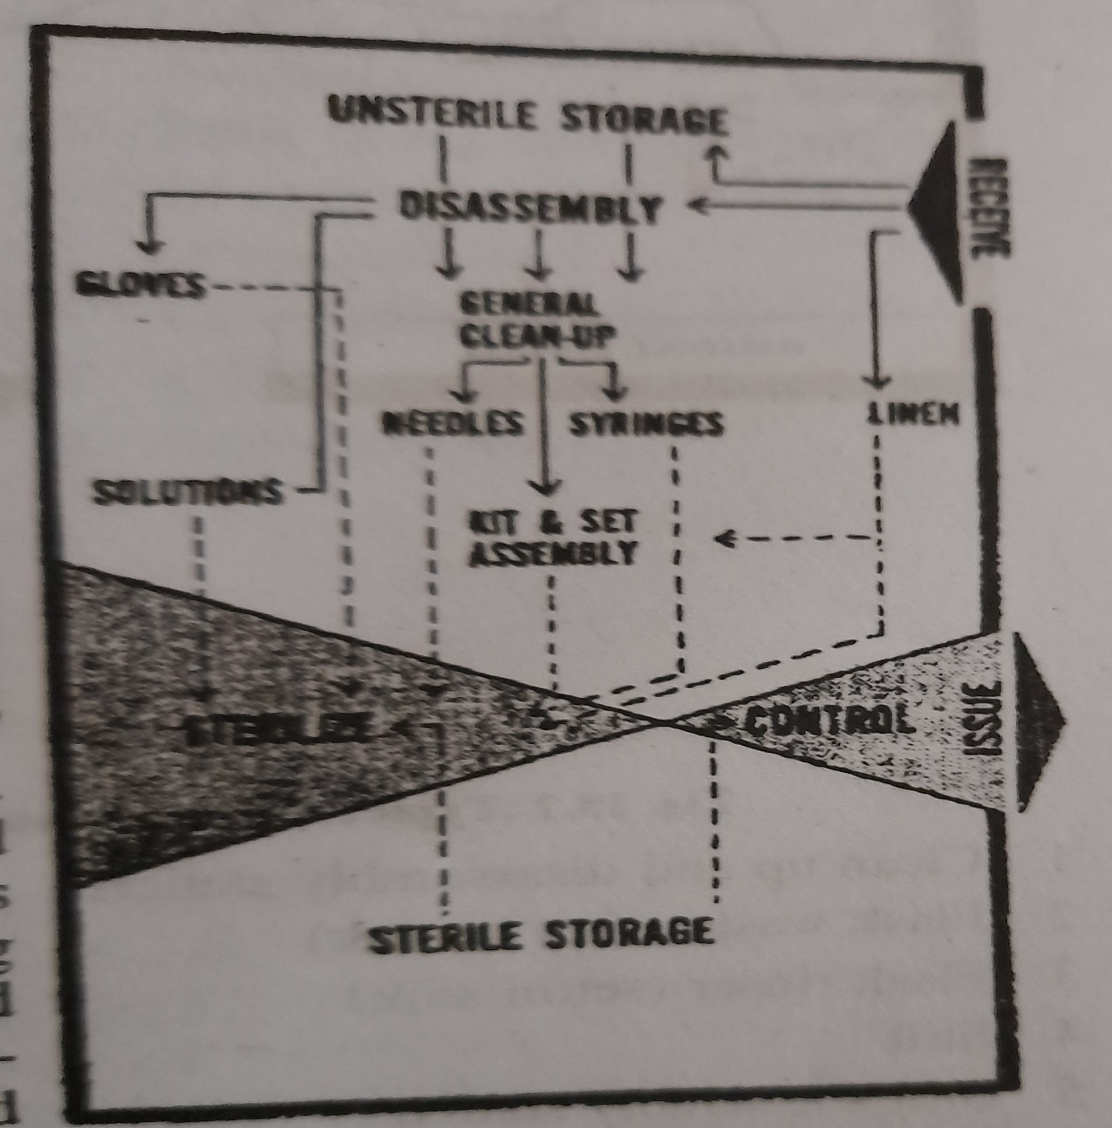
GENERAL CONCEPT OF MATERIAL FLOW IN A CSSR

Slide 5
LAMINAR AIR FLOW:-
Although many hospitals have abandoned the preparation of large volume, sterile IV fluids etc.
Other programmes such as I.V solution additive procedure which require sterile techniques to be performed in an atmosphere of microfiltered air.
In order to create such an atmosphere, various manufacturers of hoods have incorporated into them laminar flow principles.
Laminar flow is defined by Federal std. 209 as: “ Air flow in which the entire body of air with a confined area moves with uniform velocity along parallel flow lines, within a minimum of eddies.

Slide 6
“By providing a constant outward flow of microfiltered air over the entire face of the hood’s work area opening, dust particles may be kept from entering the work are from the ambient atmosphere”.
Hospital pharmacists who plans to commence I.V solution additive programme or those who are called upon to produce special sterile research projects should investigate the possibilities which such an installation offers.
Pharmacy CSSRs that still produce parenteral fluids should install laminar flow hoods in order to ensure safe, sterile products.

Slide 7
The standardisation committee ( Current Practices Committee) :-
The standardisation committee may be defined as that group within the hospital which is commissioned with the objectives to investigate, to develop and to standardise procedures and equipment.
This assures the hospital administration, that a concerted effort is being made to reduce duplication of inventory and produce standardisation of procedures.
Membership on this committee should be done by appointment of interested staff members, the appointment being jointly made by the chief of staff and administrator of the hospital.
Each major discipline in the hospital should be represented in the committee.
Other areas such as dietary, engineering and maintenance should be invited to attend the meeting during which subjects pertaining to their services are discussed.

Slide 8
A chairman and secretary should be appointed from the committee membership.
Meetings should be held according to set schedule throughout the year.
The secretary should be assigned the responsibility of gathering all samples and prices of materials, as well as other pertinent data dealing with a particular procedure or type of equipment.
The chairman of the committee may then assign the responsibility for the investigation and development phases of the problem under discussion to a subject group of a master committee.

Slide 9
CONT…
Once the smaller group has reached a decision as to equipment or developed a new procedure, the secretary should write up the material in accordance with a procedure.
The secretary should write up the material in accordance with a predetermined format and submit it to the staff and pavilions.
An index should be published periodically and distributed to all those on the mailing list.
The bound volume of ‘bulletin’ may then be referred to as standardisation manual or the current practices manual and should serve as an authorative procedural manual.

Slide 10
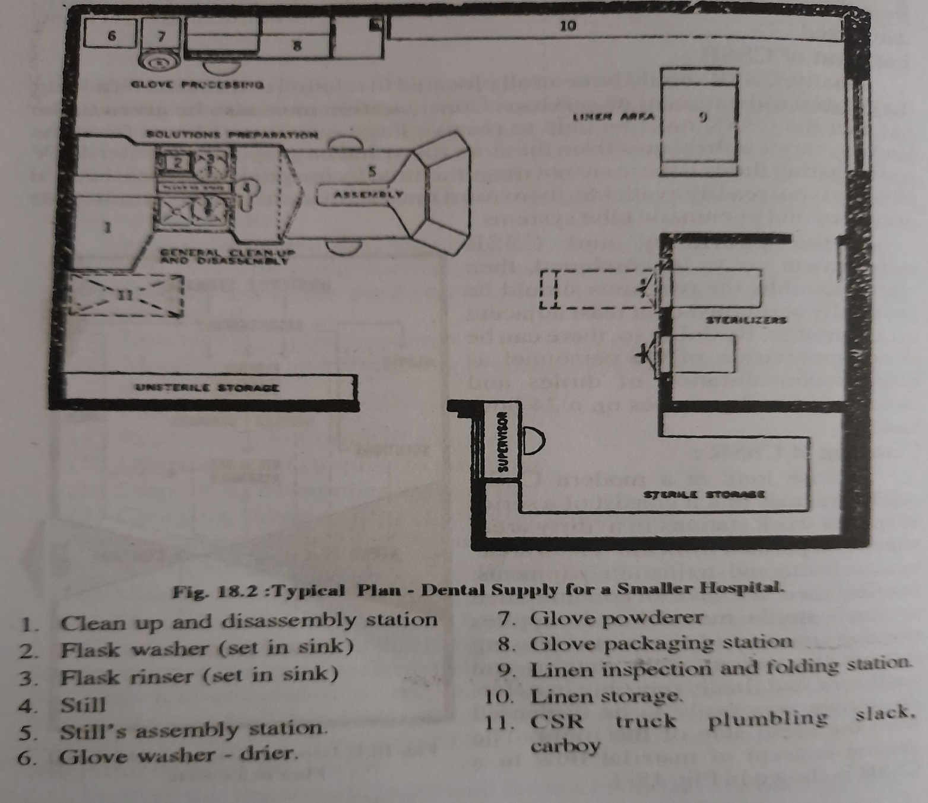
CENTRAL STERILE SUPPLY FOR SMALLER SIZE HOSPITAL

Slide 11
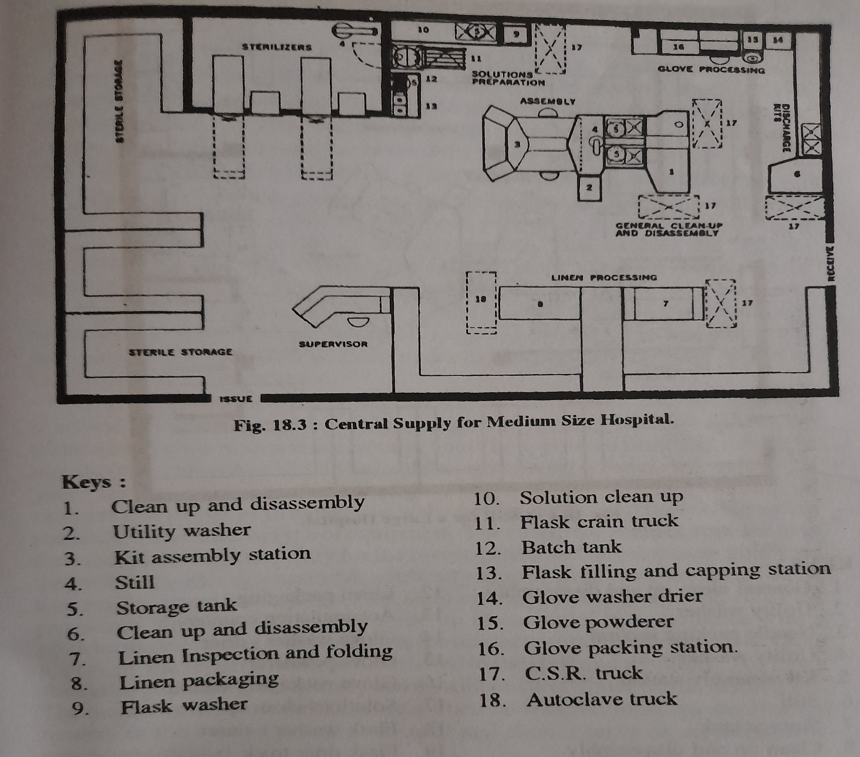
CENTRAL STERILE SUPPLY FOR MEDIUM SIZE HOSPITAL

Slide 12
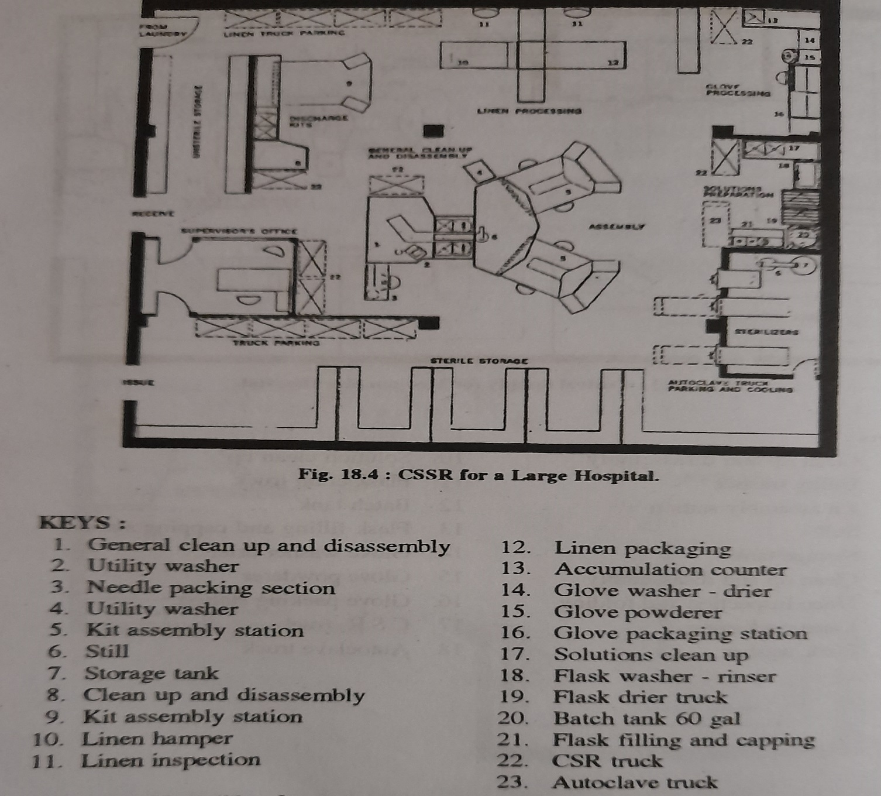
CENTRAL STERILE SUPPLY FOR LARGE SIZE HOSPITAL

